Slide 1
NuPECC meeting @ Oslo May 2026
Paul Stevenson
(on behalf of Marielle Chartier & David Ireland)

Slide 2
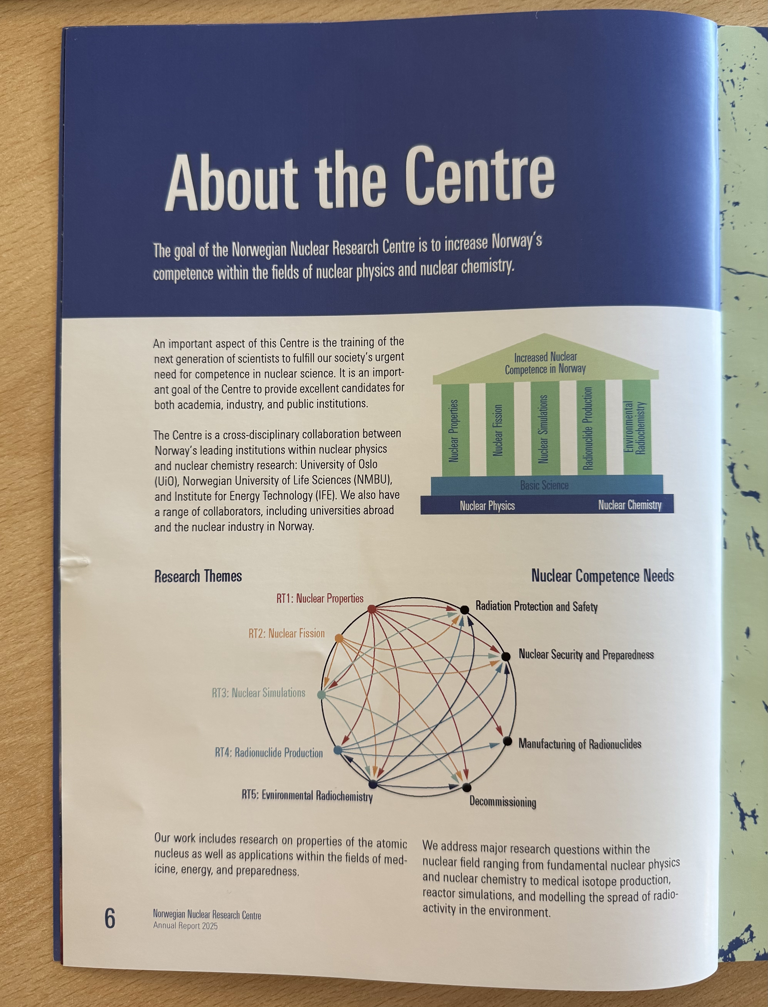
Norwegian National Research Centre
Preceeding NuPECC committee meeting: A tour of nuclear in Norway:
• Brings together nuclear activity across Universities and other research centres in Norway
• Running new UG programme: BSc Nuclear Physics and Nuclear Technology, with first bachelor cohorts now moving on to new MSc programme (“Master of Nuclear Technology”
• 4 research themes ranging across basic and applied areas:
Nuclear properties (nuclear data)
Nuclear simulations (in a nuclear engineering sense)
Nuclear physics
Radionuclide production
Director: Sunniva Siem

Slide 3
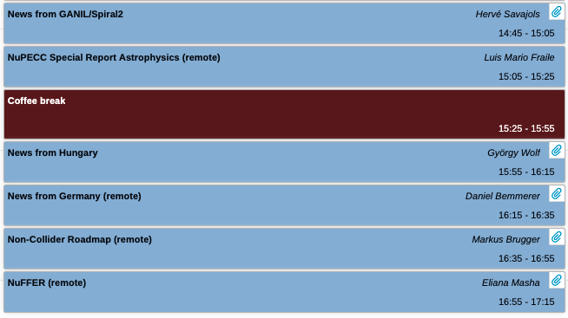
Day 1

Slide 4
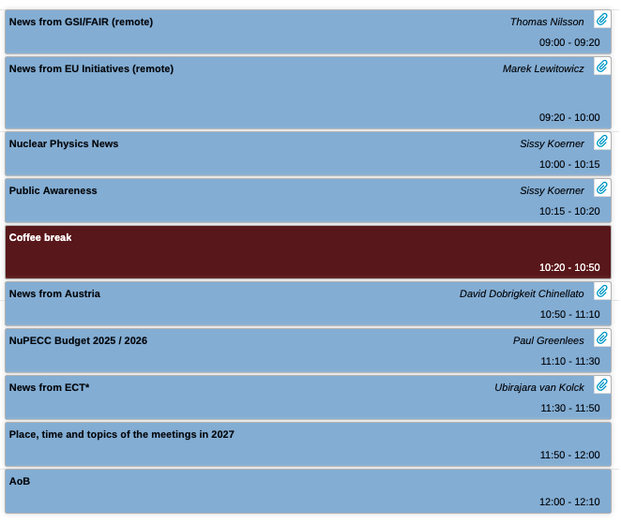
Day 2

Slide 5
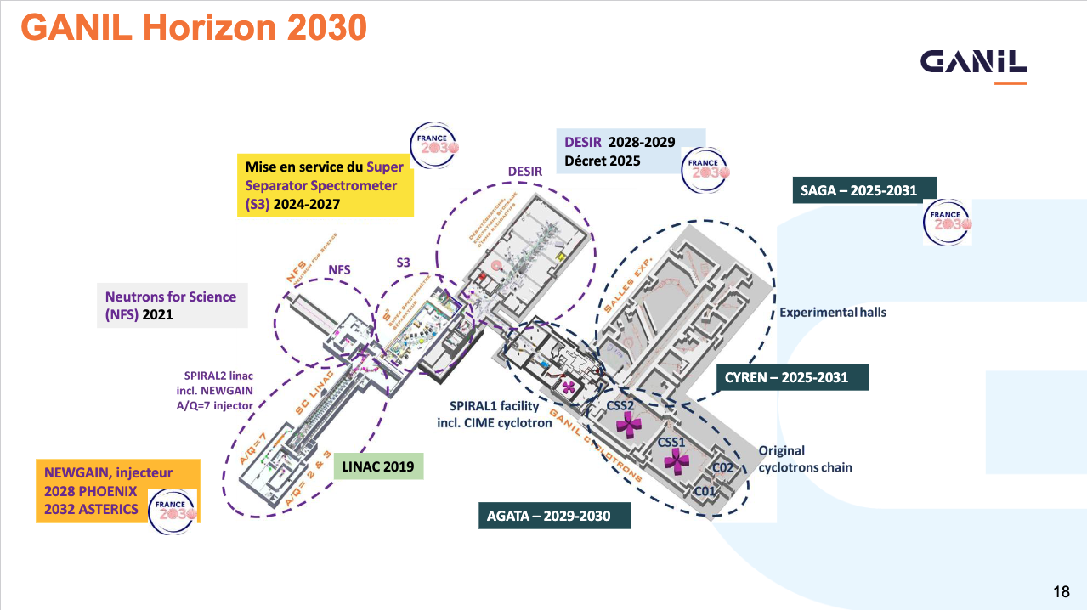

Slide 6
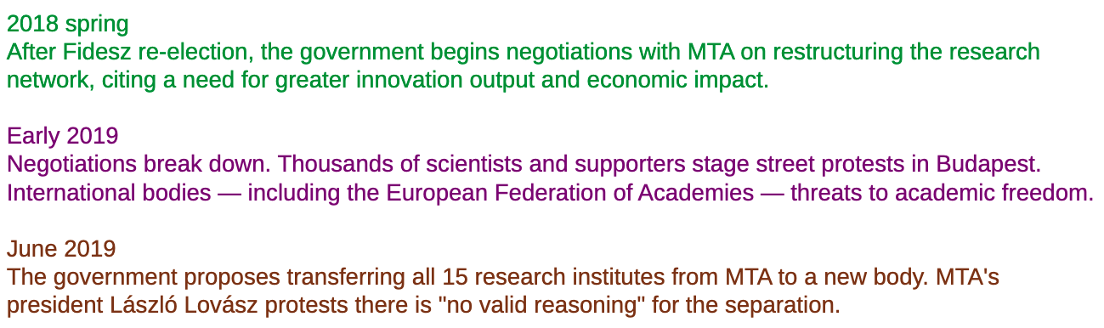

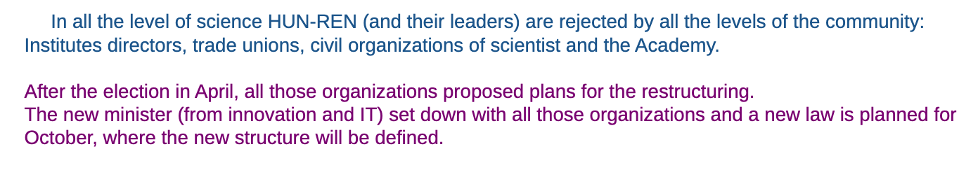
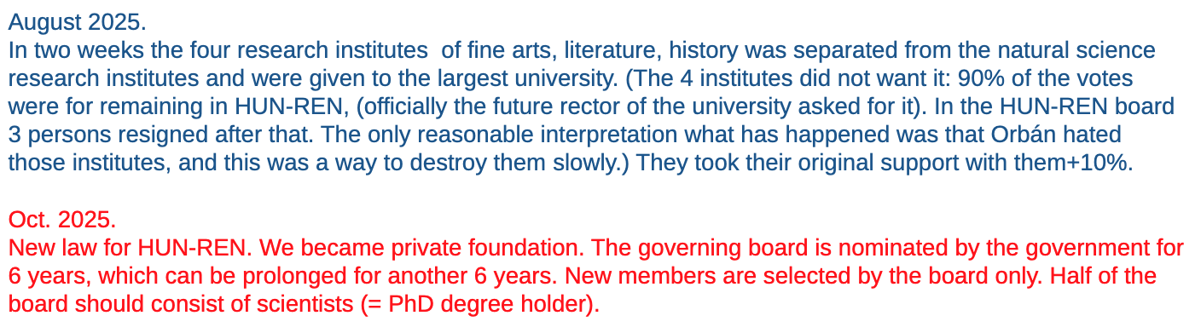
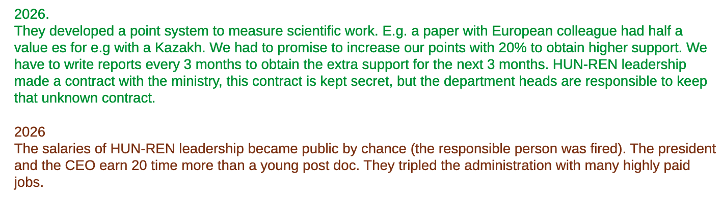
News From Hungary
…

Slide 7
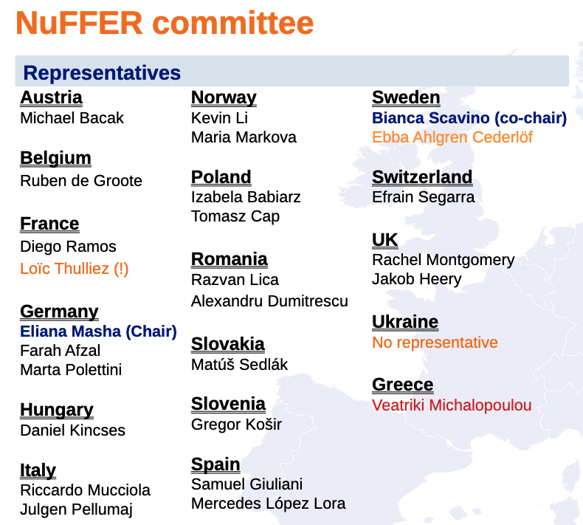
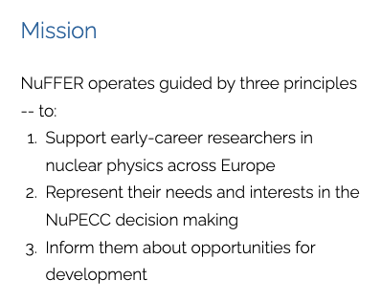
NuFFER - http://nuffer.eu/

Slide 8
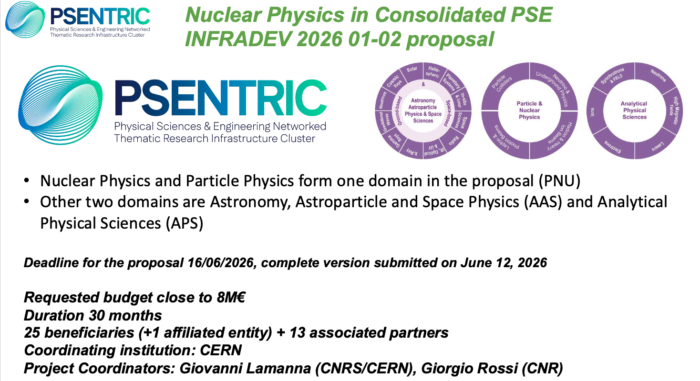
“News from EU initiatives”

Slide 9
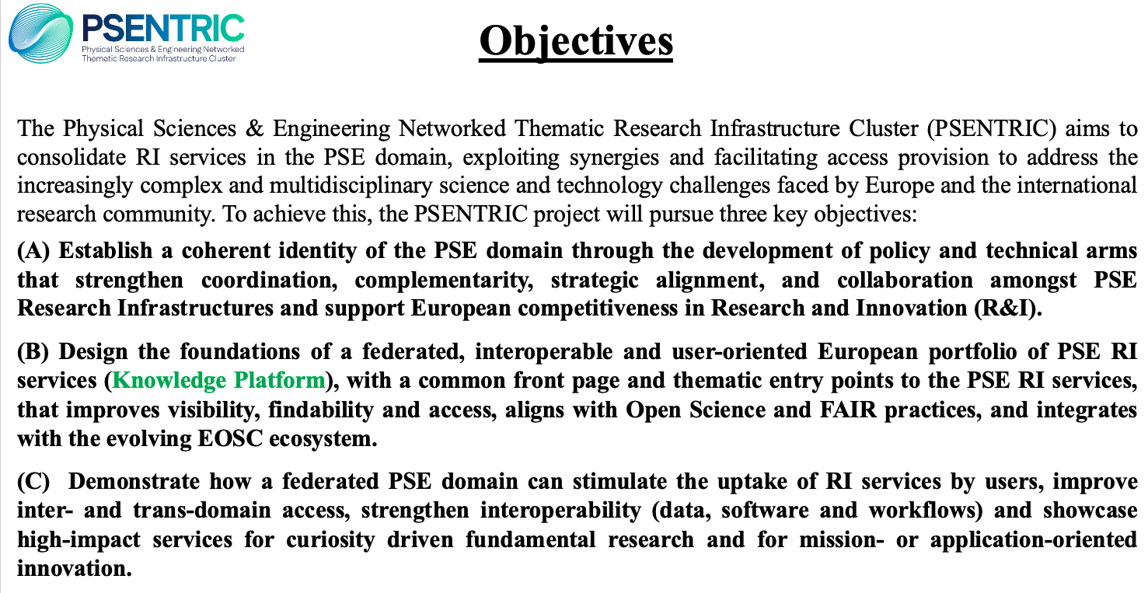
PSENTRIC

Slide 10
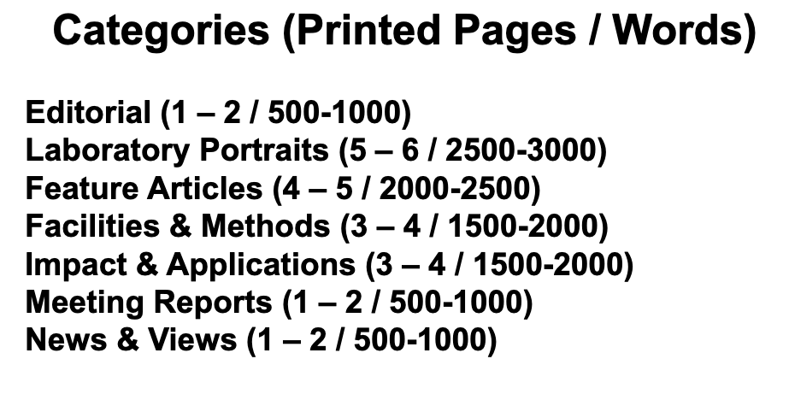
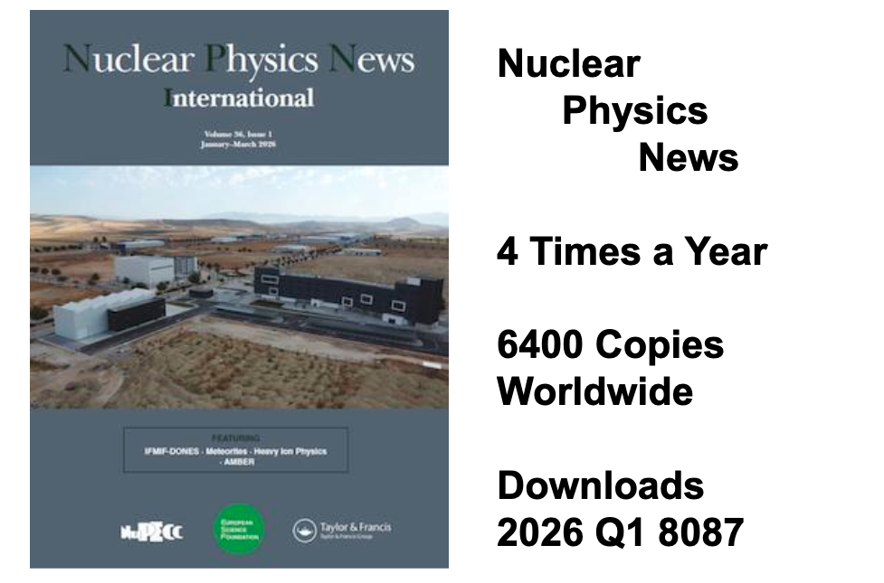
Nuclear Physics News
⇧⇧⇧⇧⇧⇧⇧⇧⇧⇧⇧⇧⇧
Articles needed in any and all areas. Please volunteer!
Can discuss with Paul Stevenson (on Editorial Board)

