Slide 1
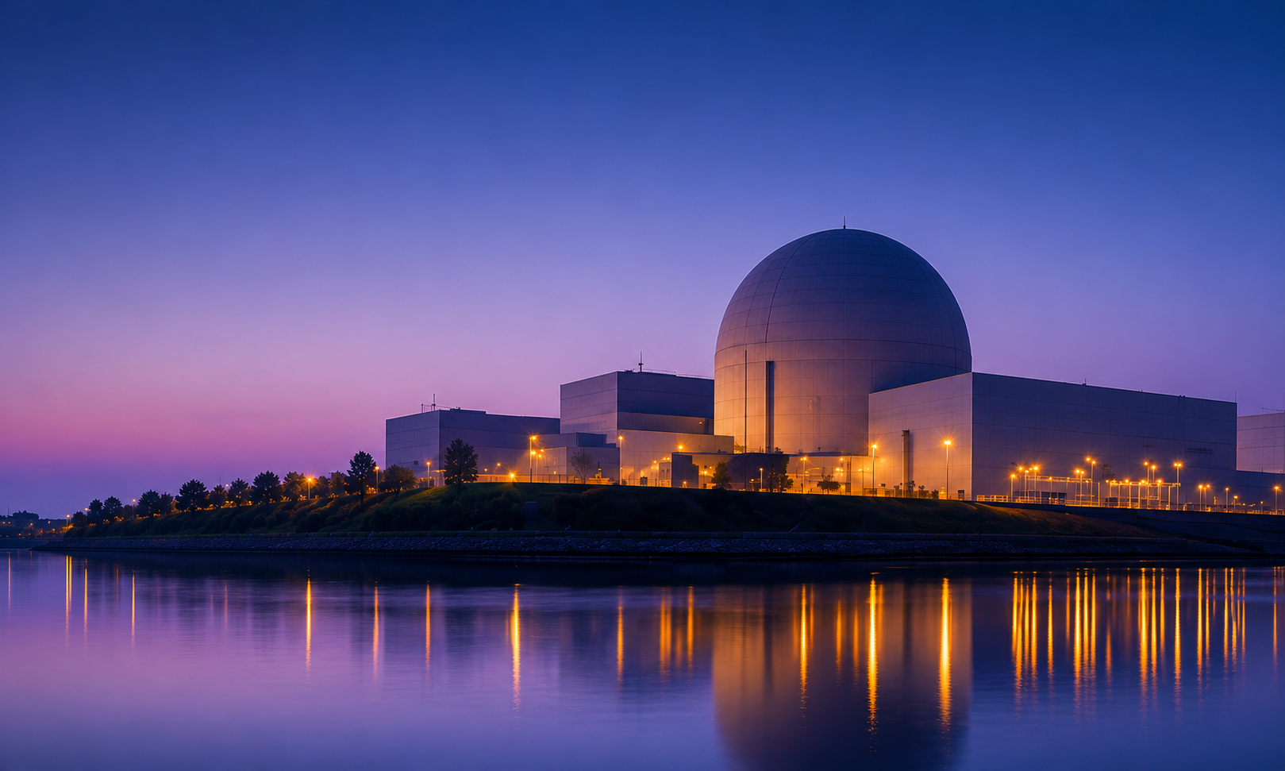





Doctoral Focal Award:
Skills Centre for Advancing Nuclear Sciences
Training the next generation of leaders in nuclear energy science, combining world class research, innovation and collaboration to deliver a sustainable energy future.

Slide 2
SCANS, the Skills Centre for Advancing Nuclear Systems is a new Doctoral Focal Award (DFA) project designed to address the opportunities identified in UK Government nuclear strategy. This includes:
Regenerating and growing the UK’s domestic nuclear fuel cycle capabilities
Accelerating the delivery of fuel cycle projects and stimulating nuclear research, development and innovation.
Providing the workforce skills, leadership and capacity in research and training required to underpin and drive UK cluster and supply chain development.

Slide 3
Nuclear
Systems
Nuclear
Systems
System Design
&
Process
Challenges
System Design
&
Process
Challenges
Sensing & Monitoring
Sensing & Monitoring
HPC, AI,
Data Science & Modelling
HPC, AI,
Data Science & Modelling
Management
&
Business
Skills
Developing
the
Skills for Industry
Management
&
Business
Skills
Extreme Environments
Robotics
&
Remote Handling
Extreme Environments
Defence & Security Challenges & Opportunities​
Defence & Security Challenges & Opportunities​

Slide 4
Industry Engagement
SCANS unites researchers from the University of Glasgow, SUERC: Centre for the Isotope Sciences, the University of Edinburgh, and Heriot-Watt University with 25 partners from industry and national organisations across the nuclear sector.
A defining feature is strong integration with industry and national stakeholders. Each student will engage with project partners through co-supervision, placements, site visits, and collaborative research activities.

Slide 5
Solid background + specialism + leadership skills:
PhD
Year 1
Year 2
Year 3
Year 4
Sem 1: Core (UoG)60 credits
PD 30 credits
Grand Challenge 15 credits
Elect. 15 credits
Elect. 30 credits
Sem 2: Elect. 30 credits
Research project
Mini-conference
Summer school
Grand challenge
presentations

Slide 6
Projects
Large Tandem Accelerator Mass Spectrometer Modelling
Understanding the Redox Chemistry of Aged MOX Pellets
SMARTT-WATER: Sensing, Mapping and Real-Time Trending of Waterborne Contaminants in Nuclear Environments
Pushing the Frontiers of Ultra-Trace Plutonium Isotope Measurements in Environmental Samples
Next-Generation Mass Spectrometry for Nuclear Isotope Measurement Across the Nuclear Fuel Cycle
Notes:
Some examples. Full list available online.

Slide 7
Industry Advisory Group (IAG)
University Governance Group (UGG)
Executive Team (ET)
Professional Services
Group (PSG)
Farnaby
PI & Co-Director
Mount
Co- Director
Ireland
Deputy Director
Mark
Deputy Director
Mansell
Deputy Director
Coordinators Administrators
Events Coordinators (EC)
Industry Engagement Manager (IEM)
Sub-Committees (SC)
Stakeholder Engagement
Recruitment & Careers
Skills Training & Researcher Development
SCANS Supervisors Community (SSC)
Student Cohorts 1,2,3,4
Links to other DFA / CDTs

Slide 8
Contact
scans@glasgow.ac.uk
LinkedIn - /scans-doctoral-focal-award/
Website
www.scans-dfa.org.uk

