Slide 1


Navigating a New Era
of Science Communication
Ottilie Goodfellow | 24 June 2026
1

Slide 2
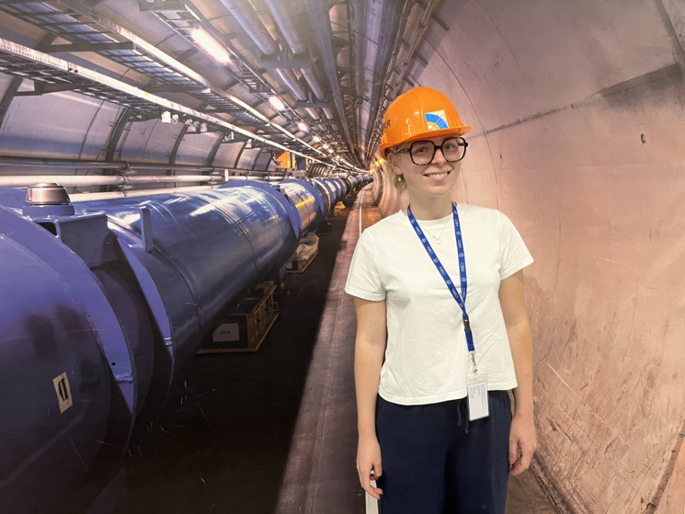
Agenda
1
What is science communication?
2
What changes are impacting science communication?
3
What do people think about science & scientists?
4
What are the recommendations for this new era of science communication?
Physics with Astrophysics, University of Bath
Science Communication Industrial Placement, PPD
5
What comms does PPD do, and how can you get involved?
Ottilie Goodfellow | 24 June 2026
2

Slide 3
Agenda
1
What is science communication?
Ottilie Goodfellow | 24 June 2026
3

Slide 4








Local communities
General public
Policymakers
Media and journalists
Science Communication
Schools and young people
Funding bodies
Other
scientists
Industry
Method and purpose – who are you talking to?
Ottilie Goodfellow | 24 June 2026
4
Notes:
Sharing ideas, findings, processes to audiences outside/inside research community
Range of activity: press releases and media visits, social media and web presence, outreach events and exhibits, policy briefs and studies
Range of audiences
Method/purpose depends on audience and key message
Stand alone discipline with its own methods, ethics and growing body of research

Slide 5
How can we define good science communication?
Good
science
Funding, policy support
& diversity in science
Science
communication
Public understanding,
engagement & support
Ottilie Goodfellow | 24 June 2026
5

Slide 6

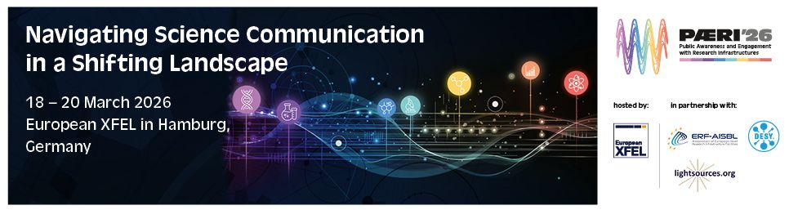
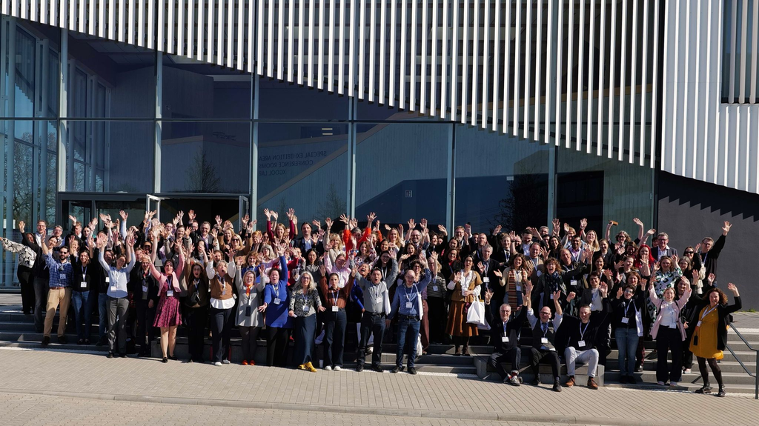
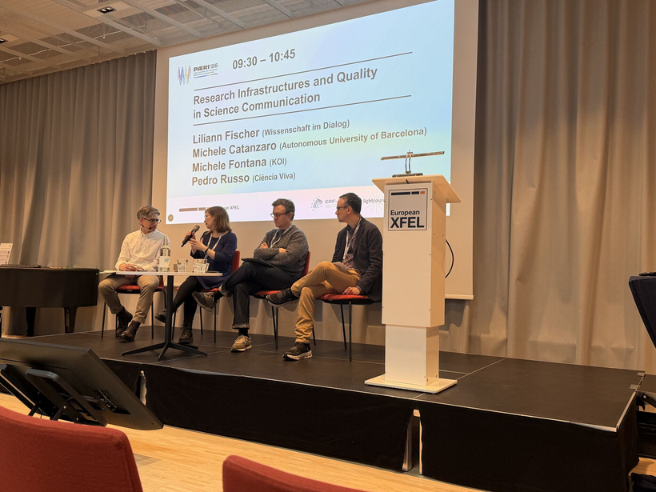
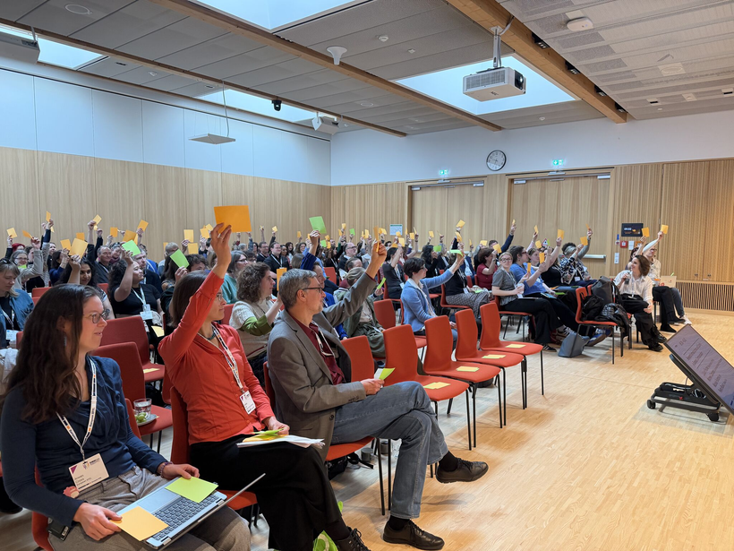
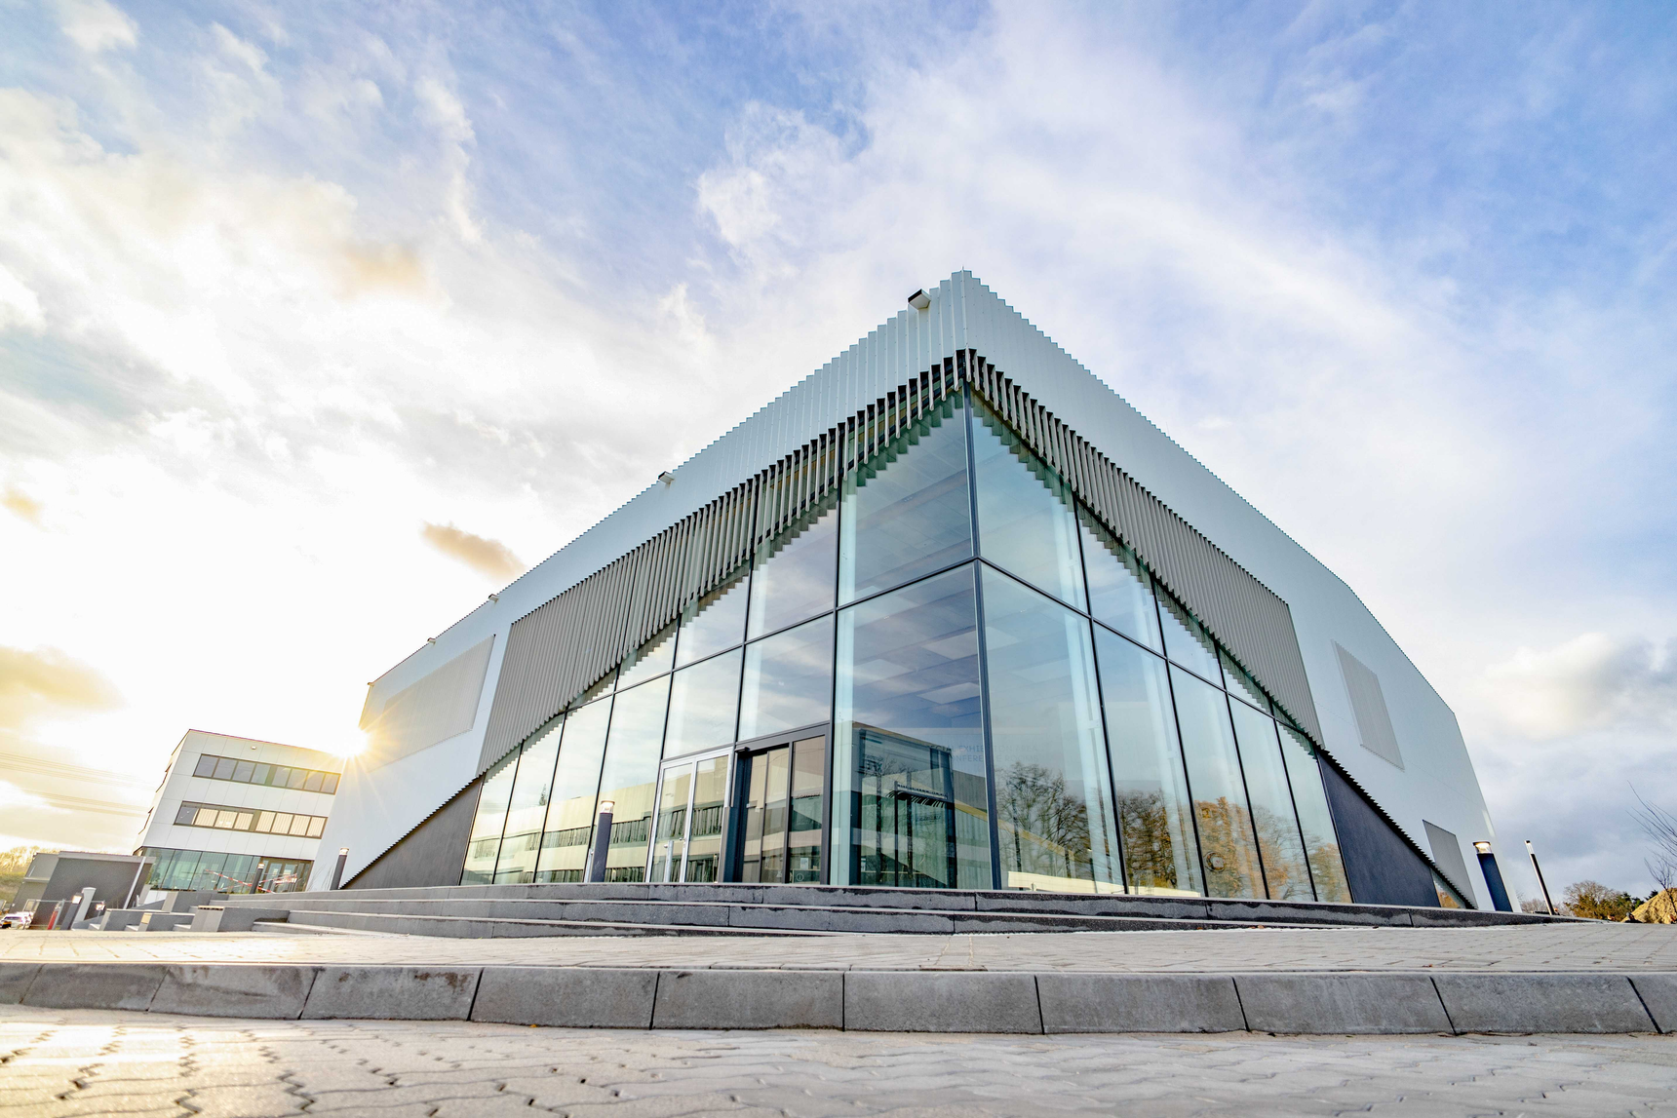
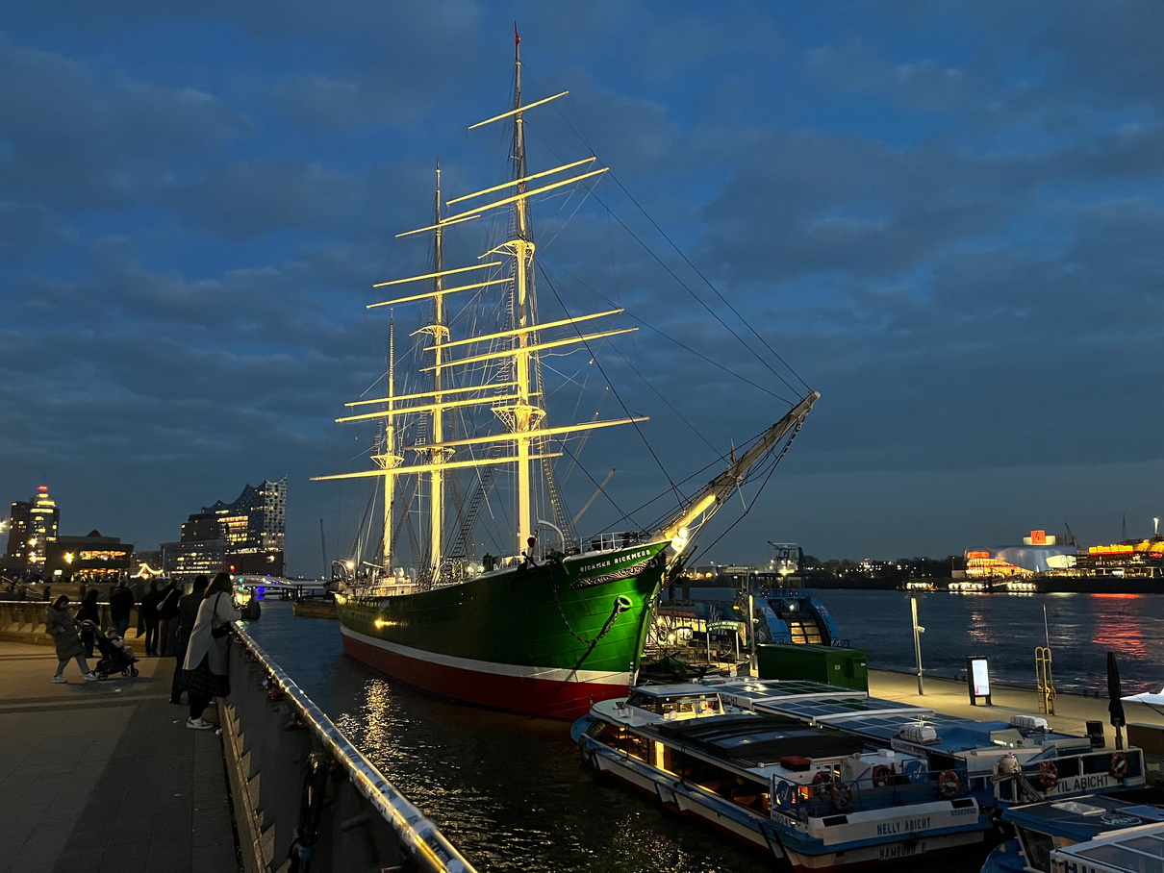
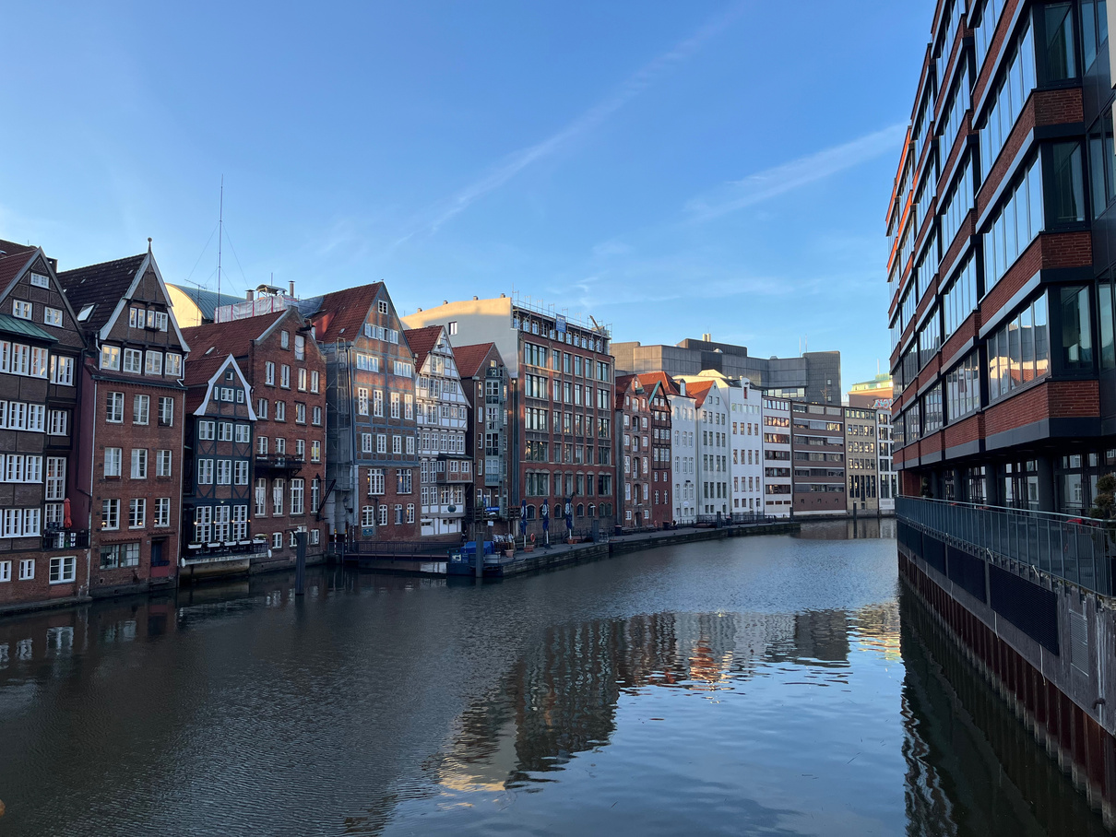
PAERI’26: Navigating Science Communication in a Shifting Landscape
18-20 March 2026 | EuXFEL and DESY
6
Ottilie Goodfellow | 24 June 2026
Notes:
Lay the foundation for this seminar – interesting ideas and talking points
Conference for comms professionals, science journalists etc – both freelance, private and embedded in RI
Like field of science communication, PAERI is growing
Favourite thing about conference – varied interpretations
New and emerging technologies
How we consume media
Political landscapes
Ugrades to RI
Key takeaway – sci comms is changing

Slide 7
PAERI’26: Navigating Science Communication in a Shifting Landscape
18-20 March 2026 | EuXFEL and DESY
SCIENCE COMMUNICATION IS CHANGING
7
Ottilie Goodfellow | 24 June 2026

Slide 8
Agenda
1
What is science communication?
2
What changes are impacting science communication?
Ottilie Goodfellow | 24 June 2026
8

Slide 9

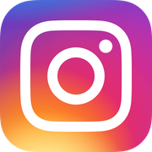

The shift from traditional to new media
Traditional
New
Anyone can create and anything can be shared
Ottilie Goodfellow | 24 June 2026
9
Notes:
Monumental shift away from traditional media towards new media
Anyone can make content – tools and platforms exist to create and publish science-related content at no/minimal cost​
Explosion of content – scientific knowledge has become incredibly accessible, digestible, (in some cases) fun/light-hearted ​
Predominantly used by young people – more exposure to science and representation in science outside of the classroom ​
But it comes with some challenges….
​

Slide 10
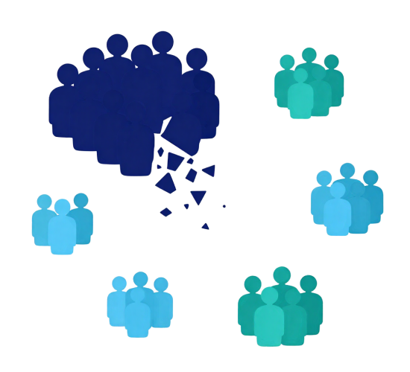
Fragmented audiences
  More platforms with more creators = competing for attention
  Requires tailored, platform-specific content instead of a single, unified broadcast
  Harder and more time-consuming to disseminate accurate, interesting science information impactfully
Ottilie Goodfellow | 24 June 2026
10
Notes:
New paper/experiment – for new media alone, you will have to adapt your content for the different platforms (text-based, pictures, video?, formatting)
Traditional media ASWELL – press releases or article

Slide 11
Spread of mis- and disinformation
Misinformation
Disinformation
False or misleading information shared without intent to harm
False information spread deliberately to deceive or manipulate
  Very prevalent on social media
  Hard to police and verify credibility
  Vaccine safety, climate change, 5G etc.
Ottilie Goodfellow | 24 June 2026
11
Notes:
Boom of mis and dis information
Both as dangerous as eachother?
content from a qualified expert and content from someone with no scientific background can look visually identical — same format, same polish — making it hard for audiences to judge credibility at a glance​
​

Slide 12
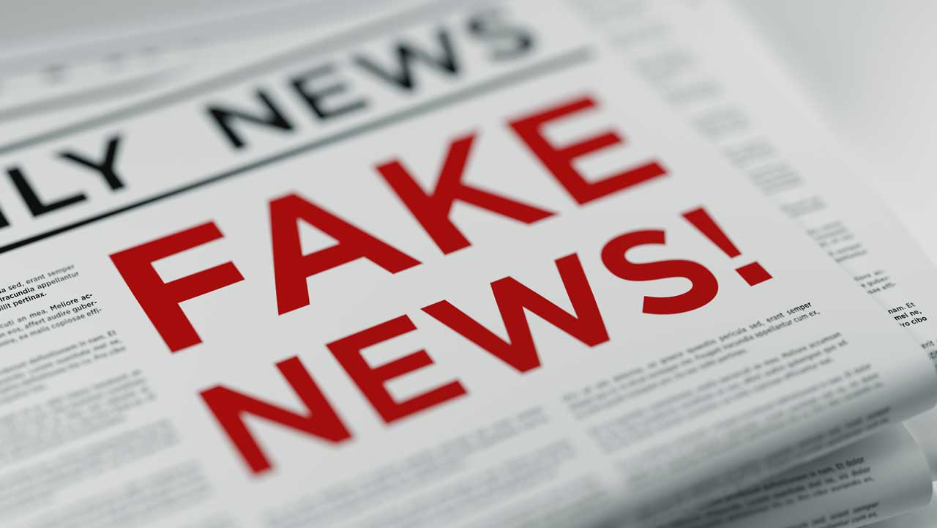
Fake news travels faster
MIT study (Vosoughi, Roy & Aral, Science, 2018)
  126,000 rumour cascades
  spread by ∼3 million people
  2006-2017
Fake news was:
70%
more likely to be reshared than true news
6x
faster to reach 1,500 people
Ottilie Goodfellow | 24 June 2026
12
Notes:
Researchers removed bots – didn’t impact figures, meaning humans are sharing not bots.
Likely explanation: fake news is often novel/surpising/triggers emotional reaction – people are more inclined to share
Since the algorithm rewards engagement, not accuracy – fake news can spread like wildfire

Slide 13
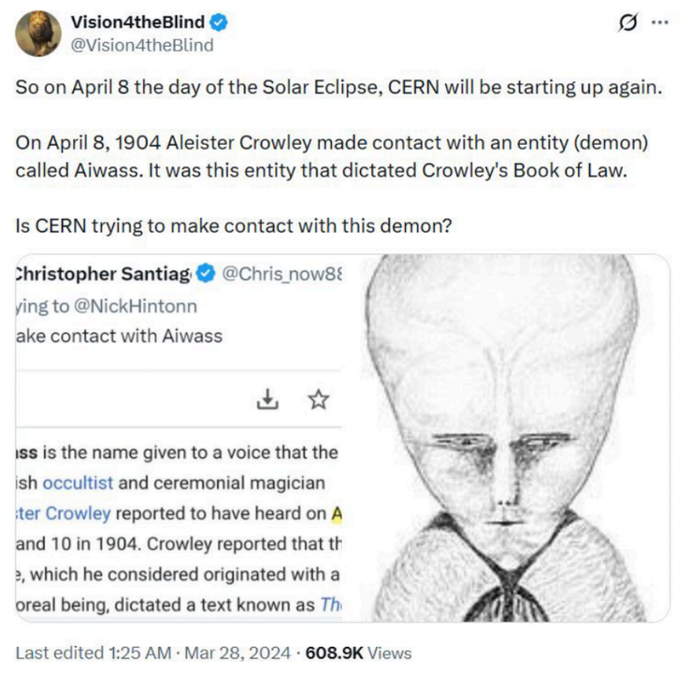
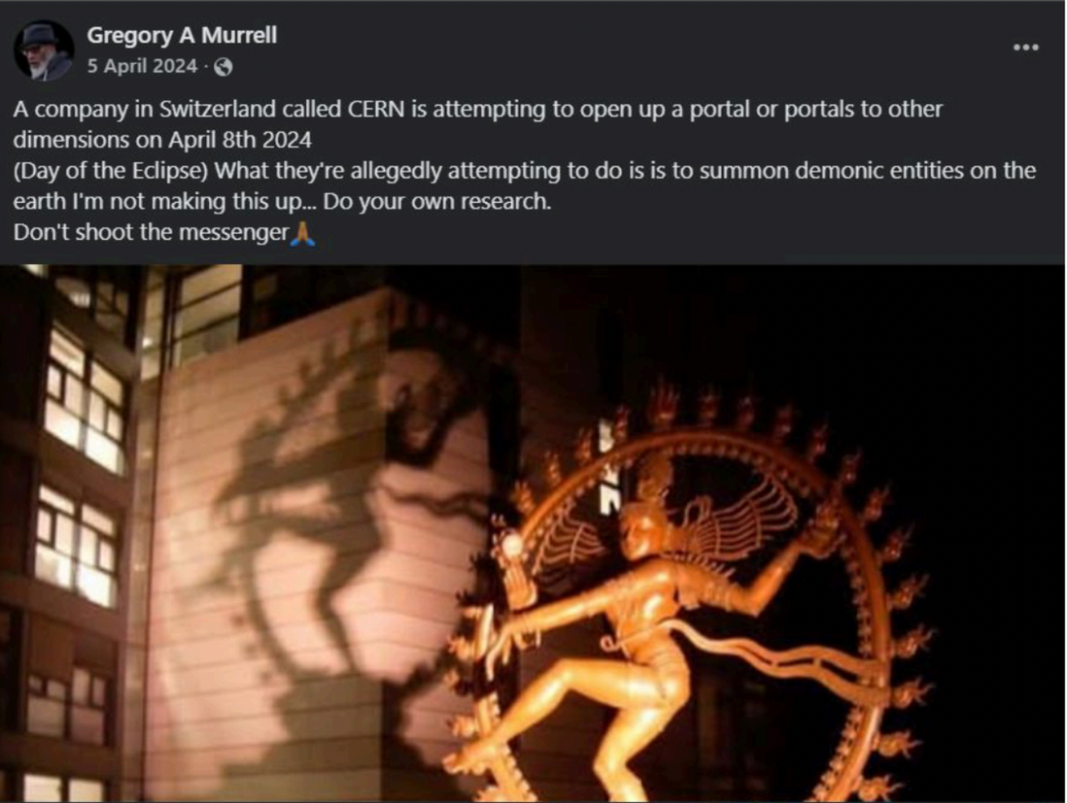
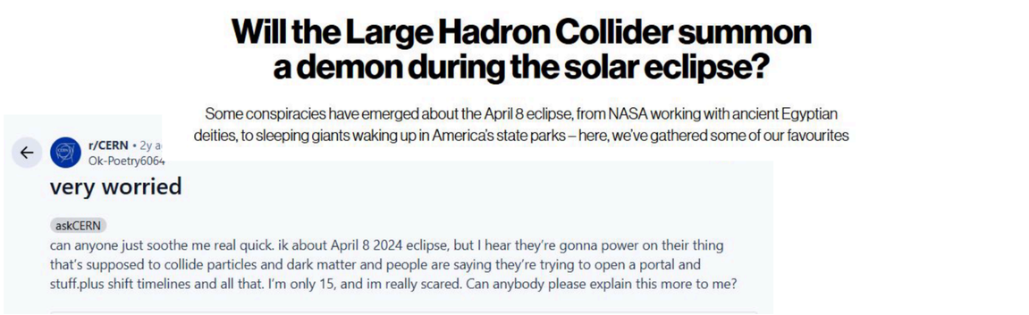
CERN conspiracy theories
8 April 2024: LHC restart coincided with total solar eclipse over Canada and USA
Example shared at PAERI'26 by Tyra Kaddu-Mulindwa (CERN), “Correcting the conspiracies: How CERN manages misinformation”
Ottilie Goodfellow | 24 June 2026
13
Notes:
Easy to fall down conspiracy theory rabbit holes – potentially fall into an echo chamber
If you’re not getting information elsewhere, soon social media has an extreme sway on your world view
Lots of people talking nonsense, but also some real worry – important to address

Slide 14
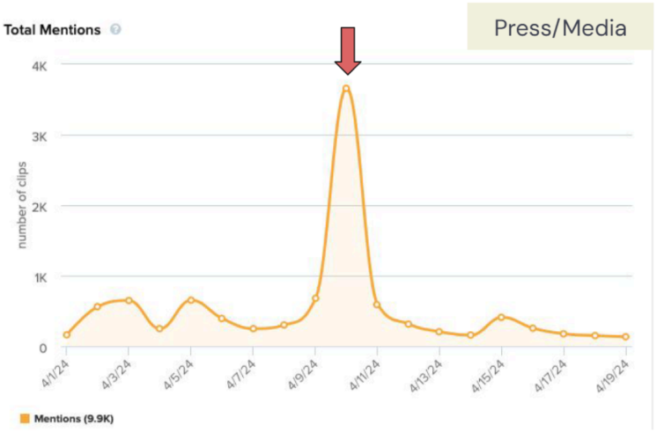
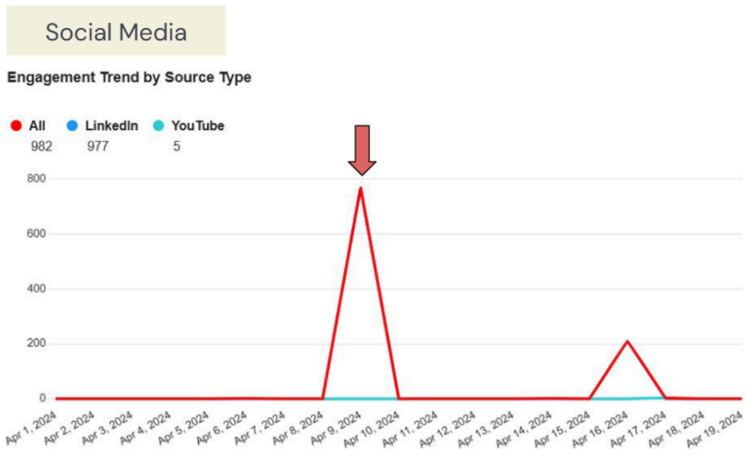
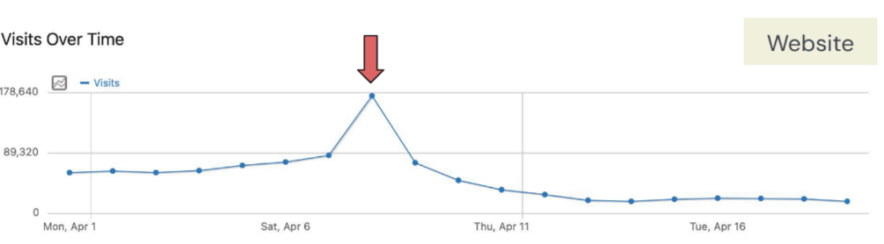
CERN conspiracy theories
Figures shared at PAERI'26 by Tyra Kaddu-Mulindwa (CERN), “Correcting the conspiracies: How CERN manages misinformation”
Ottilie Goodfellow | 24 June 2026
14
Notes:
Correcting the conspiracy:
Redirect to scientifically accurate info/orgs
Dialogue over declaration – don’t just shoot them down
Audience mapping – concerned, conspiracy theorists, critics (can they have any influence?)

Slide 15
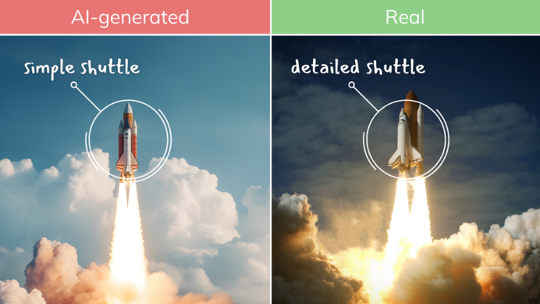
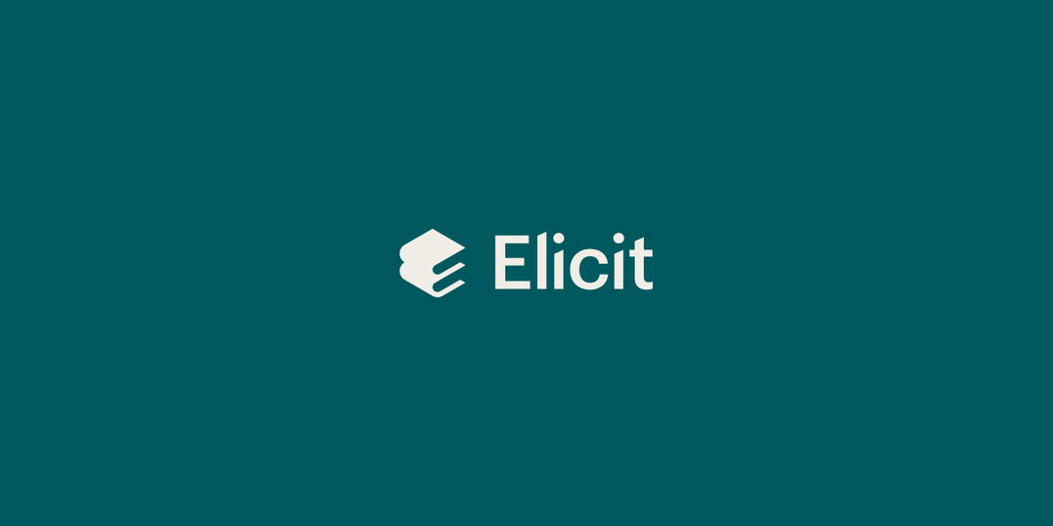
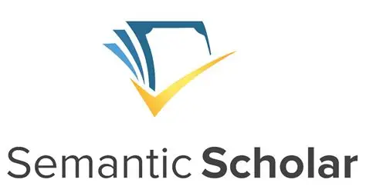
GenAI: threat or tool?
Threat
Tool
  Synthetic text, images and video — indistinguishable from real
  AI search tools surfacing unverified claims as fact
  Find and synthesise scientific literature
  Translation, summarisation, personalisation
Ottilie Goodfellow | 24 June 2026
15
Notes:
AI generated images and video
Challenging for older audiences
Something you can read about/learn how to spot
GenAI search engines can surface univerified claims as fact
Also several AI tools with potential to streamline/support sci comms

Slide 16
Searching for information with GenAI
58%
of people are replacing traditional searches with GenAI
Old path:
User
Google/Bing
List of links
Website
Find information
New path:
User
ChatGPT/Claude/Copilot
AI-generated answer
(no click needed)
Inspired by Nancy Jackman (Marketbridge), “A shifting landscape: Generative AI in research infrastructure comms”, PAERI’26
Ottilie Goodfellow | 24 June 2026
16
Notes:
The way we search for information is fundamentally shifting
Even the way Google gives you information has changed with Google AI summaries

Slide 17
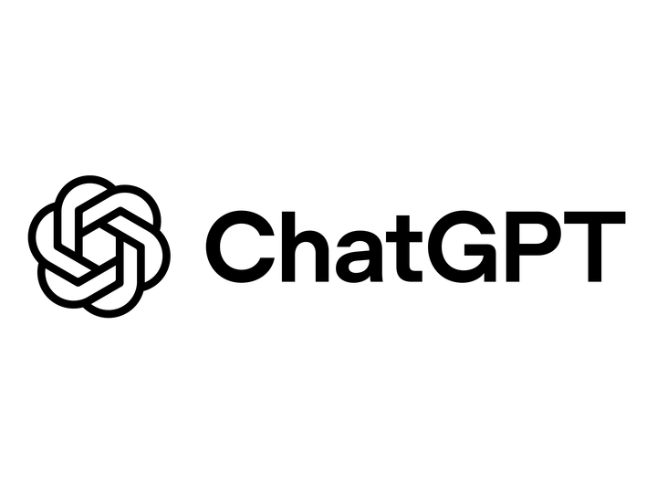
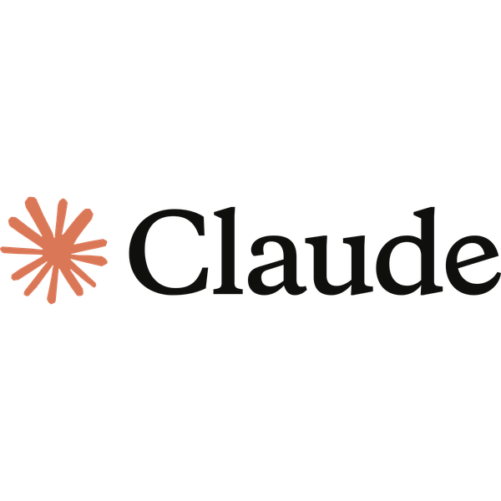
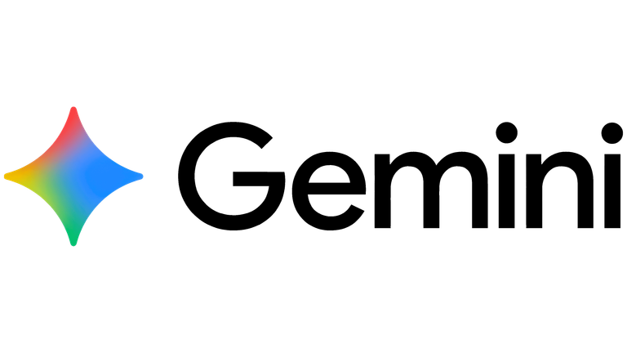
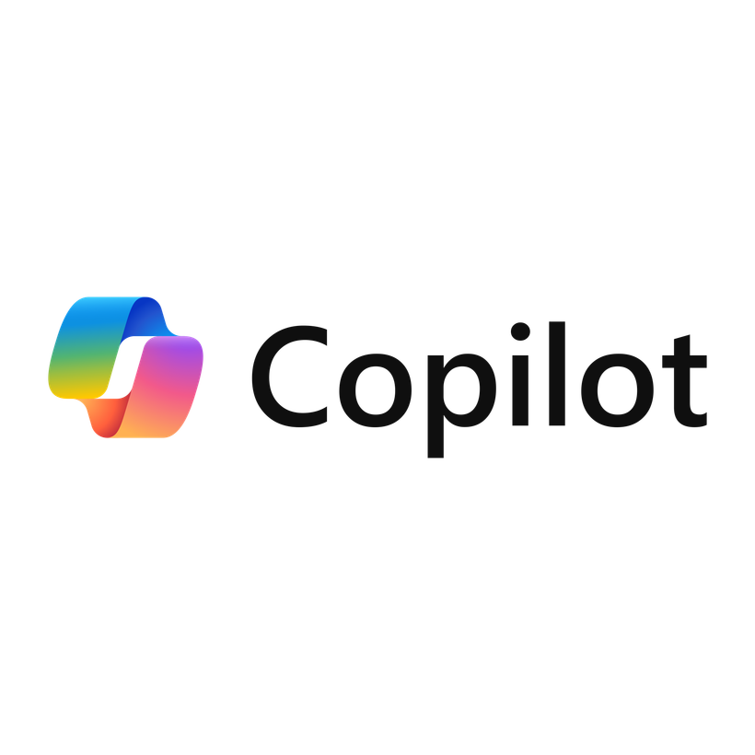
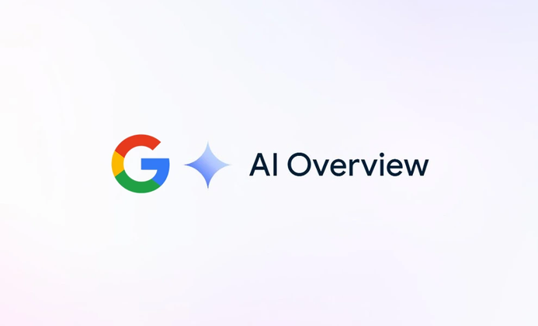
Generative Engine Optimisation
The practice of structuring and refining digital content so that AI-driven search and answer engines—like ChatGPT, Perplexity, or Google’s AI Overviews—can accurately interpret, summarise, and cite it.
  Functions differently from SEO
  URLs cited by AI rarely matches what Google/Bing ranks
  What influence is possible?
Inspired by Nancy Jackman (Marketbridge), “A shifting landscape: Generative AI in research infrastructure comms”, PAERI’26
Ottilie Goodfellow | 24 June 2026
17
Notes:
Influence – training vs grounding data
Grounding data – used to verify
Potential influence using social media and website
Such as explicitly stating questions
Will become increasingly important in science comms AND general strategic comms

Slide 18
Agenda
1
What is science communication?
2
What changes are impacting science communication?
3
What do people think about science & scientists?
Ottilie Goodfellow | 24 June 2026
18

Slide 19
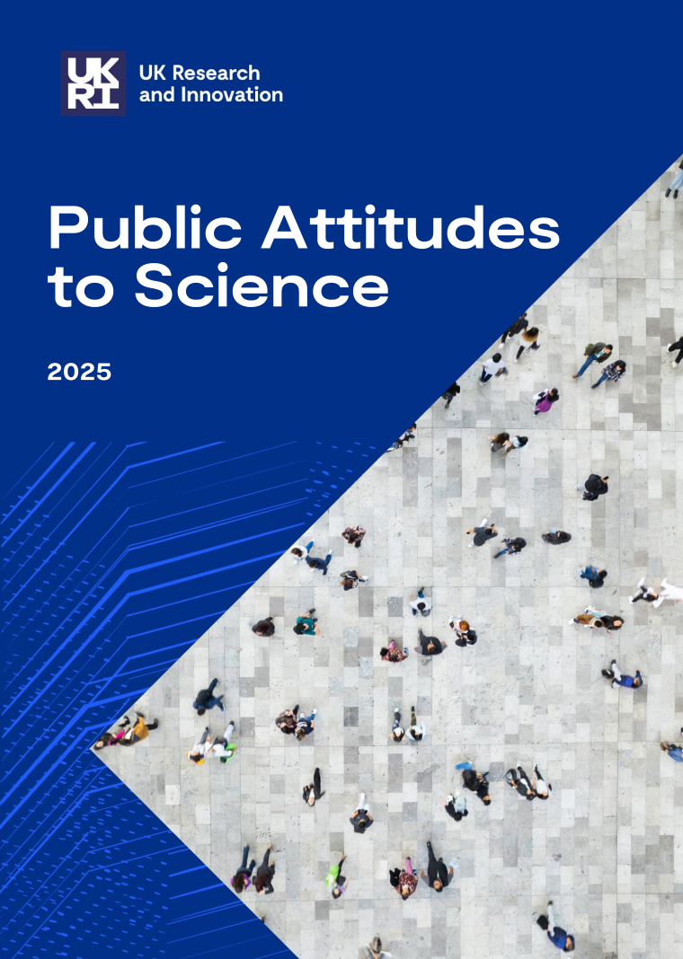
What does the UK public think?
  Views on scientists
  Responsible and ethical science
  New and emerging technologies
  Consumption of science
  Participation in science
  Science capital
Source: Ipsos / UKRI, Public Attitudes to Science 2025.
Figures in slides 19 to 30 from PAS 2025.
Ottilie Goodfellow | 24 June 2026
19

Slide 20
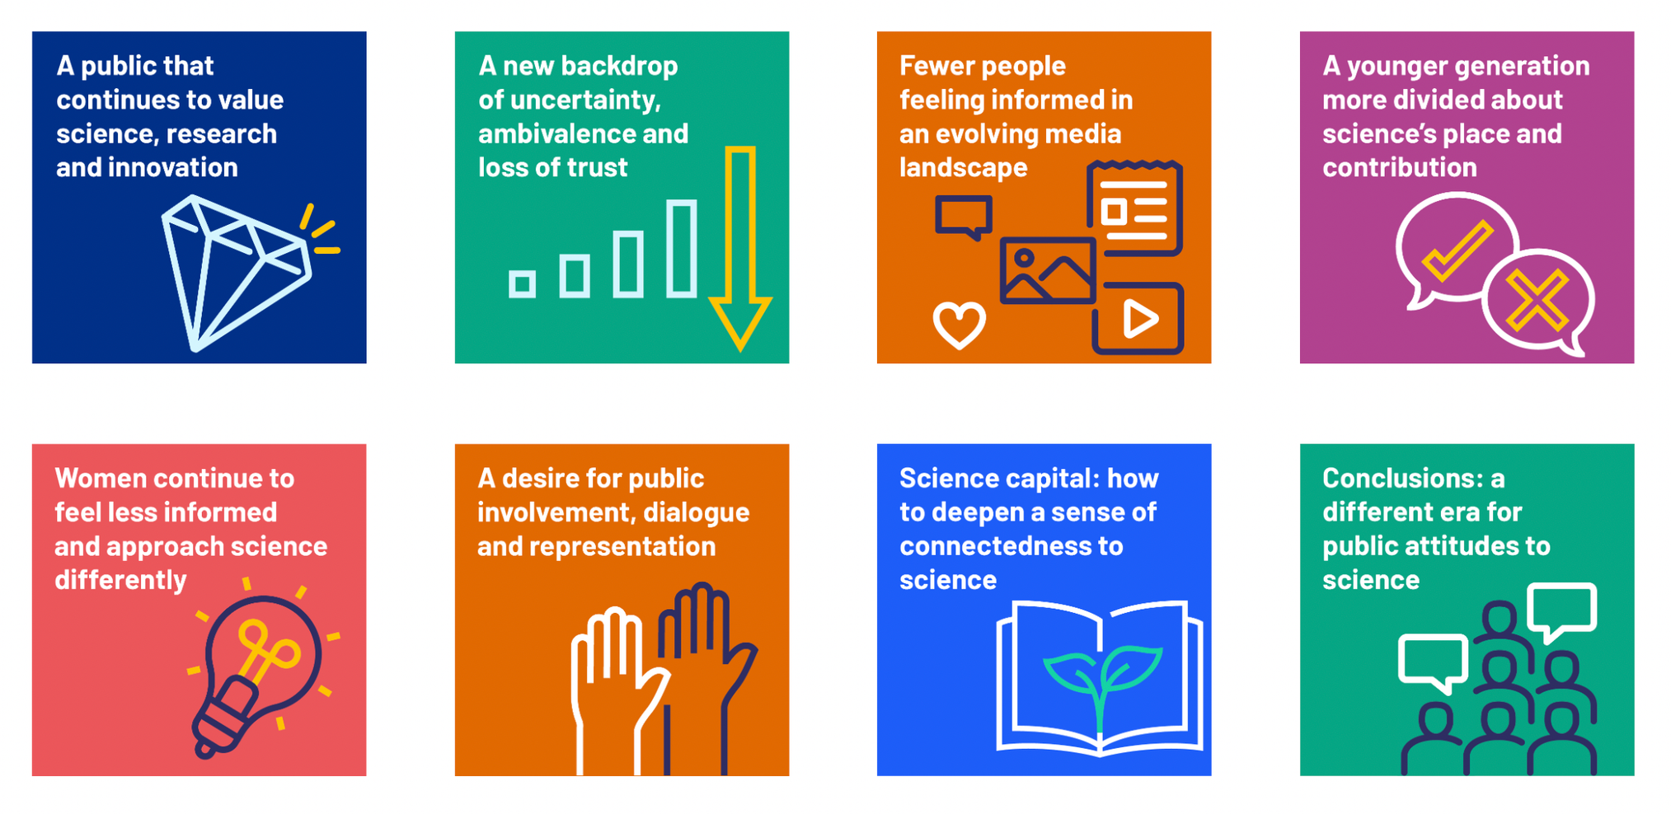
Key findings of PAS 2025
Ottilie Goodfellow | 24 June 2026
20
Notes:
In particular: ​
Public that values science ​
A new backdrop of uncertainty and lack of trust – post-pandemic, new technologies etc.​
new media has enabled increased access to a large volume of content – this doesn’t necessarily mean people are well-informed​
Desire for representation and participation in science​

Slide 21
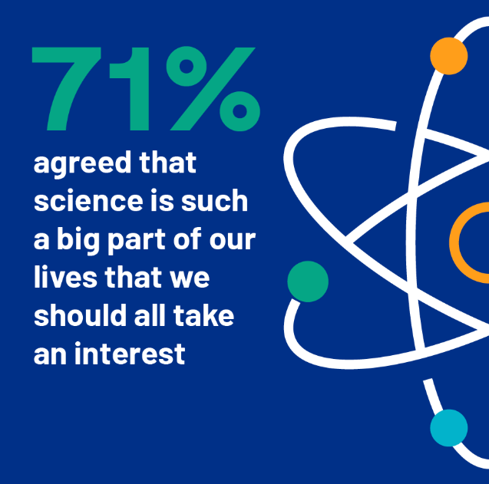
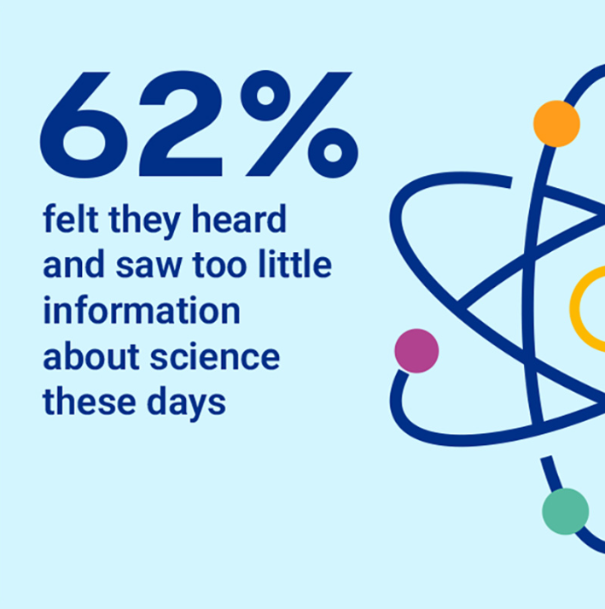
What science means
  We should all be interested in science
  Shift from outright disengagement to passive engagement ​
  Fewer people are feeling well informed 43% from 51% in 2019
Ottilie Goodfellow | 24 June 2026
21
Notes:
Outright disengagement has fallen ​
Fewer people saying science is not for them​
More say they’re interested but don’t make a special effort to keep informed​
This is a positive shift, but more can be done to turn large portion (almost 2/3rd of our population) into active audience
People want to hear more
There are also fewer people feeling well informed​
But no explanation – could this relate to the amount of information? Trust? Effort to keep informed?

Slide 22
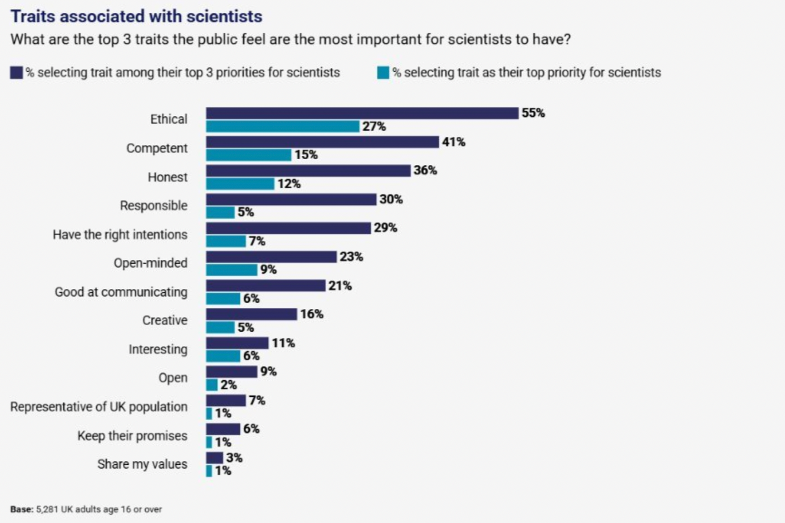
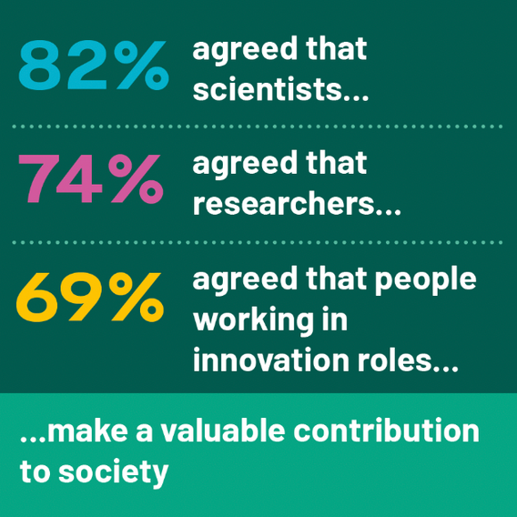
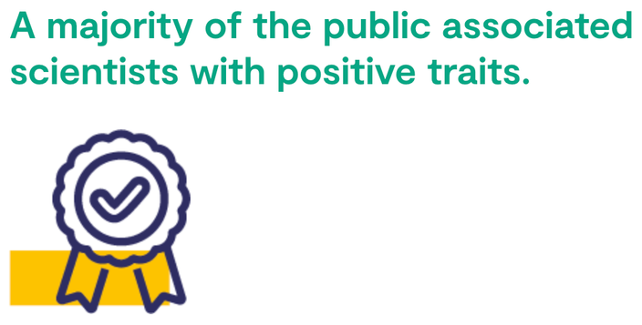
Views on scientists
and researchers
Ottilie Goodfellow | 24 June 2026
22
Notes:
Good news for the scientists in the room……PAS has consistently highlighted positive public attitudes towards scientists
But both figures have fallen from steady pre-2019 levels​
Doesn’t reflect rise in negative attitudes, but rather rise in uncertainty/ambivalence​
This pattern repeats across the survey and is not fully understood – people don’t know enough to judge? Growing indifference?
Traits associated – interesting, creative, competent, well-intentioned, open-minded
Reflects desire traits for scientists – acting as the public hope they would
This hints at an increase appetite for scientists to be good science communicators – which I’ll touch on later.​

Slide 23
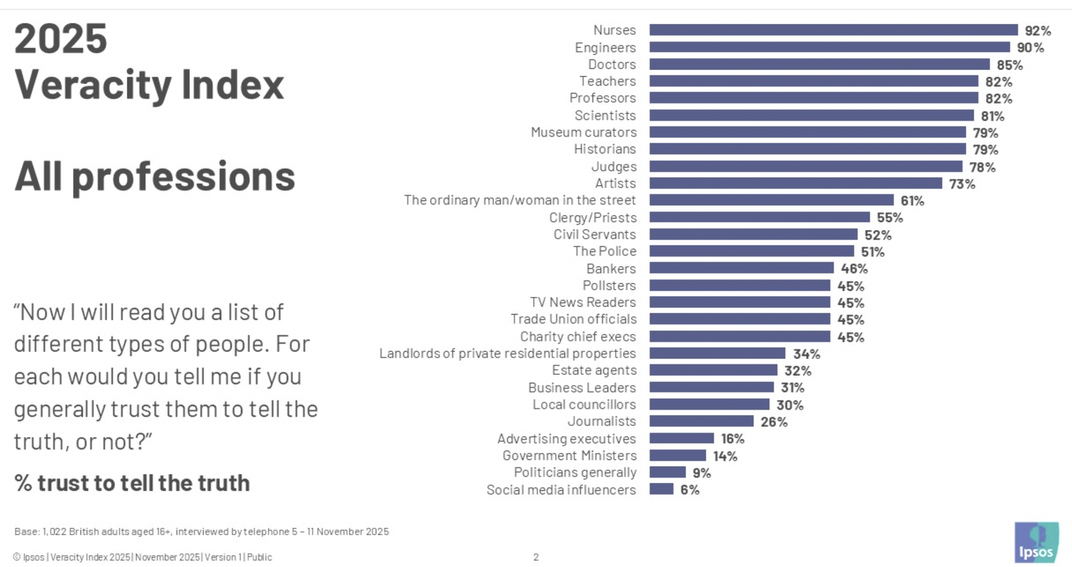
Scientists vs communicators
We need scientists to get involved in communications!
Ottilie Goodfellow | 24 June 2026
23
Notes:
The Ipsos veracity Index is an annual survey that measures public trust in various professions. It doesn’t vary that much year by year.
The takeaway here is ​
People trust scientists more than journalists and communication professionals​
Therefore they should be the ones attached to quotes, standing in front of cameras etc. ​
​
Whilst science communicators might do all the work behind the scenes, might have science backgrounds, degrees, or doctorates, they won’t be trusted in the same way. ​
​
Whether people are away of it or not, judgements and prejudices towards who is telling you some scientific information can make people question its legitimacy.

Slide 24
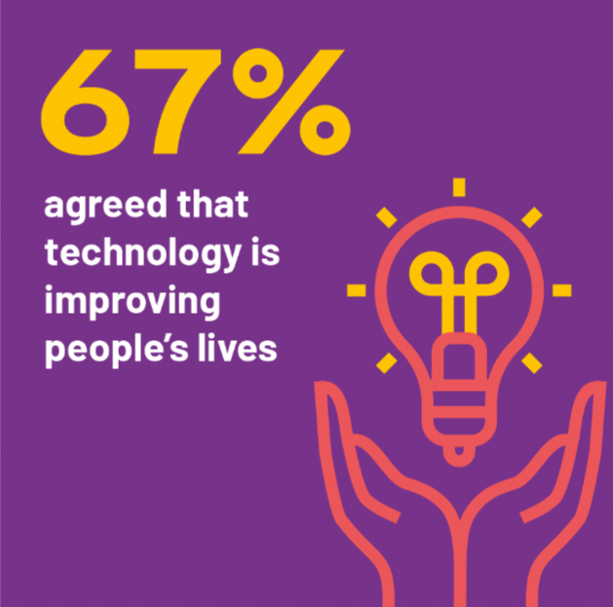
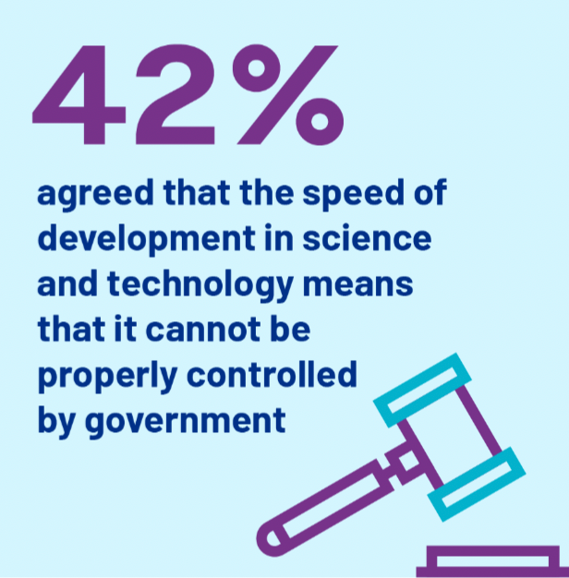
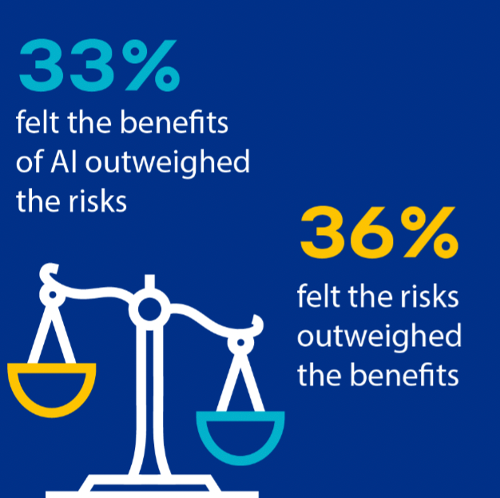
Embracing technology - with reservations
Ottilie Goodfellow | 24 June 2026
24
Notes:
Largely embracing new technology
Concern about pace and oversight
Ai is the sharpest edge:
For those feeling somewhat informed, 33% felt benefit of AI outweighed risks
36% felt opposite
Notably different from something like vaccination, where you have an 80/6 split in favour of benefits
AI is a massively polarising issue
Feeling more informed does not increase positive attitudes – important for how we think about sci comm around emerging technologies

Slide 25
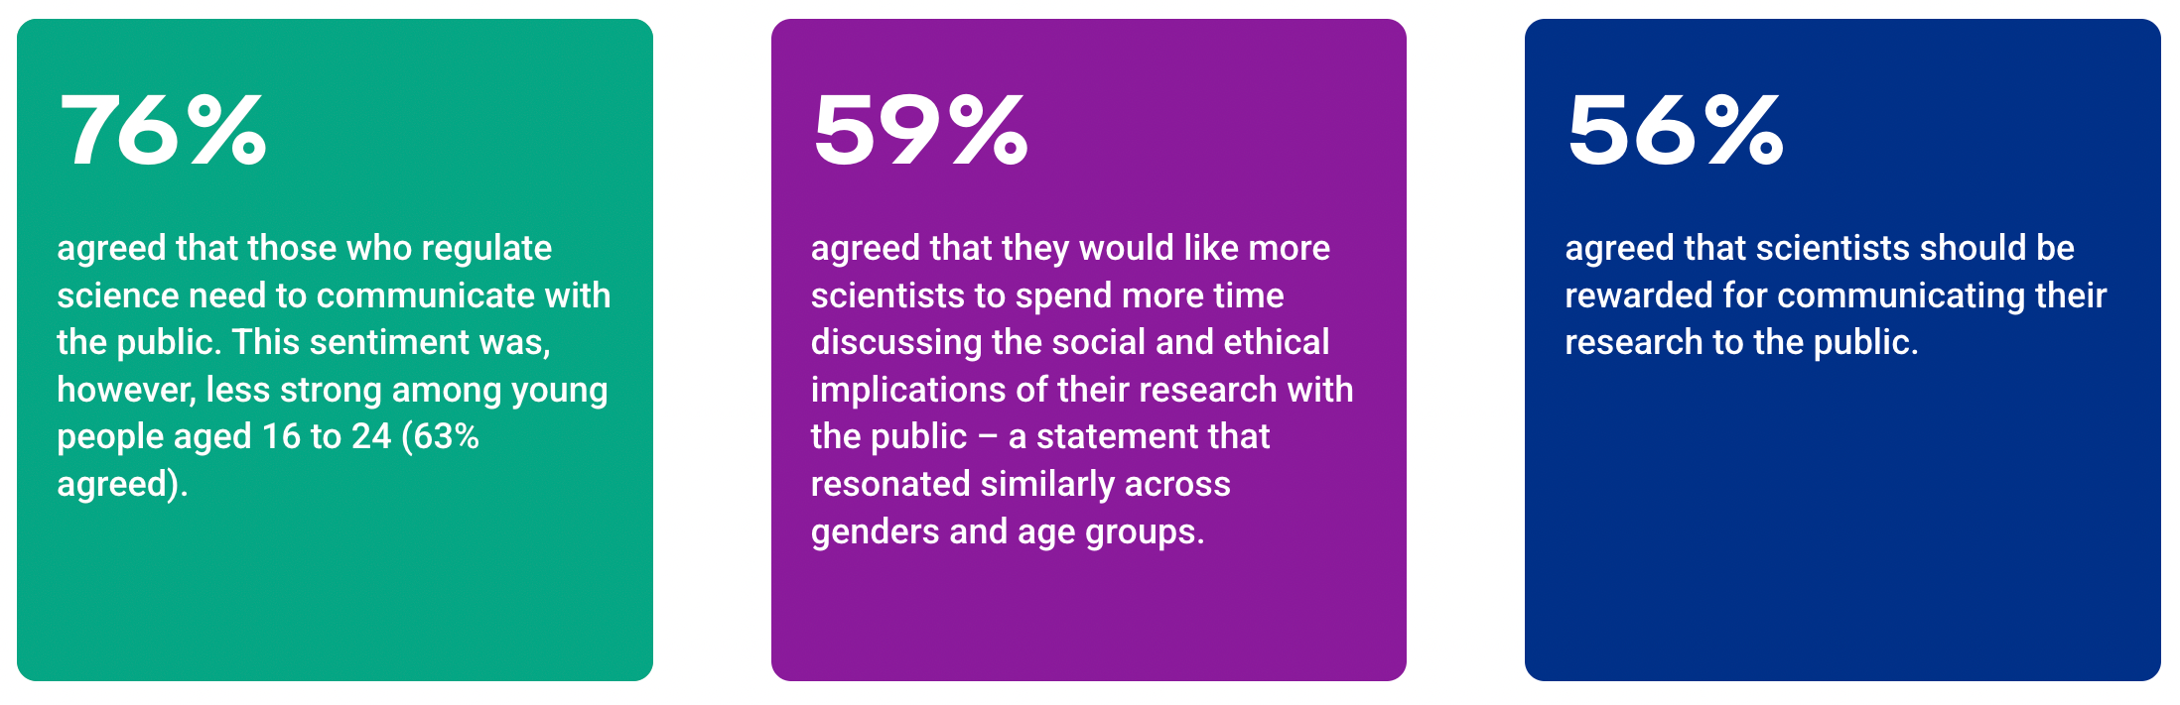
Communicating with the public
Ottilie Goodfellow | 24 June 2026
25
Notes:
Genuine public appetite for scientists to engage
Public want to hear more from regulators and scientists – not just about science but also ethical implications etc
Public also think scientists should be rewarded/recognized – sense its not routinely valued/rewarded in careers
Barrier is internal culture and incentive structures – which ill touch on later

Slide 26
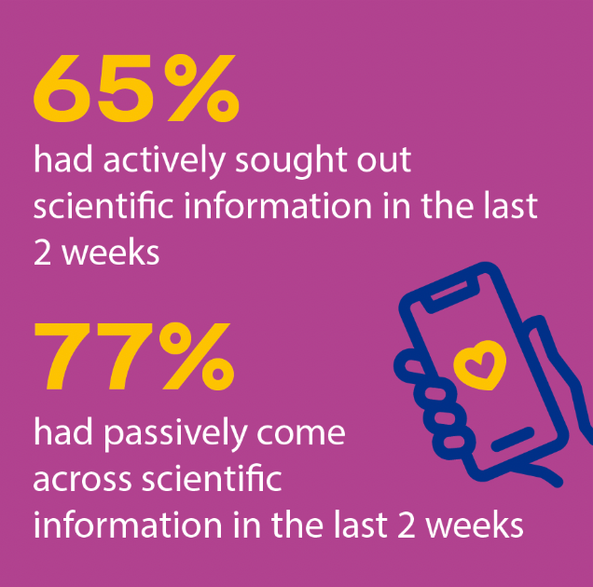
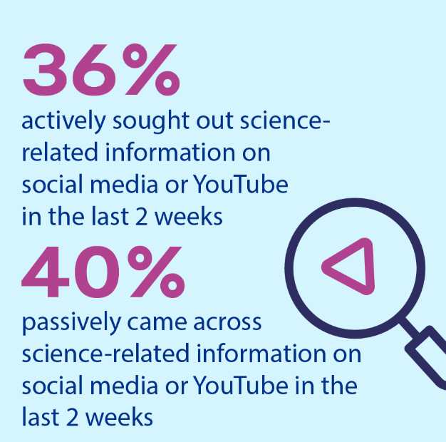
Shifts in the media landscape
  16-24s: new media has surpassed TV, radio and newspapers
  Top platforms: Instagram, TikTok, X (formerly Twitter)
Ottilie Goodfellow | 24 June 2026
26
Notes:
As we’ve seen, major shifts in how we consume media
Particularly for 16-24s
There is a direct implication for science communicators – the next generation of taxpayers, voters and potential scientists are finding a significant amount of their science content on social media. ​
​
We must cater to this. Outputs can’t exist solely in formats suited to traditional media (press releases, articles, broad coverage etc.)

Slide 27
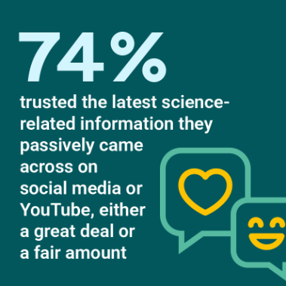
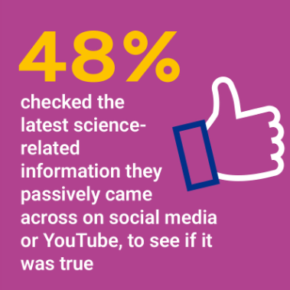
Who are people trusting for science-related information?
  Trust equal across all channels
  Based on institutional confidence, not verification
Institutional credibility = currency
Ottilie Goodfellow | 24 June 2026
27
Notes:
Trusted equally whether
BBC documentary
Tiktok video
Whatsapp conversation with a friend
Channel doesn’t predict trust, lots of people not verifying information
Trust grounded in confidence in sources and institutions

Slide 28
Science capital – who has it?
The sum of an individual’s science-related knowledge, attitudes, experiences, and social connections that influence their engagement and aspirations in science
High
Medium
Low
21%
66%
13%
2025
22%
60%
18%
2019
The middle is growing — but the top isn't
Ottilie Goodfellow | 24 June 2026
28
Notes:
Someone whose parent is a scientist, who watches science documentaries, who reads popular science books – they're accumulating science capital.
Someone with no science in their job, social circle or media diet has very little, regardless of how intelligent and qualified they may be in their own field
Fewer people with low science capital – positive
Same amount with high science capital – room for improvement
Why is high science capital so important?

Slide 29
Links between science capital and attitudes towards science
High Science Capital
Low Science Capital
Support for govt. funding
of blue-sky research
84%
44%
Sought out science-related information
91%
17%
Actively sought science
information
Agreed science increased
personal prosperity
84%
13%
To improve general attitudes towards science, we need to improve science capital
Ottilie Goodfellow | 24 June 2026
29
Notes:
High science capital has strong correlation to overall support for science
Positive attitudes to science
Greater trust in scientists
Greater willingness to engage
Greater feeling of benefitting from science
To improve general attitudes towards research and science, we need to improve science capital. If someone never encounters science in their daily life — through their job, their family, their media diet — they're less likely to feel it's relevant to them, less likely to get involved, and less likely to support funding it.

Slide 30
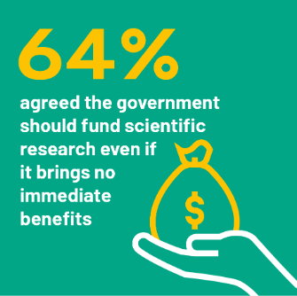
Blue-skies research and institution type
Public trust by institution
87%
Universities
84%
Charitable orgs.
77%
Environmental groups
69%
Government
60%
Pharmaceutical companies
48%
Other private companies
Down from 76-79% in previous surveys
Ottilie Goodfellow | 24 June 2026
30
Notes:
Finally – picked out two particularly relevant to PPD
Blue-skies science:
64% agree
Only 9% disagreed
But its down – we need to show importance of blue-skies research!
Public’s trust in scientists – framed by institution

Slide 31
Conclusions from PAS 2025
1
The public values science and wants to hear more about it
2
Scientists are broadly trusted, respected and associated with positive traits
3
Consumption of science is shifting fast from traditional to new media
4
More access hasn’t led to more understanding - uncertainty is rising
5
Science capital is the strongest predictor of support for science
What can we do with this data?
Ottilie Goodfellow | 24 June 2026
31

Slide 32
Agenda
1
What is science communication?
2
What changes are impacting science communication?
3
What do people think about science & scientists?
4
What are the recommendations for this new era of science communication?
Ottilie Goodfellow | 24 June 2026
32

Slide 33
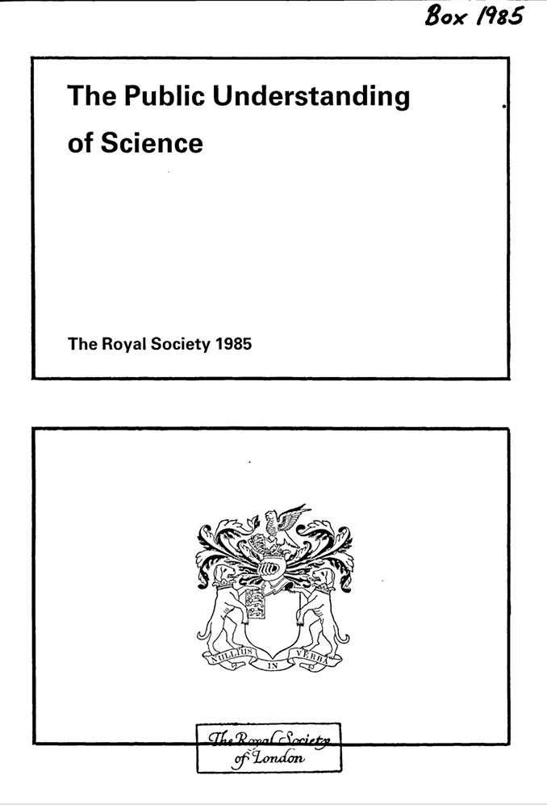
The first recognition for science communication?
Turning point – public engagement became a legitimate part of being a scientist ​
📅 National Science Week created
📝 PE statements required in grant applications
💰 Research Councils funded public understanding
🎤 Faraday Lecture introduced
Source: Royal Society, The Public Understanding of Science, 1985
Ottilie Goodfellow | 24 June 2026
33
Notes:
Sir Walter Bodmer
Before this, the idea that practising scientists had any responsibility to engage with the public wasn't widely accepted
Engagement becoming embedded in the Royal Society's mission and an integral part of scientists' activities in higher education institutions.​
Directly reshaped funding requirements and institutional behaviour. This is why revisiting it 40 years later, is so important

Slide 34
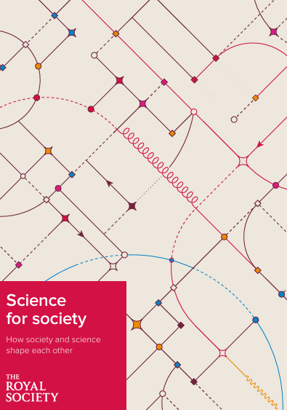
Bodmer revisited: the Science for society report
40+ years
Source: Royal Society, Science for society, 2026
The Public Understanding of Science, 1985
Science for Society, 2026
Ottilie Goodfellow | 24 June 2026
34
Notes:
April 2026, Rs published direct successor
Rs has established what has changed, and what has not
Audience; primarily scientific community, as well as communicators, funding agencies, policy maker etc.
Findings of PAS are directly considered

Slide 35
What Bodmer couldn’t have predicted
🖥️
🤖
📡
The Digital World
AI
Misinformation at Scale
  1985: 13% of homes had a computer
  2026: Instant access to almost all human knowledge
  The new report's equivalent unknown
  Could accelerate scientific discovery
  Public deeply polarised on benefits vs. risks
  Unlimited content = democratised access
  Competition for trustworthy information
Ottilie Goodfellow | 24 June 2026
36
Notes:
Internet just a couple of years old
Today - instantaneous access to all human knowledge
Competition for attention
Reports new unknown
Significant risk as employment, finance, energy and science become increasingly enmeshed with it
Misinformation operates at a scale that wasn’t considered
Shift away from limited, information
Democratised access to knowledge
Pose challenges to anyone trying to communicate trustworthy info to guide important decisions

Slide 36
Key Themes & Recommendations
Education
Policy
Informal
engagement
Science for society
Scientific
community
Mass media
Industry and business
Ottilie Goodfellow | 24 June 2026
35
Notes:
120 pages
20 formal recommendations organized by chapters
Each recommendation is targeted at specific audience with specific actions
Government
Royal Society
Scientiifc community
Research organisations
Industry
Unifiying thread – science communication and public engagement is essential part of research lifecycle
Researchers across academia, industry and third sector should be protected and rewarded for doing it

Slide 37
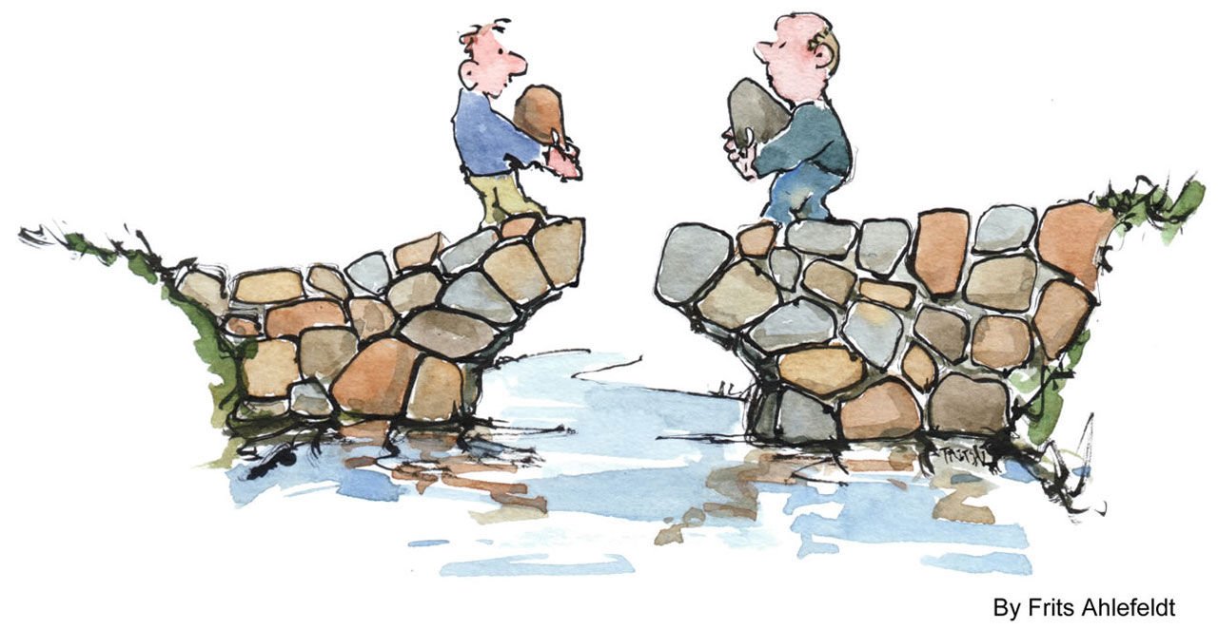
The gap between wanting to and being able to
The public
wants to hear
from them
How do we bridge the gap?
  Sci comm training
  Career progression criteria
  Protected time
  Explicit outreach budgets
Scientists
want to
engage
No time, no reward, no structure
Ottilie Goodfellow | 24 June 2026
37
Notes:
Royal Society commissioned “Factors affecting public engagement by UK researchers’ survey
Clear and growing wish to support PE but facing barriers
Not a core activity
Not important to career progression
Hard to prioritise with limited time and money
Problem – scientists are best, most trusted asset
What we need is structural change to how science communication is viewed and rewarded. ​
Formal career progression criteria​
Dedicated and protected time for outreach activities and training​
Funding bodies setting explicit targets for outreach budgets​
Sci Comm/outreach training as part of formal BSc, grad schemes etc.

Slide 38
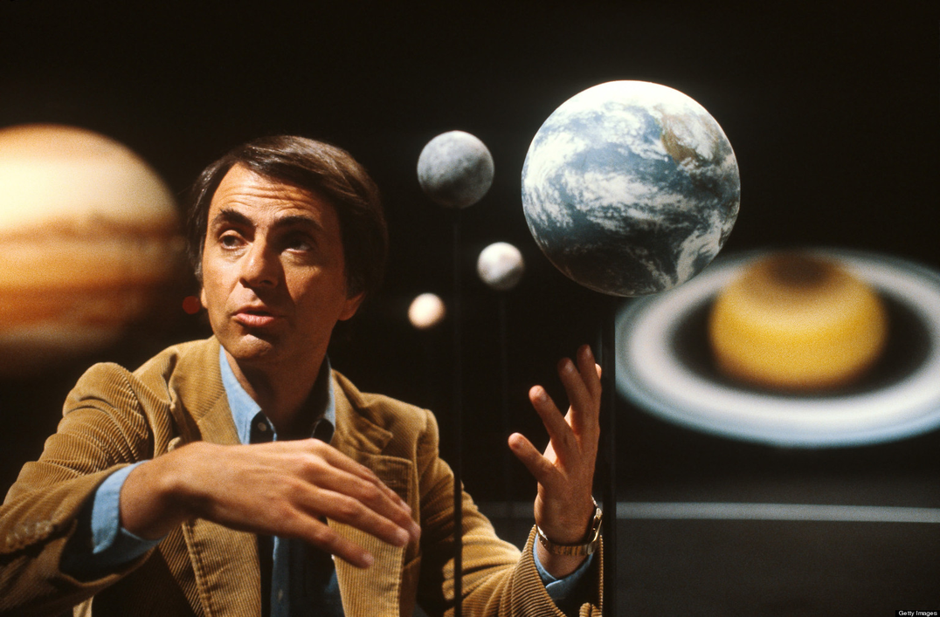
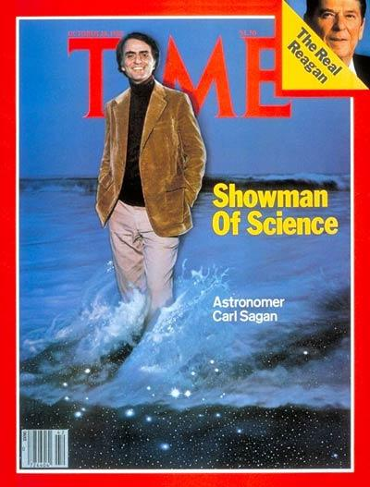
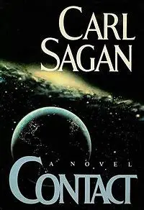
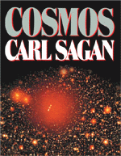
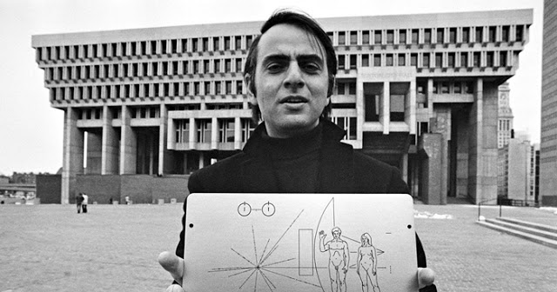
The Sagan effect
Too public to be taken seriously?
Ottilie Goodfellow | 24 June 2026
38
Notes:
Another problem that deters researchers: Sagan effect
Late Carl Sagan – renowned astronomer and science communicator
Rumours: tenure at Harvard and nomination to National Academy of Science rejected – too much emphasis on public career
Fear of being viewed by peers as seeking fame, less skilled/productive.
Stigma doesn’t match the evidence = research indicated PE is widely done and can benefit careers
Starting to see a shift – successful/decorated scientists also popular sci comms
Trusted and popular with public
Successful careers
Not mutually exclusive

Slide 39


Science is a two-way street
The ‘Deficit model’ of science communication
  expert to audience
  criticised in House of Lord’s Science and Technology Committee’s 2000 report
New era:
  Citizen science (e.g. Big Butterfly Count)
  Participatory research
  Dialogues on ethics and implications
Ottilie Goodfellow | 24 June 2026
39
Notes:
Royal Society also makes point that the way we go about science communication has fundamentally changed.
Deficit model – non-scientific audiences are empty vessels, waiting to be filled with wisdom of science, scientists should be in control of this information flow
Calls for audience to play a more participatory role, making science a two way street

Slide 40
Agenda
1
What is science communication?
2
What changes are impacting science communication?
3
What do people think about science & scientists?
4
What are the recommendations for this new era of science communication?
5
What comms does PPD do, and how can you get involved?
Ottilie Goodfellow | 24 June 2026
40

Slide 41






Science communication at PPD
External Comms
  LinkedIn
  Website
  Articles and press releases
  Photos, videos, posters
Internal Comms
  Monthly newsletter
  TV news screens
  Quarterly highlights for EB
  The Source and STFC webinars
Ottilie Goodfellow | 24 June 2026
41
Notes:
Don't have time to talk about all of the interesting work I've gotten involved with over my placement

Slide 42

New PPD website!
Ottilie Goodfellow | 24 June 2026
42

Slide 43




Science communication at PPD
Public Engagement
  Masterclasses
  Work & Engineering Experience programmes
  Visits and tours
  Public access days
Ottilie Goodfellow | 24 June 2026
43

Slide 44



How YOU can get involved
  PPD Public Engagement meetings
  Volunteer at events – masterclasses, access days etc.
  Register as a STEM Ambassador – mailing list
  Become a Summer Work Experience supervisor
Ottilie Goodfellow | 24 June 2026
44
44

Slide 45



How YOU can get involved
  Upcoming result, paper, or milestone? Share early!
  No ideas too small
  Engage! Follow us on LinkedIn
Ottilie Goodfellow | 24 June 2026
45

Slide 46
Summary
1
Sci Comms is no longer one way – it’s a dialogue between science and society
2
Landscape has shifted: new media, AI and misinformation have changed the game
3
Public support for science is real and needs nurturing
4
Building science capital builds positive attitudes towards science
5
You can (and should!) get involved with public engagement
Thank you. Questions?
Ottilie Goodfellow | 24 June 2026
46

