Slide 1



Introduction Presentation
Zhen Ng
Notes:
The abstract pattern can be removed or repositioned if required. Be careful to ‘Send to Back’ so that it does not obscure any important information.

Slide 2

My Locations
Now
From
Born
Notes:
To change the map, select ‘Format’ from the PowerPoint menu and ‘Slide Background’ from the drop-down menu. Within the new list of options that appears on the right of the screen, select the ‘File’ button under ‘Insert picture from’ and select your image from your file browser. Remember to delete the image credit if using your own image.
To edit the points on the map, click the box and reposition. You can then drag the dot to show your specific location. Click into the box to edit the copy. To add more points, click the box and copy and paste the box.

Slide 3
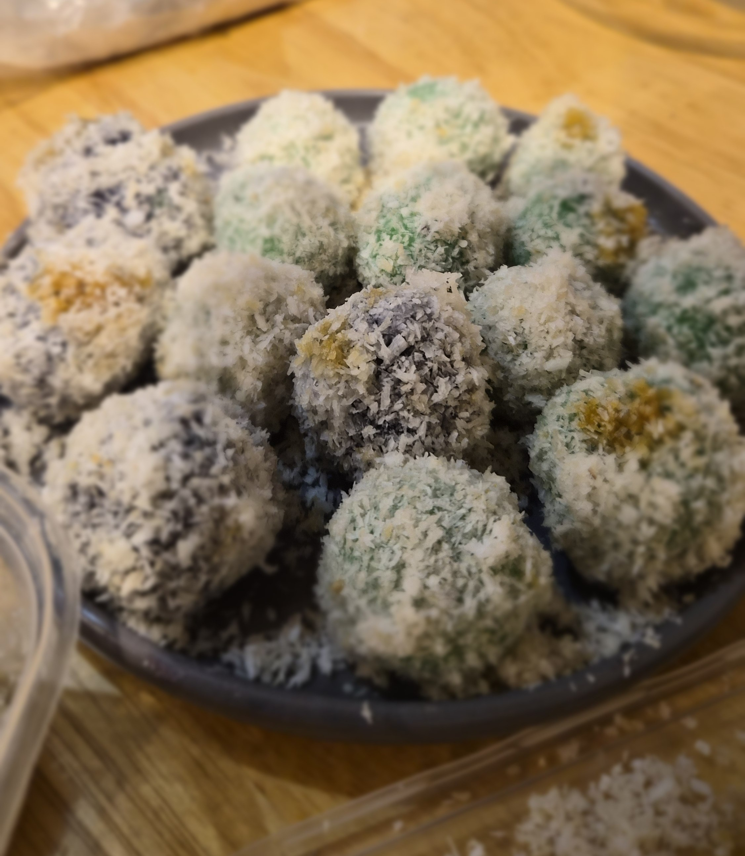
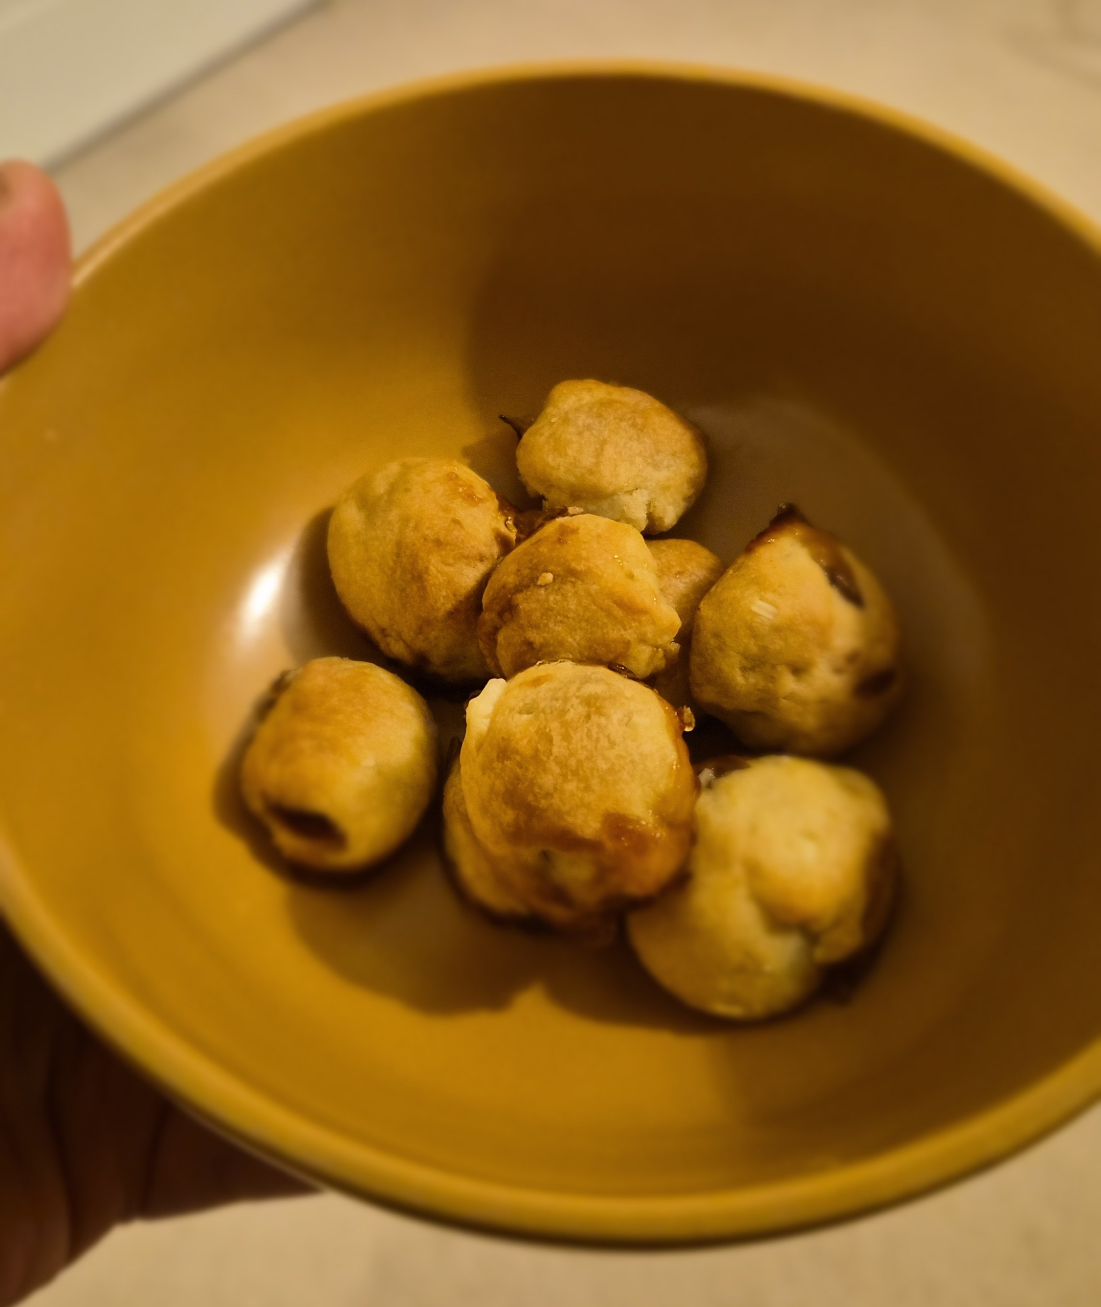
Festive Seasons
Klepon/Onde-onde
Nastar

Slide 4
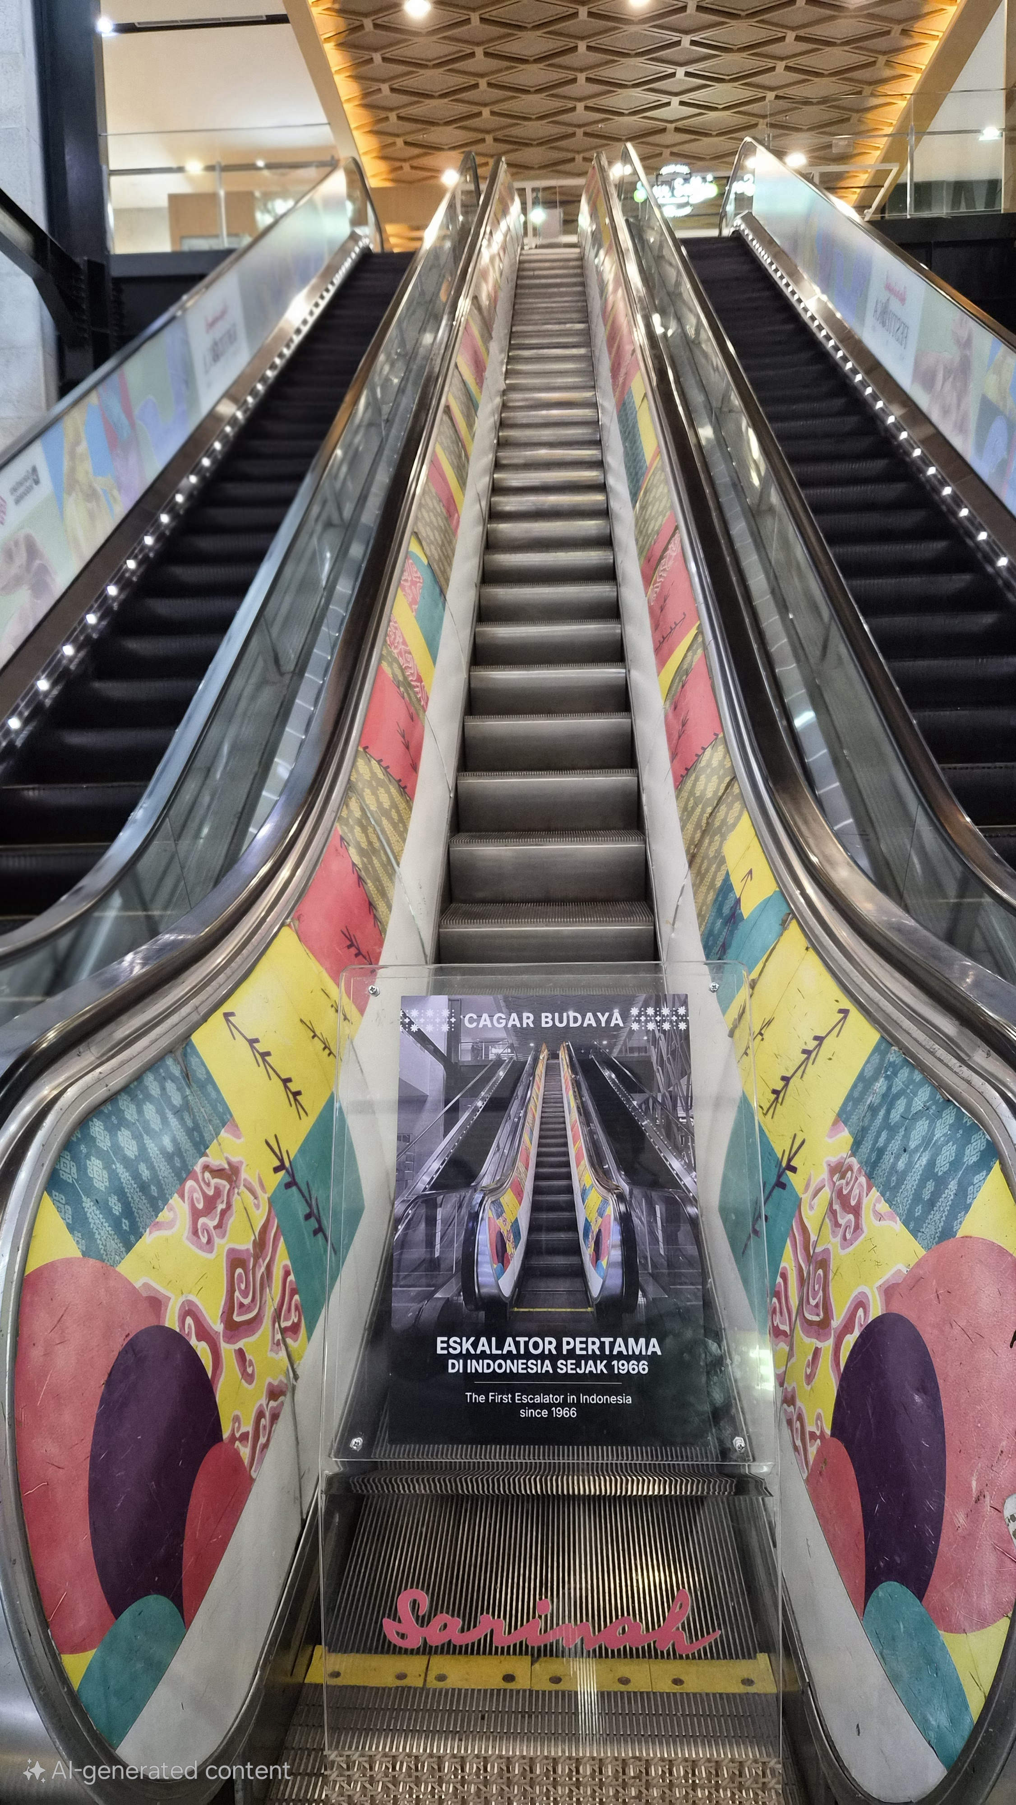
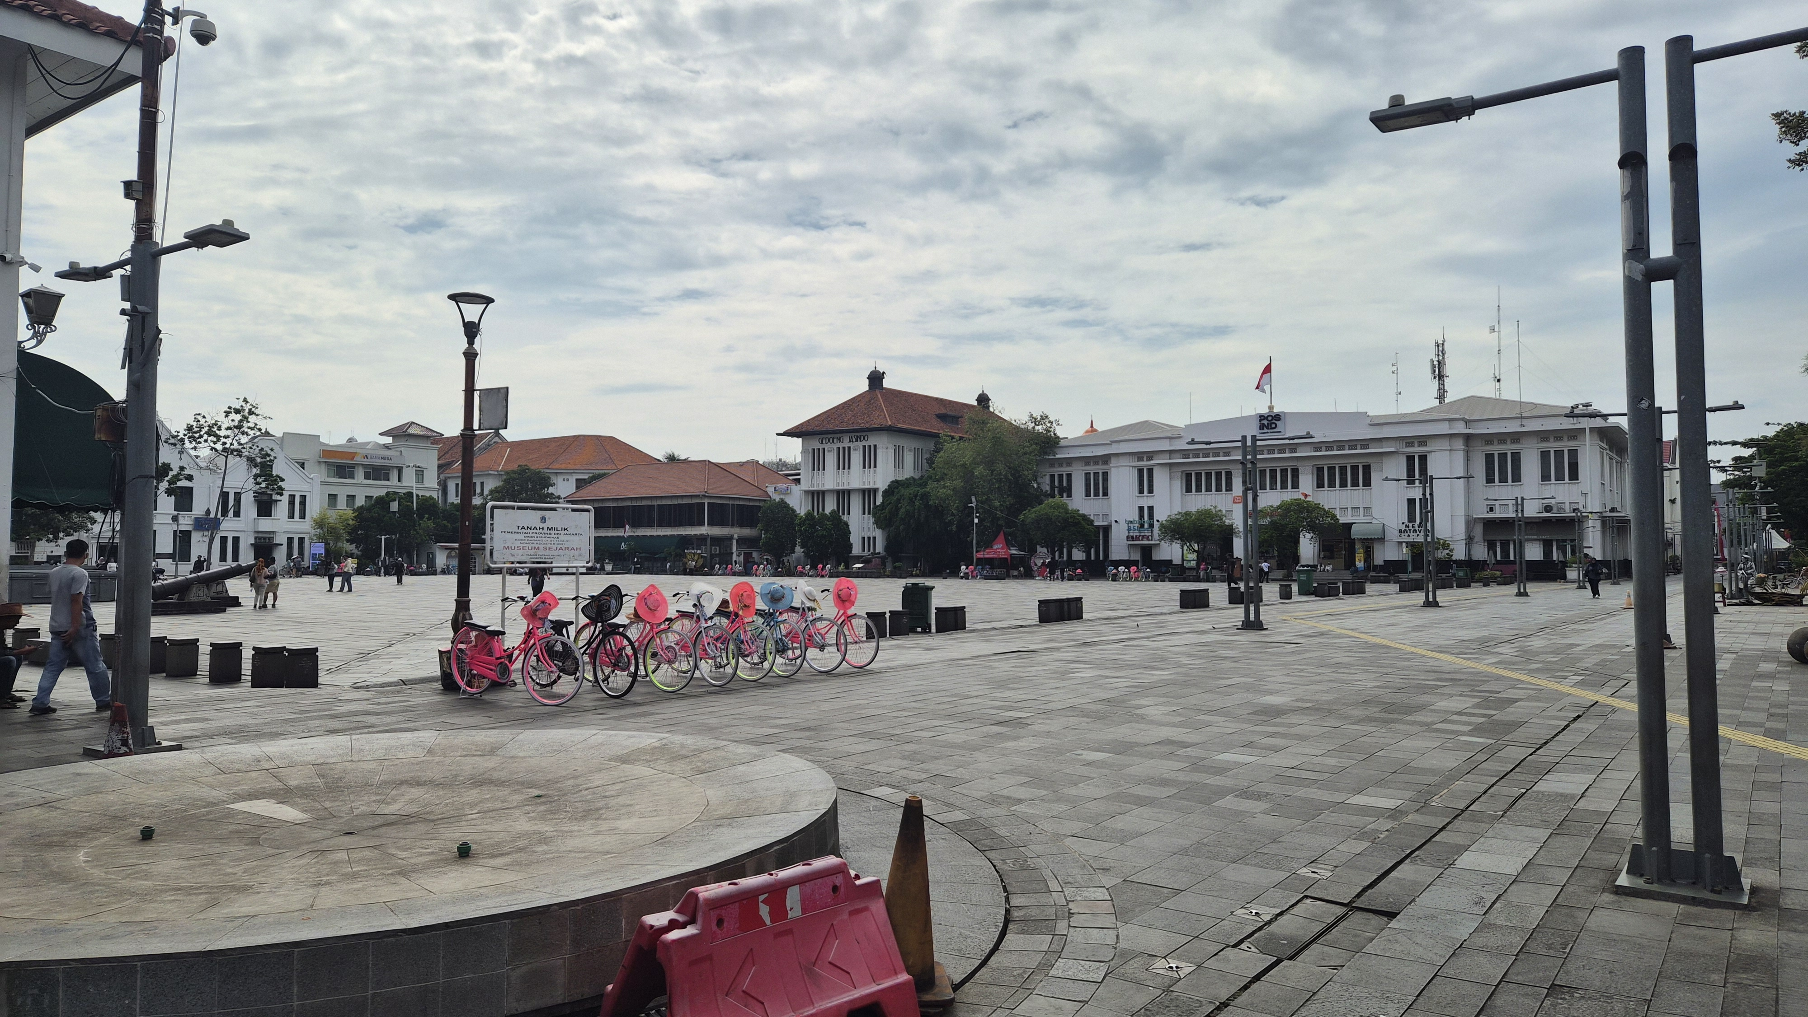
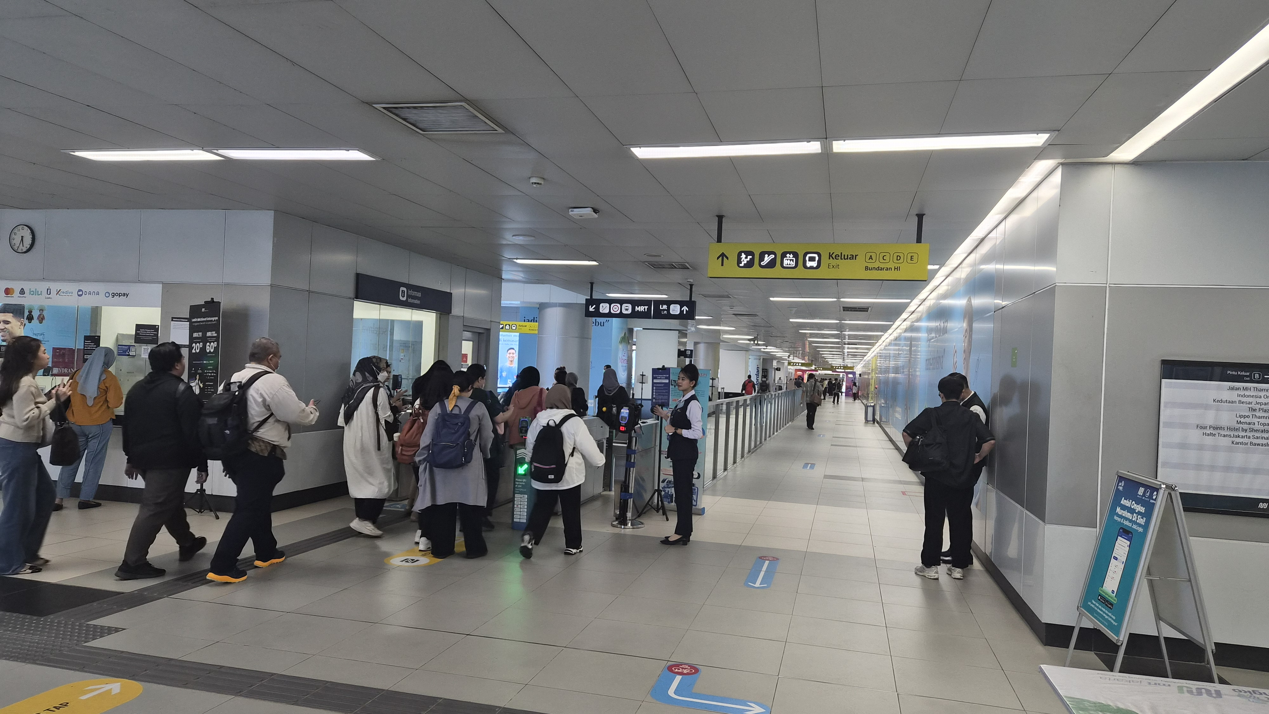
City - Id

Slide 5
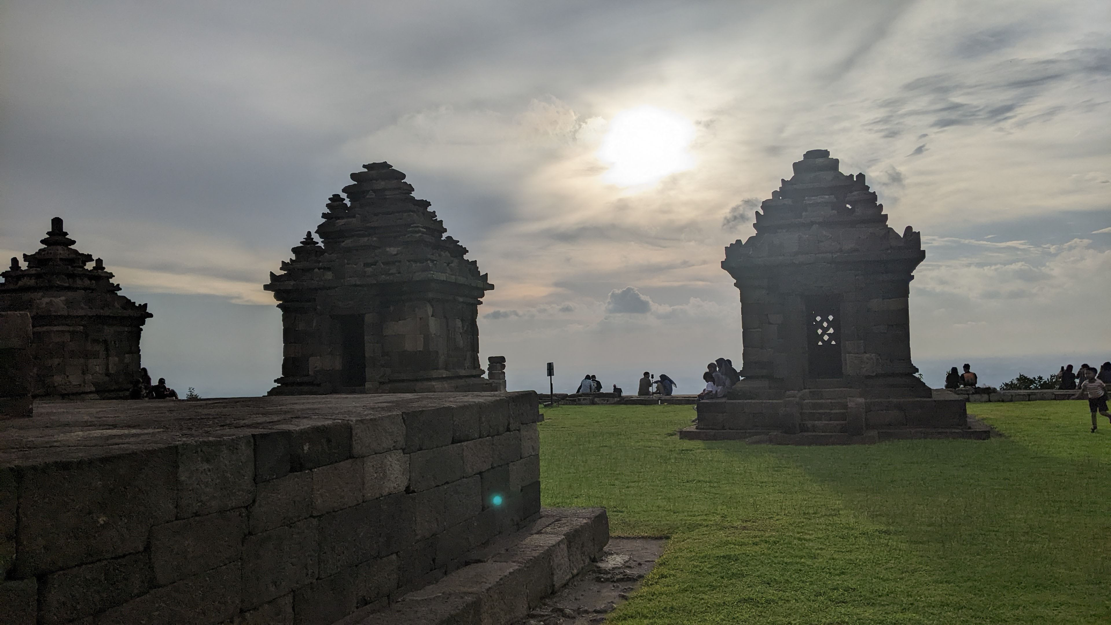
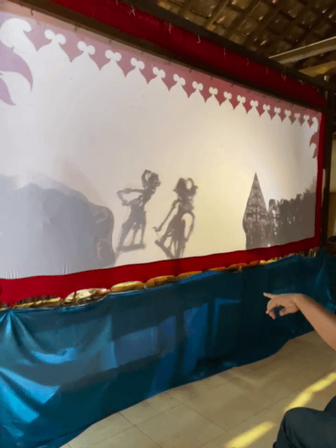

Outside - Id

Slide 6
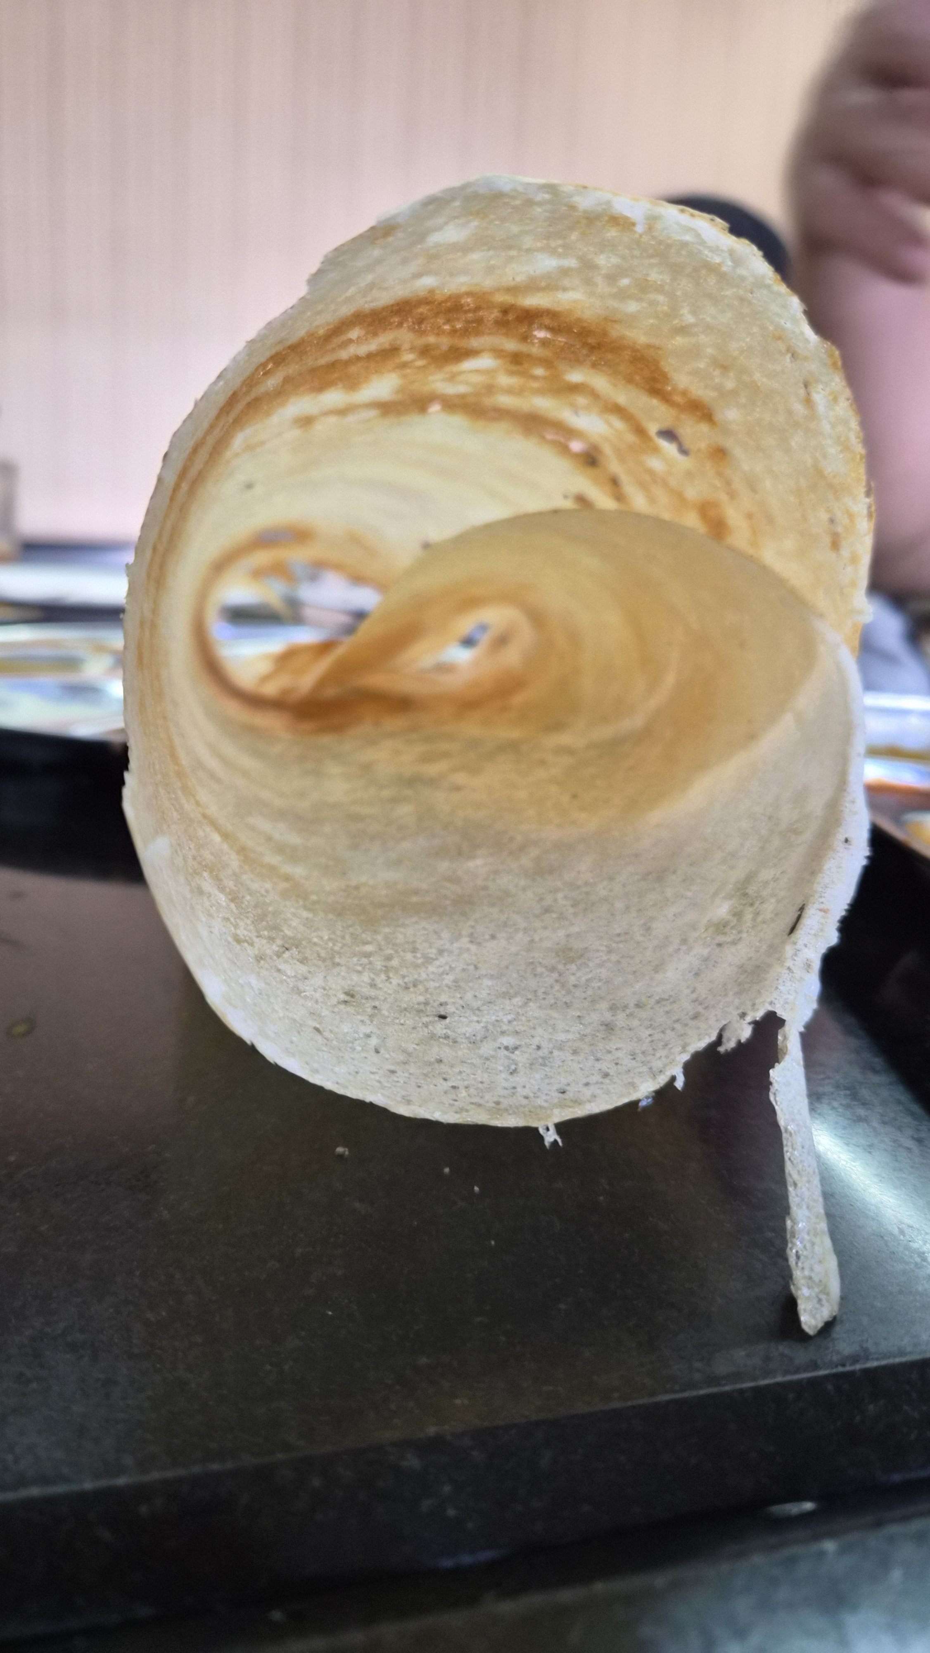
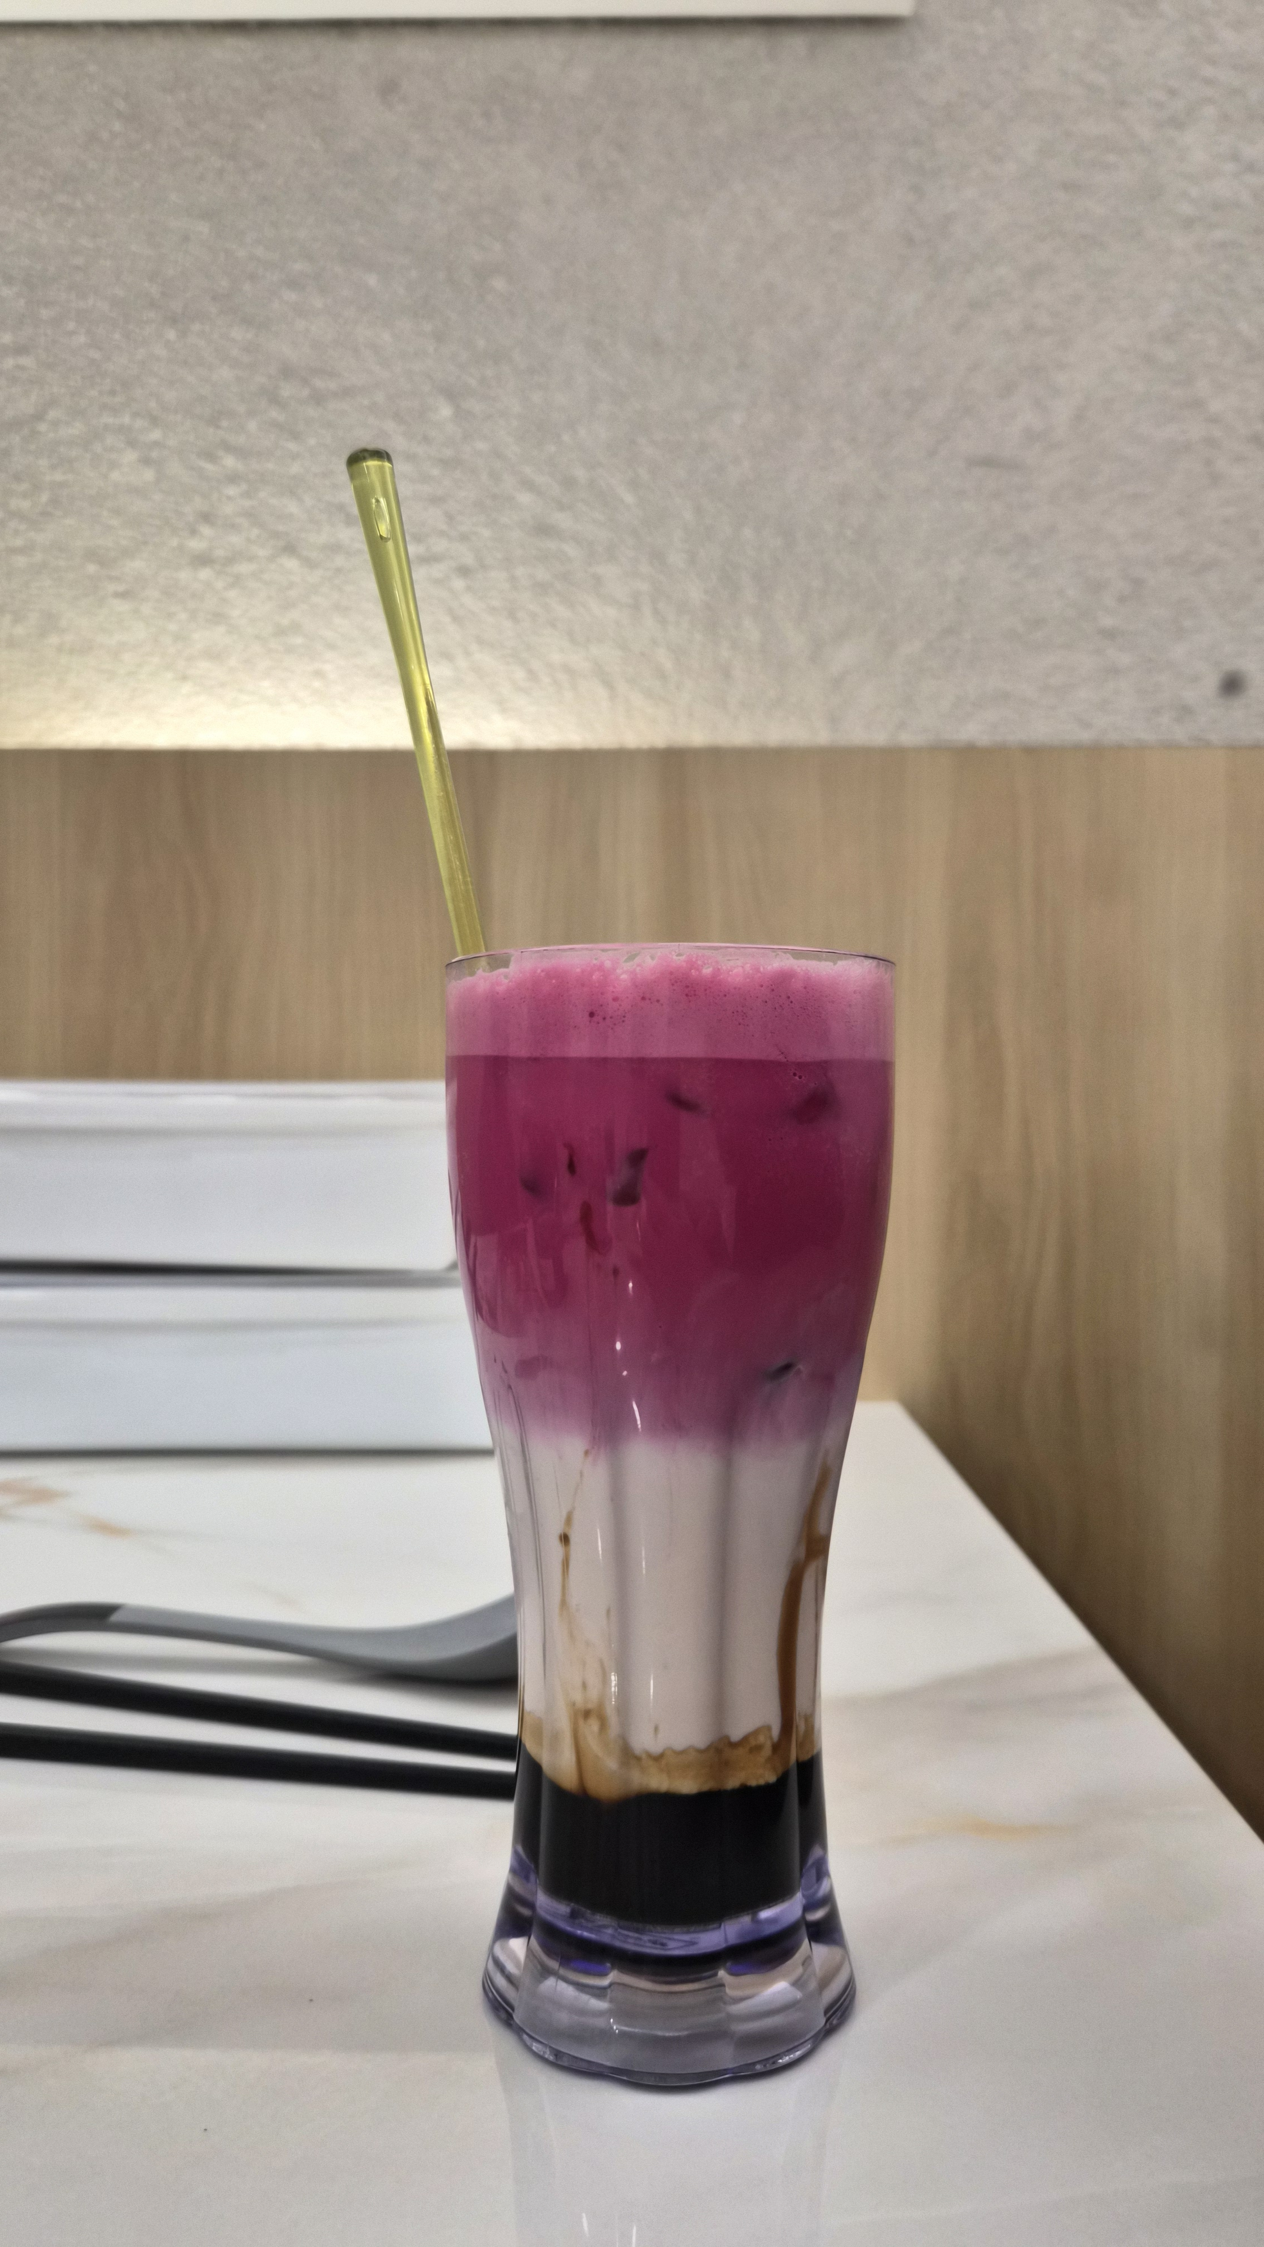
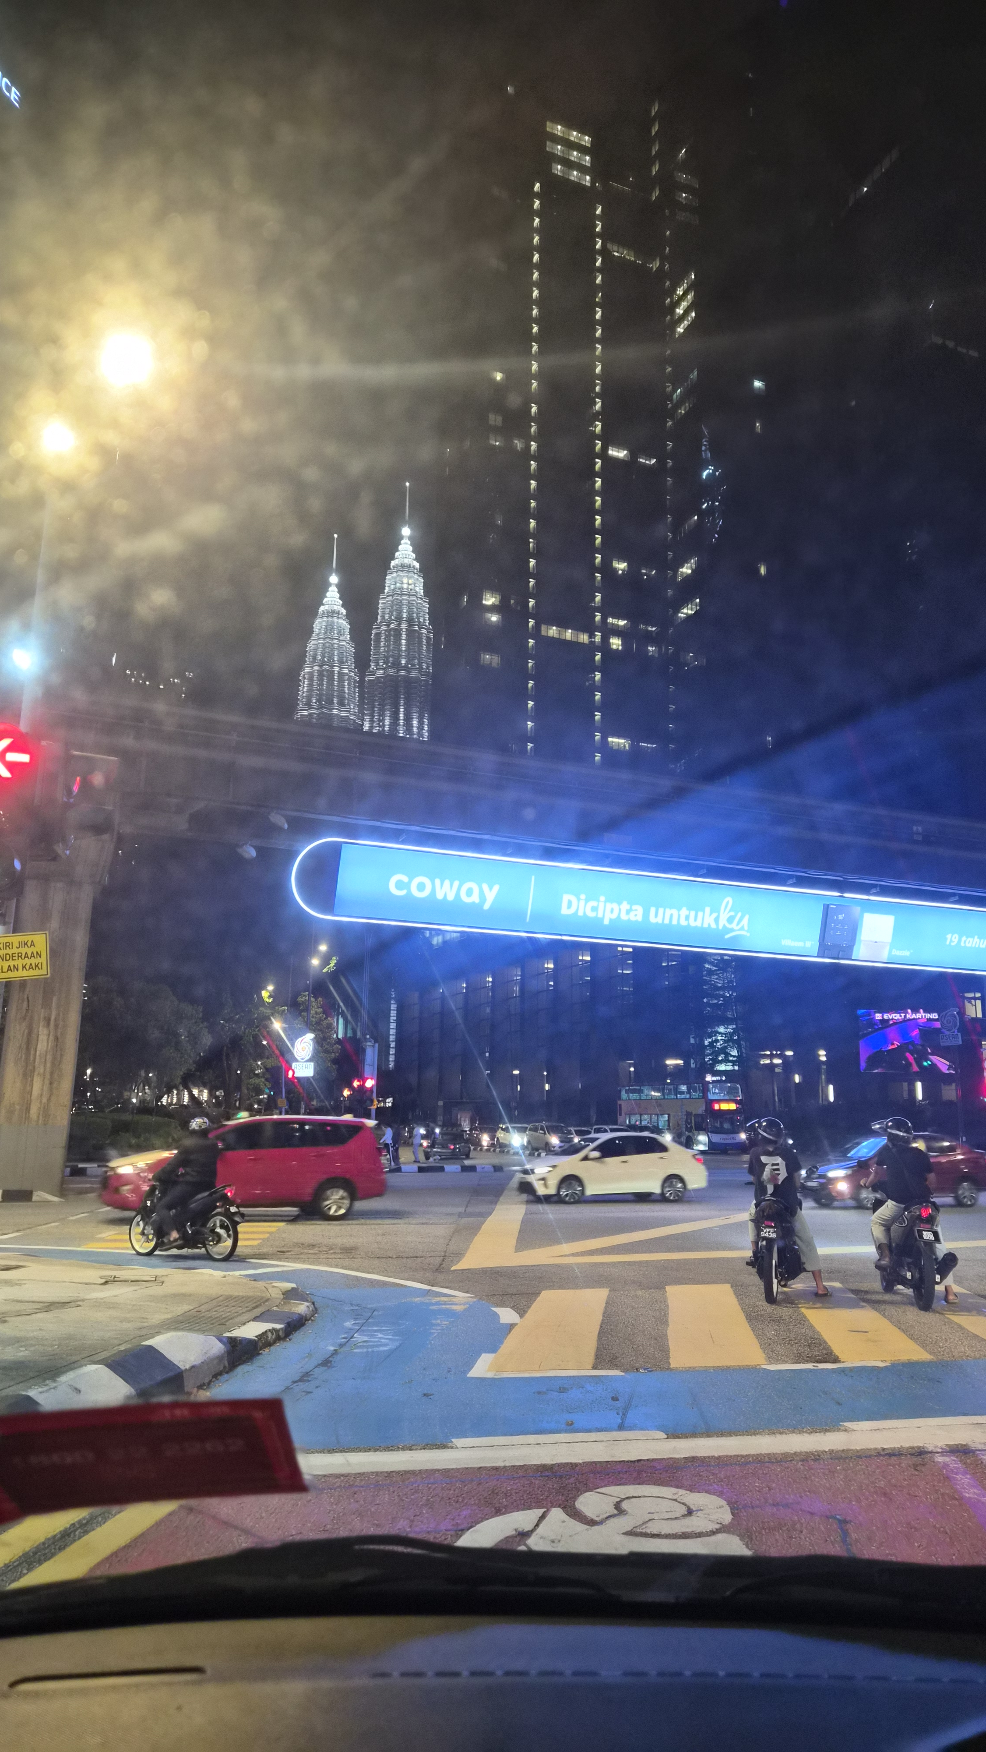
City & Food - My

Slide 7
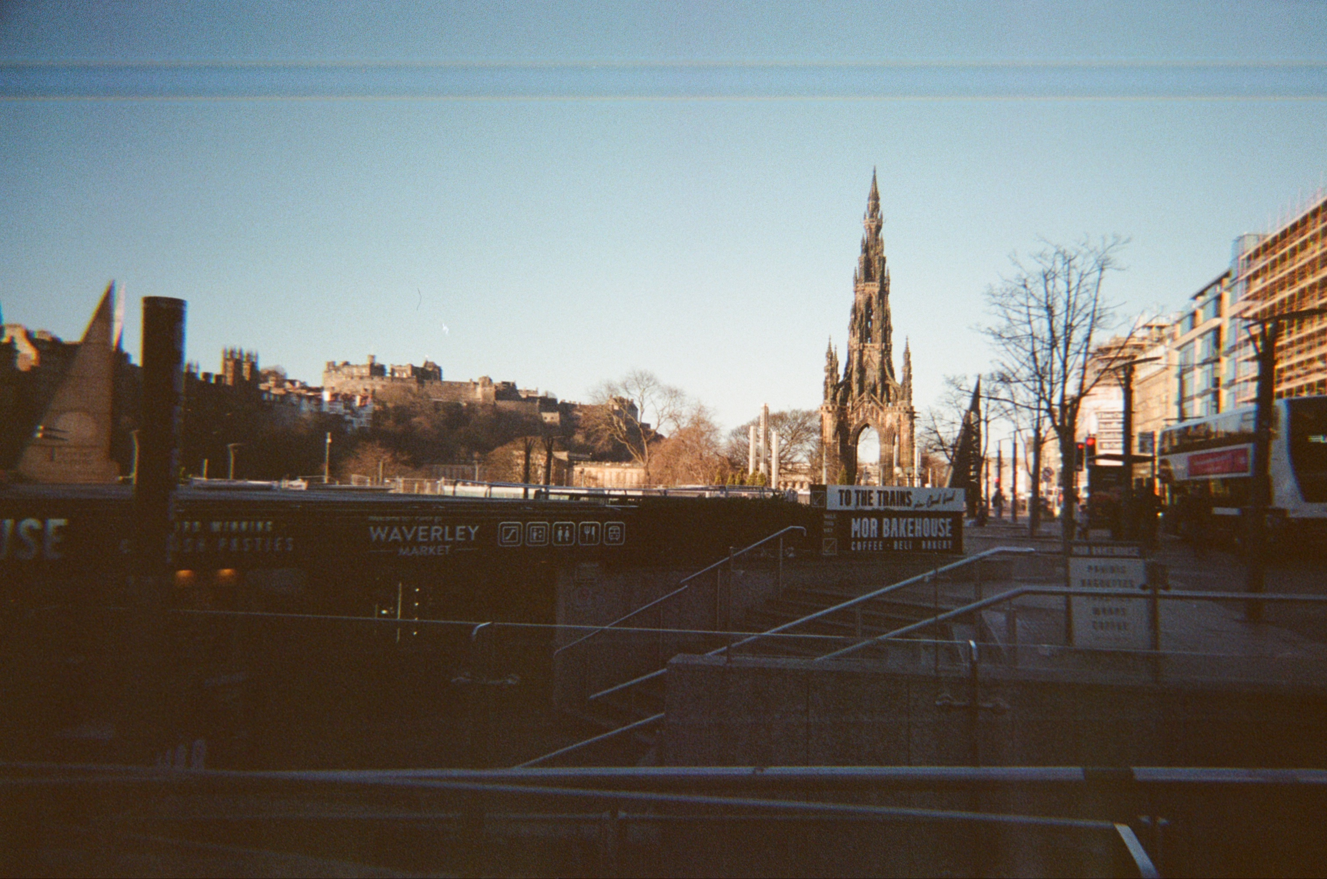
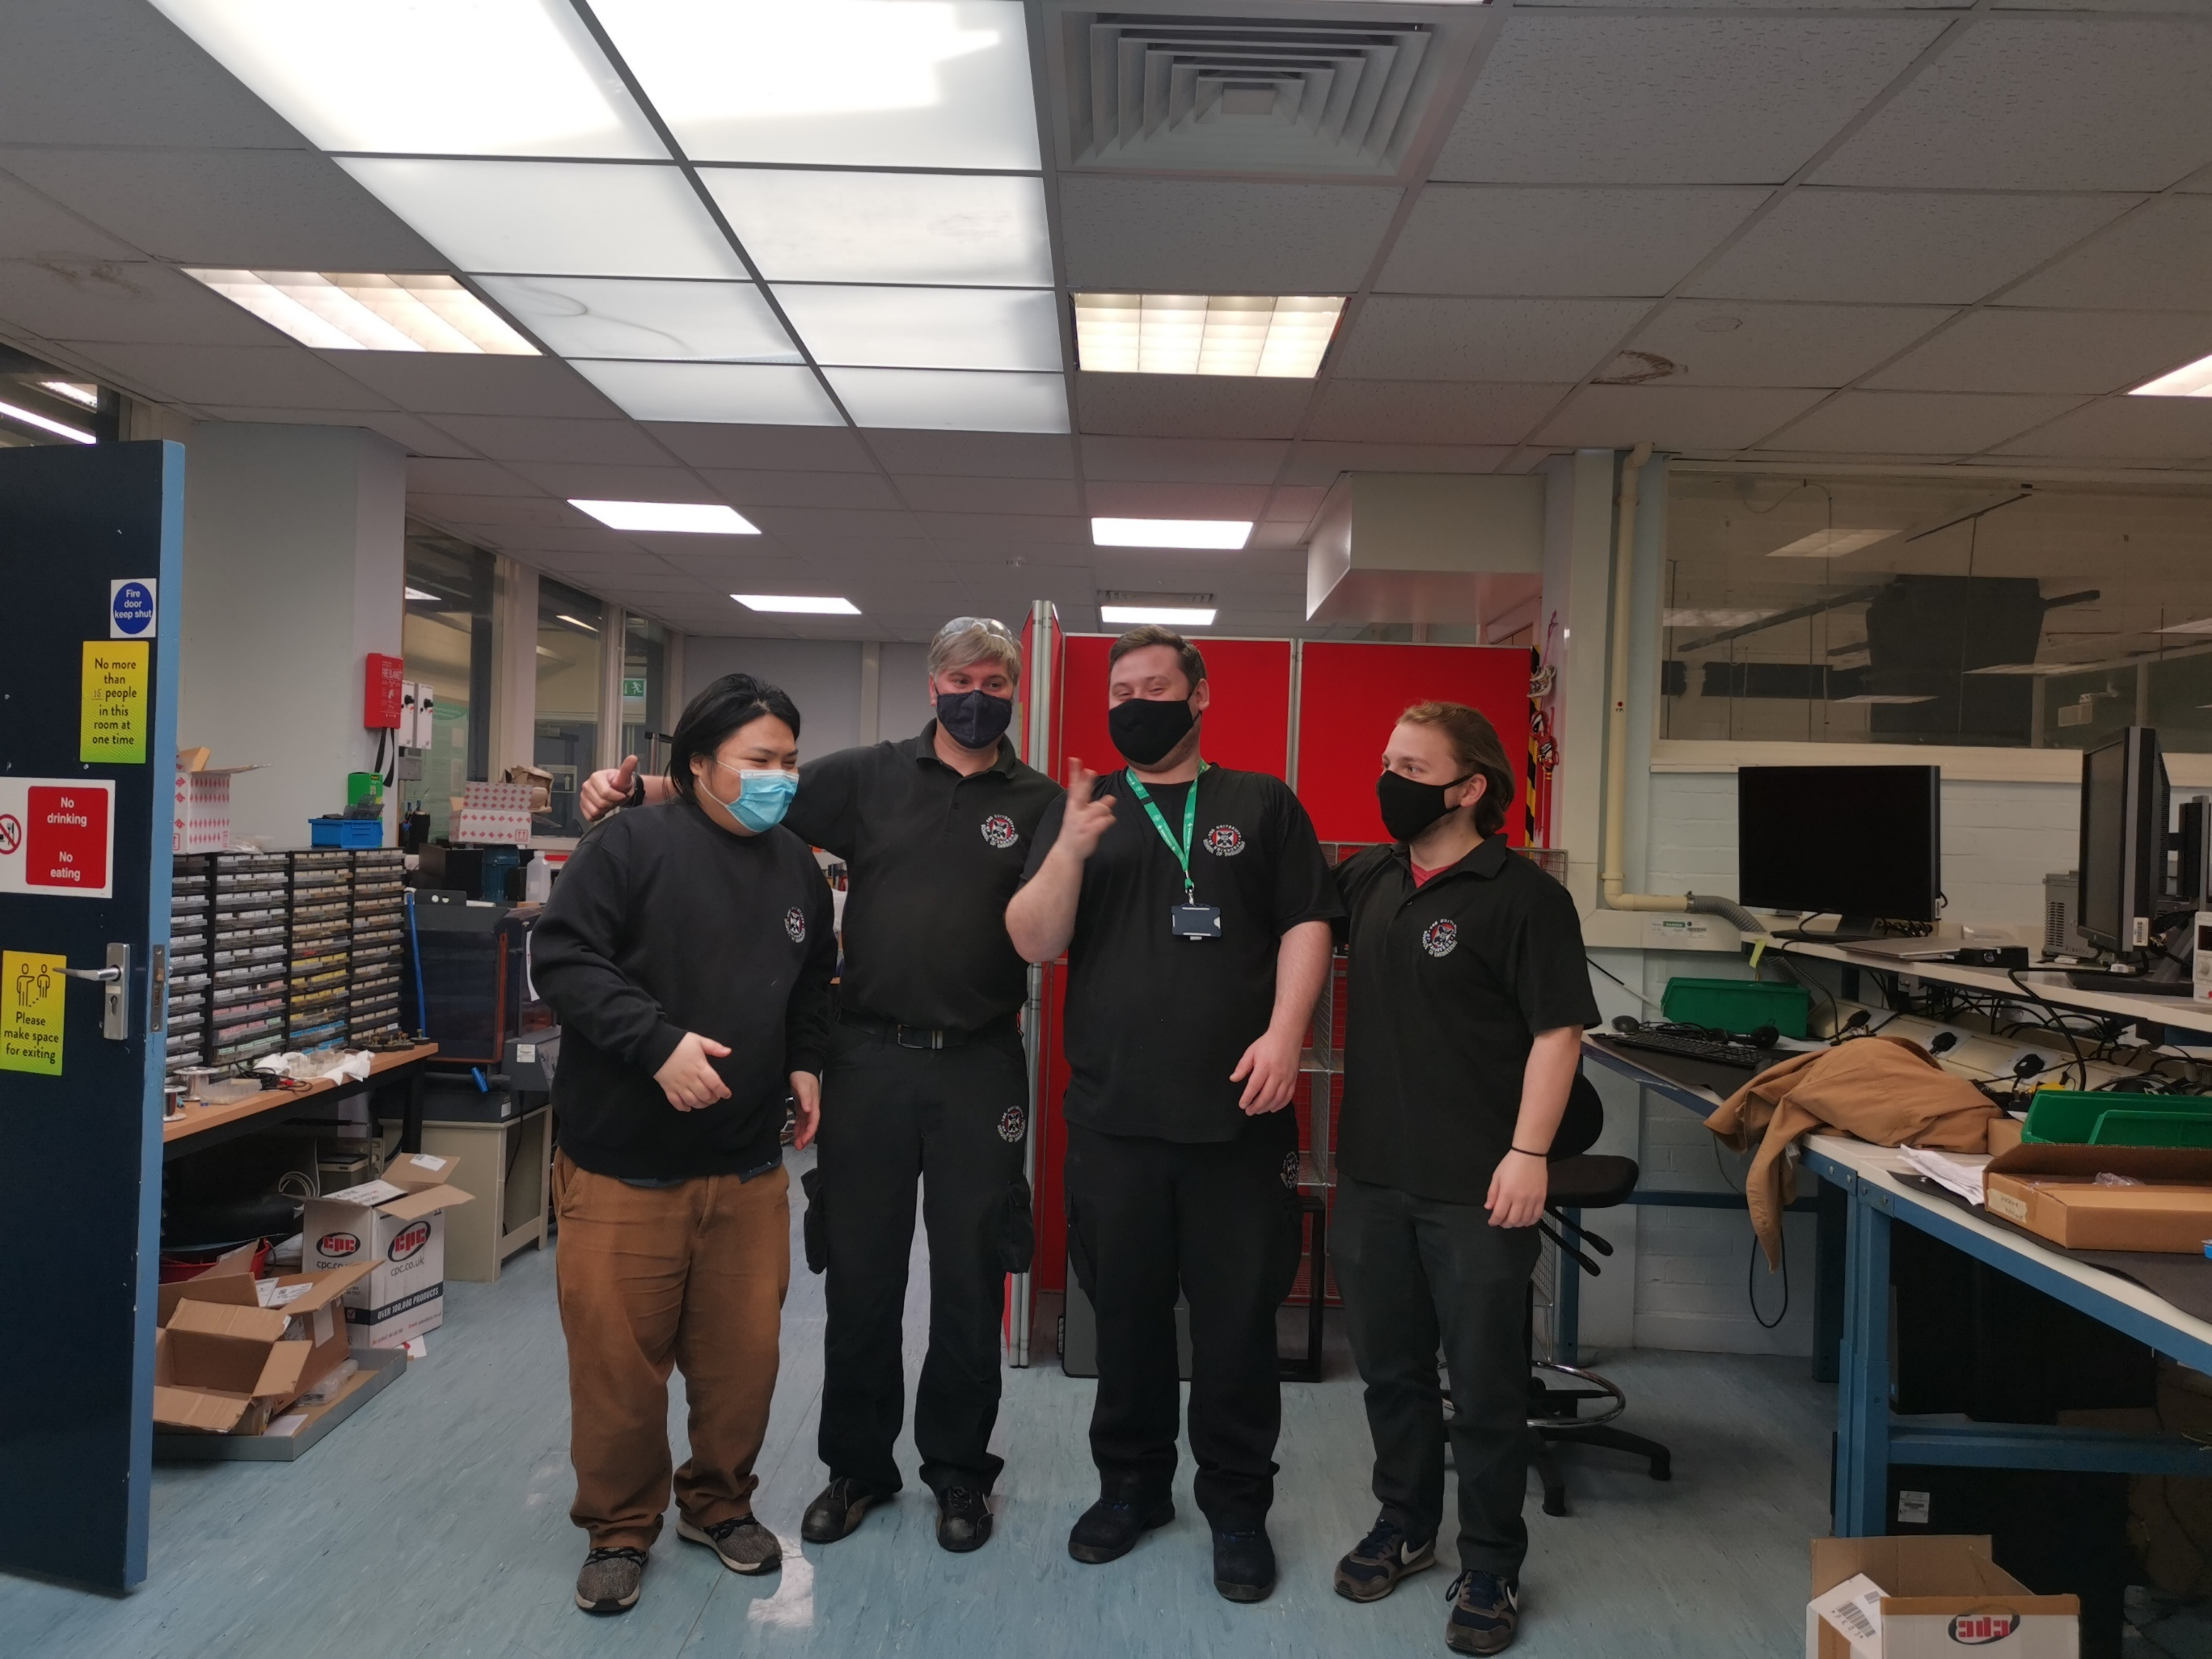
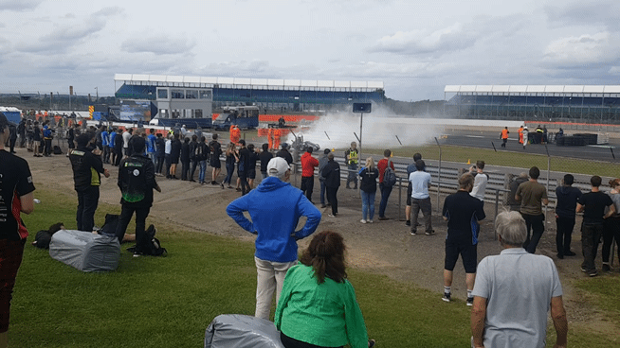
University
Labs:
Analogue Mixed Signal & PCB Making
Digital
Power systems & Presentation
Other Things:
Formula student
Peer Learning → 1st year electrical topics

Slide 8

Tokamak Energy - Intern
Fusion energy startup based at Milton Park
My line manager was in the same course as my current line manager
Oxfordshire is packed with Fusion companies:
UKAEA – CCFE
Tokamak Energy
First Light
Battery replacement PCB
GUI using Tkinter for graphing power supply voltages
Notes:
To edit the graph data. Click on the chart, Chart design, and choose select data or edit chart data in excel.

Slide 9
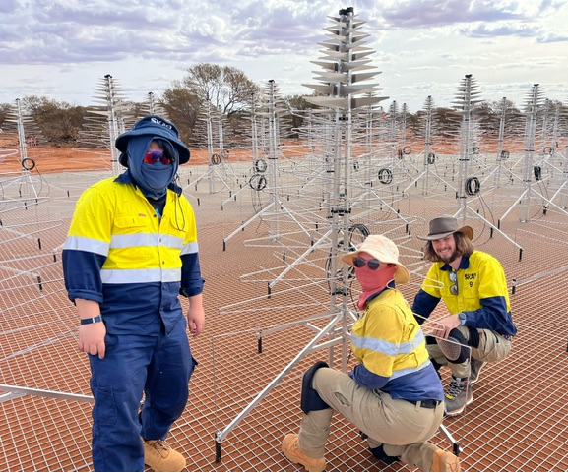

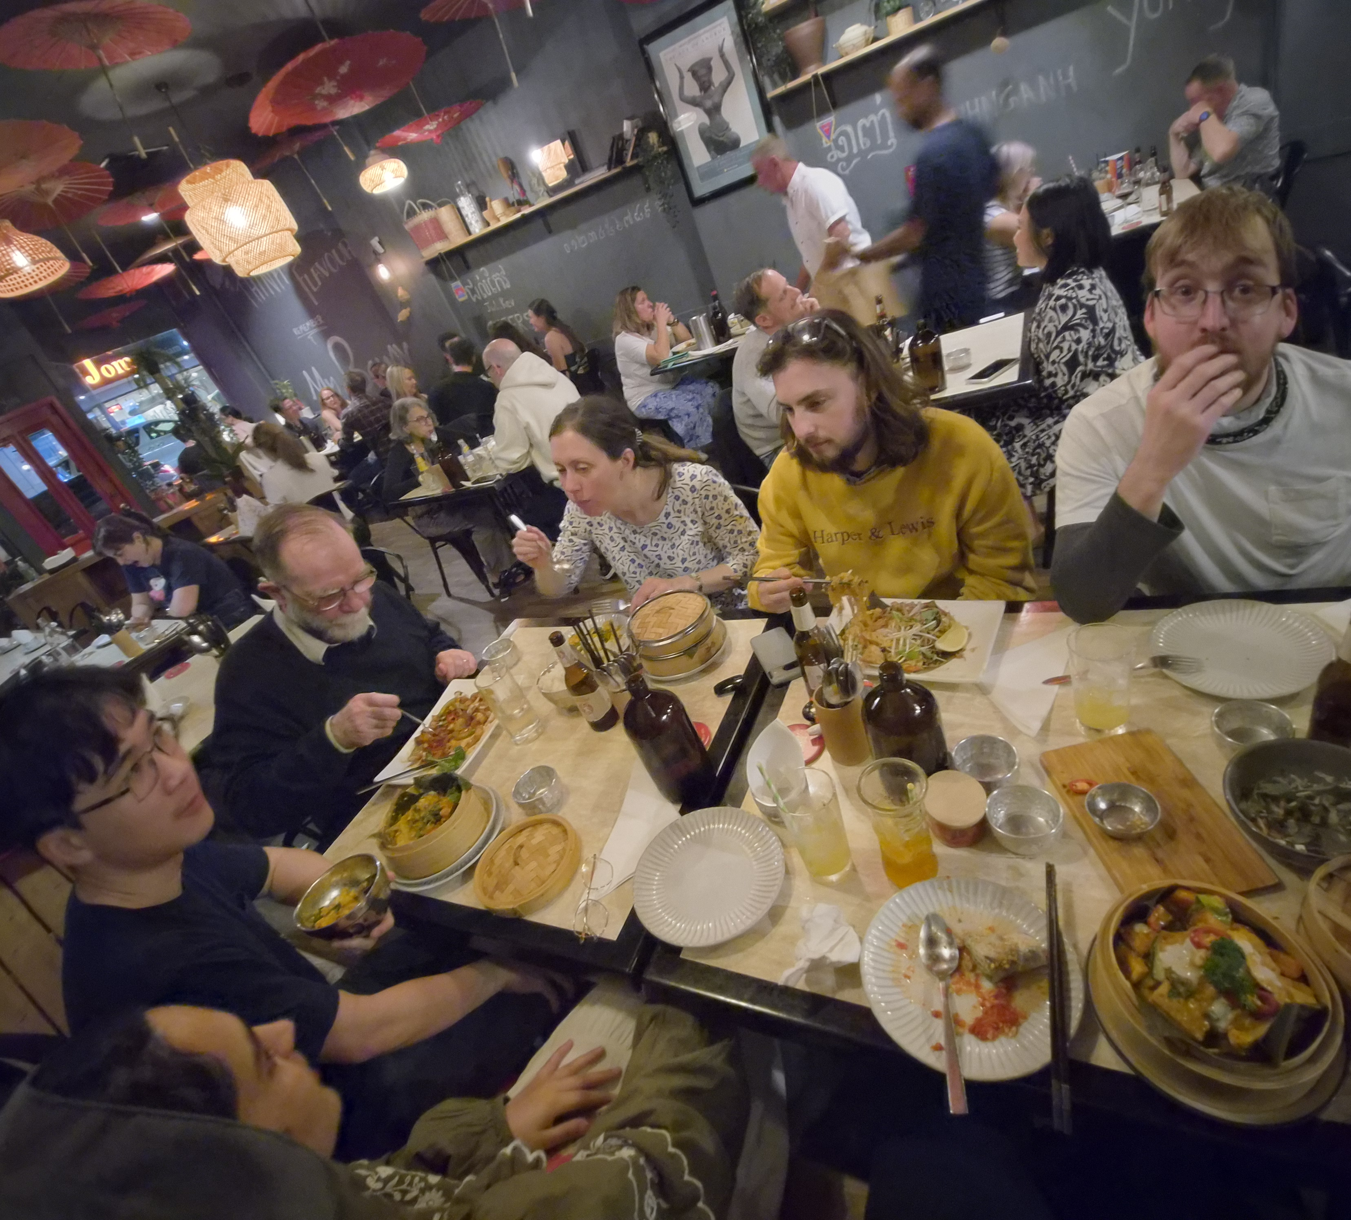
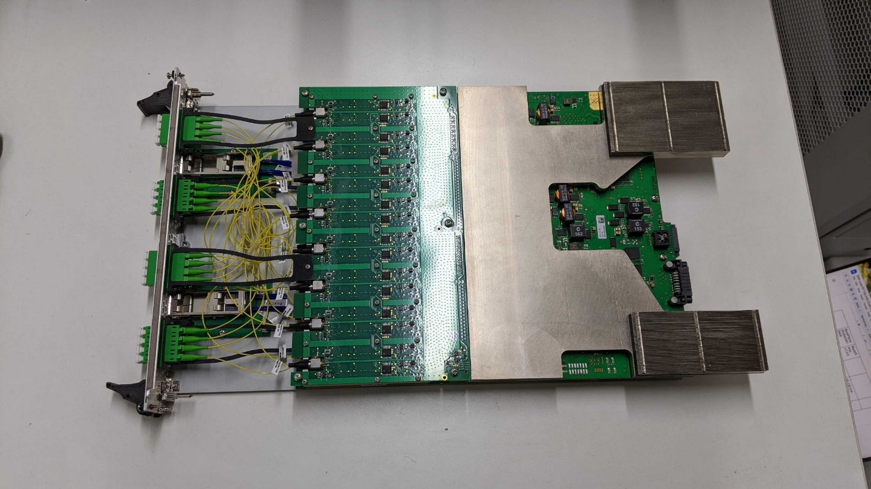
SKA-Low → Western Australia
50 – 350 MHz; 131072 Antennas
We write the firmware and low level software
Collaborate with partners from all over the globe:
Italy → manufacturing, hardware creators
RAL/Online → Kubernetes
Australia → site and operations

Slide 10




HiRIME
High-Resolution Imager for Mars Exploration aims to replace HiRISE (High Resolution Imaging Science Experiment)
Feasibility study on suitable FPGAs to handle a wavelet image compression algorithm
Lots of data: example100Gbits down to 10Gbit every couple of hours
ProSPA
Processing and Analysing samples, part of the wider ESA PROSPECT. ProSEED is the drill and ProSPA analysis the samples at the south pole of the moon
Microsemi/Michrochip RT3PE3000L-CQ256 FPGA. The interface with the electronics:
Controls the PWM control signal for power supply of the electronics
Collects housekeeping data on the power supplies
TMR, operating range -55 °C to 125 °C, ≥16.176 kRad total dose
Register Caching using for Read/Write Multibyte words (BUS only 1 Byte Large):
Prevents SPI misread/write, ‘shadow register’ caches data and can be toggled to release it

Slide 11
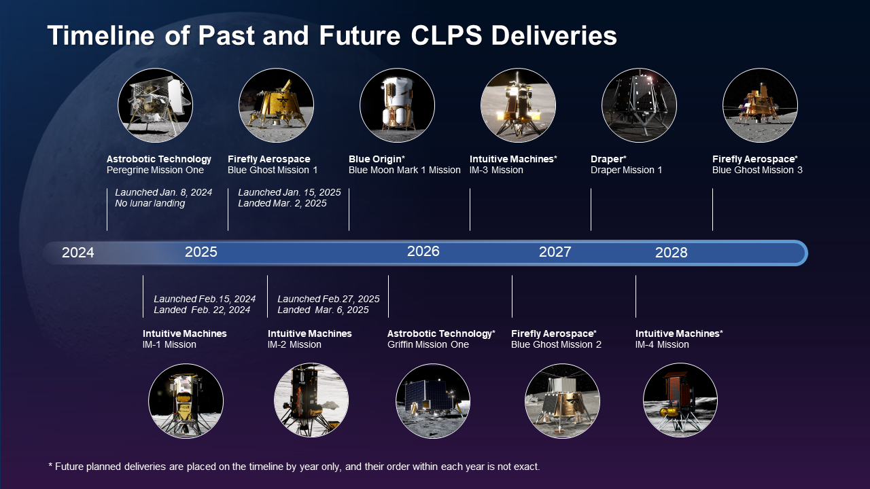
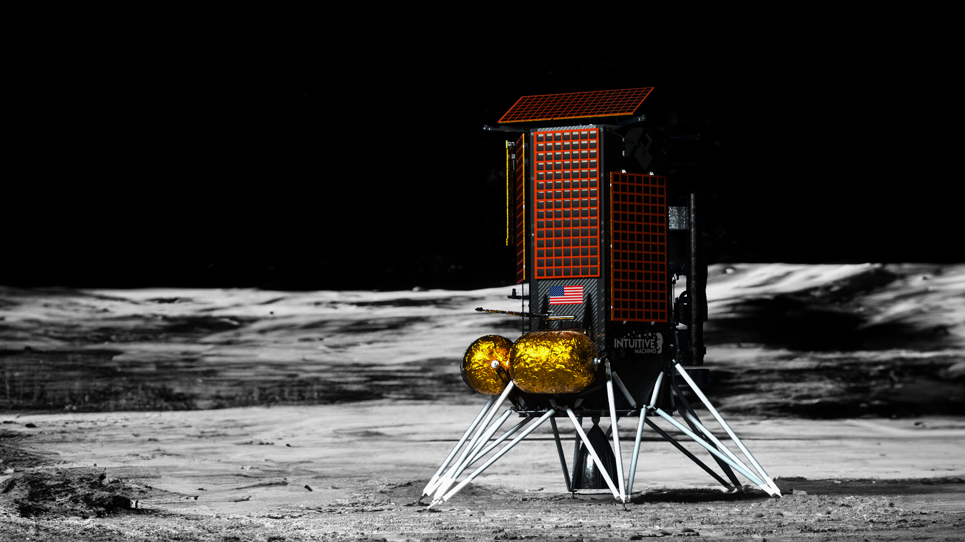
ProSPA Launch Updates – NASA Commercial Lunar Payload Services for 2027-2028

Slide 12
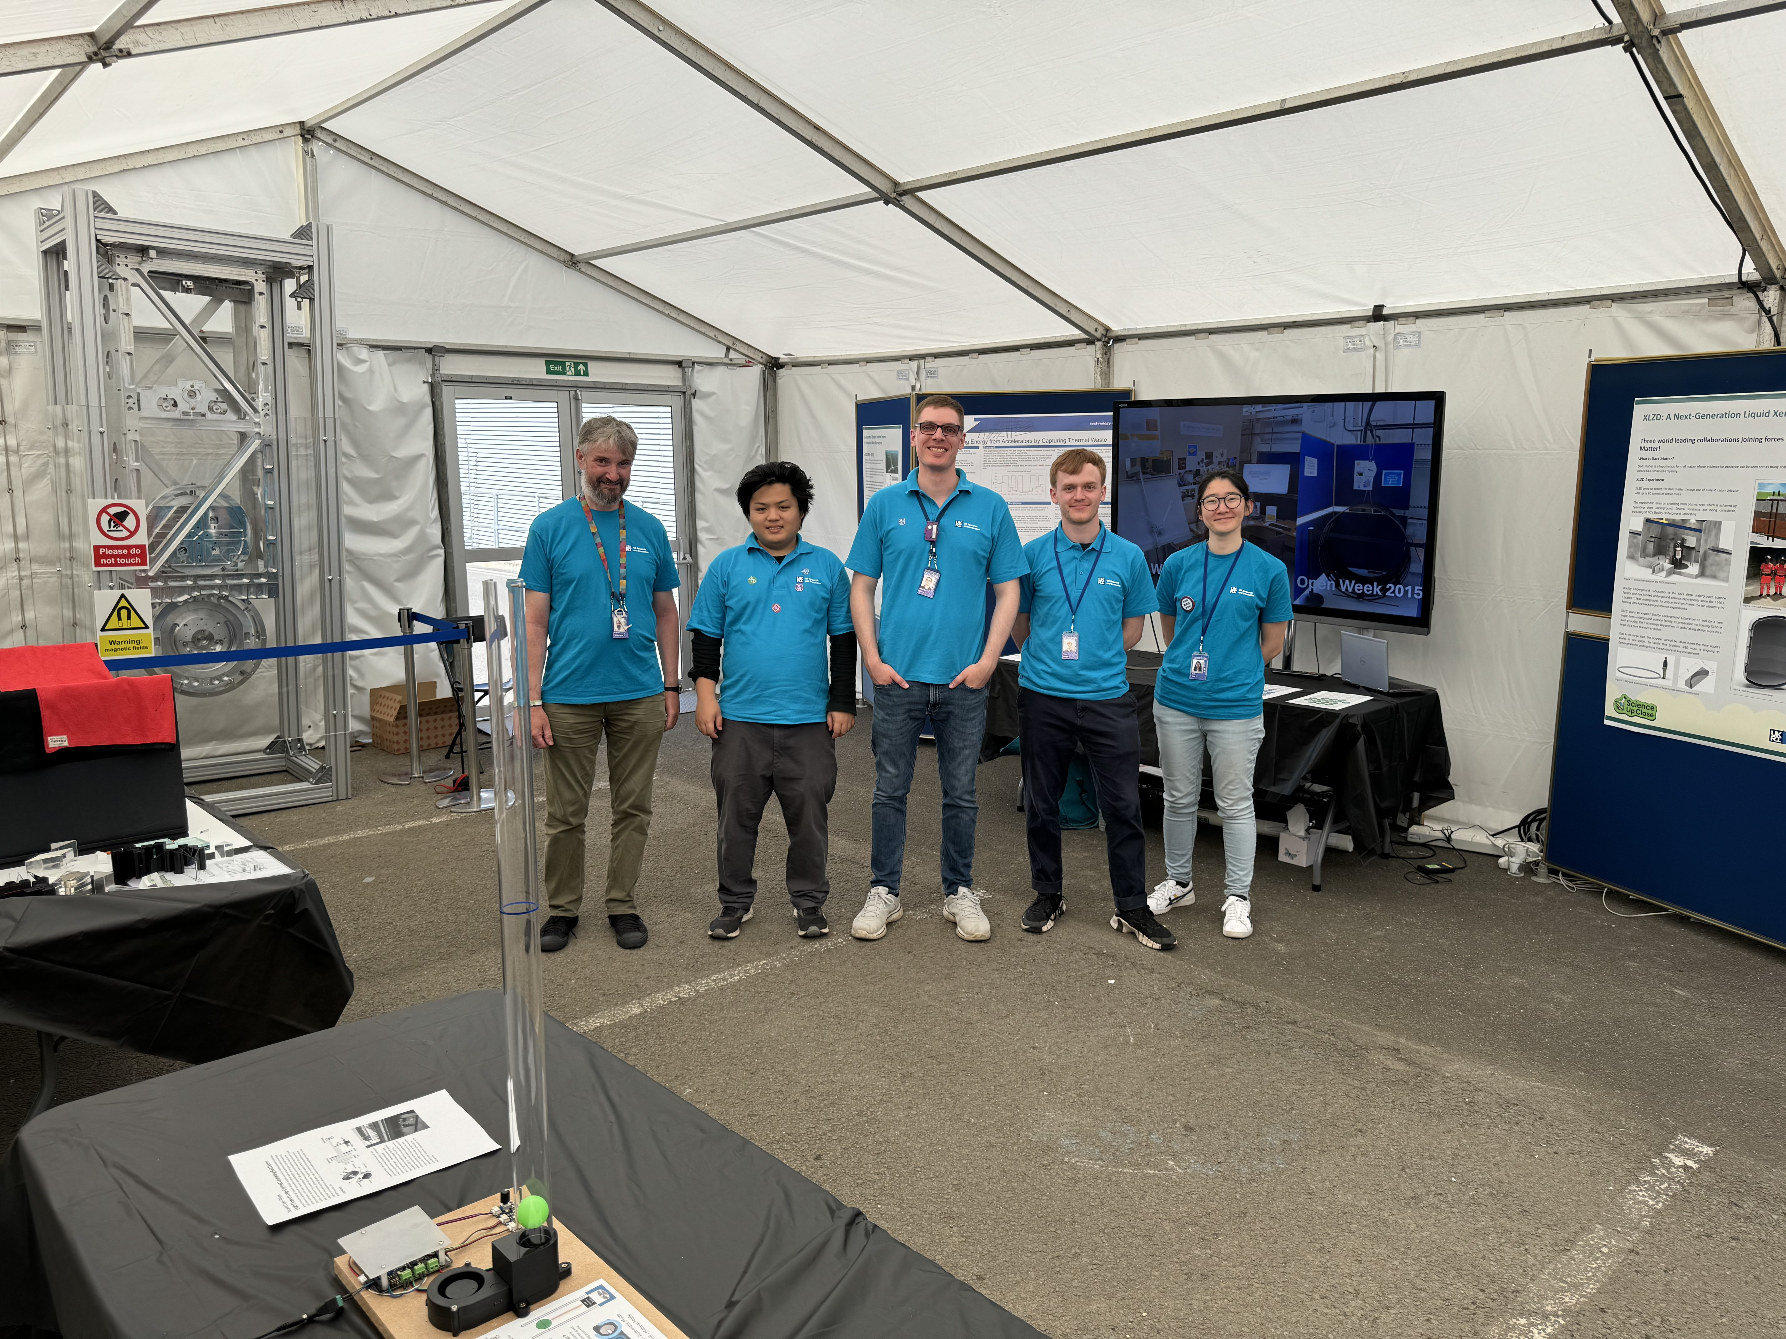
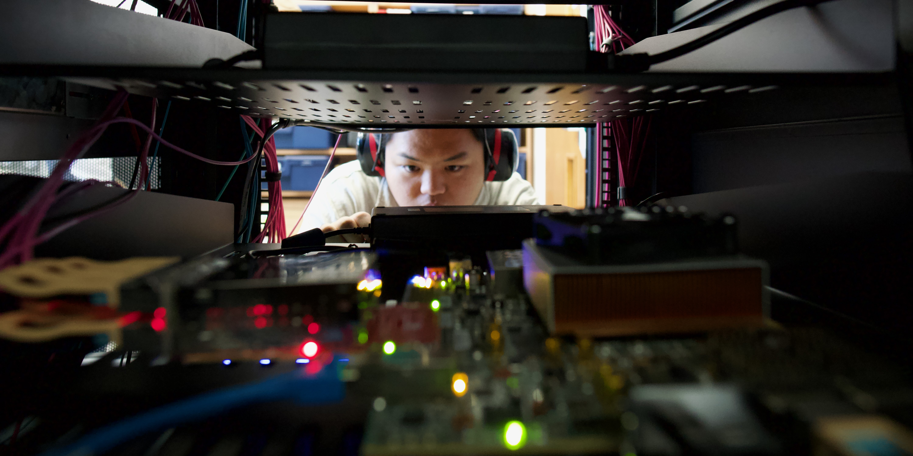
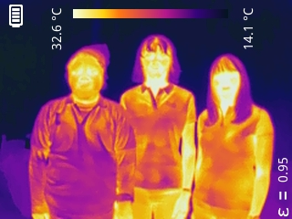
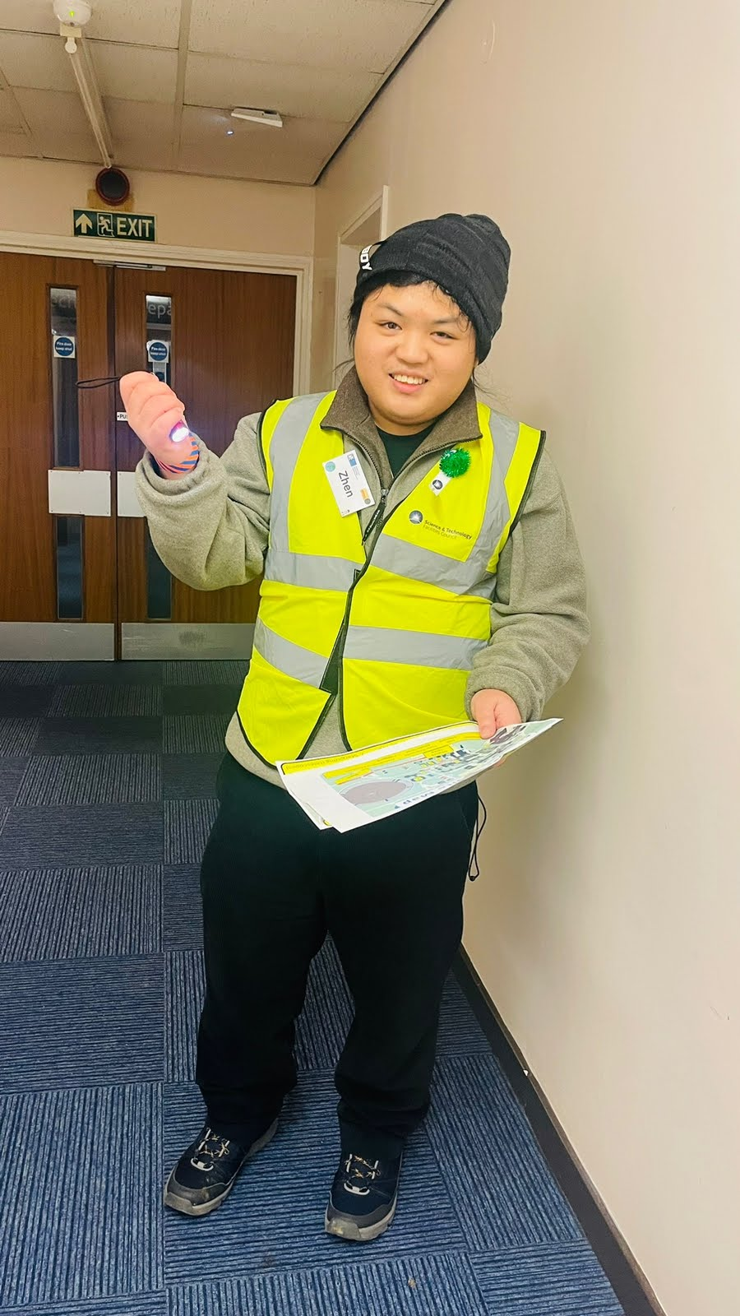
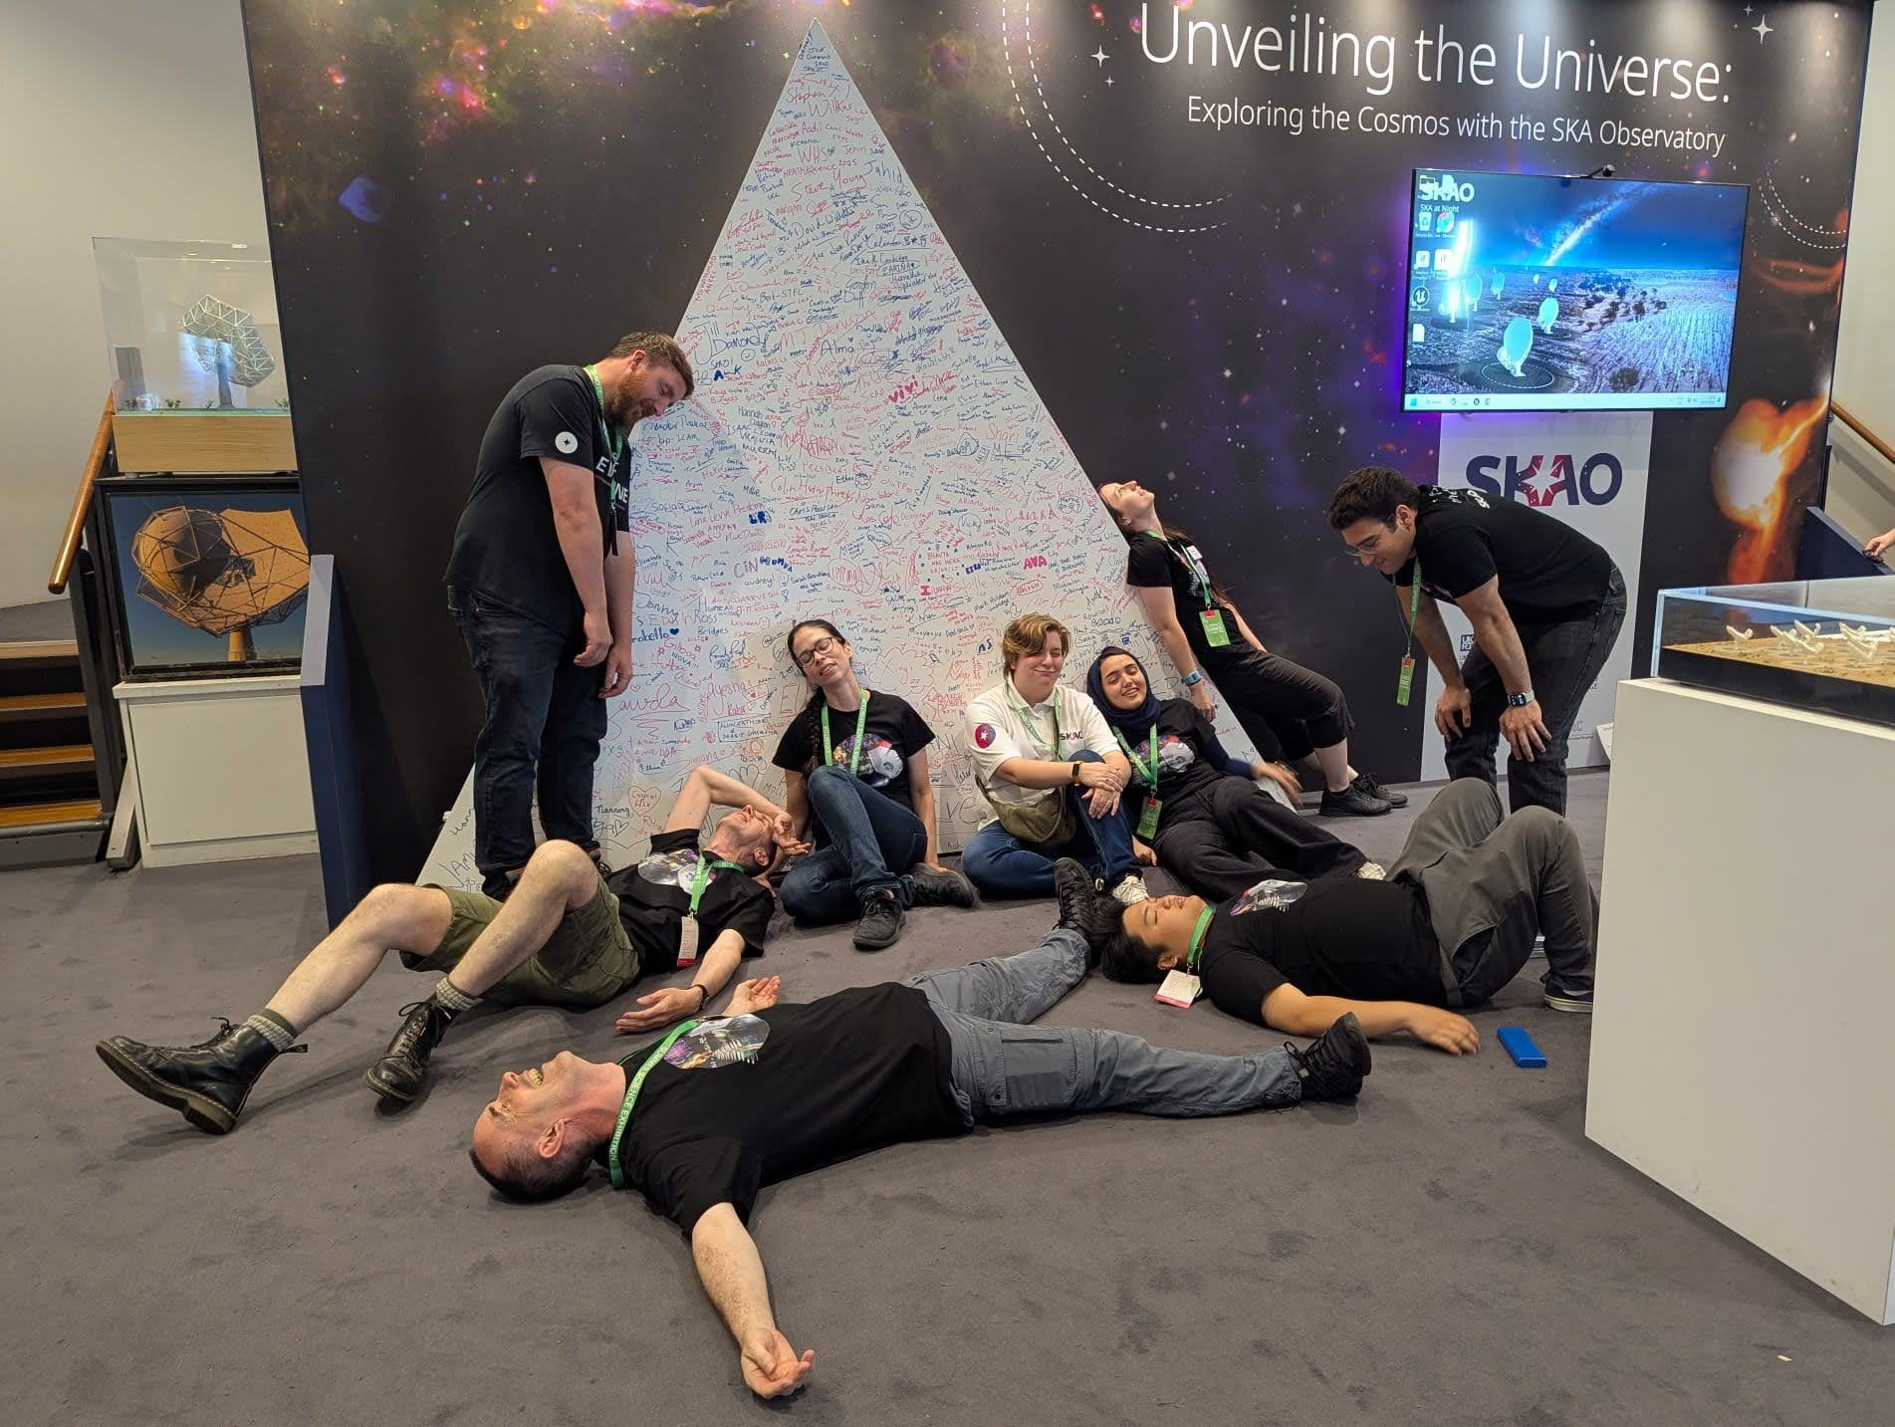
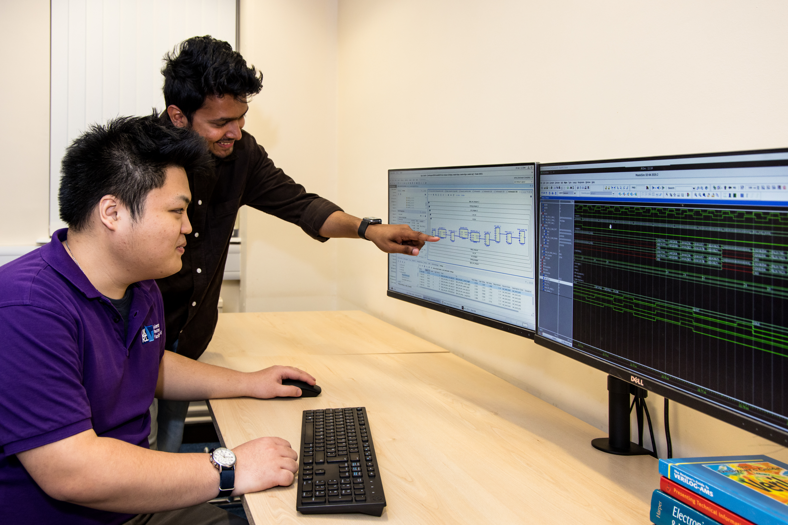
Volunteering

Slide 13
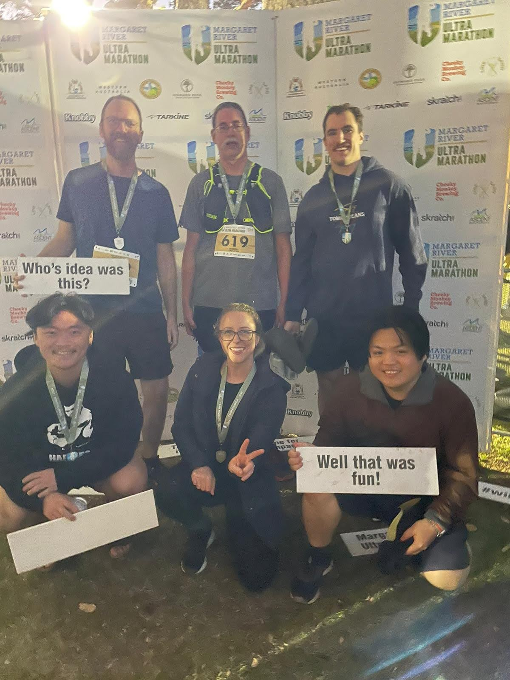
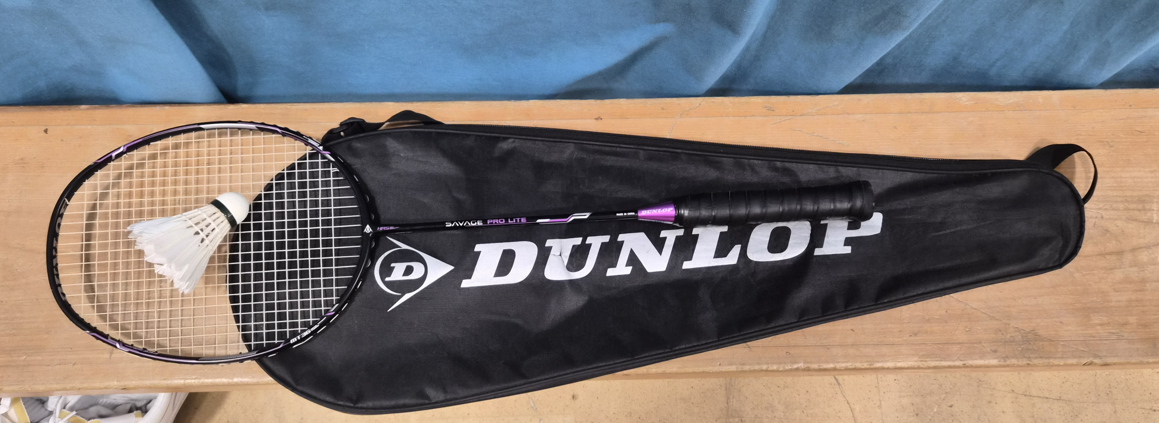
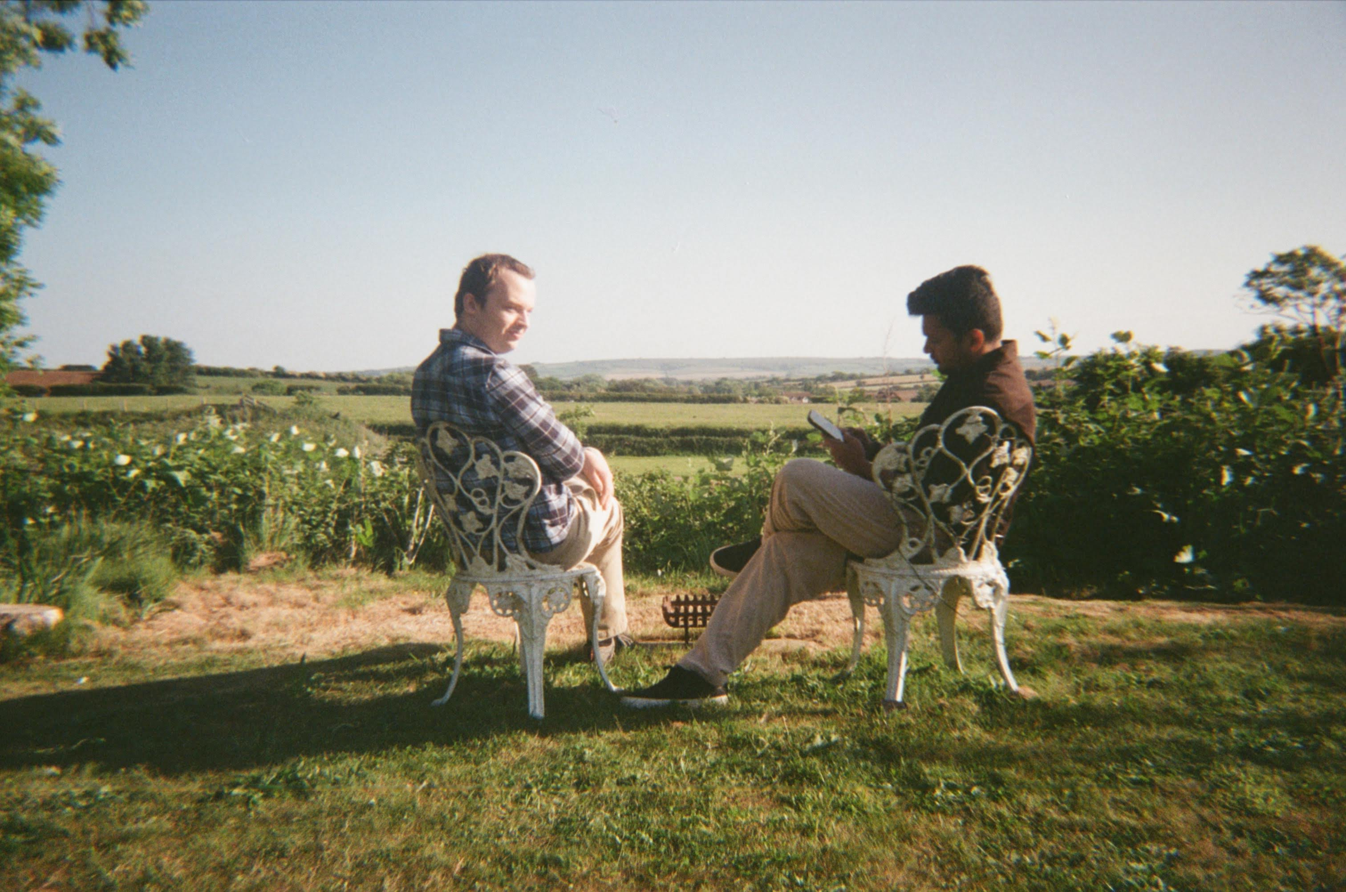
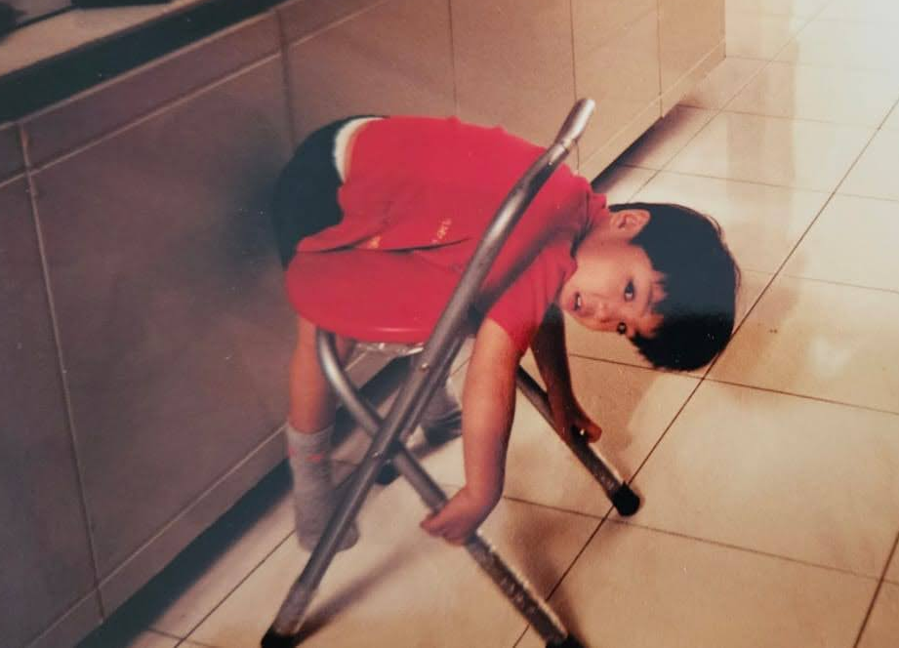
Other Activities
Notes:
Replace this guidance text with your own bullet pointed content.
For further guidance please see https://www.bdadyslexia.org.uk/advice/employers/creating-a-dyslexia-friendly-workplace/dyslexia-friendly-style-guide

Slide 14





technology.stfc.ac.uk
Science and Technology Facilities Council
Science and Technology Facilities Council
Notes:
The abstract pattern can be removed or repositioned if required. Be careful to ‘Send to Back’ so that it does not obscure any important information.

