Slide 1
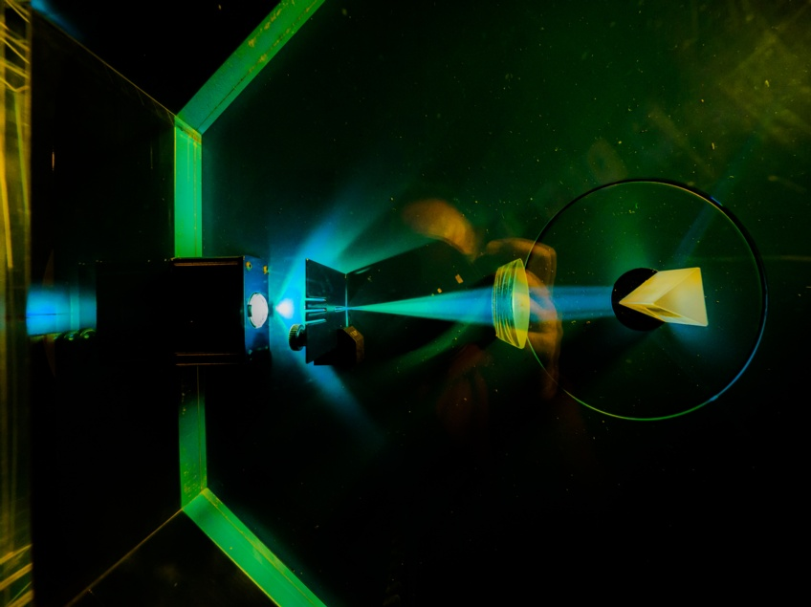


Electronic System Design Group
Management Update
Group Meeting, 26 February 2026
CR03 & Zoom
Image © STFC Alan Ford
Notes:
To edit the background image, select ‘Format’ from the PowerPoint menu and ‘Slide Background’ from the drop-down menu. Within the new list of options that appears on the right of the screen, select the ‘File’ button under ‘Insert picture from’ and select your image from your file browser. Please remove or amend the image credit if you are using a different image to the one provided.

Slide 2
Fire Alarm!
A reminder: the fire alarm in this room may be tested at some point in this meeting
  For which, apologies
  You may remain seated
But if we’re luck, we’ll finish before that happens

Slide 3
Overview
Staff Seminar
Wellbeing
UKRI People Survey
APRs
OTL
Group Organisation
Projects 2025-26
Capital Purchases
Procuement Deadlines
SHE
Project Reports in Fusion
Meeting this Year

Slide 4
STFC Staff Seminar This Morning
Moved this meeting to accommodate
But I have no insider knowledge of what will be said
Via Teams or in Pickavance
Recording may be available here afterwards
  They usually are but
  Recording of previous seminar is still not

Slide 5
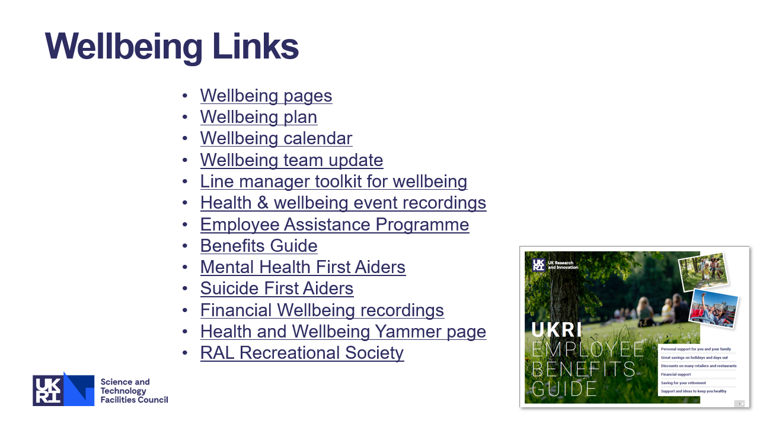
Wellbeing
The latest wellbeing slides can be found on the TD internal web
  Events, guidance, training, resources, staff benefits….

Slide 6
UKRI People Survey 2026
In general, results weren’t encouraging & response rate was very low
  TD Results (response rate 62%)
Much beyond control of TD
See Matt’s email of 16/2/26
  Learning and Development
    Specifiy requirements in APR for 26-27, these will be collated & prioritised
  Muscular Skeletal Problems
    Contact Simon Canfer if you want in person-manual handling training
    Complete DSE assessments
      Ask for any improvements identified
  IT Problems and Fusion
    Concerned about low scores. Response to Fusion?
    Are there any specific IT needs or problems? Please let me and/or Nicky know
  Stress and Wellbeing
      Fusion courses: Stress Awareness, Building Resilience
      Talk to people: LM, SLM, HR, Unions, Well-being allies…
      At APR, consider your workloads with your LM

Slide 7
APRs
End of APR year approaches
  Please start updating paperwork
  DED Review 13 May
APR for 2026-27
  Now in Fusion
    What could go wrong? (Currently Senior Line Managers can’t view reports)
  Need to set 5–8 ‘goals’ for 26-27 by 1 April
  Training videos here
  Training for Line Managers this afternoon: 2-3pm, Teams, registration required
    More general training antipated
From an incomplete viewing of videos
  Mechanism looks simple; not sure about policy
  Now have
    Performance goals: can be time-bound (SMART), but also ongoing
    Development goals: run through-out year

Slide 8
OTL
Thank you all for completing OTL bookings for February before deadline today
But…
Nearly at end of FY
  Department will want to understand finances
  Likely to be asked to complete March bookings very soon
  If you’re planning on taking significant leave, please complete OTL first

Slide 9
Group Organisation & Staff Changes
Ian Brawn
Ronnie Brumfitt
Joseph Hindmarsh
Weiming Qian
Kelvin Gascoyne
John Holden
Simon Moorby
Zhen Ha Ng
Geoffrey Betts
Matt Roberts
Chad Silk
Joshua Davies
Mohamed Siyad
Dave Templeman
Piers Coode
Jack Day
Martin Torbet
John Coughlan
Adam Barcock
Sooraj Pradeep
Hajira Bazaz
Berk Bilgin
Peter Furey-Duffin
Lucie Sharpe
William John
Saeed Taghavi
Changes
New Graduate Recruit
  Willis Chiu will start in September

Slide 10
Projects 2025–26
2026–27
  ATLAS funding still uncertain
  SKA potentially winding down at end of 2026
  New Opportunities
    Involved in 3 CfI bids
      Image Processing
      EMP (Machine Learning)
      Quantum Computing
    Chilbolton radar correlation
    Buckets & IS8?
Notes:
Numbers from
H:\ESDG_business\EffortProfiles\EffortProfile_Projection_2025_d3

Slide 11
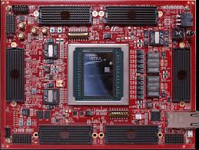
Capital Purchases
HTG-960 dev board
    Xilinx Ultrascale+ VU19P
    High-density FMC
  + various FMC cards
  $50k
  Now pre-paid; await delivery
Remaining TD funds uncertain
  Requested VPK180 should any be found
    Versal Premium VP1802
    £19k; in sock at Farnell, but….
https://www.hitechglobal.com/Boards/VirtexUltraScale+_VU19P_Board.htm

Slide 12
Procurement Deadlines
30 January 2026 - for new requirements with a value of £10k-£50k (typically 3 quotes).
27 February 2026 - for new requirements with a value under £10k (if a new supplier needs to be set up).
13 March 2026 - for new requirements with a value under £10k (where a supplier already exists on Fusion).

Slide 13
SHE
New Fire Safety Code
  Key changes:
    Revised roles & responsibilities for those with additional duties and legal responsibilities
    Introduction of General Fire Precautions which covers the fire precautions that are to be followed at STFC sites.
      All UKRI/STFC staff, tenants, facility users working at STFC sites should read Fire Code 1; (smoking, vaping, Lithium Ion batteries…)
    Building Fire Managers renamed Building Fire Coordinators & responsibilities revised
    Fire Awareness Training refreshers now every 3 years
    Re-Introduction of Practical Fire Extinguisher training for staff working in higher risk environment
New Fire Safety Hub
Michael’s Story
  Friday 6 March, 10:30–12:00, Teams
  LESSONS FROM A PREVENTABLE FATALITY
    Michael Adamson was an experienced electrician, who died on 4 August 2005. His story is told by his sister Louise.

Slide 14
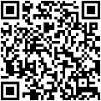
SHE: Who’s Representing YOU?
Good Health and Safety (H&S) management relies on the support and commitment of all staff to make our workplaces safe.
TU Health and Safety Reps represent all staff, not just TU members.
If you have any H&S concerns that you think are not being properly dealt with, please contact any of these reps; your input will be treated in the strictest confidence.
Representative | UNION | Contact extension/e-mail
Rutherford Appleton Laboratory (RAL)
Charles Ballard | Prospect | 7721 / charles.ballard@stfc.ac.uk
Joel Kurati | Prospect | 5156 / joel-stephen-prabhakar.kurati@stfc.ac.uk
Michael Hirsch | Prospect | 7145 / michael.hirsch@stfc.ac.uk
Andrew Seville | Prospect | 5689 / andrew.seville@stfc.ac.uk
Stephen Bell | Prospect | 5416 / stephen.bell@stfc.ac.uk
David McGarry | Prospect | 4453 / dave.mcGarry@stfc.ac.uk
Adrian Coveney | Prospect | 6516 /adrian.coveney@stfc.ac.uk
Further detail can be
obtained from your
local SHE Group
Issued July 2025

Slide 15
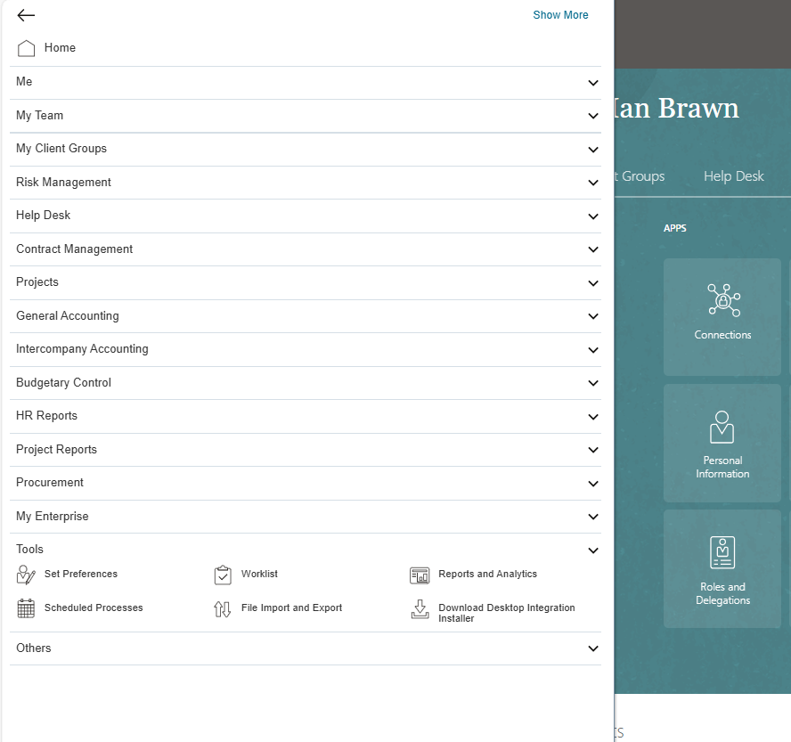
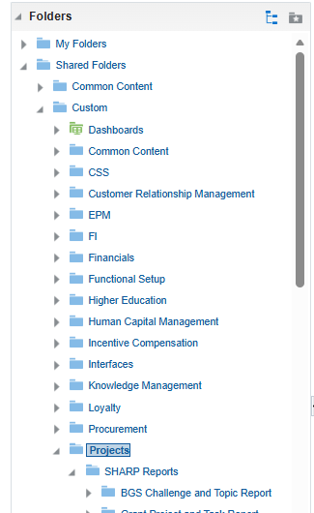


Project Reports in Fusion
Some project reports of old UKSBS style can be found in Fusion
  Main menu (top left)
    →Tools
      →Reports and analytics
  Browse Catalog (top right)
  Shared Folders
    →Custom
      →Projects
URLs to reports can be bookmarked
Caveat: not sure all reports work & everybody has required permissions

Slide 16
Meetings This Year
Meeting | Date | Start Time | Location
ESDG Group Meeting | Thursday 29 January | 10:30 am | CR03
ESDG Group Meeting | Thursday 26 February | 10:15 am | CR03
ESDG Group Meeting | Thursday 26 March | 10:30 am | CR03
DED Forum | Wednesday 1 April | 10:00 am | Visitor Centre
ESDG Group Meeting | Thursday 30 April | 10:30 am | CR03
ESDG Group Meeting | Thursday 28 May | 10:30 am | CR03
ESDG Group Meeting | Thursday 25 June | 10:30 am | CR03
ESDG Group Meeting | Thursday 30 July | 10:30 am | CR12
ESDG Group Meeting | Thursday 27 August | 10:30 am | CR12
ESDG Group Meeting | Thursday 24 September | 10:30 am | CR12
ESDG Group Meeting | Thursday 26 October | 10:30 am | CR12
ESDG Group Meeting | Thursday 26 November | 10:30 am | CR12
Christmas Party | TBA
Room change

Slide 17






AOB
technologysi.stfc.ac.uk
@STFC_matters
Science and Technology Facilities Council
Science and Technology Facilities Council
Notes:
The abstract pattern can be removed or repositioned if required. Be careful to ‘Send to Back’ so that it does not obscure any important information.

Slide 18
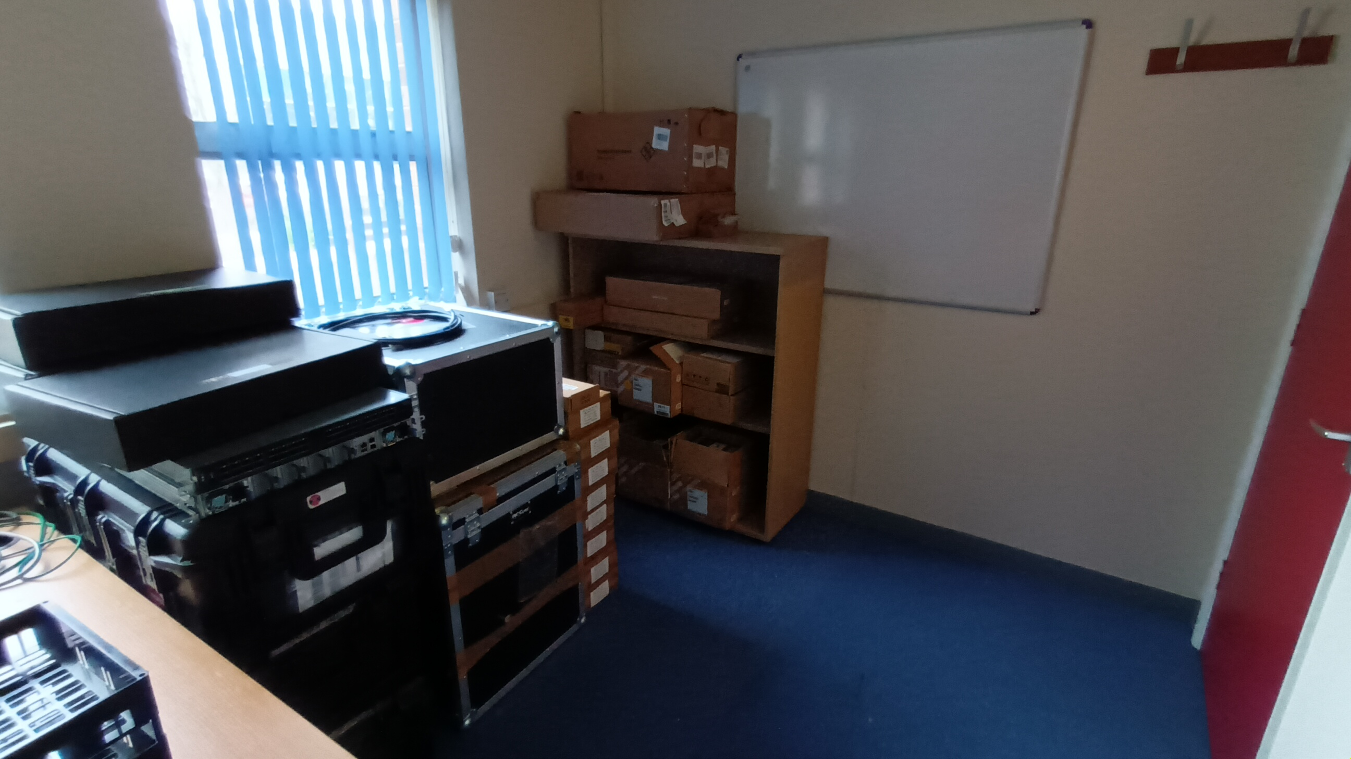
ESDG Accommodation in R66
Storage office: R66, G07
  Shelves finally arrived

