Slide 1



An introduction to STFC’s Computational Mathematics Theme
Tyrone Rees – Theme Leader
tyrone.rees@stfc.ac.uk
https://numerical.rl.ac.uk
Notes:
The abstract pattern can be removed or repositioned if required. Be careful to ‘Send to Back’ so that it does not obscure any important information.

Slide 2
STFC Scientific Computing Department
Themes
AI for Science
Comp. Biology
Comp. Eng.
Comp. Materials Science
Comp. Maths
Cyber Security
Data Eng.
Enabling Funcs
Infrastruc-ture
Open Science
Platforms and Services
Software Eng.
ALC
IRIS
Programmes
CoSeC
Photo by David Watkis on Unsplash
PSDI
…

Slide 3
STFC Scientific Computing Department
Themes
AI for Science
Comp. Biology
Comp. Eng.
Comp. Materials Science
Comp. Maths
Cyber Security
Data Eng.
Enabling Funcs
Infrastruc-ture
Open Science
Platforms and Services
Software Eng.
ALC
IRIS
Programmes
CoSeC
Photo by David Watkis on Unsplash
PSDI
…

Slide 4
STFC Scientific Computing Department
Themes
AI for Science
Comp. Biology
Comp. Eng.
Comp. Materials Science
Comp. Maths
Cyber Security
Data Eng.
Enabling Funcs
Infrastruc-ture
Open Science
Platforms and Services
Software Eng.
ALC
IRIS
Programmes
CoSeC
Photo by David Watkis on Unsplash
PSDI
…

Slide 5


STFC Scientific Computing Department
Themes
AI for Science
Comp. Biology
Comp. Eng.
Comp. Materials Science
Comp. Maths
Cyber Security
Data Eng.
Enabling Funcs
Infrastruc-ture
Open Science
Platforms and Services
Software Eng.
ALC
IRIS
Programmes
CoSeC
Photo by David Watkis on Unsplash
PSDI
…

Slide 6
STFC Scientific Computing Department
Themes
AI for Science
Comp. Biology
Comp. Eng.
Comp. Materials Science
Comp. Maths
Cyber Security
Data Eng.
Enabling Funcs
Infrastruc-ture
Open Science
Platforms and Services
Software Eng.
ALC
IRIS
Programmes
CoSeC
Photo by David Watkis on Unsplash
PSDI
…

Slide 7
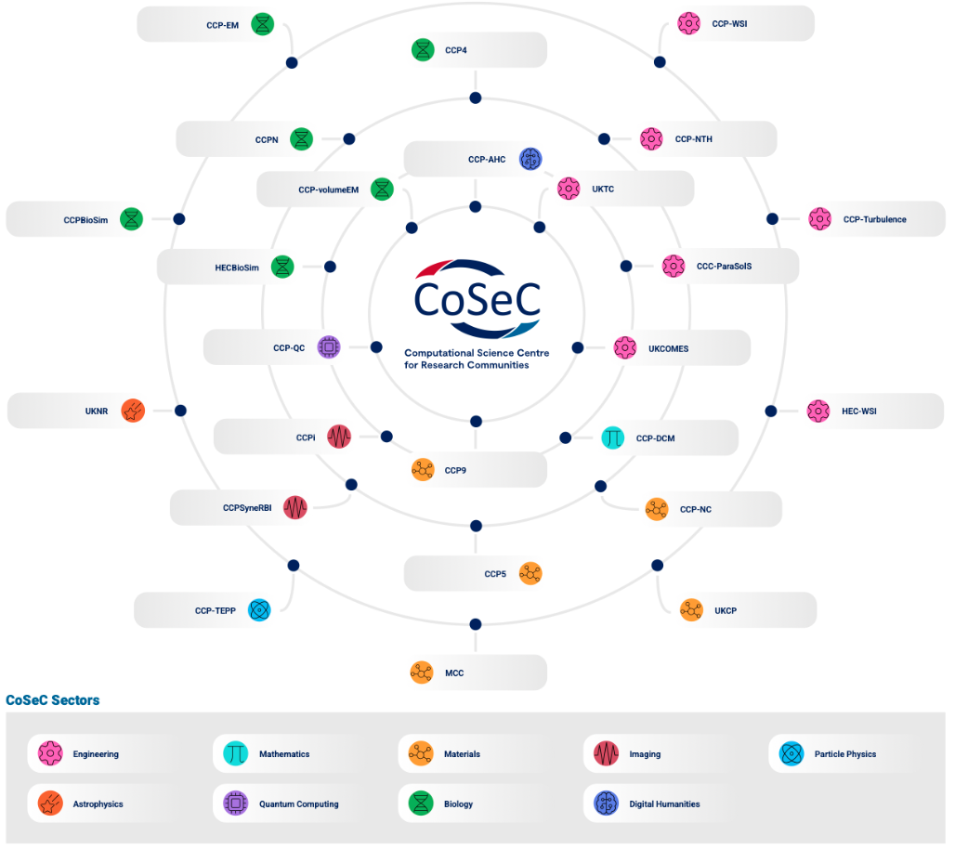

STFC Scientific Computing Department
Themes
AI for Science
Comp. Biology
Comp. Eng.
Comp. Materials Science
Comp. Maths
Cyber Security
Data Eng.
Enabling Funcs
Infrastruc-ture
Open Science
Platforms and Services
Software Eng.
ALC
IRIS
Programmes
CoSeC
Photo by David Watkis on Unsplash
PSDI
…

Slide 8
STFC Scientific Computing Department
Themes
AI for Science
Comp. Biology
Comp. Eng.
Comp. Materials Science
Comp. Maths
Cyber Security
Data Eng.
Enabling Funcs
Infrastruc-ture
Open Science
Platforms and Services
Software Eng.
ALC
IRIS
Programmes
CoSeC
Photo by David Watkis on Unsplash
PSDI
…

Slide 9

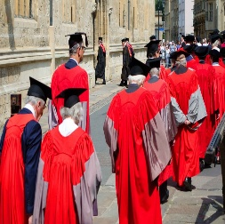


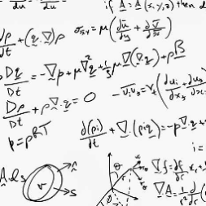
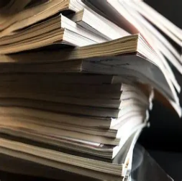
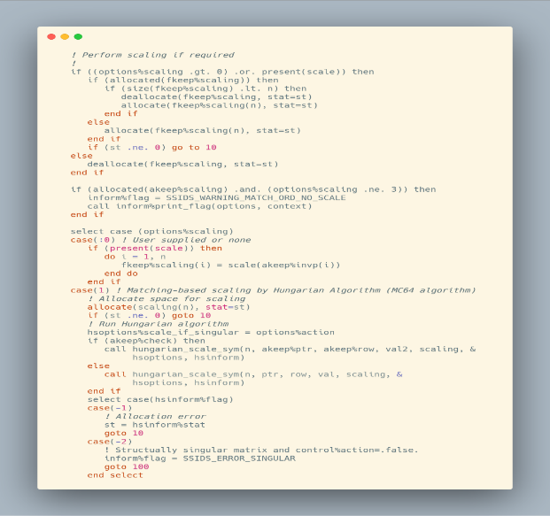
Role of theme in the UK ecosystem
STFC Facilities
CoSeC Communities
UNIVERSITIES
SC Themes
Mathematical
Algorithms?
SC Computational Mathematics
RESEARCH
Other UK Labs
Diamond
LITERATURE
IS-8 Priorities
SOFTWARE

Slide 10
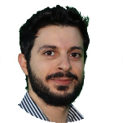

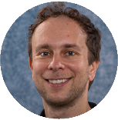
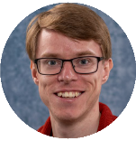
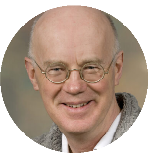
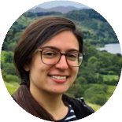
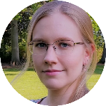
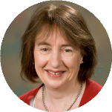
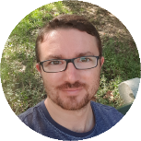
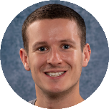
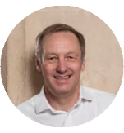
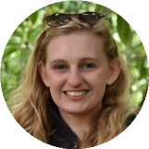
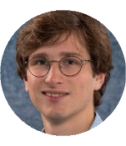
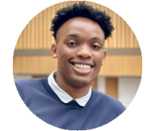
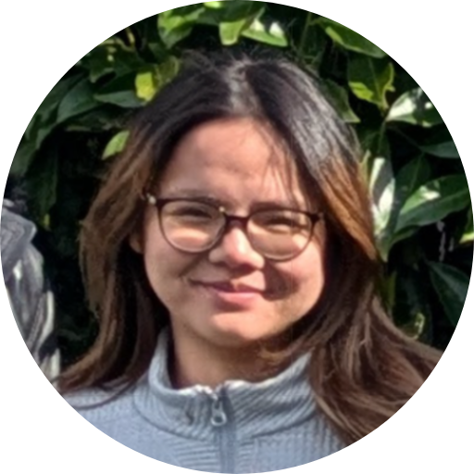
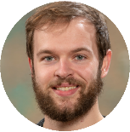

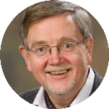
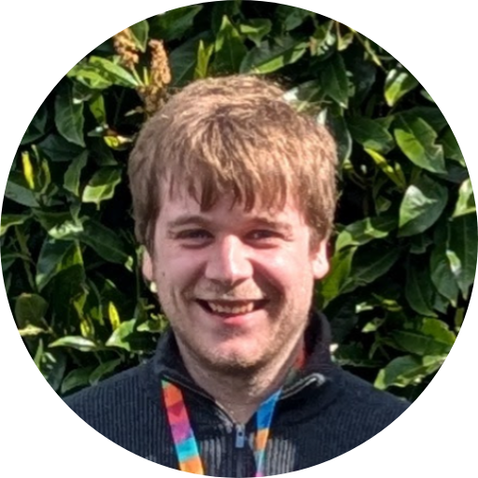
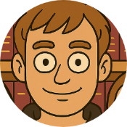
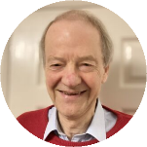

Computational Mathematics Theme
Theme Lead: Tyrone Rees
Numerical Linear Algebra
Hussam Al Daas
Niall Bootland
Kathryn Lund
Jennifer Scott
Andy Wathen
Adam Greenbank
Andrew Lister
Iain Duff (Honorary scientist)
John Reid (Honorary Scientist)
Lorenzo Lazzarino (Oxford – PhD)
Continuous Optimization
Jari Fowkes
Nick Gould
Boris Shustin
Jess Huntley
Alan Muriithi
(Oxford – PhD)
Inverse Problems
Margaret Duff
Letizia Protopapa
Bryce Shirley
Sam Cunningham
(Graduate)
Anastasia Doan
(Bath – PhD)
Robert Johnson
(Bath – PhD)

Slide 11
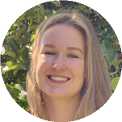
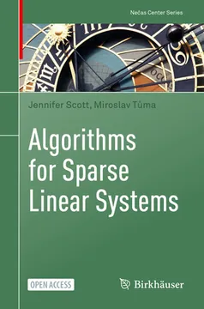
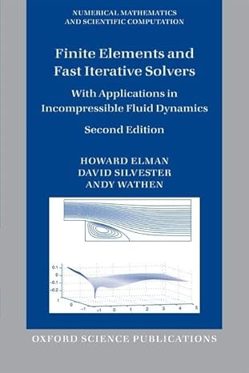
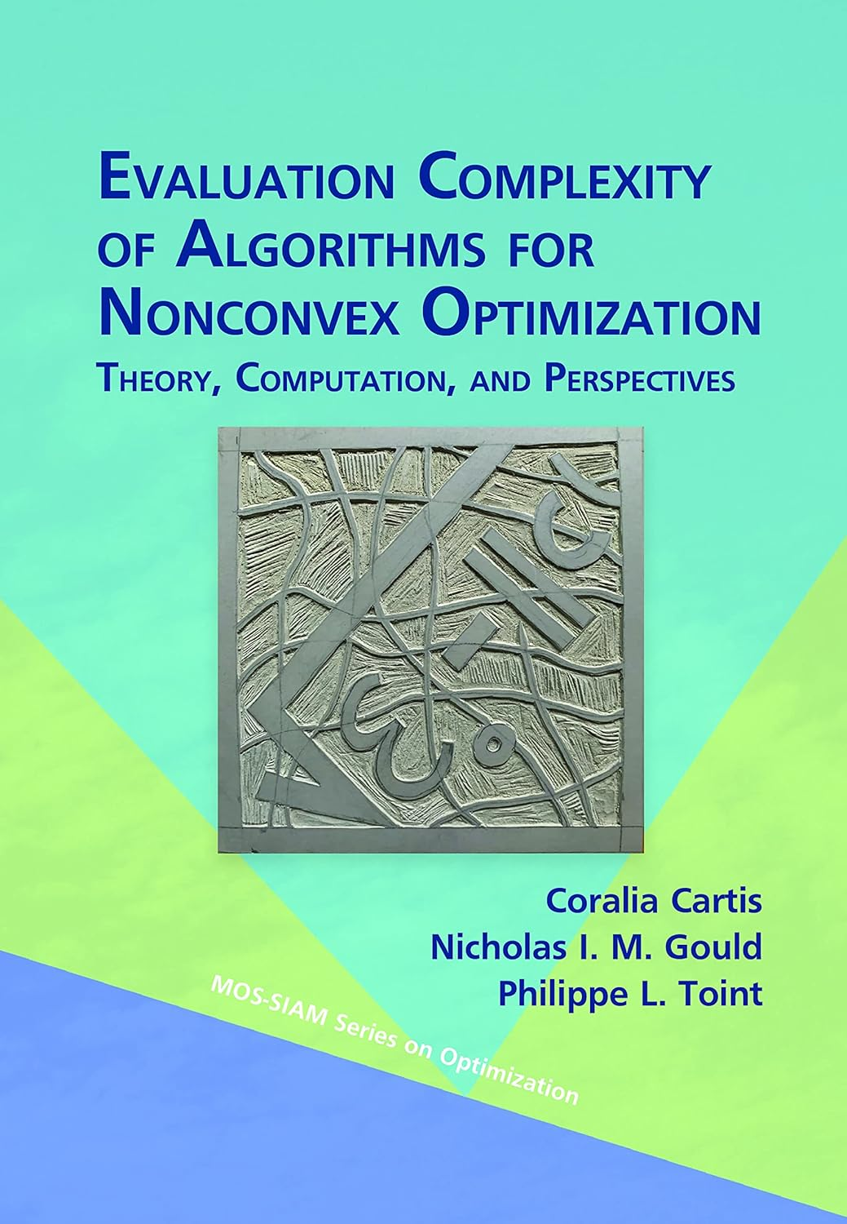
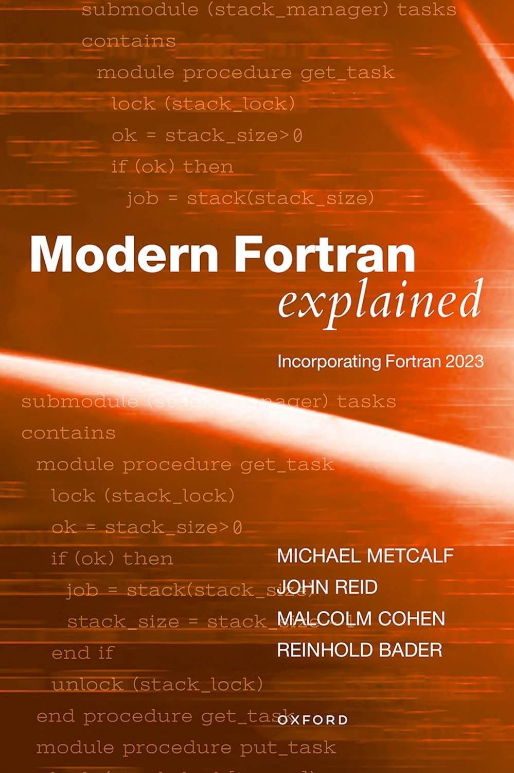
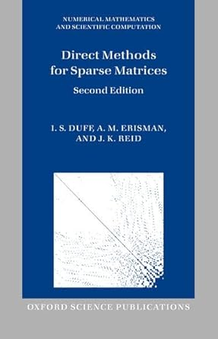
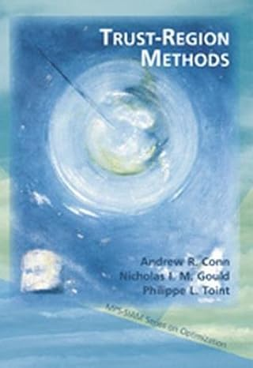
Computational Mathematics Theme
Theme Lead: Tyrone Rees
Numerical Linear Algebra
Hussam Al Daas
Niall Bootland
Kathryn Lund
Jennifer Scott
Andy Wathen
Adam Greenbank
Andrew Lister
Iain Duff (Honorary scientist)
John Reid (Honorary Scientist)
Lorenzo Lazzarino (Oxford – PhD)
Continuous Optimization
Jari Fowkes
Nick Gould
Boris Shustin
Jess Huntley
Alan Muriithi
(Oxford – PhD)
Inverse Problems
Margaret Duff
Letizia Protopapa
Bryce Shirley
Sam Cunningham
(Graduate)
Anastasia Doan
(Bath – PhD)
Robert Johnson
(Bath – PhD)

Slide 12
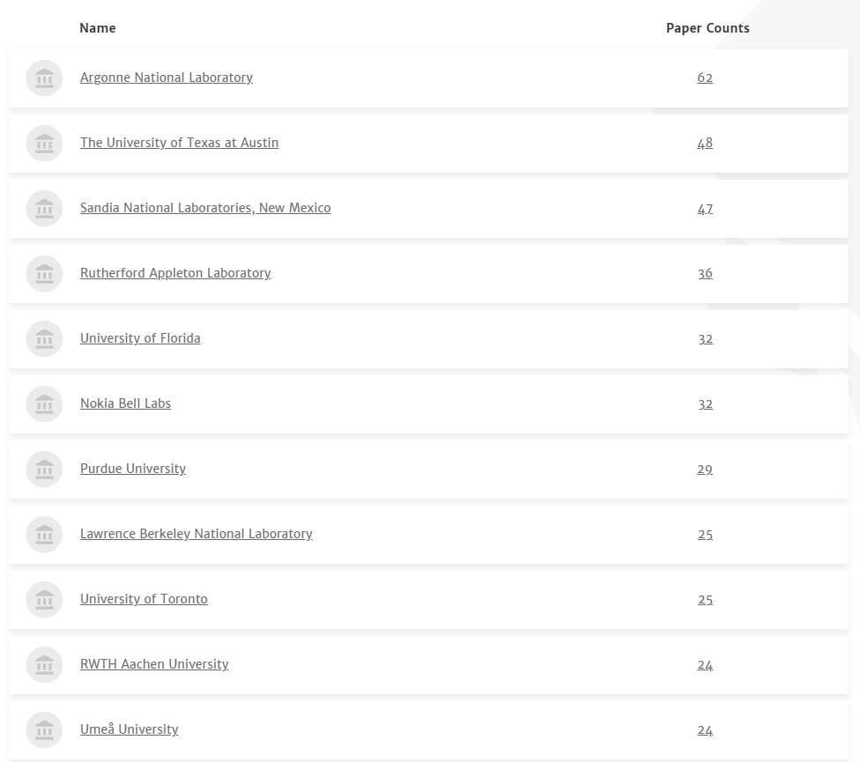


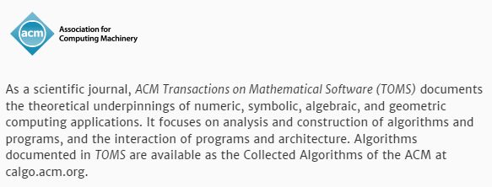

Slide 13


Slide 14
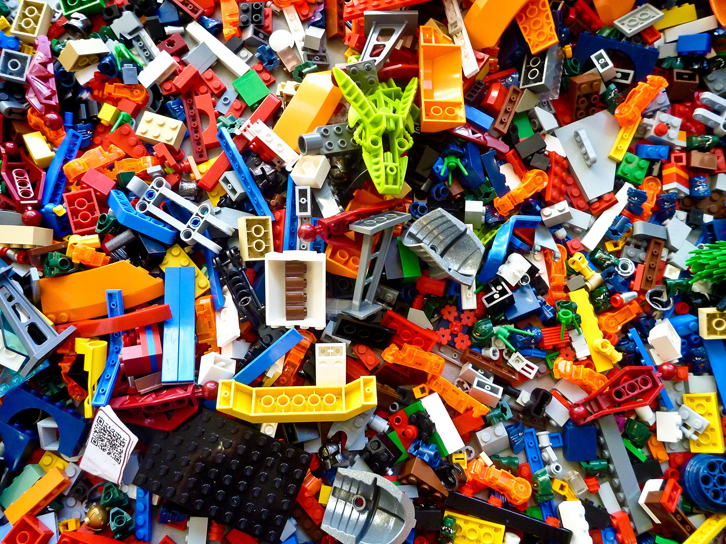

Slide 15
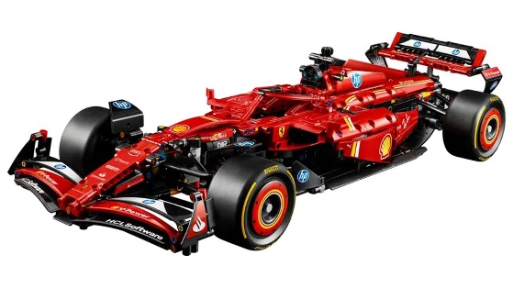
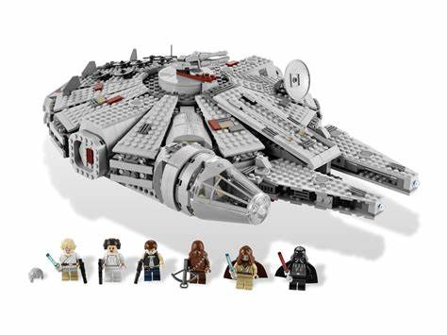
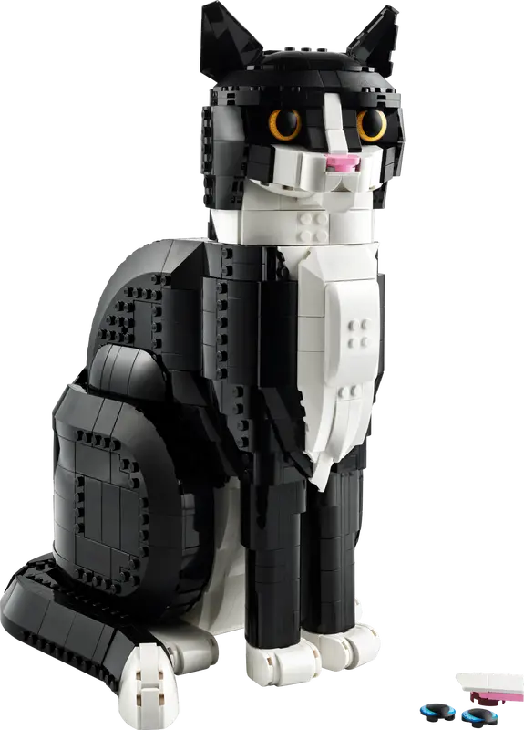
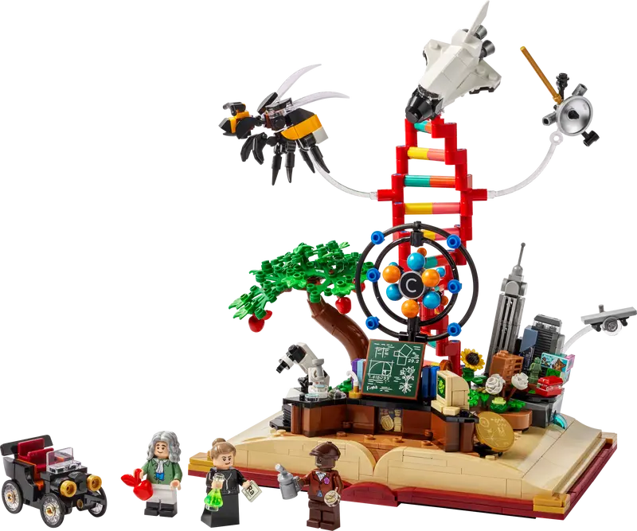
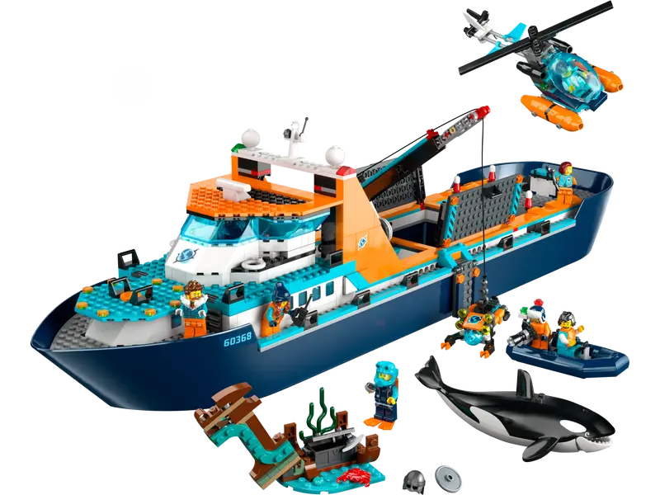

Slide 16


Numerical Linear Algebra
Notes:
The abstract pattern can be removed or repositioned if required. Be careful to ‘Send to Back’ so that it does not obscure any important information.

Slide 17

$$A x=b$$

Slide 18
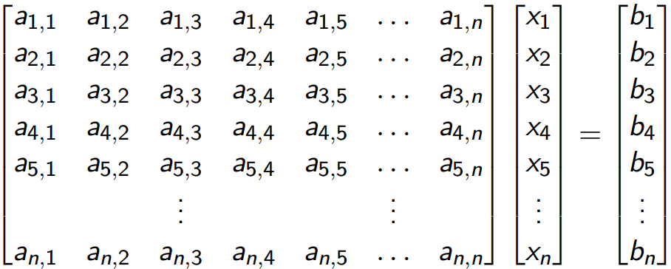
Linear Systems

Slide 19
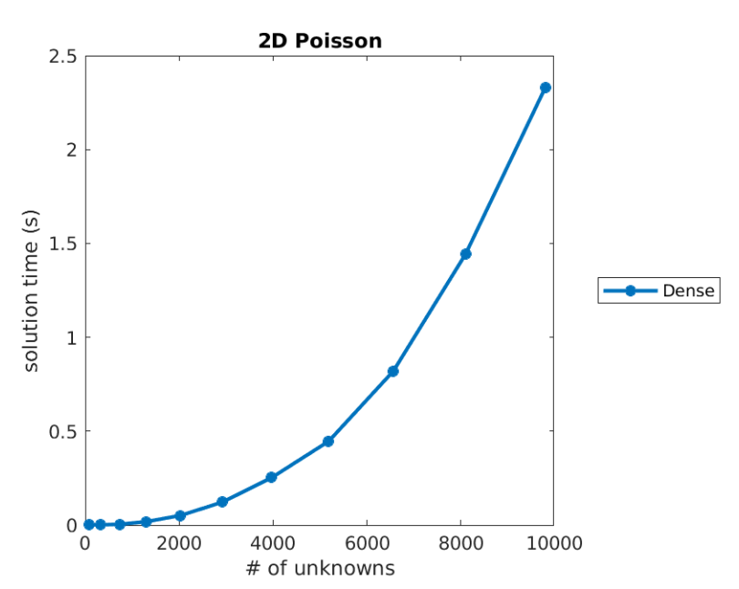
Linear System Solves

Slide 20
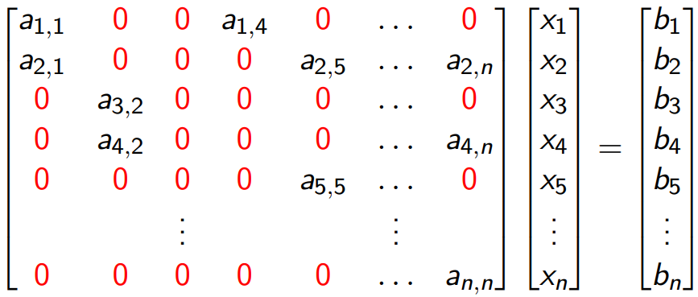
Sparse Linear Systems

Slide 21
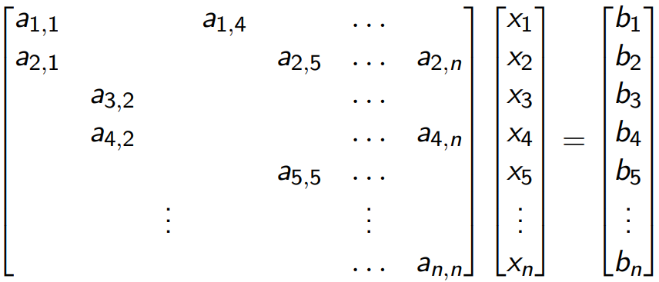
Sparse Linear Systems

Slide 22
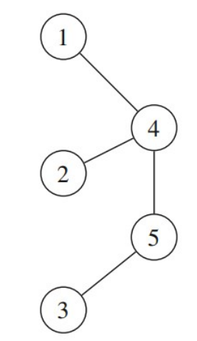
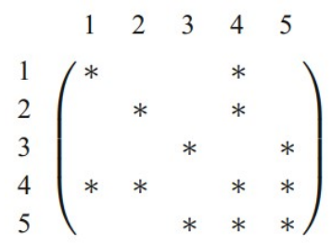
Sparse Matrices and Graphs
[Scott and Tůma, Algorithms for Sparse Linear Systems, 2023]

Slide 23
Linear System Solves

Slide 24
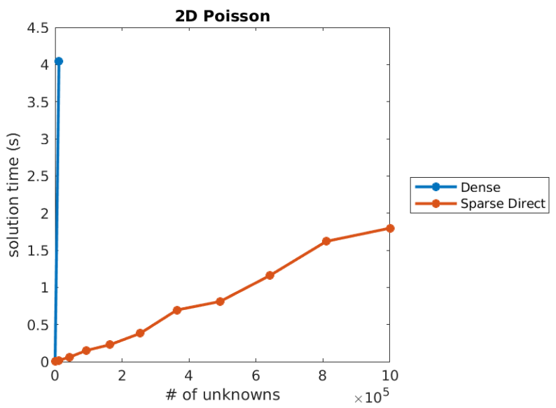
Linear System Solves

Slide 25
HSL History
I. S. Duff
G. W. Stewart
P. W. Gaffney
K. Madsen
….
E. Ovtchinnikov
A. C. Damhau
P. R. Amestoy
T. A. Davis
….
T. Rees
H. Al Daas
N. Bootland
A. Lister
….
1960s
1970s
1980s
1990s
2000s
2010s
2020s
A.R. Curtis
M.J.D. Powell
J.K. Reid
R. Fletcher
…
P. L. Toint
N.I.M. Gould
M. D. Hebden
J.A. Scott
….
Jorge Nocedal
M. Arioli
N. Munksgaard
H. S. Dollar
J. D. Hogg
….

Slide 26
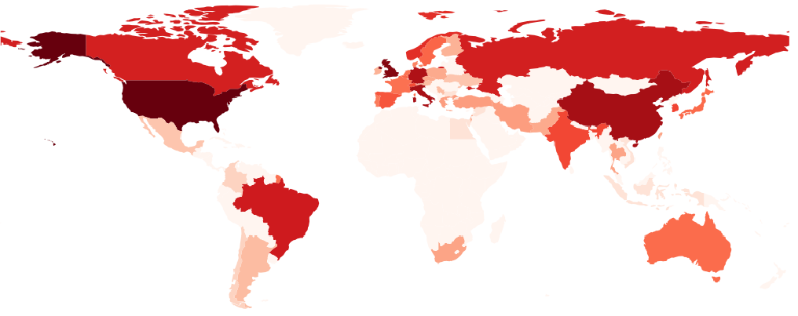

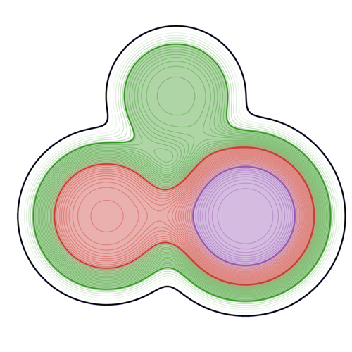








Academic Users
A free licence is available for HSL for all employees and students of Universities and non-profit Research Labs across the world.
We give out around 4,000 academic licences to HSL software every year.

Slide 27


















Commercial Users
We offer user licences,
site licences and incorporation licences to commercial users.
All income is used to fund development and maintenance of HSL software.

Slide 28
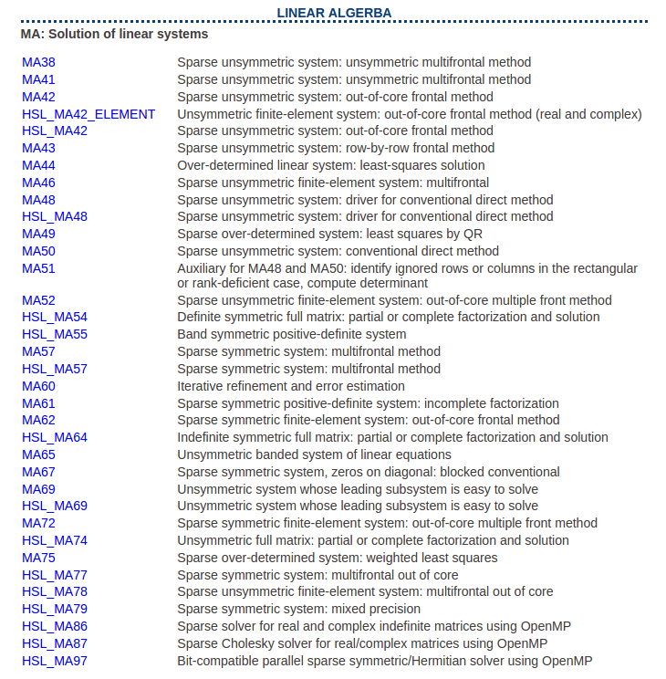

Software
https://www.hsl.rl.ac.uk

Slide 29
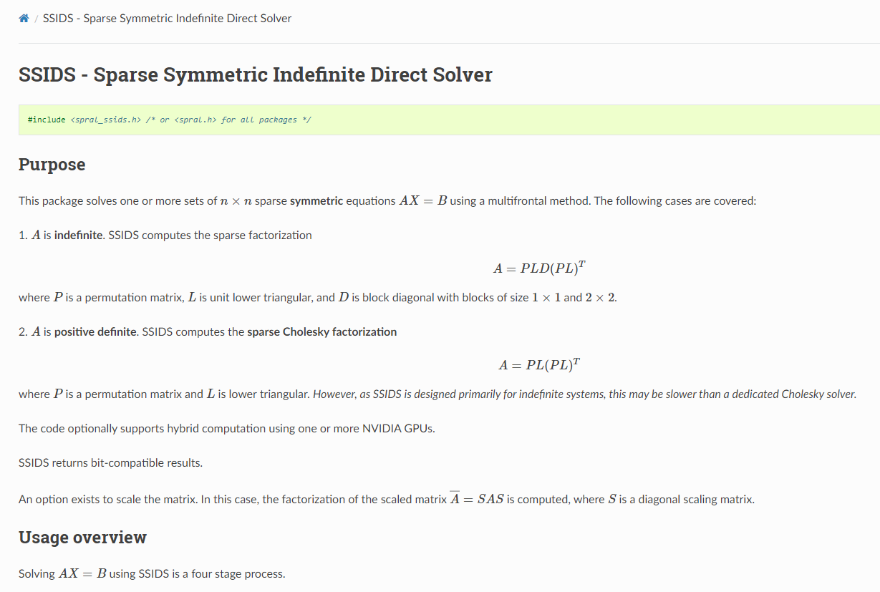

Software
https://github.com/ralna/spral

Slide 30


Software
HSL - Home Page (rl.ac.uk)

Slide 31



Software

Slide 32


$$A x=b$$
Direct Methods
Iterative Methods

Slide 33



Solving linear systems
Direct Methods
Iterative Methods

Slide 34



Iterative methods

Slide 35

Iterative methods

Slide 36

Iterative methods

Slide 37

Software

Slide 38
Linear System Solves
Notes:
O(n^3/2)

Slide 39

Linear System Solves

Slide 40

Linear System Solves

Slide 41

Linear System Solves
Notes:
SD- O(n^2) in 3D

Slide 42






Anisotropic equation solvers for Nuclear Fusion
Physics
Southworth, Al Daas, Wimmer, Threlfall ’26
Geometry
Robust
Solvers

Slide 43

Anisotropic equation solvers for Nuclear Fusion
Physics
Southworth, Al Daas, Wimmer, Threlfall ’26
Geometry
Robust
Solvers

Slide 44







Other Linear Algebra…
Linear least-squares
Tensor methods
Eigenvalue Problems
Singular Value Decomposition/ Principal Component Analysis
Functions of Matrices
Data Compression via CUR Decomposition
Model Order Reduction

Slide 45
Continuous Optimization
Notes:
The abstract pattern can be removed or repositioned if required. Be careful to ‘Send to Back’ so that it does not obscure any important information.

Slide 46



Nonlinear Programming
$$\min{f(x)}$$
$$s.t. Ax>b$$

Slide 47


Software
https://www.galahad.rl.ac.uk

Slide 48



Software

Slide 49



Software

Slide 50
Nonlinear Least-squares
$$\min{f(x)}$$
$$s.t. Ax>b$$

Slide 51

Nonlinear Least-squares
$$\min{\frac{1}{2}}{\left\|r\left(x\right)\right\|}^{2}$$
$$s.t. Ax>b$$

Slide 52


Nonlinear Least-squares
$$\min{\frac{1}{2}}{\left\|r\left(x\right)\right\|}^{2}$$

Slide 53






Nonlinear Least-squares - software
$$\min{\frac{1}{2}}{\left\|r\left(x\right)\right\|}^{2}$$
AMD Optimizing CPU
Libraries - Data Analytics
(AOCL-DA)
https://github.com/ralna/RALFit

Slide 54



Nonlinear Least-squares - software
$$\min{\frac{1}{2}}{\left\|r\left(x\right)\right\|}^{2}$$

Slide 55
Nonlinear Least-squares - software
$$\min{\frac{1}{2}}{\left\|r\left(x\right)\right\|}^{2}$$

Slide 56

Global nonlinear Least-squares

Slide 57





Slide 58



Slide 59























FitBenchmarking
AOCL-DA
Bumps
GSL
interface any data fitting software
Ceres
GOFit
DFO-GN/LS
RALFit
Minuit
to any source of test problems

Slide 60

FitBenchmarking
How it works…

Slide 61

FitBenchmarking
How it works…

Slide 62

FitBenchmarking
How it works…

Slide 63

FitBenchmarking
How it works…

Slide 64



https://ccp-tepp.github.io

Slide 65
Inverse Problems
Notes:
The abstract pattern can be removed or repositioned if required. Be careful to ‘Send to Back’ so that it does not obscure any important information.

Slide 66






What is an inverse problem?
$$F(x)≈y$$
Forward model
Unknown
(Noisy) Data
Source
Sample
Detector
Projections
Reconstruction
3D volume

Slide 67


What is an inverse problem?
Ill posed problem
$$F(x)≈y$$
In case either:
No solution
Not unique solution
Solution sensitive to noise
Projections
Reconstruction
3D volume

Slide 68








Motion Compensation in Tomography
Reconstruction with and without motion compensation
stochastic primal dual hybrid gradient algorithm
With motion compensation
Without motion compensation

Slide 69


Motion Compensation
Reconstruction with and without motion compensation
stochastic primal dual hybrid gradient algorithm
With motion compensation
Without motion compensation

Slide 70






Ptychography
ePIE
Nonlinear Conjugate Gradients
L-BFGS

Slide 71








Thick sample ptychography
The multislice approach has some limitations when trying to push for thicker samples:
Accuracy:
Non-crystalline structure, especially biological samples, are not well-approximated by layered slices
Multislice suffers from the “leaky duct” problem (well-documented in other fields)
Speed:
Propagation between slices is sequential and becomes costly when more slices are needed
For truly thick samples multislice needs small step sizes between slices for accuracy, increasing the bottleneck
Sequential steps
$$P$$
$$P$$
$$P$$
$$P$$
$$P$$
$$F$$
$$φ_{in}$$
Sample
Detector

Slide 72



Thick sample ptychography
Solve paraxial wave equation through the sample
Difficult linear
systems
$$F$$
$$φ_{in}$$
Sample
Detector

Slide 73
Computational Mathematics
Groups in:
Numerical Linear Algebra
Continuous optimization
Inverse Problems
Also interests in numerical solution of differential equations, numerical integration, time stepping methods,…
Always on the look out for interesting problems!
tyrone.rees@stfc.ac.uk
https://numerical.rl.ac.uk
Notes:
The abstract pattern can be removed or repositioned if required. Be careful to ‘Send to Back’ so that it does not obscure any important information.

