Slide 1



AXI4-Streaming Components
Matt Roberts
Adam Barcock
Sooraj Pradeep

Slide 2
AXI4-Stream Monitoring Overview
From here:
https://gitlab.stfc.ac.uk/tech-esdg/common-libraries/lib_stfc/axi4/-/tree/axis_monitor?ref_type=heads
Min/Max update counters give scope to monitor stability
Remove min/max registers for tID and tDEST
Add tUSER monitoring
Include AXI4-Stream config values in Status Register

Slide 3
AXI4-Stream Monitoring Overview
From here:
https://gitlab.stfc.ac.uk/tech-esdg/common-libraries/lib_stfc/axi4/-/tree/axis_monitor?ref_type=heads
Min/Max update counters give scope to monitor stability
Remove min/max registers for tID and tDEST
Add tUSER monitoring
Include AXI4-Stream config values in Status Register

Slide 4
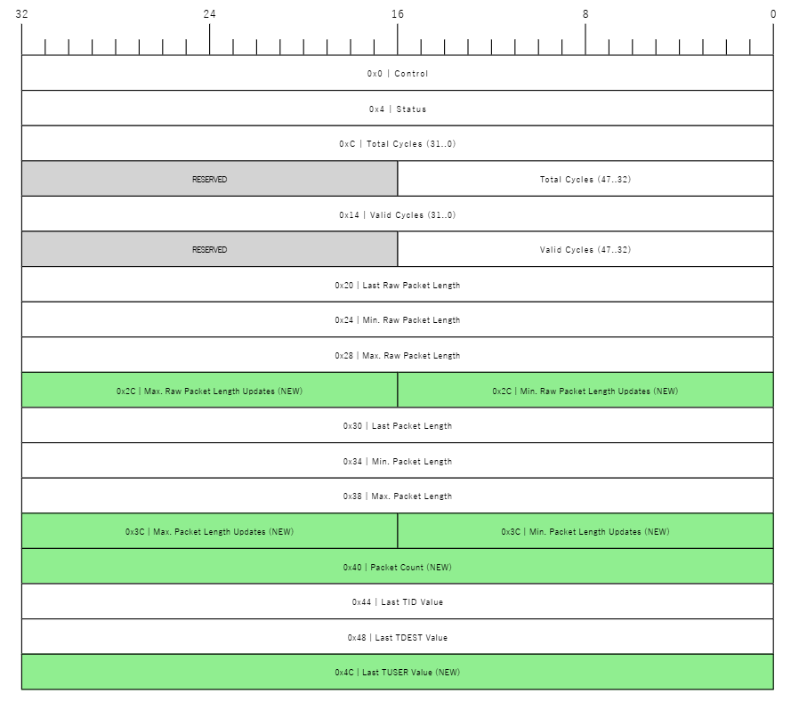
AXI4-Stream Monitoring Address Map
Interactive shell for packetdiag
packetdiag {
colwidth = 32
node_height = 36
scale_direction = right_to_left
scale_interval = 8
0-31: 0x0 | Control
32-63: 0x4 | Status
64-95: 0xC | Total Cycles (31..0)
96-111: Total Cycles (47..32)
112-127: RESERVED [ color = lightgrey ]
128-159: 0x14 | Valid Cycles (31..0)
160-175: Valid Cycles (47..32)
176-191: RESERVED [ color = lightgrey ]
192-223: 0x20 | Last Raw Packet Length
224-255: 0x24 | Min. Raw Packet Length
256-287: 0x28 | Max. Raw Packet Length
288-303: 0x2C | Min. Raw Packet Length Updates (NEW) [ color = lightgreen ]
304-319: 0x2C | Max. Raw Packet Length Updates (NEW) [ color = lightgreen ]
320-351: 0x30 | Last Packet Length
352-383: 0x34 | Min. Packet Length
384-415: 0x38 | Max. Packet Length
416-431: 0x3C | Min. Packet Length Updates (NEW) [ color = lightgreen ]
432-447: 0x3C | Max. Packet Length Updates (NEW) [ color = lightgreen ]
448-479: 0x40 | Packet Count (NEW) [ color = lightgreen ]
480-511: 0x44 | Last TID Value
512-543: 0x48 | Last TDEST Value
544-575: 0x4C | Last TUSER Value (NEW) [ color = lightgreen ]
}

Slide 5
AXI4-Stream Insertion Overview
From here:
src/vhdl/axi4s_insert_into_stream.vhd · develop · esdg / libraries / lib_stfc / hexitec_mhz · GitLab
Should insert a full AXI4-Stream packet on STREAM 1, in-front of STREAM 2.
Header insertion when
STREAM 1 = HEADER | STREAM 2 = PAYLOAD
Footer insertion when:
STREAM 1 = PAYLOAD | STREAM 2 = FOOTER

