Slide 1
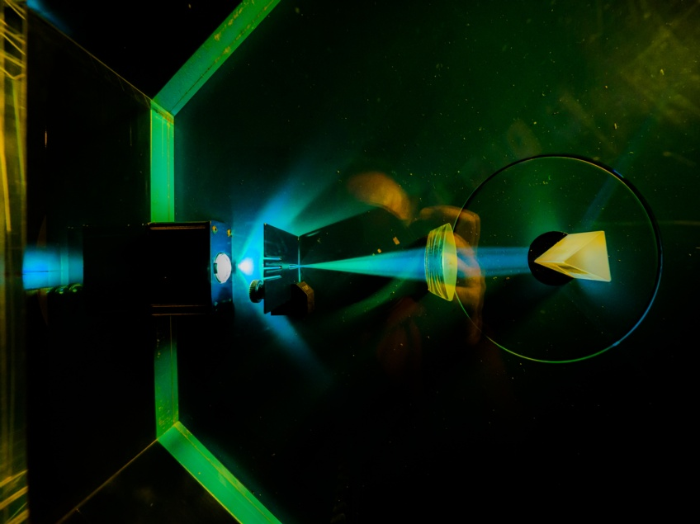




Image © STFC Alan Ford
Notes:
To edit the background image, select ‘Format’ from the PowerPoint menu and ‘Slide Background’ from the drop-down menu. Within the new list of options that appears on the right of the screen, select the ‘File’ button under ‘Insert picture from’ and select your image from your file browser. Please remove or amend the image credit if you are using a different image to the one provided.

Slide 2



Dynamic Reconfiguration Port
In Xilinx IP Cores
ESDG
Matt Roberts
Sooraj Pradeep
Notes:
The abstract pattern can be removed or repositioned if required. Be careful to ‘Send to Back’ so that it does not obscure any important information.

Slide 3
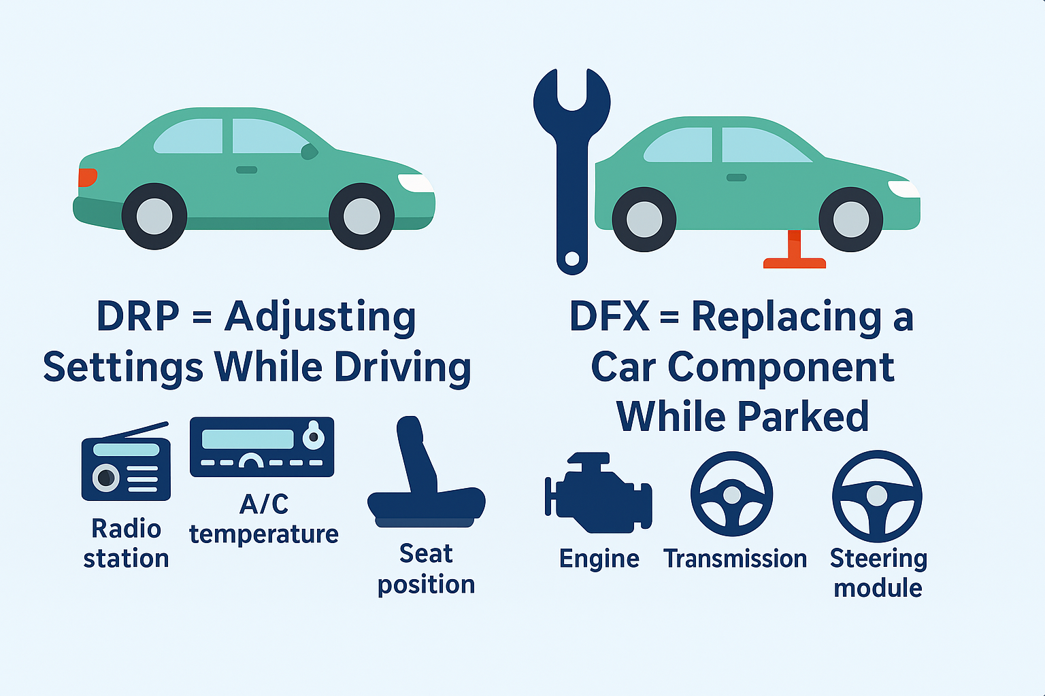
What it is
What DRP is:
  A register‑level interface inside certain Xilinx IPs used to change configuration parameters at runtime.
  Allows small, controlled adjustments (e.g., PLL frequencies, transceiver equalization, ADC settings)

Slide 4
What it is Not
What DRP is Not:
  ❌ Not Dynamic Function eXchange (DFX)
  ❌ DRP does not replace or reconfigure logic blocks or hardware modules.
  ❌ No partial bitstreams, no region swapping, no module‑level reconfiguration.
  ❌ DRP only updates existing IP registers, not the FPGA fabric.

Slide 5
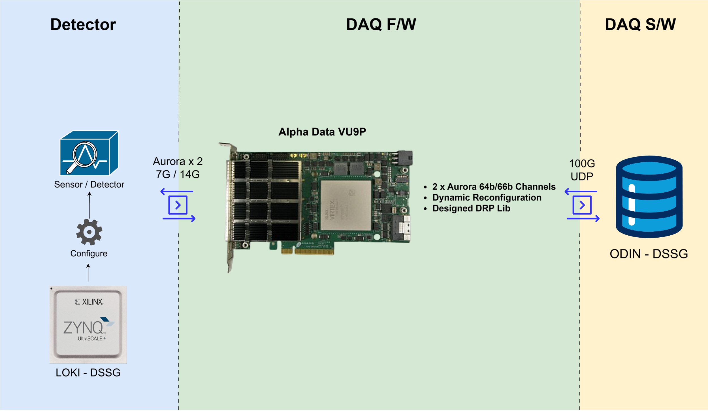
Why?

Slide 6
Why?

Slide 7
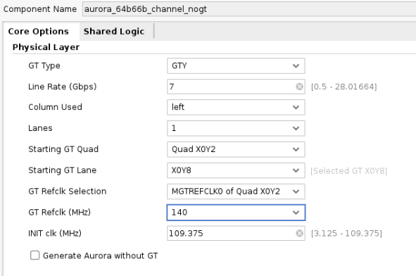

Why?
Bitstream 7G

Slide 8
Why?
Bitstream 14G

Slide 9
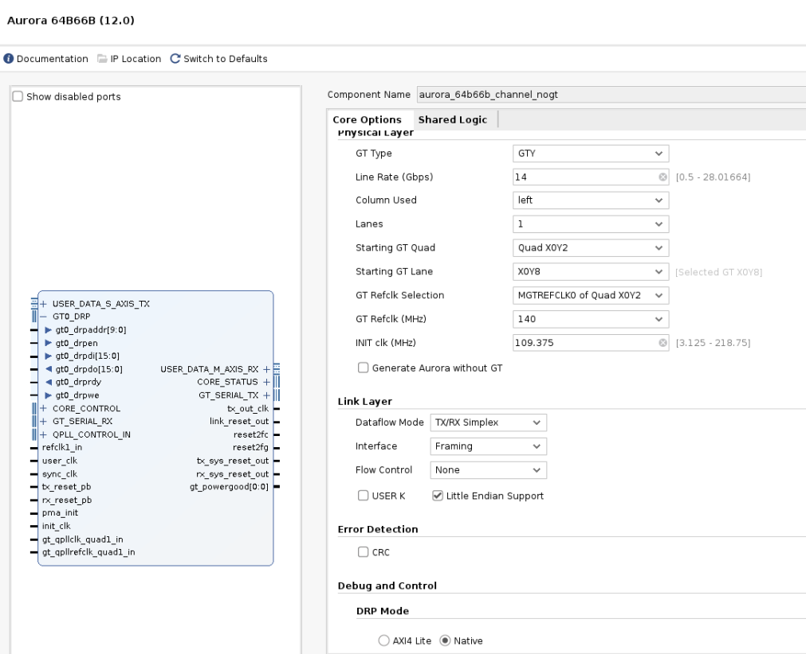
How?

Slide 10
How?

Slide 11
How?

Slide 12
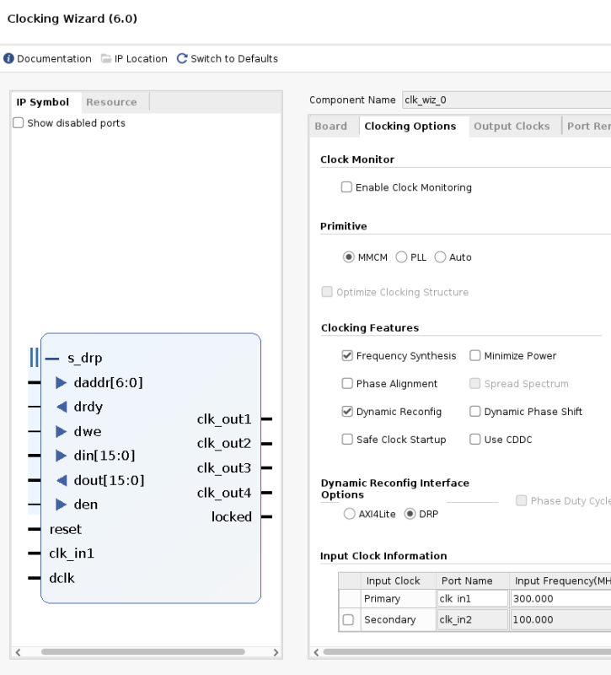
How?

Slide 13
How?

Slide 14
How?
Aurora IP Internal Registers
Address | Name | Value
0x01 | Line rate
0x02 | Ref Clk Frequency
0x03 | Init Clk Hz
0x04 | GT Quad
0x05 | GT Lane

Slide 15
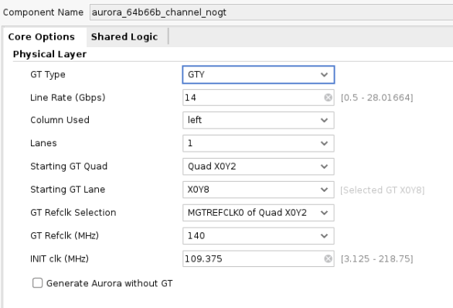
How?
Aurora IP Internal Registers
Address | Name | Value
0x01 | Line rate
0x02 | Ref Clk Frequency
0x03 | Init Clk Hz
0x04 | GT Quad
0x05 | GT Lane

Slide 16
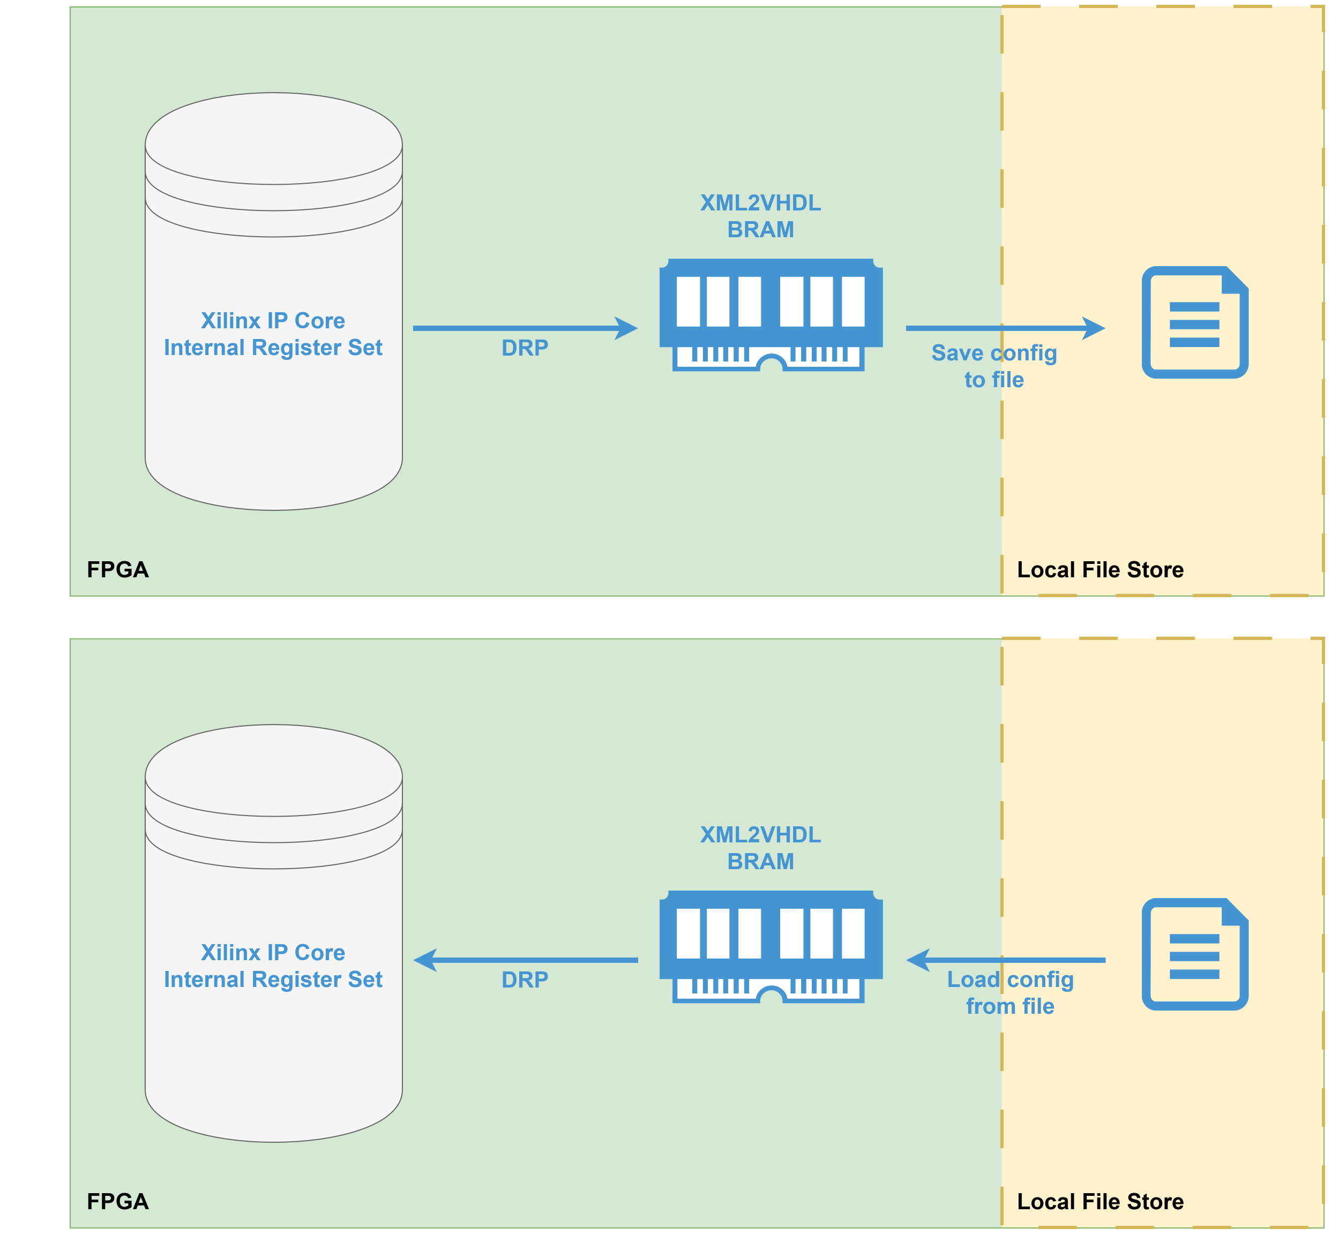
DRP Lib

Slide 17
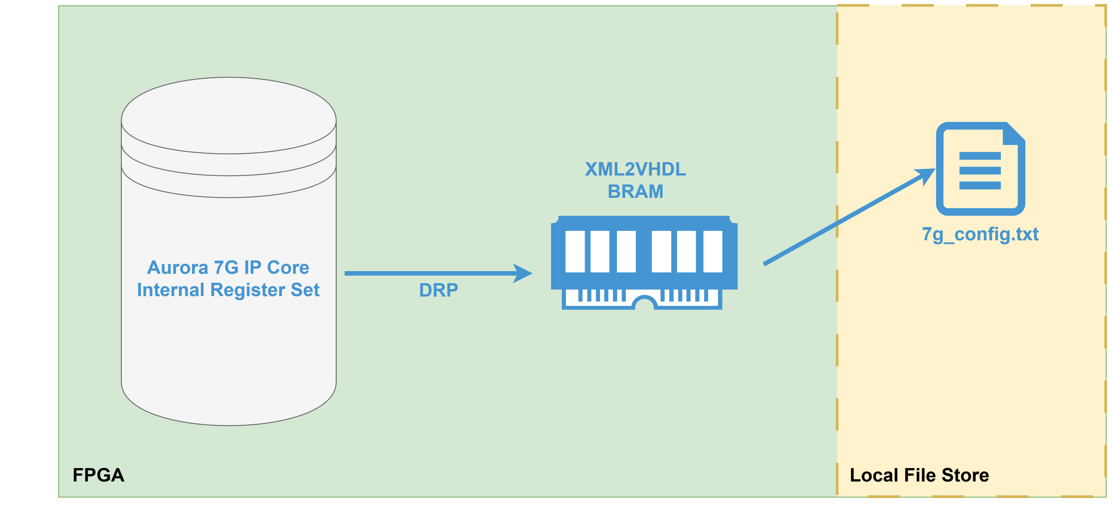
DRP Lib

Slide 18
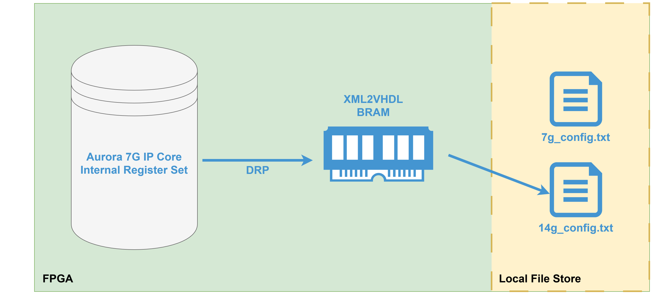
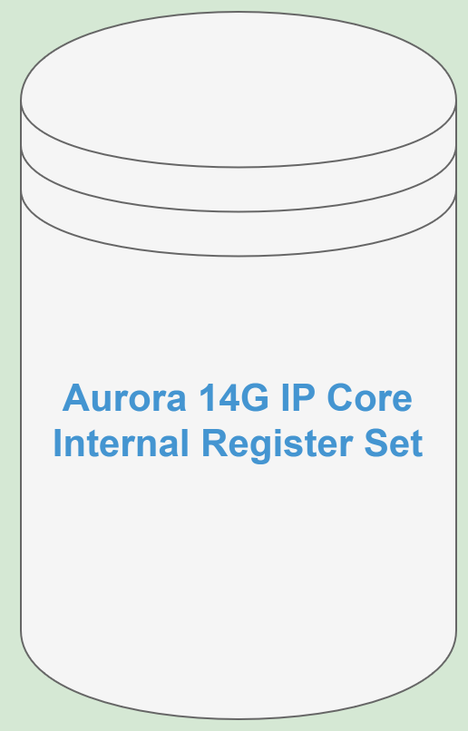
DRP Lib

Slide 19
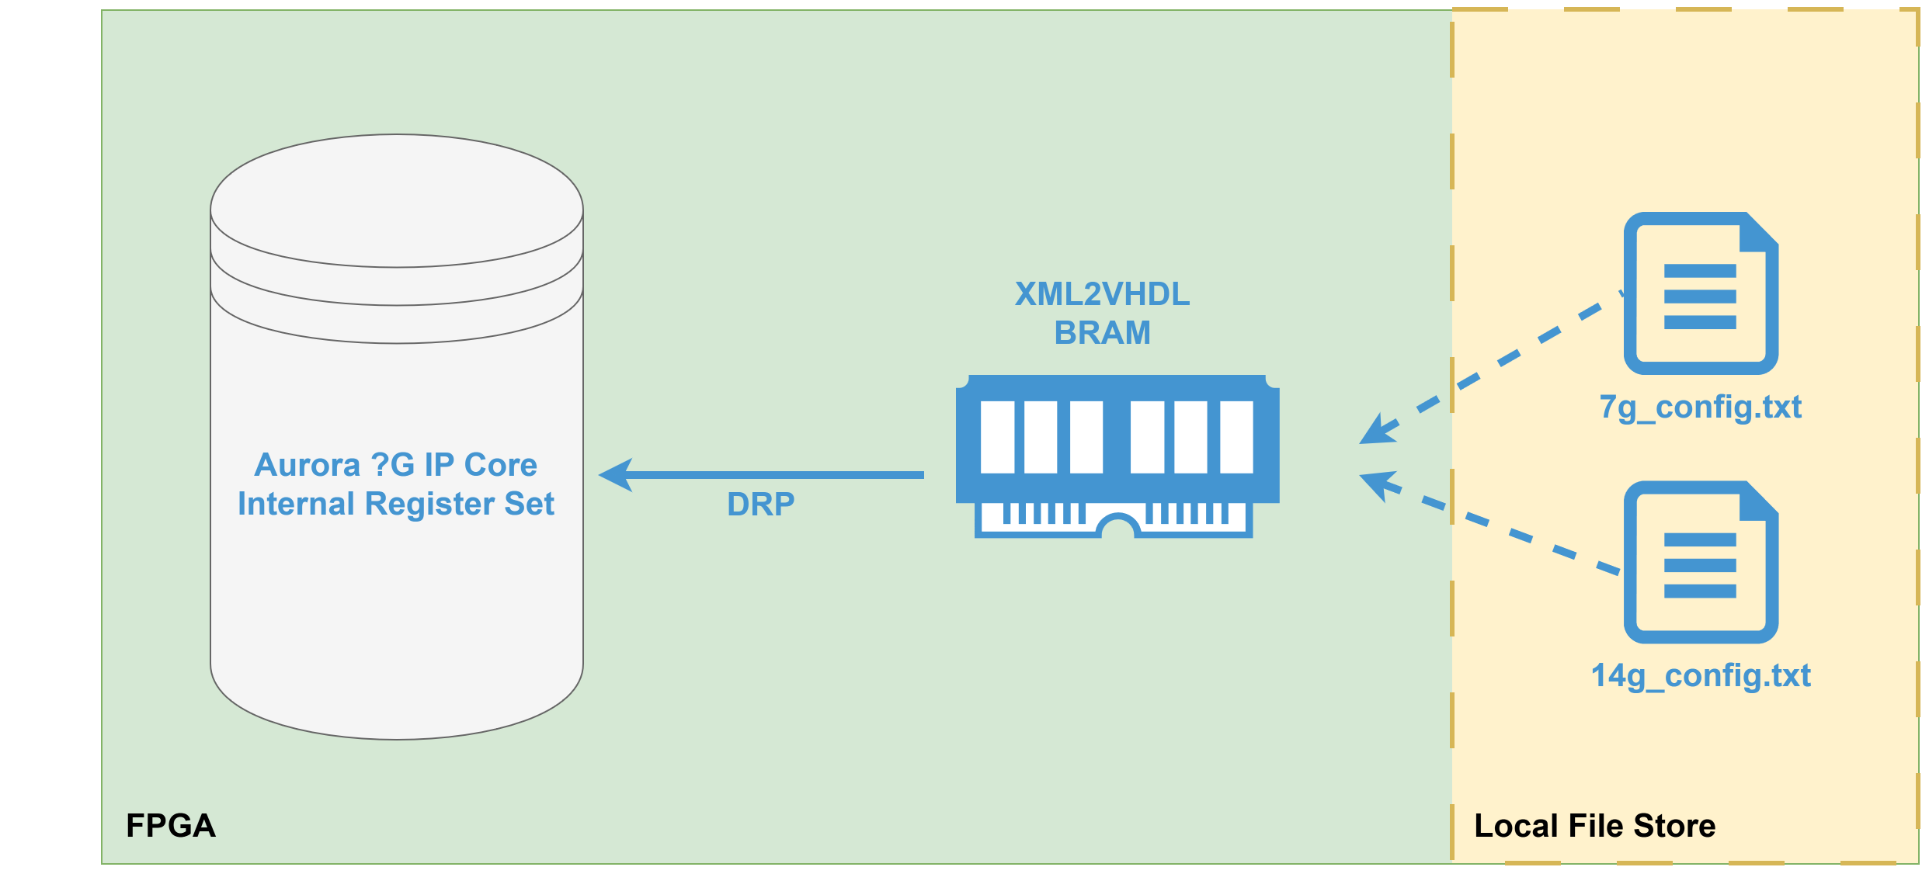
DRP Lib

Slide 20

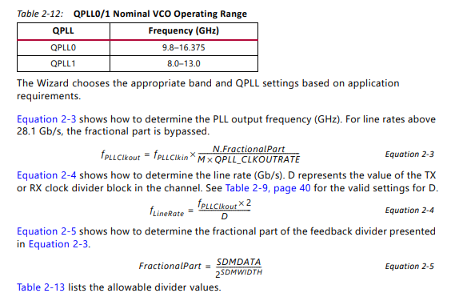
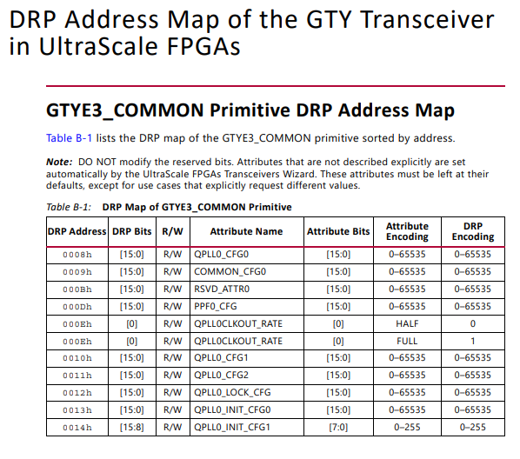
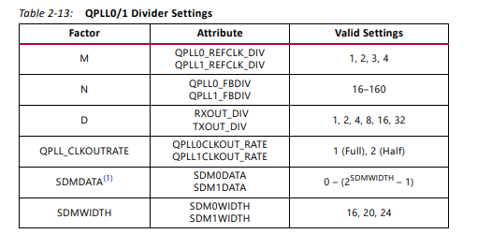
DRP Lib

Slide 21
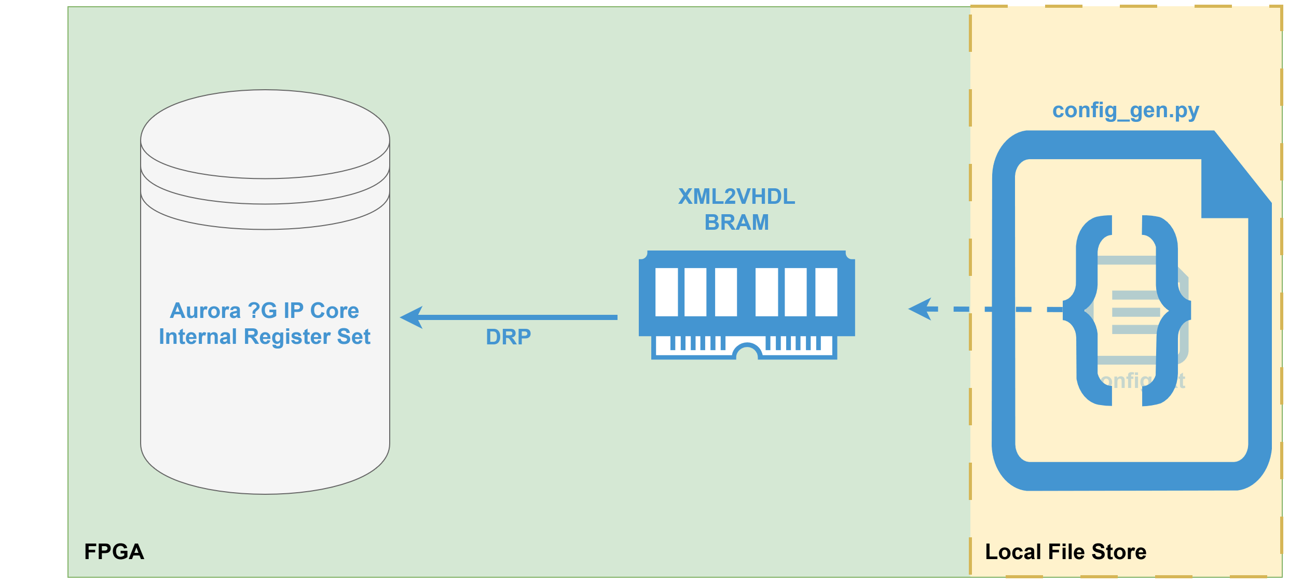
DRP Lib

Slide 22
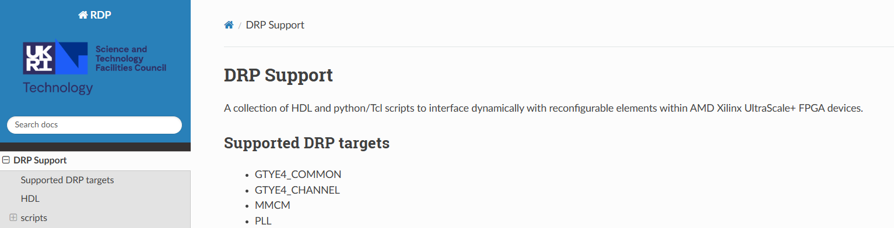
DRP Lib
http://www-local.technology.stfc.ac.uk/ESDG/documentation/common-libraries/drp/0.5.2/README.html

Slide 23
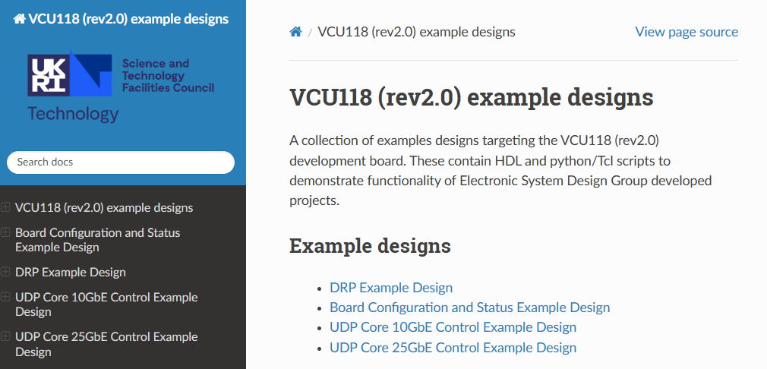
DRP Lib
http://www-local.technology.stfc.ac.uk/ESDG/documentation/example_designs/vcu118_rev2_0/0.4.0/

Slide 24

Notes:
The abstract pattern can be removed or repositioned if required. Be careful to ‘Send to Back’ so that it does not obscure any important information.

Slide 25




technologysi.stfc.ac.uk
@STFC_Matters
Science and Technology Facilities Council
Science and Technology Facilities Council
Notes:
The abstract pattern can be removed or repositioned if required. Be careful to ‘Send to Back’ so that it does not obscure any important information.

