Slide 1
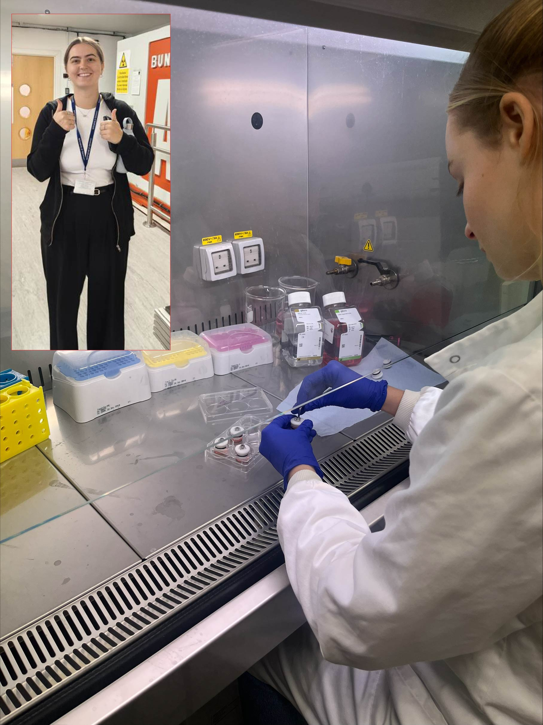
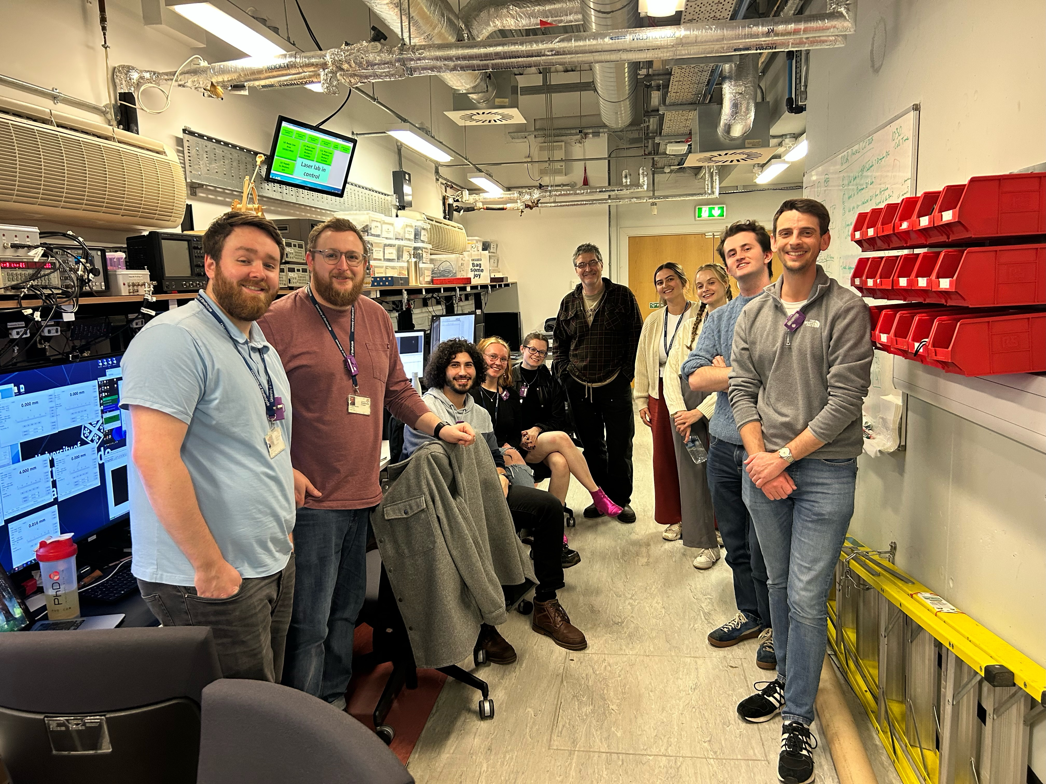
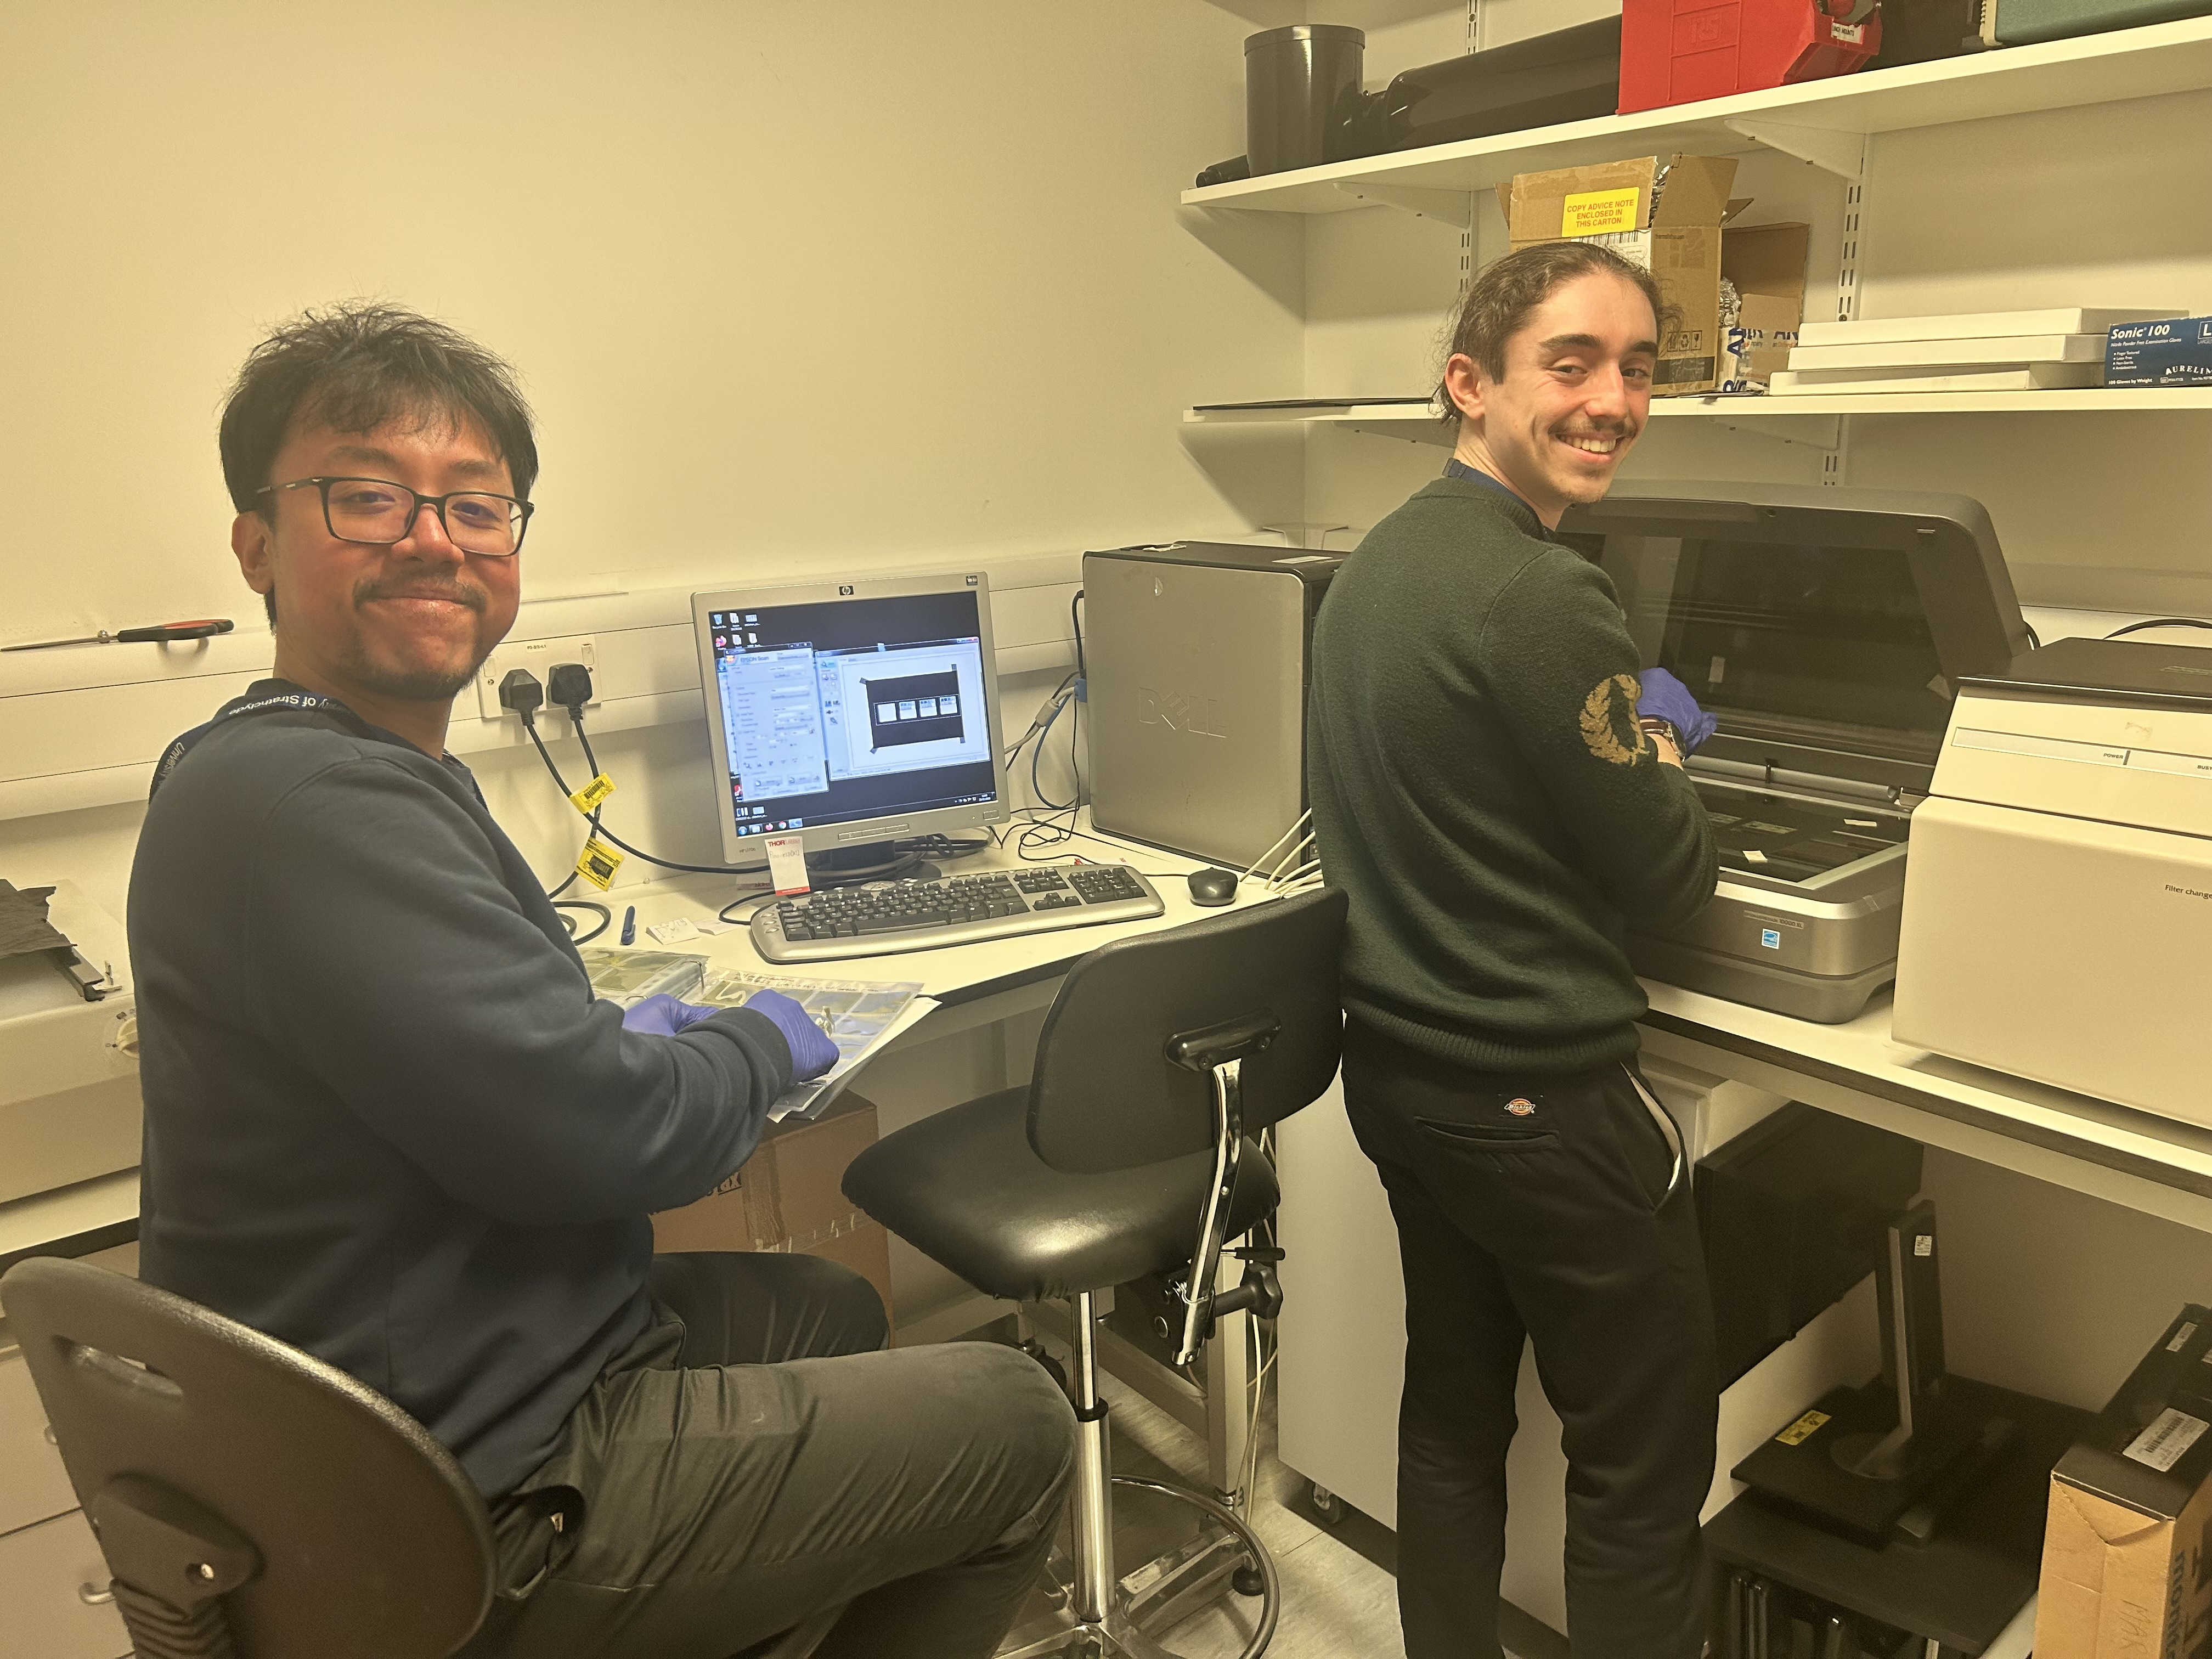
PoPLaR Update Meeting: Welcome
Notes:
Radiobiology Results
SCAPA and Beamline
Lunch
Instrumentation
Break before LhARA fortnightly
Instrumentation (continued)
Break
Looking Forward

Slide 2
Plan for the Day
Radio
Notes:
Mention:
Large Variation No Clear dependence on shot number
Potential Dependence on Smaller Film Size

