Slide 1



Square Kilometre Array Observatory
Peter Furey-Duffin Electronic System Design Group
29th January 2026

Slide 2



Slide 3
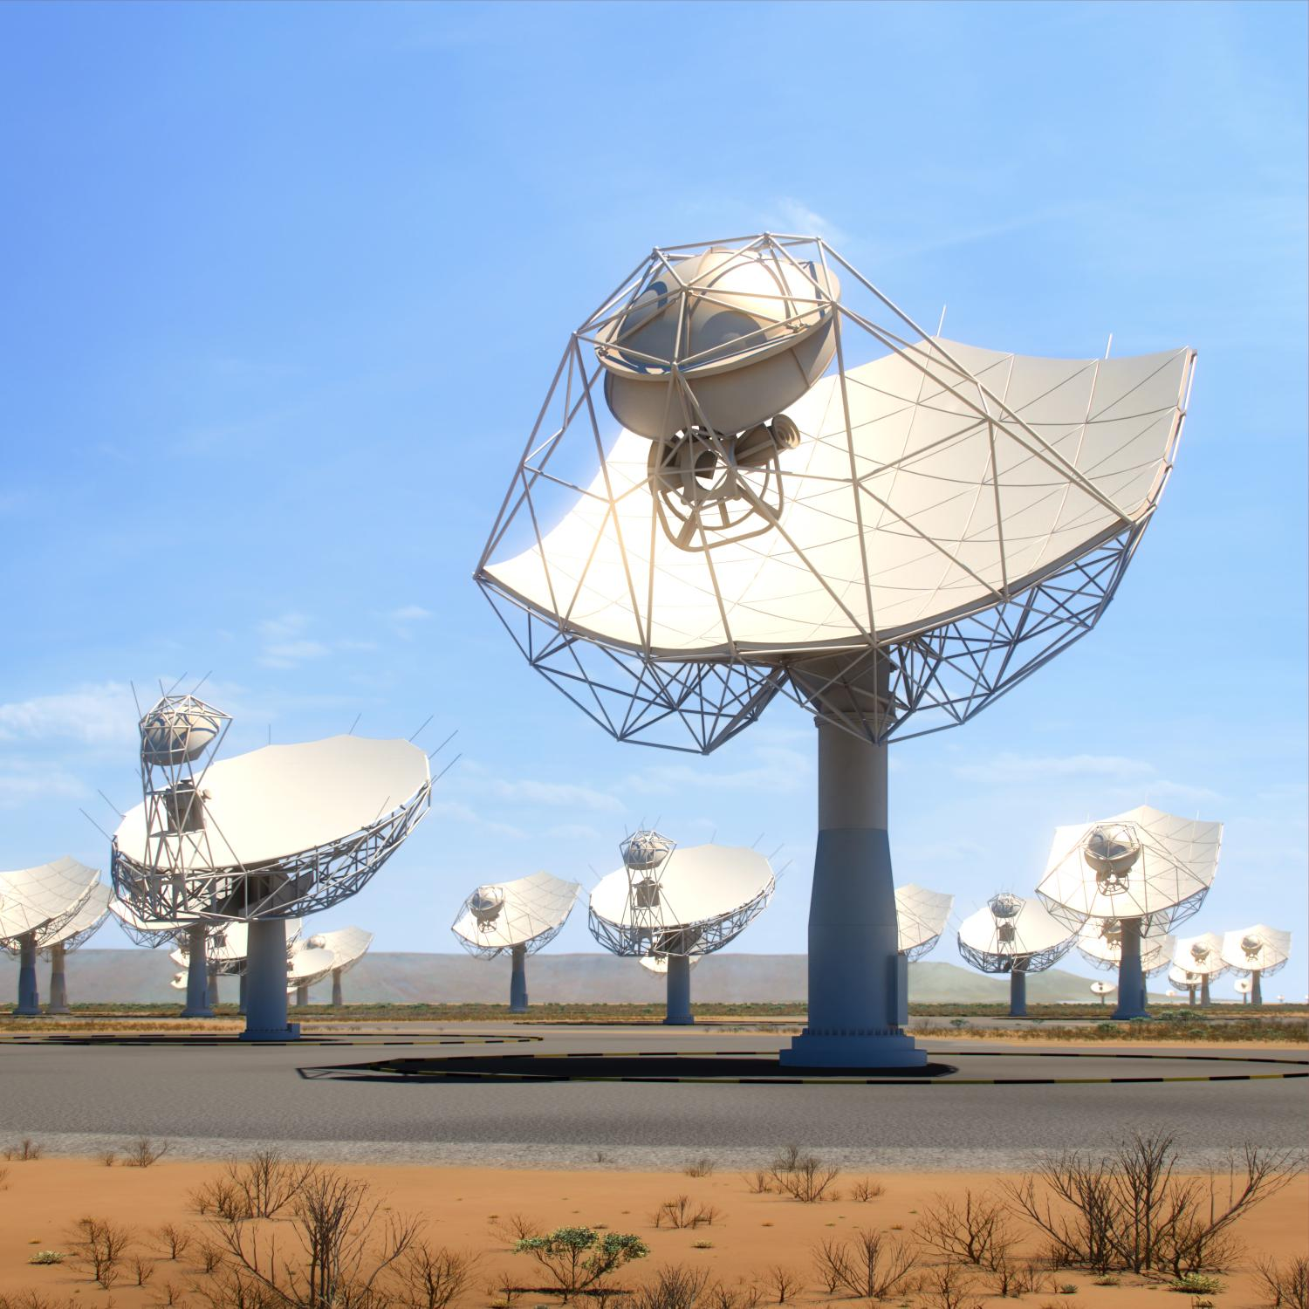
SKA-Mid
350 MHz – 15.4 GHz
197 Dishes

Slide 5

SKA-Low
50 MHz – 350 MHz
131,072 Antennas

Slide 7

SKAO GHQ
0 Dishes
Lots of Scientists

Slide 8


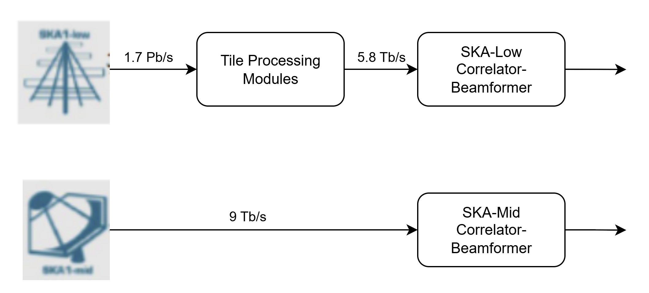
SKA-Low
131,072 Dual Polarization Antennas Grouped into Stations of 256 antennas.
16 Tile Processing Modules per Station
Each responsible for 16 antennas.
99.7% Data Reduction
Station beamforming reduces the 1.7 Pb/s of raw antenna data to 5.8 Tb/s. Comparable to SKA-mid’s 9 Tb/s of raw dish data.

Slide 9
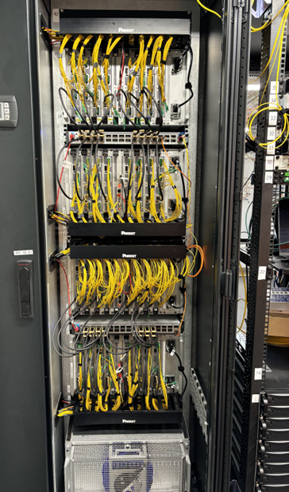
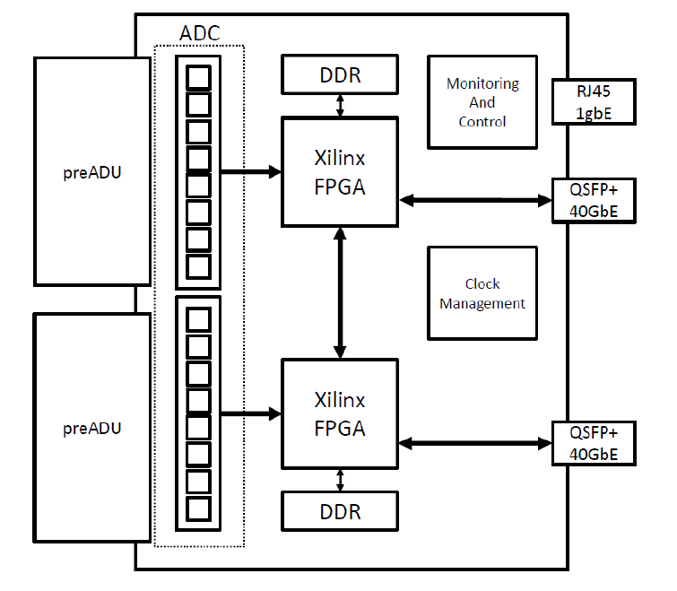
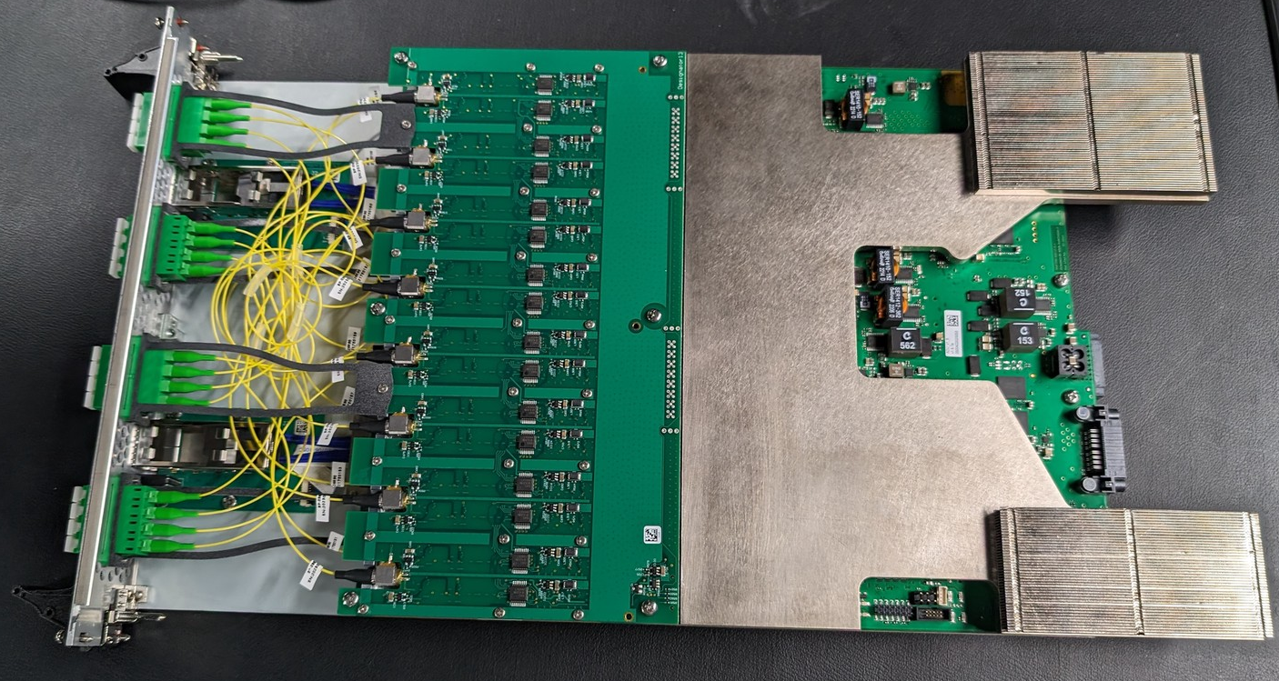
SKA-Low Signal Processing System
Tile Processing Module 2.0.5b
2 Kintex™ UltraScale+™ FPGAs
16 Dual Channel ADCs
32GB DDR4
40 Gb/s QSFP
Tile Processing Module 3.0.0
JTAG
?
Tile Processing Module (TPM) Hardware Overview
Tile Processing Module (TPM) v2.0.5b
Signal Processing System (SPS) Cabinet

Slide 10


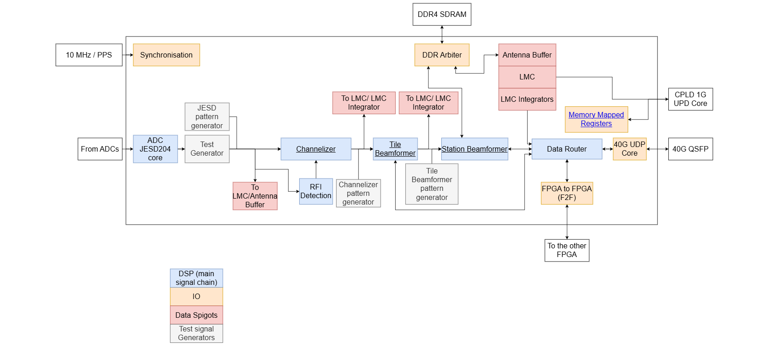

Team Janus
“Janus is the god of beginnings, gates, transitions, time, duality, doorways, passages, frames, and endings. Usually depicted as having two faces.”
Responsibilities
Notes:
Please replace photo of presenter with a portrait of your own. 1) Send the geometric shape overlay to the back – Right-Click > Send to Back > Send to Back. 2) Replace image – use the guides provided to correctly position it. 3) Send your portrait to the back so that the geometric overlay re-appears over the portrait.

Slide 11

Team Janus
Responsibilities
TPM FPGA Firmware
TPM Python API
SPS Python Test Suite
TPM FPGA Firmware Overview
Notes:
Please replace photo of presenter with a portrait of your own. 1) Send the geometric shape overlay to the back – Right-Click > Send to Back > Send to Back. 2) Replace image – use the guides provided to correctly position it. 3) Send your portrait to the back so that the geometric overlay re-appears over the portrait.

Slide 12
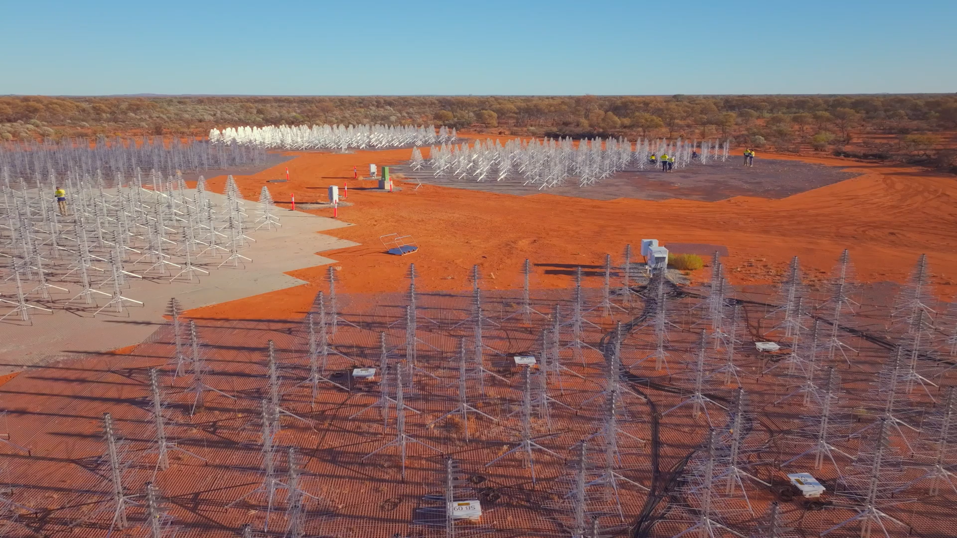
Current Status
16 Stations & SPS deployed
Challenges with production in Italy
Environmental challenges
Contract extension until end of 2026

Slide 13
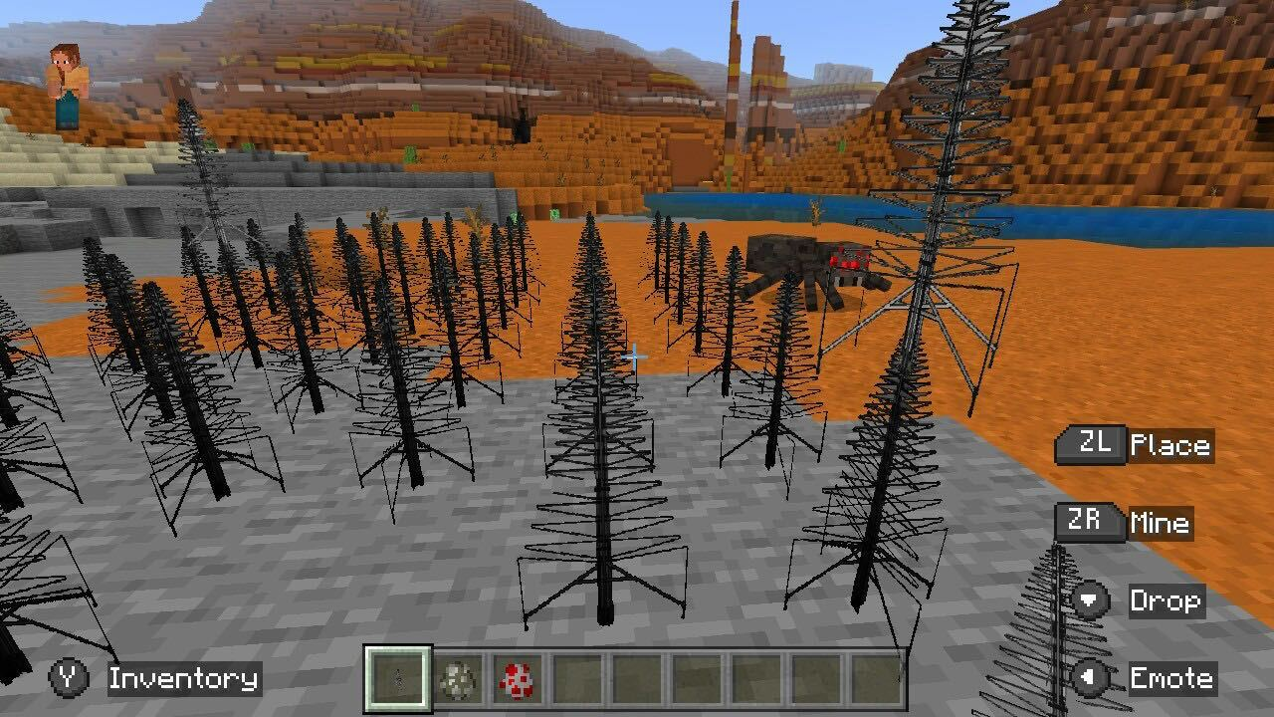
Thank you

