Slide 1
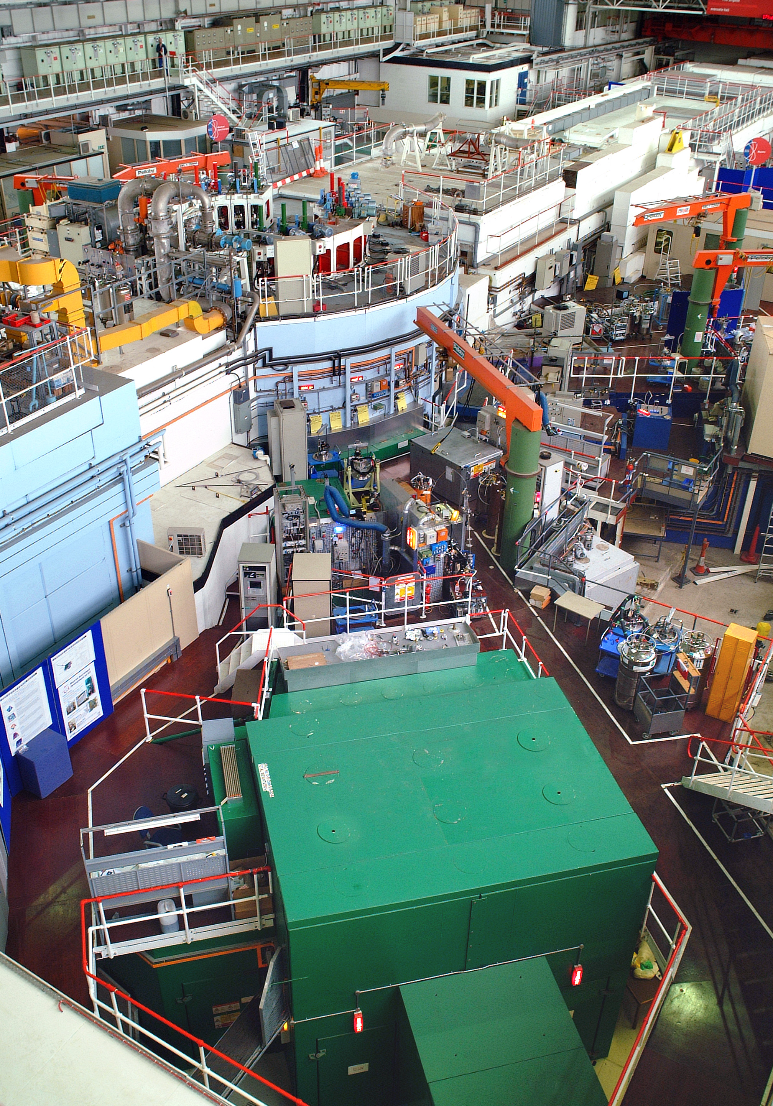

ISIS Detector Systems Group Support Project
Ronnie Brumfitt
January 2026

Slide 2
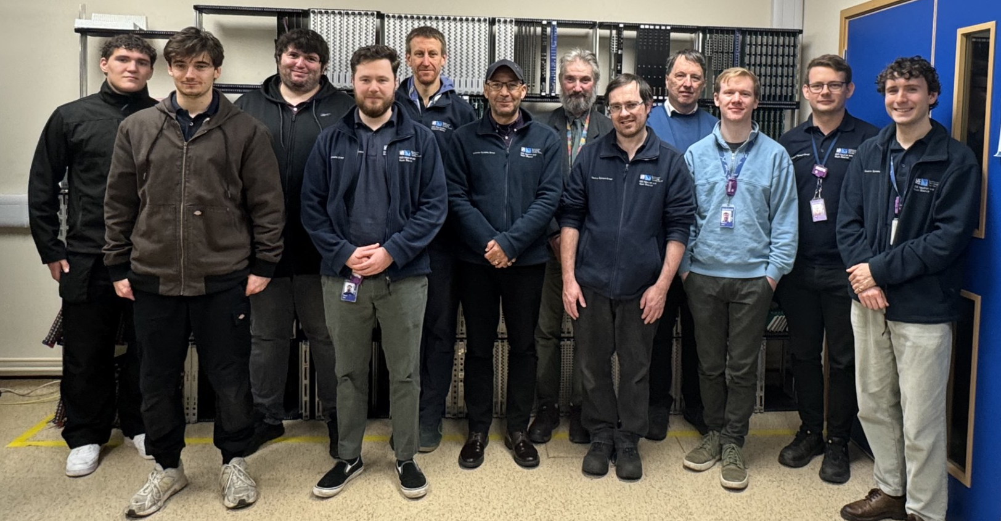
ISIS Detector Systems Group Electronics Section
"The development, delivery and support of data acquisition systems, effectively and efficiently to ISIS customers"
Ronnie Brumfitt, Piers Coode, Joshua Davies, Jack Day, Kelvin Gascoyne, Simon Moorby, Chad Silk, Dave Templeman, Martin Torbet.
Josh Preston, Anthony Ellacott

Slide 3
ISIS Detector Systems Group Support Project
Team News
Jack : Completed STFC Degree Apprenticeship with BEng Degree First
Chad : Started UKRI Management Development Programme
Dave, Piers, Will : Started ML/AI in Python training at Oxford University
Will : In-Year Award for IMAT work and Team Instant Recognition Award for Muon call-out
Simon : In-Year Award for ARGUS work
Chad : In-Year Award for Work Experience Supervisors Guide
Ronnie & Martin : In-Year Award for QMS work
3 Apprentice and 8 Work Experience placements in 2025
Hoping to recruit 4th year apprentice as Band C technician in September
Technology Safety Committee member & QMS Internal Audit Team member
Fire/Building Wardens
Risk Assessors & COSHH Assessors
PAT testers & Ladder Inspectors
Apprenticeship Committee member, Apprentice & Work Experience Supervisors
First Aider, ISIS Tour Guides & RecSoc Committee member

Slide 4
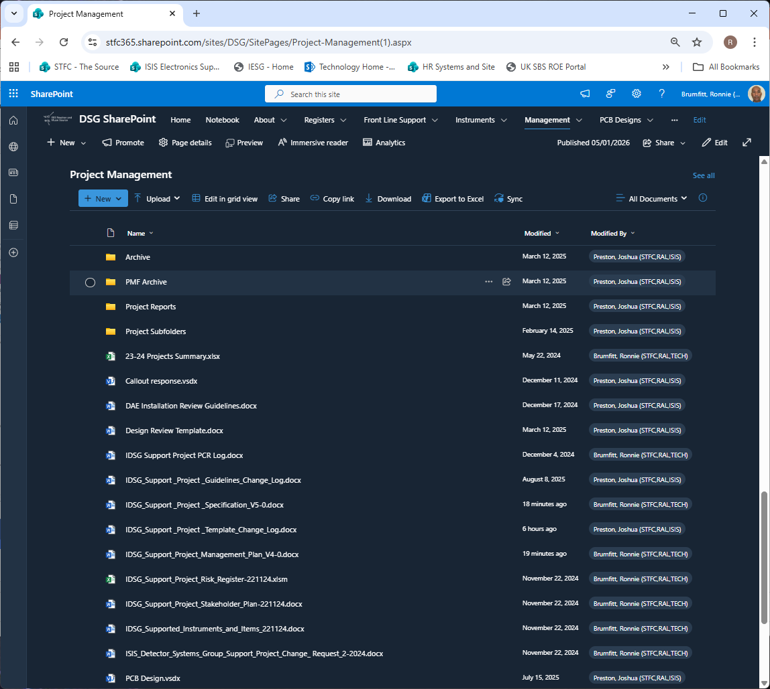
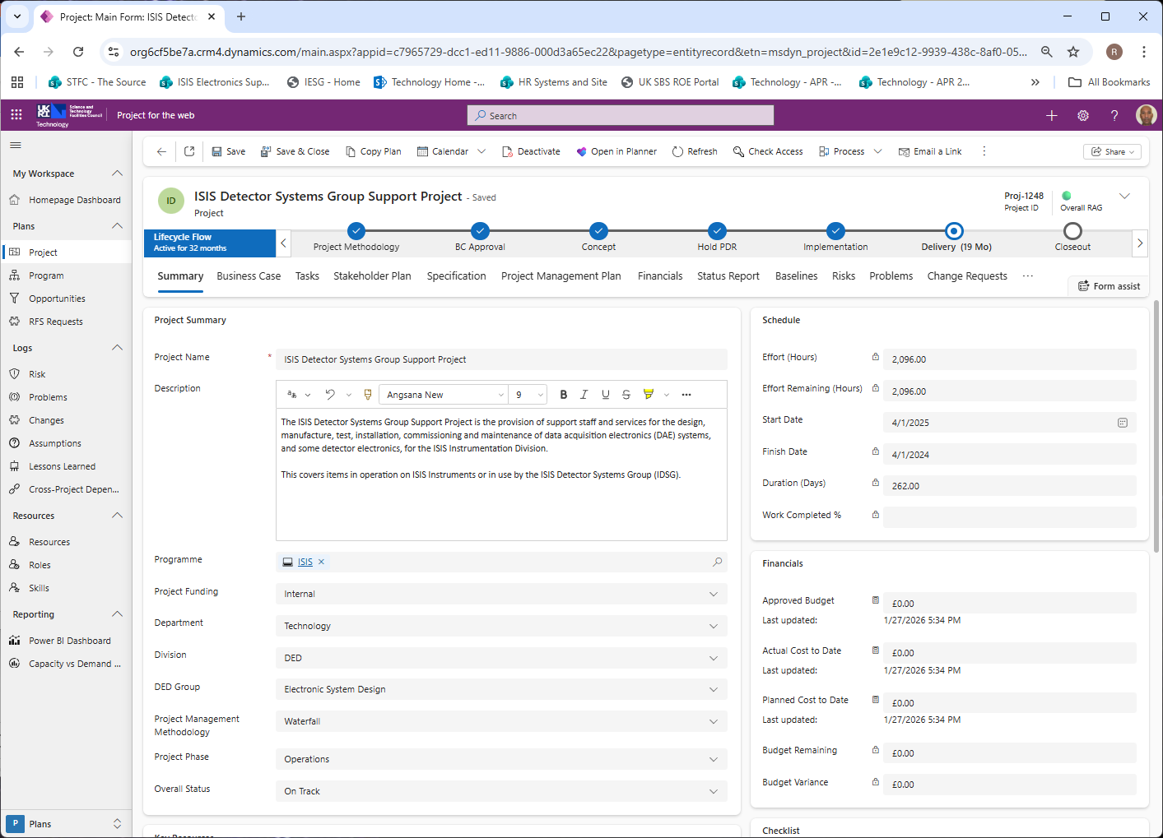
ISIS Detector Systems Group Support Project
Project Management
The ISIS Detector Systems Group Support Project is the provision of support staff and services for the design, manufacture, test, installation, commissioning and maintenance of data acquisition electronics (DAE) systems, and some detector electronics, for the ISIS Instrumentation Division.

Slide 5
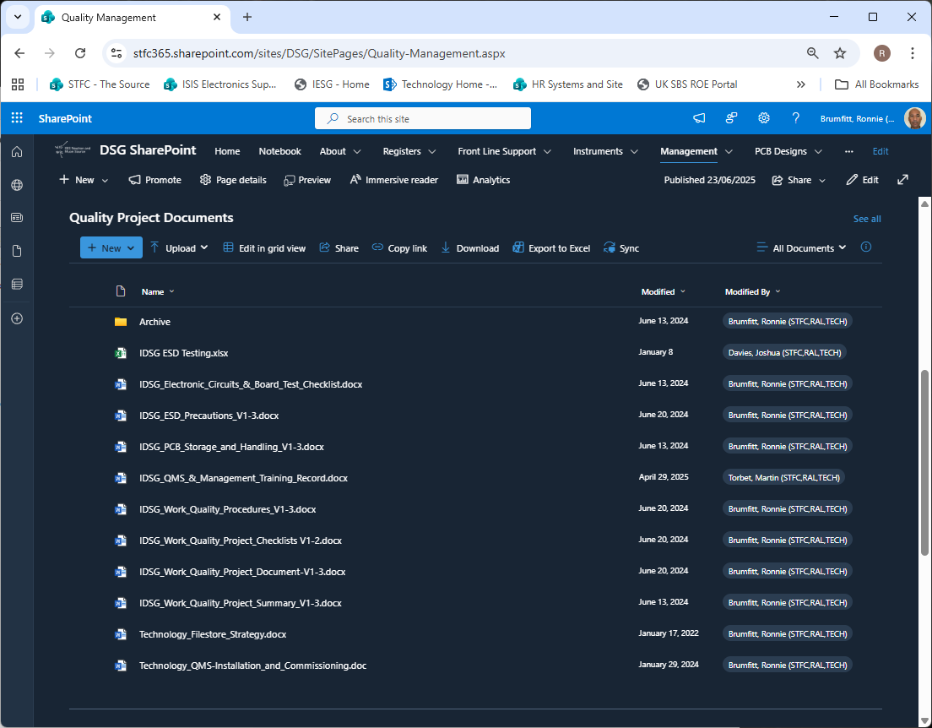
ISIS Detector Systems Group Support Project
Quality Management
The IDSG Work Quality Project is the method used to define how staff should manage, record and monitor the quality of their work and to report and feedback such information in a consistent manner on a regular basis.
All IDSG Support Project staff are responsible for creating, maintaining and updating entries and documents in the QMS systems in accordance with their roles for the Group.
Project Tracker for design projects
Shutdown Planner for shutdown work
Design Data Folders for PCBs
Build Register
Problem Reports (PCBs & Installation)
Board Register (also Crates, Racks, HT, & Test Equipment)
ISIS Event Log (Call-outs, Upgrades, Changes)
Training Records, Competency & Authorization Matrix
Assorted Templates & Guidelines

Slide 6
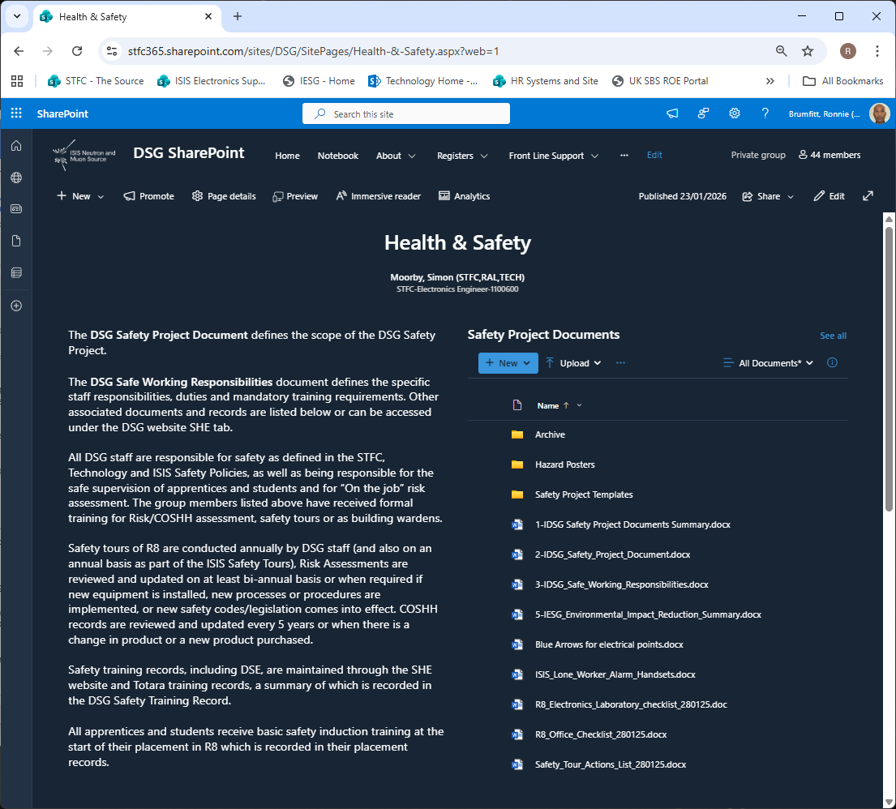
ISIS Detector Systems Group Support Project
Health & Safety Management
All IDSG Support Project staff are responsible for safety as defined in the STFC, Technology and ISIS Safety Policies, as well as being responsible for the safe supervision of apprentices and students and for “On the job” risk assessment.
Safety Project Document defines the scope of the project
Safe Working Responsibilities defines staff roles and subsequent responsibility, duties & training requirements
Risk Assessments (via ISIS SHE SharePoint)
COSHH documents (via Sypol CMS system)
Training List & Staff Training Records
SHE Event Log
Routine Checks List
Safety Tour Records
Ladder Inspection, LEV, PAT & ESD records

Slide 7
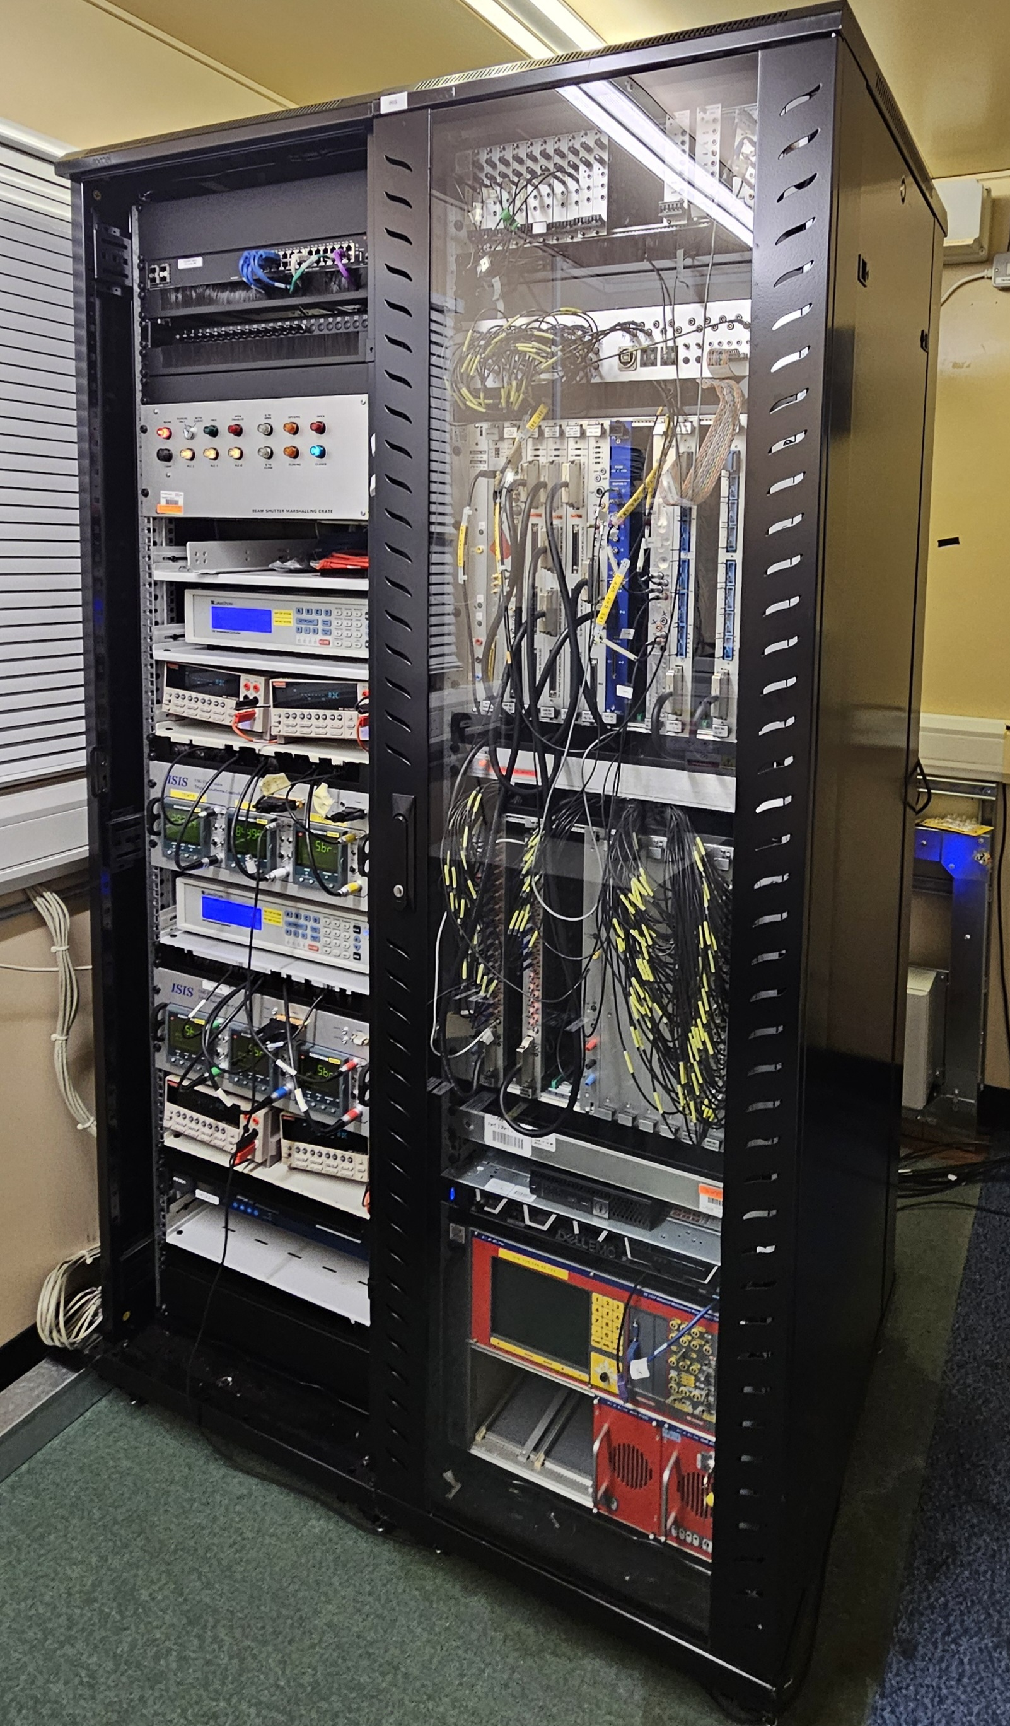
ISIS Detector Systems Group Support Project
Frontline Support
The Frontline Support Team are responsible for the DAE circuits & systems on 38 ISIS Instruments, comprising over 2000 DAE and Detector Electronics PCBs in 146 crates; 360+ HT cards and 66+ HT crates; 56+ Eurocard crates and 100’s of Eurocards; 15 CAEN Discriminator Cards and crates.
Power-down & Start-up procedures for ISIS Run Cycles
Routine DAE systems reviews, inspection and maintenance
Fault finding & repair of boards, crates, fan trays & power supplies when required
Periodic upgrades of existing systems to replace old hardware, improve reliability, increase performance, etc.
Installation & commissioning of new systems
In-hours call-outs & out-of-hours rota during Run Cycles
Event Log records all call-outs & upgrades/changes
Shutdown Planner records ongoing, imminent and future upgrades/changes
Recorded in the Event Log during 2025
107 Callouts (44 during shutdowns or pre-cycle start-up; 63 during cycle; 13 out-of-hours)
54 Upgrades/changes (Hardware or firmware)
54 Pre-cycle faults (Start-up issues – Mostly PSUs, HT, and DSP settings)
IRIS DAE after maintenance
Notes:
Programming, test, installation & commissioning
Fault finding/repair/replacement of systems & boards
Call-outs to Instruments to resolve reported problems or faults
Any subsequent board level fault diagnosis & rework
System racks, crates, power supplies & cabling of boards
Maintaining working spares of supported items
Now includes HT systems and Beam Monitors
All call-outs, Start-up/Shut-down tests/procedures & details of faulty boards returned from Instruments recorded in SharePoint
Aim to respond to ‘working hours’ call-outs within 15 minutes
Now providing 24/7 support during Run Cycles
Aim to have less than 5% of Instrument downtime in a Run Cycle due to IDSG supported items

Slide 8
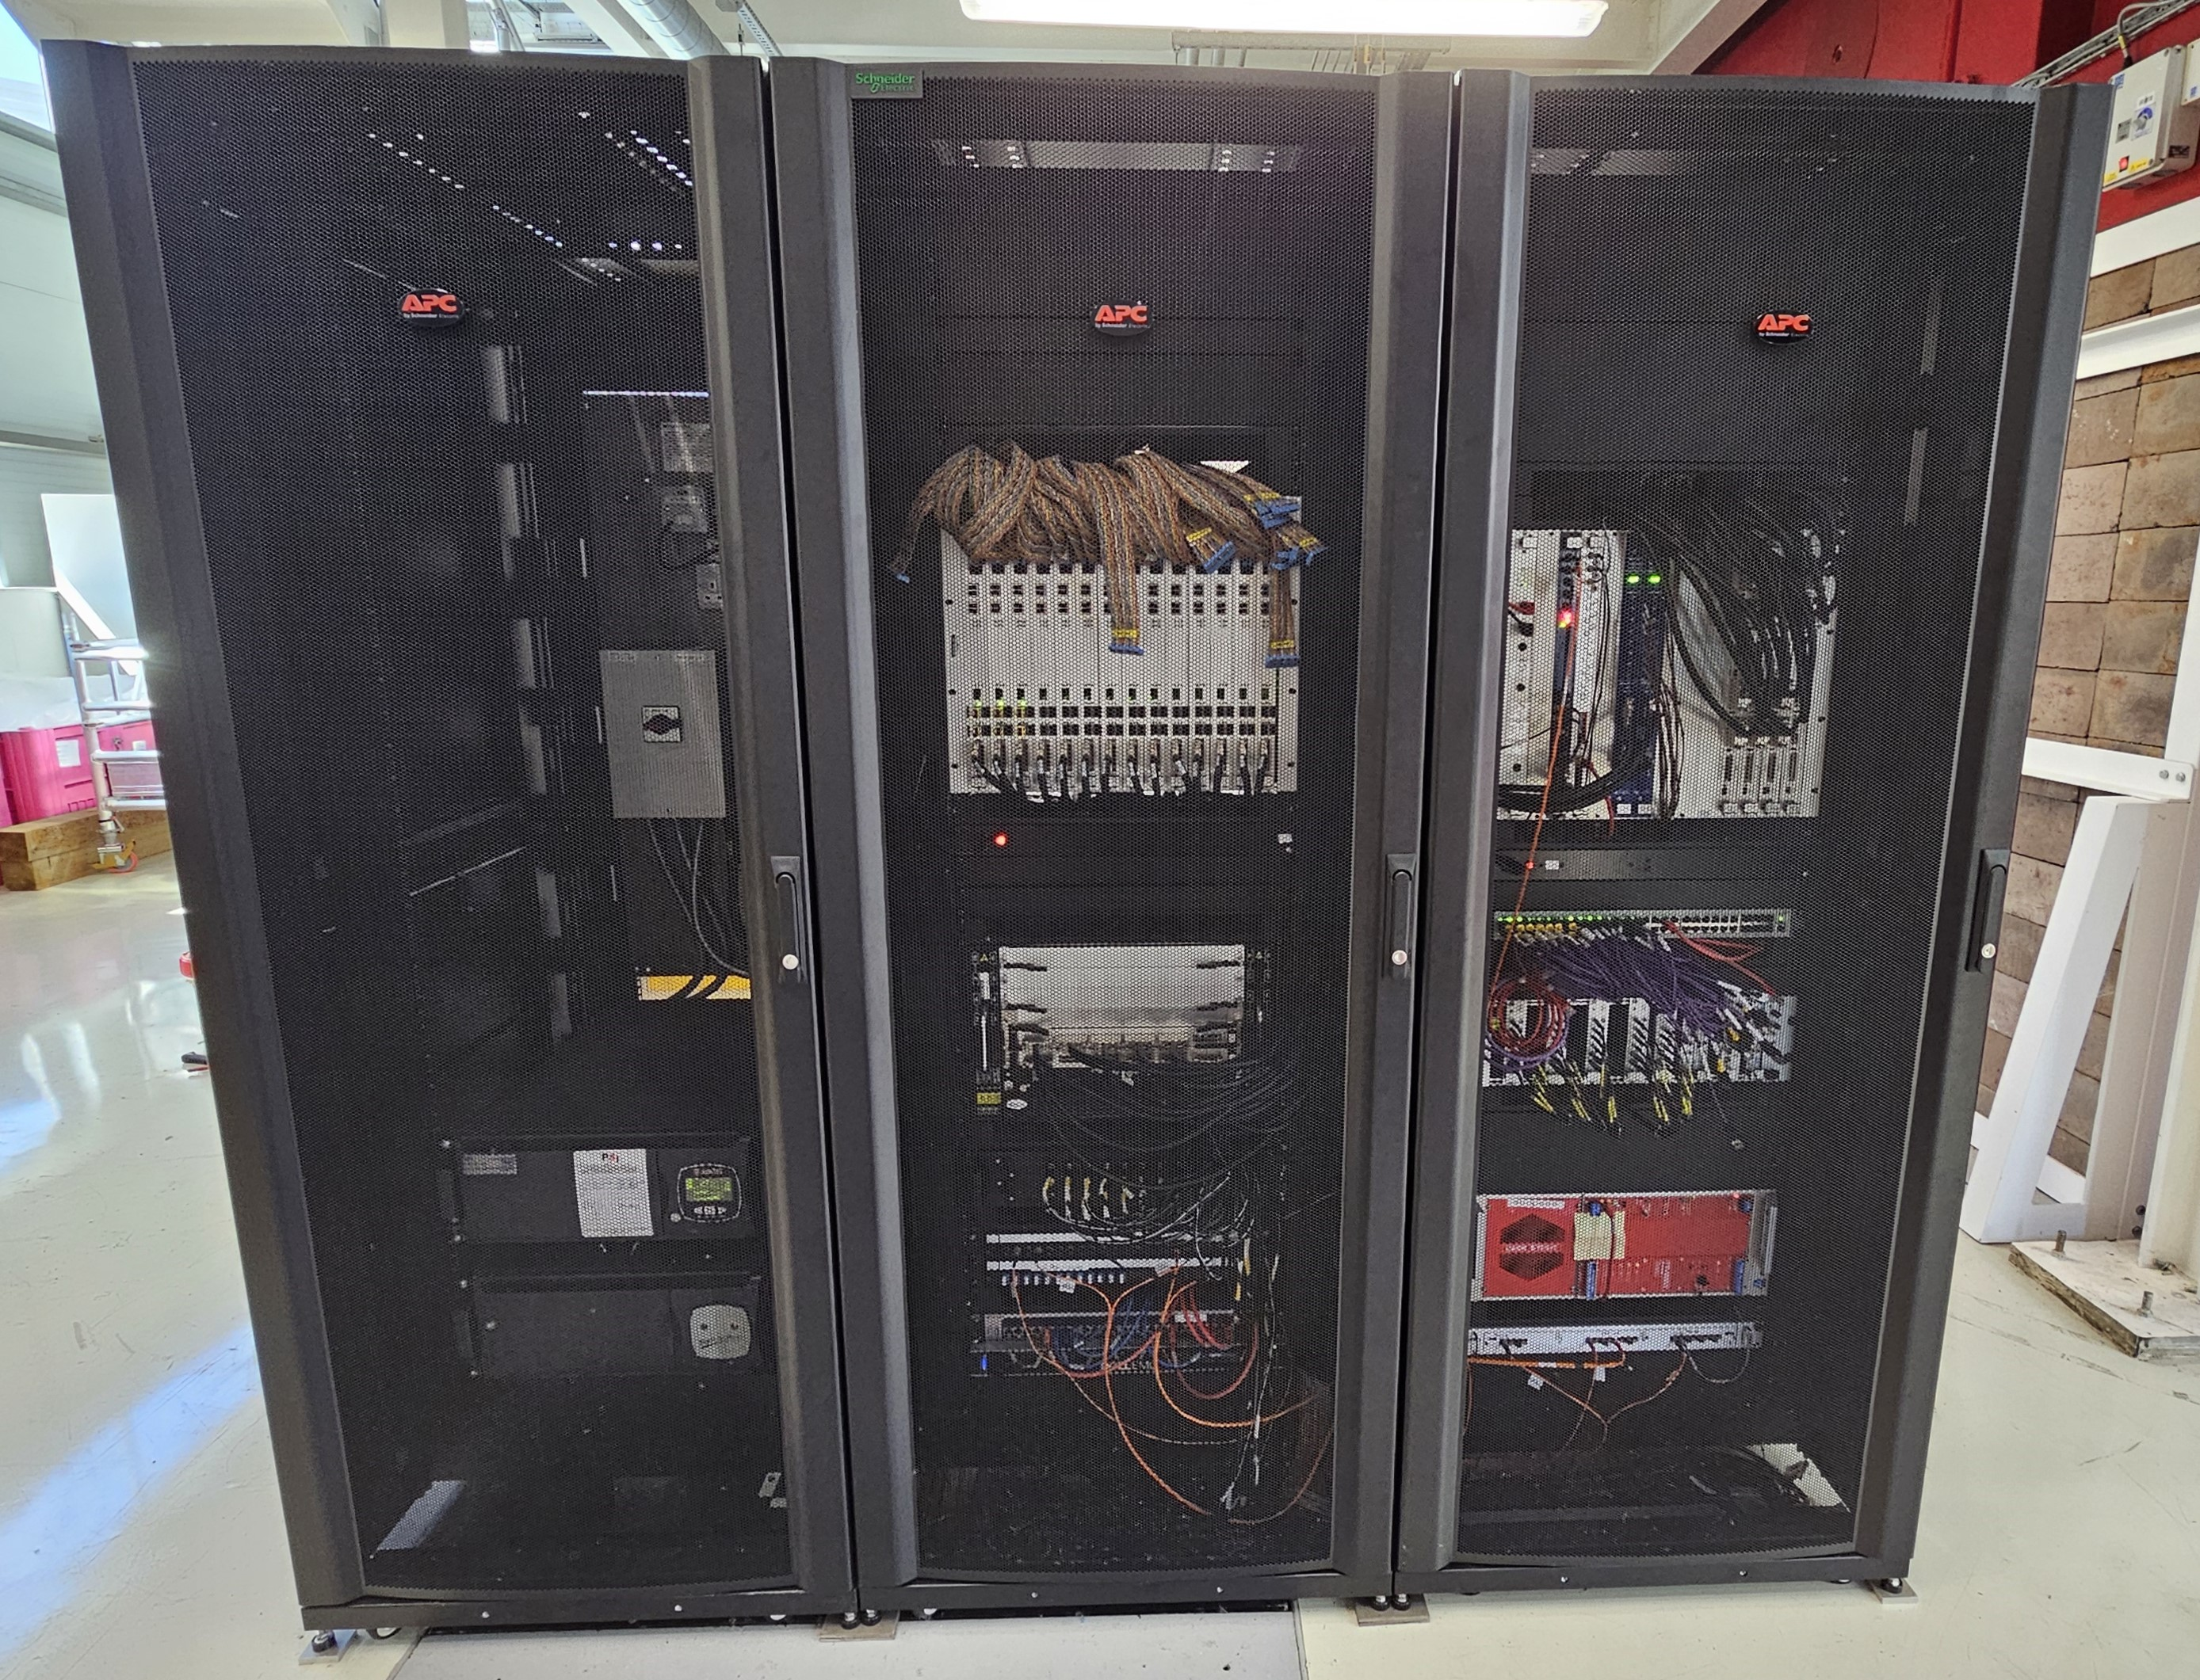
ISIS Detector Systems Group Support Project
Upgrades, Installation and Commissioning
Upgrades, installation and commissioning work during 2025 included:
IMAT Detector Upgrade
New cabling, DAE hardware and racks installed and commissioned
Close-out review conducted & problems recorded
Lessons learnt & planning improvements implemented
HRPD Decommissioning
Removal of all DAE cabling, hardware, racks, etc.
Worked closely with other ISIS Groups in CDM area
Repurposed reusable items, recycled or disposed appropriately
Assorted Upgrades
CHRONUS rack layout refurbishment
8 Instruments upgraded with new DAE3 firmware
16 Instruments upgraded with new Monitor Interfaces
5 Instruments upgraded with new Environment Interfaces
7 Instruments upgraded with Environment Interface hardware & firmware changes
IMAT DAE after upgrade

Slide 9
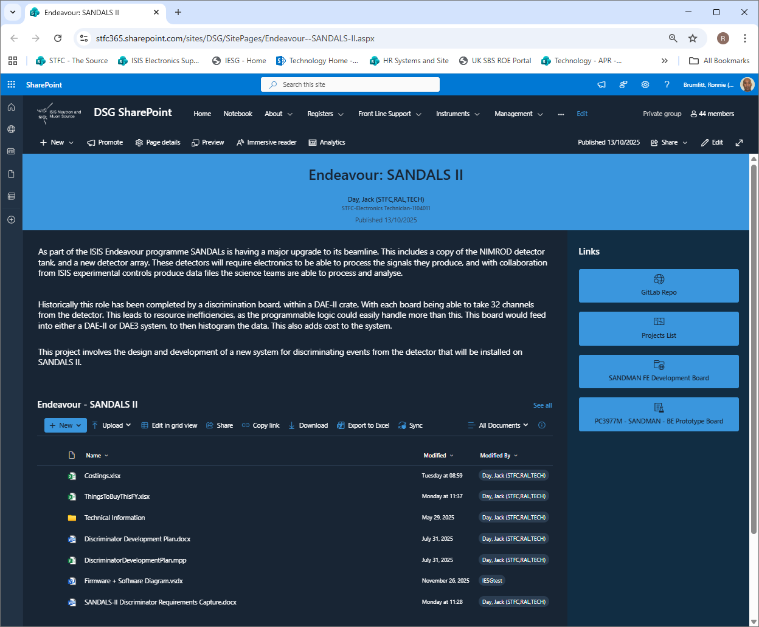
ISIS Detector Systems Group Support Project
Design and Development Projects
Design and development projects may incorporate: Circuit design & development; PCB design, component & board procurement; Mechanical CAD drawings & 3D printing; Programmable logic firmware design & development; Microcontroller software design; POT, Boundary Scan, automated test systems & software design.
15 Ongoing design & development projects include:
9U x 160 Crate Development
DAE3 Firmware Development
DAEMON V2
Endeavour HRPD-X
Endeavour SANDALS II
MS-GS20 Detector
OSIRIS Silicon Analyser DAE Upgrade
Streaming Monitor Processor Board
Timing Distribution System
VXI Streaming Control Board V2
Projects are listed in the SharePoint Projects Tracker and are monitored through monthly Projects Meetings.
Each project has a page and/or Design Data folder in the SharePoint site which should contain all relevant project documentation.
Firmware & software is stored/managed through the IDSG GitLab.
Notes:
9U x 160 Crate Development: Chad (Backplane PCB design complete pending FDR. Crate Controller schematic capture ongoing)
DAE3 Firmware Development: Kelvin (Version 3.1.26 installed on 8 Instruments. Instrument specific PPP issue being investigated)
DAEMON V2: Jack (50 boards manufactured. Test, programming and mounting into 3D printed boxes ongoing)
Endeavour HRPD-X: Will (Discriminator prototype board test ongoing on EMMA)
Endeavour SANDALS II: Jack (FE PCB design ongoing in DO. BE schematic capture started. Firmware development ongoing)
MS-GS20 Detector: Will (16 Channel Pre-Amp V2 design nearing completion)
OSIRIS DAE Upgrade: Joshua (RJ45 to HDMI Adaptor design complete. Relay Controller schematic complete & PCB design ongoing)
Streaming Monitor Processor: Piers (Circuit design and firmware design ongoing. Schematic capture & PCB design on hold)
Timing Distribution System: Chad (Commissioning tests ongoing when beamtime is available)
VXI Streaming Control Board V2: Dave (Schematic & PCB changes complete pending FDR. Quotation requests ongoing)

Slide 10
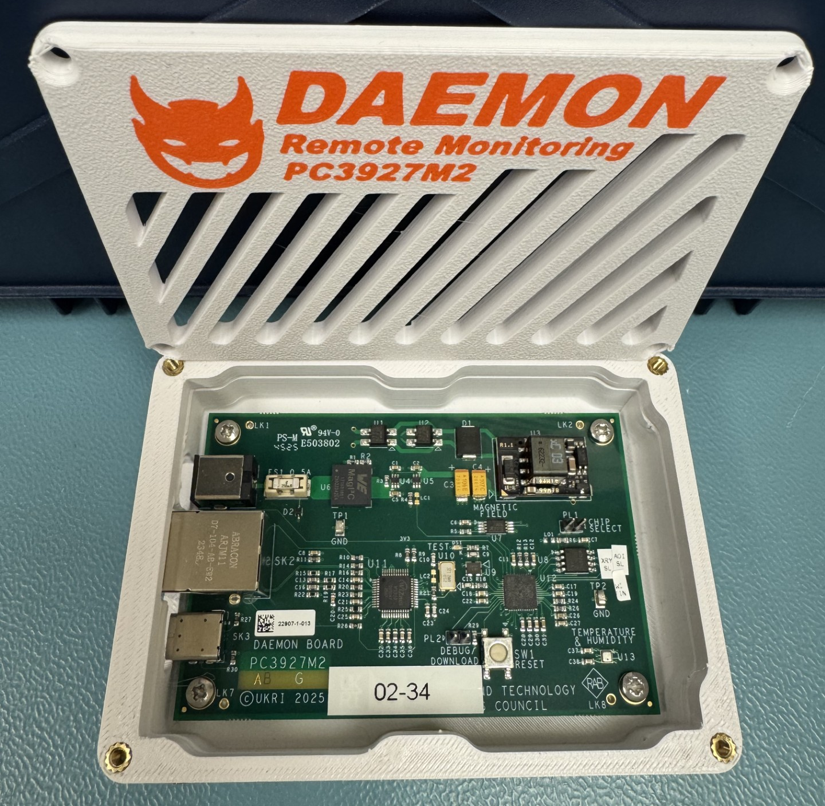
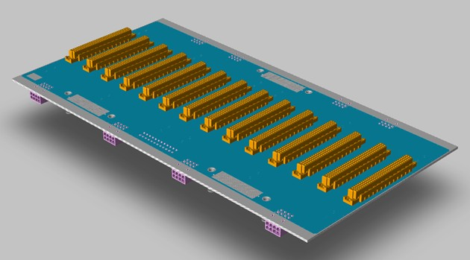
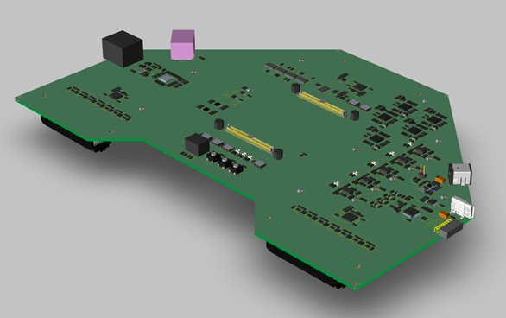
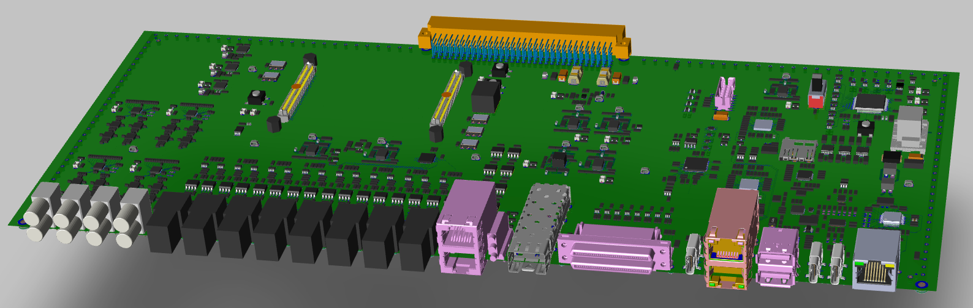
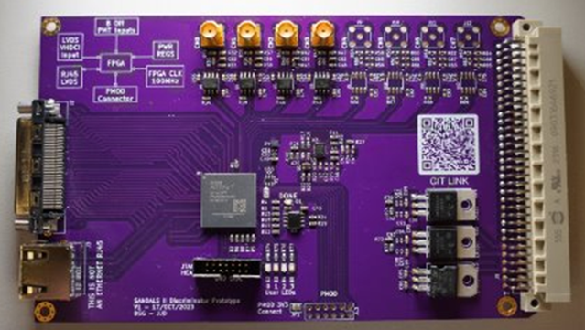
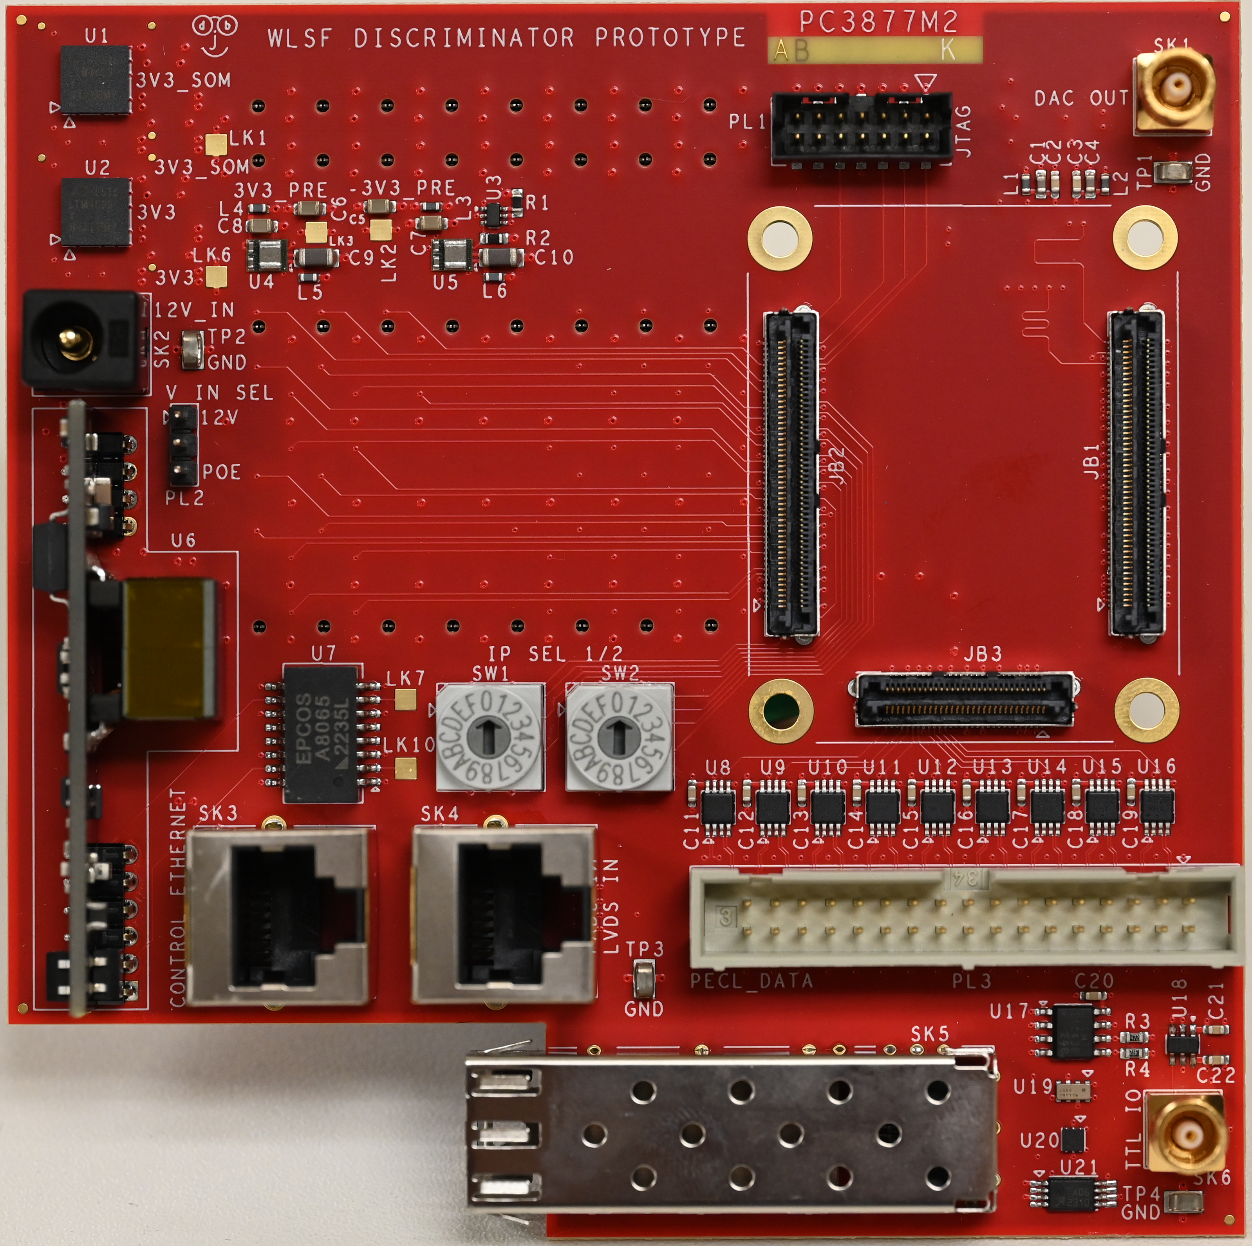
ISIS Detector Systems Group Support Project
PCB Design and CAD
PCB designs: 16 Completed in 2025; 9 Ongoing; 6 On Hold; 24 Upcoming. During 2025: Manufacture of 197 Boards & 107 Front Panels.

Slide 11
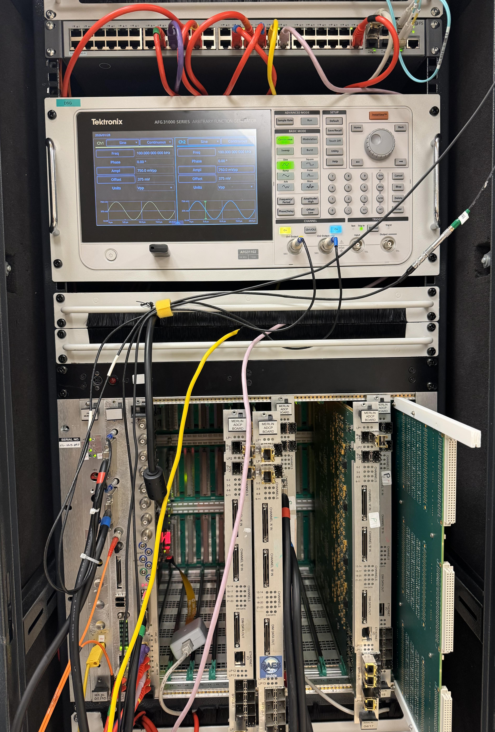
ISIS Detector Systems Group Support Project
Test Systems & Development
Test systems and design/development projects can involve: Test circuit design & development + PCB design, component & board procurement; Programmable logic firmware design & development; POT, Boundary Scan & NI automated test systems; Software design for test programs & microcontrollers.
Current test rigs & systems include:
DAE3 Hardware & Firmware
MERLIN & WISH ADC Hardware
Period Card
DAE II Detector Card & Daughterboard
GPS Slot 0 Board & VXI Streaming Control Board
128 Channel LVDS Processor Board
Ongoing test system developments include:
ADC Revival (to improve availability of working spares)
Streaming Test Platforms (to develop firmware, software & tools required for future data streaming).
New test systems will be required for the Crate Controller, Streaming Monitor Board and Endeavour Instrument DAE hardware designs.

Slide 12
ISIS Detector Systems Group Support Project
Technology Communications
Joshua : My Journey from an Apprentice
to an Electronics Technician
Chad : Work Experience Supervisor’s guide
Joshua & Chad: Reports for Technology Comms
Jack : IDSG Grafana System presentation at DED Summer Forum
Dave : Endeavour Programme Update presentation at DED Summer Forum
Hayden : ESDG Apprentice Poster for DED Summer Forum
Simon : IDSG Front Line Support presentation at ESDG meeting
Joshua : OSIRIS Silicon Analyser DAE Upgrade at ESDG meeting
Assorted presentations at ESDG meetings

Slide 13
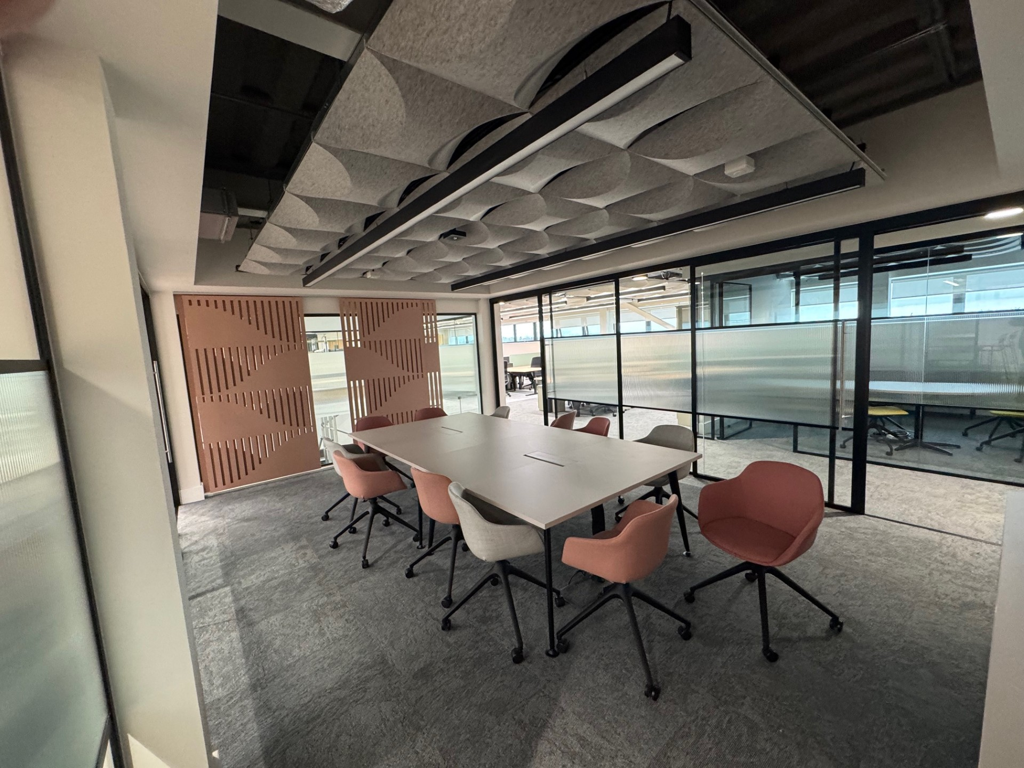
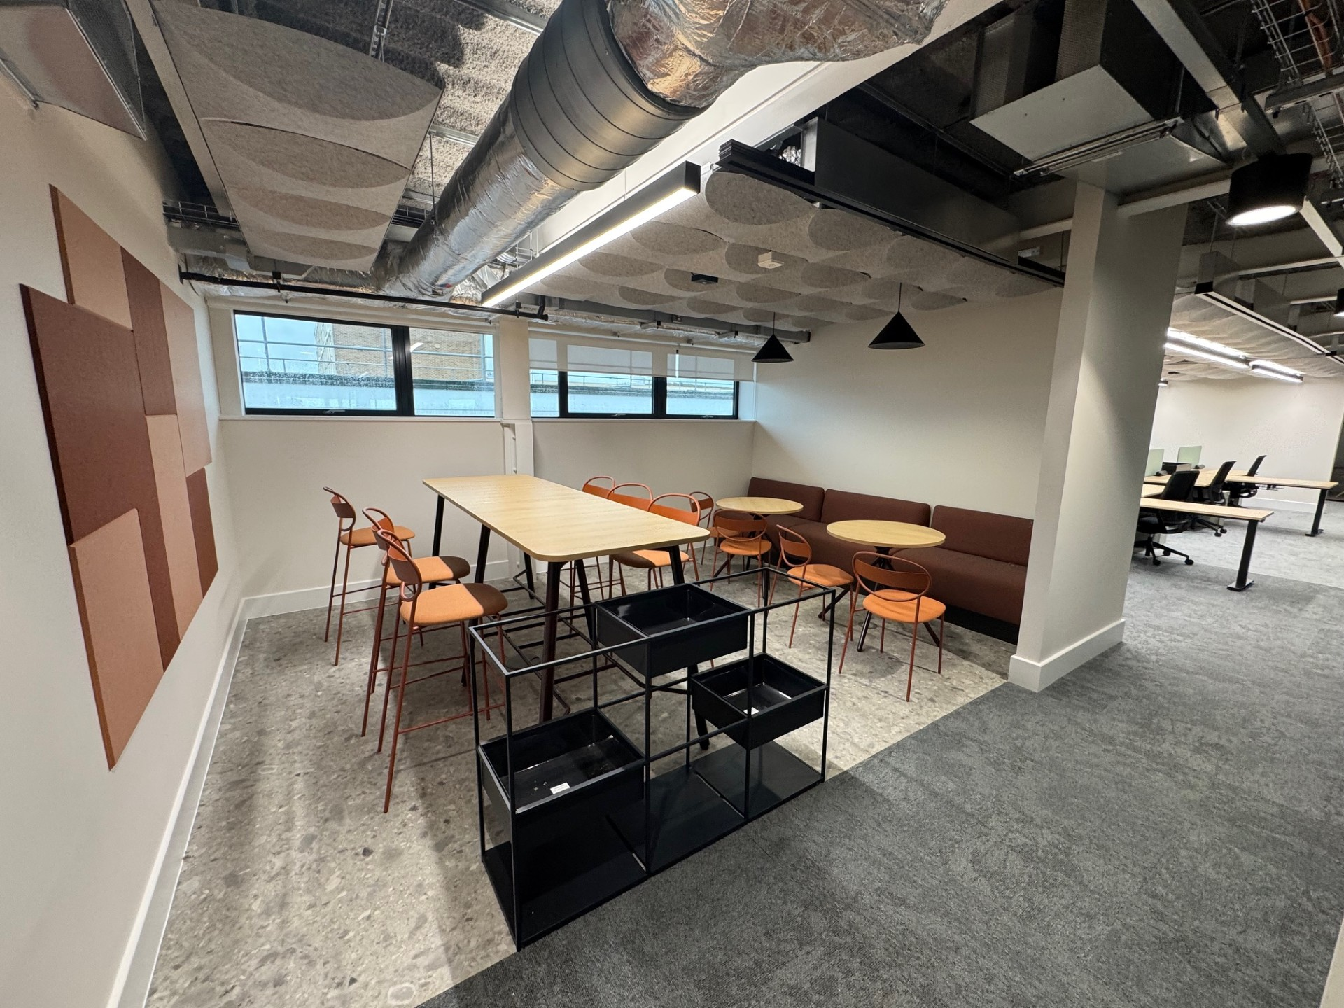
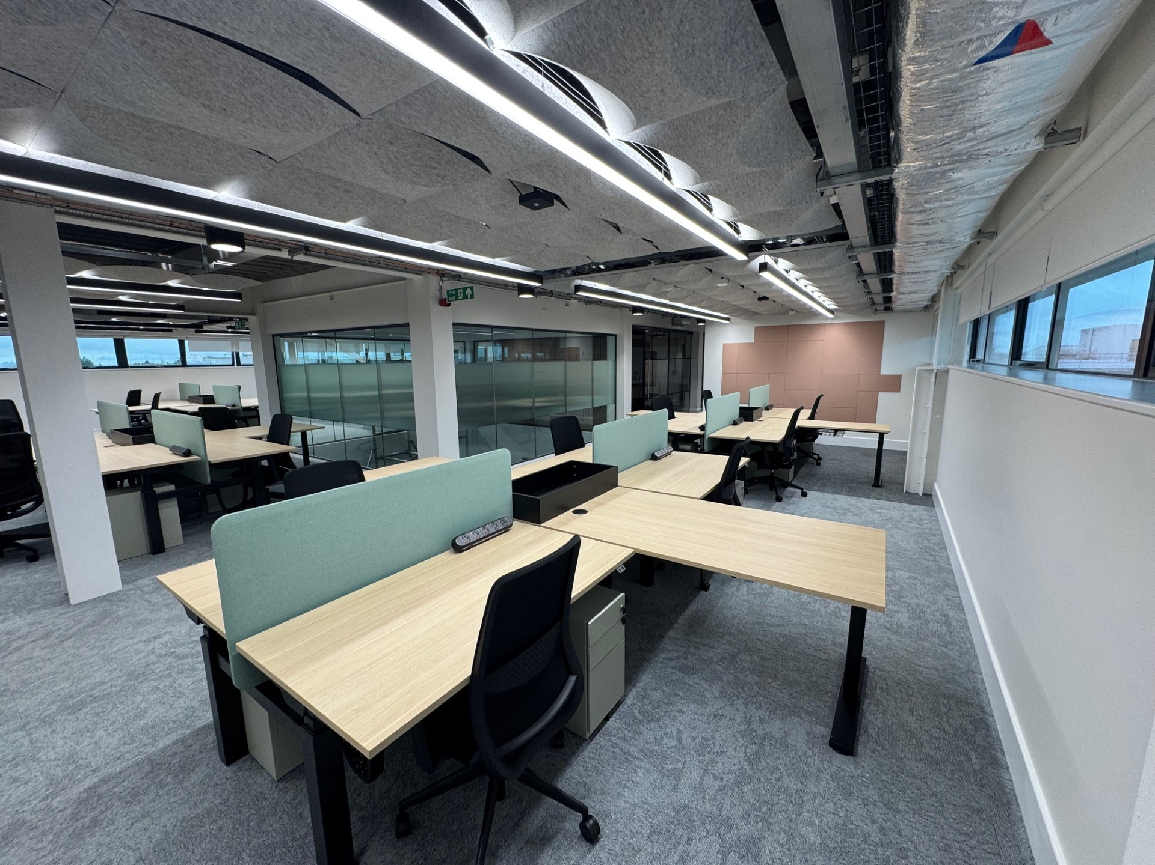
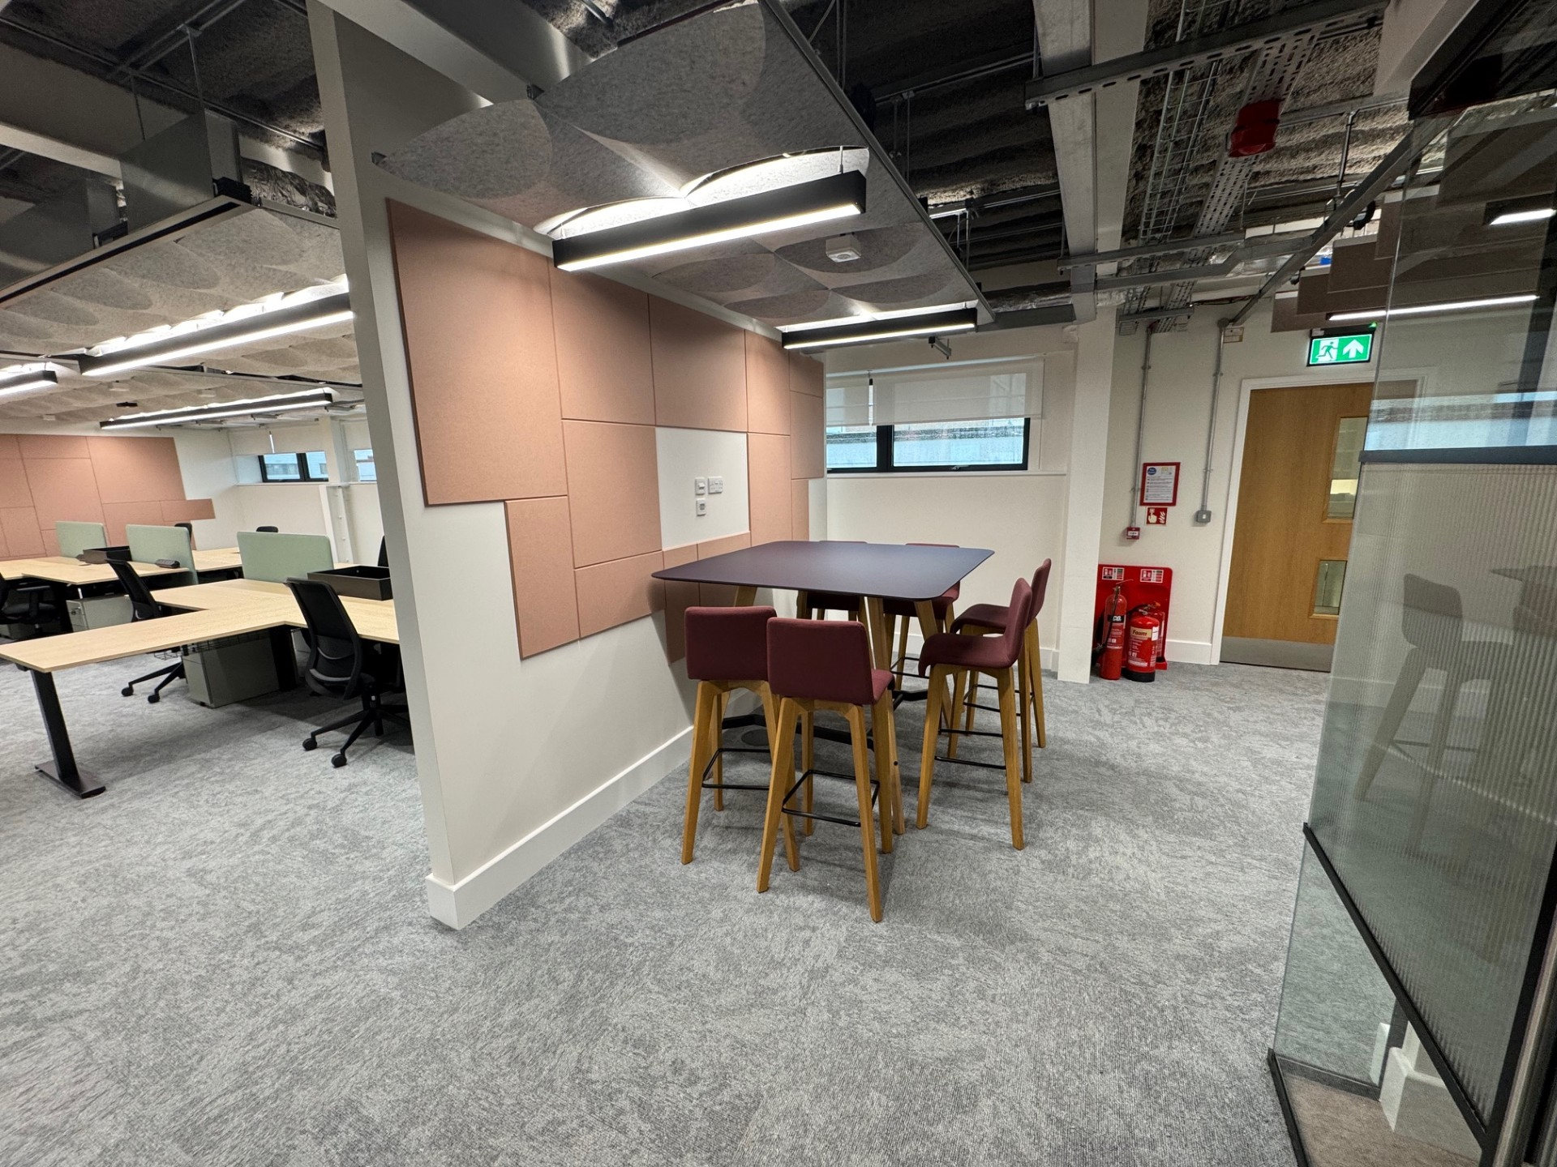
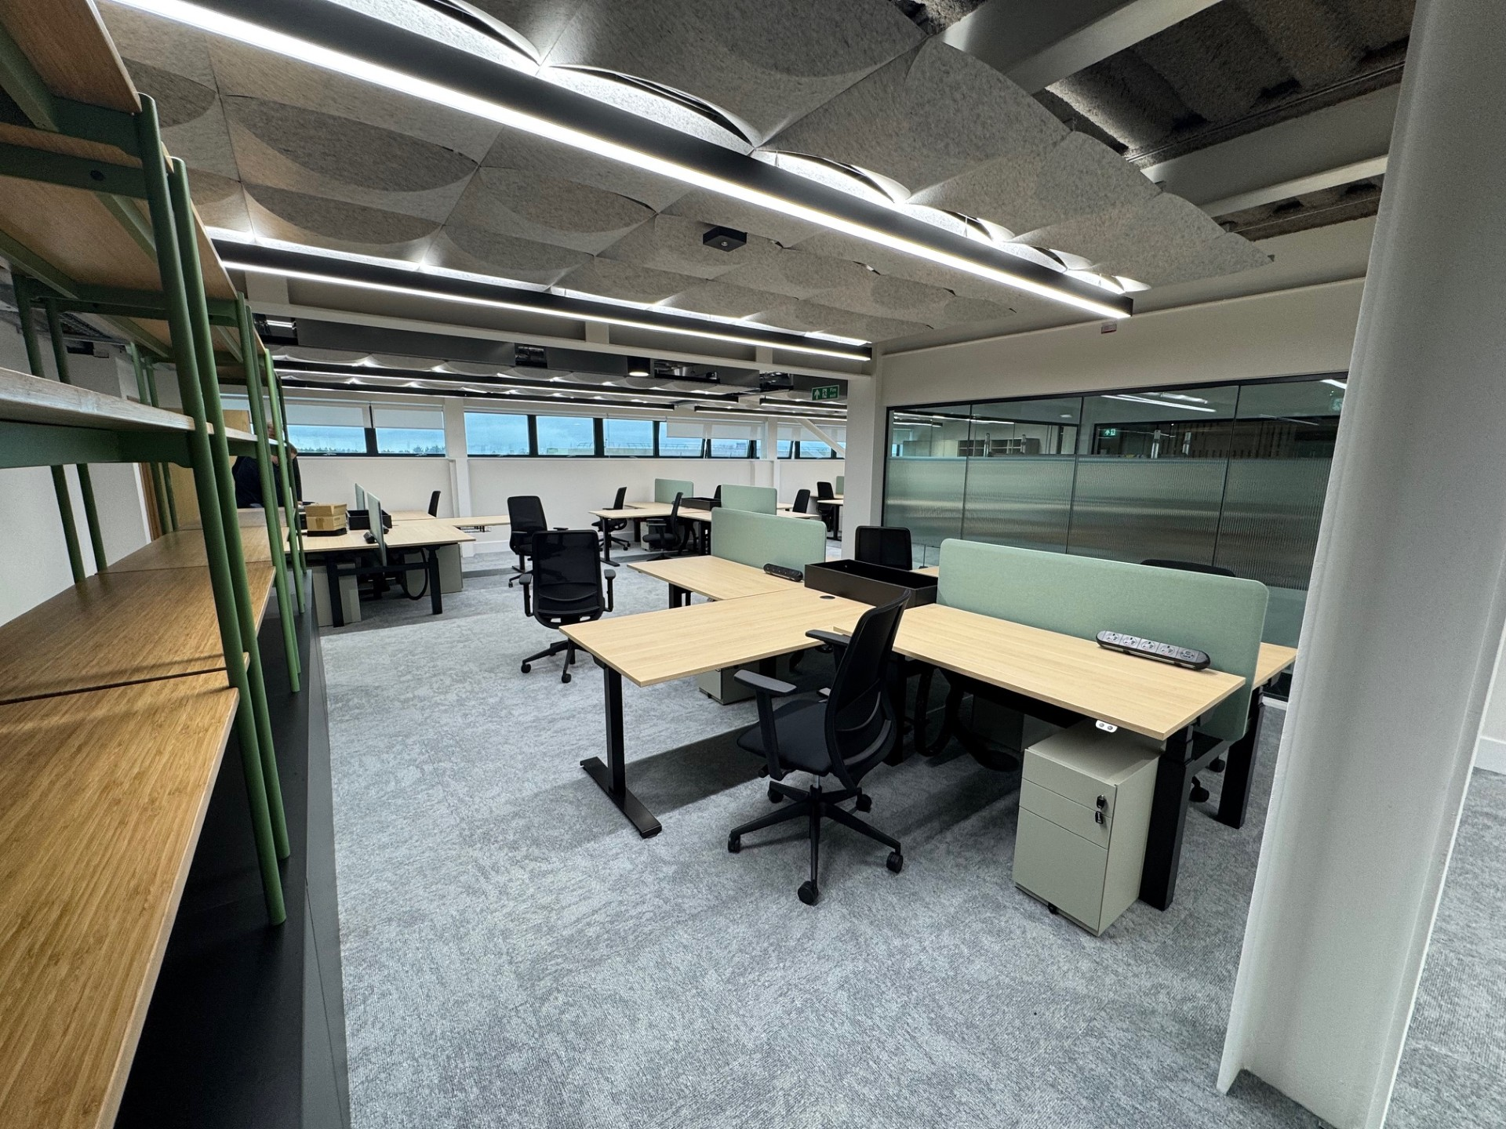
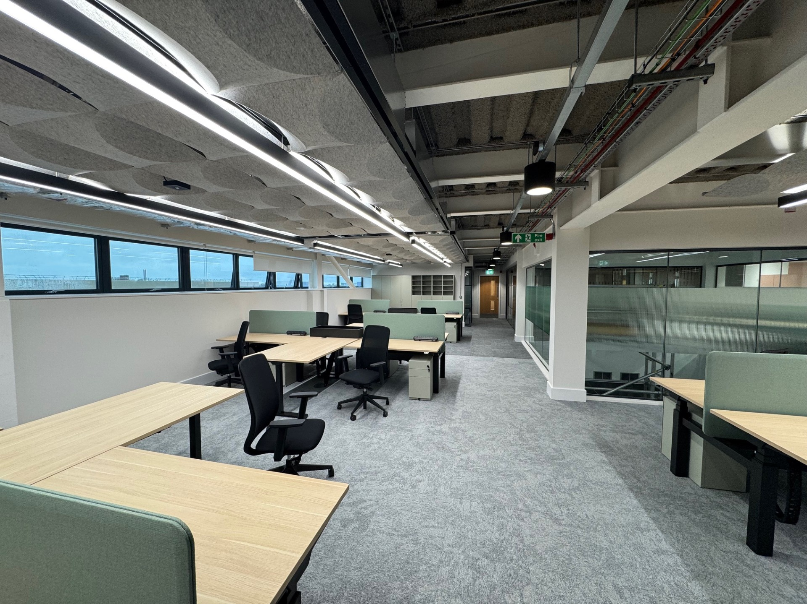
ISIS Detector Systems Group Support Project
The impending move to R4

Slide 14




Any questions?
Science and Technology Facilities Council
@STFC_matters
Science and Technology Facilities Council

