Slide 1

European Spallation Source
(In 5 minutes or less)
Joseph Hindmarsh
Electronic Systems Design Group

Slide 2
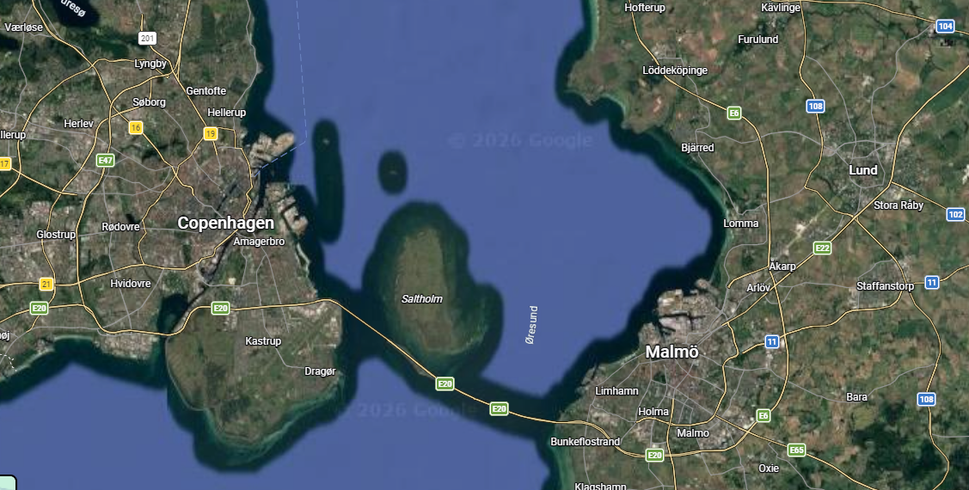
Where is ESS?
Notes:
PLEASE DELETE/REPLACE PHOTO CREDIT IF CHANGING THE IMAGE.

Slide 3
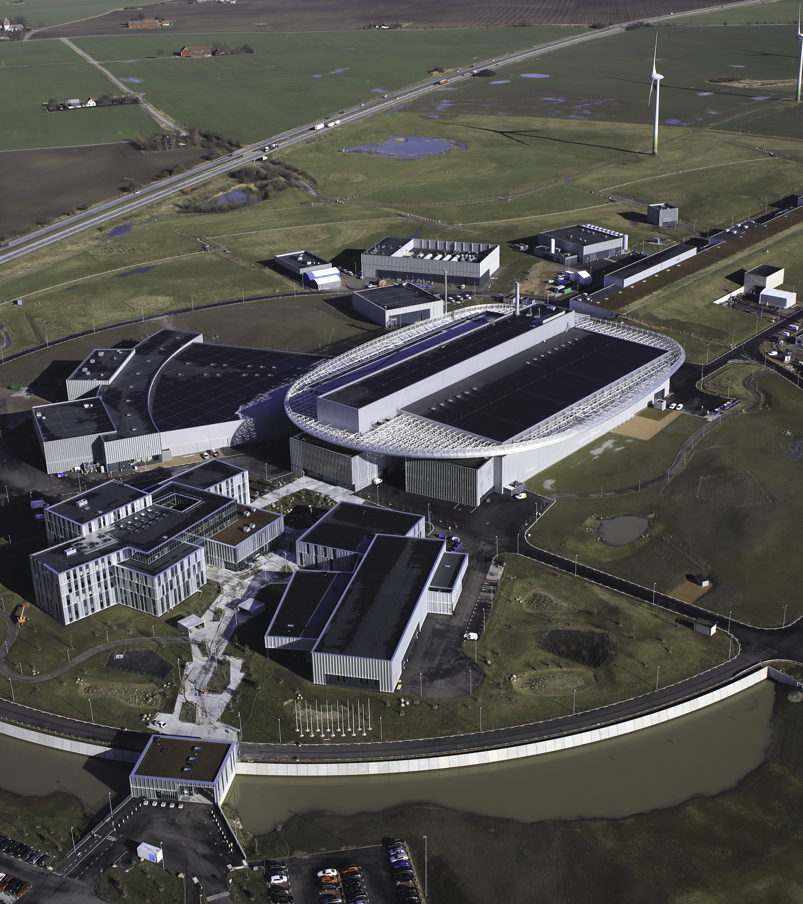
What is ESS?
European Spallation Source (ESS)
Next-generation Neutron Source
Under construction in Lund, Sweden
UK contributions through In-Kind agreement
Detector Readout
LOKI and FREIA Instruments
Accelerator components (DL)
16 Instruments in construction
These need a common interface for controls, timing and data
Image © ESS Perry Nordeng
Notes:
PLEASE DELETE/REPLACE PHOTO CREDIT IF CHANGING THE IMAGE.

Slide 4
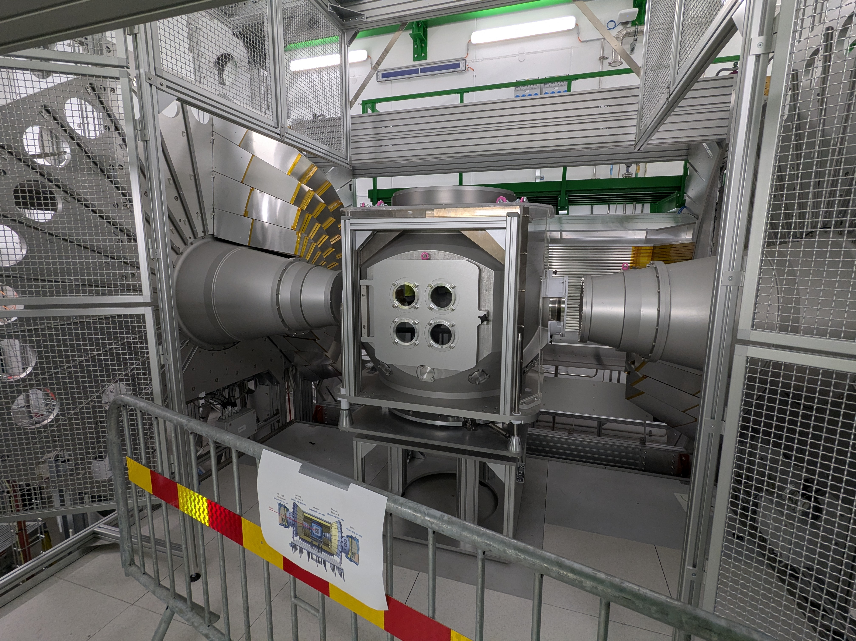
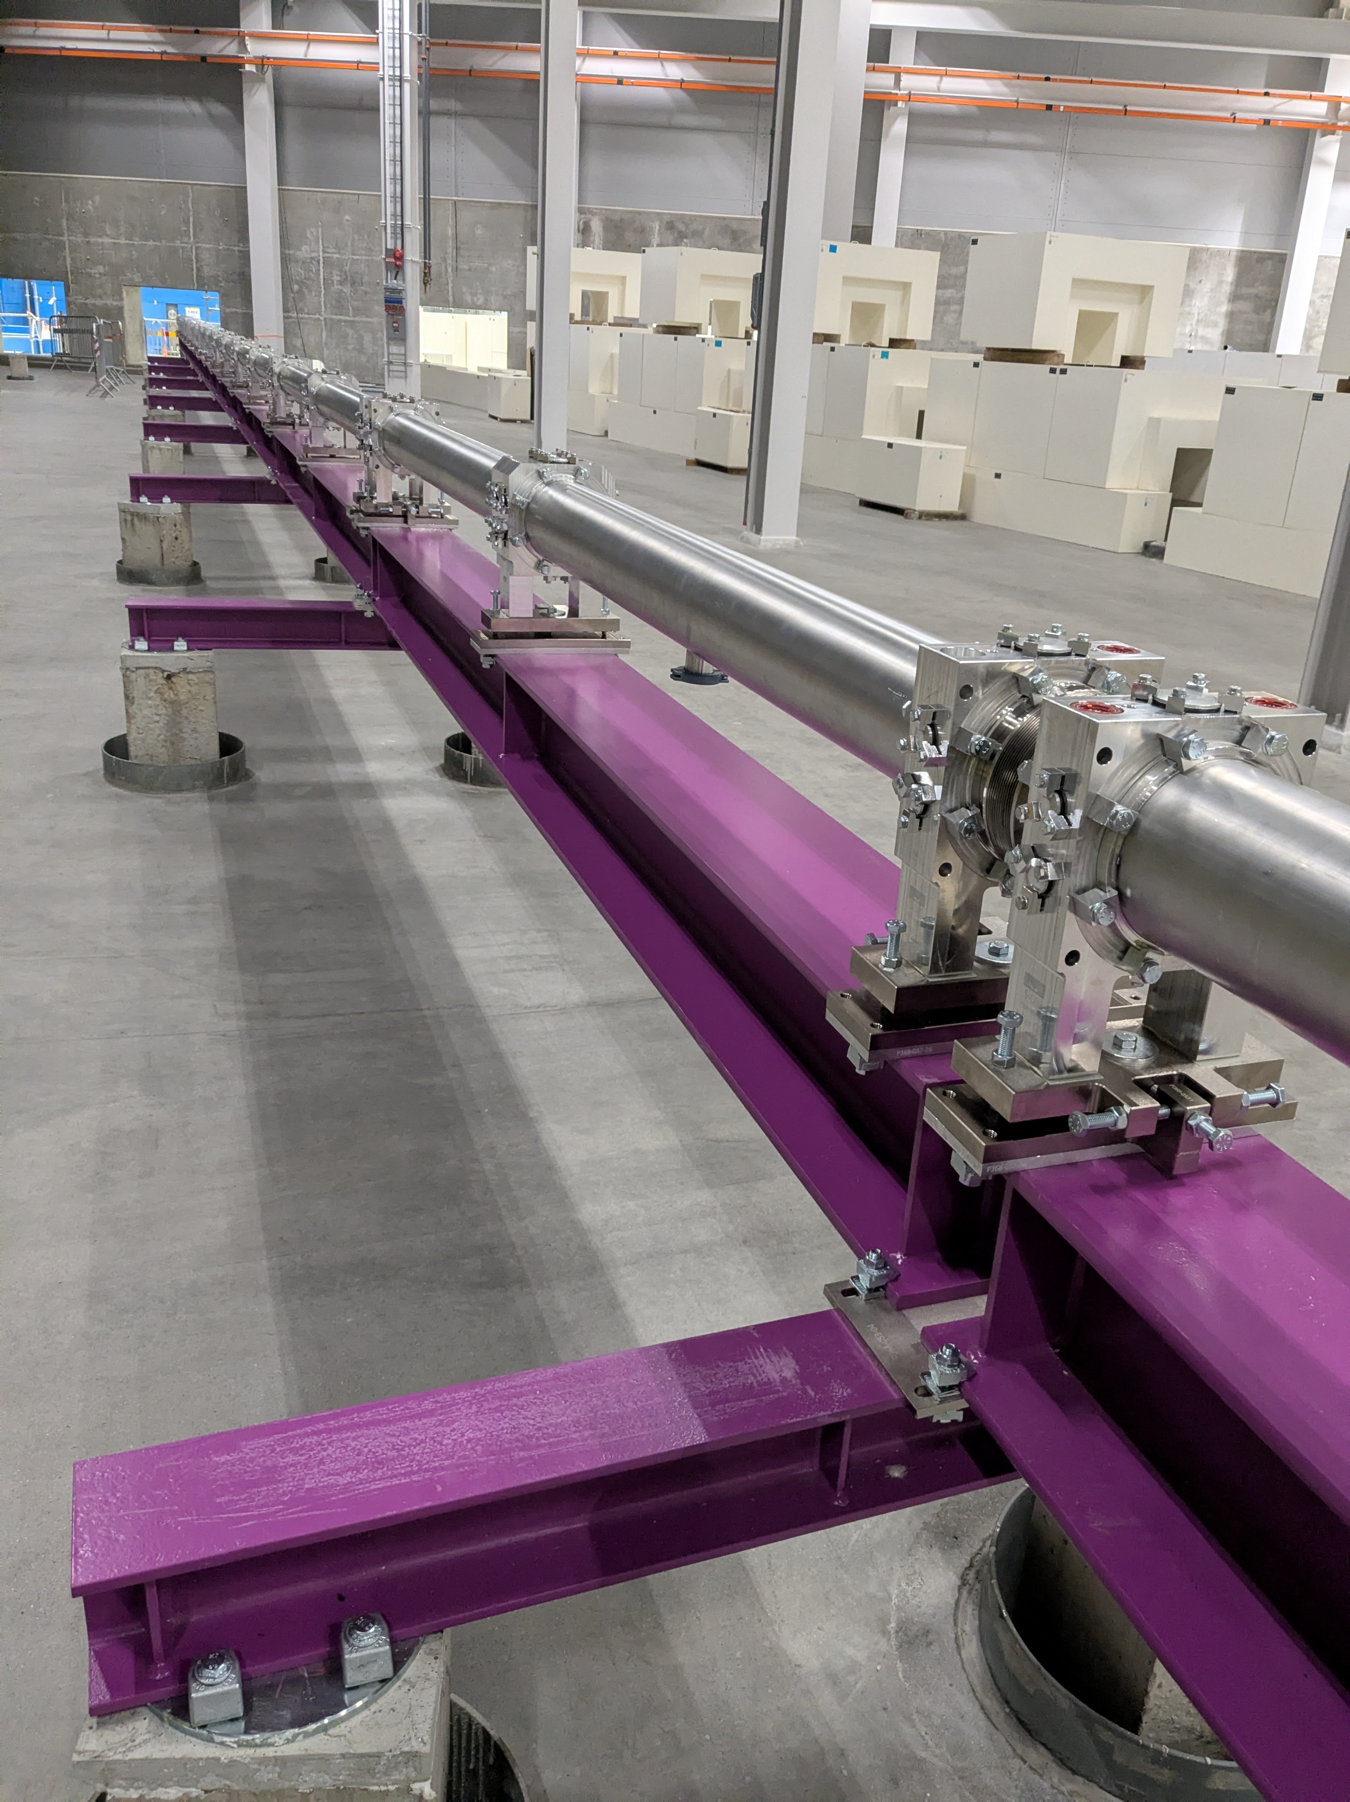
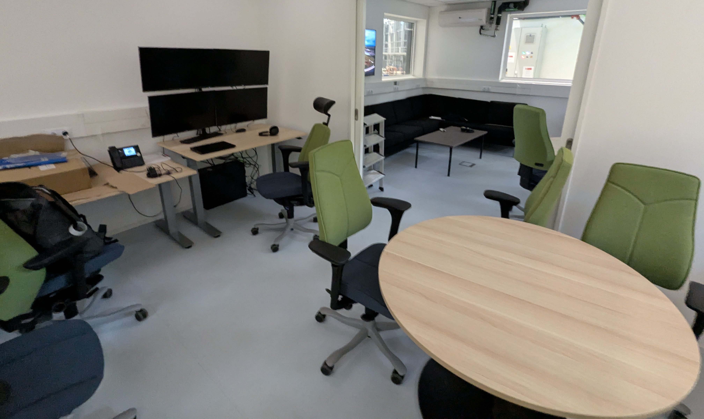
Photos from Site

Slide 5
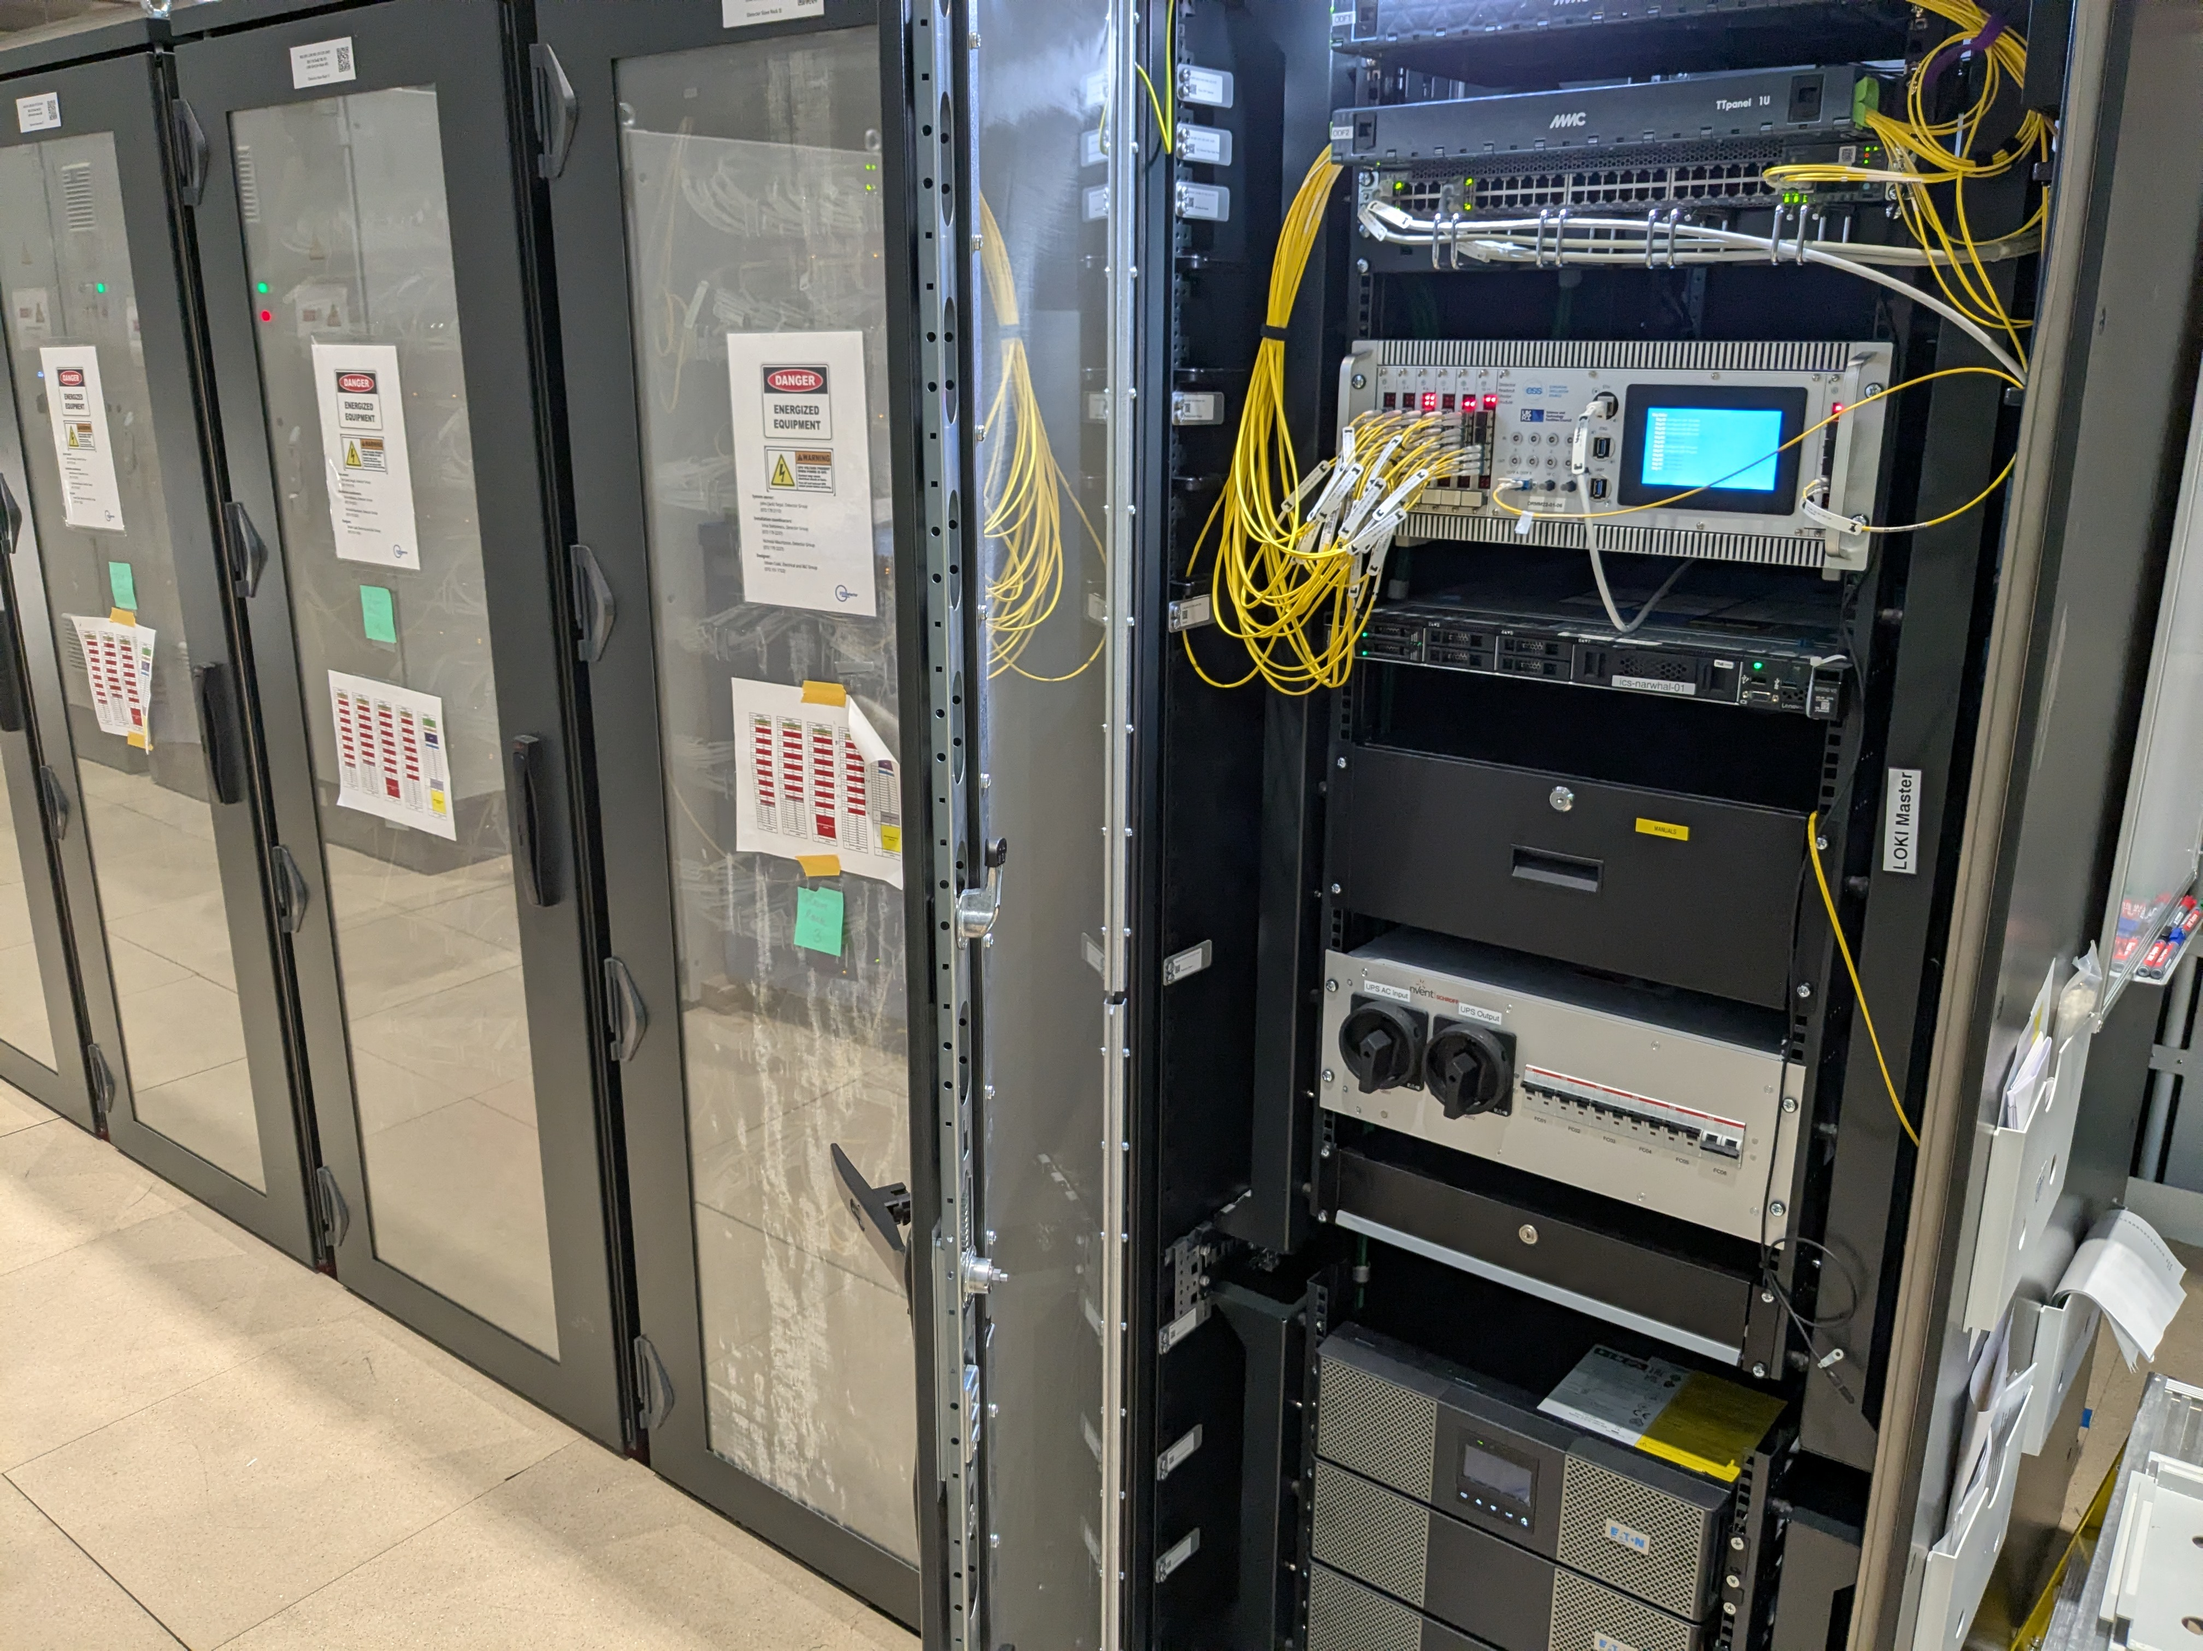
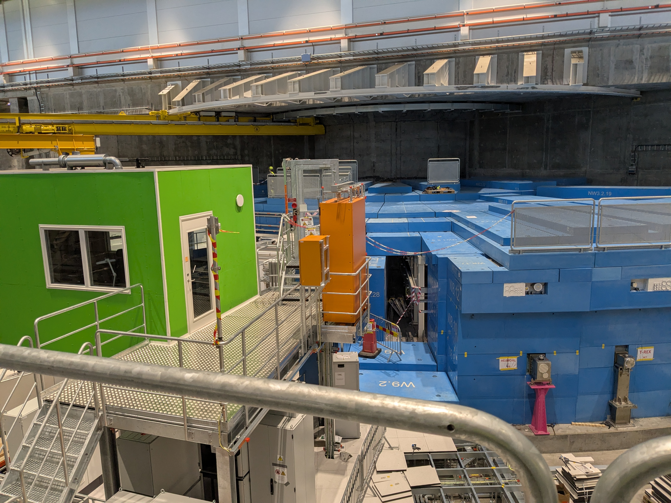
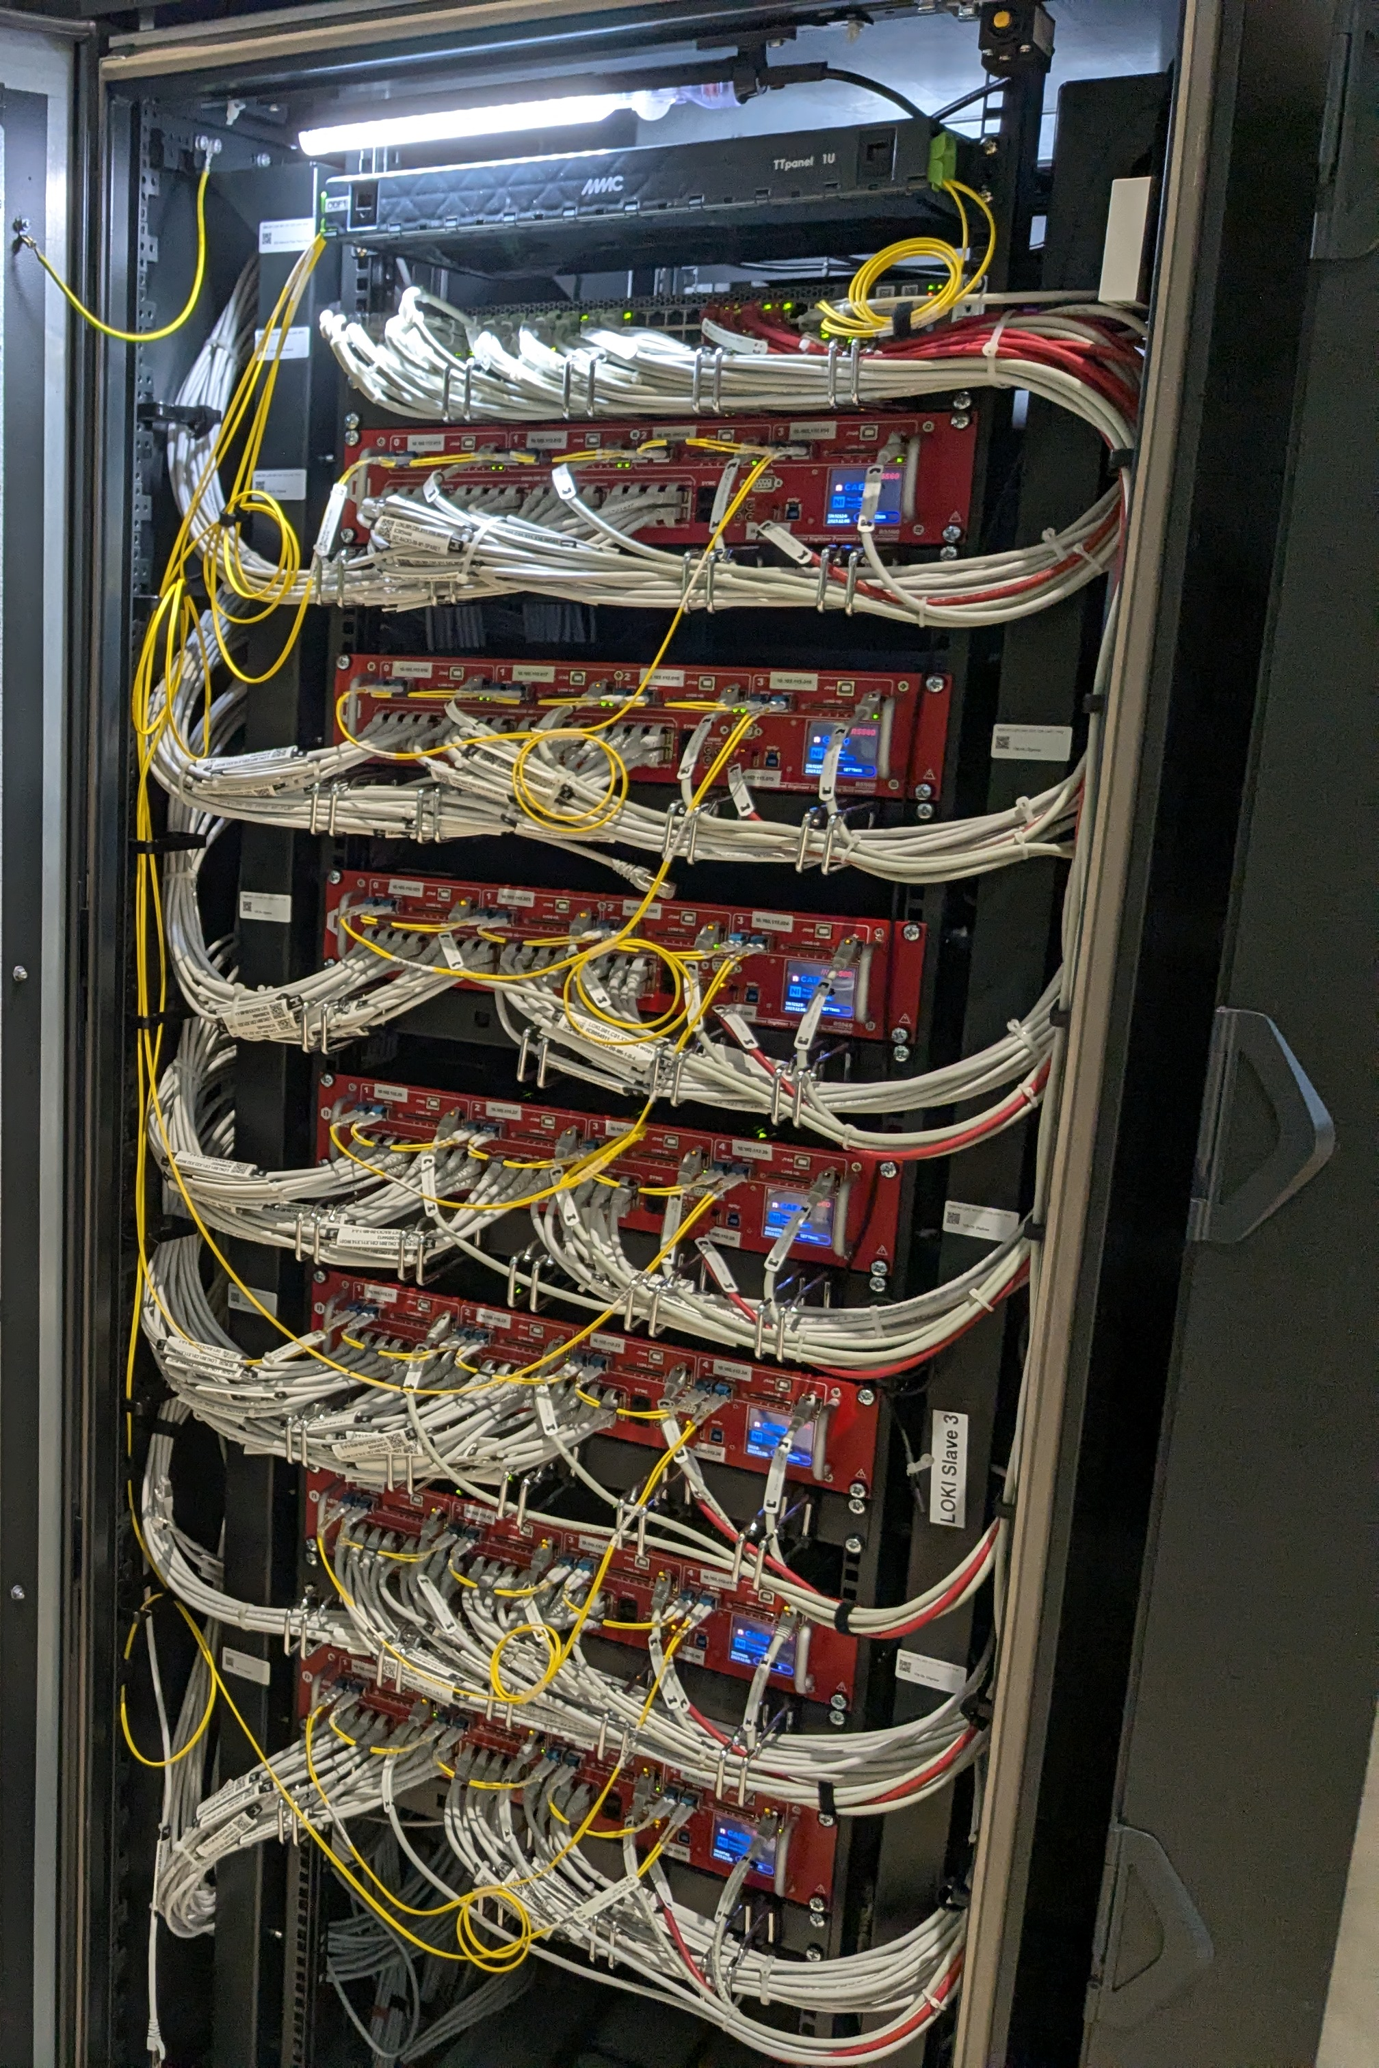
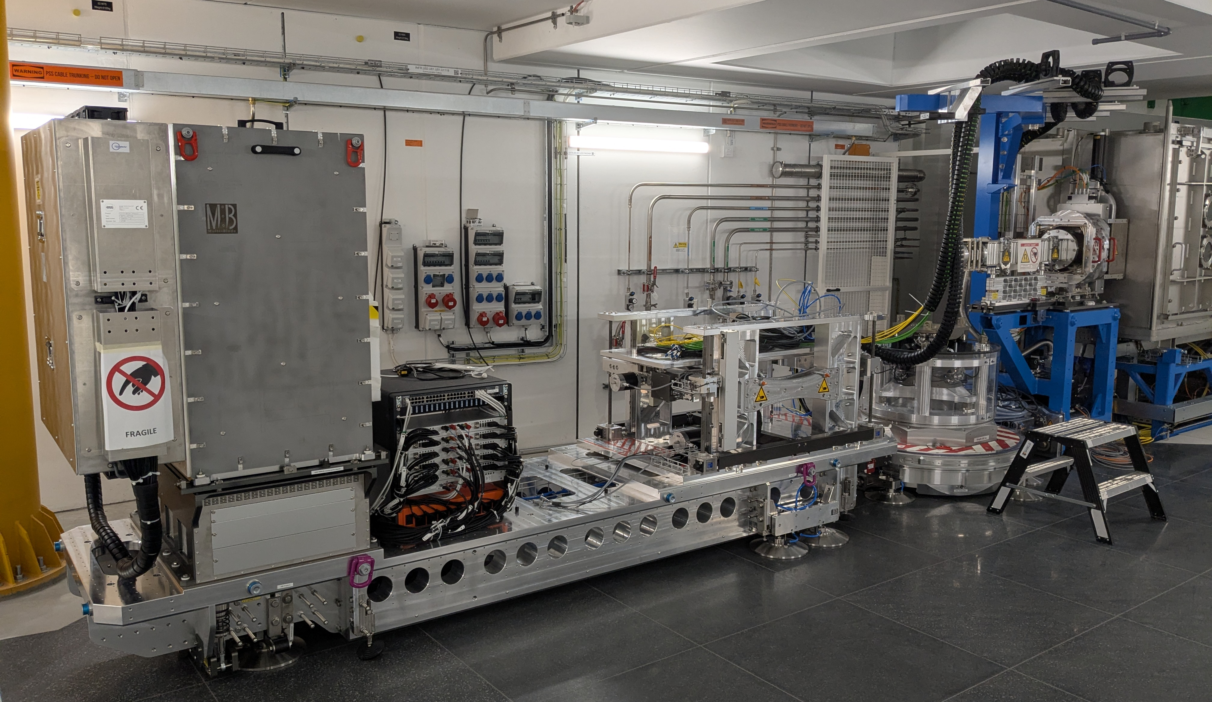

Slide 6
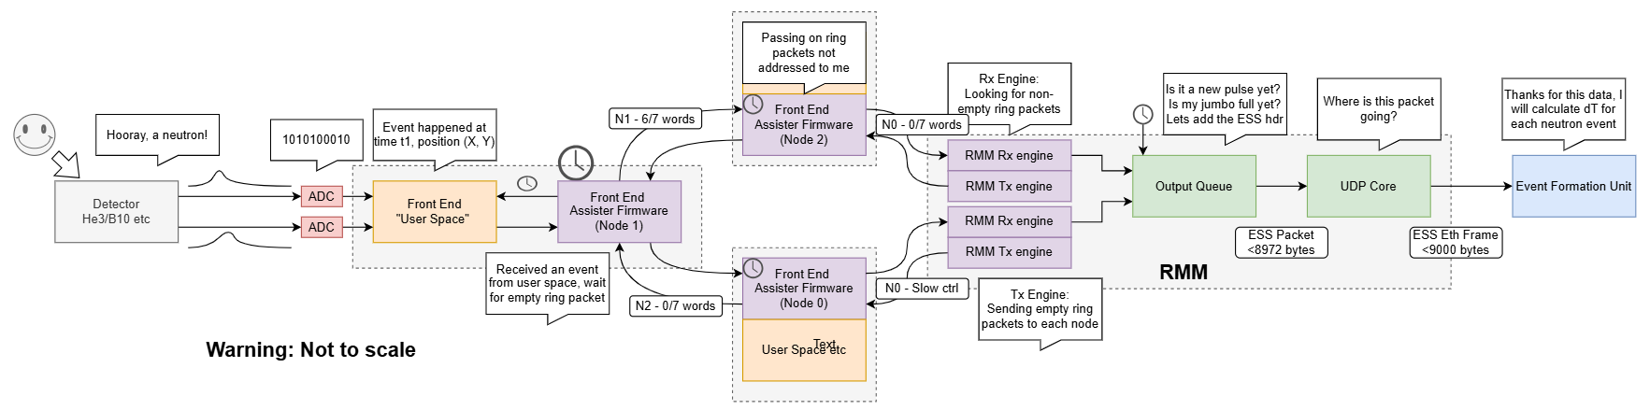
Journey of a Neutron

Slide 7
Journey of a Neutron

Slide 8
Journey of a Neutron
“Insert STFC Firmware Here”

Slide 9
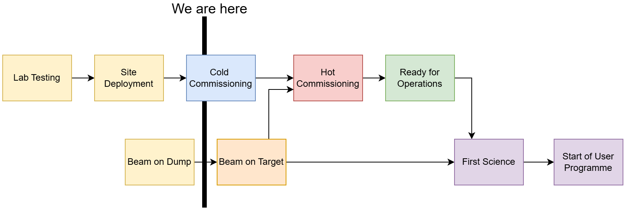
Where are we now?
European Spallation Source (ESS)
Notes:
PLEASE DELETE/REPLACE PHOTO CREDIT IF CHANGING THE IMAGE.

Slide 10
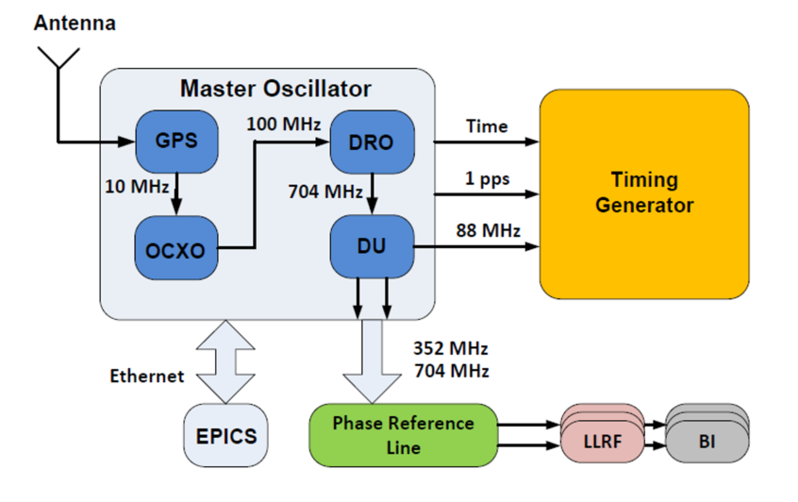
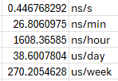
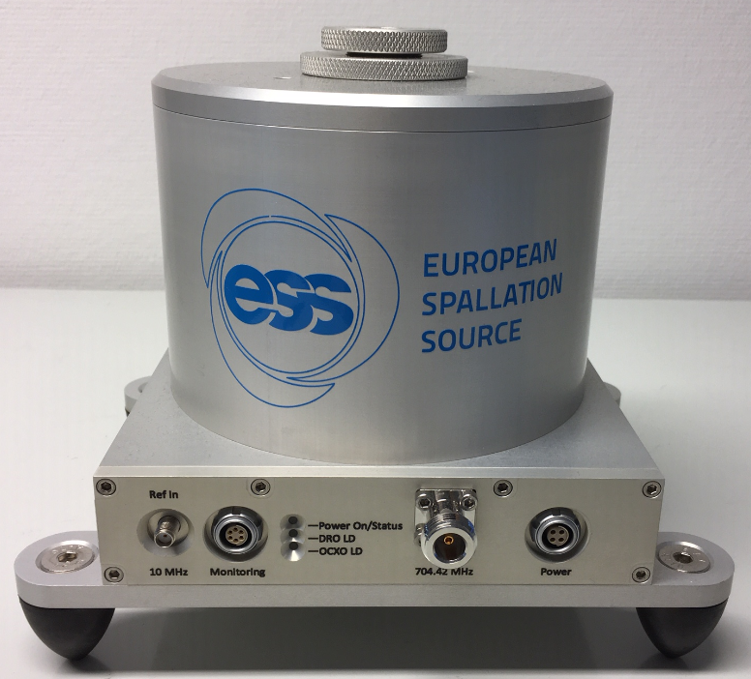
Teething issues on site
How long is a second?
88052500 Hz nominal frequency in lab, generated PPS
88052500.039339065 Hz actual frequency on site
Every 25.4200246… seconds, error buildup causes a “second” to be one tick longer as defined by external PPS
Timestamps drift over time
Where should the fix be made?
Hardware of master oscillator/PPS
Data processing software
Slow control software
Firmware monitoring and adjusting automatically
Notes:
PLEASE DELETE/REPLACE PHOTO CREDIT IF CHANGING THE IMAGE.

Slide 11
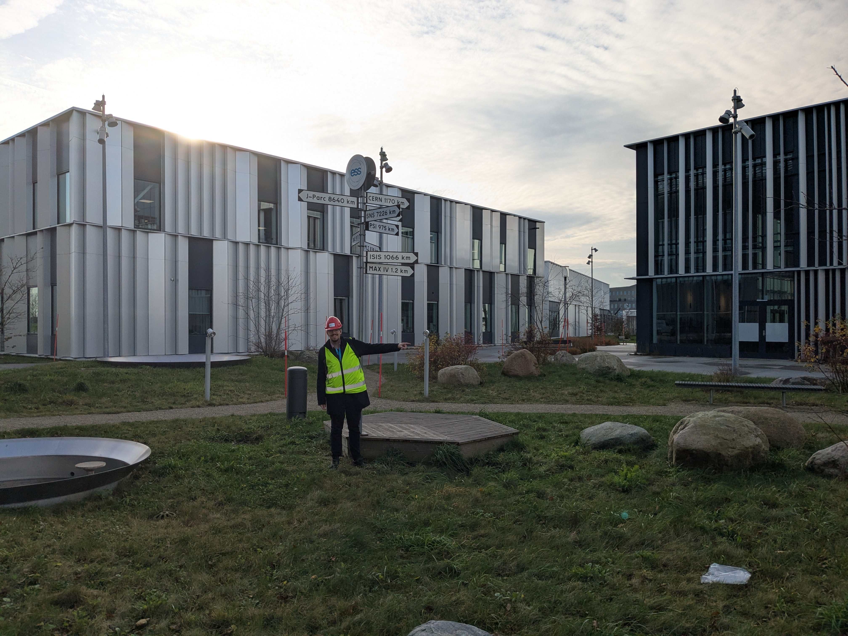
Notes:
PLEASE DELETE/REPLACE PHOTO CREDIT IF CHANGING THE IMAGE.

