Slide 1

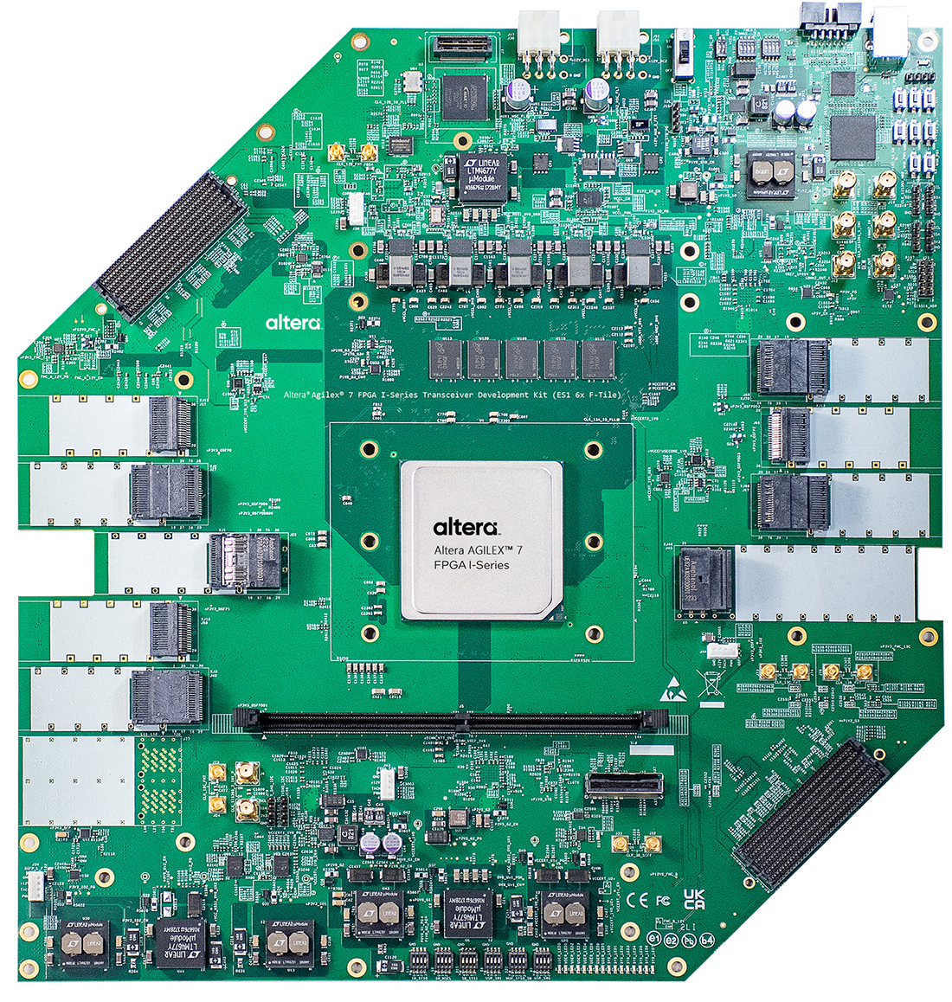
EMP on Agilex 7
Lucie Sharpe
29th January 2026

Slide 2
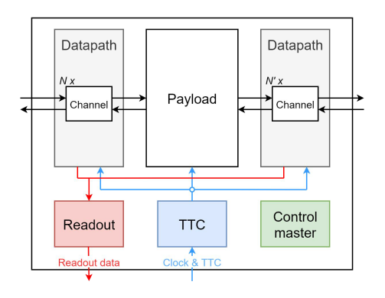
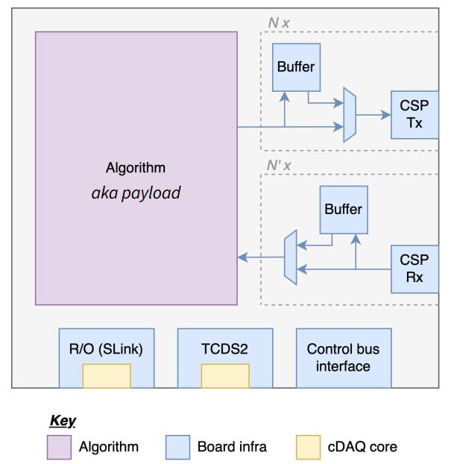
Overview of the EMP Framework
EMP: Extensible, Modular data Processor
Receives multiple channels of input data and passes them through a user created algorithm
Uses internal buffers to capture and playback data during tests
Uses IPbus for internal communication and implements a UDP interface for external control
Provides the infrastructure for the project specific firmware in the algorithm
Image © STFC John Dawson
Notes:
PLEASE DELETE/REPLACE PHOTO CREDIT IF CHANGING THE IMAGE.

Slide 3
IPbus implementation
https://gitlab.stfc.ac.uk/tech-esdg/ppd-cms/quartus-ipbus
Replaced the Xilinx MAC with Intel Triple-Speed Ethernet IP running on an F-Tile
Created a wrapper around the IP converting the Avalon-ST MAC interface to AXI Stream
Created a startup script using the JTAG interface to set initial configuration of the MAC/Phy
IOPLL wrapper creates the MAC and IPB clocks
MAC is configured to use 1Gb SGMII over the SFP connector on the dev board
Responds to ARP, Ping and UDP interactions with the IPB payload register
System Console
JTAG
Avalon Master
Triple Speed Ethernet MAC/Phy
MAC transmit/receive
IPB UDP Interface
MAC
IPB
SysPLL
156.25MHz
IOPLL
125MHz
62.5MHz
31.25MHz
IPB
IPB Payload

Slide 4
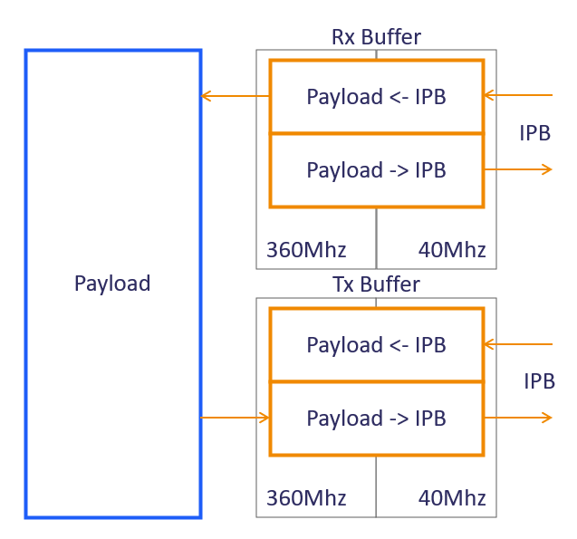
EMP implementation
https://gitlab.stfc.ac.uk/tech-esdg/ppd-cms/quartus-emp
Implemented all the IPB slaves used in EMP
Found an issue in the MAC AXI Stream interface leading to packets being dropped when sent in quick succession
  This was fixed by implementing a back pressure system.
  This may need to be added to the IPbus example project implementation
Agilex 7 does not support the true dule port RAM used for the channel buffers in EMP
  To resolve this, they where reimplemented as two one-way dule port RAMs
  This allows the same entity to be used for both RX and TX buffers to match the original implementation

Slide 5
EMP implementation
This design allows for data to be uploaded to the channel buffers over UDP and passed through the demo algorithm.
Passes the EMP test suite except for IPB read back from a channel buffer that was written to by IPB
  This is due to the channel buffer implementation as shown on the previous slide
Due to the VCO max of an IOPLL it was not able to match all the clocks used in the VCU118 EMP example.
  However, as not all clock where utilized in this design, they can be removed to resolve this issue.
Another place for improvement is the configurability of the clocks. EMP uses a package to define all the clocks used in the design which are passed to a parametrizable macro MMCM
  This design currently used a fixed IOPLL IP with no external configuration

