Slide 1



DUNE
29th January 2026
ESDG Group Meeting
Adam Barcock

Slide 2
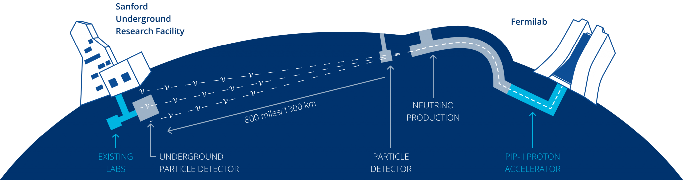
The DUNE Experiment
South Dakota
Illinois
Notes:
DUNE stands for the deep underground neutrino experiment.
A neutrino is a fundamental particle with a very small mass. Neutrinos are produced in almost all interactions between atomic nuclei and are the second most abundant particle in the universe. They come in three flavours, electron, tau and muon. Neutrinos only interact through the weak force and gravity. As a result of their tiny mass, they do not interact with most matter. Consequently, to study neutrinos it is necessary to build large detectors and intense sources of neutrinos. This is what we are doing for DUNE.
Two large-scale facilities combine to make the DUNE experiment possible. The proton accelerator and high-power target located at Fermilab will produce the neutrino beam. Also, located at Fermilab is a smaller particle detector, called the near detector. The large far detector is located 1300 Km away at the Stanford Underground Research Facility in South Dakota.
Why bother with all this? Neutrinos may explain why the universe is made from matter and not antimatter. Additionally, neutrinos from a core-collapse supernova may allow us to understand the formation of black holes.

Slide 3
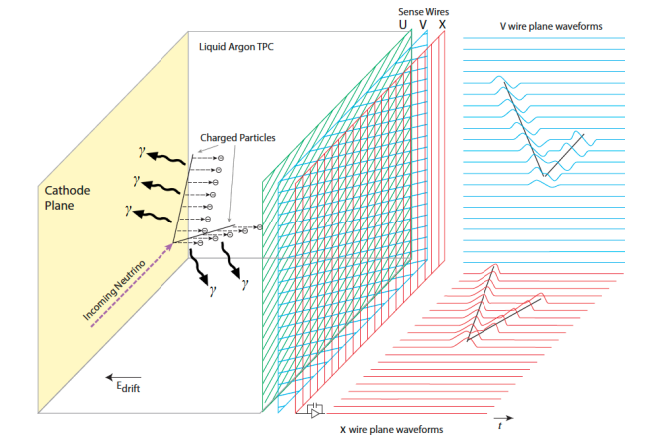
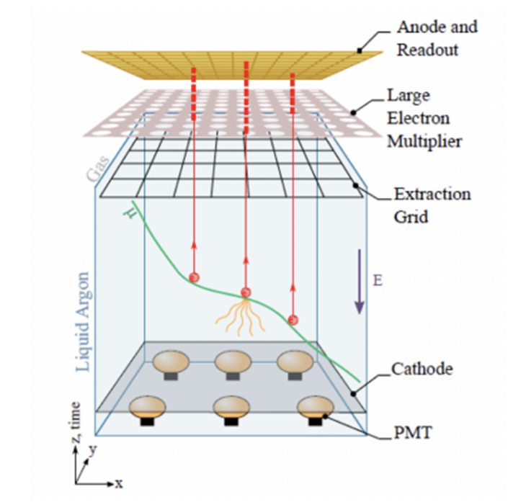
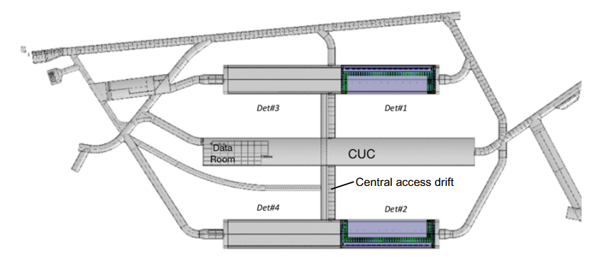
The Far Detector
Notes:
The UK DUNE DAQ project is contributing to the delivery of the DUNE Far Detector. The 70 kT liquid argon time projection chamber is located 1.5 km below the ground. The detector will be divided into four modules each containing 17.5 kT of liquid Argon. We are currently supporting the installation of the first two detector modules.
An incoming neutrino interacts with the detector volume and produces charged ions. The ionisation electrons drift under the influence of the electric field away from the negatively charged cathode towards the anode. The 180 kV potential difference between the anode and the cathode results in a strong E field of 500 V/cm and a maximum drift distance of 3 m. If an electron strikes an argon atom, then the atom emits a photon of UV light in a process called scintillation.
Two front-end systems digitise the signals from the first far detector module. These are the WIBs and DAPHNEs that readout the APAs and photomultiplier tubes, respectively.
The second far detector module is a TPC rotated by ninety degrees so the electrons drift vertically. There is a separate readout system for the second module called the Top Detector Electronics. The Top Detector Electronics is divided into 320 uTCA crates that sit on the cryostat roof.

Slide 4
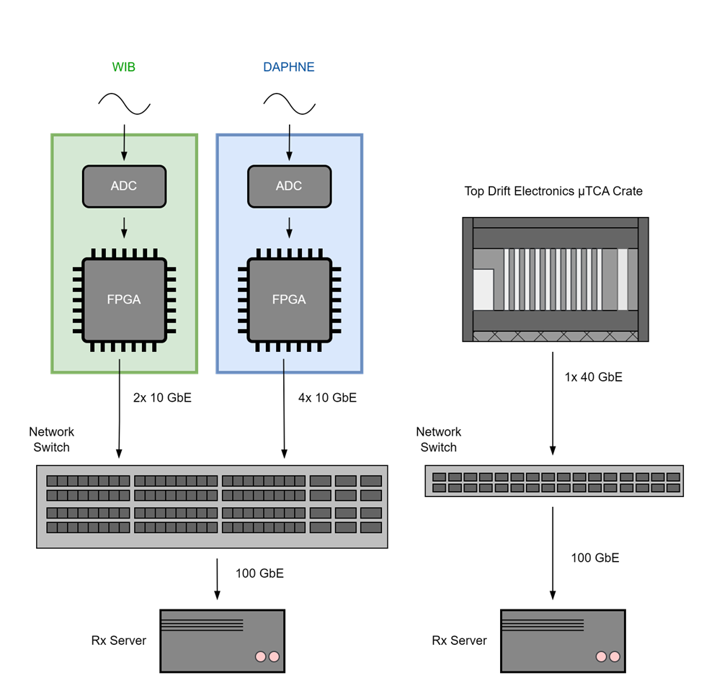
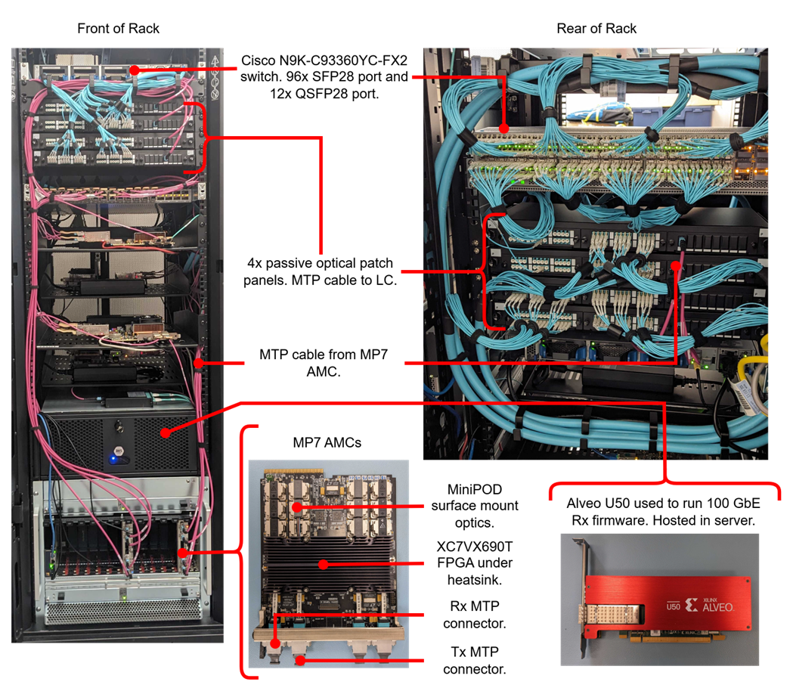
ESDG’s Contribution
Notes:
My team and I are responsible for the delivery of the DUNE DAQ Readout Network. This includes the firmware transmitter that integrates with the WIBs and DAPHNEs, as well as the Readout Network switches and optics. The network switches will aggregate the lower speed links from the front ends into 100 GbE links that are processed by the readout servers.
The Readout Network will cost approximately £1.5 million, with the switches accounting for most of that capital spend. Therefore, we are creating a network switch test stand to verify that the switches can perform this aggregation. This involves creating emulators of subsections of the detector to fully populate the switches undertest. We have also created custom receivers to analyse the aggregated 100 GbE links.
Hopefully, work from this project can be reused.
The 10 GbE PCS/PMA firmware developed for the 10 GbE transmitter, scales to all the transceivers on a quad and can be used with non-standard reference clocks.
The emulators used in the test stand use the available clock network resources efficiently by sharing clocks between adjacent quads and using a single global Tx clock. This works because the elastic buffer in the transceiver can be used to account for the phase difference between the global and local clocks in each quad.
The test stand was used to generate the experimental results found in the UDP Core report.

Slide 5

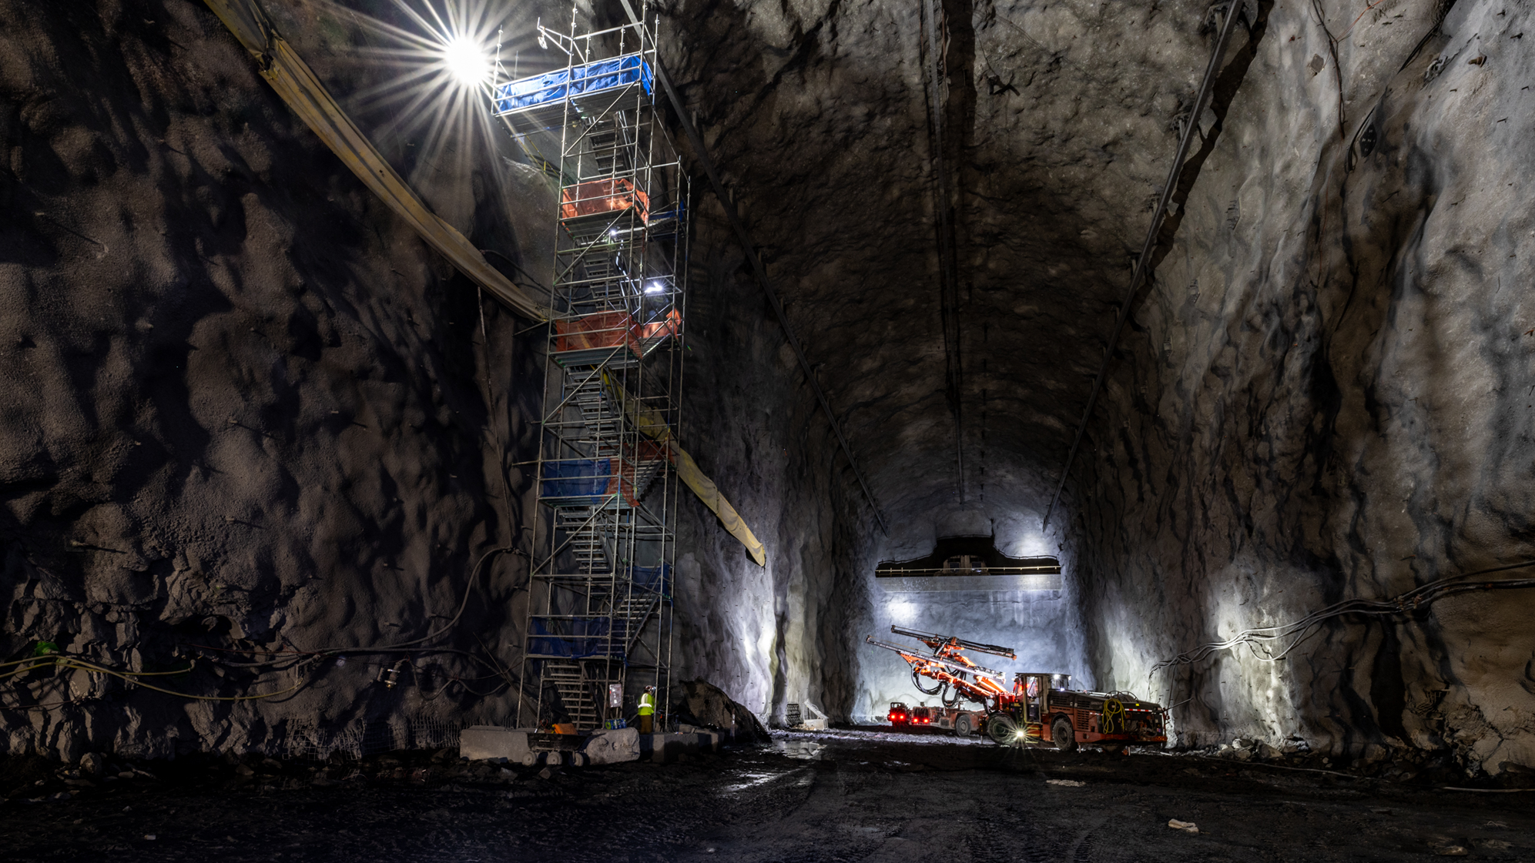




Thank you
Science and Technology Facilities Council
@STFC_matters
Science and Technology Facilities Council

