Slide 1
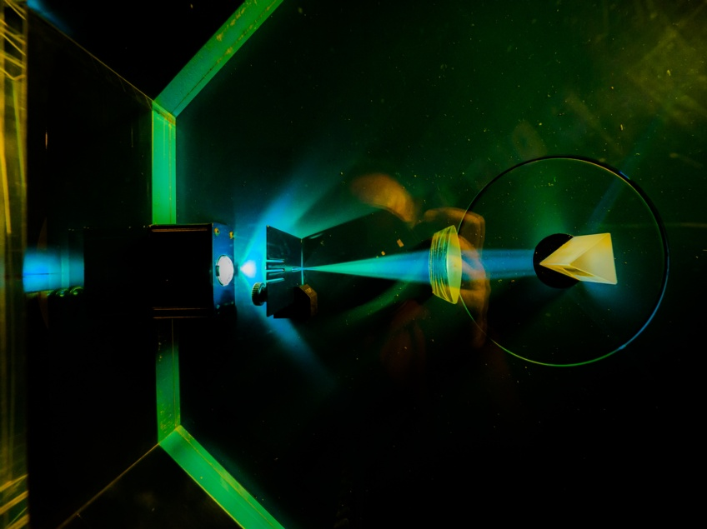



Notes:
To edit the background image, select ‘Format’ from the PowerPoint menu and ‘Slide Background’ from the drop-down menu. Within the new list of options that appears on the right of the screen, select the ‘File’ button under ‘Insert picture from’ and select your image from your file browser. Please remove or amend the image credit if you are using a different image to the one provided.

Slide 2



Detector Hub
Sooraj Pradeep
ESDG
Notes:
The abstract pattern can be removed or repositioned if required. Be careful to ‘Send to Back’ so that it does not obscure any important information.

Slide 3
Hexitec 2x6
Hexitec
Mhz
BabyD
XiDyn
RDP
Detector Hub

Slide 4
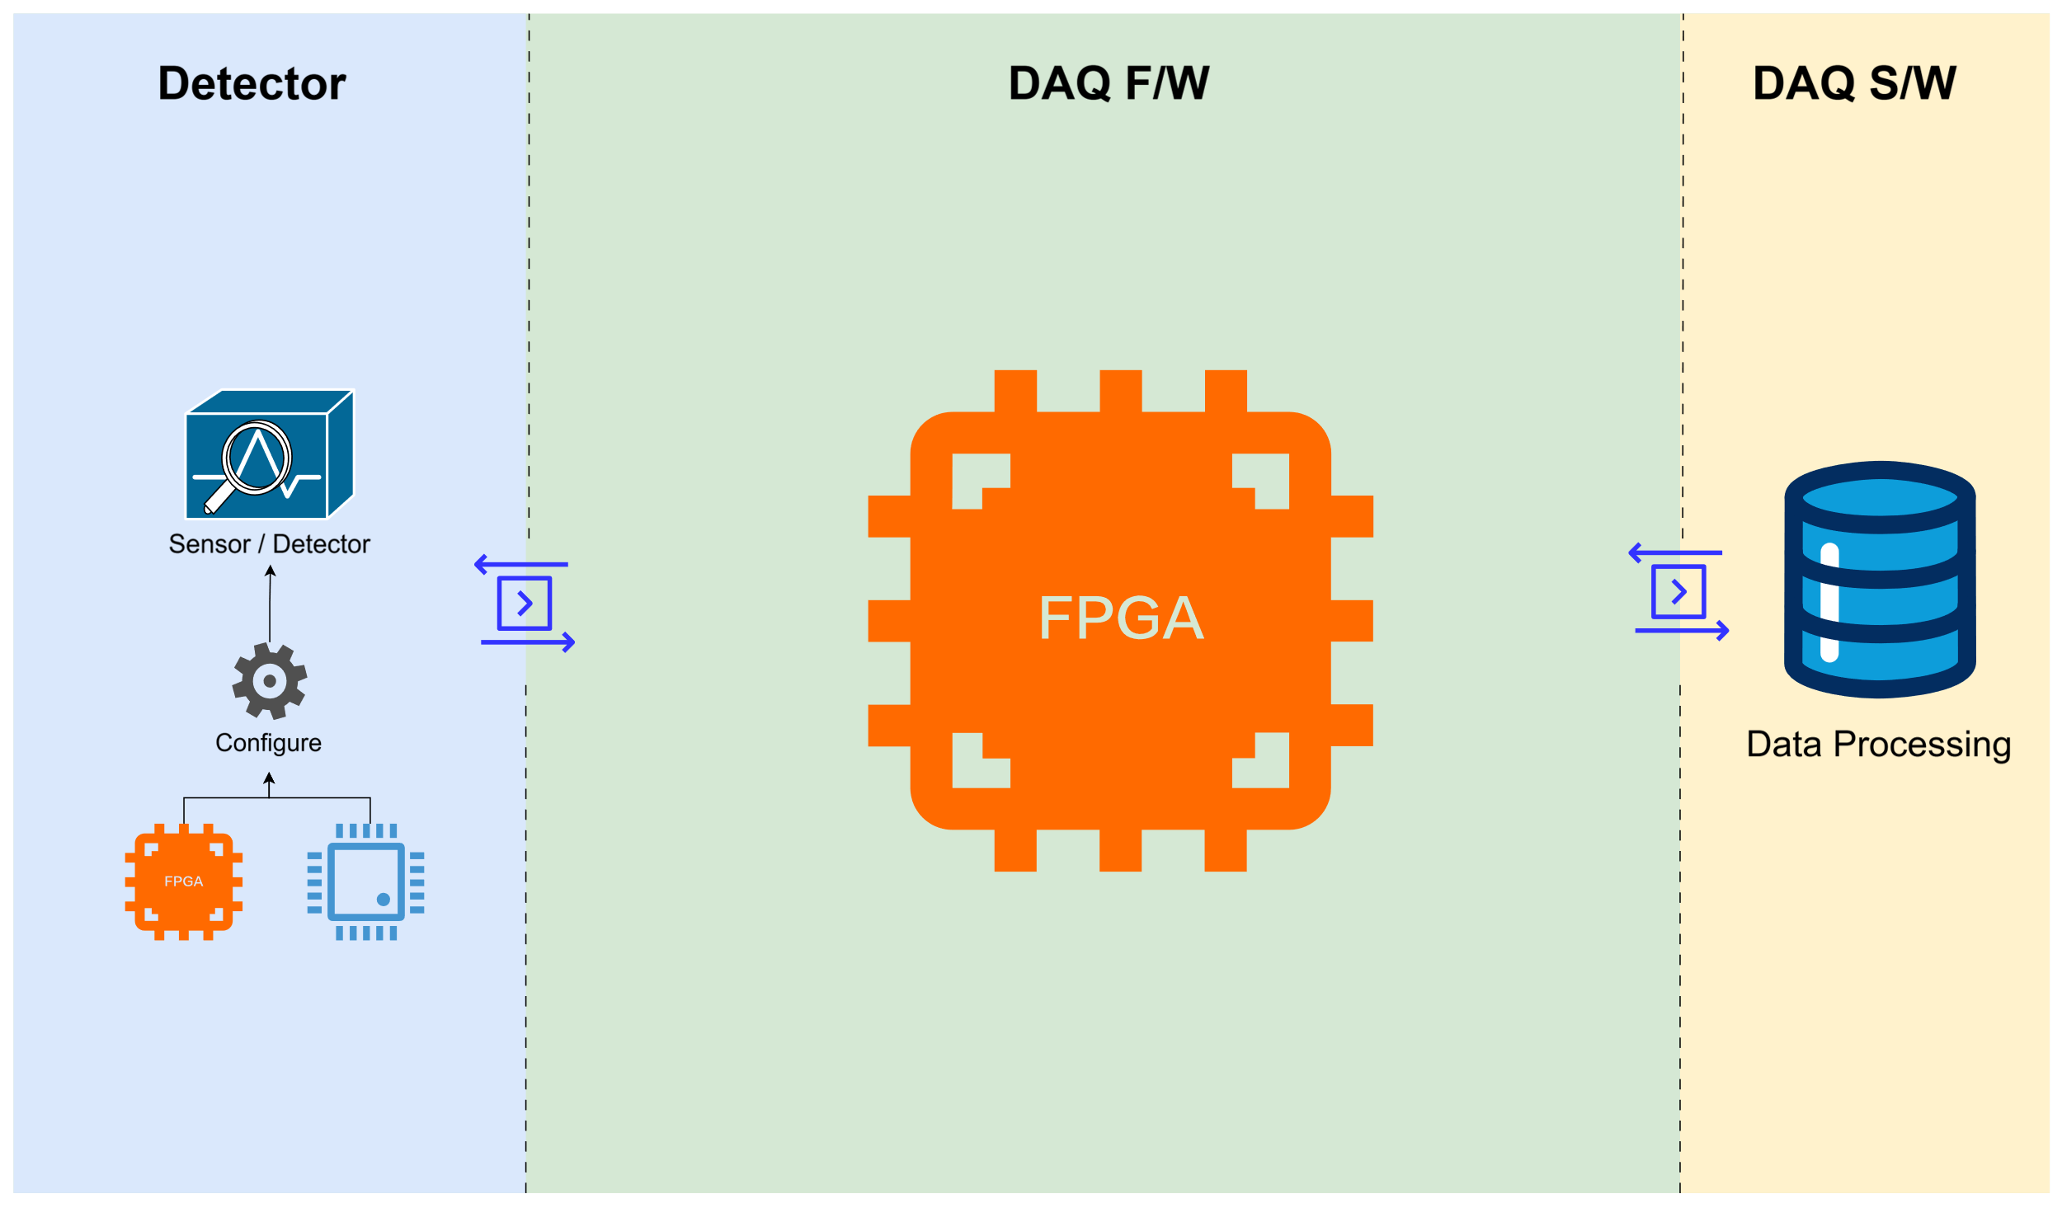
Detector Hub

Slide 5
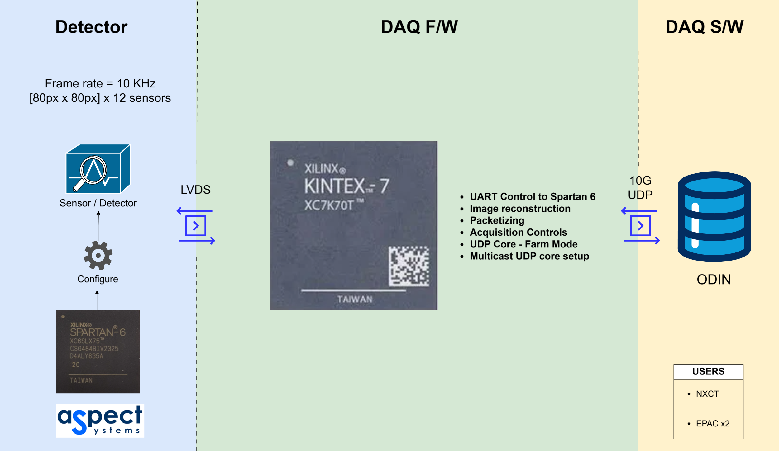
Hexitec 2x6

Slide 6
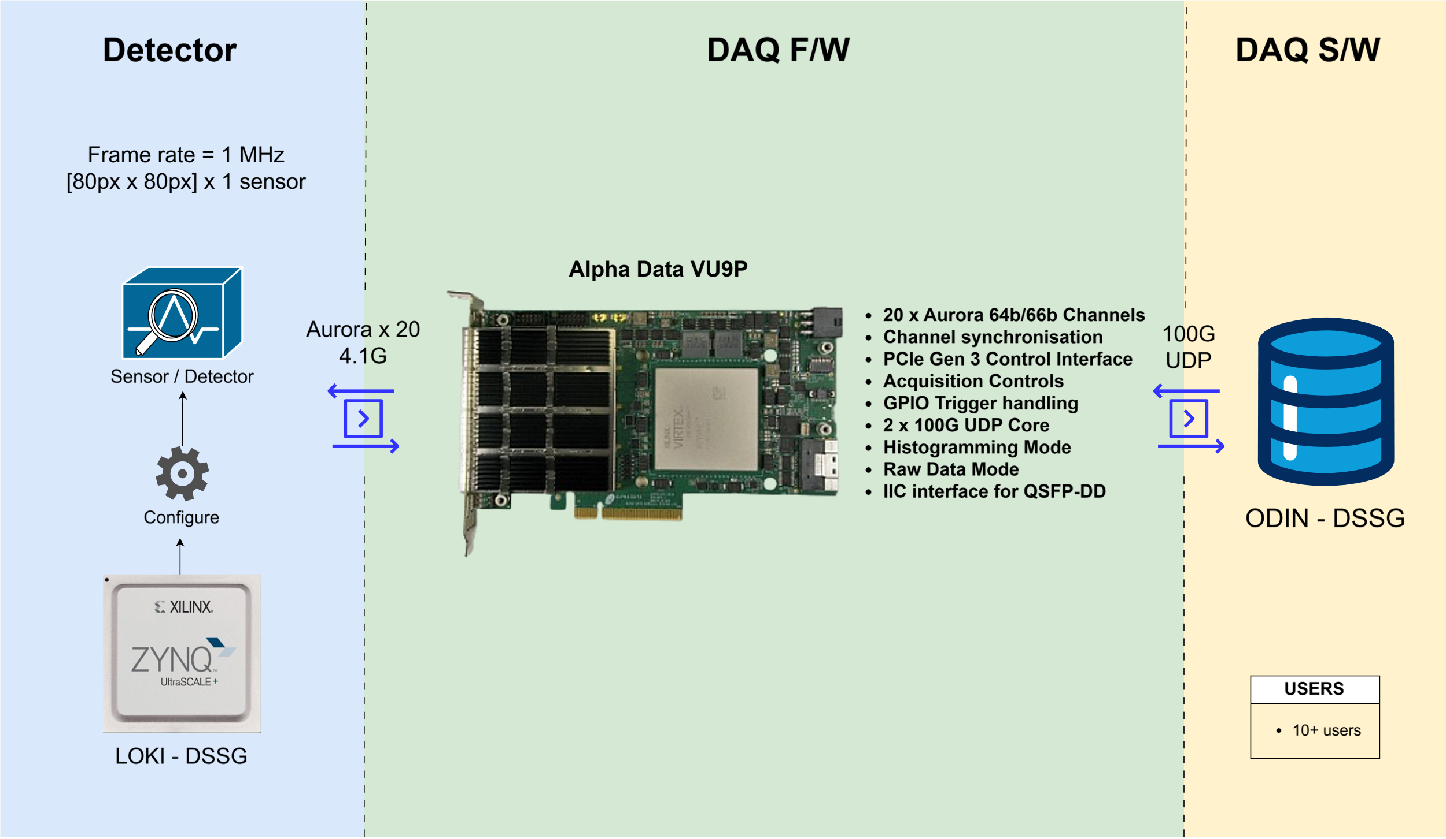
Hexitec MegaHertz

Slide 7
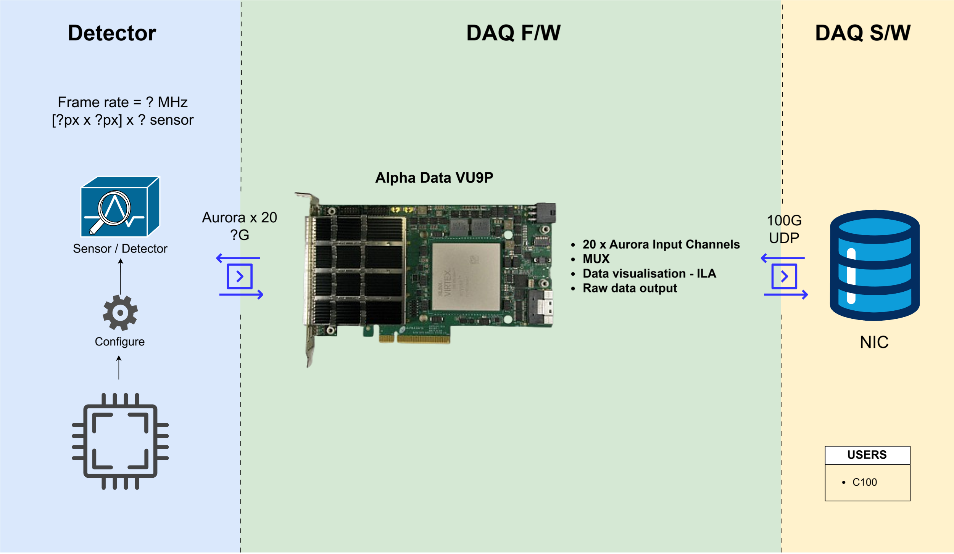
Raw Data Processor

Slide 8
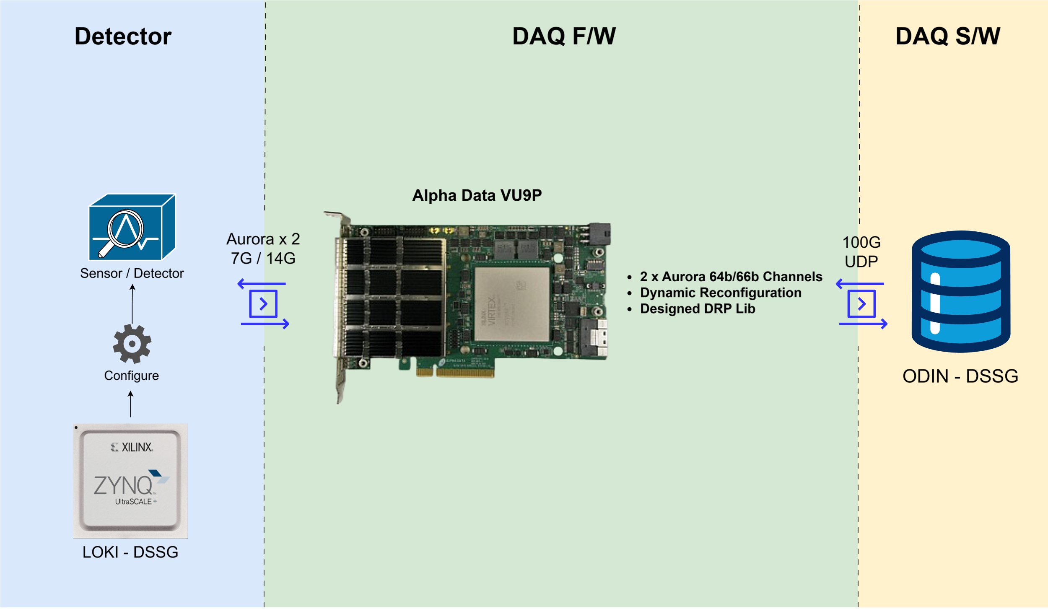
BabyD

Slide 9
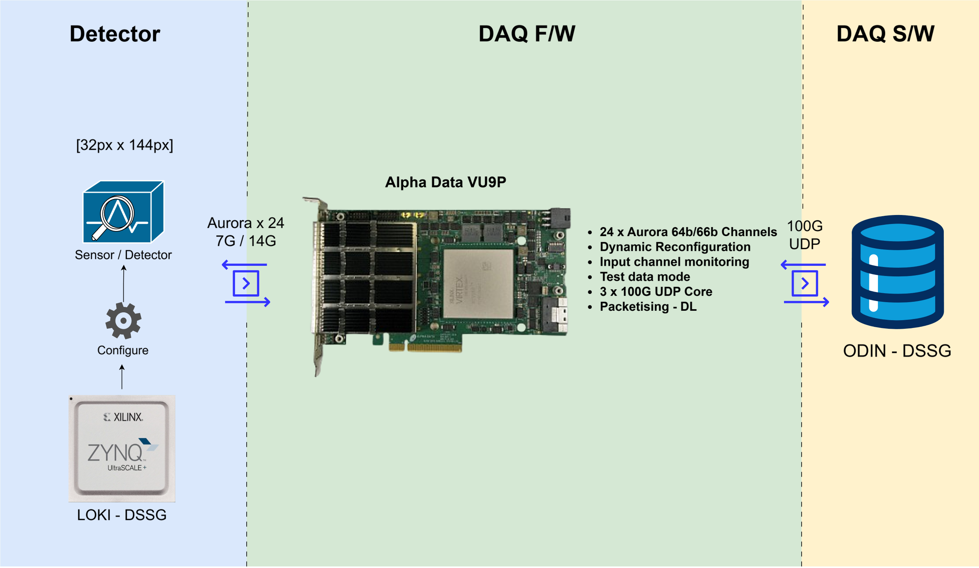
XiDyn

Slide 10




technologysi.stfc.ac.uk
@STFC_Matters
Science and Technology Facilities Council
Science and Technology Facilities Council
Notes:
The abstract pattern can be removed or repositioned if required. Be careful to ‘Send to Back’ so that it does not obscure any important information.

