Slide 1
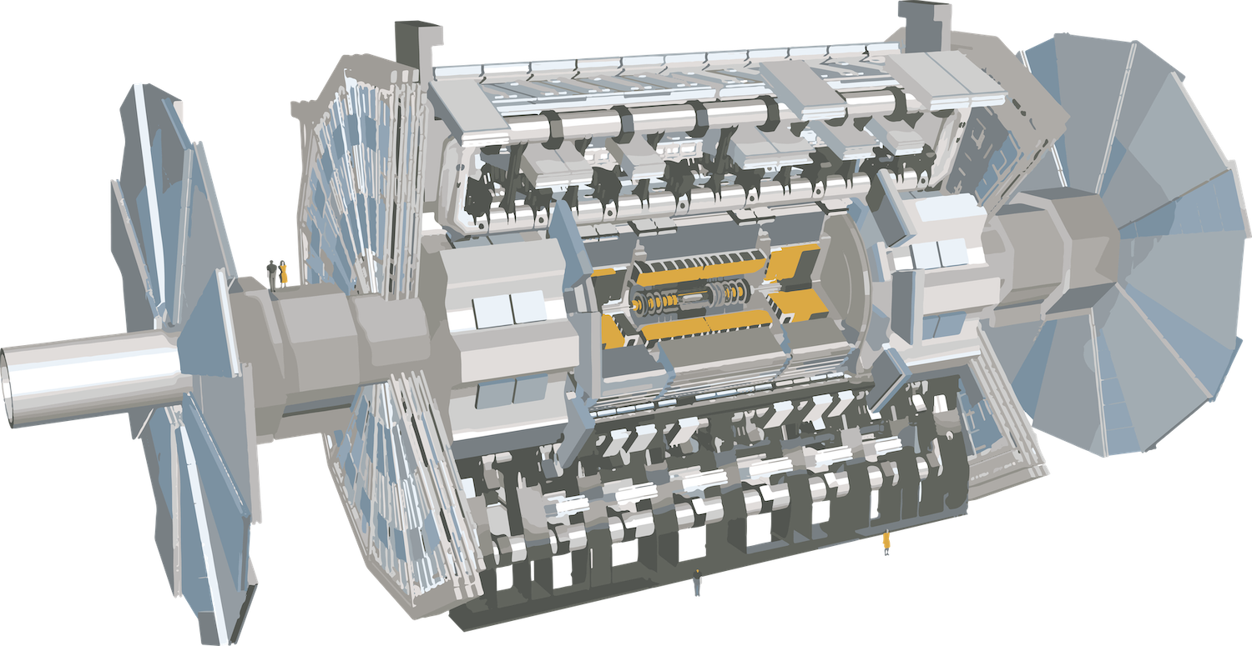
ESDG current ATLAS contributions

Slide 2
outline
ATLAS TDAQ overview
ATLAS TDAQ Phase-II upgrade
ESDG contributions
L0Calo
Management
F/W
L0Global
Management
H/W
F/W

Slide 3

ATLAS TDAQ overview
ATLAS trigger and data acquisition (TDAQ) system
Data stored in synchronous scrolling memories on detectors temporarily before its trigger decision arrives
Trigger latency (trigger algorithm + cable propagation delay) < Scrolling memory length
Data acquisition (DAQ)
Trigger
40MHz peak collision rates
~10,000,000 detector channels
Real time data generation ~ PB/s

Slide 4
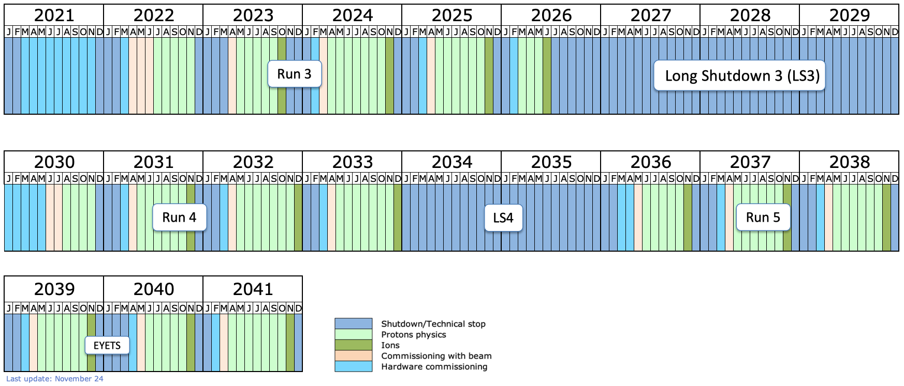
LHC Schedule

Slide 5
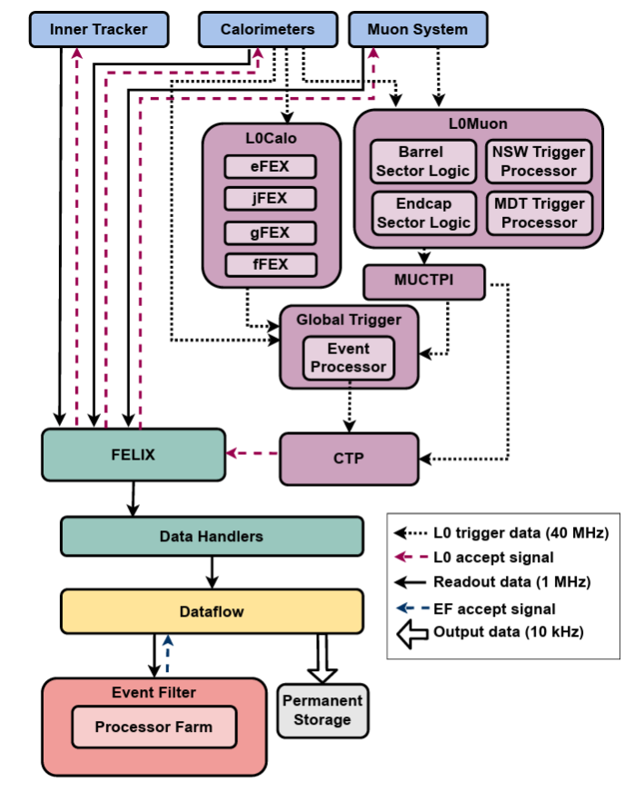
ATLAS TDAQ Phase-II Upgrade

Slide 6
ATLAS L0Calo
ESDG contributions:
Management
Ian Brawn is the L0Calo coordinator
F/W
Geoffrey Betts is updating the eFEX f/w for Phase-II upgrade
Main drive
Trigger latency increased x4
Trigger rate increased x10

Slide 7
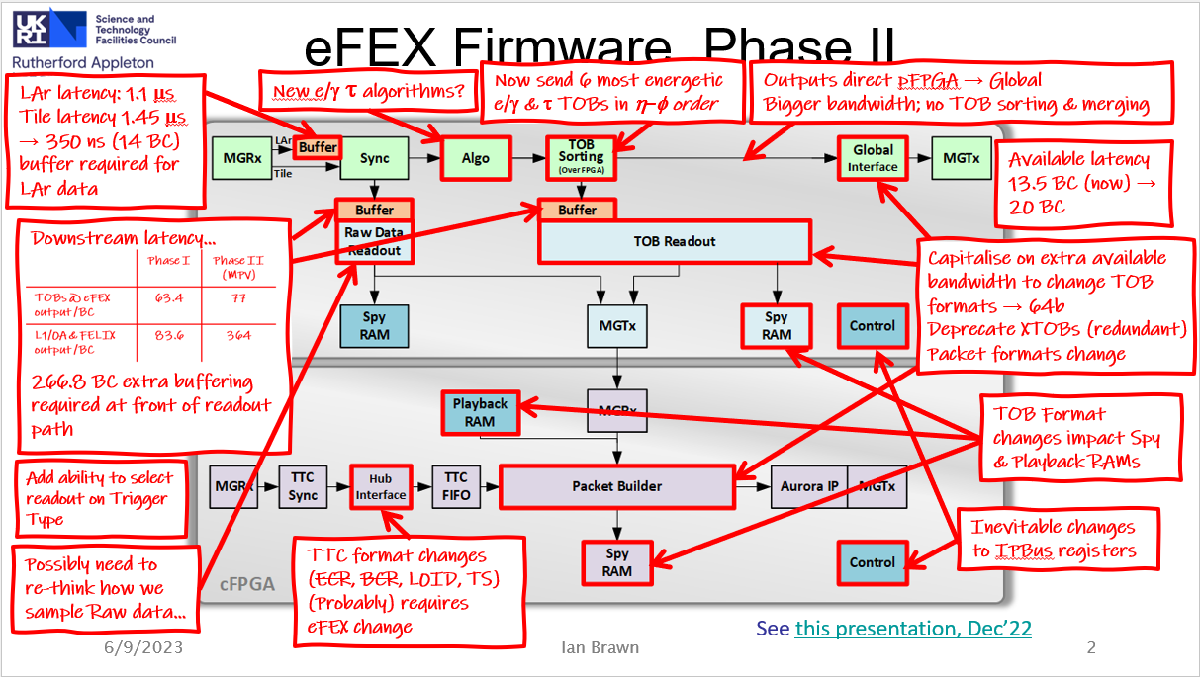
eFEX f/w Phase-II upgrade details
A lot of firmware changes needed
Significant increase in readout buffering
Longer latency → Keep data for longer before filtering
Process 10x events
Process more data per event
General optimisation
Comprehensive rewrite
Timing closure is a big challenge
Notes:
Emphasise readout path

Slide 8
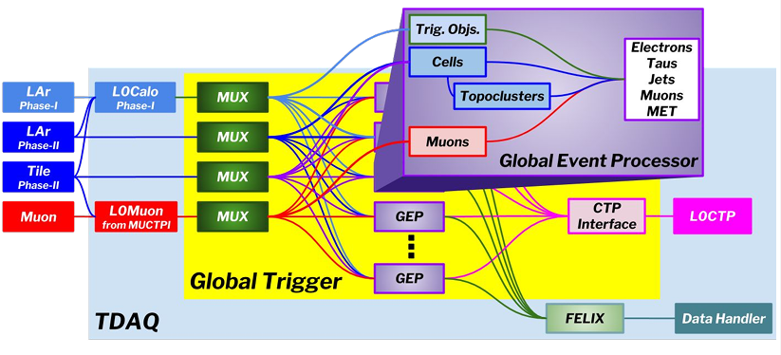
ATLAS Global Trigger

Slide 9
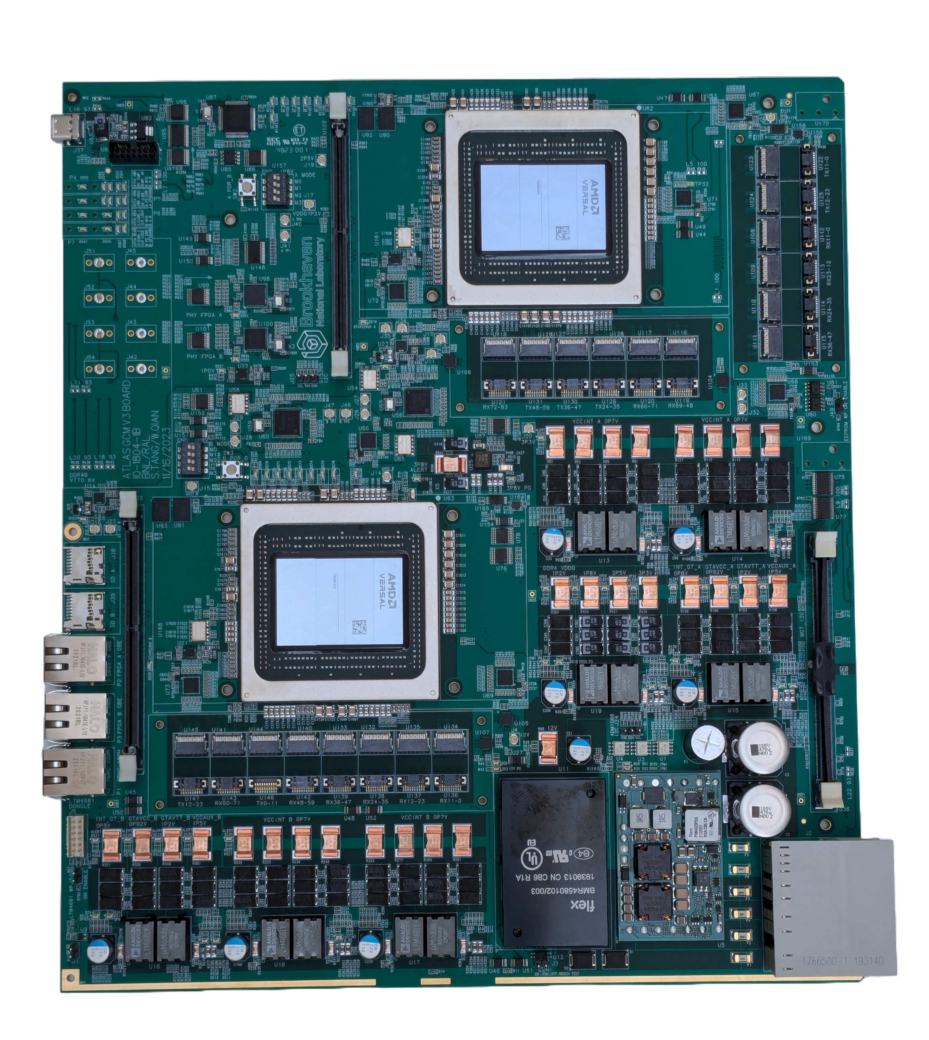
ATLAS Global Trigger
ESDG contributions
Management
I’m co-coordinator for the Global hardware project with BNL (US)
H/W
I’m the co-designer for Global Common Module
F/W
Mohamed Siyad is involved in the gCTPi f/w design

Slide 10
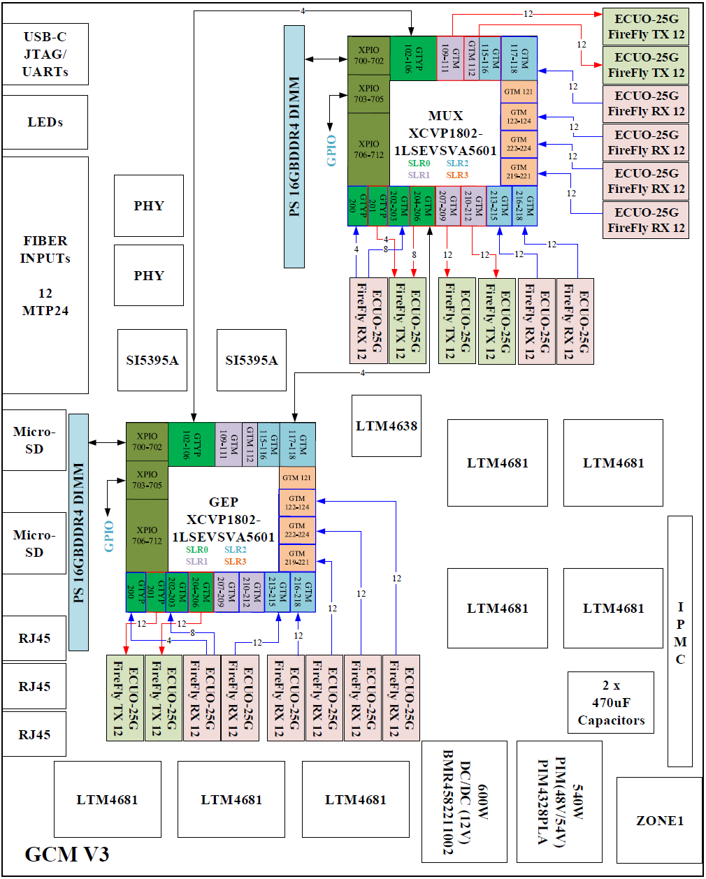
GCM hardware Technology Choices
Platform
ATCA front board
1 MUX node + 1 GEP node per board
FPGA
Versal Premium adaptive SoC VP1802 for MUX node
Versal Premium adaptive SoC VP1802 for GEP/gCTPi node
VSVA5601 package
75x75, 0.92mm pitch
Minimizing crosstalk
Optics
20 Firefly 28G parallel optical engines
12 ch/optical engine
PCB
26 layers
Via-in-pad
Backdrill

Slide 11
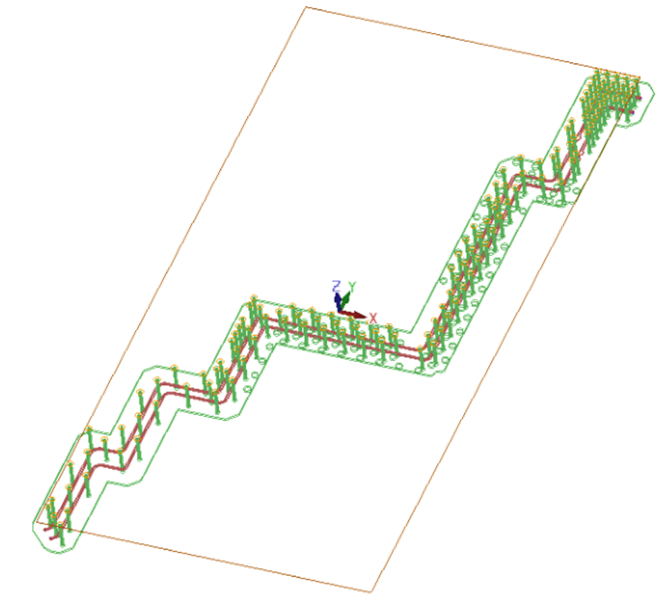
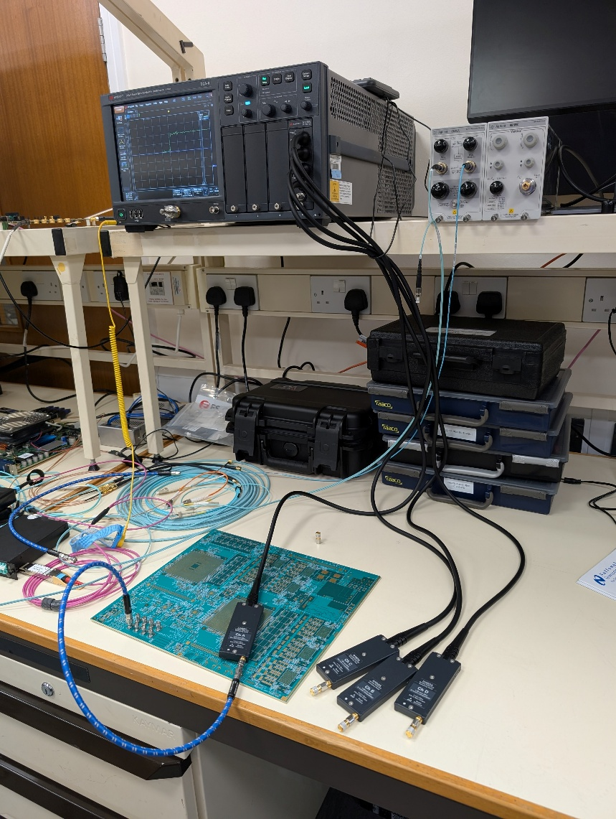
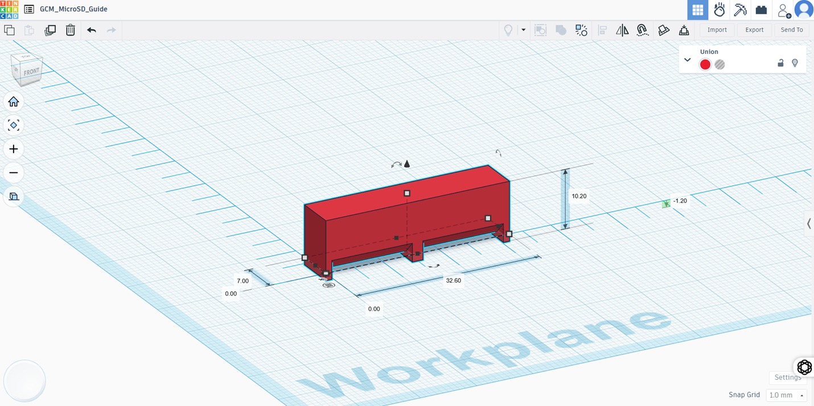
GCM hardware work examples

Slide 12
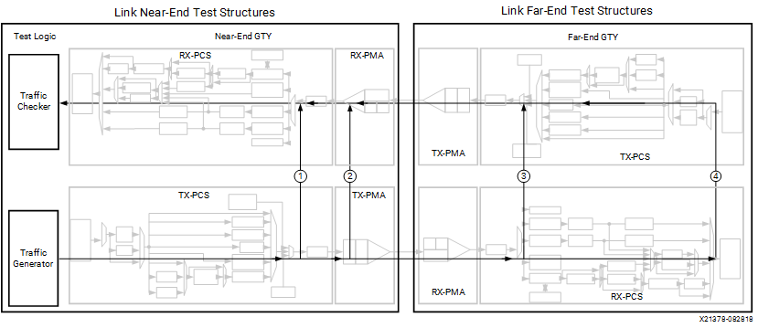
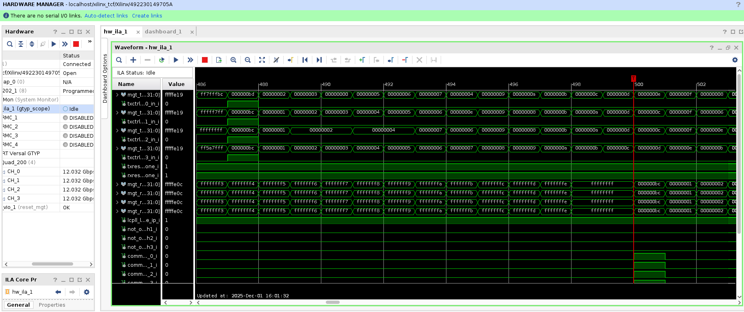
gCTPi f/w example
GTPY link design
Fixed latency
Minimal latency

Slide 13
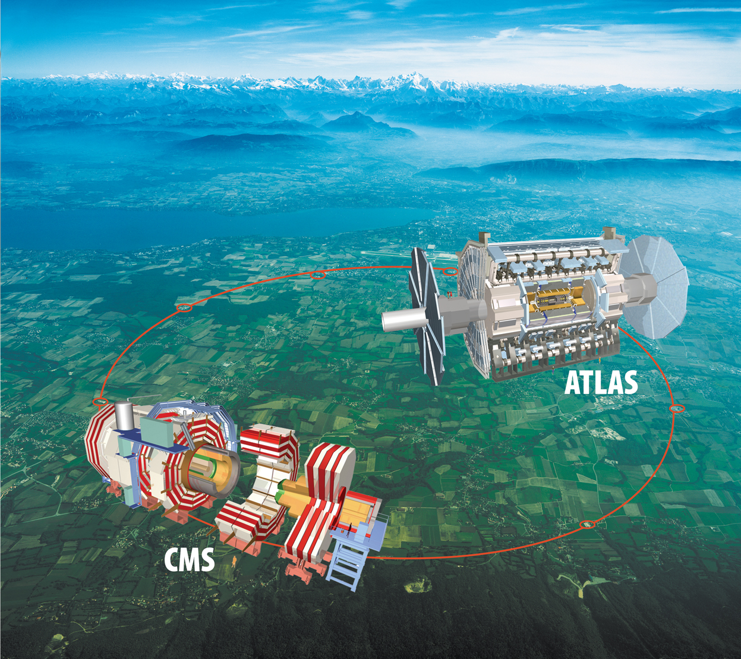
Summary
ATLAS is a very big experiment involving huge internation collaborations.
ESDG is making crucial contributions to the ATLAS TDAQ Phase-II Upgrade.

