Slide 1
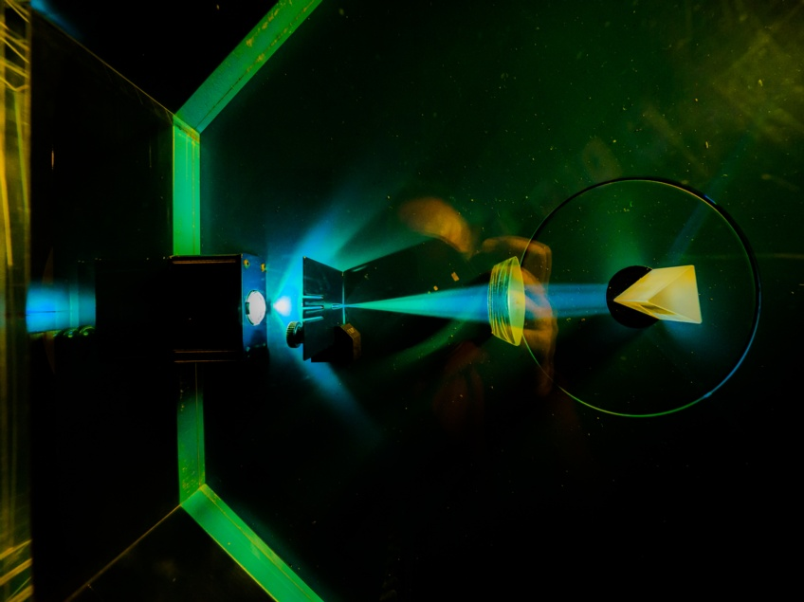


Electronic System Design Group Management Update
Group Meeting, 29 January 2026
CR03 & Zoom
Image © STFC Alan Ford
Notes:
To edit the background image, select ‘Format’ from the PowerPoint menu and ‘Slide Background’ from the drop-down menu. Within the new list of options that appears on the right of the screen, select the ‘File’ button under ‘Insert picture from’ and select your image from your file browser. Please remove or amend the image credit if you are using a different image to the one provided.

Slide 2
Fire Alarm!
A reminder: the fire alarm in this room will probably be tested at some point in this meeting
For which, apologies
You may remain seated

Slide 3
Overview
Notes from the STFC Staff Seminar yesterday
Wellbeing
Group Organisation & Staff Changes
Projects 2025-26
Meetings this Year

Slide 4
STFC Staff Seminar 28/1/26 (1)
Recording will be available here. Meanwhile, my notes….
STFC has received record £38.6b investment for coming period, but
STFC's growing cost base is no longer affordable without fundamental change
2026 will be rocky year, but will be on sustainable footing by the end
But "This work will continue well into 2026/27"
“Must be financially sustainable by end of FY 2029/30”
Seeking ~£162m savings
Re-prioritising science portfolio: do fewer things
Reduce PPAN (Particle Physics, Astronomy & Nuclear) funding cut by ~30%

Slide 5
STFC Staff Seminar 28/1/26
Transformation Programme
Inc. Anna Orlowska on Engineering delivery
Transformation roadshows to seek staff input -- RAL 18 March
Ideas to: transformstfc@stfc.ukri.org
Structural change
We have a "less-than-optimum delivery model"
Working on a new vision based on
Facility provision at campuses
Funding of PPAN + Space projects
My observation: much as at present, but with increased emphasis on partnership
At the heart of the new mission of UKRI
Advance Knowledge, Improve Lives, Drive Growth
What does all this mean?

Slide 6
Wellbeing
The latest wellbeing slides can be found on the TD internal web
Events, guidance, training, resources, staff benefits….
More wellbeing allies are wanted, please consider
A couple of slides from the deck…

Slide 7
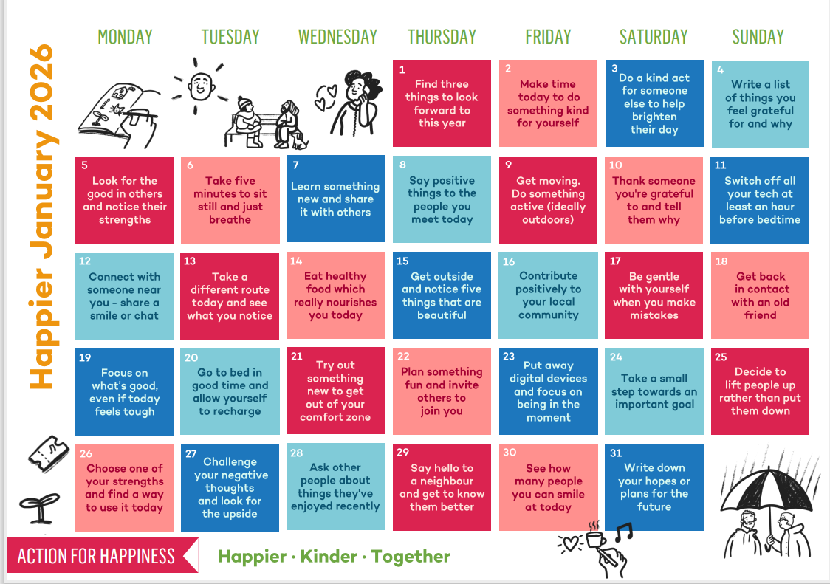
Action for Happiness
10 Keys to Happier Living – science-based ingredients for living a happier life
Free online ten days coaching programme ’10 Days of Happiness’ for a wellbeing boost
https://actionforhappiness.org/calendar

Slide 8
Training
Find out more about UKRI Wellbeing Ambassador Network
The Wellbeing Ally role description
UKRI Wellbeing Ally training course
Purpose
to ensure that every person in UKRI feels like they can talk confidentially to their line manager, colleague or HR about a wellbeing concern and get the support they need.
How to sign up
Training takes approximately 4 hours and can be completed face-to-face or virtually.
Please see the link to book on one of the Wellbeing training sessions:
Learning Item Details - Oracle Fusion Cloud Applications
.

Slide 9

Wellbeing Links
Wellbeing pages
Wellbeing plan
Wellbeing calendar
Wellbeing team update
Line manager toolkit for wellbeing
Health & wellbeing event recordings
Employee Assistance Programme
Benefits Guide
Mental Health First Aiders
Suicide First Aiders
Financial Wellbeing recordings
Health and Wellbeing Yammer page
RAL Recreational Society

Slide 10
Group Organisation & Staff Changes
Ian Brawn
Ronnie Brumfitt
Joseph Hindmarsh
Weiming Qian
Kelvin Gascoyne
John Holden
Simon Moorby
Zhen Ha Ng
Geoffrey Betts
Matt Roberts
Chad Silk
Joshua Davies
Mohamed Siyad
Dave Templeman
Piers Coode
Jack Day
Martin Torbet
John Coughlan
Adam Barcock
Sooraj Pradeep
Hajira Bazaz
Berk Bilgin
Peter Furey-Duffin
Lucie Sharpe
William John
Saeed Taghavi
Changes
Saeed has retired
New Graduate Recruit
Willis Chiu will start in September

Slide 11
Projects 2025–26
Slightly Approximate
Fully employed this FY
Next FY:
Await funding results for ATLAS
Notes:
Numbers from
H:\ESDG_business\EffortProfiles\EffortProfile_Projection_2025_d3

Slide 12
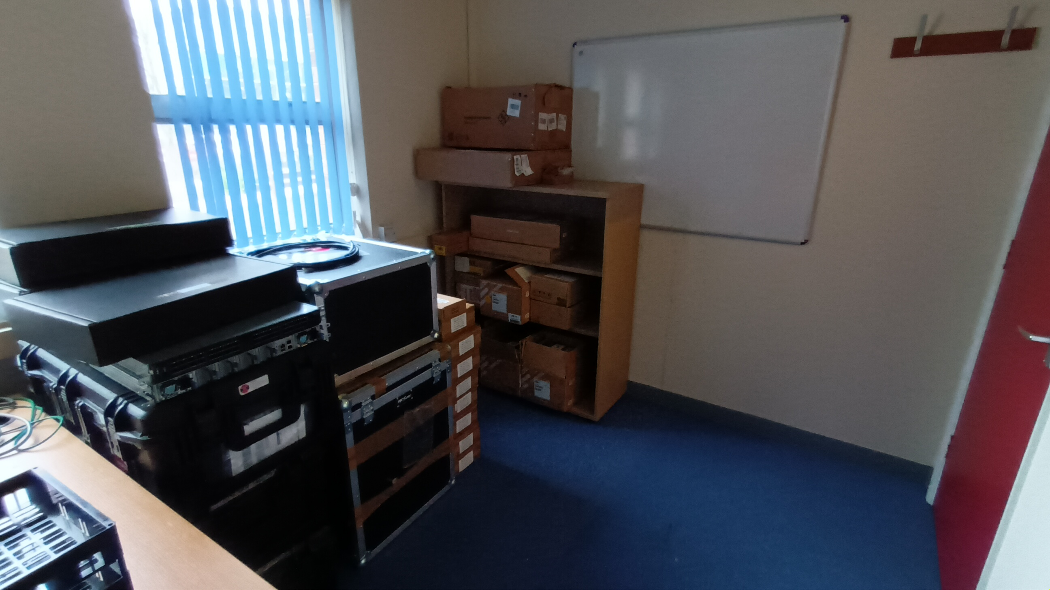
ESDG Accommodation in R66
Storage office: R66, G07
Shelves finally arrived

Slide 13
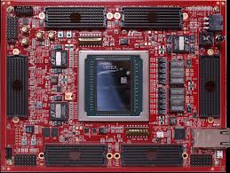
Development Boards
Capital funds used to purchase
HTG-960
Xilinx Ultrascale+ VU19P
High-density FMC
Procurement in process
+ various FMC cards
$50k
Purchase ongoing
SSA + pre-payment required
1st iteration took so long price had increased
https://www.hitechglobal.com/Boards/VirtexUltraScale+_VU19P_Board.htm

Slide 14
Meetings This Year
Meeting | Date | Start Time | Location
ESDG Group Meeting | Thursday 29 January | 10:30 am | CR03
ESDG Group Meeting | Thursday 26 February | 10:30 am | CR03
ESDG Group Meeting | Thursday 26 March | 10:30 am | CR03
ESDG Group Meeting | Thursday 30 April | 10:30 am | CR03
ESDG Group Meeting | Thursday 28 May | 10:30 am | CR03
ESDG Group Meeting | Thursday 25 June | 10:30 am | CR03
ESDG Group Meeting | Thursday 30 July | 10:30 am | CR12
ESDG Group Meeting | Thursday 27 August | 10:30 am | CR12
ESDG Group Meeting | Thursday 24 September | 10:30 am | CR12
ESDG Group Meeting | Thursday 26 October | 10:30 am | CR12
ESDG Group Meeting | Thursday 26 November | 10:30 am | CR12
DED Forums | TBA
Christmas Party | TBA
Room change

Slide 15






AOB
technologysi.stfc.ac.uk
@STFC_matters
Science and Technology Facilities Council
Science and Technology Facilities Council
Notes:
The abstract pattern can be removed or repositioned if required. Be careful to ‘Send to Back’ so that it does not obscure any important information.

