Slide 1
Collelction of info on LCF project for the RF panel in view of the LDG workshop (actual status)
Laura Monaco, 28/01/2026

Slide 2
Critical RF Challenges for LCF
(1) 1.3 GHz 9-cell cavities (SRF Bulk Nb) (WG1)
(2) Power Couplers (WG3)
(3) Power Sources (WG5)
(4) LLRF, AI and ML (WG6)

Slide 3
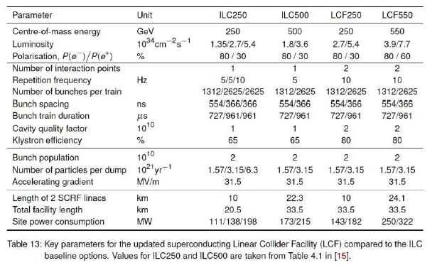
ILC to LCF Design Specifications

Slide 4
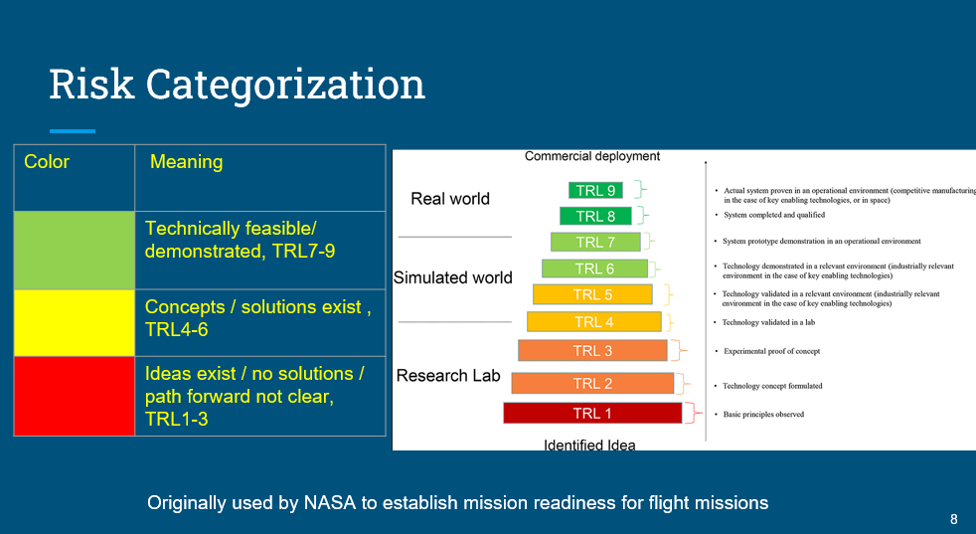
TRL levels
TRL definition
During our past activities for the RF panel, we used the TRL shown on the right
For the current analysis, I propose to use the TRL prepared by Frank Gerigk (below the example for cavities)
TRL1 | Define basic properties
TRL2 | Analystical study
TRL3 | Proof of concept
TRL4 | Pre-prototype
TRL5 | Pre-prototype tested in lab
TRL6 | Prototype tested in relevant environment
TRL7 | Approved prototype
TRL8 | Pre-serial manufacturing
TRL9 | Series production (product on market)
Interpretation for cavities:
TRL3: sample test achieves specs
TRL4: a similarly shaped cavity without ports has achieved similar specs in a vertical cold test -> SINGLE-CELL
TRL5: bare and dressed cavities with ports in vertical cold test has achieved specs- > 9-CELL
TRL6: fully dressed cavity with FPC in horizontal test achieves specs
TRL7: cavity in prototype CM achieves specs
DO WE HAVE TO KEEP TRL6 FOR HOR TEST OR JUST CONSIDER TRL7 FOR CM?

Slide 5
(1) 1.3 GHz SRF Cavity Design Specifications (WG1)
Cavities | ILC250 (TDR) | LCF250, LCF550
1.3 GHz, 9-cell (CM) | <31.5> MV/m (±20%) @ Q0 = 1.0 x 10¹⁰ | <31.5> MV/m (±20%) @ Q0 = 2 x 10¹⁰
1.3 GHz, 9-cell (VT) | <35.0> MV/m (±20%) @ Q0 = 0.8 x 10¹⁰ | <35.0> MV/m (±20%) @ Q0 = 1.6 x 10¹⁰ (*)
(*) Q0 scaled by experience
The project we refer to is LCF (not ILC project reported in the Yellow Book).
Specs shown here are the LCF 250 & LCF 550 ones (specs of ILC (TDR) are reported only for comparison)

Slide 6
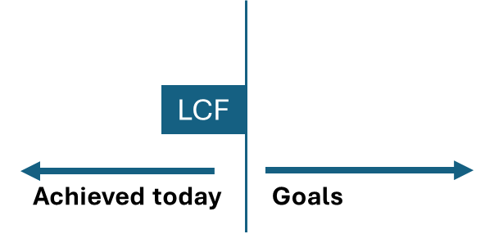
(1) 1.3 GHz SRF Cavity Design Specifications (LCF/ILC case) (WG1)
Cavity configuration | single cell | 9-cell full equipped (bare/dressed) | HTC (FPC, tuner, shielding) | CM
Test orientation | vertical | vertical | horizontal | horizontal
Technical readiness | TRL4 | TRL5 | TRL6 | TRL7
Accelerating Gradient Goal | (*) <40.0> +/- 20 % MV/m | <35.0> +/- 20% MV/m | <31.5> +/- 20% MV/m | <31.5> +/- 20% MV/m
Quality Factor Goal | (*) 1.8 x 10¹⁰ | (*) 1.6 x 10¹⁰ | 2.0 x 10¹⁰ | 2.0 x 10¹⁰
Achievements | DESY: (EP cold, Mid-T, low-T baking): 40 MV/m @ Q0 ≥ 2.4 x 10¹⁰ (L. Steder et al., 2407.12570v1, 2024) KEK - ITN: (EP cold, 900 °C, 2-step baking): best performance: Q0 = 1.7 x 10¹⁰ @ 35 MV/m (Q0 = 2.0 x 10¹⁰ @ 31.5 MV/m) 4 to 6 cav: Q0 > 1.0 x 10¹⁰ @ 35 MV/m (E. Viklund et al., MOP34, SRF25) FNAL: (EP cold + 2-step baking) 40 MV/m @ Q0 1.8 x 10¹⁰ (D. Bafia, IMCC 2023) | IHEP: (Bulk EP + 900 °C + Mid-T): 31.0 MV/m @ Q0 = 4.9 x 10¹⁰ (Weimin Pan et al., PRAB, 27.092003, 2024) ILC (ITN) at KEK: (EP cold + 900 °C + 2-step baking): 40 MV/m @ Q0 > 1 x 10¹⁰ FNAL (for HGC): (EP cold + 2-step baking) best performance: 45.5 MV/m @ Q0 0.8 x 10¹⁰ (40.0 MV/m @ Q0 1.0 x 10¹⁰) (S. Posen) |  | KEK STF-2: 31.5 MV/m @ Q0 < 1 x 10¹⁰ in CM (doi:10.18429/JACoW-SRF2017-THYA02) FNAL: <32.2> MV/m @ Q0 = 0.8 x 10¹⁰ (doi:10.1088/1367-2630/aaec57) SHINE (cw): (Bulk EP, EP cold, 900 °C, Mid-T) Q0 = 3.2 x 10¹⁰ @ Eave 29.0 MV/m (best cavity: Q0 = 2.8 x 10¹⁰ Eacc 32 MV/m) (doi:10.1007/s41365-024-01630-y)
On-going | ITN-EU: (test in 2026) FG Nb and MG Nb for cost reduction studies | ITN and ITN-EU: (test in 2026-2027) VT on several cavities scheduled |  | ITN cryomodule in KEK: (CM assembly and CM test in 2027) - 4 ITN KEK cav; - 2 ITN KEK cav (mech. in EU industry) - 2 ITN-EU cav (mech & treat in EU industry)
ILC TRL is well advanced reaching TRL6. Performances have been proven on single and 9-cell cavities in VT, and also in CM. More measurements must be done to verify the reliability of results, already planned in 2026 (ITN cryomodule)
LCF TRL is advanced reaching TRL5. Results on single-cell and 9-cell are promising but more statistic is needed to have a reliable recipe to reach TRL6. For CM, LCF specs are not still reached but results obtained in several labs are very promising
(*) scaled by experience

Slide 7
(1) R&D Objectives to reach TRL6 (WG1)
Needed activities toward TRL6:
Improve Q0 value to reach 2 x 10¹⁰ @ 31.5 MV/m (driven by surface and thermal treatments), and establish its reproducibility
A better understanding of fundamental mechanisms and limiting factors of SRF surface treatments is mandatory to reach HQ/HG performances:
More single-cell cavities R&D used to optimize parameters (Thermal treatments, EP cold, etc.)
Transfer recipes to 9-cell cavities, improve performance reproducibility (industrialization)
CM ecouraging results already available -> waiting for KEK-ITN results (within 2026-2027) (TRL7 for ILC)
Since the high requests on performances, field emission must be limited:
improve knoledge and technique on cleanliness operation during cavity and string assembly (cobot, etc.)
work on cavity performance recovery in CM (plasma processing, etc.)

Slide 8
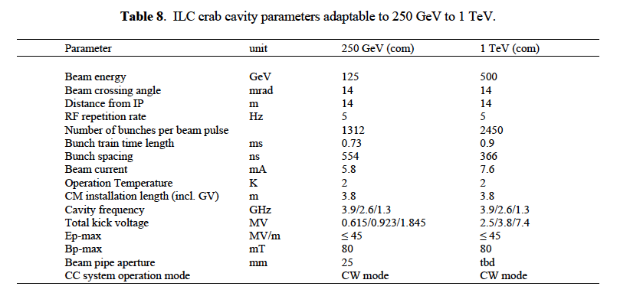
(1) Crab cavity (for the IPs) (WG1)
 | ILC250 (TDR) | ILC250 (ITN) | LCF250, LCF550
 | 3.9 GHz Race-track | Prototypes design: 1.3 GHz RF dipole (ODU JLab) 2.6 GHz QMIR (FNAL) | tbd
ILC crab cavity prototype design has been chosen (2023 for ITN), reaching TRL2. It may be adapted to LCF.
RF dipole prototype for ITN is expected to be developed, at first, in view to reach TRL4

Slide 9
(1) Objective Resources (WG1)
RF Coordination Panel (RFCP) request (Bisoffi and McIntosh):
How much total staffing required (from now). → tbd
How much equipment cost required (from now). → tbd
Timescale anticipated to complete objective (from now). → 3~5 years
What collaborators are currently involved. → ITN
What new collaborators could be involved. → tbd
(if relevant, please provide a breakdown of each R&D objective among the principal RF systems described in slide 1)
ITN-EU (ILC Technology Network):
CEA, CERN, INFN, (DESY is collaborating)
activities done in collaboration with KEK (surface treatments toward HQ/HG), cavities exchange, etc.

Slide 10
(1) Infrastructure (WG1)
RF Coordination Panel (RFCP) request (Bisoffi and McIntosh):
What development/validation infrastructure required.
What exists currently and is being used.
Who might have applicable infrastructure.
Labs that have infrastructures for the R&D activities to reach TRL6 (TRL7):
CEA, CERN, CNRS/IJCLab, DESY, ESS, HZB, INFN, STFC, UHH, Uppsala/FREIA
List of new infrastructures that would be needed by labs (to better perform R&D for TRL6)
Requests expressed by EU labs contacted via the survey (2024):
clean room, HPR, EP, vertical test (new or upgrade), cobot, material characterization, thermal treatment (high and mid T) , plasma processing

Slide 11
(1) Possible partners with capabilities in the needed R&D (WG1)
Labs capable of bulk Nb SRF R&D to reach TRL6 (Horizontal test required?):
EU: CEA, CERN, CNRS/IJCLab, DESY, ESS, HZB, INFN, STFC, UHH, Uppsala/FREIA, etc.
US: FNAL, JLAB, SLAC, etc.
Asia: KEK, IHEP, SHINE, Korea Univ. etc.
All labs involved in ILC Technology Network (ITN), and in the TESLA collaboration
Labs in EU capable on CM Test to reach TRL7: CEA, DESY, ESS
“Please note that this should not be understood as any form of commitment from the LDG laboratories, but merely as an indication of their capabilities. It will then be up to the LDG directors to assess whether and to what extent they may wish to contribute”
My personal thought: labs already involved (as an example in ITN) or labs that have the needed experience must be added but this does not mean that labs have already decided to participate, but only that they have the experience needed for these activities
in my opinion this is exactly the goal of RF Panel activities

Slide 12
General scheme for the other WGs
WG3, WG5, WG6: for each WGs the structure will be the same (please refer to WG1 structure as example):
Specs/goals, actual status, what is needed to reach TRL6
Objective resources, infrastructures, possible parnters
Delays in collecting info from WGs experts…(mainly my fault)
but I’m confident to complete the work in time for the LDG workshop

Slide 13
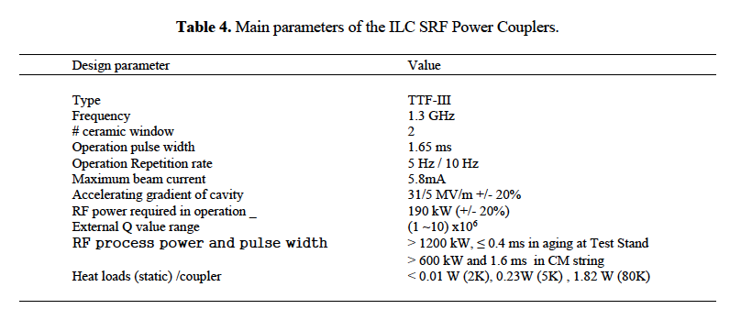
(2) Power Couplers specification for LCF (WG3)
 | ILC250 (TDR) | LCF250, LCF550
 | (*) TTF-III type | (**) See my comment below
 | (*) currently produced in industry | (**) being the LCF accelerating field equal to ILC one, being the Q0 double, the expected RF power should be much smaller
Actual status? Please WG3 experts comment on this
My opinion: Since TTF-III type is already produced in industry, it reaches TRL9 -> please comment if this is not true
Missing:
R&D objectives to rech TRL6
Objective resources
Infrastructures
Possible partners with capabilities in the needed R&D

Slide 14
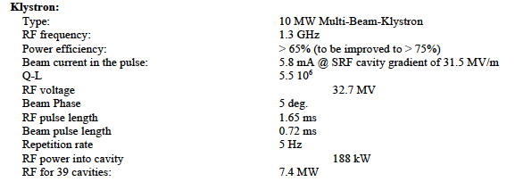
(3) Power Sources specification for LCF (WG5)
 | ILC250 (TDR) | LCF250, LCF550
High efficiency | 65% | 80% (reference, ESPPU26 goal)
Beam Repetition Rate | 5 Hz | 10 Hz
Actual status? Please WG5 experts comment on this
WG5 experts feedback on:
R&D objectives to rech TRL6
Objective resources
Infrastructures
Possible partners with capabilities in the needed R&D

Slide 15
(4) LLRF, AI and ML (WG6)
 | ILC250 (TDR) | LCF250, LCF550
Could WG6 experts help to fill this part and provide feedbacks?
WG6 experts feedback on:
R&D objectives to rech TRL6
Objective resources
Infrastructures
Possible partners with capabilities in the needed R&D

Slide 16
LCF synergy with ILC and other 1.3 GHz large series projects
I propose to have one slide only dedicated to large series projects (based on 1.3 GHz technology). Below what I’ve summarized for cavities.
Please add any further worthwhile information
1.3 GHz cavities have a high TRL (some projects reached TRL9) since they reach the industrialization stage: full process done in industries, including mechanical, surface treatments and cavity preparation “from raw material to ready to be installed in string assembly”:
Pulsed operation:
Eu-XFEL (DESY), 800 cavities
CW operation:
LCLS-II + HE (SLAC-Fermilab-JLab), 440 cavities (this number is only for LCLS-II-HE)
SHINE (Shanghai), 600 cavities
LCF inherits all the know-how and, asking for a higher Q0 at High field (see table of cavity specs), it is necessary to work mainly to improve surface and thermal treatments that require:
R&D on several single-cell and 9-cells (already in progress, see results in next slides)
Measurements in CM also available or under way (ITN KEK cryomodule foreseen in 2026-2027)

Slide 17
BACK-UP SLIDES

Slide 18
Delivery Plan (per primary objective)
RF Coordination Panel (RFCP) request (Bisoffi and McIntosh):
The objective is an aggregate of the various RF systems required: if relevant, please provide a breakdown of each R&D objective among the principal RF systems described in slide 1)
Objective 1 | Yr1 | Yr2 | Yr3 | Yr4 | Yr5 | Yr6
Design
Manufacture
Validate
Integrate
TRL6 Demonstration
??

