Slide 1


Project LHeC :
SRF needs
M. Baylac (CNRS/LPSC, Grenoble)
With inputs from F. Gerigk and R. Camaga (CERN), G. Olry (CNRS/IJCLab)

Slide 2
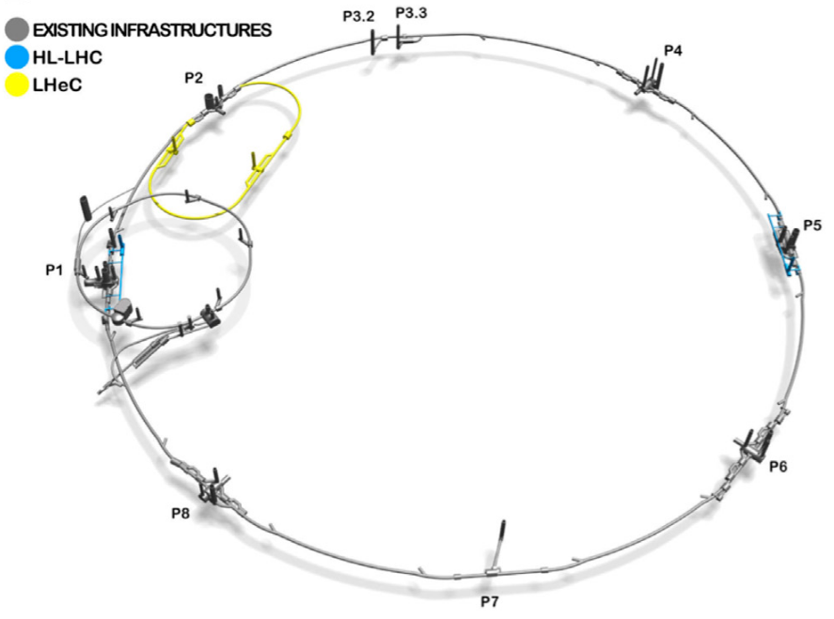
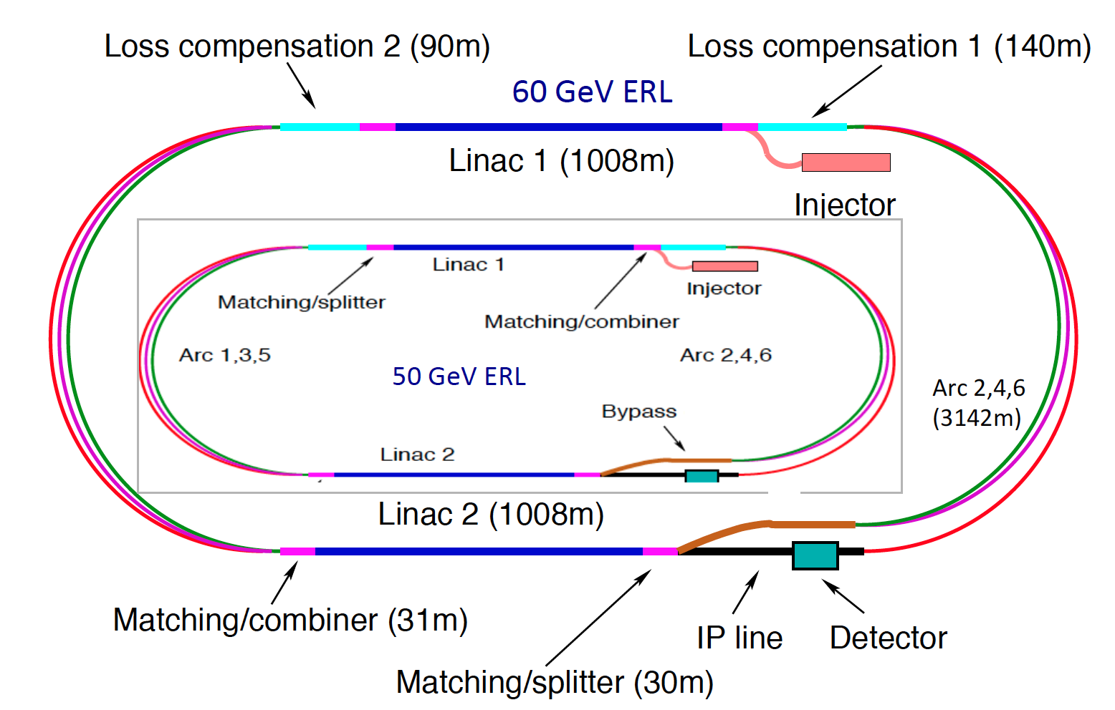
LHeC : introduction
  LHeC project
    Energy-recovery linac (ERL) where 50 GeV electrons scatter off the LHC beams
    The reference document for LHeC is arXiv:2007.14491
O Bruning (CERN), Front. Phys. 10.886473, Feb 2022

Slide 3
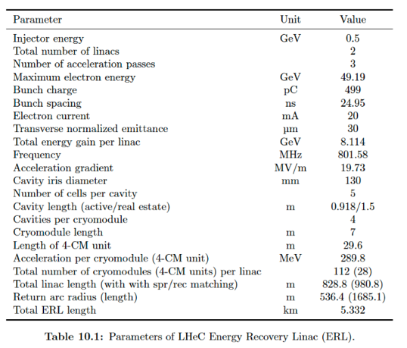
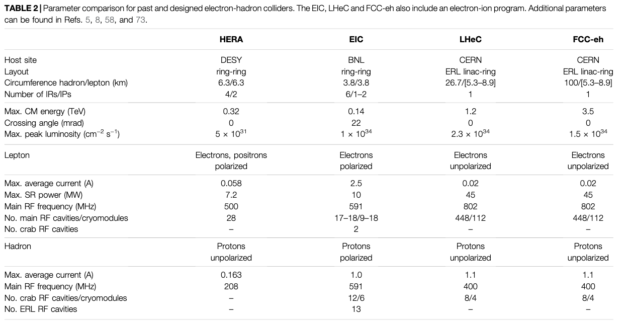
LHeC : key parameters
arXiv:2007.14491
From O Bruning (CERN), Front. Phys. 10.886473, Feb 2022
➔ Very strong synergies with FCC

Slide 4
LHeC : methodology
  Due to the strong existing synergies, discussions with the RF experts of FCC and PERLE
  Meeting with O. Bruning, F. Gerigk, R. Calaga, G. Olry (December 19, 2025)
    Discussion of the SRF needs for LHeC
    Comparison with needs for FCCee and PERLE
  After circulation of the meeting’s notes, additional feedback
    From Peter, Jorgen D’Hondt
    Some further exchanges with Frank and Rama
    Discussion with PERLE RF team
  Presentation of the summary of these inputs

Slide 5
LHeC : SRF needs
SRF needs for LHeC and comparison with the needs of FCC or PERLE
    1. Cavities
  Bulk Nb 5-cell cavities at 802 MHz with Eacc = 20 MV/m and Q0 = 3.1010
➔ similar to FCC 802 MHz with 5-cell instead of 6 for PERLE (PERLE : Q₀ = 3.10¹⁰ at 22 MV/m)
  Thin film technology is not considered for LHeC (yet R&D would be helpful)
    2. Fundamental Power couplers
    RF power for FPC ~ 50 kW
    ➔ similar to PERLE (less than FCC), no difficulty foreseen for FPC
    3. HOM dampers
    Similar to FCC 802 MHz (5-cell or 6-cell)

Slide 6
LHeC : SRF needs
The SRF needs for LHeC and comparison with the needs of FCC or PERLE:
    4. Power sources
    Requirement for 50 kW at 802 MHz
      presently operational in the SPS with TH793 tube
      similar to PERLE (R&D on IOT by Thales initiated, to be tested at PERLE)
    5. LLRF
    Initial requirements could be considered similar to PERLE
      QL = 8E6 at 802 MHz : BW = 100 Hz
    Considering requirements for FCC booster ttbar :
      FCC booster ttbar : 2.7E7 to 9.2E7 at 802 MHz ➔ BW_{min} = 90 Hz
      ➔ similar to PERLE (planned without FE-FRT)

Slide 7
LHeC : SRF needs summary
Conclusions
    The SRF needs for LHeC are covered by the needs of FCC-802 MHz and PERLE (supported by iSAS project)
    No additional R&D challenge is identified
    Comments
      Nice to have : FE-FRT would help for low BW control : R&D underway within iSAS project
      LLRF : Maintain ERL mode in case of failures/incorrect energy recovery
      ➔ both topics have strong synergies with FCC

Slide 8
LHeC : SRF needs summary
BACK UP

Slide 9
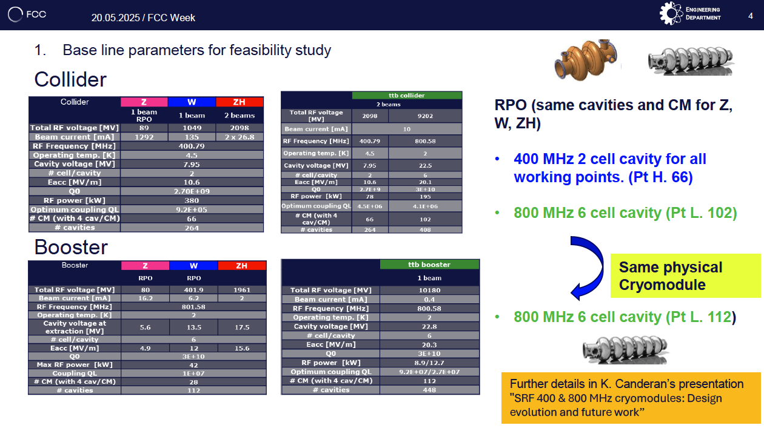
FCC
FCC week, F. Valchkova-Georgieva and Marc Timmins

Slide 10
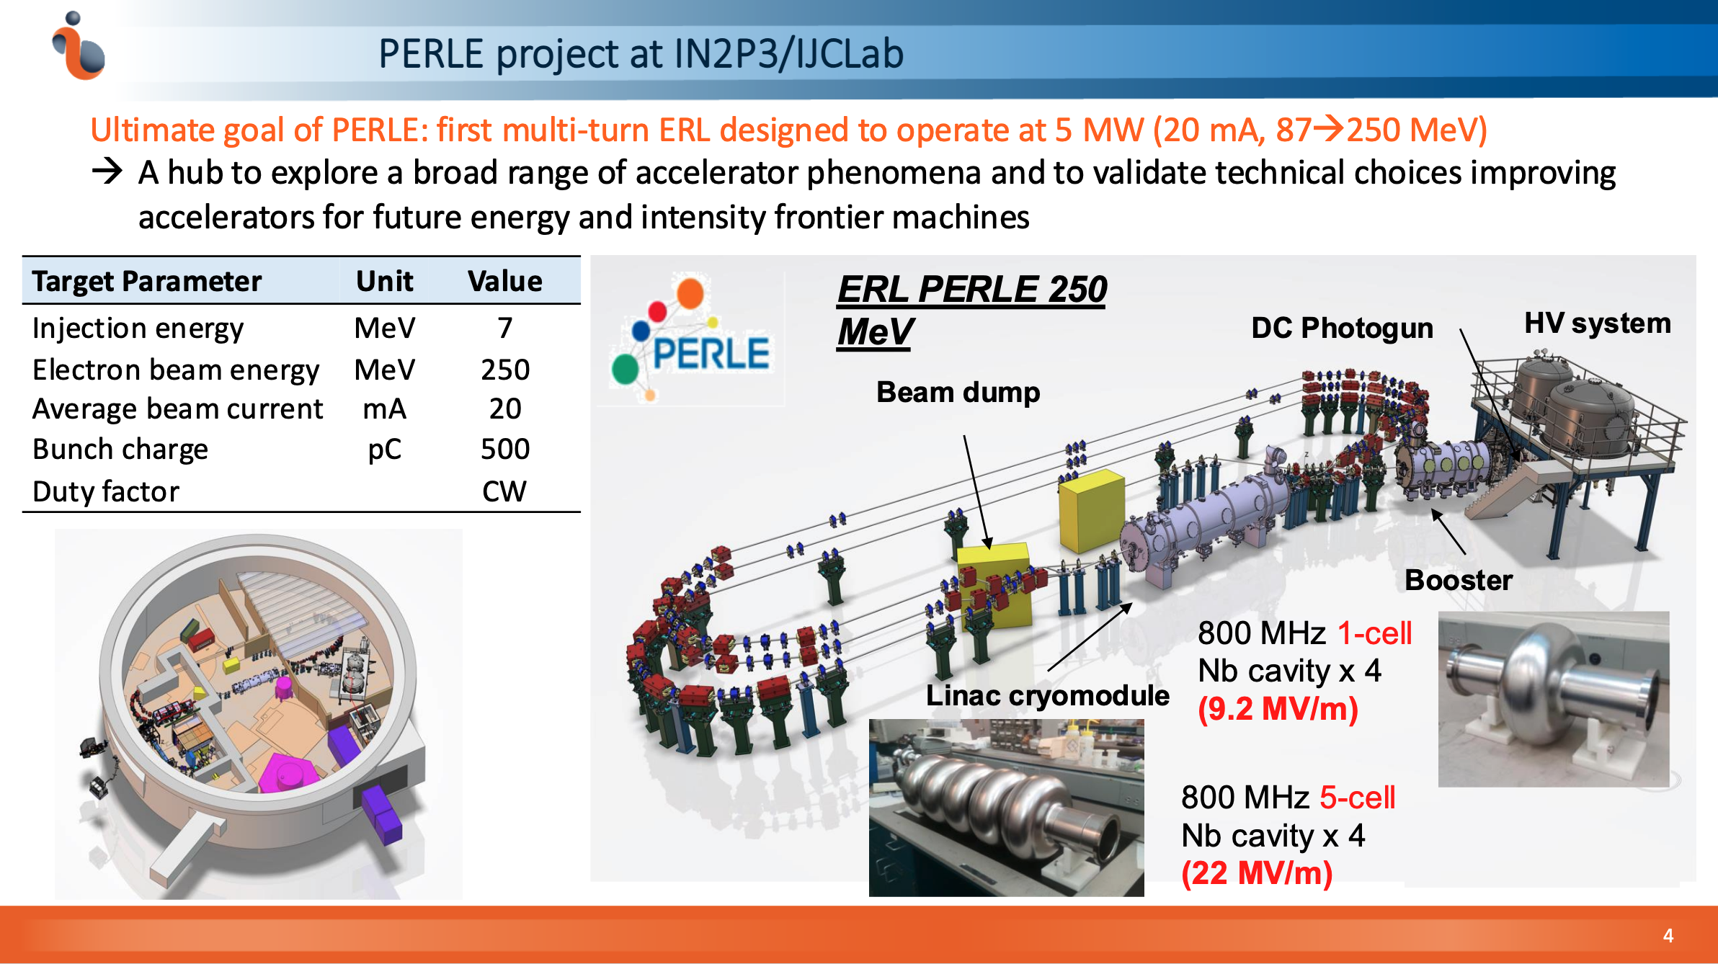
PERLE
A. Miyazaki, PERLE collaboration meeting, oct 2025

Slide 11
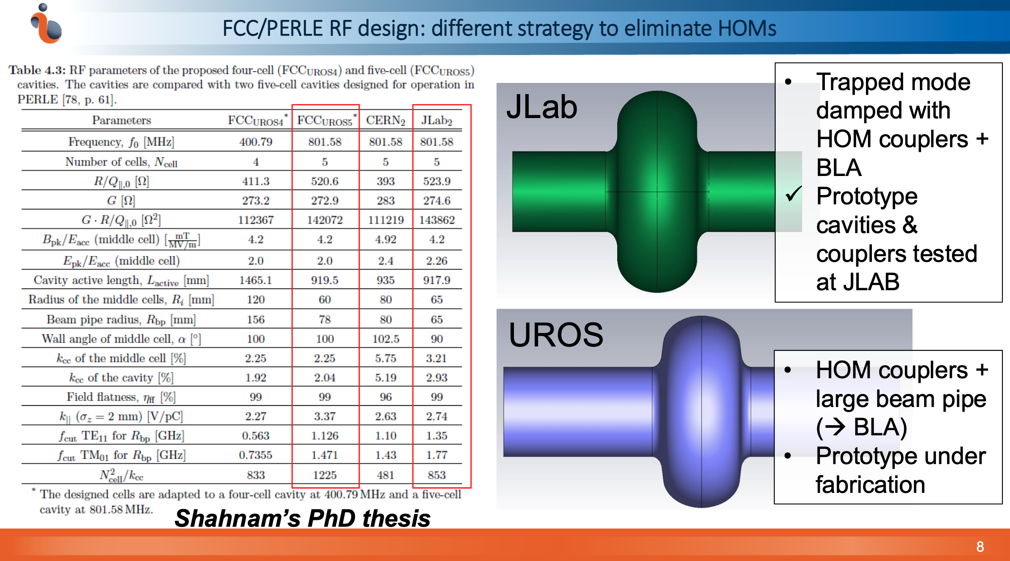
PERLE
A. Miyazaki, PERLE collaboration meeting, oct 2025

Slide 12
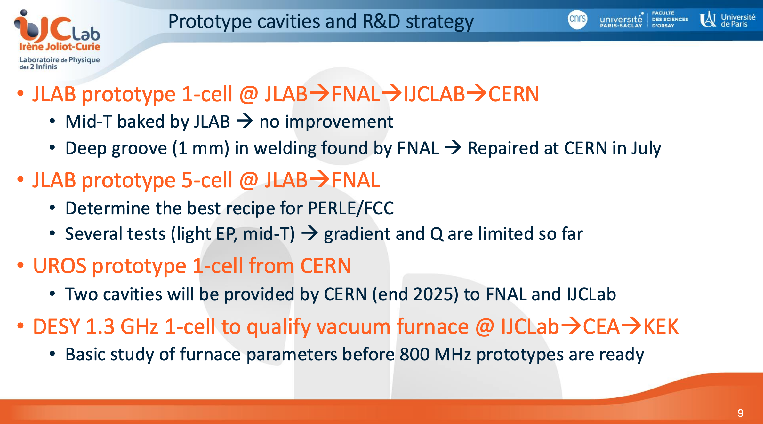
PERLE
A. Miyazaki, PERLE collaboration meeting, oct 2025

Slide 13
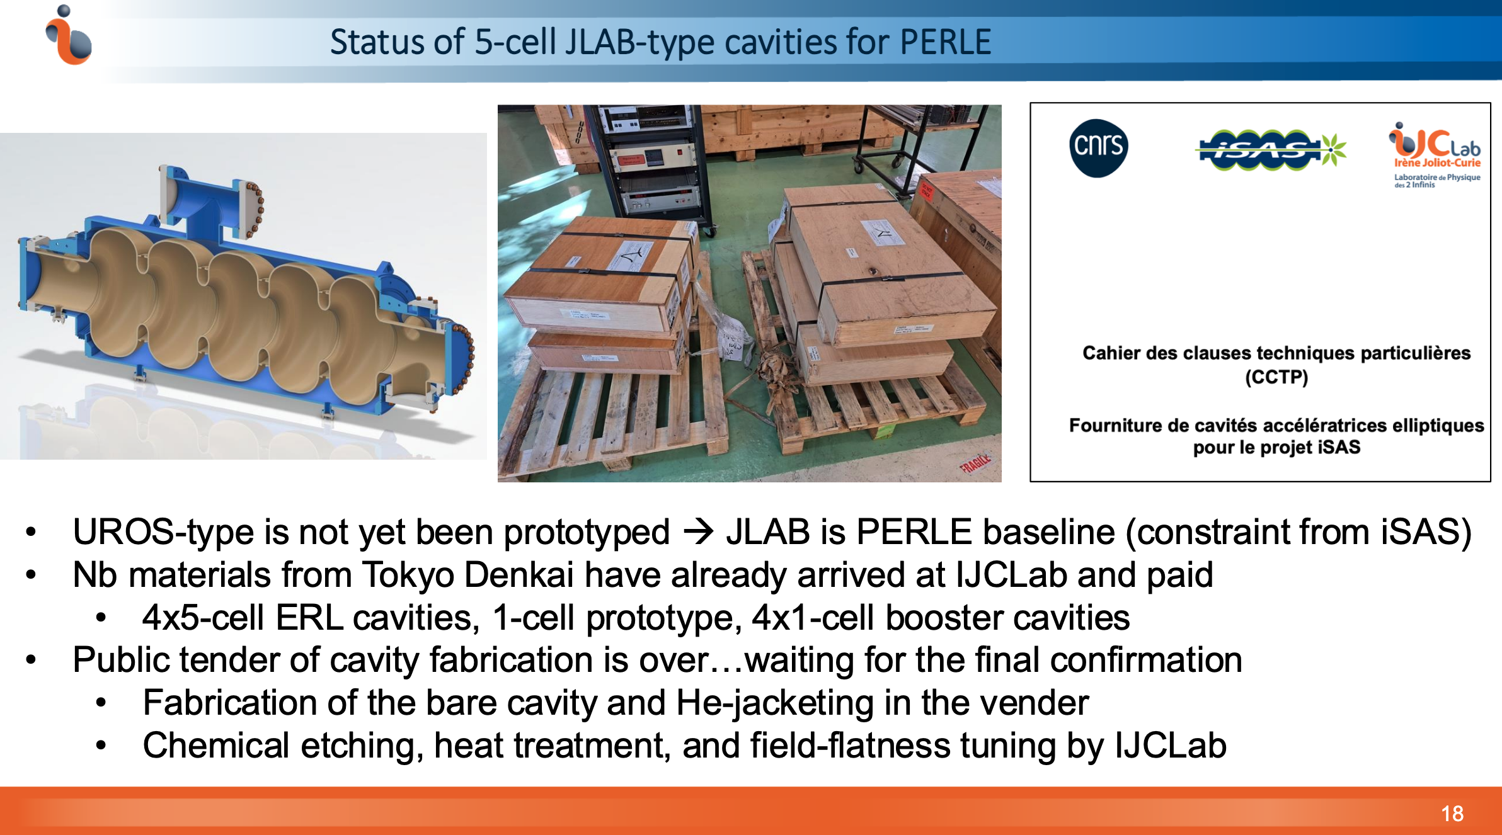
PERLE
A. Miyazaki, PERLE collaboration meeting, oct 2025

Slide 14
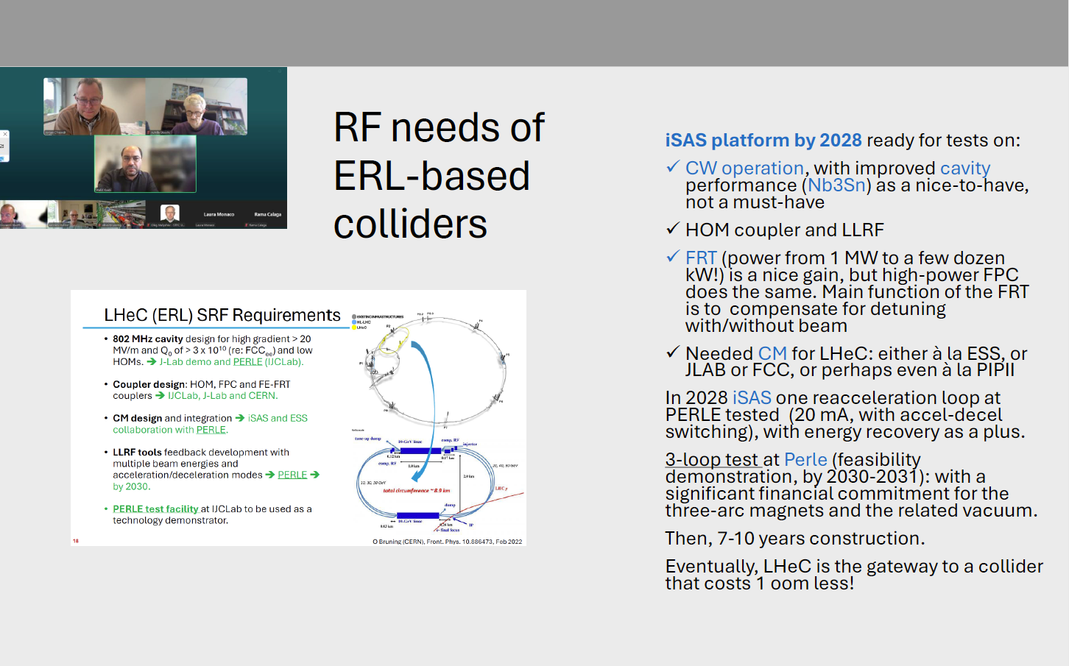
LHeC : SRF needs from meeting

Slide 15
Challenges toward new generation of efficient ERL
Challenges on RF/SRF system
ERL specificity
Undesired effect
Proposed solutions
Cavity treatment with optimised recipe (EP, Doping, infusion, Mid T-baking…)
Act on cavity design + optimized HOM couplers and BLA
Optimized Filling pattern and HOM extraction & damping scheme
Development of FE-FRT
Development of a digital AI-assisted field and detuning control, smart amplifier control
CW operation (RF)
High current operation
Multi-pass/multi-bunch operation
Efficient use of RF power
Efficient beam energy recuperation
High dynamic losses
High HOM excitation
Increase beam instabilities
Microphonics detuning and mechanical stability
Beam load variation, Mismatch between acc/decc bunches
High Q₀ cavity
Efficient HOMs extraction
The highest BBU threshold
Fast tuning, prevent external vibrations
Fast feedback and perfect phase synchronisation

Slide 16
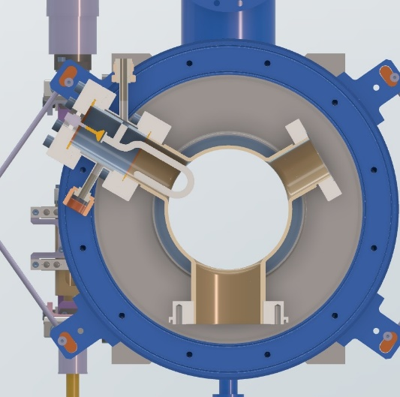
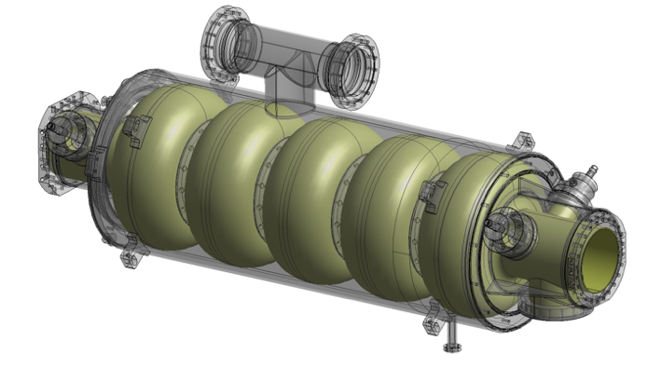
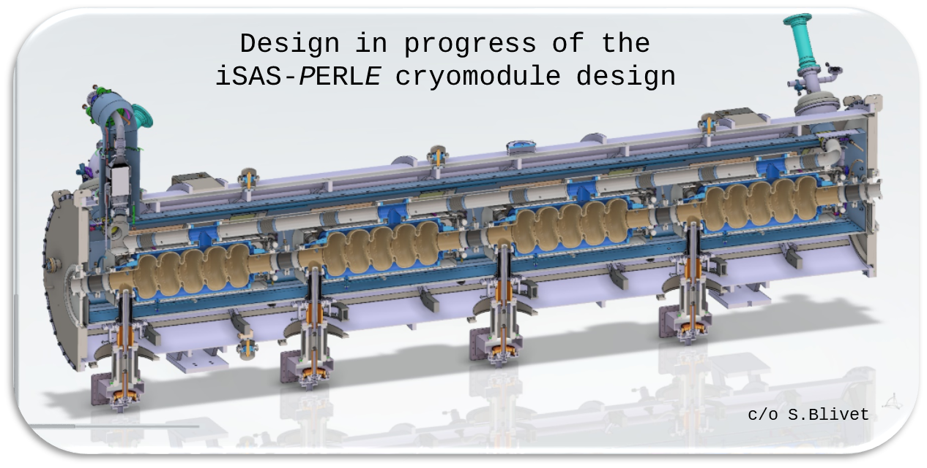
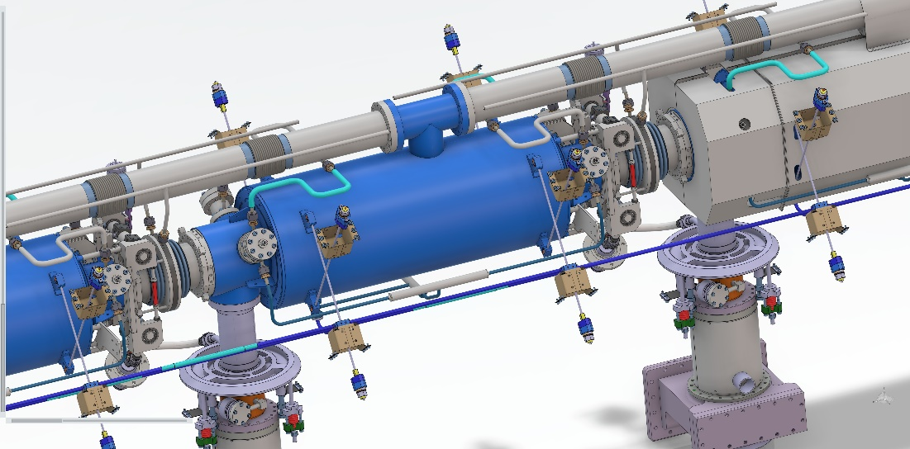
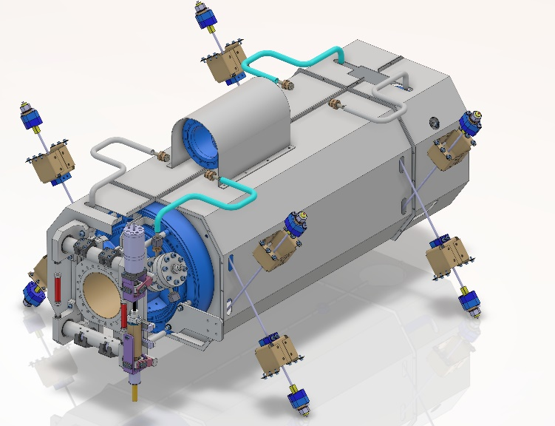
PERLE Cryomodule minimum configuration in 2028
HOM couplers: 2 Hook type / cavity
5-cell 800MHz cavities (bulk Nb): 22.5MV/m @ Qo 3E+10
Power Couplers: P=35kW CW
+ RF power sources: 50kW CW max
Cold Tuning Systems with piezos

Slide 17
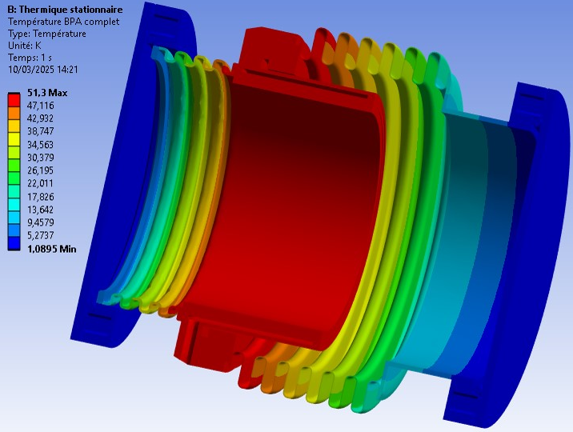
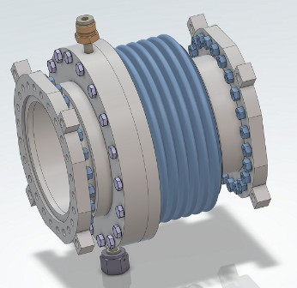
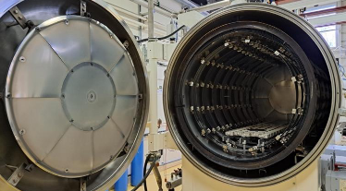
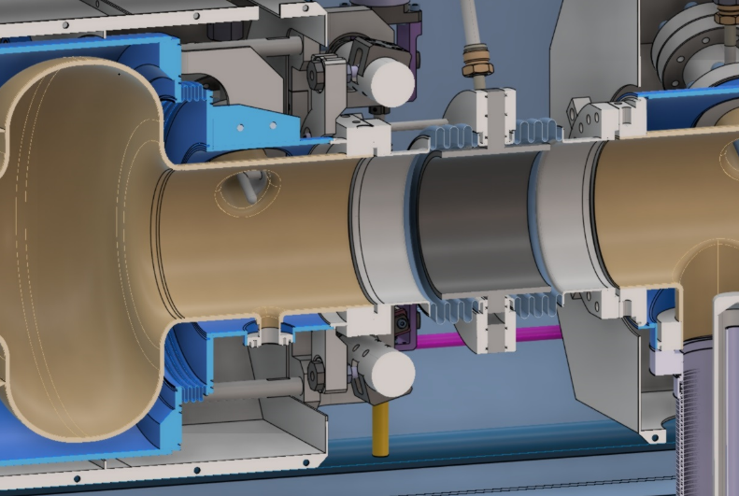
PERLE Cryomodule improved configuration for 2033?
5 cell 800MHz cavities (bulk Nb): 22.5MV/m @ Qo > 3E+10
Compact cold beam absorbers (50W @ 40K)
Optimized preparation (cold EP) and heat treatments
+
Optimized fast cooling scenario
Power Couplers: P=<25kW CW with optimized bandwith (<80Hz)
+ RF power sources with high efficiency (>85%)
Fast Reactive Tuners to mitigate microphonics detuning

Slide 18
PERLE Cryomodule ideal configuration > 2035
5 cell 800MHz cavities made of Nb3Sn

