Slide 1
Collection of statements of interest towards FCC-ee related RF R&D for the LDG RF panel
Frank Gerigk & Franck Peauger, 28.01.2026

Slide 2
Critical RF challenges for FCCee
400 MHz 2-cell cavities & 800 MHz 6-cell cavities
RF power & HOM couplers 400 MHz + 800 MHz
400 MHz & 800 MHz prototype CM
400 & 800 MHz high-efficiency power source
400 & 800 MHz high-power infrastructure for coupler and system test

Slide 3
Request to potential collaborators
State interest in one or more of these activities,
State if additional funding is needed to get involved,
List relevant infrastructure that could be of use for the topic in question,

Slide 4
Expression of interest by xxxLab
R&D challenge | Interest to participate | Additional resources needed | Existing infrastructure that could be used
400 MHz 2-cell cavities
800 MHz 6-cell cavities
400 MHz power & HOM couplers
800 MHz power & HOM couplers
400 MHz CM
800 MHz CM
High-efficiency power source 400 MHz
HE power 800 MHz
High-power test infrastructure

Slide 5

RF Roadmap 2026 - 2031
Construction
Tests
Design
funded
Design
Construction
Tests
not funded
Towards the first FCCee RF demonstrators & required RF infrastructures
 | 2026 | 2027 | 2028 | 2029 | 2030 | 2031
400 MHz 2-cell cavities
400 MHz cryomodule
800 MHz 6-cell cavities
800 MHz cryomodule
SA18 SRF building
400 MHz multi-beam tristron
800 MHz RF power source
RF test stations for power couplers and cryomodules
1st cavity fabricated
4 x cavities qualified
Nb/Cu coating recipe ready
HTC
DEMO
Full power test of 1x cavity
Cav. string assembly
Cryomodule ready for tests
1st coupler qualified
1st cavity fabricated
Cryomodule ready for tests
Building Permit
Partial handover
SA18 start of operation
Handover
Design Review
Manufacturing Review
Prototype tested
Adaptation of existing test stands
Start of SM18 transformation
After 2031:
Preparation of in-kind agreements, industrialisation and production the pre-series cryomodules in 2031-2036
Fabrication and qualification of 66 + 28 Cryomodules in 2036-2044.
Installation & commissioning: 2044-2046 → FCCee beam for Z, W, ZH operation in 2047.

Slide 6
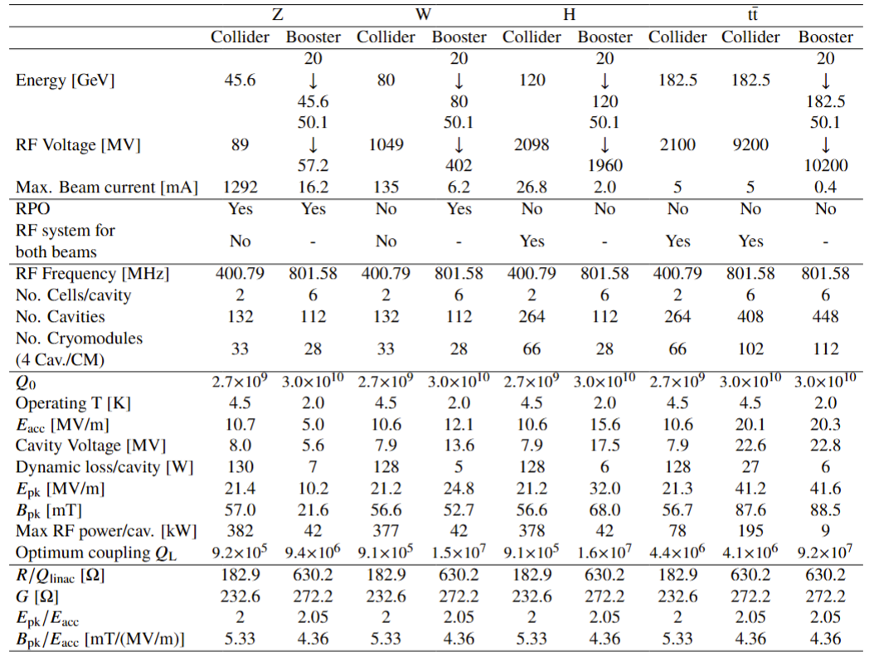
1,2) 400 & 800 MHz design specifications

Slide 7
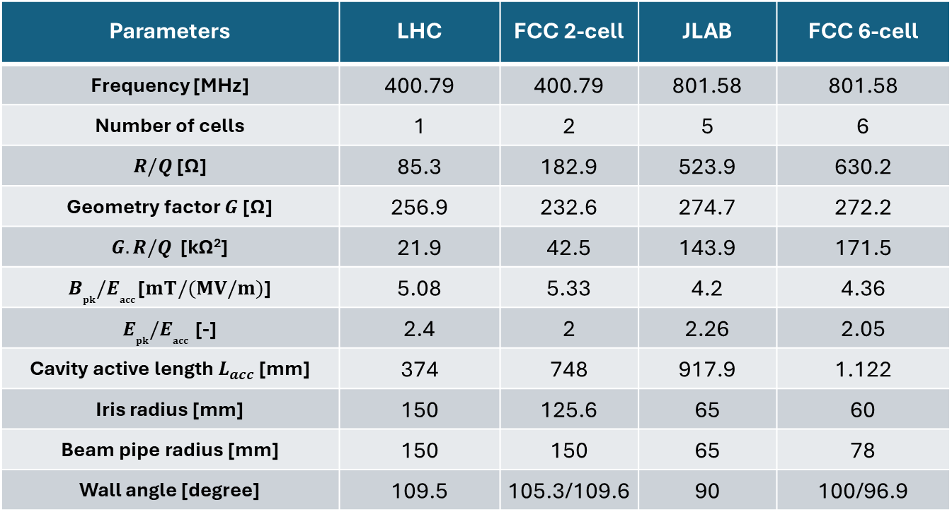
400 & 800 MHz cavity design parameters compared with existing cavities (LHC & JLAB test cavity)
Parameters | LHC | FCC 2-cell | JLAB | FCC 6-cell
Frequency [MHz] | 400.79 | 400.79 | 801.58 | 801.58
Number of cells | 1 | 2 | 5 | 6
$R/Q$ [Ω] | 85.3 | 182.9 | 523.9 | 630.2
Geometry factor $G$ [Ω] | 256.9 | 232.6 | 274.7 | 272.2
$G.R/Q$ [kΩ²] | 21.9 | 42.5 | 143.9 | 171.5
$B_{pk}{/E}_{acc}$ [$mT/(MV/m)$] | 5.08 | 5.33 | 4.2 | 4.36
$E_{pk}{/E}_{acc}$ [-] | 2.4 | 2 | 2.26 | 2.05
Cavity active length $L_{acc}$ [mm] | 374 | 748 | 917.9 | 1.122
Iris radius [mm] | 150 | 125.6 | 65 | 60
Beam pipe radius [mm] | 150 | 150 | 65 | 78
Wall angle [degree] | 109.5 | 105.3/109.6 | 90 | 100/96.9

Slide 8
TRL levels
TRL1 | Define basic properties
TRL2 | Analystical study
TRL3 | Proof of concept
TRL4 | Pre-prototype
TRL5 | Pre-prototype tested in lab
TRL6 | Prototype tested in relevant environment
TRL7 | Approved prototype
TRL8 | Pre-serial manufacturing
TRL9 | Series production (product on market)
Interpretation for cavities:
TRL3: sample test achieves specs
TRL4: a similarly shaped cavity without ports has achieved similar specs in a vertical cold test
TRL5: bare and dressed cavities with ports in vertical cold test has achieved specs
TRL6: fully dressed cavity with FPC in horizontal test achieves specs
TRL7: cavity in prototype CM achieves specs

Slide 9
1) 400 & 800 MHz cavity specifications
Input for ESPP
Cavity configuration |  | single cell w/o ports | multi-cell w/o ports | bare with ports | dressed (He tank, HOMCs) | HTC (FPC, tuner, shielding) | CM
Test orientation |  | vertical | vertical | vertical | vertical | horizontal | horizontal
Technical readiness |  | TRL4 | TRL4 | TRL5 | TRL5 | TRL6 | TRL7
400 MHz | Cavity design | LHC |  | FCC 2-cell
 | E_{acc} (MV/m) | 8.5 @ 4.5K 10 @ 4.0 K | - | 13 | 12.4 | 11.8 | 10.6
 | Q₀ | 2.5x10⁹ @ 4.5 K 3.1x10⁹ @ 4.0 K | - | 3.3x10⁹ | 3.15x10⁹ | 3.0x10⁹ | 2.7x10⁹
800 MHz | Cavity design | FCC 1-cell | JLAB | FCC 6-cell
 | E_{acc} (MV/m) | Tests in 2026 | 30.0 | 24.8 | 23.6 | 22.5 | 20.25
 | Q₀ | Tests in 2026 | 3x10¹⁰ | 3.8x10¹⁰ | 3.65x10¹⁰ | 3.5x10¹⁰ | 3.0x10¹⁰
Achieved today
Goals

Slide 10
1) 400 & 800 MHz cavities: reaching TRL 6
Input for ESPP
Cavity | HTC (FPC, tuner, shielding) | Main parameter to be improved | Improvement factor | Manpower [FTE-y] | Material [MCHF] | Timescale [years]
400 MHz cavities, | 11.8 MV/m, Q=3.0x10⁹ | Gradient & Q | x2 (LHC) | ~12 | 6 (CERN) | 5-6
800 MHz cavities | 22.5 MV/m, Q=3.5x10¹⁰ | Q | 6 (ESS) | ~10 (coll. + CERN) | 6 (coll. + CERN) | 5-6
The effort that CERN estimates to reach TRL 6. So far for 400 MHz the effort takes place only at CERN. For 800 MHz multiple labs are capable of working on the recipe. The effort of multiple labs would be appreciated to reach the specs.

Slide 11
2) 400 & 800 MHz FPC & HOMC
 |  | High-power similar coupler | Low power test protoype | HP test (test box) | HTC (FPC, tuner, shielding) | CM with beam
TRL |  | TRL4 | TRL4 | TRL5 | TRL6 | TRL7
400 MHz | FPC P_{CW} (kW), 382 if matched, 500 to compensate failing cavities | LHC: 300 kW, tested at 500 kW (>= 500 may need full height waveguides) | S11 <-25 dB | 600 (only for Z) | 600 | 600
 | HOM P_{CW} (kW) | LHC Hook: 1 kW ? SOLEIL Hook: designed for 5 kW | S21 <-90 dB at fundamental mode, S21> -15 dB at HOMs | ⁻ | Test of fundamental mode rejection | Narrow band: 1 kW Wide band (coax, BLA): 7 kW (between cavities)
800 MHz | FPC P_{CW} (kW), 196 if matched, 250 with margin | SNS 805 MHz FPC: 550 kW pulsed, 50 kW average, ESS 704 MHz FPC: 1.2 MW pulsed, 60 kW average, SPS 800 MHz window (disk): 150 kW CW | S11 <-25 dB | 250 | 250 | 250
 | HOM P_{CW} (kW) | ? | S21 <-90 dB at fundamental mode, S21> -15 dB at HOMs |  | Test of fundamental mode rejection | Narrow band: 0.2 kW per C Wide band (BLA): 3 kW
Achieved today
Goals

Slide 12
2) 400 & 800 MHz FPC & HOMC: reaching TRL 6
Input for ESPP
Coupler |  | HTC (FPC, tuner, shielding) | Main parameter to be improved | Improvement factor | Manpower [FTE-y] | Material [MCHF] | Timescale [years]
400 MHz | FPC P_{CW} (kW) | 382+margin -> 600 | Av. power | x 2 | ~ 2 - 3 FTE.y | ~ 3 - 4 MCHF | 5-6
 | HOM P_{CW} (kW) | ^{Narrow band: 1 kW per coupler} Wide band (coax, BLA): 70 kW per CM | power | ^{Narrow band: x 1} Wide band: x 4 compared to SuperKEKB | ~ 1 - 2 FTE.y | ~ 0.6 - 0.8 MCHF | 5-6
800 MHz | FPC P_{CW} (kW) | 195+margin -> 250 | Av. power | x 5 | ~ 2 - 3 FTE.y | ~ 2 - 3 MCHF | 5-6
 | HOM P_{CW} (kW) | ^{Narrow band: 0.2 kW} ^{Wide band (BLA): 3 kW} | power | ^{Narrow band: x 1} Wide band: x1000 compared to XFEL | ~ 1 - 2 FTE.y | ~ 0.6 - 0.8 MCHF | 5-6
The effort that CERN estimates to reach TRL 6. So far a dedicated design & construction effort takes place only at CERN, however multiple labs are capable of working on the design. Support for design review, industrialisation, and testing would be appreciated.

Slide 13
3) TRL levels for cryomodules
TRL1 | Define basic properties
TRL2 | Analystical study
TRL3 | Proof of concept
TRL4 | Pre-prototype
TRL5 | Pre-prototype tested in lab
TRL6 | Prototype tested in relevant environment
TRL7 | Approved prototype
TRL8 | Pre-serial manufacturing
TRL9 | Series production (product on market)
Interpretation for CMs:
TRL4: CM assembled,
TRL5: low-power cold test (cryogenic performance, cavity frequencies, coupler adjustments, tuner)
TRL6: full power cold test in test stand
TRL7: test with beam (PERLE, LHC?)

Slide 14
3) 400 & 800 MHz CM: effort for (TRL5), full power cold test (TRL6) not yet funded
CM |  | Critical aspects | Manpower [FTE-y] | Material [MCHF] (excluding cavities, FPC, HOMS) | Timescale [years]
400 MHz | Collider | New key items: He tank, tuner, integration new FPCs, HOMs Complex and heavily manpower demanding, new large assembly infrastructure (SA18) Prototype (performance) in time for pre-series (costing) Transport from European labs/industry | ~ 50 FTE.y | ~ 9-10 MCHF (CERN effort) | 6-7
800 MHz | Booster/Collider (ttbar) | Depending on collaboration with labs (no commitment today) Relies on competence of labs → importance of prototyping Integration of HP FPC (CERN delivery) Engineering and QA/QC compatibility with non-EU standards and norms (pressure equipment) Overseas transportability | ~ 50 FTE.y | ~9-10 MCHF (estimated external effort) | 6-7

Slide 15
4) 400 & 800 MHz high-efficiency power sources
 |  | existing | Pre-protoype | High-power test | Tested on cavity | industrialisation
TRL |  | TRL4 | TRL4 | TRL5 | TRL6 | TRL7
400 MHz | type | LHC HE klystron | HE tristron | HE tristron | HE tristron | HE tristron
 | P_{CW} (kW) 382 in steady state, 500 to compensate for failing cavities | 350 | ? | 500 | 500 | 500
 | efficiency | 70% | 90% | 90% | 90% | 90%
800 MHz | type | IOT, (SPS) | tristron | tristron | tristron | tristron
 | P_{CW} (kW) 195 in steady state, 250 with margin | 40 kW | ? | 250 | 250 | 250
 | efficiency | ~68% | ? | 90% | 90% | 90%
Achieved today
Goals

Slide 16
4) 400 & 800 MHz power sources: reaching TRL 6
Input for ESPP
Cavity | HTC (FPC, tuner, shielding) | Main parameter to be improved | Improvement factor | Manpower [FTE-y] | Material [MCHF] | Timescale [years]
400 MHz | 500 kW CW | CW power | X1.4 (LHC) | xx | xx (CERN) | 3
800 MHz | 250 kW CW | CW power | 6.2 (SPS) | xx | xx (coll. + CERN) | xx
Collaboration with SLAC and Thales/IJCLab on single beam HE-IOT. Multi-beam tristron effort based at CERN.

Slide 17
5) 400 & 800 MHz cavities, couplers and cryomodules: infrastructure needed for TRL6 validation
Cavity Vertical Test Stand (2026), more or less existing at CERN
Self Excited Loop, precise RF power meters
RF amplifier: 400 MHz (700 W CW) & 800 MHz (400 W CW)
Vertical cryostats and cryogenics, instrumentation, controls, interlocks
High-Power Coupler Test Stand (2028), to be implemented
High power RF source in CW and circulator: 400 MHz - 600 kW , 800 MHz - 250 kW, either full power sources or resonant ring with LHC klystron (400 MHz, 2x multiplication) and resonant ring with IOT (800 MHz, 6-7x multiplication)
RF distribution (matched load and variable short circuit), cooling, bakeout, vacuum, LLRF & controls, interlocks
Cryomodule Test Stand (2031/32) to be implemented
Compatible with Horizontal Test Cryostat (HTC) and cryomodules
High power RF source in CW and circulator: 400 MHz - 500 kW , 800 MHz - 250 kW
RF distribution (waveguide switches), cooling, bunker, cryogenics, vacuum, LLRF & controls, interlocks

Slide 18
Present landscape of collaborations (many still to be agreed)

Slide 19







SRF R&D Ongoing collaborations
SRF Basic Research
Fundamental SRF research
Magnetic flux expulsion studies
Point contact Tunneling Spectroscopy
Nb coating on copper
Nb3Sn coating on copper
Nb3Sn coating on niobium
Atomic Layer Deposition
SRF thin films
High Q0 800 MHz cavities
Clean room process, chemistry, surface inspection & robotisation
SRF surface treatments
SRF process equipment for SA18 building
Low & high pressure ultra-pure water rinsing systems
Clean equipment (Lifters, gantries, assembly toolings)
Horizontal airflow cleanrooms
Hydroforming of copper cavity substrates
Dry cryogenics cooling
Cavity test methods and diagnostics
Ferro-electric Fast-Reactive tuner
SRF Technologies

Slide 20
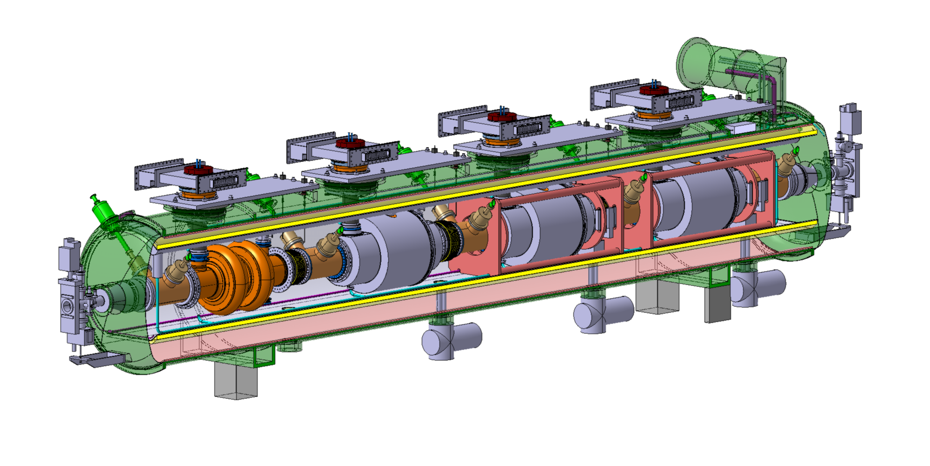

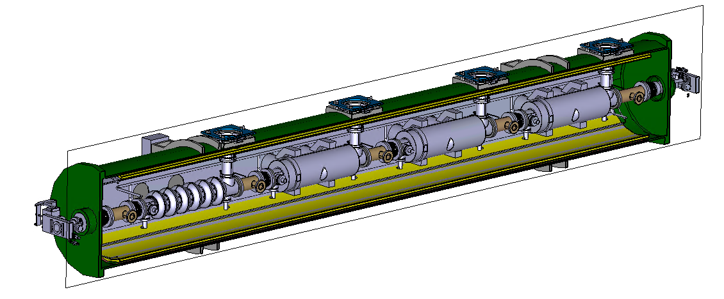
SRF Hardware Developments Collaborations (partly agreed & under negotiation)
400 MHz cryomodule prototype
Design
Cavities procurement
Cavity surface treatment & tests
Cryomodule construction
Cryomodule Testing
Design
Cavities procurement
Cavity surface treatment & tests
Cryomodule construction
Cryomoudle Testing
800 MHz cryomodule prototype

Slide 21
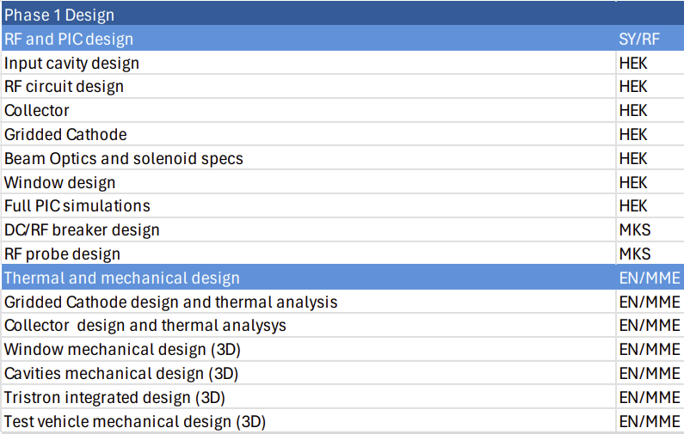
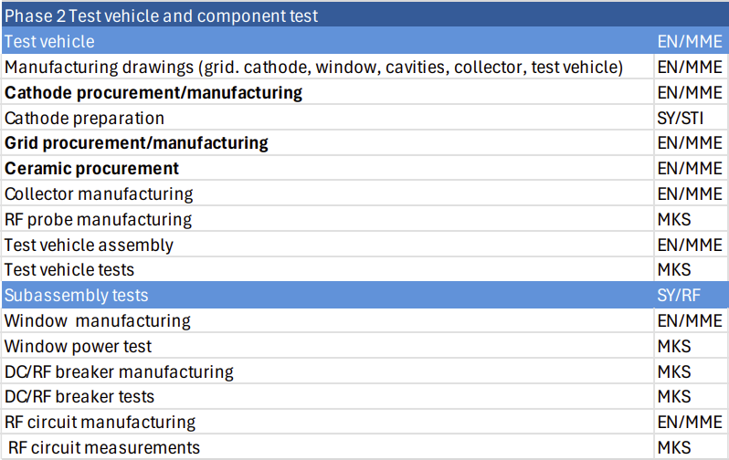
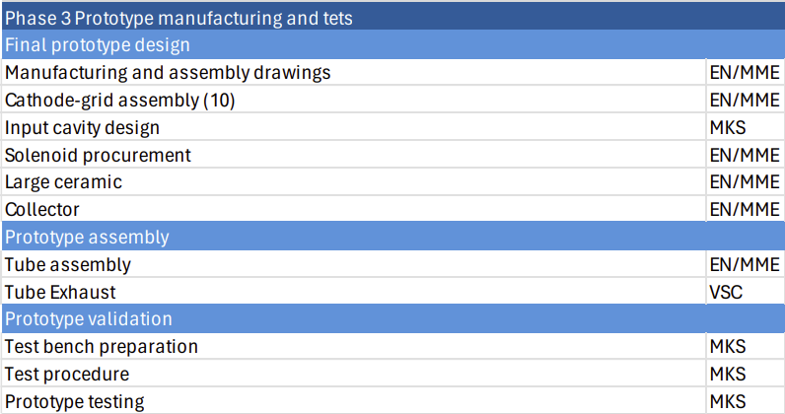
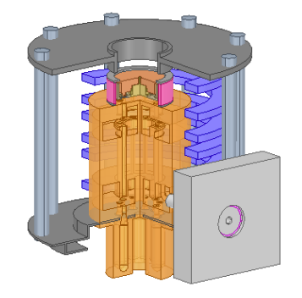


Tristrons Collaborations & Work Breakdown
Tristron prototype development 400 MHz
Single beam / multibeam Tristron stiudies
Single beam high efficiency IOT studies
Tristron and IOTs studies 800 MHz

Slide 22
Technical highlights

Slide 23
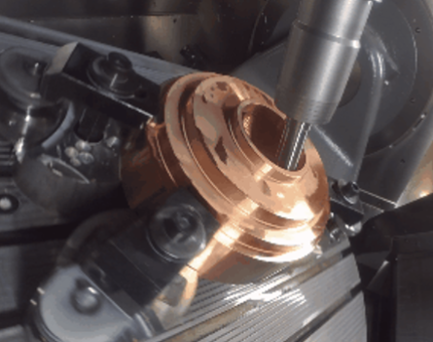
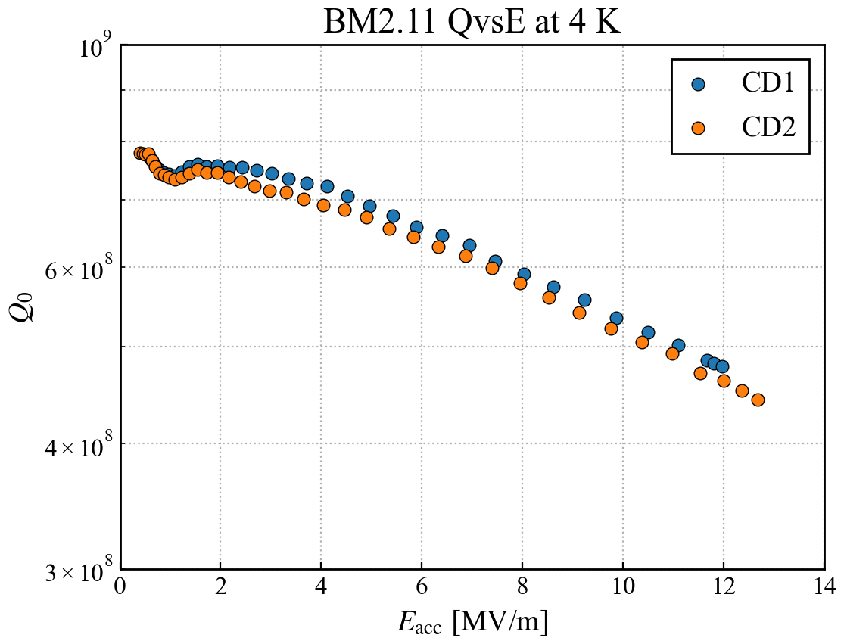
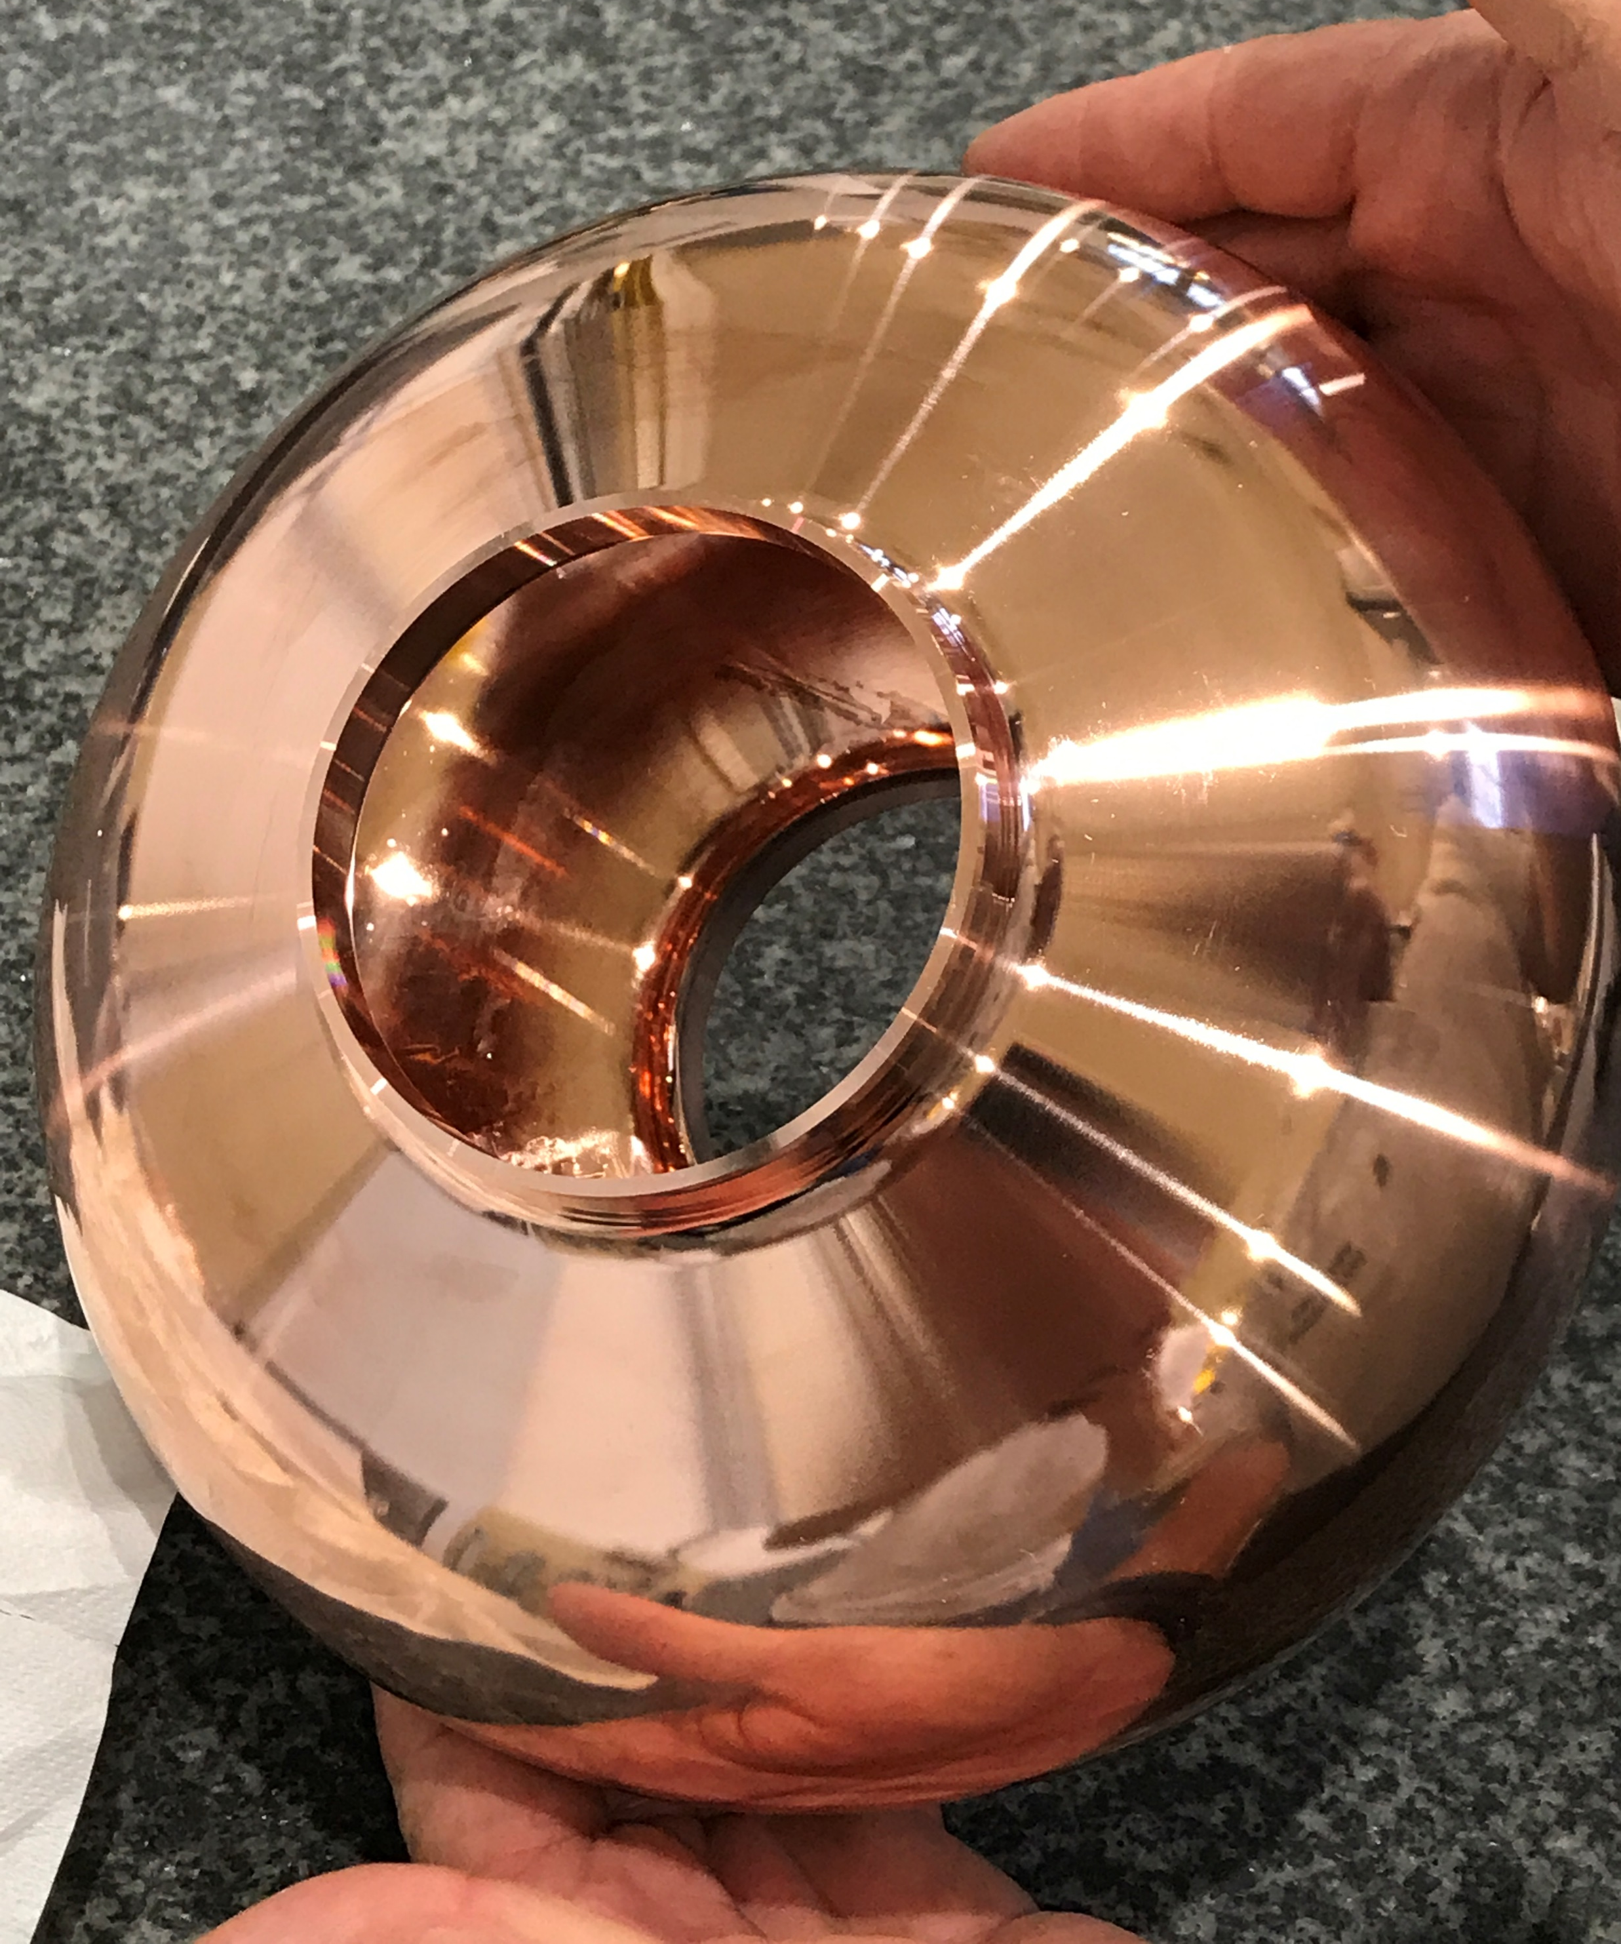
Cavity Performances – 1.3 GHz Nb/Cu
With “seamless” 1.3 GHz cavities, the chemical electropolishing and niobium coating using High Power Impulse Magnetron Sputtering (HiPIMS) has shown successful performances at cold temperature.
The scaled FCC targets for Eacc and Q0 have been reached on bulk machined cavities with a good reproducibility.
Some promising preliminary results were obtained recently on hydroformed cavities within the CERN-KEK collaboration.
BM2.11
Scaled FCC target
4.2 K
Kristof Brunner (CERN) - LCWS 2025

Slide 24
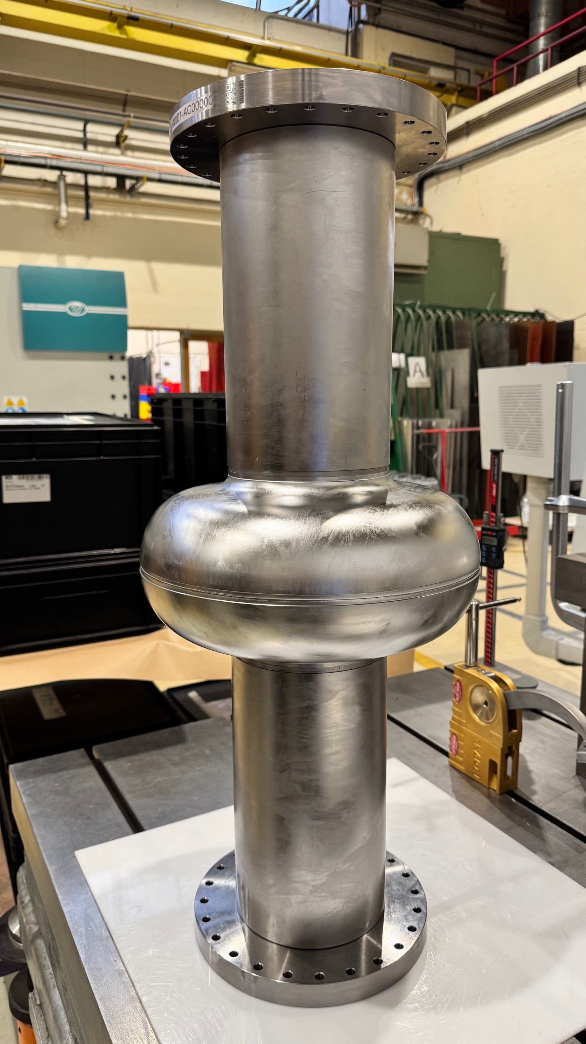
Cavity Fabrication – 800 MHz single cell
The main goal is to find the good recipe to reach ultra-high quality factor Q0 with the FCC design shape.
The mechanical design is also compatible with Nb3Sn thin film coating.
Single cell cavities are under fabrication at CERN/MME.
Knowledge of deep-drawing and electron beam welding process of niobium inherited from crab cavities manufacturing.
2 + 5 cavities will be produced in 2026.
Surface treatments will be done outside CERN :
Involvement of FNAL, IJCLab and Cornell University
3 additional cavities could be manufactured to explore both high Q0 and high gradient -> interesting for other projects
With DESY ? CEA ? KEK ?

Slide 25
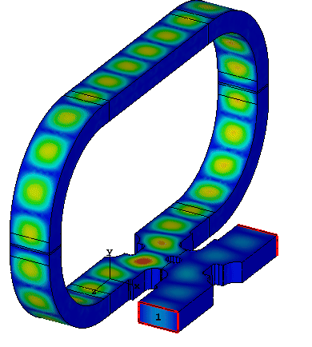
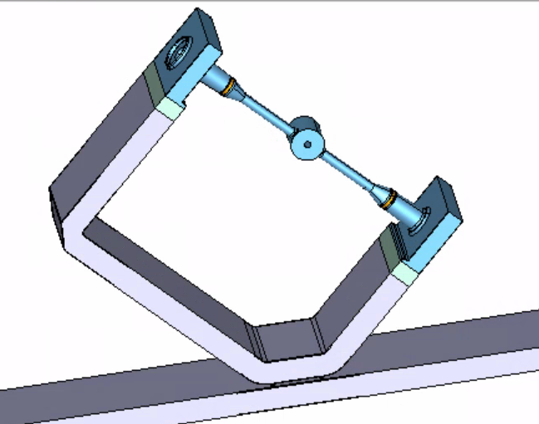
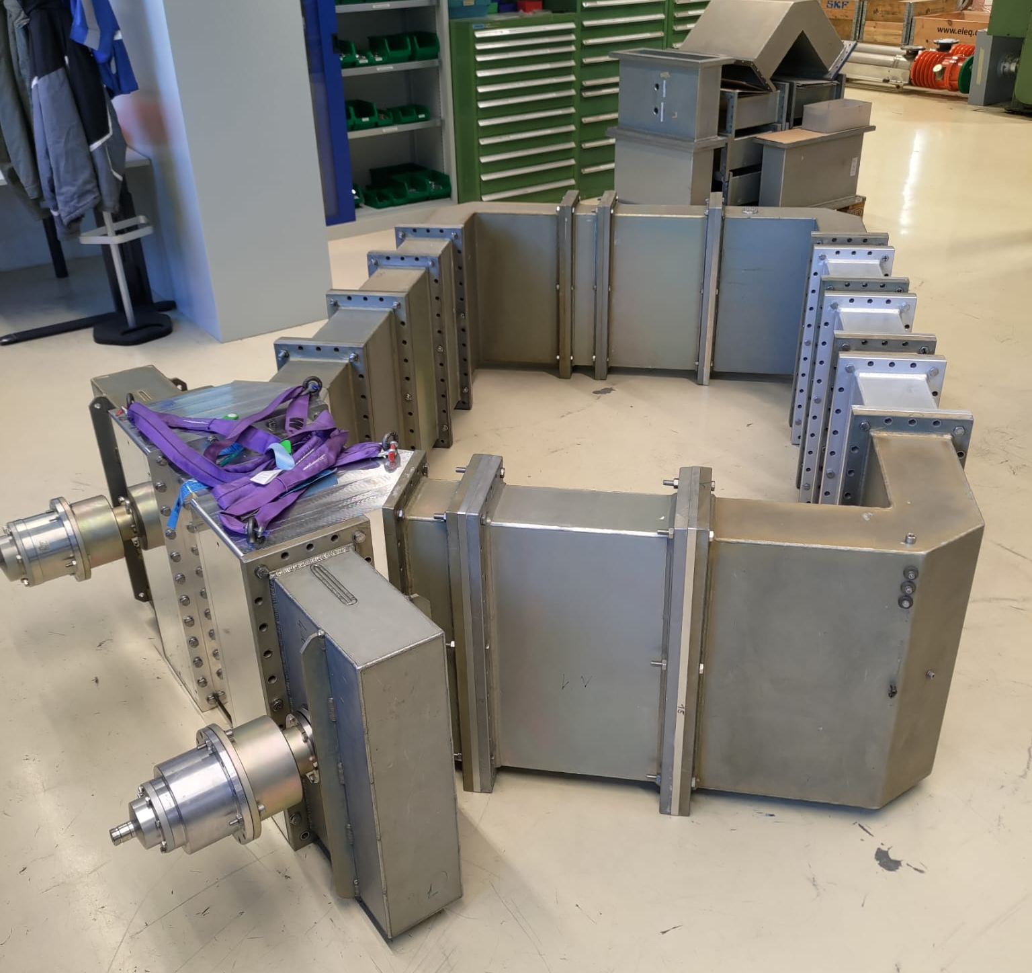
RF Resonant Ring
Prototype ring at 400 MHz in b. 864
Coupler 1
Test box
Coupler 2
A promising solution to test new Fundamental Power Couplers for FCC at nominal power with very limited investment (no need of high-power source).
Typical Gain ~ 10 dB.

Slide 26
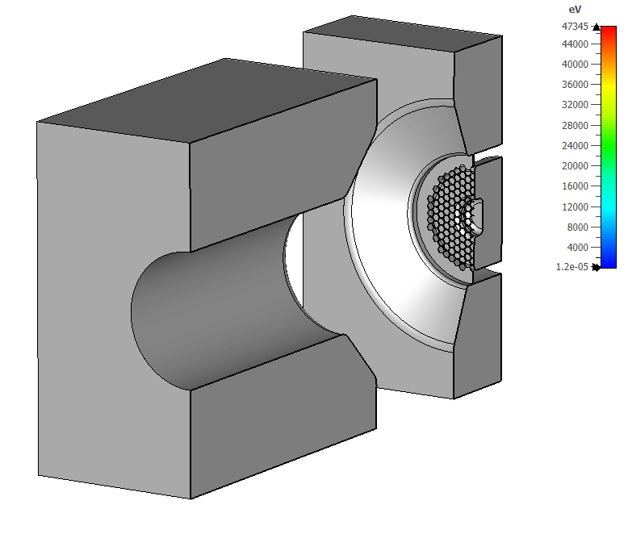
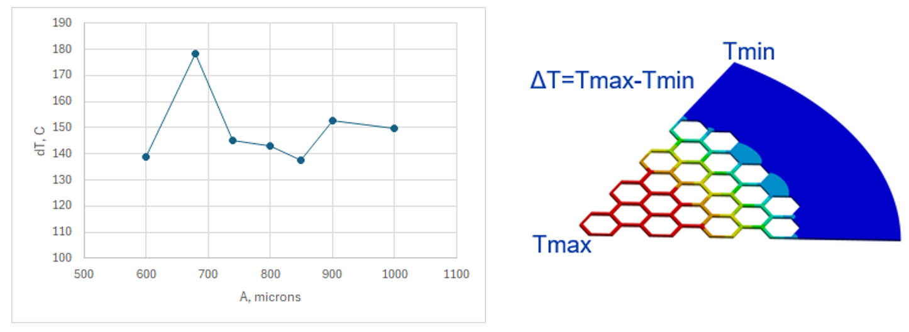
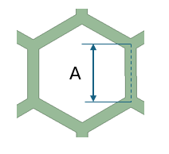
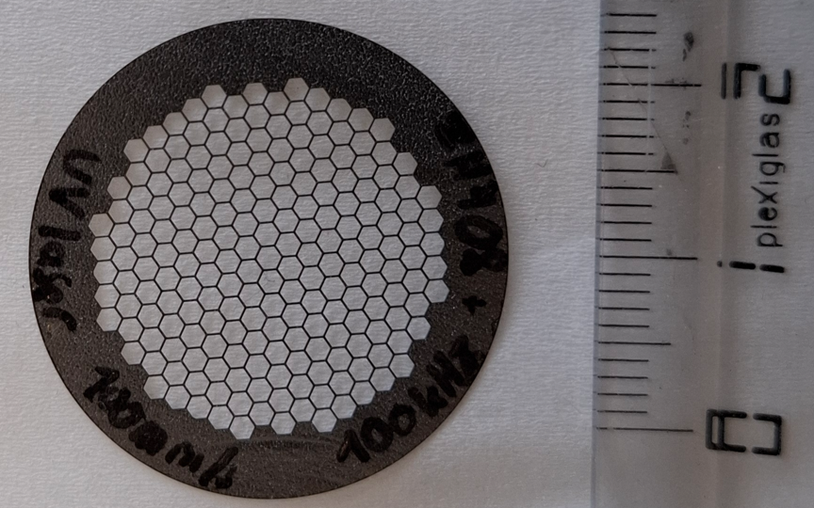
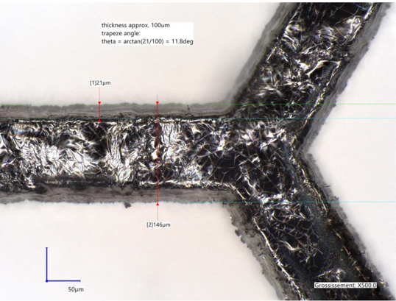
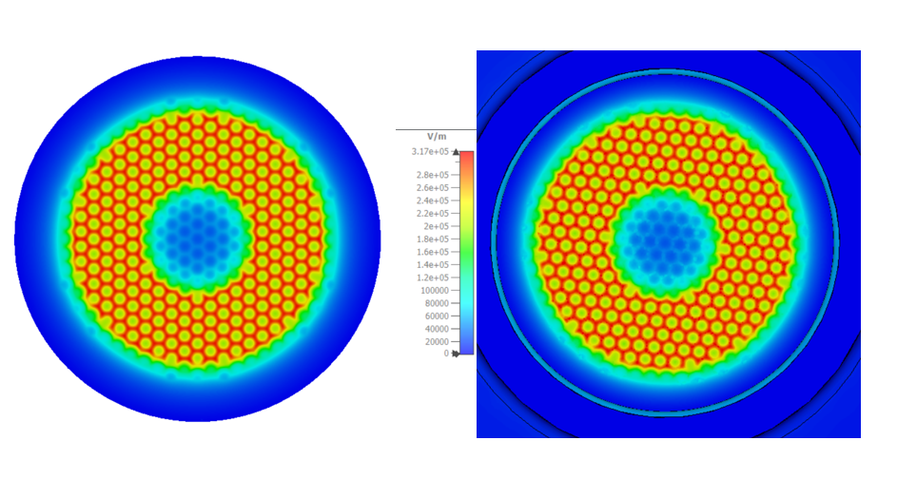
Gridded cathode is a core element of the tristron.
Tristron Gridded cathode
CST PIC simulations.
Gridded cathode development is a multi-discipline project:
Massive beam dynamics simulation and analysis.
Thermomechanical and deformation studies.
Mechanical integration with unique precision of 10μm.
Fabrication technology and reliability.
This project is on a good pace with (almost) all deliverables been following the planned schedule.
Temperature rise of the gid for the different beam opacity.
The full-scale grid was fabricated in January 2026 at CERN EN/MME using laser cutting technique on the 100 microns thick pyrolytic graphite (TPG) foil:
Electrostatic (left) and RF (right) field patterns in the middle of the cathode – grid gap.
Courtesey of Igor Syratchev and EN/MME team

Slide 27
Expressions of interest

Slide 28
Expression of interest by IJCLab+LPSC
R&D challenge | Interest to participate | Additional resources needed | Existing infrastructure that could be used
400 MHz 2-cell cavities
800 MHz 6-cell cavities | Preparation & test @ IJCLab | 20 k€ (EP) + 25 k€ (VT) per catity | Supratech platform
400 MHz power & HOM couplers | Multipactor studies (FPC,HOM) |  | Multipactor LPSC test bench for simulation validation (400 MHz)
800 MHz power & HOM couplers | Test at IJCLab (data analyzis) Multipactor studies (FPC,HOM) | RF sources needed | Supratech platform Multipactor LPSC test bench for simulation validation (800 MHz)
400 MHz CM
800 MHz CM | Design @ IJCLab | - | -
High-efficiency power source 400 MHz
HE power source 800 MHz | Test @ IJCLab | Needed for FPC & CM tests | Supratech platform & PERLE facility
High-power test infrastructure | CM test with beam | RF sources | PERLE facility

Slide 29
Expression of interest by STFC-DL
R&D challenge | Interest to participate | Additional resources needed | Existing infrastructure that could be used
400 MHz 2-cell cavities | Y – UK Cu fabrication (not including coating) Cavity provision Present TRL4 To achieve TRL4 | Staff effort: 10 FTE yrs Cavity material (assumes 5 prototype cavities) Tooling (dyes etc) New CSI insert RF adaption to 400 MHz (Amplifier and ancilliries) HPR adaption for 400 MHz cavity Cost: ~£7.0M | UK fabrication/industry partnership (EBW, pressing, machining). Cryoplant Cavity test; VTF Bunker ISO4/5 Cavity Cleanroom HPR facility
 | Y – UK Cu fabrication (including coating) Present TRL4 To achieve TRL5 | Staff effort: 12 FTE yrs Cavity material (assumes 5 prototype cavities) + Coating material Tooling (dyes etc) New coating chamber Surface treatment facility New CSI insert RF adaption to 400 MHz (Amplifier and ancilliries) HPR adaption for 400 MHz cavity Cost: ~£8.5M | UK fabrication/industry partnership (EBW, pressing, machining). Existing superconducting thin film coating and characterisation capability (Deposition and and analysis) Cryoplant Cavity test; VTF Bunker ISO4/5 Cavity Cleanroom HPR facility
800 MHz 6-cell cavities | Y – UK Cu fabrication (including Nb/Nb3Sn coating) Present TRL2-3 To achieve TRL5 | Staff effort: 10-12 FTE yrs Material Tooling (dyes etc) Polishing capability and new deposition facility New CSI insert New RF amplifiers and ancilliaries HPR adaption for 800 MHz cavity Cost: ~£9.5M | UK fabrication/industry partnership (EBW, pressing, machining). Existing superconducting thin film coating and characterisation capability (Deposition and analysis) Cryoplant Cavity test; VTF Bunker ISO4/5 Cavity Cleanroom HPR facility
 | Y - UK bulk Nb fabrication Present TRL2-3 To achieve TRL5 | Staff effort: 10-12 FTE yrs Material Tooling (dyes etc) New CSI insert New RF amplifiers and ancilliaries HPR adaption for 800 MHz cavity Cost: ~£9.5M | UK fabrication/industry partnership (EBW, pressing, machining). ASTeC provide RF expertise. Cryoplant Cavity test; VTF Bunker ISO4/5 Cavity Cleanroom HPR facility

Slide 30
Expression of interest by STFC-DL
R&D challenge | Interest to participate | Additional resources needed | Existing infrastructure that could be used
400 MHz power & HOM couplers | N
800 MHz power & HOM couplers | N
400 MHz CM | Y – CM build Present TRL4 To achieve TRL5 | Staff effort: 35 - 40 FTE yrs (Design ~20 FTE yrs, Build ~15 -20 FTE yrs) Material New string assembley and CM tooling Etching facility Low power cold test capability to be developed Cost: ~£17.0M | ISO4/5 Cleanroom & string assembly infrastructure Existing CM build facility (PIP-II)
800 MHz CM | Y – CM build Present TRL4 To achieve TRL5 | Staff effort: 35 - 40 FTE yrs (Design ~20 FTE yrs, Build ~15 -20 FTE yrs) Material New string assembley and CM tooling Low power cold test capability to be developed Cost: ~£17.0M | ISO4/5 Cleanroom & string assembly infrastructure Existing CM build facility (PIP-II)
High-efficiency power source 400 MHz | N
HE power 800 MHz | N
High-power test infrastructure | Y – Cavity testing N - Coupler Testing N - CM Testing | Staff effort: ~0.5 - 1 FTE yrs New cryostat insert New RF amplifiers and ancilliaries (400 and/or 800 MHz) Cost: ~£0.5M | Cryoplant Cavity test; VTF Bunker

Slide 31
Expression of interest by ULAN
R&D challenge | Interest to participate | Additional resources needed | Existing infrastructure that could be used
400 MHz 2-cell cavities
800 MHz 6-cell cavities
400 MHz power & HOM couplers | Yes | Yes
800 MHz power & HOM couplers | Yes | Yes
400 MHz CM
800 MHz CM
High-efficiency power source 400 MHz | Yes | Yes | RF test bunker could be used for power source testing.
HE power 800 MHz | Yes | Yes | RF test bunker could be used for power source testing.
High-power test infrastructure

Slide 32
Next steps

Slide 33
Collaboration agreements
DESY– CERN: exchange on SRF R&D is ongoing. Framework agreement for collaboration on 800 MHz with funding via German ministry. Detailed agreement to be set up.
IJCLAB – CERN: framework agreement in place, detailed agreement in preparation (mechanical design of cavity, CM, some R&D work on cavity performance, CM testing at PERLE), financing in place.
STFC – CERN (incl. Lancaster Uni): agreement ready for signature on R&D under the umbrella of sustainability (e.g. total carbon footprint, exchange on chemistry and coating technologies, FRT, general SRF testing aspects).
CEA – CERN: fields of interest identified, further discussions needed to arrive at an agreement.
KEK – CERN: being prepared for signatures, general exchange on SRF R&D including exchange of cavities & personnel.
FNAL – CERN: work advancing on 800 MHz cavity & CM design (continues in parallel with IJCLAB), contract ready but not signed.
Cornell – CERN: personel exchange, interest in Nb3SN, missing funding for now.
JLAB – CERN: framework agreement in place. Active exchange on SRF R&D & FRT

Slide 34
Further discussions on collaborations
DESY– CERN meeting 29.01.2026: define scope of DESY engagement on 800 MHz (funded by German ministry)
3d CEA – CERN meeting 30.01.2026: preparation of a collaboration agreement (800 MHz CM assembly, couplers, SRF R&D, coating, etc). Fields of interest have been identified, financing to be clarified.
CEA – CERN (F. Sabatier & M. Benedikt), 23.03.2026: discussion on FCC collaboration & financing.
STFC – CERN meeting tbd: clarify resource needs for chemistry & coating infrastructure.
CERN – IJCLab, CEA, DESY meeting 07.04.2026: coordination between contributions to 800 MHz module.

Slide 35
Funding opportunities with German institutes
The DESY – CERN collaboration on prototyping 800 MHz cavities with industry is fully financed via a special grant from the German ministry.
The express purpose is to prepare Germany for a large industrial procurement (with supervision by institutes) in case FCC gets approved.
Further CERN collaborations with German institutes can be supported! (in view of future German procurements)
Potential topics include: power and HOM couplers, coupler testing (resonant ring), custom height waveguides and high-power equipment (between half-height and full-height), SRF high-Q, Nb3Sn, clean process equipment for clean-rooms (assembly toolings, LPR/HPR also with alcohol, in-situ FPC exchange, ..)

