Slide 1


RFCP – Preparation to the LDG workshop
GB and PAM
Zoom, January 28, 2026

Slide 2
Framework: ESPP, European Strategy Group, Dec 2025
The electron–positron Future Circular Collider (FCC-ee) is recommended as the preferred option for the next flagship collider at CERN.
A descoped FCC-ee is the preferred alternative option for the next flagship collider at CERN.
Then: CLIC and LCF , LEP3, LHeC
… development and industrialisation of key technologies: advanced SC and NC RF structures, efficient RF power sources (…)
…high-current multi-turn ERL
high-gradient wakefield acceleration, (…) bright muon beams (synergies with the US)
RFCP, LDG workshop preparation

Slide 3
RFCP Goal for the LDG workshop 1/2
M. Seidel: «The panel chairs will present the proposed future plans, expanding on the bullet lists previously prepared for the Nov 2025 LDG meeting. Please focus on the priorities and in particular updates with respect to the original roadmap”
Update of R&D objectives as stated at the February 2025 Review, focusing on:
  main R&D results to be achieved,
  target TRL (overall goal: TRL 6),
  required personnel and budgetary resources.
  The approach is now project-driven rather than theme-driven.
Project interactions:
  FCC (Frank), LHeC (Maud), LCF (Laura), CLIC (Walter), MC (Graeme), HALHF (David)
  close interaction with project representatives and RFCP-WG conveners.

Slide 4
RFCP Goal for the LDG workshop 2/2
Identification of contributing laboratories:
  labs already contributing to the various efforts,
  labs that could potentially contribute over the next six years,
  with the aim of closing the gap between needs and available resources.
Preparation for the LDG Workshop (19–20 February):
  prior to the workshop, LDG Directors must be fully informed of the content to be presented.
Level of commitment:
  contacts and agreements with laboratories will span different levels of maturity,
  ranging from initial expressions of interest to well-defined and concrete proposals
  (e.g. FCC may have an imminent and well-defined need).
Alignment within LDG:
  all LDG Directors must be aware of:
    what will be presented,
    the associated level of commitment from the different laboratories.

Slide 5
Critical RF Challenges
What are principal RF system demands:
  Accelerator technology (bulk, thin film, NC)
  Power Coupler (power, configuration)
  Amplifier technology (technology, power)
  RF control (stability, synchronisation, reliability)
Template

Slide 6
Design Specifications
All principal RF operating performance parameters for HEP facility:
  i.e. Frequency, power, gradient, Qo, stability, etc.
Template

Slide 7
R&D Objectives to reach TRL6
What’s been reached today.
What’s still to be completed for next ESPP period:
  I.e. design, prototype, verification, integration, demonstration
Template

Slide 8
Infrastructure
What development/validation infrastructure required.
What exists currently and is being used.
Who might have applicable infrastructure.
Template

Slide 9
Objective Resources
How much total staffing required (from now).
How much equipment cost required (from now).
Timescale anticipated to complete objective (from now).
What collaborators are currently involved.
What new collaborators could be involved.
Template

Slide 10
Delivery Plan (per primary objective)
Objective 1 | Yr1 | Yr2 | Yr3 | Yr4 | Yr5 | Yr6
Design
Manufacture
Validate
Integrate
TRL6 Demonstration
Template

Slide 11
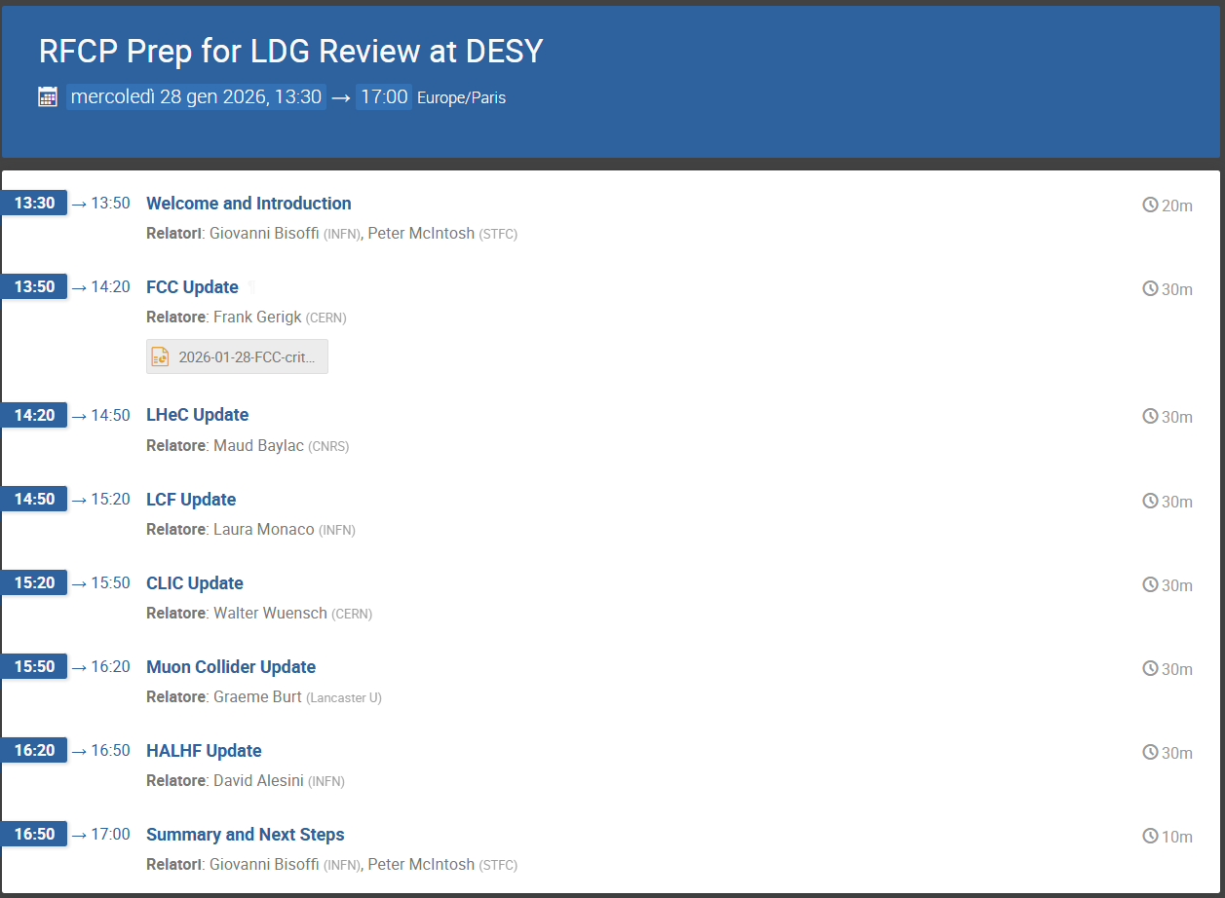

Slide 12
Action plan
Check how far we are today (January 28)
Trigger actions to fill the gaps, provide material (Jan 29-Feb 9)
Converge on a message to LDG directors within February 10
Prepare the presentations to the LDG workshop (Feb 11-18)
Ideally: at least the coordinators (Frank, Maud, Laura, Walter, Graeme, David) in presence in Hamburg on Feb 19
There might be a report to write, soon after the LDG workshop: we count on your support

Slide 13
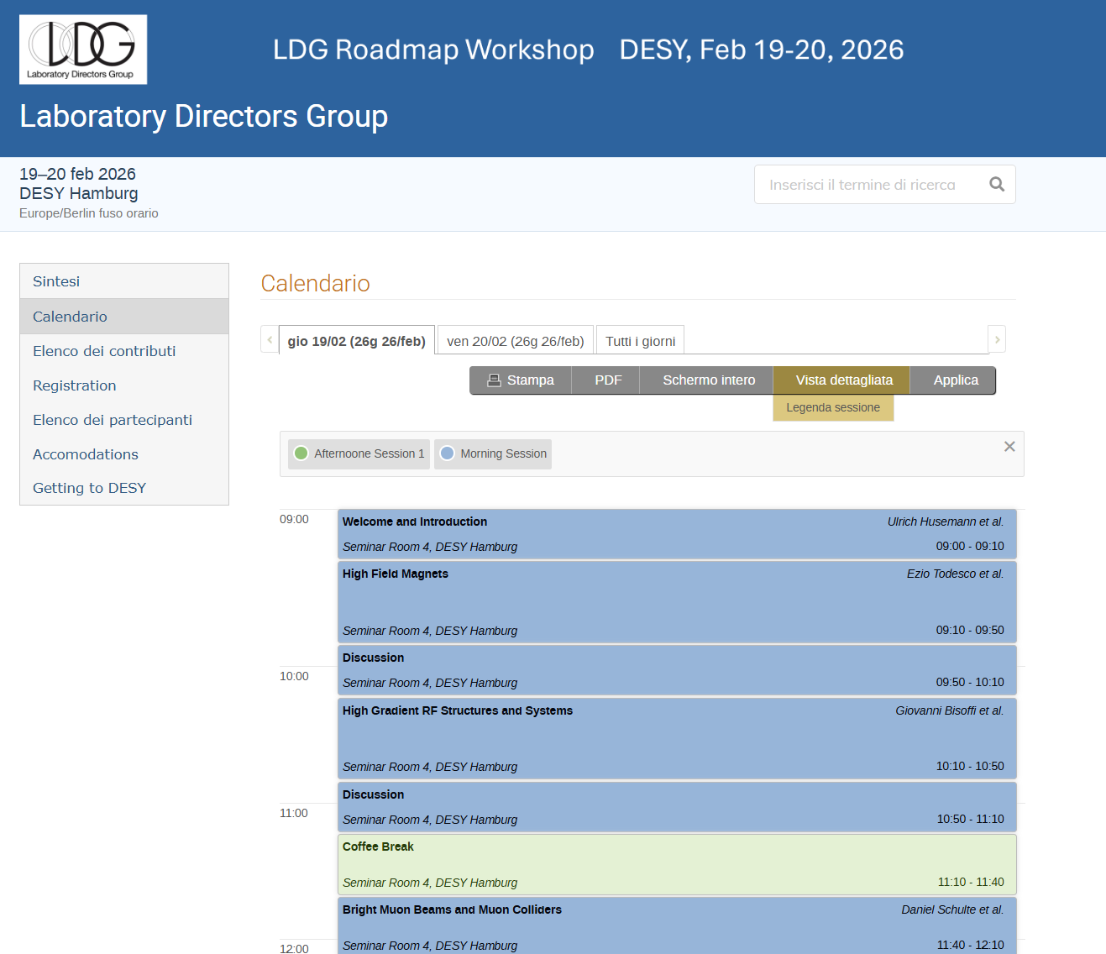
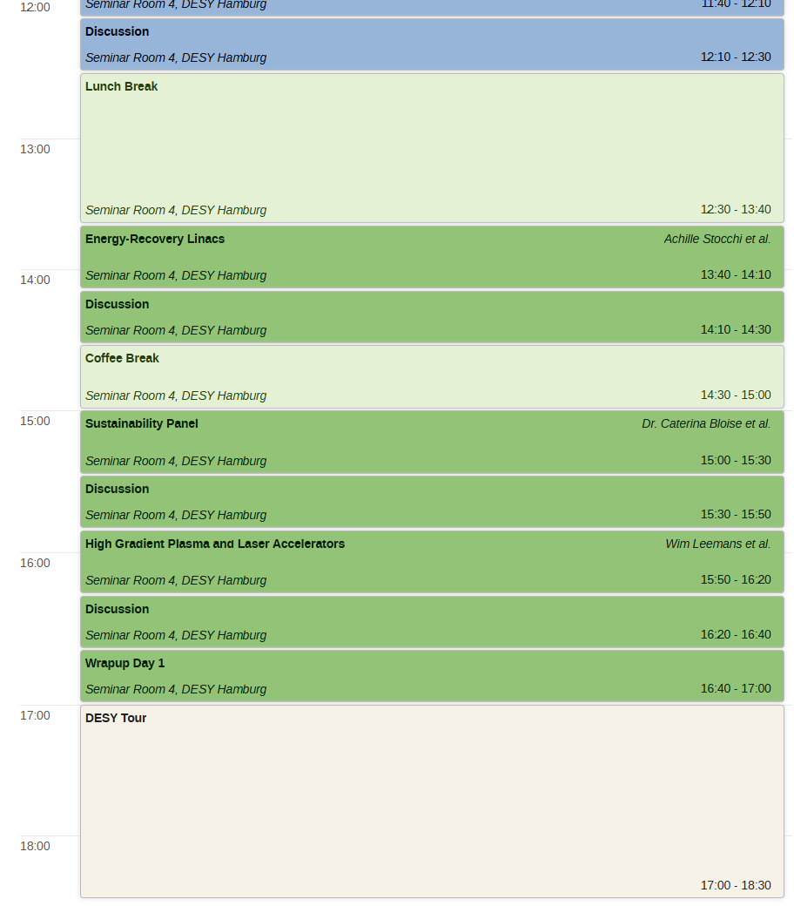
LDG workshop
https://indico.desy.de/event/51275/
please register !

