Slide 1
Axion Searches with X-ray Free-Electron Lasers
Jack W. D. Halliday^{1, 2, 3,†}, G. Marocco⁴, K. A. Beyer⁵, C. Heaton¹, M. Nakatsutsumi⁶, T. R. Preston⁶, C. D. Arrowsmith¹, C. Baehtz⁷, S. Goede⁶, O. Humphries⁶, A. Laso Garcia⁷, R. Plackett¹, P. Svensson¹, G. Vacalis¹, J. Wark¹, D. Wood¹, U. Zastrau⁶, R. Bingham^{3, 8}, I. Shipsey¹, S. Sarkar¹, and Gianluca Gregori¹
¹University of Oxford; ²Imperial College London; ³STFC, Rutherford Appleton Laboratory; ⁴Lawrence Berkley National Lab; ⁵Max-Planck-Institut für Kernphysik Saupfercheckweg; ⁶European XFEL; ⁷Helmholtz Zentrum Dresden-Rossendorf; ⁸University of Strathclyde
†jack.halliday@stfc.ac.uk – jackhalliday.github.io
This project was begun with the collaboration of Prof. Ian Shipsey – to whom this talk is dedicated

Slide 2
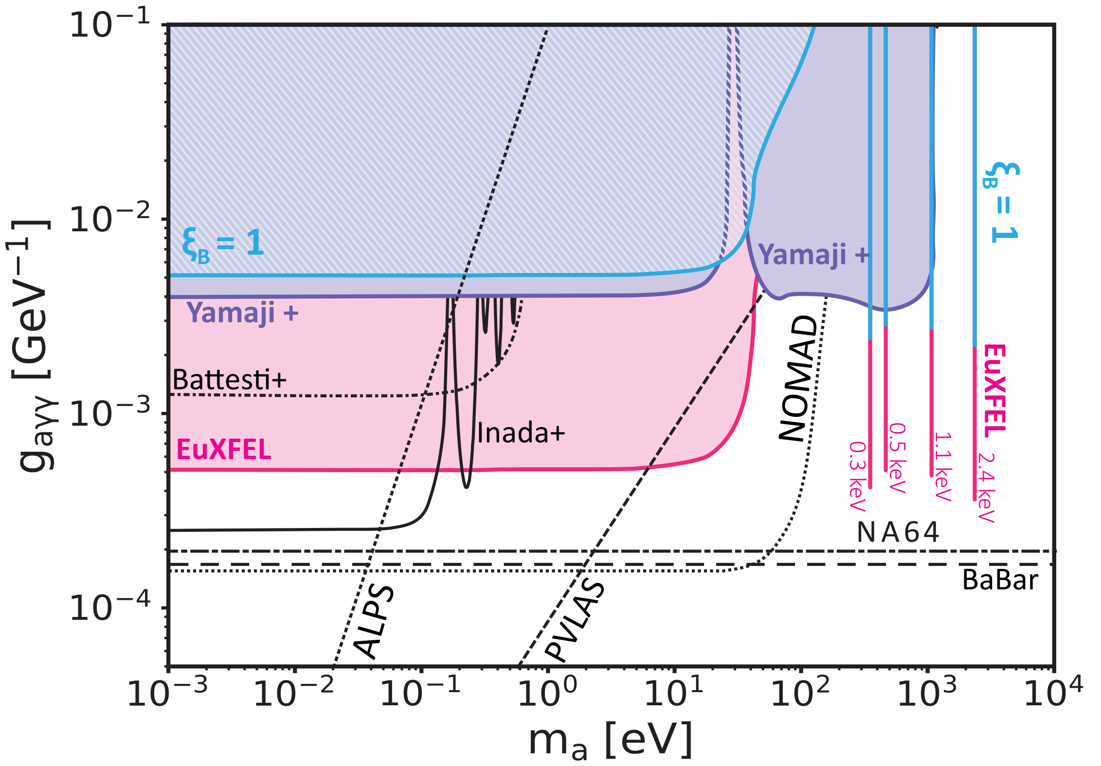
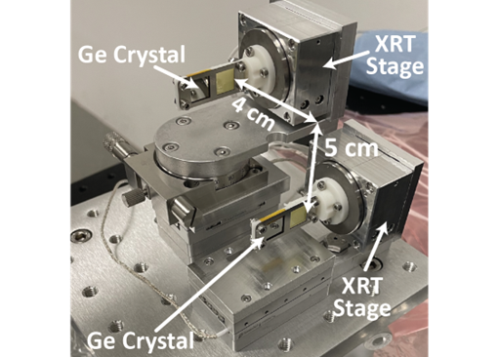
Overview
Introduction to Axions / ALPS and overview of search strategies
Experimental design for a light shining through a wall experiment with an X-Ray Free Electron Laser (XFEL)
Experimental data for initial experiments on EuXFEL
Follow-up work at SACLA (QCD sensitivity)
Fundamental physics with high powered lasers

Slide 3
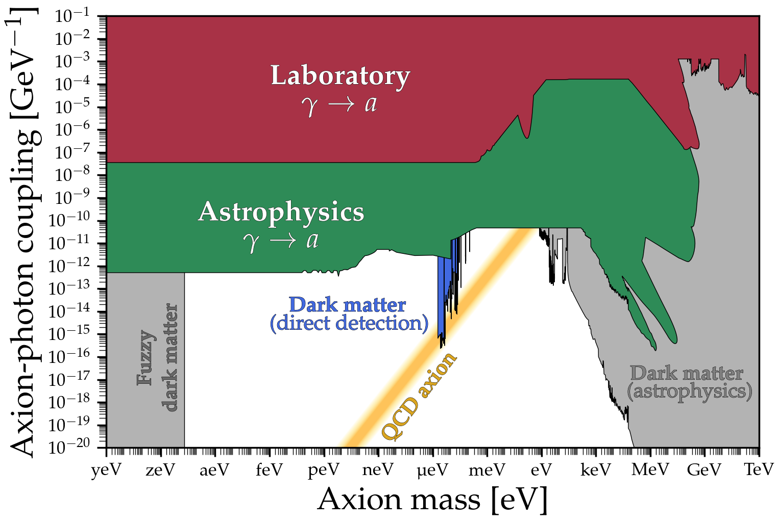
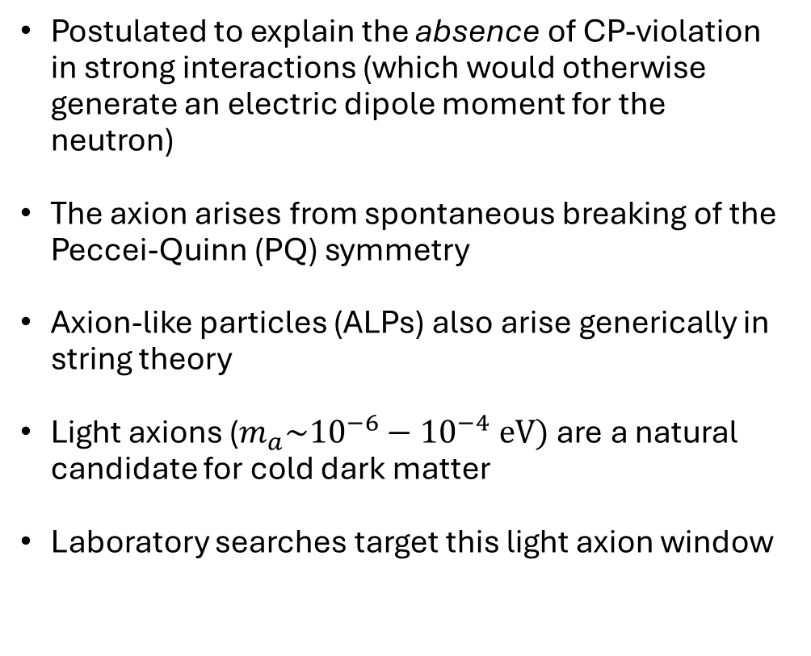

Axions solve the strong CP problem and are a cold dark matter candidate
Postulated to explain the absence of CP-violation in strong interactions (which would otherwise generate an electric dipole moment for the neutron)
The axion arises from spontaneous breaking of the Peccei-Quinn (PQ) symmetry
Axion-like particles (ALPs) also arise generically in string theory
Light axions ($m_{a}\sim {10}^{−6}−{10}^{−4} eV)$are a natural candidate for cold dark matter
Laboratory searches target this light axion window
Haloscopes (e.g. ADMX)
$$g∝m_{a}$$
Credit: Ciaran O'Hare (github.com/cajohare/AxionLimits)
F. Chadha-Day et al. “Axion dark matter: What is it and why now?” Sci. Adv. 8, eabj3618 (2022).

Slide 4
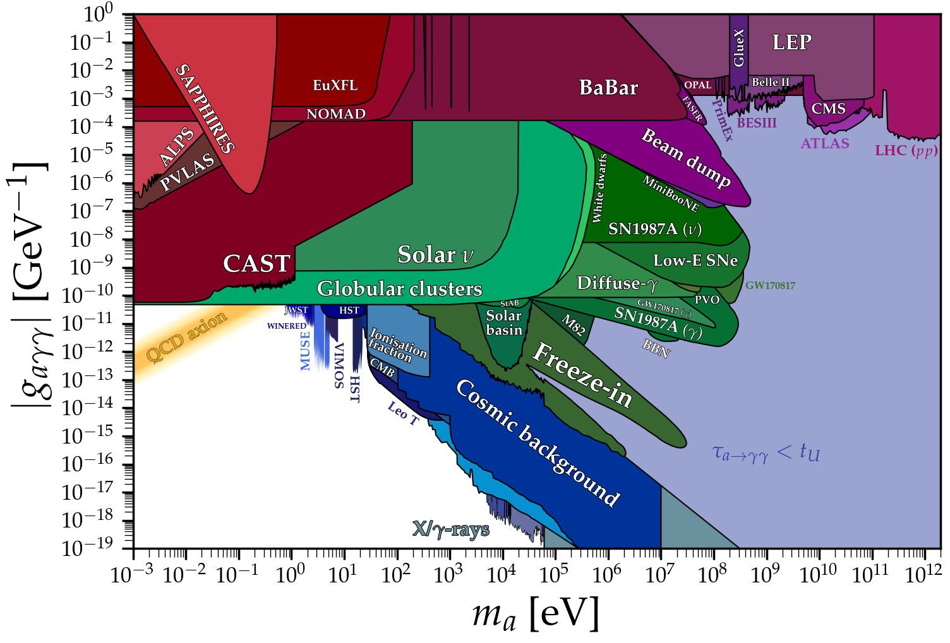
There has recently been interest in heavier axions, which motivates our study
Recent suggestion: When PQ symmetry is broken after cosmological inflation, axions are also produced in the decay of axion domain walls
Taking this additional contribution into account requires axions which make up dark matter to have a mass above 10⁻² eV
A. Ringwald & K. Saikawa, “Axion dark matter in the post-inflationary Peccei-Quinn symmetry breaking scenario”.
Phys. Rev. D 93, 085031 (2016).
K. Beyer & S. Sarkar, “Ruling out light axions: The writing is on the wall”, SciPost Phys. 15, 003 (2023).
Credit: Ciaran O'Hare (github.com/cajohare/AxionLimits)

Slide 5
There are a variety of complimentary axion search strategies
Astrophysical
Axion losses in stellar models
Lab detection
Helio/haloscopes
Lab generation
Generate (& detect) terrestrially
Increased sensitivity
Reduced model dependence
Yannis K. Semertzidis & SungWoo Youn, “Axion dark matter: How to see it?”, Sci. Adv. 8, eabm9928 (2022).
A. Caputo & G. Raffelt, “Astrophysical Axion Bounds: The 2024 Edition”, Proceedings of Science 454, 041 (2024).
Credit: Ciaran O'Hare (github.com/cajohare/AxionLimits)

Slide 6
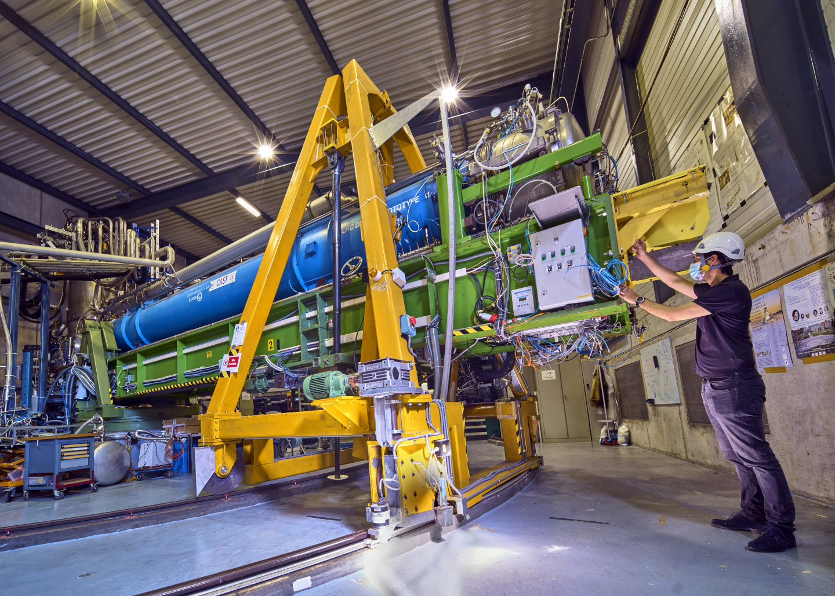
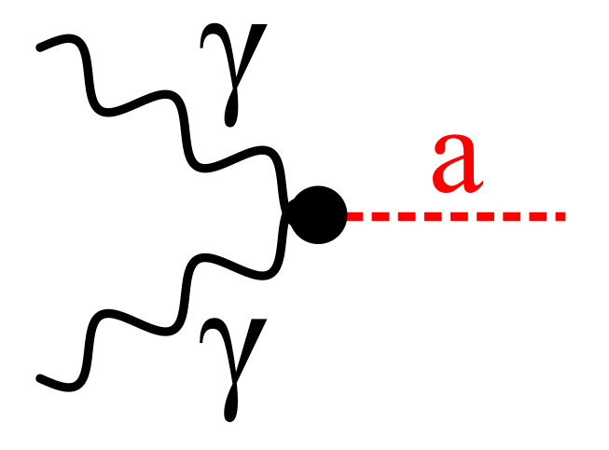
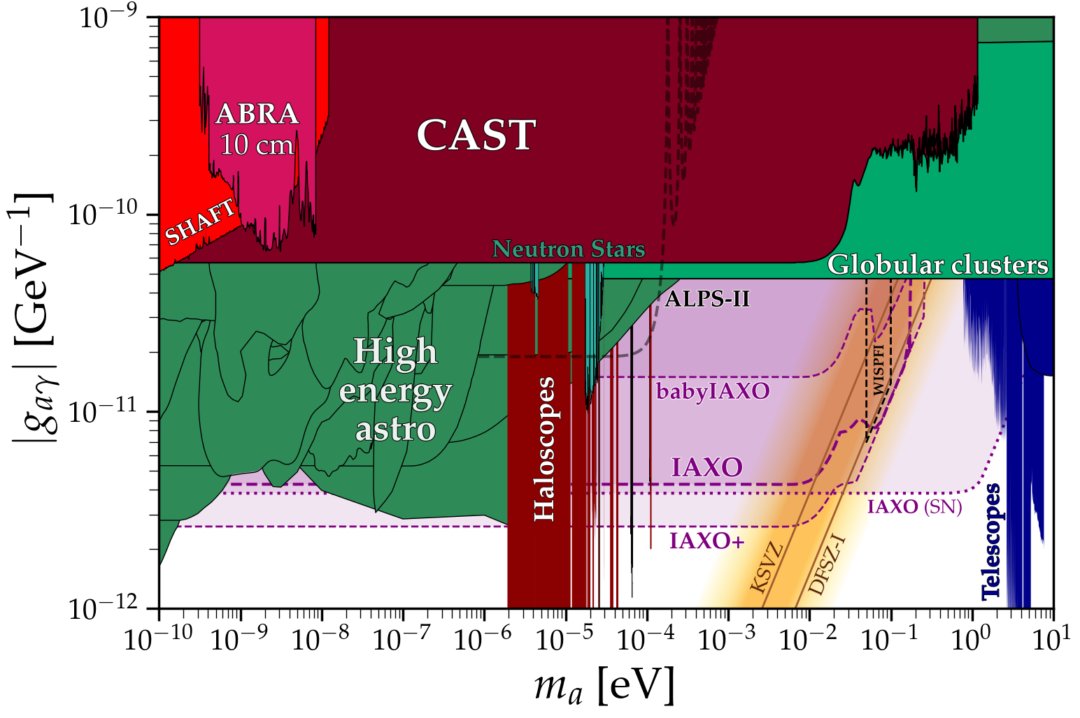

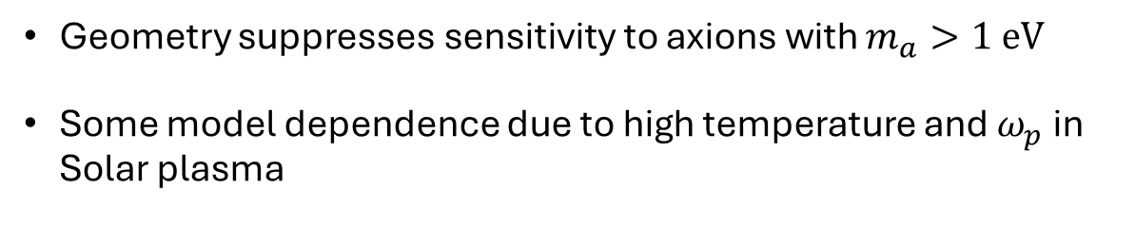

For $m_{a}≤1 eV$, stringent bounds are imposed by the CERN Axion Telescope (CAST)
Helioscope: Axions produced in the sun convert into photons via the Primakoff effect:
$$ℒ_{axion}=g_{aγγ}E⋅Ba$$
Geometry suppresses sensitivity to axions with $m_{a}>1 eV$
Some model dependence due to high temperature and $ω_{p}$ in Solar plasma
CAST Collaboration, “New CAST limit on the axion–photon interaction” Nature Phys. 13, 584 (2017).
J. Jaeckel et al. “Need for purely laboratory-based axionlike particle searches”, Phys. Rev. D 75, 013004 (2007)

Slide 7
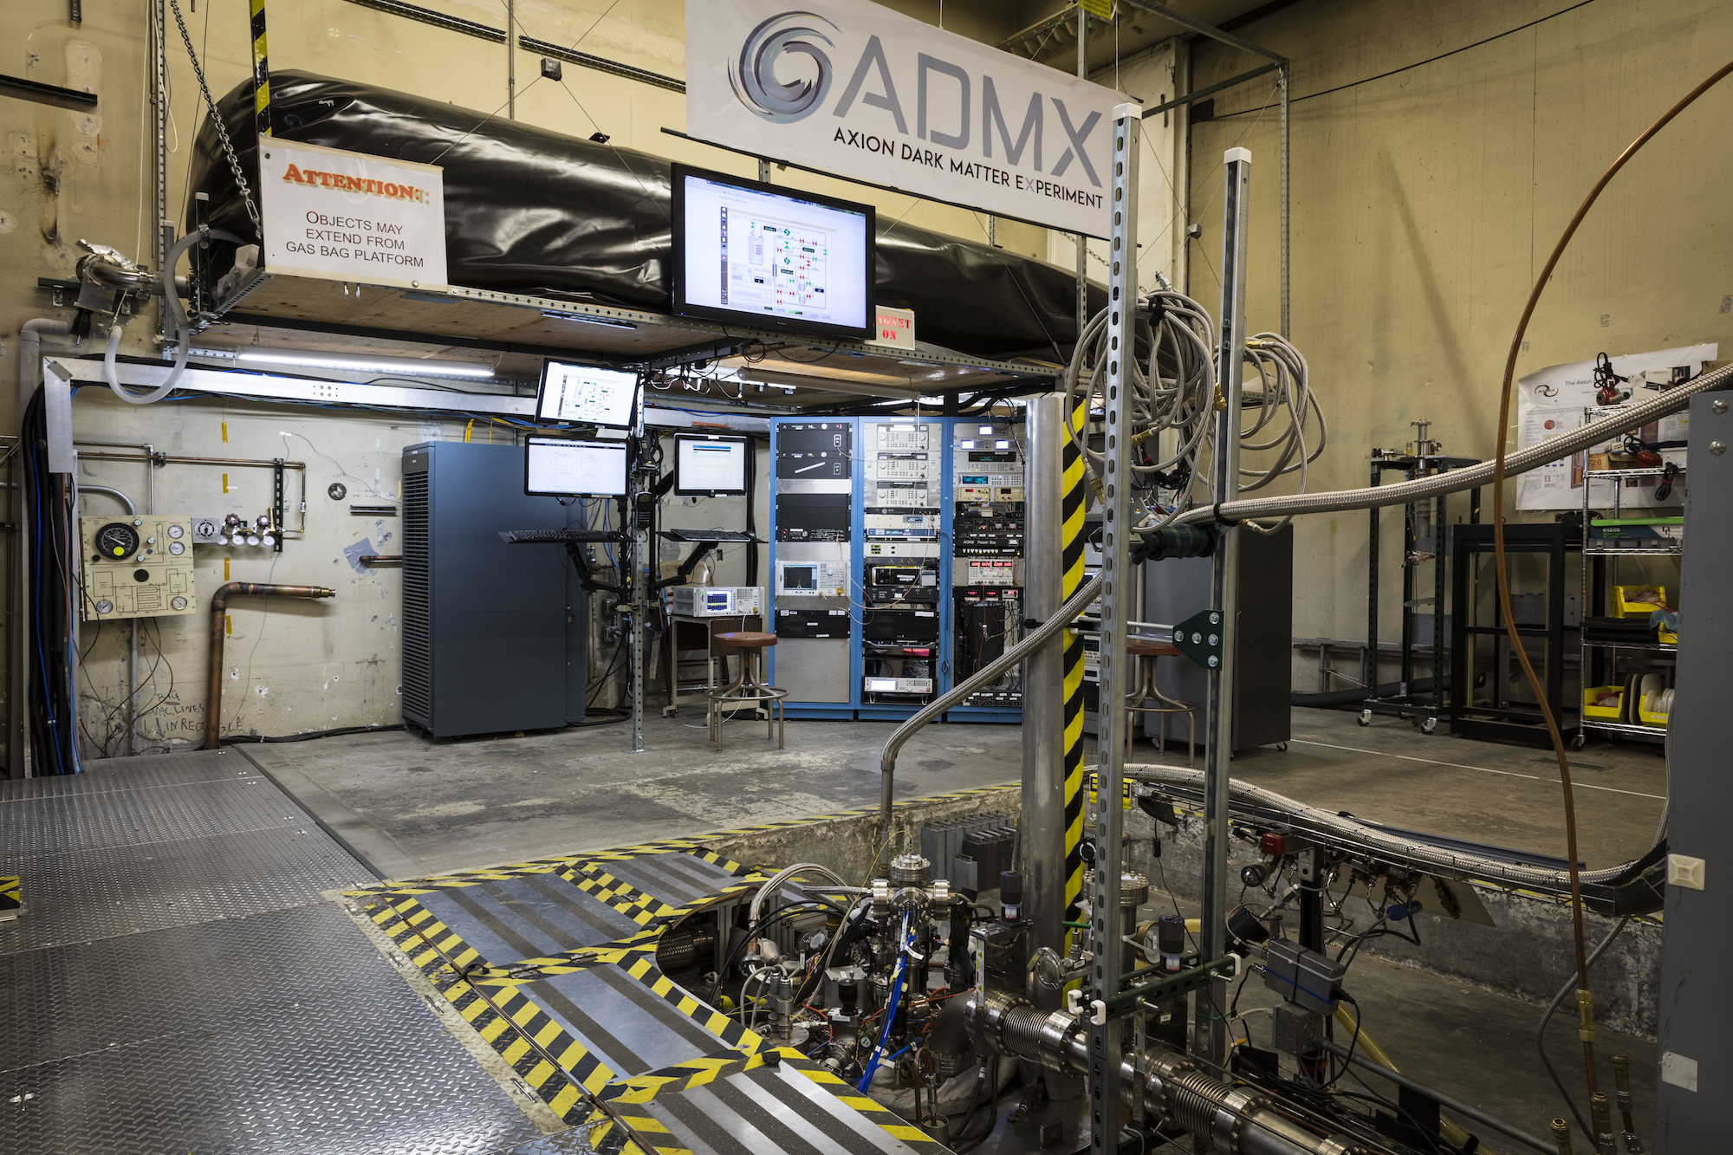
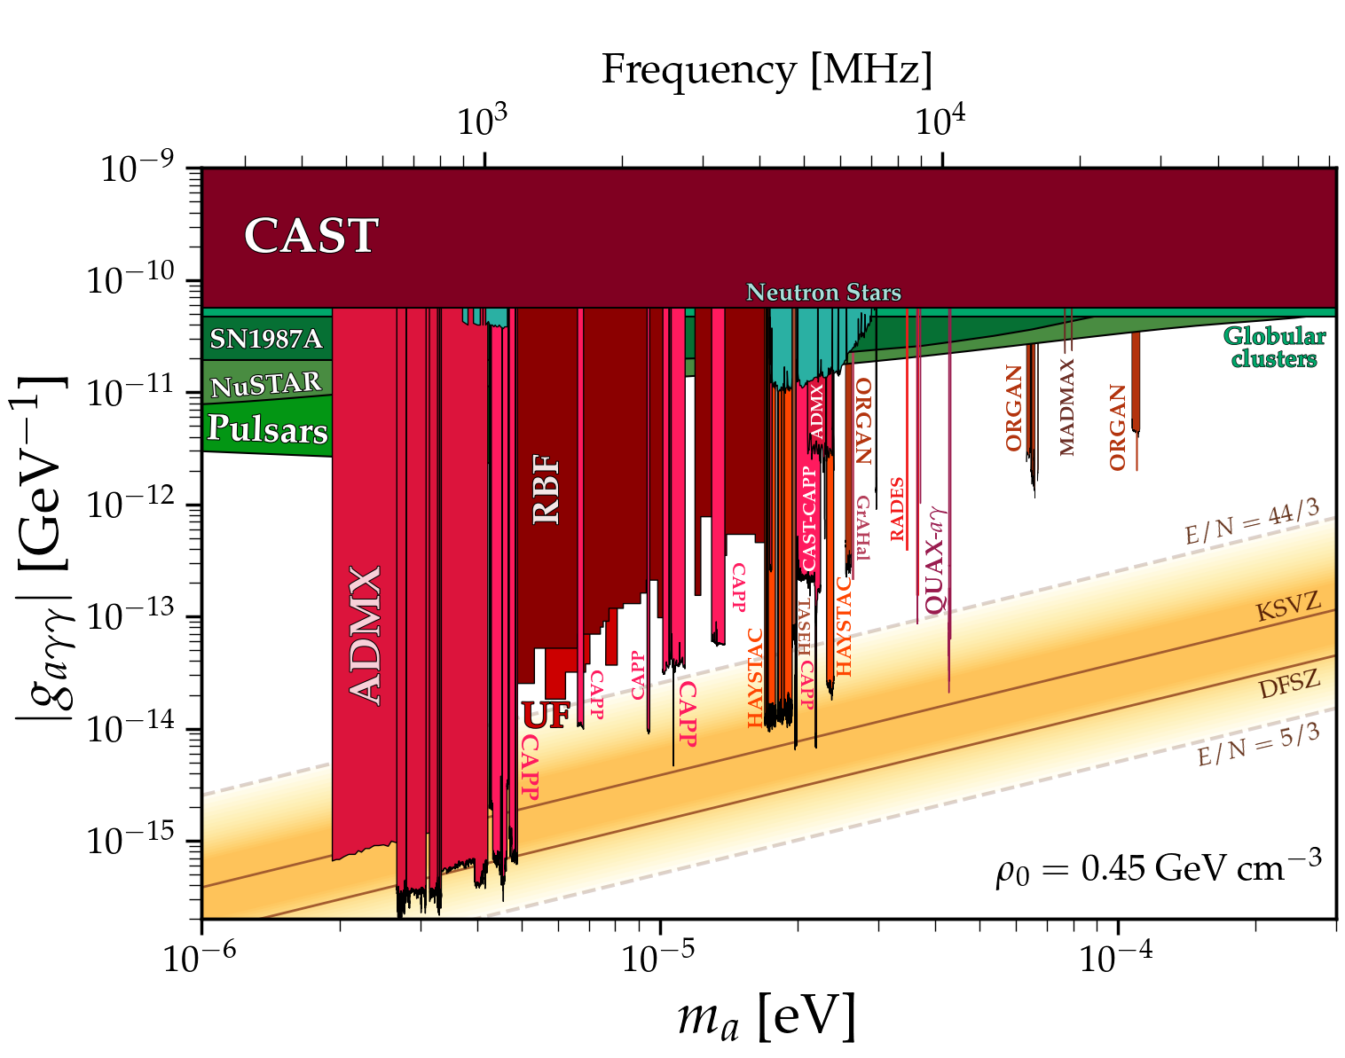
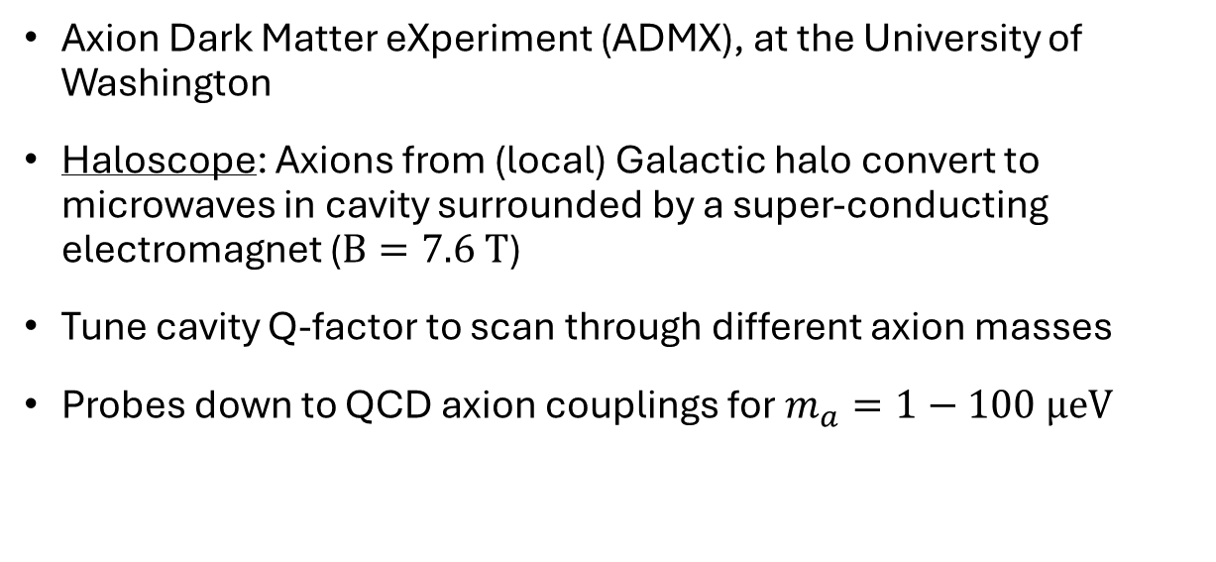
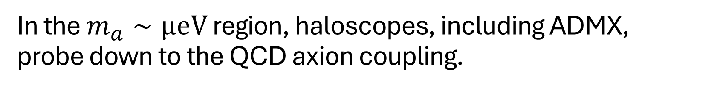
In the $m_{a}∼μeV$ region, haloscopes, including ADMX, probe down to the QCD axion coupling.
Axion Dark Matter eXperiment (ADMX), at the University of Washington
Haloscope: Axions from (local) Galactic halo convert to microwaves in cavity surrounded by a super-conducting electromagnet ($B=7.6 T$)
Tune cavity Q-factor to scan through different axion masses
Probes down to QCD axion couplings for $m_{a}=1−100 μeV$
C. Goodman et al, “Axion dark matter experiment around 3.3 eV with Dine-Fischler-Srednicki-Zhitnitsky discovery ability”, Phys. Rev. Lett. – in press (2025)

Slide 8
There are a variety of complimentary axion search strategies
Astrophysical
Axion losses in stellar models
Lab detection
Helio/haloscopes
Lab generation
Generate (& detect) terrestrially
Increased sensitivity
Reduced model dependence
Yannis K. Semertzidis & SungWoo Youn, “Axion dark matter: How to see it?”, Sci. Adv. 8, eabm9928 (2022).
A. Caputo & G. Raffelt, “Astrophysical Axion Bounds: The 2024 Edition”, Proceedings of Science 454, 041 (2024).
Credit: Ciaran O'Hare (github.com/cajohare/AxionLimits)

Slide 9
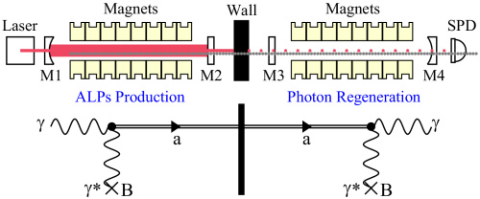
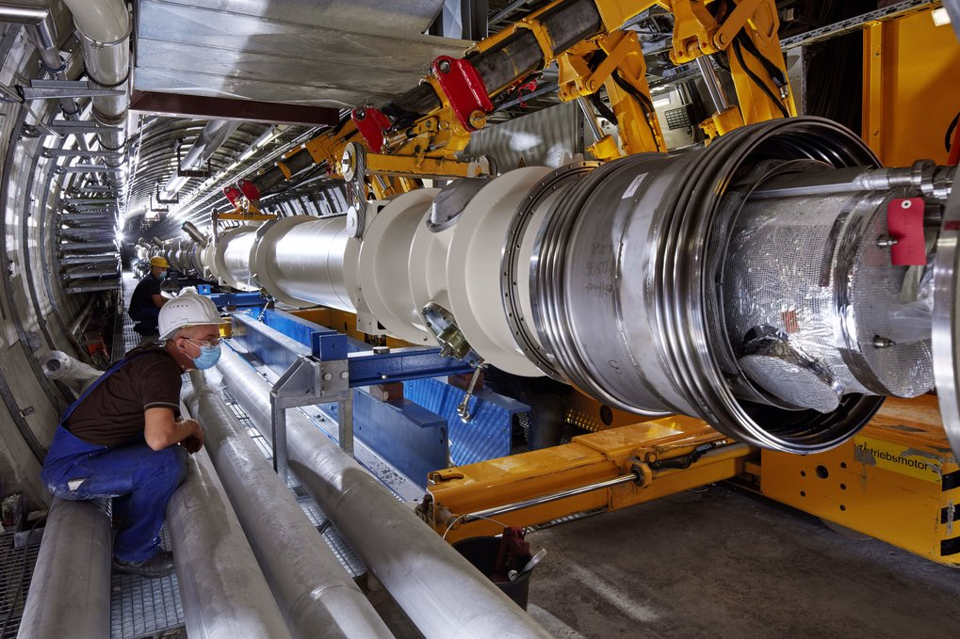
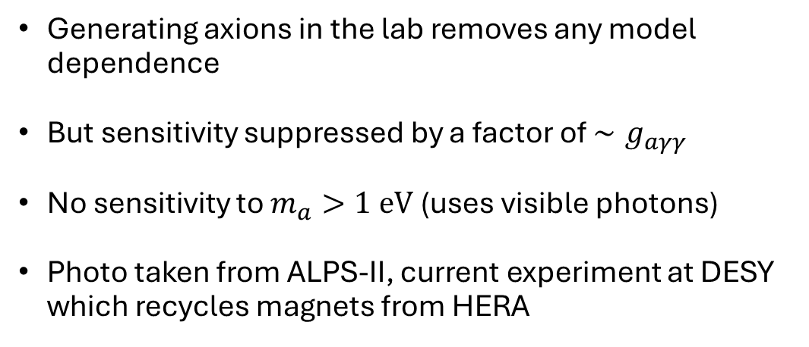
Light shining through wall (LSW) experiments are an example of direct detection searches
Generating axions in the lab removes any model dependence
But sensitivity suppressed by a factor of $∼g_{aγγ}$
No sensitivity to $m_{a}>1 eV$ (uses visible photons)
Photo taken from ALPS-II, current experiment at DESY which recycles magnets from HERA
C. Robilliard et al, “No light shining through a wall”, Phys Rev. Lett. 99, 190403 (2007).
Klaus Ehret et al, “New ALPS results on hidden-sector lightweights”, Phys. Lett. B 689, 149 (2010).
QSQAR collaboration, “New exclusion limits on scalar and pseudoscalar axionlike particles” Phys. Rev. D92, 092002 (2015).

Slide 10
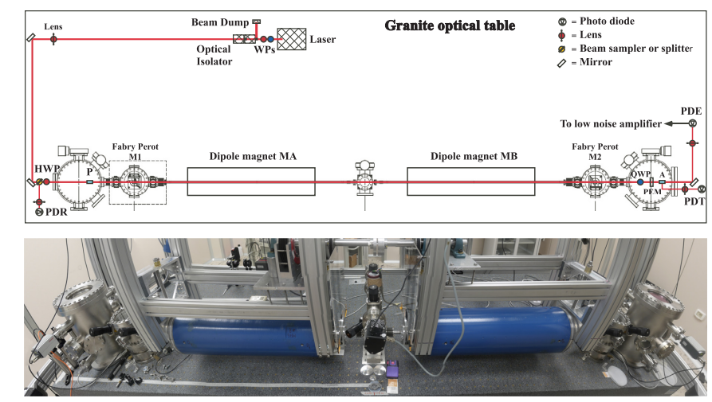
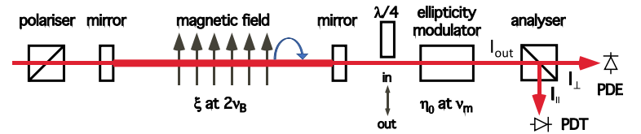
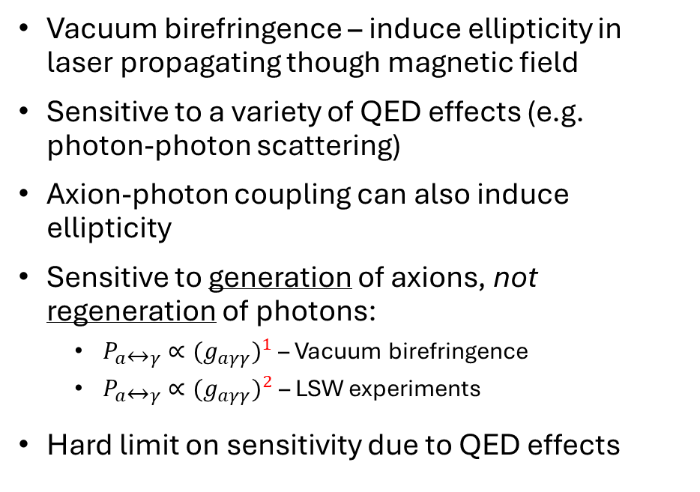
Vacuum birefringence experiments, including PVLAS, are also sensitive to axions generated terrestrially
Vacuum birefringence – induce ellipticity in laser propagating though magnetic field
Sensitive to a variety of QED effects (e.g. photon-photon scattering)
Axion-photon coupling can also induce ellipticity
Sensitive to generation of axions, not regeneration of photons:
$P_{a↔γ}$ $∝{{(g}_{aγγ})}^{1}$ – Vacuum birefringence
$P_{a↔γ}$ $∝{{(g}_{aγγ})}^{2}$ – LSW experiments
Hard limit on sensitivity due to QED effects
A. Ejlli et al, “The PVLAS experiment: A 25 year effort to measure vacuum magnetic birefringence” Phys. Rep. 871, 1 (2020).

Slide 11
Overview
Introduction to Axions / ALPS and overview of search strategies
Experimental design for a light shining through a wall experiment with an X-Ray Free Electron Laser (XFEL)
Experimental data for initial experiments on EuXFEL
Follow-up wort at SACLA (QCD sensitivity)
Fundamental physics with high powered lasers

Slide 12
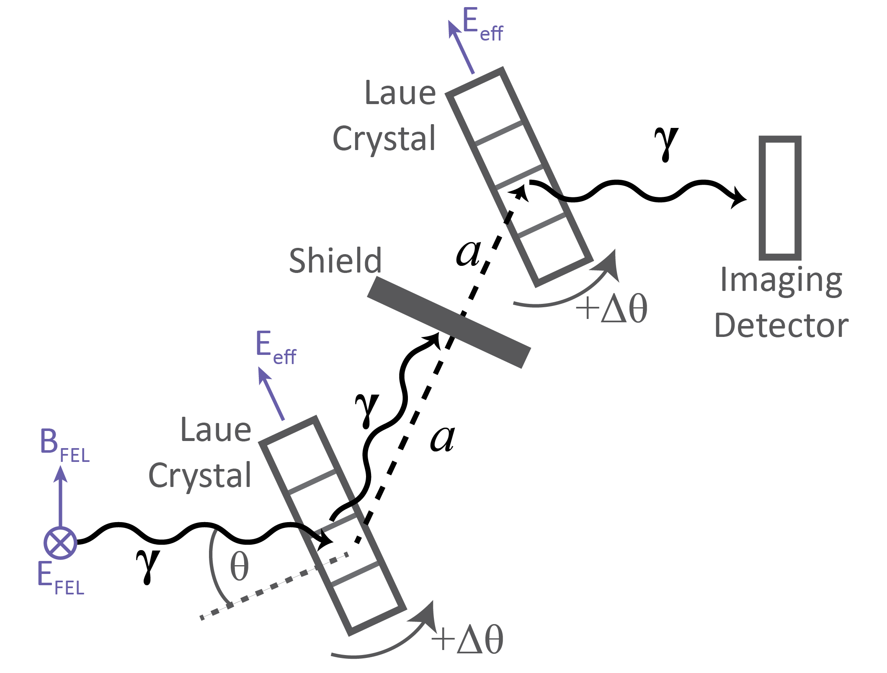
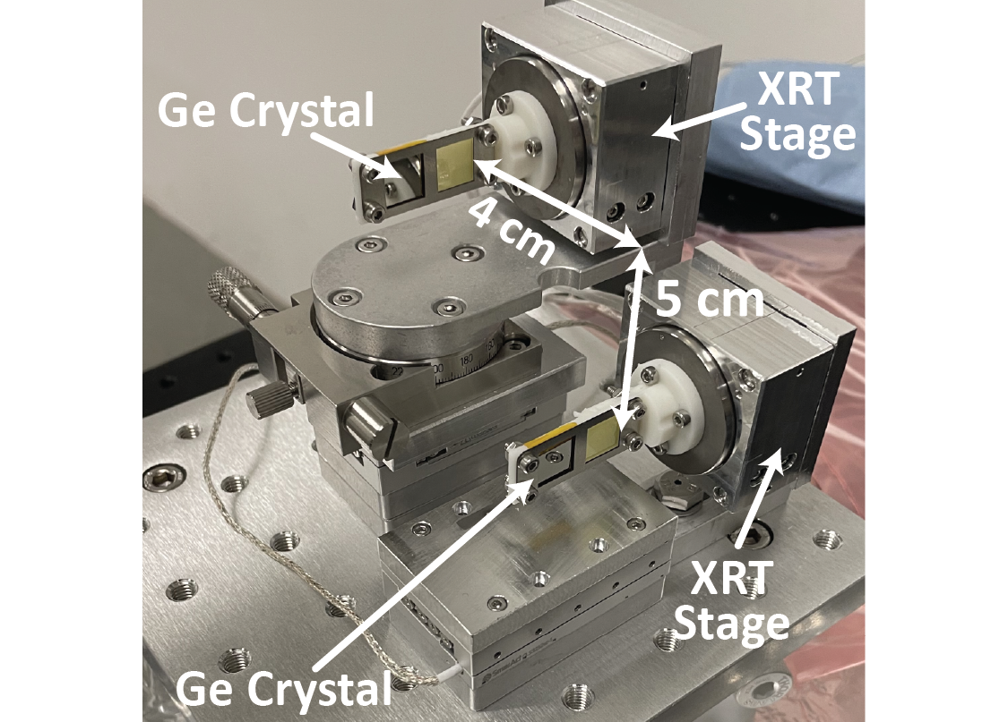

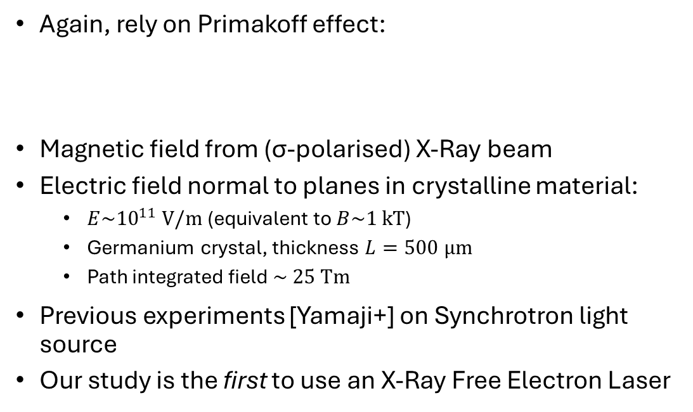
X-ray light sources enable the extension of light shining through wall experiments to search for heavy axions
Again, rely on Primakoff effect:
Magnetic field from (σ-polarised) X-Ray beam
Electric field normal to planes in crystalline material:
$E\sim {10}^{11} V/m$ (equivalent to $B\sim 1 kT$)
Germanium crystal, thickness $L=500 μm$
Path integrated field $\sim 25 Tm$
Previous experiments [Yamaji+] on Synchrotron light source
Our study is the first to use an X-Ray Free Electron Laser
$$ℒ_{axion}=g_{aγγ}E⋅Ba$$
Buchmüller & Hoogevee, “Coherent production of light scalar or pseudoscalar particles in Bragg scattering”, Phys. Lett. B 267, 2 (1990).
T. Yamaji et al, “Search for Axion like particles using Laue-case conversion in a single crystal” Phys. Lett. B 782, 526 (2018).

Slide 13
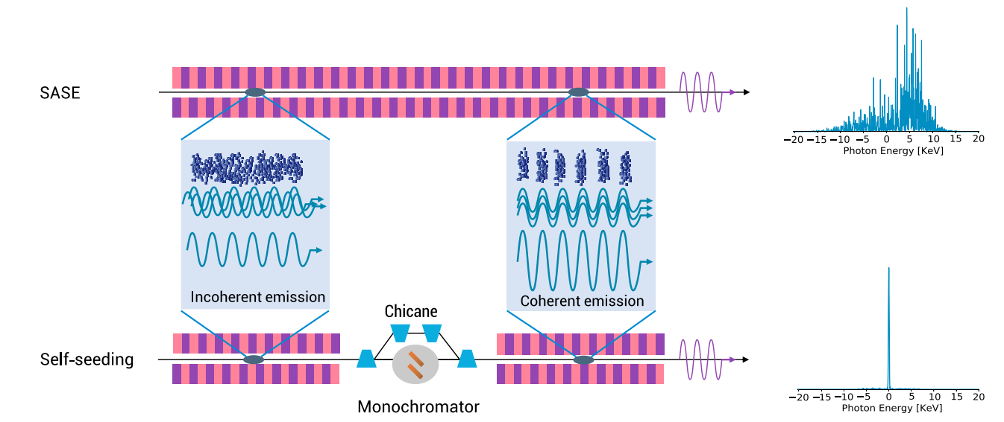
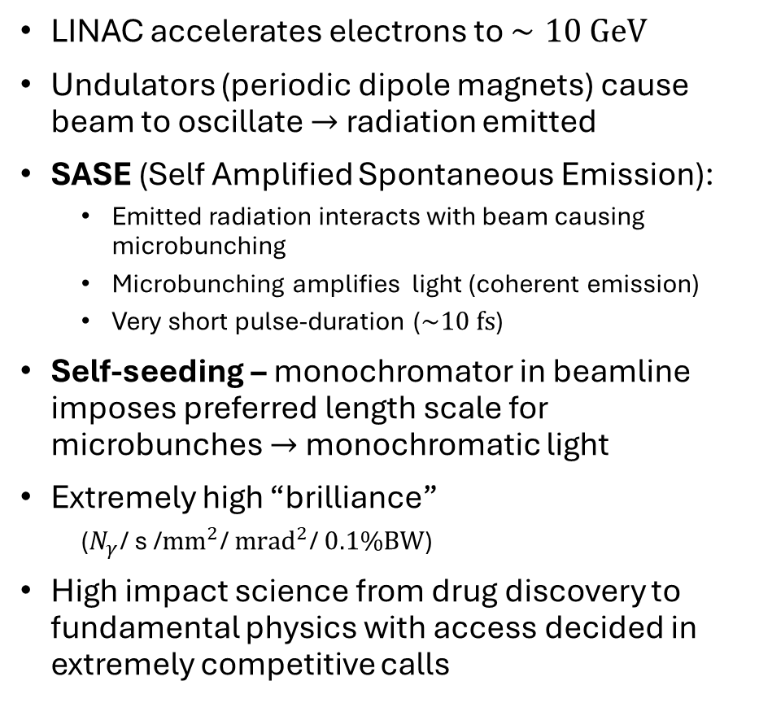
An X-ray Free Electron Laser (XFEL) is a light source, based on an electron LINAC
LINAC accelerates electrons to $∼10 GeV$
Undulators (periodic dipole magnets) cause beam to oscillate $→$ radiation emitted
SASE (Self Amplified Spontaneous Emission):
Emitted radiation interacts with beam causing microbunching
Microbunching amplifies light (coherent emission)
Very short pulse-duration ($\sim 10 fs$)
Self-seeding – monochromator in beamline imposes preferred length scale for microbunches $→$ monochromatic light
Extremely high “brilliance”
($N_{γ}$/ s /${mm}^{2}$/ ${mrad}^{2}$/ $0.1\%BW$)
High impact science from drug discovery to fundamental physics with access decided in extremely competitive calls
Facility | Beam energy [GeV] | Photon energy [eV] | Pulse duration [fs]
EuXFEL | 8.5 – 17.5 | 240 – 25,000 | 3-150
LCLS-II | 4 – 15 | 200 – 25,000 | 1 – 500
SACLA | 5.1 – 8.9 | 400 – 12,800 | 2 – 10
N. Huang et al. “Features and futures of X-ray free-electron lasers”. The Innovation. 2, 2 (2021)

Slide 14
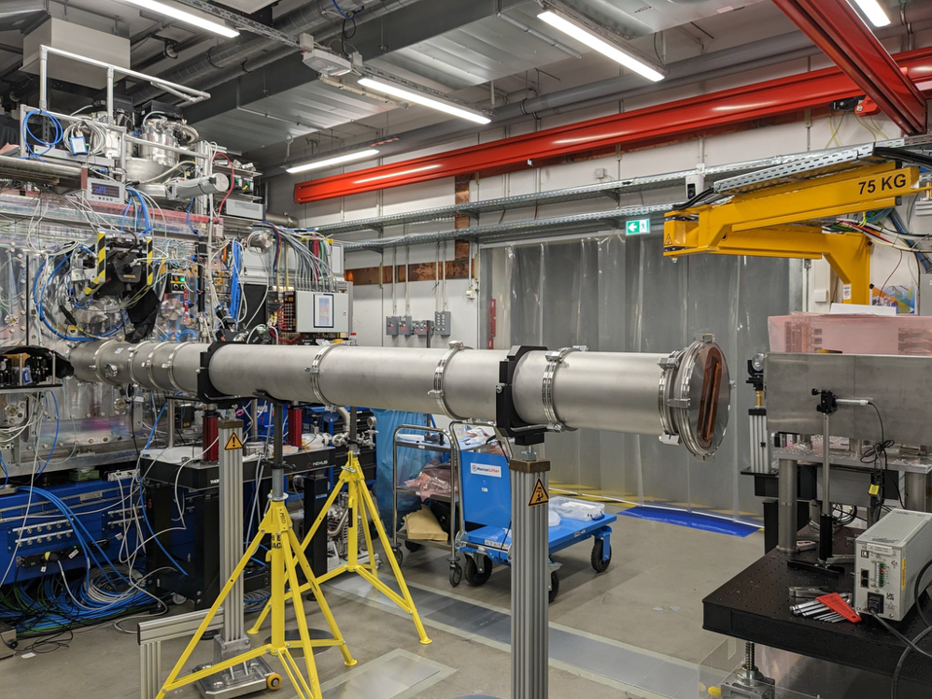
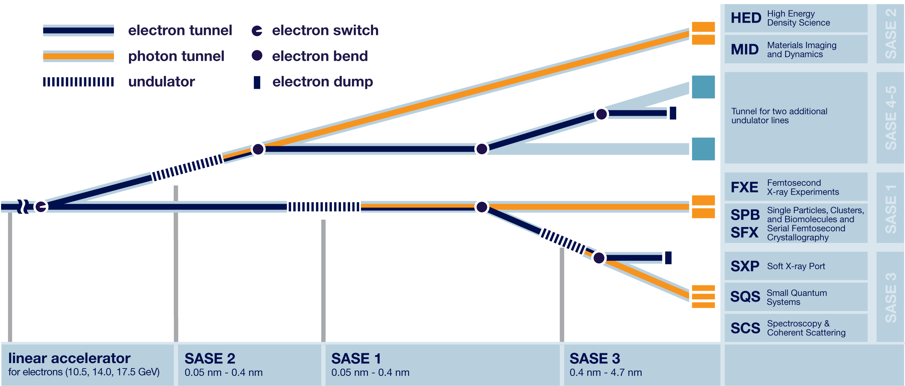
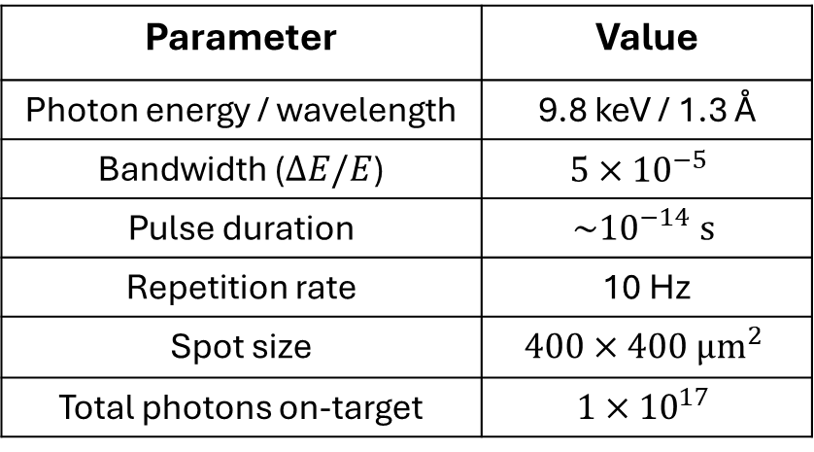
Configuration used for our experiment at The European XFEL (EuXFEL)
Our search used the HED/HiBEF instrument at EuXFEL, Hamburg
Three days (72 hrs) of beamtime awarded over the Easter bank holiday 2023
Operated in a self-seeded mode
Parameter | Value
Photon energy / wavelength | 9.8 keV / 1.3 Å
Bandwidth ($ΔE/E$) | $$5×{10}^{−5}$$
Pulse duration | $$\sim {10}^{−14} s$$
Repetition rate | 10 Hz
Spot size | $$400×400 μm^{2}$$
Total photons on-target | $$1×{10}^{17}$$

Slide 15
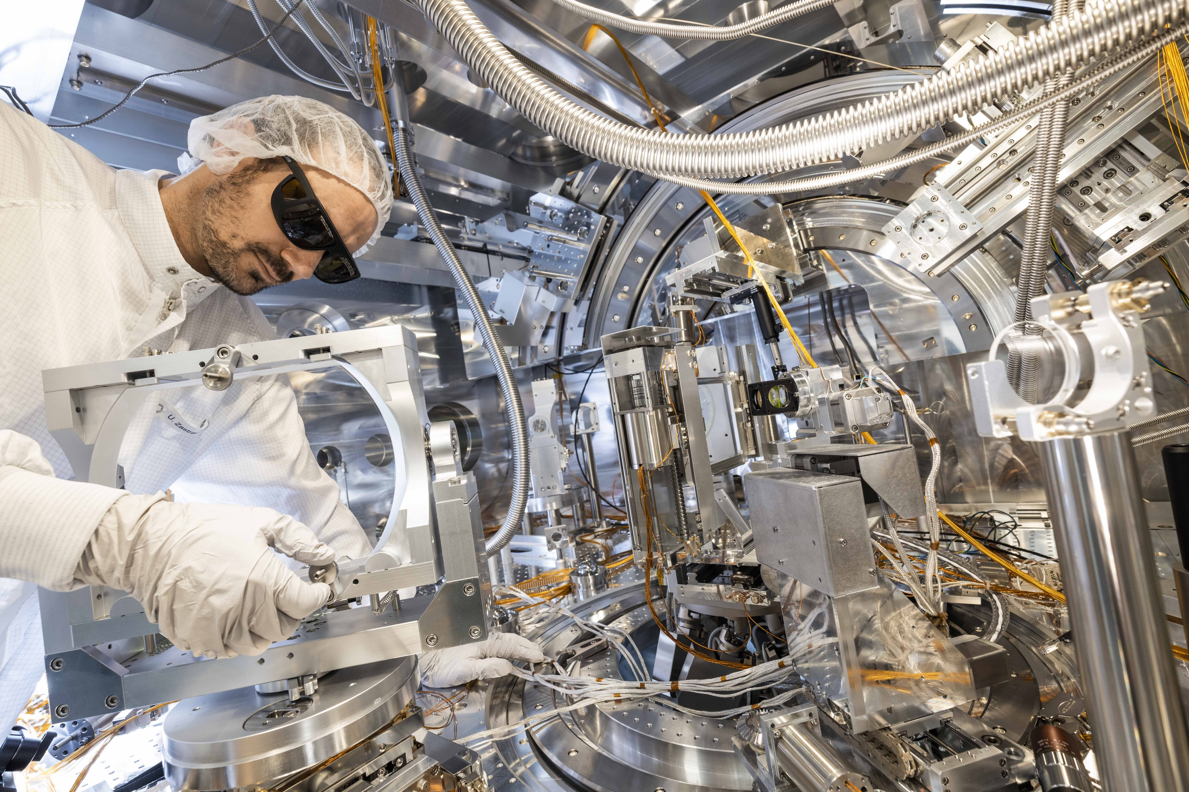
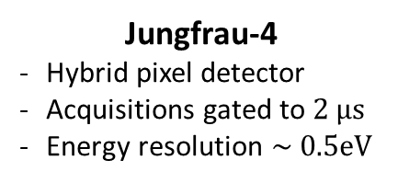
The HED/HiBEF instrumentation enabled an accurate constraint to be placed on input / output X-ray flux
2 m
X-ray gas monitor
Energy per-pulse
Absolute calibration
Jungfrau-4
Hybrid pixel detector
Acquisitions gated to $2 μs$
Energy resolution $\sim 0.5eV$
Vacuum chamber
6 m
XFEL Beam
Double crystal
converter
Regenerated photons
Flight tube

Slide 16
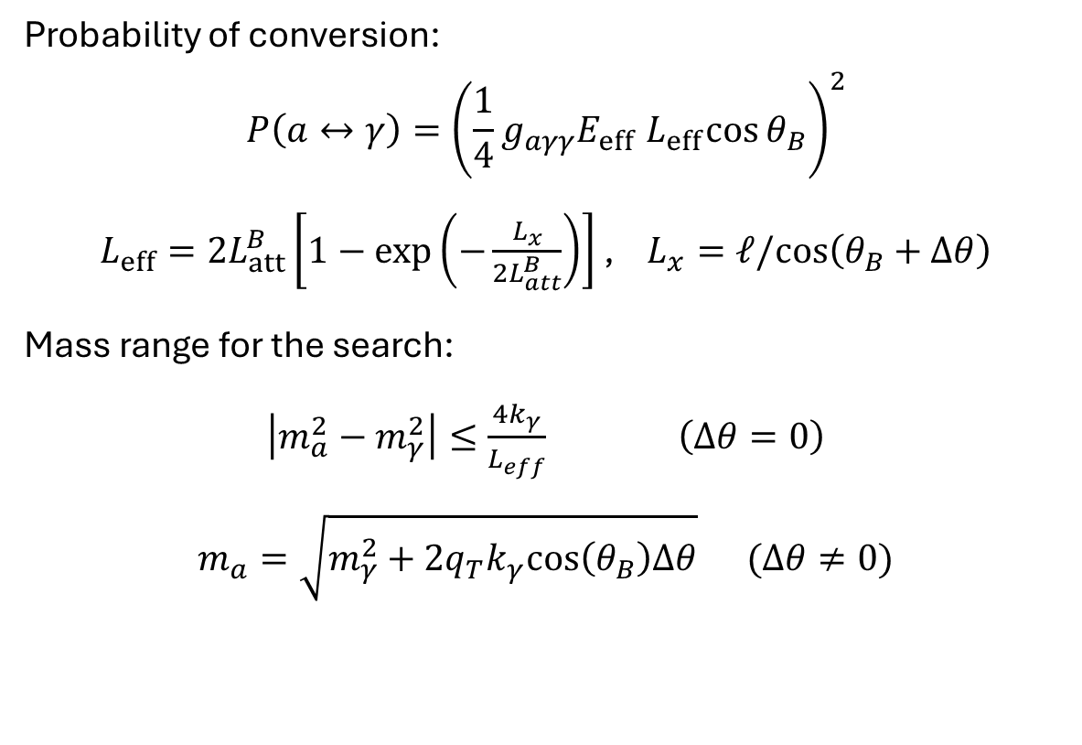
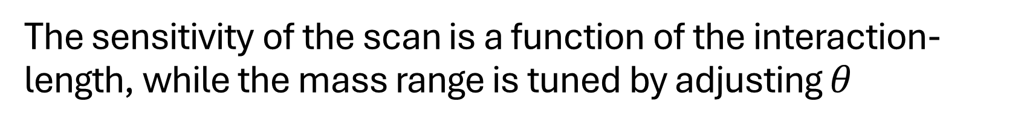
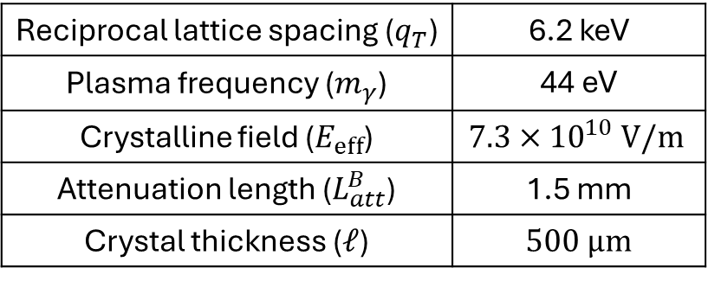

The sensitivity of the scan is a function of the interaction-length, while the mass range is tuned by adjusting $θ$
Probability of conversion:
$$P\left(a↔γ\right)={\left(\frac{1}{4}g_{aγγ}E_{eff}{ L}_{eff}\cos{θ_{B}}\right)}^{2}$$
$L_{eff}=2L_{att}^{B}\left[1−exp\left(−\frac{L_{x}}{2L_{att}^{B}}\right)\right]$ , $L_{x}=ℓ/cos\left(θ_{B}+Δθ\right)$
Mass range for the search:
$\left|m_{a}^{2}−m_{γ}^{2}\right|≤\frac{4k_{γ}}{L_{eff}}$ $\left(Δθ=0\right)$
$m_{a}=\sqrt{m_{γ}^{2}+2q_{T}k_{γ}cos\left(θ_{B}\right)Δθ}$ $(Δθ≠0)$
$$θ=Δθ+θ_{B}$$
Reciprocal lattice spacing ($q_{T}$) | 6.2 keV
Plasma frequency ($m_{γ}$) | 44 eV
Crystalline field ($E_{eff}$) | $$7.3×{10}^{10} V/m$$
Attenuation length ($L_{att}^{B}$) | 1.5 mm
Crystal thickness ($ℓ$) | $500 μm$
T. Yamaji et al, “Theoretical calculation of coherent Laue-case conversion between x-rays and ALPS for an X-ray LSW experiment” Phys. Rev. D 96, 15001 (2017).

Slide 17
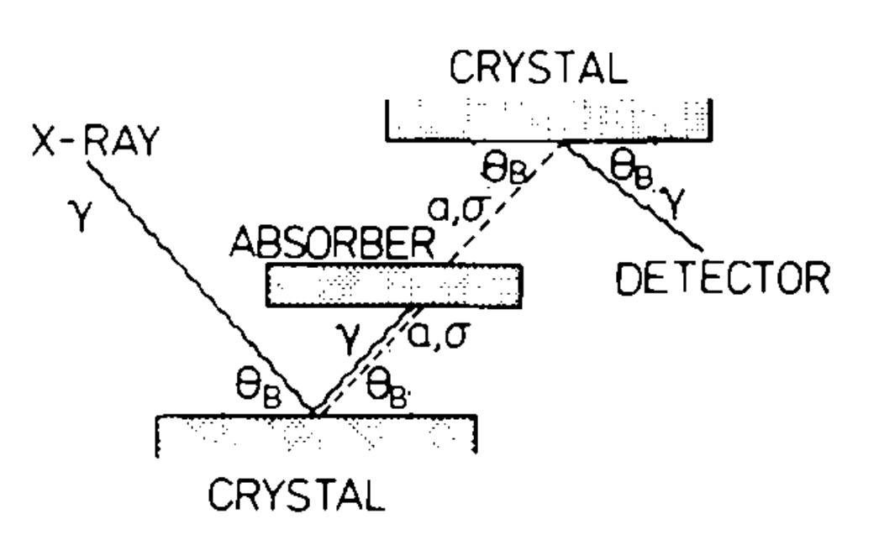
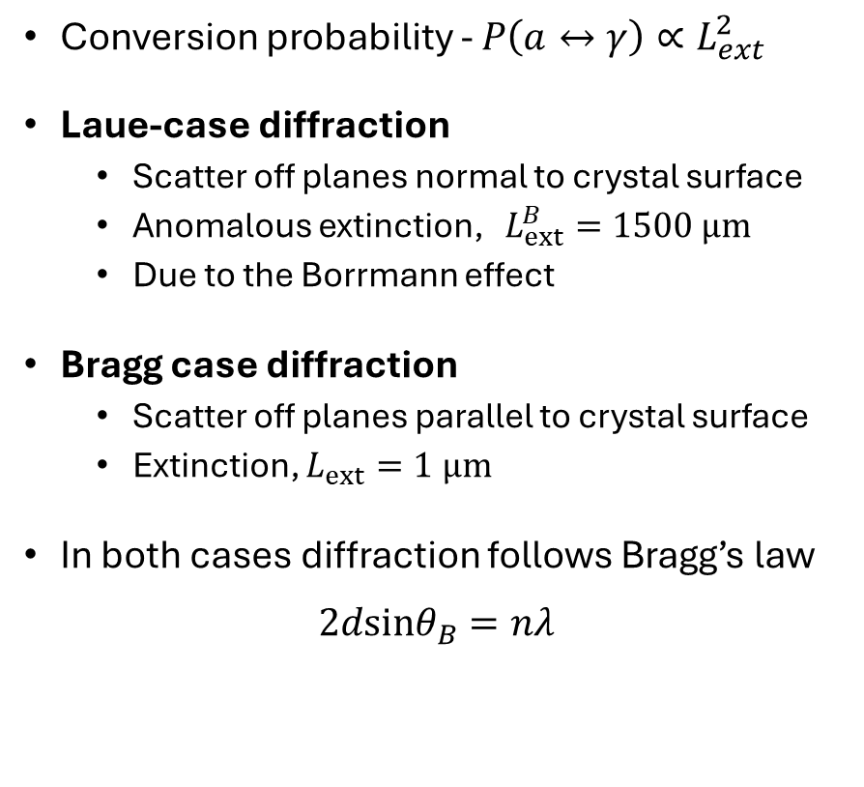
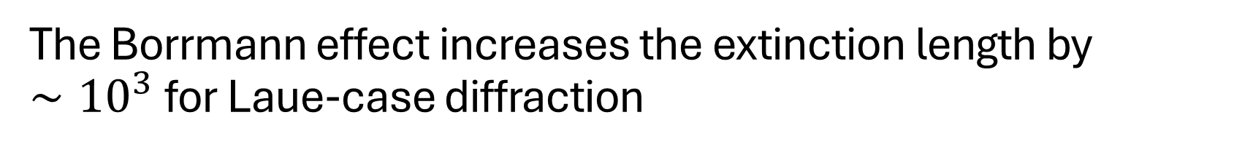
The Borrmann effect increases the extinction length by $∼{10}^{3}$for Laue-case diffraction
Conversion probability - $P\left(a↔γ\right)∝L_{ext}^{2}$
Laue-case diffraction
Scatter off planes normal to crystal surface
Anomalous extinction, $L_{ext}^{B}=1500 μm$
Due to the Borrmann effect
Bragg case diffraction
Scatter off planes parallel to crystal surface
Extinction, $L_{ext}=1 μm$
In both cases diffraction follows Bragg’s law
$$2dsinθ_{B}=nλ$$
Laue
Bragg
G. Borrmann “Über Extinktionsdiagramme von Quarz” Physikalische Zeitschrift 42 (1941).
[Buchmüller & Hoogeveen – 1990]

Slide 18
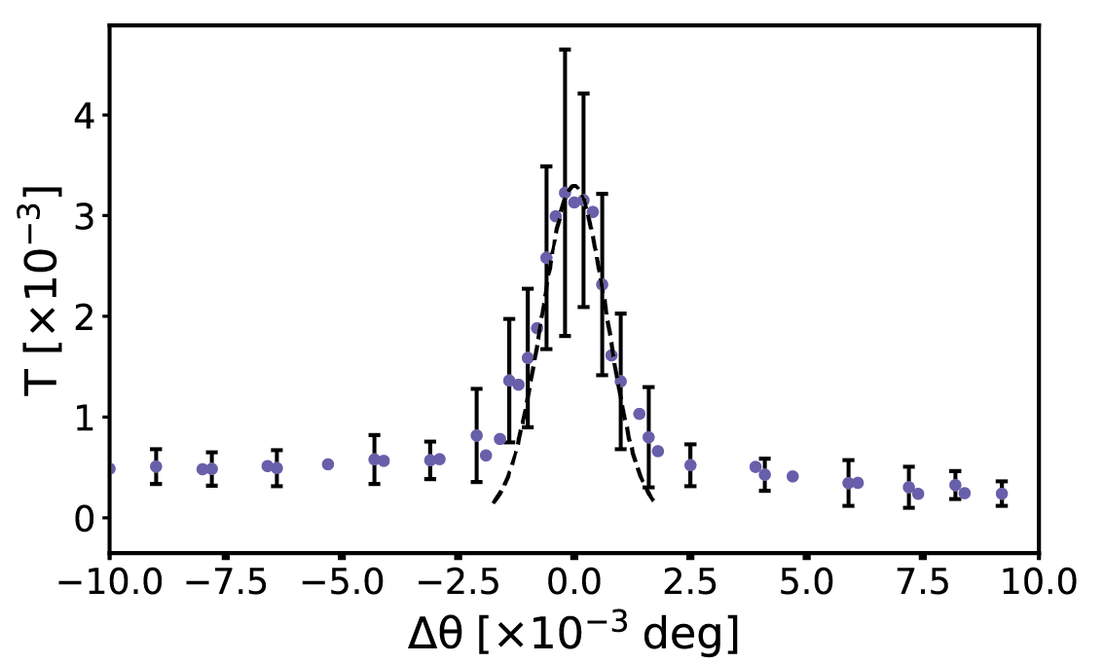
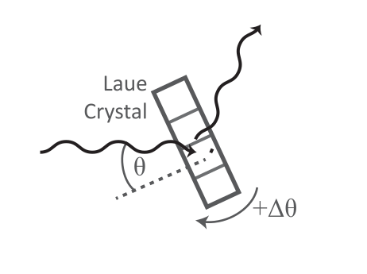

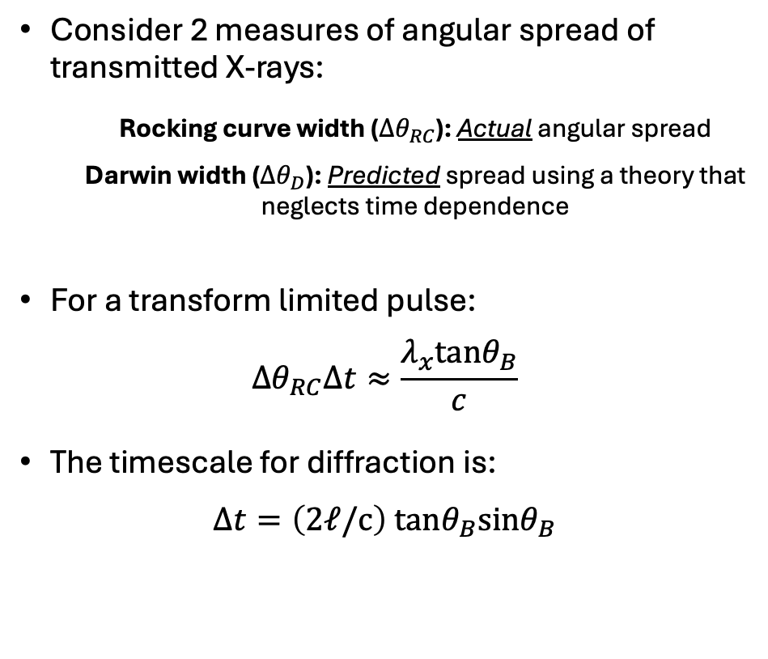


For XFEL experiments, the pulse duration is short compared to the timescale associated with diffraction
Consider 2 measures of angular spread of transmitted X-rays:
Rocking curve width (${Δθ}_{RC}$): Actual angular spread
Darwin width (${Δθ}_{D}$): Predicted spread using a theory that neglects time dependence
For a transform limited pulse:
$${Δθ}_{RC}Δt≈\frac{λ_{x}tanθ_{B}}{c}$$
The timescale for diffraction is:
$$Δt=\left(2ℓ/c\right) tanθ_{B}sinθ_{B}$$
$$F^{∗}$$
$$T=F^{∗}/F$$
$$F$$
Wark & Lee, “Simulations of femtosecond X-ray diffraction from unperturbed and rapidly heated single crystals”, Journal of Applied Crystallography 32 (1999).

Slide 19
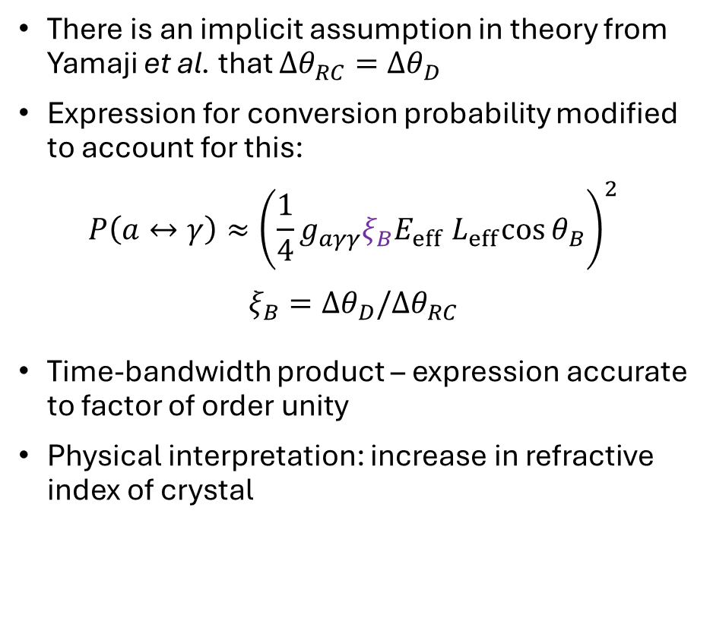

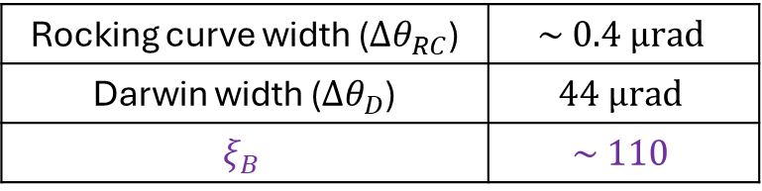
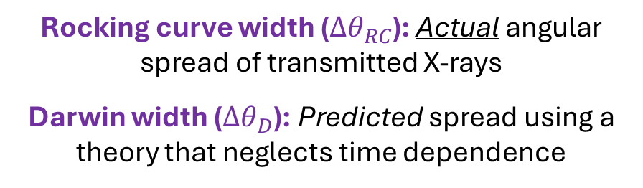
Probability for photon-axion conversion should account for this short pulse-duration
There is an implicit assumption in theory from Yamaji et al. that ${Δθ}_{RC}=Δθ_{D}$
Expression for conversion probability modified to account for this:
$$P\left(a↔γ\right)≈{\left(\frac{1}{4}g_{aγγ}{ξ_{B}E}_{eff}{ L}_{eff}\cos{θ_{B}}\right)}^{2}$$
$$ξ_{B}=Δθ_{D}/Δθ_{RC}$$
Time-bandwidth product – expression accurate to factor of order unity
Physical interpretation: increase in refractive index of crystal
Rocking curve width (${Δθ}_{RC}$): Actual angular spread of transmitted X-rays
Darwin width (${Δθ}_{D}$): Predicted spread using a theory that neglects time dependence
Rocking curve width (${Δθ}_{RC}$) | $$\sim 0.4 μrad$$
Darwin width (${Δθ}_{D}$) | $$44 μrad$$
$$ξ_{B}$$ | $$\sim 110$$
“Brilliance” of XFEL amplifies conversion probability
T. Yamaji et al, “Theoretical calculation of coherent Laue-case conversion between x-rays and ALPS for an X-ray LSW experiment” Phys. Rev. D 96, 15001 (2017).
($N_{γ}$/ ${mm}^{2}$/ ${s/mrad}^{2}$/ $0.1\%BW$)

Slide 20
Overview
Introduction to Axions / ALPS and overview of search strategies
Experimental design for a light shining through a wall experiment with an X-Ray Free Electron Laser (XFEL)
Experimental data for initial experiments on EuXFEL
Follow-up work at SACLA (QCD sensitivity)
Fundamental physics with high powered lasers

Slide 21
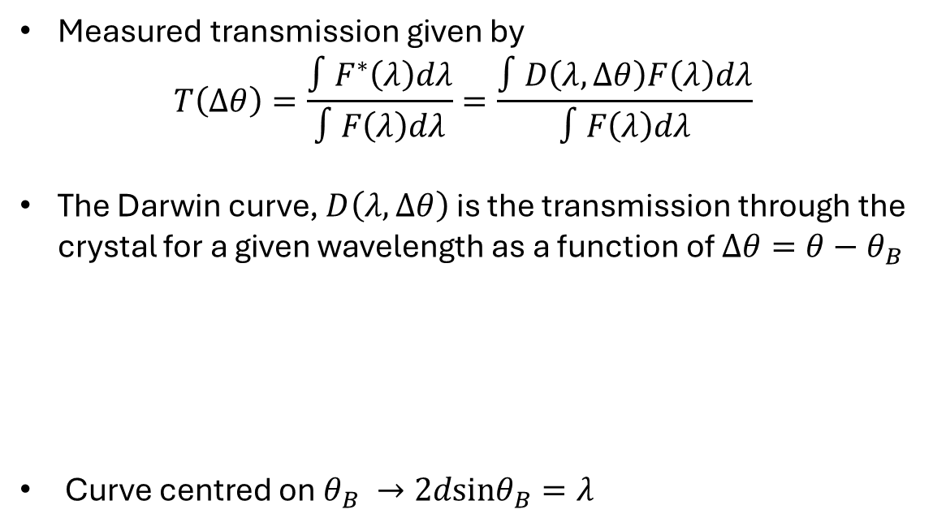
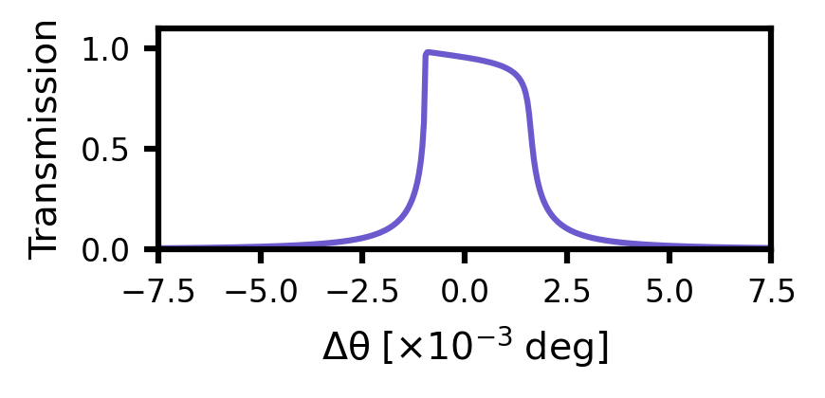



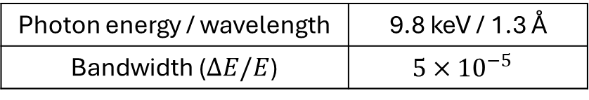

The measured rocking curve is a convolution of the XFEL spectrum and the Darwin curve of the crystal
Measured transmission given by
$$T\left(Δθ\right)=\frac{∫F^{∗}\left(λ\right)dλ}{∫F\left(λ\right)dλ}=\frac{∫D\left(λ,Δθ\right)F\left(λ\right)dλ}{∫F\left(λ\right)dλ}$$
The Darwin curve, $D\left(λ,Δθ\right)$ is the transmission through the crystal for a given wavelength as a function of $Δθ=θ−θ_{B}$
Curve centred on $θ_{B} →2dsinθ_{B}=λ$
$$λ=\text{1.3 Å}$$
$D\left(Δθ\right)$
$$F^{∗}$$
$$F$$
Photon energy / wavelength | 9.8 keV / 1.3 Å
Bandwidth ($ΔE/E$) | $$5×{10}^{−5}$$

Slide 22
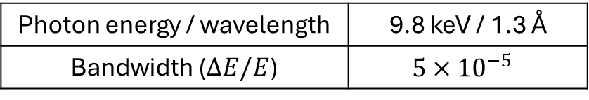

The bandwidth of the XFEL limits the angular resolution in a rocking curve measurement
Seeded peak
$$\frac{2σ}{tanθ_{B}}≈\frac{ΔE}{E}$$
SASE pedestal
Photon energy / wavelength | 9.8 keV / 1.3 Å
Bandwidth ($ΔE/E$) | $$5×{10}^{−5}$$

Slide 23
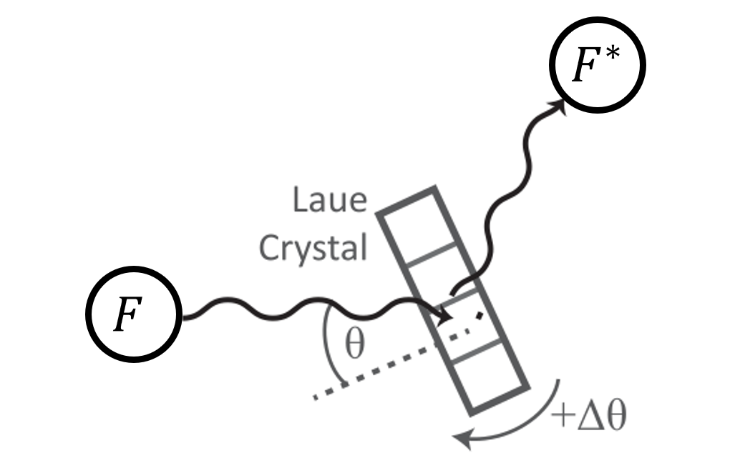
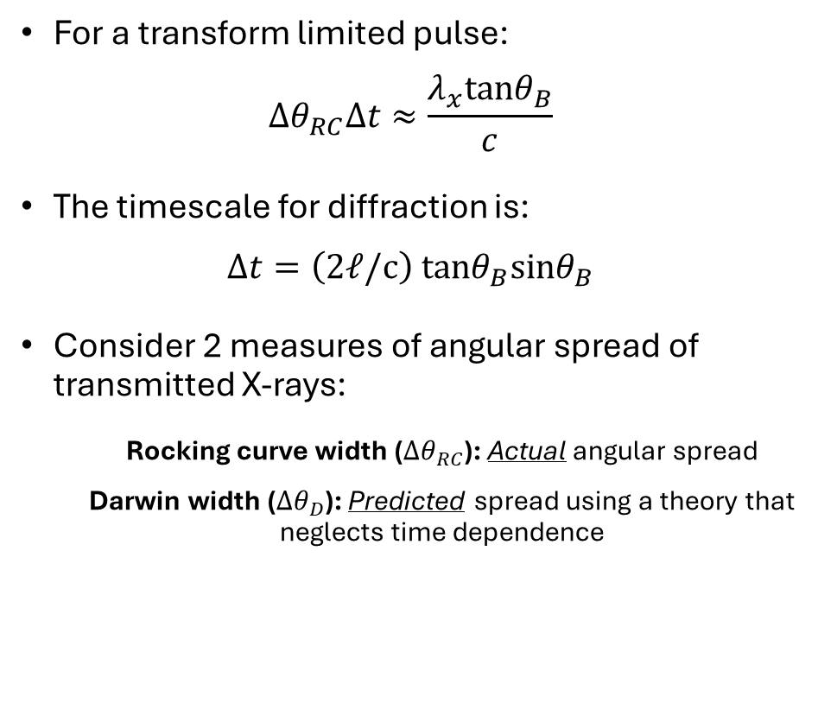

It was found that the X-ray pulse duration was short compared to the timescale associated with diffraction
For a transform limited pulse:
$${Δθ}_{RC}Δt≈\frac{λ_{x}tanθ_{B}}{c}$$
The timescale for diffraction is:
$$Δt=\left(2ℓ/c\right) tanθ_{B}sinθ_{B}$$
Consider 2 measures of angular spread of transmitted X-rays:
Rocking curve width (${Δθ}_{RC}$): Actual angular spread
Darwin width (${Δθ}_{D}$): Predicted spread using a theory that neglects time dependence
Measured curve convolved with XFEL bandwidth
$$T=F^{∗}/F$$
Wark & Lee, “Simulations of femtosecond X-ray diffraction from unperturbed and rapidly heated single crystals”, Journal of Applied Crystallography 32 (1999).

Slide 24
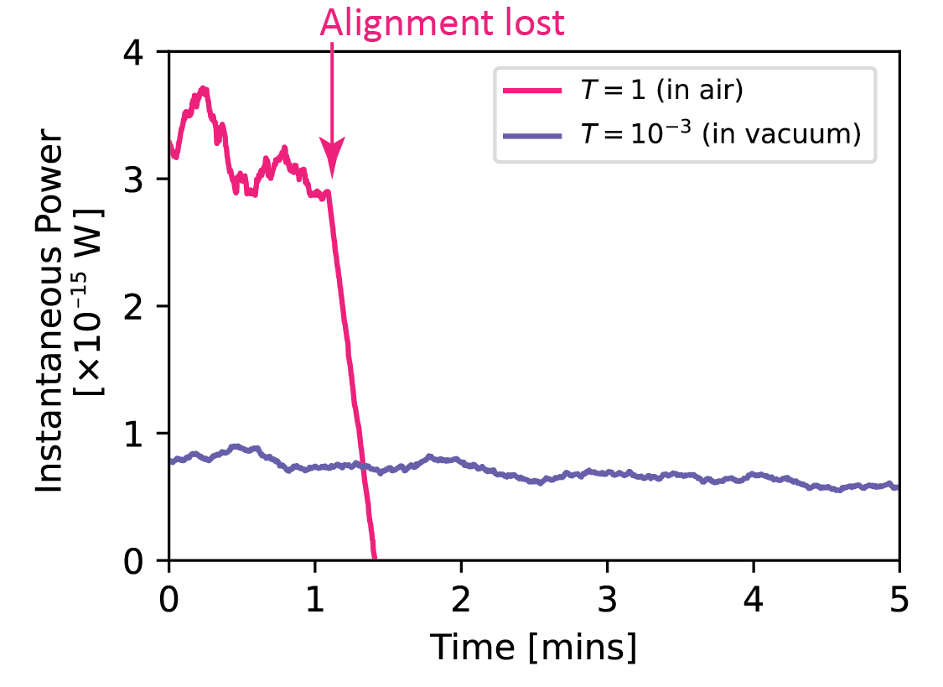
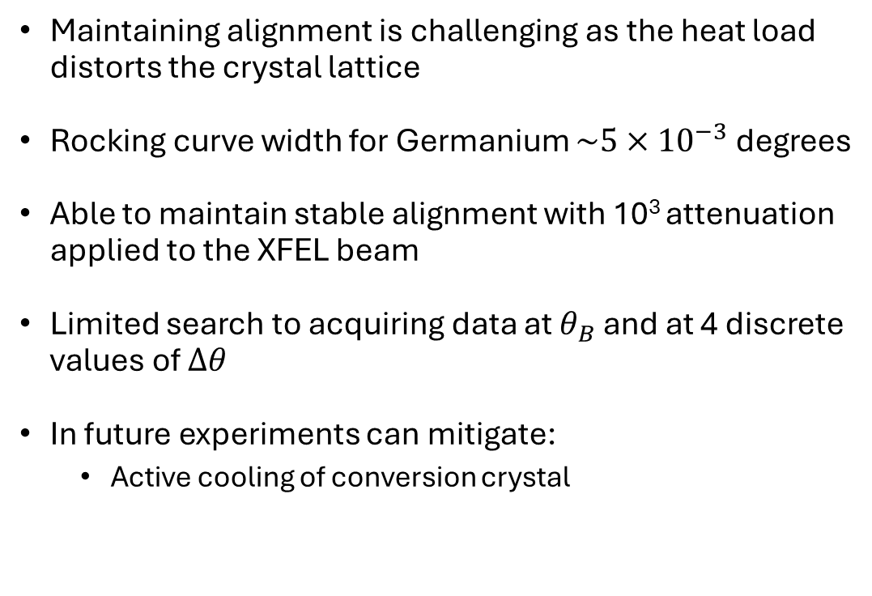
Crystal heating was a major problem during the beamtime
Maintaining alignment is challenging as the heat load distorts the crystal lattice
Rocking curve width for Germanium $\sim 5×{10}^{−3}$degrees
Able to maintain stable alignment with 10³ attenuation applied to the XFEL beam
Limited search to acquiring data at $θ_{B}$ and at 4 discrete values of $Δθ$
In future experiments can mitigate:
Active cooling of conversion crystal

Slide 25
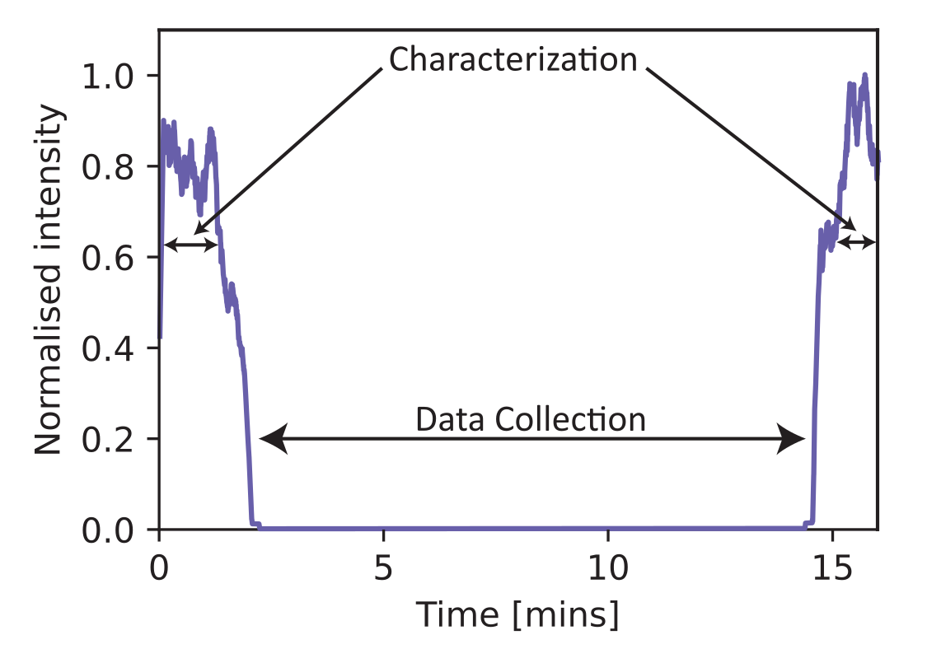

Due to crystal heating, a multi-step process was used for data collection
Process for data collection:
Stages tuned to $θ_{B}$ and radiation shield removed. ~2 mins characterization data collected.
Stages tuned to search angle & radiation shield returned. ~10 mins search data collected.
Stages tuned back to $θ_{B}$ and shield removed. ~2 mins characterization data collected.
For the $i^{′}th$ run calculate:
$$η_{i}=\frac{1}{T_{Ge}^{2}}\frac{E_{i}^{JF, ch}}{E_{i}^{in,ch}}$$
Then, for all runs at a given $Δθ$:
$$ηN_{in}=\sum_{i}{η_{i}E_{i}^{in, aq}/k_{γ}}$$
Measured probability of axion generation then:
$$P{\left(a↔γ\right)}^{2}=\frac{N_{det}}{ηN_{in}}$$

Slide 26
The HED/HiBEF instrumentation enabled an accurate constraint to be placed on input / output X-ray flux
2 m
X-ray gas monitor
Energy per-pulse
Absolute calibration
Jungfrau-4
Hybrid pixel detector
Acquisitions gated to $2 μs$
Energy resolution $\sim 0.5eV$
Vacuum chamber
6 m
XFEL Beam
Double crystal
converter
Regenerated photons
Flight tube

Slide 27




No events consistent with axion production were detected during the experiment
Hits ($k_{γ}>4 keV)$
Events consistent with axion production have $k_{γ}=9.8 keV$.
They should also lie on the X-Ray spot observed on the Jungfrau when in characterisation mode.

Slide 28


Bounds on the coupling strength were calculated taking a 90% confidence interval
Measured probability of axion generation:
$$P{\left(a↔γ\right)}^{2}=\frac{N_{det}}{ηN_{in}}$$
Take $N_{det}=2.3$ events (assume events Poisson distributed, 90 % confidence interval with $μ=0$)
Upper bound on axion-photon coupling:
$$g_{aγγ}<{\left(\frac{1}{4}E_{eff}L_{B}ξ_{B}cosθ_{B}\right)}^{−1}P{\left(a↔γ\right)}^{1/2}$$
$$Δθ [mrad]$$ | $$m_{a} [eV]$$ | $$g_{aγγ} [{Gev}^{−1}]$$
$$0.0$$ | $$< 44$$ | $$3.91×{10}^{−4}$$
$$1.0$$ | $$3.4×{10}^{2}$$ | $$3.10×{10}^{−4}$$
$$1.8$$ | $$4.6×{10}^{2}$$ | $$3.87×{10}^{−4}$$
$$10.0$$ | $$1.1×{10}^{3}$$ | $$3.69×{10}^{−4}$$
$$50.0$$ | $$2.4×{10}^{2}$$ | $$2.76×{10}^{−4}$$
T. Junk “Confidence level computation for combining searches with small statistics” Nucl. Instrum. Meth. A 434, 435 (1999)

Slide 29
Bounds obtained in this work are competitive with existing studies - using a complementary search technique
J. W. D. Halliday et. al. “Bounds on Heavy Axions with an X-Ray Free Electron Laser” Phys. Rev. Lett. 134, 055002 (2025)

Slide 30



Bounds obtained in this work are competitive with existing studies - using a complementary search technique
$$g_{aγγ}<{\left(\frac{1}{4}E_{eff}L_{B}ξ_{B}cosθ_{B}\right)}^{−1}{\left(\frac{N_{det}}{ηN_{in}}\right)}^{−1/4}$$
$$\left|m_{a}^{2}−m_{γ}^{2}\right|≤\frac{4k_{γ}}{L_{eff}}$$
$$m_{a}=\sqrt{m_{γ}^{2}+2q_{T}k_{γ}cos\left(θ_{B}\right)Δθ}$$
J. W. D. Halliday et. al. “Bounds on Heavy Axions with an X-Ray Free Electron Laser” Phys. Rev. Lett. 134, 055002 (2025)

Slide 31



Our bounds are complimentary to those imposed from searches using accelerators
BaBar
Bounds on dark photon detection [BaBar Collaboration] recast by Dolan et al. to obtain a bounds on $g_{aγγ}$.
Probes spontaneous axion decay
NA64
Target-Bremsstrahlung photons generated by 100 GeV electrons in NA64 beam dump produce axions via the Primakoff effect
Search for both spontaneous axion decay and missing energy in calorimetry data
The BaBar collaboration. “Search for Invisible Decays of a Dark Photon Produced in e⁺e⁻ Collisions at BaBar” , Phys. Rev. Lett. 119 (2017)
J. Dolan et al. “Revised constraints and Belle-II sensitivity for visible and invisible axion-like particles”, J. High Energ. Phys. 94 (2017)
The NA64 Collaboration, “Search for Axionlike and Scalar Particles with the NA64 Experiment” Phys. Rev. Lett. 125 (2020)

Slide 32


Follow-up SACLA measurements yield preliminary bounds approaching the QCD axion band
Follow-up axion search performed at SACLA building directly on the EuXFEL configuration
Operation in air enabled passive crystal cooling, allowing a deliberate trade-off of increased photon flux (~10⁴) against reduced per-photon SNR
Sensitivity was further improved through the use of thicker Germanium samples ($ℓ∼L_{ext}^{B}=1.5 mm$)
Preliminary axion–photon coupling bounds extracted from 3 days of data collection (in October 2025)
Sensitivity approaches the QCD axion band at discrete masses (off-Bragg scans)
Future prospects: improved signal-to-noise and implementation of continuous mass scans via photon-angle tuning

Slide 33
Overview
Introduction to Axions / ALPS and overview of search strategies
Experimental design for a light shining through a wall experiment with an X-Ray Free Electron Laser (XFEL)
Experimental data for initial experiments on EuXFEL
Follow-up work at SACLA (QCD sensitivity)
Fundamental physics with high powered lasers

Slide 34


Vulcan 2020: Extreme Optical Fields for Strong-Field Experiments
Optical laser system $\left(λ∼1 μm, ε_{ν}∼1 eV\right)$
Primary beam will deliver 20 PW peak power in a 20 fs pulse
Large-aperture beam $(\sim 650 × 650 mm²$) focused to $∼5 µm$, enabling peak intensities $I≳ 10²³ W/cm²$ ($I_{Sch}∼{10}^{29} W/cm^{2}$ but strong-field QED and perturbative non-linear vacuum effects accessible in targeted setups)
Facility design explores splitting the primary beam into two equal arms, enabling dual-beam geometries (e.g. photon–photon interactions)
Complemented by VOPPEL (1 PW-class) laser, optimised for laser-wakefield acceleration ($\sim 1 GeV$electron beams synchronised to the optical pulse with comparable spot size and duration)

Slide 35

There are a growing number of PW and multi-PW laser systems globally
1+PW Lasers
(operational)

Slide 36




There are a growing number of PW and multi-PW laser systems globally
10+PW Lasers
(planned)

Slide 37



Selected Fundamental-Physics Experiments to Explore with Multi-PW Lasers
Simulated photon-photon scattering: four-wave mixing scheme to detect elastic photon–photon scattering in vacuum using multi-PW lasers [E. Lundström et al., “Using high-power lasers for detection of elastic photon–photon scattering,” Phys. Rev. Lett. 96, 083602 (2006).]
Quantum radiation reaction: high-significance $(>5σ$) experimental validation of quantum radiation-reaction models in laser-electron collisions at strong fields [E. E. Los et al., “Observation of quantum effects on radiation reaction in strong fields,” Nat. Commun. 17, 1157 (2026).]
Axion photon / axion electron coupling: exploratory experimental concepts discussed in the following slides
Longer-term directions: Exotic atoms; Post Newtonian gravity; high-frequency gravitational wave detection…

Slide 38




E.g. consider an axion search, with optical lasers, sensitive to $m_{a}=1−10 eV$
Two short-pulse optical laser beams with orthogonal polarisations crossed in vacuum
Axion production via the axion–photon interaction:
$$L_{axion}=g_{aγγ}E⋅Ba$$
Axions reconverted to photons via the inverse process using a third (stimulating) beam (LSW geometry)
Projected sensitivity shown for the Aton-4 laser (ELI, Czech Republic) in the 1-10 eV mass range
The same experimental concept is directly adaptable to multi-PW optical facilities including Vulcan-2020
Optical & FEL
Optical
K. Beyer et al. “Light-shining-through-wall axion detection experiments with a stimulating laser” Phys. Rev. D 105, 035031 (2022)

Slide 39



Laser-driven schemes targeting the axion–electron coupling have also been proposed
Two counter-propagating laser pulses form a standing wave in a gas jet, directly accelerating electrons via the oscillating electric field.
Accelerated electrons have a probability to emit axions during this direct acceleration process (by analogy with radiation from an accelerated charge)
Axions traverse through a wall and interact with electrons in the material, enabling reconversion via a Compton-like process ($a+e^{−}→γ+e^{−}$)
Projected sensitivities for multi-PW laser facilities are competitive with existing accelerator searches
G. Vacalis, A. Higuchi, R. Bingham, and G. Gregori, Proposal to use laser-accelerated electrons to probe the axion–electron coupling, Phys. Rev. Lett. 135, 195003 (2025).

Slide 40

Conclusions
Axions explain the absence of CP-violation in strong interactions and are a cold dark matter candidate
We performed a search for heavy axions on EuXFEL
Had issues with crystal heating, but we could still impose competitive bounds on $g_{aγγ}$ using a search technique complimentary to collider-based experiments
Follow up experiment at SACLA demonstrated sensitivity approaching the QCD axion band
High powered lasers have potential uses for fundamental physics, including in axion searches.
J. W. D. Halliday et. al. “Bounds on Heavy Axions with an X-Ray Free Electron Laser” Phys. Rev. Lett. 134, 055002 (2025)

