Slide 1

Cockcroft Institute Lectures – Register Attendance
QR code will take you to a Google form.
Record attendance for each day of lectures.

Slide 2
Lecture 4: HOM Wakefields
Louise Cowie
ASTeC
Slides adapted from Prof G Burt

Slide 3
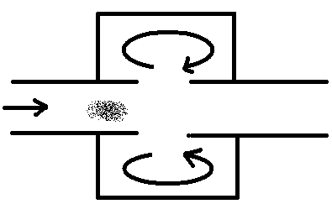
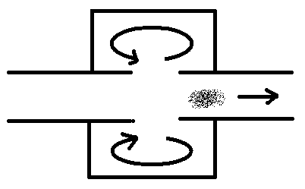
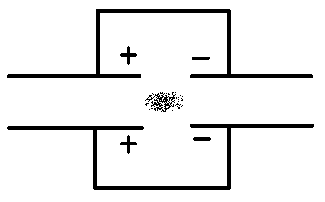
Generation of RF Current
The negative potential difference causes the electrons to slow down and the energy is absorbed into the cavity
A
C
The lower energy electrons then pass through the cavity and force the electrons within the metal to flow back to the opposite side
A bunch of electrons approaches a resonant cavity and forces the electrons to flow away from the bunch.
B

Slide 4
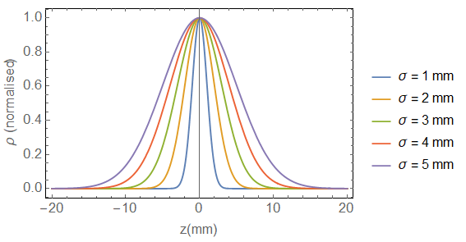
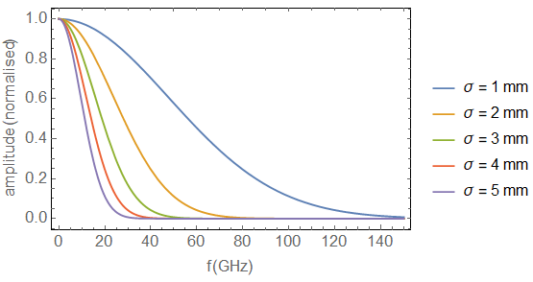



Bunch Spectrum
A charged bunch can induce wakefields over a wide spectrum
A Gaussian bunch has a Gaussian spectrum.
On the short timescale (within the bunch) all the frequencies induced can act on following electrons within the bunch.
On a longer timescale (between bunches) the high frequencies decay and only trapped low frequency (high Q) modes participate in the interaction.
$$ρ\left(z\right)=e^{−\frac{z^{2}}{2σ^{2}}}$$
$$ρ\left(t\right)=e^{−\frac{{(ct)}^{2}}{2σ^{2}}}$$
$$A\left(f\right)=e^{− \frac{{2π}^{2}σ^{2}}{c^{2}}f^{2}}$$

Slide 5
Mode Indices
All modes in the beams frequency spectrum are excited.
Modes are of order TM_{mnp}, the first mode is the TM₀₁₀ accelerating mode so all other modes are higher order modes (HOMs)
Modes of very high azimuthal order have very little fields near the beam so we can ignore them, so we concentrate on m=0, 1 and 2

Slide 6
Pancake effect
For relativistic bunches Lorentz contraction means the electric fields of the bunch are almost entirely perpendicular to the bunch.
We don’t need to consider direct electron to electron forces
It is the generation of fields behind the charge in the conducting boundaries that can apply a force to electrons in the bunch

Slide 7
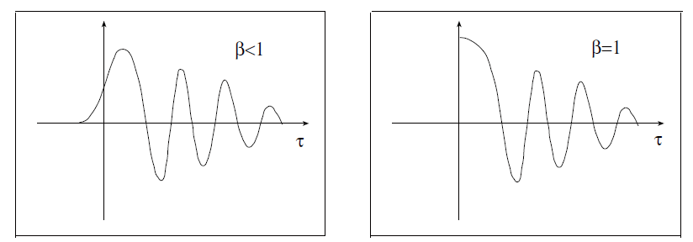
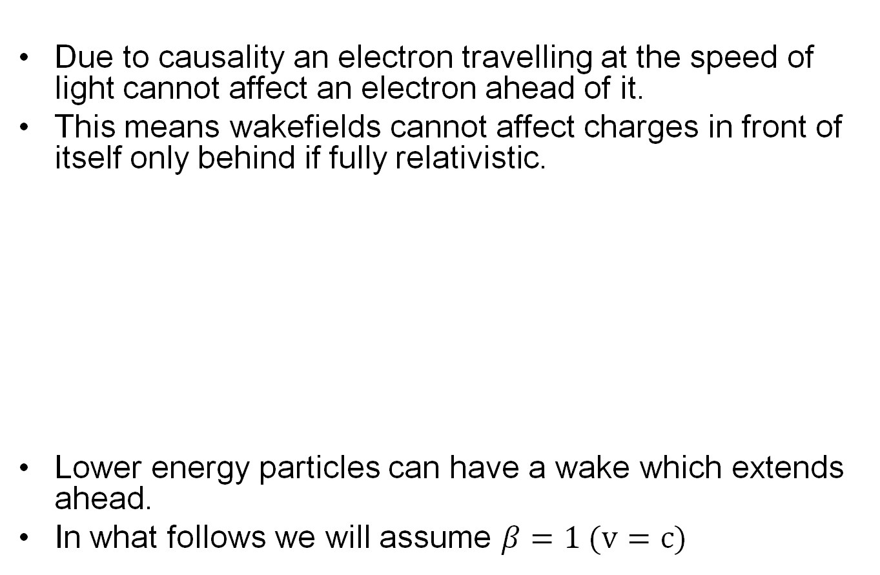
Wakefields
Due to causality an electron travelling at the speed of light cannot affect an electron ahead of it.
This means wakefields cannot affect charges in front of itself only behind if fully relativistic.
Lower energy particles can have a wake which extends ahead.
In what follows we will assume $β=1 (v=c)$

Slide 8
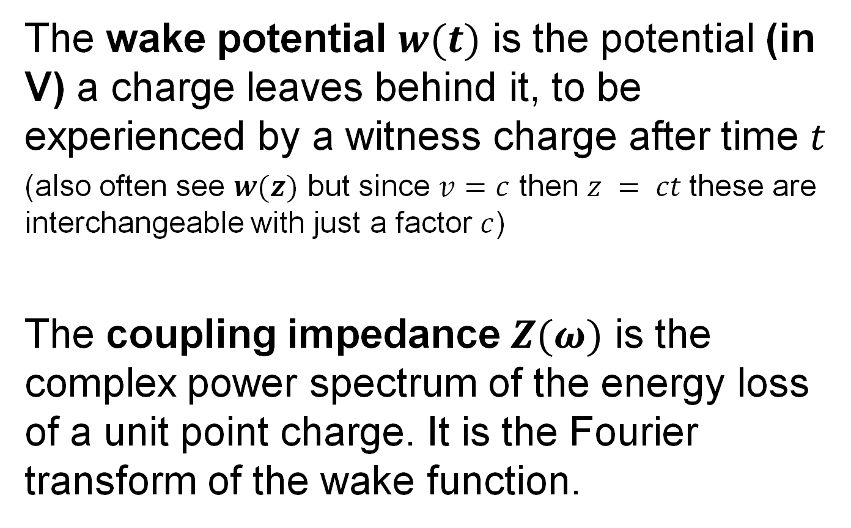
Wake field quantities
The wake potential $w(t)$ is the potential (in V) a charge leaves behind it, to be experienced by a witness charge after time $t$
(also often see $w(z)$ but since $v=c$ then $z = ct$these are interchangeable with just a factor $c$)
The coupling impedance $Z(ω)$ is the complex power spectrum of the energy loss of a unit point charge. It is the Fourier transform of the wake function.

Slide 9
Coupling Impedance
Cut-off
Narrowband Impedance
Broadband Impedance
Impedance
frequency
The coupling impedance in the frequency domain is shown above. It has three regions.
The broadband impedance region doesn’t look like it has much of an effect but it covers a huge frequency spectrum so it’s integral can dwarf the narrowband region.

Slide 10
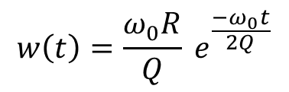
Single mode impedance & wake
If we take the impedance of a single cavity mode and Fourier transform it we get a wake potential.
The real part of Z is responsible for the energy loss
The imaginary part of Z defines the phase shift between the wake potential and the witness particle
$$w\left(t\right)=\frac{ω_{0}R}{Q} e^{\frac{−ω_{0}t}{2Q}}$$

Slide 11
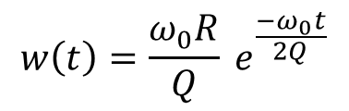
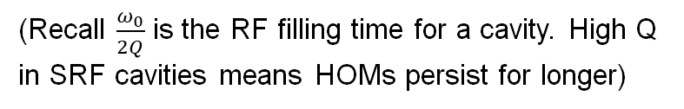


Single mode wakefields
$$w\left(t\right)=\frac{ω_{0}R}{Q} e^{\frac{−ω_{0}t}{2Q}}$$
For cavities normally Q>>1 so we can reduce the formula
For cavities with very high Q factors the equation reduces to
$$w\left(t\right)=\frac{ω_{0}R}{Q} e^{\frac{−ω_{0}t}{2Q}}$$
(Recall $\frac{ω_{0}}{2Q}$ is the RF filling time for a cavity. High Q in SRF cavities means HOMs persist for longer)
$$w\left(t\right)=\frac{ω_{0}R}{Q} e^{\frac{−ω_{0}t}{2Q}}$$

Slide 12
Single Bunch Wake
A mode excited by a single bunch will decay exponentially with time due to ohmic heating and external coupling.
Wake (V)
The single bunch will excite several modes each with different beam coupling and damping rates.
Bunch Separation km

Slide 13
Multibunch Wakefields
For multibunch wakes, each bunch induces the same frequencies at different amplitudes and phases.
These interfere to increase or decrease the fields in the cavity.
As the fields are damped the wakes will tend to a steady state solution.

Slide 14
Transverse Kicks
The force on an electron is given by
If an electron is travelling in the z direction and we want to kick it in the x direction we can do so with either
An electric field directed in x
A magnetic field directed in y
As we can only get transverse fields on axis with fields that vary with Differential Bessel functions of the 1st kind only modes of type TM_{1np} or TE_{1np} can kick electrons on axis.
We call these modes dipole modes

Slide 15
Dipole modes
Dipole mode have a transverse magnetic and/or transverse electric fields on axis. They have zero longitudinal field on axis. The longitudinal electric field increases approximately linearly with radius near the axis.
Electric Magnetic
Wakefields are only induced by the longitudinal electric field so dipole wakes are only induced by off-axis bunches.
Once induced the dipole wakes can apply a kick via the transverse fields so on-axis bunches can still experience the effect of the wakes from preceding bunches.

Slide 16
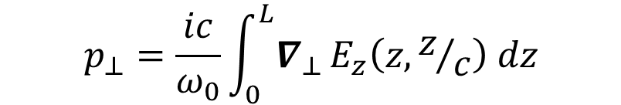
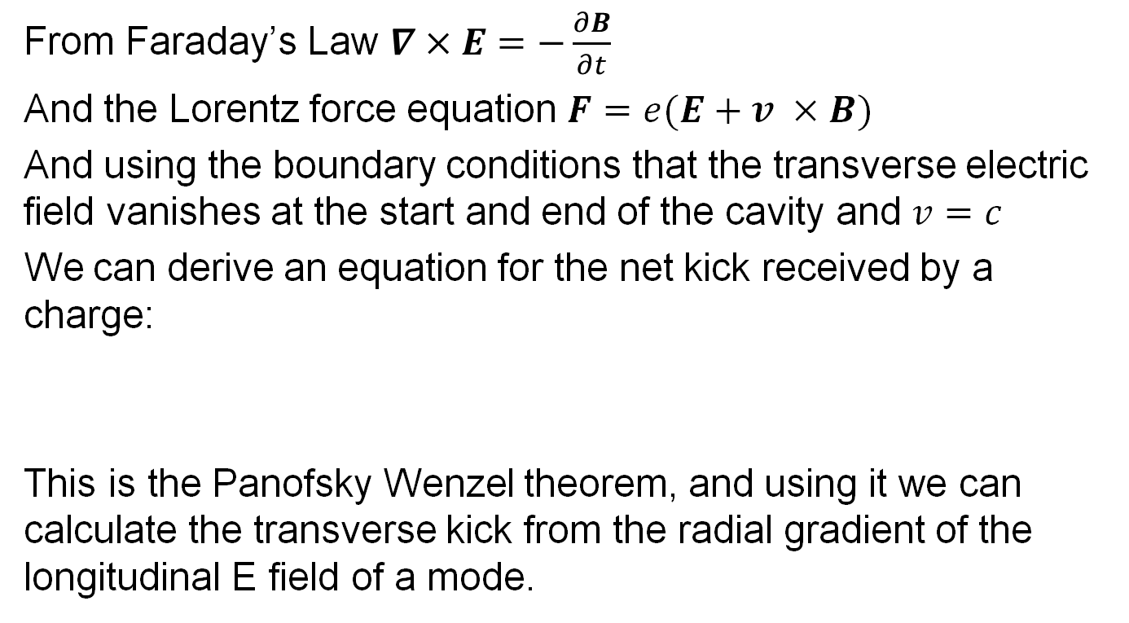
Panofsky-Wenzel Theorem
From Faraday’s Law $∇×E=−\frac{∂B}{∂t}$
And the Lorentz force equation $F=e(E+v ×B)$
And using the boundary conditions that the transverse electric field vanishes at the start and end of the cavity and $v=c$
We can derive an equation for the net kick received by a charge:
This is the Panofsky Wenzel theorem, and using it we can calculate the transverse kick from the radial gradient of the longitudinal E field of a mode.
$$p_{⊥}=\frac{ic}{ω_{0}}\int_{0}^{L}{∇_{⊥}}E_{z}\left(z,z/c\right) dz$$

Slide 17
Panofsky-Wenzel Theorem
If we rearrange Faraday’s Law ( )and integrate along z we can show
Inserting this into the Lorentz (transverse( force equation gives us
for a closed cavity where the 1st term on the RHS is zero at the limits of the integration due to the boundary conditions this can be shown to give
This means the transverse voltage is given by the rate of change of the longitudinal voltage

Slide 18
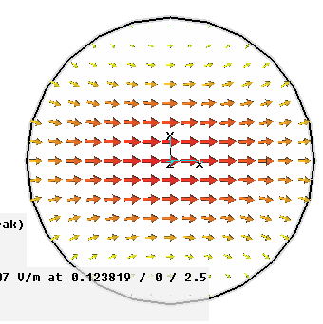
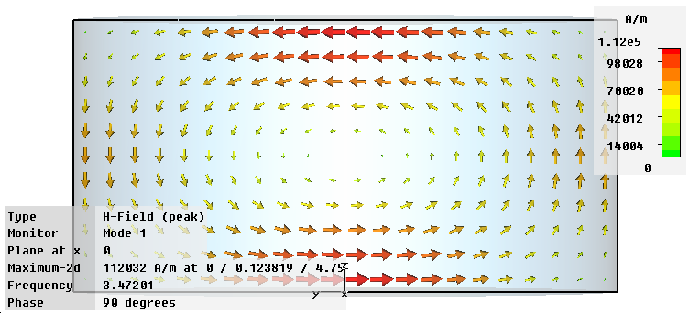
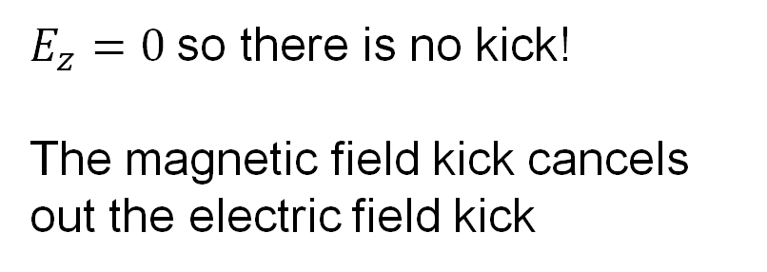
TE₁₁₁ Dipole Mode
E
H
Beam
$E_{z}=0$so there is no kick!
The magnetic field kick cancels out the electric field kick

Slide 19
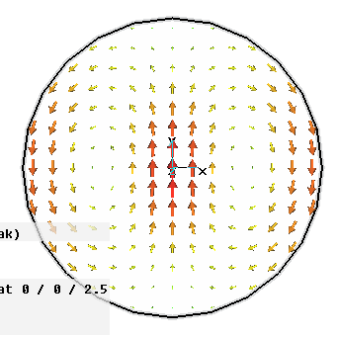
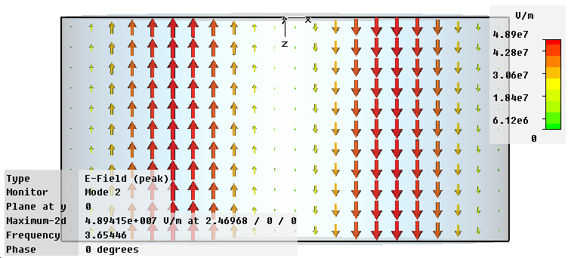
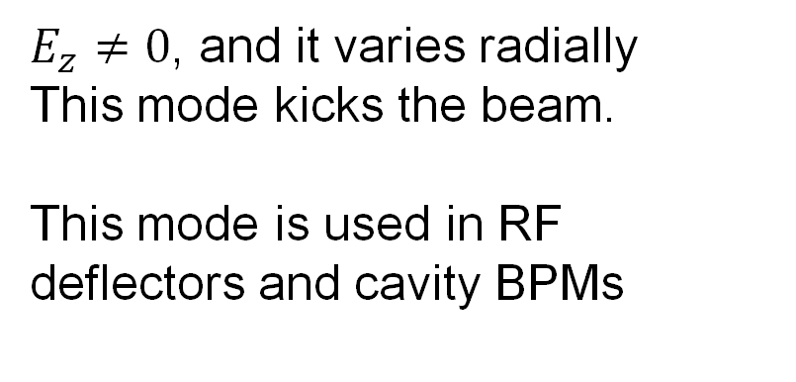
TM₁₁₀ Dipole Mode
H
E
Beam
$E_{z}≠0$, and it varies radially
This mode kicks the beam.
This mode is used in RF deflectors and cavity BPMs

Slide 20
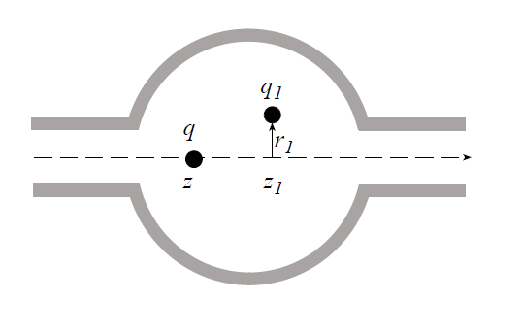
Transverse Wakes

Slide 21
Resonances
As you are summing the contribution to the wake from all previous bunches, resonances can appear. For monopole modes we sum
Hence resonances appear when
It is more complex for dipole modes as the sum is
This leads to two resonances at +/-some Δfreq from the monopole resonant condition.

Slide 22
Damping
As the wakes from each bunch add together it is necessary to damp the wakes so that wakes from only a few bunches add together.
The smaller the bunch spacing the stronger the damping is required (NC linacs can require Q factors below 50).
This is normally achieved by adding external HOM couplers to the cavity.
These are normally quite complex as they must work over a wide frequency range while not coupling to the operating mode.
However the do not need to handle as much power as an input coupler.

Slide 23
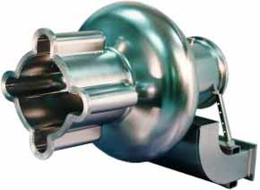
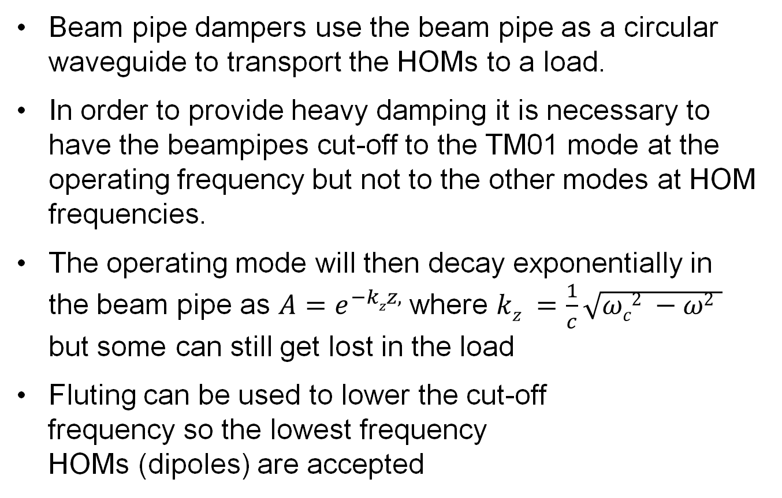
Beampipe damping
Beam pipe dampers use the beam pipe as a circular waveguide to transport the HOMs to a load.
In order to provide heavy damping it is necessary to have the beampipes cut-off to the TM01 mode at the operating frequency but not to the other modes at HOM frequencies.
The operating mode will then decay exponentially in the beam pipe as $A=e^{−kzz,}⁡$where $kz =\frac{1}{c}\sqrt{ωc2 −ω2 }$ but some can still get lost in the load
Fluting can be used to lower the cut-off
frequency so the lowest frequency
HOMs (dipoles) are accepted

Slide 24
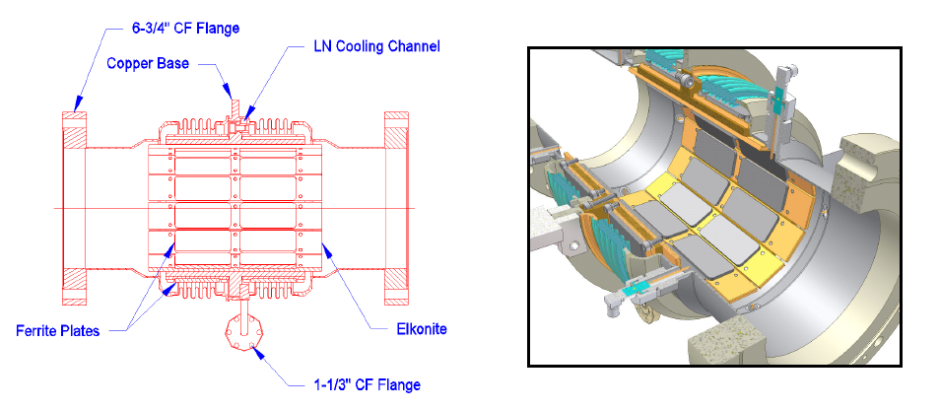
Beampipe HOM Dampers
For really strong HOM damping we can place ferrite dampers directly in the beampipes. This needs a complicated engineering design to deal with the heating effects.
This type of damping lowers the filling factor.

Slide 25
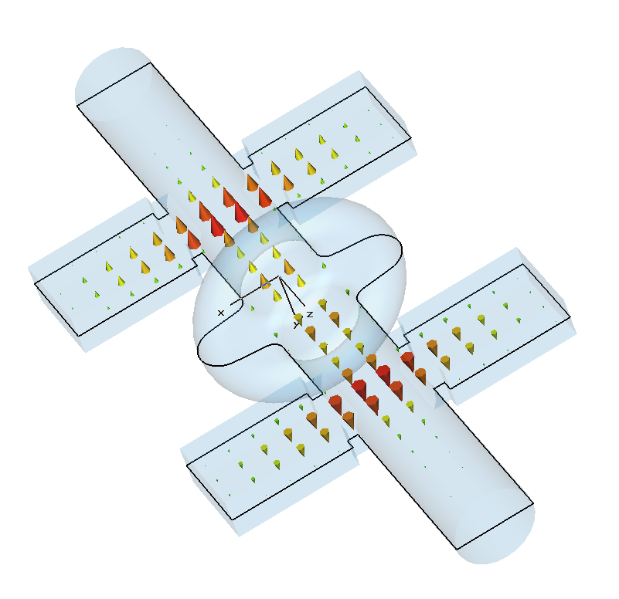
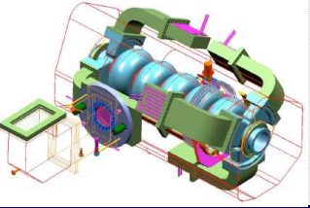
Rectangular waveguide couplers
Waveguide HOM couplers allow higher power flow than co-axial couplers (next slide) and tend to be used in high current systems. They also have a natural cut-off frequency.
They also tend to be larger than co-axial couplers so are not used for lower current systems.
To avoid taking the waveguides through the cryomodule, ferrite dampers are often placed in the waveguides to absorb all incident power.

Slide 26
Coaxial HOM couplers
HOM couplers can be represented by equivalent circuits. If the coupler couples to the electric field the current source is the electric field (induced by the beam in the cavity) integrated across the inner conductor surface area.
I
C_{s}
R
If the coaxial coupler is bent at the tip to produce a loop it can couple to the magnetic fields of the cavity. Here the voltage source is the induced emf from the time varying magnetic field and the inductor is the loops inductance.
L
V
R

Slide 27
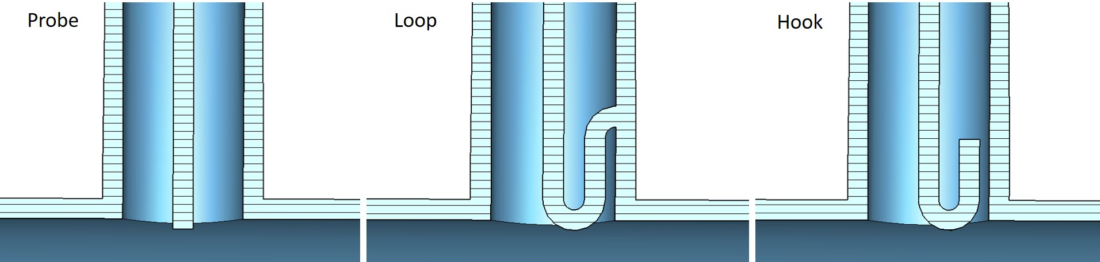
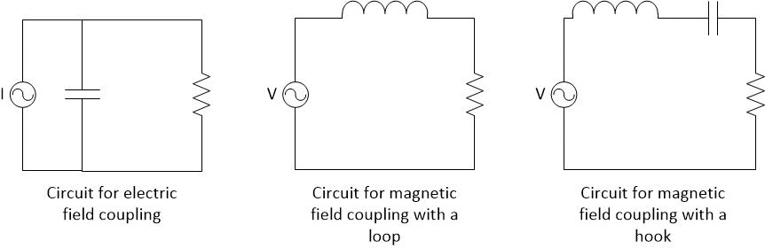
Probes, Loops and Hooks

Slide 28
Loop HOM couplers
Inductive stubs to probe couplers can be added for impedance matching to the load at a single frequency or capacitive gaps can be added to loop couplers.
Also capacitive gaps can be added to the stub or loop inductance to make resonant filters.
L
L
I
C_{s}
R
I
C_{s}
R
C_{f}
The drawback of stubs and capacitive gaps is that you get increase fields in the coupler (hence field emission and heating) and the complex fields can give rise to an electron discharge known as multipactor. As a result these methods are not employed on high current machines.

Slide 29
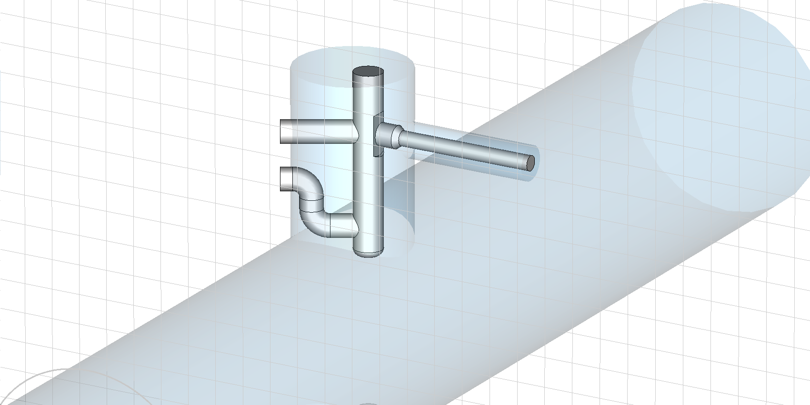
F-probe couplers
Capacitive gaps
F-probe couplers are a type of co-axial coupler, commonly used to damp HOM’s in superconducting cavities.
Their complex shapes are designed to give the coupler additional capacitances and inductances.
These additional capacitances and inductances form resonances which can increase or decrease the coupling at specific frequencies.
Inductive stubs
Output antenna
The LRC circuit can be used to reduce coupling to the operating mode (which we do not wish to damp) or to increase coupling at dangerous HOM’s.
Log[S₂₁]
frequency

Slide 30
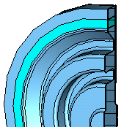
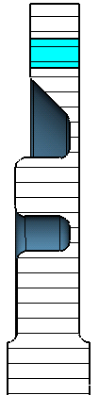



Choke Damping
load
choke
cavity
For high gradient accelerators, choke mode damping has been proposed. This design uses a ferrite damper inside the cavity which is shielded from the operating mode using a ‘choke’. A choke is a type of resonant filter that excludes certain frequencies from passing.
The advantage of this is simpler (axially-symmetric) manufacturing

Slide 31
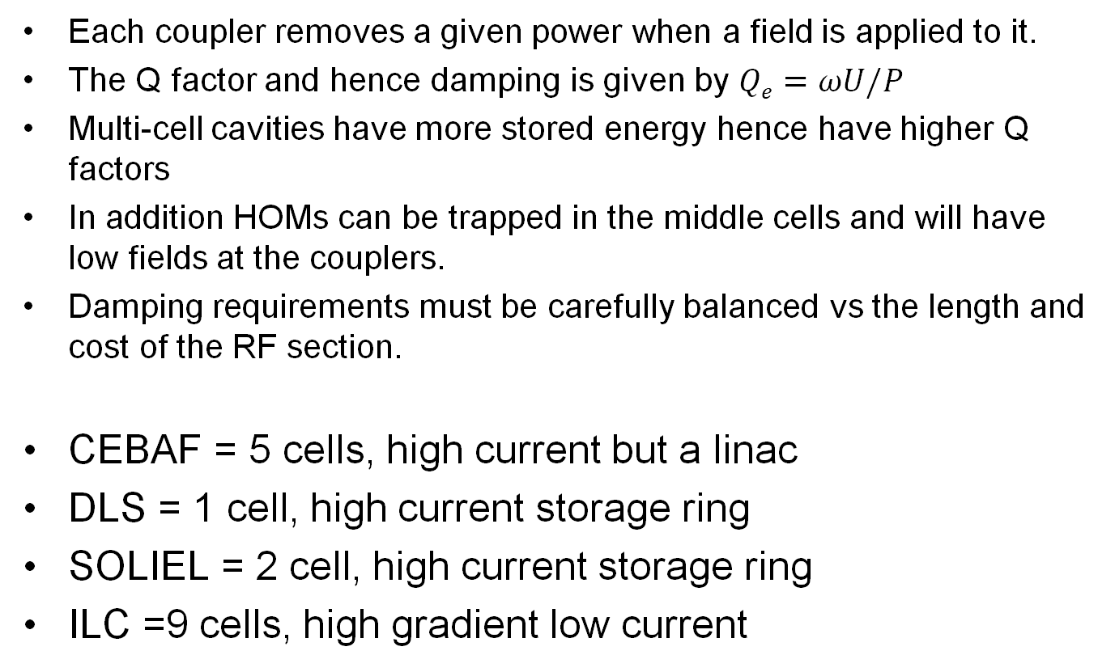
Multicell cavity damping
Each coupler removes a given power when a field is applied to it.
The Q factor and hence damping is given by $Qe=ωU/P$
Multi-cell cavities have more stored energy hence have higher Q factors
In addition HOMs can be trapped in the middle cells and will have low fields at the couplers.
Damping requirements must be carefully balanced vs the length and cost of the RF section.
CEBAF = 5 cells, high current but a linac
DLS = 1 cell, high current storage ring
SOLIEL = 2 cell, high current storage ring
ILC =9 cells, high gradient low current

Slide 32
Putting it all together
First we need to know the beam current, how much it needs to be accelerated by, and the overvoltage.
Can use this to calculate required power and Q factors for an SRF and/or NCRF system based on pillbox numbers.
Investigate possible power sources.
Single or multicell?
SCRF or NCRF
Choose frequency.
Model real cavity and look at HOM damping.
Adjust calculations using numbers from RF models.

Slide 33
References
Linear Accelerators – Wangler
HOM mitigation – R. Jones RF CAS 2010 https://indico.cern.ch/event/69321/contributions/2069682/attachments/1028719/1464831/Jones-1.pdf
HOM dampers – S. Belomestnykh USPAS 2009 https://uspas.fnal.gov/materials/09UNM/SRF/USPAS2009_Lecture_11_HOM_dampers.pdf

Slide 34
Assessment
RF assessment will be on the Indico for today’s lecture
Due date is 16th February
Email me your answers louise.cowie@stfc.ac.uk or drop them on my desk A24B

