Slide 1

Caversham Science Fair
Ottilie Goodfellow | LhARA CM April 2026

Slide 2
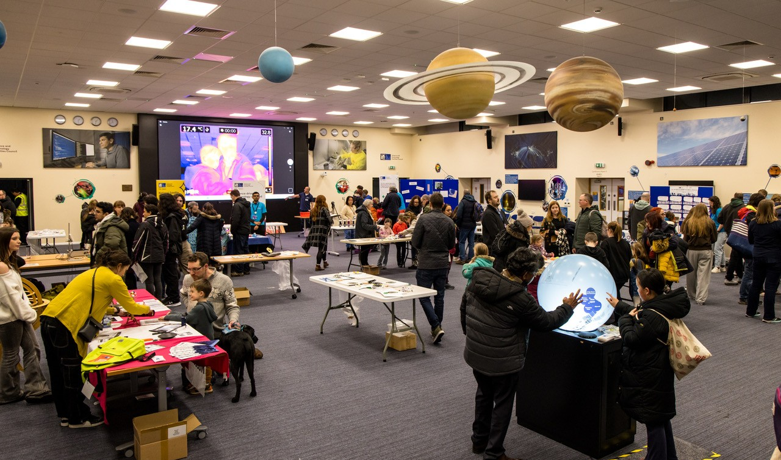
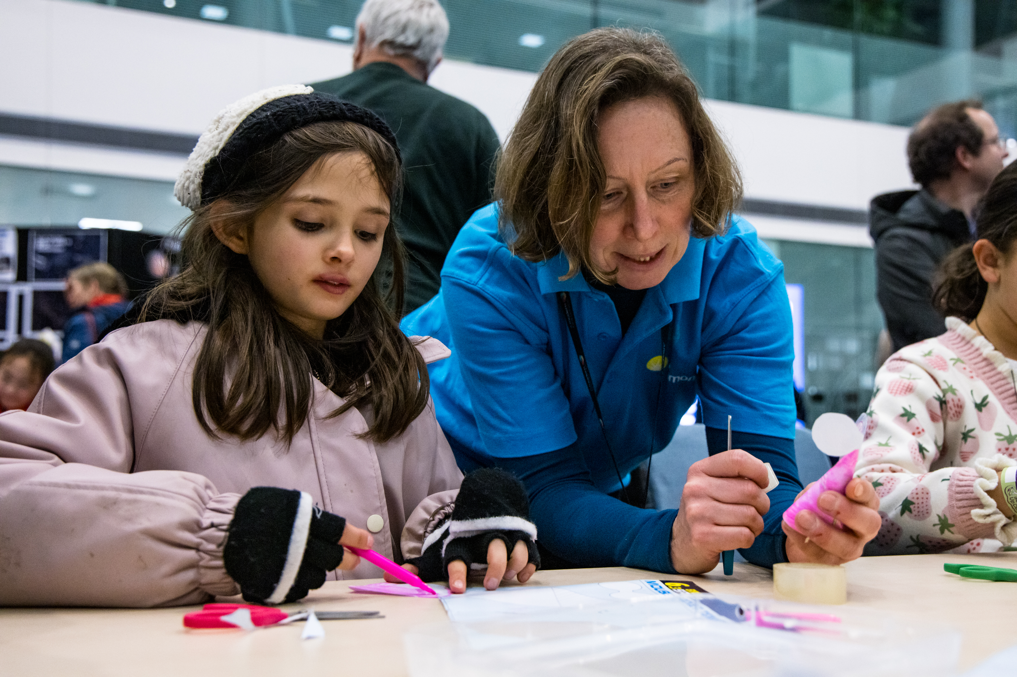
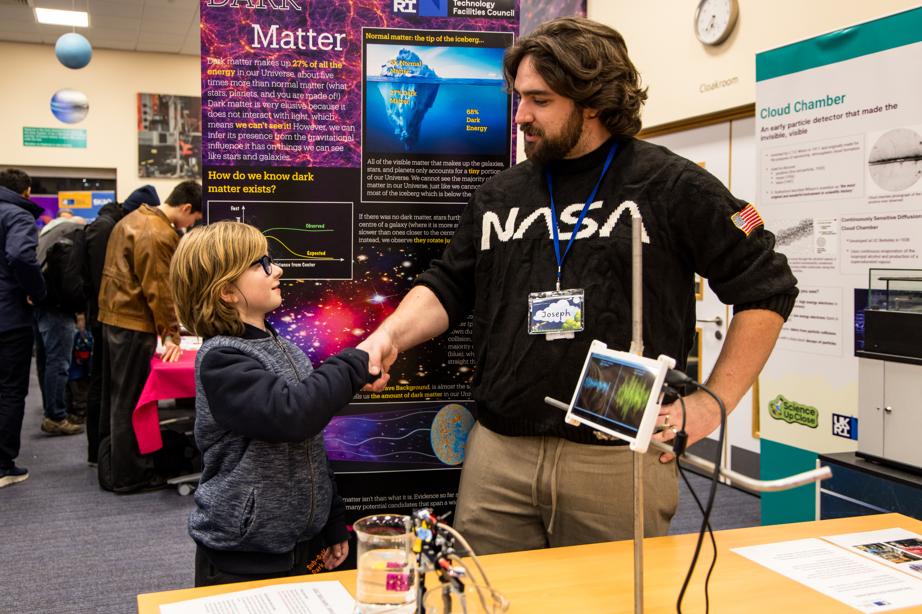
Science Fair at Caversham community centre
Wednesday 27th May, 13:30-16:30
Small science fair for general public in Caversham, Reading
Stalls with interactive activities, displays, presenters etc.
Organised by PPD – mainly particle
physics stalls
Half term – expecting lots of families
Ottilie Goodfellow | LhARA CM April 2026

Slide 3
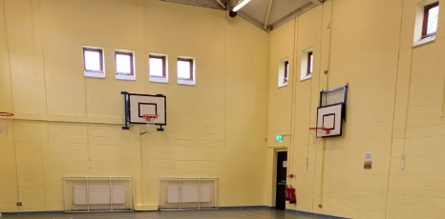
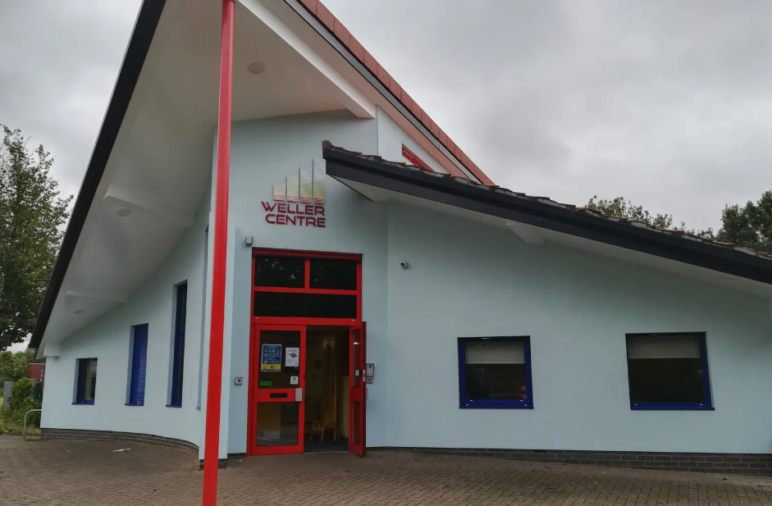
Caversham community centre
Weller Centre, Caversham
Top 20% most deprived areas in the UK according to Index of Multiple Deprivation
Sports hall rented 12:30-17:30 (incl. set up and clean up)
Tables and power provided
We’d love for LhARA to have a stall!
Ottilie Goodfellow | LhARA CM April 2026
Notes:
What is the IMD?
Measure of multiple deprivation indicators within an area. Includes:
Income Deprivation (22.5%)
Employment Deprivation (22.5%)
Education, Skills and Training Deprivation (13.5%)
Health Deprivation and Disability (13.5%)
Crime (9.3%)
Barriers to Housing and Services (9.3%)
Living Environment Deprivation (9.3%)
All 7 combine (weighted as indicated) to create the IMD, the official measure of deprivation in England.

