Slide 1
Laser-focussed on science for radiotherapy
LhARA exhibit at the
2026 Royal Society Summer Science Exhibition
Status update

Slide 2
Exhibit preparation
Preparation area:
  4x2 m² space secured in Physics laboratory
  Agreement to rebuild exhibit in Physics Common Room in run-up to SSE
Elements of exhibit:
  Back-drop:
    Design: LhARA web/comms group
    Order to be placed (IC Physics Comms team) this/next week
  Currently working on 6 activities/demos
    Different levels of maturity

Slide 3
What we know of schedule:

Slide 4
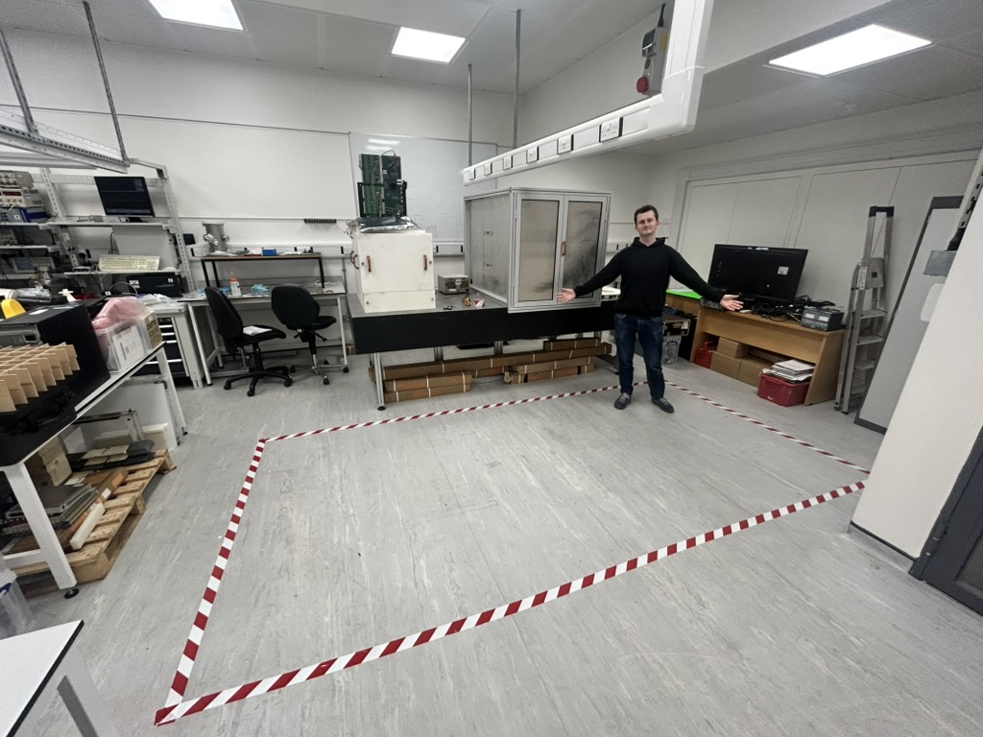

Slide 5
Exhibit preparation
Activities/demos (not all activities for all sessions!):
VR tour of LhARA
2) Plasma lens demonstrator (Quadrupole trap)
- we have one trap ready, building a second one
3) Laser balloon popping
- device ready, in discussions about sourcing back up components
4) Leo Cancer Care EVE chair prototype
- ready
5) LhARA 3D model
- printing final components of the model
6) Treatment planning activity
- at the planning stage

Slide 6
Presenter team
Presently signed up:
  ~27 drawn from across UK’s 4-nations and European collaborators
  Most attended RS Public Engagement Training
    Additional training being planned (see next slide)
  Still time to volunteer!
Accommodation for team members:
  A headache!
  Booked: mixture of IC and private accommodation

Slide 7
Communication and messaging
Preparing short briefs on (OG + …):
  Clinical impact (statistics on RT, cures, etc.)
  Market size and potential impact (global value, etc.)
  Science and innovation potential
Planning further training/team building:
  Target for end of May/early June
  First a briefing/training lead by the messaging team, followed by practice session at IC

Slide 8
Acknowledgments …
Paul Jurj; doing an excellent job!

