Slide 1
Welcome and introduction

Slide 2
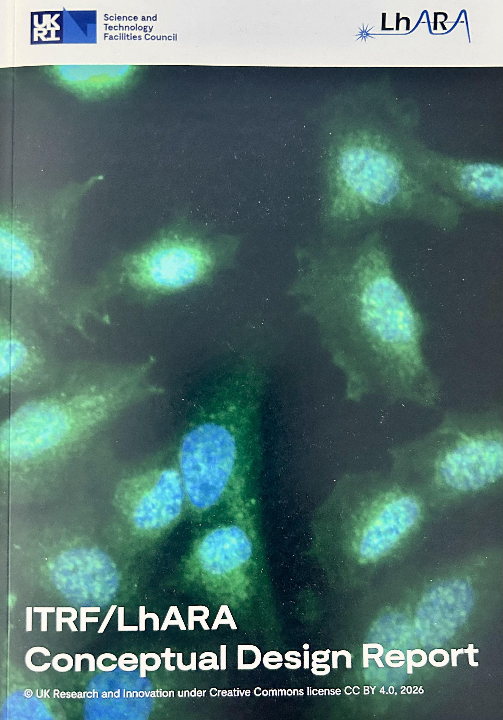
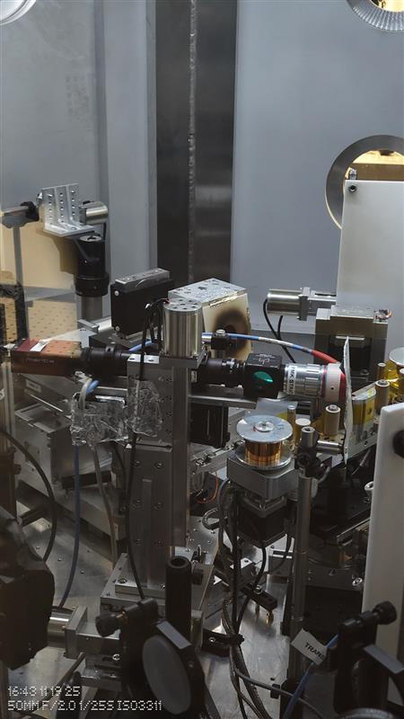
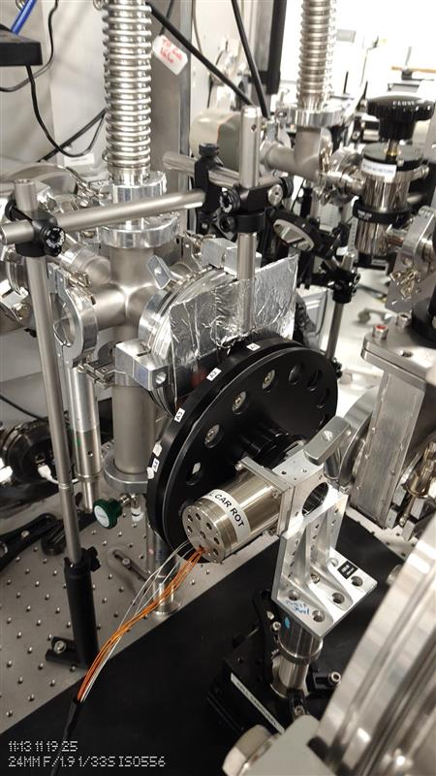
Since our last collaboration meeting (Sep25)
PoPLaR @ SCAPA
Conceptual Design Report
DOI: 10.5286/stfctr.2026007

Slide 3
Publication: Frontiers
Article hub:
Proposal in preparation
Vehicle to publish content of CDR + additional material
Focus for summer/autumn

Slide 4
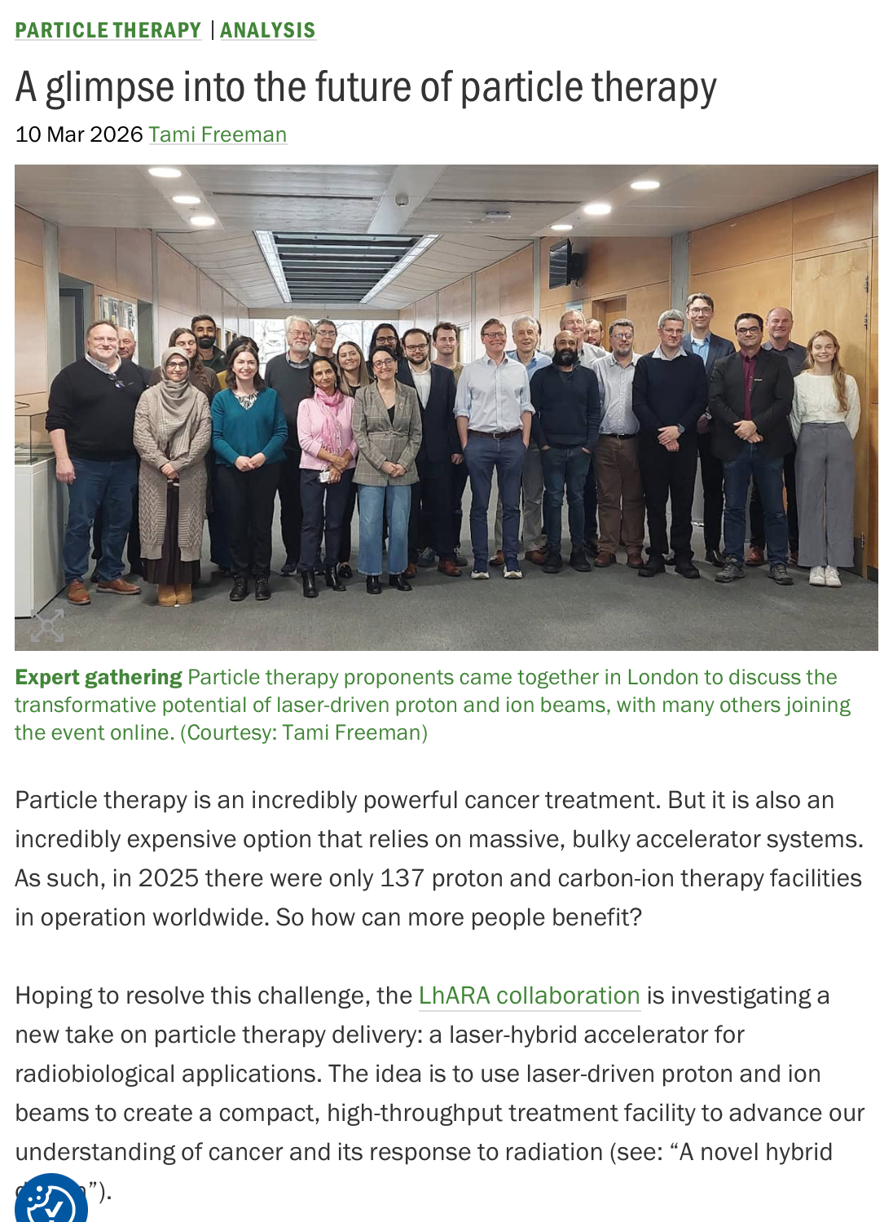

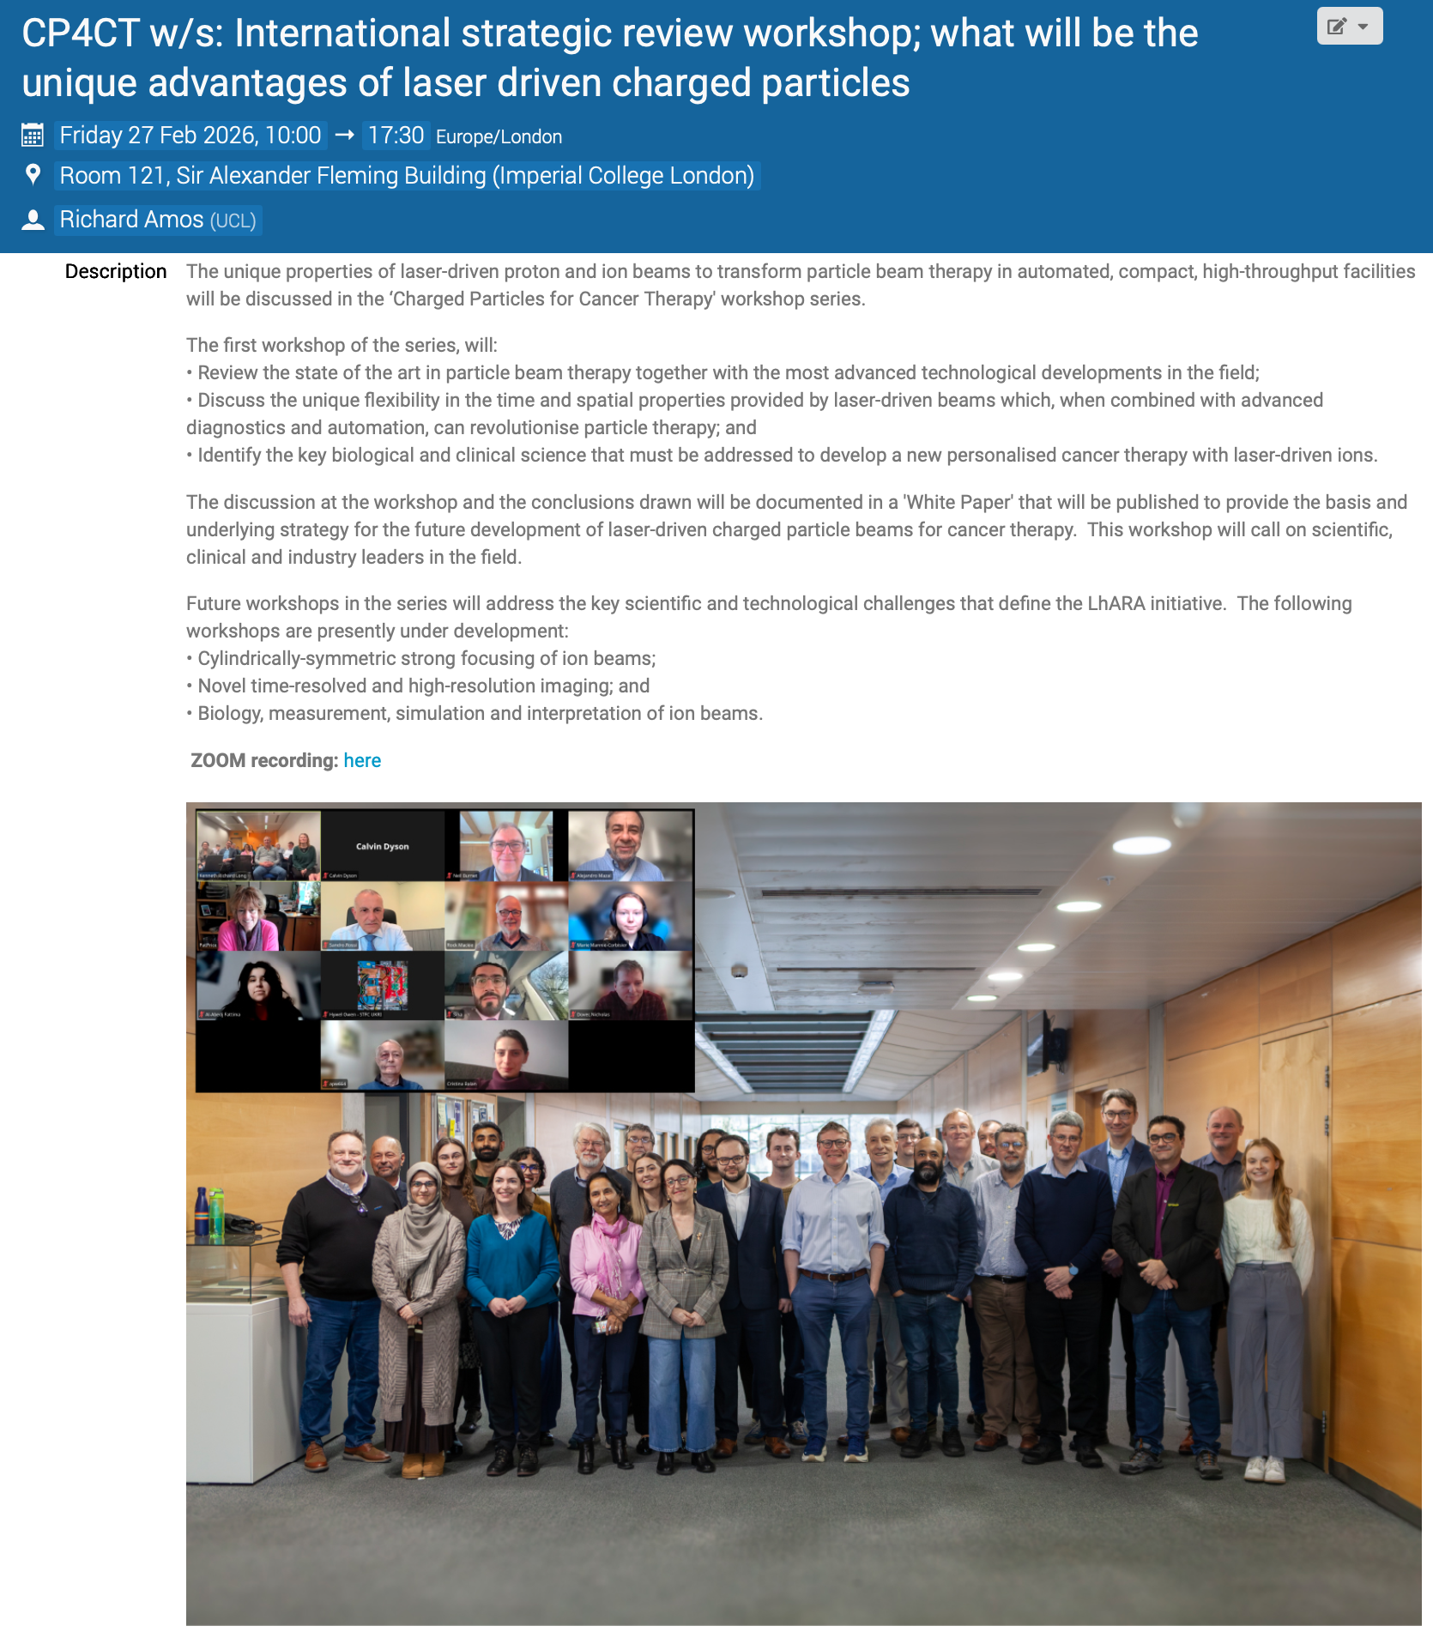
Peer-group meeting series
First of series: 27Feb26
Success!
Plasma lens meeting planning restarted
https://physicsworld.com/a/a-glimpse-into-the-future-of-particle-therapy/
https://indico.stfc.ac.uk/event/1703/

Slide 5
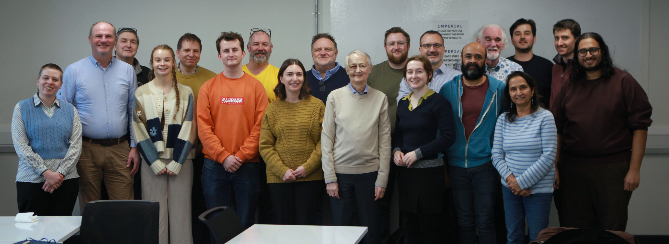
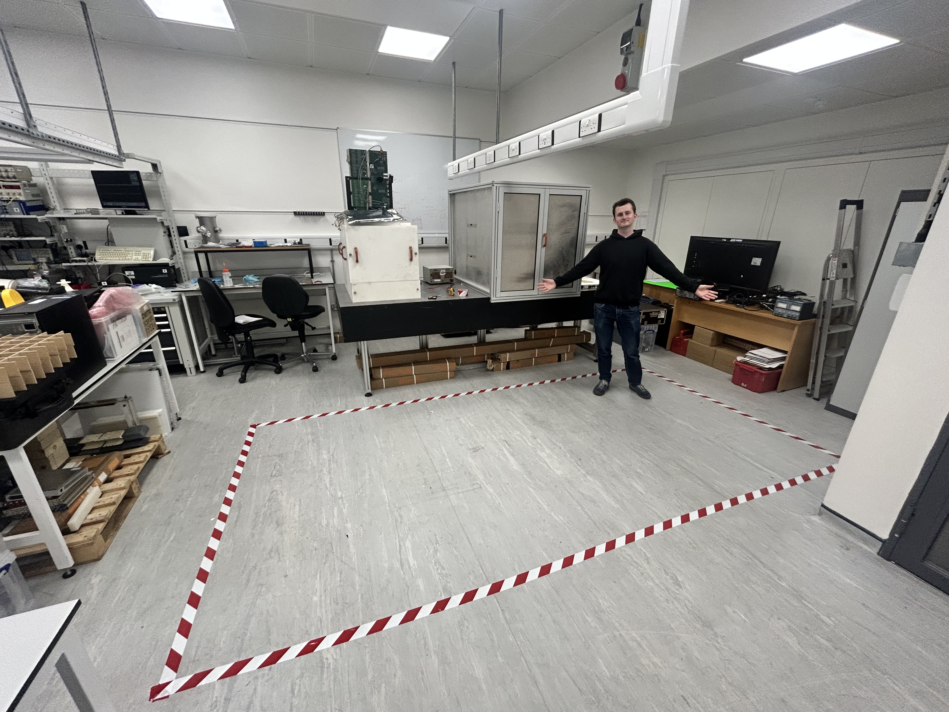
We are going to …
Communication training:
26Feb26; IC
Success!
Pressure! Creating exhibit now
Still time to get involved

Slide 6

Building the three pillars
PoPLaR
as part of
systematic
programme
Science: radiobiology
Project: LhARA
Impact: co-creation

Slide 7
Refresh
Institutes and authors:
Institutes and authors defined through CDR
Logo-slide refresh, Matt Pereira:
80% done – goal, complete by end THIS CM
Needed for RS SSE
Portfolio funding model:
LhARA
Institutes
UKRI
EU/ERC
Industry partners
Philanthropists
Foundations
…

Slide 8
LhARA collaboration business case
Vision that encompasses institutional business plans

Slide 9

Programme, project and business plans
Agreed to develop business plans; now start “for real” …
Agreed with STFC/RAL/PPD that Christopher Townsley will be our consultant
Begin to prepare:
Ideas required for 21May26 …

Slide 10
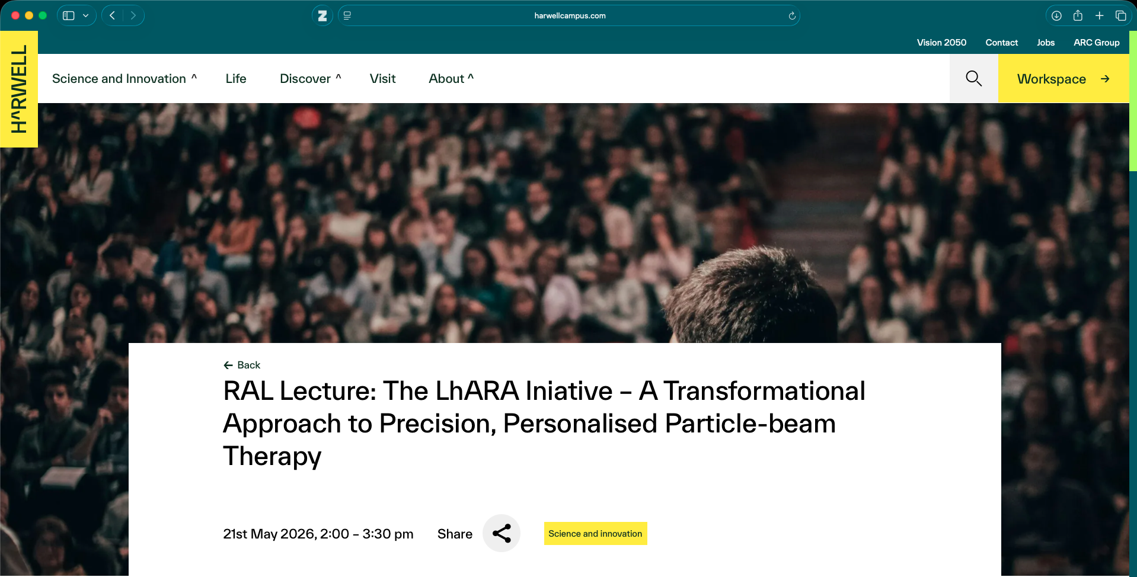
Presentation of our initiative
To be followed by Discussion of the LhARA initiative:
Discussion leads:
Radiation biology; science: Emma Melia
LhARA project: Colin Whyte
Co-creation/co-investment Tracy Underwood

Slide 11
Three pillars
PoPLaR
as part of
systematic
programme
Science: radiobiology
Project: LhARA
Impact: co-creation

Slide 12
CM #9:
All set! Main objective:
Initiate definition of next phase of LhARA initiative!

