Slide 1

Beamline Diagnostics for PoPLaR
Presenter: Calvin Dyson
18th September 2025
LhARA 8th Collaboration Meeting,
Notes:
Welcome to the simulation of the LION beam with LLO
Calvin Dyson and work completed with

Slide 2
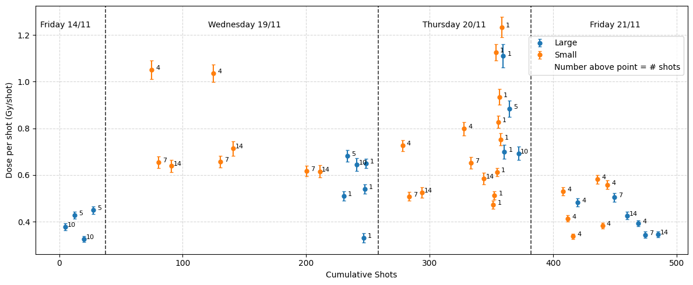
Why do we need an in-beam diagnostic
Shot-to-shot Variation
Reduce vertical cell time
Provide a better understanding of the beam

Slide 3
Sparse Scintillating Fibre

Slide 4
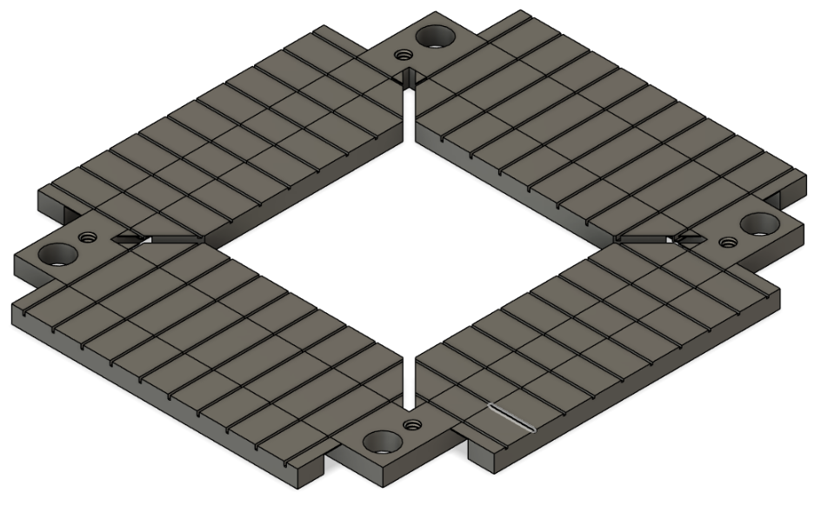
Sparse Scintillating Fibre
The Design
Fibres
    250 μm diameter
    BCF-20
    3.3mm spacing between fibres’ centres
Holder
    48 x 42 mm
    Central hole is a 34mm square
    Space for a total of 20 fibres in a criss-cross pattern
  Concerns
    Energy deposited per fibre
    Transmission of light outside of the vacuum chamber
    Impact on the beam

Slide 5
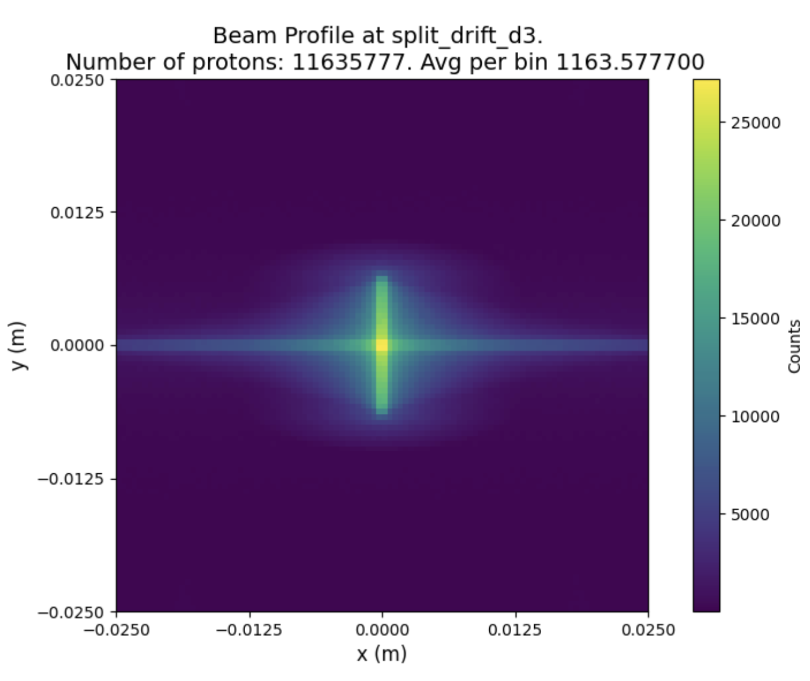
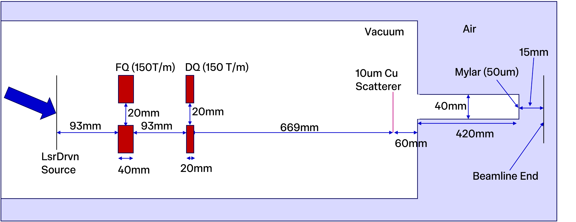
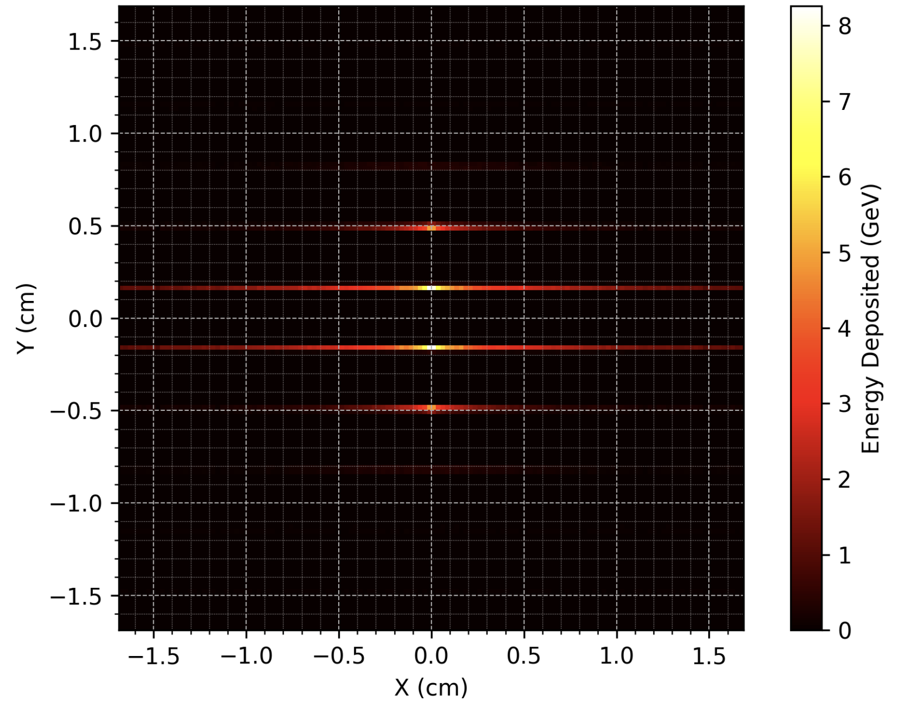
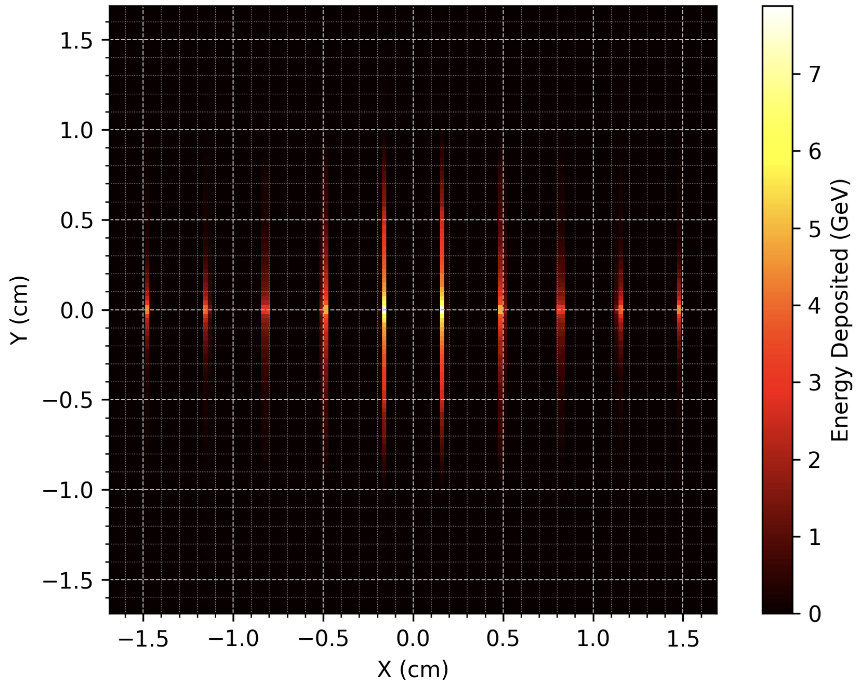
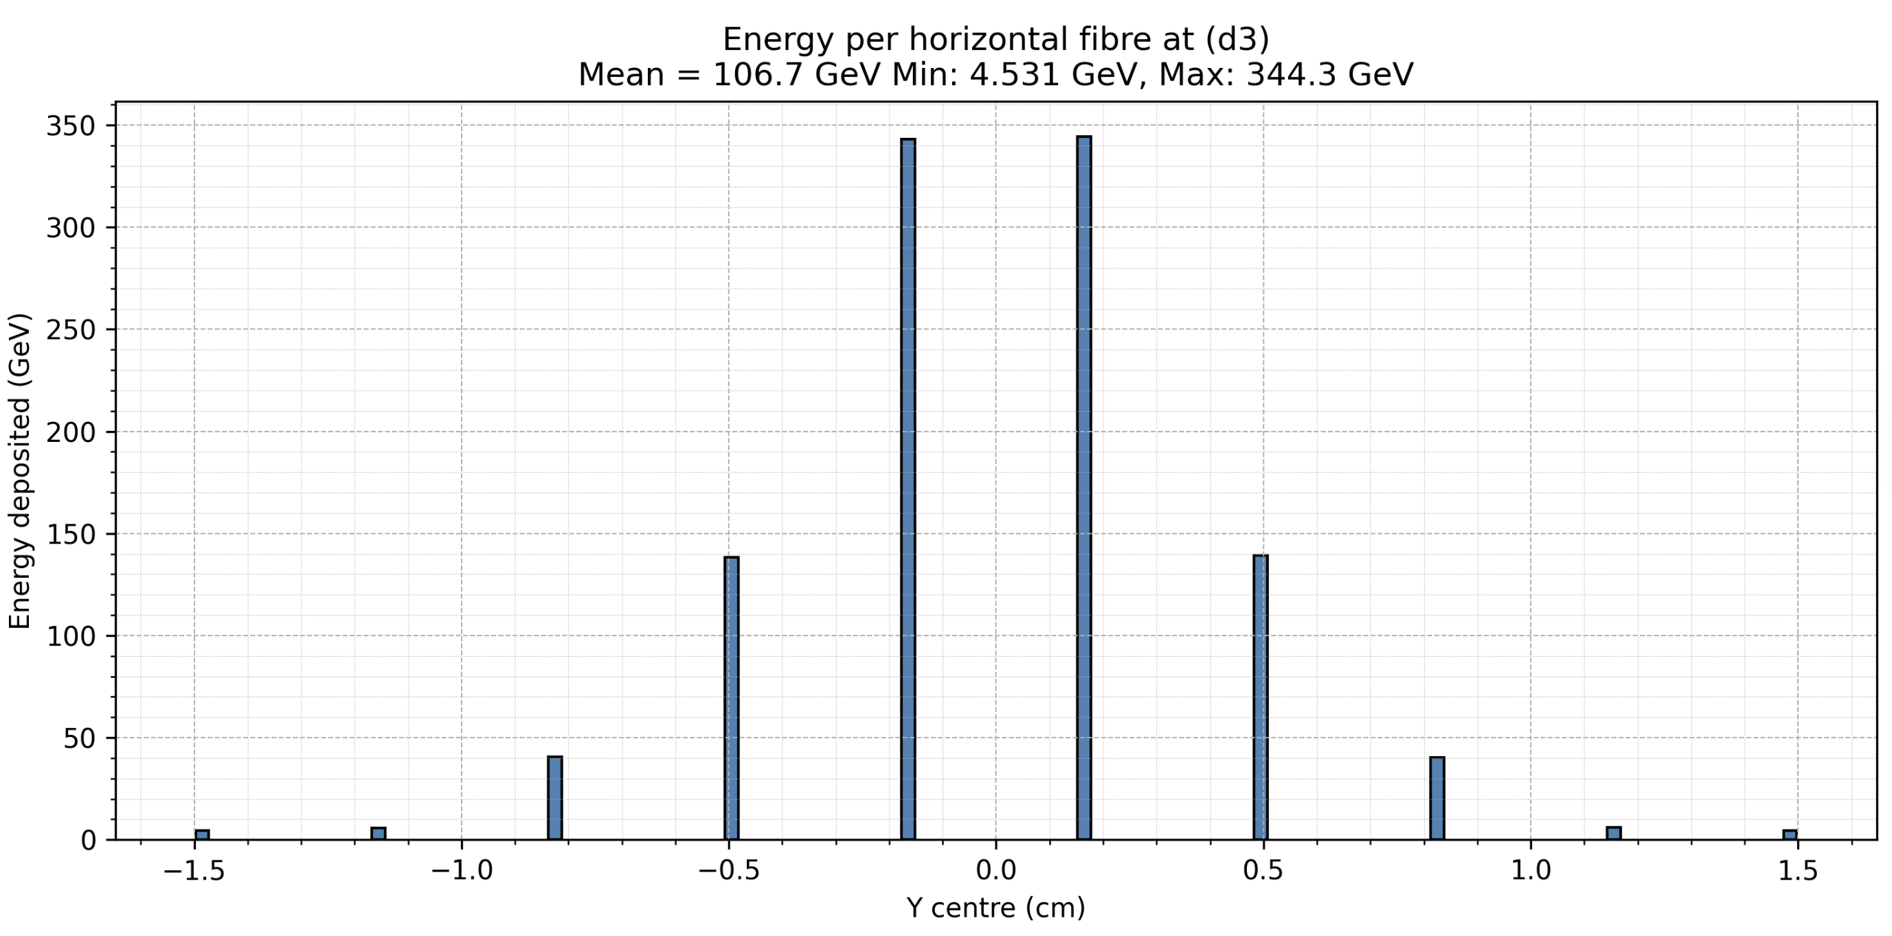
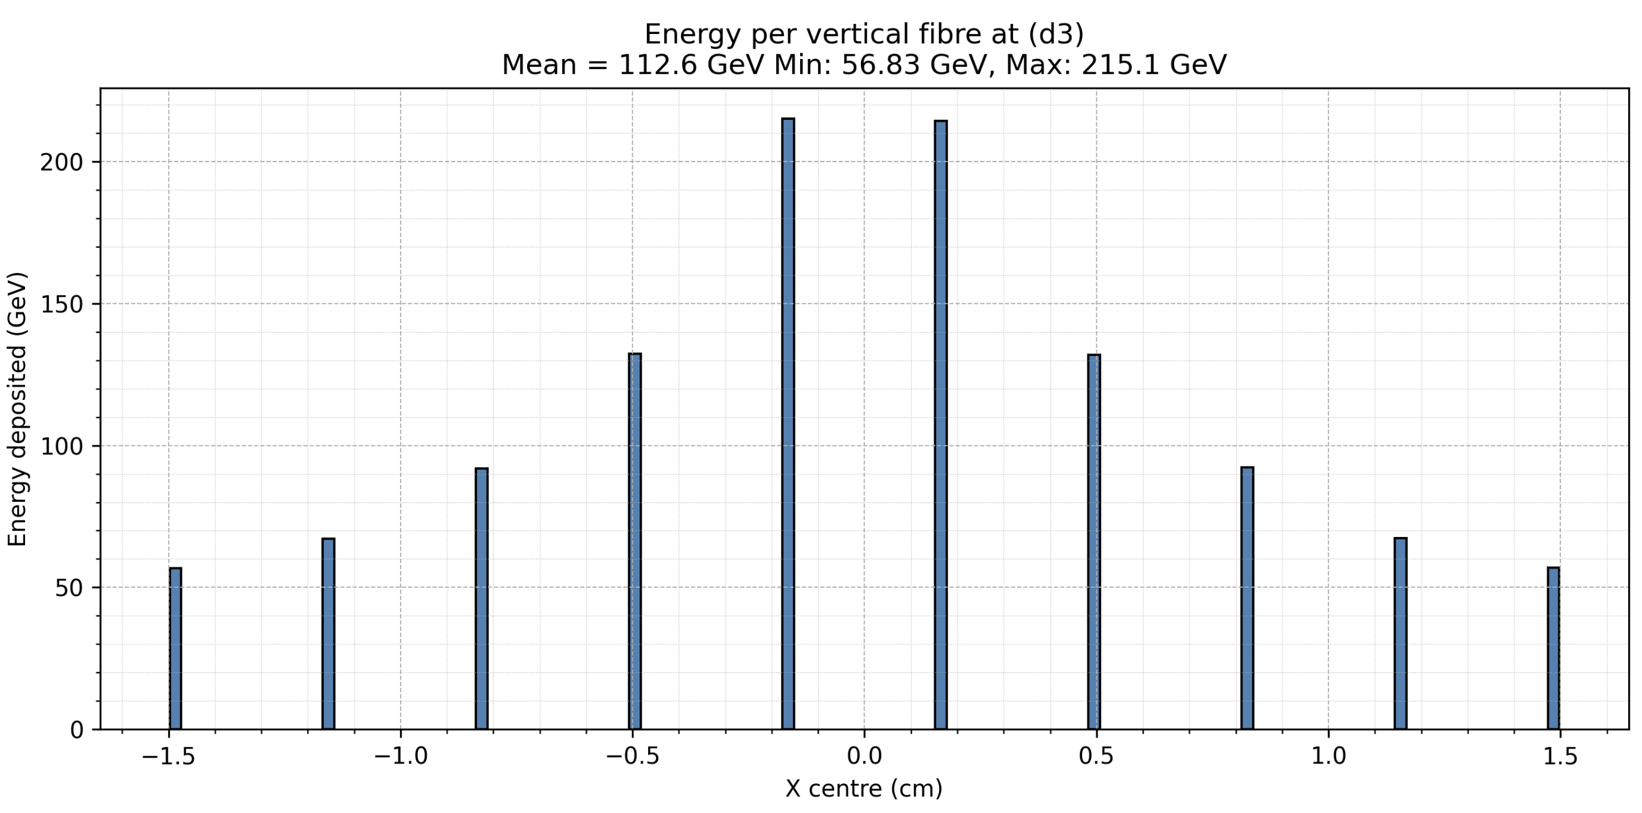
Sparse Scintillating Fibre
Example at D3
Simulations of energy deposited per fibre
Scintillating Fibre Locations
“D1”
“D2”
“D3”
“Air”
Simulations
1e8 Source Particles
Laser-Driven Source Energy Distribution between 1 and 11.5MeV

Slide 6
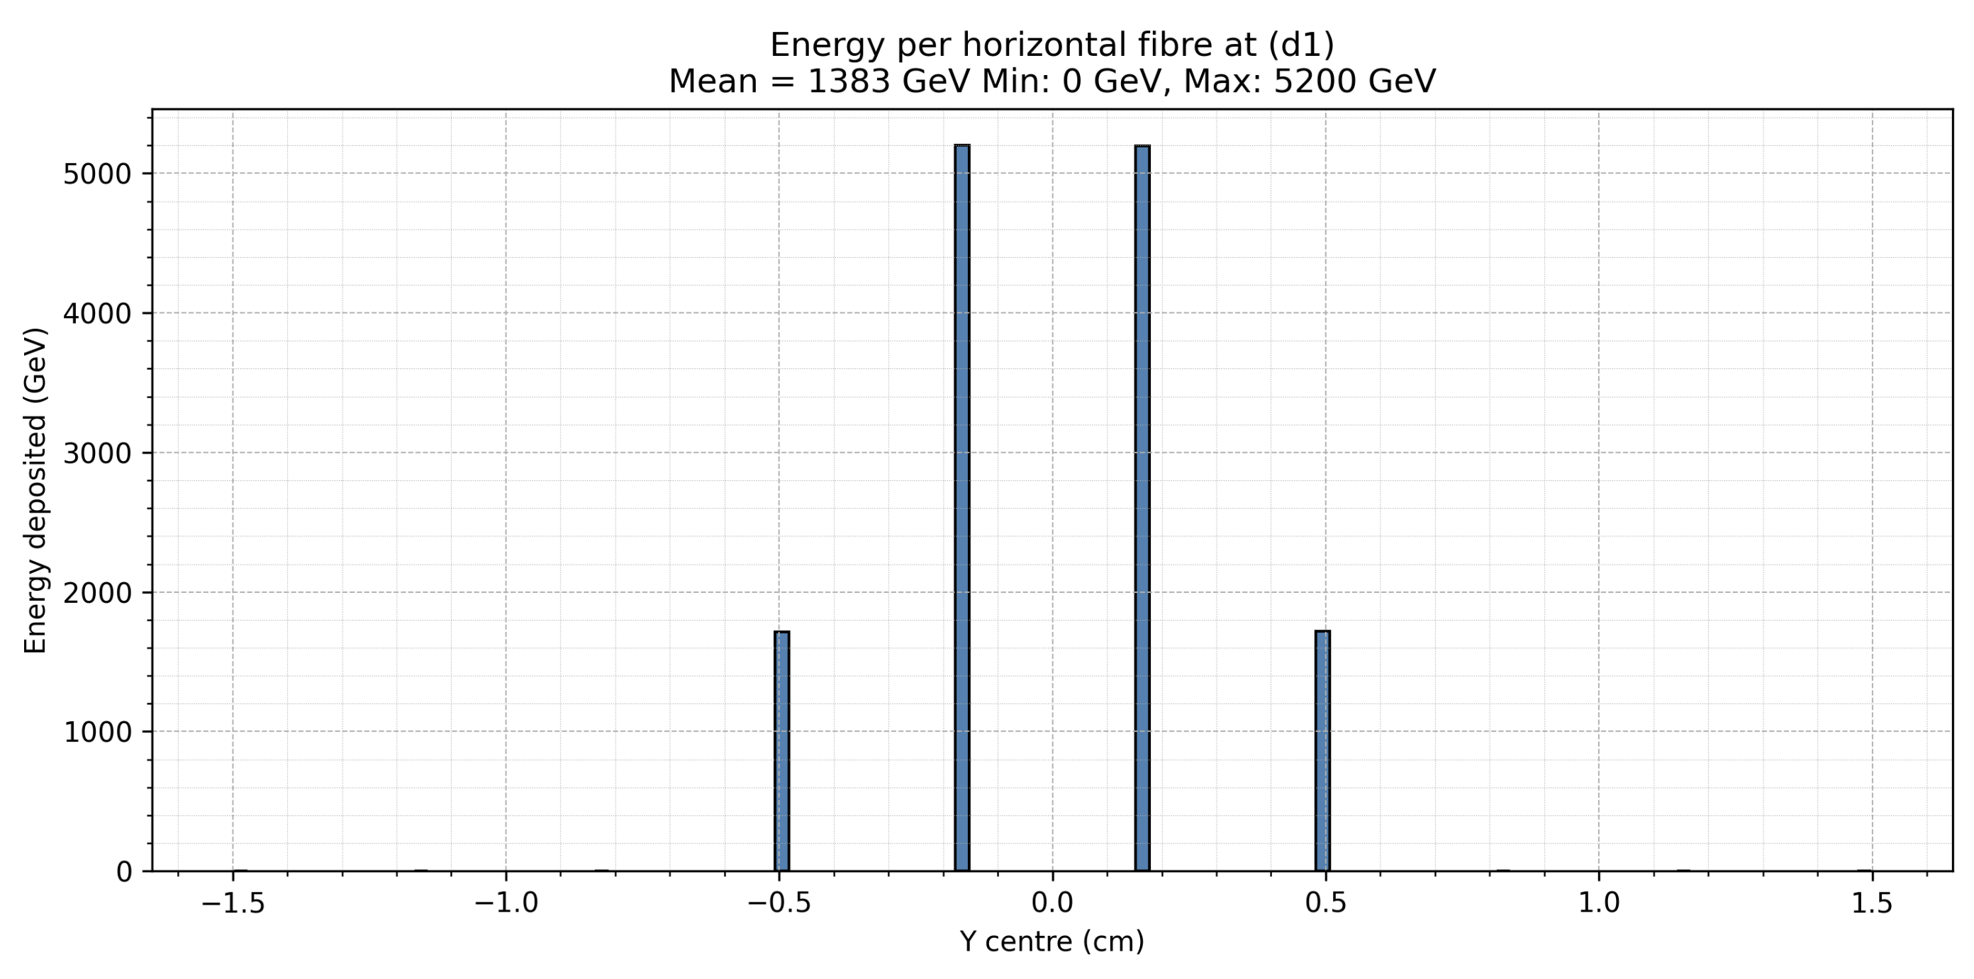
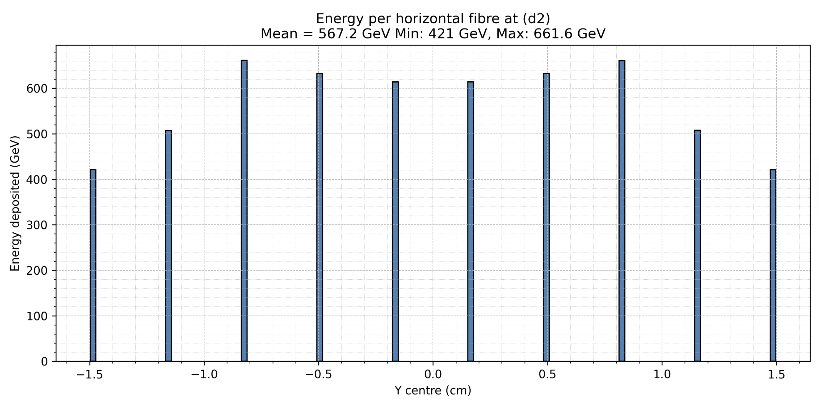
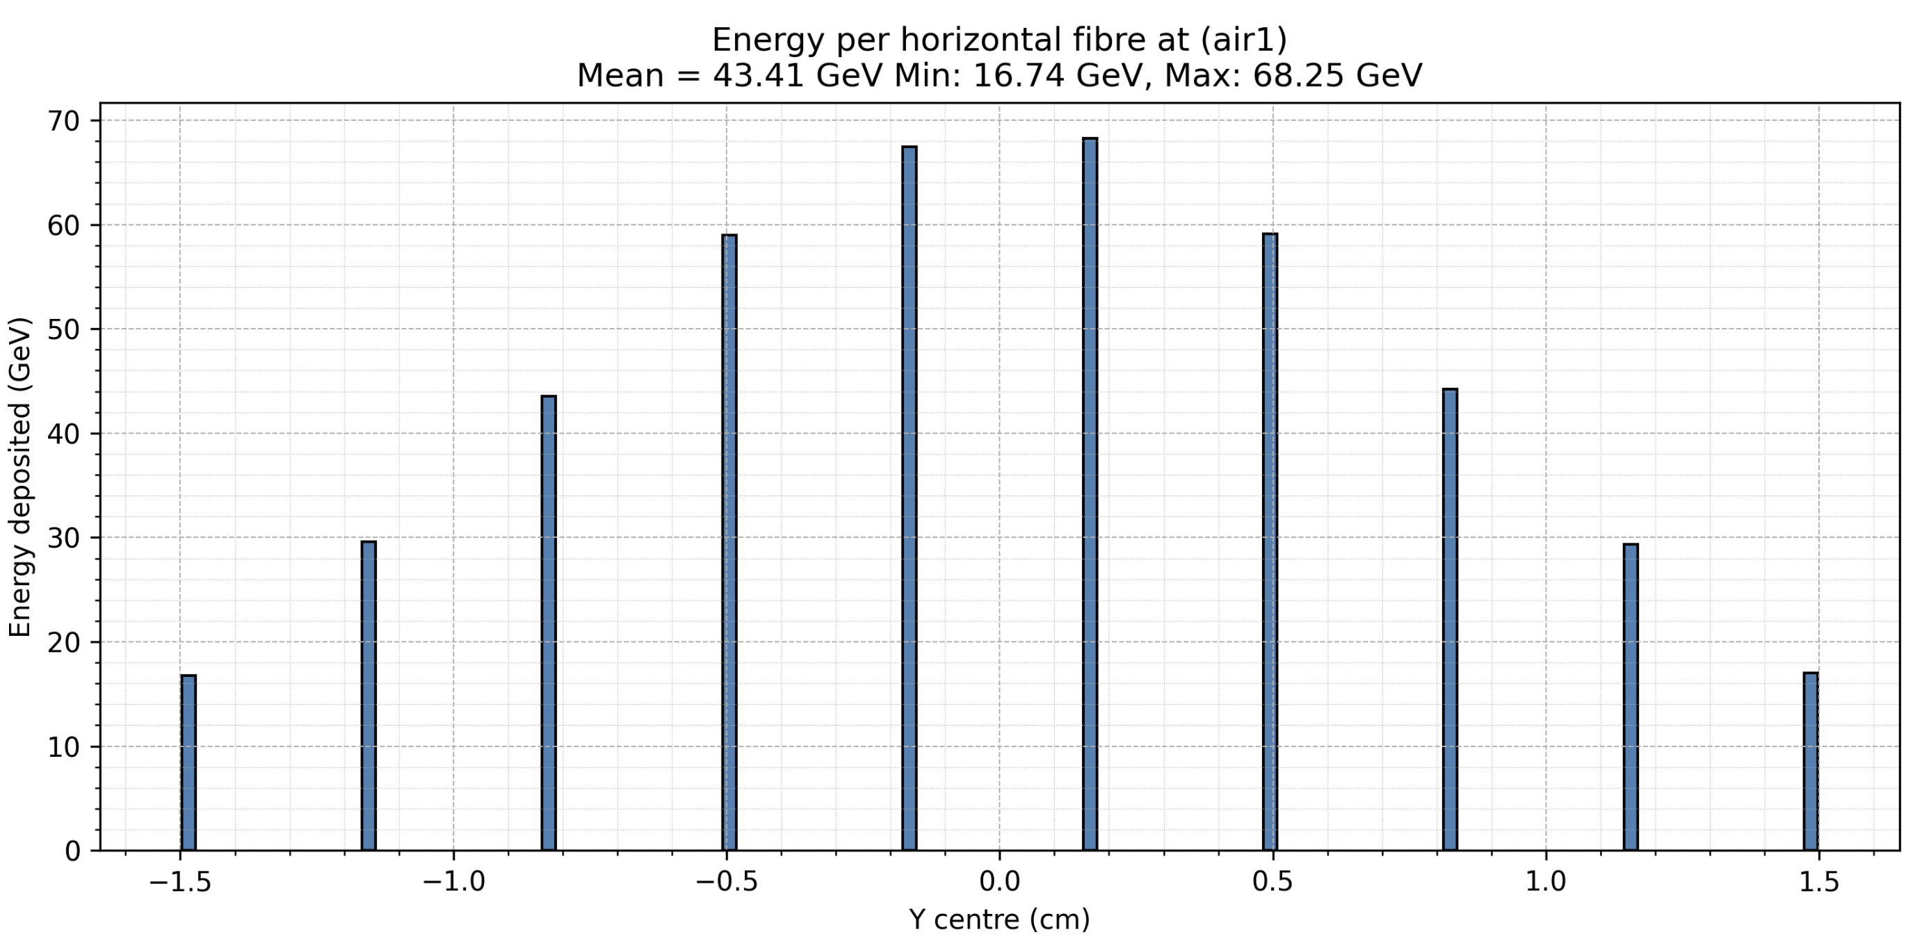
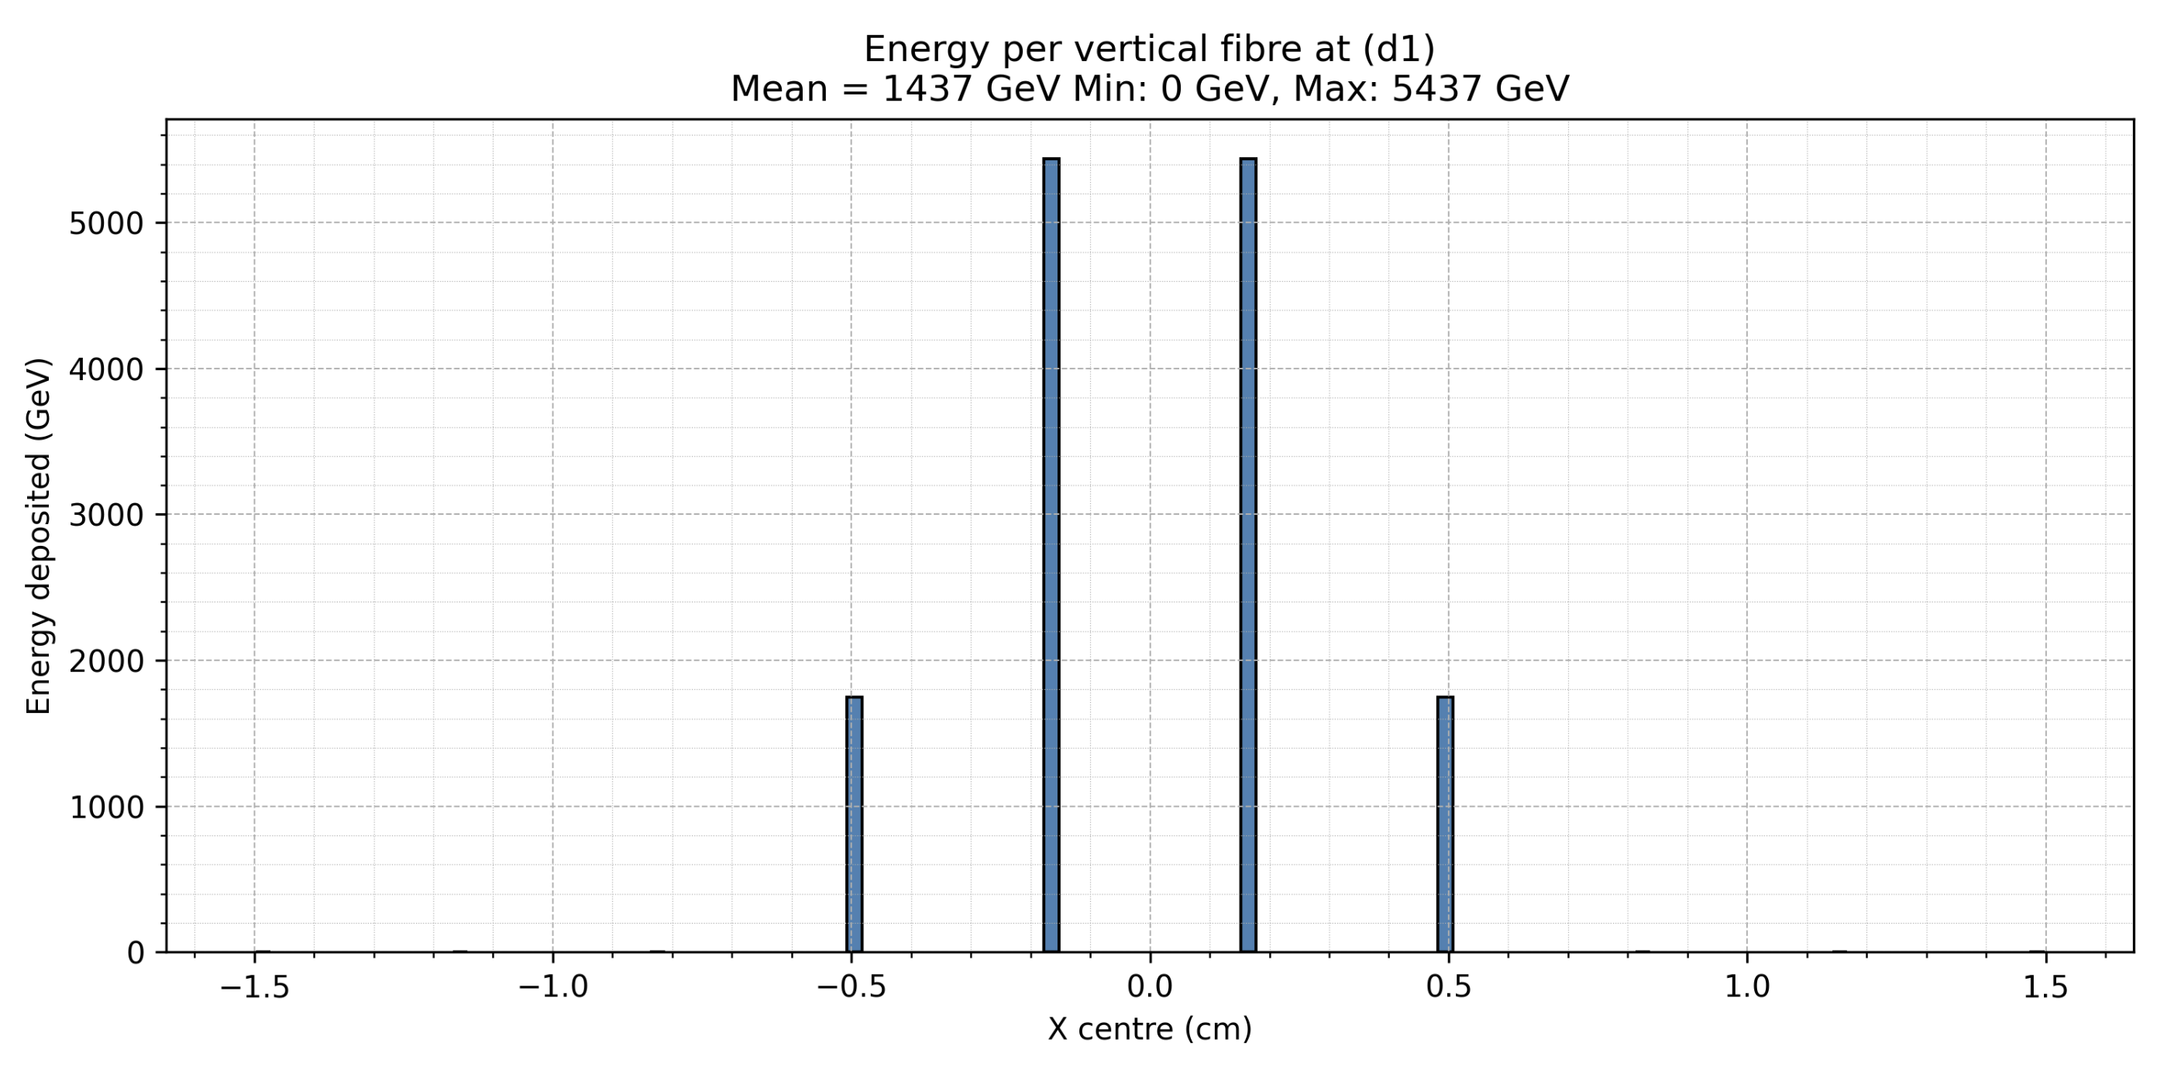
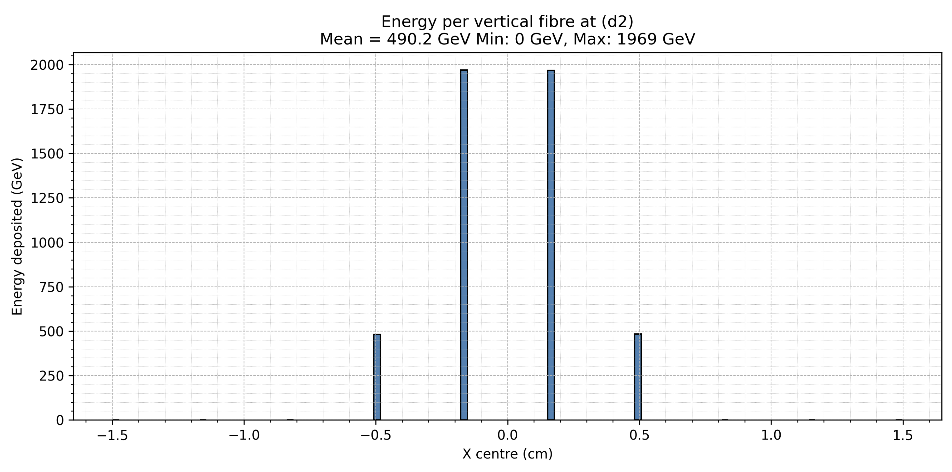
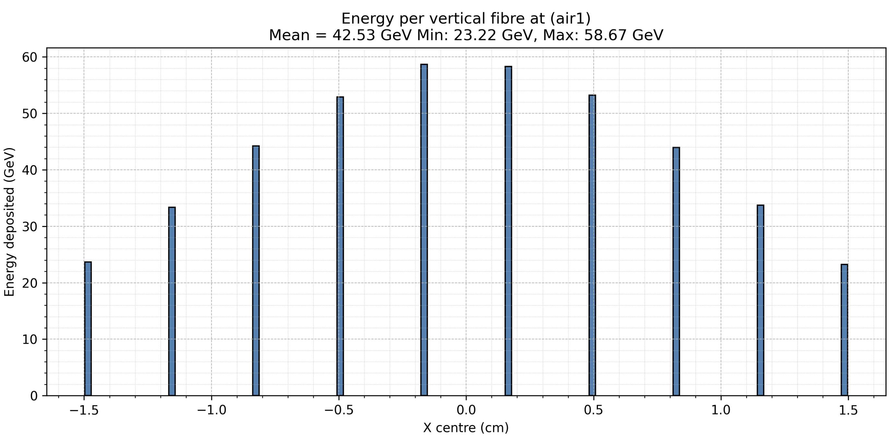
Sparse Scintillating Fibre
Simulations of energy deposited per fibre
D1
D2
D3
Air
Average Energy
1410GeV
528.7GeV
109.7GeV
42.97GeV
Max Energy
5437GeV
1969GeV
344.3GeV
68.25GeV
Notes:
140GeV per 250um cube so around 1Gy at D1
10^4 Gy is the damage threshold
Will be Birks law quenching

Slide 7
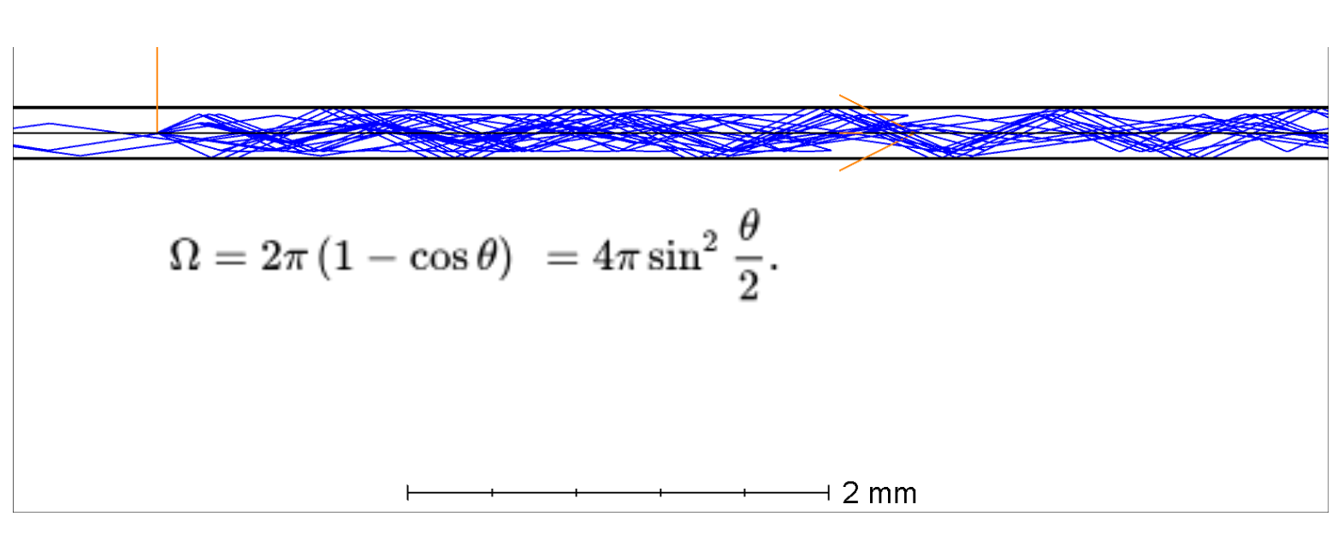
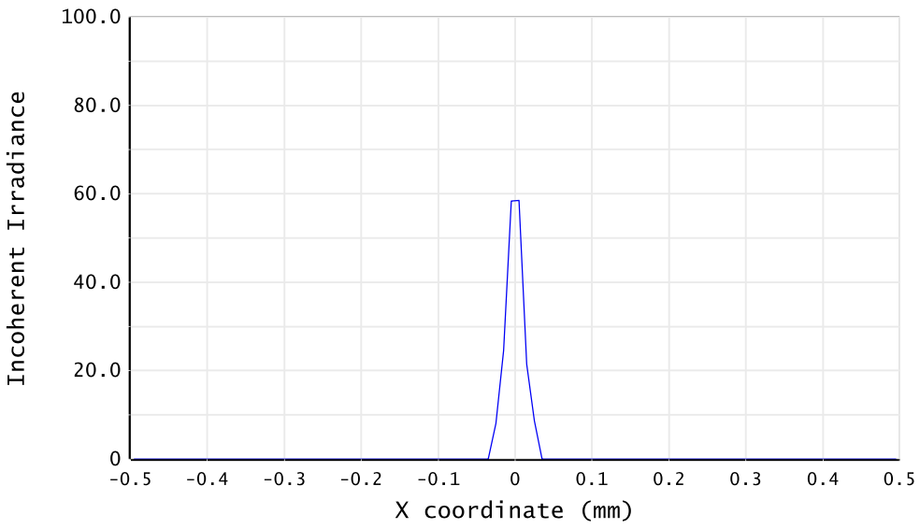
Sparse Scintillating Fibre
ANSYS ZEMAX Simulations of light transmission – Non sequential ray tracing mode
Simulation of Light in Realistic Fibre
Point source with a 70-degree cone apex angle emitting to the right
1W Source Power
Light Distribution Imaged to Camera
F=25mm
6mm aperture
150mm from the fibre end
<0.1% of total source power transmitted

Slide 8
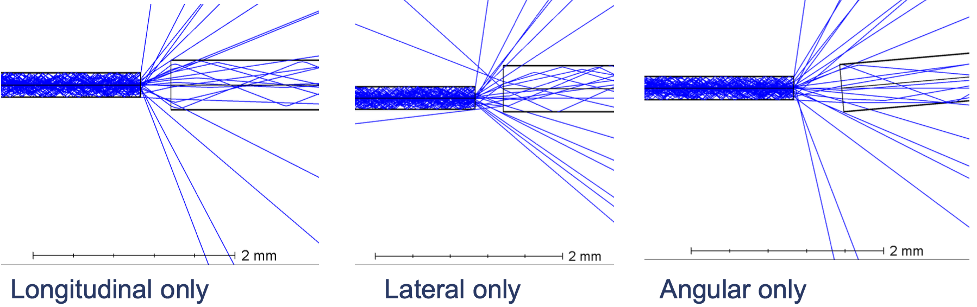
Sparse Scintillating Fibre
Coupling to Transparent Fibre
Longitudinal Offset (mm) | Lateral Offset (mm) | Angular Offset (Degrees) | Power Transmission to Transparent Fibre
0.1 | 0.00 | 0.0 | 37.3%
0.5 | 0.00 | 0.0 | 9.7%
1.0 | 0.00 | 0.0 | 3.1%
0.1 | 0.05 | 0.0 | 36.8%
0.5 | 0.05 | 0.0 | 9.7%
0.1 | 0.10 | 0.0 | 35.0%
0.5 | 0.10 | 0.0 | 9.3%
0.5 | 0.00 | 1.0 | 9.7%
0.5 | 0.00 | 3.0 | 9.7%
0.5 | 0.00 | 5.0 | 9.7%
Transparent Fibre matched to scintillating fibre
500 μm Diameter
BCF98XL
Tolerance Test Takeaways
Angular offset has little impact
Most sensitive to longitudinal offset
Lateral offset more significant at lower longitudinal offsets

Slide 9
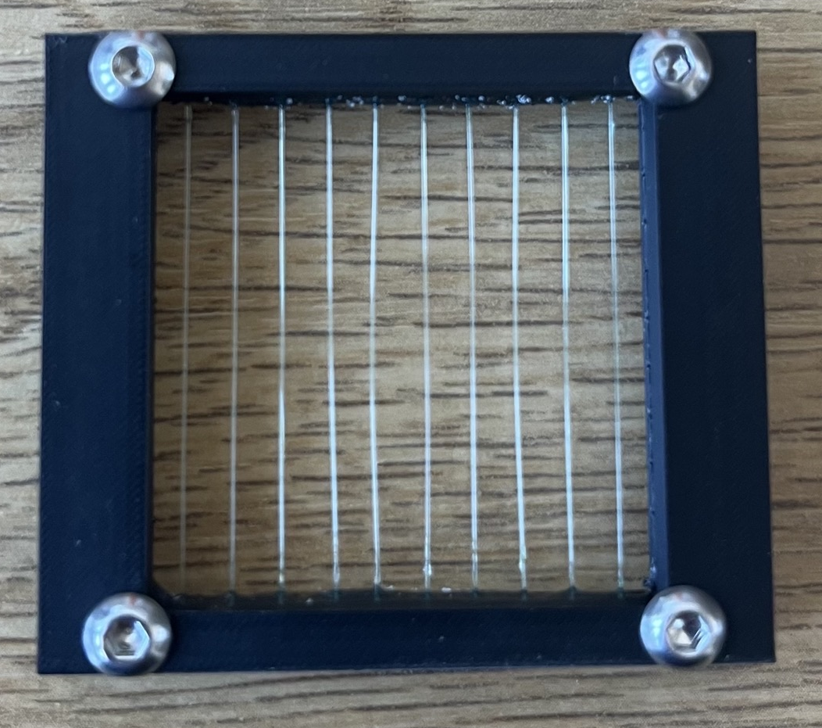
Calvin and Peter carried out a quick imaging test
  Camera: BFLY-U3-23S6M-C (1920 x 1200 5.86 × 5.86 μm pixels) 10/12 bit ADC;
  Lens: 25 mm, F1.4 – F16 from EO;
  Fibre ends located at 106.6 mm from front ring of lens;
  Lens set at F16;
  Fibre plane illuminated by near UV LED – illumination not uniform;
  Ends of fibres imaged at ~ closest focus of lens (nominal 100 mm) ;
  Camera features not optimised, mainly set to auto. SpinView used for control and capture;
  LED power decreased until no saturation seen at 16-bit imaging.
Many thanks to Peter for his help in the lab!

Slide 10
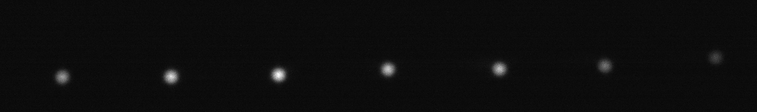
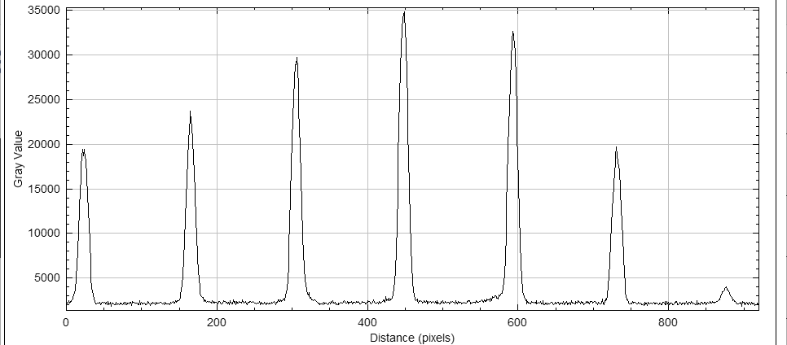
Fibres 16-bit TIFF, no dark frame subtracted
5.86 × 5.86 μm pixels)

Slide 11
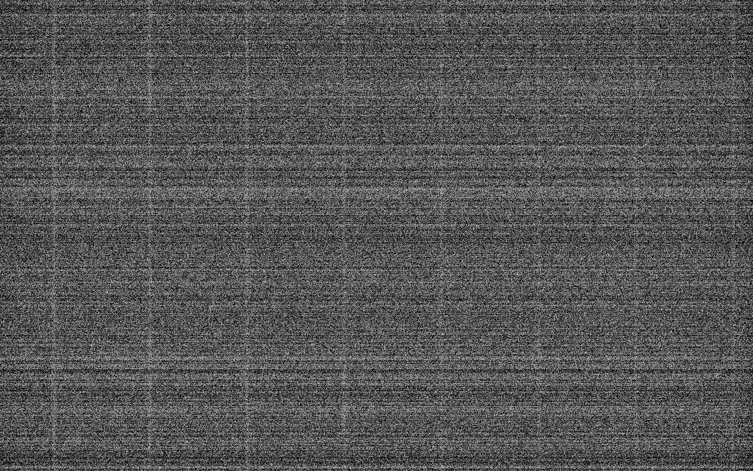
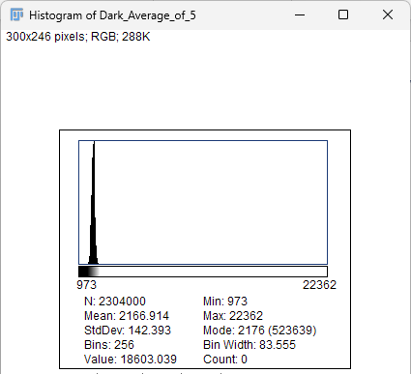
Average of 5 Dark frames
Evidence of hot pixels and fixed pattern noise.

Slide 12
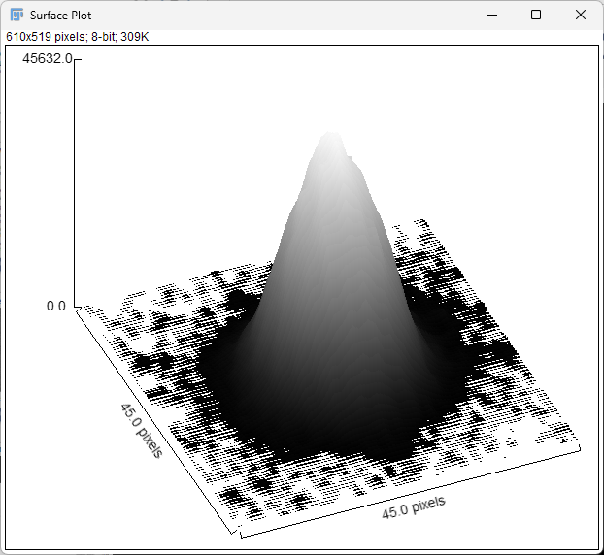
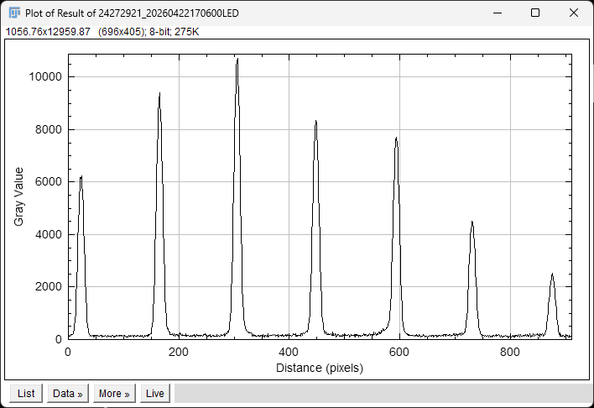
Fibres 16-bit TIFF, average dark frame subtracted
5.86 × 5.86 μm pixels)
5.86 × 5.86 μm pixels)

Slide 13
What next for PoPLaR?
  The matched transparent fibres from Luxium to take a bundle from the fibre plane to a small connector that would be inside the vacuum vessel. Unfortunately, Luxium are not making these fibres in small quantities at present;
  Propose to use a Thorlab FP600URT 0.5 NA, 600 μm core diameter fibre;
  Develop a design, evaluate in ZEMAX to enable this approach to be tested (3D printing);
  Repeat measurements and evaluate results.
Fibre bundle adapter, could use fibres from more than one sparse scintillator frame
Sparse fibre scintillator frame
Transparent fibres inside vacuum chamber
Lens and camera outside vacuum chamber, imaging via a vacuum viewport
Fibre frame holder

Slide 14
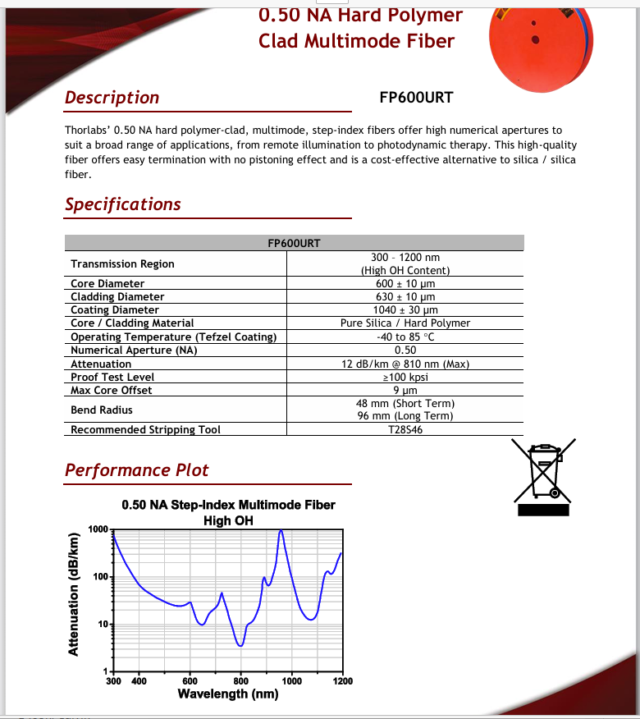
Thorlabs 0.5 NA fibre available in multiples of 1m

Slide 15
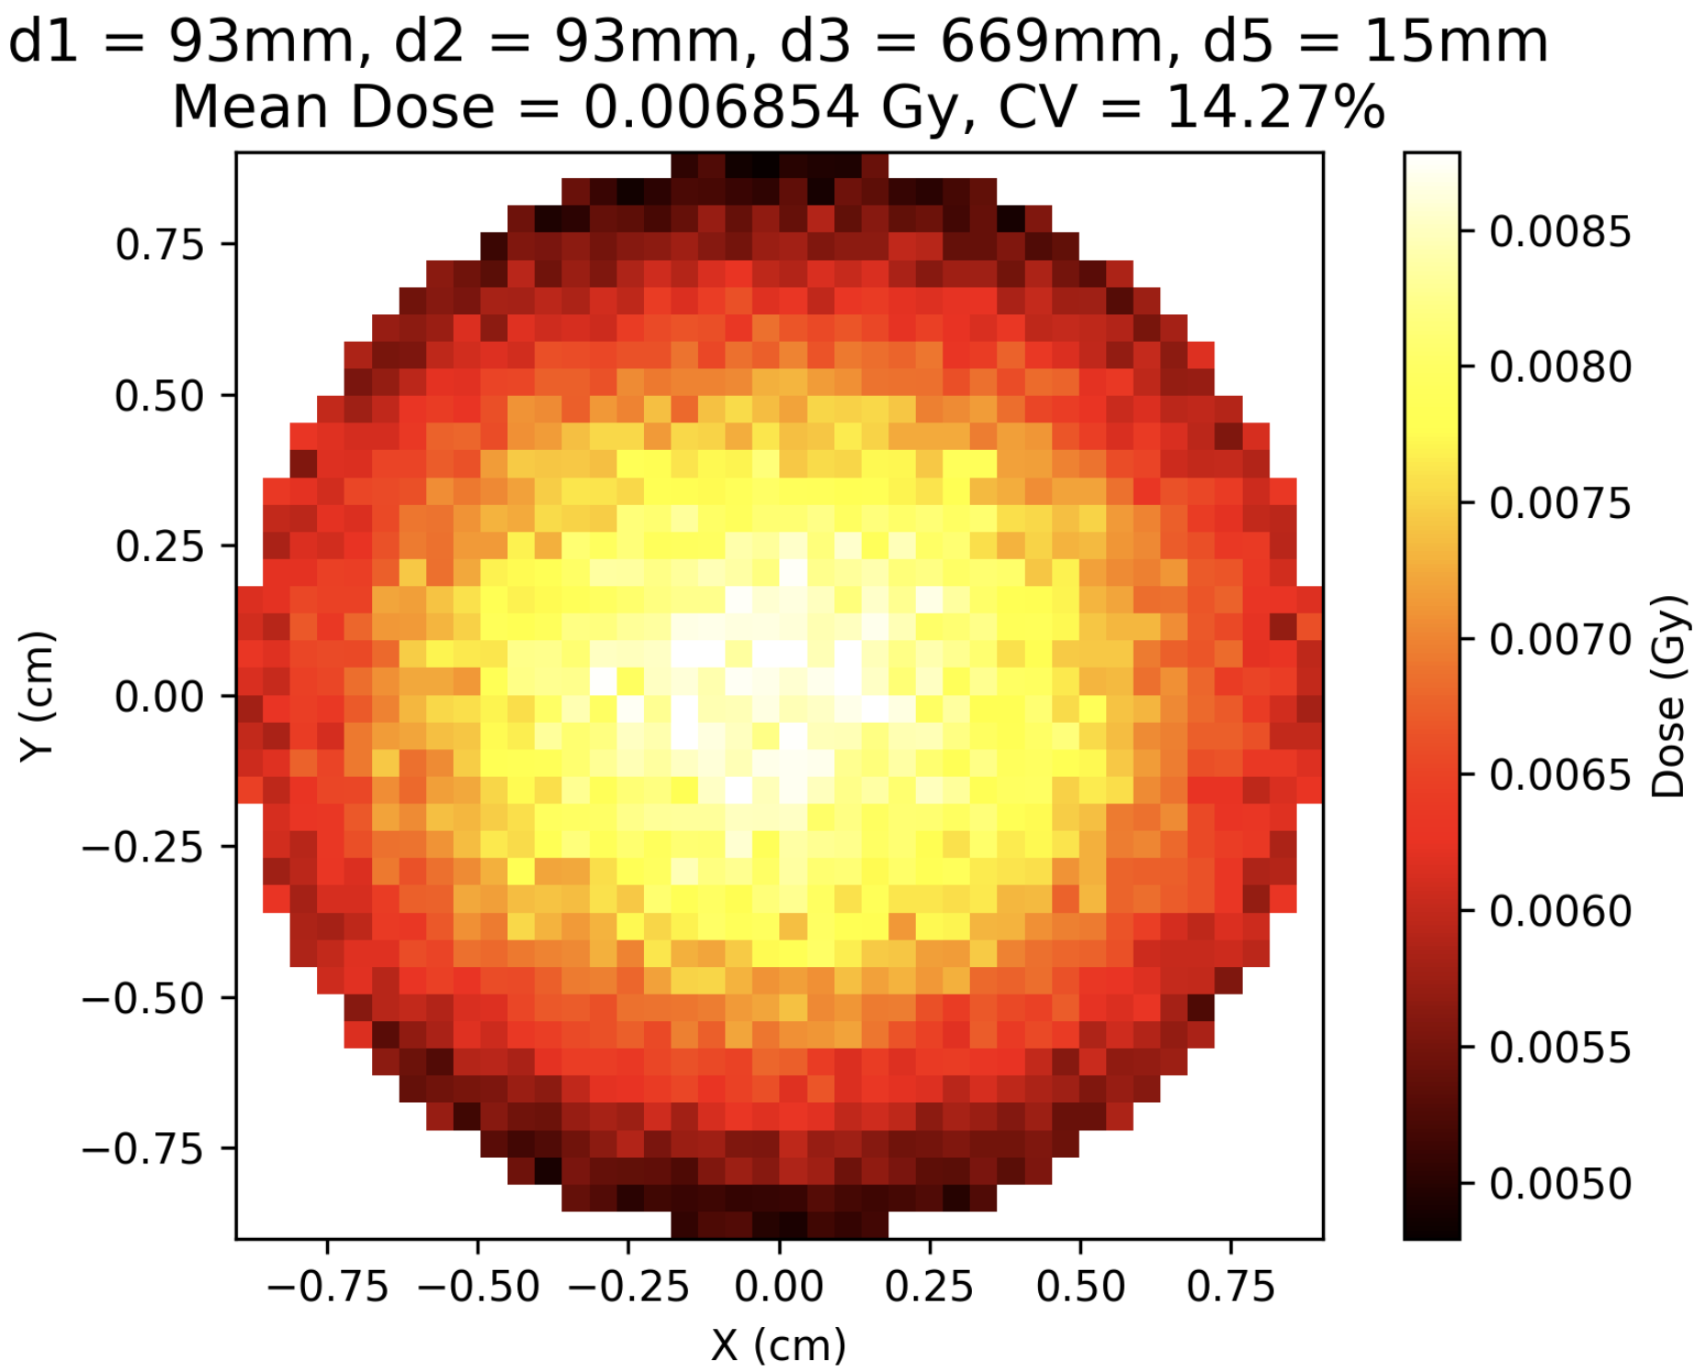
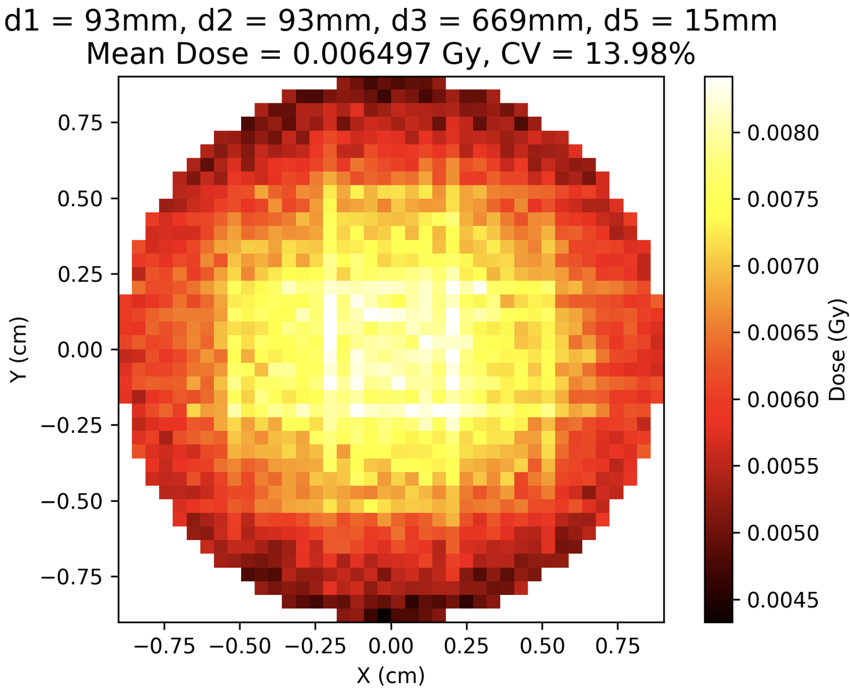
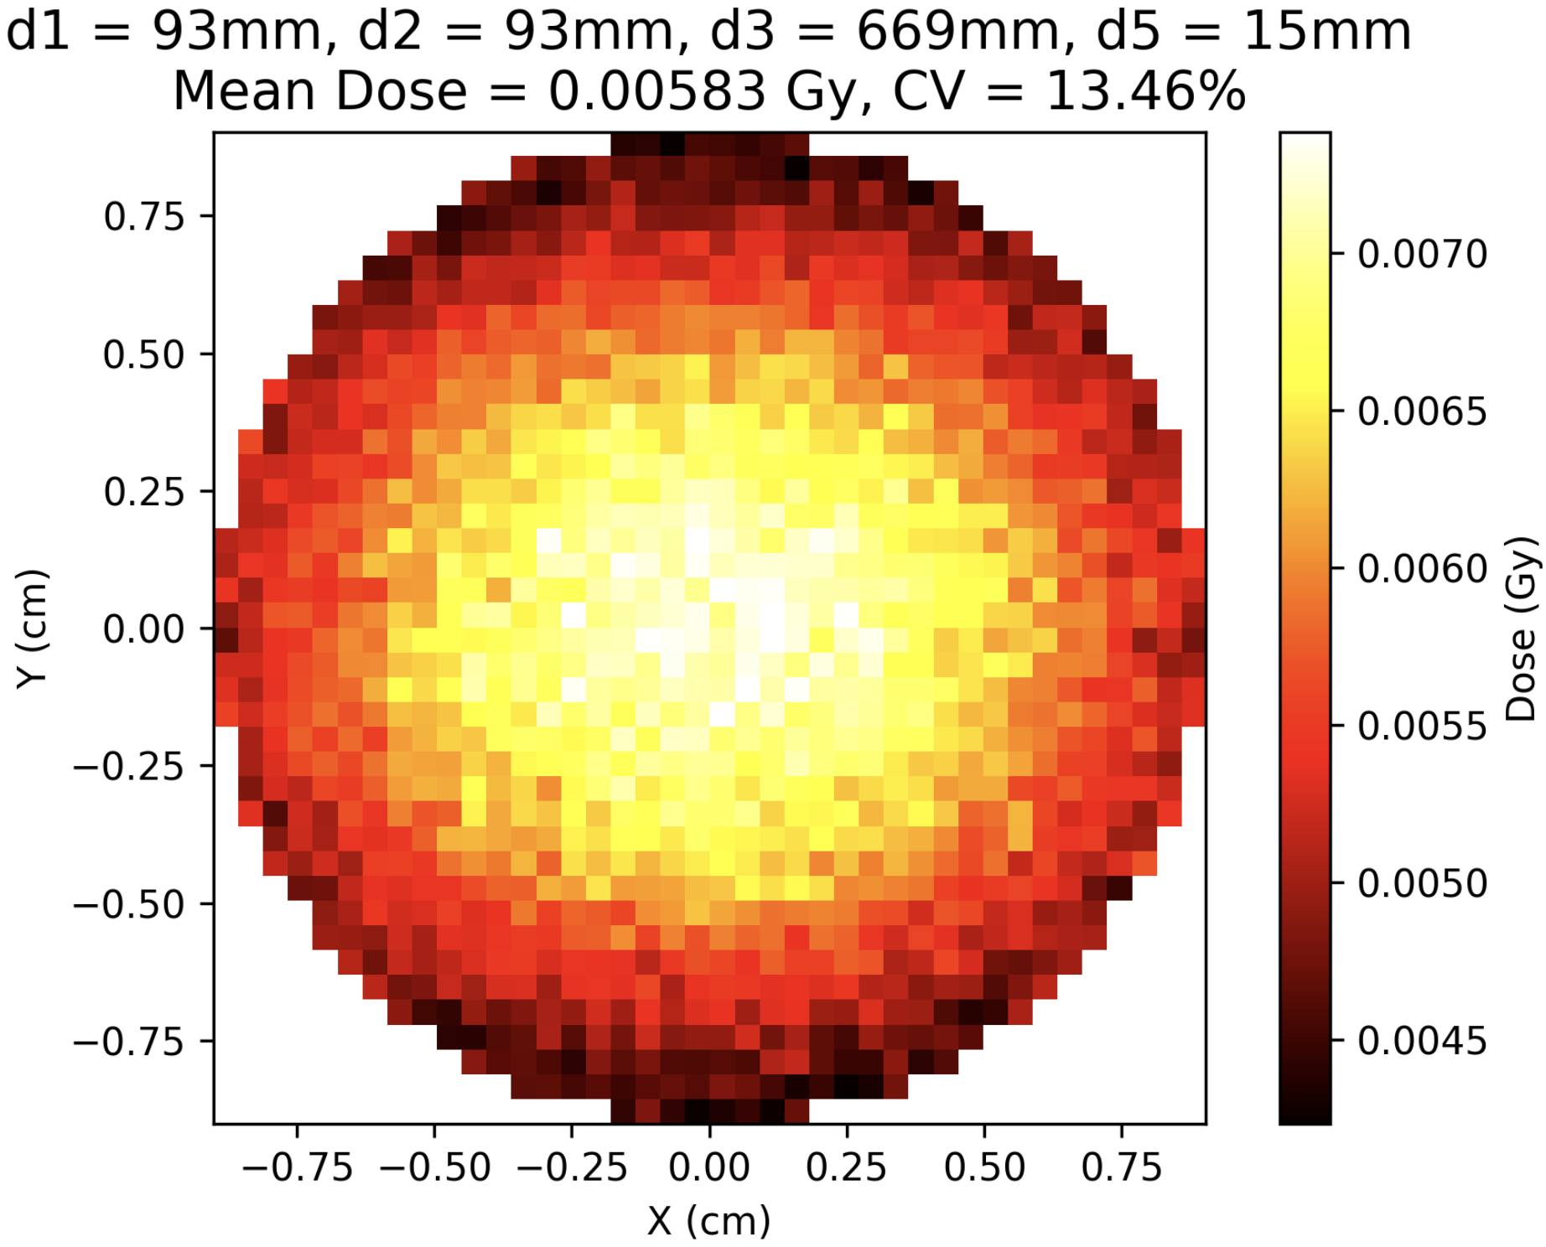
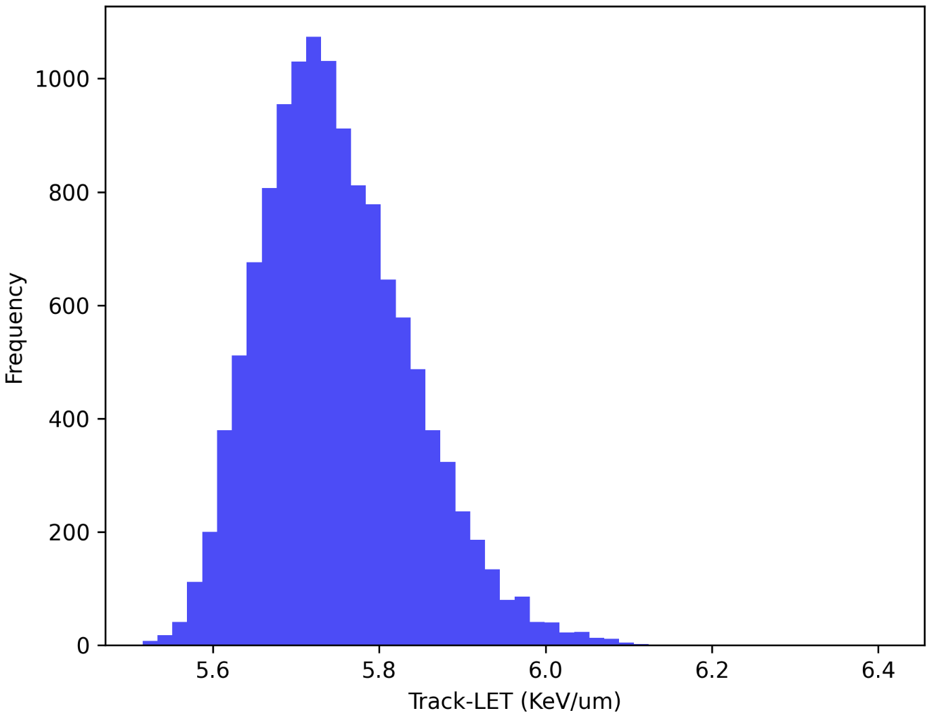
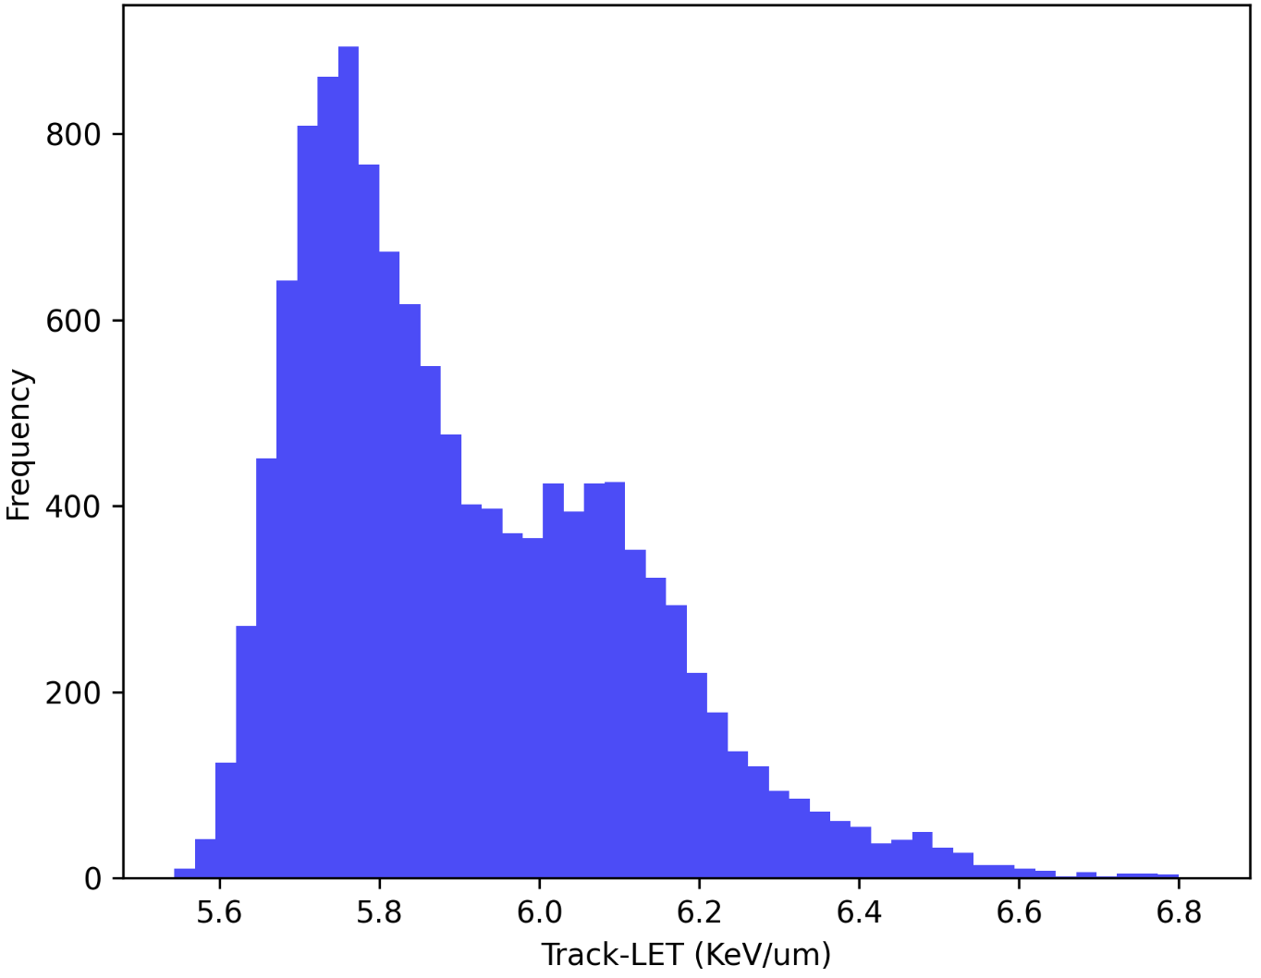
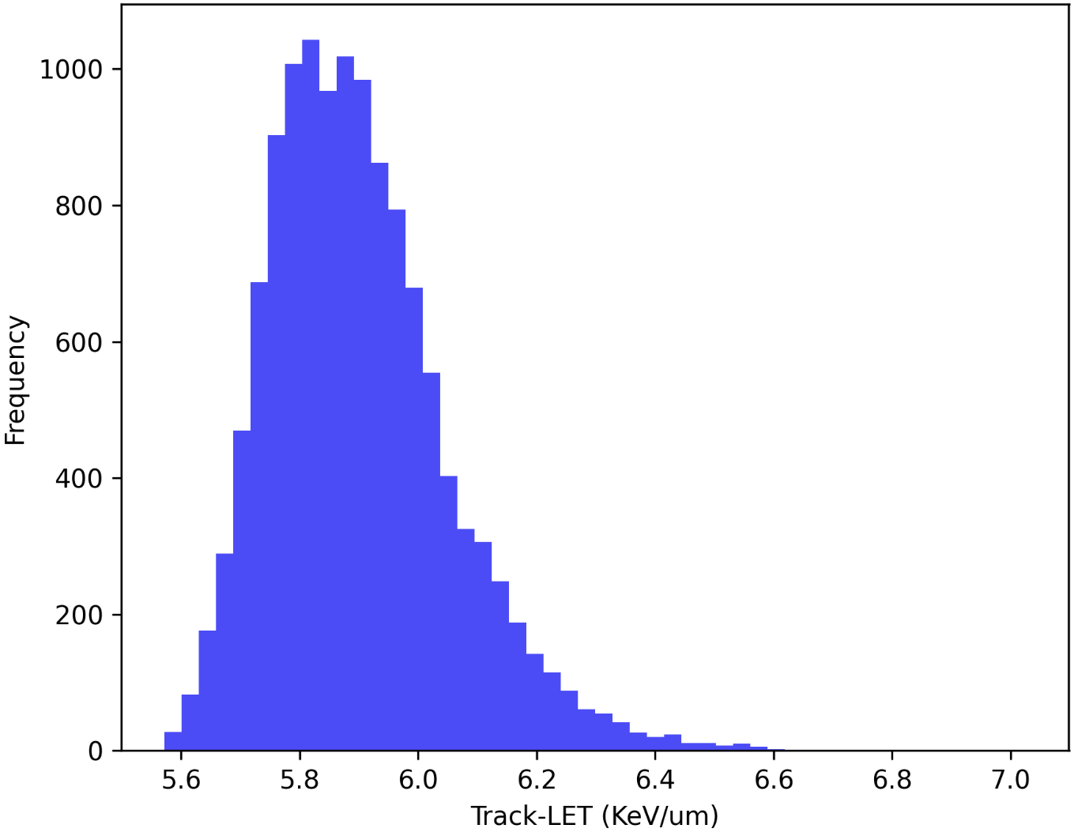
Sparse Scintillating Fibre
Impact on beam
SciFi at D3 and Air
SciFi at D1, D2 and D3
Current

Slide 16
Sparse Scintillating Fibre
Conclusions and Next Steps
Energy per Fibre
    Unlikely to cause radiation damage to the fibres
Transmission out of the chamber
      Using transparent fibres
        Longitudinal offset is key
      Next:
        Obtain transparent fibres from Thorlabs
  Impact on Beam
    Little impact to the uniformity if before the scatterer
    Fibres early in the beam cause a reduction in dose

Slide 17
RCF

Slide 18
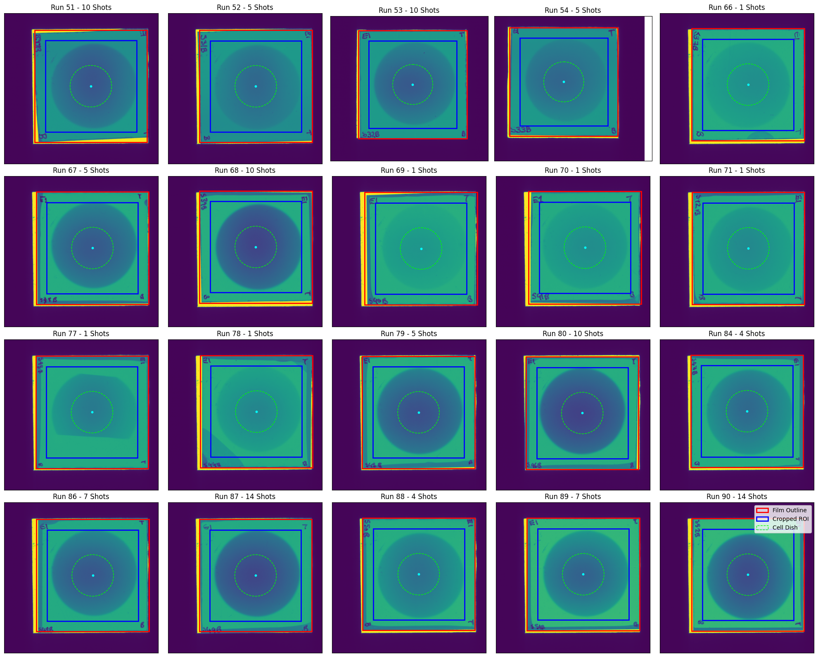
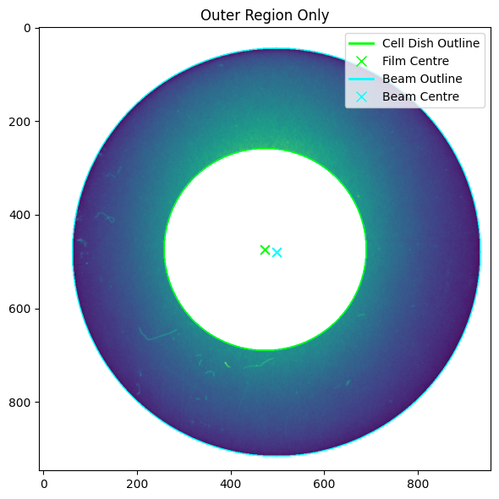
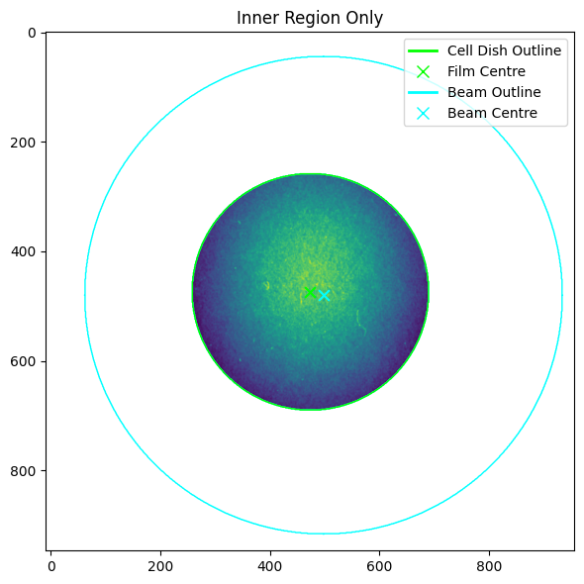
RCF around the Cell Dish

Slide 19
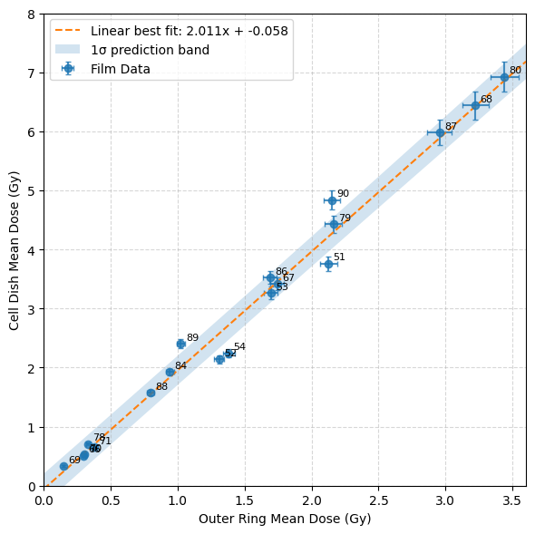

RCF around the Cell Dish
Evaluation
Originally completed a linear fit with measured uncertainties:
    𝜒_{r}²: 6.12
Added a new ”film-to-film” uncertainty
    “Beam jitter”?
    Allowed it to vary until 𝜒_{r}² ~1
    Uncertainty on fit became: 0.225 Gy
Alternative to RCF:
Scintillating Fibre Coil around the Cell Dish
Instant Feedback
Avoids transmission issue since it is
not in the vacuum chamber

Slide 20
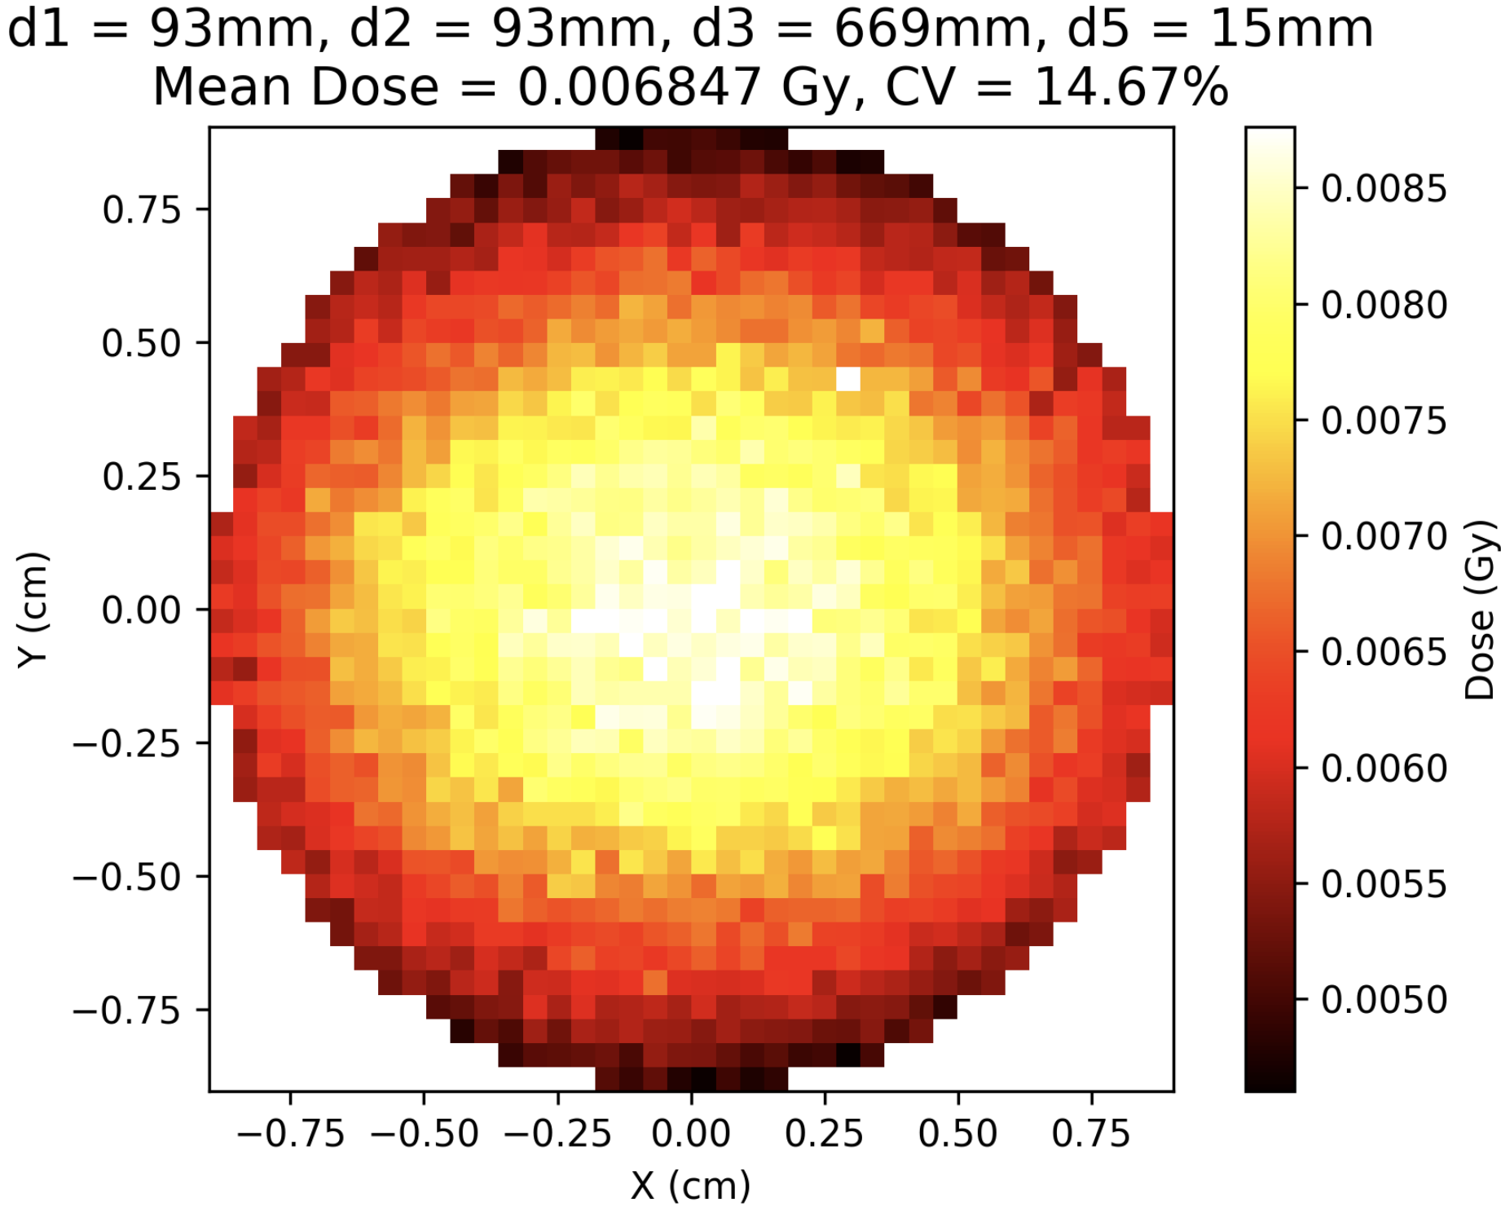

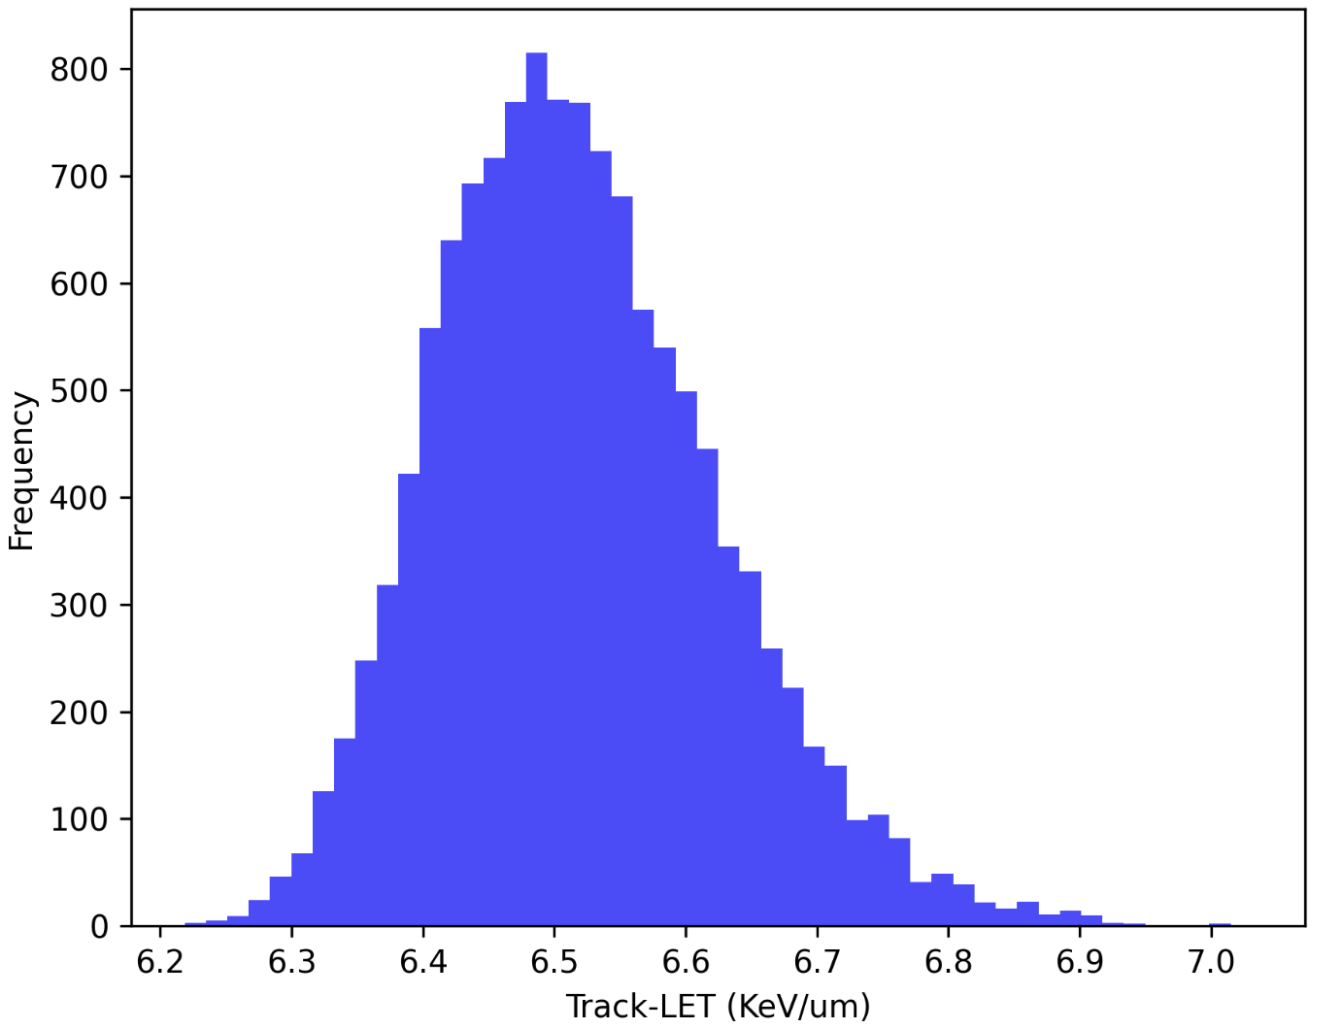
In-Beam Delaminated EBT3
On RCF
On Cells
Evaluation
Polymer Layer
Cells
Beam
Active Layer
Mylar Cover
No RCF
RCF
  Increases LET by an acceptable amount
  Dose received on RCF is ~90% dose seen on cells
  Main issue is supplier no longer making delaminated EBT3
    Could potentially make our own?
Notes:
Tony

Slide 21
RCF
Conclusions
Useful Back-Up
Cons
    24 hr delay
    Calibration and handling
    Can we travel with RCF? Radiation on planes/X-ray scanners
    Accessibility of delaminated EBT3
Pros
      Currently available (ish)
      Know how to use it
      Will have to use it for the calibration of other diagnostics

Slide 22
Other Suggestions

Slide 23
Scintillating Plane
Ideas
If there has to be a scatterer, why not make it a diagnostic
    Use a plane of scintillating material?
    Wire attached to the copper?
  If delaminated RCF is running out, use a replacement?
    Use a plane of scintillating material?
  Simulations carried out using a 250 μm-thick scintillating material

Slide 24
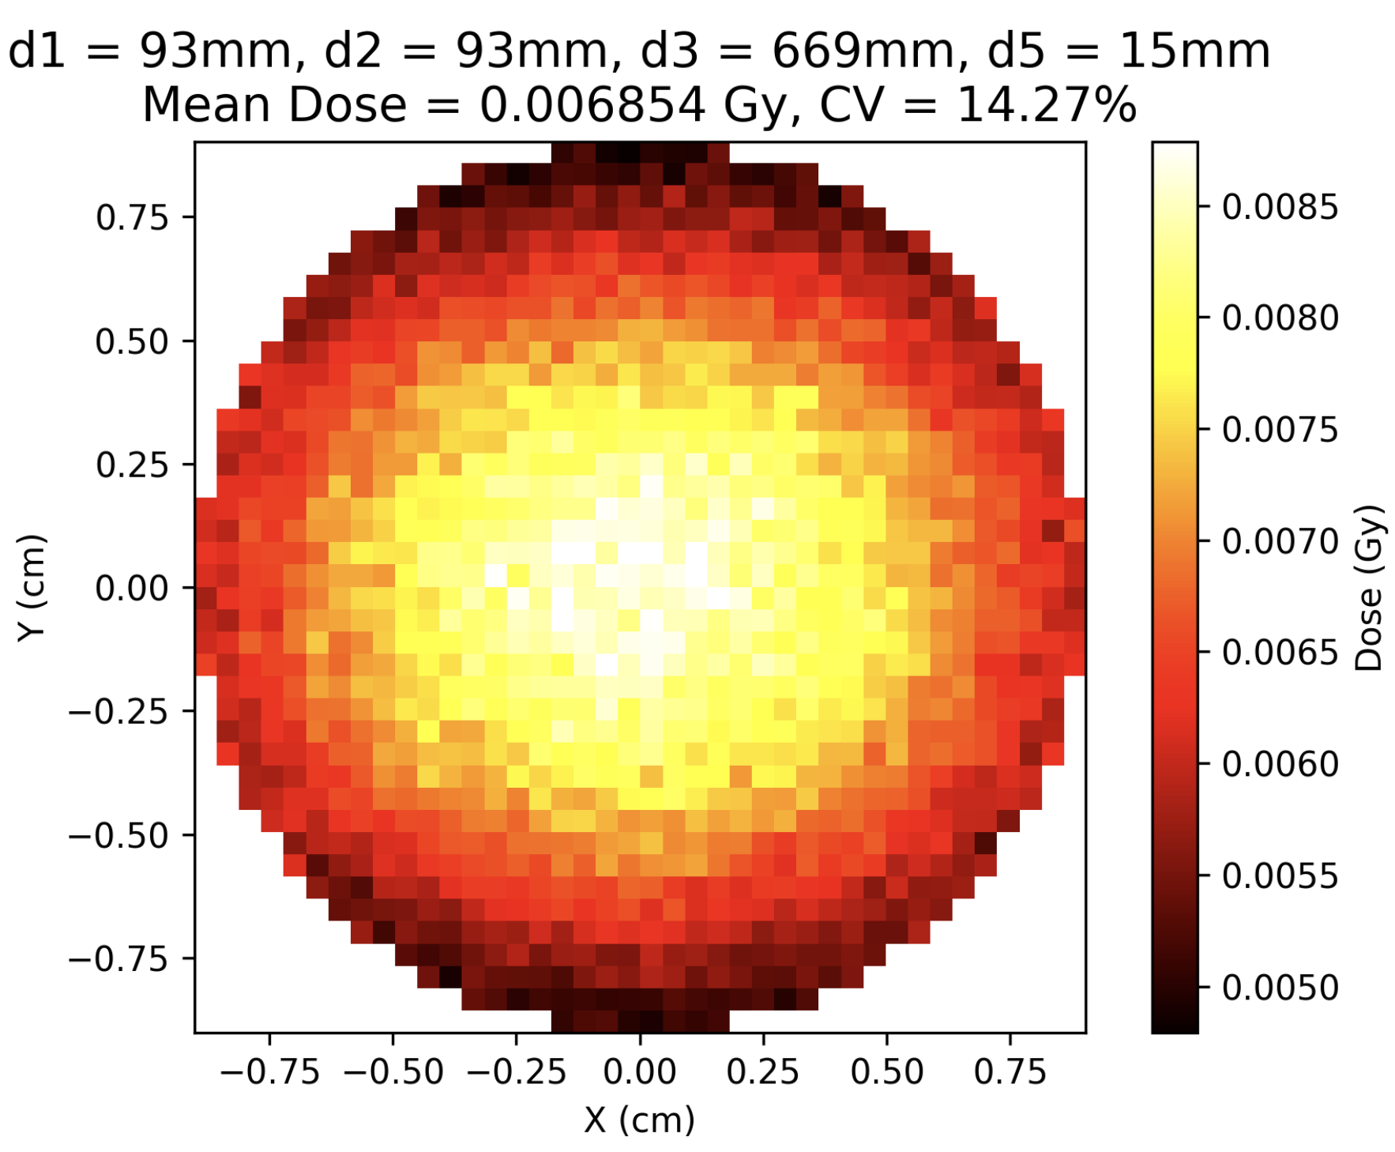
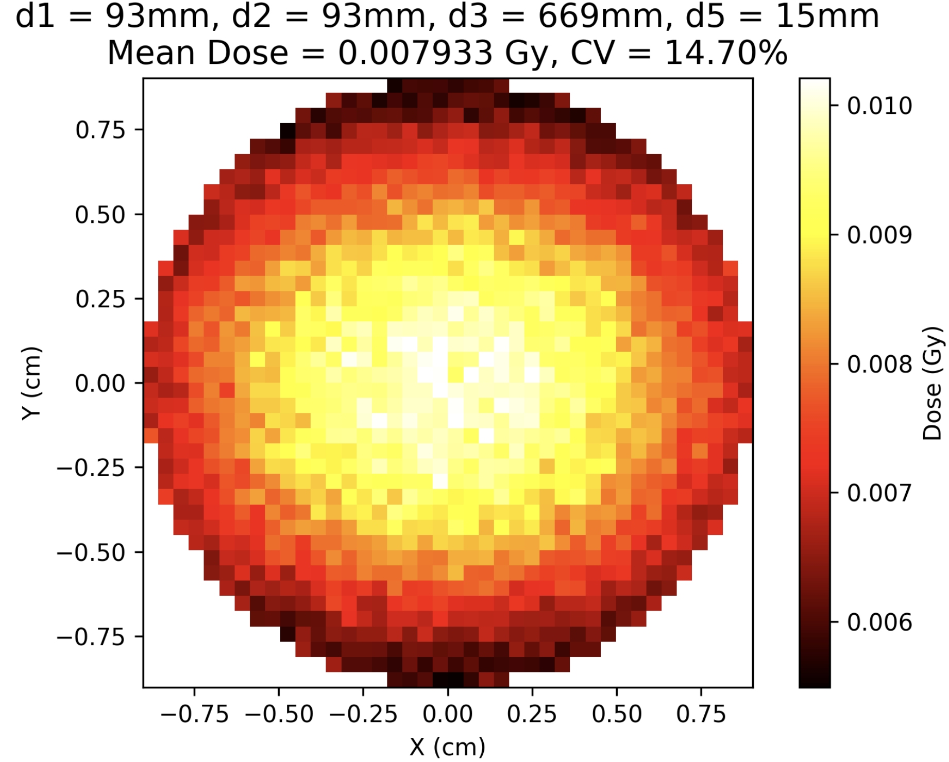

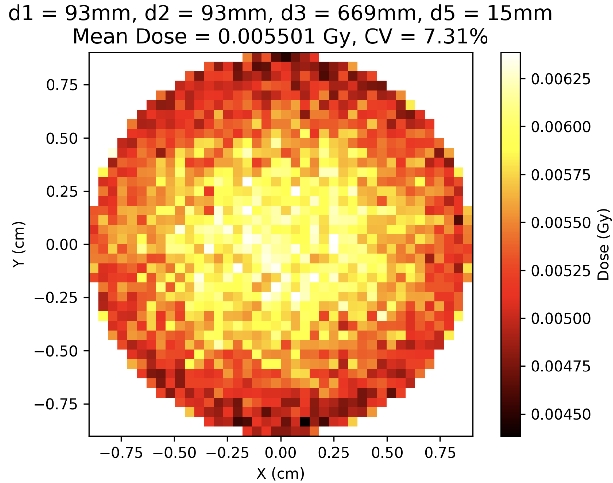
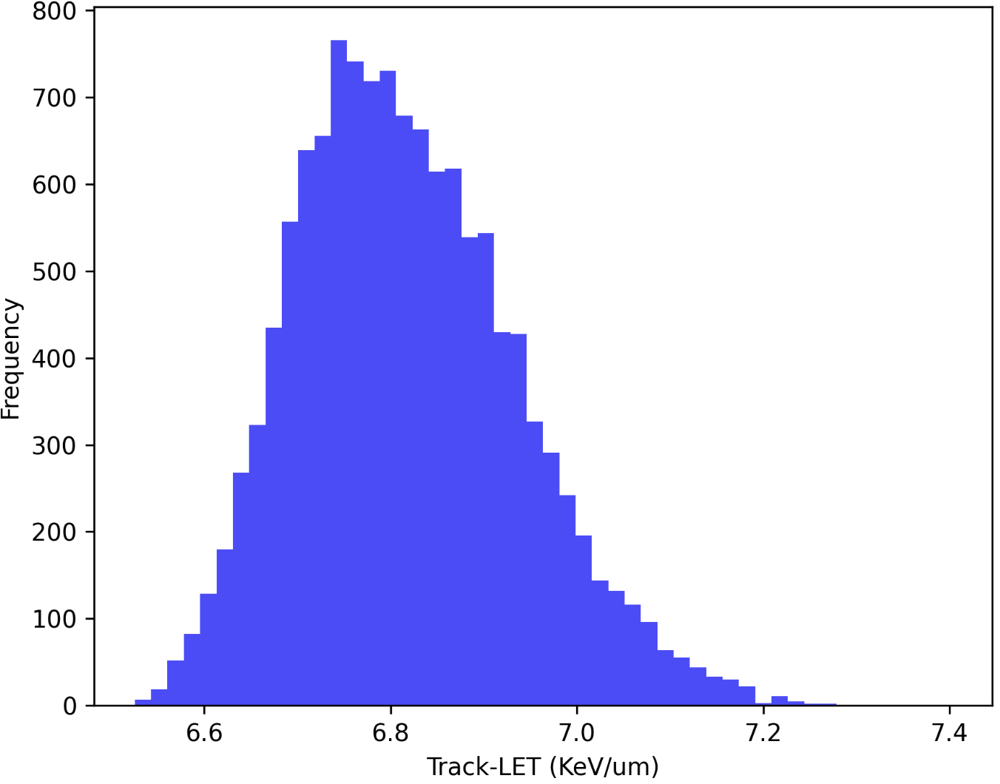
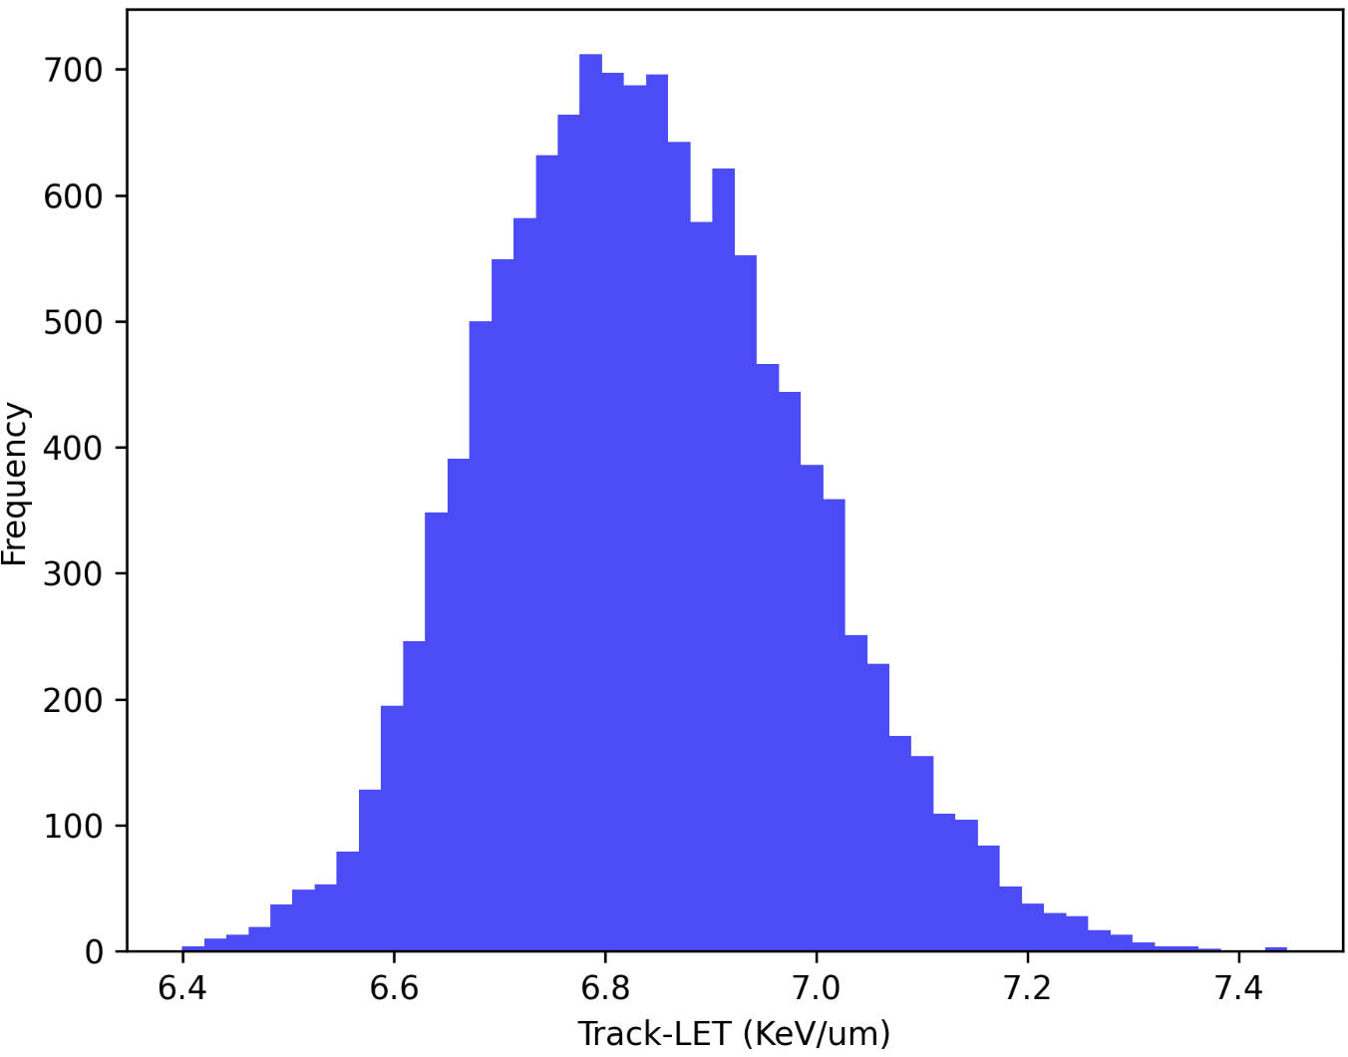
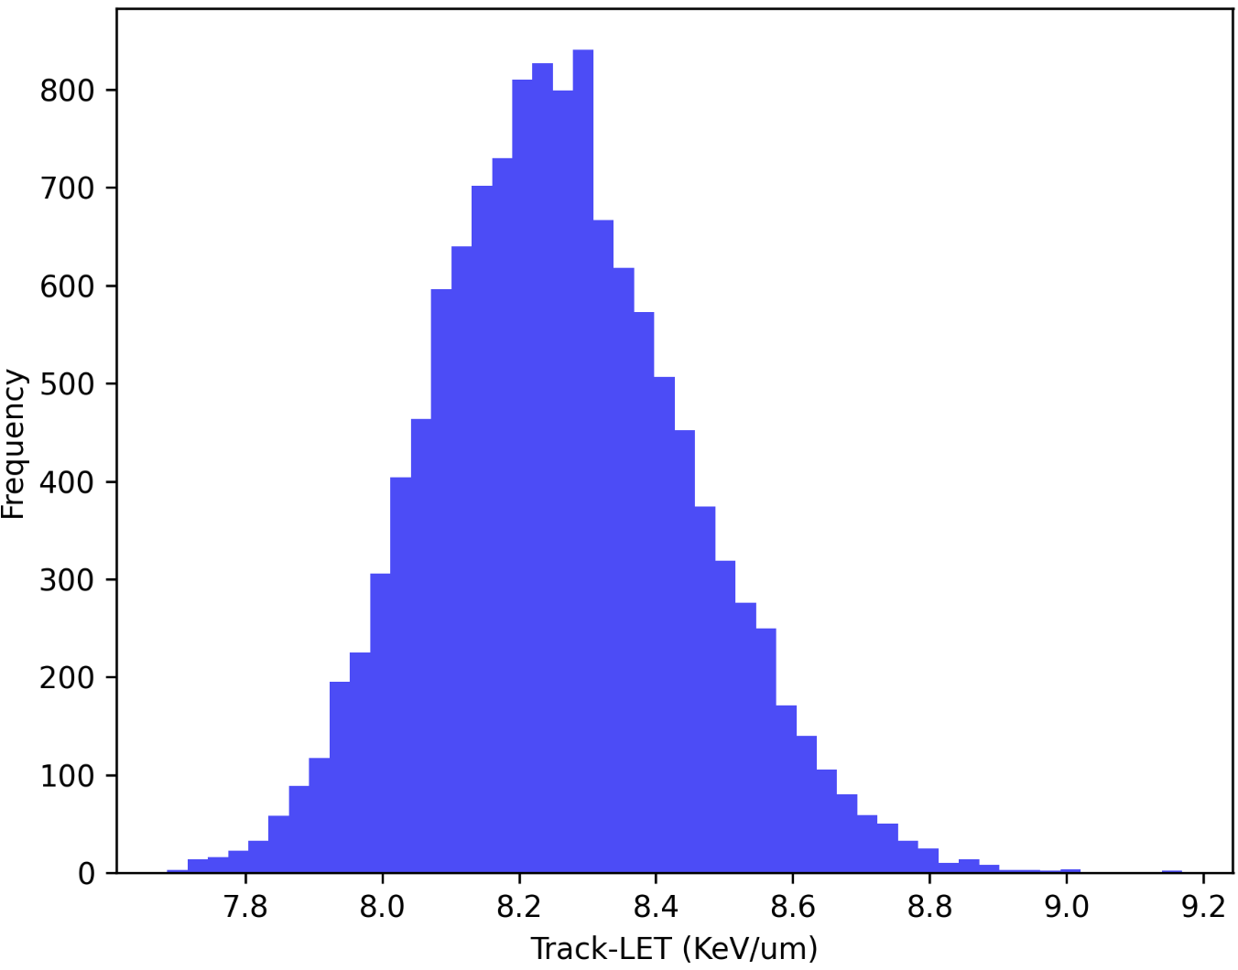
Scintillating Plane
SciPlane in front of cells
SciPlane as a scatterer
Evaluation
Current
Both
335
335

Slide 25
Tony’s Techniques
Thin Phosphor (Instrumented Cell Dish Bottom?)
Secondary Standard Calorimeter
Concept: Can deposit phosphor onto thin Kapton sheets or potentially onto the bottom of the cell dish
Appeal:
  Real-time measurement
  Full beam profile
  Cell dish bottom as close to the cells as possible
Collaborators: Simon Joly (Peter Hobson has worked with phosphor at Brunel)
Challenges:
  Transport of light from the phosphor sheet to a detector
Status: ???
Concept: Adapting a secondary standard calorimeter to provide traceable absorbed-dose-to-water measurements at FLASH
Appeal:
  Real-time measurement
  Measures dose
  Traceably calibrated
Developer/Collaborators: Sam Flynn (NPL)
Challenges:
  Can only be placed in front of the cell dish since the EMP is too strong within the chamber.
  Full spectrum needed for characterisation
  Currently sensitive to 2Gy. Target is ~0.3Gy
Status:
  Tests in 2025 showed:
    “Calorimeters were successfully calibrated in terms of absorbed dose to water in conventional radiotherapy beams at approximately 5Gy/min with an estimated uncertainty of ±2-2.5% (k=2), and performed similarly in a 6MeV electron beam delivering approximately 180Gy/s” - Bass GA, Shipley DR, Flynn SF, Thomas RAS. A prototype low-cost secondary standard calorimeter for reference dosimetry with ultra-high pulse dose rates. doi:10.1259/bjr.20220638
Last Design: Secondary Standard Calorimeter. Sam Flynn at NPL has been designing a version for FLASH, with a final prototype built and the last tests before production were done in 2025. Currently, the lowest measurement is 2Gy. Sam believes it could reach 0.3Gy. Would be placed in front of the cell dish, so the fear of using electronics due to the EMP is less of an issue. There is still an issue in that an energy spectrum would be required to fully characterise the beam. This could be done with Nick's time-of-flight detector, but this runs into the same issue as the Thompson Parabola because it only samples a small portion of the beam

Slide 26
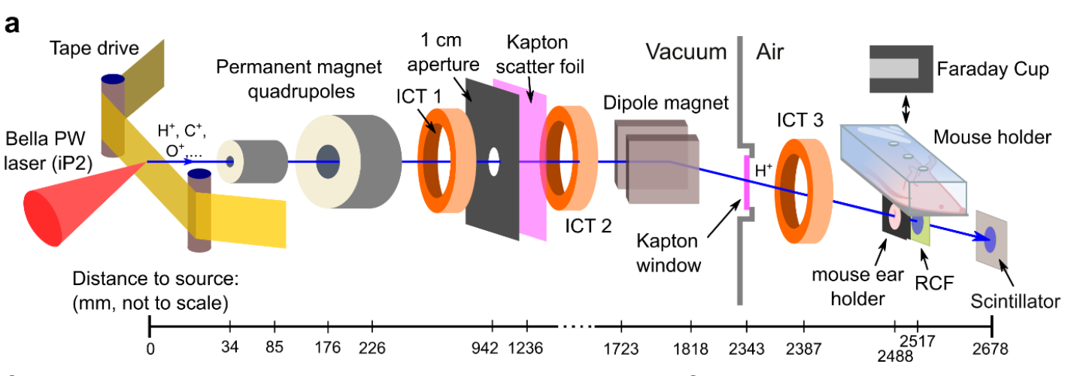
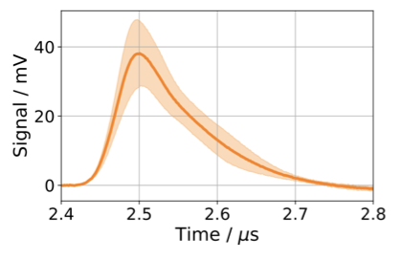
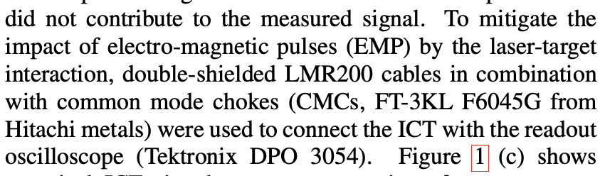
Integrated Current Transformers
BELLA
How?
Moving charge (the beam) generates a current in the coil. Reading off the current tells you the amount of charge in the beam.
Pros
In-beam diagnostic
Non-destructive
Can be calibrated with dose
Cons
No particle species discrimination
No spatial/beam profile information
Susceptible to EMP (readout chain requires mitigation)
Expensive?
Obst-Huebl, Lieselotte, et al. "Radiation damage to normal mammalian tissue in vivo with laser-driven protons at ultra-high instantaneous dose rate." arXiv preprint arXiv:2602.20460 (2026).
Geulig, Laura D., et al. "Online charge measurement for petawatt laser-driven ion acceleration." Review of Scientific Instruments 93.10 (2022).
Notes:
Signal trace measured with the ICT
and the oscilloscope readout representative of the ion beam charge
measurements during cell sample irradiations. The solid line shows
an average over 10 shots and the shaded area indicates the standard
deviation.

Slide 27
Advacam MiniPIX
LET Detector
How?
Silicon Sensor attached to a grid of pixel electrodes.
Each pixel measures how long the signal stays above threshold and when it arrived
A particle creates a signal in several pixels producing a track
Can determine direction, energy deposited, species and LET
Pros
Measures LET
Compact and portable
Lots of measurements in one
Peter Hobson has experience?
Cons
Not on-shot (would replace cells)
Possible minimum energy threshold of 8MeV
Cost: €8,700-€12,100
Existing validation almost all for conventional continuous beams
Convert LET from Silicon to Water (Cells)
Paulina Stasica et al 2023 Phys. Med. Biol. 68 104001

Slide 28
Overall Conclusions & Next Steps
Beamline Diagnostics
Short-term aims (Next Beamtime)
    Resolve transparent-fibre supplier situation
    Evaluate scintillating coil as RCF replacement for cell-dish dosimetry
    Investigate the possibility of delaminating RCF ourselves
Sparse Scintillating Fibre
    Damage risk is low
    Better placed upstream of the scatterer
    Transparent-fibre coupling supplier unresponsive — switch to Thorlabs and complete further tests
RCF / Delaminated EBT3
    Useful back-up
    RCF around the dish might be better as a scintillating coil
Scintillating Plane
    Dual-use as a scatterer and a diagnostic is attractive
  ICT
    Long-term promise
    Have to deal with EMP
    Cost
  Advacam MiniPIX
    Fills a key gap in current detection
    Minimum energy threshold of 8MeV poses a problem

Slide 29
Thank you
Simulations for PoPLaR
18/09/2025

