Slide 1



Improving beam tracking using a hybrid code strategy
LhARA Collaboration meeting
30/04/2026
Marie Mannie-Corbisier (ULB)
Supervisor: William Shields (RHUL)

Slide 2
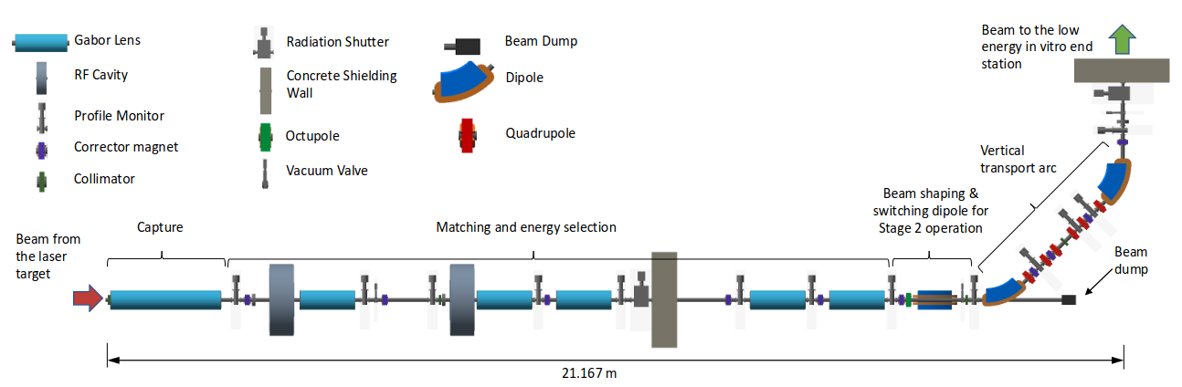
Beam tracking workflow: Previous
Injection: Nozzle with Space Charge effect
TNSA beam production
Stage 1 beamline
Space charge effect missing
LhARAlinearOptics
GPT
BDSIM
Dispersion missing
+ tricky way to handle magnets
Space charge effect significant where the beam density is high
GPT
Small size after the nozzle
Focus point

Slide 3
RF-Track: particle tracking code
Collective effects: space charge, wakefield,…
Beam of different particle species
User friendly (python code)
Dispersion
...
developed at CERN for the design and optimisation of particle accelerators

Slide 4
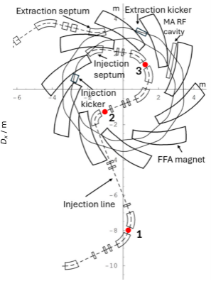
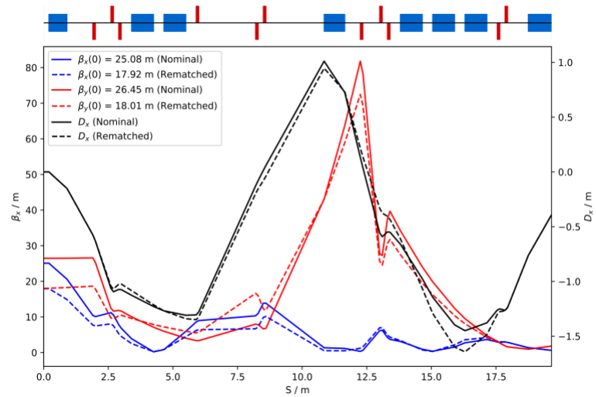
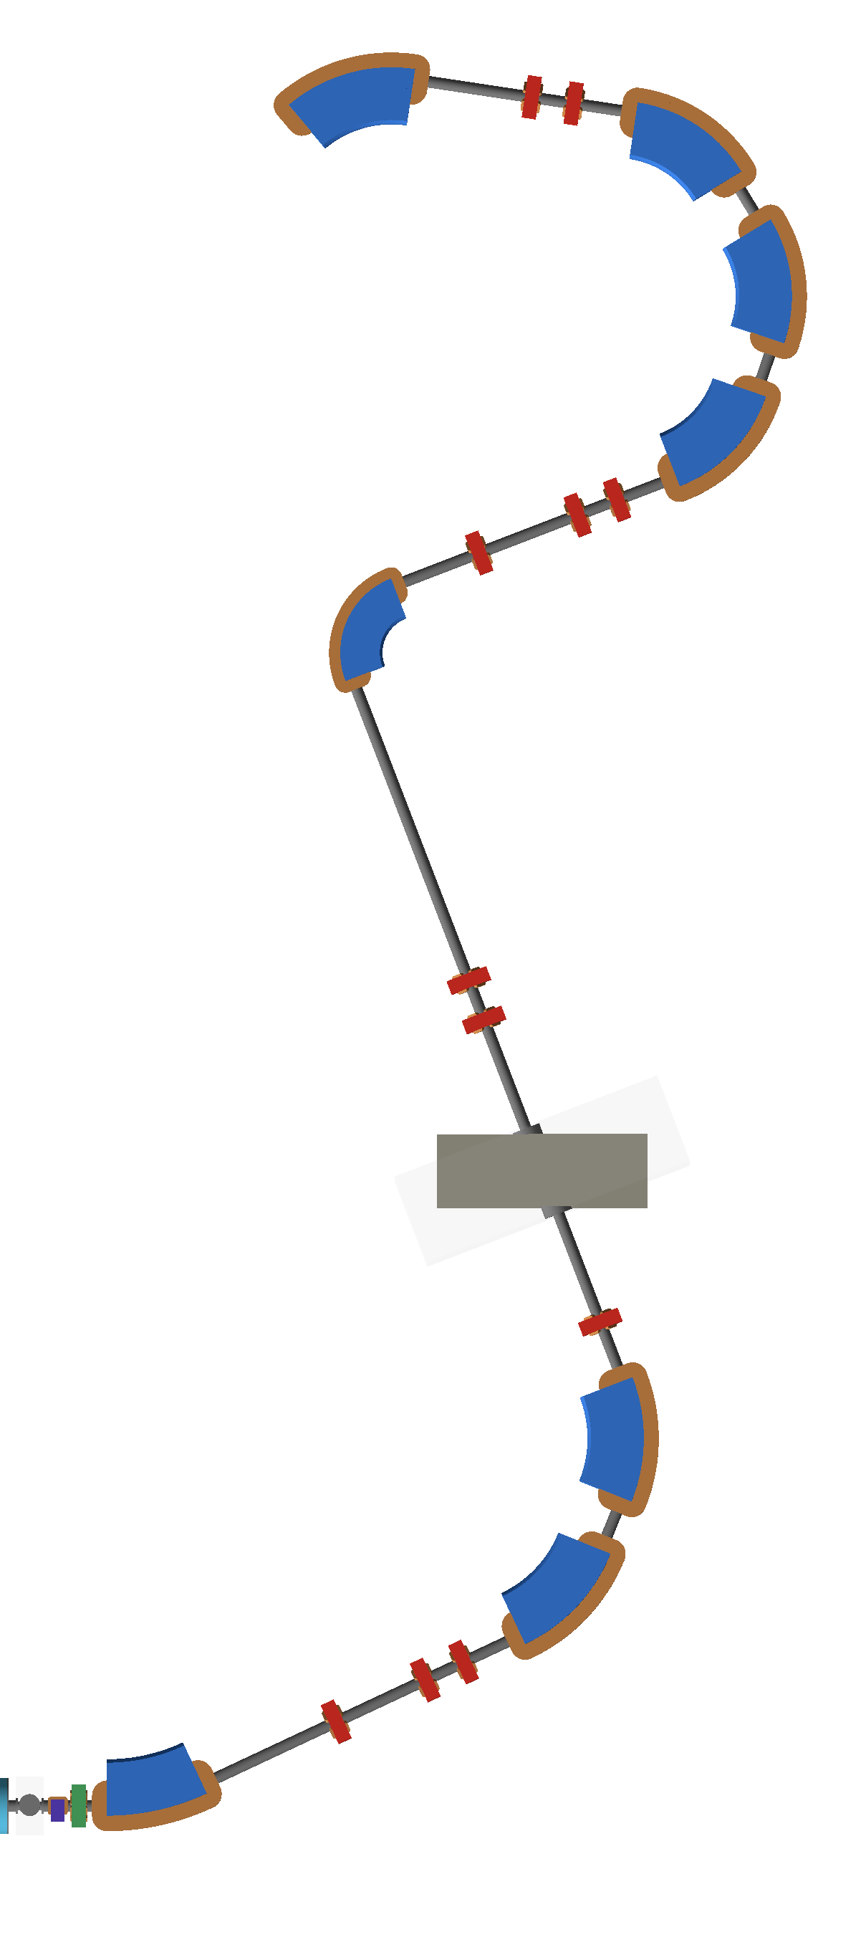
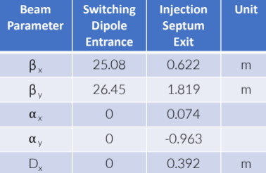
FFA injection line design with dispersion
Without SC
Dx=0
Dx=
0.4m
Dispersion at the exit
No dispersion at the start
Various physical effects to simulate
Losses (BDSIM: , RF-Track: , GPT: )
Space-charge effect (RF-Track: ,GPT: ,BDSIM: )
Dispersion ( BDSIM: ,RF-Track: , GPT: )

Slide 5
Beam tracking workflow: Next
RFTrack
LhARAlinearOptics
Full Stage 1 beamline with Space Charge effect
INTERFACE
BDSIM
TNSA beam production
Discretised element
Software used:
B
R
B
R
B
R
B
R

Slide 6
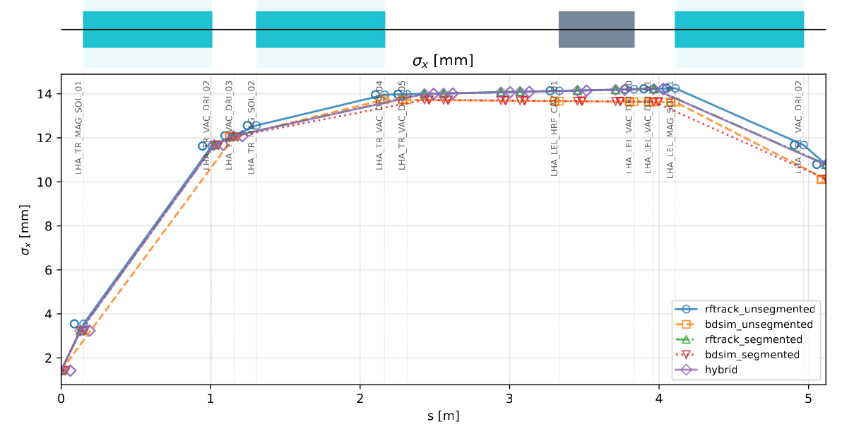
Preliminary simulation results: validation
Comparison without space charge effect
GPT VS RF-Track space charge effect: work in progress.

Slide 7
Conclusion
BDSIM is well suited for particle–matter interactions, but not sufficient alone for accurate collective beam tracking.
GPT presents limitations, especially in dispersive regions and magnetic elements for long beams.
A hybrid strategy combining BDSIM and RF-Track appears to be the most appropriate solution.
Next steps:
Extend tracking in RF-Track by using time integration instead of space.
Validate space-charge simulations in RF-Track against GPT.

Slide 8
Thank you for your attention!

