Slide 1

3rd Pillar

Slide 2

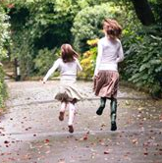
Business Case
Answer all the unknowns in radiobiology, usher in a new dawn of biology-physics-engineering cross disciplinary research and banish cancer for ever and ever…
until the next time (©Spike Milligan)
Skip joyfully into the new dawn
How?

Slide 3
Overarching strategic Plan
Build from CDR - Aim is large facility stuffed full of active research.
Requires ‘political’ campaign.
Starting gun was fired years ago
  Exhibition Road, Macron, politician engagement
  Royal Soc. Summer Exhibition and road trip - Glasgow Science Festival, events in Belfast and Swansea?
Also need to address how to get funding now

Slide 4
Exploit what we have already achieved.
Find co-travellers in all areas
  Build collaborative effort
  Adjust targets to maximise ‘returns’
  Grow community with tentacles into the maximum number of funding sources.
    Upsides
      maximises opportunities
      Spreads funding and improves robustness
    Downsides
      some applications are less ‘utopian’
      Charities need to have a care who they work with

Slide 5
What’s been done to date …
Initial contact for ion acoustic measurements. Needs more work including simulation of planar environment
Alternate proton beam use for radiation damage – requires low energy protons that can deposit significant dose in <1um.
non-spherical focussing element to direct low energy protons to appropriate focus. Useful for other purposes.

Slide 6
What have we achieved?
This is the bit where an undergraduate lecture would risk descending into humiliation as the students refuse to speak….
So I’ll start..
We’ve built and operated a proton beam line that delivers:
  10^9? protons centred on 8MeV with FWHM of 2-3?MeV.
  Beam uniformity of x% and we have ‘some’ understanding of that measure
  RCF procedure developed.
  Know how to kill cells with no need for protons - plan to reduce collaterals
  Learned how to run Bayesian beamline optimisations.
  Trapped far more electrons than expected….
Use next x minutes to bulk this list up…. brainstorm
I have a picture to help…

Slide 7
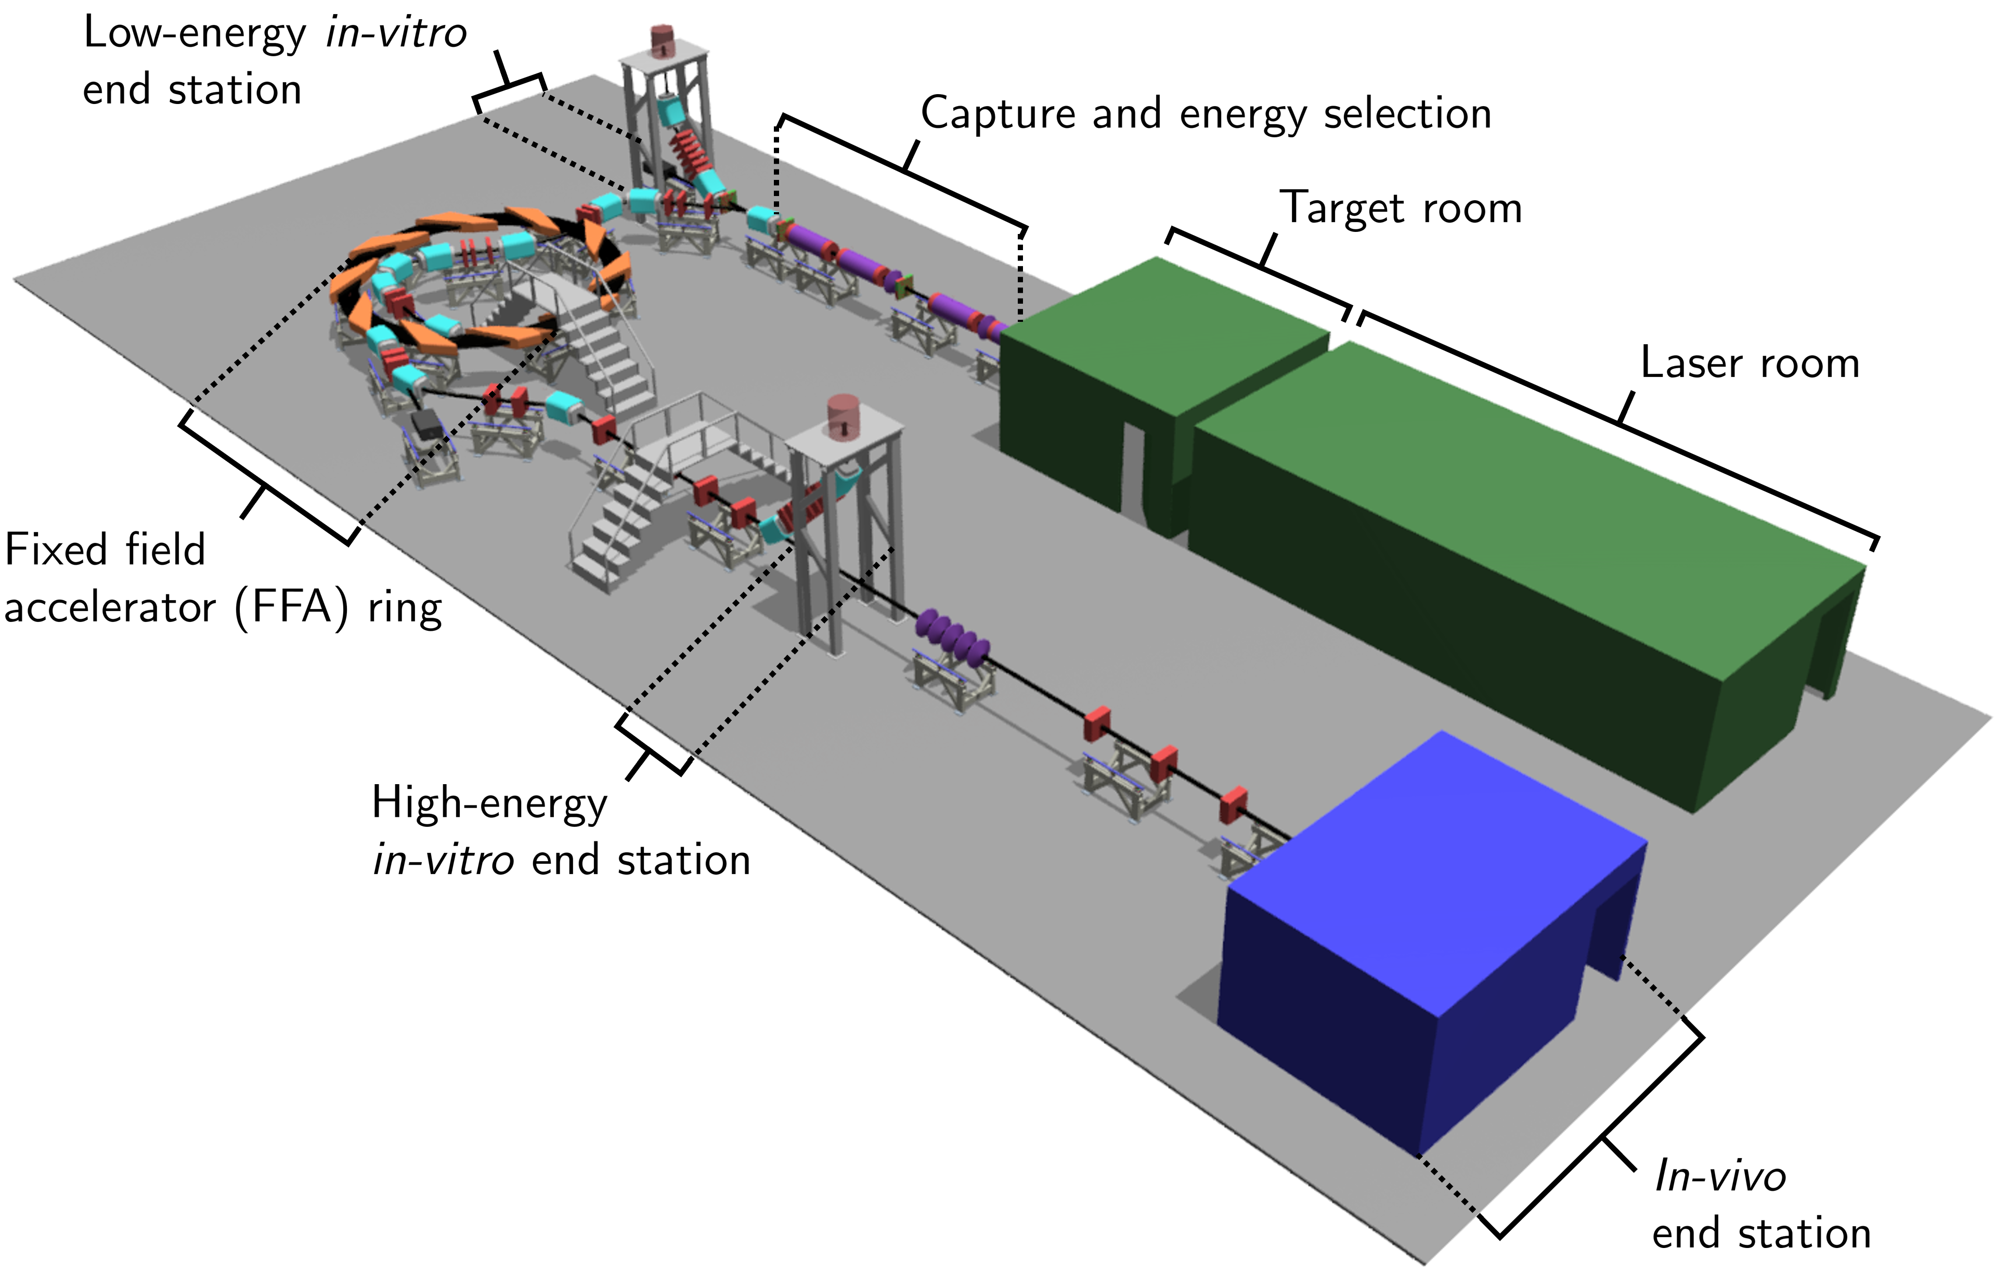
ITRF
Ion Therapy Research Facility

