Slide 1
PoPLaR Phase 2: RCF Analysis
Calvin Dyson

Slide 2
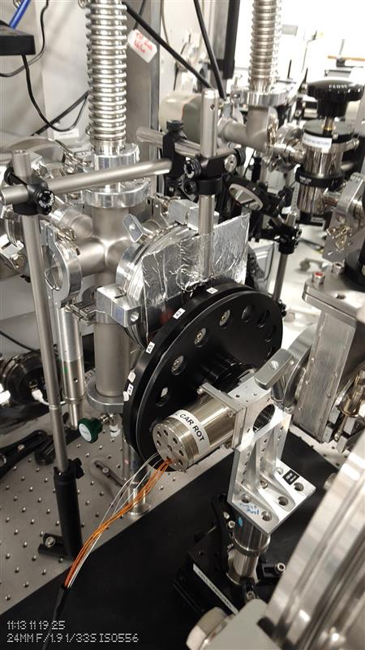
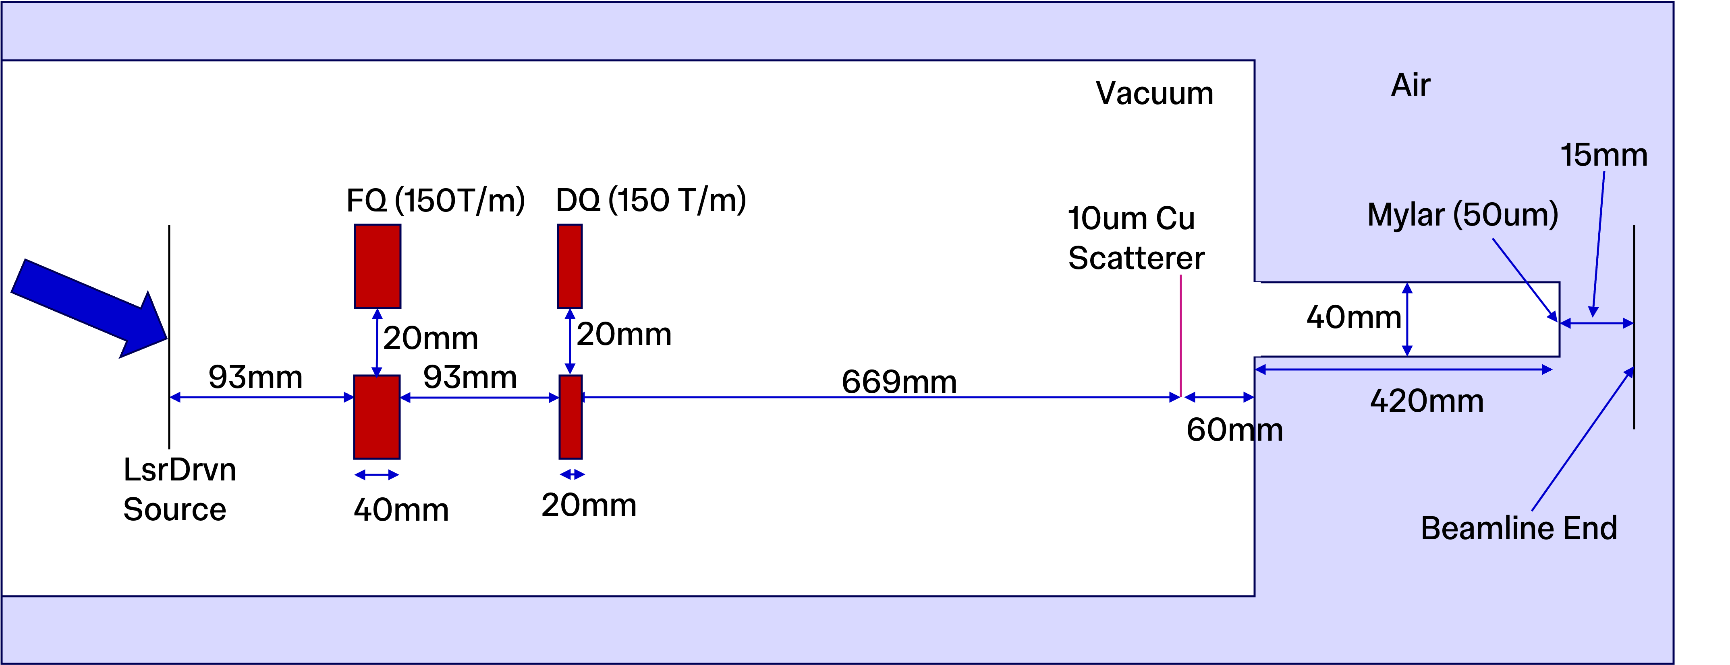
Overview
RCF was used to estimate the dose delivered to the cells
Two Main Sources of Uncertainty
Temporal (Variation in dose between shots)
Spatial (Variation in dose across the cell dish)
Cu Scatterer (10𝜇m)
Mylar (50𝜇m)

Slide 3
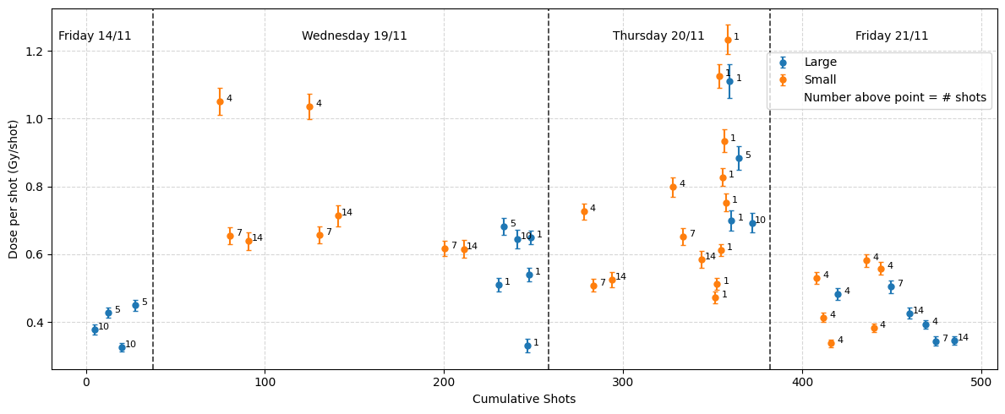
Dataset
Collected 50 Films
20 larger than the cell dish
30 smaller than the cell dish
Used the larger films to estimate the conversion of the smaller films to the full cell dish area
Range of shots taken: 1-14
Key shot numbers are 4, 7 and 14 shots
Range of Dose Delivered: 0.01 – 9.99 Gy
Notes:
Mention:
Large Variation No Clear dependence on shot number
Potential Dependence on Smaller Film Size

Slide 4
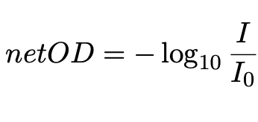
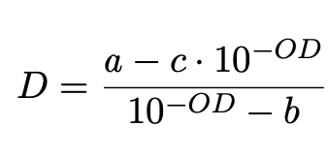
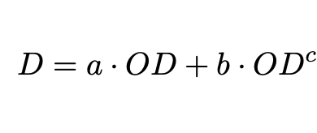
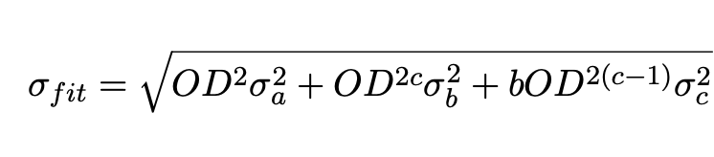
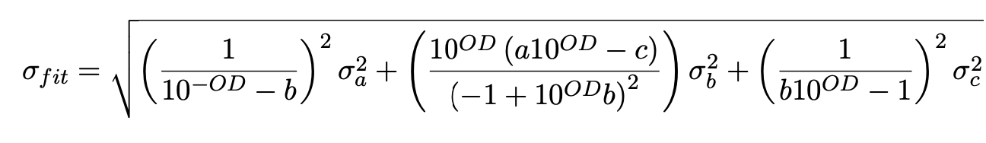
Calibration
Models
Gafchromic’s Recommended Model
Polynomial Model

Slide 5
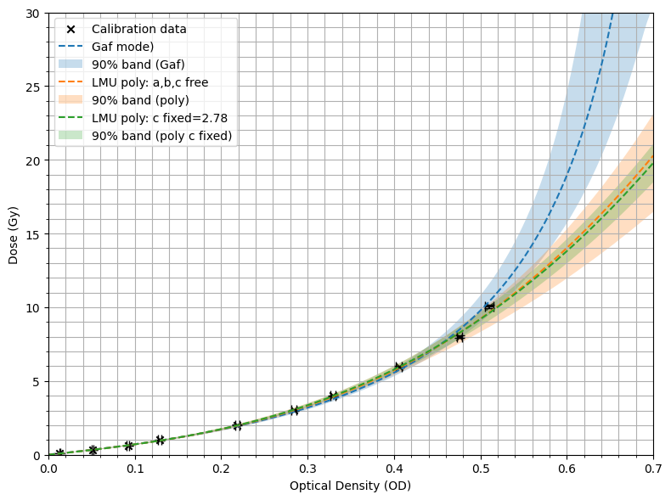
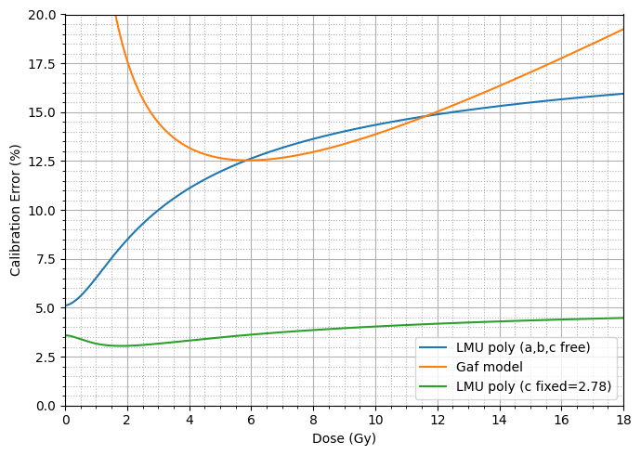
Calibration
Evaluation
Model | a | b | c | 𝜒_{r}²
Gafchromic | 2.13±0.13 | 0.167±0.015 | 2.12±0.13 | 9.87
Polynomial | 6.43±0.33 | 43.7±8.8 | 2.85±0.25 | 9.63
Polynomial (C fixed) | 6.36±0.23 | 41.3±2.4 | 2.78 | 8.55
Devic S et al 2004 Dosimetric properties of improved GafChromic films for seven different digitizers Med.
Phys. 31 2392–401

Slide 6

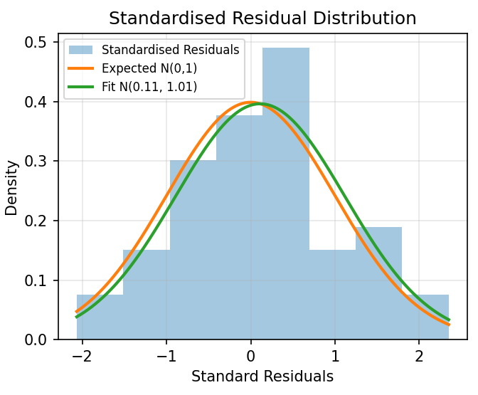
Estimating Dose Delivered
Shot-to-shot Variation
Performed a Maximum Likelihood Fit on the mean dose and the shot-to-shot variation
Assumes normally distributed shot-to-shot variation.
N_{i} = Number of Shots, 𝜇 = Mean Dose per Shot,
𝜎_{shot} = Shot-to-shot Variation, 𝜎_{D} = Measurement Error
Result:
𝜇 = 0.57 Gy
𝜎_{shot} = 0.40 Gy
𝜎_{D} = 0.03 Gy
𝜒_{red}² = 1.05 (p=0.384)

Slide 7
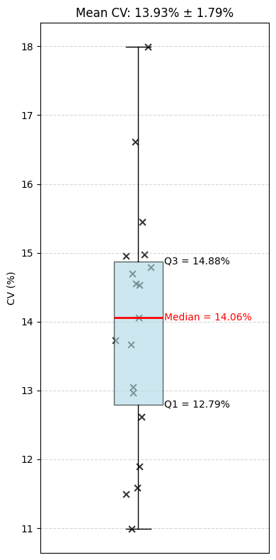
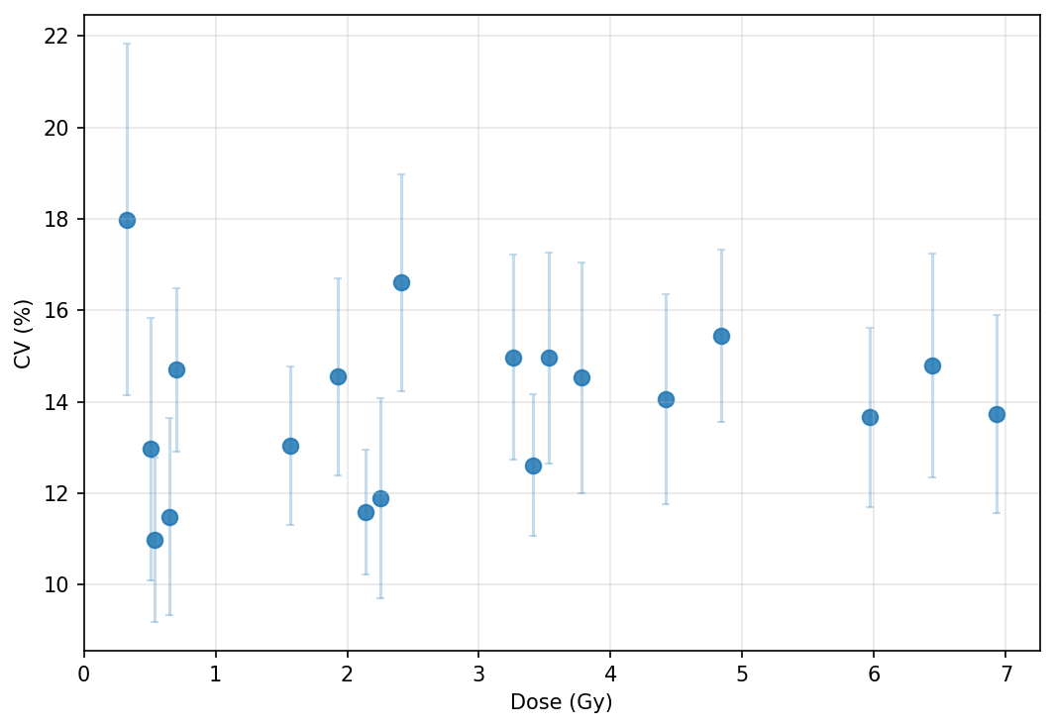
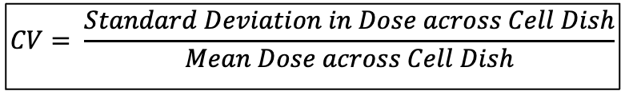
Estimating Dose Delivered
Spatial Variation
$$CV= \frac{Standard Deviation in Dose across Cell Dish}{Mean Dose across Cell Dish}$$
20 Large Films
Mean CV: 13.93%
No obvious dependence on mean dose

Slide 8
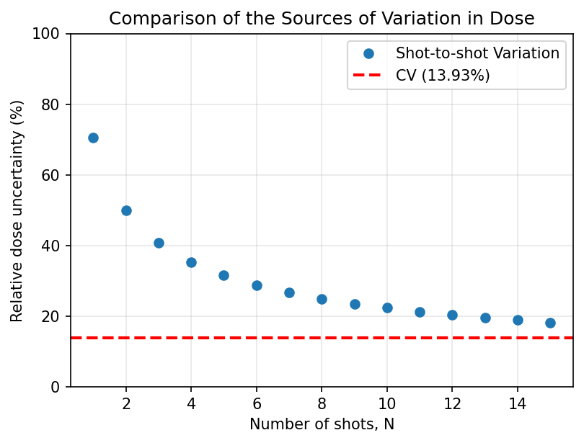
Estimating Dose Delivered
Compare Dose Variation Sources
Main Error is shot-to-shot variation
Need to reduce the spatial variation as well
CV becomes the bigger proportional error at 26 shots (or 14.8 Gy)

Slide 9
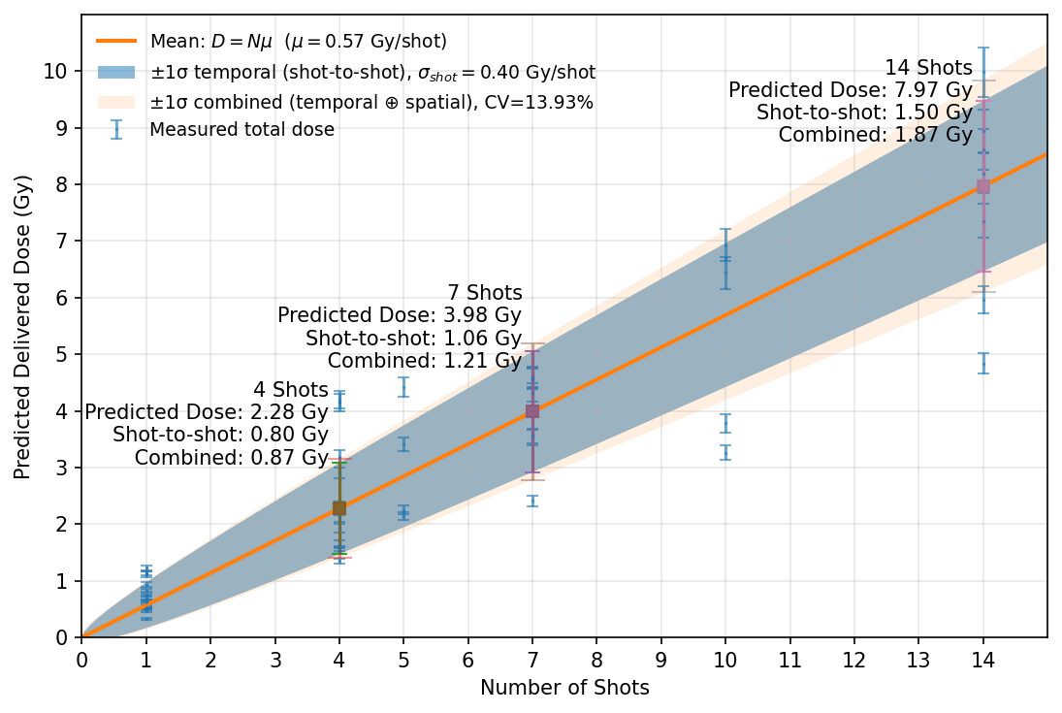
Estimating Dose Delivered
Final Results
Shots | Predicted Dose /Gy | Uncertainty /Gy
4 | 2.28 | 0.87
7 | 3.98 | 1.21
14 | 7.97 | 1.87

Slide 10
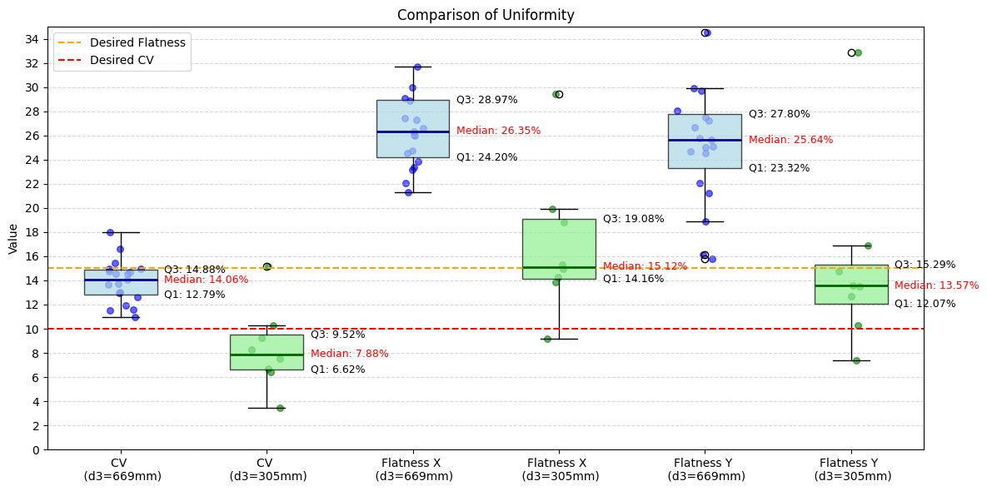
Uniformity Improvement
Move Copper Scatterer Closer

Slide 11
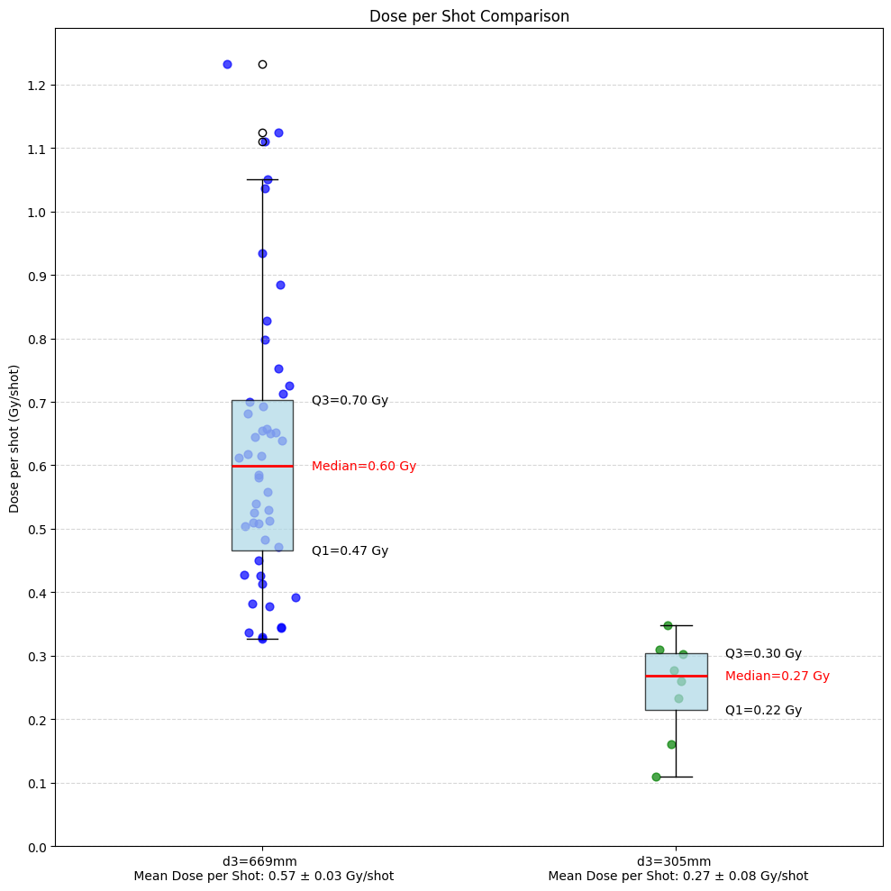
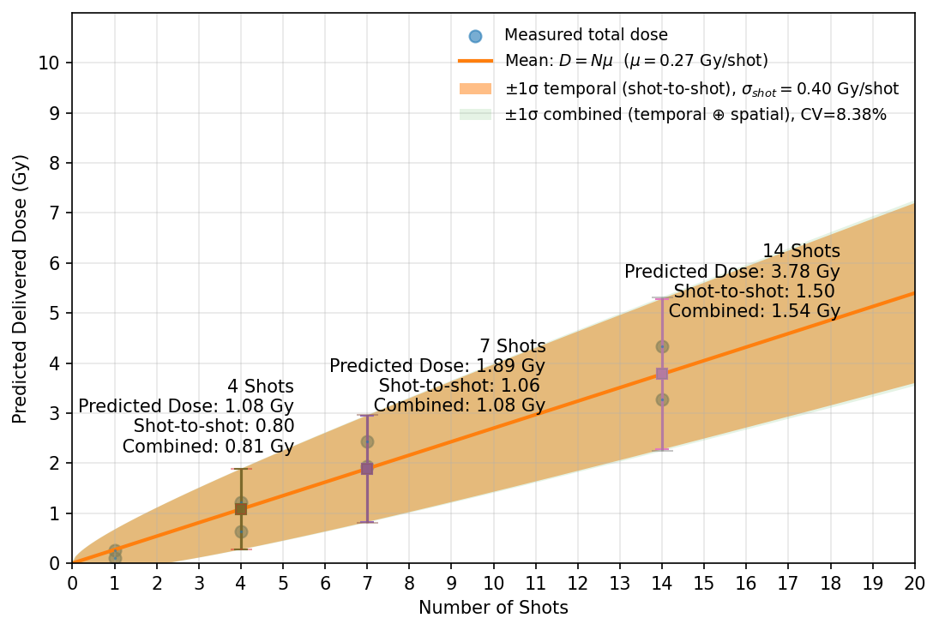
Uniformity Improvement
Move Copper Scatterer Closer

Slide 12
Conclusions and Future
Shot-to-Shot Variation is the biggest uncertainty
Requires in-beam diagnostic
Delivered roughly twice the dose as expected
Spatial Non-Uniformity Considerable
Moving the scatterer closer does improve uniformity
Delivers a little less than half the dose per shot
12

