Slide 1

Plasma Trap Simulations
Presenter: Calvin Dyson
29th April 2026
LhARA 9th Collaboration Meeting,
Notes:
Welcome to the simulation of the LION beam with LLO
Calvin Dyson and work completed with

Slide 2
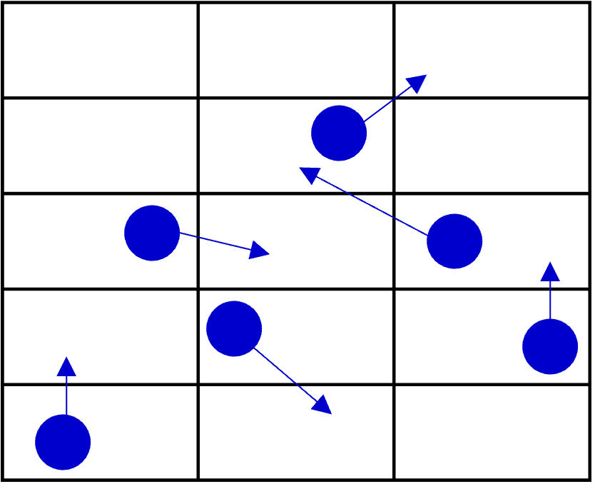
PIC Simulations
Field Solve (Poisson/Maxwell)
Calculate forces and generate equations of motion
Push particles
Deposit charge on grid
Introduction
Simulating a real plasma has too many degrees of freedom (too many particles)
The computational cost is reduced by grouping particles into macroparticles
Allows study of collective plasma behaviour

Slide 3

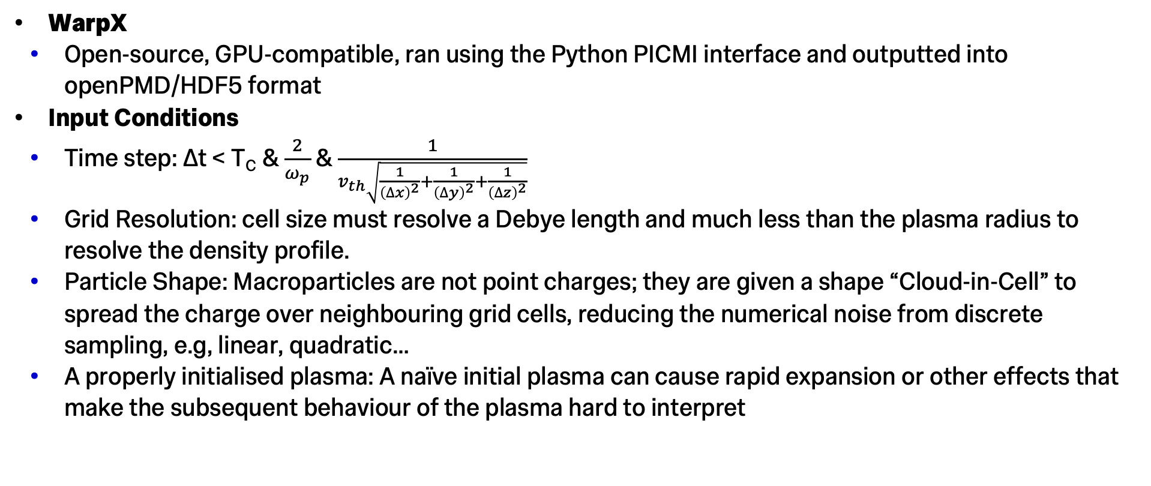
PIC Simulations
Key information
WarpX
Open-source, GPU-compatible, ran using the Python PICMI interface and outputted into openPMD/HDF5 format
Input Conditions
Time step: ∆t < T_{C} & $\frac{2}{ω_{p}}$ & $\frac{1}{v_{th}\sqrt{\frac{1}{{\left(∆x\right)}^{2}}+\frac{1}{{\left(∆y\right)}^{2}}+\frac{1}{{\left(∆z\right)}^{2}}}}$
Grid Resolution: cell size must resolve a Debye length and much less than the plasma radius to resolve the density profile.
Particle Shape: Macroparticles are not point charges; they are given a shape “Cloud-in-Cell” to spread the charge over neighbouring grid cells, reducing the numerical noise from discrete sampling, e.g, linear, quadratic…
A properly initialised plasma: A naïve initial plasma can cause rapid expansion or other effects that make the subsequent behaviour of the plasma hard to interpret
Notes:
Must be able to resolve cyclotron motion
Plasma frequency sets the timescale for collective charge oscillations. If time step too large than the oscillations will grow rather than oscillate
Long one is so that a particle moving at thermal velocity shouldn’t cross more than one cell per timestep. If they did then the charge deposition becomes inaccurate

Slide 4
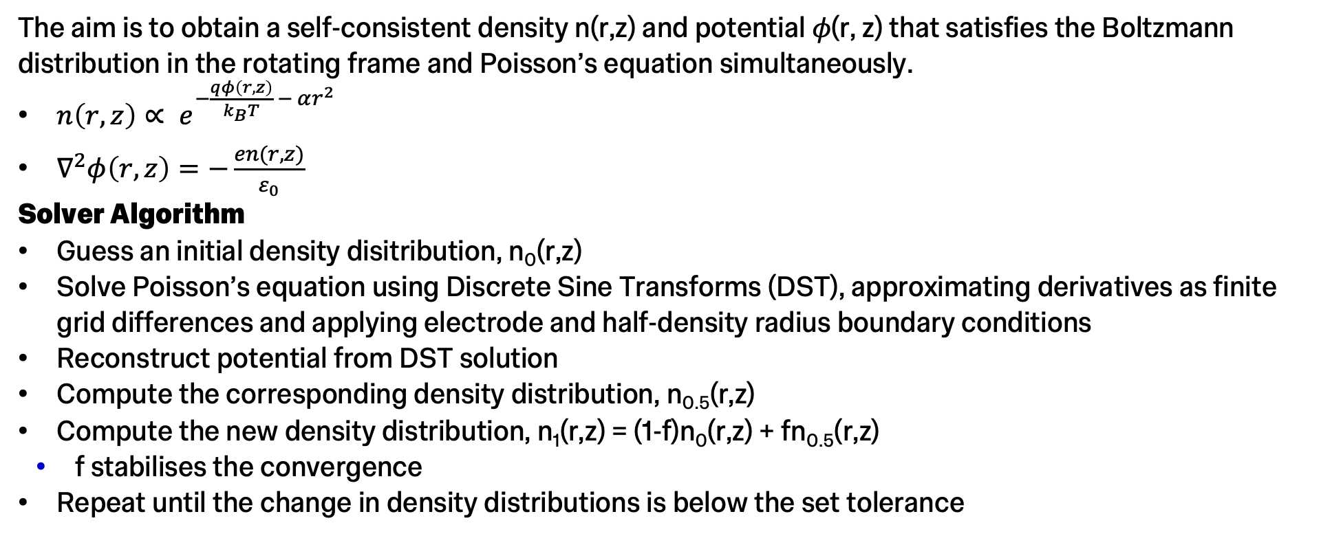
Initialising a stable plasma
Method
The aim is to obtain a self-consistent density n(r,z) and potential 𝜙(r, z) that satisfies the Boltzmann distribution in the rotating frame and Poisson’s equation simultaneously.
$n\left(r,z\right)∝ e^{−\frac{qφ\left(r,z\right)}{k_{B}T} − αr^{2}}$
$∇^{2}φ\left(r, z\right)=−\frac{en(r,z)}{ε_{0}}$
Solver Algorithm
Guess an initial density disitribution, n₀(r,z)
Solve Poisson’s equation using Discrete Sine Transforms (DST), approximating derivatives as finite grid differences and applying electrode and half-density radius boundary conditions
Reconstruct potential from DST solution
Compute the corresponding density distribution, n_{0.5}(r,z)
Compute the new density distribution, n₁(r,z) = (1-f)n₀(r,z) + fn_{0.5}(r,z)
f stabilises the convergence
Repeat until the change in density distributions is below the set tolerance

Slide 5
Inputs
Simple 140V Version of Poram’s Trap
Trap Setup
Trap Radius: 2.1cm
Gap between Electrodes: 28cm
Length of Full Simulation: 60cm
B-Field: 0.04T
Electrode Voltage: -140V
Plasma
Max Density: 8e13 m⁻³
Temperature: 31000K
Simulation Parameters
Time Step: 10ps
Grid: 64x64x1024
Particle Shape: Linear
Macroparticles: 255,214
Particle Weight: 5000

Slide 6
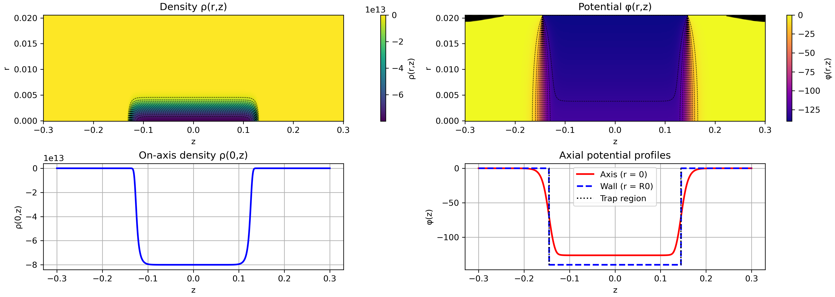
Initialising a stable plasma
Results

Slide 7
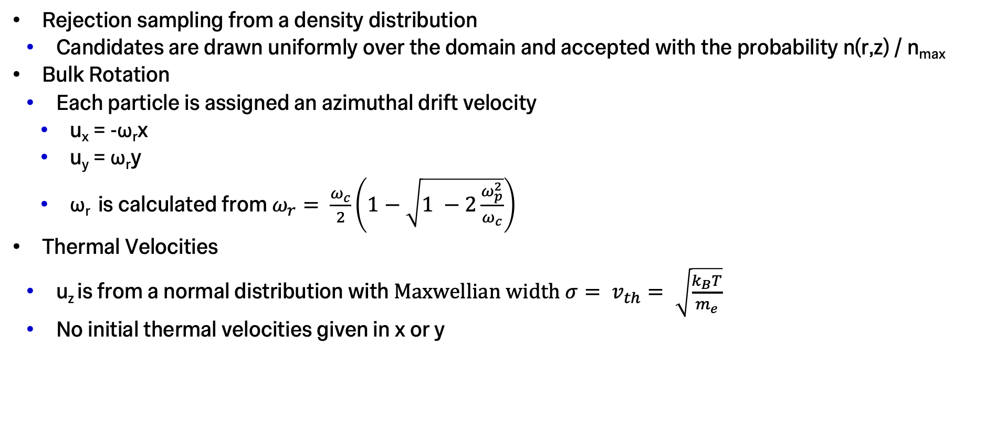
Sampling Plasma
Method
Rejection sampling from a density distribution
Candidates are drawn uniformly over the domain and accepted with the probability n(r,z) / n_{max}
Bulk Rotation
Each particle is assigned an azimuthal drift velocity
u_{x} = -ω_{r}x
u_{y} = ω_{r}y
ω_{r} is calculated from $ω_{r}= \frac{ω_{c}}{2}\left(1−\sqrt{1 −2\frac{ω_{p}^{2}}{ω_{c}}}\right)$
Thermal Velocities
u_{z} is from a normal distribution with $Maxwellian width σ= v_{th}= \sqrt{\frac{k_{B}T}{m_{e}}}$
No initial thermal velocities given in x or y
Notes:
Omega_r is the solution for a cold-plasma rotating around a magnetic field

Slide 8
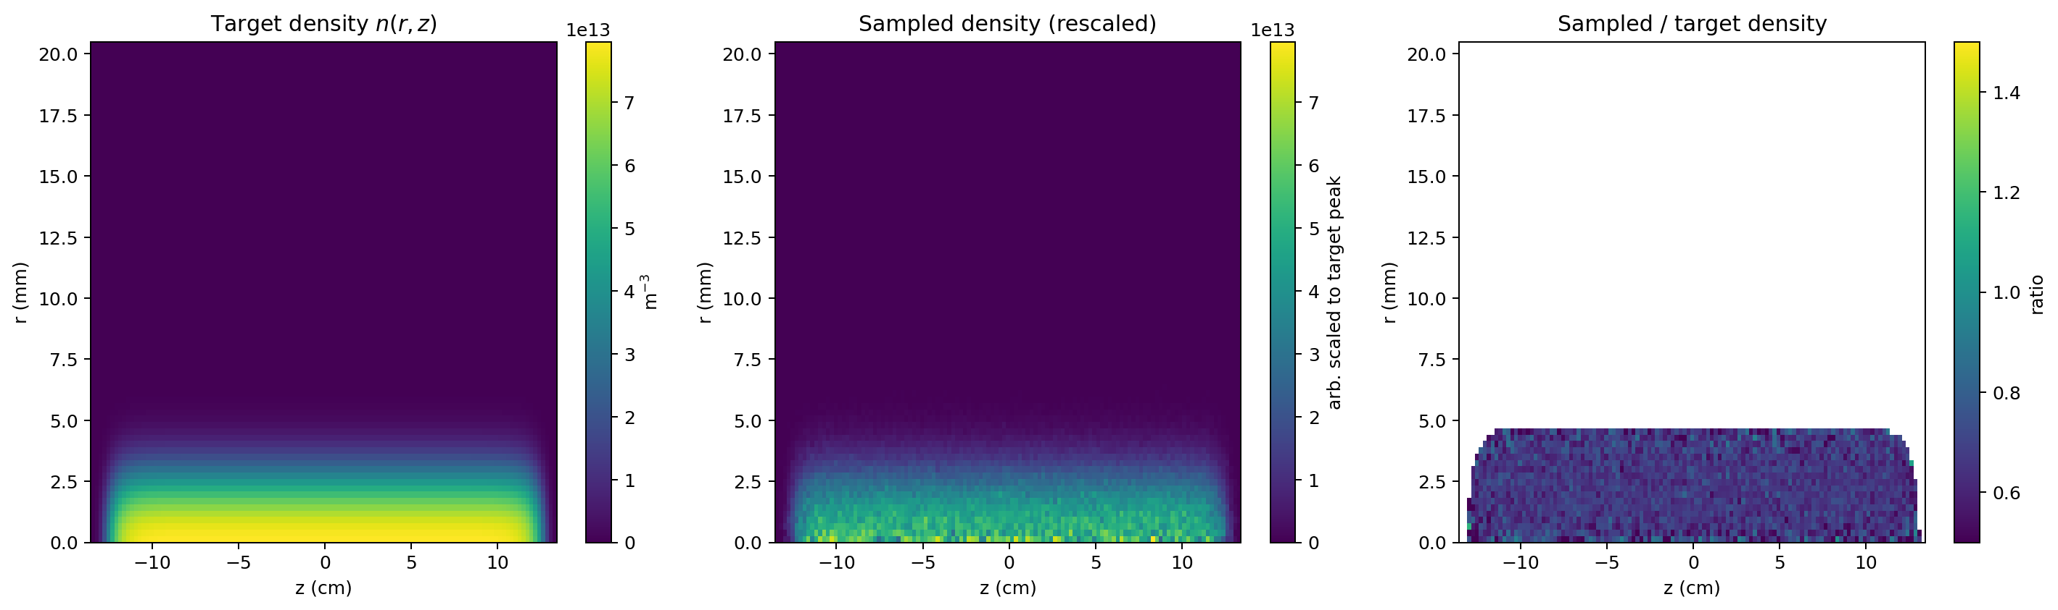
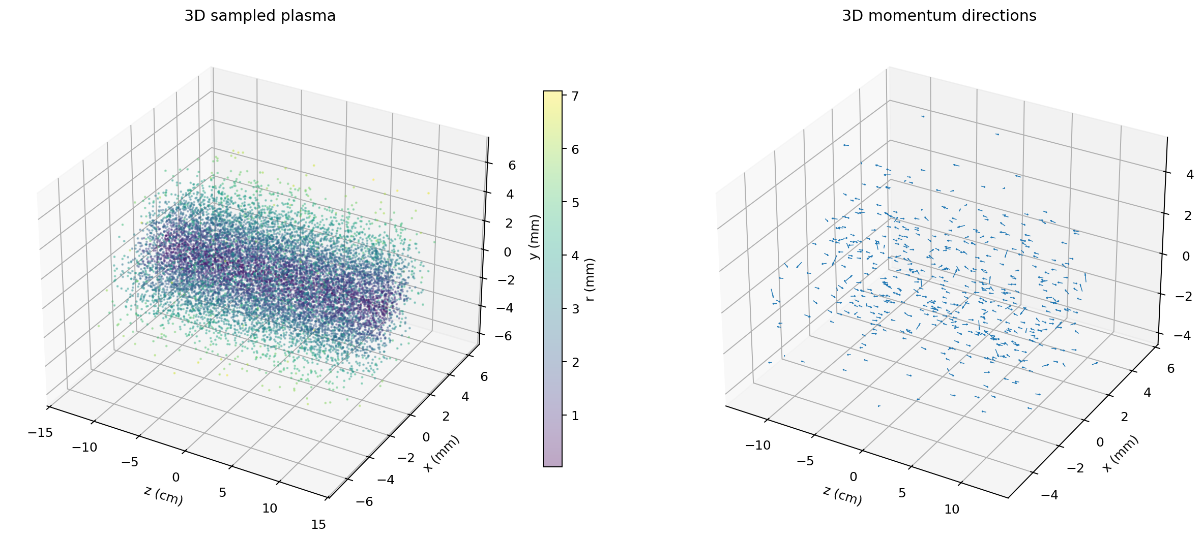
Sampling Plasma
Results

Slide 9
Sampling Plasma
Results

Slide 10
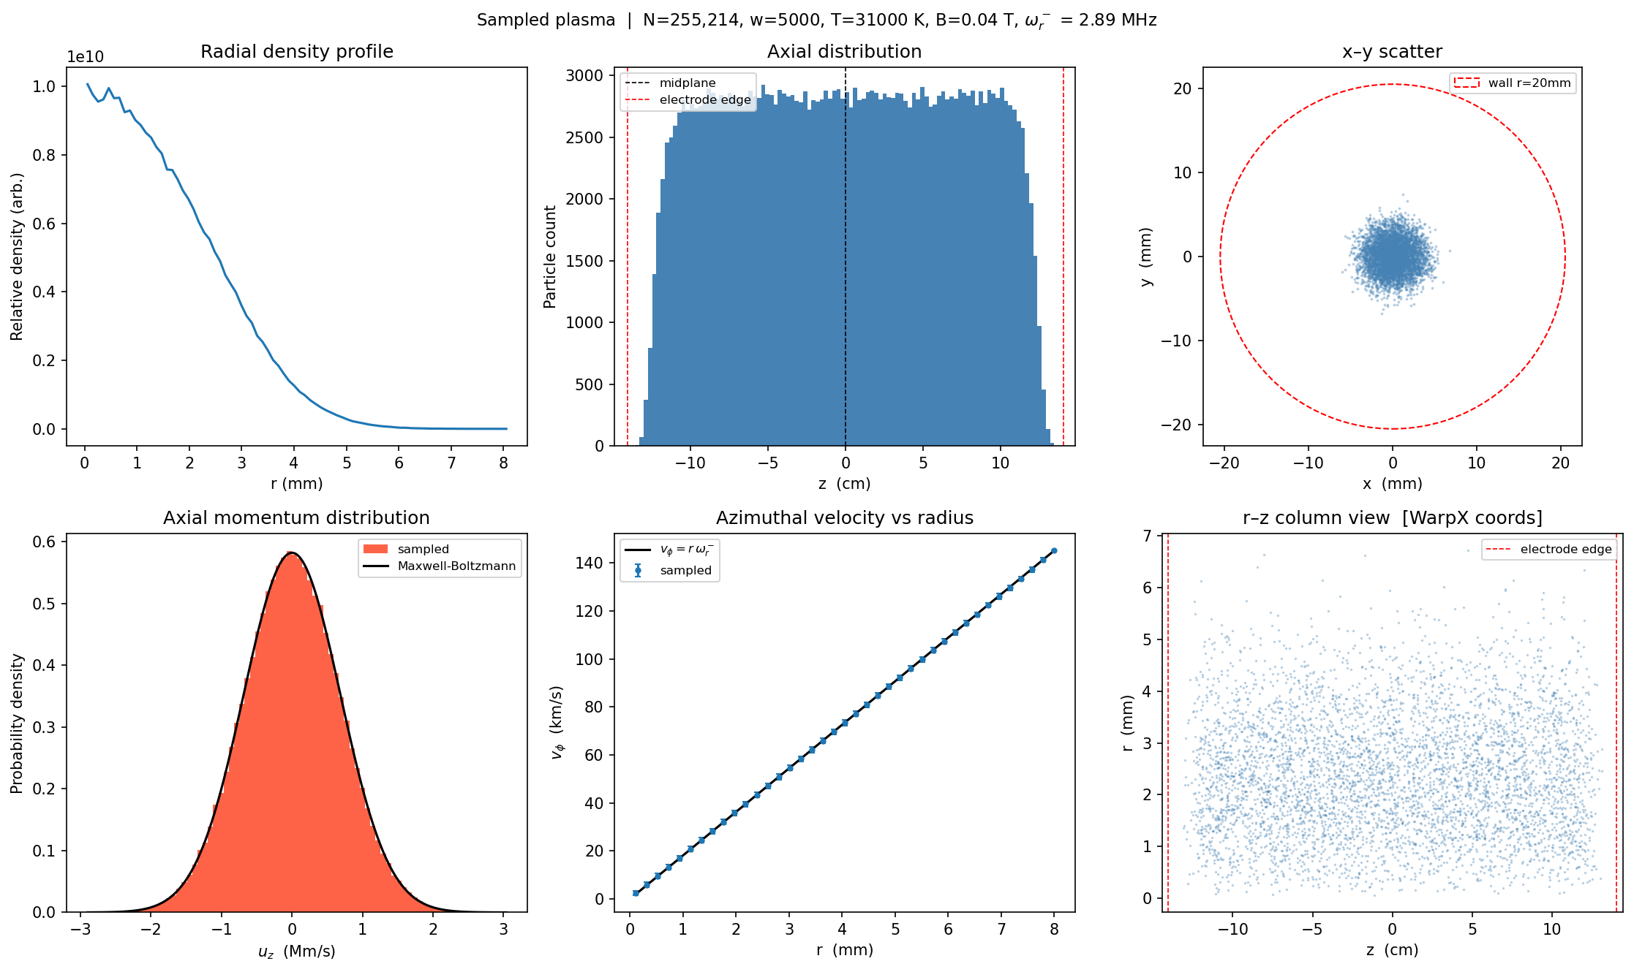
Sampling Plasma
Diagnostics

Slide 11
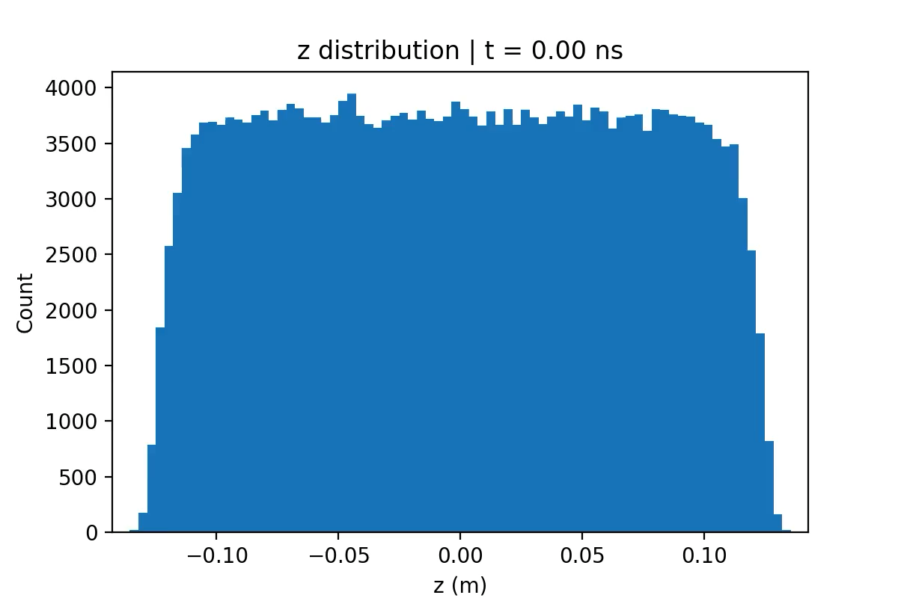
PIC Simulation
Example of mistaken electrode voltage

Slide 12
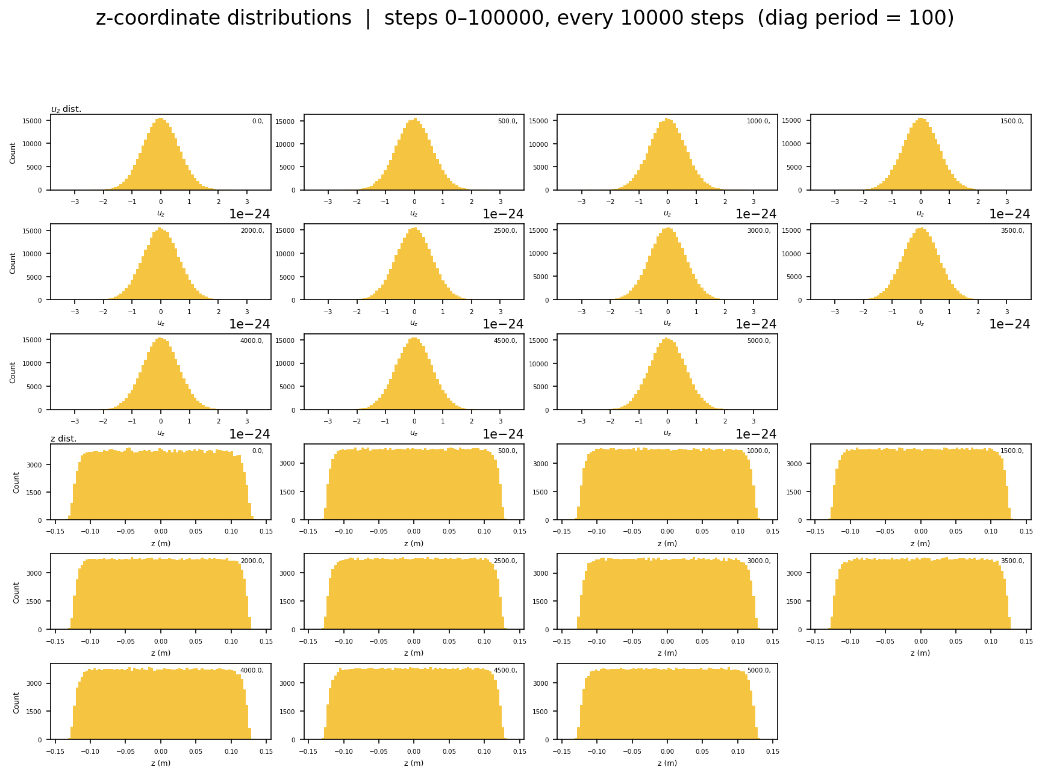
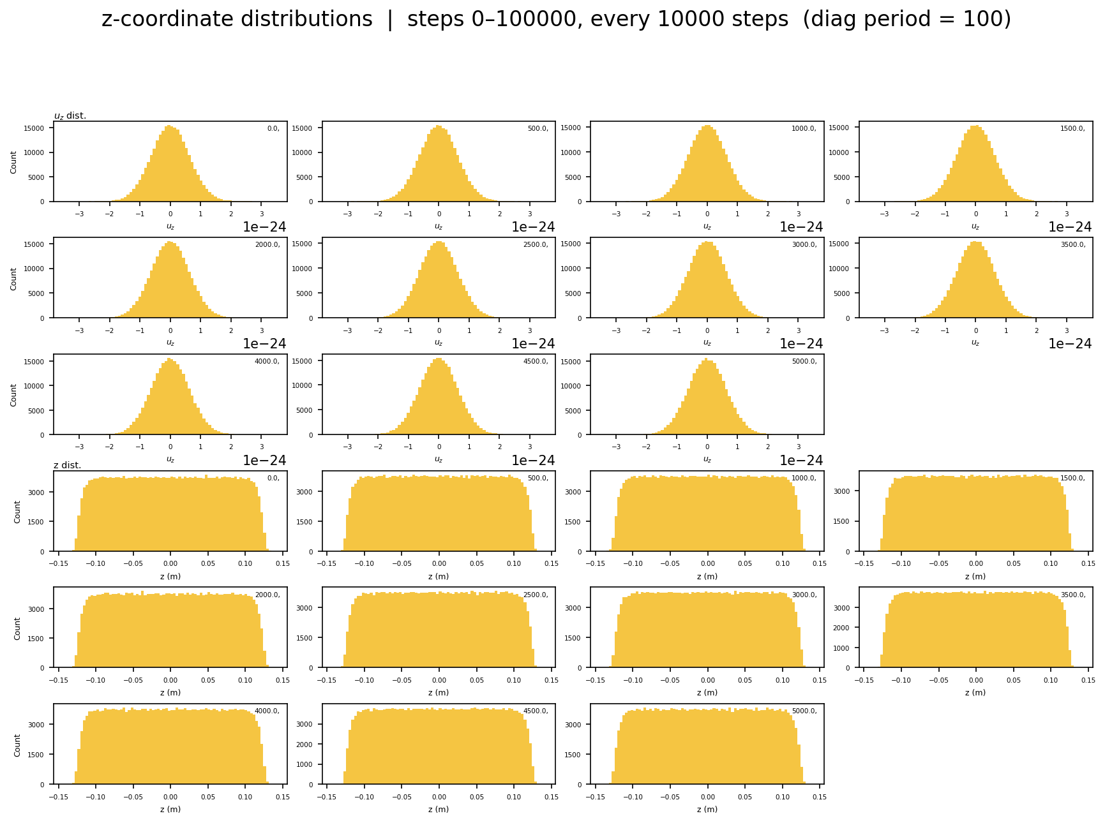
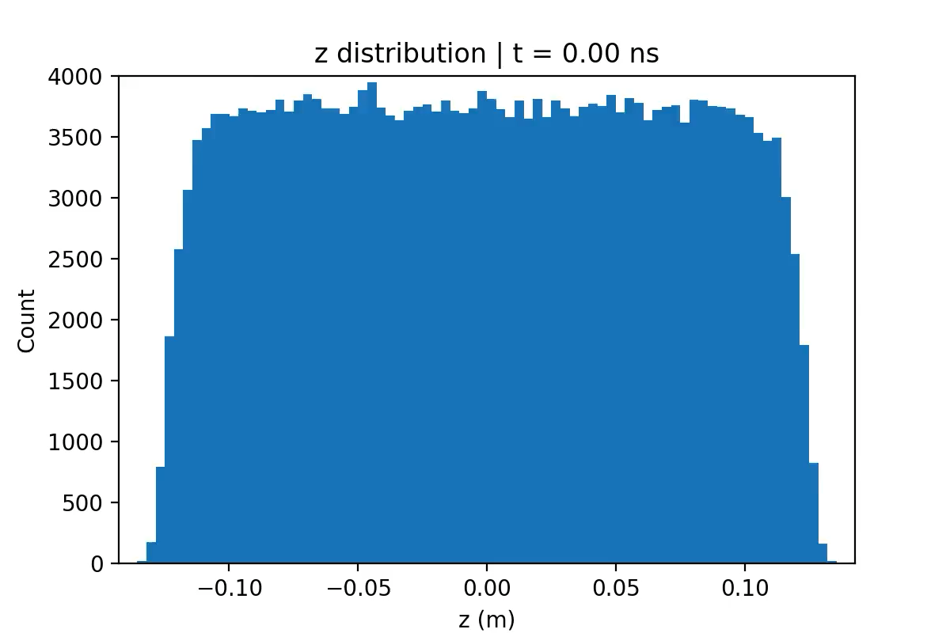
PIC Simulation
Step-by-step
0-5𝜇s
5-10𝜇s

Slide 13
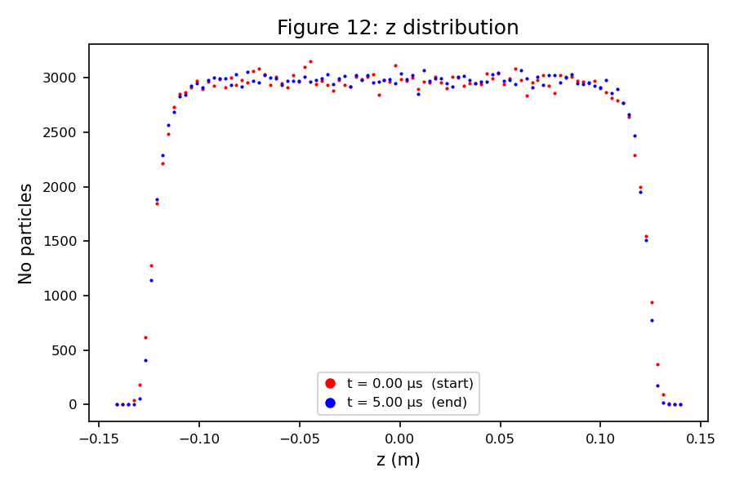
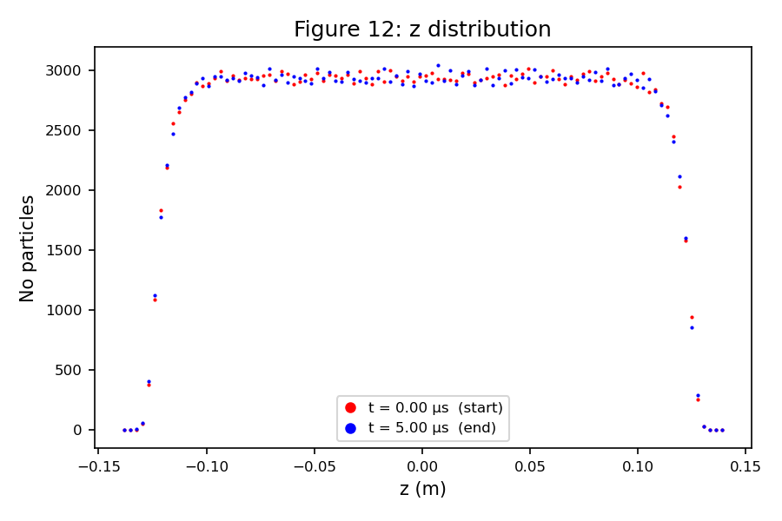
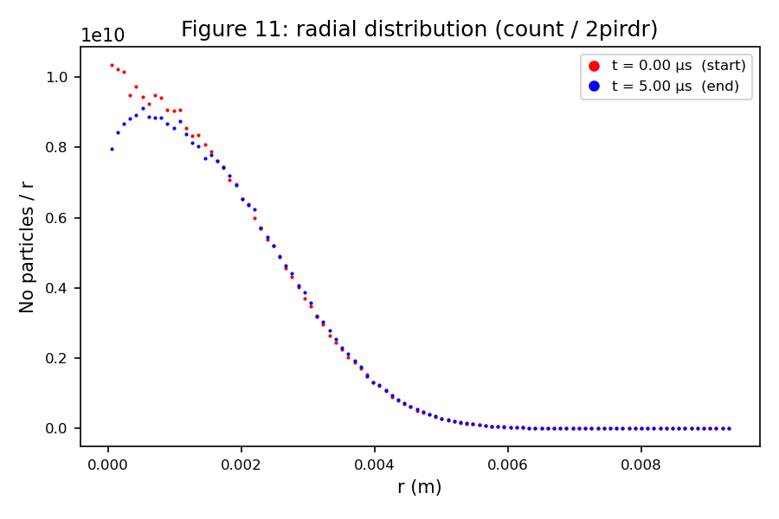
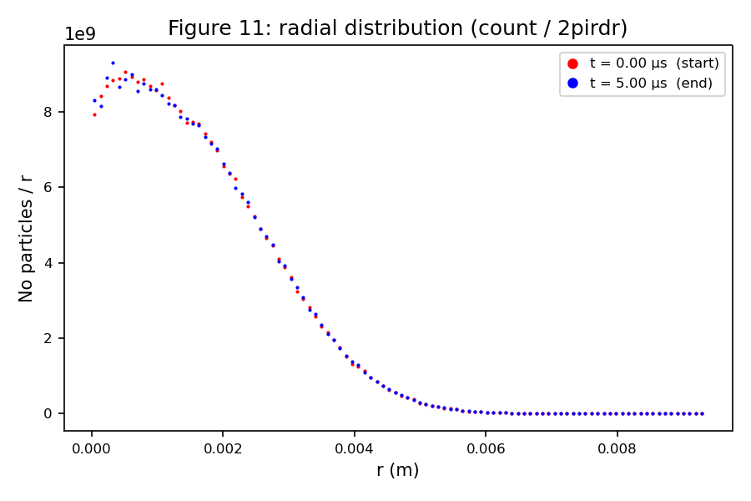
PIC Simulation
Start and End Comparison
0-5𝜇s
5-10𝜇s

Slide 14
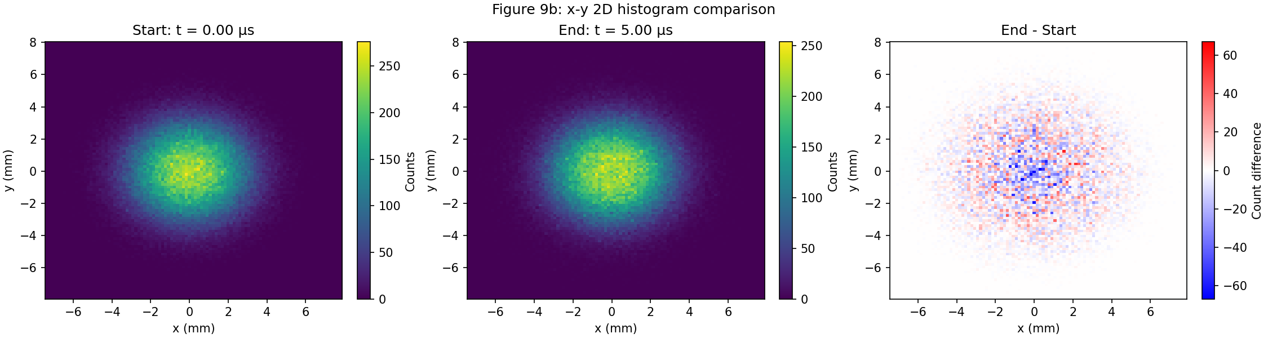
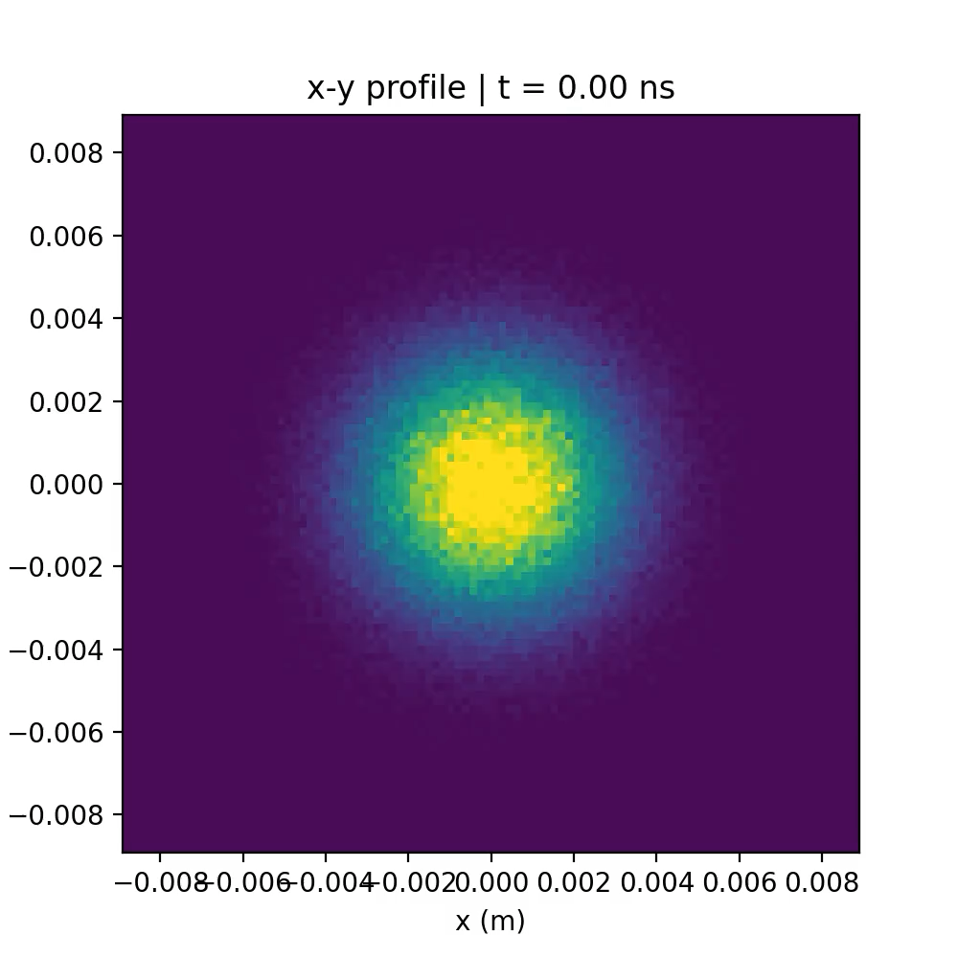
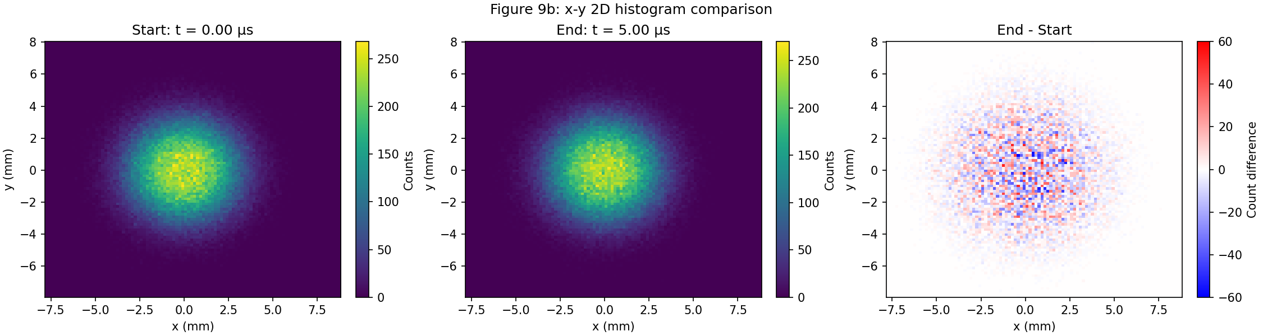
Running for 10us
Profile Checks
0-5𝜇s
5-10𝜇s

Slide 15
Computer Troubles and Next Steps
Computer Systems
Local Laptop – 8GB RAM 4 Cores. Takes 37 hours to run 5us
Imperial HPC (CX3) – 32 CPUs uses 15GB RAM. Takes 5 hours to run 5us.
HPC WarpX has a bug that left the electrode potential undefined. Led to extreme particle loss.
Future Systems
Imperial HPC (CX3) has GPUs – WarpX is highly compatible with GPUs.
Imperial HPC (HX1) has improved GPUs – Further speed increase

Slide 16
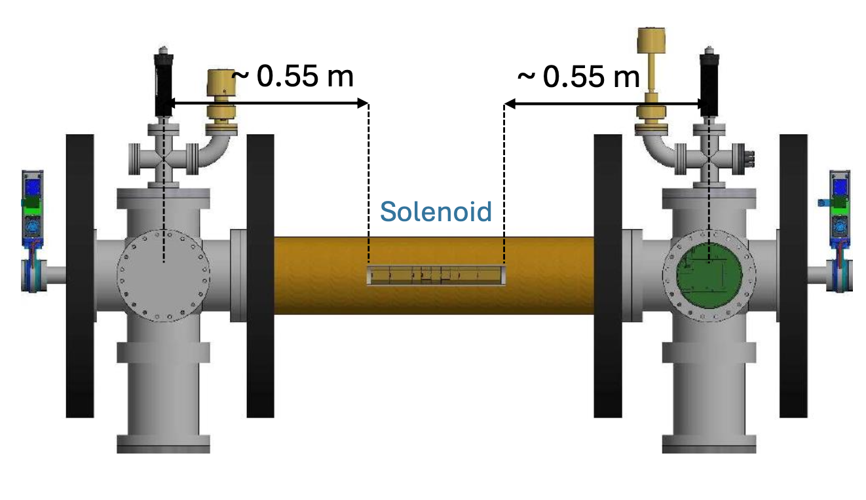
Computer Troubles and Next Steps
Aims for Simulation
Aim to better understand the temperature measurement and how the plasma evolves from the trap to the phosphor screen
Requires more time per simulation (Opening of electrode potential takes 10us)
Multiple initial temperatures means lots of simulations
Do this at 140V and at 400V
400V increases the max density and grid resolution, which increases simulation time
Other improvements that increase simulation time
Reduce weighting – more particles per cell
Higher-order particle shape – Less noise

Slide 17
Thank you
Plasma Trap Simulations
29/04/2026

