Slide 1
LhARA Stage 1 Start-to-End Tracking
Status and Studies Ongoing
30/04/26

Slide 2
Outline
Stage 1 Start-to-End Tracking Overview
Magnetic Source Capture Study
Full Spectrum Source Tracking
Energy Selection Collimator Performance

Slide 3
Stage 1 Start-to-End Tracking
In CDR
Parametrised source beam generation
Gabor lens matching flexible to the conventional beam sizes (3.0 to 1.0 cm)
Space charge tracking through solenoid equivalent Gabor lens lattice for 3.0 cm to 2.0 cm
In-vitro end station dose modelling for ‘gold standard’ dose rate values
Ongoing and Further
Final focus quadrupoles – magnetic minibeam and uniformity schemes
Vertical arc chromaticity correction
Magnetic source capture
Energy selection performance with full spectrum tracking

Slide 4
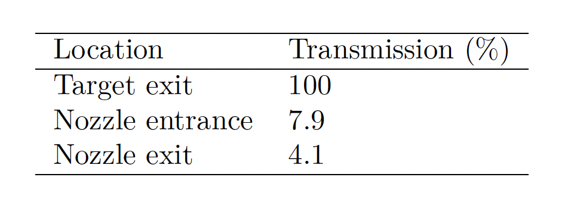
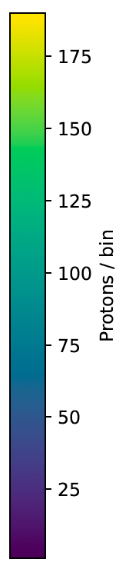
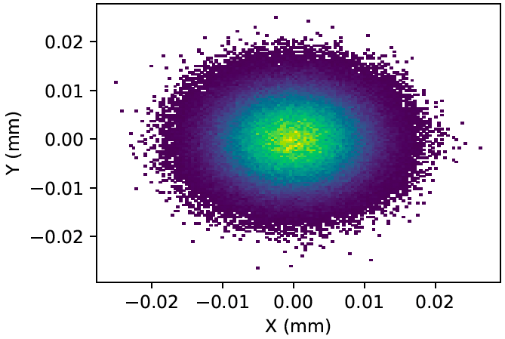
Stage 1 Source Nozzle
Vacuum nozzle couples the source to the S1 beamline
Tapered radial aperture 2.0 mm -> 2.87 mm
~96% immediate beam loss
Downstream effects
Transmission from the source sets the limit on deliverable dose rate
Divergence and energy spread leads to emittance growth through the Gabor lenses
b
a b
c
a
c
Table from LhARA CDR
5 cm
5 cm
Spatial Profile off the Target
Spatial Profile at the Nozzle Exit

Slide 5
Magnetic Source Capture
Proposed Solution: A permanent magnet quadrupole system between the source and the start of the stage 1 beamline.
Objectives:
Minimise angular divergence
Maximise transmission
Minimise asymmetry
Free Parameters:
Quadrupole Lengths (varies integrated field) – bounds [0.02, 0.05] m
Quadrupole apertures (scales inversely with quadrupole gradient) – bounds [0.01, 0.03] m
Drift Lengths (adjustments to quadrupole positions) – bounds [0.0, 0.25] m
Quadrupole’s based on Halbach array PMQs used at SCAPA for PoPLAR
F
D
F
F
D
F
GL1

Slide 6
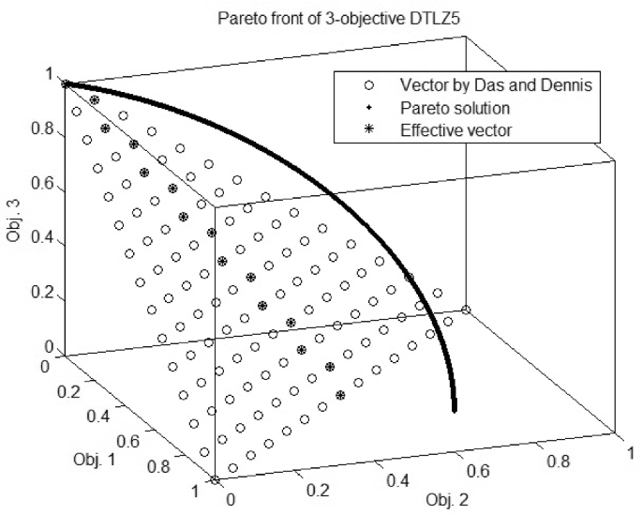
Optimisation Method
Multi-Objective Bayesian Optimisation with a Pareto Front
Reduces the number of expensive BDSIM runs by learning surrogate behaviour
Highly parallelisable - Batch BDSIM runs lead to greater improvements per step
Each objective is modelled separately – handles competing objectives and removes manual tuning of weights
Returns a Pareto front of non-dominated solutions – insights into the intrinsic trade-offs of the beamline and feasibility of present designs
Notes:
Hua Y, Jin Y, Hao K, Cao Y. Generating multiple reference vectors for a class of many-objective optimization problems with degenerate Pareto fronts. Complex & Intelligent Systems. 2020 Jul;6(2):275-85.

Slide 7
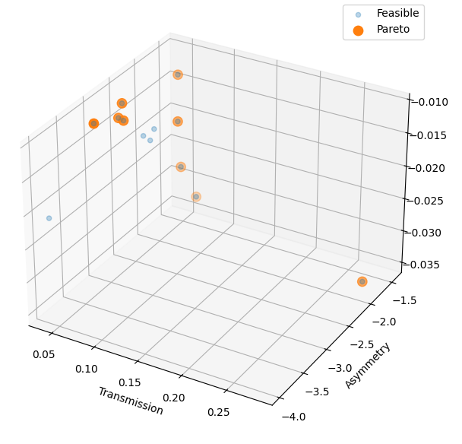
Staged Optimisation
Staged Approach
Optimise the first triplet with soft constraint
T > 4.1% (headroom for second triplet losses)
Objectives: minimise A and D
Select a small set of configurations from the pareto front
Best overall balance: T=7.4%, A=2.0, D=0.17
Lowest Divergence: T=4.5%, A=2.6, D=0.012
Lowest Asymmetry: T=6.3%, A=1.4, D=0.032
Optimise the second triplet parameters with the first triplet parameters fixed and constraints set
T ≥ 4.1%, A ≤ 0.5, D ≤ 0.015
Examine the pareto fronts of the second stage simulations for feasible solutions

Slide 8
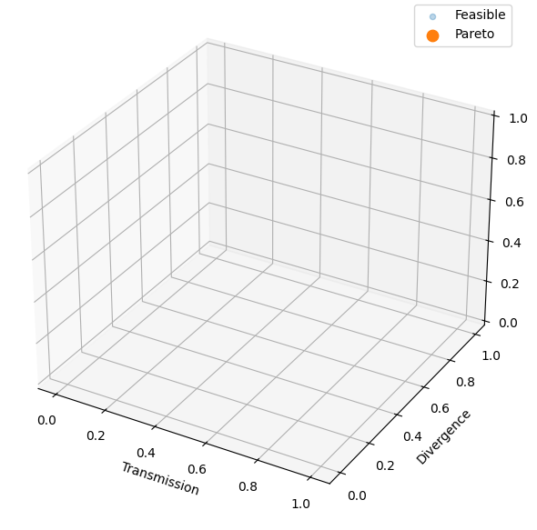
Staged Optimisation
No Solutions Found
Trade-off between the three objectives is too competitive to find a solution satisfying all three
Main reason a given simulation is deemed infeasible is the transmission constraint
The aperture bounds for these runs were left fairly wide and still there were no solutions
Divergence cannot be controlled in time to ‘save’ transmission losses from the additional apertures

Slide 9
Magnetic Source Capture Summary
No Solutions Found
Trade-off between the three objectives is too competitive to find a solution satisfying all three
Divergence cannot be controlled in time to ‘save’ transmission losses from the additional apertures
Currently concluded – space for potential further investigations
Varying the nominal energy band that is being targeted for capture
Revisiting these methods after further space charge modelling – LhARA Model in RF Track
Applying the same optimisation wrapper for other stage 1 studies – RF and Collimation

Slide 10
Full Spectrum Tracking
Initial Objectives for an RF and Collimation Performance Study
Run the parametrised source workflow for the full KE spectrum (1-25 MeV)
Inspect the beam at nozzle exit to assess survival of the nominal energy band
Inspect the phase space at the first collimator as the initial conditions for a collimation study
Optimise collimator for energy cleaning and nominal energy band survival
RF cavity modelling, aiming to increase the population of of the nominal band

Slide 11
Full Spectrum Beam Generation
Source parameters taken from LhARA CDR
GPT tracking through the nozzle apertures
Particle coordinates at the nozzle exit as input to BDSIM tracking of the Stage 1 lattice (Shown on this slide)
3M protons at source generation -
~29,000 protons in 15±2% MeV band
250k protons survive the nozzle
~1000 protons in 15±2% MeV band

Slide 12
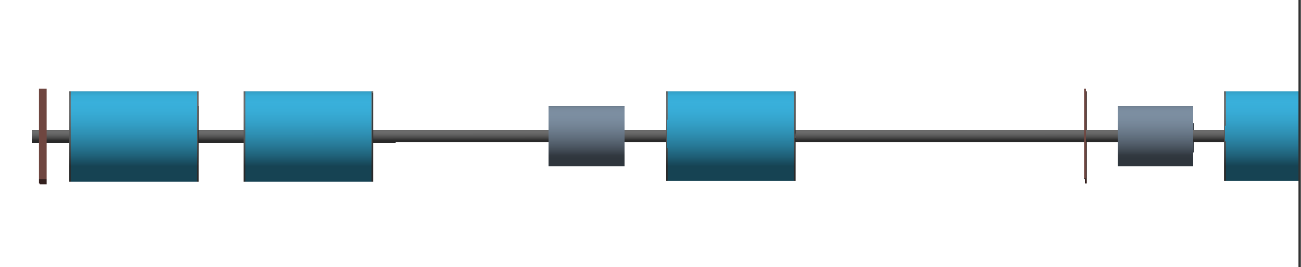
Full Spectrum Phase Space at the Collimator
BDSIM Tracking
Physical aperture of 3.65cm radius
No collimation simulated
Observe three regions of transverse focusing in the full spectrum beam.
Three Gabor lenses – three foci
Cavity 01
LEL Drift 02
LEL Drift 03
Collimator 01
TR Drift 04
LEL Drift 00 + 01
TR Drift 02 + 03
TR Drift 05
Gabor Lens 3
Gabor Lens 1
Gabor Lens 2
TR Drift 01
Particle Count scaled to represent a proton population of 10⁹

Slide 13
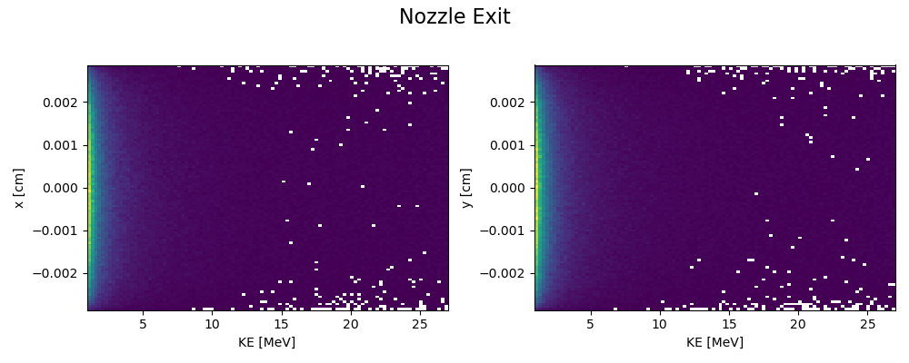
Development of Transverse-KE Phase Spaces
New region of high intensity introduced at each Gabor Lens
Particles of ascending KE being focused to a point and then diverging again
This is all before the energy selection collimator, so it is an unavoidable feature of the broad band energy spectrum
Cavity 01
LEL Drift 02
LEL Drift 03
Collimator 01
TR Drift 04
LEL Drift 00 + 01
TR Drift 02 + 03
TR Drift 05
Gabor Lens 3
Gabor Lens 1
Gabor Lens 2
TR Drift 01

Slide 14
Updated Objectives
Run the parametrised source workflow for the full KE spectrum (1-25 MeV)
Inspect the beam at nozzle exit to assess survival of the nominal energy band
Inspect the phase space at the first collimator as the initial conditions for a collimation study
Optimise collimator for energy cleaning and nominal energy band survival
RF cavity modelling, aiming to increase the population of of the nominal band before collimation
Plot loss maps and identify ‘hot spots’ for energy deposition in Stage 1

Slide 15
Summary
No feasible solution found for a PMQ source capture system
Transmission cost of new apertures too high for divergence control
Space for further investigation – Lower nominal energy band, further space charge modelling
Full spectrum tracking revealed a multiple focusing feature of the broad band beam
Challenges the efficacy of a simple collimator aperture
Potential improvements with a tapered geometry being investigated
Next: RF and Energy Selection study
Parallel optimisation of collimator geometry and RF cavity parameters

