Slide 1
Lecture 2: RF power
Louise Cowie
STFC ASTeC
Slides by Prof. G Burt

Slide 2
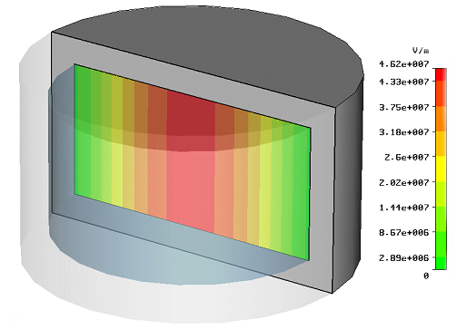
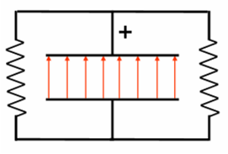
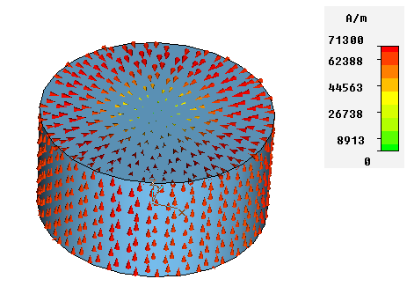
Capacitor
The electric field of the TM₀₁₀ mode is contained between two metal plates
E-Field
–
This is identical to a capacitor.
This means the end plates accumulate charge and a current will flow around the edges
Surface Current

Slide 3
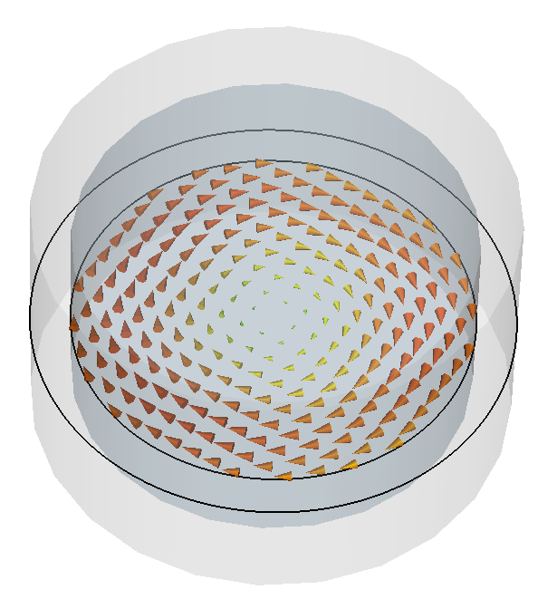
Inductor
B-Field
Surface Current
The surface current travels round the outside of the cavity giving rise to a magnetic field and the cavity has some inductance.
–

Slide 4
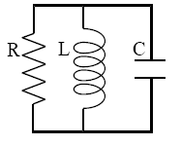
Resistor
Finally, if the cavity has a finite conductivity, the surface current will flow in the skin depth causing ohmic heating and hence power loss.
Surface Current
This can be accounted for by placing a resistor in the circuit.
In this model we assume the voltage across the resistor is the cavity voltage. Hence R takes the value of the cavity shunt impedance (not R_{surface}).

Slide 5
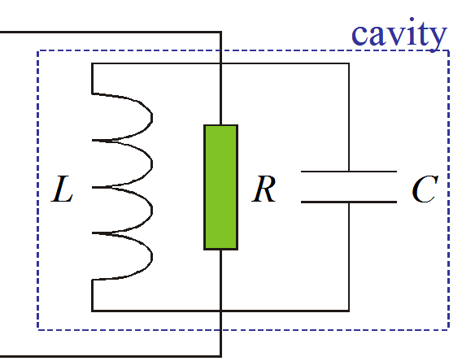
Equivalent circuits
To increase the frequency the inductance and capacitance has to be increased.
The stored energy is just the stored energy in the capacitor.
The voltage given by the equivalent circuit does not contain the transit time factor, T. So remember
V_{c}=V₀ T

Slide 6
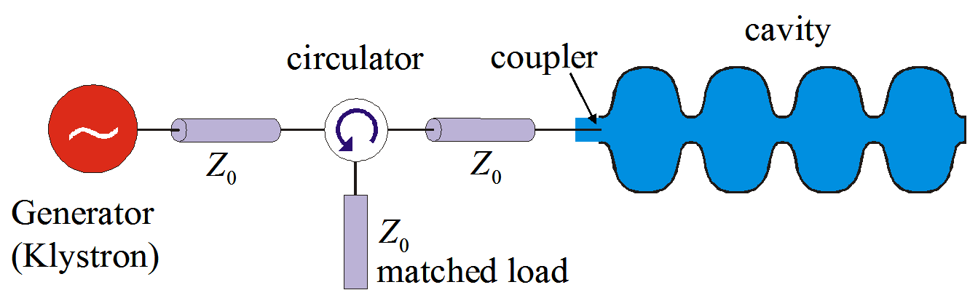
Couplers
We need to connect the RF power source to the cavity which is done via a waveguide/coaxial line called a coupler.
The couplers can also be represented in equivalent circuits. The RF source is represented by a ideal current source in parallel to an impedance and the coupler is represented as an n:1 turn transformer.

Slide 7
External Q factor
Ohmic losses are not the only loss mechanism in cavities. We also have to consider the loss from the couplers (power can flow into and out of the cavity via the coupler) . We define this external Q as,
Where P_{e} is the power lost through the coupler when the RF sources are turned off.
We can then define a loaded Q factor, Q_{L}, which is the ‘real’ Q of the cavity

Slide 8
Scattering Parameters
When making RF measurements, the most common measurement is the S-parameters.
Black Box
Input signal
S_{1,1}
S_{2,1}
input reflection coefficient
forward transmission coefficient
The S matrix is a m-by-m matrix (where m is the number of available measurement ports). The elements are labelled S parameters of form S_{ab} where a is the measurement port and b is the input port.
S₁₁
S₁₂
S =
S₂₁
S₂₂
The meaning of an S parameter is the ratio of the voltage measured at the measurement port to the voltage at the input port (assuming a CW input).
S_{ab} =V_{a} / V_{b}

Slide 9
Resonant Bandwidth
P
1
ω₀
Δ ω=
=
t_{L}
Q_{L}
ω-ω₀
SC cavities have much smaller resonant bandwidth and longer time constants. Over the resonant bandwidth the phase of S₂₁ also changes by 180 degrees.

Slide 10
Cavity responses
A resonant cavity will reflect all power at frequencies outside its bandwidth hence S11=1 and S21=0.
The reflections are minimised (and transmission maximised) at the resonant frequency.
If the coupler is matched to the cavity (they have the same impedance) the reflections will go to zero and 100% of the power will get into the cavity when in steady state (ie the cavity is filled).
S11
The reflected power minima in steady state is given by
where

Slide 11

Cavity Coupling
Cavity Behaviour examples
Steady state
The most important behaviour we must understand is when the cavity is in steady state (ie when the cavity stored energy is constant and U=U₀). We can use the definitions of beta and Q and the steady state power to derive
From this equation we can see that the cavity energy is maximum when β=1.

Slide 12
Cavity Filling
When filling, the impedance of a resonant cavity varies with time and hence so does the match this means the reflections vary as the cavity fills.
note:
No beam!
As we vary the external Q of a cavity the filling behaves differently. Initially all power is reflected from the cavity, as the cavities fill the reflections reduce.
The cavity is only matched (reflections=0) if the external Q of the cavity is equal to the ohmic Q₀ (you may include beam losses in this).
A conceptual explanation for this as the reflected power from the coupler and the emitted power from the cavity destructively interfere.

Slide 13
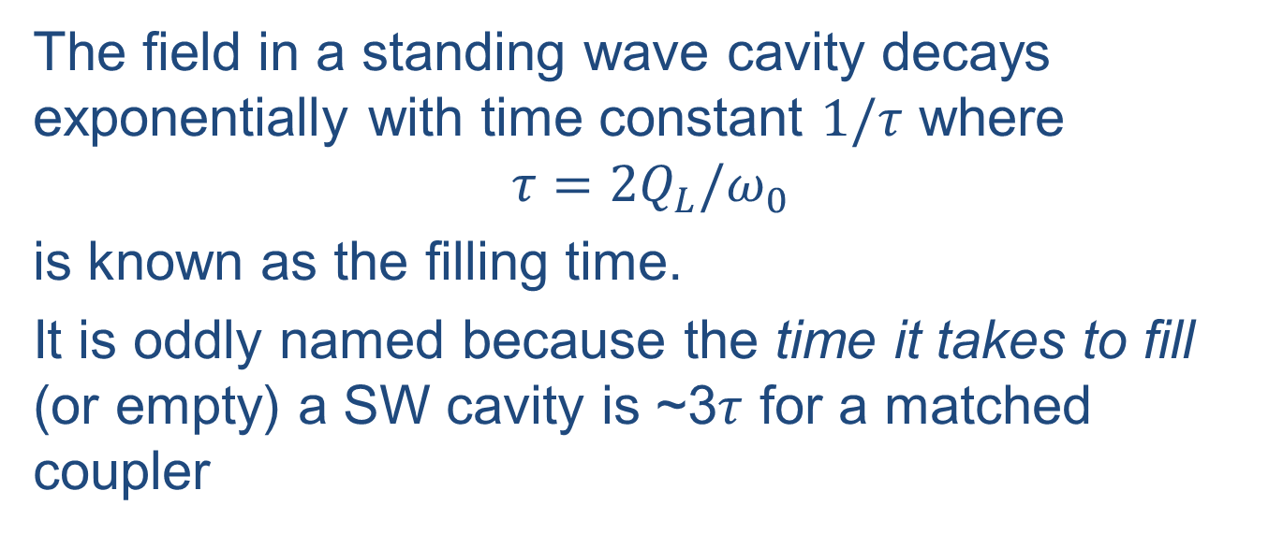
Filling time
The field in a standing wave cavity decays exponentially with time constant $1/τ$ where
$$τ=2Q_{L}/ω_{0}$$
is known as the filling time.
It is oddly named because the time it takes to fill (or empty) a SW cavity is ~3$τ$ for a matched coupler
reflection
cavity empties
RF in cavity
RF reverse
t
t

Slide 14
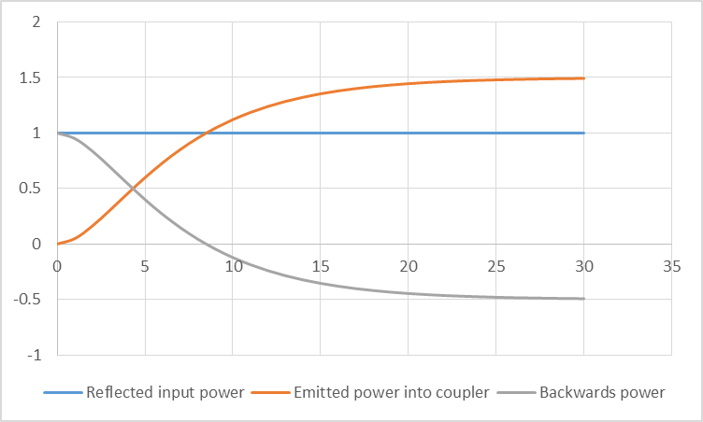
Overcoupled cavity example

Slide 15
Beam Loading
In addition to ohmic losses we must also consider the power extracted from the cavity by the beam.
The beam draws a power P_{b}=V_{c} I_{beam} from the cavity.
I_{beam}=q f, where q is the bunch charge and f is the bunch repetition rate
If the voltage and current is in phase this additional loss can be lumped in with the ohmic heating as an external circuit cannot differentiate between different passive losses.
This means that the cavity requires different powers without beam or with lower/higher beam currents.

Slide 16
Coupling with Beam Loading
The rf source will not see any difference between the power dissipated in the cavity walls and the power extracted by the beam hence we can calculate a new Q factor, Q_{cb}.
this Q_{cb} will replace Q₀ when calculating cavity filling. This means the match will change as well as needing more power.
Normally we aim for β=1 with beam and have reflections when filling.

Slide 17
Typical RF System
feedback
Low Level RF
RF
Amplifier
Transmission System
Cavity
DC Power Supply or Modulator
A typical RF system contains
A LLRF system for amplitude and phase control
An RF amplifier to boost the LLRF signal
Power supply to provide electrical power to the Amplifier
A transmission system to take power from the Amplifier to the cavity
A cavity to transfer the RF power to the beam
Feedback from the cavity to the LLRF system to correct errors.

Slide 18
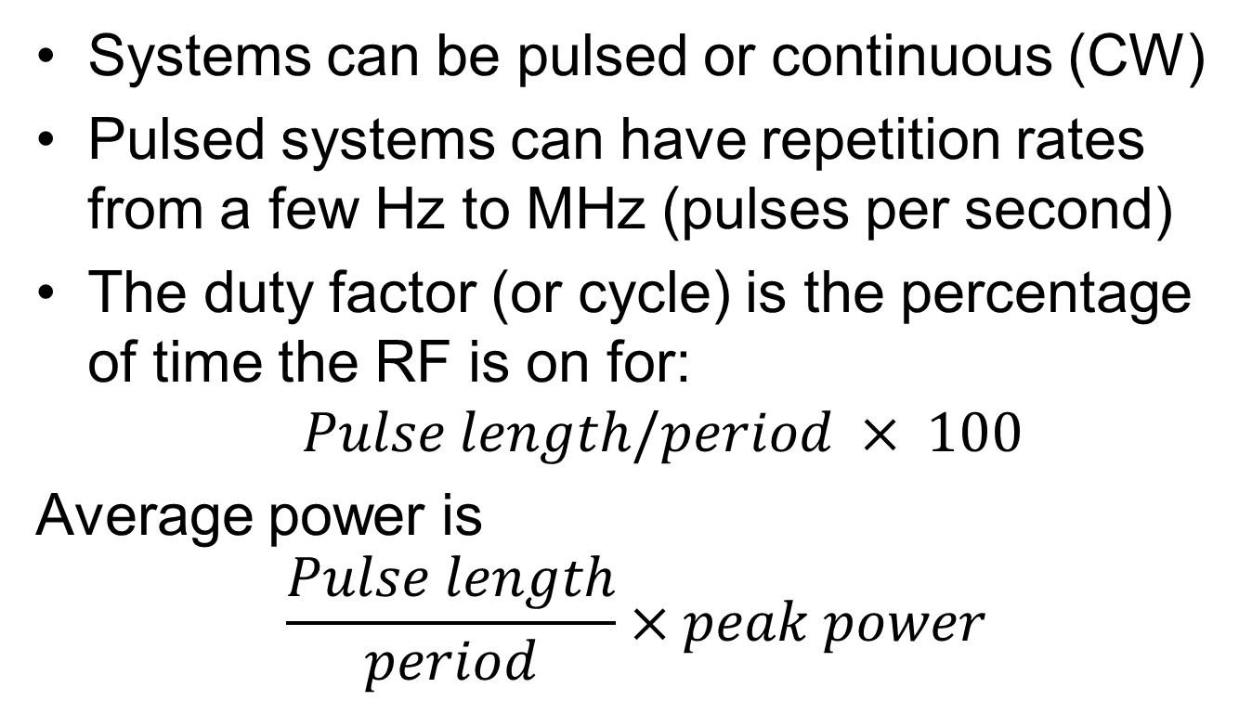
Average power
Systems can be pulsed or continuous (CW)
Pulsed systems can have repetition rates from a few Hz to MHz (pulses per second)
The duty factor (or cycle) is the percentage of time the RF is on for:
$$Pulse length/period × 100$$
Average power is
$$\frac{Pulse length}{period}×peak power$$

Slide 19
Basic Amplifier Equations
Input power has two components, the RF input power which is to be amplified and the DC input power to the beam.
Gain=RF Output Power / RF Input Power = P_{rf} / P_{in}
RF Efficiency= RF Output Power / DC Input Power = P_{rf} / P_{dc}
If the efficiency is low we need large DC power supplies and have a high electricity bill.
If the gain is low we need a high input power and may require a pre-amplifier.

Slide 20
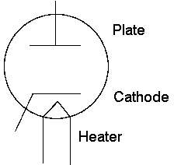
Electron Guns (Diodes)
When a cathode is heated, electrons are given sufficient energy to leave the surface.
When a high enough voltage is applied, electrons will travel across the voltage gap.
A current is then measured on the anode.

Slide 21
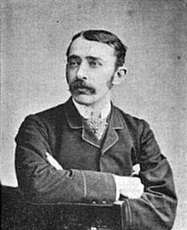
John Ambrose Fleming
The first vacuum diode (electron gun) was invented by John Ambrose Fleming (who was from Lancaster)
This was the first electronic component an was considered to be the start of electronics and his diode was used in radio recievers for 50 years before being replaced by solid-state diodes.

Slide 22
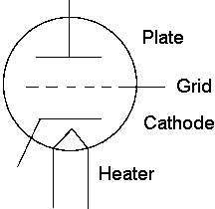
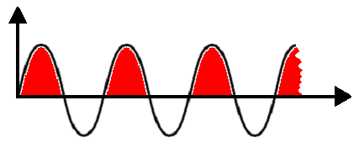
Triode Guns
A grid can be inserted into a diode to control the voltage on the cathode surface.
An RF voltage can be applied to the grid to produce bunches of electrons.
The grid was added by L. de Forest but Fleming said he copied his idea.
Grid voltage
Time
Electron bunches

Slide 23
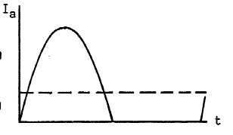
Triode Theory
The Beam induced from the cathode has a transient current. The current is given by I=I_{dc}+I_{ac}
The dc input power is then given by P_{dc}=V_{anode}I_{dc}
The ac input power is given by P_{in}=V_{grid}I_{ac}
The ac output power is given by P_{rf}=V_{anode}I_{ac}
In Class A I_{dc}=I_{ac}
Efficiency= P_{rf} / P_{dc}=50%
Gain =P_{rf}/P_{in}
Class A
Using different ratio of AC
to DC current we can improve the efficiency at the expense of Gain
Class B

Slide 24
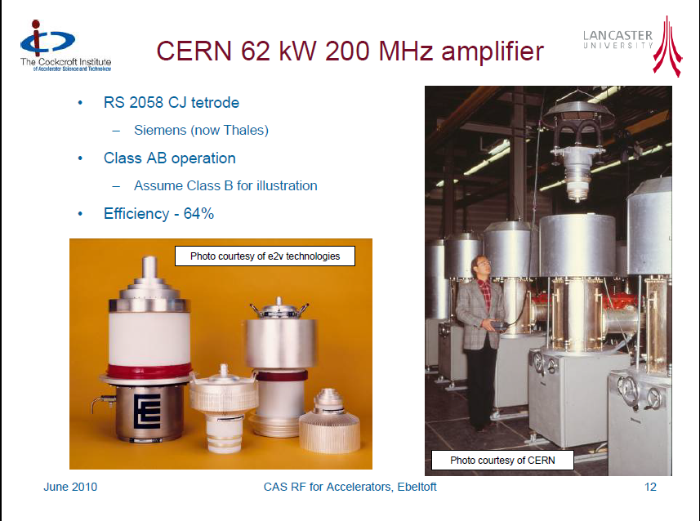
CERN Tetrode Example
Frequency=200 MHz
Power= 62 kW
Gain=14 dB
Efficiency = 64%
Cathode Voltage= 10 kV
A tetrode also has a 2nd grid to screen the control grid from the anode to avoid feedback
Gain is low so needs a SSPA or IOT driver. This lowers the overall efficiency and increases the cost.
A diacrode is a sort of two sided tetrode that doubles the power.

Slide 25
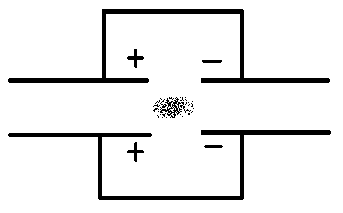
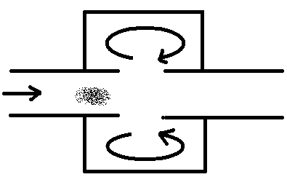
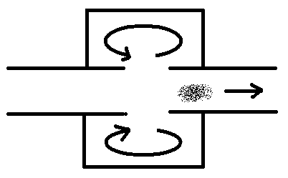
Generation of RF Power
A bunch of electrons approaches a resonant cavity and forces the electrons within the metal to flow away from the bunch.
B
The lower energy electrons then pass through the cavity and force the electrons within the metal to flow back to the opposite side
A
At a disturbance in the beampipe such as a cavity or iris the negative potential difference causes the electrons to slow down and the energy is absorbed into the cavity
C

Slide 26
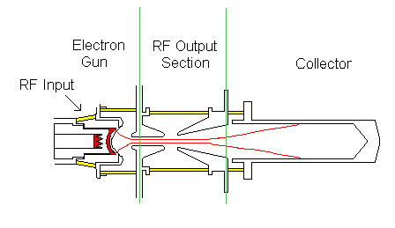
IOT Schematics
Grid voltage
Density Modulation
Time
Electron bunches

Slide 27
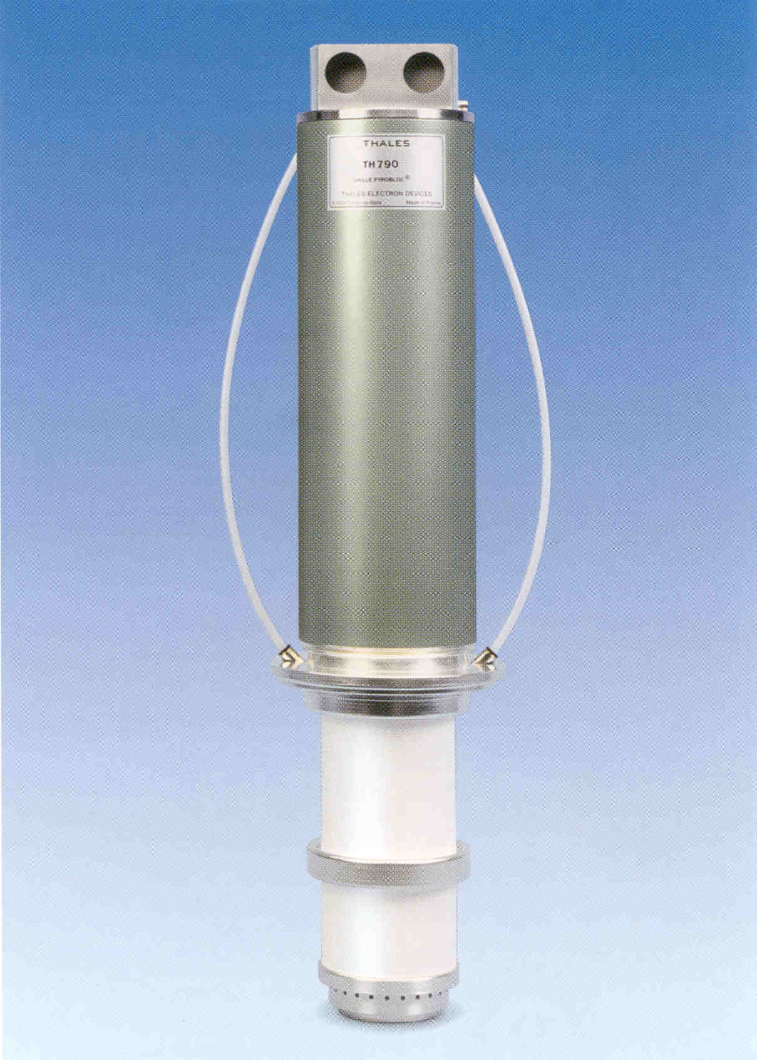
IOT- Thales
80kW
34kV 2.2Amp
160mm dia, 800mm long, 23Kg weight
72.6% efficiency
25dB gain
160W RF drive
35,000 Hrs Lifetime
4 IOT’s Combined in a combining cavity
RF Output Power 300kW

Slide 28
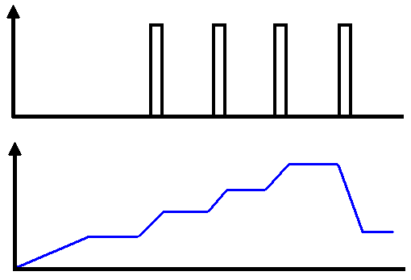
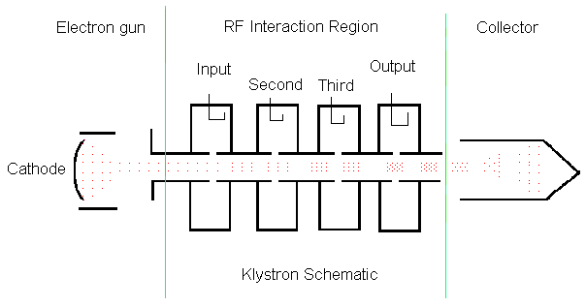
Klystron Schematics
Interaction energy
Electron energy
Electron density
Notes:
Features highlighted in greater detail.

Slide 29
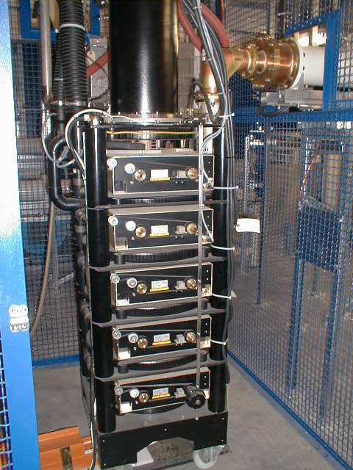
Klystron
RF Output Power 300kW
DC, -51kV, 8.48 Amp
2 Meters tall
60% efficiency (40% operating)
30W RF drive
40dB Gain
35,000 Hrs Lifetime

Slide 30
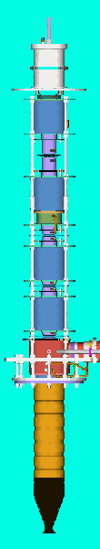
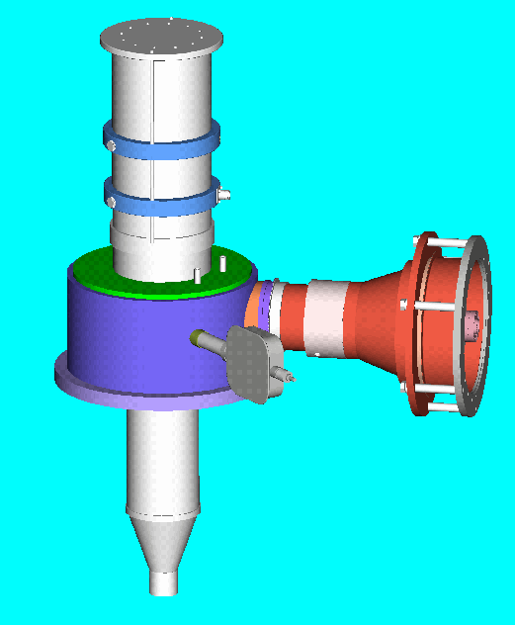
Technical Data
Klystron
IOT
Electron Bunches formed by velocity modulation from the cavities.
Several bunching cavities
  High Gain
  Long Device
  Expensive
Considerable velocity spread
Maximum gap voltage determined by the slower electrons
Rapid reduction in efficiency for reduced output power
High Gain
Density modulation
direct from the cathode
Little velocity spread
Higher gap voltage
  Increased output power
  Higher efficiency
Efficiency is approximately constant for reduced output power
Low Gain
Grid geometry will not permit IOTs to operate at high frequencies like Klystrons.

Slide 31
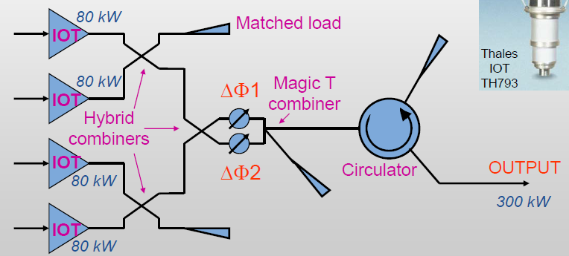
Combining Tubes
IoT’s, tetrodes or SSPA’s are often combined to give a higher power output.
This reduces efficiency as the combiners are lossy (perhaps 5-10% less).
It is more reliable as if one amplifier breaks you only loose some of the power.
Power output limited by heating, normally under 500 kW-1 MW.

Slide 32
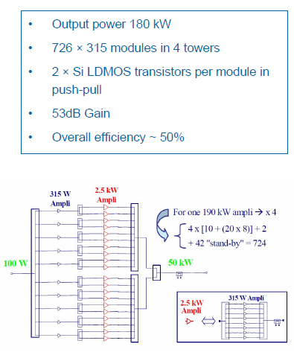
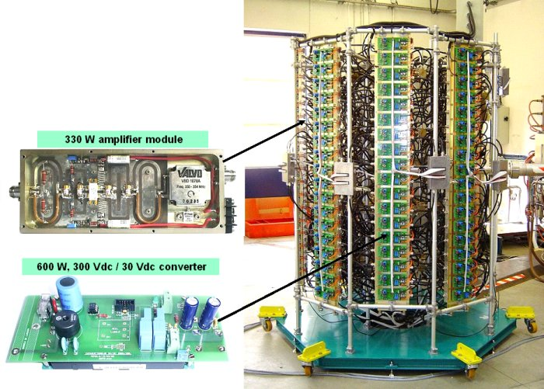
Solid State Power Amplifier (SSPA)
We can also make a high power amplifier by combining hundreds of low power solid state amplifiers

Slide 33
SSPA vs Tubes
Advantages
No warm-up time
High reliability
Low voltage (<100 V)
Air cooling
High stability
Graceful degradation
Disadvantages
Complexity
Losses in combiners
Failed transistors must be isolated
Electrically fragile
High I2R losses
Low efficiency
High maintenance

Slide 34
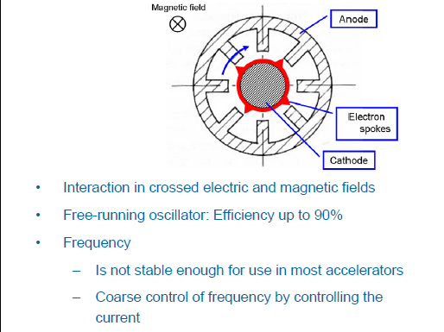
Magnetrons
For small industrial accelerators the most common source is the magnetron.
This works by having an electron cloud rotate around a coaxial cathode.
They are cheap and fairly efficient and can reach powers of 5 MW pulsed or 30 kW CW at 3 GHz (100 kW at lower frequencies).
Phase stability is not good enough for large accelerators.
It may be possible to phase-lock magnetrons to allow them to be used for larger accelerator.

Slide 35
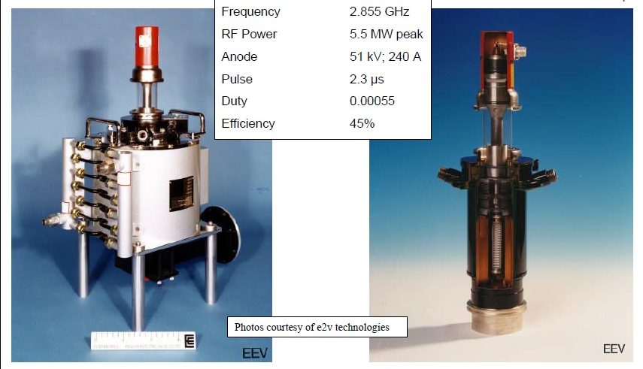
Magnetrons for medical linacs

Slide 36
Pulse Compression
For pulse linacs it is often cheaper and easier to produce longer RF pulses and compress them to produce higher peak powers.
Typically pulse are compressed in time by a factor of 10 and in power by 4.
Power
Compressed Pulse
This is performed by storing the RF in a cavity and switching the external Q of the cavity (or otherwise increasing the output power).
Can reach 200 MW for 200 ns.
Klystron
Pulse
time

Slide 37
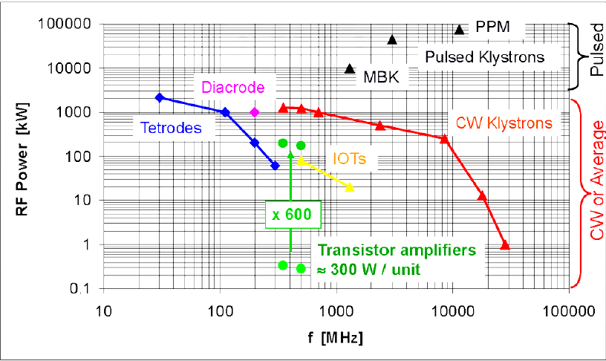
When to use what types?

Slide 38
When to use what types
In the range of 400 MHz to 1.3 GHz you have a choice. There is no right answer different accelerators make different choices.
IoTs are higher efficiency but limited to <100 kW and normally need combining.
SSPA’s are very low down-time but expensive, inefficient and need a parts replaced a lot. Limited power.
Klystrons are high power and difficult to swap so if one breaks you have trouble. Can be noisy.
Tetrodes are very low gain so need more amplifiers to drive them. Not for high frequency.
Magnetrons are unstable so are not used for large machines with multiple cavities, medical/industrial only.

Slide 39
Device frequency
You can only buy many tubes for accelerators at discrete frequencies hence most accelerators have to use common frequencies. The frequencies are:
200 MHz, 267 MHz, 352 MHz, 400 MHz, 508 MHz, 650 MHz, 704 MHz
1.3 GHz, 2.87 GHz, 3 GHz, 3.7 GHz, 3.9 GHz, 5.6 GHz, 9.3 GHz, 11.424 GHz, 11.994 GHz
The frequencies tend to correspond to integer wavelengths in mm and inches and try to avoid frequencies used in broadcast and comms.

Slide 40
References
Wangler “RF Linear Accelerators”
Carter “RF power generation” CAS 2010
https://arxiv.org/abs/1112.3209

