Slide 1

Cockcroft Institute Lectures – Register Attendance
QR code will take you to a Google form.
Record attendance for each day of lectures.

Slide 2
Lecture 1 Introduction to RF for Accelerators
Louise Cowie
STFC ASTeC
Slides adapted from Prof. G. Burt

Slide 3
Electrostatic Acceleration
+
-
-
-
-
-
-
-
+
+
+
+
+
+

Slide 4
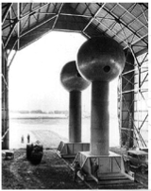
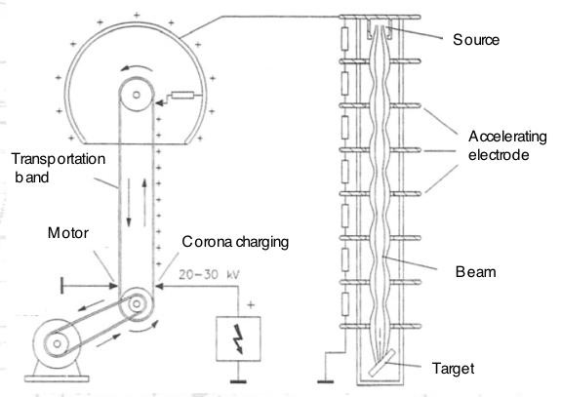
Van-de Graaff - 1930s
A standard electrostatic accelerator is a Van de Graaff
These devices are limited to about 30 MV by the voltage hold off across ceramic insulators used to generate the high voltages (dielectric breakdown).

Slide 5
RF Acceleration
By switching the charge on the plates in phase with the particle motion we can cause the particles to always see an acceleration
- + - +
- + - +
You only need to hold off the voltage between two plates not the full accelerating voltage of the accelerator.

Slide 6
Early Linear Accelerators (Drift Tube)
Proposed by Ising (1925)
First built by Wideröe (1928)
Alvarez version (1955)
Replace static fields by time-varying fields by only exposing the bunch to the wave at certain selected points. Long drift tubes shield the electric field for at least half the RF cycle. The drift tubes increase length with distance.

Slide 7
Boundary conditions
The electric field vector E and the magnetic field vector B are subject to boundary conditions on metallic surfaces.
No component of the E vector may be parallel to a metallic surface. The E field vector is perpendicular to the surface.
No component of the B vector may be perpendicular to a metallic surface. The B field vector is parallel to the surface.

Slide 8
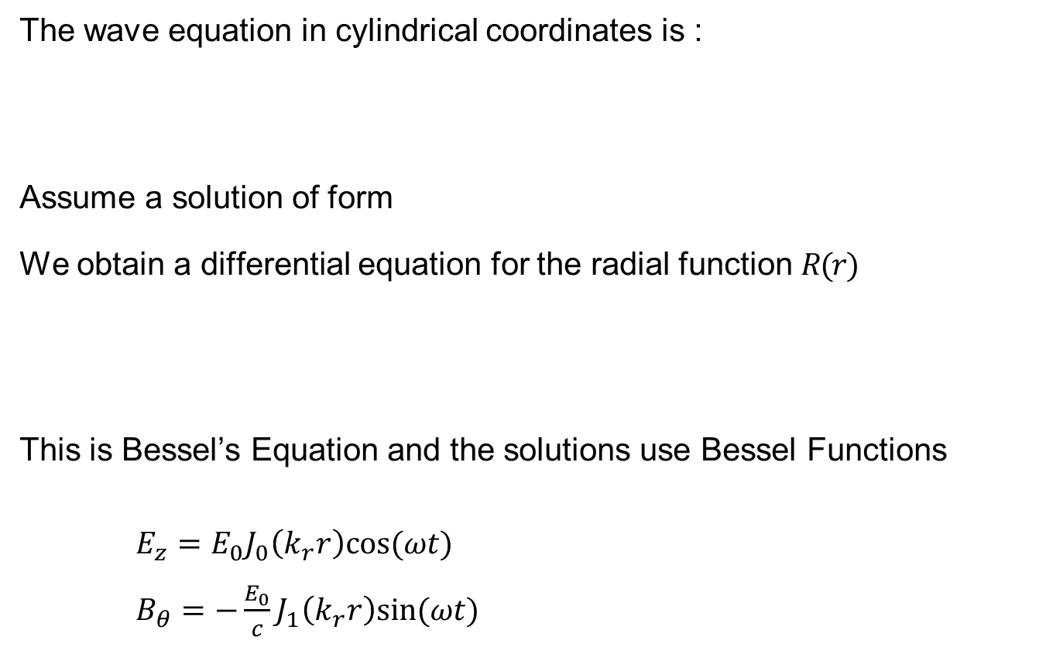
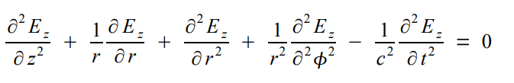

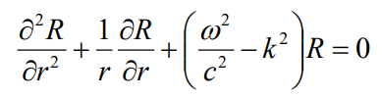
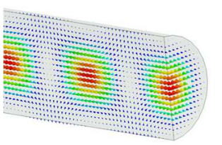
Cylindrical Waveguide
Notes:
Azimuthally symmetric trial solution
Nonzero field components
Boundary condition of Ez -> 0 at r=R

Slide 9
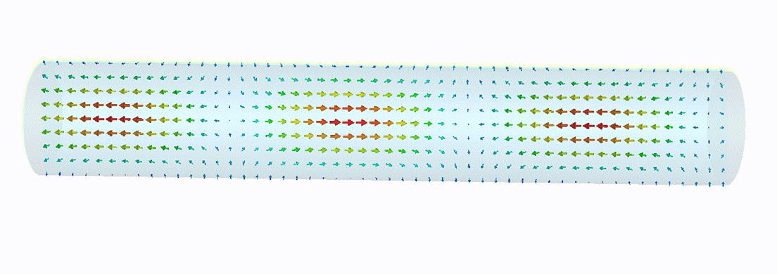
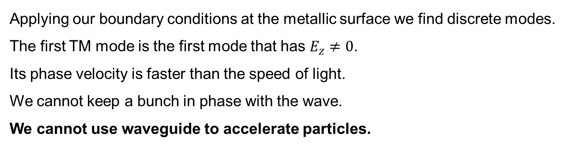

Cylindrical waveguide (2)
Applying our boundary conditions at the metallic surface we find discrete modes.
The first TM mode is the first mode that has $E_{z}≠0$.
Its phase velocity is faster than the speed of light.
We cannot keep a bunch in phase with the wave.
We cannot use waveguide to accelerate particles.
$$v_{p}=\frac{ω}{k}>c$$
More generally there are two sets of solutions to the wave equation:
TM modes have no magnetic field in the direction of propagation (z) they are Transverse Magnetic and have electric field component parallel to z
TE modes have no electric field in the direction of propagation they are Transverse Electric and have magnetic field component parallel to z

Slide 10
Bessel Function
J_{m}(k_{T}r)
m=0
The solutions to our Bessel Equation use the Bessel Functions J
E_{z} (TM) and H_{z} (TE) vary radially as Bessel functions
All functions have zero at the centre except the 0th order Bessel functions.
m=1
m=2
m=3
k_{T}r
First four Bessel functions.
One of the transverse fields varies with the differential of the Bessel function J’
All J’ are zero in the centre except the 1st order Bessel functions

Slide 11
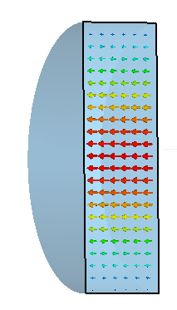
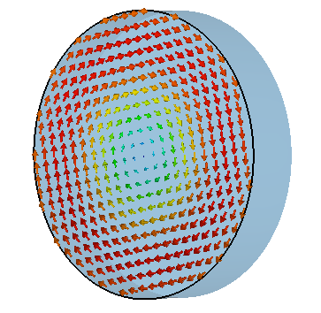
Pillbox Cavities
If we place metal walls at each end of the waveguide we create a cavity.
The waves are reflected at both walls creating a standing wave.
Now wavenumber k is limited to certain discrete values by the length, which limits the frequencies.
The boundary conditions are only met at discrete frequencies only when there is an integer number of half wavelengths in all directions.
These are the cavity eigenfrequencies

Slide 12
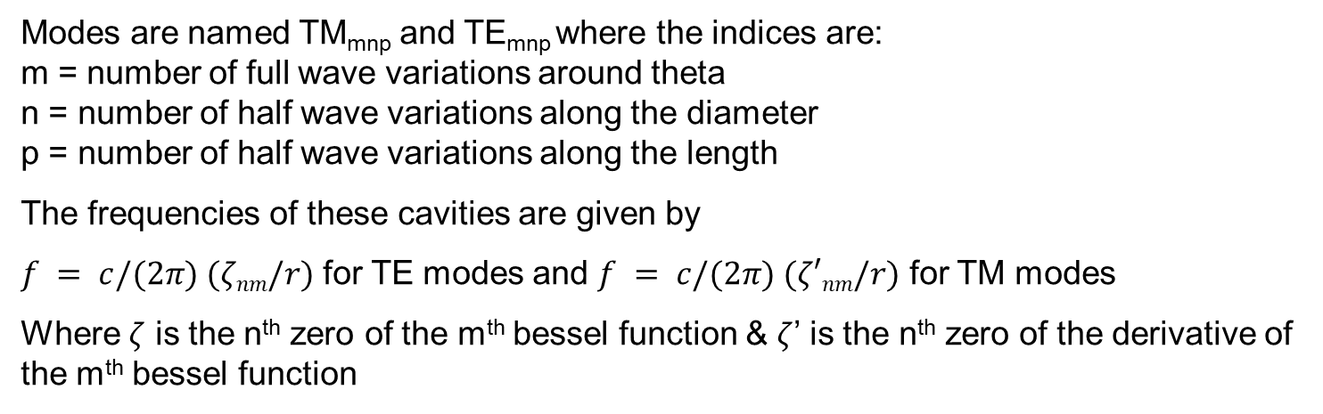
Cavity Modes
r
θ
TE₁₁
TE₂₁
TE₀₁
TM₀₁
TM
TE

Slide 13
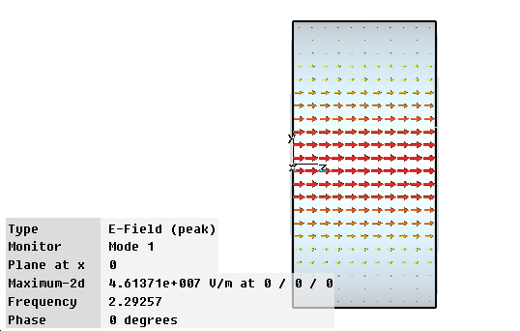
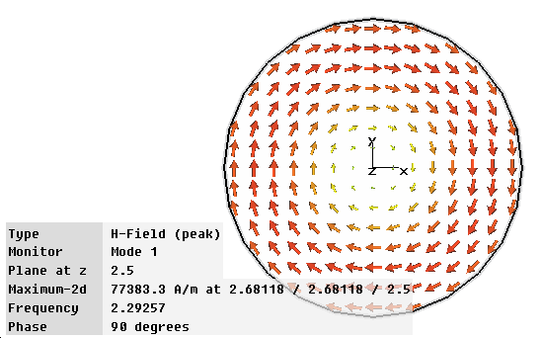

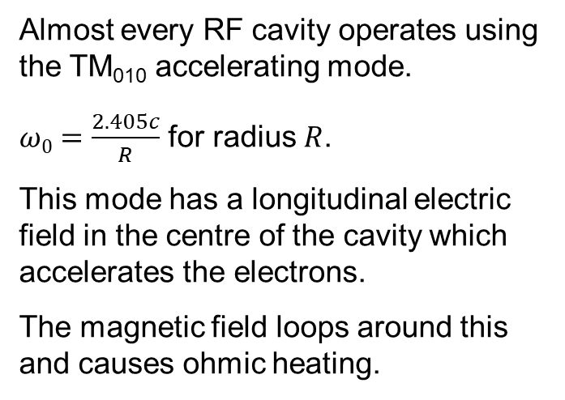
TM₀₁₀ Accelerating mode
Almost every RF cavity operates using the TM₀₁₀ accelerating mode.
$ω0=\frac{2.405c}{R}$ for radius $R$.
This mode has a longitudinal electric field in the centre of the cavity which accelerates the electrons.
The magnetic field loops around this and causes ohmic heating.
$$Z0=377 Ω$$
Magnetic Fields
Electric Fields

Slide 14
Accelerating Voltage
Ez, at t=0
Normally voltage is the potential difference between two points but an electron can never “see” this voltage as it has a finite velocity (ie the field varies in the time it takes the electron to cross the cavity)
Ez, at t=z/v
Position, z
The voltage now depends on what phase the electron enters the cavity at.
If we calculate the voltage at two phases 90 degrees apart we get real and imaginary components
real
Position, z
imaginary

Slide 15
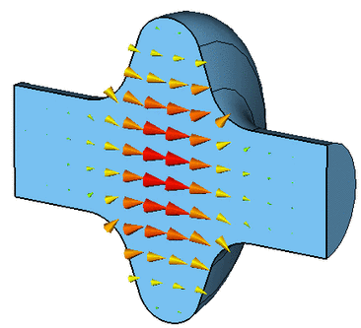
Accelerating voltage
An electron travelling close to the speed of light traverses through a cavity. During its transit it sees a time varying electric field. If we use the voltage as complex, the maximum possible energy gain is given by the magnitude,
To receive the maximum kick with multiple cells the particle should traverse the cavity in a half RF period
Real cavities must have an aperture for
the beam to travel through, which affects E_{z}
(now has z dependence)

Slide 16


Transit time factor
Define a value E₀ which is the average of E
Where T is the transit time factor given as the ratio of the instantaneous voltage to the voltage seen by the beam by
For a pure TM₀₁₀ mode with gap length g where $β=v_{particle}/c$
For a given Voltage (=E₀L) it is clear that we get maximum energy gain for a small gap relative to the wavelength.
Ez, at t=z/v
g
real
z
imaginary

Slide 17
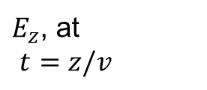

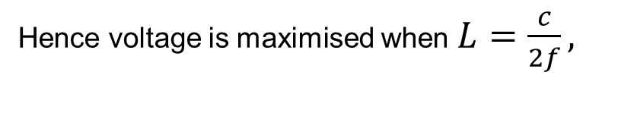
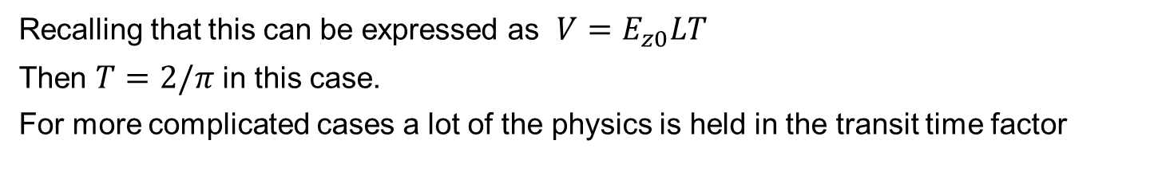

For TM010 pillbox mode
$$V_{b}$$

Slide 18
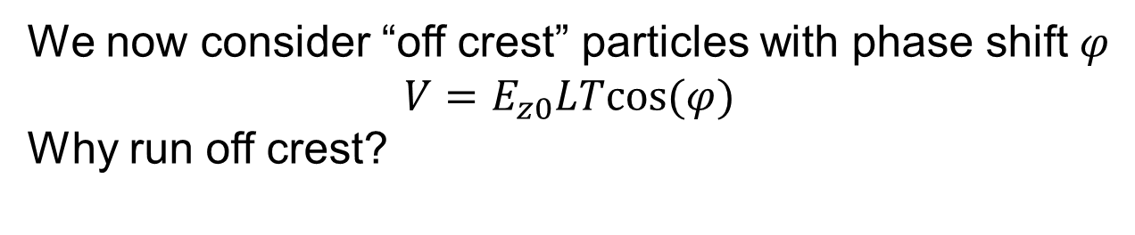
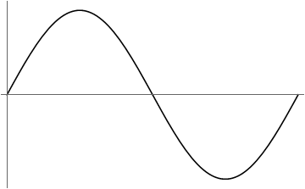
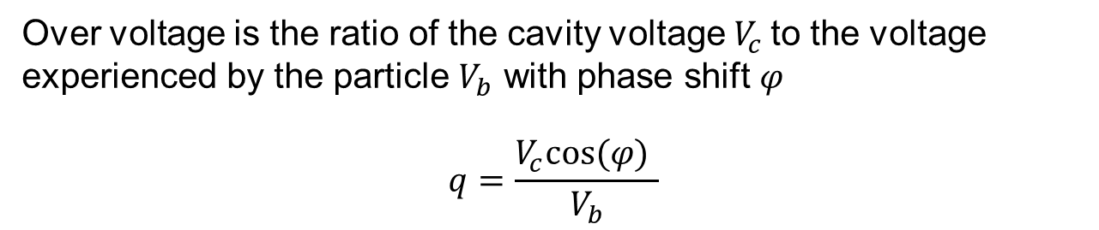
Off crest particles
q
Early particle (too fast) sees less field
Late particle (too slow) sees more field
→ Longitudinal focusing of the beam
(doesn’t work for fully relativistic particles)
time

Slide 19
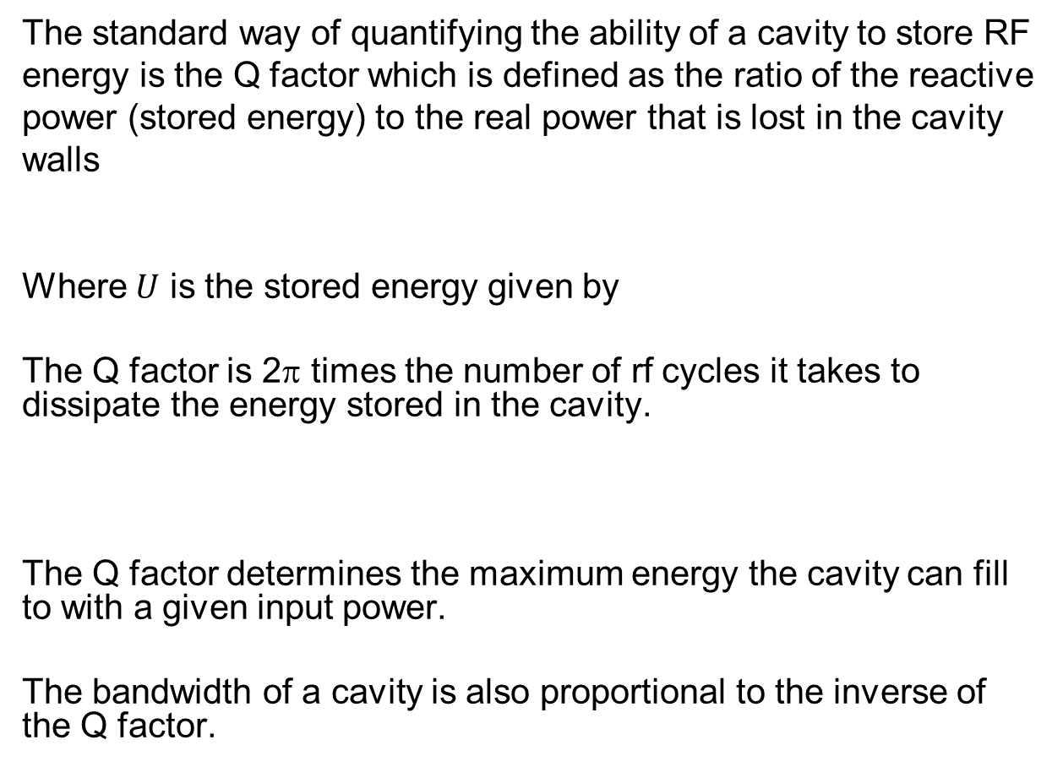
Cavity Quality Factor

Slide 20
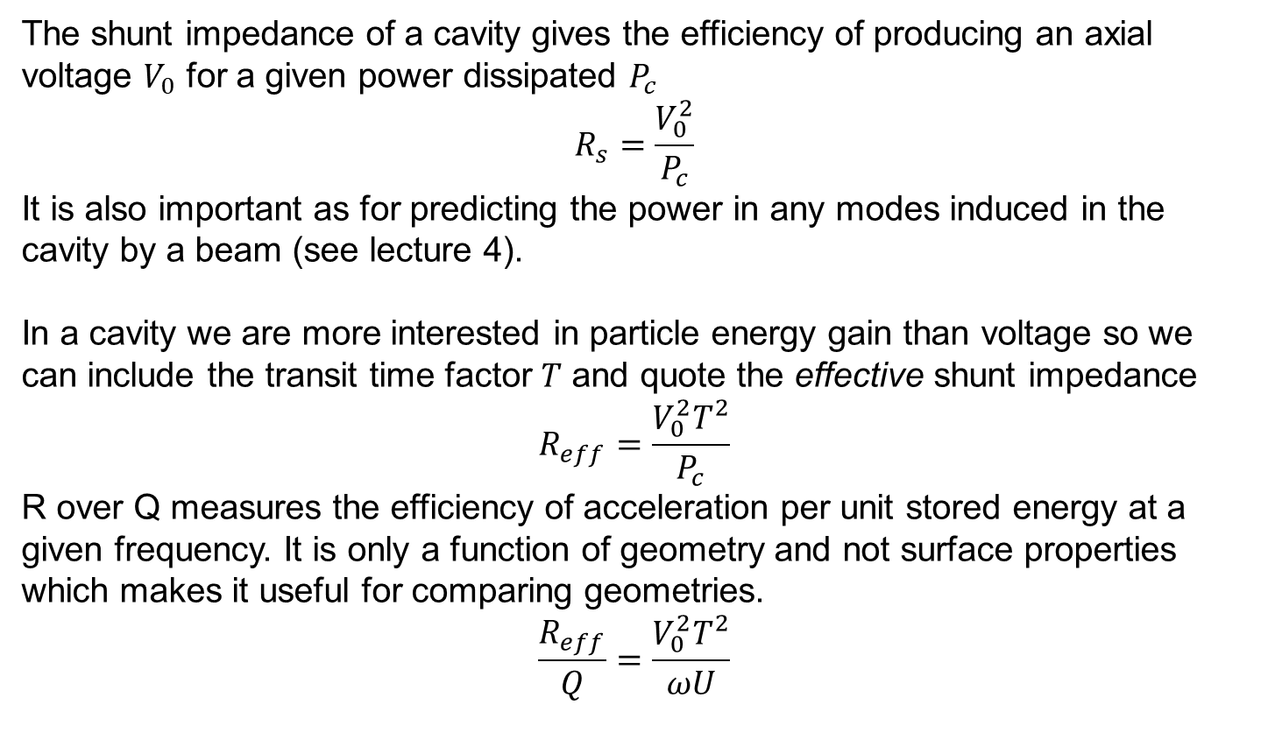
Other figures of merit
The shunt impedance of a cavity gives the efficiency of producing an axial voltage $V_{0}$ for a given power dissipated $P_{c}$
$$R_{s}=\frac{V_{0}^{2}}{P_{c}}$$
It is also important as for predicting the power in any modes induced in the cavity by a beam (see lecture 4).
In a cavity we are more interested in particle energy gain than voltage so we can include the transit time factor $T$ and quote the effective shunt impedance
$$R_{eff}=\frac{V_{0}^{2}T^{2}}{P_{c}}$$
R over Q measures the efficiency of acceleration per unit stored energy at a given frequency. It is only a function of geometry and not surface properties which makes it useful for comparing geometries.
$$\frac{R_{eff}}{Q}=\frac{V_{0}^{2}T^{2}}{ωU}$$

Slide 21


Shunt impedance
Disambiguation
Cavity Definition
Circuit Definition
$R_{s}=\frac{V_{0}^{2}}{P_{c}}$
$R_{eff}=\frac{V_{0}^{2}T^{2}}{P_{c}}$
${Z_{s}=\frac{R_{s}}{L}\text{, }Z}_{eff}=\frac{R_{eff}}{L}$
$\frac{R_{eff}}{Q}=\frac{V_{0}^{2}T^{2}}{ωU}$
$\frac{Z_{eff}}{Q}=\frac{V_{0}^{2}T^{2}}{LωU}$
${\hat{R}}_{s}=\frac{1}{2}\frac{V_{0}^{2}}{P_{c}}$
${\hat{R}}_{eff}=\frac{1}{2}\frac{V_{0}^{2}T^{2}}{P_{c}}$
${{\hat{Z}}_{s}=\frac{{\hat{R}}_{s}}{L}\text{,} \hat{Z}}_{eff}=\frac{{\hat{R}}_{eff}}{L}$
$\frac{{\hat{R}}_{eff}}{Q}=\frac{1}{2}\frac{V_{0}^{2}T^{2}}{ωU}$
$\frac{{\hat{Z}}_{eff}}{Q}=\frac{1}{2}\frac{V_{0}^{2}T^{2}}{LωU}$
Shunt impedance relates axial voltage to power loss
Effective shunt impedance includes transit time factor
Effective shunt impedance per unit length is length independent
R over Q measures the efficiency of acceleration per unit stored energy at a given frequency. Always uses effective shunt impedance.
Sometimes it may be useful to quote the R over Q per unit length

Slide 22
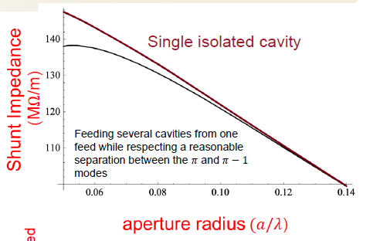
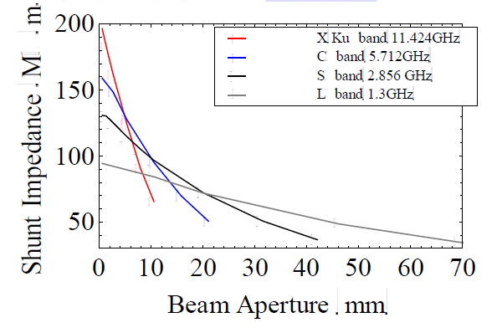
Cavity geometry
Figures borrowed from Sami Tantawi
The shunt impedance is strongly dependant on aperture
Similarly larger apertures lead to higher peak fields on the surface.
Using thicker walls has a similar effect.
Higher frequencies need smaller apertures as well

Slide 23
Multicell
It takes x4 power to double the voltage in one cavity but only x2 to use two cavities/cells to achieve the same voltage (R_{s} ~number of cells).
To make our accelerator more compact and cheaper we can add more cells. We have lots of cavities coupled together so that we only need one coupler. For N cells the shunt impedance is given by
This however adds complexity in tuning, wakefields and the gradient of all cells is limited by the worst cell.

Slide 24
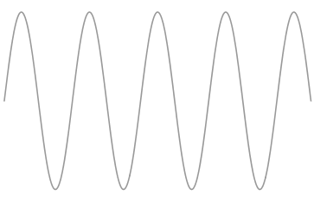
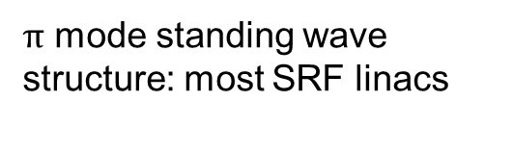
Standing or travelling wave
Travelling wave cavities are essentially waveguide with discs to slow down the phase velocity so it can match the beam velocity. They have an output coupler and they fill in space.
Standing wave cavities have no output coupler: the power reflects back down the structure creating a standing wave. They fill in time.
Travelling wave structure: most NCRF linacs

Slide 25
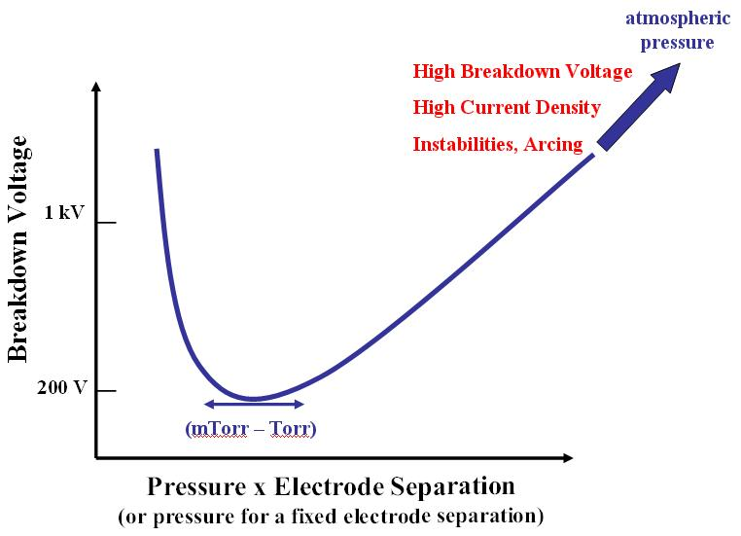
Gas Breakdown
If we apply a high voltage across a gap we can ionise the molecules in the intervening gas.
At high pressure the mean free path is too low to gain enough momentum
At low pressure there are not enough molecules to ionise.
Does this mean we don’t get breakdown in vacuum?

Slide 26
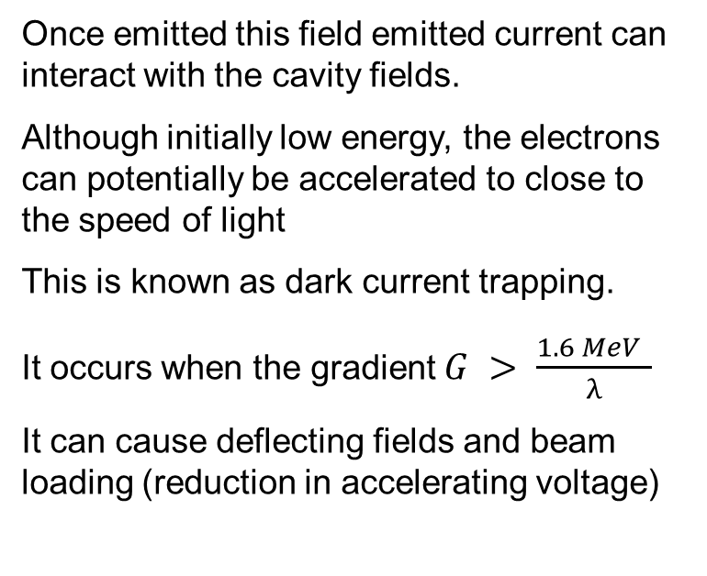
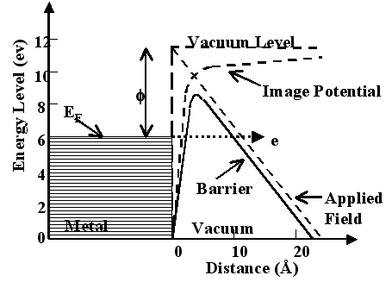
Field Emission
High electric fields can lead to electrons quantum tunnelling out of the structure creating a field emitted current.

Slide 27
Field Enhancement
The surface of an accelerating structure will have a number of imperfections at the surface caused by grain boundaries, scratches, bumps etc.
As the surface is an equipotential the electric fields at these small imperfections can be greatly enhanced.
In some cases the field can be increase by a factor of several hundred.
E_{local}=β E₀
2b
h

Slide 28
Vacuum Breakdown
Breakdown occurs when a plasma discharge is generated in the cavity.
This is almost always associated with some of the cavity walls being heated until it vaporises and the gas is then ionised by field emission. The exact mechanisms are still not well understood.
When this occurs all the incoming RF is reflected back up the coupler.
This is the major limitation to gradient in most pulsed RF cavities and can permanently damage the structure.

Slide 29

Kilpatrick Limits
A rough empirical formula for the peak surface electric field is
It is not clear why the field strength depends on frequency.
It is also noted that breakdown is mitigated slightly by going to lower group velocity structures.
The maximum field strength also varies with pulse length as t^{-0.25} (only true for a limited number of pulse lengths)
As a SCRF cavity would quench long before breakdown, we only see breakdown in normal conducting structures.

Slide 30

Surface Resistance
When a time varying magnetic field impinges on a conducting surface current flows in the conductor to shield the fields inside the conductor.
Current Density, J.
However if the conductivity is finite the fields will not be completely shielded at the surface and the field will penetrate into the surface.
x
This causes currents to flow and hence power is absorbed in the surface which is converted to heat.
Skin depth is the distance in the surface that the current has reduced to 1/e of the value at the surface, denoted by
The surface resistance is defined as
For copper 1/σ = 1.7 x 10⁻⁸ Ωm

Slide 31
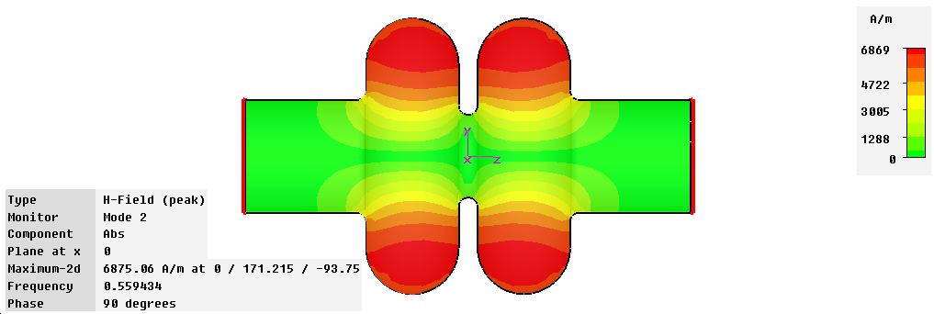
Power Dissipation
The power lost in the cavity walls due to ohmic heating is given by,
R_{surface} is the surface resistance
This is important as all power lost in the cavity must be replaced by an rf source.
A significant amount of power is dissipated in cavity walls and hence the cavities are heated, this must be water cooled in warm cavities and cooled by liquid helium in superconducting cavities.

Slide 32
Average Heating
In normal conducting cavities, the RF deposits large amounts of power as heat in the cavity walls.
This heat is removed by flushing cooling water through special copper cooling channels in the cavity. The faster the water flows (and the cooler), the more heat is removed.
For CW cavities, the cavity temperature reaches steady state when the water cooling removes as much power as is deposited in the RF structure. (Limit is ~ 1 MW but 500 kW is safer)
This usually is required to be calculated in a Finite Element code to determine temperature rises.
Temperature rises can cause surface deformation, surface cracking, outgassing or even melting.
By pulsing the RF we can reach much higher gradients as the average power flow is much less than the peak power flow.

Slide 33
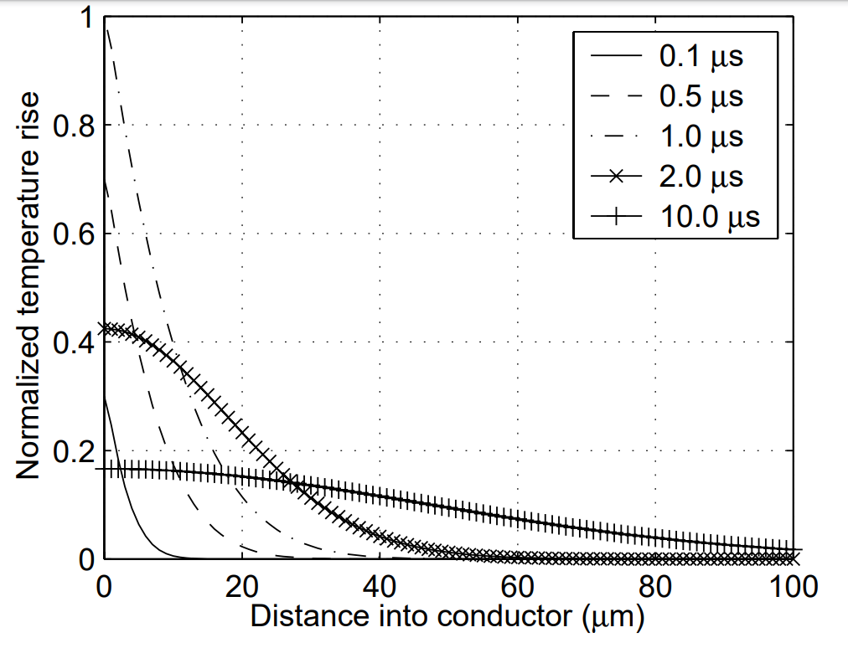
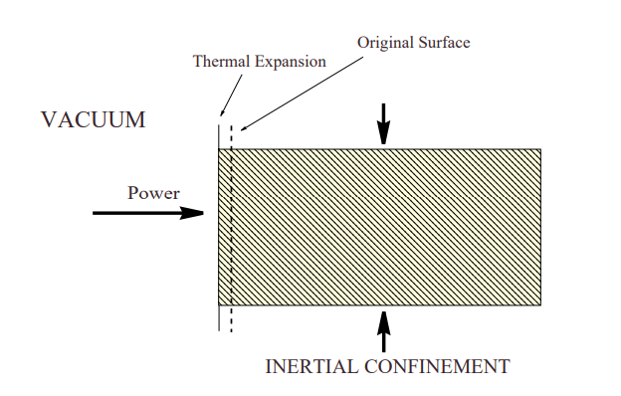
Pulsed Heating
Plot from D. Pritzkau thesis
The power deposited is
And the temperature rise on the surface is
ρ is density, κ is thermal conductivity and c_{e} is specific heat
Pulsed RF however has problems due to heat diffusion effects.
Over short timescales (<10µs) the heat doesn’t diffuse far enough into the material to reach the water cooling. This means that all the heat is deposited in a small volume with no cooling.
Cyclic heating can lead to surface damage if the temperature rise creates thermal stress (~40 K) .

Slide 34
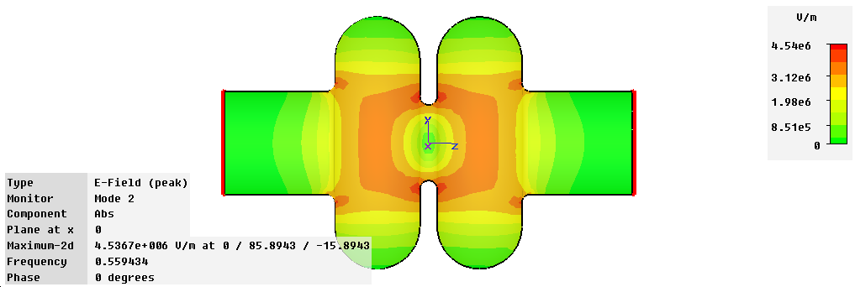
Peak Surface Fields
The accelerating gradient is the average gradient seen by an electron bunch,
The limit to the energy in the cavity is often given by the peak surface electric and magnetic fields. Thus, it is useful to introduce the ratio between the peak surface electric field and the accelerating gradient, and the ratio between the peak surface magnetic field and the accelerating gradient.
For a pillbox
Electric Field Magnitude

Slide 35
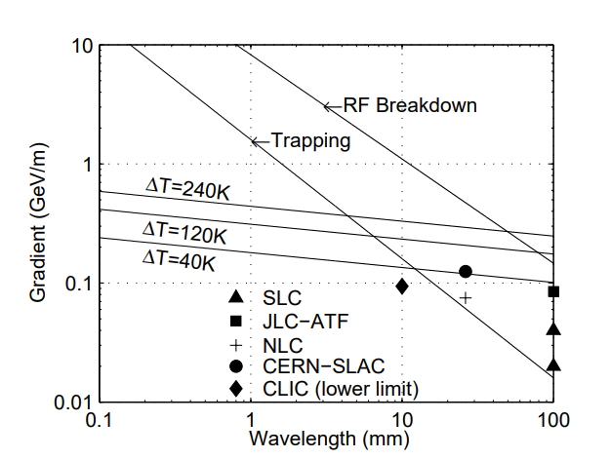
Maximum Gradient Limits
Plot from D. Pritzkau thesis
All the limiting factors scale differently with frequency.
They also mostly vary with pulse length.
The limiting factor tends to be different from cavity to cavity.
For a CW machine the gradient is limited by average heating instead. Also need to think about the electricity bill as 1 MW is £200 per day.

Slide 36
References
Wangler “RF Linear Accelerators”
Jensen “RF cavity design” CAS 09 https://arxiv.org/ftp/arxiv/papers/1601/1601.05230.pdf
Gerigk “RF Basics I and II” CAS 13
https://cds.cern.ch/record/1518867/files/CERN-2013-001-p71.pdf

Slide 37
Extra slides

Slide 38
Q factor Pillbox

Slide 39
TM010 Shunt Impedance

