Slide 1
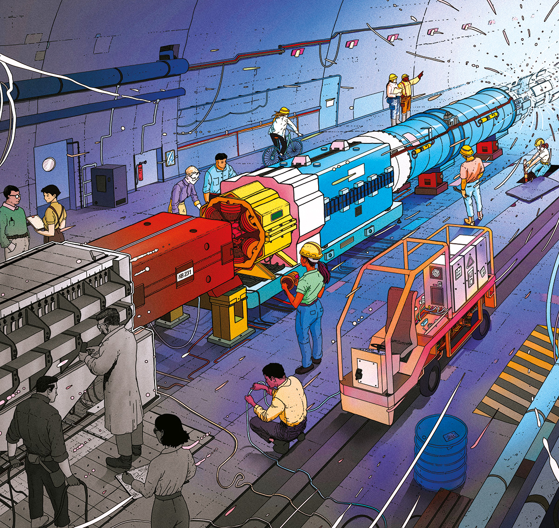




Shaping Big Science
Europe’s Community Driven Strategy
Haroon Rafique, STFC, UK
Notes:
Thank Amanda Hoyland, Ivana, Brij, DI, and others for organising this seminar on short notice
Joint privileges of ECFA ESPPU UK and LBNL visit
Wanted to engage with LBNL accelerator community
This story is part of our own, I hope it piques your interest

Slide 2
The Journey
Table-top → big science
Nobels → Nukes
Science for Peace
CERN (& RAL)
European Strategy for Particle Physics (ESPP)
2026 ESPP Update
The Future
The Cost
© CERN / A. Roy (artist)
Notes:
We’ll start with some context for the story of how big science started
Then understand the consequences of early big science
Before moving on to CERN and the ESPPU

Slide 3
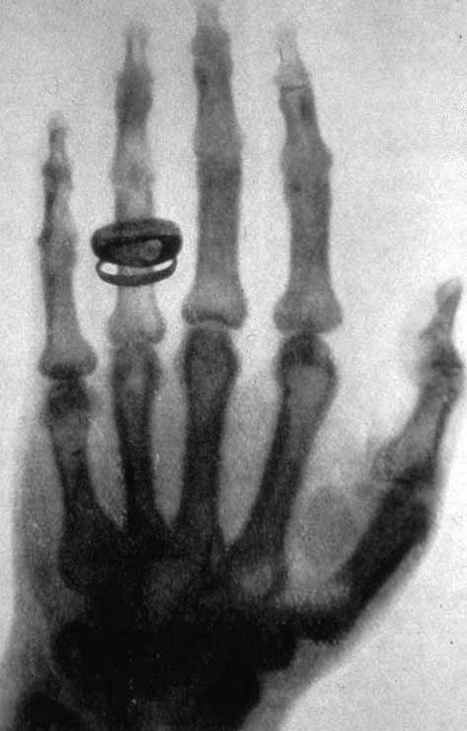
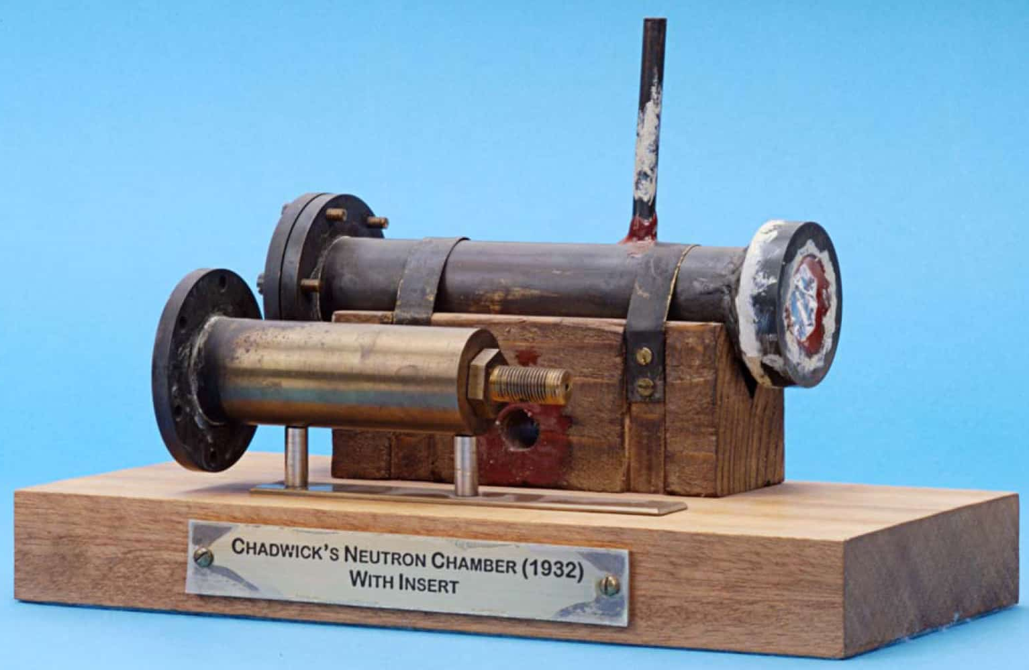
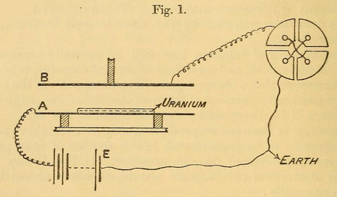
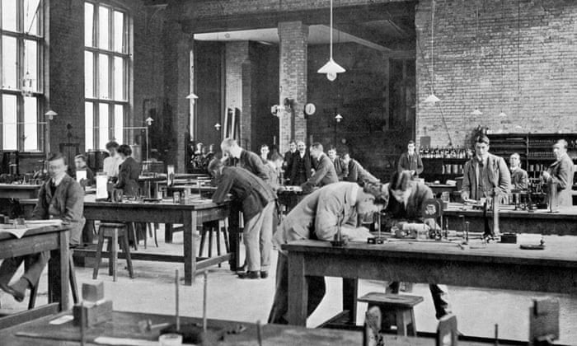
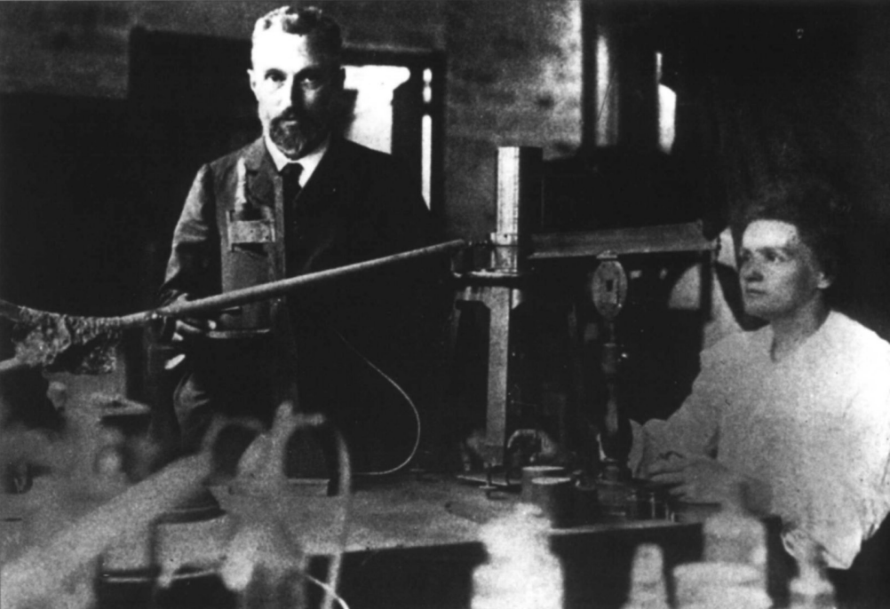
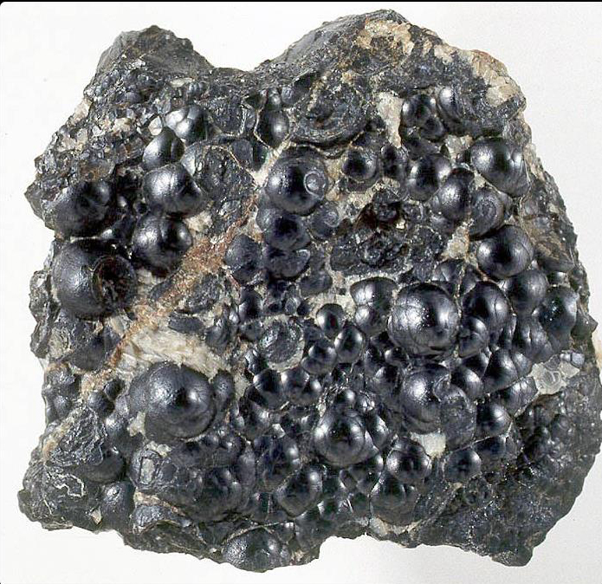
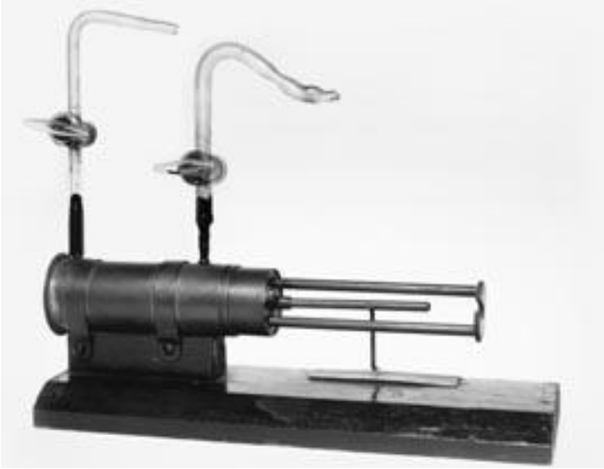
Table-Top Discovery
1895
Wilhelm Röntgen discovers X-rays while studying cathode rays, revealing penetrating radiation and transforming experimental physics
(Ann. Phys., 1895; Nobel Prize in Physics 1901)
1899
Radiation types:
Ernest Rutherford distinguishes alpha and beta radiation, showing that radioactive emissions are not a single phenomenon
(Phil. Mag., 1899)
1911
Nuclear atom:
Ernest Rutherford interprets large-angle alpha scattering as evidence for a compact, massive atomic nucleus
(Phil. Mag., 1911)
1932
James Chadwick discovers the neutron, enabling nuclear reactions unconstrained by the Coulomb barrier
(Proc. Roy. Soc. A, 1932; Nobel Prize in Physics 1935)
1898
Radioactive elements:
Marie Skłodowska-Curie and Pierre Curie isolate polonium and radium from pitchblende, establishing radioactivity as an atomic property
(Comptes Rendus, 1898; Nobel Prize in Physics 1903 with Becquerel)
1902
Radioactive decay law:
Ernest Rutherford & Frederick Soddy formulate the exponential decay law (half-life) and introduce the concept of atomic transmutation
(Phil. Mag., 1902 , Nobel Prize in Chemistry 1908)
1913
Quantised atomic structure:
Niels Bohr explains atomic spectra using quantised electron orbits around a nucleus
(Phil. Mag., 1913; Nobel Prize in Physics 1922)
1934
Artificial radioactivity:
Irène Joliot-Curie & Frédéric Joliot-Curie demonstrate induced radioactivity, creating new radioactive nuclei using particle bombardment
(Comptes Rendus, 1934; Nobel Prize in Chemistry 1935)
Notes:
There was once a time when Nobel prizes were won on a table-top. The scientific method was painstaking, tedious, and long.
MSK processed a ton of pitchblende to isolate <g of po/ra
Rutherford master of this experimental method – didn’t want overly complicated experiments
Chadwick confirmed the neutron using small apparatus.
1895: Röntgen discovers x-rays when studying cathode rays (1901 Nobel Physics)
1898: Skłodowska & Curie isolate polonium and radium from pitcheblende (1903 Nobel Physics with Becquerel)
1899: Rutherford distinguishes alpha and beta radiation
1902: Rutherford & Soddy define radiative decay law (half-life) & transmutation concept (1908 Nobel Chemistry with other things)
1911: Large angle scattering of alphas gives rise to Rutherford model of the atom
1913: Bohr explains atomic spectra with quantised electron orbits (1922 Nobel Physics)
1932: Chadwick discovers the neutron (1935 Nobel Physics)
1934: Artificial activation / induced radioactivity performed by Joliot & Curie (1935 Nobel Chemistry)

Slide 4
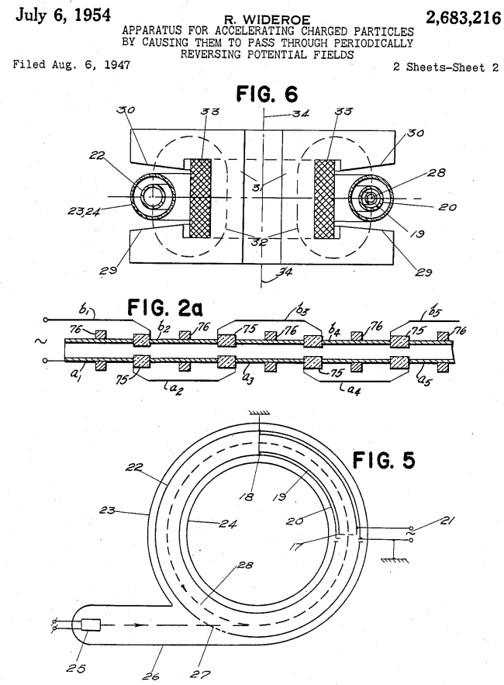
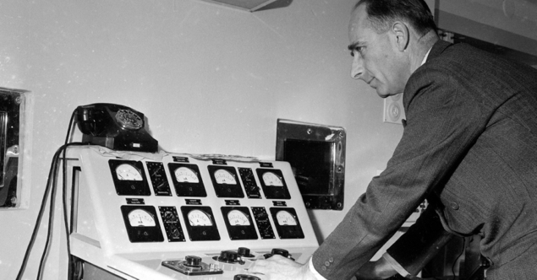
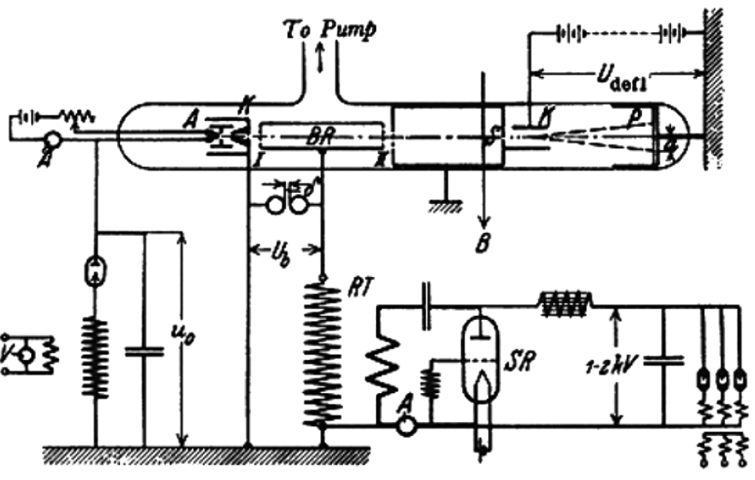
1928: Radio Frequency (Linear) Acceleration
Rolf Wideröe
Drift Tube RF Linac Patent
Notes:
1920s golden age for radio,1924 Gustav Ising proposes first accelerator with time-dependent fields
Wideröe’s 1928 RF drift-tube linac technically ingenious but severely limited by RF tech (power, freq) and vacuum/sparking constraints,
Not immediately adopted accelerator path in the late 1920s – professor famously said it wouldn’t work and he should forget about it…
Still table top – check out the complete experiment: ion source, RF accelerating cavity, detector, all in vacuum!
1928 Wideroe’s thesis work is published in a paper

Slide 5
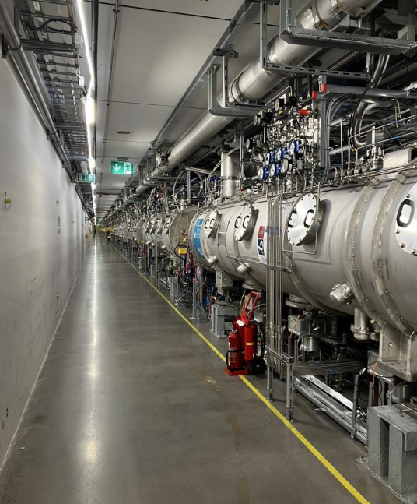
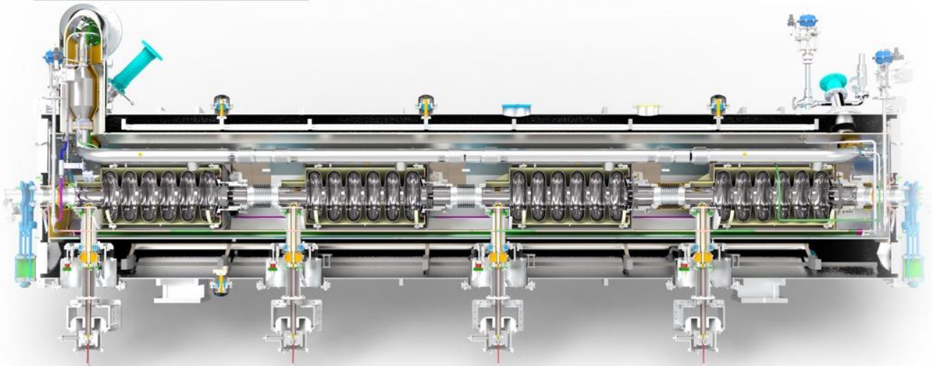
1928: Radio Frequency (Linear) Acceleration
Rolf Wideröe
ESS 2 GeV (2.5 mA average) super conducting Linac
Drift Tube RF Linac Patent
ESS 216 – 571 MeV SC Cavity
Notes:
Modern highest energy proton linac: ESS in Sweden currently in commissioning

Slide 6
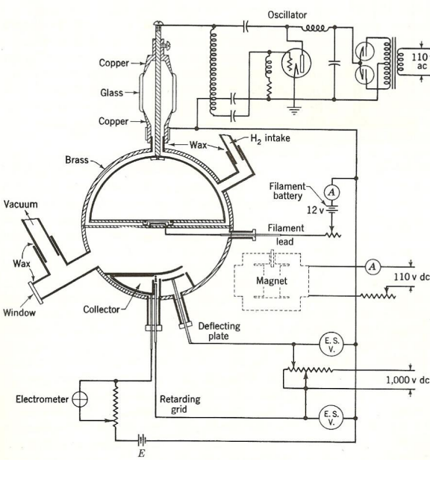
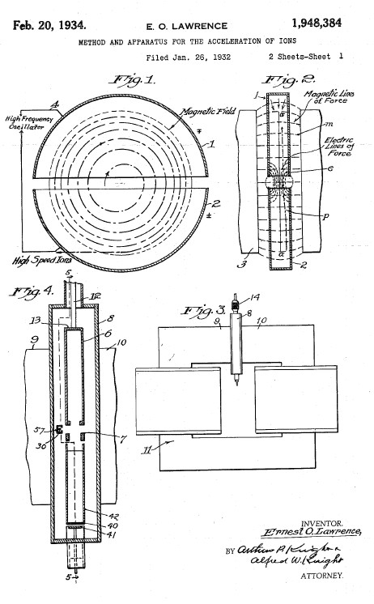
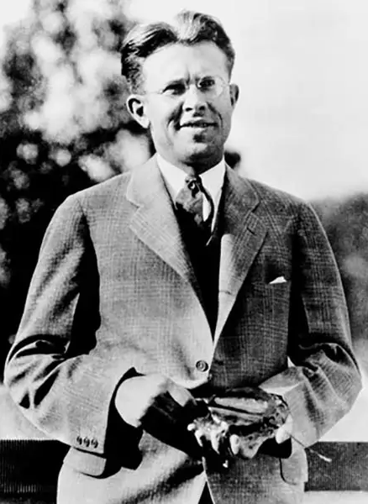
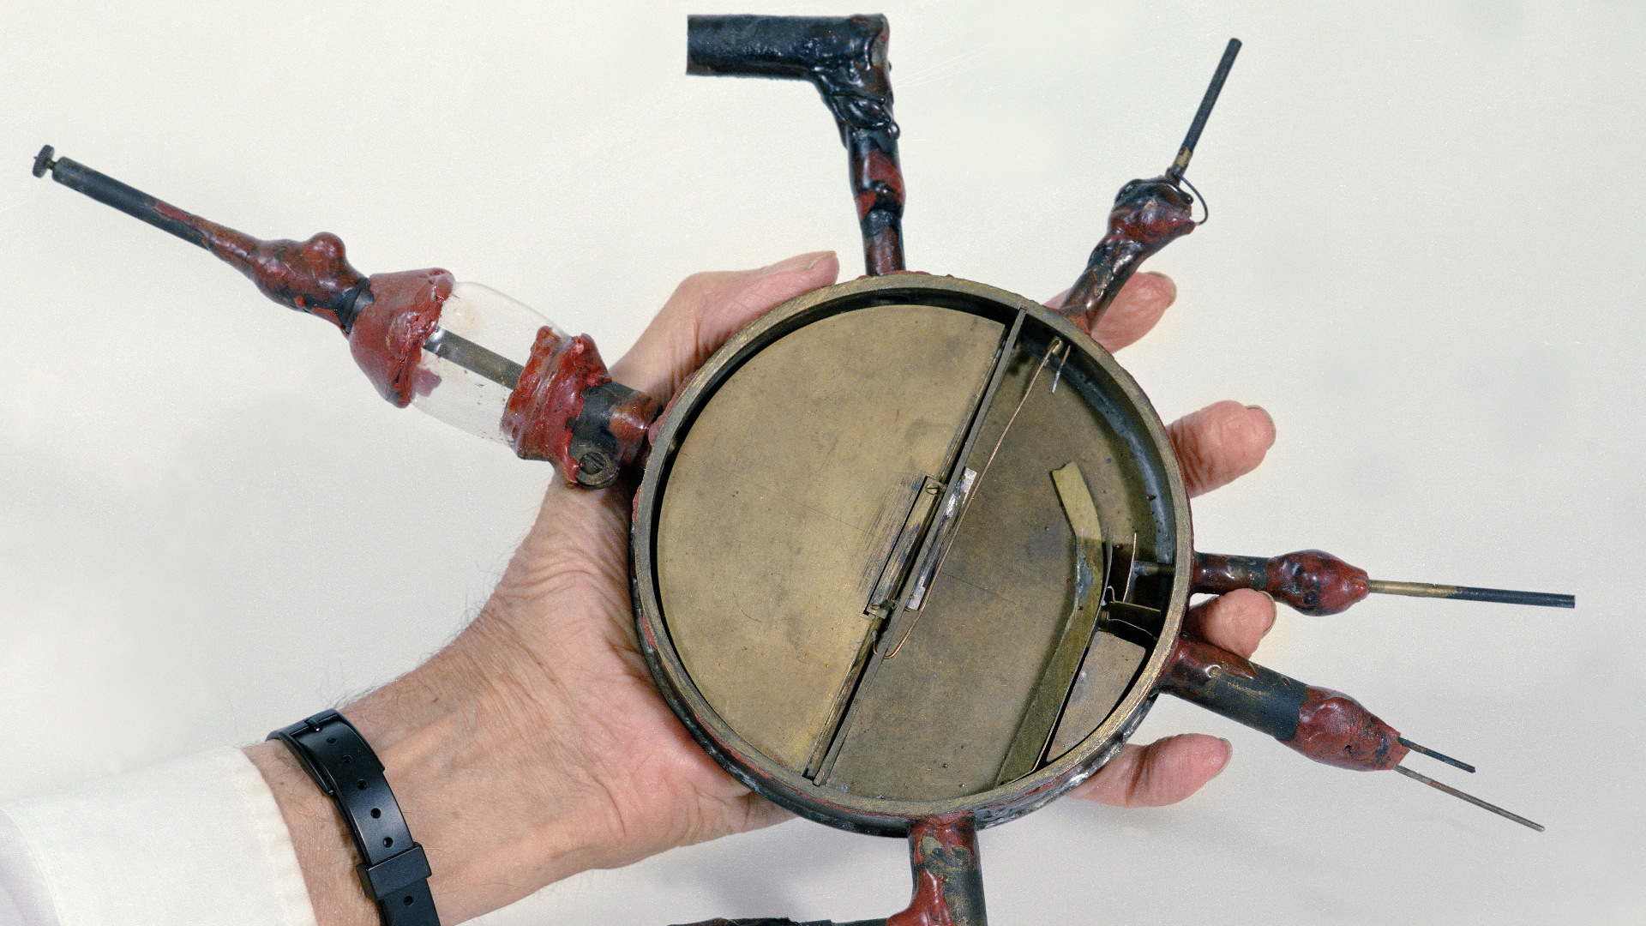
1929: Radio Frequency (Circular) Acceleration
E. O. Lawrence
Cyclotron Patent
Notes:
1MV Q of the day, Lawrence sees Wideröe’s thesis work (mainly diagrams) converts the principle to a circular one ‘I’m going to be famous’
Seminal moment in accelerator history – overcomes tech limit kV input for MV acceleration multi-pass
Hollow coin, apply rf across, put in big dipole field.
Charged particles injected at small E, spiral in the B, accelerated via RF gap
1MV question of the day: Lawrence sees Wideröe’s thesis work in a German journal, mainly understands the concept from the diagrams and converts the principle to a circular one.
This is a seminal moment in accelerator history:
Wideröe’s linac is limited by the tech of the day – 1MeV proton requires 1MV (high power, high freq RF): single pass machine
Lawrence, by applying the RF across his ‘dees’, and putting the thing in a massive magnetic field (spiral beam motion) invents the multi-pass machine. Now kV of RF power achieve MeV acceleration!
World changing – this machine would herald a paradigm shift in science – see next few slides ☺ large team of big names (Oliphant, McMillan, Livingston, Alvarez, …) got their hands dirty developing the cyclotron – this was before knowledge of artificial radioactivity (Activation), or even basic radiation safety.
Energy limit – modern biggest machines:
PSI 590 MeV protons
TRIUMF 520 MeV Protons
Also used heavily in industry to produce radioisotopes in hospitals etc.

Slide 7
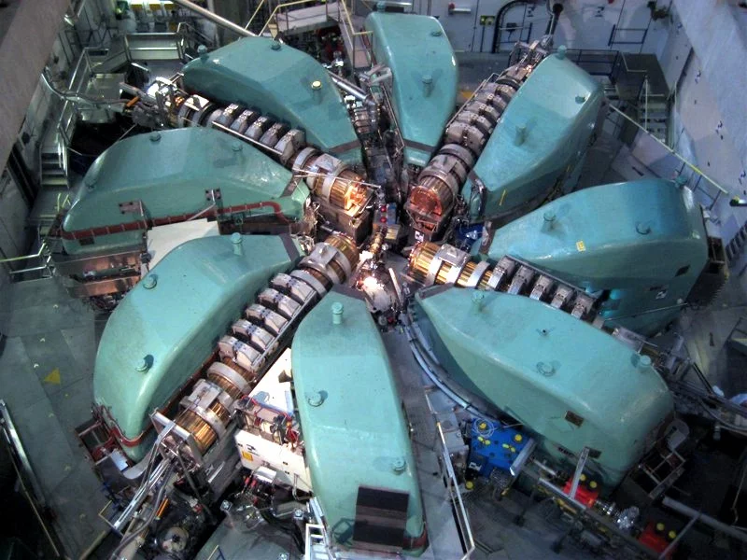
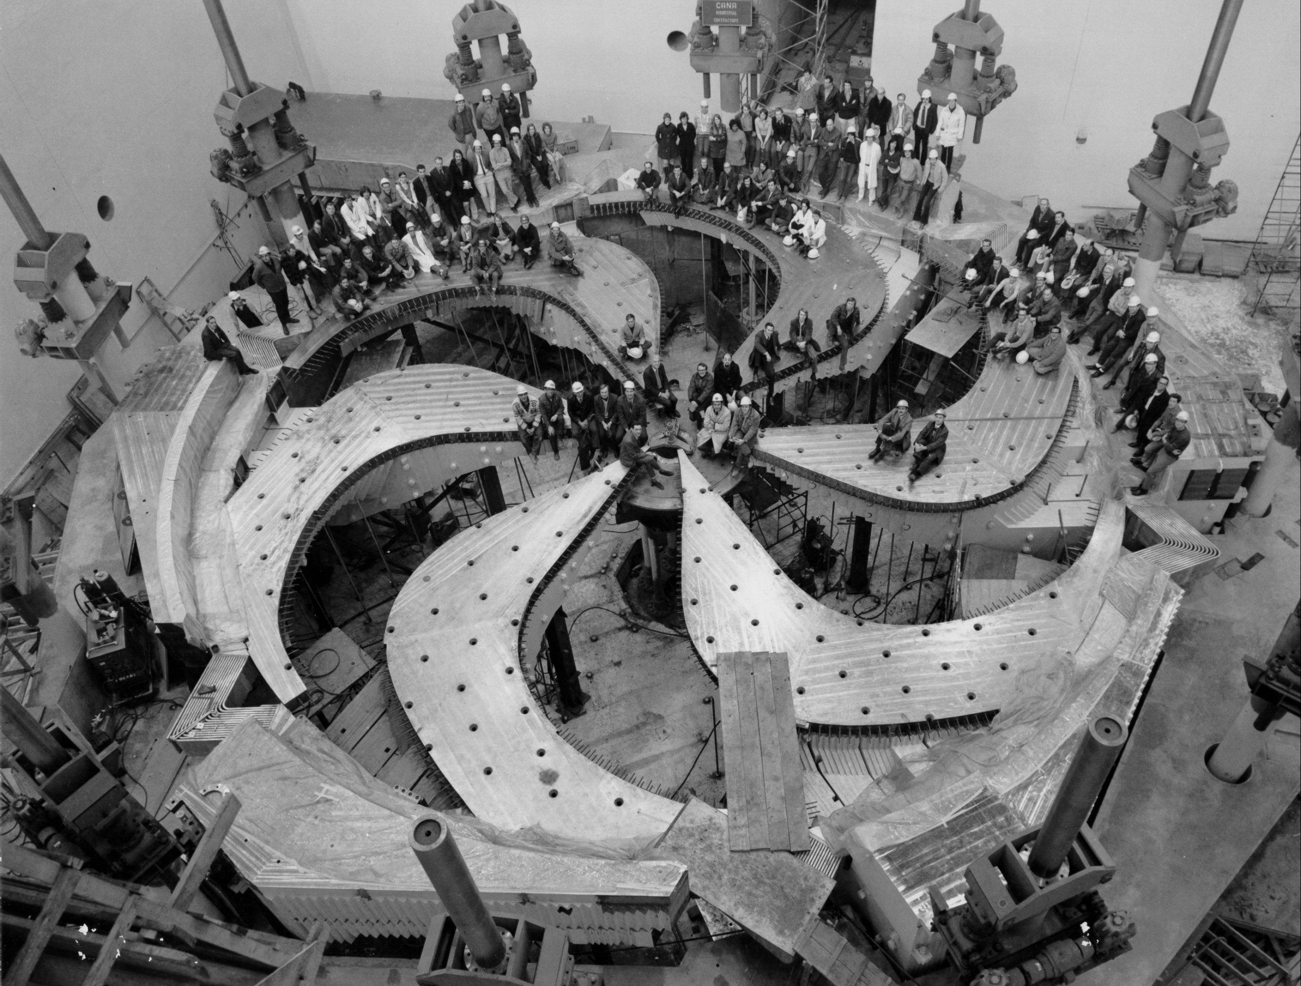
1929: Radio Frequency (Circular) Acceleration
PSI 590 MeV (2 mA av.) Cyclotron
TRIUMF 520 MeV (150 µA av.) Cyclotron
E. O. Lawrence
Cyclotron Patent
Notes:
Energy limit – modern biggest machines:
PSI 590 MeV protons
TRIUMF 520 MeV Protons
Also used heavily in industry to produce radioisotopes in hospitals etc.

Slide 8
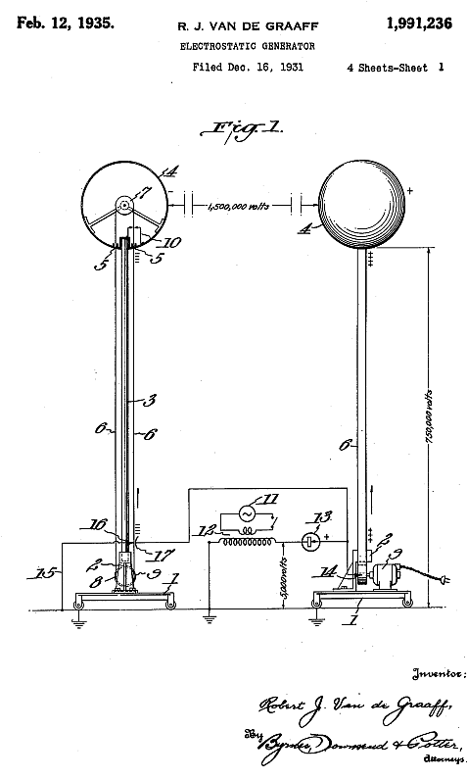
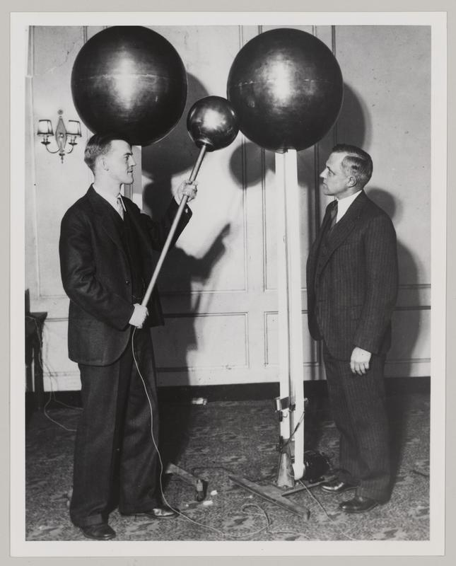
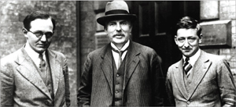
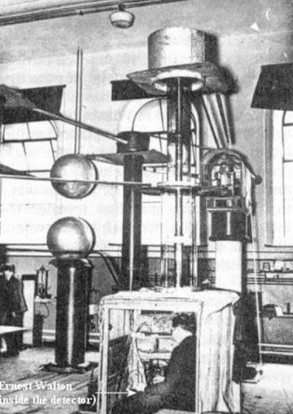
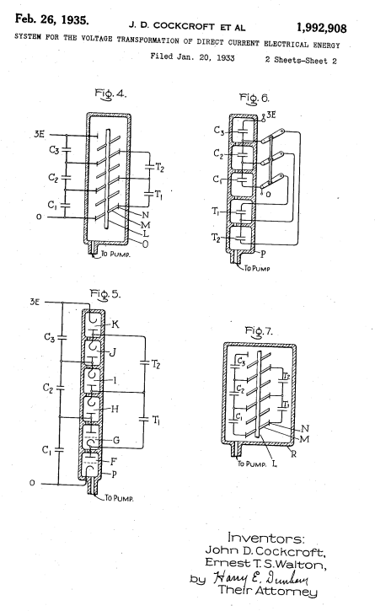
1929-1932: Electrostatic Acceleration
Van De Graaf Electrostatic Generator Patent
E. T. S. Walton, (E. Rutherford), J. D. Cockcroft
R. J. Van De Graaff (+ K. T. Compton)
E. T. S. Walton
Cockcroft Walton Electrostatic Generator Patent
Notes:
1929-31 VDG: developed for high voltages not originally acceleration
1930-32: C-W: developed to split the atom via acceleration of charged particles
Both methods similar to Wideroe – single pass machines (but using DC voltage)
~15 MV Tandem VDGs operating in Italy, Australia, Brookhaven (shown)
25.5 MV record at Oak Ridge now shut down
C-W: 750 KeV CERN Linac 2, FNAL, 665kV @ ISIS replaced by RFQ in 2005
Multi-pass circular machine – cyclotron - (as well as these) adopted worldwide

Slide 9
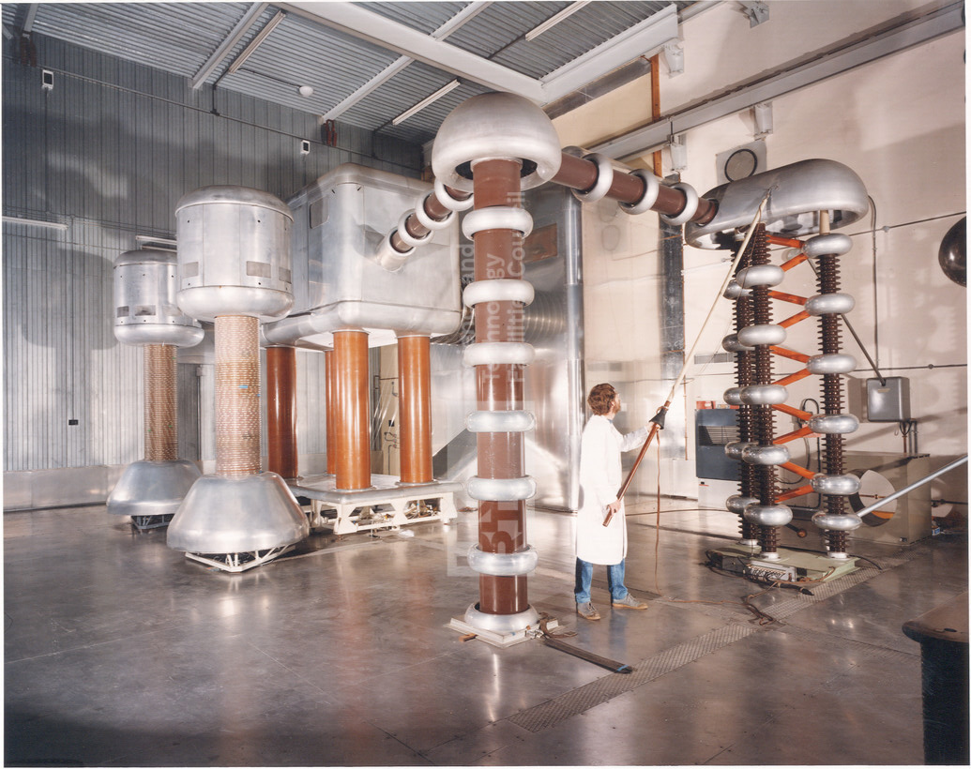
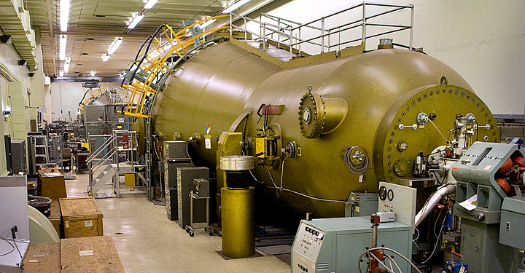
1929-1932: Electrostatic Acceleration
Van De Graaf Electrostatic Generator Patent
ISIS 665 kV (0.5 mA) Cockcroft Walton
E. T. S. Walton, (E. Rutherford), J. D. Cockcroft
R. J. Van De Graaff (+ K. T. Compton)
BNL 15 MV (~µA) Tandem VDG
E. T. S. Walton
Cockcroft Walton Electrostatic Generator Patent
Notes:
~15 MV Tandem VDGs operating in Italy, Australia, Brookhaven (shown)
25.5 MV record at Oak Ridge now shut down
C-W: 750 KeV CERN Linac 2, FNAL, 665kV @ ISIS replaced by RFQ in 2005
Multi-pass circular machine – cyclotron - (as well as these) adopted worldwide

Slide 10
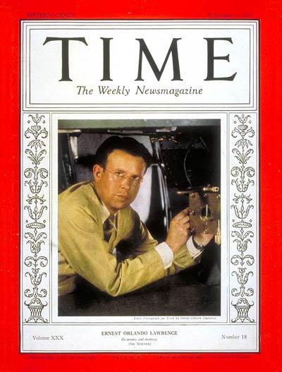
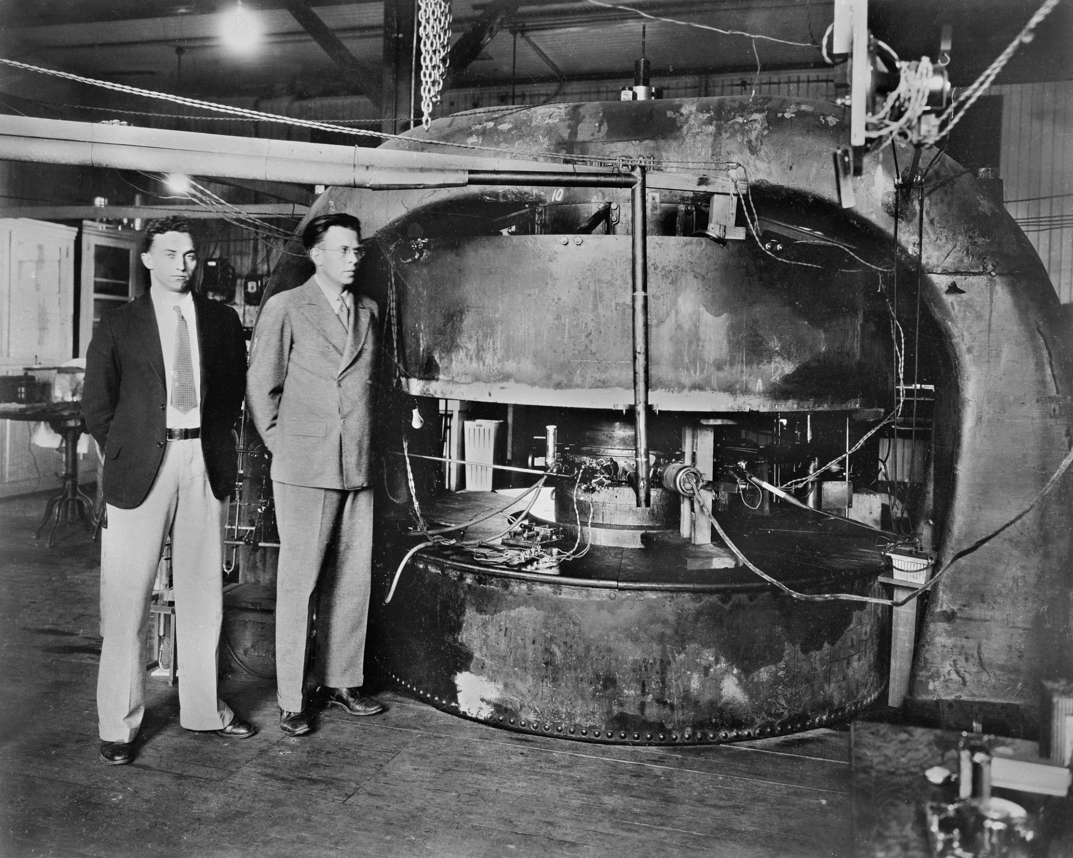
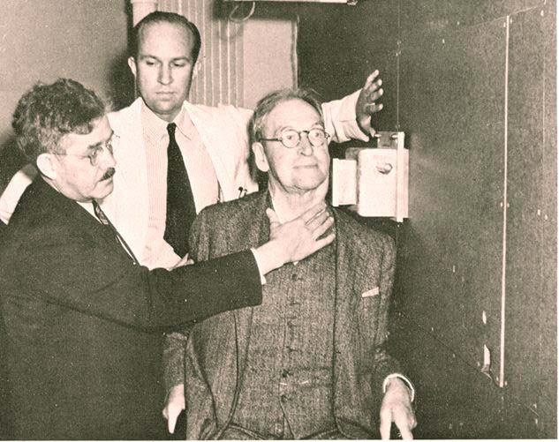
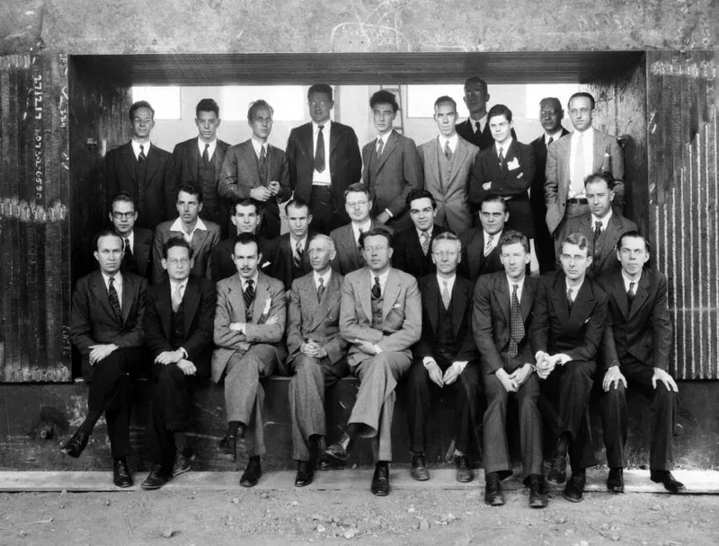
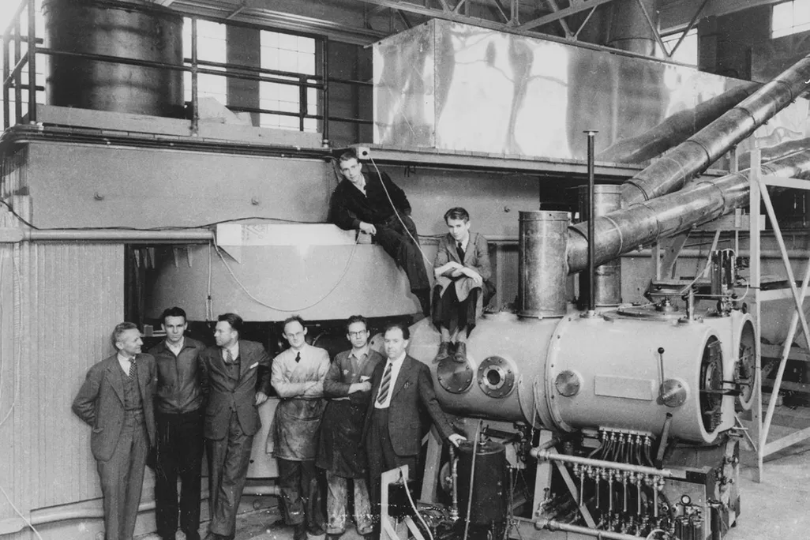
1930 – 1940 “He creates and destroys”
27” Rad Lab cyclotron
R. Stone and J. Lawrence (EOLs brother): neutron therapy
E. O. Lawrence and M. S. Livingston
60” Crocker Lab cyclotron
Notes:
11” breaks 1.1 MeV 1931 – got their hands dirty – made many mistakes
Rides mostly medical applications to acquire funding (becomes a salesman – rubs shoulders with oil barons and high society – he’s famous!)
Breaks mould of unworldly man of science – became famous for vigour and leadership
Created user facility 60” Crocker – massive radioisotope production, medical treatment, nuclear work, etc
Inter-disciplinary: physicists, chemists, medical doctors, mathematicians, technicians, students. Brought theory into the lab (Oppy) especially after neutron mass fiasco
1939 Nobel leveraged to gain $1.1-1.5 million from Rockefeller Foundation for 184” cyclotron (sold on medical applications)
In less than a decade EOL brings together multiple application streams for the cyclotron: fundamental nuclear research, radio-isotope production medical applications, energy,
Mainly rode medical/biological funding as post-depression physics funding was dry, created ‘radio-sodium’ which emitted gammas heavily – used at the time for treatment of cancer.
1931 (Aug): 11″ cyclotron breaks the MeV barrier (~1.1 MeV H⁺) Livingston removed the W grids from Dees – called Lawrence @ Yale proposing to his wife. Lawrence interprets as electric focussing – Livingston goes on to work with Courant & Snyder to define the strong focussing accelerator.
1932–1933: 27″ cyclotron reaches multi-MeV (≈3.6 MeV protons; ≈4.8 MeV deuterons) (pictured top middle). This 80 ton magnet was ‘donated’ via Lawrence’s funding-savvy methods.
1936: 37″ cyclotron: ~8 MeV deuterons / ~16 MeV alphas, dedicated lab operations + radiochemistry support. (15–40 staff plausible estimate.)
1939: 60″ cyclotron (Crocker Lab) operates with ~220–225 ton magnet (pictured bottom right two photos, and top right)
Missed a few Nobels: artificial activation (Joliot-Curie 1934), neutron induced radioactivity (Fermi 1934), tritium (Cavendish Labs). Expertise in deuton (deuterium) beams – far more smashing than neutrons!
Einstein was an unworldly wild eyed mystic and couldn’t manage his own bank account – in contrast Lawrence was athletic, amiable and conveyed concepts with ease, and became the most famous US scientist – scientists went from oddball genius to intellectual energy and physical vigour. Time magazine Nov 1937 (Nobel 1939) (pictured left)
Team of interdisciplinary scientists: physicists, chemists, medical doctors, mathematicians, technicians, students. Brought theory into the lab (Oppy) especially after neutron mass fiasco.
He ‘created’ the user-facility and leveraged his Nobel to secure the massive $1.1+million Rockefeller Foundation grant, the largest ever given on a single application (based around medical applications pre-war) for the 184” cyclotron, and later via the Manhattan project ignited big science and the military industrial complex.

Slide 11
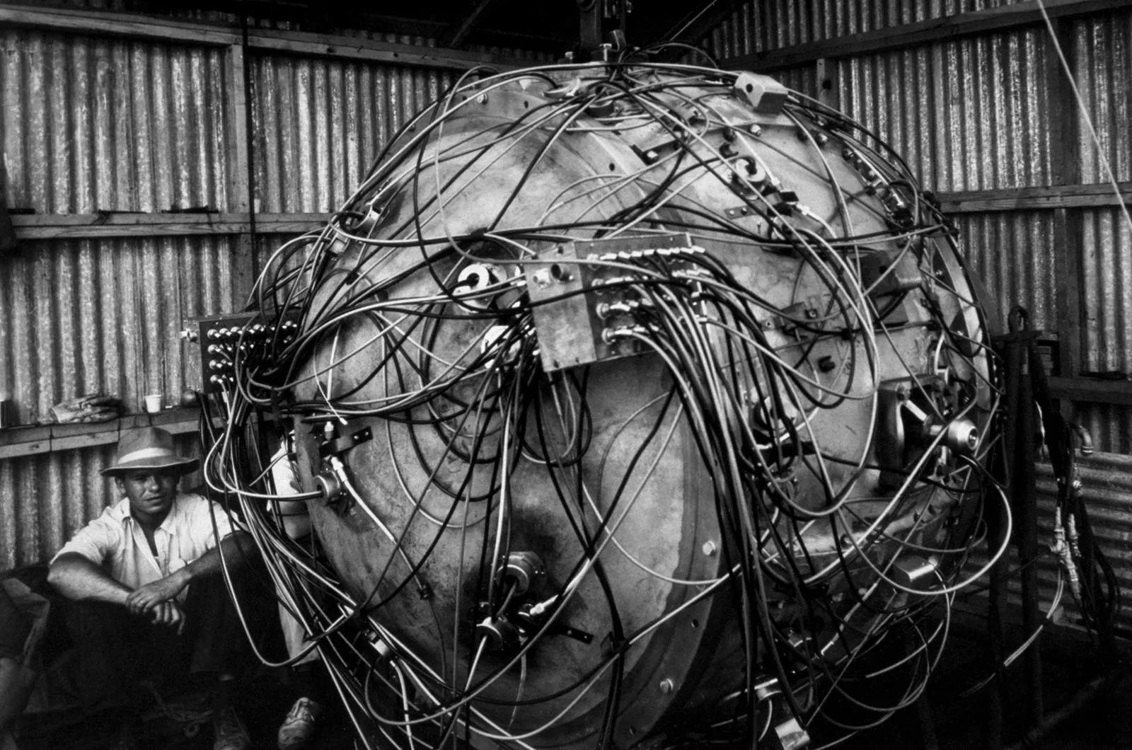
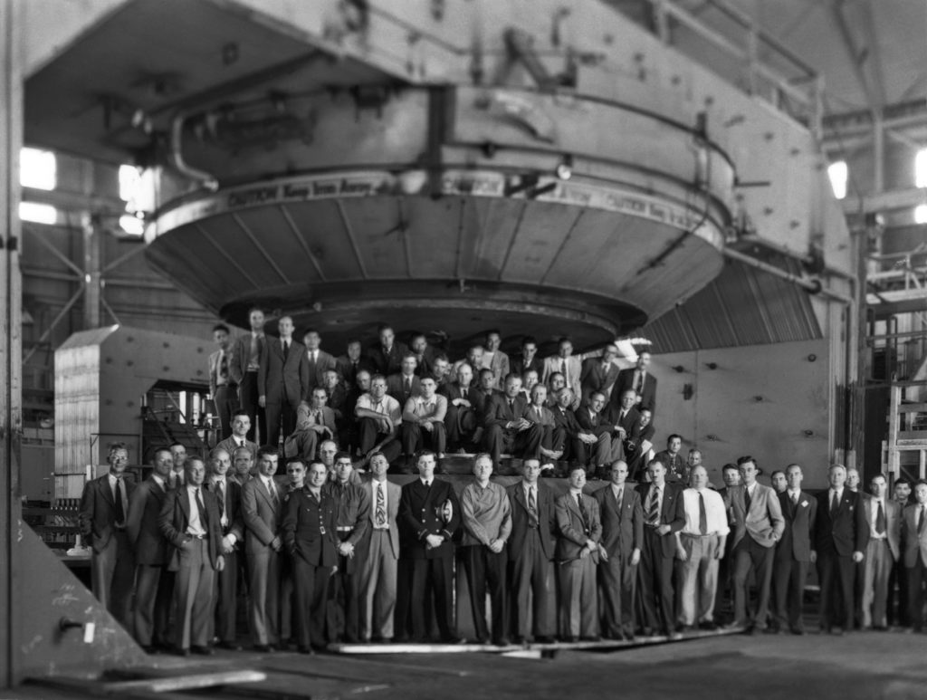
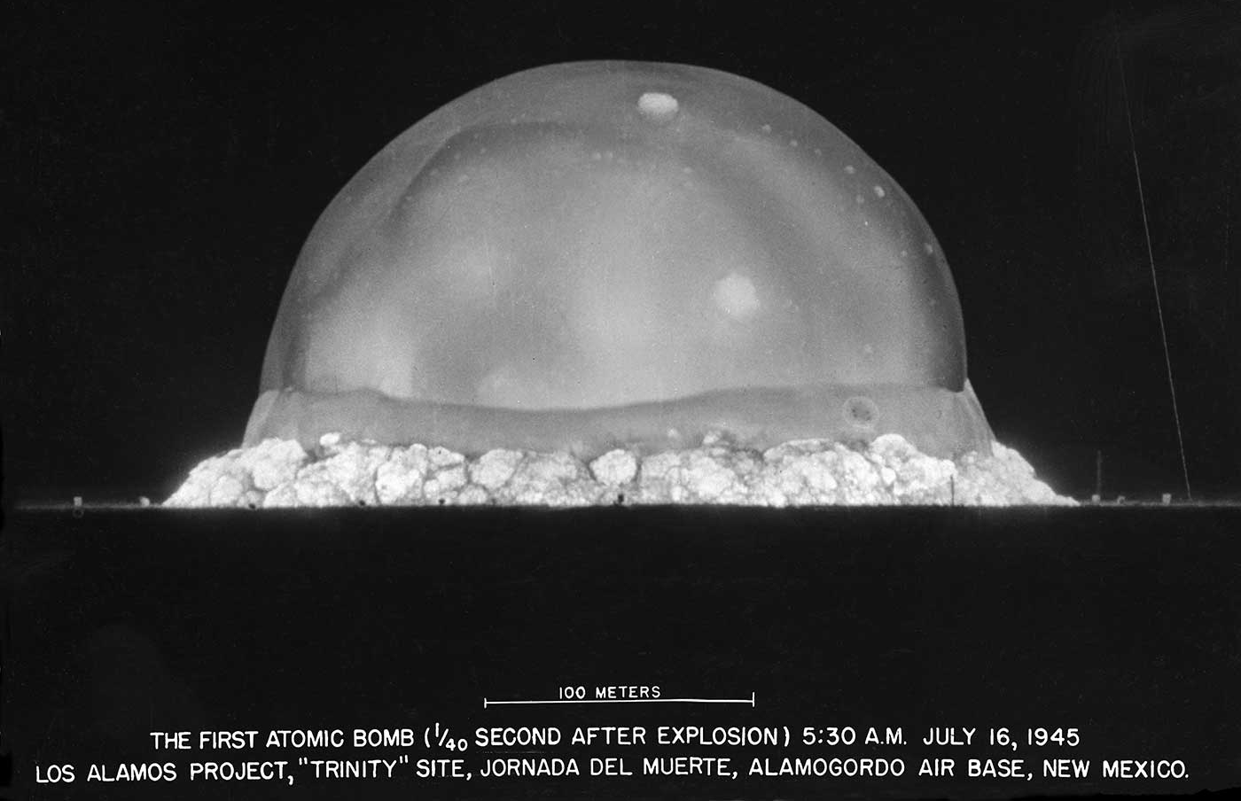
1940 - 1945 Nobels to Nukes
Trinity ‘Gadget’ Plutonium Test Bomb
184” Rad Lab cyclotron
Notes:
Fascinating story which later was summarised by an American historian: 3 key factors to success of Manhattan
Originally Lawrence (and US scientists) didn’t think the bomb was feasible (no route to enrichment)
Convinced by the British (Frisch-Peierls Memoranda under Tube Alloys, M.A.U.D)
184” cyclotron used to develop and test the calutron EM separation device to separate U235/238
Manahattan project was the real birth of big science – 130k staff, multiple sites created – operations becomes profession
69 British mission scientists contributed heavily – gaseous diffusion, detonation circuit, initial calculations, political pressure
Lawrence et. al. didn’t believe the fission bomb was achievable
Oliphant convinced him & Oppenheimer after Frisch-Peierls memorandum (MAUD and Tube Alloys story worth reading about)
Ideas developed on the table-top, refined via accelerators, now focussed with unprecedented resource
Cyclotron hardware repurposed for isotope separation and combined with multiple other methods; Calutron developed (refined with the help of the British)
Multiple labs and ‘science cities’ created (Los Alamos, Oak Ridge, Hanford, Chicago Metallurgical Lab → Argonne, eventually Lawrence Livermore, Fermilab)
Massive staffing working on “science machines” ~129k (50k @ Oak Ridge!) for the Manhattan Engineer District of the U.S. Army Corps of Engineers.
Operations becomes a profession
Result: Atomic (fission) weapons, thermonuclear (fusion) weapons, and nuclear reactors
Pictured 184” = 467.36 cm diameter cyclotron magnet – used in pilot U235 separation
4000 ton magnet (3700 steel, 300 cu)

Slide 12
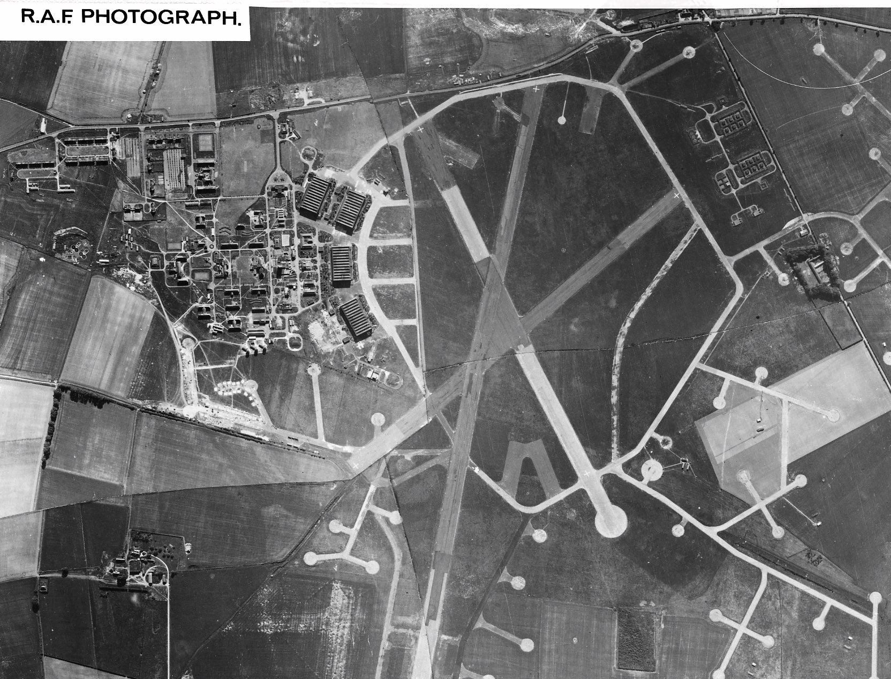
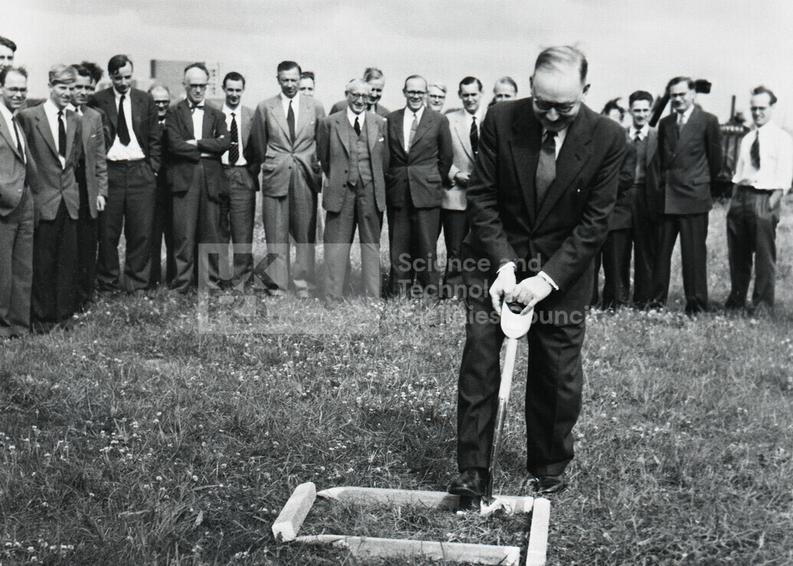
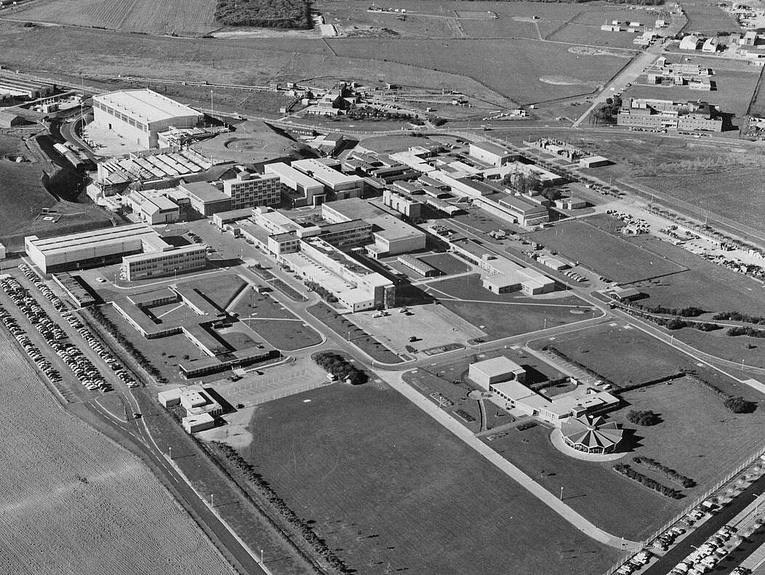
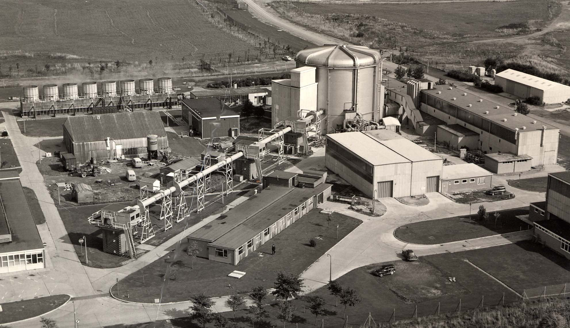
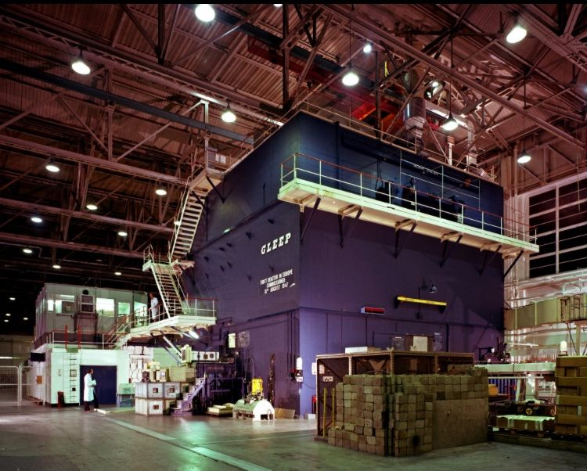
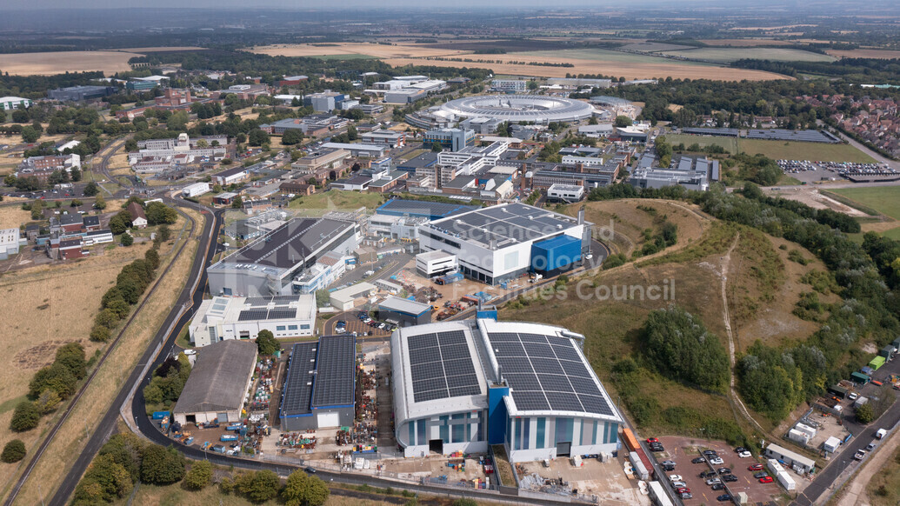
1946 AERE Harwell
RAF Harwell ~ 1945
Sir John Cockcroft breaks ground at AERE Harwell 1946
AERE Harwell 1972
Rutherford Appleton Laboratory 2025
DIDO Reactor ~ 1956
Graphite Low Energy Experimental Pile (GLEEP) 1947 - 1990
Notes:
Chadwick led British mission to Manhattan, he and Cockcroft push for central national lab, govt. funded, separate from unis
1946 JDC leads AERE
Manahattan project was training – first nuclear reactor outside USA (GLEEP)
Enabled Windscale (Sellafield) reactors, worked together with AWE to produce UKs nukes
Thomas Gerald Pickavance (later led Harwell synchrocyclotron, NIMROD, and lab) worked in Liverpool under Chadwick on Tube Alloys, but not Manhattan. 2nd chairperson of ECFA -> CERN
Post war Chadwick and Cockcroft argue strongly for: A central national laboratory, Separation from university-scale physics, Direct government control and funding
Cockcroft leads Atomic Energy Research Establishment (AERE)
The Manhattan Project trained a generation of British scientists in large-scale, government-directed science; Chadwick ensured the UK retained sovereignty, and Cockcroft turned that experience into AERE Harwell — Britain’s first true national nuclear laboratory.
Worth noting that Thomas Gerald Pickavance (later led Harwell synchrocyclotron, NIMROD, and lab) worked in Liverpool under Chadwick on Tube Alloys, but not Manhattan. 2nd chairperson of ECFA.
British contributions to the ‘uranium’ projects: gaseous diffusion sintered Nickel and development, precursor spherical shockwave (triggering, shaping, etc), as well as the initial calculations that convinced Lawrence. 69 strong ‘British mission’ including Niels Bohr, Rudolph Peierls, Otto Frisch, Klaus Fuchs, Mark Oliphant, Ernest Titterton, etc – under the leadership of James Chadwick.
Chadwick and Cockcroft argue strongly for: A central national laboratory, Separation from university-scale physics, Direct government control and funding
Cockcroft leads Atomic Energy Research Establishment (AERE) based at former RAF Harwell from 1946, funded by the Ministry of Supply
The Manhattan Project trained a generation of British scientists in large-scale, government-directed science; Chadwick ensured the UK retained sovereignty, and Cockcroft turned that experience into AERE Harwell — Britain’s first true national nuclear laboratory.
Worth noting that Thomas Gerald Pickavance (later led Harwell synchrocyclotron, NIMROD, and lab) worked in Liverpool under Chadwick on Tube Alloys, but not Manhattan. 2nd chairperson of ECFA.
1946 140 - 160 MeV synchrocyclotron https://www.ppd.stfc.ac.uk/Pages/History.aspx
1947 GLEEP (Graphite Low Energy Experimental Pile) first nuclear reactor outside the USA
1948 BEPO (British Experimental Pile – 0) reactor provided district heating using waste heat,
1950s enables construction of national nuclear reactors (Windscale / Calder Hall now known as Sellafield) – enabled plutonium bomb

Slide 13
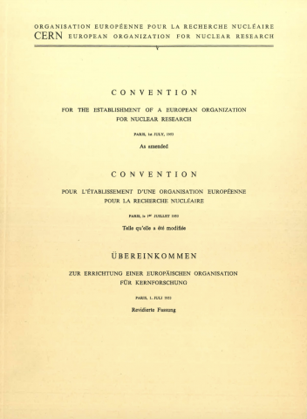
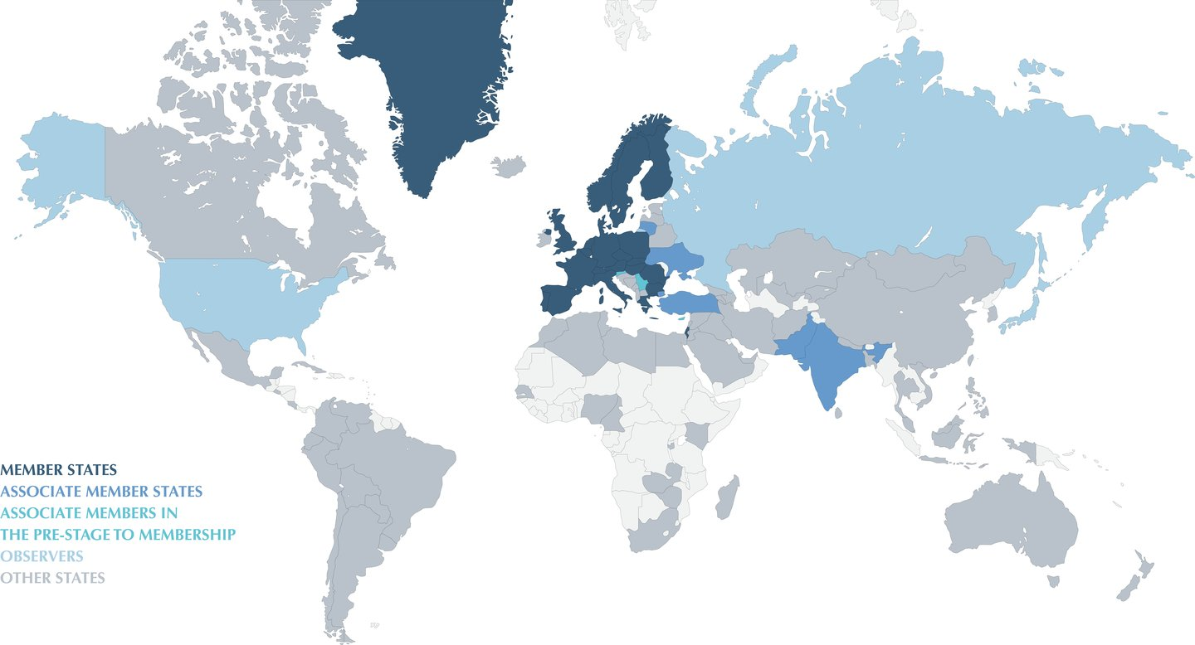
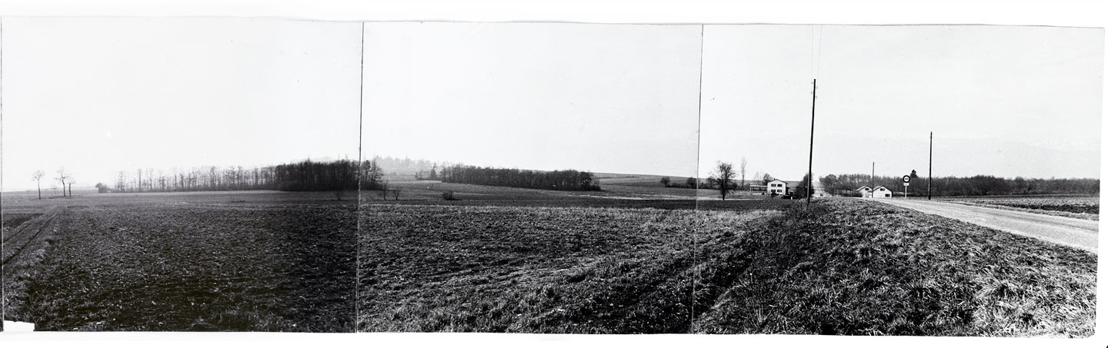
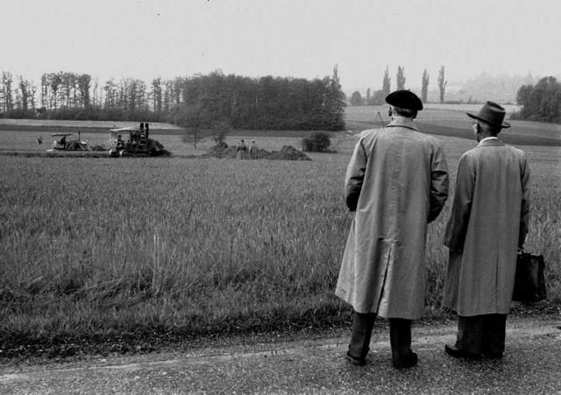
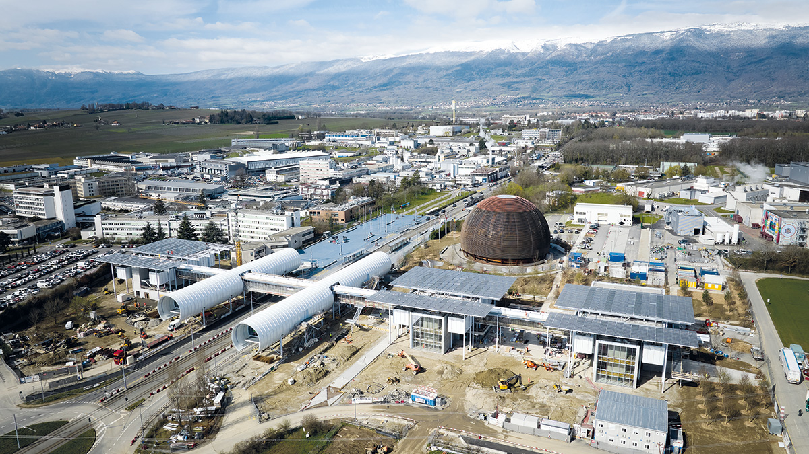
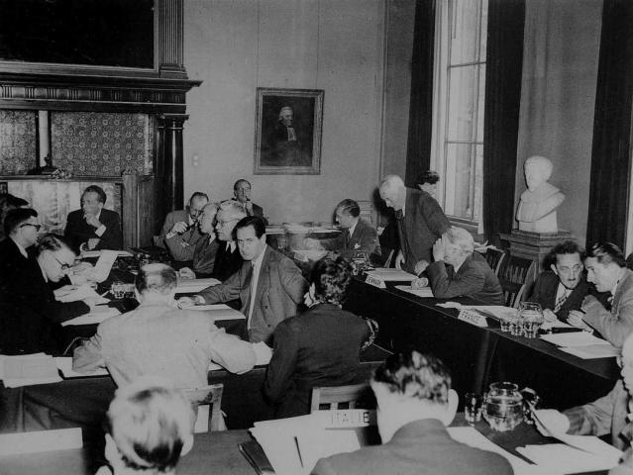
1954 CERN
ECFA formed in 1963 by DG & SPC Chair to shape the future of physics with high-energy accelerators ECFA is advisory to CERN Management, CERN Council and its Committees, and to other organisations, national, or international. More information may be found at its website https://ecfa.web. cern.ch/
CERN Meyrin Site ~1954
CERN Convention 29 June 1953
CERN Provisional Council Oct 1952
CERN Meyrin Site ~1954
CERN Meyrin Site 2023
12 founding member states: Belgium, Denmark, France, the Federal Republic of Germany, Greece, Italy, the Netherlands, Norway, Sweden, Switzerland, the United Kingdom and Yugoslavia (left CERN) in 1961
Currently 25 member states: + Austria (1959), Spain (1961-1969, re-joined 1983), Portugal (1985), Finland (1991), Poland (1991), Czechoslovak Republic (1992), Hungary (1992), Bulgaria (1999), Israel (2014), Romania (2016), Croatia (2019), Serbia (2019), Estonia (2021), Slovenia (2023). The Czech Republic and Slovak Republic re-joined CERN after their mutual independence in 1993.
Cyprus is an Associate Member State in the pre-stage to membership, and​ Brazil, Croatia, India, Ireland, Latvia, Lithuania, Pakistan, Turkey and Ukraine are Associate Members States.
Notes:
WW2 showed what big science could do (radar, reactors, weapons)
To prevent brain drain (to new US labs), stabilise European research: De Broglie, Rabi, others: ask UNESCO for help
Set up CERN 1952, SCIENCE FOR PEACE, theoretical physics under Bohr @ Copenhagen
Convention 1953, Meyrin site in neutral Switzerland 1954
ECFA 1963 Victor Weisskopf and chair of SPC Cecil Frank Powell (Nobel 1950 – detection of mesons) act as the community’s strategic voice – advises CERN on what to build, why, and when.
Accelerators have become the discovery tool of the century
WW2 showed what big science could do (radar, reactors, weapons)
Prevent mass migration to US labs, stay competitive, and stabilise research in Europe: European science-for-peace project
Louis de Broglie (1949) calls for, Isidor Rabi (1950) tables UNESCO resolution asking UNESCO to assist and encourage formation of regional international research labs
Conseil Européen pour la Recherche Nucléaire (CERN) is established as provisional council 1952, theory group based in Copenhagen under Niels Bohr until 1954
CERN convention signed by 12 founding states (under UNESCO) 1953, begins 1954
The European Committee for Future Accelerators (ECFA) created in 1963 by director general Victor Weisskopf and chair of SPC Cecil Frank Powell (Nobel 1950 – detection of mesons) to act as the community’s strategic voice – advises CERN on what to build, why, and when.

Slide 14
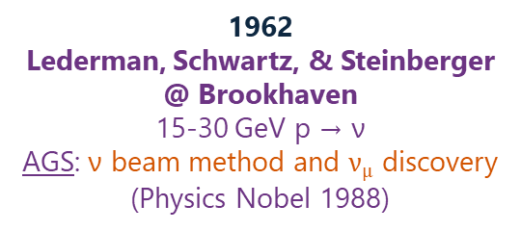
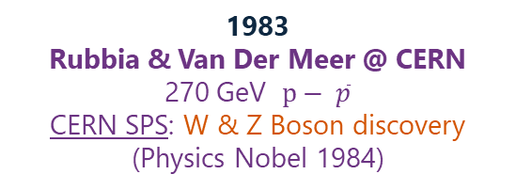
Flagships of Discovery
1940-41
Seaborg & McMillan @ Berkeley
10 MeV light ions
Cyclotron: Plutonium & transuranic elements
(Chemistry Nobel 1951)
Late 1960s
Freidman, Kendall, Taylor
~20 GeV e⁻ fixed target
SLAC Linac: Deep Inelastic Scattering (quark substructure)
(Physics Nobel 1990)
1979
Glashow / Salaam / Weinberg
26 GeV p fixed target
CERN PS: Weak neutral current
(Physics Nobel 1979)
2012
Higgs & Englert
6.5 TeV p – p
CERN LHC: Higgs Boson
(Physics Nobel 2013)
1930s
E. O. Lawrence @ Berkeley
0.1 -20 MeV p, d, α
Cyclotron: nuclear reactions and radioisotopes
(Physics Nobel 1939)
1960s
L. Alvarez @ Berkeley
Multi-GeV hadron beams
Bevatron: + H₂ bubble chamber detectors
(Physics Nobel 1968)
1974
Richter @ SLAC & Ting @ BNL
4.8 GeV e⁺e⁻, 28 GeV p fixed target
SPEAR & AGS: J/ψ (charm quark) discovery
(Physics Nobel 1976)
1932
Cockcroft & Walton @ Cavendish
0.4 – 0.7 MeV p
First artificial nuclear disintegration
(Physics Nobel 1951)
1962
Lederman, Schwartz, & Steinberger @ Brookhaven
15-30 GeV p → ν
AGS: ν beam method and $ν_{µ}$ discovery
(Physics Nobel 1988)
1974-75
Martin Perl @ SLAC
4.8 GeV e⁺e⁻
SPEAR: Tau lepton discovery
(Physics Nobel 1995)
1955
Segrè & Chamberlain @ Berkeley
~6 GeV p fixed target
Bevatron: antiproton production. (Physics Nobel 1959)
1968
Georges Charpak @ CERN
26 GeV p fixed target
CERN (PS): multiwire proportional chambers (modern electronic detectors)
(Physics Nobel 1992)
1983
Rubbia & Van Der Meer @ CERN
270 GeV $p− \overline{p}$
CERN SPS: W & Z Boson discovery
(Physics Nobel 1984)
Notes:
Cyclotrons everywhere – Joliot-Curie needed help from Berkeley, then sabotaged for the Nazis…
Lawrence pushed for bevatron (weak focusing synch) after approaching cyclotron limit, died shortly before nobel
Weak focusing synch -> strong focusing synch -> high power linac -> PS + linac -> PS, eS, PS, PS, …
No flagship is complete without advanced detectors!
CERN currently hosts the flagship: LHC
In the 1930s the cyclotron became the weapon of choice for many labs around the world. Many of them had been sent emissaries from the rad lab, those who didn’t consult often failed. Late 30s Jolie-Curie lab – Livingston and McMillan told them they needed a new magnet – had to remove a wall as the thing was built in already. Machine later commandeered by the Nazis, Joliot-Curie and a German (sent by Nazis) sabotaged it – great story.
Later Lawrence recognised they were reaching a limit and pushed for the Bevatron. He died shortly before the 1959 nobel announcement.
American machine such as the alternating gradient synchrotron @ BNL, and the SLAC linac and SPEAR (Stanford Positron Electron Accelerating Ring), each achieved significant discoveries, even sharing one (J/ψ)
CERN’s PS, SPS, and LHC have all contributed major discoveries – pretty high success rate per flagship!
No flagship is complete without advanced detectors!

Slide 15
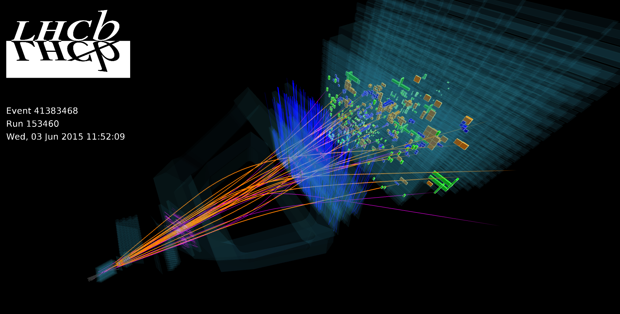
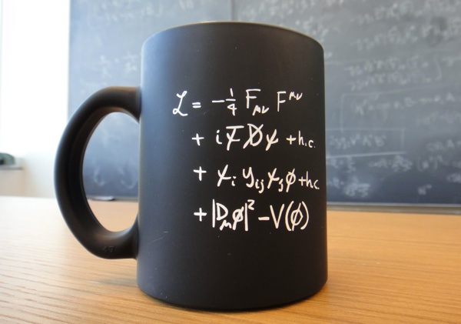






Matter – antimatter asymmetry
CP Violation
Theoretical Backbone
Mapped Standard Model
Precision Measurements
UK-CERN Accelerator Celebration
Haroon Rafique
15
Recreated early universe conditions
Quark Gluon Plasma
Discovered key force carriers W, Z, Higgs
Notes:
LHC impact: fundamental discovery – impact may not be understood in our lifetime

Slide 16




CLOUD
ISOLDE
Alpha Magnetic Spectrometer onboard the ISS
Notes:
There is more to CERN than the LHC, massive accelerator complex serving experiments in many domains: heavy isotope beams, atmosphere, space (particle physics still).
CERN has a remit to ensure that its technology and expertise deliver prompt and tangible benefits to society wherever possible. Let’s look at some examples of CERN benefits to society…

Slide 17







CERN Impact
The first PET image taken at CERN, in 1977, showing the skeleton of a mouse. Unlike a modern-day image, this one is truly digital – it is composed of numbers. Each number indicates how much of the isotope has been emitted at each point.
The image on the cover page of Tim Berners-Lee's proposal for the World Wide Web in March 1989
2007 White Rabbit timing technology
1999 MEDIPIX / TIMEPIX collaborations
CERN Open Hardware Licence
First capacitive touchscreens used at CERN 1973
“… in 1997, CERN set up a reinforced policy and team to support its knowledge- and technology-transfer activities. As a publicly funded Laboratory, CERN has a remit to ensure that its technology and expertise deliver prompt and tangible benefits to society wherever possible.”
Notes:
The technological development required for fundamental discovery science yields the unexpected.
LHC 120% ROI, HL-LHC 170%-180%
Medical: PET, medipix (detectors)
Touchscreens, open hardware licence, timing technology
WWW – created to solve technical problems
Let’s go back to the flagship
ROI
LHC 120%: https://www.sciencedirect.com/science/article/abs/pii/S0040162516000731
HL-LHC 170-180%: https://www.tandfonline.com/doi/abs/10.1080/00036846.2022.2140763
1968: Multi wire proportional detector chambers (G. Charpak Nobel Prize) applied to medical field to reduce patient dose in imaging modalities
1973: First physical touch screen development by Frank Beck and Bent Stumpe
1977: Jeavons (hardware) and Townsend (software) begin the path to modern PET scanning using coincidence detection with avalanche chambers
1989: Administrative fix for communication based on scientific necessity, Tim Berners Lee develops the World Wide Web
1990: Crystal Clear Collaboration led to specialised PET scanners and improved time resolution
30 April 1993: CERN released the original World Wide Web software into the public domain and made the source code available free of charge
GEANT4 and FLUKA used as industry standard for radiation – matter interaction, used in medical fields.
Medipix, Timepix
Optimised photovoltaic cells
Neural networks deployed in particle physics before “Machine Learning”
White Rabbit timing technology
CERN Open Hardware Licence: legal framework to let people freely use, modify, and share hardware designs

Slide 18

CERN Flagship Timeline
2005
ESPP
ESPPU
#1
ESPPU
#2
ESPPU
#3
Notes:
2005 – CERN Council initiates the first European Strategy process
Forms the European Strategy Group (ESG) to produce a strategy document
Forms the Physics Preparatory Group (PPG) to organise and carry out required preparatory work
Community consultation phase leading into 2006. Subsequent updates follow. Timed nicely around the start of LHC long shutdowns.

Slide 19


2005 European Strategy for Particle Physics
Europe needed to agree on a single long-term plan
Community input + strategy group
Delivery and exploitation of the LHC top priority
Hints at significant LHC upgrade
Ramp up accelerator & detector R&D for post-LHC
Europe should lead and co-ordinate internationally
Potential linear collider collaboration
Participation in global neutrino programme
Foresaw increased collaboration with astro-particle & nuclear physics
Recognised importance of communications and technology transfer
Notes:
Single long term plan (LHC about to switch on)
Establish community input to strategy group
LHC priority, hints at upgrade
Ramp up R&D for post-LHC

Slide 20



2013 ESPPU #1
LHC top priority
High Luminosity LHC upgrade
Design LHC successor p-p or e– e+
  Corresponding accelerator & detector R&D
  Strong case for e– e+
  Europe looks to Japan (ILC)
Long baseline neutrino support
Diverse theory programme
Low energy precision measurements
Detector R&D programmes
Synergies with nuclear / astro-particle physics
Impact
  Knowledge transfer
  Education & training
Outreach & communication
Notes:
LHC top priority
HL-LHC named as upgrade
Request to design successor – strong e+e- case
Long baseline neutrino etc

Slide 21
2013 ESPPU #1
LHC top priority
High Luminosity LHC upgrade
Design LHC successor p-p or e– e+
  Corresponding accelerator & detector R&D
  Strong case for e– e+
  Europe looks to Japan (ILC)
Long baseline neutrino support
Diverse theory programme
Low energy precision measurements
Detector R&D programmes
Synergies with nuclear / astro-particle physics
Impact
  Knowledge transfer
  Education & training
Outreach & communication
Notes:
Highlight vigorous accelerator R&D programme
Europe looks to Japan for ILC

Slide 22




2020 ESPPU #2
Delivery of HL-LHC, full exploitation of LHC & HL-LHC top priority
Future Collider:
  e+e- Higgs factory priority
  p – p beyond the Higgs factory
  Increased Accelerator R&D
  Design studies by next update
  At least 100 TeV hadron collider with e+e- Higgs/EW factory as first stage
  Collaboration with Japan for ILC?
Accelerator R&D
Global Detector R&D Roadmap
Continued support of long baseline neutrino physics in Japan and USA
Continued European scientific leadership
Adequate resources to strengthen European ecosystem
Strong international partnership also in neighbouring fields required
Diversity of particle physics programme
Theory and computational tools
Software and computing infrastructures, resources for open data
Minimise environmental impact
ECR support. Equality, Diversity, and Inclusion
Knowledge transfer
Public engagement
Notes:
HL-LHC & LHC top priority
Accelerator & Detector R&D
Software and computing infrastructure, theory computing tools
ECR support, EDI

Slide 23
2020 ESPPU #2
Delivery of HL-LHC, full exploitation of LHC & HL-LHC top priority
Future Collider:
  e+e- Higgs factory priority
  p – p beyond the Higgs factory
  Increased Accelerator R&D
  Design studies by next update
  At least 100 TeV hadron collider with e+e- Higgs/EW factory as first stage
  Collaboration with Japan for ILC?
Accelerator R&D
Global Detector R&D Roadmap e+e-
Continued support of long baseline neutrino physics in Japan and USA
Continued European scientific leadership
Adequate resources to strengthen European ecosystem
Strong international partnership also in neighbouring fields required
Diversity of particle physics programme
Theory and computational tools
Software and computing infrastructures, resources for open data
Minimise environmental impact
ECR support. Equality, Diversity, and Inclusion
Knowledge transfer
Public engagement
Notes:
Highlight explicit mention At least 100 TeV hadron collider with e+e- Higgs/EW factory as first stage

Slide 24

CERN Flagship Timeline
2005
ESPP
ESPPU
#1
ESPPU
#2
ESPPU
#3
Notes:
- #1 requested the HL-LHC upgrade, and to start designing an LHC successor.
- #2 explicitly states “At least 100 TeV hadron collider with e+e- Higgs/EW factory as first stage” – FCC study
- Note that the physics case is being set (Higgs/EW factory)
- Now comes the story of the third update

Slide 25
2026 ESPPU Process
4 Nov 2024
UK Drafting Meeting
@ Daresbury Laboratory
14 Nov 2025
Deadline for submission of final community input
26 May 2025
Deadline for submission of additional community input
Sep 2024
CERN Council appoint PPG
Decide on Venice for open symposium
31 Mar 2025
Deadline for submission of main community input
September 2025
PPG submits the ‘Briefing Book’ to ESG
End Jan 2025
ESG submits draft strategy to CERN Council
23 – 26 Sep 2024
UK Kick-Off Meeting @ Durham University
28 April 2025
UK Drafting Meeting
@ Rutherford Appleton Laboratory
29 October 2025
UK Plan B Meeting
Online
9 Jan 2025
UK Drafting Meeting
@ University College London
23 -27 June 2025
Open Symposium in Venice
1 – 5 Dec 2025
ESG Strategy Drafting Session in Ascona, Switzerland
ESPPU Timeline
UK Timeline
Notes:
In Sep 24 the PPG was appointed, ESG provided questions to the community via ECFA etc
Between then and Mar 25 Europe produced 268 national and collaboration level inputs to the ESPPU.
3 rounds of input in total, final one after briefing book (summary of inputs produced by PPG) released in Sep 25.
Before final input further guidance was provided – what is plan B?

Slide 26




Community Collaboration
Kick-off + 4 drafting days
→ 550 participants
→ 90+ pages produced
→ 18 internal meetings
→ countless drafting hours.
All Contributions to the ESPPU: https://indico.cern.ch/event/1439855/contributions/
UK Input Drafting Team:
Ruben Saakyan (Chair of PPAP), Jim Clarke (Director of ASTeC), Sinead Farrington (Director of STFC PPD), Mark Lancaster (UK representative on the European Strategy Group)
UK ECFA delegates: Sarah Williams (Cambridge), Daniela Bortoletto (Oxford), Joel Goldstein (Bristol), Haroon Rafique (STFC ISIS), Aidan Robson (Glasgow), Michael Spannowsky (Durham), Matthew Wing (UCL)
UK ECR ECFA delegates (who did most of the minute taking): Patrick Dougan (Manchester), Allison Elliot (STFC PPD), Holly Pacey (Oxford), Harriet Watson (Edinburgh), Aidan Wiederhold (Manchester)
Notes:
Main questions asked by ESG to community: Plan A, Plan B, priorities, contingencies.
Priorities for collider complimentary exploration
Thanks to all for engagement and collaboration
Special thanks to Sarah and Ruben for leading the UK input process

Slide 27




Community Collaboration
Previously
Prof. Dave Newbold
Notes:
Another slide to acknowledge the immense time and expertise dedicated to these tasks.
PPG produced a summary of the 268 inputs in the Physics Briefing Book
Shown are the members of the ESG (green arrows show UK members)

Slide 28






Accelerator Options
Compact Linear Collider (CLIC)
380 GeV / 1.5 TeV (e⁺ - e⁻)
12.1 km / 29 km
7.2 / 14.3 BCHF
Muon Collider (at CERN)
3.2 / 7.6 TeV (µ⁺ - µ⁻)
11 km
12 / 17 BCHF
Future Circular Collider (FCC) integrated programme
91.2 – 365 GeV (e⁺ - e⁻)
90.7 km
15 BCHF
84.6 TeV (p - p)
90.7 km
FCC-ee + 19 BCHF
Standalone 28.4 BCHF
Linear Collider Facility (LCF based on ILC)
91.2 / 250 / 550 GeV (e⁺ - e⁻)
33.5 km
8.3 / +0.8 /+5.5 BCHF
Large Electron Positron Collider 3 (LEP3)
91.2 / 160 / 230 GeV (e⁺ - e⁻)
26.7 km (existing LEP/LHC tunnel)
3.9 BCHF
Large Hadron electron Collider (LHeC)
26.7 km (existing LEP/LHC tunnel)
1.18 TeV (e⁻ - p)
2 BCHF
Notes:
Main accelerator options considered have been analysed in detail – massive report from WG2a in references.
Linear collider options.
Reuse of LHC/LEP tunnel options.
Circular collider options.

Slide 29





Accelerator Options
Re-use LHC tunnel
LHeC CHF 2 Billion
LEP3 CHF 3.9 Billion
Linear colliders
CLIC CHF 7 – 16.5 Billion
LCF CHF 8.3 – 14.4 Billion
Circular colliders
FCC-ee CHF 15 Billion
FCC-hh CHF +19 Billion
MC CHF 12 – 17 Billion
Staged energy approach to lepton colliders optimised for specific resonances or thresholds
Notes:
Parameter comparison – for the physics reach comparisons please see these presentations from the last plenary ECFA meeting
Re use tunnel CHF 2-4 billion
LCs CHF 7 – 17 billion
CCs CHF 12 - 29 billion
Assessed by WG2a
91 GeV and 160 GeV are about electroweak precision through gigantic statistics at poles/thresholds,
240–250 GeV is the clean, model-independent Higgs factory,
365 GeV adds top-threshold precision plus stronger $WW$-fusion Higgs,
550 GeV targets the hard Higgs stuff (top Yukawa and the Higgs potential via double Higgs).

Slide 30




Assessment of Options
Notes:
WG2a of the ESG performed detailed analysis of all inputs
Done in terms of technological readiness levels
Lot’s of technological challenges: CLIC drive beam not fully demo’d, SC magnets for FCC-hh, LEP3 early stage design, ERL for LHeC, and lots for MC: cooling demonstrator needed.
Perhaps you can see where this is going

Slide 31


2026 ESPPU #3
Notes:
Plan A: FCC-ee (provides route to re-using tunnel for FCC-hh Plan B: Descoped FCC-ee
CERN Council to adopt by mid 2026
If adopted expect a decision in 2028
Then we have to pay for it

Slide 32








Notes:
The FCC will require 16.4 million tonnes of excavation, c.f. 130 for HS2 phase 1
Power consumption is comparable to LHC
Environmental impact??

Slide 33

Notes:
When the LHC was built questions were asked – would this be the end of big science?
With the right friends, perhaps not ☺

Slide 34
Notes:
We have seen how Lawrence leveraged his cyclotron to create the rad lab, and how his salesmanship, celebrity, and leadership led to the ‘biggest’ scientific project of the time. ~130,000 staff
The discoveries enabled by accelerators (building on those of table-top physics/chemistry before) led to the creation of big science, which historically has always been collaborative.

Slide 35
Notes:
Also led to the creation of RAL, CERN, LBNL, LANL, LLNL, BNL, ANL, FNL, many more worldwide
We’ve gone from Nobels, to Nukes, and back to Nobels – the accelerator has become the definitive tool of big science – an engine of discovery!

Slide 36
Notes:
CERN hosts the current flagship.
Through rigorous and collaborative community effort, the European Physics Community hopes to host the next flagship of discovery, the Future Circular Collider, at CERN.
The precious gem of big science was created under immense pressure
Such complex machines require thousands of lifetimes of dedication – teamwork on an unprecedented scale

Slide 37

What is the price of big science?
What are we willing to pay to answer fundamental questions?
Is it worth it?
Thank you
Questions?
2024 RAL Open Days: ISIS Target Station 2 Accelerator Zone #WheresWally #WheresWaldo
Notes:
Questions I often ponder

Slide 38


References
Maurizio Vretenar, History of Radio Frequency Linacs, CERN Summer School on Linacs, 2015
Ken Peach, CERN Council Strategy Group Report, Vancouver Linear Collider Workshop/GDE Meeting, 19-22 Jul 2006
Tracey Berry, ESPPU plans overview and discussion, PPAP Community Meeting 24-26 Jun 2024
Karl Jakobs, Status of the ESPP update process, 117th Plenary ECFA Meeting, CERN, Nov 2025
G. Arduini (convener), F. Bordry, R. Brinkmann, P. Burrows (convener), K. Desch, S. Farrington, F. Gianotti, K. Hanagaki, N. Holtkamp, J. Keintzel, B. Kilminster, T. Lesiak, L. Rivkin, F. Sabatié, M. Tuts, A. Zoccoli, WG2a: preliminary machine comparison of flagship projects, 117th Plenary ECFA Meeting, CERN, Nov 2025
G. Arduini (convener), F. Bordry, R. Brinkmann, P. Burrows (convener), K. Desch, S. Farrington, F. Gianotti, K. Hanagaki, N. Holtkamp, J. Keintzel, B. Kilminster, T. Lesiak, L. Rivkin, F. Sabatié, M. Tuts, A. Zoccoli, Assessment of large-scale accelerator projects at CERN, Report of ESG WG2a, 31 October 2025
Most images are linked to their indivual online sources, the rest are from the UKRI/STFC Digital Media Library
The 268(!) community inputs to the 2026 ESPPU: https://indico.cern.ch/event/1439855/contributions/
Thanks to the thousands who have contributed to the many studies, experiments, consultations, drafts, assessments, and other activities linked to the process of updating the European Strategy for Particle Physics. #Teamwork #StrongerTogether #StandingOnTheShouldersOfGiants #BigScience
Notes:
Recommend these books!

