Slide 1


CI-Mag-106 - Conventional Magnets for Accelerators
Lecture 4
Dr Alex Bainbridge
Magnetics and Radiation Sources Group
ASTeC
Daresbury Laboratory
alex.bainbridge@stfc.ac.uk
Record your attendance!
Or on indico!

Slide 2
Contents
Direct field measurements
  Nuclear magnetic resonance
  Hall effect and Hall probes
  Fluxgate magnetometers
Integrated field measurements
  Floating wire
  Stretched wire
Measuring field harmonics
  Rotating coil
Practical magnet construction

Slide 3
Direct field measurements

Slide 4
NMR theory
NMR probes are built around a vial containing a very high purity sample. There is only 1 hard restriction on the choice of sample: The nucleus must have an intrinsic magnetic moment , i.e. spin ≠ 0
  If N_{protons} and N_{neutrons} are both even (N_{total} is even), nucleus has spin = 0
  If N_{protons} and N_{neutrons} are both odd (N_{total} is even), nucleus has spin = 1,2,3….
  If N_{protons} or N_{neutrons} are odd (N_{total} is odd), nucleus has spin = 1/2, 3/2, 5/2….
Nuclei with ½ integer spin are the simplest for measurements, a nucleus with spin S has 2S + 1 orientations, so spin ½ has only 2 options.
Not all nuclei are equal, a higher gyromagnetic ratio (γ) is better.
The most common sample is water. H-1 has spin ½ so is easy and is sensitive. O-16 (8P, 8N) has zero spin and does not respond to the field.

Slide 5
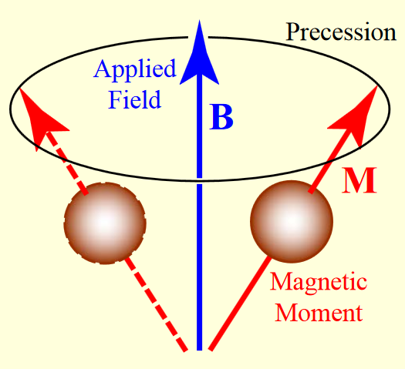
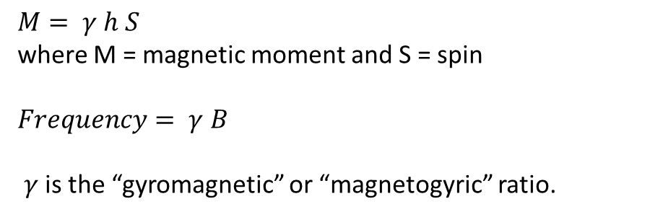
NMR theory
A nucleus with a magnetic moment precesses around an applied B field
$M= γ h S$
where M = magnetic moment and S = spin
$Frequency= γ B$
$γ$ is the “gyromagnetic” or “magnetogyric” ratio.
Sample | γ (MHz/T) | Range
e⁻ | 28027 | ~ 1 mT
H-1 | 42.58 | 0.05-2 T
H-2 | 6.536 | 2-14 T
Pic taken from
Animesh Jain, USPAS 2003 lecture notes

Slide 6

NMR theory
When no magnetic field is applied all orientations have the same energy.
When a field is applied energy level splitting occurs. Thermal distribution means the lower level will have a higher population.
The nucleus may absorb a specific frequency of radiation to cause a jump from the lower level to the higher level. This is a resonant absorption.
M = - 1/2
Energy
ΔE
$$∆E=γℏB$$
0
M = + 1/2
B

Slide 7
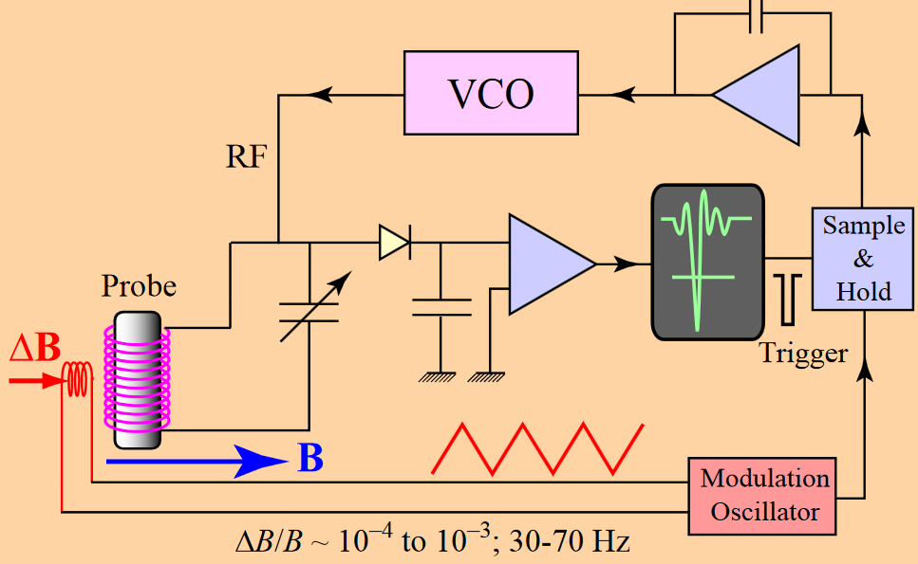
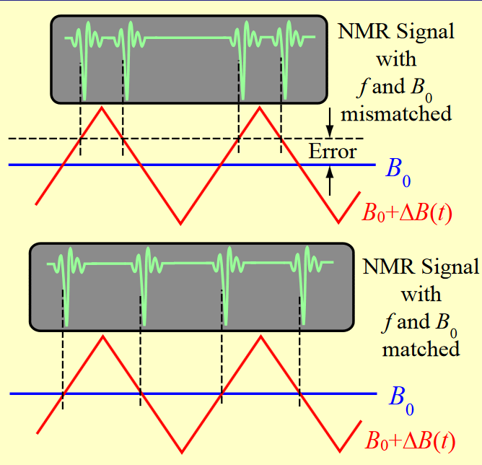
NMR In practice
A sample container is surrounded by a coil of wire, which is connected to a Voltage Controlled Oscillator (VCO).
The VCO produces a sinusoidal current at an RF frequency, changing the supply voltage changes the frequency.
Pics taken from
Animesh Jain, USPAS 2003 lecture notes

Slide 8
NMR purpose
NMR probe advantages include:
Fixed relation between flux density and resonant frequency
  probes only need to be calibrated once in the factory!
Very accurate in a uniform field such as a calibration magnet
  (~0.1 µT on a 2 Tesla field)!
Quick and easy measurements.
Commercially available probes cover a wide range of field strengths.
No directional/planar effects to interfere when you only want to know the total strength of the field.
NMR probe disadvantages include:
Probes with water samples cannot be used at cryogenic temperatures
  Flash freeze will break the sample vial
Sensors are large (~5mm) and accuracy depends on field uniformity across sensor volume.
  Not suitable for complex geometries or measurement of fine features.
Contains no direction info!
  unable to resolve field components or harmonics.
Slow response to field change
  DC magnets only

Slide 9
The Transverse Hall Effect
Electrons flowing in a conductor experience a transverse magnetic force when flowing through a field, just like free electrons.
They bunch on one side of the conductor until the force from space-charge balances the force from the magnetic field on electrons flowing through the middle. The charge imbalance creates a voltage perpendicular to the current flow that can be detected by a voltmeter.
The voltage is proportional to the magnetic field strength and is referred to as the transverse Hall voltage, first recorded in 1879 by Edwin Hall.
This is true for any conductor but produces the most noticeable effects when the conductor is a thin, flat plate.

Slide 10

The transverse Hall effect
In the very special case of a thin, perfect conducing film the transverse Hall Voltage
(I=current, e=electron charge, n=density of mobile charges)
$$V_{H}\text{= }\frac{IB}{ned}$$
B
I_{in}
-
-
+
-
+
-
+
+
Remember - current is conventionally flow of positive charges! Electrons flowing left to right!
d
V
I_{out}

Slide 11

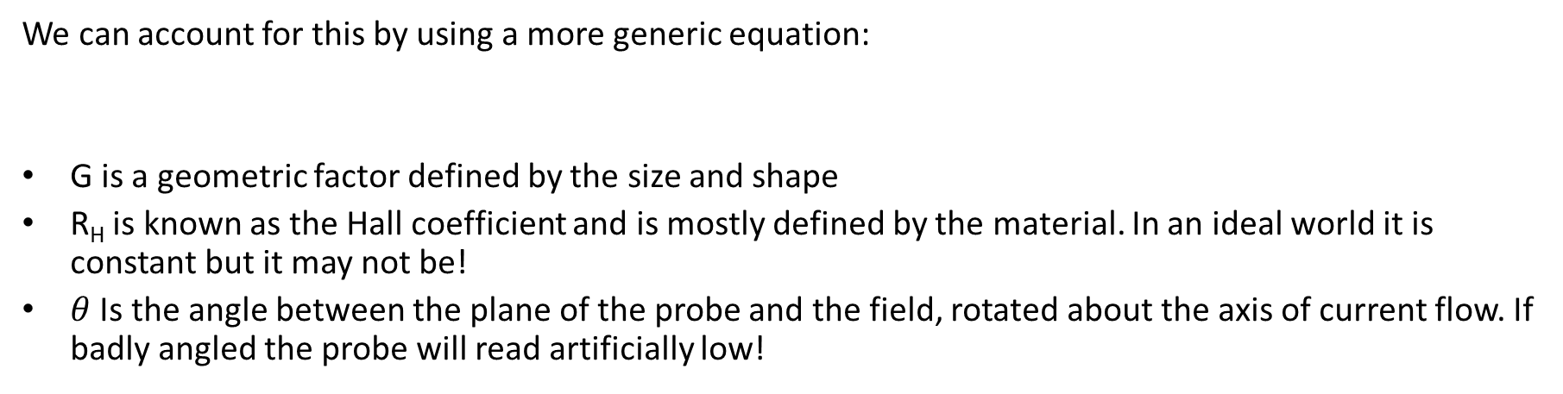
Hall probes in reality
The thin film approach is an approximation that is rarely valid in practise:
  The probe is never a perfect conductor
  The field may not be perfectly transverse
  The probe is tiny enough that d is not small relative to the other dimensions
We can account for this by using a more generic equation:
G is a geometric factor defined by the size and shape
R_{H} is known as the Hall coefficient and is mostly defined by the material. In an ideal world it is constant but it may not be!
$θ$ Is the angle between the plane of the probe and the field, rotated about the axis of current flow. If badly angled the probe will read artificially low!
$$V_{H}=GR_{H}IB\cos{θ}$$

Slide 12
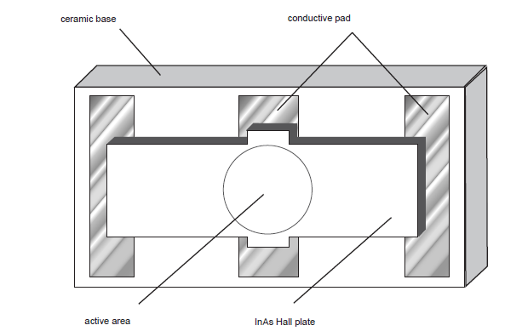
Hall probes in reality
A real hall probe has a tiny active area, generally 10-100 microns to resolve small details in field shape. Traditionally a metal film but semiconductor probes are becoming more common.
The coefficients G and R_{H} may not be immediately known and may change with time as the probe ages or is damaged.
They may also be strongly dependent on temperature – active area may expand or contract with heat. Ceramic base is designed to limit this.
Pic shamelessly nicked from
http://archives.sensorsmag.com/articles/1297/he1297/main.shtml

Slide 13
Hall probe calibration
The G and R_{H} values may be specified by the manufacturer but for accurate use a combined value should be measured. This is done using a calibration magnet arrangement.
The Hall probe is placed in a dipole magnet which produces a very stable field over a large area. An NMR probe is placed as close as possible to the Hall probe.
The Hall probe is supplied with a constant controlled current (set by a PID loop) and the magnet current is swept. At each point the Hall voltage is recorded against the field from the NMR probe.

Slide 14
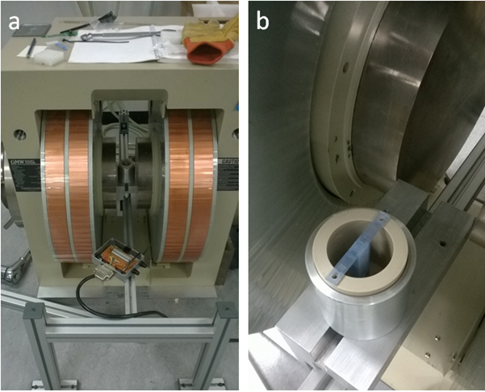
Hall probe calibration
Large cooled coils stable over wide current range
Lock holes keep probe perpendicular to field
Wide flat poles
give uniform field
Cup for LN2 (cryo calibration)
Groove keeps NMR probe close to Hall probe
Calibration magnet at DL Hall probe holder with LN2 cup

Slide 15
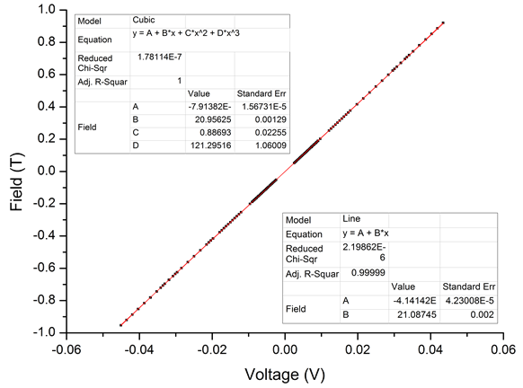
Hall probe calibration
Real calibration of a Hall probe at Daresbury
Theory suggests linear fit with gradient defined by combination of G and R_{H}
Cubic fit used to account for other nonlinearities e.g. non-constant G due to thermal expansion/ contraction

Slide 16
The planar Hall effect
If the Hall probe is rotated by an angle θ about the axis of current flow there is only a simple cos(θ) reduction in measured field.
If the Hall probe is rotated by an angle Φ about the axis of the voltage contacts then the field has a component in the plane of the current flow.
The probe may be further rotated by an angle ψ so that the component in the plane of the probe is not parallel to the current flow.
ψ
V-
Blue arrow is ideal field
Ψ rotation only matters if φ is not orthogonal to field
φ
θ
V+

Slide 17


The planar Hall effect
The planar hall voltage is given by
$$V_{HP}= G_{p} I {BXY}_{}^{2} \sin{2ψ}$$
Where G_{P} is a constant geometric factor unique to the probe and is generally unknown
V-
φ
$V=V_{H}+V_{HP}$!!!!
B_{XY}
ψ
Blue arrow is ideal field
Ψ rotation only matters if φ is not orthogonal to field
V+

Slide 18
Multi-axis probes
The total voltage across the contacts is a combination of the transverse and planar Hall voltage and the cannot be easily split!
This is a problem in 3 axis probes. A large signal is seen from the probe that is supposed to be transverse but the other axes will measure > 0V, is this purely planar Hall effect or is there really an unwanted transverse field component?
The simplest way of estimating what measurements are “real” is to repeat the reading at 90 degree rotations about θ.
Commercial “compensated probes” are available that have multiple active areas in different orientations which distinguish transverse and planar.

Slide 19
Hall probe purpose
Hall probe advantages include:
Can operate over a huge variety of ranges defines by the voltmeter.
  Probes can range from <1mT to >10T
Tiny active area
  fine features and detailed maps of complex fields.
Can operate immersed in cryogens.
  useful for superconducting magnets
Provide directionality and component information
  3-axis probes can measure XYZ field components simultaneously.
Response time is fast and generally limited by the voltmeter.
  Can measure AC magnets up to few kHz
External electronics are simple and reliable
  full multi-axis measurement bench assembly or simply use a handheld reader for quick measurements.
Hall probe disadvantages include:
Probes need to be calibrated to assess nonlinearities.
  Susceptible to long term calibration drift.
Calibration gradient is temperature sensitive.
  Must be calibrated at the temp at which they will be used, and must be actively held constant or monitored to compensate.
Error bars not fixed, accuracy is a % of read value, % changes as value range changes.
  low field measurements may be lost in noise, makes measuring harmonics difficult.
3D field mapping is complicated by the planar hall effect.

Slide 20
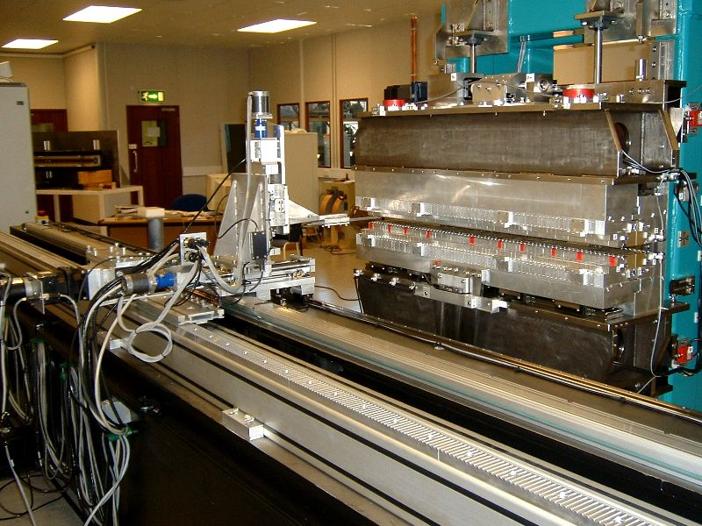
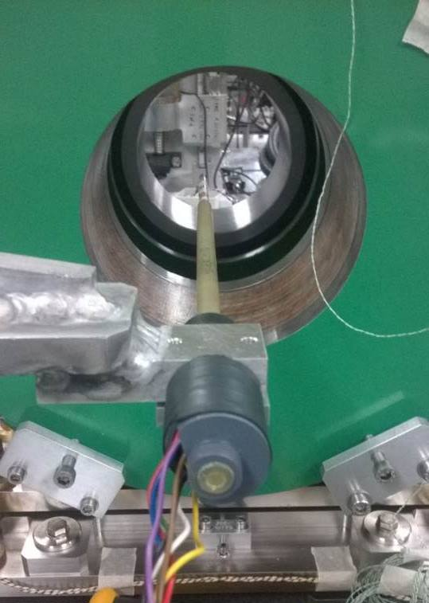
Hall probe at Daresbury

Slide 21
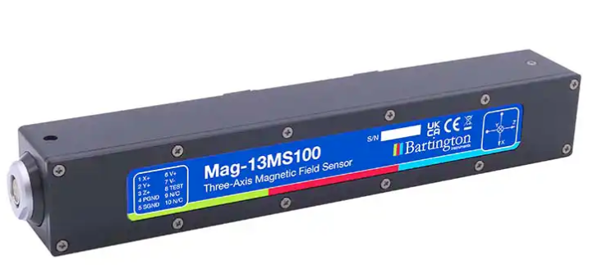
Fluxgates
Fluxgate magnetometry is an extremely sensitive technique for measuring fields with nT accuracy, but also saturate at very low fields.
Fluxgates are extremely effective at detecting tiny field variations and measuring performance of magnetic shields – but just get overloaded in high fields.
Most fluxgates cannot measure reliably above a few mT but below that can have error bars of 1 nT!

Slide 22
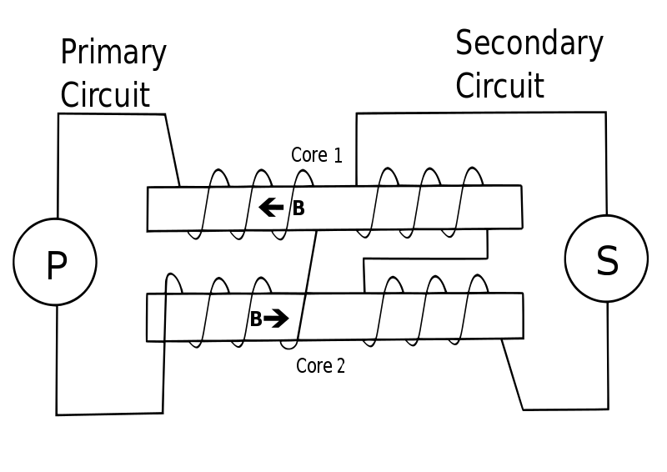
Fluxgates
There are lots of different ways of building a fluxgate – most are proprietary designs.
They all feature 2 sets of windings around high permeability material – some use 1 rod, some use 2, most use a single ring instead of rods.

Slide 23
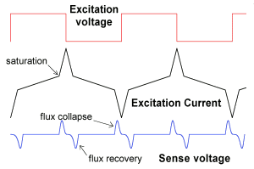
Fluxgates
1 coil saturates the rods in a sin/square wave.
2nd coil picks up change the waveform from hitting saturation

Slide 24
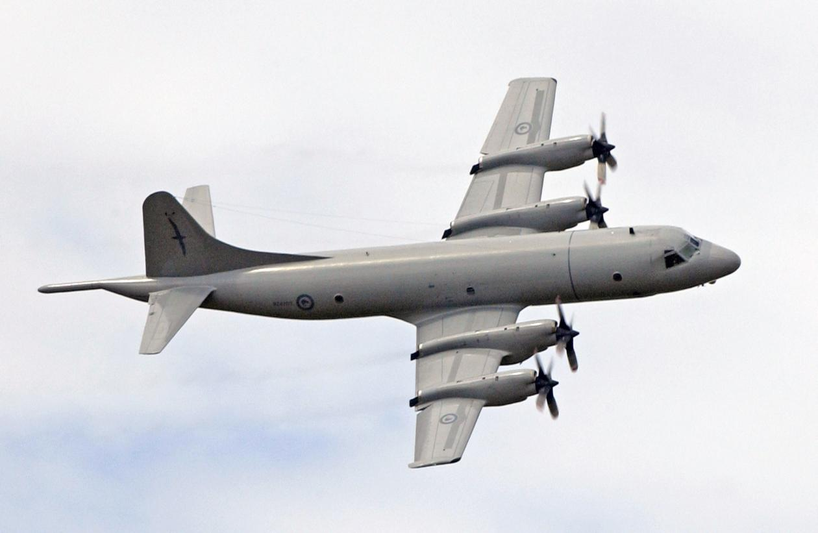
Fluxgates
Just how sensitive is a fluxgate?
Fluxgate in tail boom can detect steel hull of submarine if plane flies overhead.
Plane flying at 500 ft altitude can detect submarine at 500 ft depth!
Lockheed P3 ORION submarine hunting aircraft / torpedo bomber

Slide 25
Integrated field measurements

Slide 26
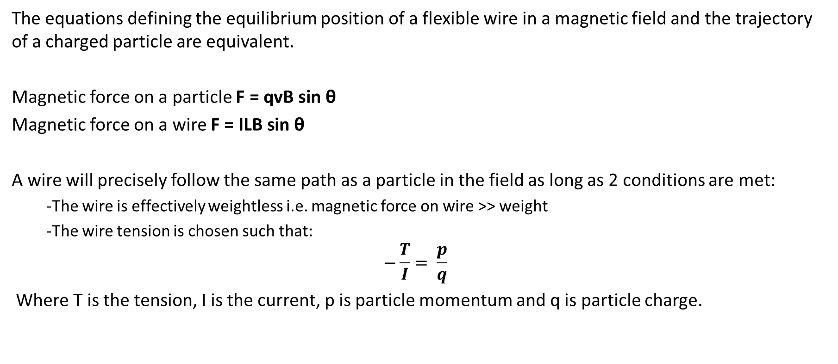
Floating wire theory
The equations defining the equilibrium position of a flexible wire in a magnetic field and the trajectory of a charged particle are equivalent.
Magnetic force on a particle $\text{F}\text{ = }\text{qvB} \text{sin} \text{θ}$
Magnetic force on a wire $\text{F}\text{ = }\text{ILB} \text{sin} \text{θ}$
A wire will precisely follow the same path as a particle in the field as long as 2 conditions are met:
  -The wire is effectively weightless i.e. magnetic force on wire >> weight
  -The wire tension is chosen such that:
  $$−\frac{T}{I}= \frac{p}{q}$$
Where T is the tension, I is the current, p is particle momentum and q is particle charge.

Slide 27
Floating wire in reality
A thin flexible wire, often Nickel due to incandescence, is placed through the magnet and a high current is pulsed to avoid overheating.
Optical detection is normally used to assess the wire position.
An old technique, not often used today for serious measurements but a fun demonstration and visualisation of dipoles and undulators.
Was very useful for checking axis of oscillation in undulators, but now superseded by other techniques.
Still occasionally used for large dipoles, very accurate at revealing bend radius and exit trajectory.

Slide 28
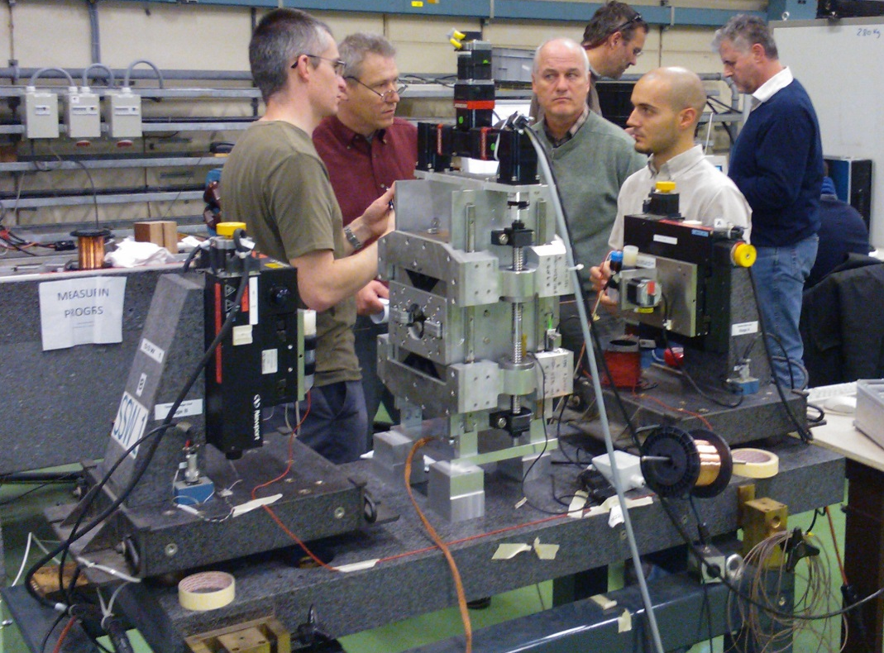
Stretched wire bench basics
Conductive wire (copper, Cu-Be or Ti-Al) stretched along Z between 2 XY motion stages.
The ends of the wire are connected through an ultra-low noise voltmeter or ammeter.
When the wire is moved a detectable voltage is induced.

Slide 29
Stretched wire bench basics
The wire must be moved at a constant speed (typically 1-5 cm/s)!
During straight motion the voltmeter/ammeter is triggered at regular intervals, the induced voltage reveals the integrated field along the entire length of the magnet (Z) at the XY coordinate of the trigger.
The wire can be swept in circular segments to measure harmonics, approximating a rotating coil system (discussed later).
Accuracy is key- speed must be known and stages must move in sync, linear encoders provide micron level position accuracy in motion stages.

Slide 30
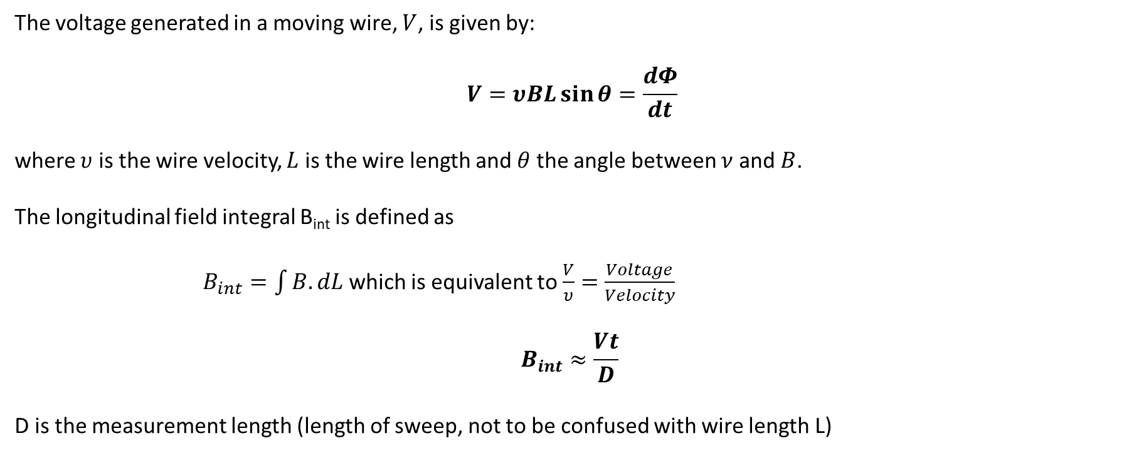
Stretched wire theory
The voltage generated in a moving wire, $V$, is given by:
$$V=υBL\sin{θ}=\frac{dΦ}{dt}$$
where $υ$ is the wire velocity, $L$ is the wire length and $θ$ the angle between $ν$ and $B$.
The longitudinal field integral B_{int} is defined as
$B_{int}=\int{B.dL}$ which is equivalent to $\frac{V}{υ}=\frac{Voltage}{Velocity}$
$$B_{int}≈\frac{Vt}{D}$$
D is the measurement length (length of sweep, not to be confused with wire length L)

Slide 31
Stretched wire purpose
The Stretched wire is an essential technique for characterising insertion devices where the integrated field should be 0! (If the integral is not zero the electron beam will exit at an angle!)
It is also useful on long multipole magnets which may not readily fit on a Hall probe measuring system.
  Not suitable for measuring curved dipoles, wire tension must be maintained!
Can be used in-situ for measurements of long straight sections including multiple focusing elements.
  Gives total integrated field and field gradient along whole path!
Also very good at finding the magnetic axis of quadrupoles!

Slide 32
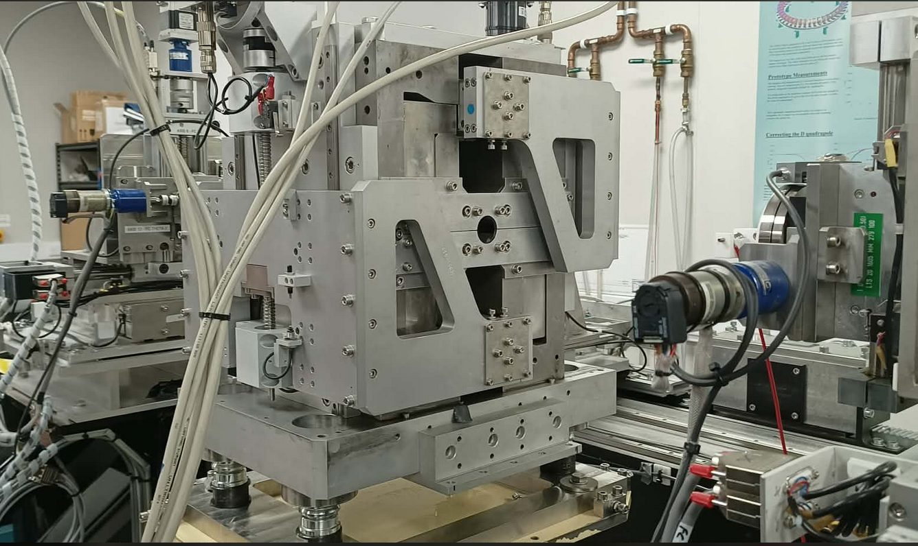
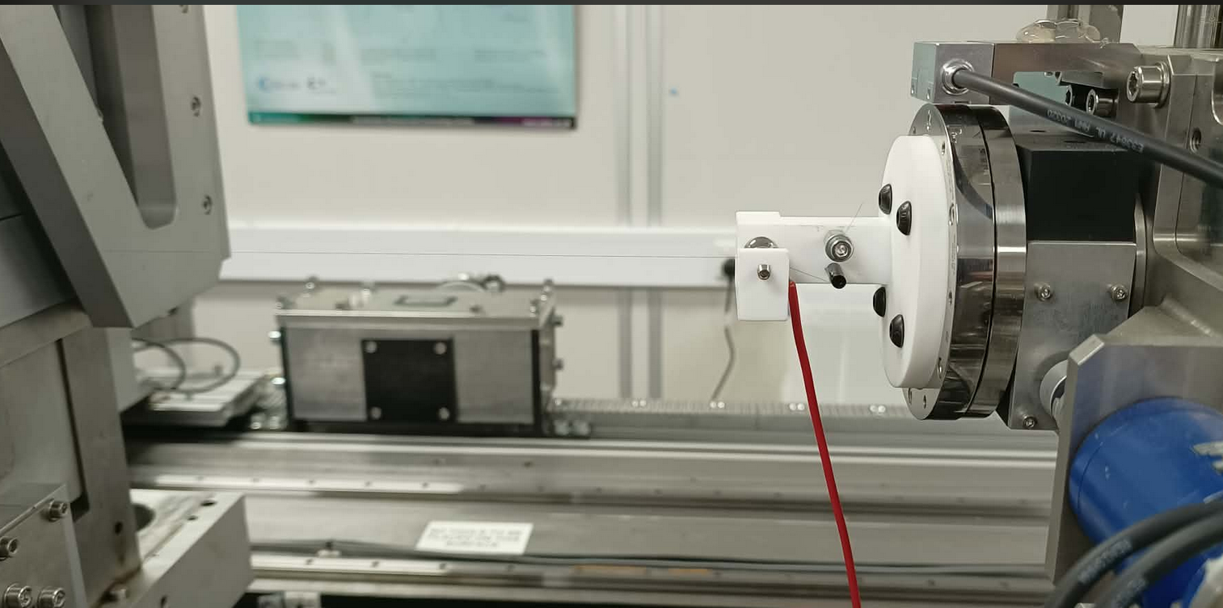
Stretched wire system at Daresbury
Uses 75 micron diameter Copper-Beryllium wire tensioned to a natural frequency of 150 Hz (50Hz software filter removes mains noise from signal)

Slide 33
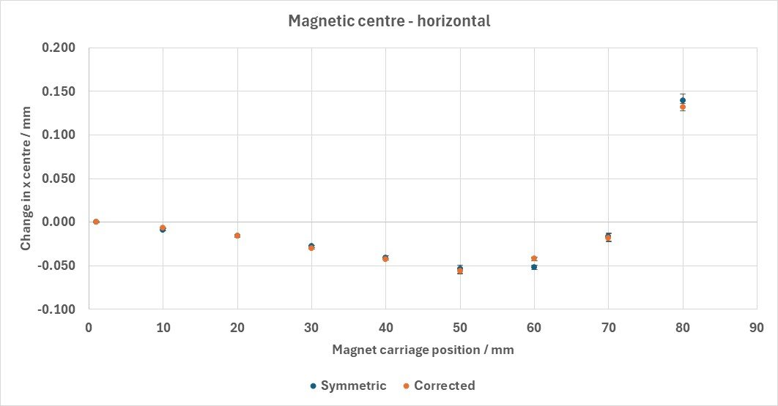
Stretched wire system at Daresbury
e.g. using stretched wire to find the magnetic axis movement of a ZEPTO quadrupole – accurate to a few microns!

Slide 34
The vibrating wire trick
If a wire in a magnet carries a time-varying current the Lorentz force will cause a detectable oscillation. Stretched wire benches often have a signal generator attached to the wire for this purpose.
This can be a very sensitive method of detecting very small fields.
  When near the magnetic axis of a quadrupole, a Hall probe will read near the noise making the exact axis location difficult to determine.
  The vibrating wire will experience smaller oscillations as it gets closer to the axis and will stop oscillating when perfectly on axis!

Slide 35
The vibrating wire trick
Vibrating wires are most commonly used to assess undulators and wigglers, as an alternative to the floating wire.
Unlike the floating wire the tension does not need to be matched, instead the applied current frequency should be vibrating mode resonance.
Path at the max amplitude of the resulting standing wave reproduces the beam trajectory. Node locations allow precise longitudinal alignment!
T=0
T=f/2

Slide 36
Measuring field harmonics

Slide 37
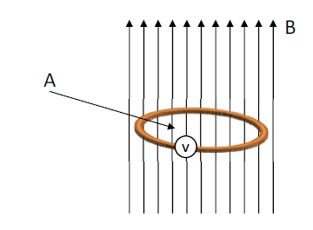
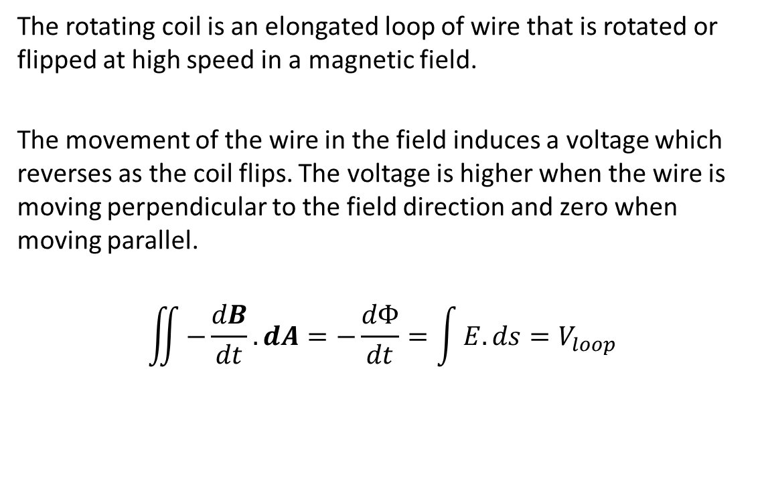
Rotating coil basics
The rotating coil is an elongated loop of wire that is rotated or flipped at high speed in a magnetic field.
The movement of the wire in the field induces a voltage which reverses as the coil flips. The voltage is higher when the wire is moving perpendicular to the field direction and zero when moving parallel.
$$\iint{−\frac{dB}{dt}.dA}=−\frac{dΦ}{dt}=\int{E.ds}=V_{loop}$$

Slide 38
Rotating Coil Basics
Unlike other integrated field techniques the rotating coil can accurately resolve higher harmonics i.e. when a dipole acts as a slight quadrupole.
This allows spotting of manufacturing errors that cause asymmetric fields that could ruin beam dynamics.
Limiting of higher order allowed and illegal harmonics is often a specified feature of magnet designs, a rotating coil is often the only way to check!
Rarely used on curved dipoles as the coil would have to follow the magnet curvature, but very useful on higher order magnets and straight dipoles. A variant called the “Traversing coil” is sometimes used on curves.

Slide 39
Rotating coil basics
A variety of configurations are possible:
  V connects to a voltmeter via an integrator
V
V
V
The most basic version-
Coil central to the magnet axis – sees odd harmonics
Better version-
1 arm of coil on the magnet axis – sees all harmonics
Asymmetric coil-
Complex but reveals additional harmonics well – discussed later

Slide 40
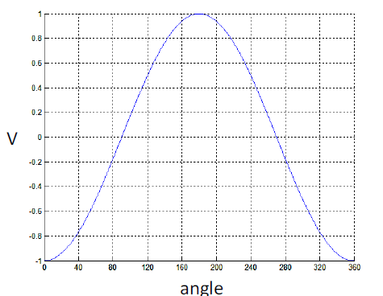
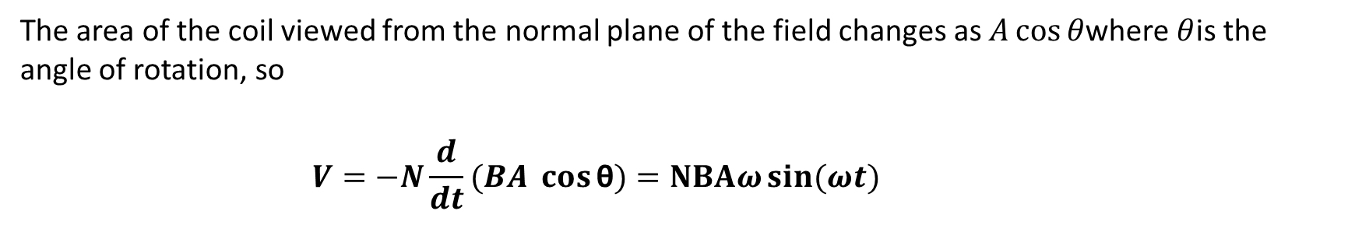
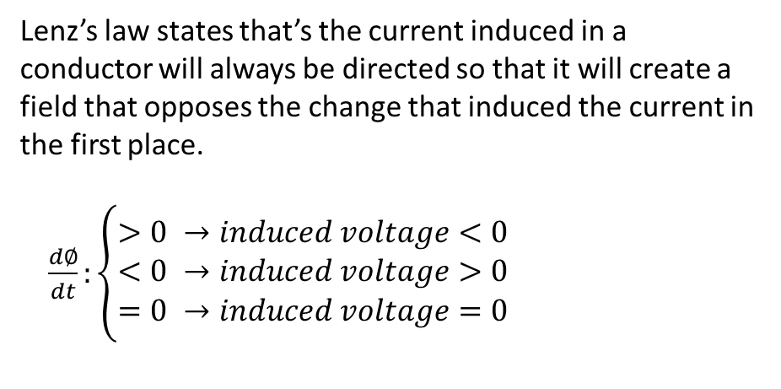
Faraday/Lenz law
The area of the coil viewed from the normal plane of the field changes as $A\cos{θ}$where $θ$is the angle of rotation, so
          $$V=−N\frac{d}{dt}(BA \cos{\text{θ})}=NBAω\sin{(ωt)}$$
Lenz’s law states that’s the current induced in a conductor will always be directed so that it will create a field that opposes the change that induced the current in the first place.
$\frac{d∅}{dt}:\left\{\begin{aligned}>0 →induced voltage<0 \\ <0 →induced voltage>0 \\ =0 →induced voltage=0\end{aligned}\right.$

Slide 41
Faraday/Lenz Law
In a perfect dipole field the voltage measured from the coil as it rotates will be perfectly sinusoidal with 1 period per complete rotation.
In a perfect quadrupole field there will be 2 periods per complete rotation, 3 for a sextupole e.t.c…
If there is an error in the magnet shape e.g. curve in dipole face producing quadrupole field, the oscillation will not be perfectly sinusiodal…
The total shape of the waveform is defined by a combination of many contributing components, mostly by the base magnet type but also inevitably by allowed multipole harmonics and additional harmonics due to manufacturing errors.

Slide 42
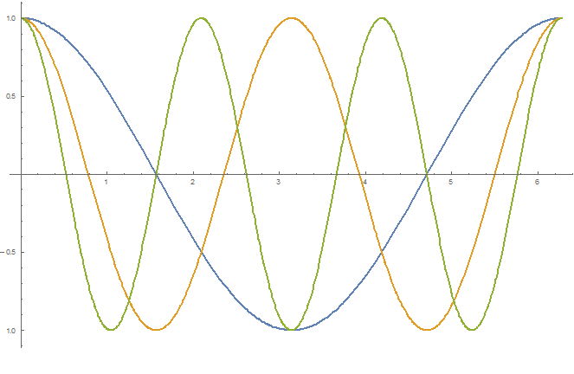
Faraday/Lenz law
V
Dipole
Quadrupole
θ
Sextupole

Slide 43
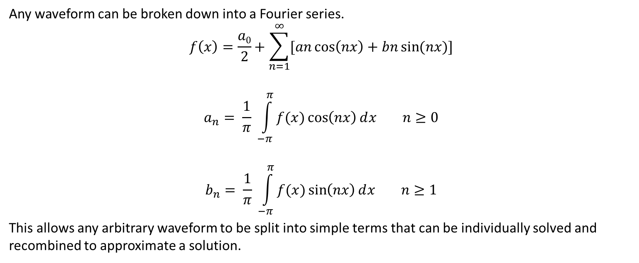
Harmonic Analysis
Any waveform can be broken down into a Fourier series.
$$f\left(x\right)=\frac{a0}{2}+\sum_{n=1}^{∞}{[an\cos\left(nx\right)+bn\sin{(nx)}]}$$
$$a_{n}= \frac{1}{π} \int_{−π}^{π}{f(x)\cos\left(nx\right)ⅆx n≥0}$$
$$b_{n}= \frac{1}{π} \int_{−π}^{π}{f(x)\sin\left(nx\right)ⅆx n≥1}$$
This allows any arbitrary waveform to be split into simple terms that can be individually solved and recombined to approximate a solution.

Slide 44
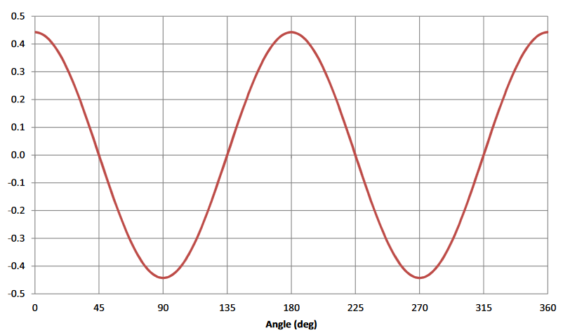
Harmonic Analysis
We can use Fourier analysis to split the measured waveform and identify anomalous components, for example:
A near perfect quad, Fourier series reveals n=6 and 10 (allowed harmonics), may effect beam dynamics
n | an | bn
1 | 0 | 0
2 | 0.4426 | 0
3 | 0 | 0
4 | 0 | 0
5 | 0 | 0
6 | 0.00012 | 0
7 | 0 | 0
8 | 0 | 0
9 | 0 | 0
10 | -0.000006 | 0
Example from USPAS 2016 (Mau Lopez)

Slide 45
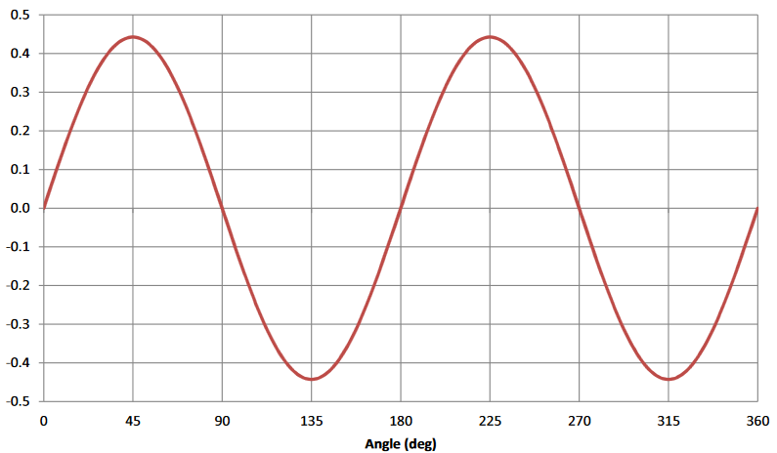
Harmonic Analysis
A Skew quad, rotation shifts terms from Cos to Sin…
A near perfect quad, Fourier series reveals n=6 and 10 (allowed harmonics), may effect beam dynamics
n | an | bn
1 | 0 | 0
2 | 0 | 0.4426
3 | 0 | 0
4 | 0 | 0
5 | 0 | 0
6 | 0 | 0.00012
7 | 0 | 0
8 | 0 | 0
9 | 0 | 0
10 | 0 | -0.000006
Example from USPAS 2016 (Mau Lopez)

Slide 46
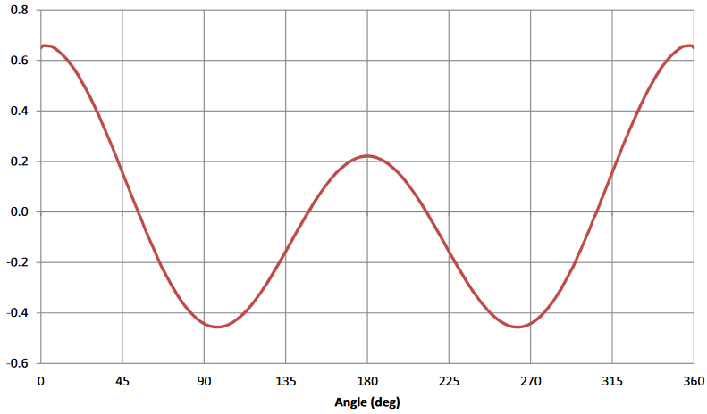
Harmonic Analysis
A slightly dodgy gradient magnet….
A gradient magnet should have significant n=1 and n=2 components, other components are inevitable but should be kept <1/1000 ratio.
n | an | bn
1 | 0.110650 | 0
2 | 0.442601 | 0
3 | 0.000019 | 0
4 | 0.000074 | 0
5 | 0.000146 | 0
6 | 0.000115 | 0
7 | -0.000009 | 0
8 | -0.000016 | 0
9 | -0.000021 | 0
10 | -0.000021 | 0
Example from USPAS 2016 (Mau Lopez)

Slide 47
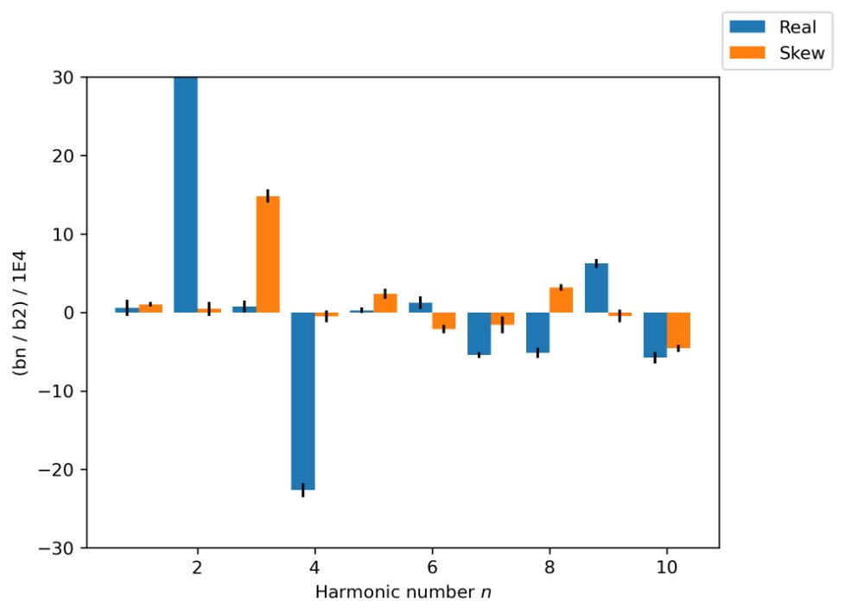
Using a stretched wire instead
It is possible to replicate the rotating coil using the stretched wire bench, we do this at Daresbury by sweeping the wire along a 22 sided polygon, approximating a circle, which gives accurate harmonics up to N=10 (more sides to get higher harmonics)
Recent magnet harmonics measurements at DL on quadrupole, using the stretched wire in a “circle”
Y axis is in “units” where harmonics are normalised to n=2 = 1000
(a weird but common convention)

Slide 48
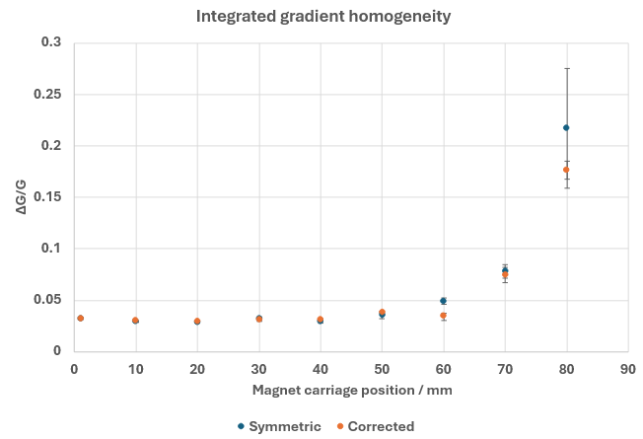

Using a stretched wire instead
The harmonic data taken by circular sweeps of the wire can also be used to calculate magnet homogeneity
(R0 is circle radius)
z=x+iy (x,y coordinates)
For a quadrupole.
Works by effectively summing up the
Higher order components

Slide 49
Bucked rotating coil
The fundamental field typically dominates the signal, and other harmonics from errors may be smaller by a factor of 1000 or more!
This is impossible to detect by single point techniques (e.g. grid of hall probe measurements) but can be detected by a sufficiently accurate rotating coil.
BUT the rotating coil is limited by the accuracy of the voltmeter or integrator, as well as the flexibility of the coil!
We can enhance the detection of errors by adding a “bucking coil”, a second coil which cancels the fundamental field!

Slide 50
Bucked rotating coil
2 nested asymmetric coils with differing numbers of turns:
  Inner coil has N_{in} turns
  Outer coil has N_{out} turns
r3
r1
r2
The 2 coils are connected
In series opposition
r4
N_{out}
N_{in}
N_{in}
N_{out}

Slide 51
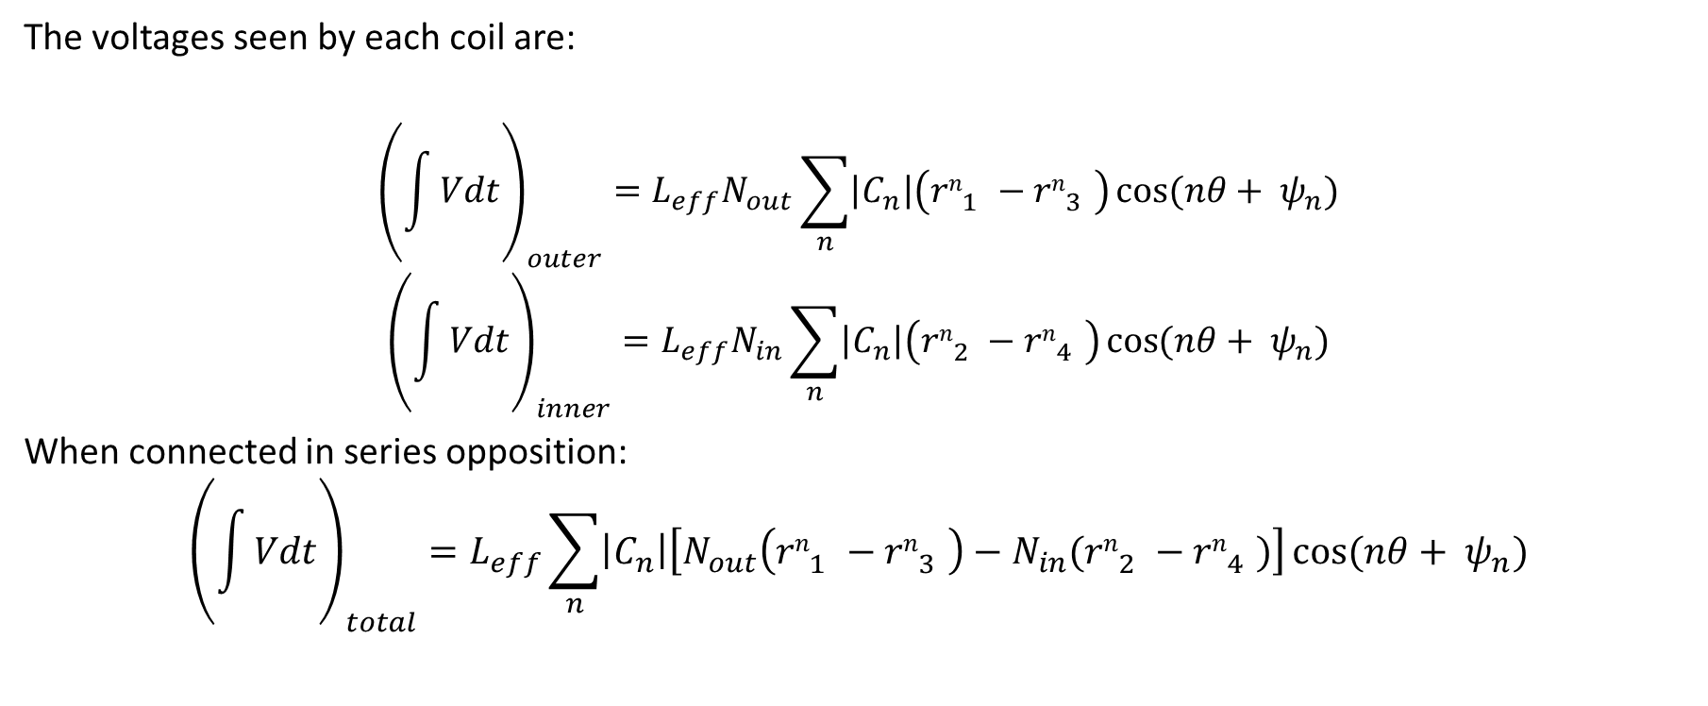
Bucked rotating coil
The voltages seen by each coil are:
$${\left(\int{Vdt}\right)}_{outer}=L_{eff}N_{out}\sum_{n}{\left|C_{n}\right|\left({rn}_{1}^{}−{rn}_{3}^{}\right)\cos{(nθ+ ψ_{n})}}$$
$${\left(\int{Vdt}\right)}_{inner}=L_{eff}N_{in}\sum_{n}{\left|C_{n}\right|\left({rn}_{2}^{}−{rn}_{4}^{}\right)\cos{(nθ+ ψ_{n})}}$$
When connected in series opposition:
$${\left(\int{Vdt}\right)}_{total}=L_{eff}\sum_{n}{\left|C_{n}\right|\left[N_{out}\left({rn}_{1}^{}−{rn}_{3}^{}\right)−N_{in}({rn}_{2}^{}−{rn}_{4}^{})\right]\cos{(nθ+ ψ_{n})}}$$
(not derived here, Cn and ψn are complex constant/phase, treat qualitatively)

Slide 52

Bucked rotating coil
Its more useful to define:
$β_{1}=\left|\frac{r_{3}}{r_{1}}\right|$ $β_{2}=\left|\frac{r_{4}}{r_{2}}\right|$ $ρ=\frac{r_{2}}{r_{1}}$ $μ=\frac{Nin}{Nout}$
We then define the coil sensitivity S_{n}:
$$S_{n}=\left(1−\left(−β_{1}\right)n\right)− μ ρn(1−\left(−β_{2}\right)n)$$
And so
$${\left(\int{Vdt}\right)}_{total}=L_{eff}\sum_{n}{\left|C_{n}\right|rn1 sn\cos{(nθ+ ψ_{n})}}$$

Slide 53

Bucked rotating coil
The S_{n} parameter can be interpreted as literally defining how sensitive the coil is to a given harmonic, and choosing parameters that make S_{n} small for a given harmonic supresses measurement of that harmonic.
For example, by picking $β_{1}=0.5, β_{2}=0.2, ρ=0.625, μ=2$ we supress both the n=1 and n=2 components of the field.
In practice measuring a dipole/quad/gradient magnet with these parameters will detected only the higher unwanted harmonics!
S
Harmonic

Slide 54
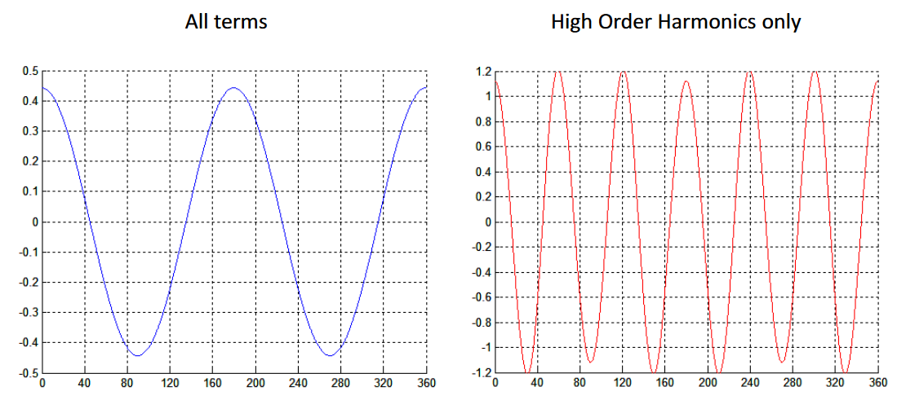
Bucked rotating coil
The resulting waveform will only have contributions from the higher harmonics, making them very easy to see and analyse.
Example from USPAS 2016 (Mau Lopez)

Slide 55
Practical magnet construction

Slide 56
Introduction
Our magnet design assumes that it can be made exactly to our perfect specifications. This is rarely the case – and in reality magnet design is about more than just physics, engineering is important!
Field quality is not just about pole design, it is also a function of fabrication, assembly and positioning tolerances and practises.
Magnet-to-magnet reproducibility also depends on the material properties.
The final magnet design must consider installation and alignment requirements from the start – here we highlight a few random things that may be overlooked despite their importance!

Slide 57
BH properties
The BH characteristics of steel vary with chemistry which depends on heat in the furnace and the cold-working history.
Even within the same batch properties can vary based on the way components float in the melt or whether the steel is from the start, middle or end of the batch as it is poured.
Laminations can help here – when a large number of laminations for different identical magnets are produced we can shuffle them between magnets. This distributes steel BH variation across the magnets.

Slide 58
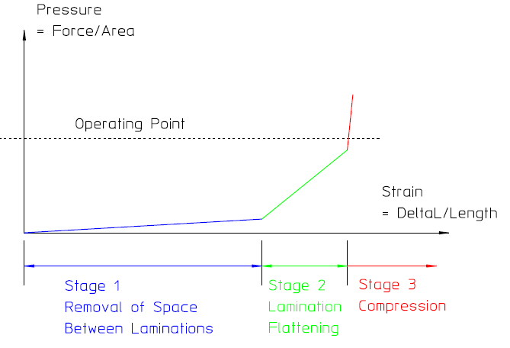
Core stacking
Stacks of laminations are slightly elastic- as the stack is compressed 3 effects happen:
Removal of space between laminations
Flattening of lamination warps
Metal compression
Cores may be assembled by welding or gluing – welding distorts the stack and gluing is weak.

Slide 59
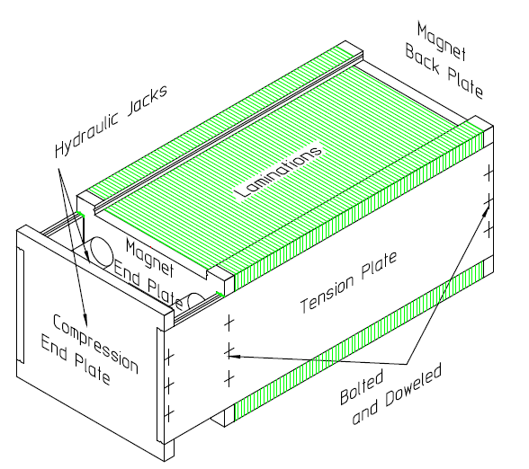
Core stacking
A mechanical frame with tension and compression plates can be used instead.
The compression plate can be moved as laminations are stacked in the frame.
Know what your tension plates are made of – they may form part of the magnetic circuit!

Slide 60
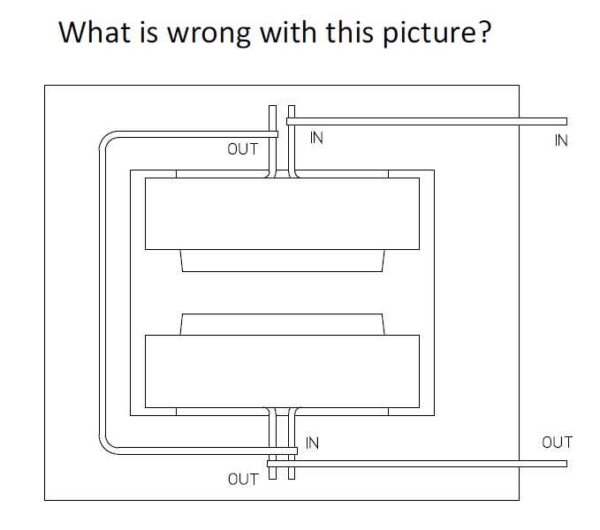
Magnet bussing

Slide 61
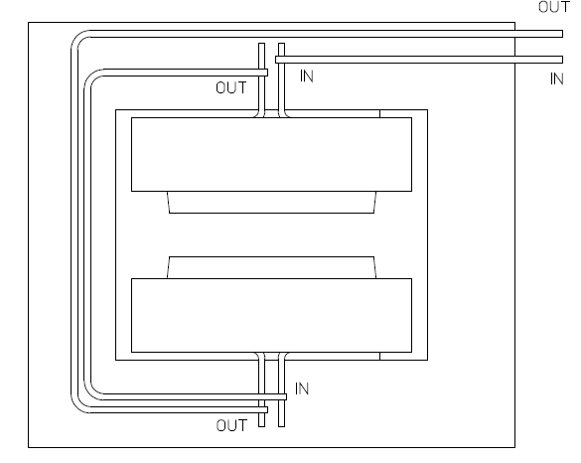
Magnet bussing

