Slide 1
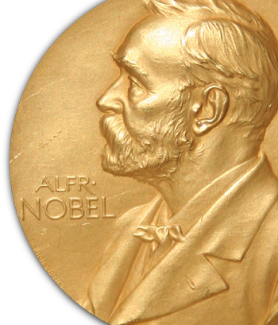
Chemistry Noble
Prize 2025
Pioneering Development of
Metal–Organic Frameworks (MOFs)
R. Robson, S. Kitagawa, and O. M. Yaghi
Mark Warren Senior Beamline Scientist, i19, DLS
mark.warren@diamond.ac.uk

Slide 2
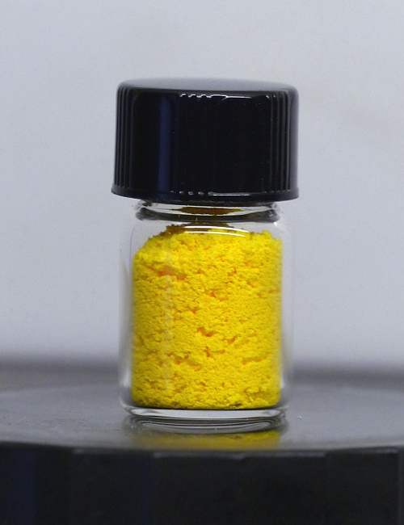
MOFs
Future Material
In the 1980s, if I told I wanted a material that could:
Pull clean drinking water out of desert air
Capture carbon dioxide like an ultra-porous sponge
Offer catalytic surface area so large that 1g equals a football field
Deliver drugs precisely to where the body needs them
Separate gases with molecular-level selectivity
Store hydrogen or methane efficiently for clean energy
Detect chemicals, pollutants, or explosives with high sensitivity
Desalinate water
But today, all these applications exist, and they fall under a single class of materials: Metal–Organic Frameworks (MOFs)
Notes:
But within 40 years this has happened

Slide 3
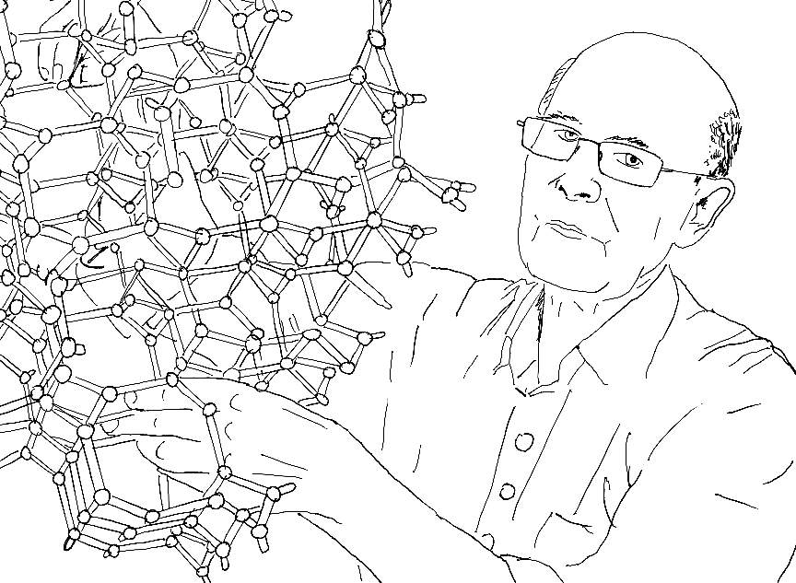
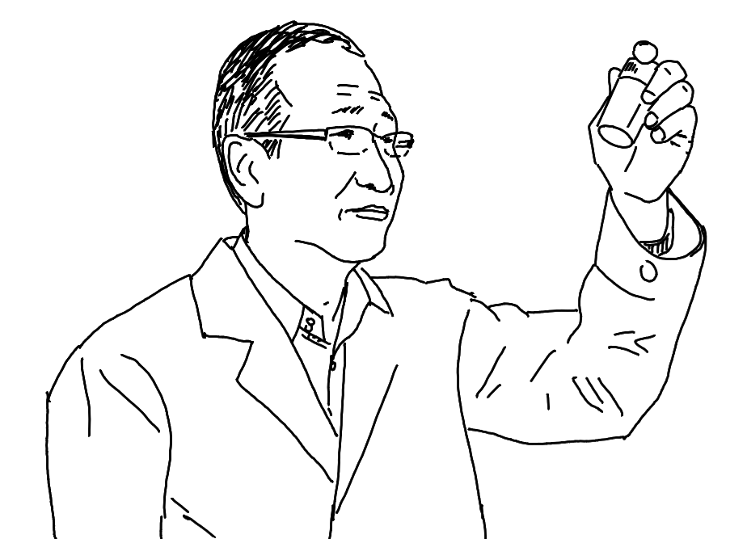
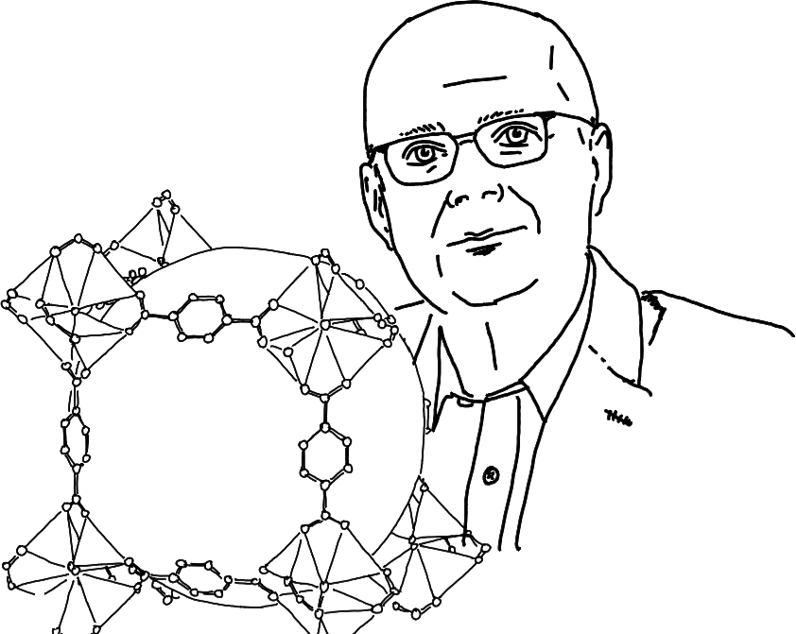
MOFs
2025 Chemistry Nobel Prize
Conception
Application
Streamline
Prof. Richard Robson
University of Melbourne Australia
Prof. Susumu Kitagawa
Kyoto University
Japan
Prof. Omar M. Yaghi
University of California,
Berkeley, USA

Slide 4
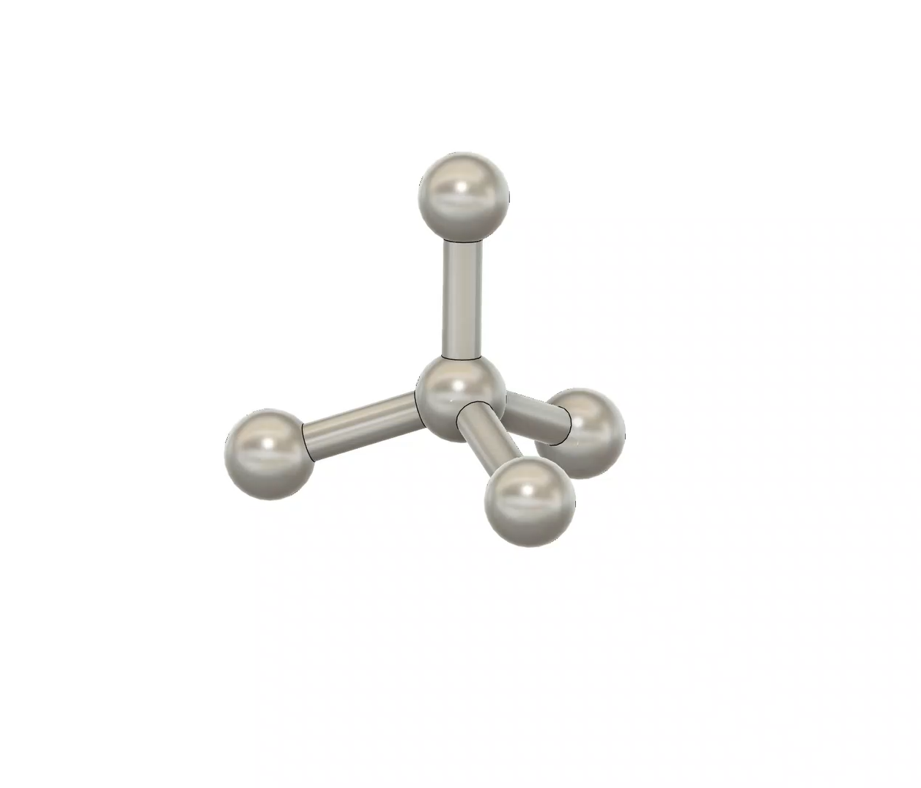
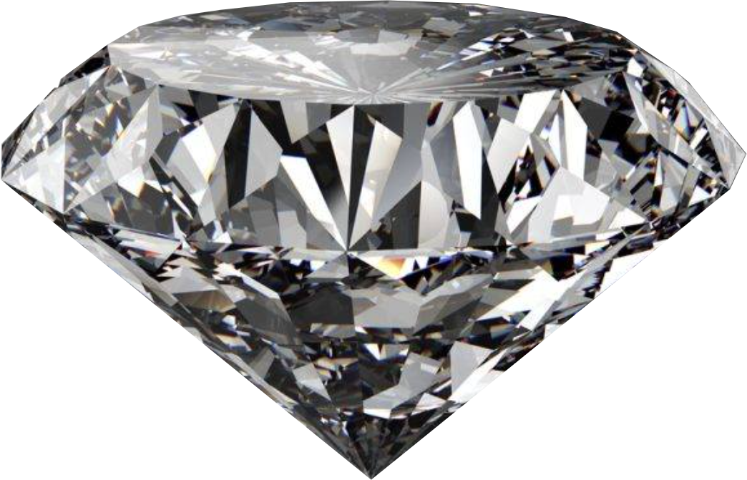
Richard Robson
CONCEPTION
Diamond
Carbon
109.5º
1.54Å
Extremely hard
Thermal conductivity High refractive index Chemical resistance
Tetrahedral geometry
Prof. Richard Robson
University of Melbourne
Notes:
Late 1980’s
Richard Robson was inspired by the structure of Diamond Every carbon atom is linked to four others
Tetrahedral geometry

Slide 5
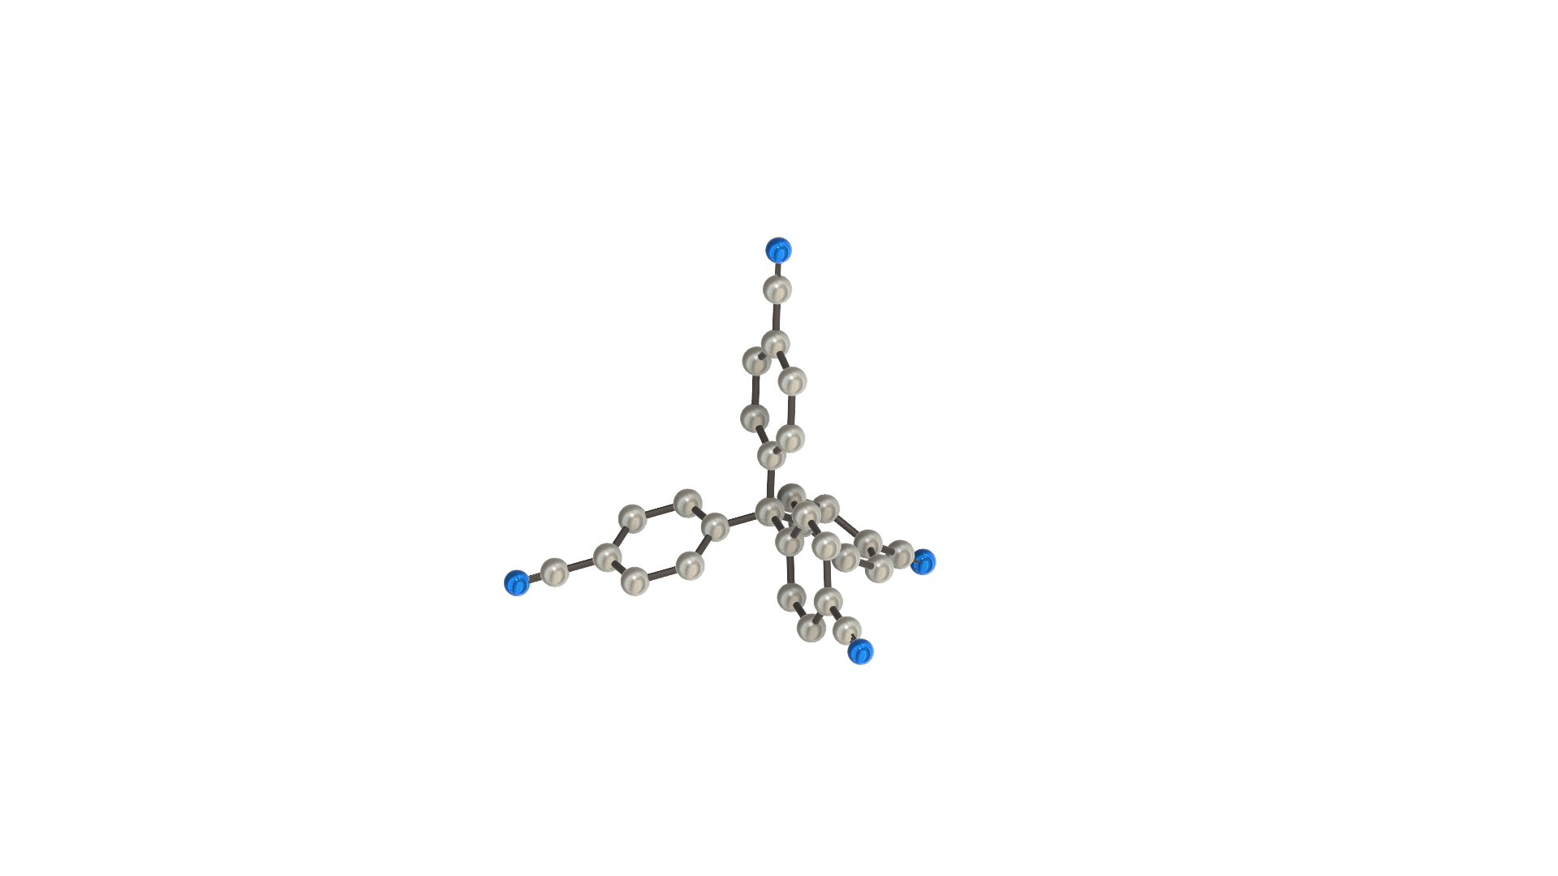
Richard Robson
CONCEPTION
4,4,4,4,-tetracyano-tetraphenyl-methane
Tetrahedral geometry
nitrile
8.86Å
109.5º
Prof. Richard Robson
University of Melbourne
tetraphenyl-methane
Notes:
In collaboration with Bernard Hoskins
Rather than carbon, he used a tetrahedral geometry organic molecule (4′,4″,4''',4''''-tetracyano-tetraphenyl-methane)
Tetraphenylmethane with a nitrile group at the tips of each phenyl

Slide 6
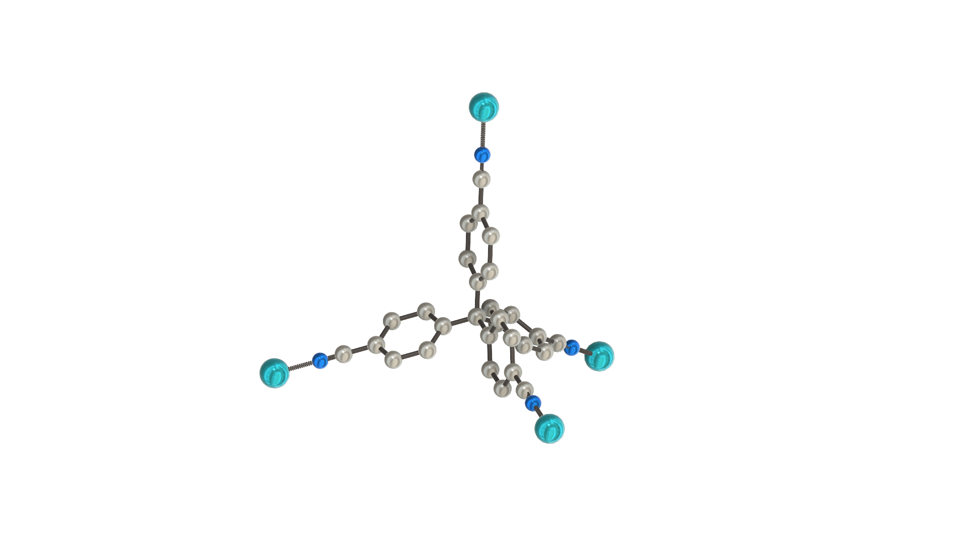
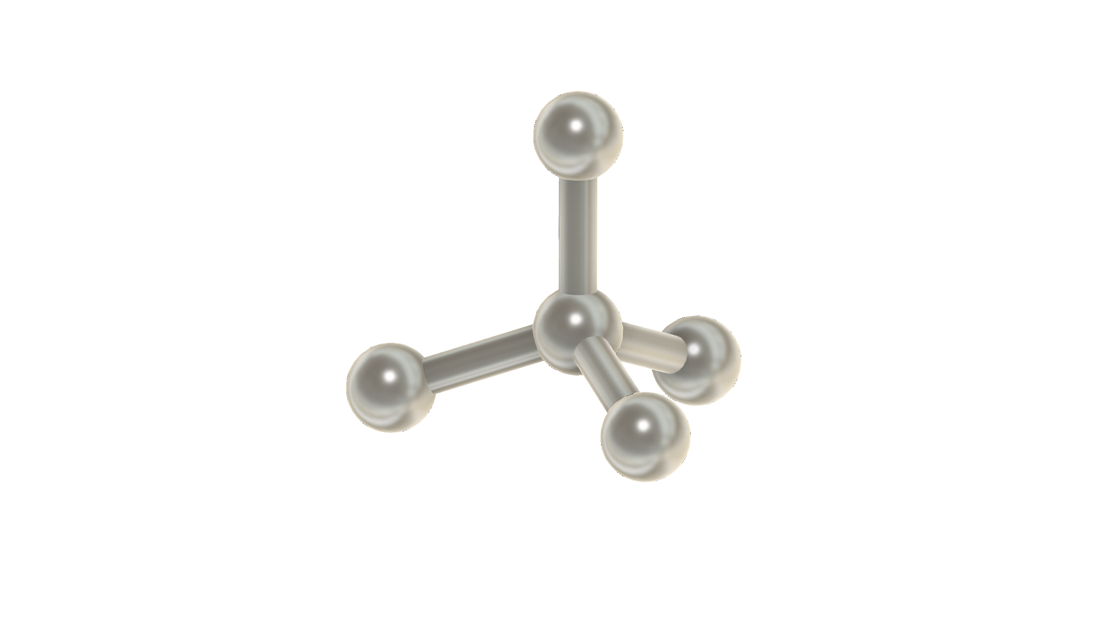
Richard Robson
CONCEPTION
Tetrahedral geometry
8.86Å
109.5º
Copper
metal node
Prof. Richard Robson
University of Melbourne
Organic linker
Notes:
This is a orgainic compound that is attracted to copper ions.
Self assemble
When the substances were combined, they formed an ordered and very spacious crystal.

Slide 7
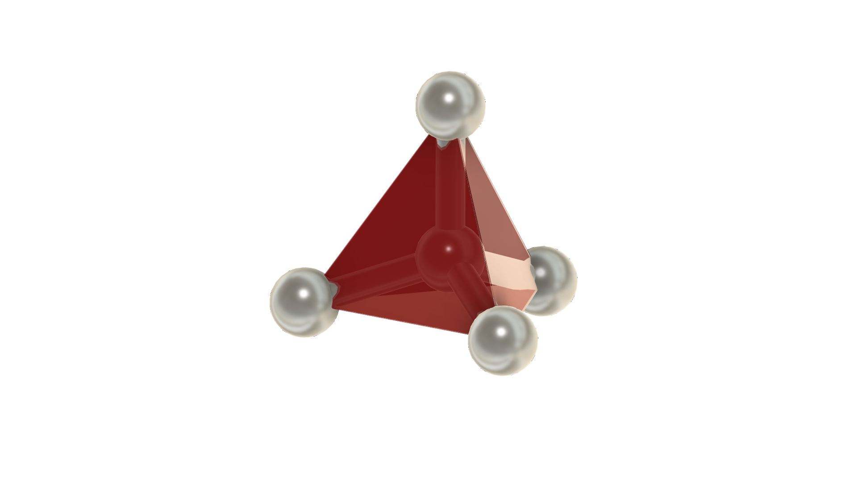
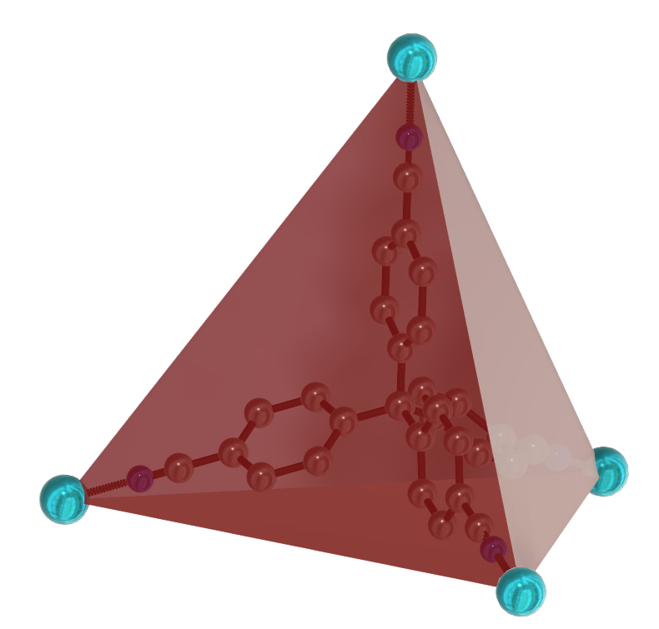
Richard Robson
CONCEPTION
Tetrahedral geometry
Prof. Richard Robson
University of Melbourne
Notes:
Late 1980’s 4′,4″,4''',4''''-tetracyano-tetraphenyl-methane
Richard Robson was inspired by the structure of diamond, in which every carbon atom is linked to four others in a pyramid-like shape. Rather than carbon, he used copper ions and a molecule with four arms, each with a nitrile at the end. This is a chemical compound that is attracted to copper ions. When the substances were combined, they formed an ordered and very spacious crystal. ©Johan Jarnestad/The Royal Swedish Academy of Sciences

Slide 8
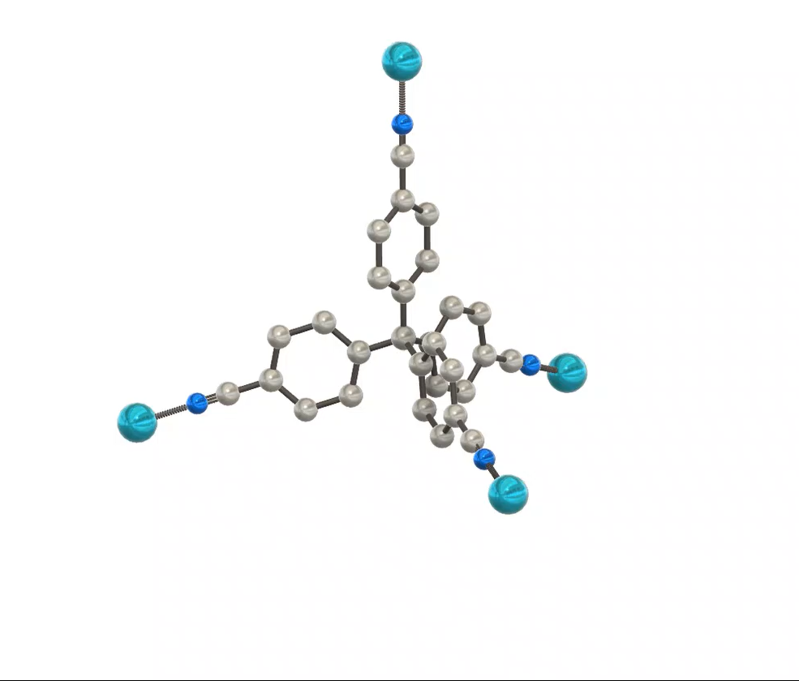
Richard Robson
CONCEPTION
Prof. Richard Robson
University of Melbourne
Notes:
In the same way at the carbon in diamond,
Each copper metal node can coordinate to four other linkers forming a 3D lattice

Slide 9
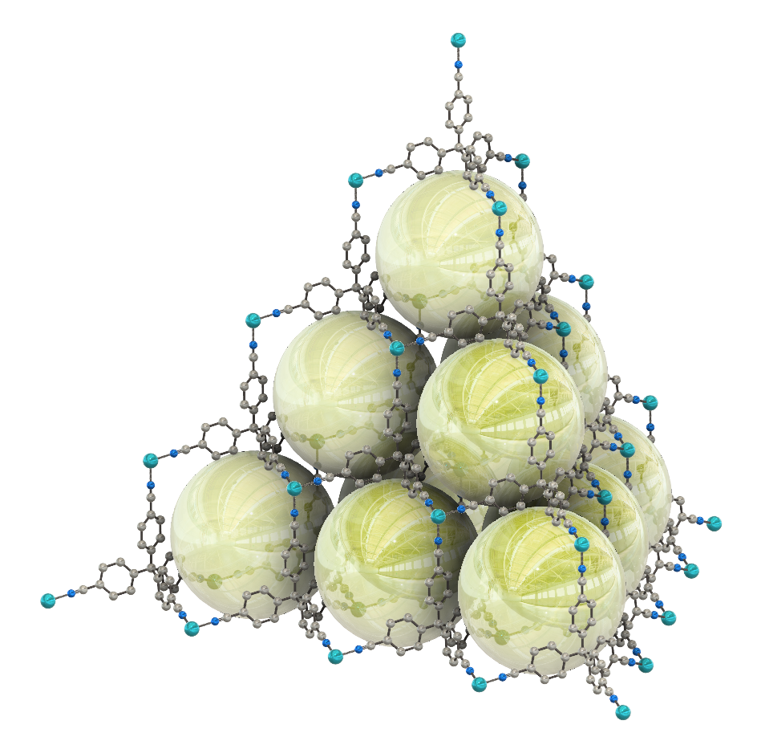
Richard Robson
CONCEPTION
voids
Prof. Richard Robson
University of Melbourne
Notes:
Remarkable these contain channels void space and channels running through the crystals
These voids give MOFS a huge internal surface area
This was the metal organic framework
However at this time these were too fragile

Slide 10
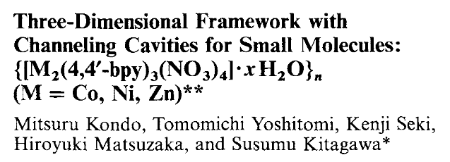
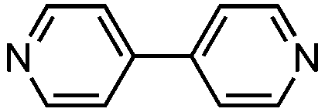
Susumu Kitagawa
Application
Current MOFs were too fragile to be in real life application
Introduced flexible organic frameworks Kitagawa showed that frameworks can also be stable, porous, and functional
Introducing the concept of porosity paving the way for MOFs in gas storage, CO2 capture, water purification and gas sensors
Prof. Susumu Kitagawa
Kyoto University, Japan
4-4-bipyridine (bpy)
Notes:
Porous Coordination Polymers (PCPs) 1997 flexible frameworks
“soft porous crystals” — MOFs whose frameworks are flexible or responsive (structurally, chemically or physically).
introducing the concept of porosity to coordination polymers
paved the way for MOFs in gas storage (hydrogen, methane), CO2 capture, water purification, and gas sensors.

Slide 11
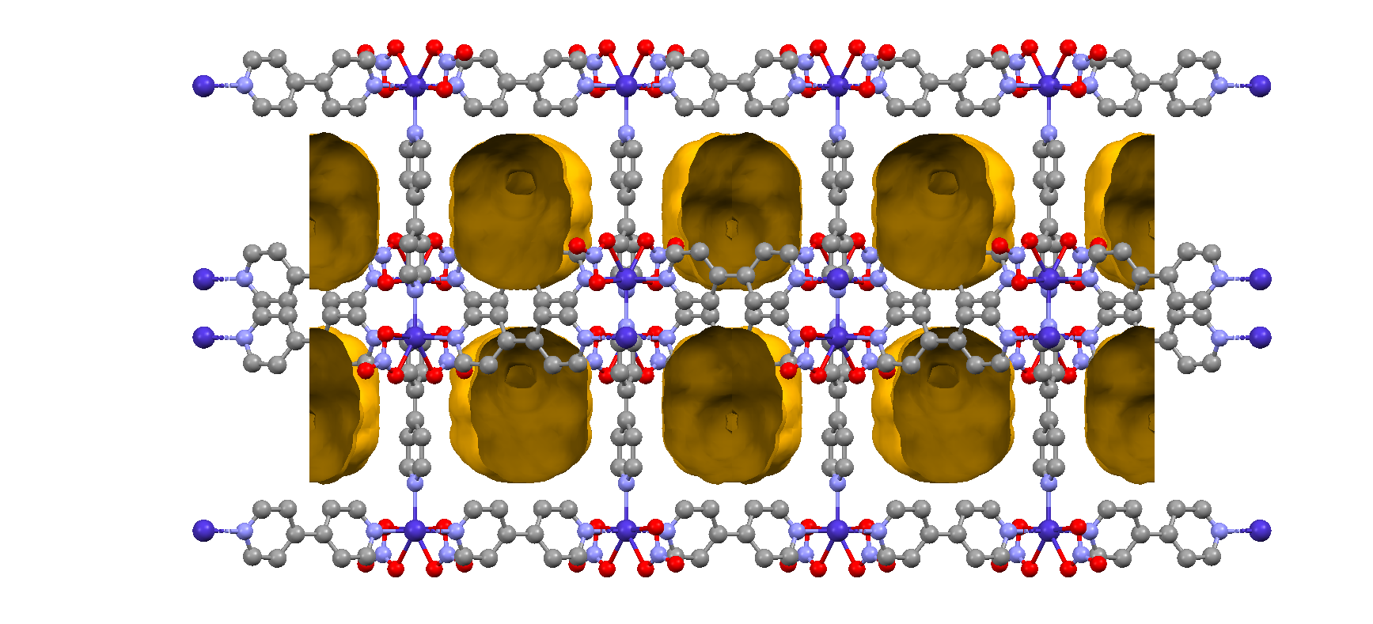
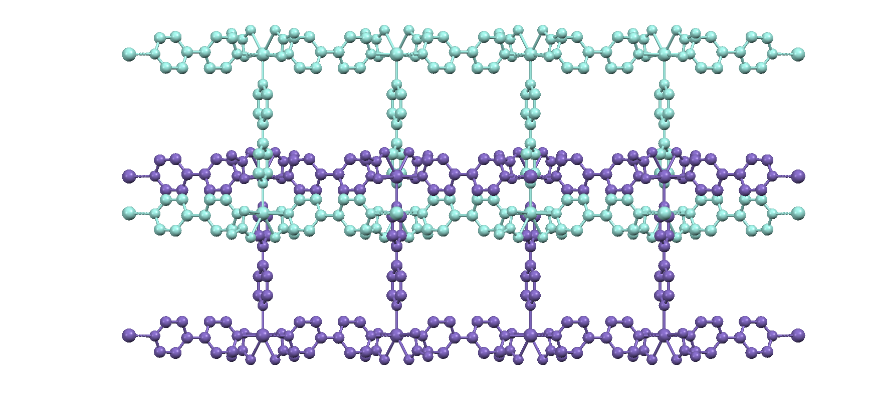
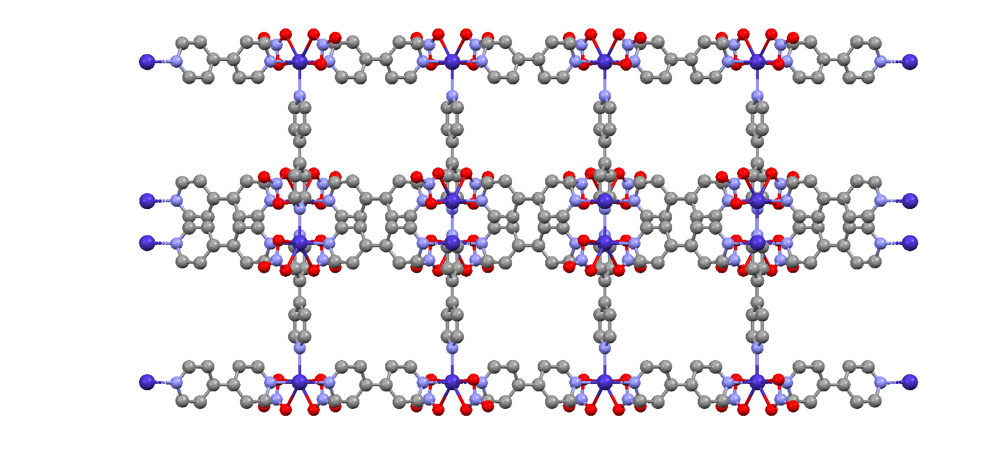
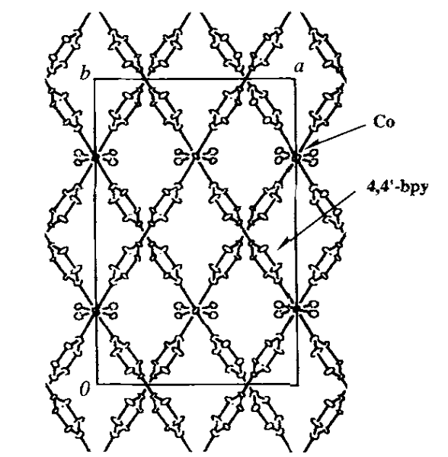
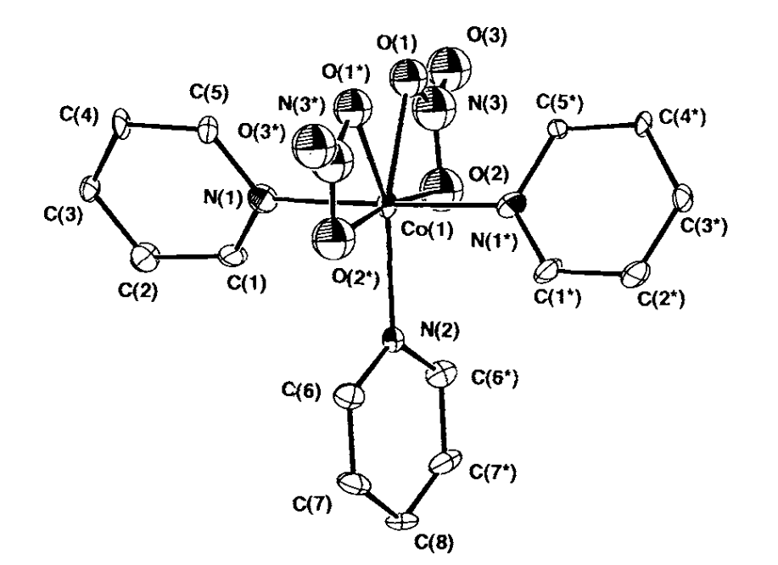
Susumu Kitagawa
Application
Prof. Susumu Kitagawa
Kyoto University, Japan
4-4-bipyridine (bpy)
Notes:
Porous Coordination Polymers (PCPs) introducing the concept of porosity to coordination polymers
paved the way for MOFs in gas storage (hydrogen, methane), CO2 capture, water purification, and gas sensors.
https://onlinelibrary.wiley.com/doi/epdf/10.1002/anie.199717251

Slide 12
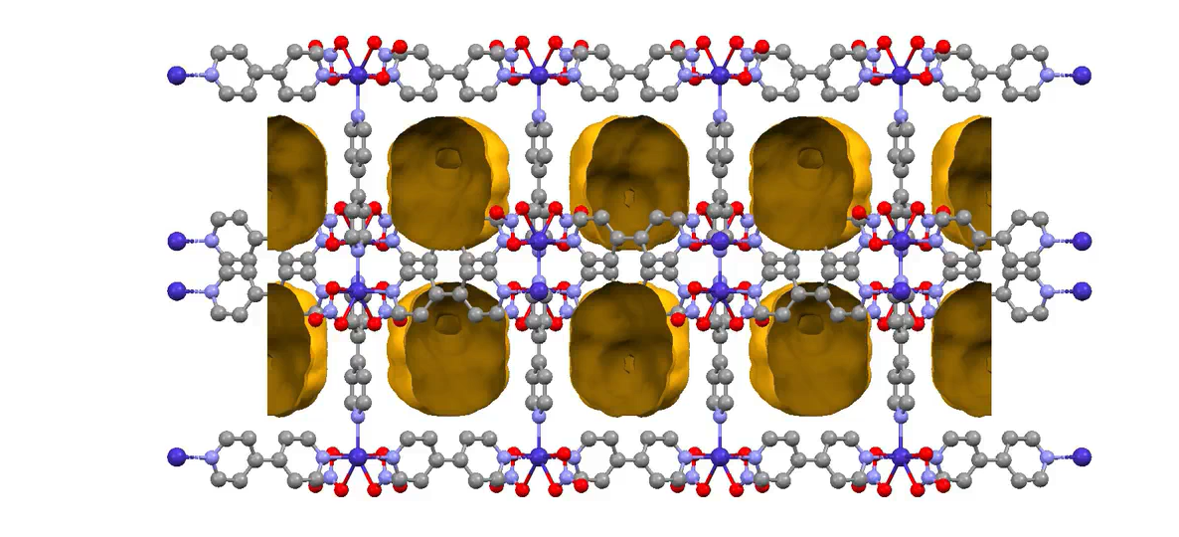
Susumu Kitagawa
Application
Prof. Susumu Kitagawa
Kyoto University, Japan
Notes:
Porous Coordination Polymers (PCPs) introducing the concept of porosity to coordination polymers
paved the way for MOFs in gas storage (hydrogen, methane), CO2 capture, water purification, and gas sensors.
https://onlinelibrary.wiley.com/doi/epdf/10.1002/anie.199717251

Slide 13
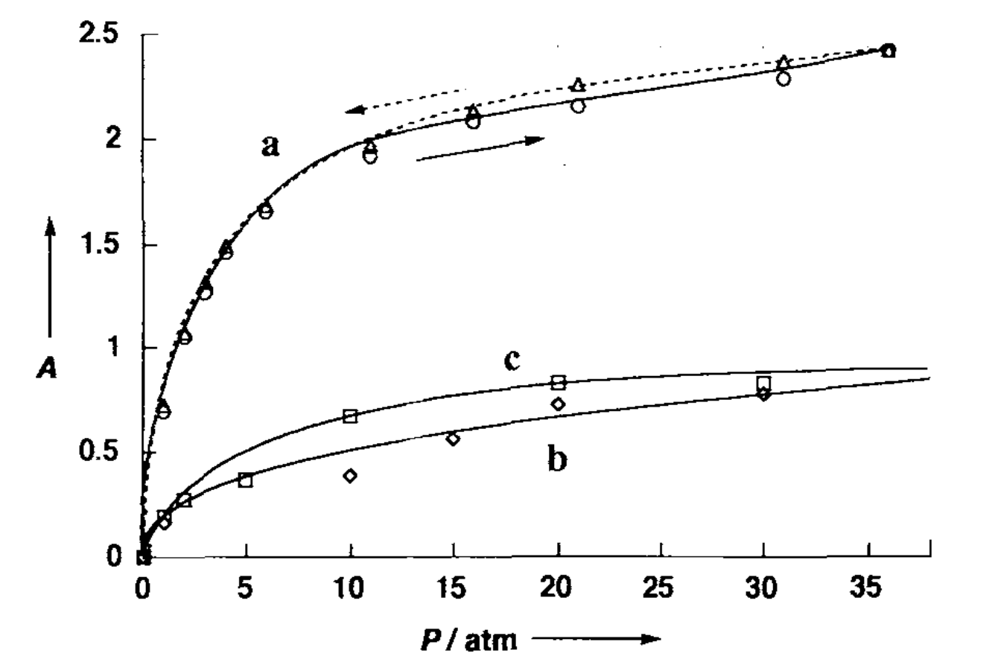
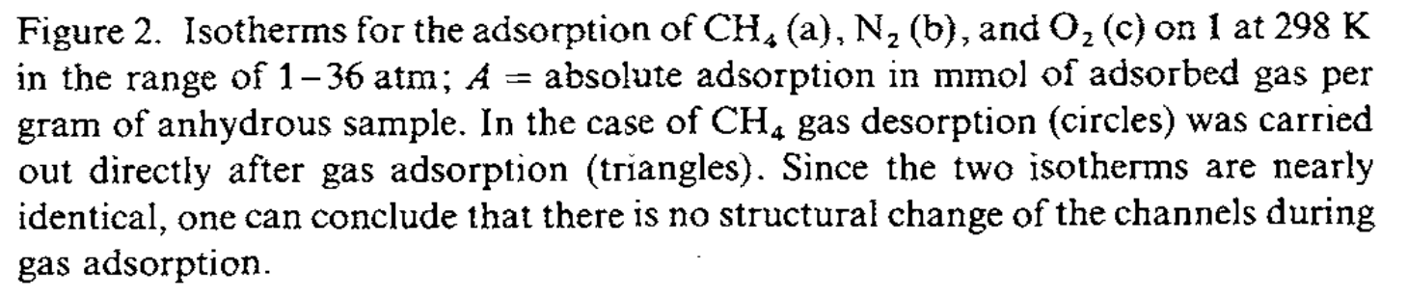
Susumu Kitagawa
Application
Prof. Susumu Kitagawa
Kyoto University, Japan
Demonstrated for the first time that MOFs can permanently maintain porosity and adsorb gases reversibly
Notes:
Porous Coordination Polymers (PCPs) introducing the concept of porosity to coordination polymers
paved the way for MOFs in gas storage (hydrogen, methane), CO2 capture, water purification, and gas sensors.
Able to absorb gas molecules and release them without falling apart. https://onlinelibrary.wiley.com/doi/epdf/10.1002/anie.199717251

Slide 14
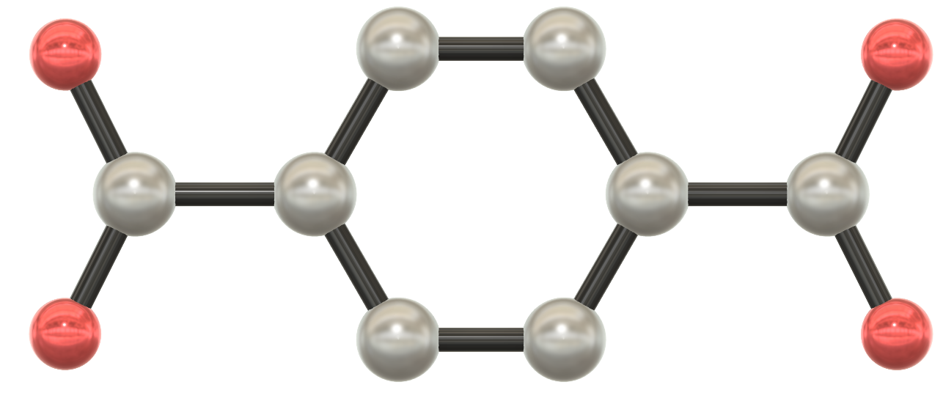
Omar Yaghi
Streamline
dicarboxylic acid – organic linkers
O
O⁻
⁻O
O
Prof. Omar M. Yaghi
University of California, Berkeley, USA
Notes:
Omar Haghi has an idea – can you make frameworks true customisable
Predictable crystalline structure - Grown up lego for the chemist
Linkers made of carboxylate groups or di-carboxylate

Slide 15
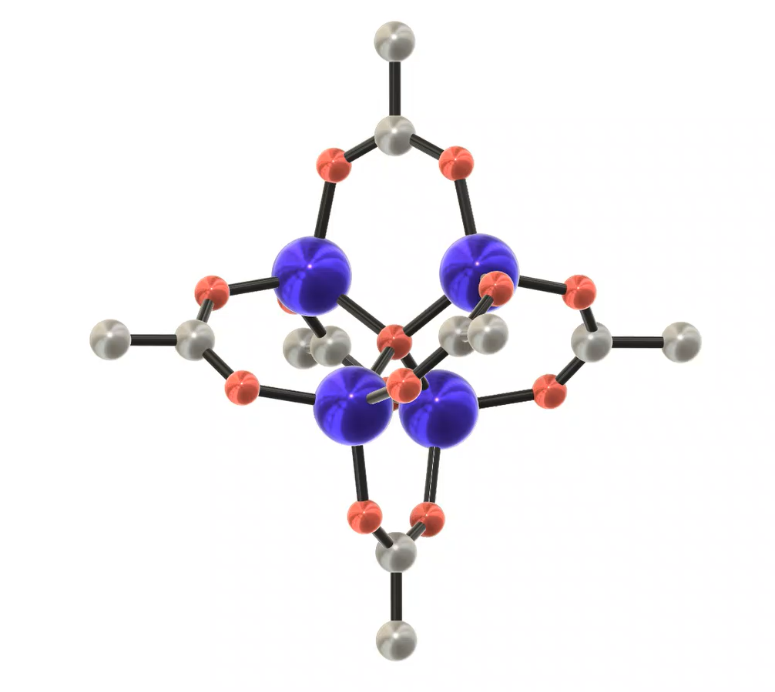
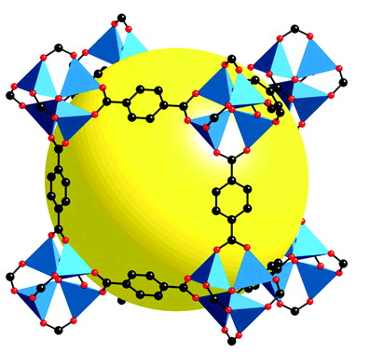
Omar Yaghi
Streamline
1-4,dicarboxylic acid – organic linkers
O
O⁻
⁻O
O
Prof. Omar M. Yaghi
University of California, Berkeley, USA
Metal paddlewheels
MOF5
Notes:
ZnO4 clusters
Paddle wheel – nodes
Combined with the dicarboxylic organic linkers
Yaghi coined the term ‘metal–organic framework’
Fantastic stability

Slide 16
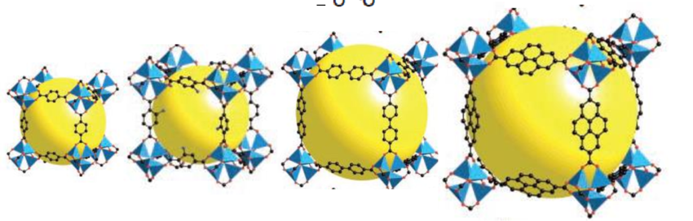
Omar Yaghi
Streamline
⁻O
O
⁻O
O
⁻O
O
O
O⁻
NH₂
⁻O
O
O
O⁻
O
O⁻
O
O⁻
Prof. Omar M. Yaghi
University of California, Berkeley, USA
O. M. Yaghi, M. O’Keeffe, N. W. Ockwig, H. K. Chae, M. Eddaoudi and J. Kim, Nature, 2003, 423, 705–714
Notes:
Able to adapt the linker to suit
16 types all with different properties
Different nano sized pours
Made customizable material to suit the requirements of the application
Opened up the field

Slide 17
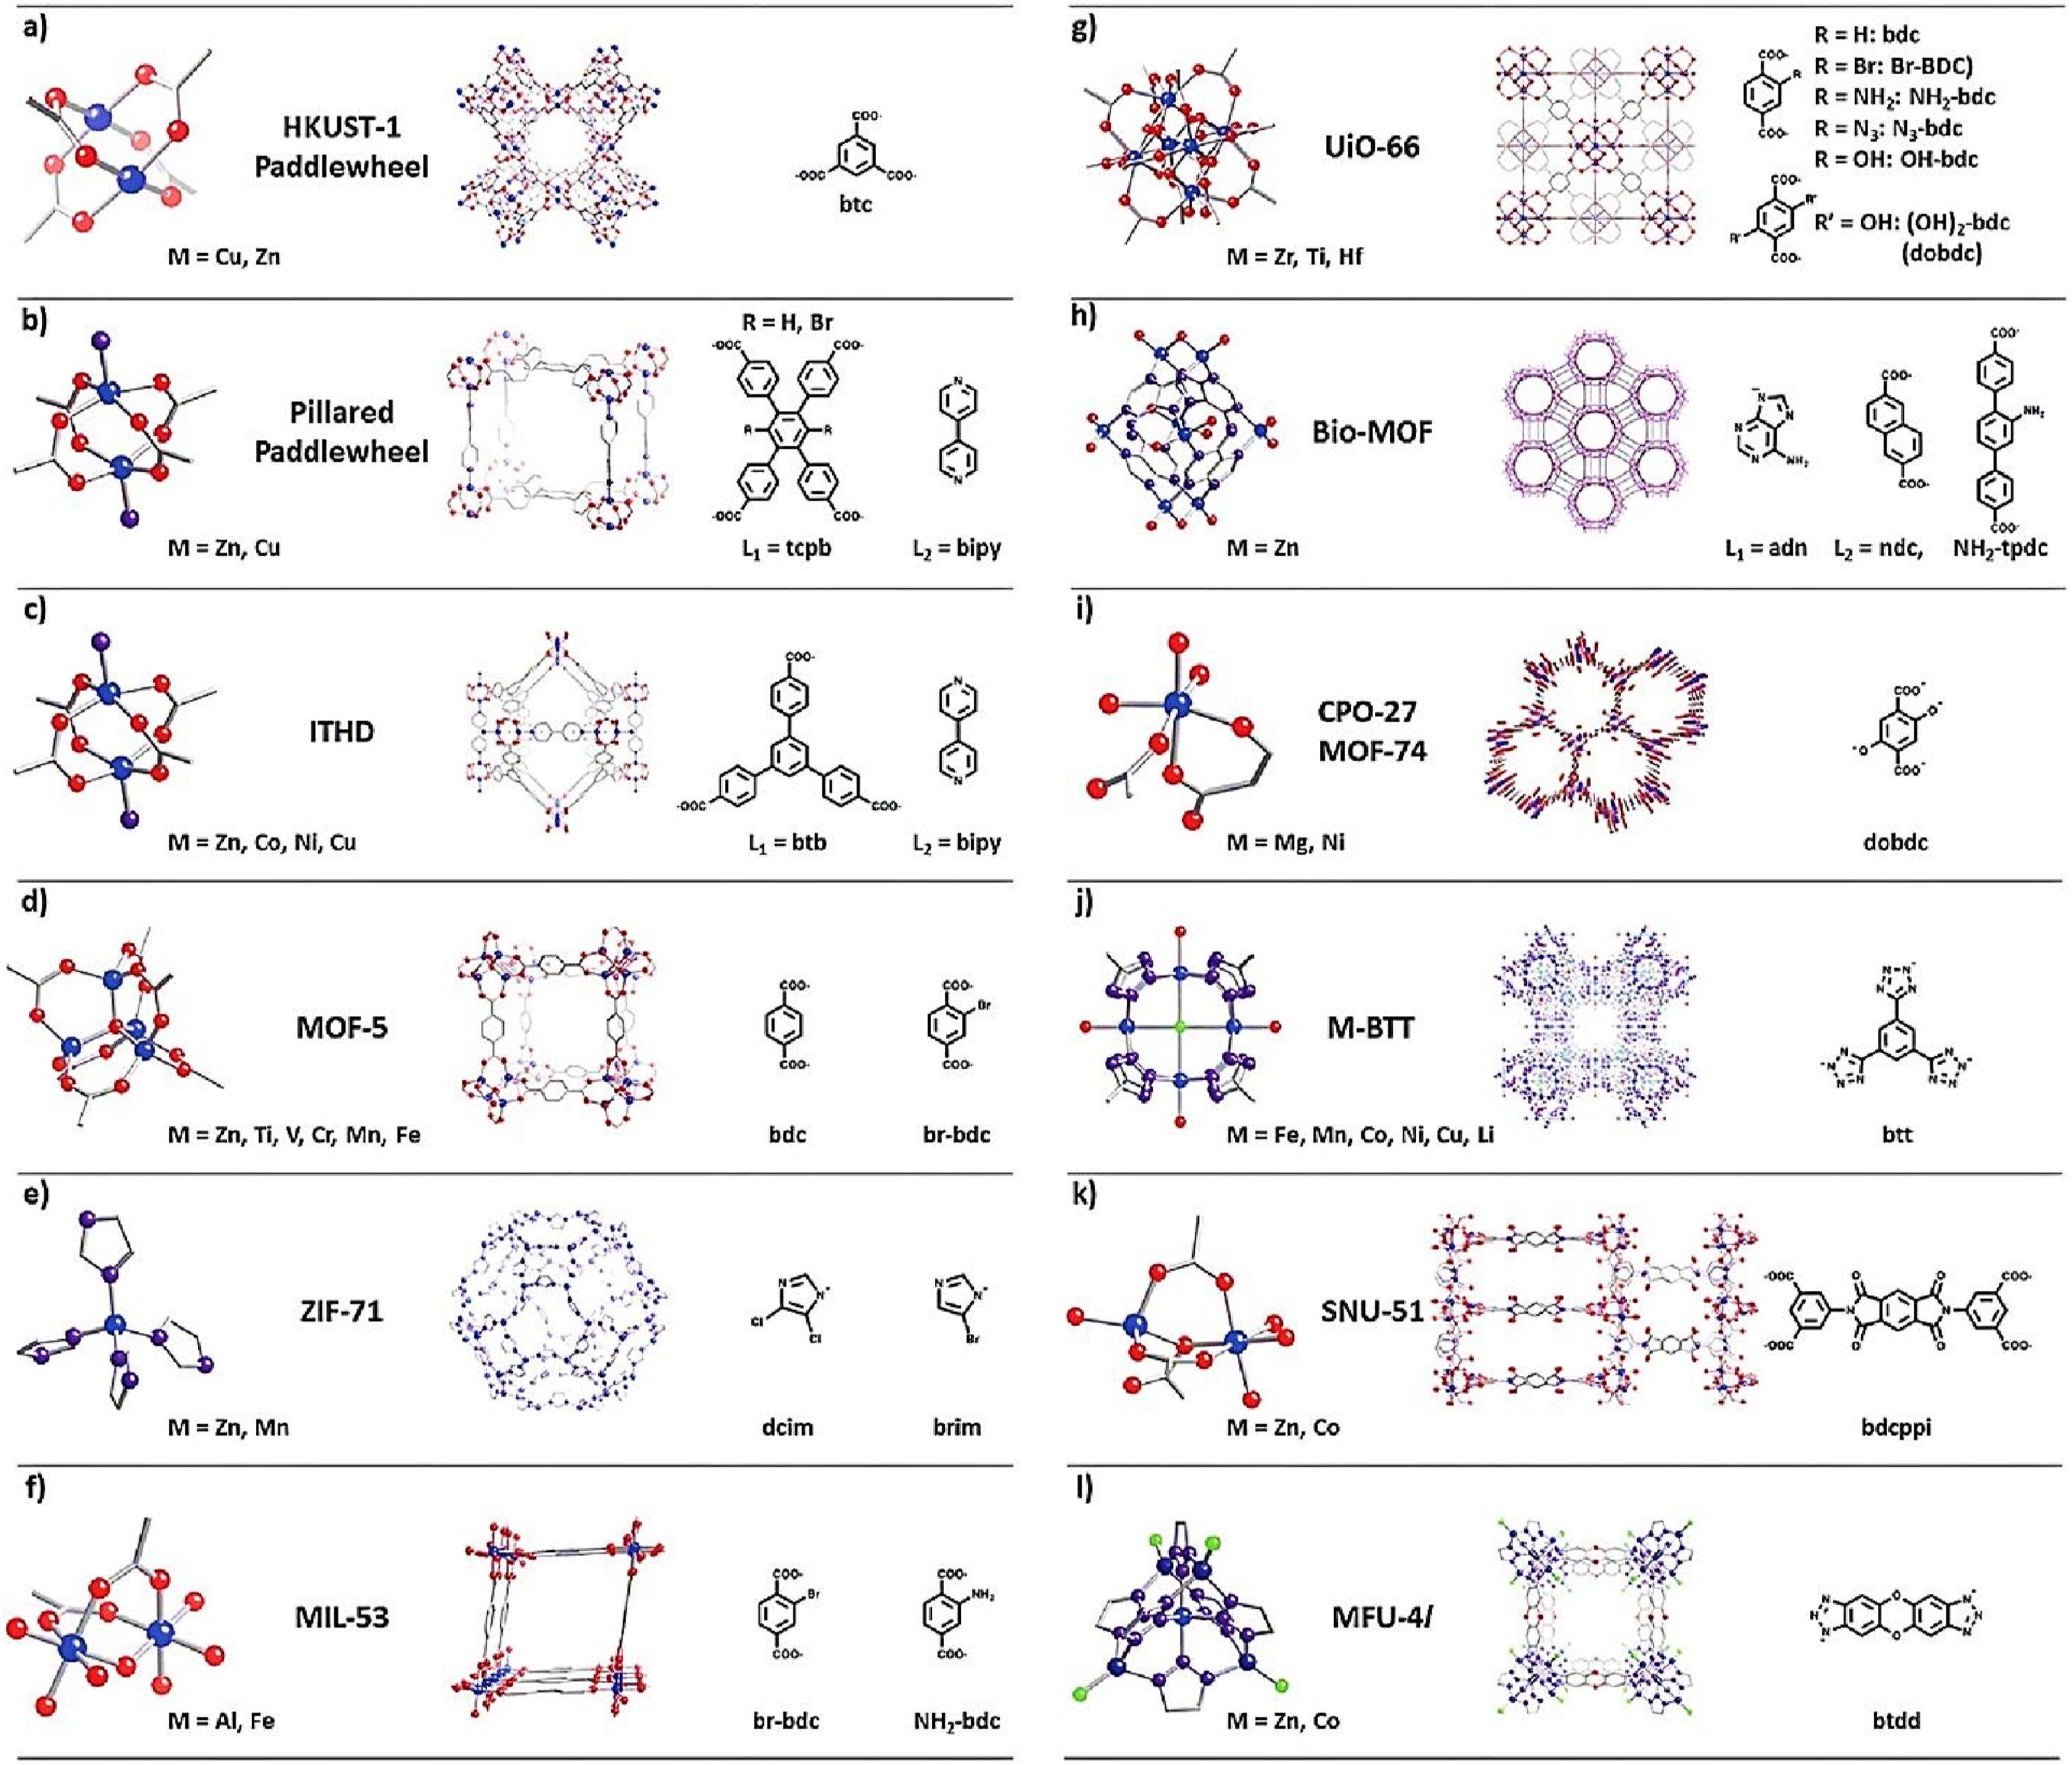
Image from: A. Aldhaher et al. Hybrid Advances 5 (2024) 100131
MOF
Properties
Change the metal node
Tune electronic properties - redox behaviour, charge distribution, binding strength
Change the functional groups on the linker
Control gas affinity & selectivity
Change the linker length or geometry
Adjust pore size and shape – diffusion rates, storage capacity, and gas accessibility
Instead of synthesizing a material and then discovering its properties, we can design a MOF with the exact features needed for a specific application
Notes:
Change the metal – change the electronic
Change the functional groups – attraction to gas molecule and selectivity properties
Change the linker size – change the pour size
This means that we don’t synthesis framework and find out the properties,
We design the MOF to suit the application needs.

Slide 18
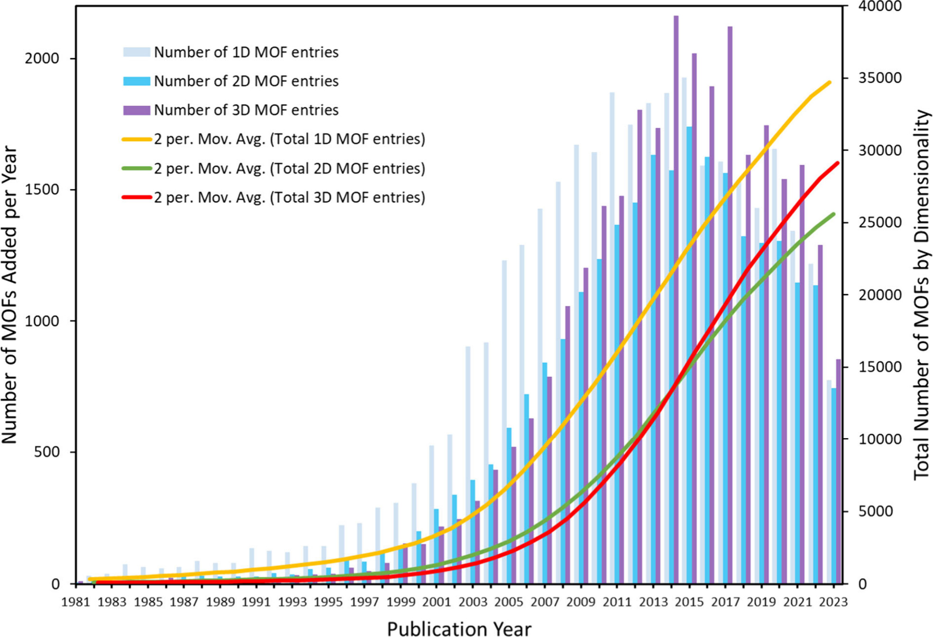
Omar Yaghi
Streamline
Image from:
L. Glasby et. al. Chem. Mater. 2024, 36, 19, 9013–9030
Notes:
Over 120 000 MOF in the Cambridge Structural Database

Slide 19
MOFs
2025 Chemistry Nobel Prize
Conception
Application
Streamline
Prof. Richard Robson
University of Melbourne Australia
Prof. Susumu Kitagawa
Kyoto University
Japan
Prof. Omar M. Yaghi
University of California,
Berkeley, USA
Notes:
These three scientist amongst other have pioneered a new area of chemistry
Majority of chemistry and material university departments have some who specialises in framework research

Slide 20
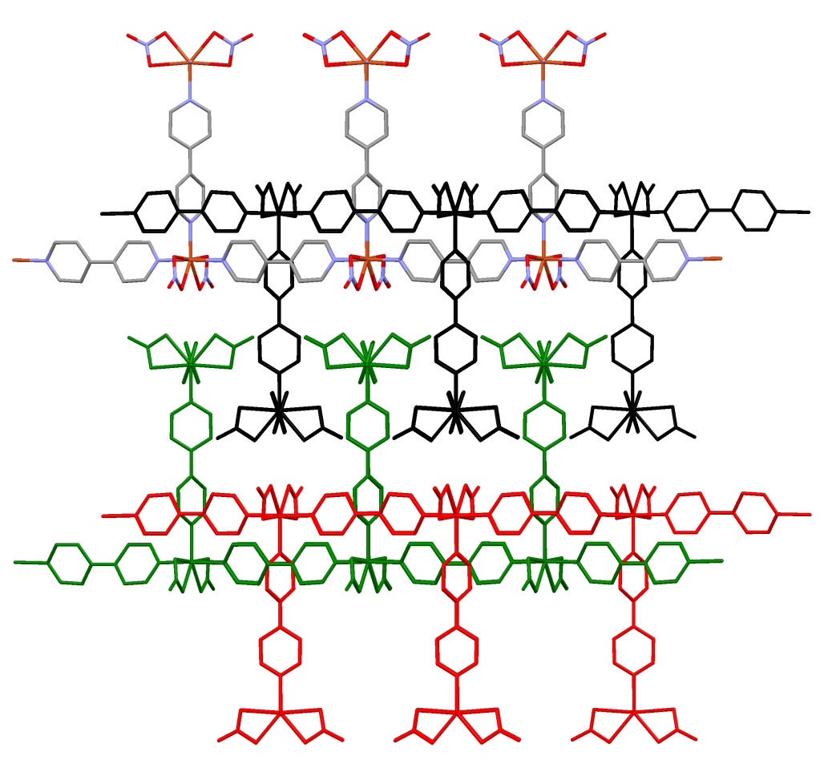
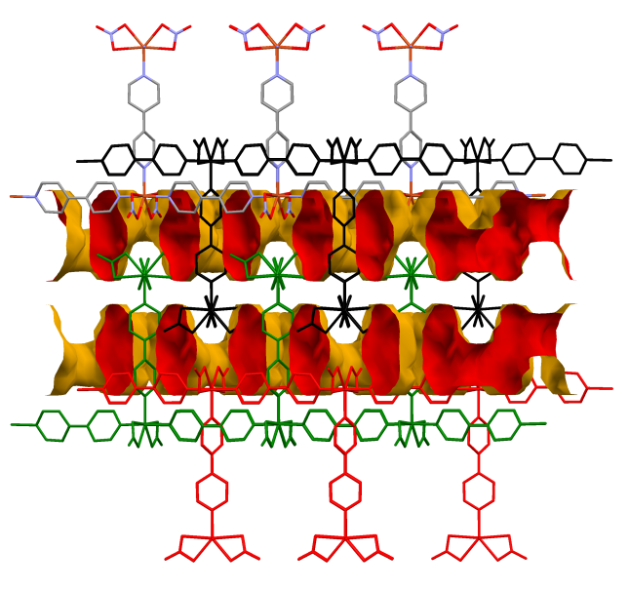
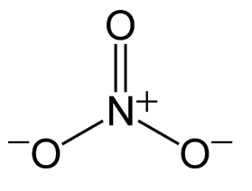
i19
Gas Experiments
Co(bpy)_{1.5}(NO₃)₂
4-4-bipyridine (bpy)
nitrate
Susumu Kitagawa

Slide 21
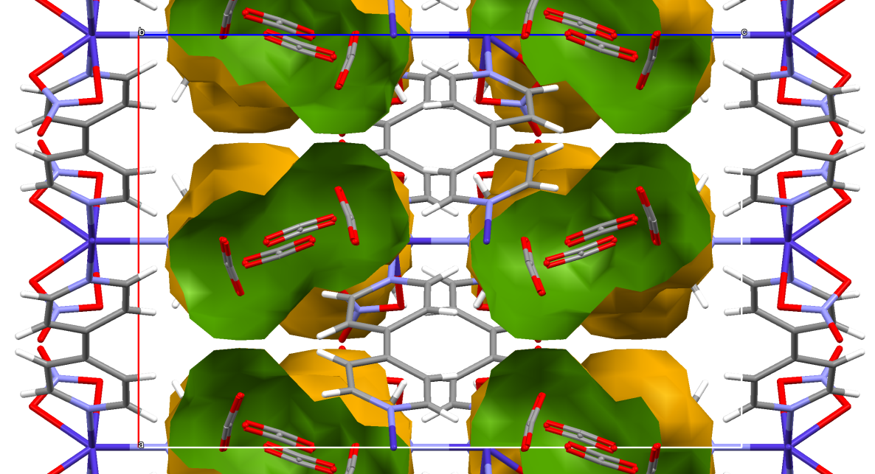
i19
Gas Experiments
Solvated
Vacuum
10 bar CO₂

Slide 22
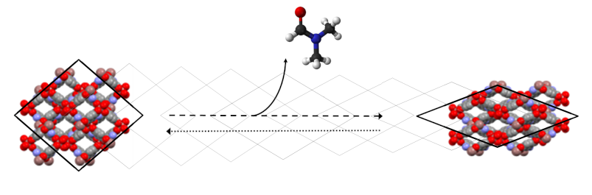
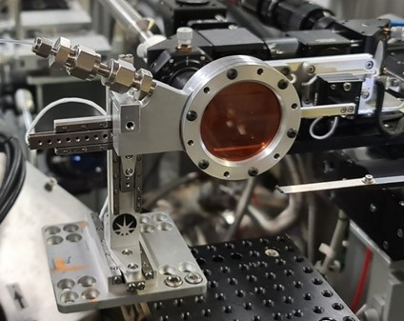
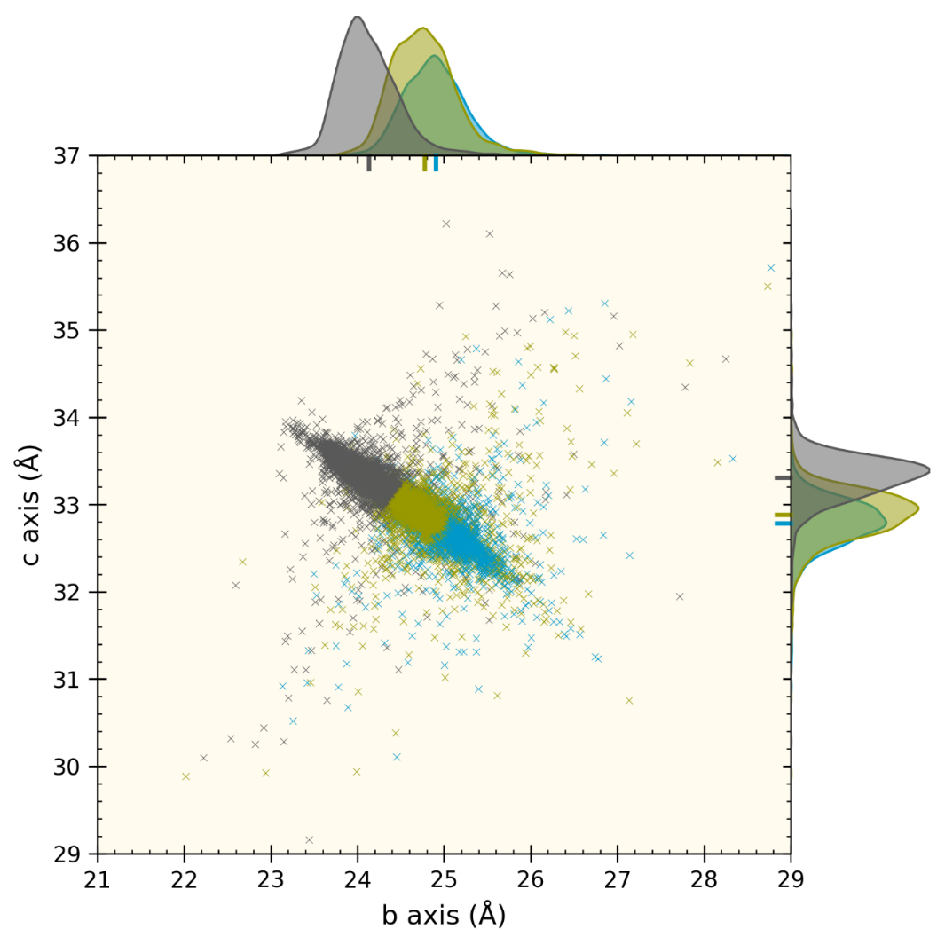
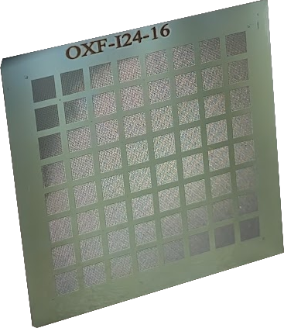
flexible framework
EH2:
Serial
GAS cELL
a)
vac start
0.5 bar
1.0 bar
400 wells x 64
25,600 welled chip
In collaboration with Josh Smith, Robin Owen, Anna Warren and Lee Brammer
Notes:
Serial work is also making a big impact on in-situ experiments
With Josh, a joint diamond PhD student, we have developed serial gas cell used to study SHF-61 which is a flexible framework
Pours in the framework is able to contract to expand as solvent or gas is added or removed
Using the still image approach - Batch analysis 25,000 crystals - as a function of CO2 pressure
Can see the distribution of change of unit cells upon update which is affected by crystal size and defects within the crystal
This cell has it limitation in pressure and collection routine

Slide 23
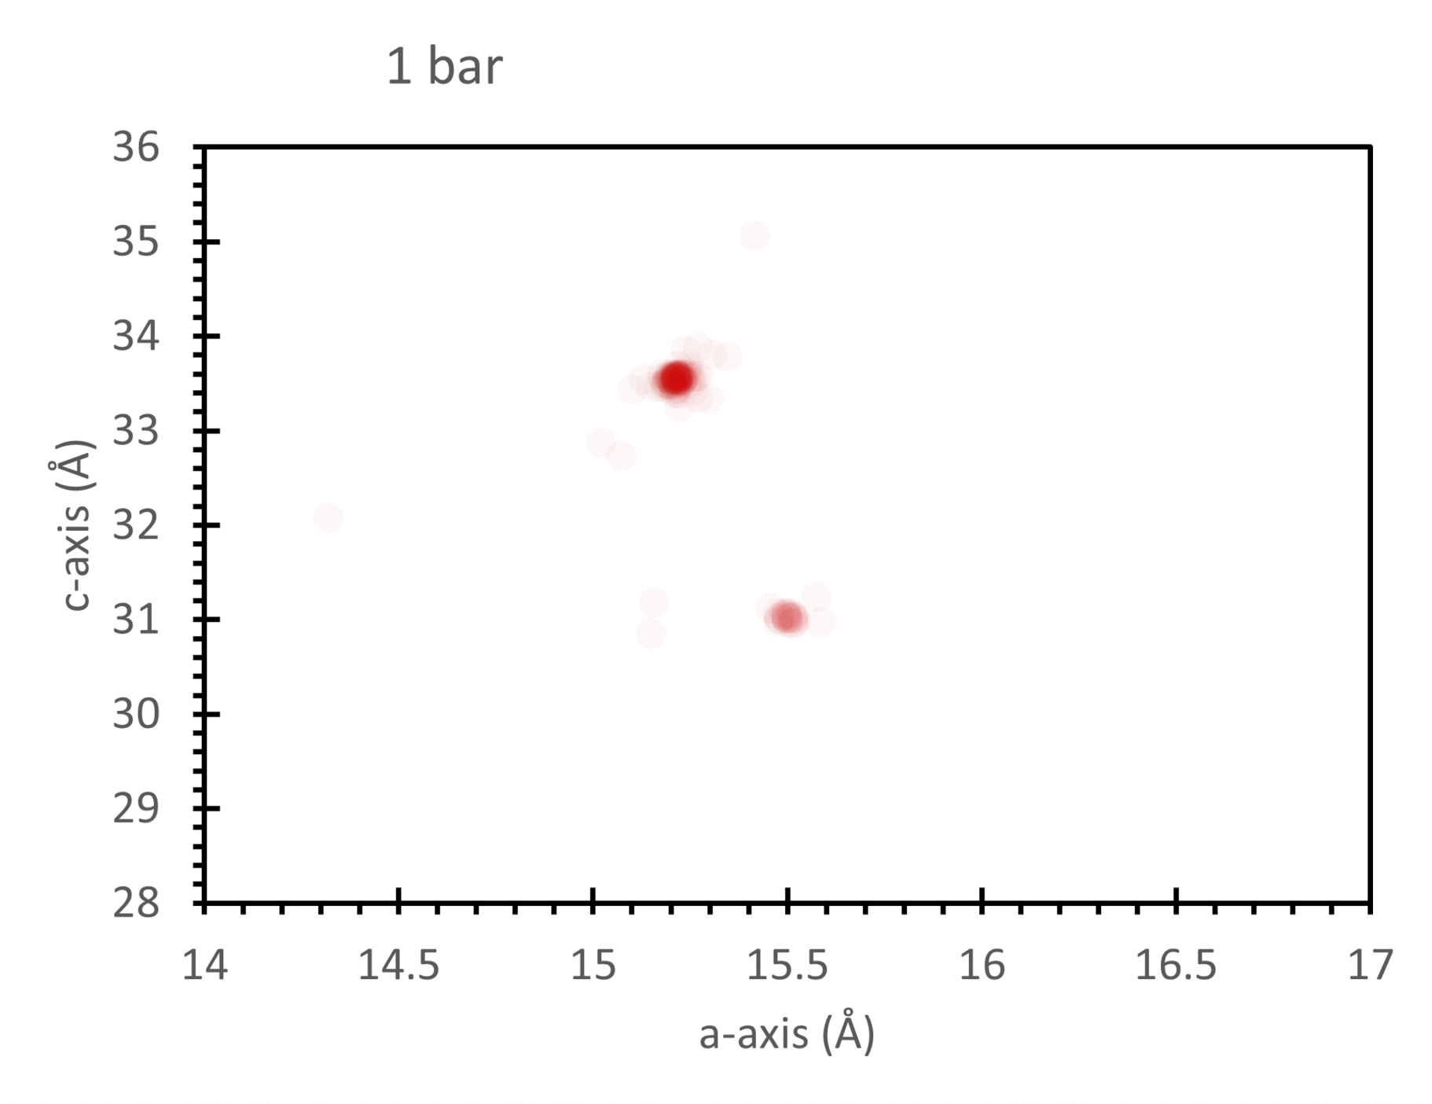
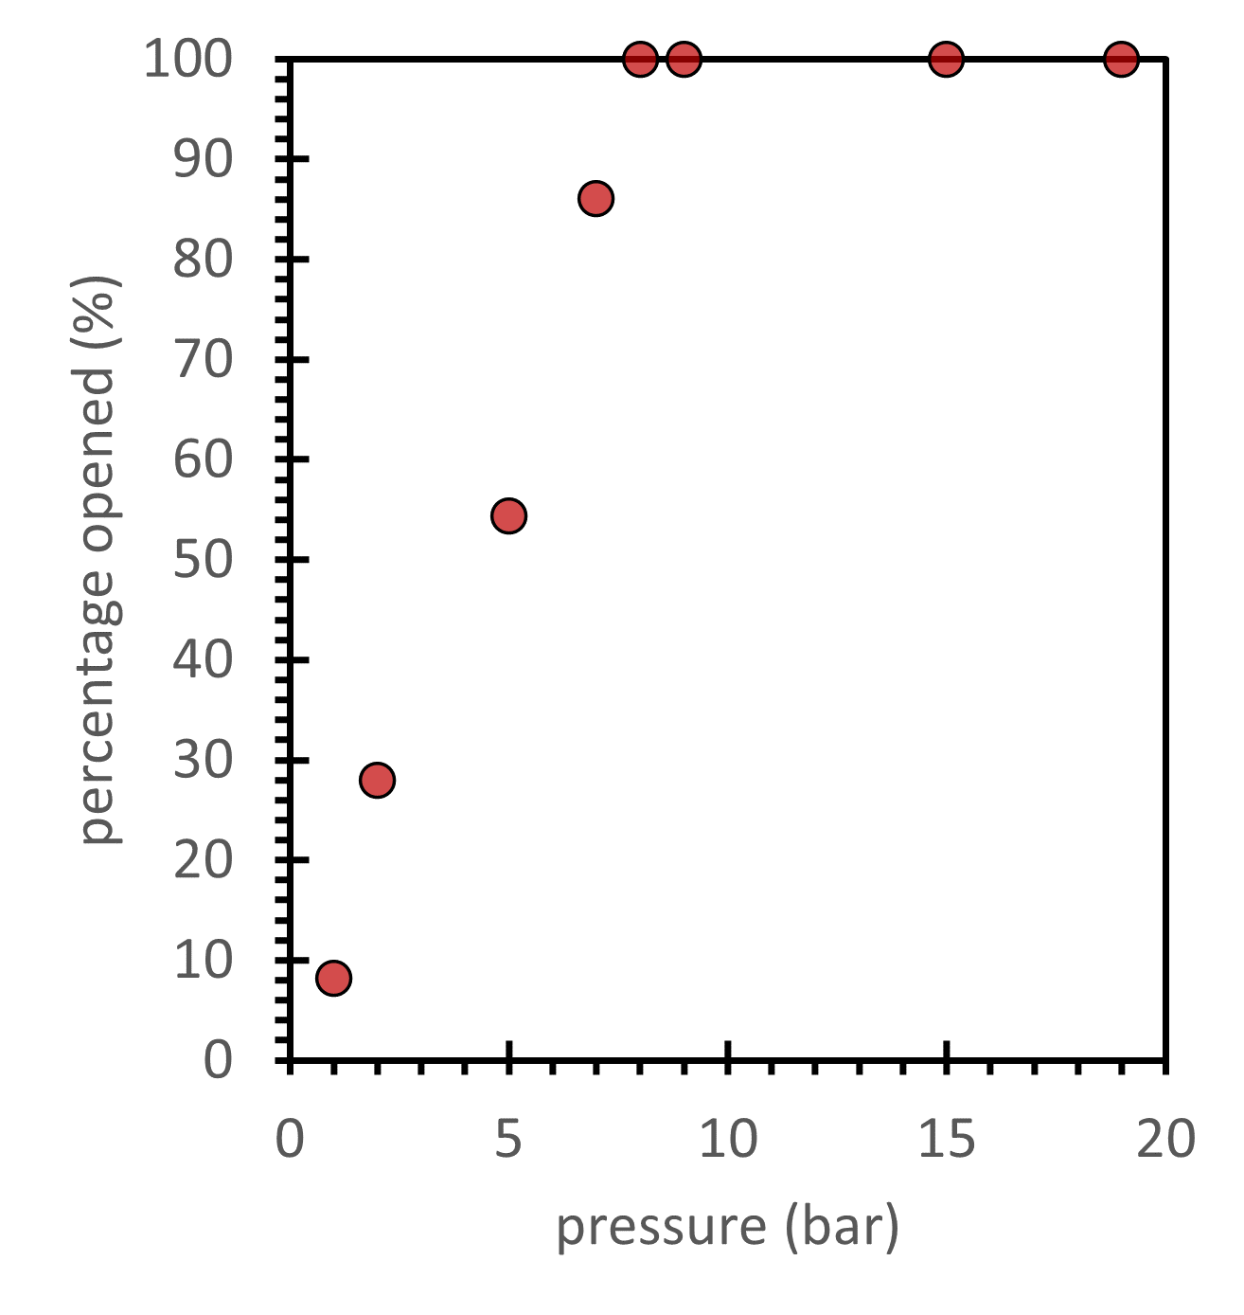
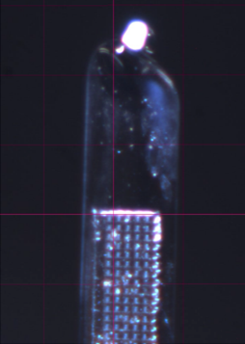
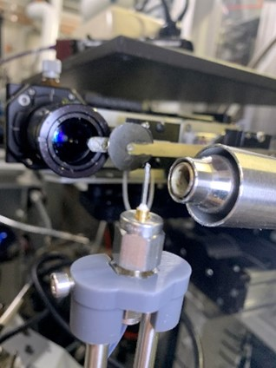
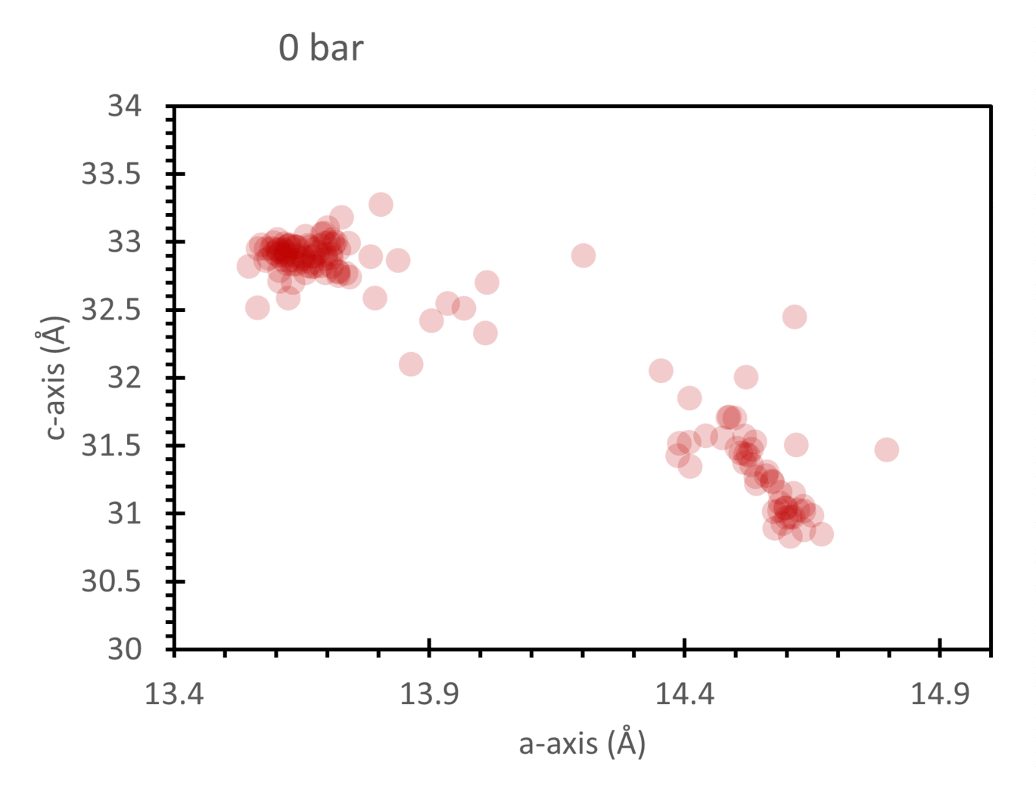
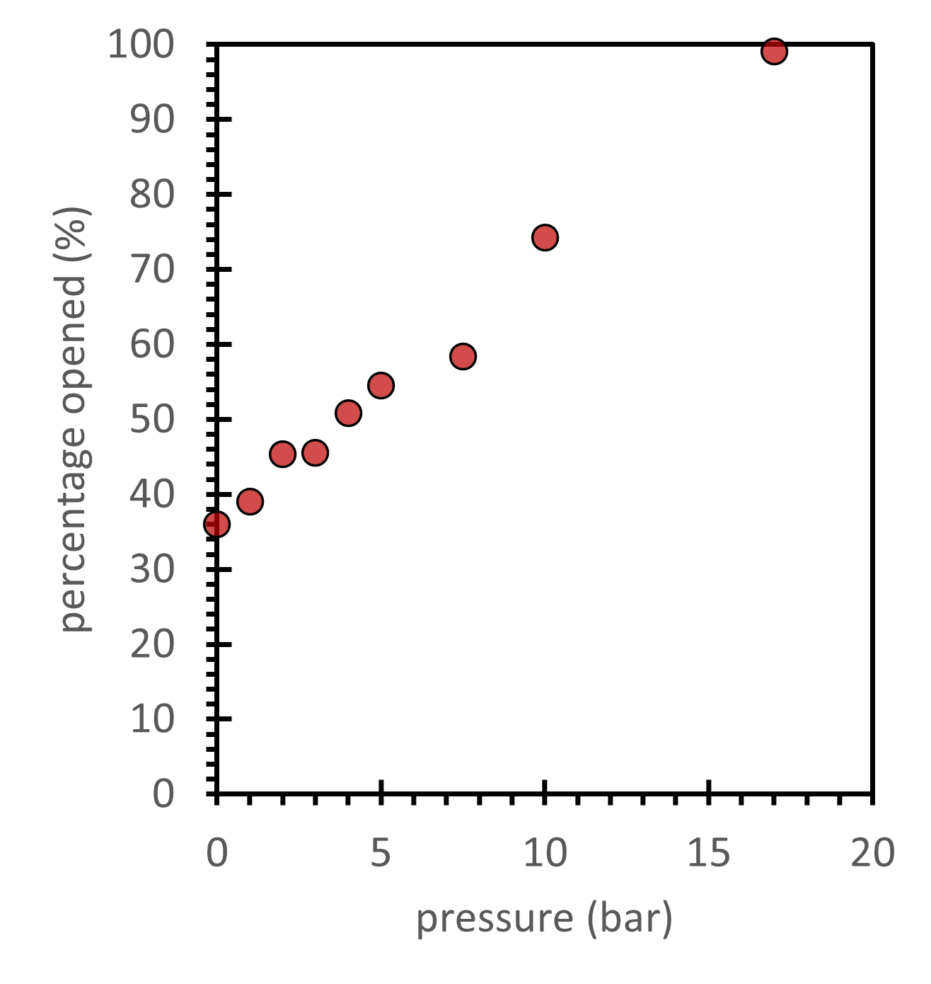
flexible framework 1
EH2:
Serial
GAS cELL
flexible framework 2
In collaboration with Josh Smith, Anna Warren, Robin Owen and Lee Brammer
Notes:
800 wells polymer grid in typical gas cell, able to go high vacuum to 40 bars
Able utilise small rotation serial methods
Able to obtain beautiful structure at pressure point.
As a comparison in the related system, we can see a much large spread as a function for pressure.
Really show that doing a gas cell experiment on single crystal sample may not be representation

Slide 24
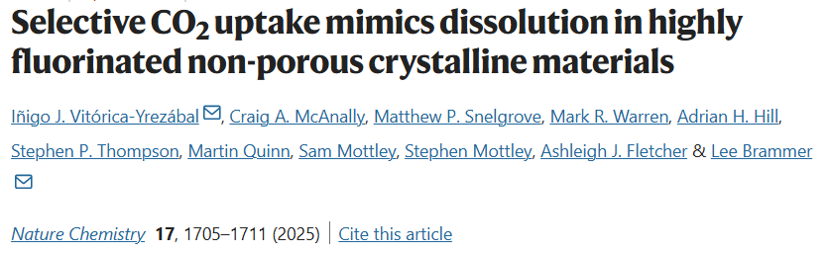
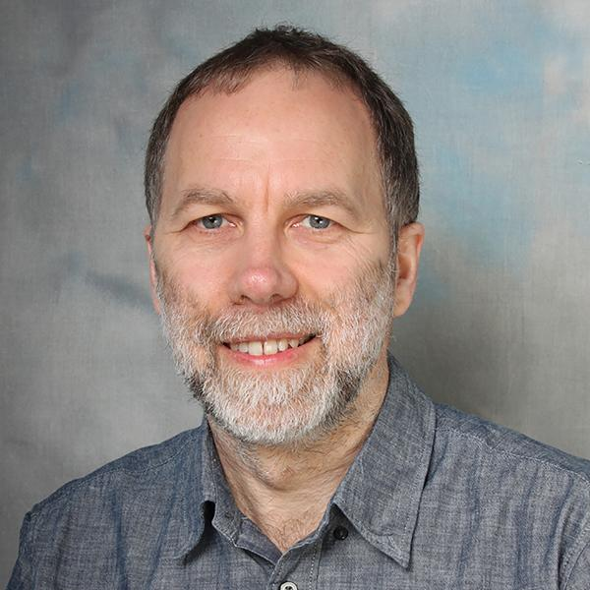
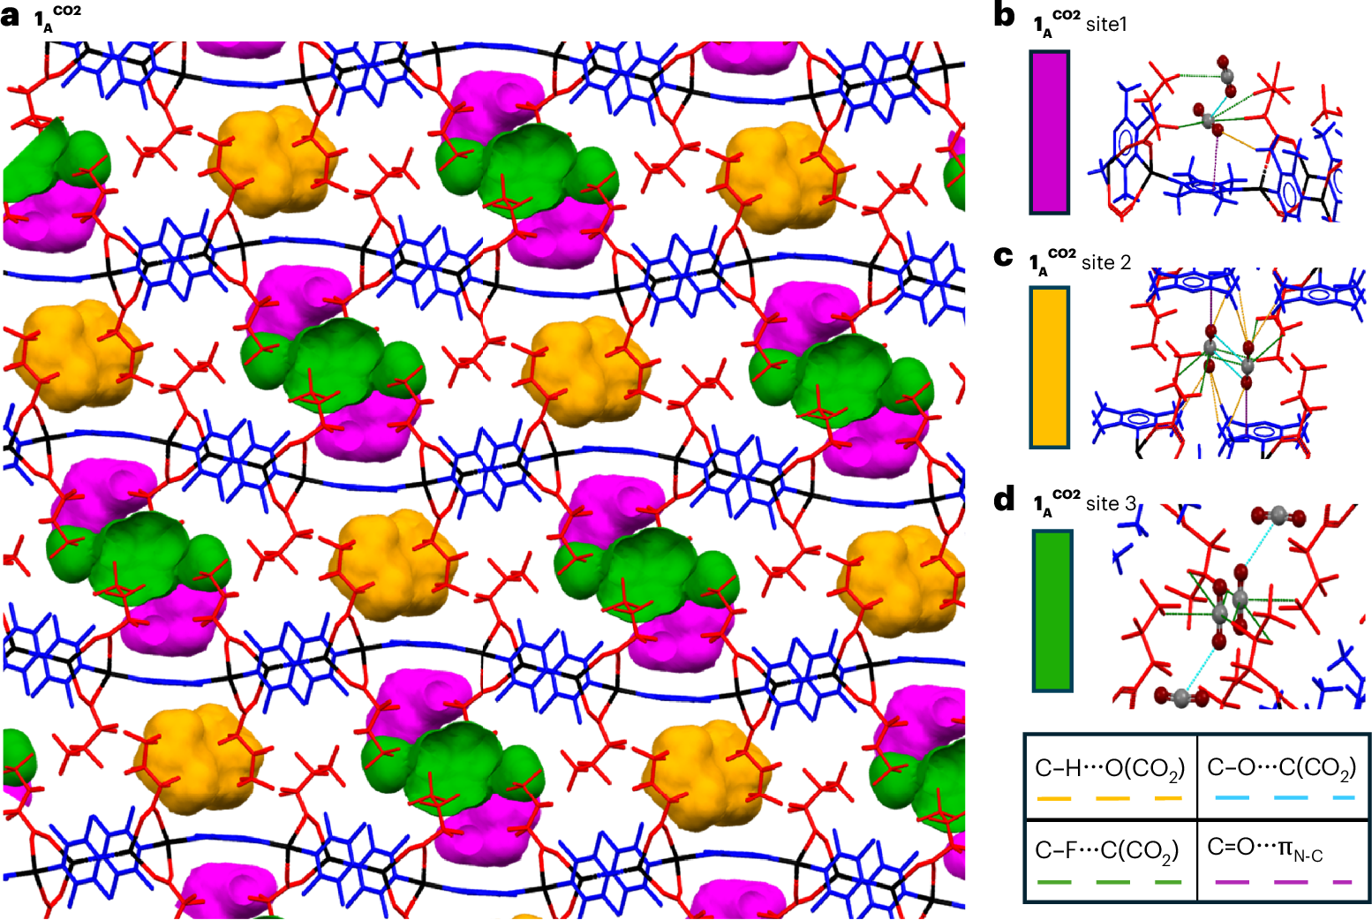
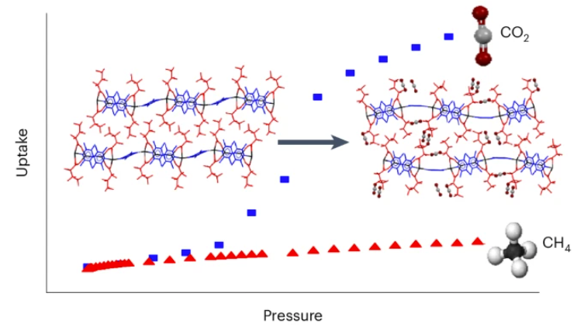
Notes:
Nature chemistry 2017

Slide 25
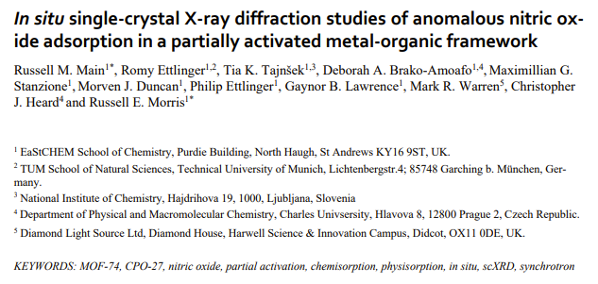
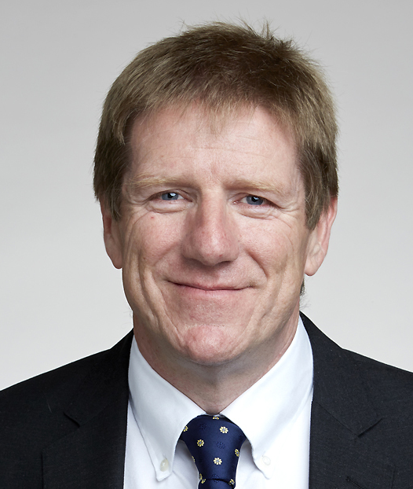






activation
NO
Notes:
NO is toxic
biologically active molecule, anti-thrombotic, wound healing
and anti-microbial properties
Glucose monitor needles
Russel has used this in a MOF within a

Slide 26


Chemistry Noble Prize 2025
Summary
MOFs and the 2025 Nobel Prize
Prof. Richard Robson – Conception
Prof. Susumu Kitagawa – Application
Prof. Omar M. Yaghi – Streamlining
Why MOFs Matter:
Ultra-porous materials enabling:
Water harvesting from air
CO₂ capture and gas separation
Drug delivery and catalysis
Hydrogen/methane storage for clean energy
Chemical sensing and desalination
Origins:
Inspired by diamond’s tetrahedral geometry
Developed using organic linkers and metal nodes
Impact:
Revolutionised material science with modular, tuneable frameworks

