Slide 1
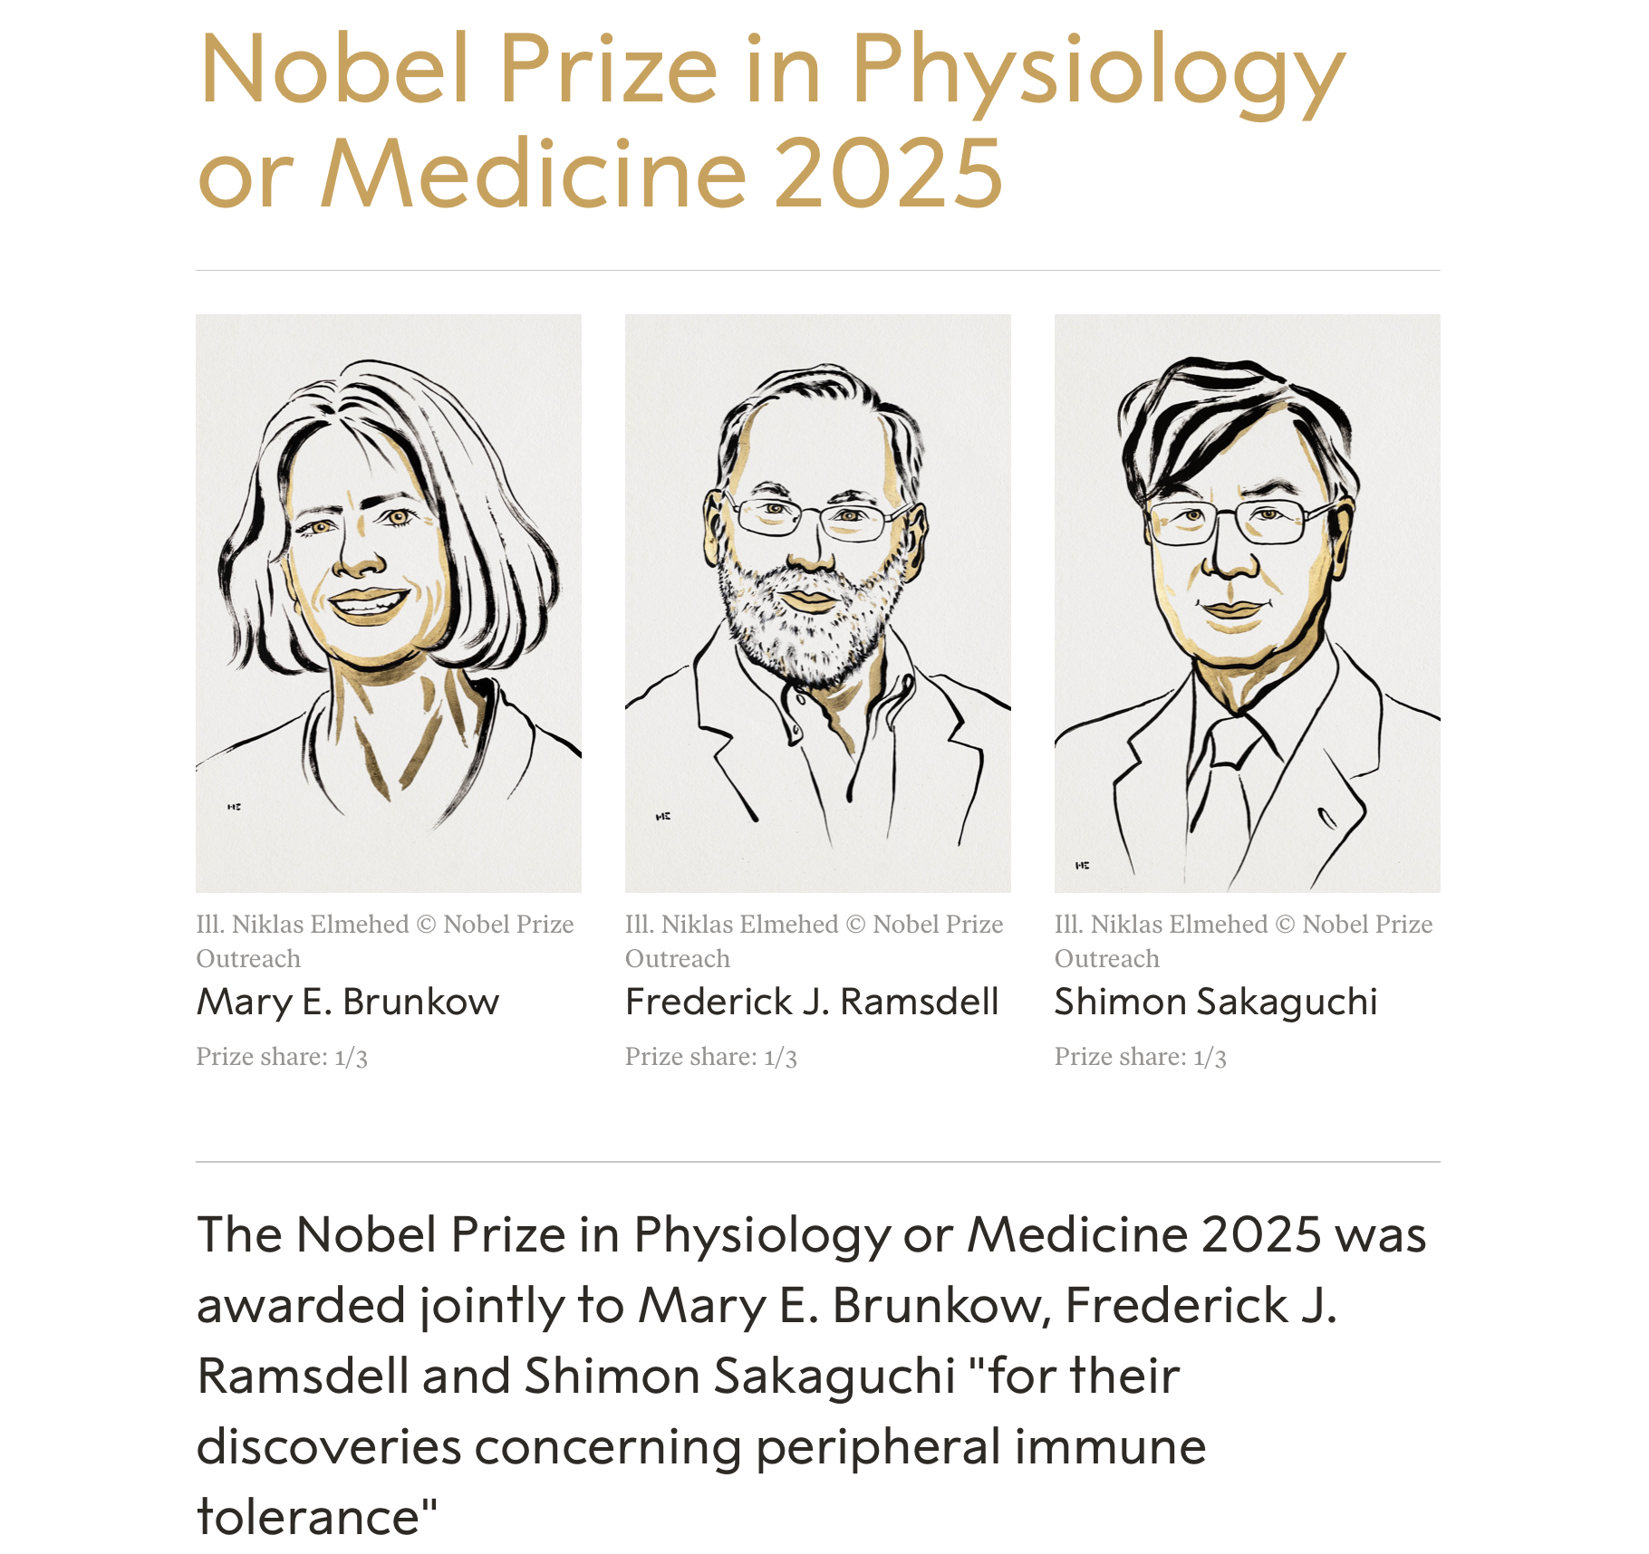
2025 Nobel Prize in Physiology or Medicine
Notes:
Introduce yourself and the lecture purpose. Explain importance of Nobel Prize and 2025 discovery.

Slide 2
So what’s it all about…?
What the Nobel Prize recognizes: “discoveries concerning peripheral immune tolerance.”
Notes:
This discovery addresses a fundamental question: how does the immune system know “friend” (our own tissues) from “foe” (pathogens) — and why in many people, it doesn’t mistakenly attack the body.

Slide 3
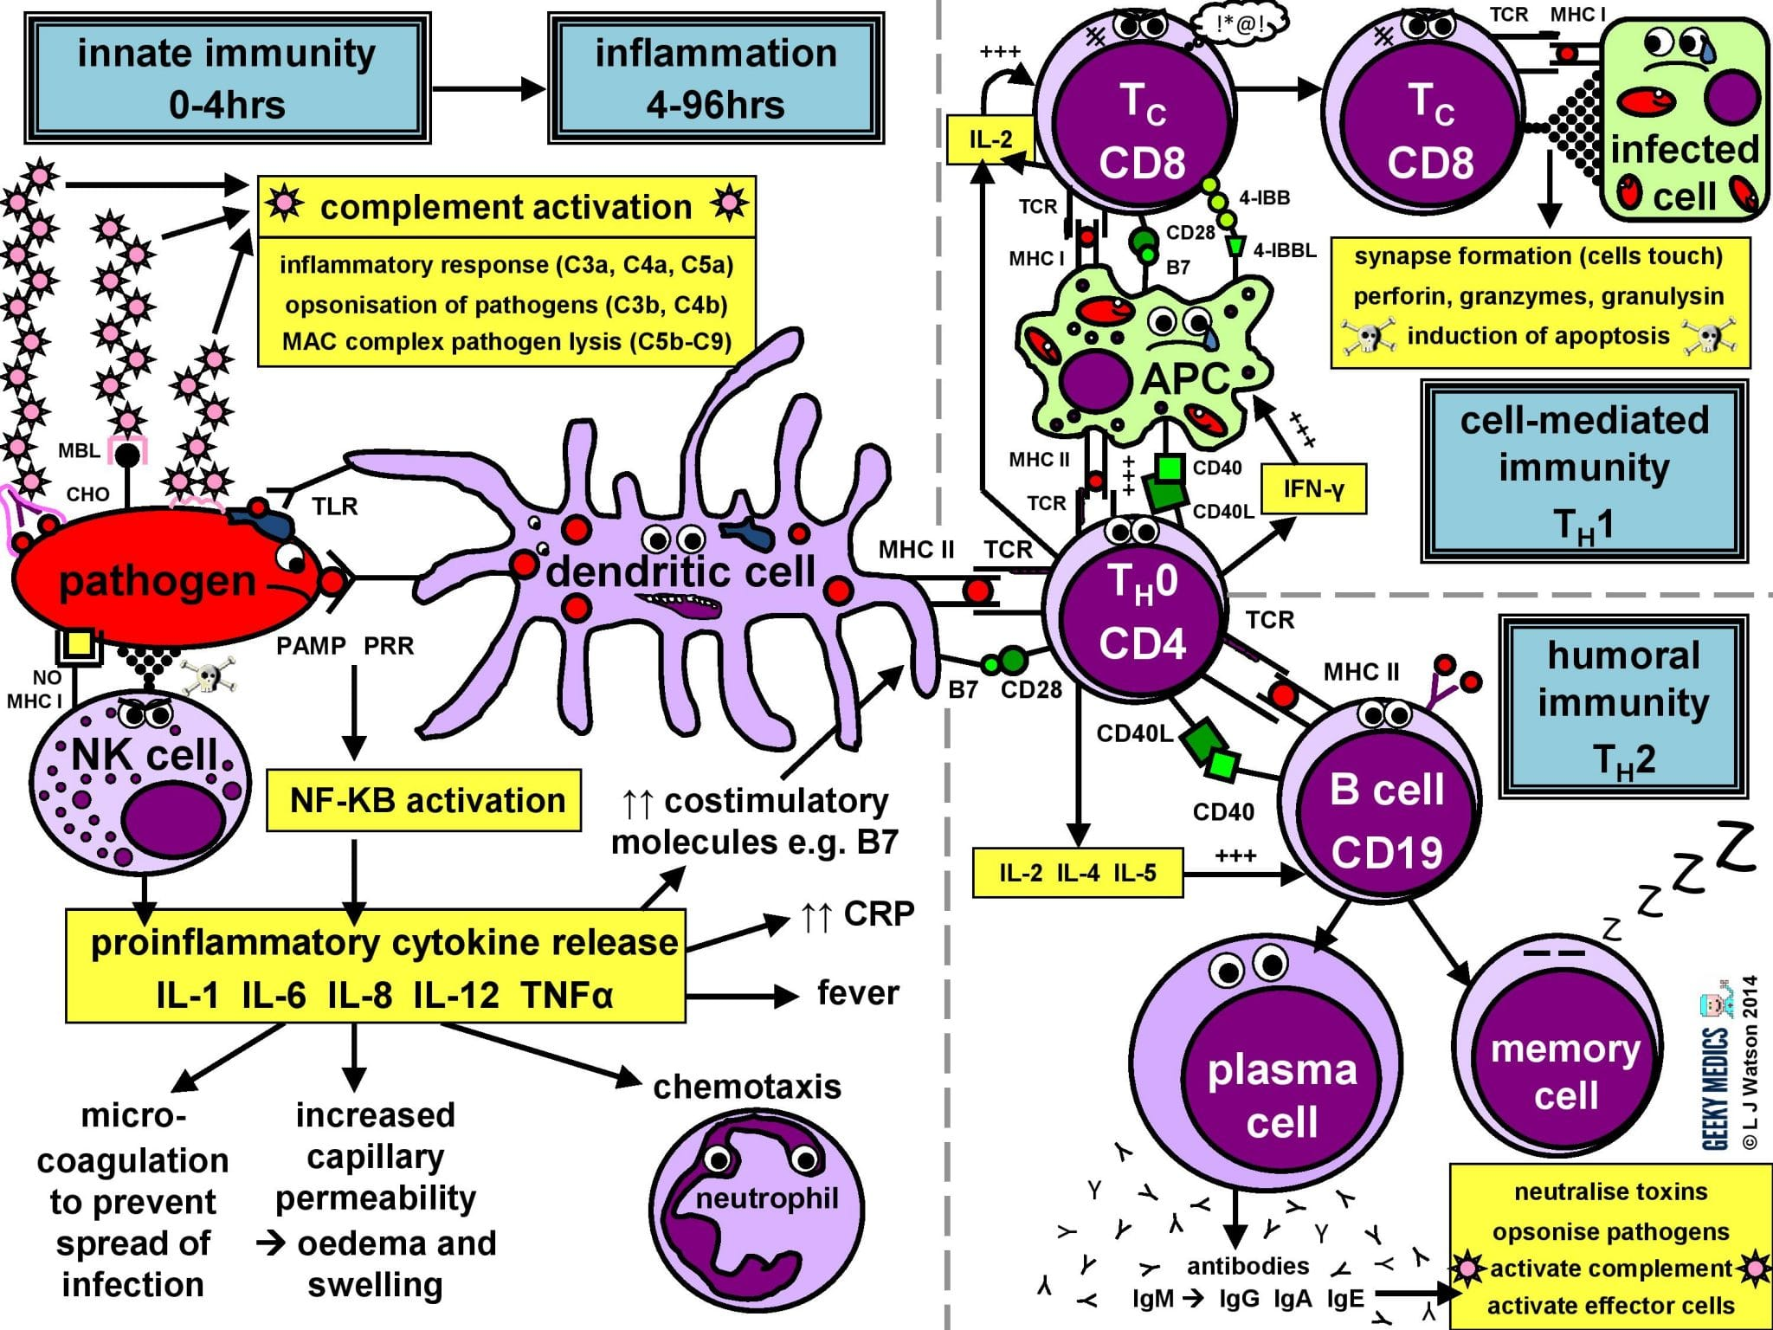
The immune system made simple

Slide 4
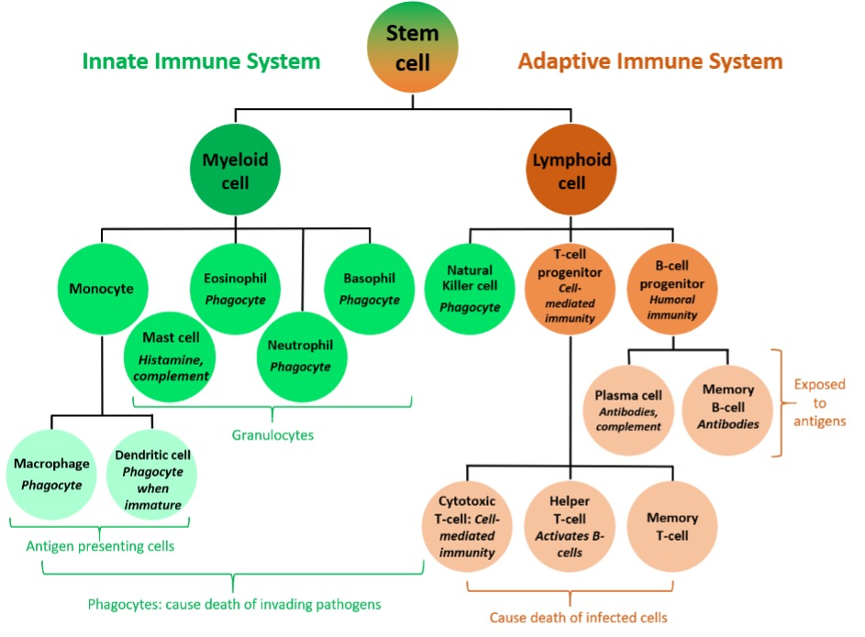
A very quick overview of immunology

Slide 5

Missing out on mis-targeting or Avoiding recognising yourself
Central vs peripheral tolerance
Notes:
Background: Immune System, T Cells & The Problem of “Self-Attack”
The immune system is a complex defense network that protects us against microbes — viruses, bacteria, fungi, etc. NobelPrize.org+1
A critical part of the immune system are T cells: they can recognize and kill infected cells, or coordinate immune responses. But this power comes with a risk: if mis-targeted, T cells may attack the body’s own healthy tissues. NobelPrize.org+1
Historically, immunologists believed that the body prevents self-attack through a process in the thymus called central tolerance, in which potentially harmful T cells are eliminated before they mature. NobelPrize.org+1
But central tolerance alone doesn’t explain why autoimmune diseases arise, or why sometimes tolerance fails. For decades, there were hints of additional regulatory mechanisms — but then came the work of Brunkow, Ramsdell, and Sakaguchi. NobelPrize.org+1
.

Slide 6
Suppressor T-Cells?

Slide 7
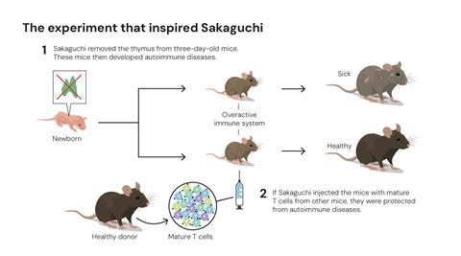
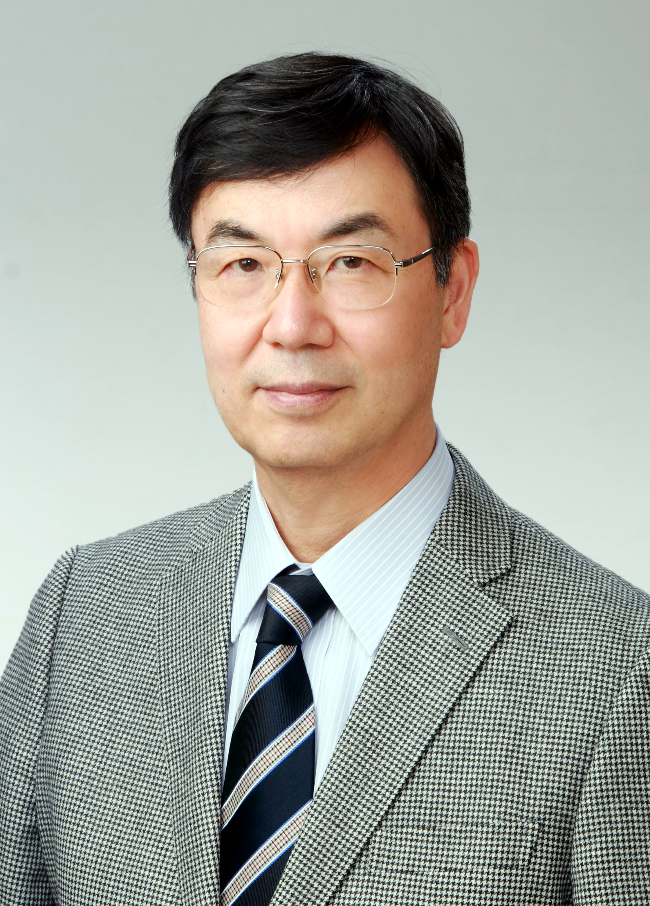
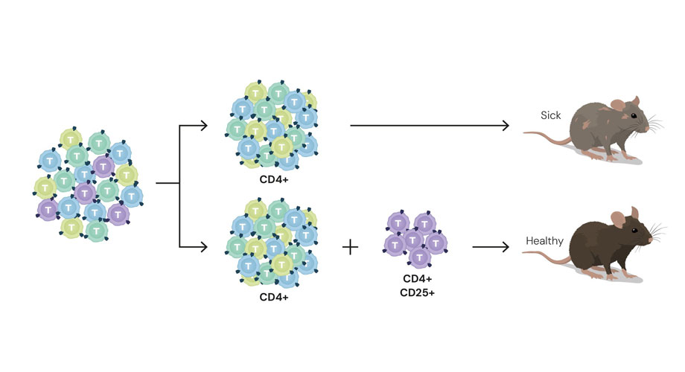

Slide 8
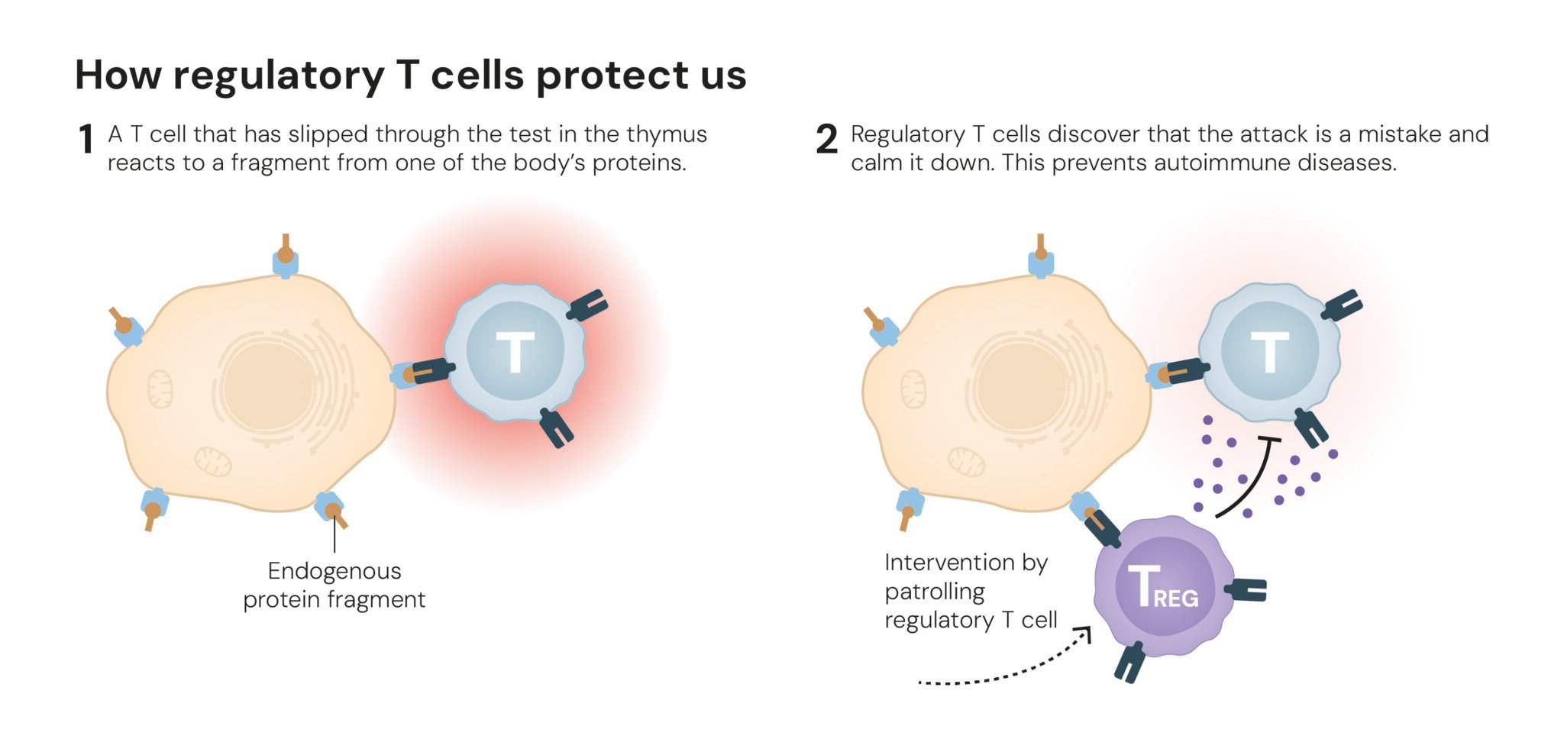
Regulatory T Cells
Notes:
The Key Discovery: Regulatory T Cells & Peripheral Immune Tolerance
The 2025 laureates discovered a previously unknown class of immune cells: regulatory T cells (often called T-regs). These act as “security guards” of the immune system: suppressing or regulating other immune cells that might otherwise attack the body’s own tissues. NobelPrize.org+2MDPI+2
The story began with Shimon Sakaguchi, who in 1995 published the first key finding: a subset of T cells that expressed certain markers (e.g., CD25) and appeared to suppress immune responses rather than participate in them. Wikipedia+2NobelPrize.org+2
Some in the field were skeptical: at the time, many doubted that such “suppressor” T cells existed. But Sakaguchi’s work challenged the prevailing view of a simple immune system regulated only by central tolerance. NobelPrize.org+1

Slide 9

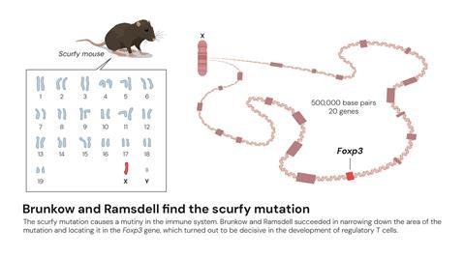
FOXP3 Gene
Notes:
Then, in 2001, Mary Brunkow and Fred Ramsdell identified a gene — called FOXP3 (initially called “scurfin” in mice) — that was critical for the development and function of regulatory T cells. Mice with mutations in this gene developed fatal autoimmune diseases. Wikipedia+2Wikipedia+2
Around the same time, human equivalents of FOXP3 mutations were shown to cause a severe autoimmune disease known as IPEX syndrome. Wikipedia+2STAT+2

Slide 10
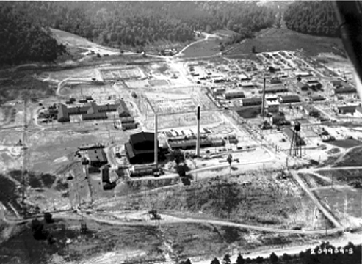
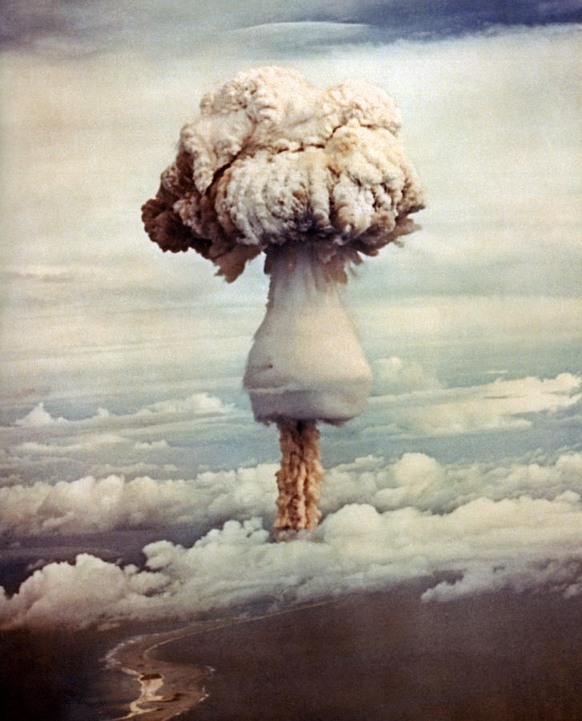
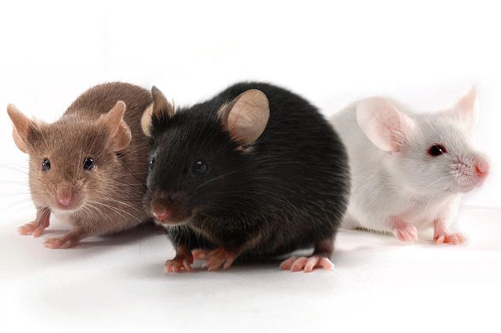
Scurfy Mice
Notes:
Then, in 2001, Mary Brunkow and Fred Ramsdell identified a gene — called FOXP3 (initially called “scurfin” in mice) — that was critical for the development and function of regulatory T cells. Mice with mutations in this gene developed fatal autoimmune diseases. Wikipedia+2Wikipedia+2
Around the same time, human equivalents of FOXP3 mutations were shown to cause a severe autoimmune disease known as IPEX syndrome. Wikipedia+2STAT+2

Slide 11
Finding the gene

Slide 12
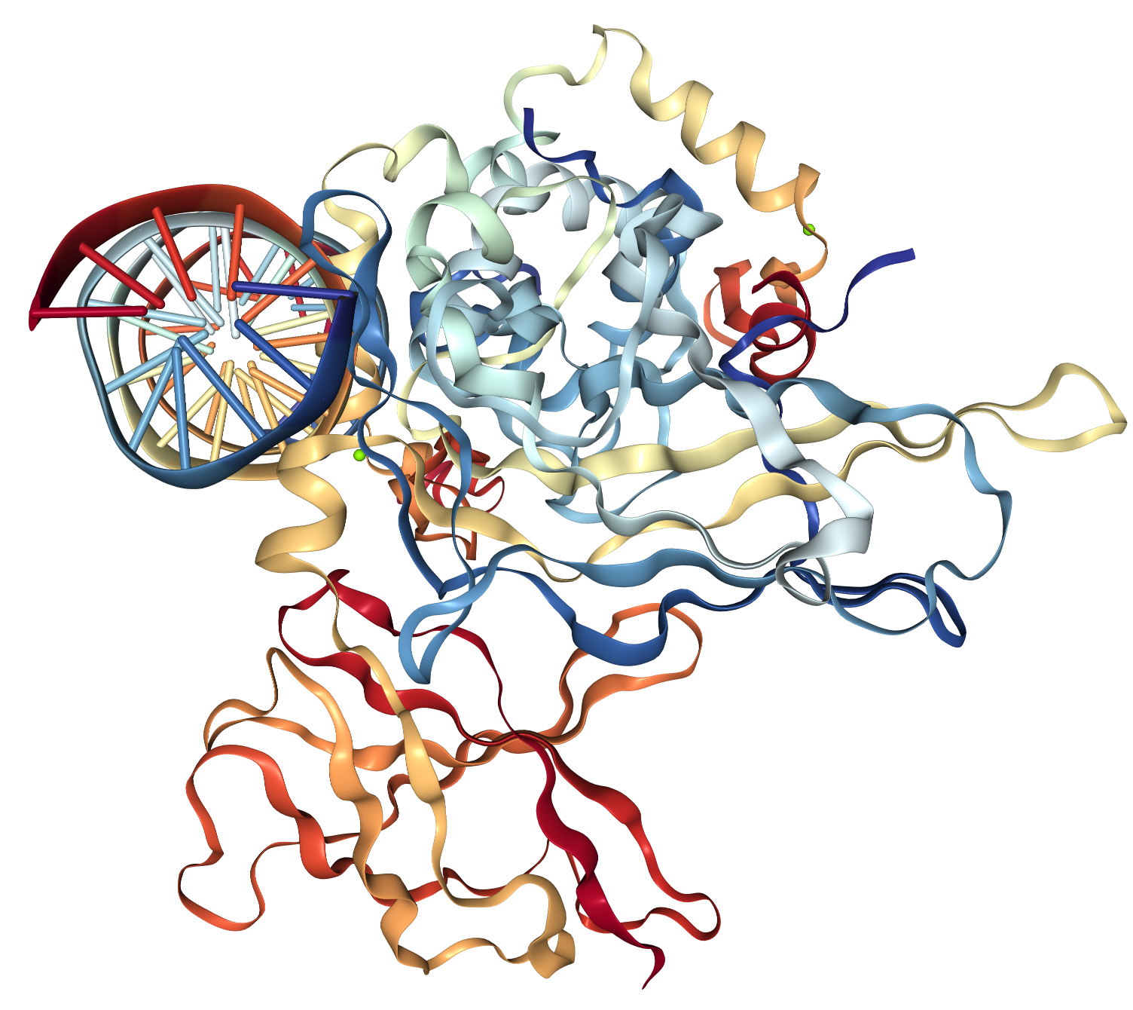
What does FoxP3 do?

Slide 13
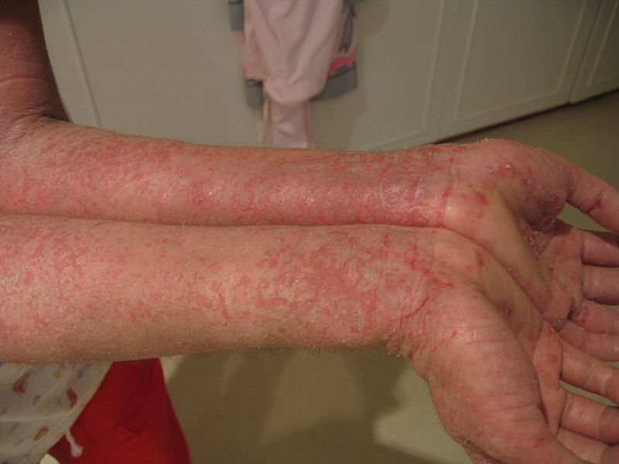
IPEX: relating the discovery to humans
Immune Dysregulation: Overactive immune system attacking the body.
Polyendocrinopathy: Autoimmune attack on endocrine glands, especially leading to Type 1 Diabetes (insulin-dependent) and thyroid issues.
Enteropathy: Severe, persistent diarrhea, malabsorption, and failure to thrive due to autoimmune gut inflammation
X-linked: affects males

Slide 14
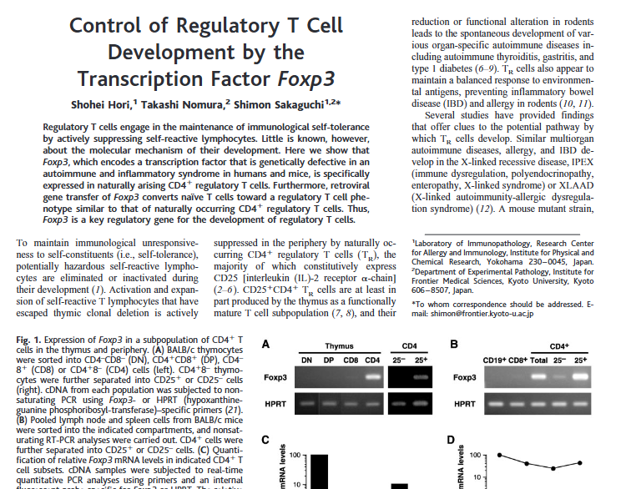
FoxP3 and Tregs
Hori S, Nomura T, Sakaguchi S. "Control of regulatory T cell development by the transcription factor Foxp3." Science 2003, 299 (5609): 1057–1061.
Notes:
In 2003, Sakaguchi and colleagues demonstrated that FOXP3 controls the development of the regulatory T cells he originally described — tying together the cell type and the gene behind it. Wikipedia+1
Thus the three laureates together mapped out a whole new regulatory layer of the immune system: peripheral immune tolerance — the mechanisms that ensure immune responses are tamed once threats are cleared, and self-tolerance is maintained.

Slide 15
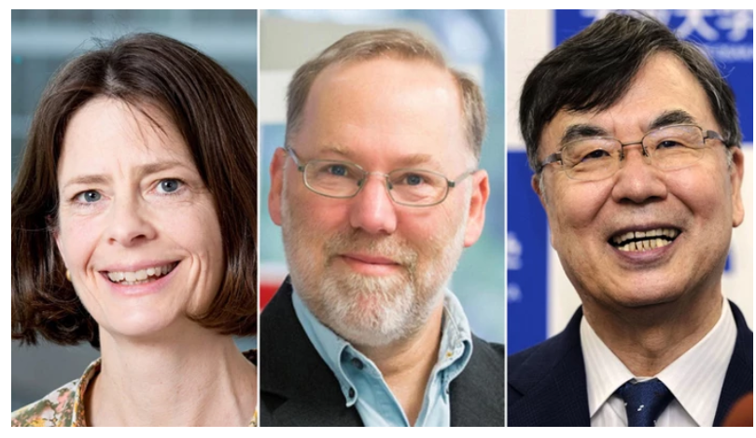
Significance
From Basic Biology to Medicine: Not just a deep insight into biology: broad implications
It explains why many people don’t develop autoimmune disease:
It clarifies why autoimmune diseases arise when regulation fails
Notes:
Highlight transformative impact on human health.

Slide 16


Clinical Impact
It opens the door to therapeutic applications: manipulating regulatory T-cells could help treat or prevent autoimmune diseases, improve transplant tolerance (so transplanted organs aren’t rejected), and even play a role in cancer therapy.
Indeed, since their discoveries, the field of T-reg–based therapies has rapidly grown: according to reporting, there are over 200 ongoing clinical trials exploring T-reg centred treatments for autoimmune diseases, transplantation and cancer.
Notes:
In other words: these discoveries provide a foundational understanding of immune regulation — and also translate into huge potential for future medicine.

Slide 17
Challenges
Over‑suppression risk
Targeting specificity
Long‑term safety
Notes:
Discuss open research questions.

Slide 18
Conclusion
The awarding of the prize now reflects both the lasting fundamental importance of the discovery and the real-world medical potential it enables
Notes:
Summarize main messages and invite questions.

