Slide 1



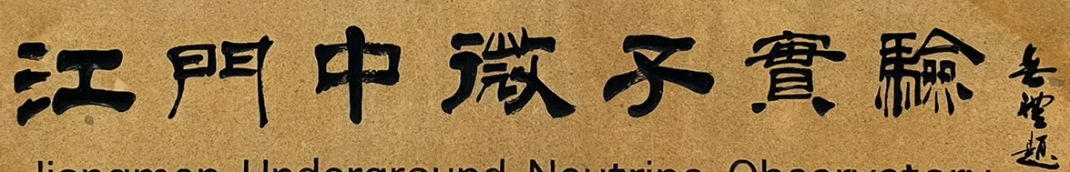
The Jiangmen Underground Neutrino Observatory (JUNO): Status and First Physics Results
LU Xianguo 卢显国
University of Warwick
On behalf of the JUNO Collaboration
PPD Seminar, RAL
2026 March 25, Didcot

Slide 2
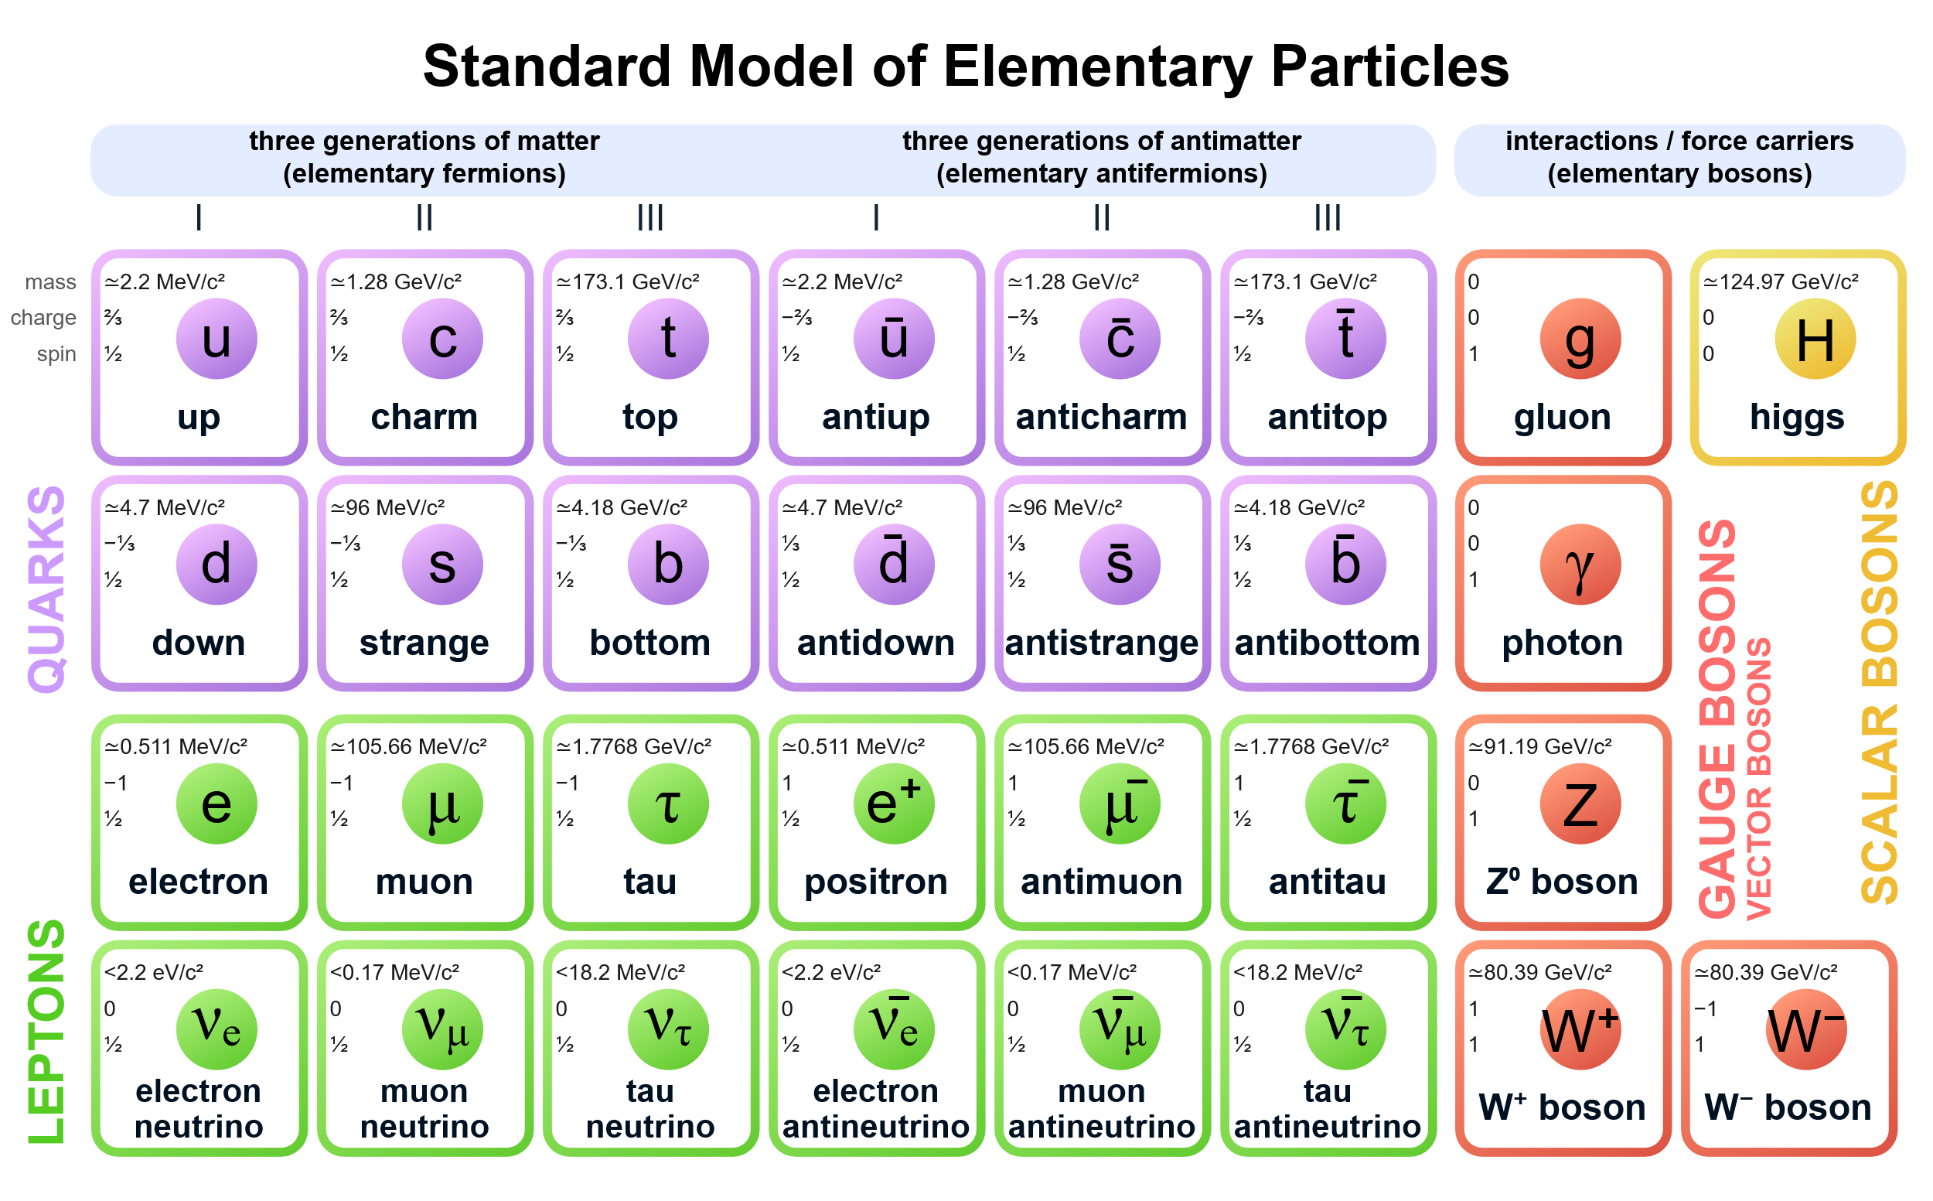
Faceless Neutrino
Neutrinos and antineutrinos in Standard Model
Charge neutral
Massless
How can we tell all 6 of them apart?
  How did we know there were 6 of them in the first place?
0
0
0
0
0
0
ν
ν
ν
ν
ν
ν
Image source: Wikipedia

Slide 3
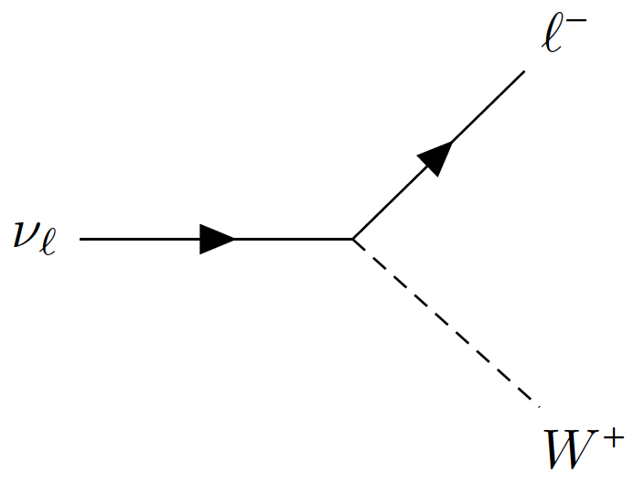

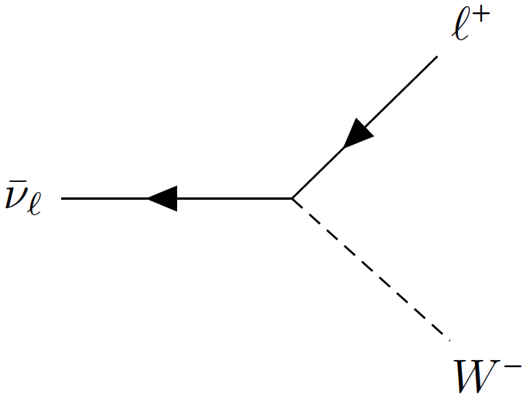
Neutrino’s Familiar Face
Neutrinos and antineutrinos in Standard Model
Charge neutral
Massless
How can we tell all 6 of them apart?
  How did we know there were 6 of them in the first place?
Flavour, defined by charged-current interactions
0
0
0
0
0
0
Image source: Wikipedia

Slide 4
Neutrino’s Two Faces
Neutrinos and antineutrinos in Nature
Charge neutral
Massless turns out to be tiny but not zero!
How can we tell all 6 of them apart? One more face (too many)
  How did we know there were 6 of them in the first place?
Flavour, defined by charged-current interactions
Image source: Wikipedia

Slide 5
Neutrino Mass and Mixing
Standard Model
Beyond Standard Model
Mass “levels”
Pontecorvo–Maki–Nakagawa–Sakata
PMNS matrix

Slide 6
Neutrino Mass and Mixing
Standard Model
Beyond Standard Model
Mass “levels”
Pontecorvo–Maki–Nakagawa–Sakata
PMNS matrix
Normal / Inverted
Mass Ordering (MO, or Hierarchy)
A problem only when there are more than 2 masses!

Slide 7
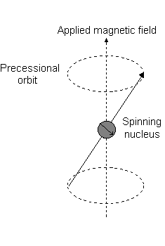

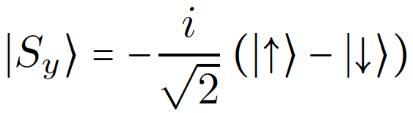
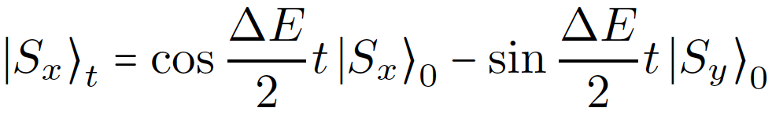
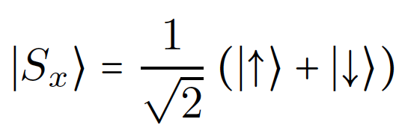
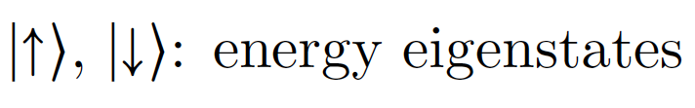
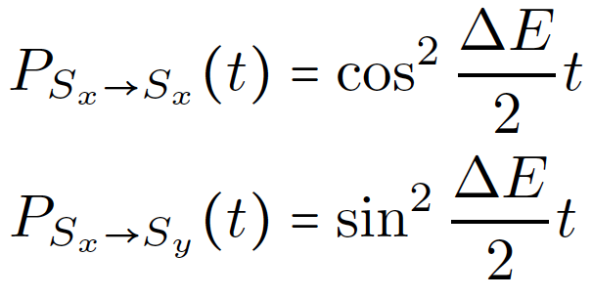
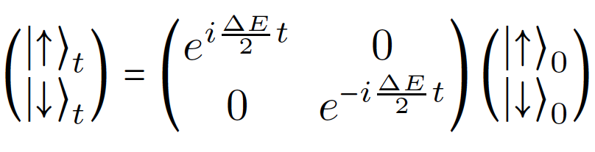
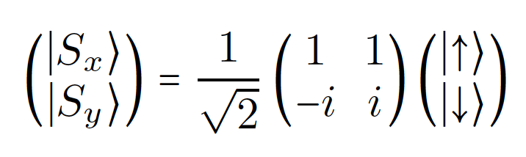
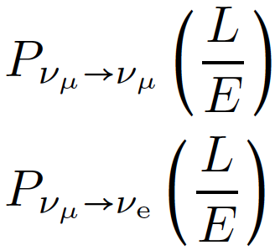
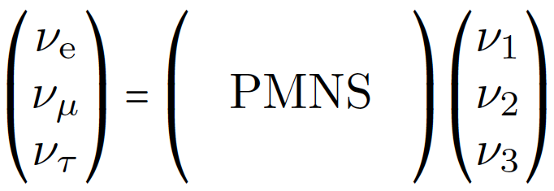


Mass gap (Δm²) and mixing lead to neutrino flavour oscillations
  Analogy: spin rotation in a magnetic field
B$≠$0
B=0
y
ΔE
Oscillation probability
x
Animated gif source: https://teaching.shu.ac.uk/hwb/chemistry/tutorials/molspec/nmr1.htm
Energy gap
Mixing
Survival
Appearance
Phase ~ Δm²L/E

Slide 8

Mass gap (Δm²) and mixing lead to neutrino flavour oscillations
  Analogy: spin rotation in a magnetic field
B$≠$0
B=0
y
ΔE
Oscillation probability
x
Animated gif source: https://teaching.shu.ac.uk/hwb/chemistry/tutorials/molspec/nmr1.htm
Energy gap
Mixing
Survival
2- or 3-flavour oscillation?
Appearance
Phase ~ Δm²L/E

Slide 9






θ₁₃ = 0
2-flavor oscillation
$$ν_{μ′}$$
$${\overline{ν}}_{μ′}$$
$$P(ν_{e})+P(ν_{μ′})=1$$
$$P({\overline{ν}}_{e})+P({\overline{ν}}_{μ′})=1$$
v_{μ}
$$ν_{e}$$
$${\overline{ν}}_{e}$$
Oscillation as a function of time
line-in-line → same trivia

Slide 10
θ₁₃ ≠ 0
3-flavor oscillation
$$ντ$$
$$\overline{ν}τ$$
$$P(νe)+P(νμ)+P(ντ)=1$$
$$P(\overline{ν}e)+P(\overline{ν}μ)+P(\overline{ν}τ)=1$$
v_{μ}
$$νμ$$
$$\overline{ν}μ$$
$$νe$$
$$\overline{ν}e$$
Oscillation as a function of time
line-in-plane → CP-violation possible

Slide 11
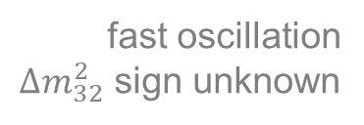
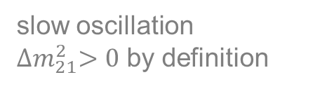
Neutrino Mass and Mixing
Standard Model
Beyond Standard Model
Mass “levels”
Pontecorvo–Maki–Nakagawa–Sakata
PMNS matrix
3
2
slow oscillation
${∆m}_{21}^{2}>0$ by definition
fast oscillation
${∆m}_{32}^{2}$ sign unknown
1
1
30
2
1
1
3
Normal / Inverted
Mass Ordering (MO, or Hierarchy)

Slide 12
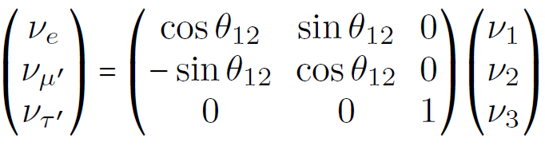
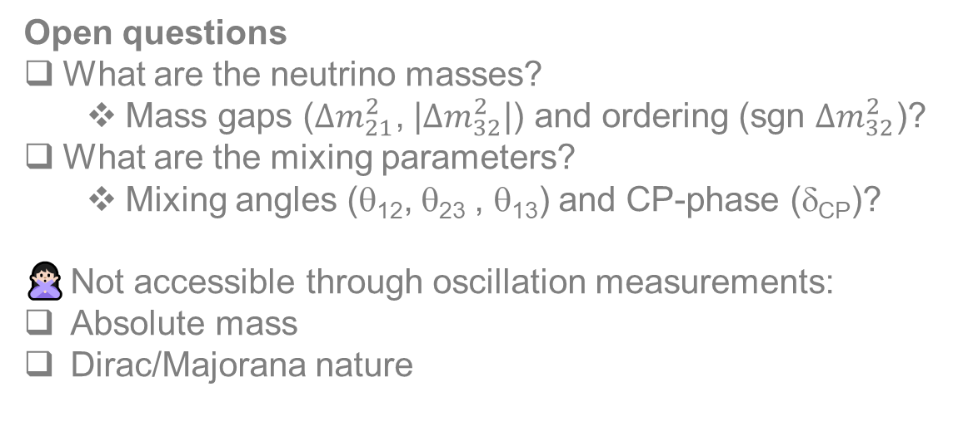
Neutrino Mass and Mixing
1
30
θ₁₃ ≠ 0 → δ_{CP} can be observed
Open questions
What are the neutrino masses?
  Mass gaps (${∆m}_{21}^{2}$, |${∆m}_{32}^{2}$|) and ordering (sgn ${∆m}_{32}^{2}$)?
What are the mixing parameters?
  Mixing angles (θ₁₂, θ₂₃ , θ₁₃) and CP-phase (δ_{CP})?
Not accessible through oscillation measurements:
Absolute mass
Dirac/Majorana nature
θ₁₂: mixing between ν₁ and ν₂
θ₂₃: mixing between ν_{μ} and ν_{τ}
θ₁₃: if 0, effective 2 flavour mixing
  No CPV!

Slide 13
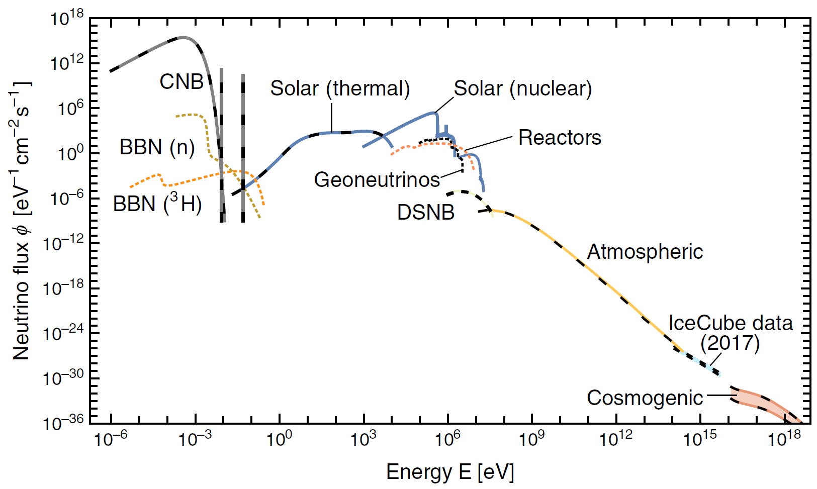
Neutrino Sources
MeV
GeV
[Vitagliano, Tamborra, and Raffelt, Rev.Mod.Phys. 92 ,45006 (2020)]

Slide 14
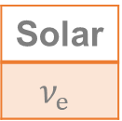
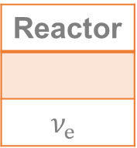
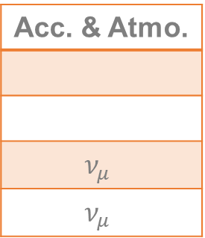
Neutrino Sources
(Oscillation-relevant) Types at source
Solar
$$ν_{e}$$
Reactor
$$ν_{e}$$
Acc. & Atmo.
$$ν_{μ}$$
$$ν_{μ}$$
MeV
GeV
Accelerators
[Vitagliano, Tamborra, and Raffelt, Rev.Mod.Phys. 92 ,45006 (2020)]

Slide 15
Neutrino Oscillation Experiments
Only two Δm²
3
2
1
1
30
2
1
1
3
Normal Inverted
Oscillation Phase ~ Δm²L/E
[Summer Blot, Neutrino 2020]

Slide 16
Neutrino Oscillation Experiments
MeV
GeV
1000 km
Only two Δm²
3
2
1
1
30
2
1
1
3
Normal Inverted
1 km
Oscillation Phase ~ Δm²L/E
[Summer Blot, Neutrino 2020]

Slide 17
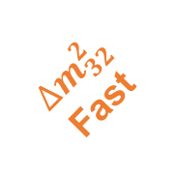



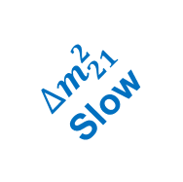
Neutrino Oscillation Experiments
MeV
GeV
Acc. & Atmo
$${∆m}_{21}^{2}$$
Slow
1000 km
$$θ_{23}$$
$$δ_{CP}$$
Only two Δm²
Reactor
3
2
$$θ_{12}$$
1
1
$${∆m}_{32}^{2}$$
Fast
30
2
1
1
3
Normal Inverted
Reactor
1 km
Oscillation Phase ~ Δm²L/E
$$θ_{13}$$
[Summer Blot, Neutrino 2020]

Slide 18
Neutrino Oscillation Experiments
MeV
GeV
Is that all?
Acc. & Atmo
$${∆m}_{21}^{2}$$
Slow
1000 km
$$θ_{23}$$
$$δ_{CP}$$
Only two Δm²
Reactor
3
2
$$θ_{12}$$
1
1
$${∆m}_{32}^{2}$$
Fast
30
2
1
1
3
Normal Inverted
Reactor
1 km
Oscillation Phase ~ Δm²L/E
$$θ_{13}$$
[Summer Blot, Neutrino 2020]

Slide 19
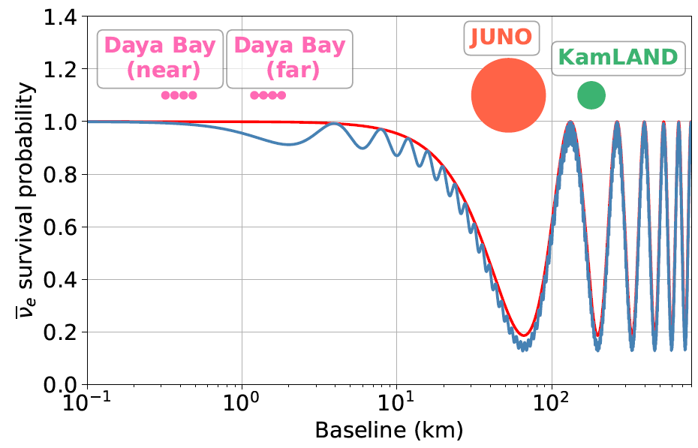
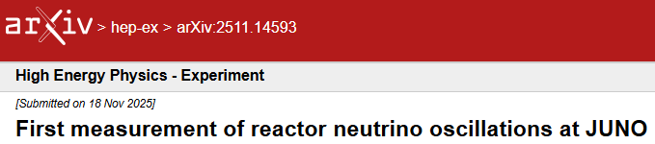
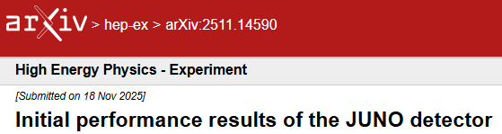
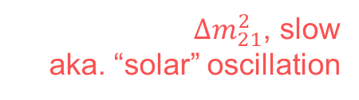
Neutrino Oscillation at JUNO
${∆m}_{21}^{2}$, slow
aka. “solar” oscillation
Today’s focus

Slide 20
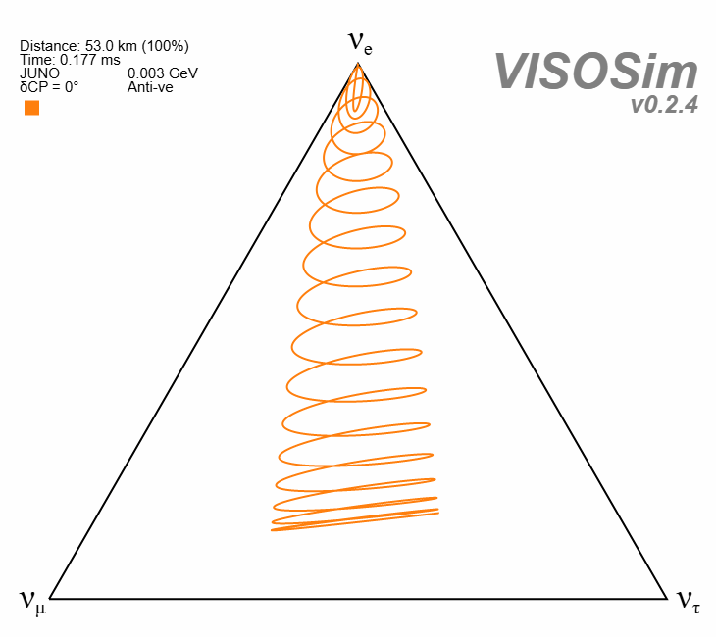
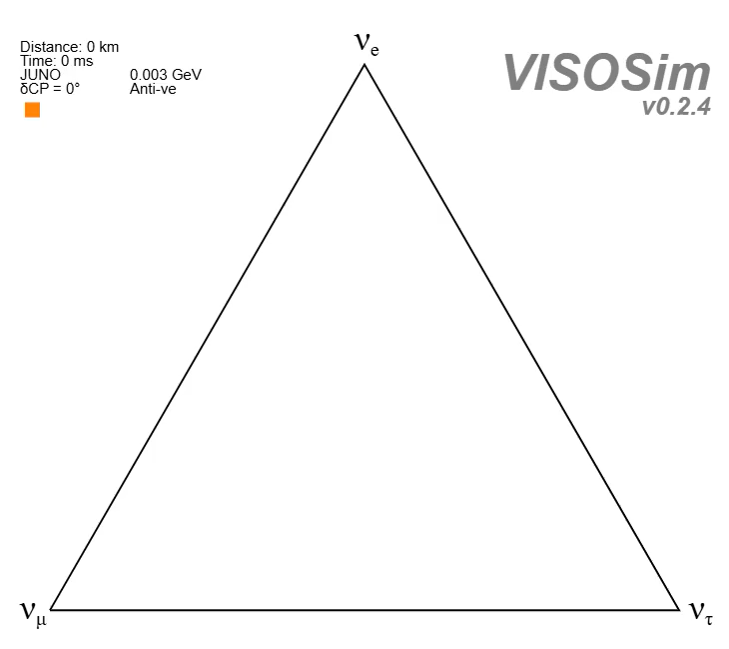
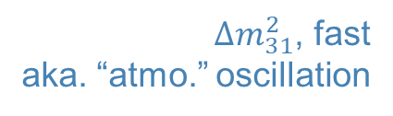
Neutrino Oscillation at JUNO
${∆m}_{21}^{2}$, slow
aka. “solar” oscillation
${∆m}_{31}^{2}$, fast
aka. “atmo.” oscillation
Today’s focus
10s video https://luxianguo.github.io/html/visos/im/

Slide 21
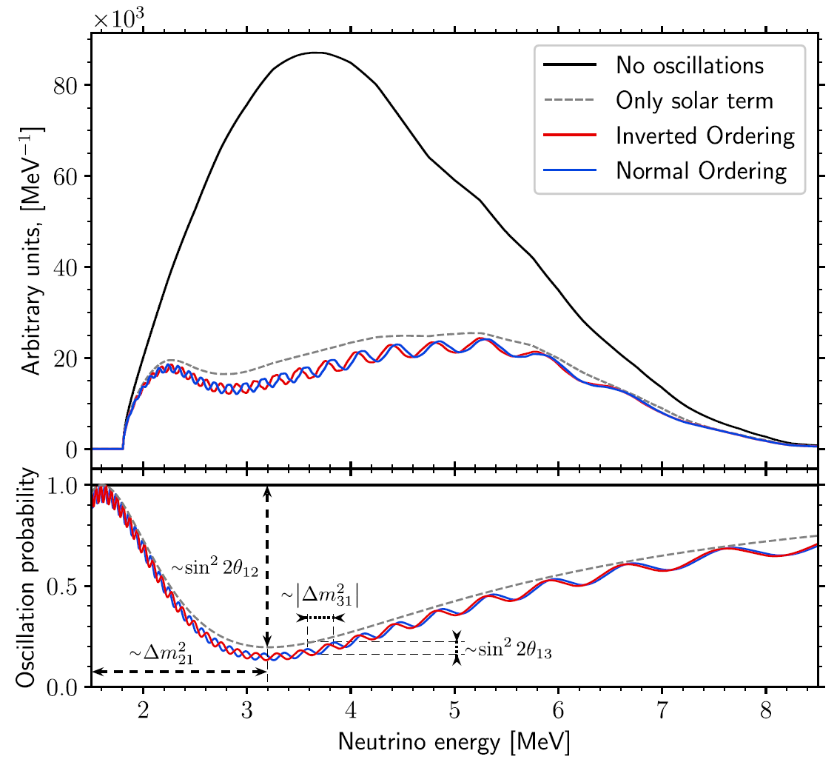
Neutrino Oscillation at JUNO
${∆m}_{21}^{2}$, slow
aka. “solar” oscillation
${∆m}_{31}^{2}$, fast
aka. “atmo.” oscillation
Today’s focus
[JUNO, Chin.Phys.C 49, 033104 (2025)]
JUNO’s main goal: Neutrino Mass Ordering

Slide 22
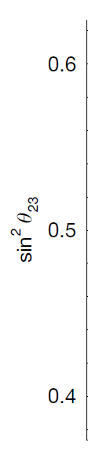
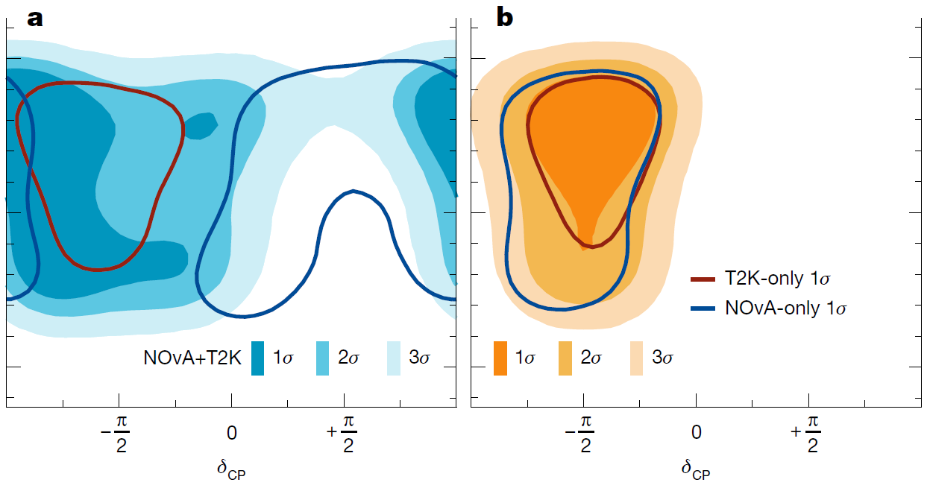
Why Neutrino Mass Ordering?
[T2K and NOvA, Nature 646, 818 (2025)]
Normal Ordering
Inverted Ordering
CP violation with neutrinos is already extremely difficult to measure even with a known NMO

Slide 23
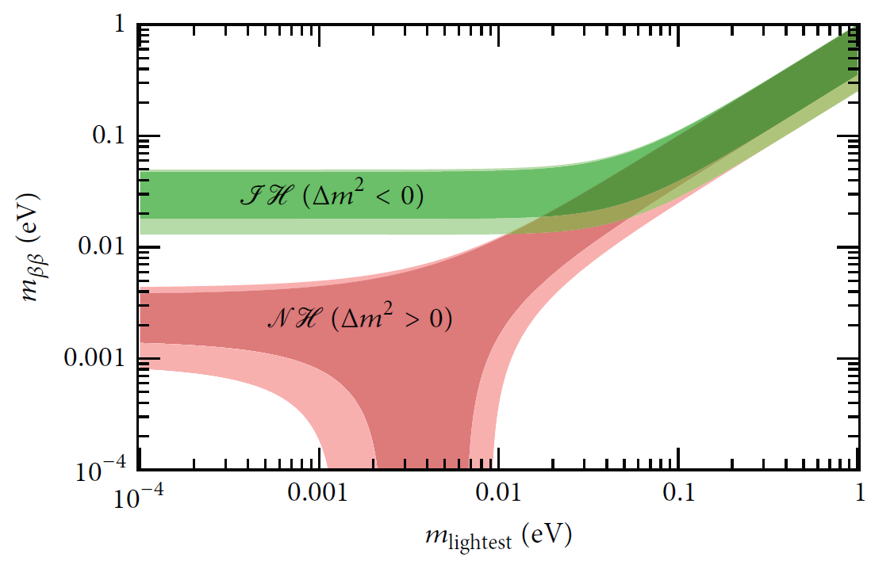
Why Neutrino Mass Ordering?
[Dell'Oro, Marcocci, Viel, and Vissani, Adv.High Energy Phys. 2016, 2162659 (2016)]
[T2K and NOvA, Nature 646, 818 (2025)]
Normal Ordering
Inverted Ordering
CP violation with neutrinos is already extremely difficult to measure even with a known NMO
Neutrinoless double beta decay interpretation depends on NMO
Cosmological input for sum of neutrino masses
Astrophysical input for supernova neutrino flavour evolution

Slide 24
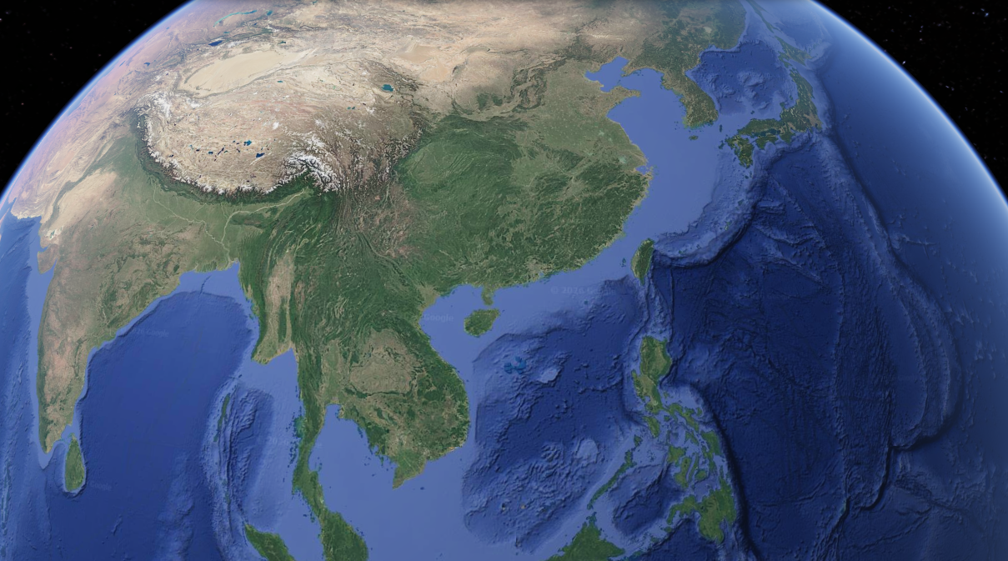
JUNO’s Location
Google Earth

Slide 25
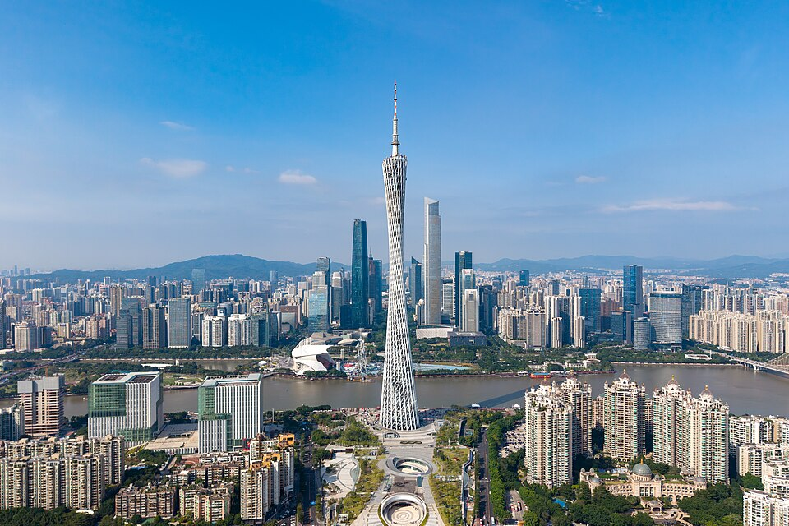
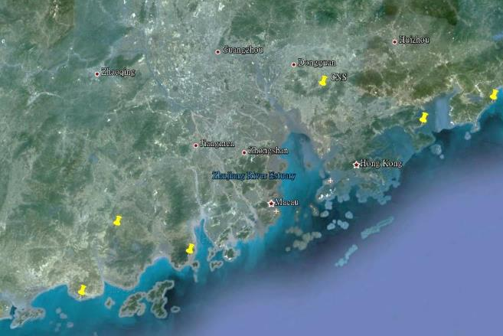



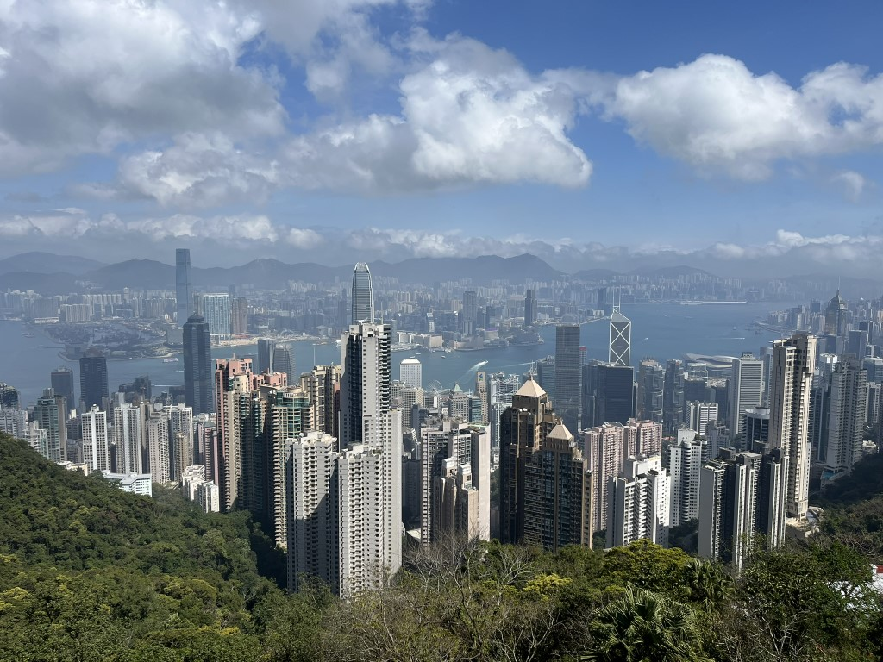
JUNO’s Location
Guangdong–Hong Kong–Macao Greater Bay Area
Photo from Wikipedia
Guang Zhou
Shen Zhen
Zhu Hai
Daya Bay NPP
Hong Kong
52.5 km
Macau
52.5 km
Taishan NPP 9.2 GW
Yangjiang NPP 17.4 GW
Photo by Xianguo Lu
Google Earth

Slide 26
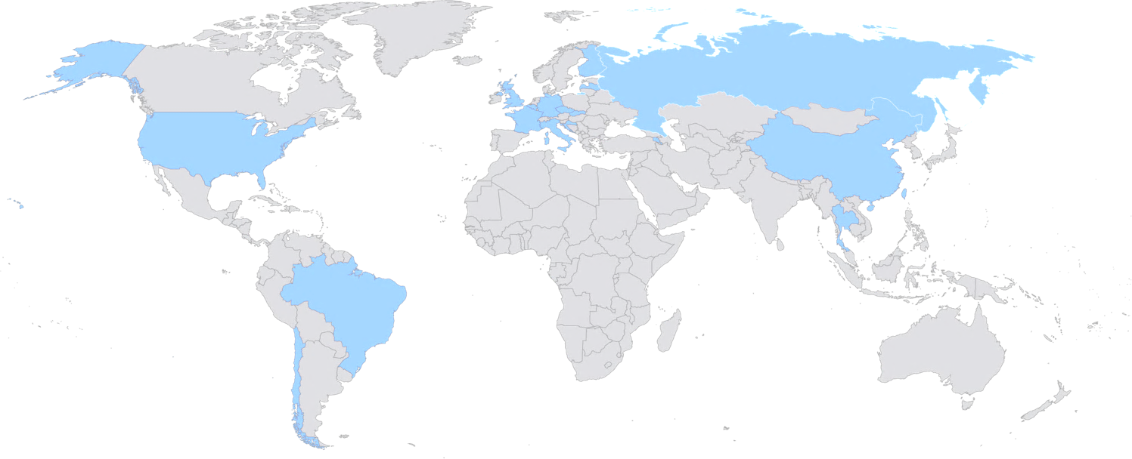
The JUNO Collaboration
= 70 institutes
> 700 participants
UK involvement
Warwick 2022/07 –
Liverpool 2024/07 –
Country | Institute | Country | Institute | Country | Institute
Armenia | YerPhI | China | SDU | Italy | INFN-CT
Belgium | ULB | China | SJTU | Italy | INFN-FE
Chile | SAPHIR | China | SUSTech | Italy | INFN-LNF
Chile | UNAB | China | SYSU | Italy | INFN-MI
China | BISEE | China | THU | Italy | INFN-MIB
China | CDUT | China | UCAS | Italy | INFN-PD
China | CNPRI | China | WHU | Italy | INFN-PG
China | CUGB | China | WuYiU | Italy | INFN-Roma3
China | DGUT | China | XJTU | Pakistan | PINSTECH (PAEC)
China | ECUT | China | XMU | Russia | JINR
China | GXU | China | ZZU | Slovakia | FMFI-UK
China | HIT | Czech | Charles U. | Taiwan-China | NCTU
China | HunanU | Finland | JyU | Taiwan-China | NKNU
China | IGGCAS | France | CPPM | Taiwan-China | NTU
China | IHEG-CAGS | France | IJCLab | Taiwan-China | NTUT
China | IHEP | France | IPHC | Thailand | CHULA
China | IMP | France | LP2iB | Thailand | NARIT
China | JNU | France | Subatech | Thailand | SUT
China | JXNU | Germany | EKUT | U.K. | U. Liverpool
China | KNRC | Germany | GSI | U.K. | U. Warwick
China | Nankai U. | Germany | U. Hamburg | USA | UCI
China | NCEPU | Germany | JGUMainz | USA | UMD-G
China | NJU | Germany | RWTH-AC
China | RNCG | Germany | TUM

Slide 27

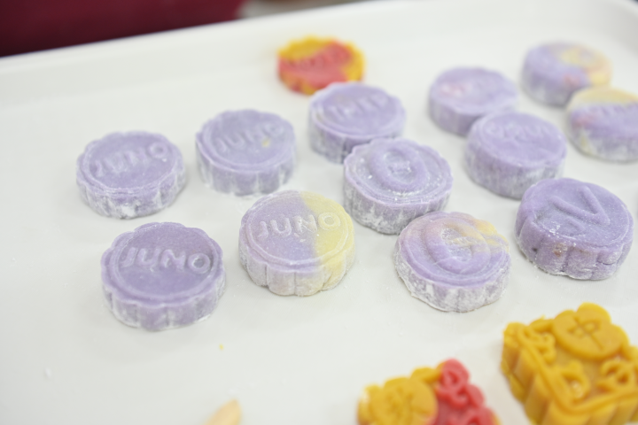
The JUNO Collaboration
= 70 institutes
> 700 participants
UK involvement
Warwick 2022/07 –
Liverpool 2024/07 –
Country | Institute | Country | Institute | Country | Institute
Armenia | YerPhI | China | SDU | Italy | INFN-CT
Belgium | ULB | China | SJTU | Italy | INFN-FE
Chile | SAPHIR | China | SUSTech | Italy | INFN-LNF
Chile | UNAB | China | SYSU | Italy | INFN-MI
China | BISEE | China | THU | Italy | INFN-MIB
China | CDUT | China | UCAS | Italy | INFN-PD
China | CNPRI | China | WHU | Italy | INFN-PG
China | CUGB | China | WuYiU | Italy | INFN-Roma3
China | DGUT | China | XJTU | Pakistan | PINSTECH (PAEC)
China | ECUT | China | XMU | Russia | JINR
China | GXU | China | ZZU | Slovakia | FMFI-UK
China | HIT | Czech | Charles U. | Taiwan-China | NCTU
China | HunanU | Finland | JyU | Taiwan-China | NKNU
China | IGGCAS | France | CPPM | Taiwan-China | NTU
China | IHEG-CAGS | France | IJCLab | Taiwan-China | NTUT
China | IHEP | France | IPHC | Thailand | CHULA
China | IMP | France | LP2iB | Thailand | NARIT
China | JNU | France | Subatech | Thailand | SUT
China | JXNU | Germany | EKUT | U.K. | U. Liverpool
China | KNRC | Germany | GSI | U.K. | U. Warwick
China | Nankai U. | Germany | U. Hamburg | USA | UCI
China | NCEPU | Germany | JGUMainz | USA | UMD-G
China | NJU | Germany | RWTH-AC
China | RNCG | Germany | TUM
Photo credit: LIU Yuexiang@IHEP

Slide 28
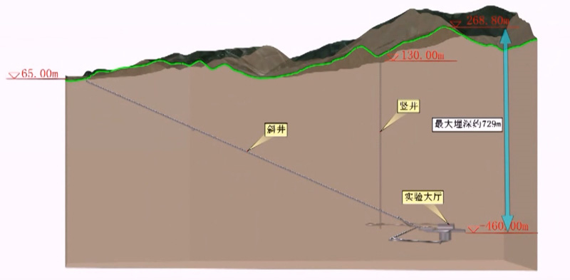
The JUNO Lab
~500 m underground
~700 m rock overburden (1800 m.w.e.)
Photo credit: LIU Yuexiang@IHEP

Slide 29
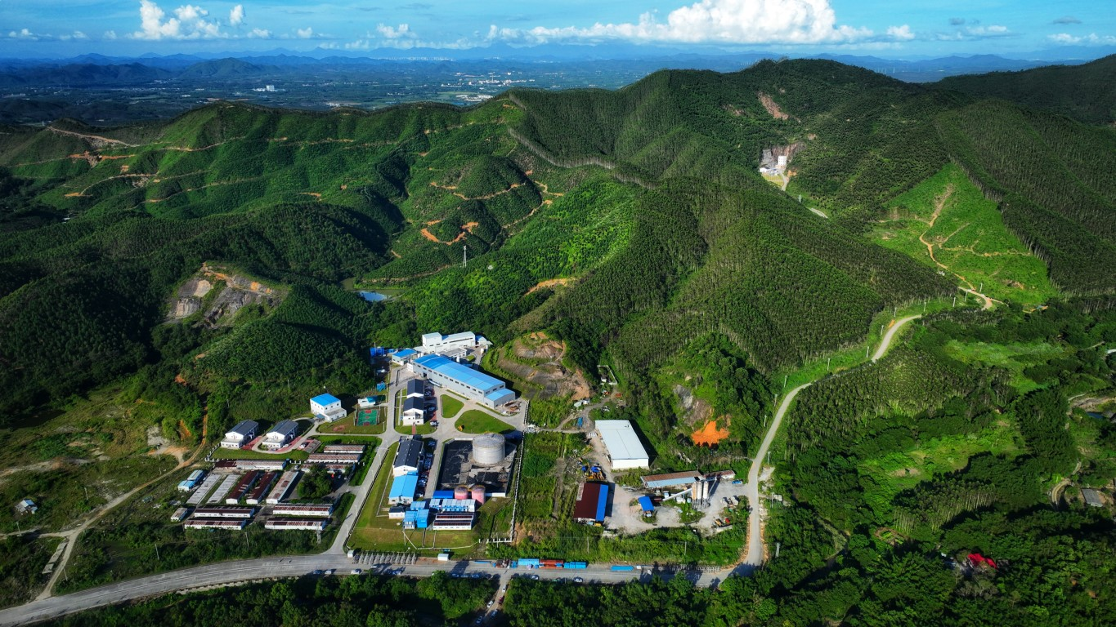
The JUNO Lab
~500 m underground
~700 m rock overburden (1800 m.w.e.)
Photo credit: LIU Yuexiang@IHEP

Slide 30
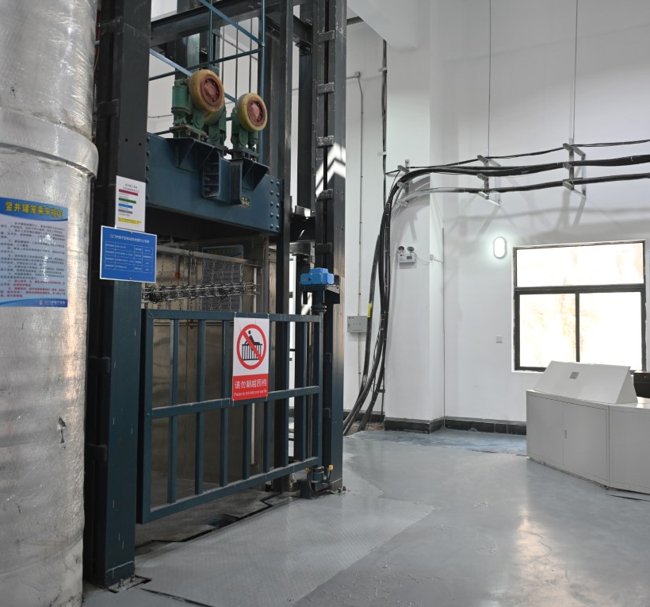
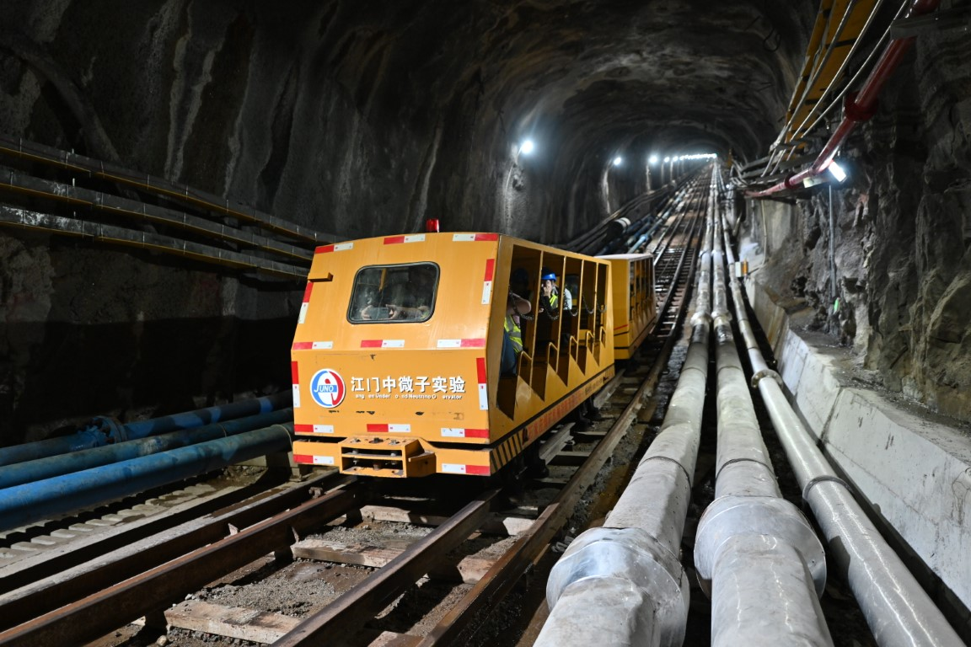
The JUNO Lab
~500 m underground
~700 m rock overburden (1800 m.w.e.)
~1300 m sloped tunnel
~600 m vertical shaft
Photo credit: LIU Yuexiang@IHEP

Slide 31
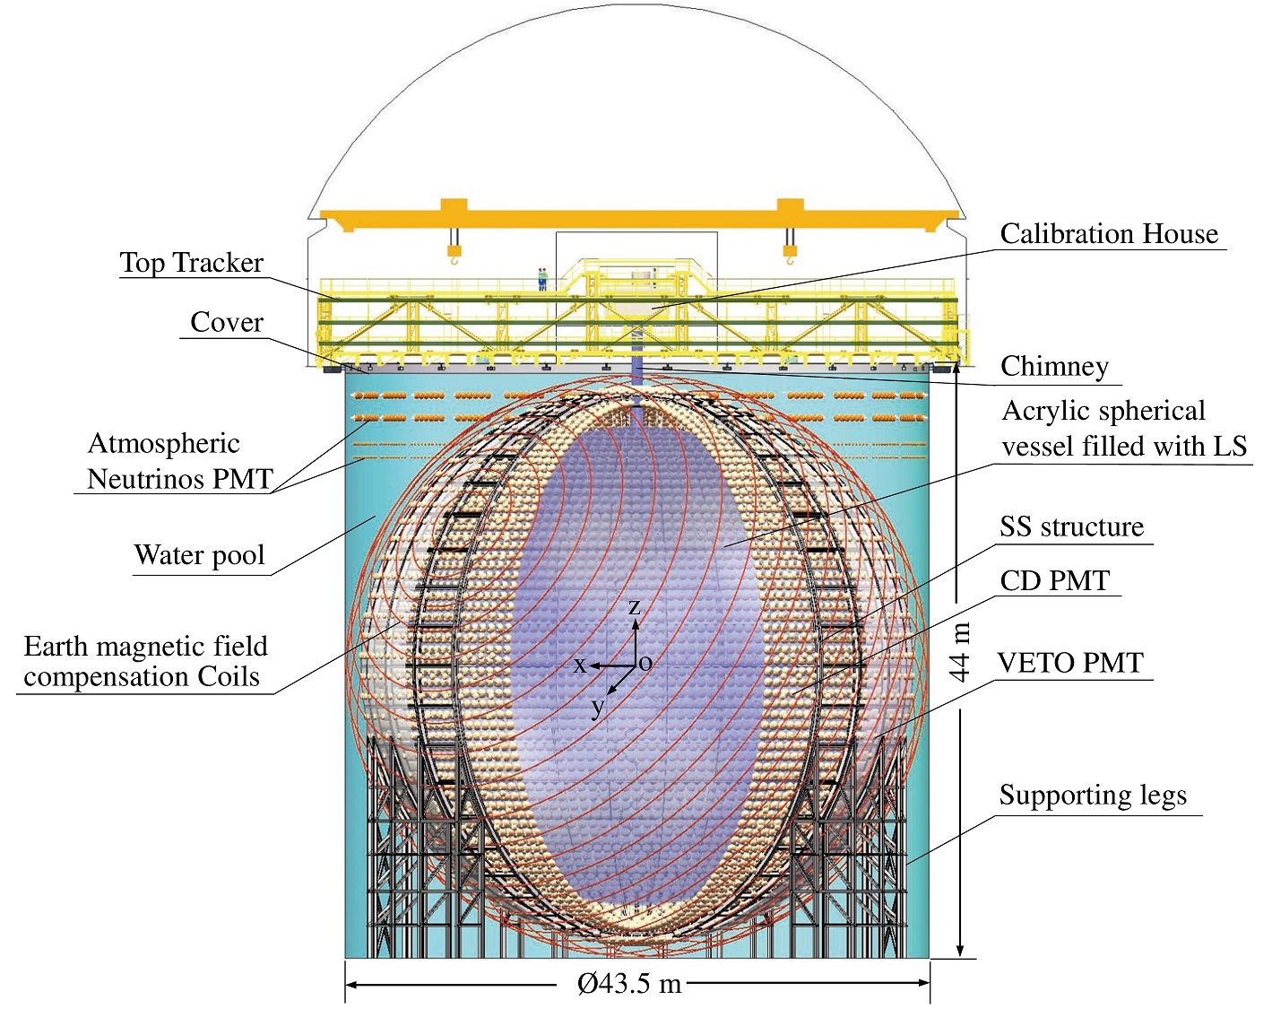
The JUNO Detector

Slide 32
The JUNO Detector
Ø43.5 m, H 44 m Water Pool/WP
  35 kt water—Water Cher’ Detector/WCD
  ---------------------------- Tyvek ----------------------------
  5 kt water buffer between WCD and AV

Slide 33
The JUNO Detector
Ø43.5 m, H 44 m Water Pool/WP
  35 kt water—Water Cher’ Detector/WCD
  ---------------------------- Tyvek ----------------------------
  5 kt water buffer between WCD and AV
Stainless Steel Structure/SSS
  WCD PMTs viewing outwards
  2,404 20’’ veto PMTs (Micro-Channel Plate/MCP)
  ---------------------------- Tyvek ----------------------------
  CD PMTs viewing inwards
  17,596 20’’ large PMTs: 4939 dynode + MCP (w/ ×2 photon detection efficiency)
  25,587 3’’ small PMTs (higher dynamic range, calibration for large PMTs; a problem due to the connections: add N₂ into water)
    75%+3% geometrical coverage ← SSS mechanical precision ~3 mm

Slide 34
The JUNO Detector
Ø43.5 m, H 44 m Water Pool/WP
  35 kt water—Water Cher’ Detector/WCD
  ---------------------------- Tyvek ----------------------------
  5 kt water buffer between WCD and AV
Stainless Steel Structure/SSS
  WCD PMTs viewing outwards
  2,404 20’’ veto PMTs (Micro-Channel Plate/MCP)
  ---------------------------- Tyvek ----------------------------
  CD PMTs viewing inwards
  17,596 20’’ large PMTs: 4939 dynode + MCP (w/ ×2 photon detection efficiency)
  25,587 3’’ small PMTs (higher dynamic range, calibration for large PMTs; a problem due to the connections: add N₂ into water)
    75%+3% geometrical coverage ← SSS mechanical precision ~3 mm
Ø35.4 m Acrylic Vessel/AV
  20 kt liquid scintillator—Central Detector/CD
    Fluorescence emission peak 430 nm (violet-blue)

Slide 35
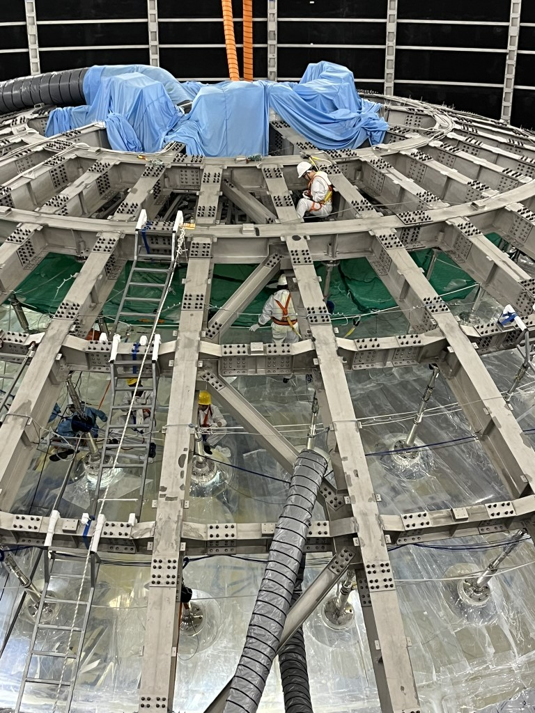
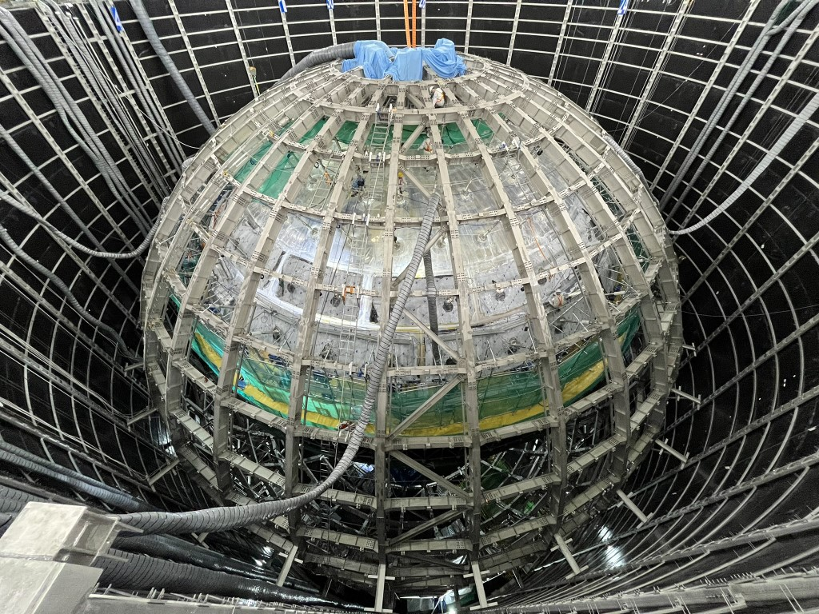
The JUNO Detector
SSS and AV
Photo credit: XL

Slide 36
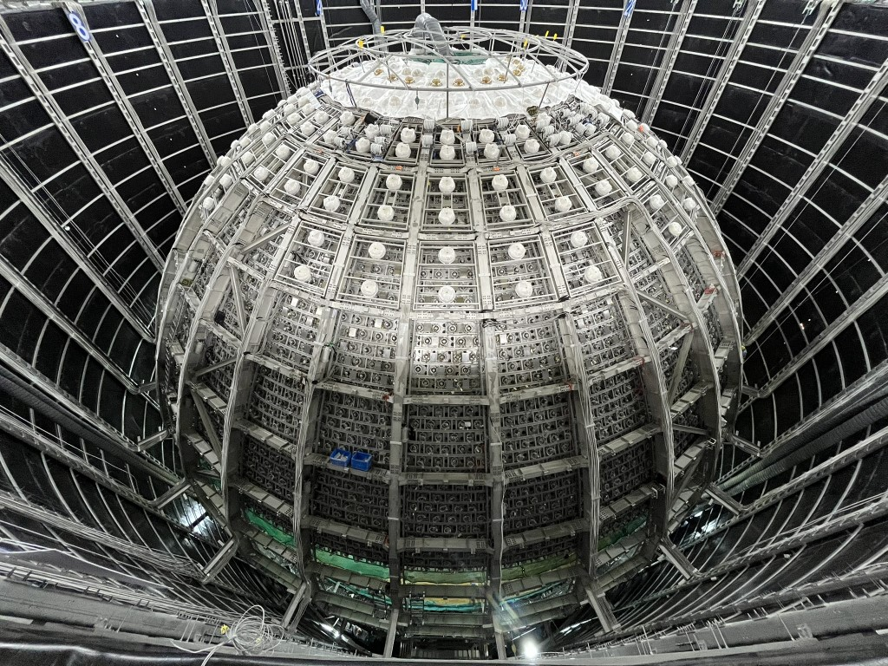
The JUNO Detector
Veto PMTs (and back of large PMTs)
Photo credit: XL

Slide 37
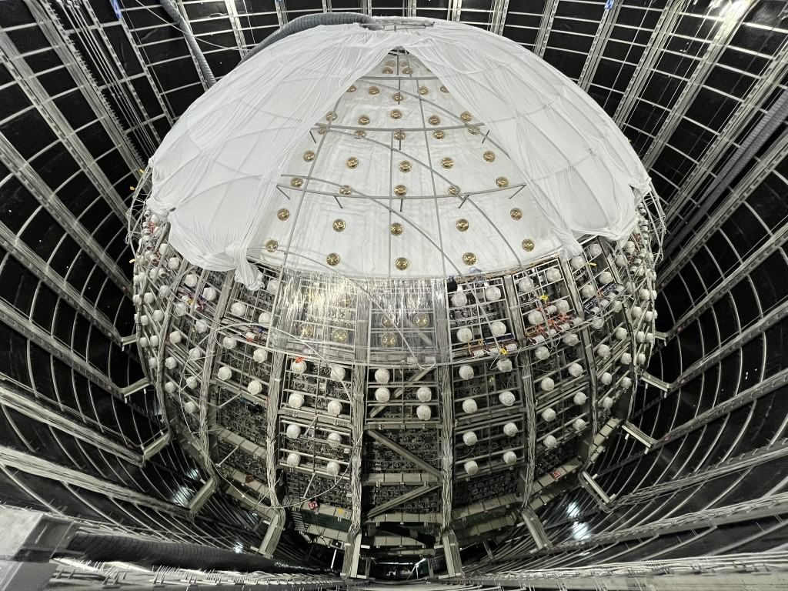
The JUNO Detector
Tyvek (and earth magnetic field compensation coils)
Photo credit: XL

Slide 38



The JUNO Detector
Large and small PMTs (and water buffer region)
Photo credit: LIU Yuexiang@IHEP

Slide 39


Towards JUNO’s First Results
2013 2015 2022 2023 2024 2025
Underground water
COVID
Project approved
Civil construction
Photo credit: LIU Yuexiang@IHEP

Slide 40

Towards JUNO’s First Results
2013 2015 2022 2023 2024 2025
Project approved
Civil construction
Detector installation
30s video

Slide 41




Towards JUNO’s First Results
2013 2015 2022 2023 2024 2025
Project approved
Civil construction
Detector installation
2022/08/15
2023/08/04
2024/09/27
2024/12/19

Slide 42


Towards JUNO’s First Results
2013 2015 2022 2023 2024 2025
Project approved
Civil construction
Detector installation
Photo credit: LIU Yuexiang@IHEP

Slide 43


Towards JUNO’s First Results
2013 2015 2022 2023 2024 2025
Project approved
Civil construction
Detector installation
1m video
Photo credit: LIU Yuexiang@IHEP

Slide 44

Towards JUNO’s First Results
2013 2015 2022 2023 2024 2025
Project approved
Civil construction
Detector installation
2024/12/18: Water filling
10s video

Slide 45


Towards JUNO’s First Results
2013 2015 2022 2023 2024 2025
Project approved
Civil construction
Detector installation
2024/12/18: Water filling
Photo credit: LIU Yuexiang@IHEP

Slide 46

Towards JUNO’s First Results
2013 2015 2022 2023 2024 2025
Project approved
Civil construction
Detector installation
2024/12/18: Water filling
2025/02/01: Water/LS exchange
2025/08/22: LS filling complete
Animated gif

Slide 47


Towards JUNO’s First Results
2025/08/22 (22:12): LS filling completed; water in CD fully replaced by LS
2025/08/23 (14:00): Detector calibration began
2025/08/26 (05:30): Start of physics data taking
  LS in CD: 23,231.6 m³
  Water in WP: 41,225.1 m³
Data set used for First Result: 08/26–11/02 (69 calendar days)
  Detector uptime > 97.8%
  Physics-quality data: 59.1 days

Slide 48




A Golden Reactor Neutrino Event
Prompt positron signal
Delayed neutron signal

Slide 49


Detector Performance
LS attenuation length average: 20.6m @430 nm
  Sensitive indicator of LS quality
  Critical for light yield and energy scale uniformity
  Designed goal 20 m for a good energy resolution
WCD water attenuation length > 70 m @400 nm
  Excellent optical transparency
  Ultra-pure water
  Design goal 40 m

Slide 50


Detector Performance
CD | Design | Measured
Singles* (Hz) | < 7.2 | <7
²³⁸U/²³²Th (×10⁻¹⁵ g/g) | <1 | <0.1
²¹⁰Po (×10⁴ cpd/kt) | <8 | <5
WCD | Design | Measured
²²²Rn (mBq/m³) | < 10 | <10
²²⁶Ra (mBq/m³) | <1 | <0.01
²³⁸U/²³²Th (×10⁻¹⁵ g/g) | <10 | <0.4
* For E>0.7 MeV and r < 17.2 m
Internal radioactivity
Cosmogenic spallation $n/{}_{}^{12}{B/{}_{}^{11}C}$ from $μ+{}_{}^{12}C$
Natural radioactivity
  ${}_{}^{238}U→{}_{}^{210}{Po}→α$
  ${}_{}^{238}U→{}_{}^{214}{Bi}→{}_{}^{214}{Po+β}$ (prompt),
  ${}_{}^{214}{Po}→α$ (delayed)
    Calibration α source
    BiPo214 very distinctive coincidence signal, easy to identify, very useful tool
Very clean detector: < 10 mg dust in 20 kt LS

Slide 51



Energy Calibration
External calibration sources deployed by ACU, CLS, and GT
  $AmC: α+{}_{}^{13}C→{}_{}^{16}{O∗}+n$
A wide range of energy covered

Slide 52

Energy Calibration
External calibration sources deployed by ACU, CLS, and GT
  $AmC: α+{}_{}^{13}C→{}_{}^{16}{O∗}+n$
A wide range of energy covered
γ 0.662 MeV
γ 0.835 MeV
γ 2.223 MeV
Guide Tube (GT)
Automatic Calibration Unit (ACU)
2γ 1.022 MeV
2γ 2.506 MeV
γ 1.460 MeV
Cable Loop System
(CLS)
γ 6.13 MeV
γ 4.43 MeV (n-LS)
1∼2γ 4.94 MeV

Slide 53

Energy Calibration
Non-linearity (due to Birks, Cherenkov, etc.) well described
  Characterised to <1% precision
γ 0.662 MeV
γ 0.835 MeV
γ 2.223 MeV
2γ 1.022 MeV
2γ 2.506 MeV
γ 1.460 MeV
γ 4.43 MeV (n-LS)
γ 6.13 MeV
1∼2γ 4.94 MeV

Slide 54


Energy Calibration
Energy scale is known to 0.5%
  Good spatial uniformity
  Consistent energy response between calibration data and IBD candidates
γ 0.662 MeV
γ 0.835 MeV
γ 2.223 MeV
2γ 1.022 MeV
2γ 2.506 MeV
γ 1.460 MeV
γ 4.43 MeV (n-LS)
γ 6.13 MeV
1∼2γ 4.94 MeV

Slide 55


Energy Calibration
Energy resolution for 𝛼 from ²¹⁴Po is < 3% @0.93MeV
Energy resolution for γ from ⁶⁸Ge is ~3.4% @0.90 MeV
  Already close to but slightly worse than the expectation of 3.1%
  Further improvements expected with better calibration and energy reconstruction

Slide 56

Timing Performance
Dynode PMT
MCP PMT
Event residual time = t_{first-hit} − t_{TOF} − t_{ref-PMT}
Well-defined prompt timing peaks
Consistent with design, not limiting factor
Sufficient for background veto and vertex reconstruction

Slide 57


Vertex Reconstruction
⁶⁸Ge, ACU
⁶⁸Ge, ACU
Vertex of “singles” at outermost 10 cm of CD
External radioactivity from joints of AV support
Z-bias within 10 cm across detector
  Deviation near boundary due to less uniform photon collection
Resolution 10-20 cm
  Optical boundary effects
Sufficient for event selection, defining fiducial volume, and correcting energy non-uniformity.

Slide 58



Reactor ${\overline{ν}}_{e}$ Event Characteristics at JUNO
Inverse beta decay (IBD)
${\overline{ν}}_{e}+p→e^{+}+n$
Only on hydrogen, not carbon
Prompt signal: $e^{+}$
  Prompt energy + 0.78 MeV ~ E_{ν}

Slide 59



Reactor ${\overline{ν}}_{e}$ Event Characteristics at JUNO
Inverse beta decay (IBD)
${\overline{ν}}_{e}+p→e^{+}+n$
Only on hydrogen, not carbon
Prompt signal: $e^{+}$
  Prompt energy + 0.78 MeV ~ E_{ν}
Delayed signal: $n+H→d+γ$
  2.2 MeV neutron capture peak
  Mean capture time ~ 200 μs
  Separation between vertices up to ~1 m
Δd

Slide 60
Event Selection
Background
Cosmogenic spallation products
  ⁹Li/⁸He: β-n decay most dangerous
Natural radioactivity
Geoneutrinos from decay of U/Th
World reactors
Event selection
Fiducial volume cut
  Remove events near CD boundary where external backgrounds enters; to keep the best performance region only
PMT flasher rejection
  Remove events produced by flashing PMTs
Muon veto
  Remove events after a cosmic-ray muon
  Spallation neutron space-time veto
Multiplicity cut
  Remove events with more than 2 triggers expected for IBD
Triple coincidence for IBD

Slide 61

Event Selection: Muon Veto
WCD
Muon tagging:
WCD
  Cherenkov light
  9 Hz
CD
  Very large and track-like energy deposition
  5 Hz
Stable performance and almost 100% tagging efficiency in WCD

Slide 62


Event Selection: Muon Veto
Single muon reconstruction
WCD and CD reconstruction consistent with MC
  Normalisation and shape
  Validating models of muon flux and rock overburden
Photo credit: LIU Yuexiang@IHEP

Slide 63



Reactor ${\overline{ν}}_{e}$ Rate at JUNO

Slide 64
Reactor ${\overline{ν}}_{e}$ Rate at JUNO
Uncertainties on predicted non-oscillated signal rate
  Proton counting in LS (geometric, chemical, etc.)
  Flux constrained by released Daya Bay near detector data

Slide 65
Reactor ${\overline{ν}}_{e}$ Rate at JUNO
Uncertainties on predicted non-oscillated signal rate
  Proton counting in LS (geometric, chemical, etc.)
  Flux constrained by released Daya Bay near detector data
  Residual reactor specific systematics

Slide 66
Reactor ${\overline{ν}}_{e}$ Rate at JUNO
~ 40 per day
Uncertainties on predicted non-oscillated signal rate
  Proton counting in LS (geometric, chemical, etc.)
  Flux constrained by released Daya Bay near detector data
  Residual reactor specific systematics
S/B ~ 5
  Cosmogenic ⁹Li/⁸He S/B ~ 8, vert good given shallow depth!
  Geo-ν irreducible but itself interesting!
~ 6 per day

Slide 67
Reactor ${\overline{ν}}_{e}$ Rate at JUNO
Uncertainties on predicted non-oscillated signal rate
  Proton counting in LS (geometric, chemical, etc.)
  Flux constrained by released Daya Bay near detector data
  Residual reactor specific systematics
S/B ~ 5
  Cosmogenic ⁹Li/⁸He S/B ~ 8, vert good given shallow depth!
  Geo-ν irreducible but itself interesting!
Efficiency ~ 70%
  Dominated by fiducial volume

Slide 68

Reactor ${\overline{ν}}_{e}$ Rate at JUNO
Neutrino rate follows reactor operations in real time
  Events are indeed from reactors
  Backgrounds do not dominate the signal
  Flux modelling is correct
  Detector stability is good
Reactor real-time monitoring
  Sensitive to single core at 50 km (8 cores, 27 GW_{th})
* Background subtracted

Slide 69



Reactor ${\overline{ν}}_{e}$ Energy Spectrum at JUNO
Dominant distortion driven by $θ_{12}$ and $Δm_{21}^{2}$
Backgrounds under control
Consistent results from three independent analyses
  Own selections, reconstructions, background estimations, detector response characterisations, and fitting implementation

Slide 70

JUNO First Measurement of Solar Mixing Parameters
Most precise single-experiment measurement of solar mixing parameters
  1.6× improvement in precision
Significant improvement over previous reactor measurements
  With only 59.1 days of data
SK+SNO (2024): SK, Phys. Rev. D 109, 092001 (2024)
KamLand (2013): KamLAND, Phys. Rev. D 88, 033001 (2013)
SNO+ (2025): SNO+, Phys. Rev. Lett. 135, 121801 (2025)

Slide 71


JUNO First Measurement of Solar Mixing Parameters
SNO (2011): SNO, Phys. Rev. C 88, 025501 (2013)
SK (2024), SK+SNO (2024), all solar ν (2024): SK, Phys. Rev. D 109, 092001 (2024)
KamLand (2013): KamLAND, Phys. Rev. D 88, 033001 (2013)
SNO+ (2025): SNO+, Phys. Rev. Lett. 135, 121801 (2025)
Mild difference still between solar and reactor
Transition to precision era of neutrino solar mixing parameter measurements
  Reactors can be used to measure at the sub-percent level, w/
    Much larger detector
    Higher statistics

Slide 72


Beyond the First Measurement
NMO sensitivity
Sensitivity dependence
[JUNO, Chin.Phys.C 49, 033104 (2025)]
[JUNO, Chin.Phys.C 46, 123001 (2022)]
7.1 years
NO: 3σ
IO: 3.1σ
Sub-percent measurements of $∆m_{31}^{2}$, $∆m_{21}^{2}$, $\sin^{2}θ_{12}$

Slide 73


Beyond the Oscillation Measurements: JUNO-ββ
[Cao et al., Chin.Phys.C 44, 031001 (2020)]
Figure from Yifang Wang, FNAL seminar, April 2025
After JUNO oscillation measurements, search for 0νββ will be the next focus
Future upgrade: Insert a balloon filled with ¹³⁶Xe-loaded LS (or ¹³⁰Te) into JUNO CD [Zhao et al., Chin.Phys.C 41, 053001 (2017)]

Slide 74







An Observatory for 30 Years
[JUNO, J.Phys.G 43, 030401 (2016)]
[JUNO, Prog.Part.Nucl.Phys. 123,103927 (2022)]
Image by CAS, published by China Daily
Cartoon from Barbara Caccianiga@INFN- Milano

Slide 75











Mixing of Solar Neutrinos
[Xu, Wang, and Chen, Prog.Part.Nucl.Phys. 131, 104043 (2023)]
Insensitive to μ- and τ-flavours, $θ_{13}≈0$
  ~ two-flavour oscillation
Low energy:
Vacuum propagation
$$\begin{matrix}\begin{aligned}ν_{1} \\ \\ \\ \\ \\ \end{aligned} \\ ν_{2}\end{matrix}$$
$${N_{1}=cos}^{2}θ_{12}n_{ν_{e}}$$
$${N_{ν_{e}}=cos}^{2}θ_{12}N_{1}$$
At production
At surface
$$ν_{e}$$
Decoherence in vacuum
$$ν_{e}$$
$${N_{2}=sin}^{2}θ_{12}n_{ν_{e}}$$
$${N_{ν_{e}}=sin}^{2}θ_{12}N_{2}$$

Slide 76


Mixing of Solar Neutrinos
[Xu, Wang, and Chen, Prog.Part.Nucl.Phys. 131, 104043 (2023)]
Insensitive to μ- and τ-flavours, $θ_{13}≈0$
  ~ two-flavour oscillation
High energy:
Avoided level crossing* + adiabatic evolution
$$\begin{matrix}\begin{aligned}ν_{1} \\ \\ \\ \\ \\ \end{aligned} \\ ν_{2}\end{matrix}$$
At production
At surface
$$ν_{e}$$
Decoherence in vacuum
$$ν_{e}$$
$$N_{2}=n_{ν_{e}}$$
$${N_{ν_{e}}=sin}^{2}θ_{12}N_{2}$$
*See Back-Up

Slide 77

Mixing of Solar Neutrinos
[Xu, Wang, and Chen, Prog.Part.Nucl.Phys. 131, 104043 (2023)]
Low energy:
Vacuum propagation
“up-turn”
High energy:
Avoided level crossing + adiabatic evolution
— How high is high?
— Relative to the only energy scale in this two-flavour mixing: $Δm_{21}^{2}$
Stretching between limits, aka “up-turn”, gives us $Δm_{21}^{2}$

Slide 78



Solar Neutrinos at JUNO
[JUNO, Chin.Phys.C 45, 023004 (2021)]
[Xu, Wang, and Chen, Prog.Part.Nucl.Phys. 131, 104043 (2023)]
Up-turn-sensitive energy with ⁸B
  Reactor-solar consistency test of solar mixing/oscillations (matter effects, ν vs. $\overline{ν}$, new physics, etc.)
  Other neutrinos to probe the Sun [JUNO, JCAP 10, 022 (2023)]

Slide 79

Solar Neutrinos at JUNO
[JUNO, Chin.Phys.C 45, 023004 (2021)]
[Xu, Wang, and Chen, Prog.Part.Nucl.Phys. 131, 104043 (2023)]
Up-turn-sensitive energy with ⁸B
  Reactor-solar consistency test of solar mixing/oscillations (matter effects, ν vs. $\overline{ν}$, new physics, etc.)
  Other neutrinos to probe the Sun [JUNO, JCAP 10, 022 (2023)]
Solar only $ν$, not $ν$
  No reaction on hydrogen nor carbon: only ES on electron
  No IBD coincidence: demanding on background (internal, cosmogenic) control

Slide 80

Summary and Outlook
After 13 years of efforts, from idea to construction, JUNO detector is fully completed, despite numerous challenges (water in the excavation, covid…)
  The Collaboration is very excited to have started the physics data taking
First JUNO physics result with 60 days of data: world-leading measurement of the solar mixing parameters ($\sin^{2}θ_{12}$and $Δm_{21}^{2}$).
Demonstrates precision reactor neutrino measurements with a 20-kton liquid-scintillator detector at a 52.5 km baseline.
Validates detector performance: calibration strategy, energy response, and background control required for precision oscillation measurements.
  Key specifications have been mostly met.
Establishes the foundation for the main JUNO goal: determining the neutrino mass ordering with
  Larger statistics
  Further optimised detector performance
  TAO: near detector at Taishan NPP site to provide reference spectrum
    -9.8 m (V, 5 m.w.e.), ~30 m (H) from 4.6 GW_{th}, 2.8 t Gd-LS, >95% photo-coverage, >50% photon detection efficiency [JUNO, arXiv:2005.08745]
    Started data taking on 2026/02/10!
Enables a diverse neutrino programme in the next 30 years

Slide 81


Photo credit: LIU Yuexiang@IHEP

Slide 82
BACKUP

Slide 83




More on Neutrino Mass: MSW Matter Effect
Before getting into atmospheric ν …
Bethe, Phys.Rev.Lett. 56, 1305 (1986)
Level crossing
Homework: Write down the Feynman diagrams of $ν_{e}$ and ${\overline{ν}}_{e}$ CC interactions with electrons.

Slide 84



More on Neutrino Mass: MSW Matter Effect
Bethe, Phys.Rev.Lett. 56, 1305 (1986)
Quiz: Is there oscillation when the mixing angle is π/2?

Slide 85

More on Neutrino Mass: MSW Matter Effect
e.g. Giunti & Kim (2007)
… will come back to this later
Homework: Recover the previous no-mixing and small gap cases with the general effective mass gap and mixing angle.

Slide 86

 | Borexino
²³⁸U | (1.6±0.1)×10⁻¹⁷ g/g
²³²Th | (6.8±1.5)×10⁻¹⁸ g/g
²¹⁰Po | 8×10⁴ cpd/kt
[Borexino, Phys.Rev.Lett. 101, 091302 (2008)]
Measured light yield along the z-axis
Better light yield than expected!
~1600 PE/MeV for ⁶⁸Ge and ~1780 PE/MeV for neutrons
Construction & installation team size > 1000
  Installation ~ 400
Taishan: 2 EPRs (European Pressurised Reactor)
  Yangjiang: 6 PWRs (pressurized water reactor)

Slide 87


