Slide 1



My career history at RAL
Kelvin Gascoyne
Introduction
Notes:
The abstract pattern can be removed or repositioned if required. Be careful to ‘Send to Back’ so that it does not obscure any important information.

Slide 2

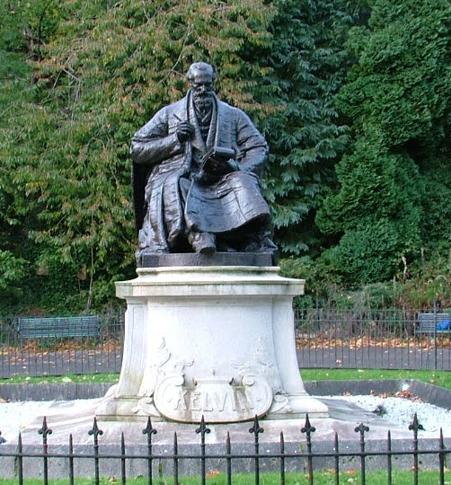
Agenda
1 Important to me
Christian, Peace, Environment.
2 Hobbies
Christian Campaign for Nuclear Disarmament, Global Justice Now, Repair Cafe, More ….
3 Nepal
Voluntary work.
4 Work
Apprenticeship, Degree, Organisations, DAE-I, DAE-II, DAE3.
Lord Kelvin, Glasgow
Notes:
To replace photo with one of your own. 1) Send the geometric shape overlay to the back – Right-Click > Send to Back > Send to Back. 2) Replace image – use the guides provided to correctly position it. 3) Send your image to the back so that the geometric overlay re-appears over the image. Remember to delete the image credit if using your own image.

Slide 3

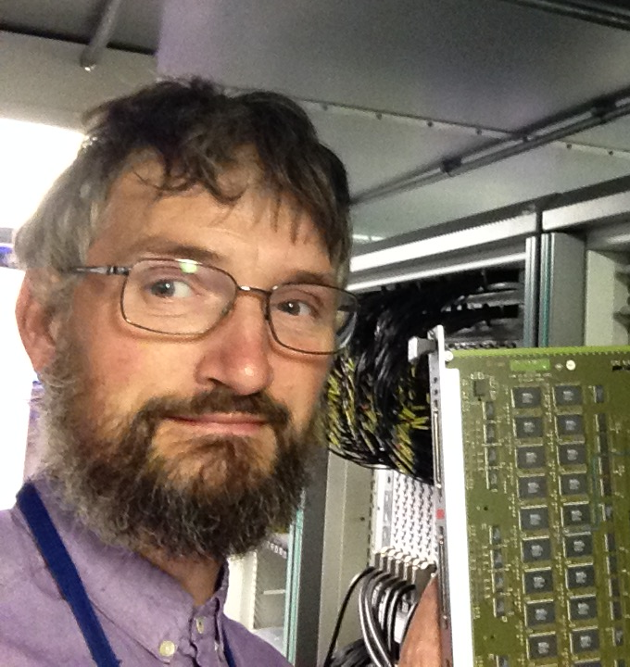
Presenter introduction
Kelvin Gascoyne
59 years old
Happy single
Work in ISIS Detector Support Group
Worked at RAL for 40 years
Live in West Hanney with my parents
Work at ISIS for 37 years
Notes:
Please replace photo of presenter with a portrait of your own. 1) Send the geometric shape overlay to the back – Right-Click > Send to Back > Send to Back. 2) Replace image – use the guides provided to correctly position it. 3) Send your portrait to the back so that the geometric overlay re-appears over the portrait.

Slide 4
Warning
I am going to talk about religion and politics.
A description of who i am would not be complete without telling you i am Christian
Some of my hobbies involve politics
Agree to disagree
We can work together even if we have different religious beliefs and pollical opinions

Slide 5


1 Important to me
Christian
Peace
Environment
Notes:
The abstract pattern can be removed or repositioned if required. Be careful to ‘Send to Back’ so that it does not obscure any important information.

Slide 6

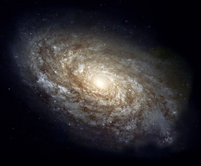
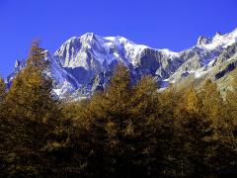
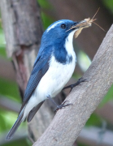
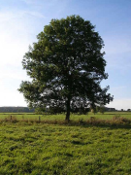
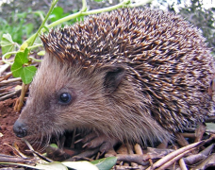
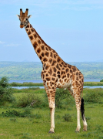
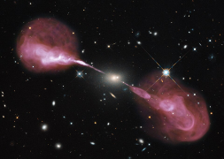
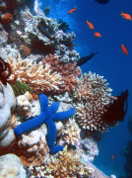
Christian
God came and lived on Earth as a human begin.
What i believe.
God created the universe.
That’s who Jesus Christ is.

Slide 7
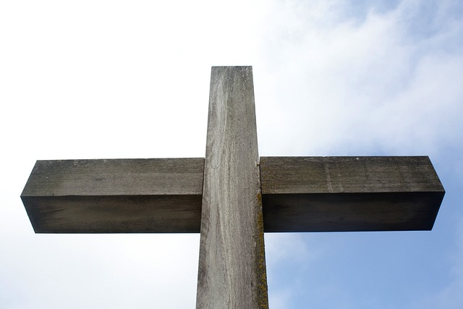
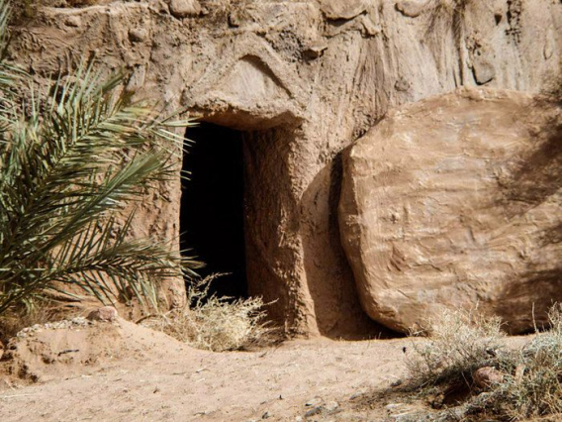
Christian
What i believe.
Jesus was killed and came back to life

Slide 8
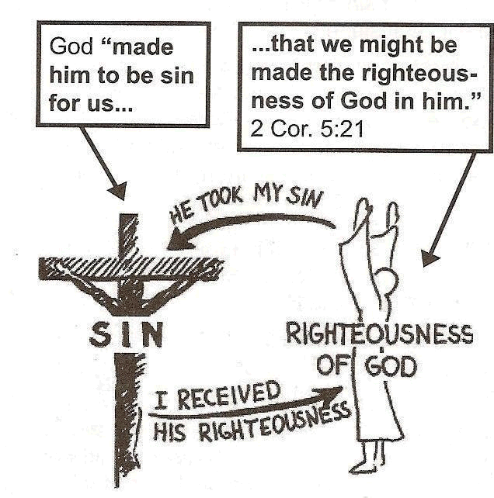
Christian
What i believe.

Slide 9
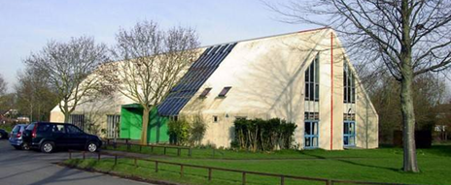
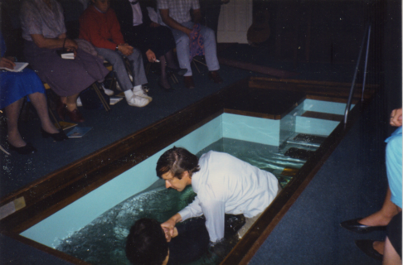
Christian
What i do.
Daily
Pray
Read Holy Bible
Sundays
Church
Prayer meeting
Thursdays
RAL Christian fellowship
Home Group

Slide 10

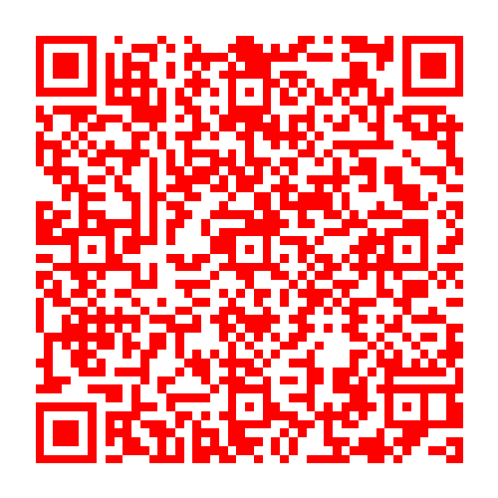
Joint Carol Service
PH, RAL, DL, Diamond, RCaH
Tuesday 2nd December
12:30 – 13:00
Come celebrate with us! Bible Readings, Carols & Mince Pies
B3SFE1 (PH), Pickavance (RAL), 7.11 (Caxton house)

Slide 11
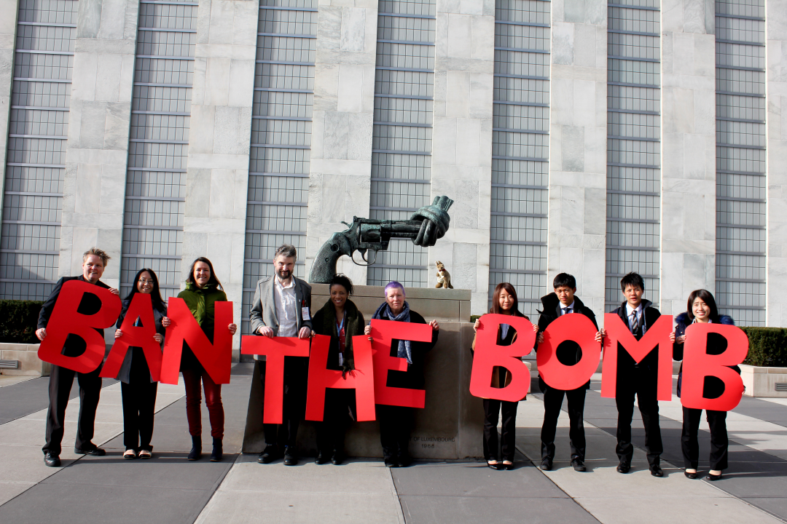
Peace
I am a pacifist.
I believe killing people is wrong.
I wouldn’t work in the arms industry.
UK should get rid of its nuclear weapons.

Slide 12
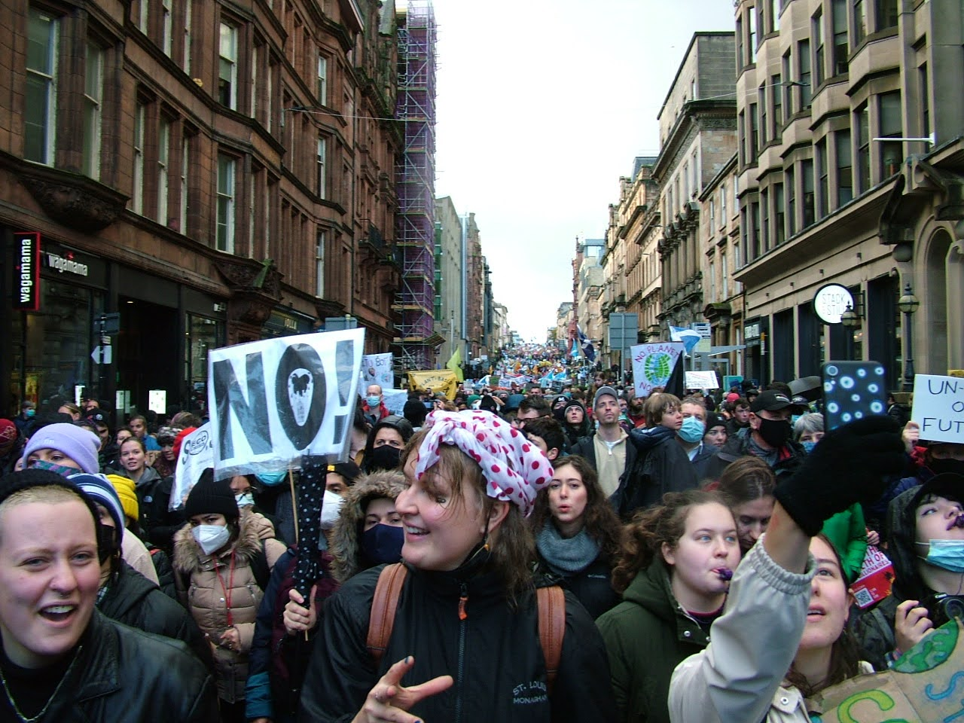
Environment
I believe human activity is causing climate change.
People are suffering because of climate change.
I want to minimise:
Resources i use
Greenhouse gasses
Pollution
So i:
Don’t have a motorbike or car
Vegetarian

Slide 13
2 Hobbies
Christian Campaign for Nuclear Disarmament
Global Justice Now
Repair Cafe
More …
Notes:
The abstract pattern can be removed or repositioned if required. Be careful to ‘Send to Back’ so that it does not obscure any important information.

Slide 14
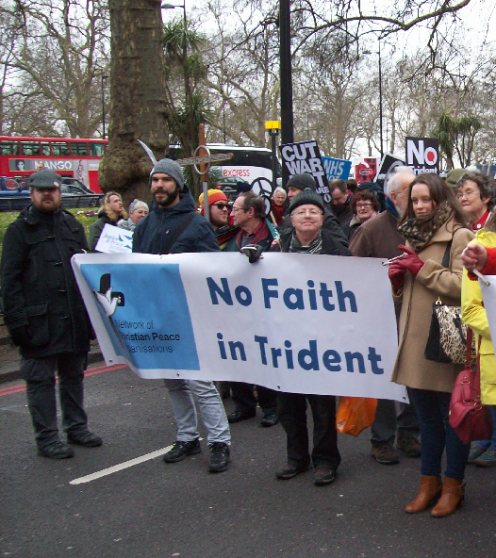

Christian Campaign for Nuclear Disarmament
Working and praying for a world free of nuclear weapons.
Specialist section of CND
I am on the executive committee
I represent Christian CND on the CND Council
I represent Christian CND at the Network of Christian Peace Organisations

Slide 15
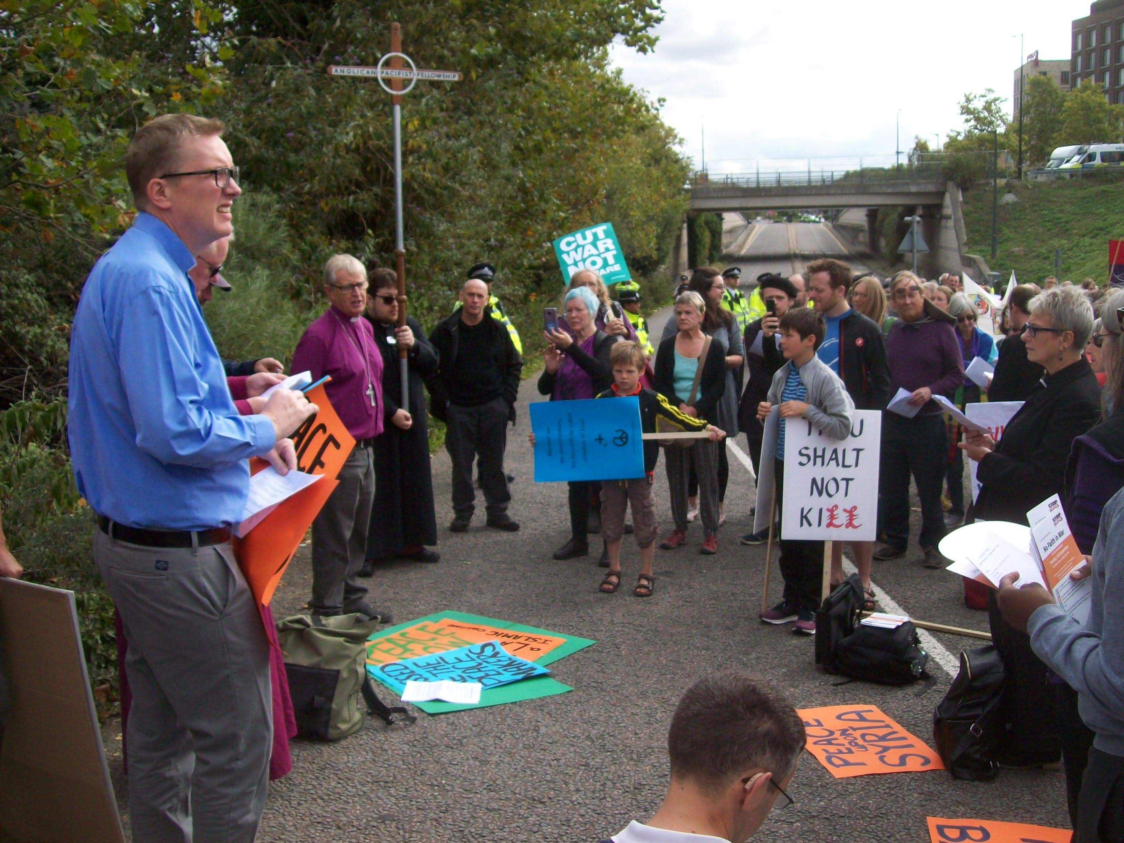
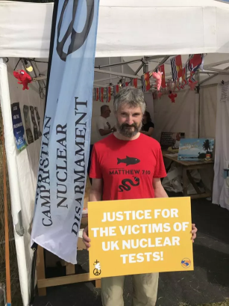
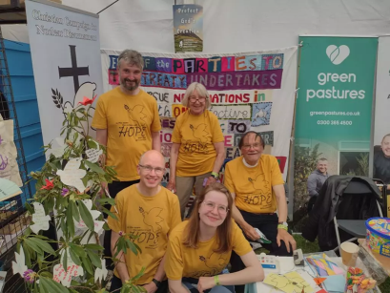
Christian Campaign for Nuclear Disarmament
Working and praying for a world free of nuclear weapons.

Slide 16
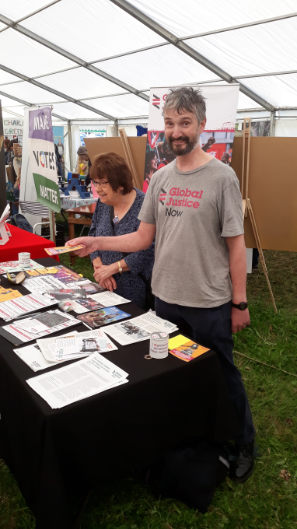

Global Justice Now
Part of a global movement to create a more just and equal world.
Global Justice Now mobilise people in the UK for change, and act in solidarity with those fighting injustice, particularly in the global south.
I am the chairperson of the Oxford group
Stalls – talk to people and give out leaflets
Go on demonstrations
Sign petitions

Slide 17

Global Justice Now

Slide 18
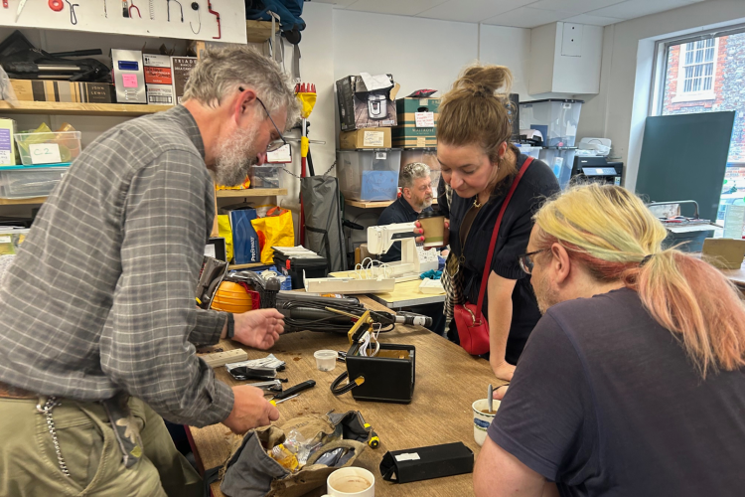
Repair Cafe
Repair Cafe first Saturday each month in the Mix, Wantage.
I regularly volunteer to help at the Wantage Repair Cafe
I have helped at Repair Cafes in Didcot, Walingford and Harwell
Use my skills to help people
I like to see broken things repaired
Reduce wastage

Slide 19
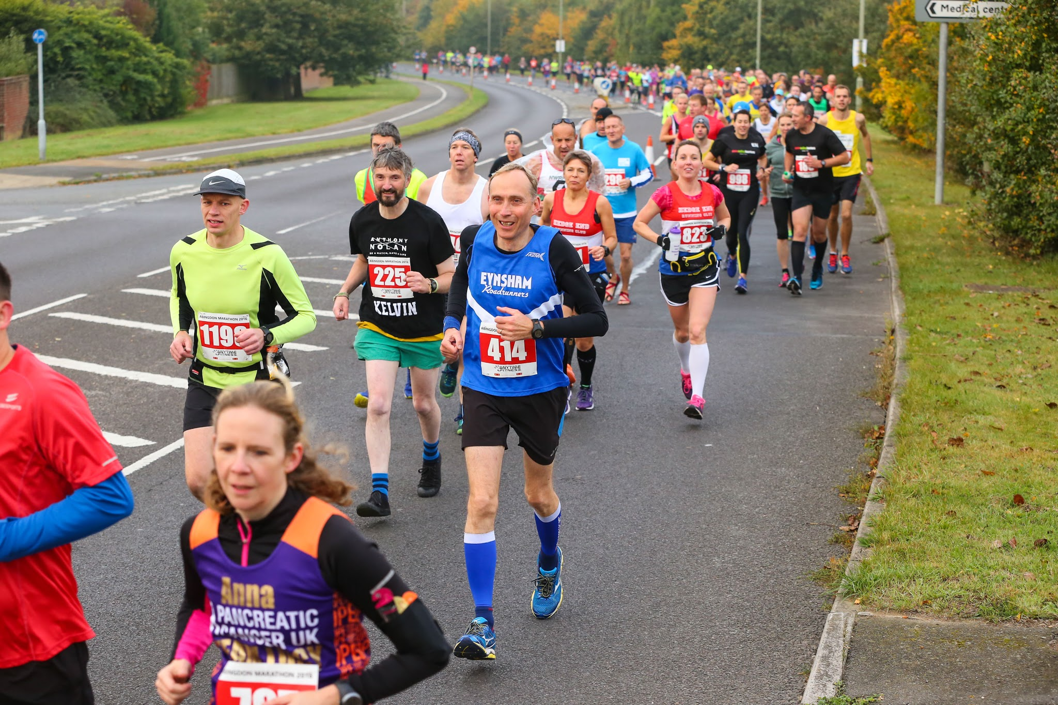
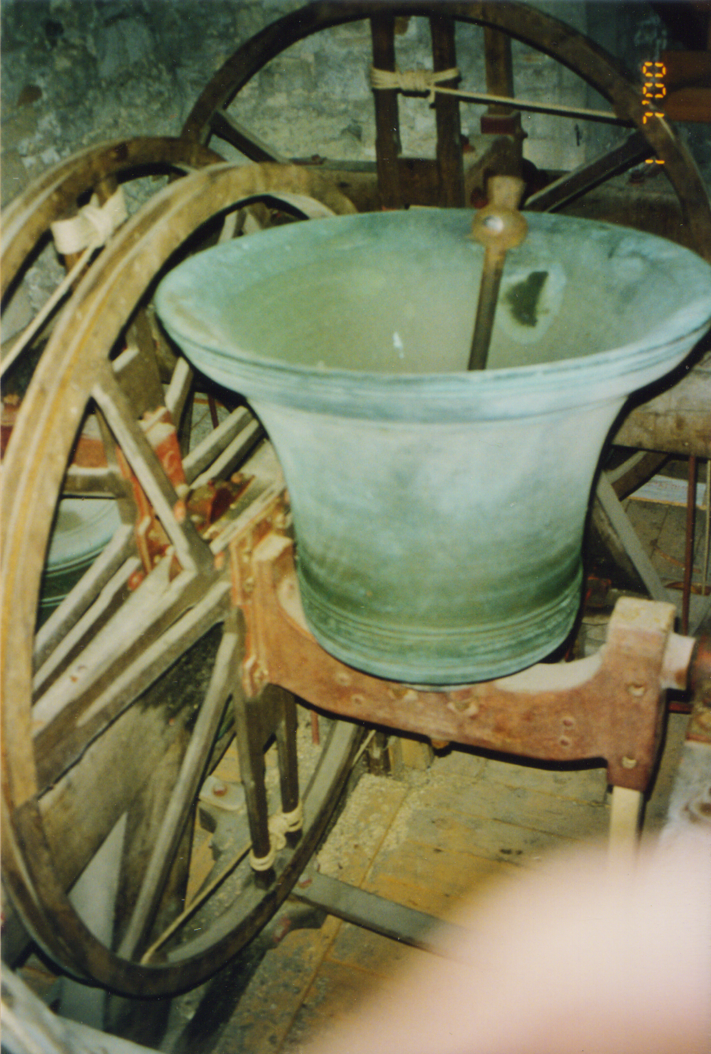
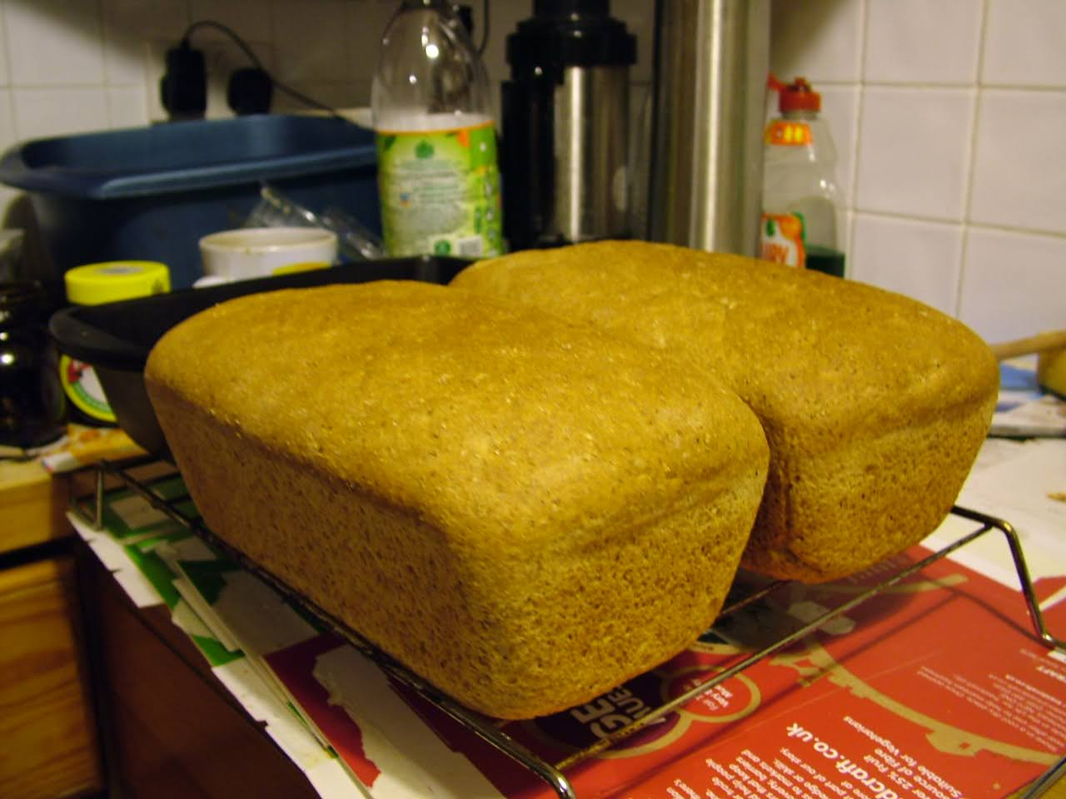
More hobbies / things i do when not at work

Slide 20
3 Nepal
Voluntary work.
Notes:
The abstract pattern can be removed or repositioned if required. Be careful to ‘Send to Back’ so that it does not obscure any important information.

Slide 21
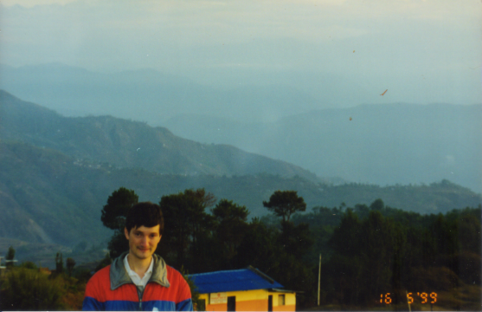
Nepal
I did voluntary work in Nepal in 1998.
I was granted unpaid leave
I went to Nepal 3 times from 1998 to 2003. I spent a total of 12 months there.
International Nepal Fellowship
Computer Department in HQ in Pokhara
I was given an electronics project to work on

Slide 22
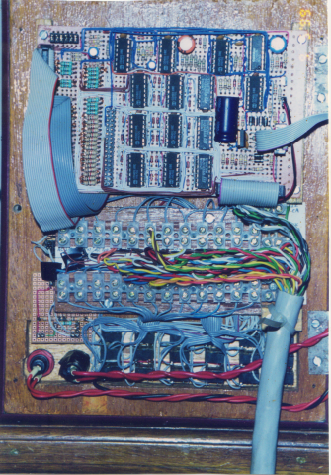
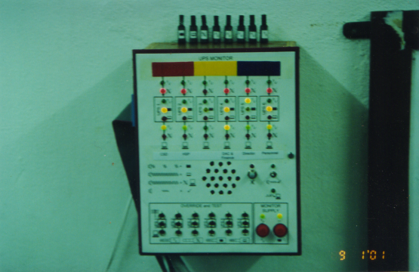
Nepal
I did voluntary work in Nepal in 1998.
UPS monitor

Slide 23
4 Work
Apprenticeship
Degree
Organisations
DAE-I
DAE-II
DAE3.
Notes:
The abstract pattern can be removed or repositioned if required. Be careful to ‘Send to Back’ so that it does not obscure any important information.

Slide 24
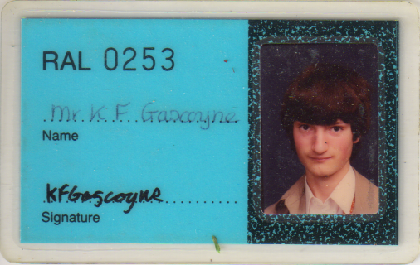
Apprenticeship
1984 – 1988 electronics apprenticeship.
1st year at Abingdon College of Further Education.
2nd year in apprentice training room in R18
3rd and 4th year 8 placements

Slide 25
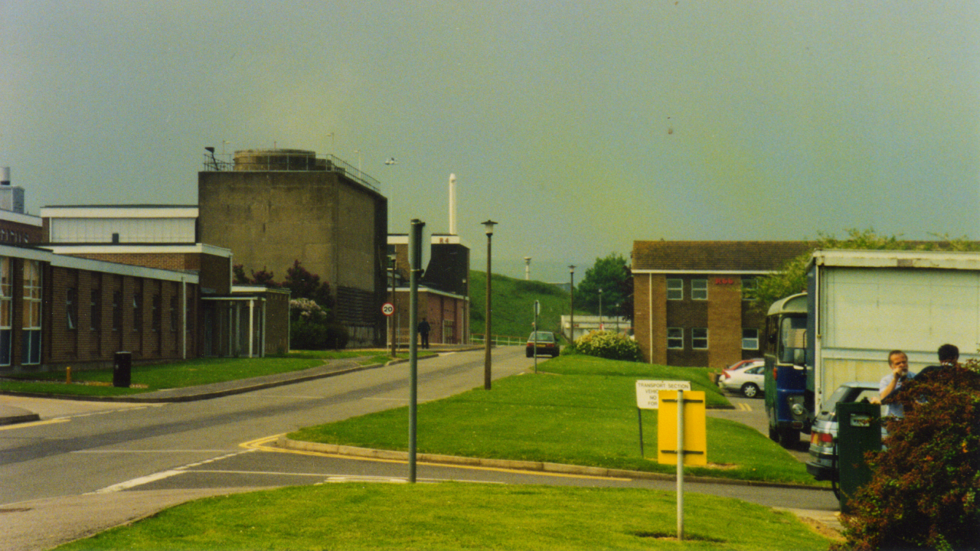

Slide 26
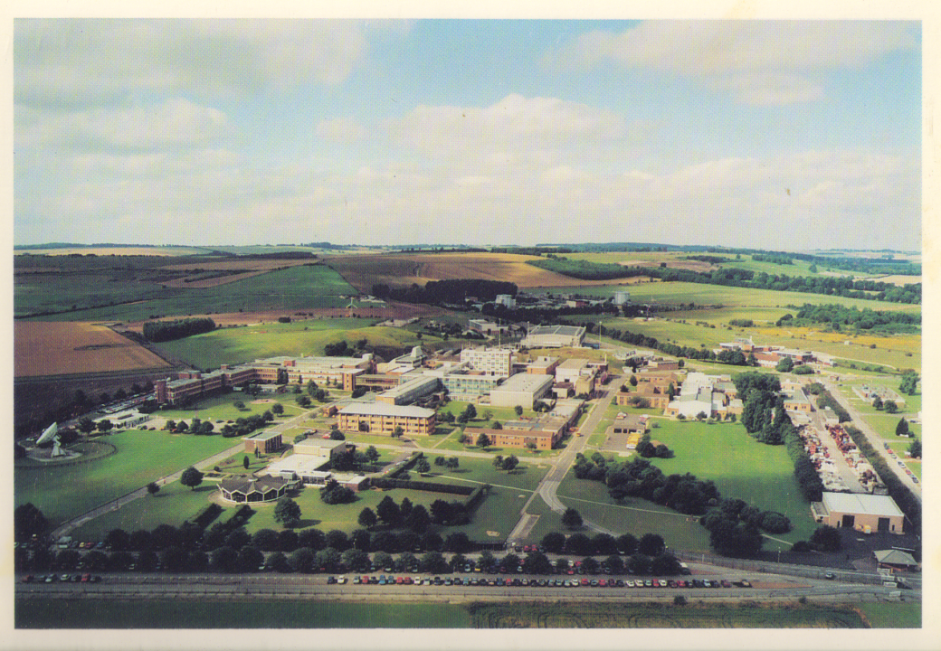
Degree
1993 – 1997 electronics degree.
Day release at University of the West of England, Bristol

Slide 27
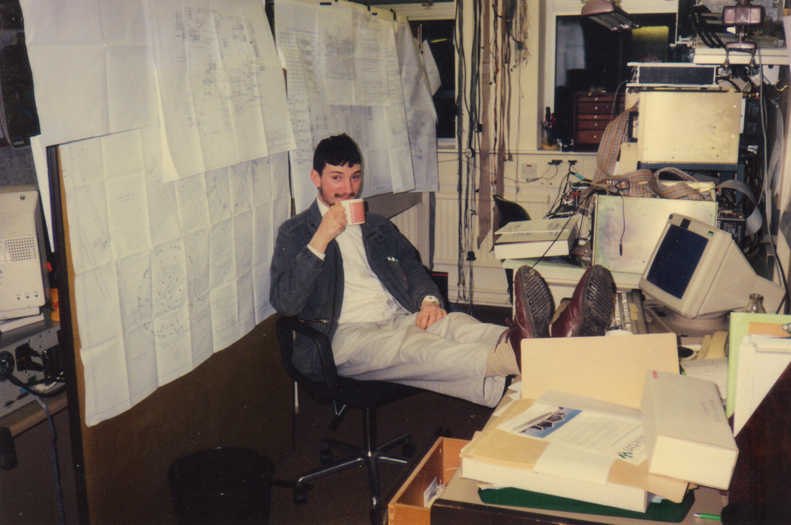

Slide 28




Organisations

Slide 29
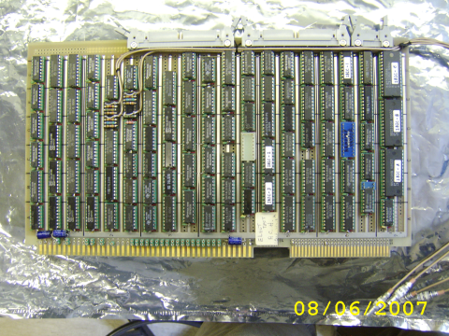
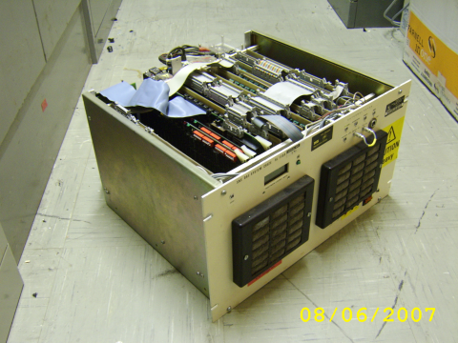
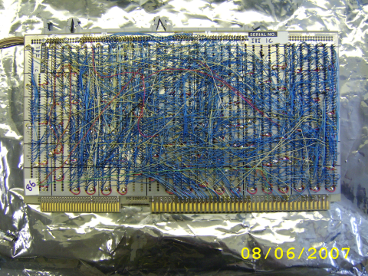
DAE-I

Slide 30
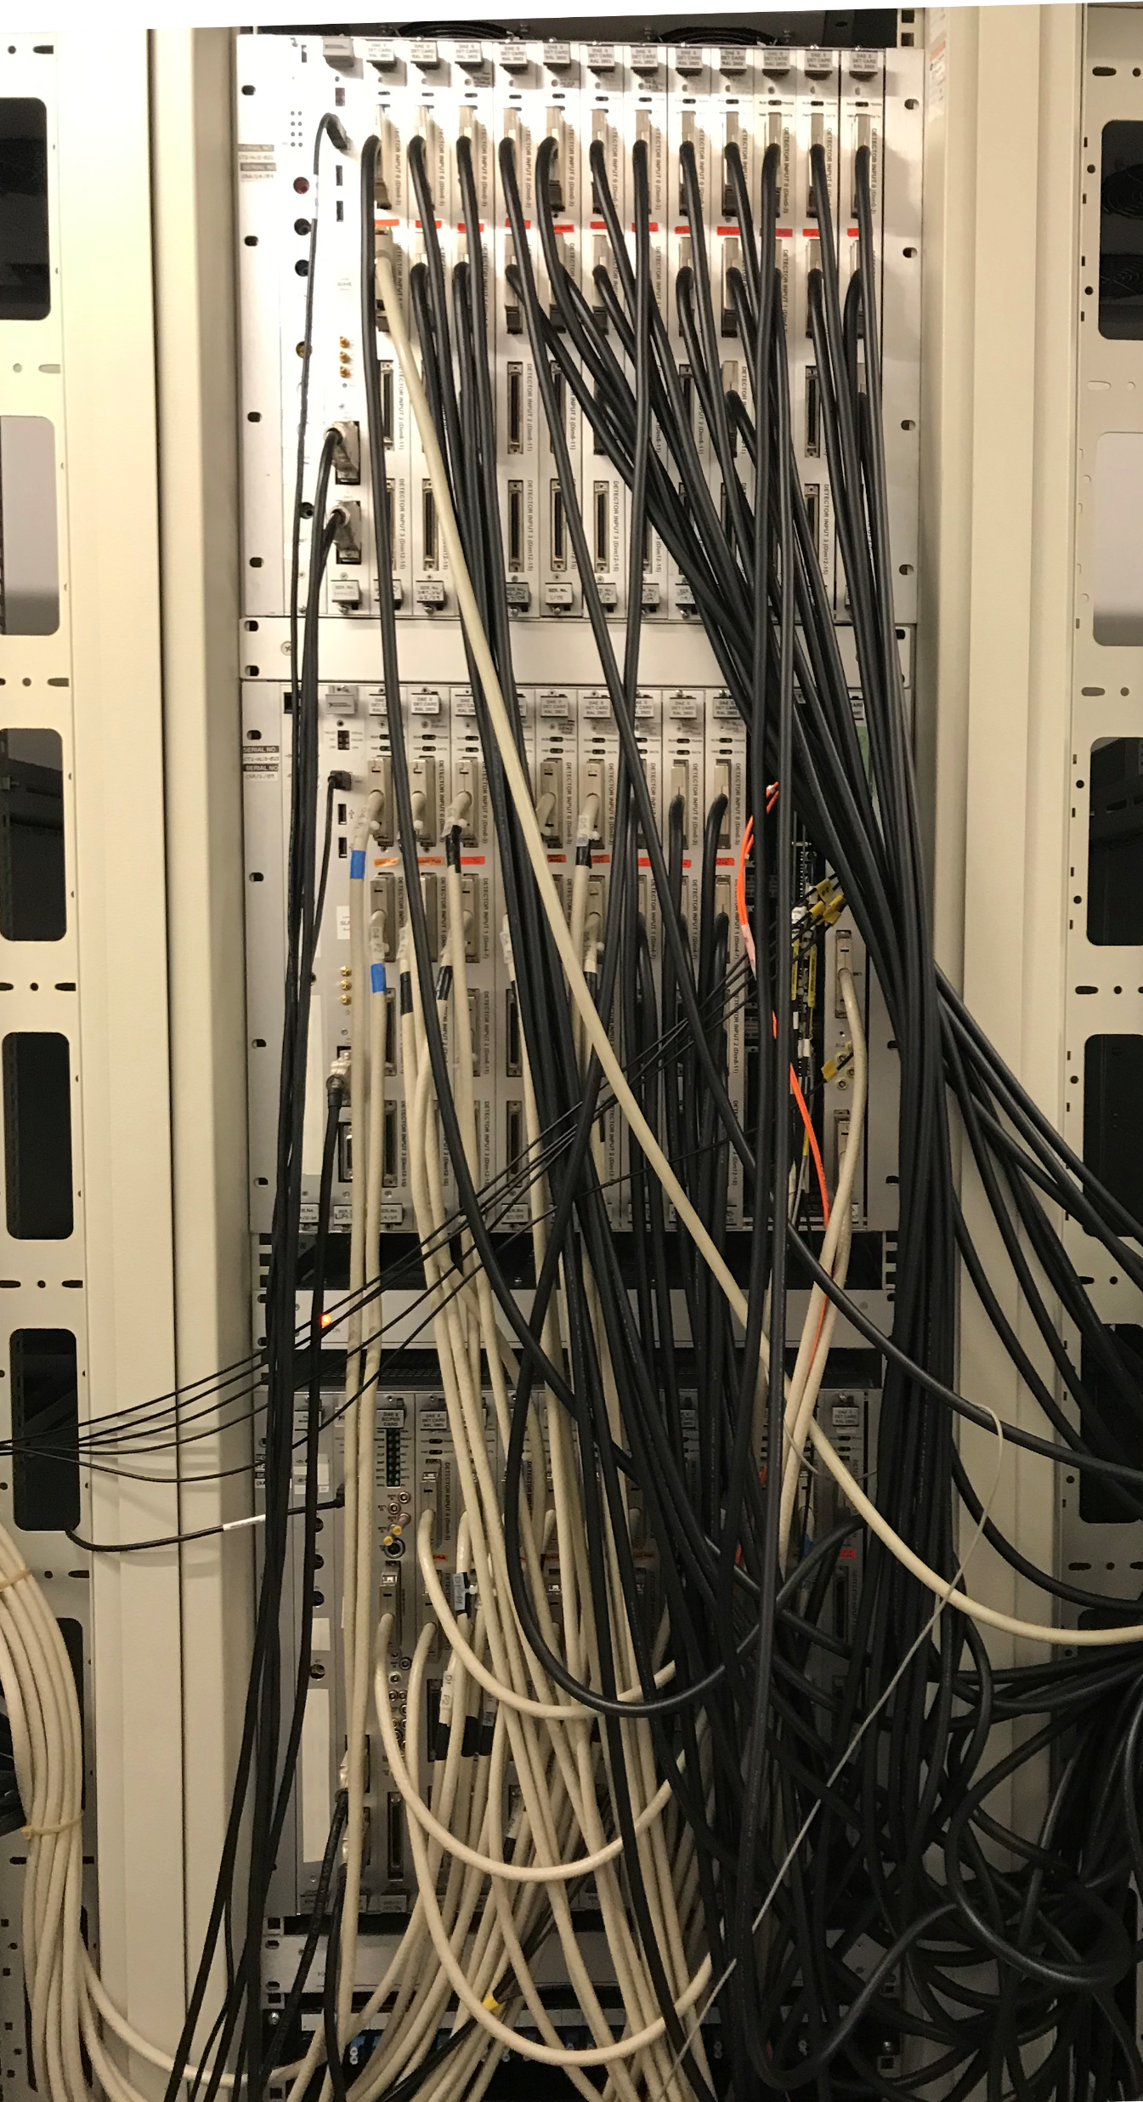
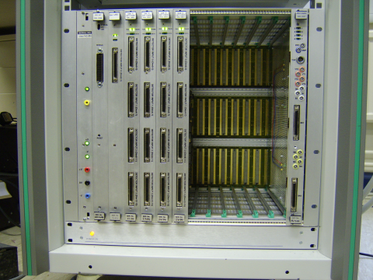
DAE-II

Slide 31
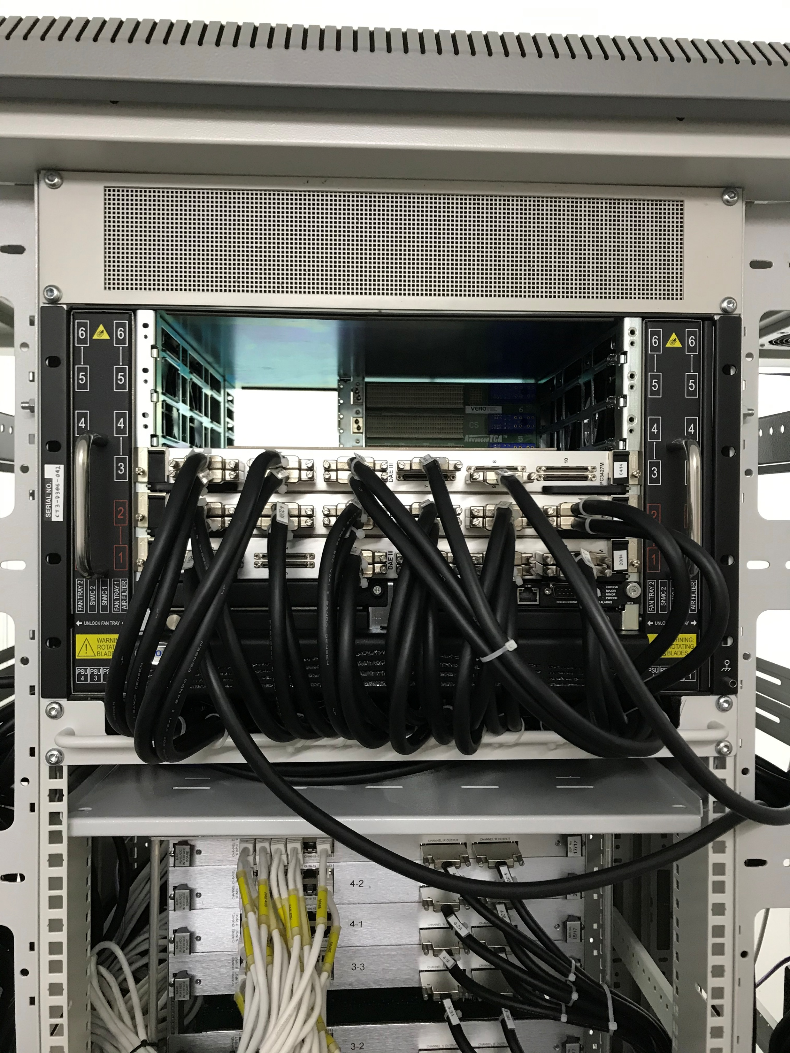
DAE3

