Slide 1



Josh Davies –
ESDG Presentation
27/11/25

Slide 2
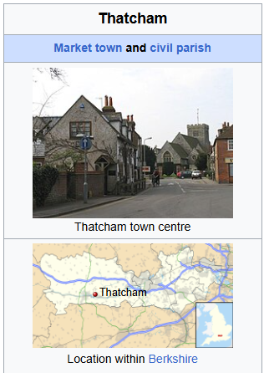
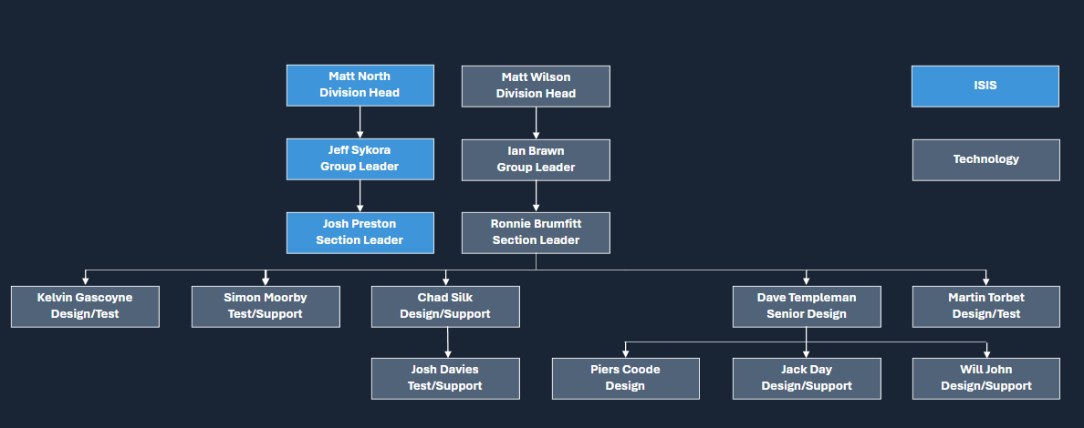
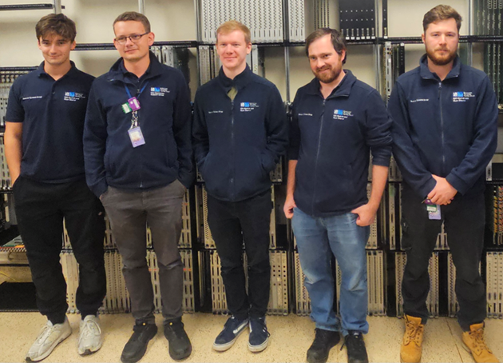
Personal Introduction
Started at STFC when I began my apprenticeship in 2019.
After finishing in 2023, I joined the Detector Systems Group as an Electronics Technician focusing on testing and supporting the Data Acquisition Electronics (DAE) on ISIS.
Notes:
Please replace photo of presenter with a portrait of your own. 1) Send the geometric shape overlay to the back – Right-Click > Send to Back > Send to Back. 2) Replace image – use the guides provided to correctly position it. 3) Send your portrait to the back so that the geometric overlay re-appears over the portrait.

Slide 3


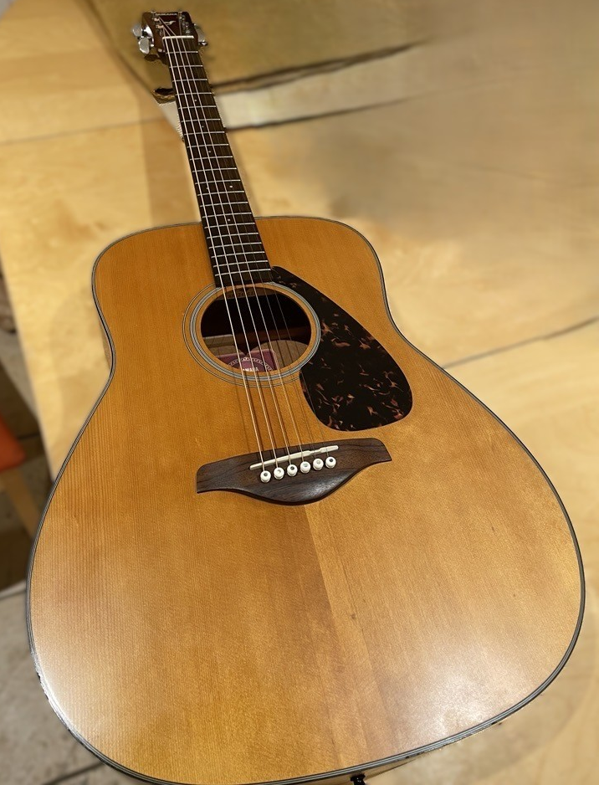

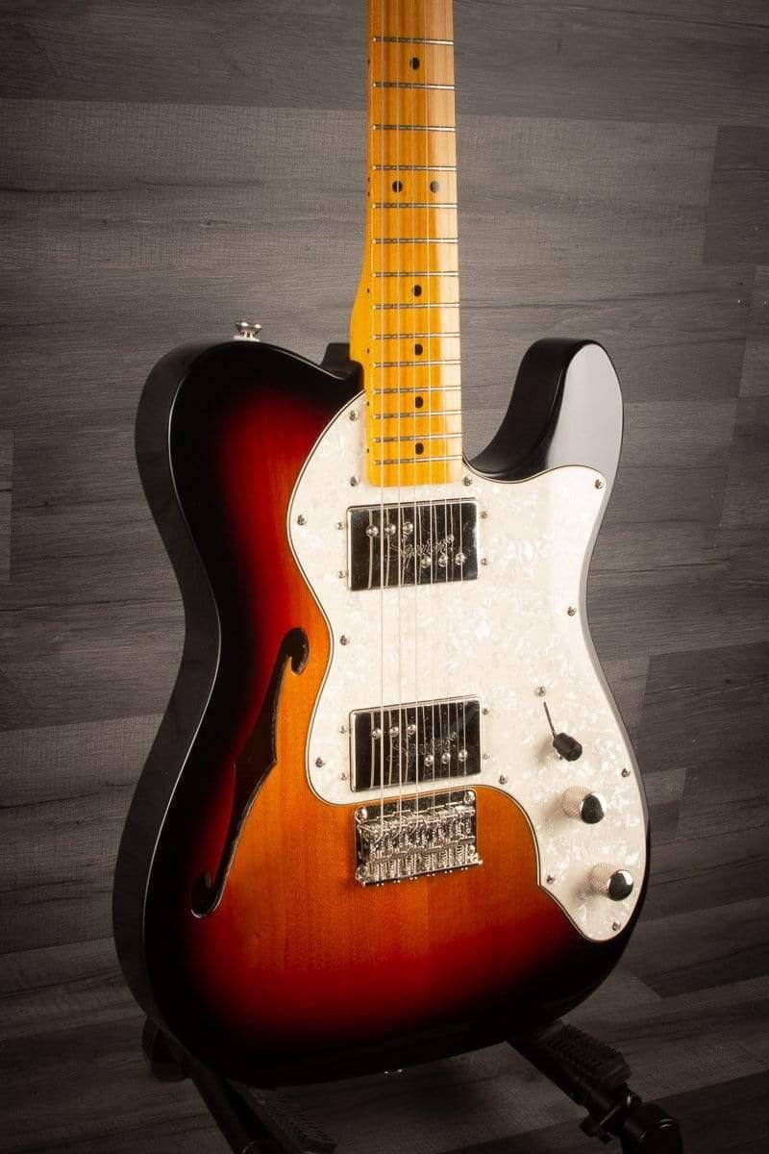
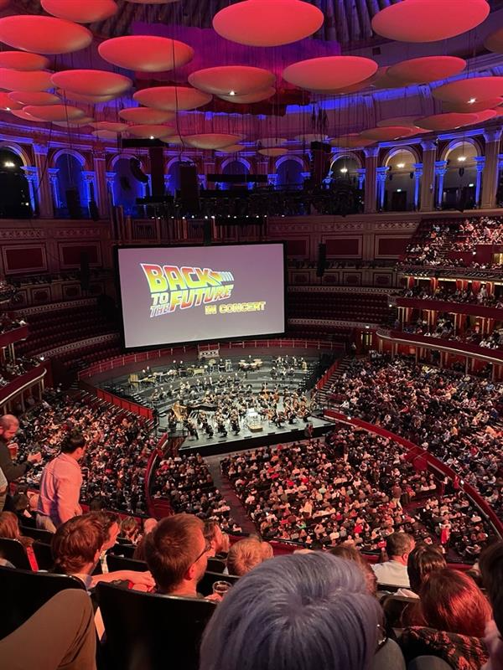

Personal Introduction
I spend most of my spare time playing/practising the guitar. I’ve been learning for 2 years now – having lessons in the RecSoc.
I also love listening to music at home and going to live shows.
Notes:
Please replace photo of presenter with a portrait of your own. 1) Send the geometric shape overlay to the back – Right-Click > Send to Back > Send to Back. 2) Replace image – use the guides provided to correctly position it. 3) Send your portrait to the back so that the geometric overlay re-appears over the portrait.

Slide 4
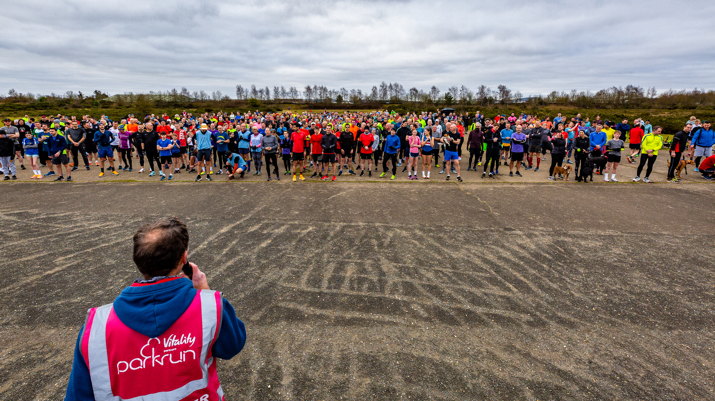


Personal Introduction
I also enjoy going to the gym and recently I have started trying to get better at running.
Some friends have signed me up for Endure 24 next summer so I’ve starting training for that (I’ve never ran consistently before).
Notes:
Please replace photo of presenter with a portrait of your own. 1) Send the geometric shape overlay to the back – Right-Click > Send to Back > Send to Back. 2) Replace image – use the guides provided to correctly position it. 3) Send your portrait to the back so that the geometric overlay re-appears over the portrait.

Slide 5
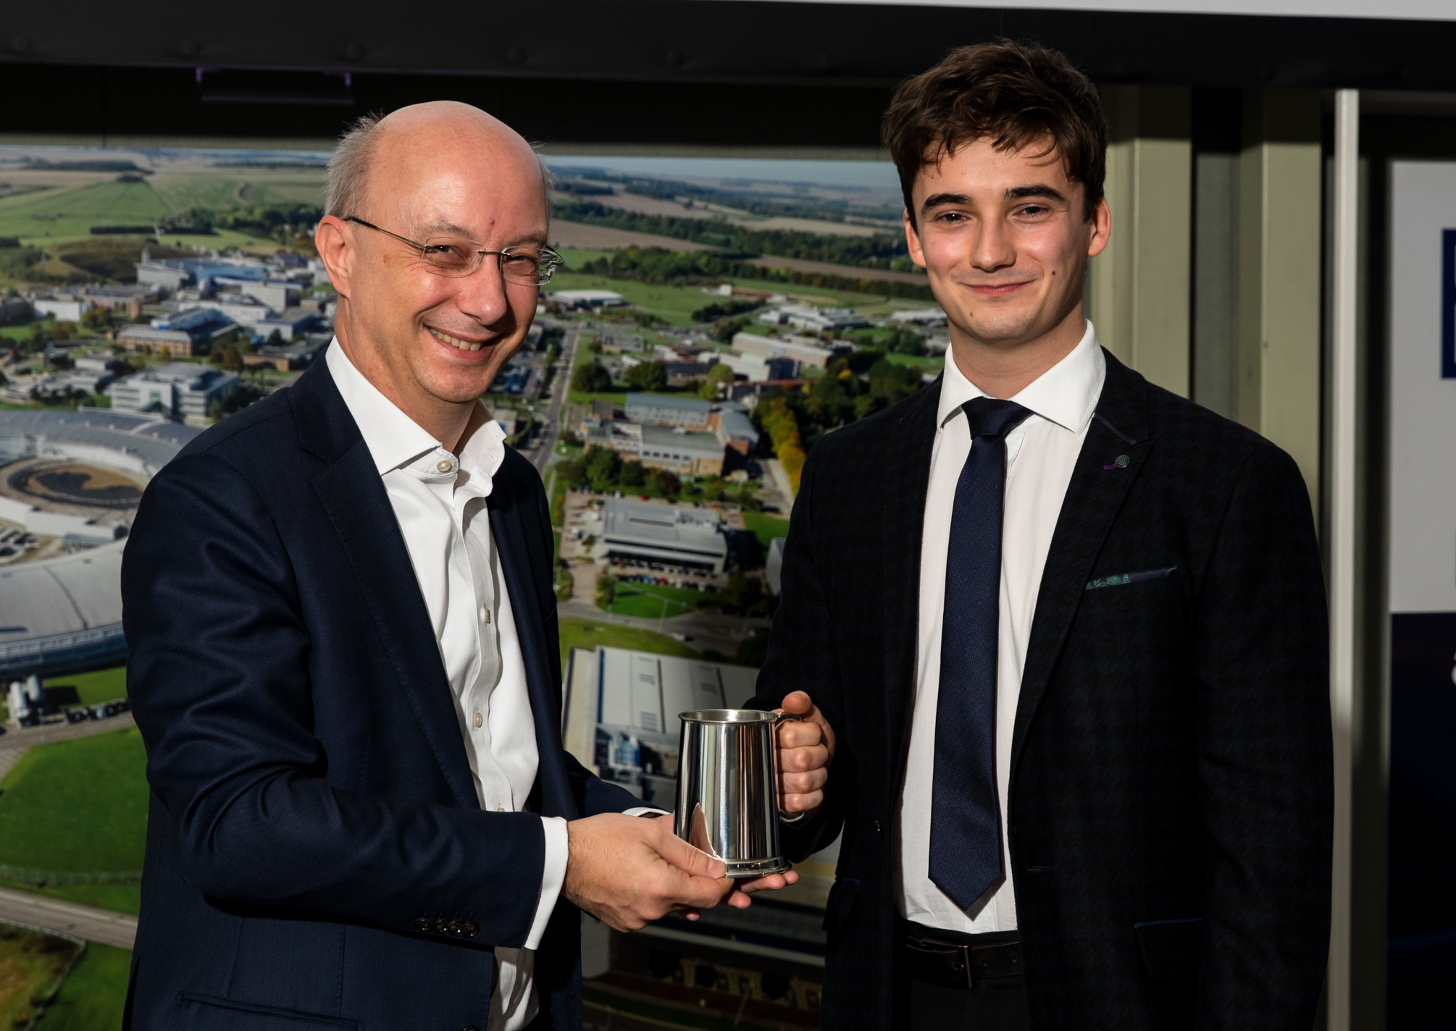
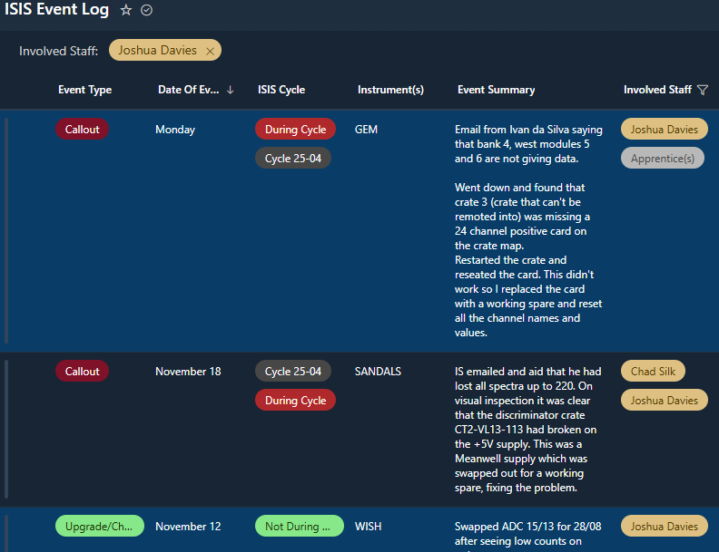
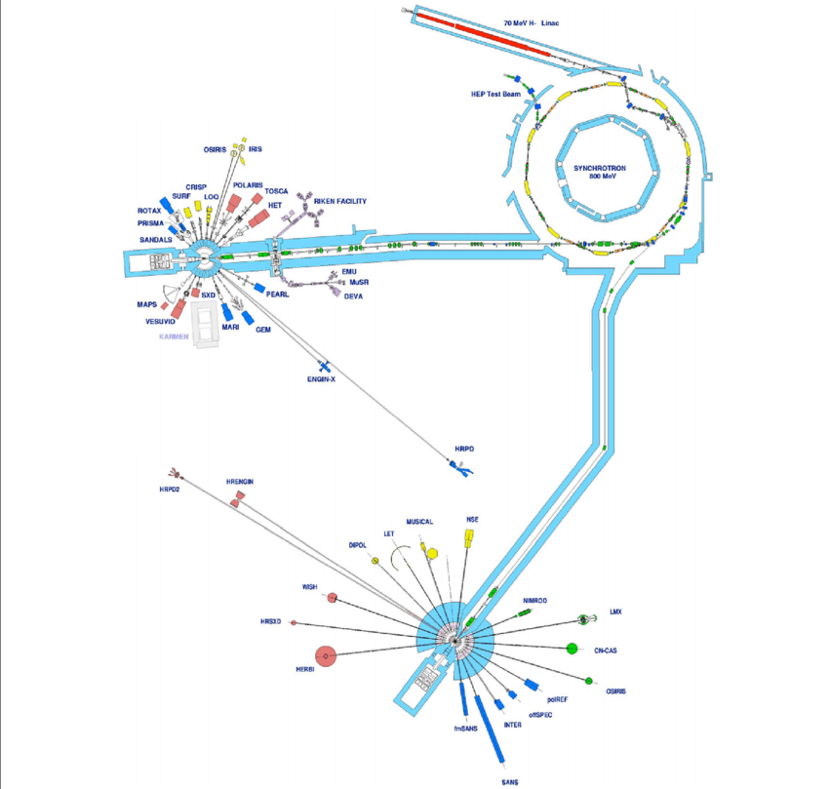
Experience in the DSG
Since finishing my Apprenticeship in 2023 I have continued to develop within the DSG.
I am a member of the Front Line Support Team.
Call-outs.
ISIS cycle start ups.
Shutdowns.
Notes:
Please replace photo of presenter with a portrait of your own. 1) Send the geometric shape overlay to the back – Right-Click > Send to Back > Send to Back. 2) Replace image – use the guides provided to correctly position it. 3) Send your portrait to the back so that the geometric overlay re-appears over the portrait.

Slide 6
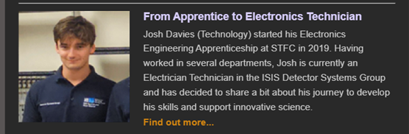
Experience in DSG
I’ve also written a bit about my experiences in the October InBrief Article.
Notes:
Please replace photo of presenter with a portrait of your own. 1) Send the geometric shape overlay to the back – Right-Click > Send to Back > Send to Back. 2) Replace image – use the guides provided to correctly position it. 3) Send your portrait to the back so that the geometric overlay re-appears over the portrait.

Slide 7
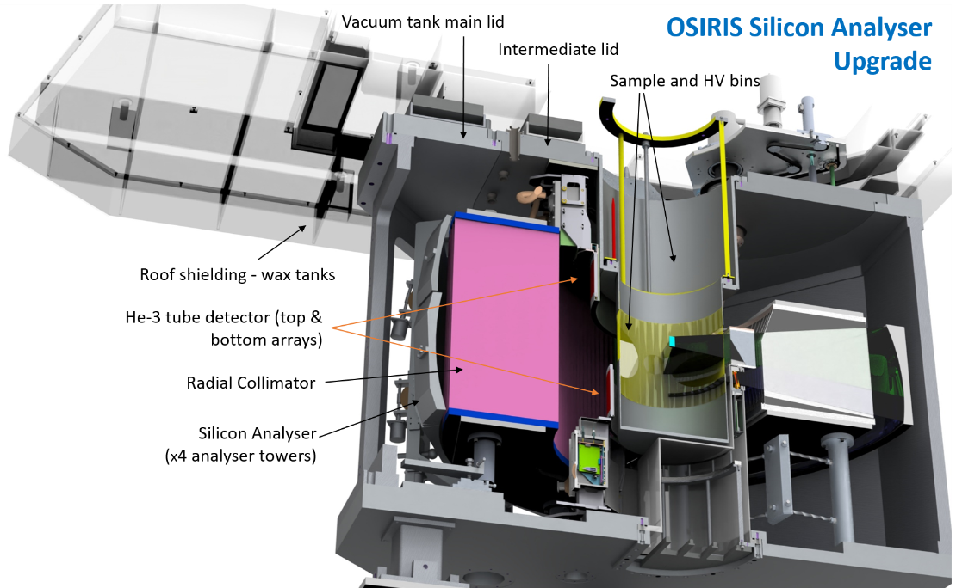
Recent Project – OSIRIS Silicon Analyser Upgrade
Background
Over the past decade OSIRIS (ISIS) has been operating with a single Pyrolytic-Graphite Analyser.
As part of an upgrade, detector tube arrays and a curved Silicon Analyser array are being added to the instrument.
↑ Increase in spectral resolution.
↑ Increase in dynamic range.
↑ Access to 4-D data sets.
Notes:
Please replace photo of presenter with a portrait of your own. 1) Send the geometric shape overlay to the back – Right-Click > Send to Back > Send to Back. 2) Replace image – use the guides provided to correctly position it. 3) Send your portrait to the back so that the geometric overlay re-appears over the portrait.

Slide 8
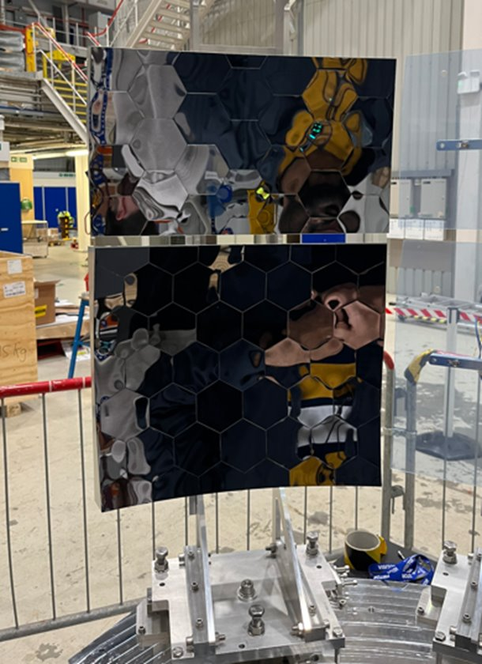
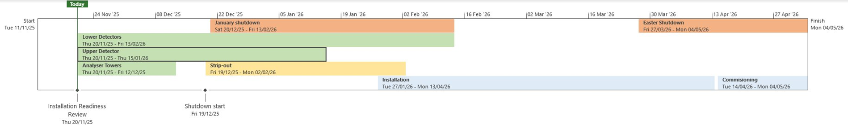
Recent Project – OSIRIS Silicon Analyser Upgrade
Progress
This upgrade is nearing its completion with the detectors being assembled now.
DAE is needed to process the new detector data.
Notes:
Please replace photo of presenter with a portrait of your own. 1) Send the geometric shape overlay to the back – Right-Click > Send to Back > Send to Back. 2) Replace image – use the guides provided to correctly position it. 3) Send your portrait to the back so that the geometric overlay re-appears over the portrait.

Slide 9
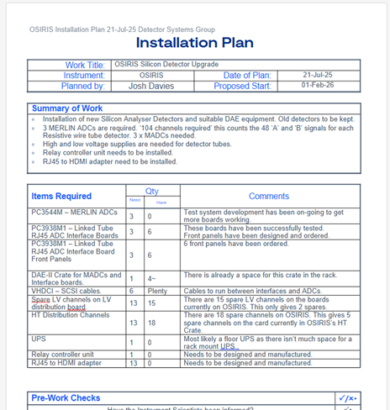
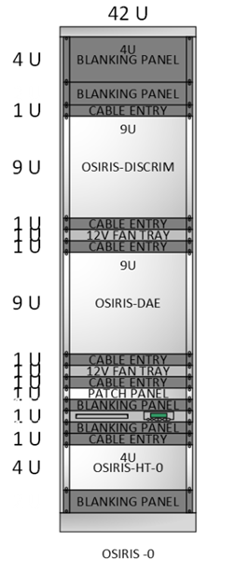
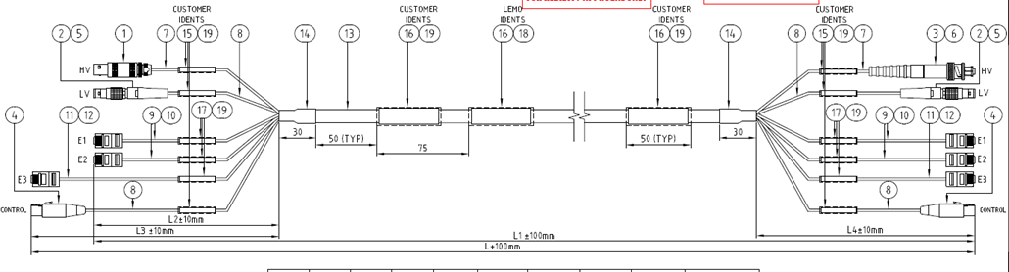
OSIRIS Silicon Analyser Upgrade
What’s needed from me?
After meeting with Erik S. (Electronics stakeholder) from the ISIS Detector Systems Group I identified everything that I needed to provide including:
13 x High and low voltage supplies for the detectors.
  There are already enough channels being provided by our current supplies
An updated rack layout to accommodate a crate for ADC and interface boards
  Me and Simon already refurbished the rack in June 2024, leaving a space for a crate.
Cables needs routing and connecting up to the DAE system.
  Already been ordered and will be routed in by the electrical team.
Notes:
Please replace photo of presenter with a portrait of your own. 1) Send the geometric shape overlay to the back – Right-Click > Send to Back > Send to Back. 2) Replace image – use the guides provided to correctly position it. 3) Send your portrait to the back so that the geometric overlay re-appears over the portrait.

Slide 10
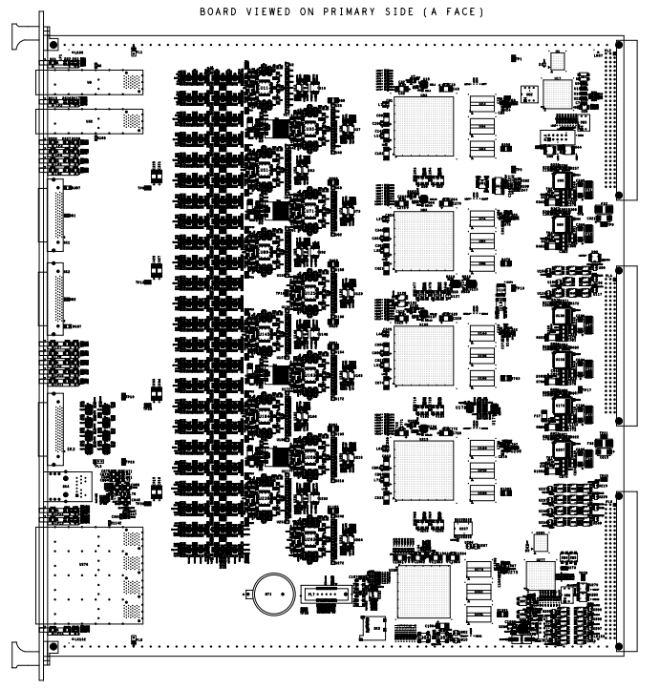
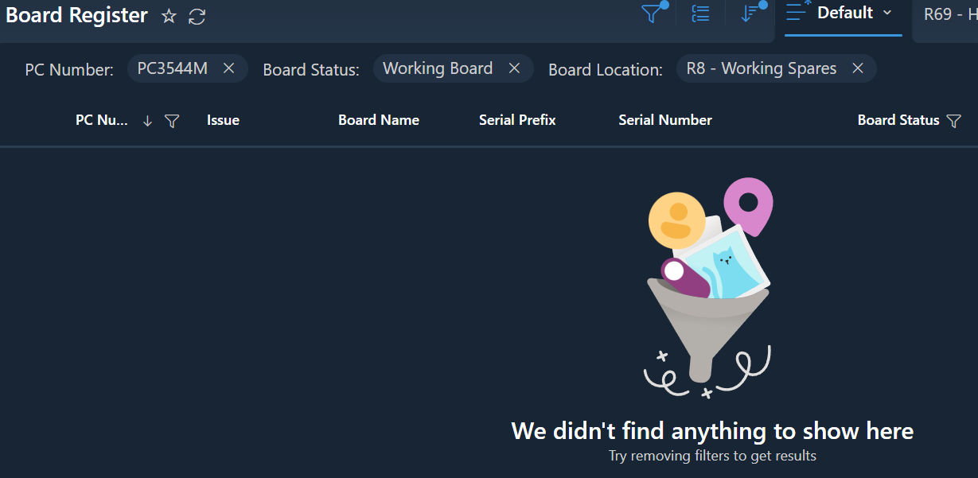

OSIRIS Silicon Analyser Upgrade -
What’s needed from me?
3 x Merlin ADC Processor Boards – to Process detector signals.
  There are no spares remaining!
  Testing and rework is needed.
Notes:
Please replace photo of presenter with a portrait of your own. 1) Send the geometric shape overlay to the back – Right-Click > Send to Back > Send to Back. 2) Replace image – use the guides provided to correctly position it. 3) Send your portrait to the back so that the geometric overlay re-appears over the portrait.

Slide 11
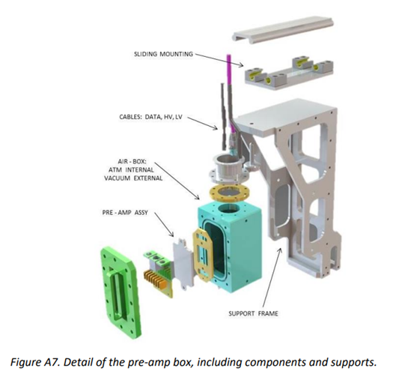
OSIRIS Silicon Analyser Upgrade –
Next steps
After another meeting with Erik, he outlined two new systems that need designing, manufacturing, and installing. This includes -
A method of switching between pre-amp channels on the pre-amp boxes in the block house.
A convertor between the HDMI connectors on pre-amp PCB assemblies and the 25m RJ45 (ethernet cables) that have already been bought.
Notes:
Please replace photo of presenter with a portrait of your own. 1) Send the geometric shape overlay to the back – Right-Click > Send to Back > Send to Back. 2) Replace image – use the guides provided to correctly position it. 3) Send your portrait to the back so that the geometric overlay re-appears over the portrait.

Slide 12
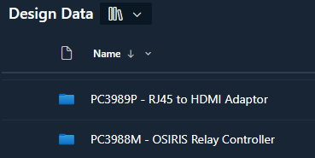
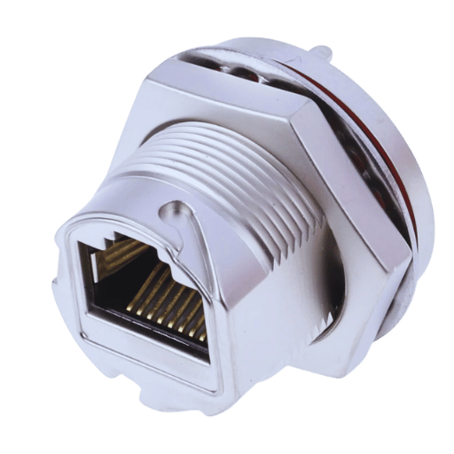
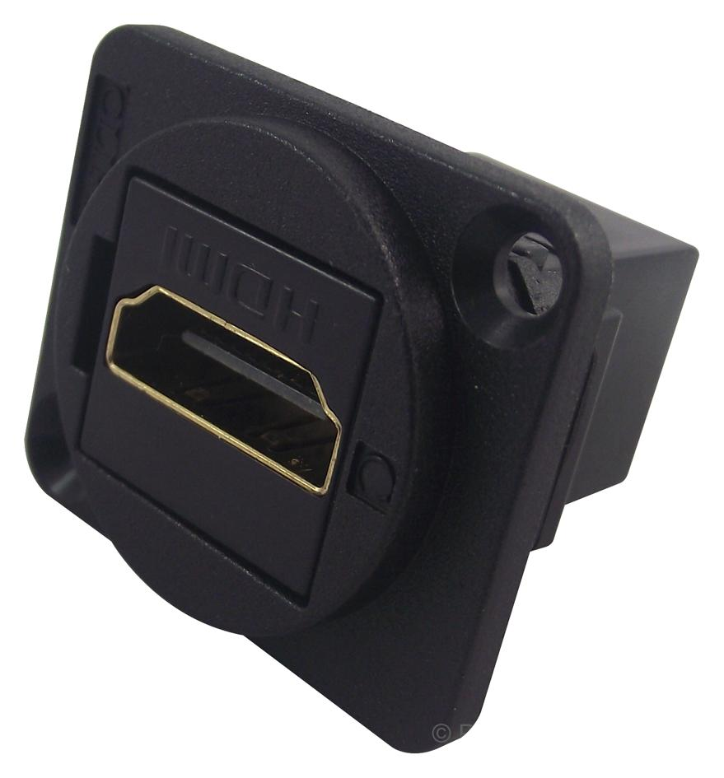
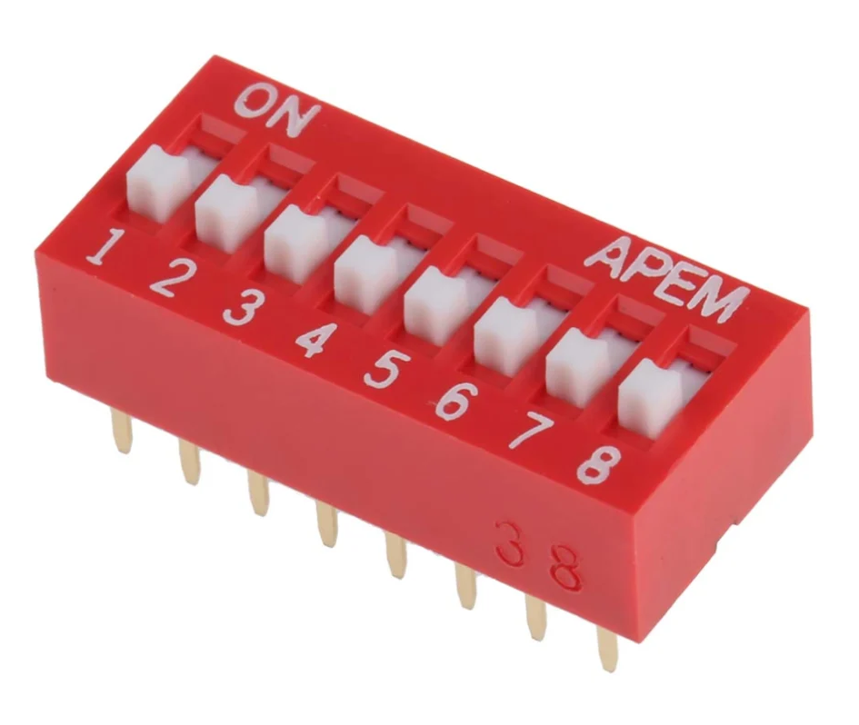

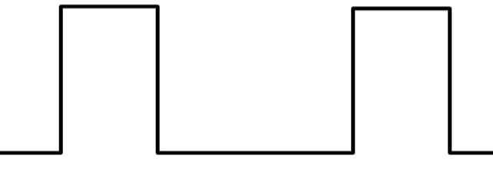
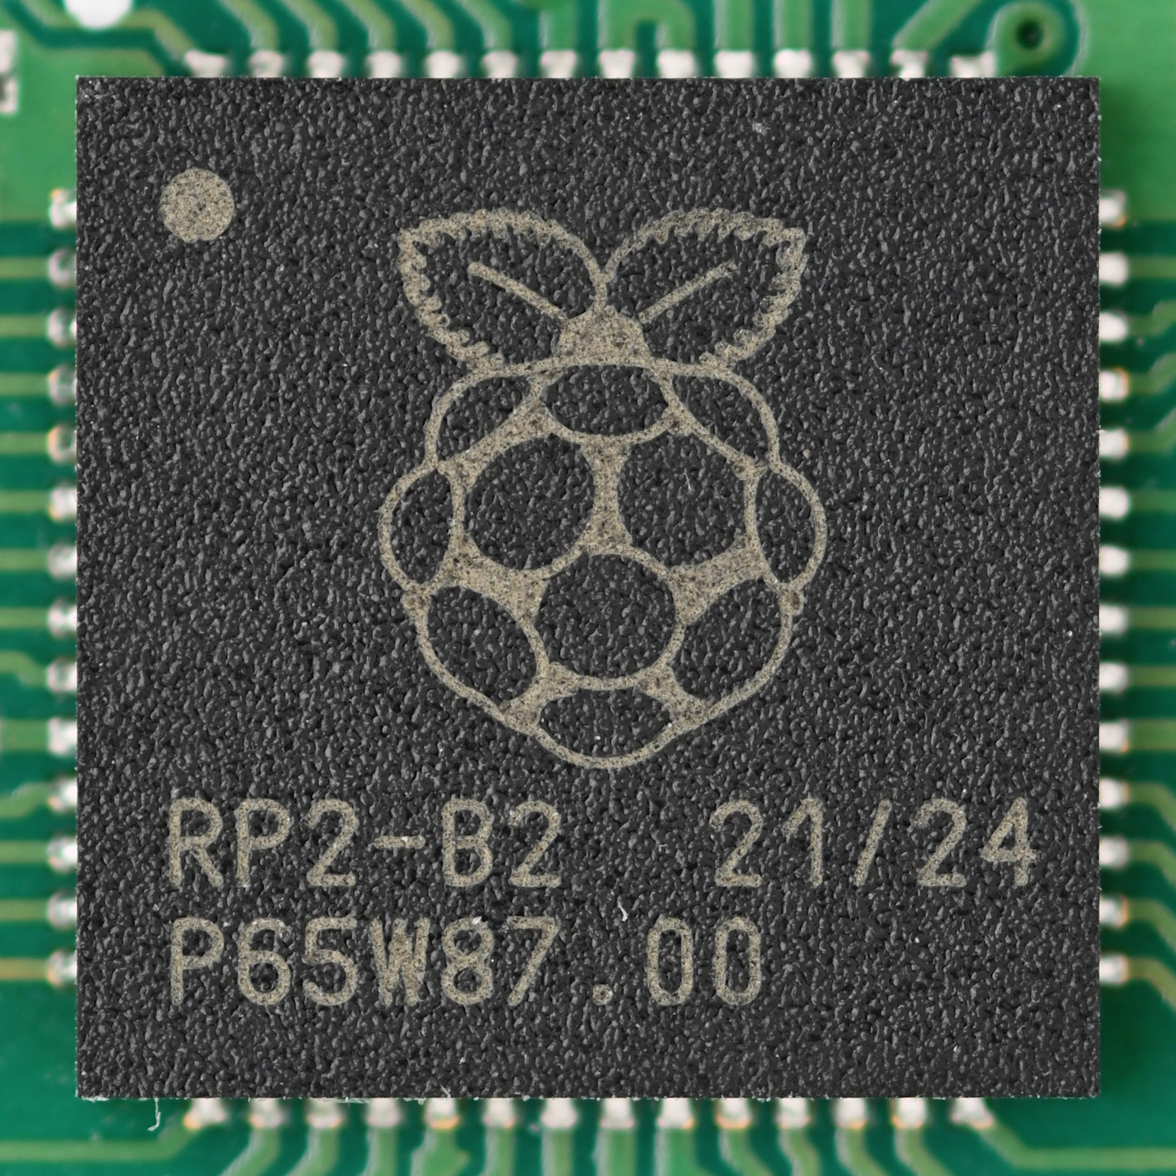
OSIRIS Silicon Analyser Upgrade
To provide these systems we will put together two new PCB designs.
RJ45 to HDMI Adaptor Board in the block house.
Simple pin to swap between connector types.
OSIRIS Relay Controller fitted in the rack in the DAE counting house.
20 x 8-way switches switch between default and spare pre-amp chips.
Notes:
Please replace photo of presenter with a portrait of your own. 1) Send the geometric shape overlay to the back – Right-Click > Send to Back > Send to Back. 2) Replace image – use the guides provided to correctly position it. 3) Send your portrait to the back so that the geometric overlay re-appears over the portrait.

Slide 13
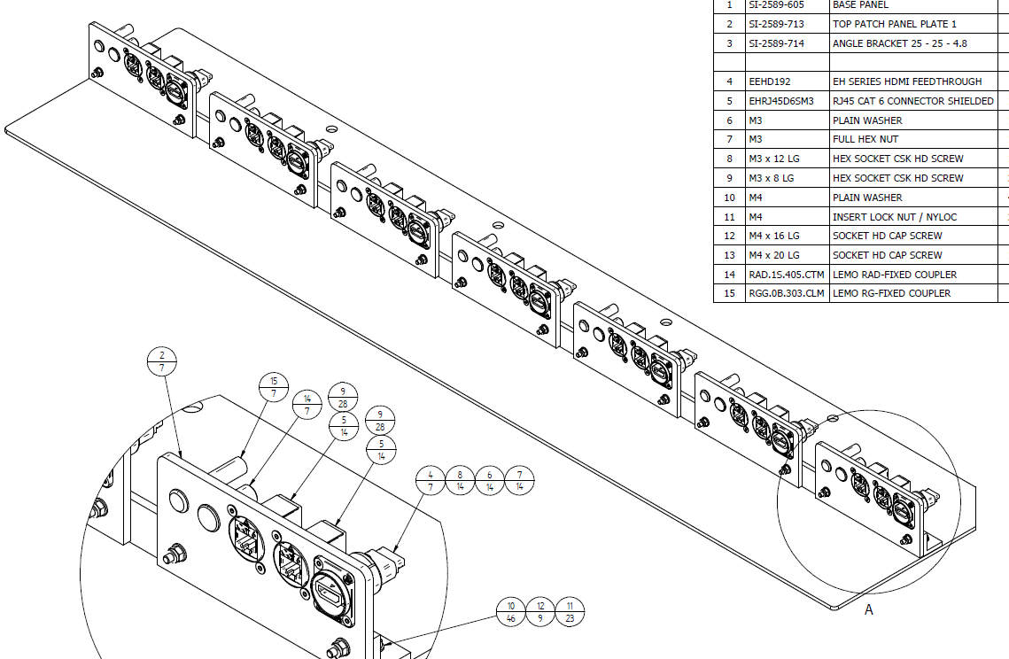
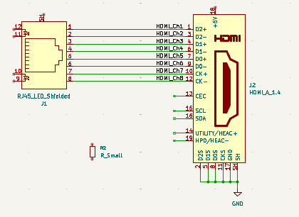
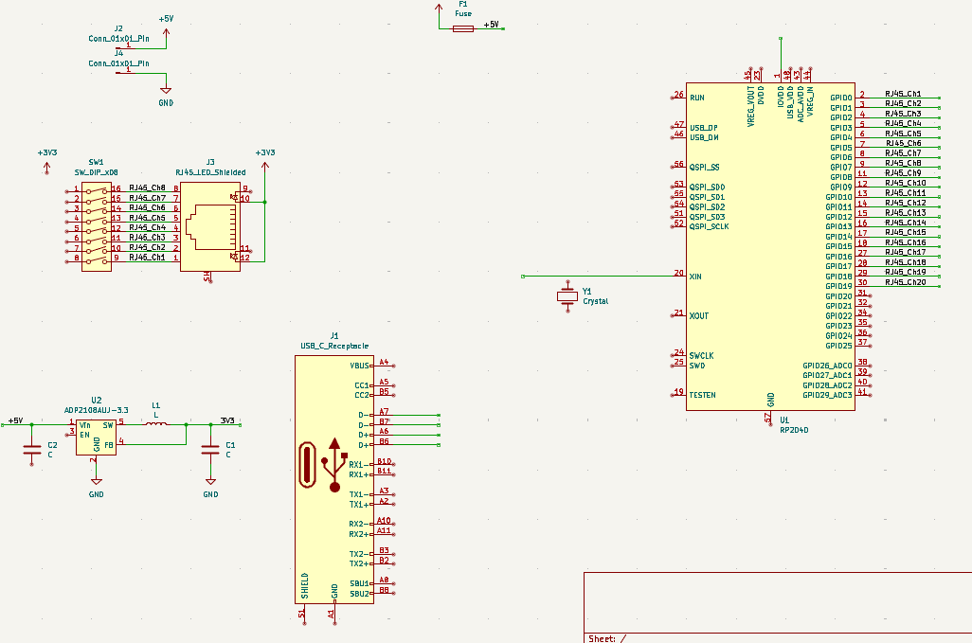
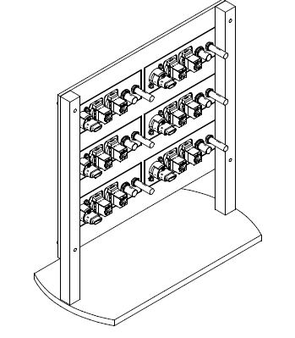
OSIRIS Silicon Analyser Upgrade
PCB schematics are being put together currently.
I’m planning to get them handed over to the PCB Design office for the circuit layout and manufacture as soon as possible.
Notes:
Please replace photo of presenter with a portrait of your own. 1) Send the geometric shape overlay to the back – Right-Click > Send to Back > Send to Back. 2) Replace image – use the guides provided to correctly position it. 3) Send your portrait to the back so that the geometric overlay re-appears over the portrait.

Slide 14


Any Questions?
Notes:
The abstract pattern can be removed or repositioned if required. Be careful to ‘Send to Back’ so that it does not obscure any important information.

Slide 15






Science and Technology Facilities Council
@STFC_matters
Science and Technology Facilities Council
Notes:
The abstract pattern can be removed or repositioned if required. Be careful to ‘Send to Back’ so that it does not obscure any important information.

