Slide 1
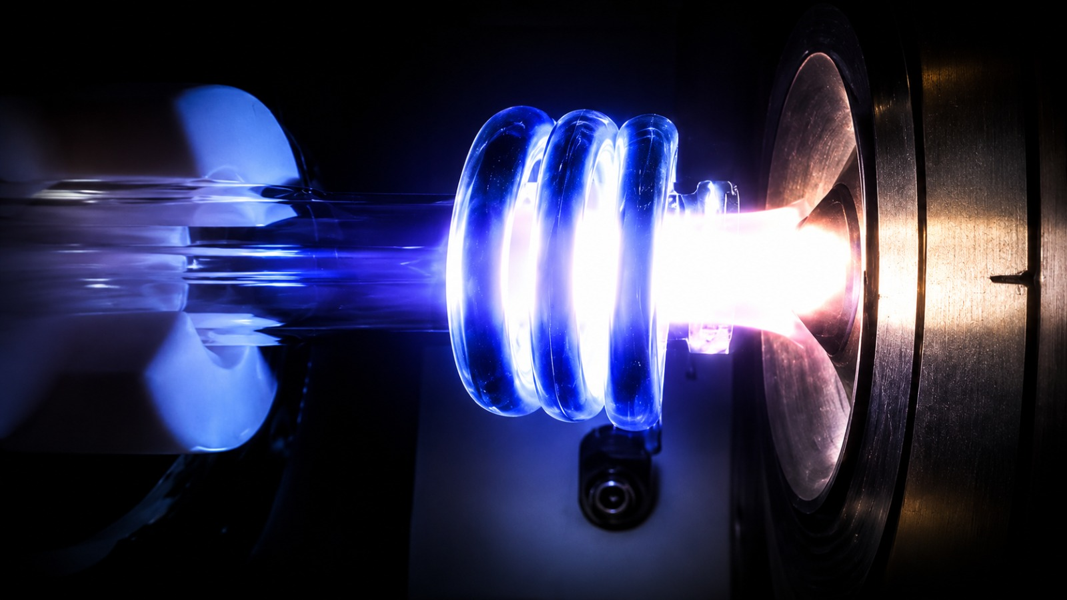



Neutron production in (α,n) reactions
Roberto Santorelli
CIEMAT – Madrid
roberto.santorelli@ciemat.es
LRT-2026 York (UK) 22/Sep/2026

Slide 2

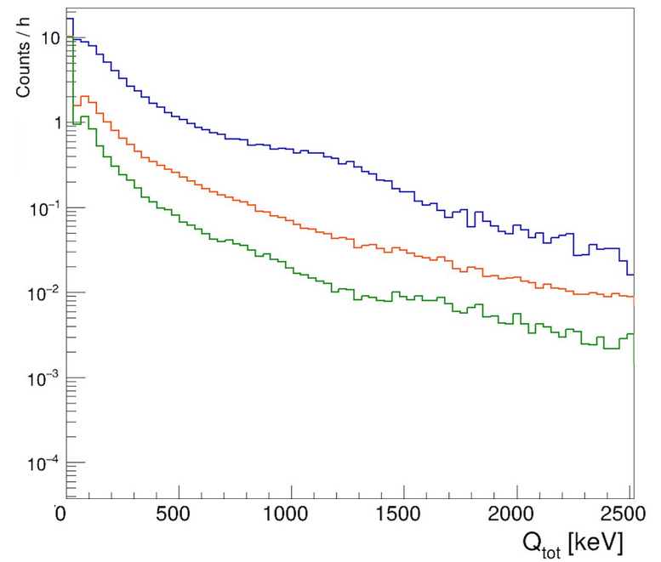
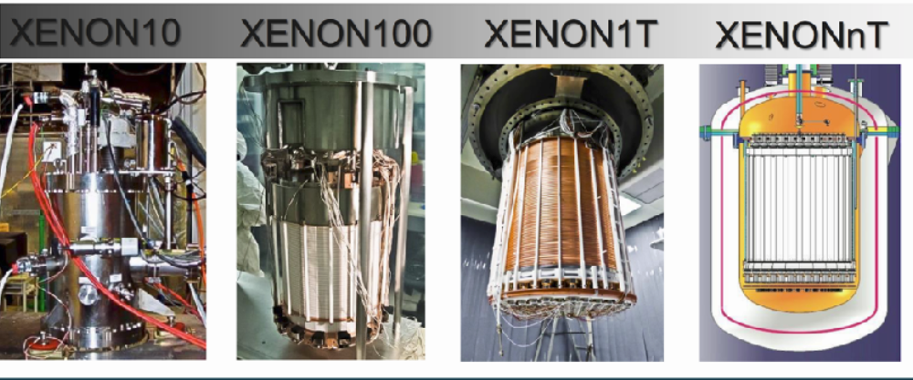
Rare-event searches: solar and SN neutrinos, double-beta decay, Dark Matter particles…
Two fundamental strategies:
10⁻¹
Increase the target mass
Reduce the bkg level
10³
10⁻²
10²
10⁻³
10¹

Slide 3

Understanding the radiogenic neutron production rate from the (α, n) reaction is crucial in many areas of physics!
(α, n) reaction also plays a significant role in nuclear energy technologies, as well as in applications such as medical physics!
XENON, DarkSide: (α, n) neutrons can produce single scattering nuclear recoils in the ROI for Dark Matter direct searches (i.e. irreducible background)
DUNE: γ-rays emitted in neutron capture reactions can contribute to backgrounds for neutrino–electron scattering and for neutrino–nucleus interactions such as neutrino absorption
0νββ: n-capture on Xe-136 (4.17 MeV β-decay by Xe-137)
JUNO, SNO+: the combination of the prompt n-signal with the delayed capture can mimic the inverse beta decay of antineutrinos on protons
γ-rays can fall in the energy region of interest for nucleon decay

Slide 4
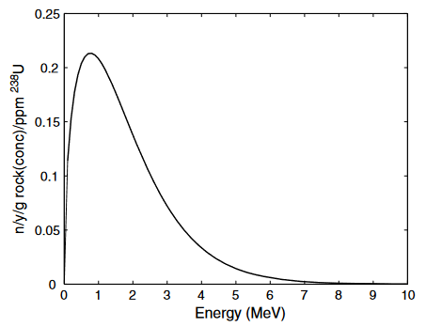
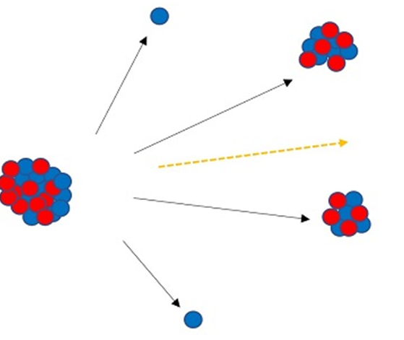
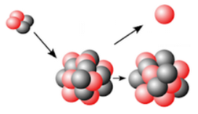
Neutron production
Main processes contributing to neutron production:
Spallation reactions from muons in the detector material and surrounding rock
Spontaneous fission: mainly from ²³⁸U, probability of about 5x10⁻⁷/U-238 decay (Dominant in high Z materials)
Watt spectrum
Typical multiplicity: ≈ 2 neutrons/fission
Energy spectrum well known
Astroparticle Physics
22 (2004) 313–322
0.52 neutrons/year/g /ppm(²³⁸U)
2.4 ± 0.2 n/fission
(α, n) reactions: Generally is dominant source for low Z-materials
(probability >10⁻⁴ / α-decay)
Produces the same neutron yield for all materials and depends only on the concentration of the fissioning nuclide
      Depends on the alpha energy and on the target
      Broad neutron energy spectrum

Slide 5
… where were we just a few years ago?

Slide 6
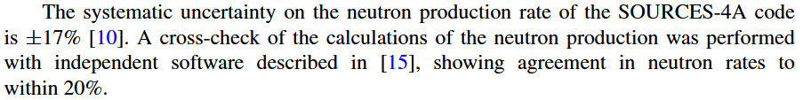
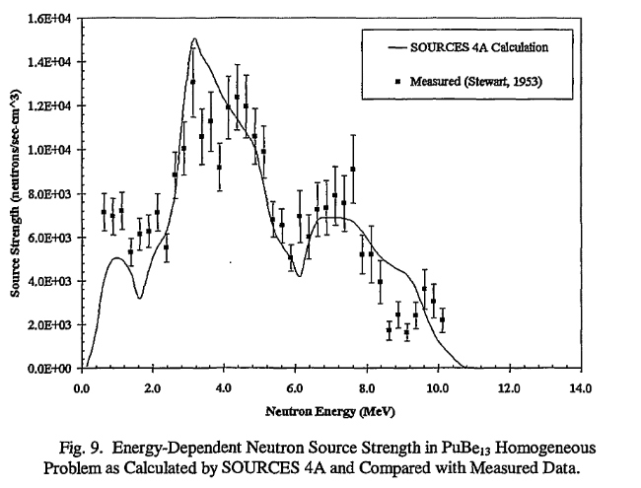
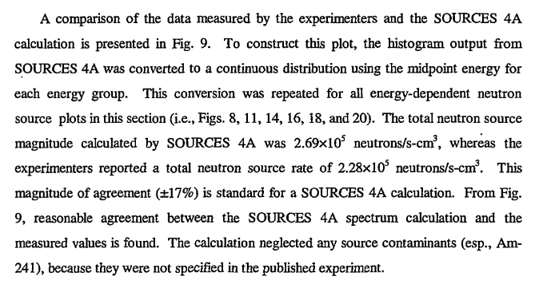
From a DM paper of the last decade
This magnitude of agreement (±17%) is standard for a SOURCES 4A calculation

Slide 7
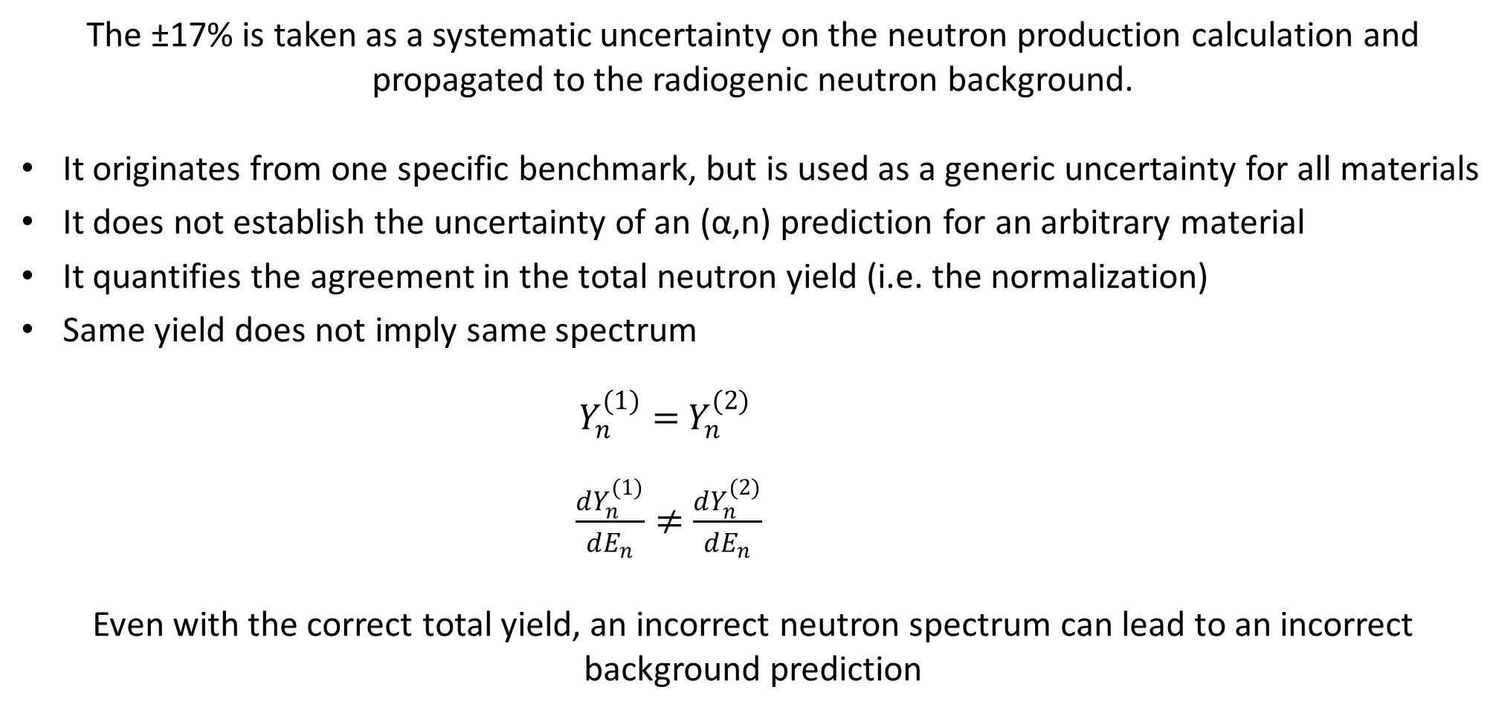
What does this ±17% actually tell us?
The ±17% is taken as a systematic uncertainty on the neutron production calculation and propagated to the radiogenic neutron background.
It originates from one specific benchmark, but is used as a generic uncertainty for all materials
It does not establish the uncertainty of an (α,n) prediction for an arbitrary material
It quantifies the agreement in the total neutron yield (i.e. the normalization)
Same yield does not imply same spectrum
$Y_{n}^{(1)}=$ $Y_{n}^{(2)}$
$\frac{dY_{n}^{(1)}}{dE_{n}}≠$ $\frac{dY_{n}^{(2)}}{dE_{n}}$
Even with the correct total yield, an incorrect neutron spectrum can lead to an incorrect background prediction

Slide 8
So…
How do we calculate (α,n) yield?
What determines its uncertainty?
i = detector component or material
j = alpha-emitting radionuclide or sub-chain
mᵢ = mass of the component
Aᵢⱼ = activity concentration in that component (→ Material assay)
Yᵢⱼ = neutron yield per decay

Slide 9

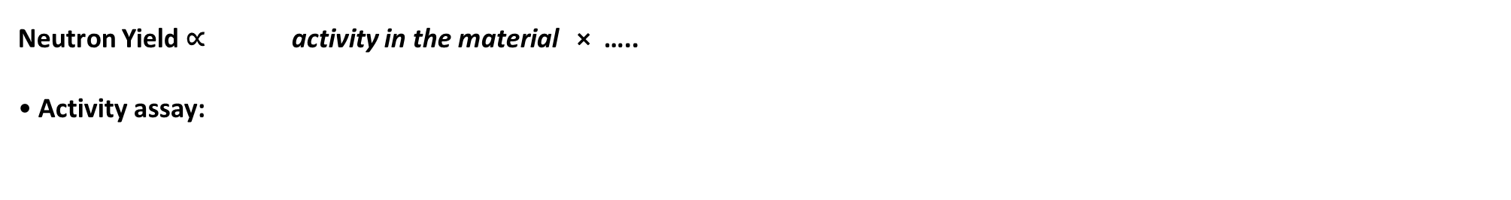
How do we calculate (α,n) yield?
Neutron Yield ∝ activity in the material × …..
• Activity assay:

Slide 10
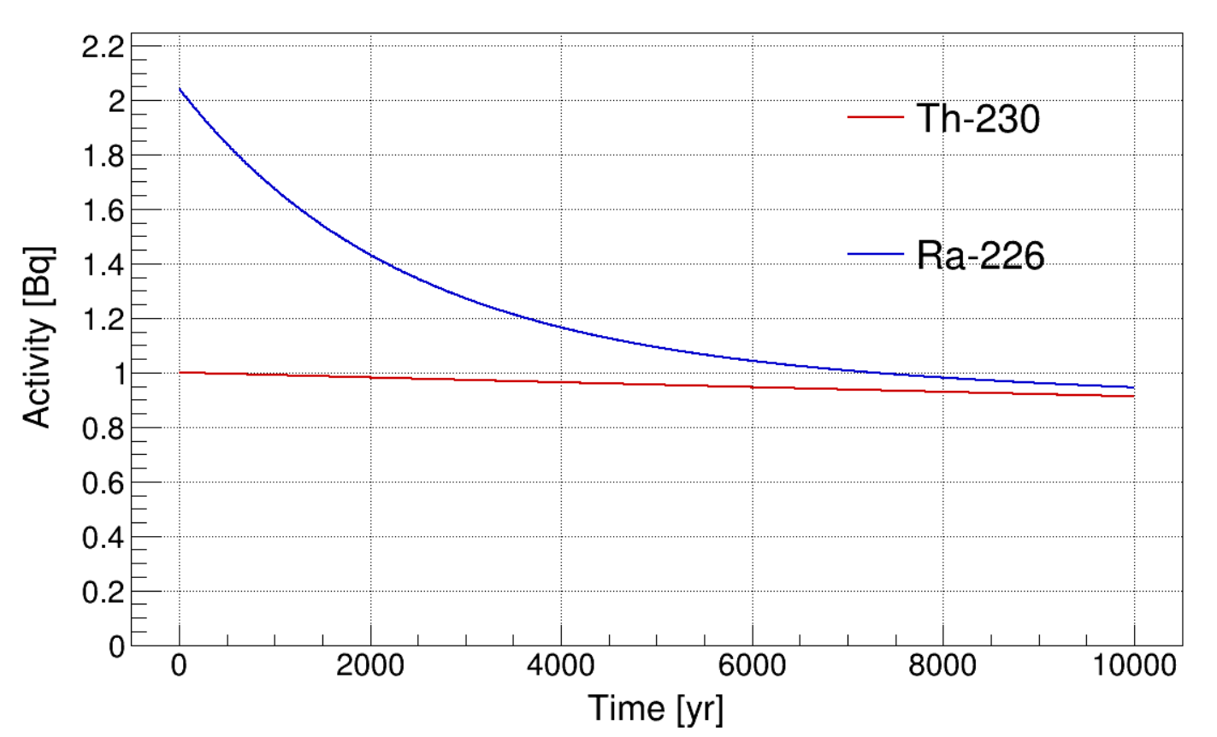
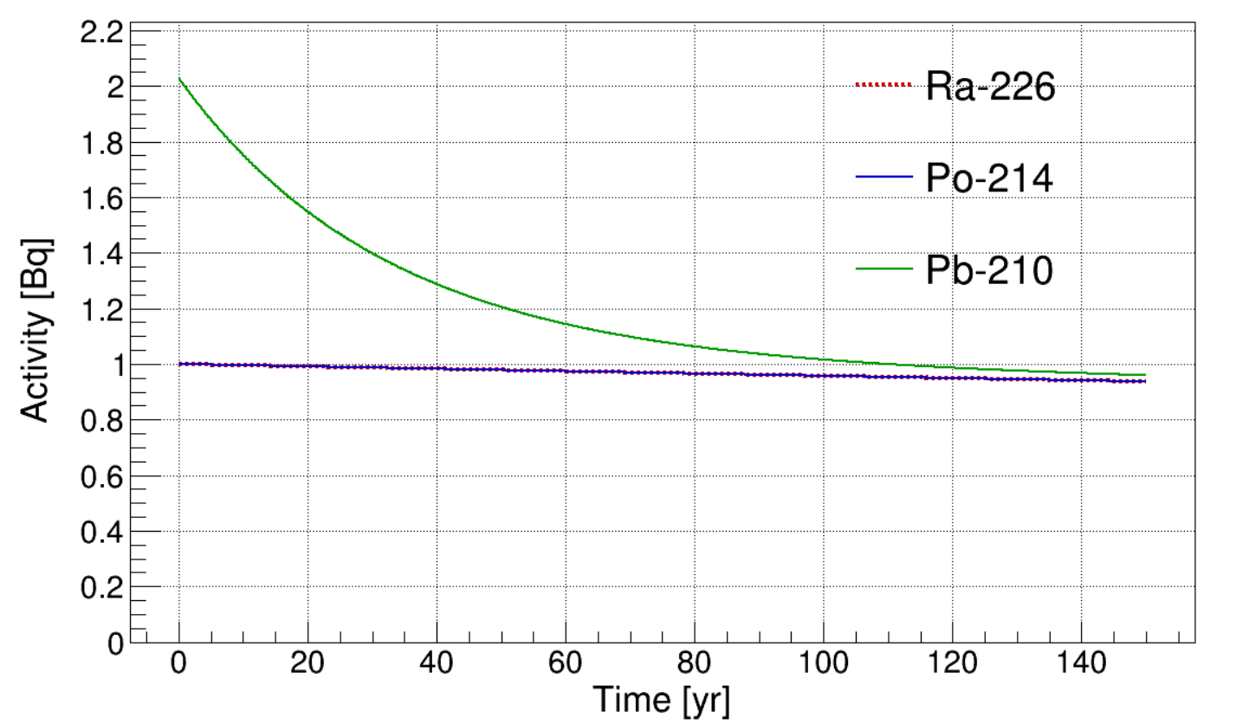
Disequilibrium in natural decay chains
Equilibrium in the decay series is rarely maintained in most surface and near-surface geological environments, as a result of physical or chemical processes:
chemical, artificial or natural processes (e.g. dissolution into groundwater) can remove one or more members of the chain.
Ra-226 enrichment
Pb-210 enrichment
Because Ra-226 and Pb-210 are long-lived, any chemical break in the chain persists for timescales much longer than those relevant to an experiment

Slide 11
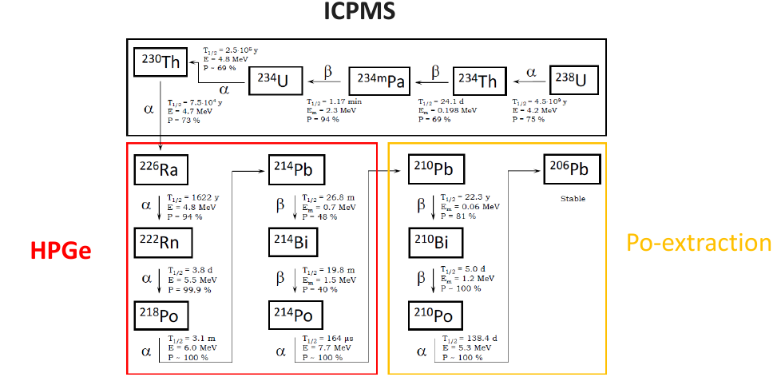
Equilibrium in the U-238 chain
BREAKING OF THE SECULAR EQUILIBRIUM AT ²²⁶Ra
SECOND BREAKING OF THE EQUILIBRIUM IN ²¹⁰Pb
Ra and U/Th have very different chemistry: Ra is an alkaline-earth metal, while U and Th are actinides
Because of this, material production can separate Ra from its U/Th parents without any intentional enrichment or depletion
In water-based processes, Ra can follow the soluble alkaline-earth fraction, while U and Th can remain bound in oxides, minerals, or insoluble residues
Pb-210 does not follow Ra chemistry: as a heavy metal, it can form stable, often poorly soluble compounds and be retained in solid residues or surface layers

Slide 12
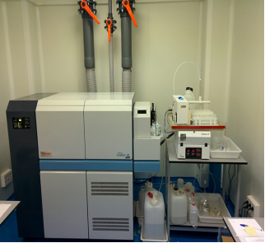
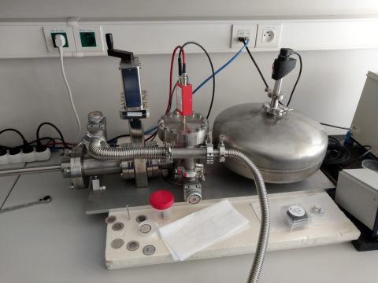
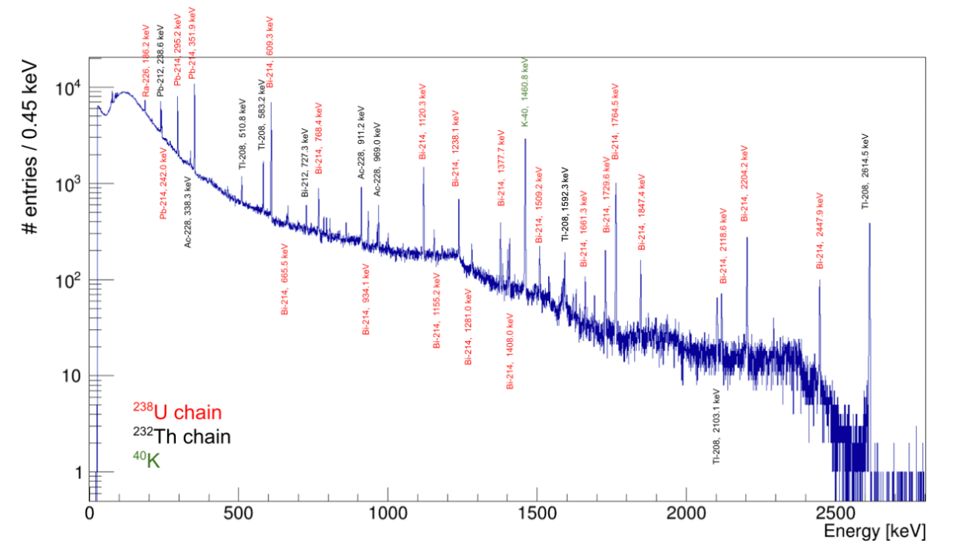
Equilibrium in the U-238 chain
Radiochemical
Little mass needed
Relatively fast
Digestion
Destructive
Only Po-210 (Pb-210)
ICPMS
Very little mass needed
Relatively fast
Digestion
Destructive
Only U-238 (Th-232)
HPGe
Larger mass needed
Slow
Non-destructive
Gamma activity

Slide 13
Material assay
In real materials, secular equilibrium of the U-238 chain is normally broken at Ra-226 and Pb-210 (three different sub-chains)
→ O(10-100) depending the production procedure, Rn exposure history etc.
Multiple assays (based on different techniques) needed to measure each part of the chain independently → Different assay results are complementary
Each assay technique probes different parts of the decay chains and carries its own intrinsic uncertainty, which propagates into the (α,n) yield and must be consistently combined across sub-chains
The equilibrium in the Th-232 chain tends to be preserved

Slide 14
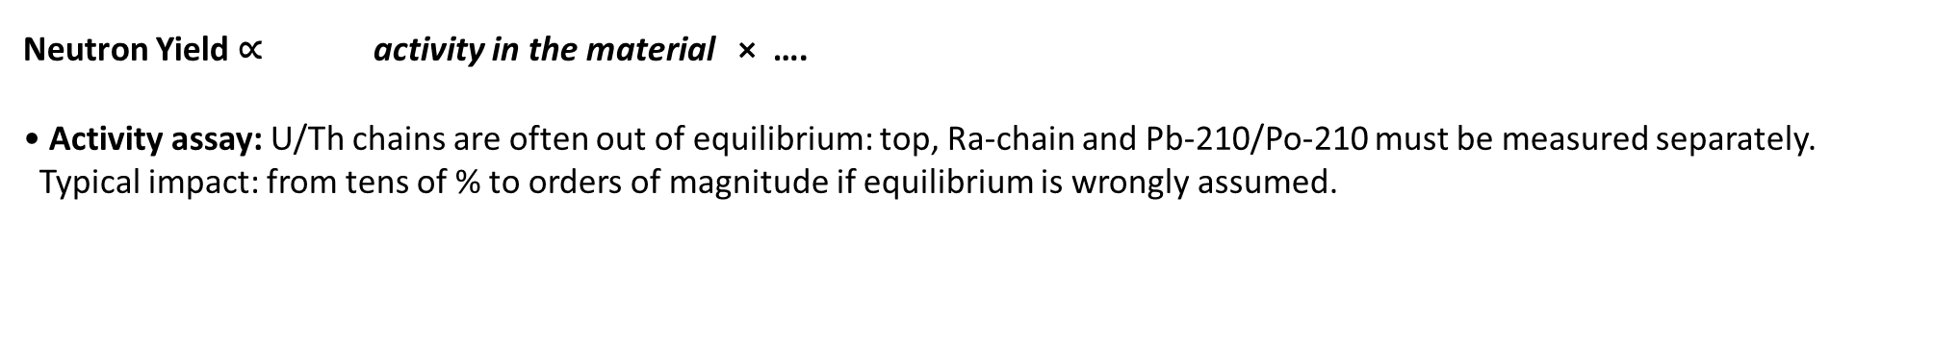
Main sources of uncertainty in (α,n) neutron background
Neutron Yield ∝ activity in the material × ….
• Activity assay: U/Th chains are often out of equilibrium: top, Ra-chain and Pb-210/Po-210 must be measured separately.
Typical impact: from tens of % to orders of magnitude if equilibrium is wrongly assumed.
Correlated systematics and cross-calibration matter for the final neutron background

Slide 15
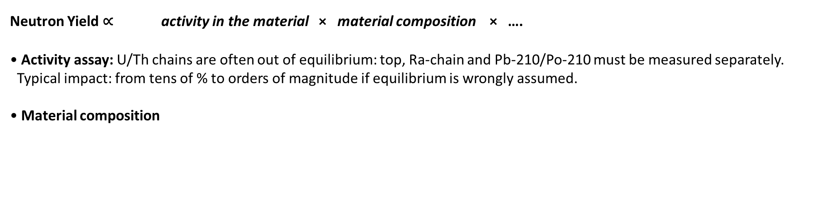
Main sources of uncertainty in (α,n) neutron background
Neutron Yield ∝ activity in the material × material composition × ….
• Activity assay: U/Th chains are often out of equilibrium: top, Ra-chain and Pb-210/Po-210 must be measured separately.
Typical impact: from tens of % to orders of magnitude if equilibrium is wrongly assumed.
• Material composition

Slide 16
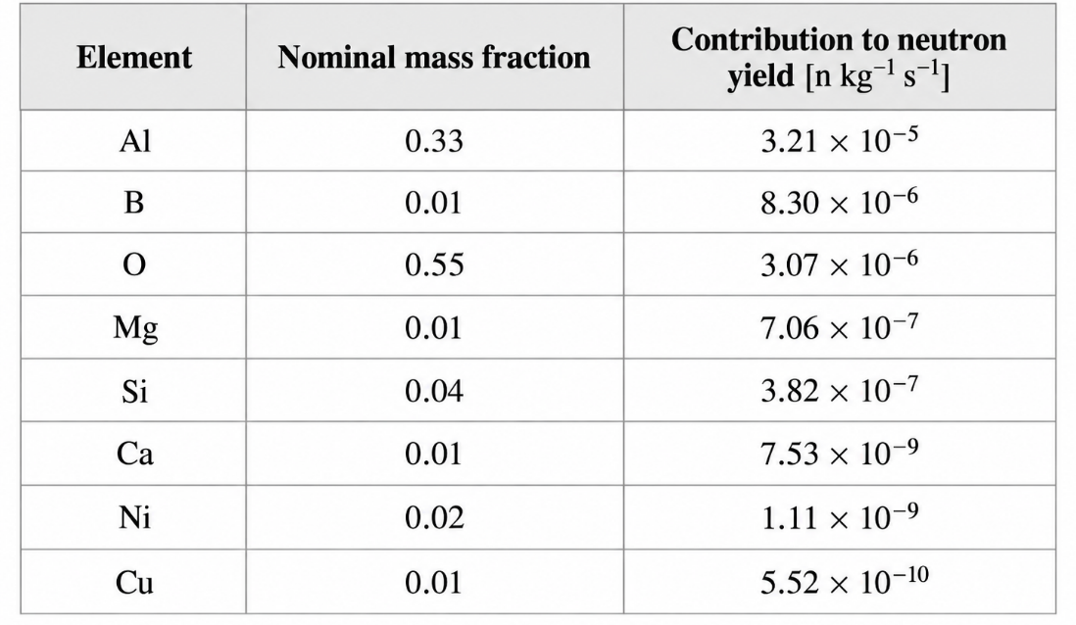
^{Material composition}
The neutron yield is not only determined by the total U/Th activity, but also by which target nuclei are present in the material
The same α activity can produce very different neutron yields depending on the target nuclei present in the material
A small amount of an element with a large (α,n) cross-section can contribute more than the main bulk material
Elemental analysis of a resistor
Aluminum constitutes 33% of the mass fraction, it contributes approximately 72% of the total neutron yield
Boron, which represents only 1% of the mass fraction, accounts for about 19% of the neutron yield
If the mass fraction of boron were increased to 2% or 3%, the total neutron yield would rise by approximately ∼19% or ∼37%, → critical role in the neutron yield balance

Slide 17
^{Material composition}
The neutron yield is not only determined by the total U/Th activity, but also by which target nuclei are present in the material
The same α activity can produce very different neutron yields depending on the target nuclei present in the material
A small amount of an element with a large (α,n) cross-section can contribute more than the main bulk material
The (α,n) yield is strongly dependent on the target nuclei, therefore a precise elemental characterization of the material is required.
Typical techniques: ICP-MS/GDMS for trace impurities, XRF for bulk composition, and combustion/inert-gas-fusion methods for light elements (C, N, O, H, S).

Slide 18
^{Material composition}
Carbon (¹³C - 1.06%): liquid scintillators, plastics (acrylic, polyethylene, nylon, PTFE), SS
Oxygen (¹⁷O - 0.03% and ¹⁸O - 0.2%): water liquid scintillators, plastics and rock
Values for 1 ppb Th-232 and U-238 (U-235 with its natural abundance)
Nitrogen (¹⁴N – 99%): plastics, wavelength shifters, fluors used in liquid scintillators
Aluminum (²⁷Al – 100%): resistors, ceramics
Fluorine (¹⁹F – 100%): component of PTFE
Beryllium (⁹Be – 100%) present in wires
Titanium & Copper: used in cryostats, shielding, support structures
Silicon: present in quartz, glass, light sensors

Slide 19
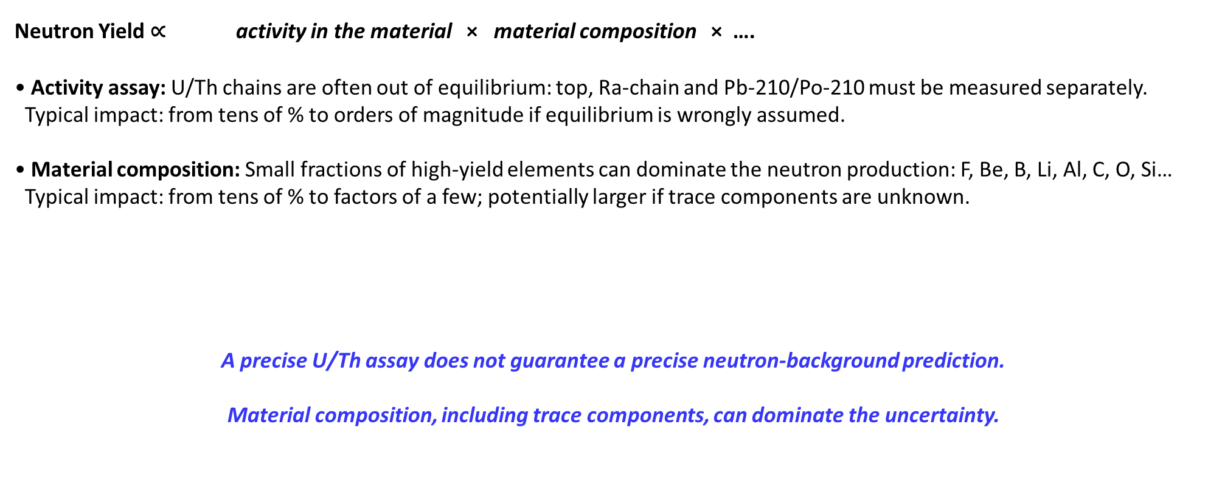
Main sources of uncertainty in (α,n) neutron background
Neutron Yield ∝ activity in the material × material composition × ….
• Activity assay: U/Th chains are often out of equilibrium: top, Ra-chain and Pb-210/Po-210 must be measured separately.
Typical impact: from tens of % to orders of magnitude if equilibrium is wrongly assumed.
• Material composition: Small fractions of high-yield elements can dominate the neutron production: F, Be, B, Li, Al, C, O, Si…
Typical impact: from tens of % to factors of a few; potentially larger if trace components are unknown.
A precise U/Th assay does not guarantee a precise neutron-background prediction.
Material composition, including trace components, can dominate the uncertainty.

Slide 20
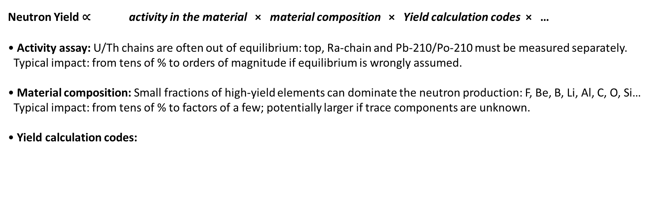
Main sources of uncertainty in (α,n) neutron background
Neutron Yield ∝ activity in the material × material composition × Yield calculation codes × …
• Activity assay: U/Th chains are often out of equilibrium: top, Ra-chain and Pb-210/Po-210 must be measured separately.
Typical impact: from tens of % to orders of magnitude if equilibrium is wrongly assumed.
• Material composition: Small fractions of high-yield elements can dominate the neutron production: F, Be, B, Li, Al, C, O, Si…
Typical impact: from tens of % to factors of a few; potentially larger if trace components are unknown.
• Yield calculation codes:

Slide 21
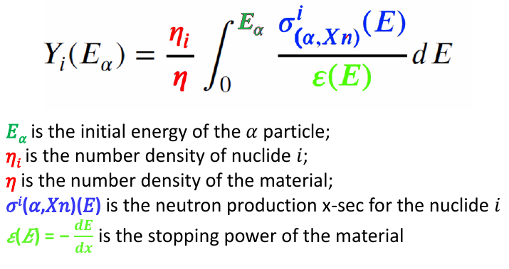
Neutron yield calculation
Codes (SOURCES4C, NeuCBOT, SaG4n)
Exploiting evaluated libraries (JENDL)
Highly complex material geometries (actual geometry and border effects)
Neutron transport, precise tracking
Biasing techniques
SaG4n: Simple and versatile tool provided to the community SaG4n (https://github.com/UIN-CIEMAT/SaG4n)
“Neutron production induced by α-decay with Geant4”, Nucl. Instrum. Methods A 960, 163659 (2020)
This approach enables the simulation of both neutron production and transport within Geant4, providing detailed information on each individual (α, n) reaction.
This level of detail is essential for accurately calculating background events caused by (α, n) neutrons, particularly in rare event search experiments.

Slide 22
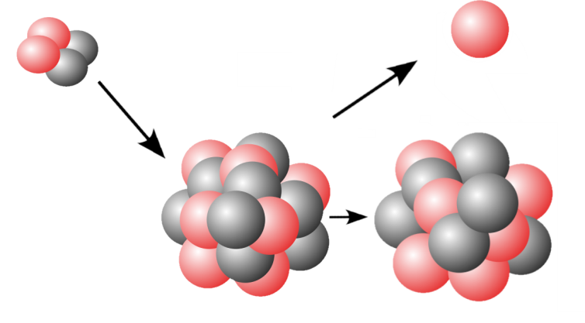
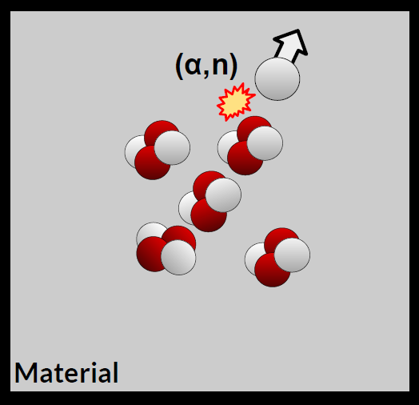
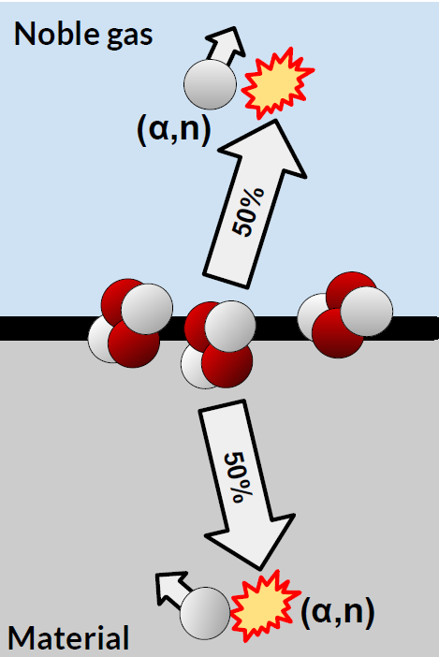
α,β,γ,….and neutrons
α-emitters produce secondary neutrons mainly through (α, n) reactions
(+ S.F.)
Bulk activity
Surface activity

Slide 23
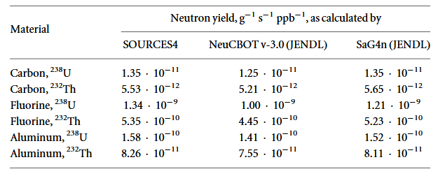
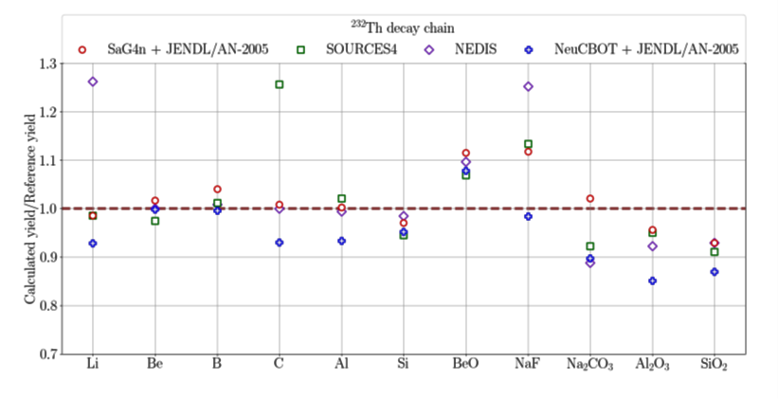
Codes for (α,n)
Neutron yield from (α, n) reactions in the ²³⁸U and ²³²Th decay chains in several
materials as calculated by different codes
Neutron yields calculated for light nuclei by applying different codes,
(The numerical values are normalized to evaluated data from various alpha-beam measurements)
“Review of neutron yield from (α, n) reactions: data, methods, and prospects”
2026 J. Phys. G: Nucl. Part. Phys. 53 023001

Slide 24
Codes for (α,n)
BeO and NaF
– large spread between codes
– highly “reactive” (α,n) materials
– strong sensitivity to: resonant cross sections
→ largest uncertainties (∼10–25%)
Silicate materials (SiO₂, Al₂O₃)
– lower yields
– still systematic differences between codes
– NeuCBOT tends to give lower yields than SOURCES4 in some cases
Light elements (Li, B, C)
– moderate but visible spread
– reflects differences in cross sections and nuclear models
Differences arise from:
– different cross-section libraries (JENDL / ENDF / NEDIS)
– different treatment of resonances
– different stopping power tables
– different treatment of excited final states
Results are “generally consistent” across tools and libraries
– typical deviations: ±5–15%
– in some cases: up to ∼25–30%
Different (α,n) codes and nuclear data libraries introduce unavoidable systematic uncertainties that depend strongly on material composition and nuclear physics inputs.

Slide 25
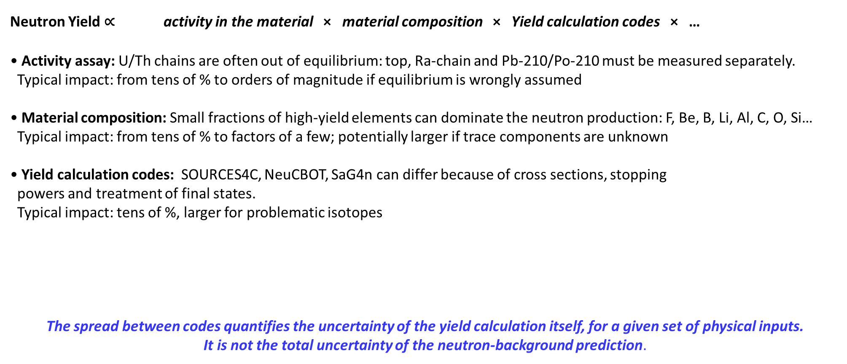
Main sources of uncertainty in (α,n) neutron background
Neutron Yield ∝ activity in the material × material composition × Yield calculation codes × …
• Activity assay: U/Th chains are often out of equilibrium: top, Ra-chain and Pb-210/Po-210 must be measured separately.
Typical impact: from tens of % to orders of magnitude if equilibrium is wrongly assumed
• Material composition: Small fractions of high-yield elements can dominate the neutron production: F, Be, B, Li, Al, C, O, Si…
Typical impact: from tens of % to factors of a few; potentially larger if trace components are unknown
• Yield calculation codes: SOURCES4C, NeuCBOT, SaG4n can differ because of cross sections, stopping
powers and treatment of final states.
Typical impact: tens of %, larger for problematic isotopes
The spread between codes quantifies the uncertainty of the yield calculation itself, for a given set of physical inputs.
It is not the total uncertainty of the neutron-background prediction.

Slide 26
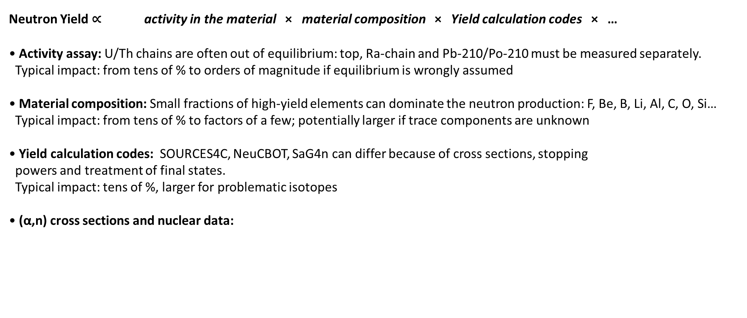
Main sources of uncertainty in (α,n) neutron background
Neutron Yield ∝ activity in the material × material composition × Yield calculation codes × …
• Activity assay: U/Th chains are often out of equilibrium: top, Ra-chain and Pb-210/Po-210 must be measured separately.
Typical impact: from tens of % to orders of magnitude if equilibrium is wrongly assumed
• Material composition: Small fractions of high-yield elements can dominate the neutron production: F, Be, B, Li, Al, C, O, Si…
Typical impact: from tens of % to factors of a few; potentially larger if trace components are unknown
• Yield calculation codes: SOURCES4C, NeuCBOT, SaG4n can differ because of cross sections, stopping
powers and treatment of final states.
Typical impact: tens of %, larger for problematic isotopes
• (α,n) cross sections and nuclear data:

Slide 27
Nuclear cross-section databases for (α,n)
• EXFOR (Experimental Nuclear Reaction Data)
– Global database of all published experimental nuclear reaction data
– Includes raw measurements: (α,n), (p,n), (n,γ), etc.
– No evaluation: data are not “recommended values”, just compiled results
– Essential for benchmarking and identifying discrepancies between experiments
• TENDL (TALYS-based Evaluated Nuclear Data Library)
– Theoretical/model-based evaluated library
(strongly model-driven, with available experimental information used in evaluations/adjustments)
– Covers almost all isotopes (even where no data exist)
– Uses nuclear reaction models (TALYS) to generate cross-sections, spectra and br. ratios
– Very complete, but model-dependent
• JENDL (Japanese Evaluated Nuclear Data Library)
– Evaluated library combining experimental data + theory
– Strongly constrained by experimental data, where available, and more curated than purely model-based evaluations
– Often used as reference for reactor and shielding calculations
– Limited coverage compared to TENDL but generally higher reliability where data exist
• ENDF/B (US Evaluated Nuclear Data Library)
– Standard evaluated library used in many simulation codes (Geant4, MCNP)
– Similar philosophy to JENDL
– Widely validated for neutron-induced reactions, less detailed for some (α,n) channels
General picture: Differences between libraries → direct source of uncertainty in (α,n) yields

Slide 28
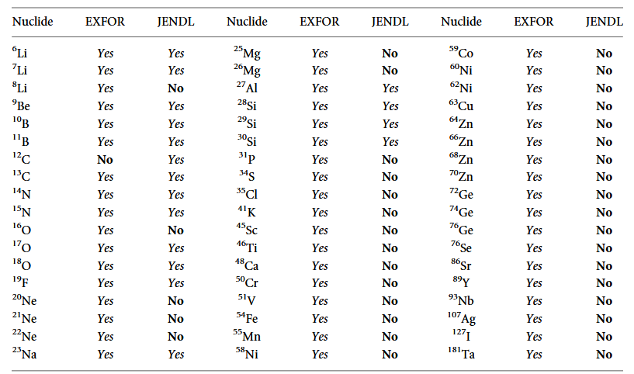
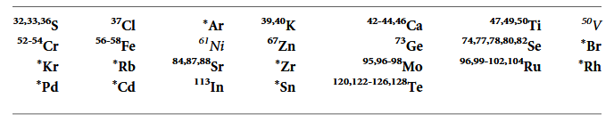
Nuclear cross-section databases for (α,n)
Nuclides for which (α, n) cross-sections are cataloged in the EXFOR and JENDL databases
Mid-Z range naturally occurring isotopes for which there are currently no measured (α, n) cross-sections in the 4–10 MeV energy range cataloged in EXFOR.
Elements for which * is listed for the mass number have no data available for any of their naturally existing isotopes.
Entries shown in bold (all except Ni and V ) are those for which missing isotopes collectively contribute at least 10% of the elements total neutron yield

Slide 29
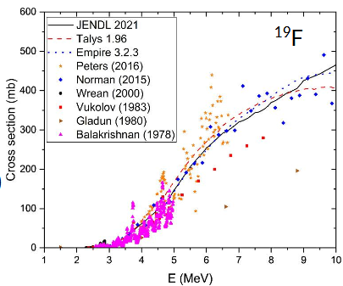
Very challenging task
Missing or scarce experimental cross-section data for many relevant target nuclei (truly evaluated cross-sections)
2.3 MeV (α,n) reaction threshold
PTFE, (C2F4)n , TeflonTM: ¹⁹F (76% total mass)
Significant difference among data
Discrepancies between experimental datasets due to different setups, efficiencies, thresholds and corrections
Resonance structures and excited final states are often poorly known, especially for light and medium-Z nuclei
Missing information on neutron spectra, angular distributions and correlated γ-ray emission

Slide 30
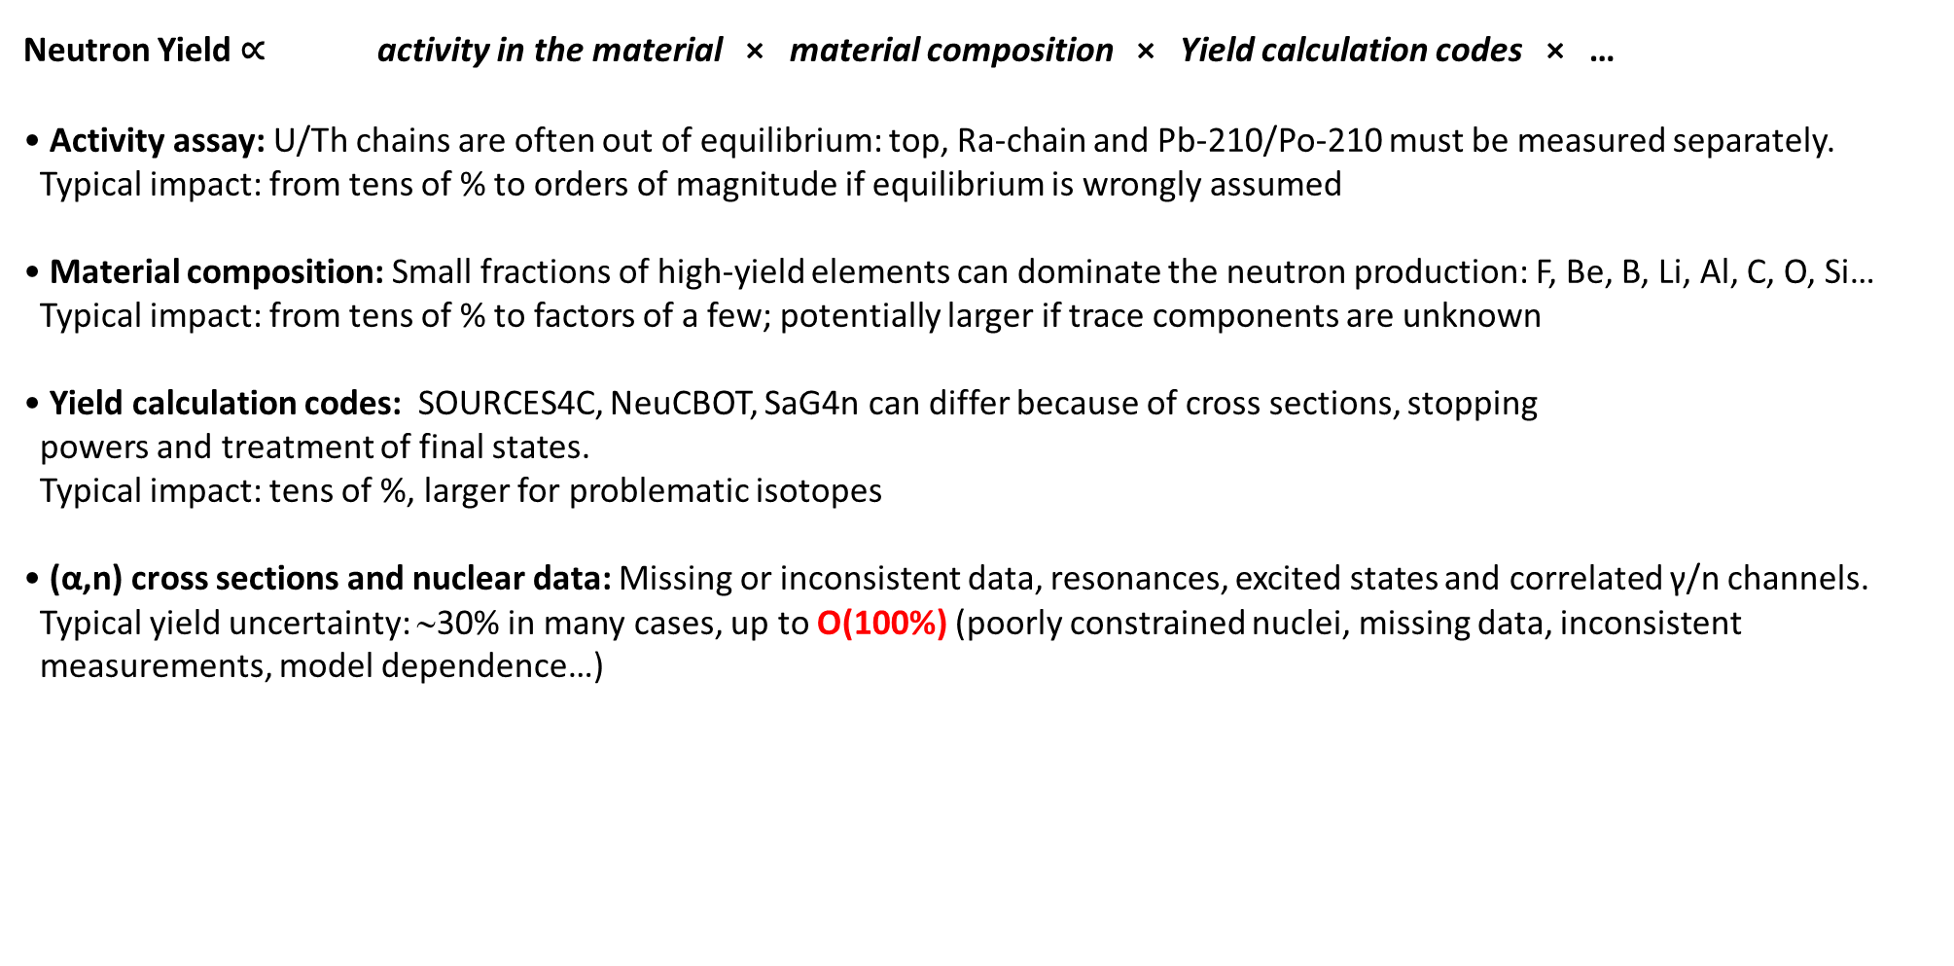
Main sources of uncertainty in (α,n) neutron background
Neutron Yield ∝ activity in the material × material composition × Yield calculation codes × …
• Activity assay: U/Th chains are often out of equilibrium: top, Ra-chain and Pb-210/Po-210 must be measured separately.
Typical impact: from tens of % to orders of magnitude if equilibrium is wrongly assumed
• Material composition: Small fractions of high-yield elements can dominate the neutron production: F, Be, B, Li, Al, C, O, Si…
Typical impact: from tens of % to factors of a few; potentially larger if trace components are unknown
• Yield calculation codes: SOURCES4C, NeuCBOT, SaG4n can differ because of cross sections, stopping
powers and treatment of final states.
Typical impact: tens of %, larger for problematic isotopes
• (α,n) cross sections and nuclear data: Missing or inconsistent data, resonances, excited states and correlated γ/n channels.
Typical yield uncertainty: ∼30% in many cases, up to O(100%) (poorly constrained nuclei, missing data, inconsistent
measurements, model dependence…)
Improved (α,n) cross-section measurements and better evaluated nuclear data are essential to reduce the uncertainty.

Slide 31
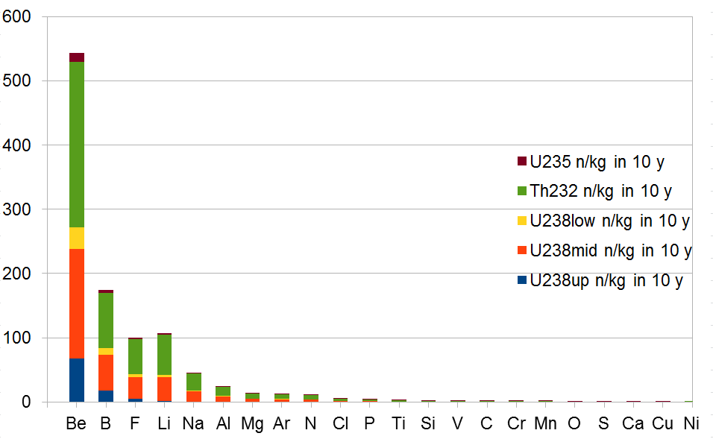
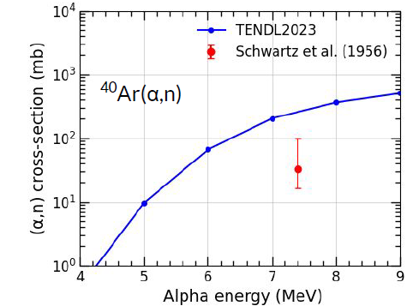
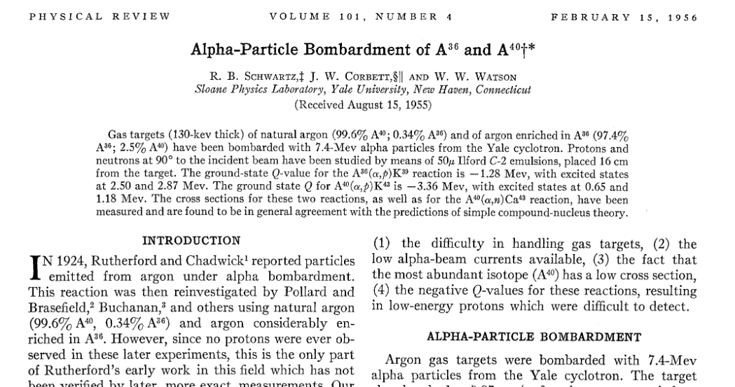
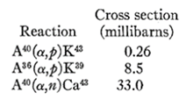
(a,n)
(α,n) on Argon
The only ⁴⁰Ar(α,n) measurement in EXFOR dates from 1956, only for one energy, with a high uncertainty associated

Slide 32
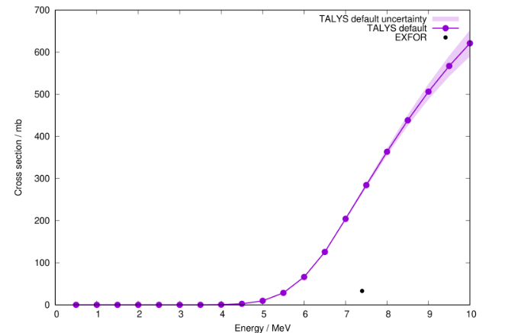
(α,n) on Argon
Where experimental data are missing, the uncertainty can be driven by the nuclear model, not by the yield-calculation code
Excitation function for ⁴⁰Ar(α, n) as calculated with TALYS 1.96 (line) based on
default settings with the associated uncertainty (band) is based on
sampling the input parameter space
“Review of neutron yield from (α, n) reactions: data, methods, and prospects”
2026 J. Phys. G: Nucl. Part. Phys. 53 023001

Slide 33
Wrapping-up
(α,n) neutron backgrounds require a combined approach based on accurate material assays, reliable nuclear data, and consistent modeling tools
Relevant uncertainties arise from disequilibrium in decay chains and from incomplete or poorly known material composition
Systematic differences between calculation codes and nuclear libraries are relevant but generally subdominant compared to other sources of uncertainty
Improved nuclear and material data—especially for poorly measured or missing (α,n) cross sections—are essential for next-generation rare-event searches

Slide 34
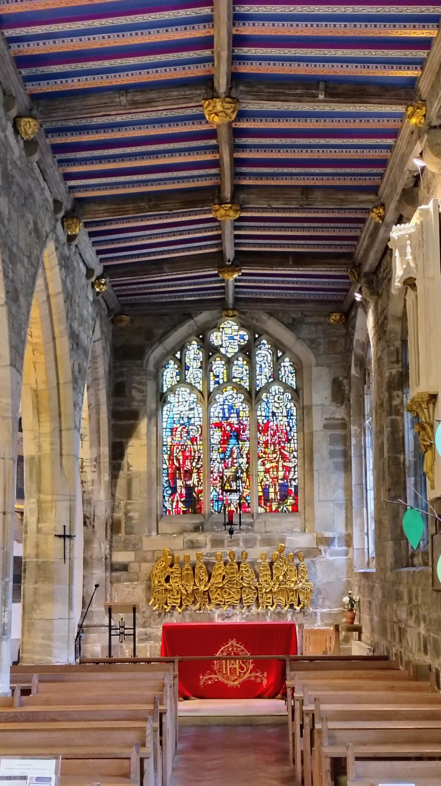
Thank you!

Slide 35
Backup

Slide 36
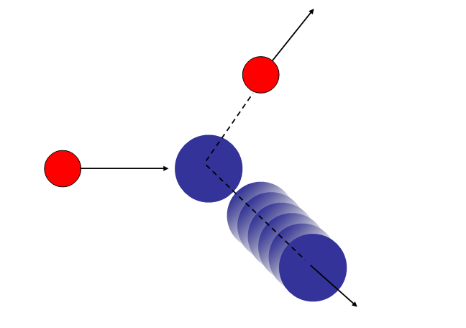
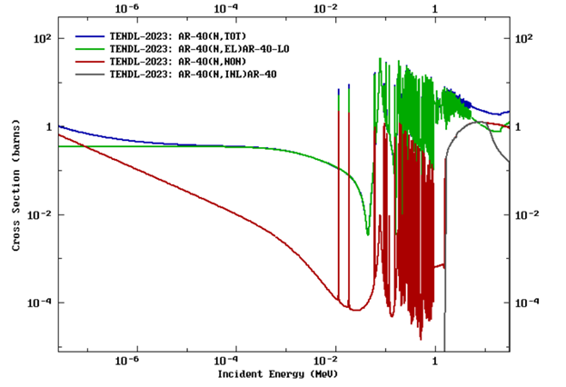
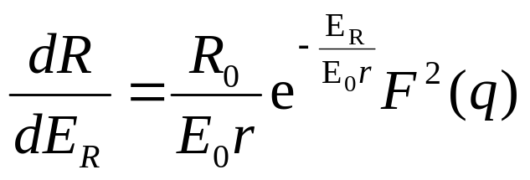
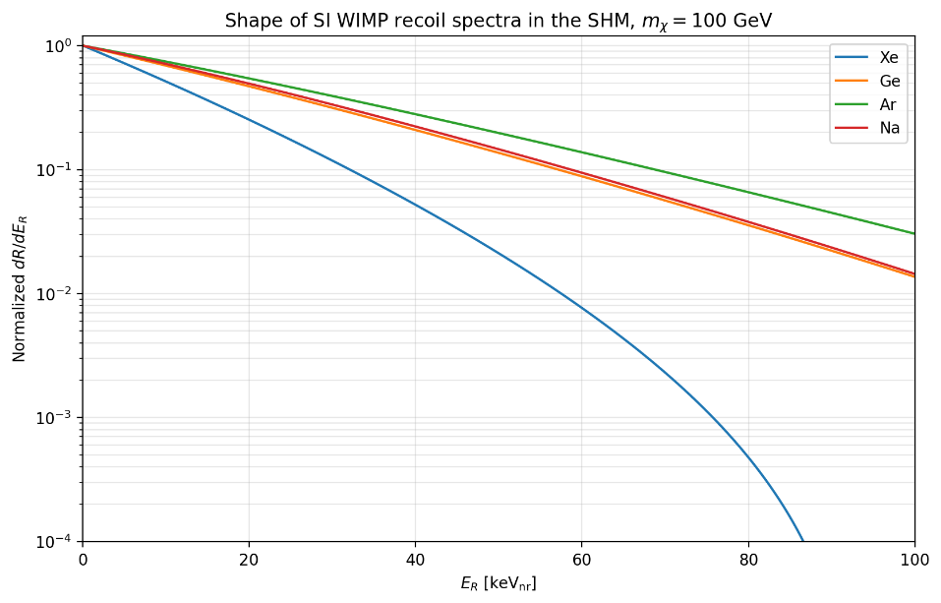
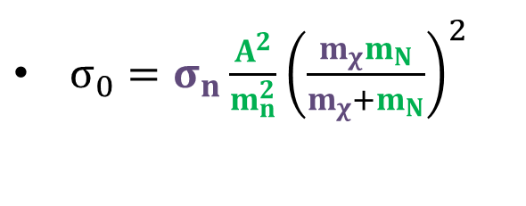
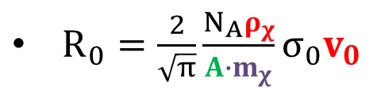
WIMP Direct detection: neutrons
neutrons can produce nuclear recoil in the WIMP search region of interest
→ Potential irreducible
background
Ar,Xe,Ge…Nuclei
(at rest)
WIMP β∼10⁻³
E_{recoil}
$R_{0}=\frac{2}{\sqrt{π}}\frac{N_{A}ρ_{χ}}{A{∙m}_{χ}}σ_{0}v_{0}$
Particle physics
Detector
DM halo
$σ_{0}=σ_{n}\frac{A^{2}}{m_{n}^{2}}{\left(\frac{m_{χ}m_{N}}{m_{χ}+m_{N}}\right)}^{2}$

Slide 37
