Slide 1

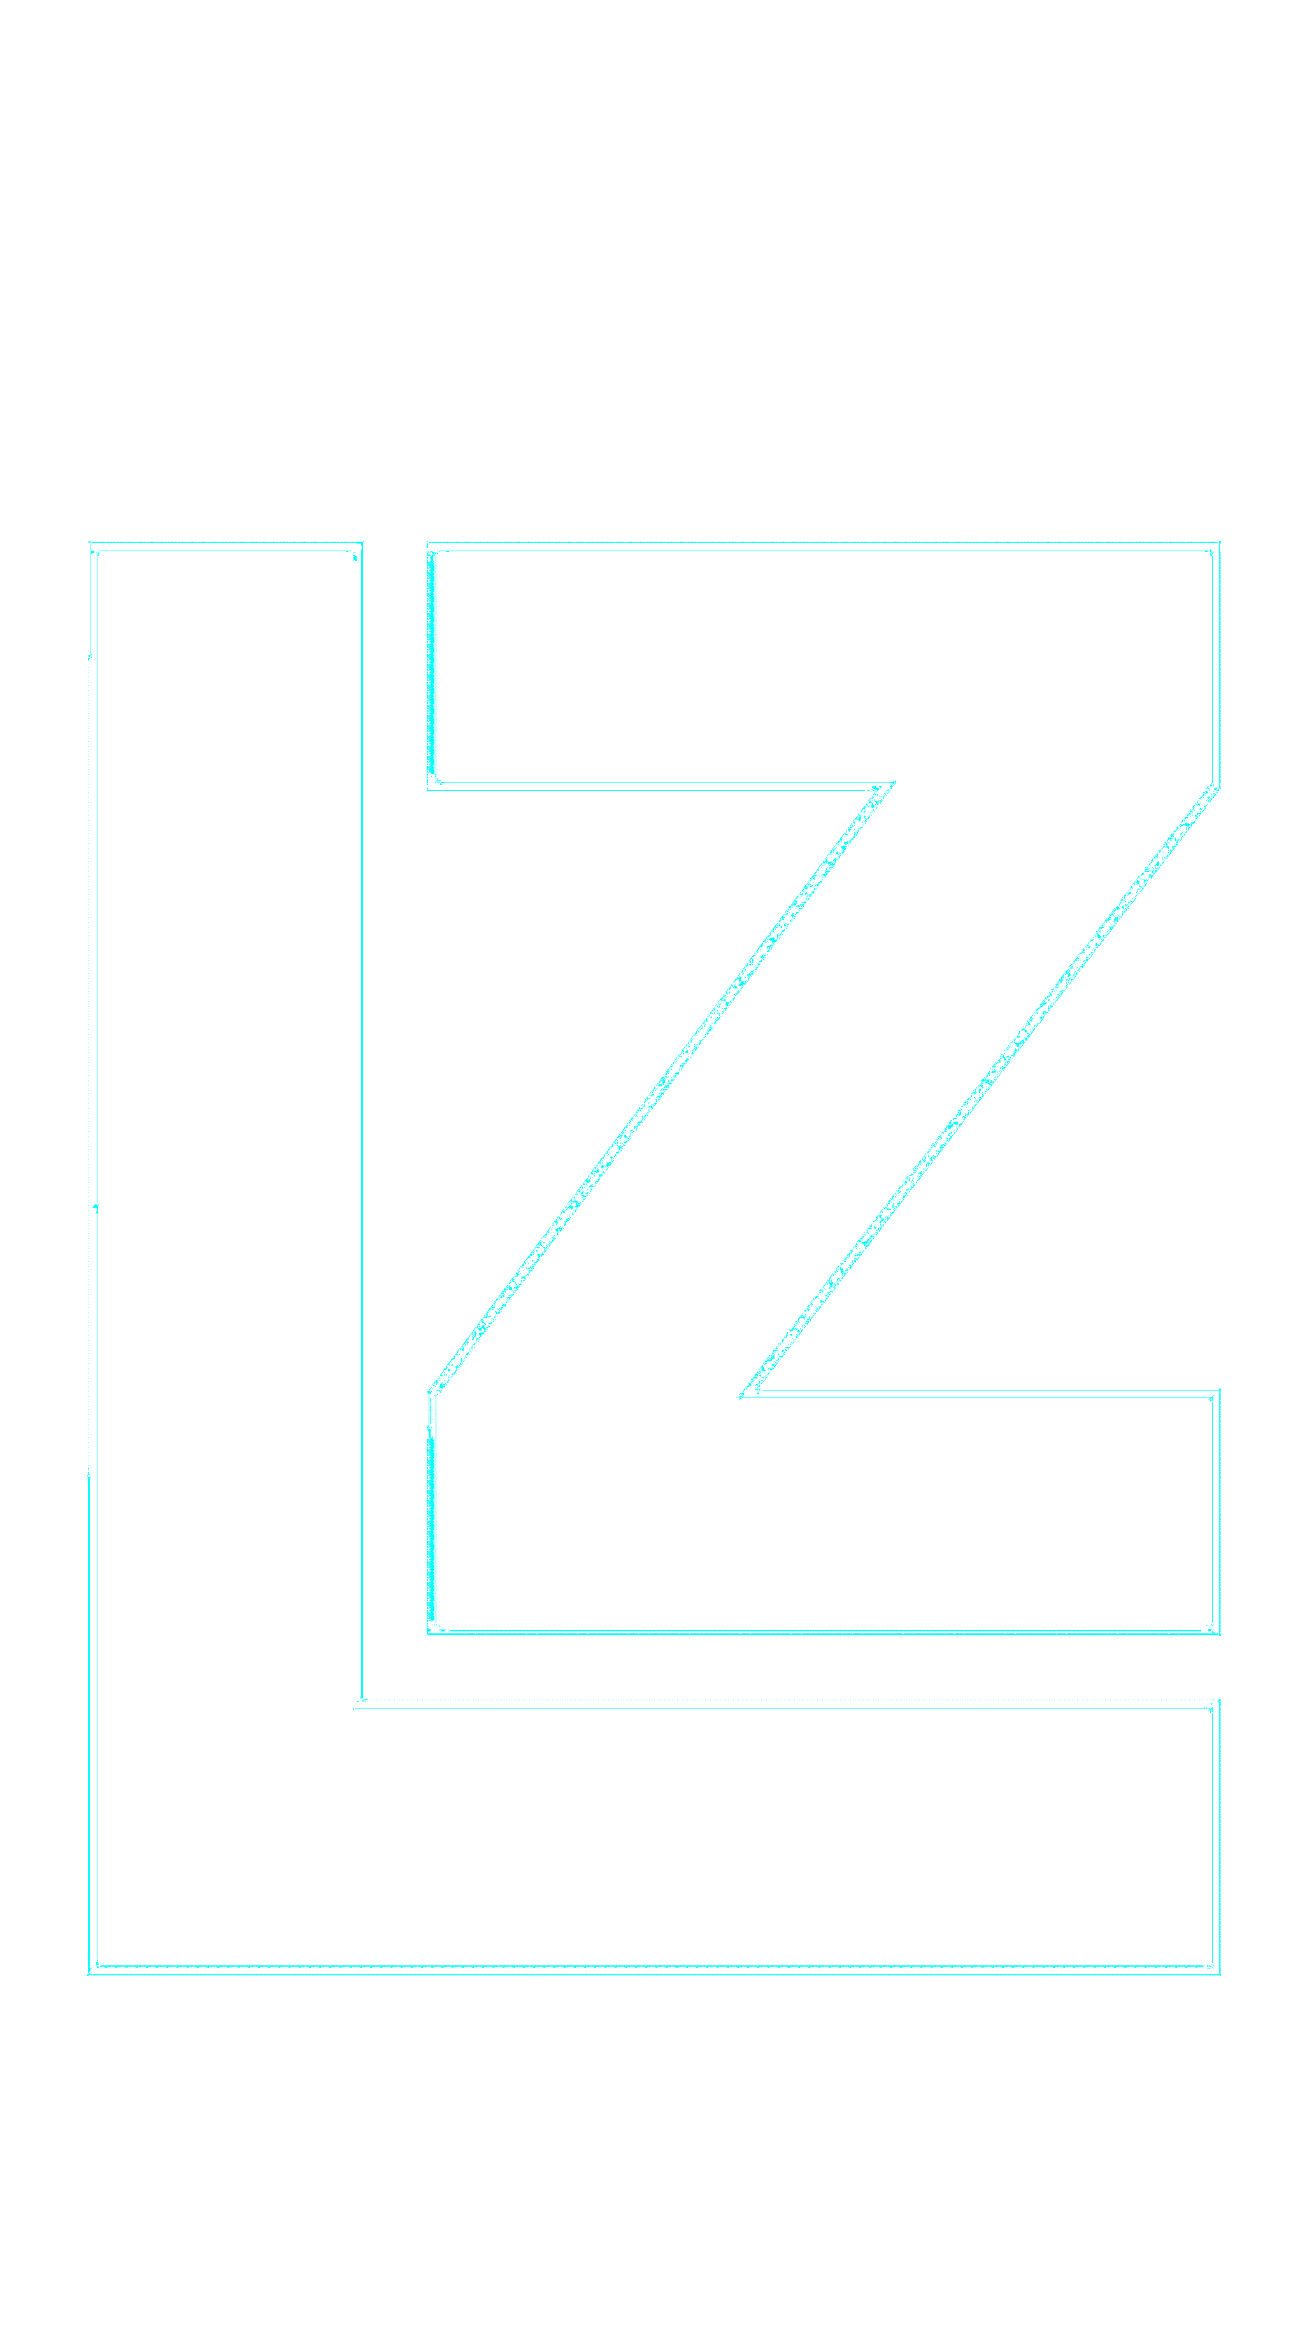

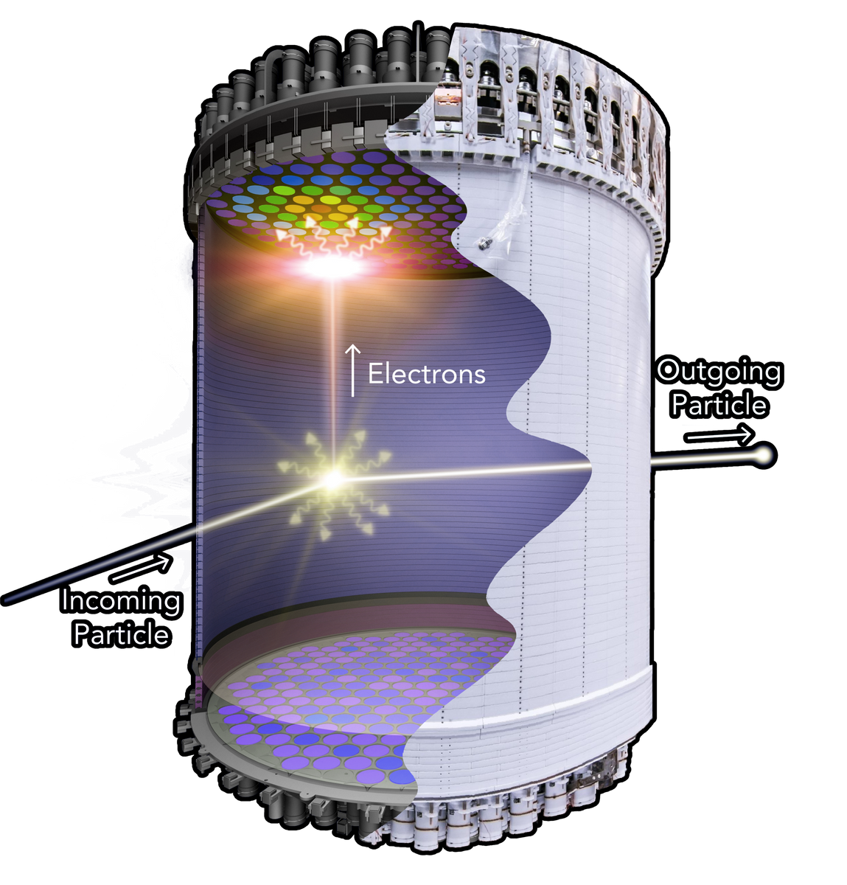
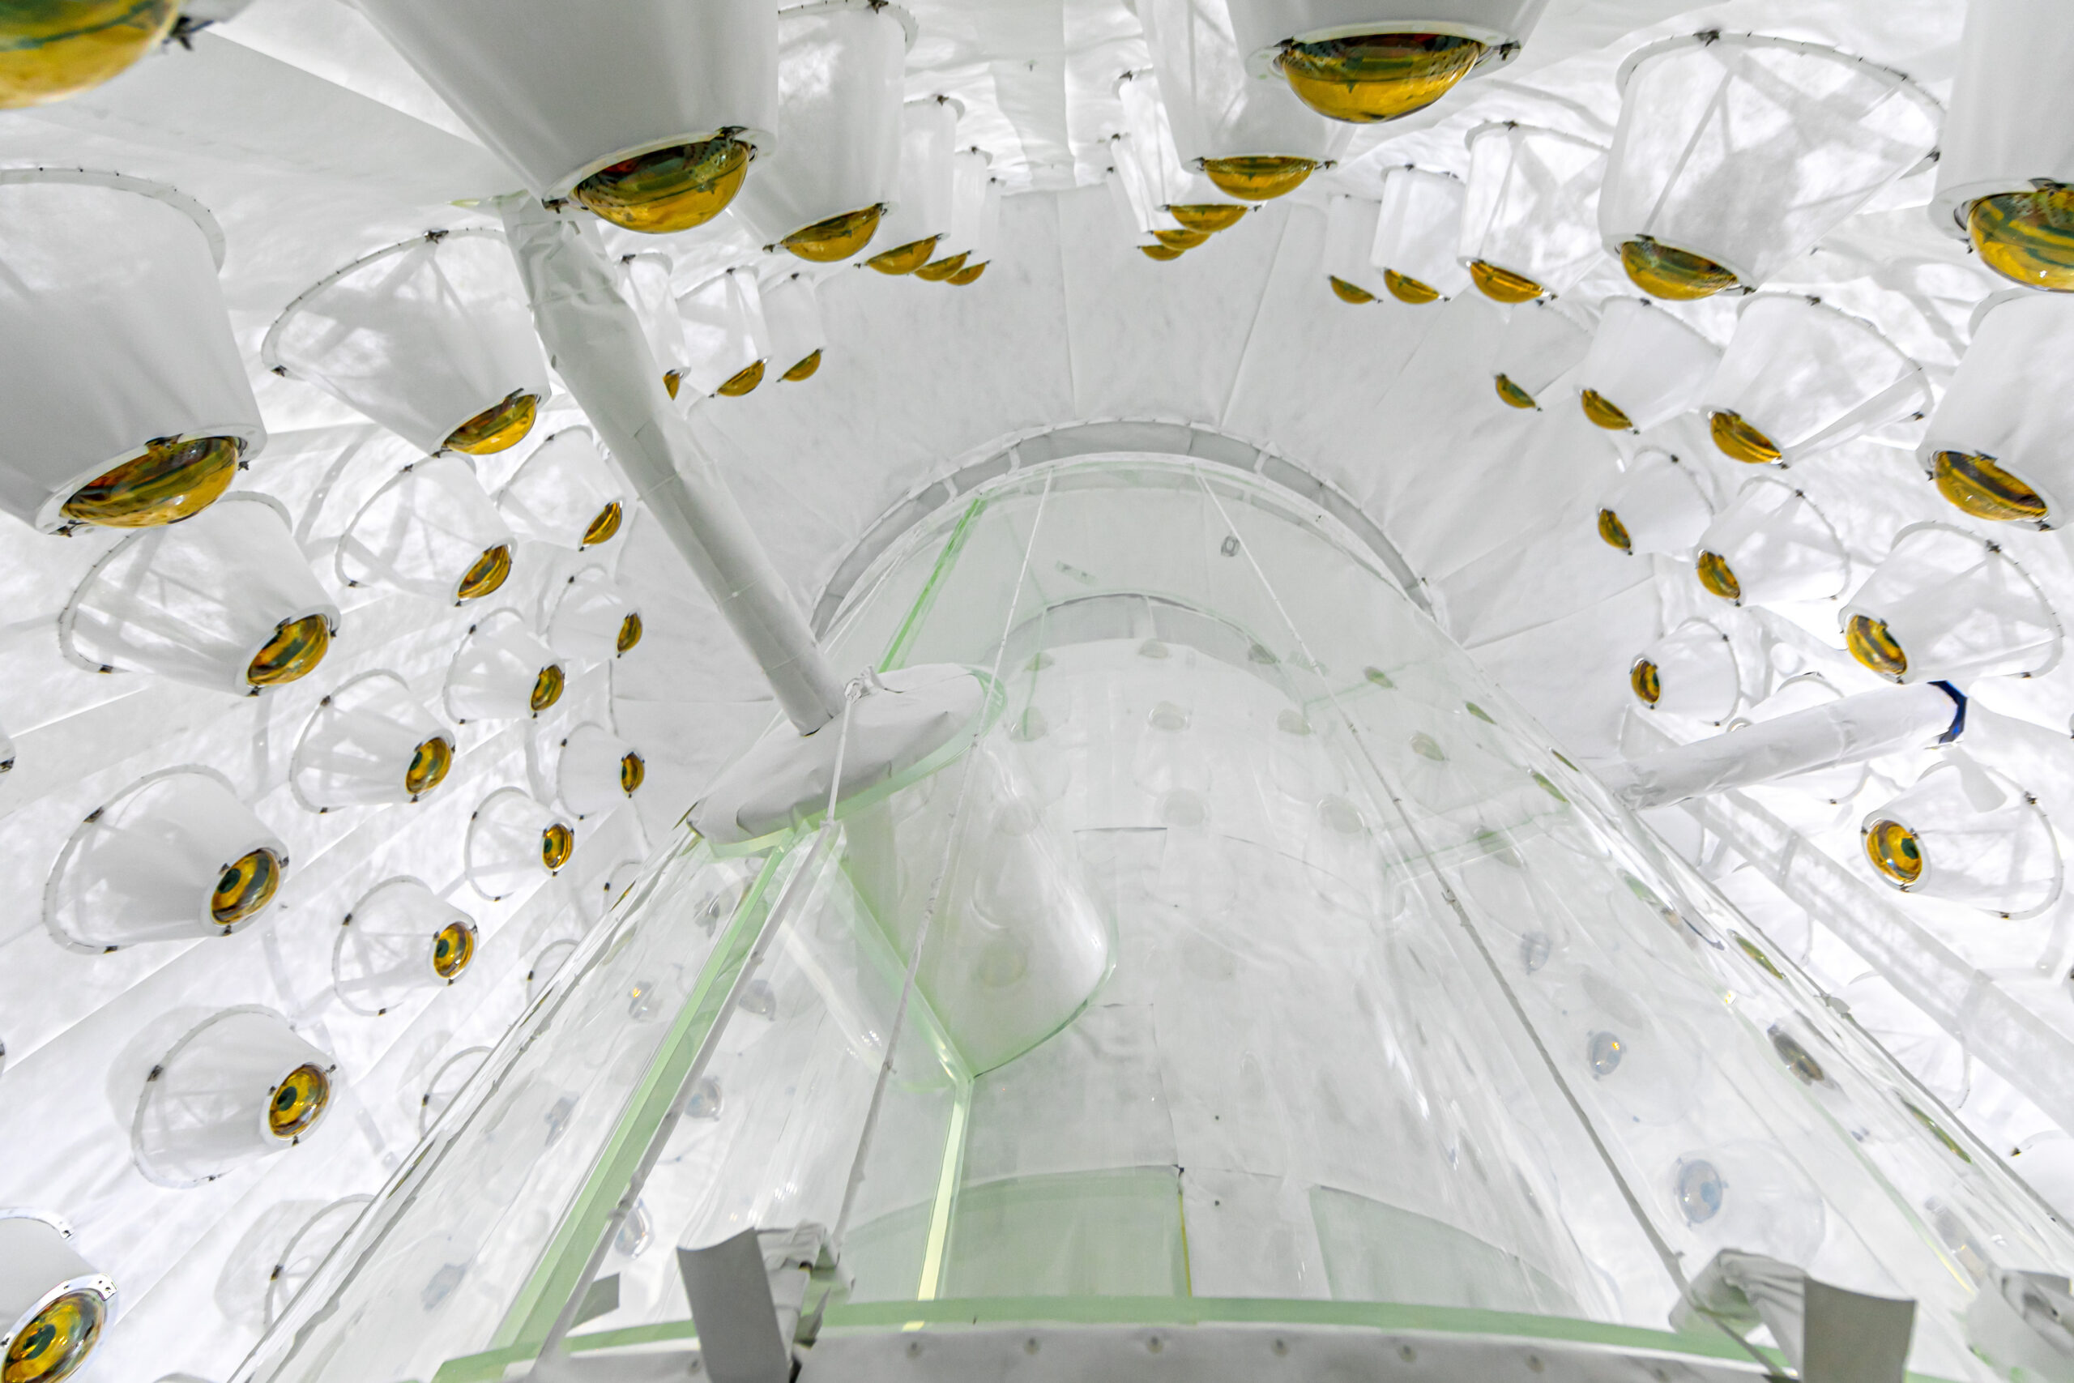
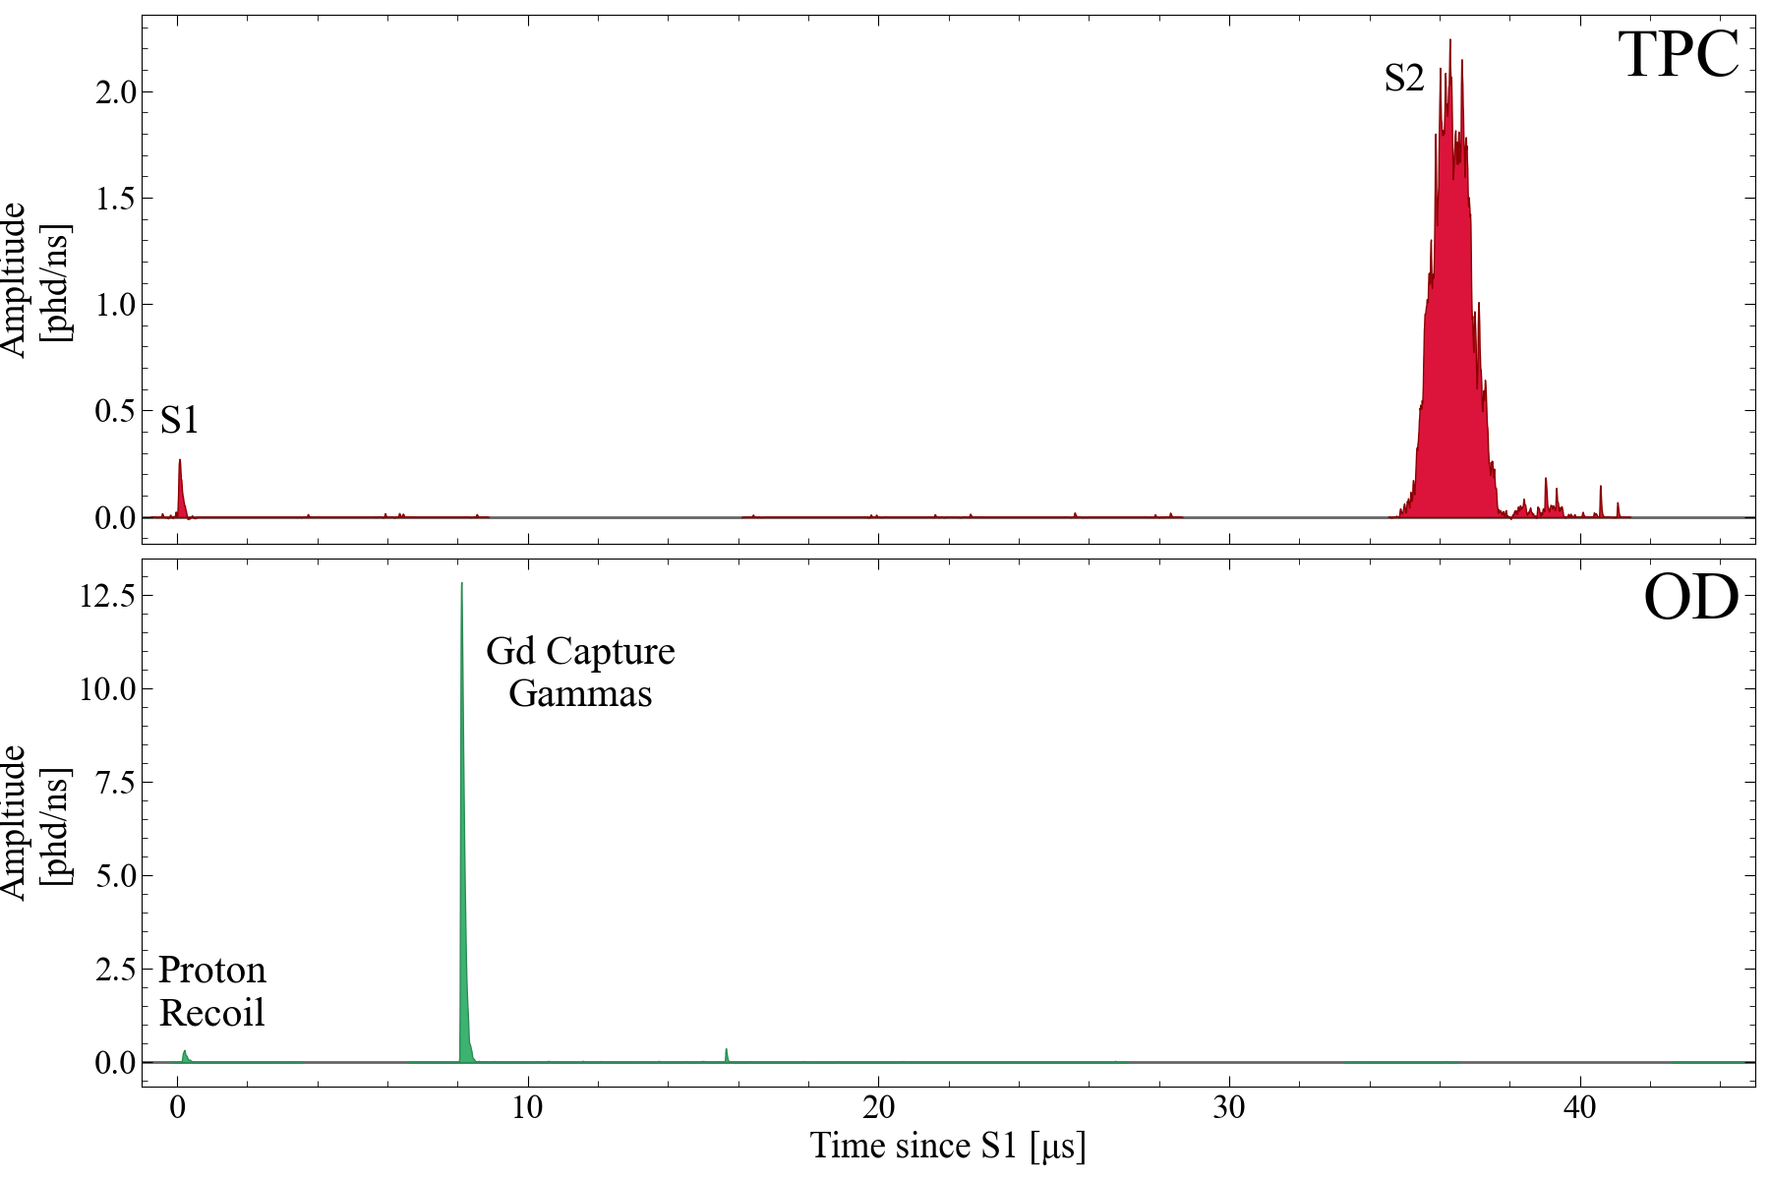
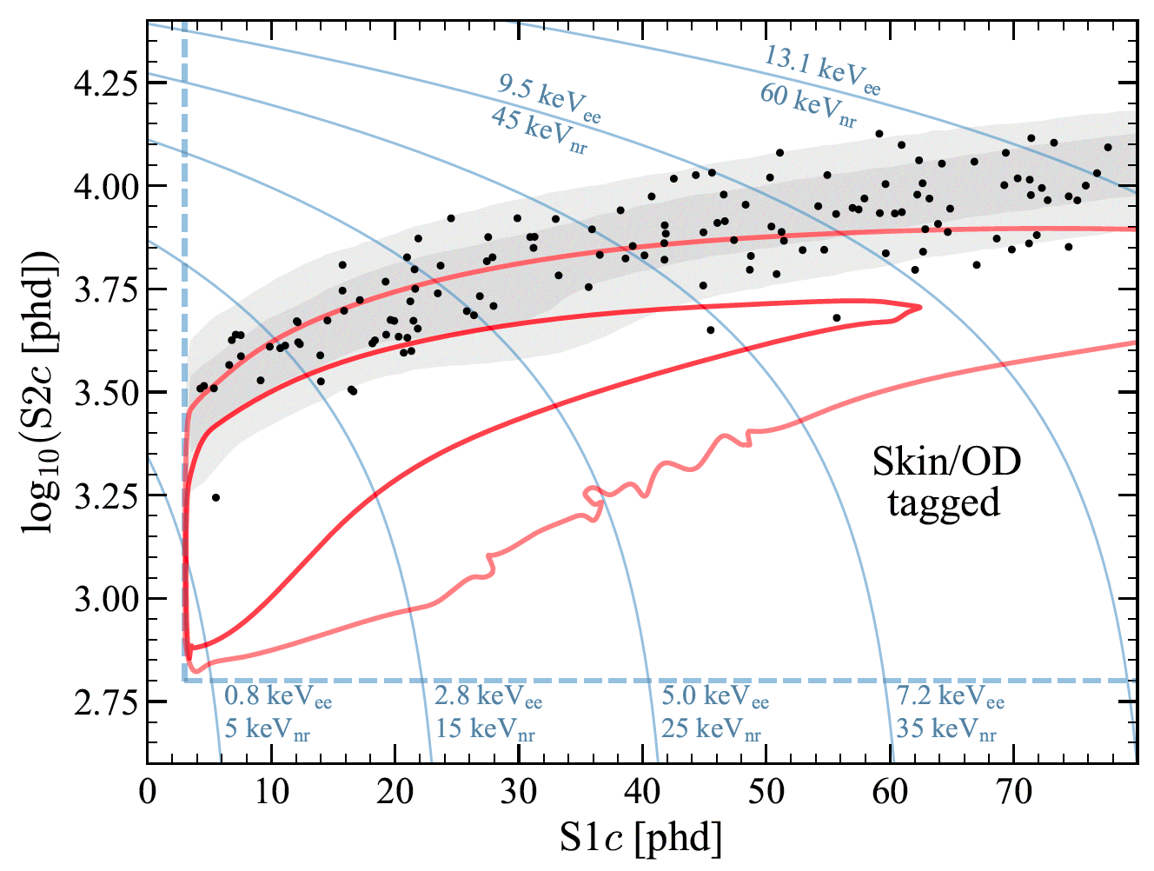
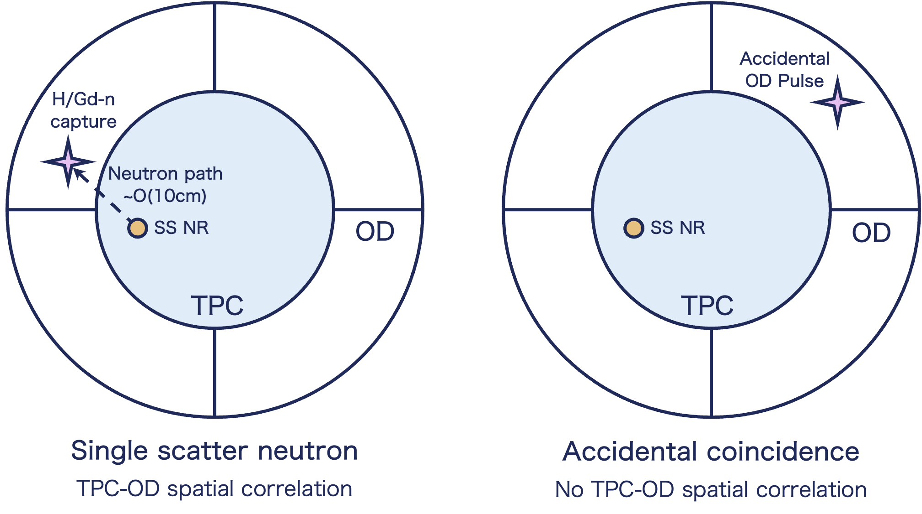
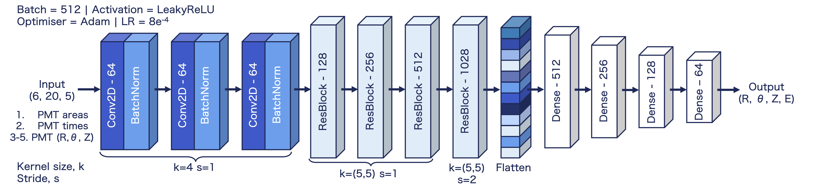
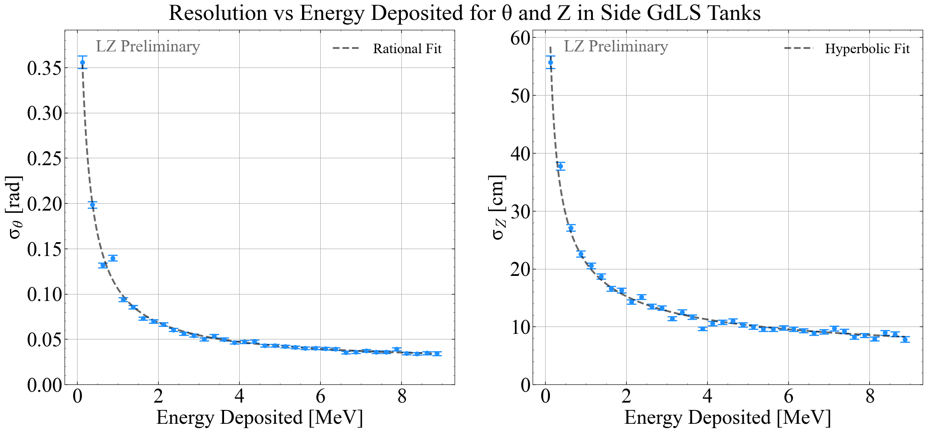
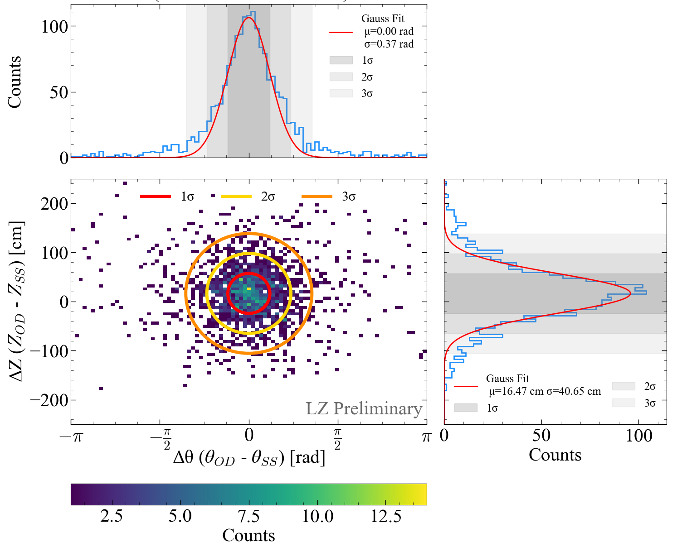
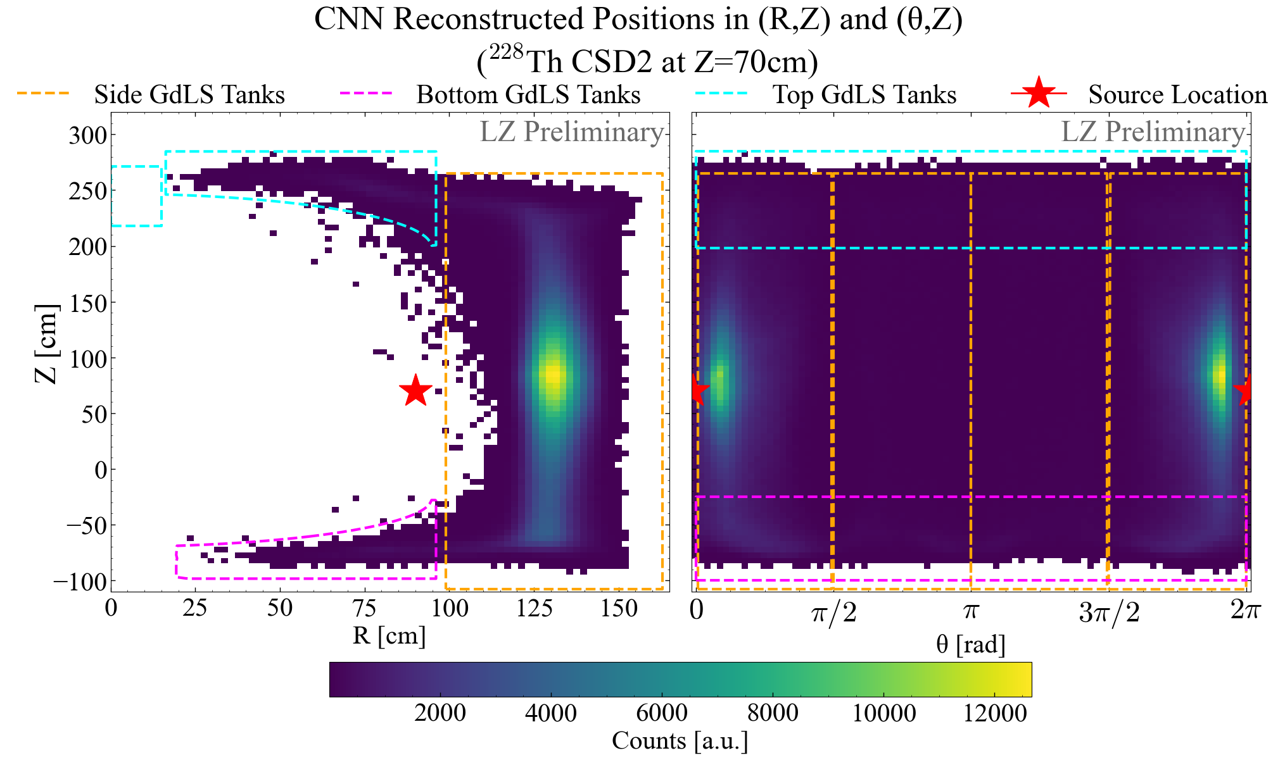


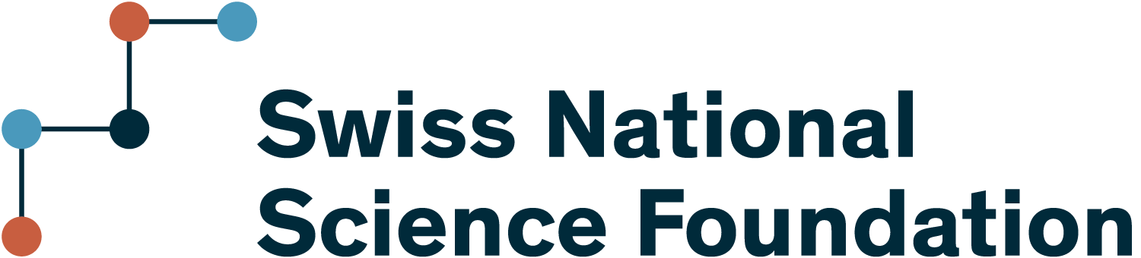
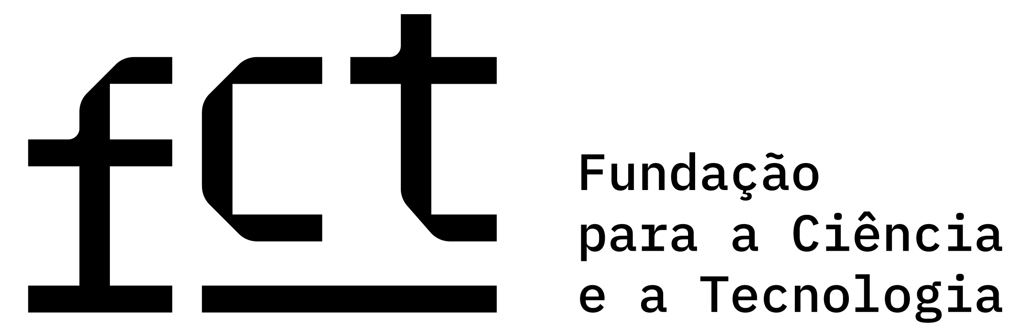
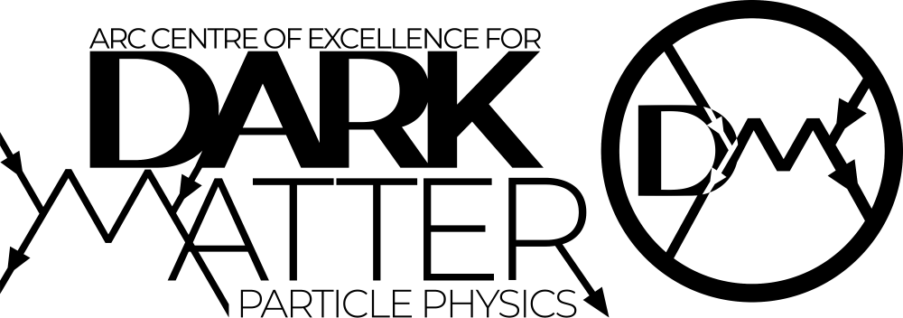


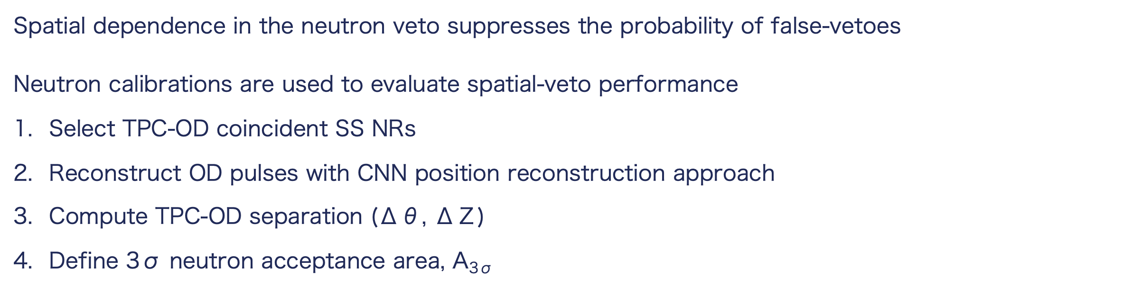
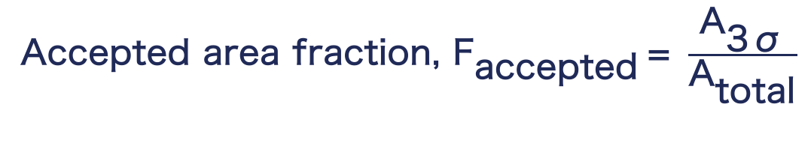
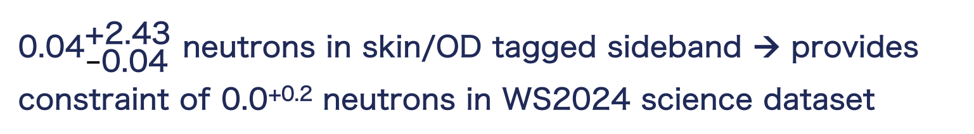
The LUX-ZEPLIN Outer Detector: Performance and
Position Reconstruction with Machine Learning Algorithms
Tea Hall (sgthall2@liverpool.ac.uk) on behalf of the LUX-ZEPLIN Collaboration
LUX-ZEPLIN (LZ)
LZ Outer Detector
Veto System Principle
Dark matter direct-detection experiment
Aiming to detect Weakly Interacting Massive Particles (WIMPs)
7t dual phase LXe time projection chamber (TPC)
The Outer Detector (OD) surrounds the TPC, enabling the tagging and vetoing of neutrons
OD comprised of 10 segmented UV-transparent acrylic tanks [1]
17t Gd-loaded liquid scintillator (GdLS)
Surrounding tank of 228t of ultra-pure water
120 8” Hamamatsu R5912 PMTs
Neutrons in the OD capture on ¹⁵⁵Gd/¹⁵⁷Gd or H
Gd-n: 4-5γ cascade, ΣE = 7.9 to 8.5 MeV
H-n: single 2.2 MeV γ
Veto system operates through two OD timing windows
Prompt window – vetoes γ-rays and proton recoils
Delayed window – tags and vetoes neutrons captured on H/Gd
Table 1: Selection criteria for each veto window
S2 hit pattern → (x,y)
Selection criteria | Prompt Window | Delayed Window
Δt = t_{OD} – t_{S1, SS NR} | ±0.3 μs | [0.3, 600] μs
PMT coincidence | 5 | 5
Pulse area | > 4.5 phd (~30 keV) | > 32 phd (200 keV)
S2
Drift time (z)
S1
Figure 1: Schematic of a particle interacting in the LZ TPC
PROMPT
Two observable signals per interaction
Prompt scintillation (S1)
Delayed electroluminescence from extracted electrons (S2)
S2/S1 → interaction type
Small ratio – nuclear recoil (NR) e.g. WIMPs, neutrons
Large ratio – electron recoil (ER) e.g. β, γ-rays
Figure 2: LZ OD pre-GdLS and water tank fill
DELAYED
LZ Neutron Veto
Figure 3: Coincident single scatter neutron event waveforms in TPC and OD
Total OD background rate of ~43 Hz in WS2024
Neutron sources used to evaluate tagging efficiency, ε
Deployed at fixed heights in calibration tubes
OD pulse tagged in either veto windows
Spurious OD coincidences introduce a false-veto probability, P_{fv}
where R is the background rate and t is the veto time-window
Veto-tagged data used to constrain neutron background
${\text{0.04}}_{\text{−}\text{0.04}}^{\text{+2.43}}$ neutrons in skin/OD tagged sideband → provides constraint of 0.0^{+0.2} neutrons in WS2024 science dataset
Delayed veto dominated by non-neutron accidentals
For a neutron, the TPC NR and OD capture are spatially correlated:
OD position reconstruction enables improved neutron tagging and accidental discrimination
Complex OD geometry limits analytical position reconstruction
→ new method developed using machine learning techniques
$$\text{ε }\text{= }\frac{{\text{N}}_{\text{Pass Cuts+}\text{Veto Tagged}}}{{\text{N}}_{\text{Pass Cuts}}} \text{= 89} \text{±} \text{3\%}$$
$${\text{P}}_{\text{fv}}\text{ = 1 - }{\text{e}}^{\text{−}\text{Rt}}\text{ = 2.84 ± 0.10\%}$$
Figure 4: Veto-tagged events in WS2022+WS2024 dataset. Red contours describe regions containing 68% and 95% of tagged neutron events [2].
Outer Detector Position Reconstruction
Spatially Dependent Neutron Veto
Convolutional neural network (CNN) → predict positions and energy deposited (R,θ, Z, E) in OD
Trained on full optical simulation of 0-9 MeV γ-rays in GdLS
$\text{Spatial }$dependence in the neutron veto suppresses the probability of false-vetoes
Neutron calibrations are used to evaluate spatial-veto performance
Select TPC-OD coincident SS NRs
Reconstruct OD pulses with CNN position reconstruction approach
Compute TPC-OD separation (Δθ, ΔΖ)
Define 3σ neutron acceptance area, A_{3σ}
Figure 5: ResNet CNN for OD position and energy reconstruction
Accepted area fraction, ${\text{F}}_{\text{accepted}} \text{= }\frac{{\text{A}}_{\text{3σ}}}{{\text{A}}_{\text{total}}}$
At E_{dep} = 2 MeV, (σ_{θ}, σ_{Z}) = (0.06 rad, 14 cm) → (1.0%, 3.6%) of OD dimensions
Scale accidental veto coincidences with ${\text{F}}_{\text{accepted}}$
Figure 6: (θ,Z) resolution as a function of energy deposited in the side GdLS tanks from simulated 0-9 MeV γ-rays.
CNN reconstruction aligns with geometry and source deployment heights in calibration data
Limited radial reconstruction from fixed-radius PMT coverage
Small source offset from γ-transport and reconstruction effects
Figure 8: (Δθ, ΔΖ) distribution for TPC–OD coincident SS NRs from AmLi neutron calibration sources deployed at a height of Z=70cm in each calibration tube, with neutron acceptance contours.
Preliminary geometric studies indicate a 4–8× reduction in false-veto probability, with minimal impact on neutron-tagging efficiency!
Further studies ongoing to optimise timing, energy and spatial selections for maximum tagging efficiency and accidental background rejection.
Figure 7: CNN reconstructed positions for a ²²⁸Th source at a height of 70cm. Clustering aligns with deployed height.
References
LUX-ZEPLIN Technical Design Report. The LZ Collaboration (2017)
Dark Matter Search Results from 4.2 Tonne−Years of Exposure of the LUX-ZEPLIN (LZ) Experiment. The LZ Collaboration. Phys. Rev. Lett. 135 (2024), 011802

