Slide 1

Measurements of Radon Diffusion and Emanation from Titanium
Richard Schnee
Rayyan Abdullah, Nicholas Chott, Austin Helgert*, Sagar Sharma Poudel, Alex Reker*,
Nate Rodenburg*, Ruccus Schauer*, Joseph Street
Amy Cottle (UCL), Pawel Majewski (STFC RAL), Jim Dobson (KCL), Ferdos Dasgiri (UCL)
Low Radioactivity Techniques Workshop 2026
September 23, 2026
*undergraduate
Notes:
(0:30)

Slide 2
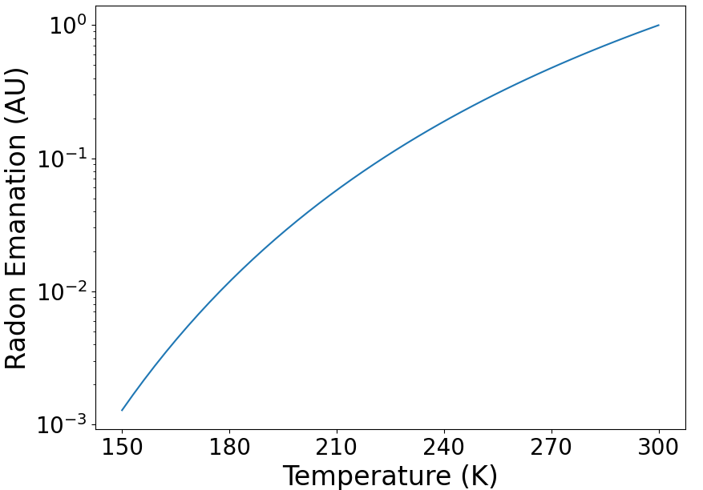

Impact of Diffusion on Rn Emanation
Two sources of Rn Emanation
  Diffusion of Rn out of material
    Follows Arrhenius relation.
    Often negligible at cryogenic temperatures (~200 K).
  86-keV Rn recoil from Ra ⍺-decay
    Range is ≲ 0.1 μm, so emanates only for surface contamination.
    Often dominates, especially for cryogenic temperatures.
Arrhenius relation
$$D=D_{0}\exp\left(−\frac{T_{0}}{T}\right)$$
Even at room temperature, can measure split between the two sources.
  Emanation into atmospheric-pressure gas collects both.
    Recoil range in gas ~100 μm, so ~all stop in gas (for smooth surface).
  Emanation into 100-mTorr gas collects ~only emanation from diffusion.
    Recoil range in gas ~7 m, so ~all recoil-induced emanating atoms implant into another surface.
      Rn from recoil not collected.
sample
High-p gas
sample
Low-p gas
Wall, etc.
Notes:
(1:30) [2:00]

Slide 3
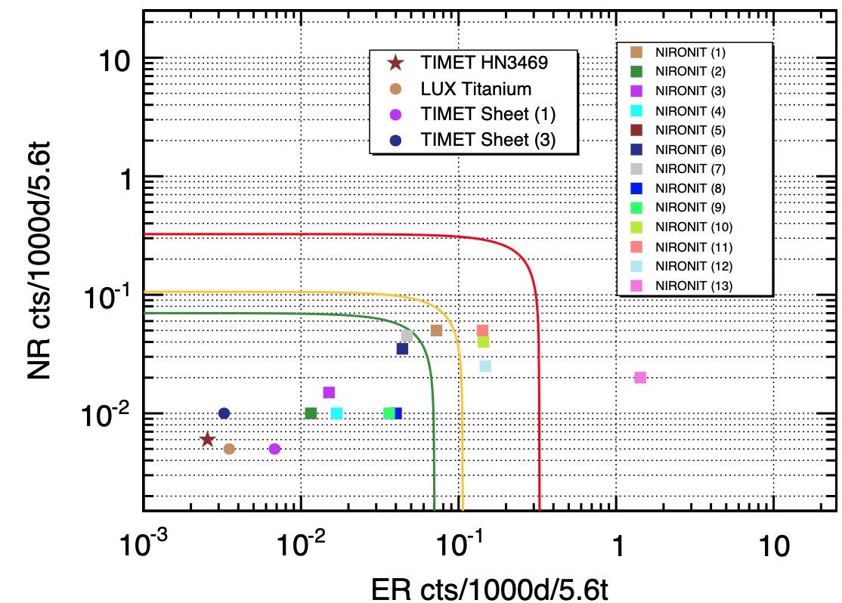
Titanium for Low-Background Cryostats
Excellent properties:
  High strength-to-weight ratio
  Lower-Z so less attenuation of gammas for better vetoing
  Low cosmogenic activation
Choice for LZ.
  Lower backgrounds expected than for stainless steel (assumed 0.15 mBq Rn).
  As-built measurements of LZ Ti Inner Cryostat Vessel (ICV) indicated ~100x higher Rn.
D.S Akerib et al. (LZ collaboration) Astropart. Phys. 96 (2017), 1-10
LZ Cryostat requirement
Stainless steel
titanium
LZ
    Largest source of Rn emanation in LZ, ~1 mBq/m² on inside.
    Despite acid etching of surface and low ²²⁶Ra concentration in ICV (~4 mBq/m²).
    Infer ~ 50% of radon emanates into inside or outside.
What went wrong?
How do we avoid such a problem in the future?
(Titanium favored for XLZD)
Notes:
(1:30) [2:00]

Slide 4
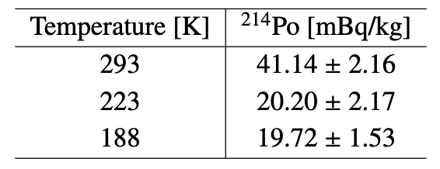
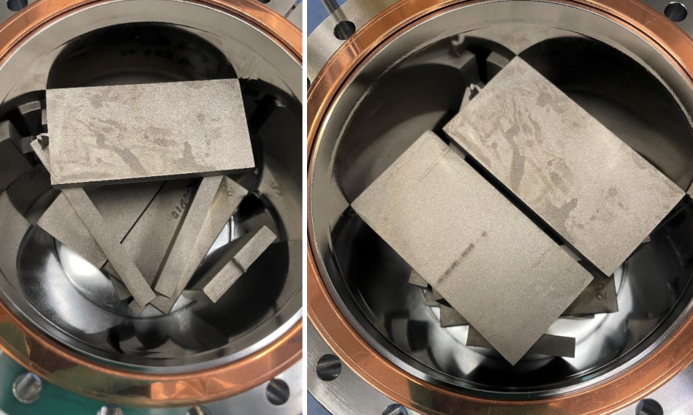
Possible causes of Rn Emanation from Ti
Three possible causes:
  Ra ~ uniform in Ti, but Rn diffusion length in titanium is much larger than typical for metals (microns)?
    Need diffusion length ≳ 2 mm even when cold.
  Radium concentrated near surfaces but surface etching ~ineffective?
  Contamination added during assembly (e.g. welds)?
Impractical to rule out (3).
Will discuss (1) and (2) in detail.
E. Perry et. al. JINST 21 P09016 arXiv:2607.22870 reported ~2x lower Rn emanation from cold Ti than from warm:
Strongly suggests diffusion is responsible for ~half of Rn emanation at room temperature, shuts off when cold.
Lorenzo Ascenzo’s talk yesterday says it is not diffusion in the Ti.
Notes:
Calculate actual diffusion length needed if uniform (warm/cold?) Add explanation of Ra concentrated near surfaces from PNNL (1:30) [2:00]

Slide 5
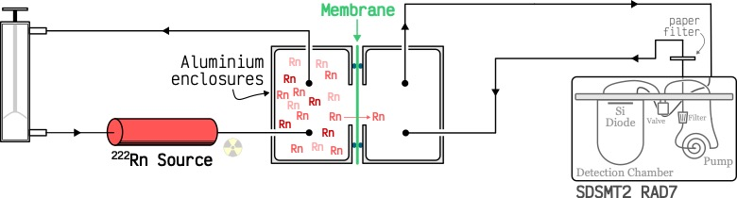
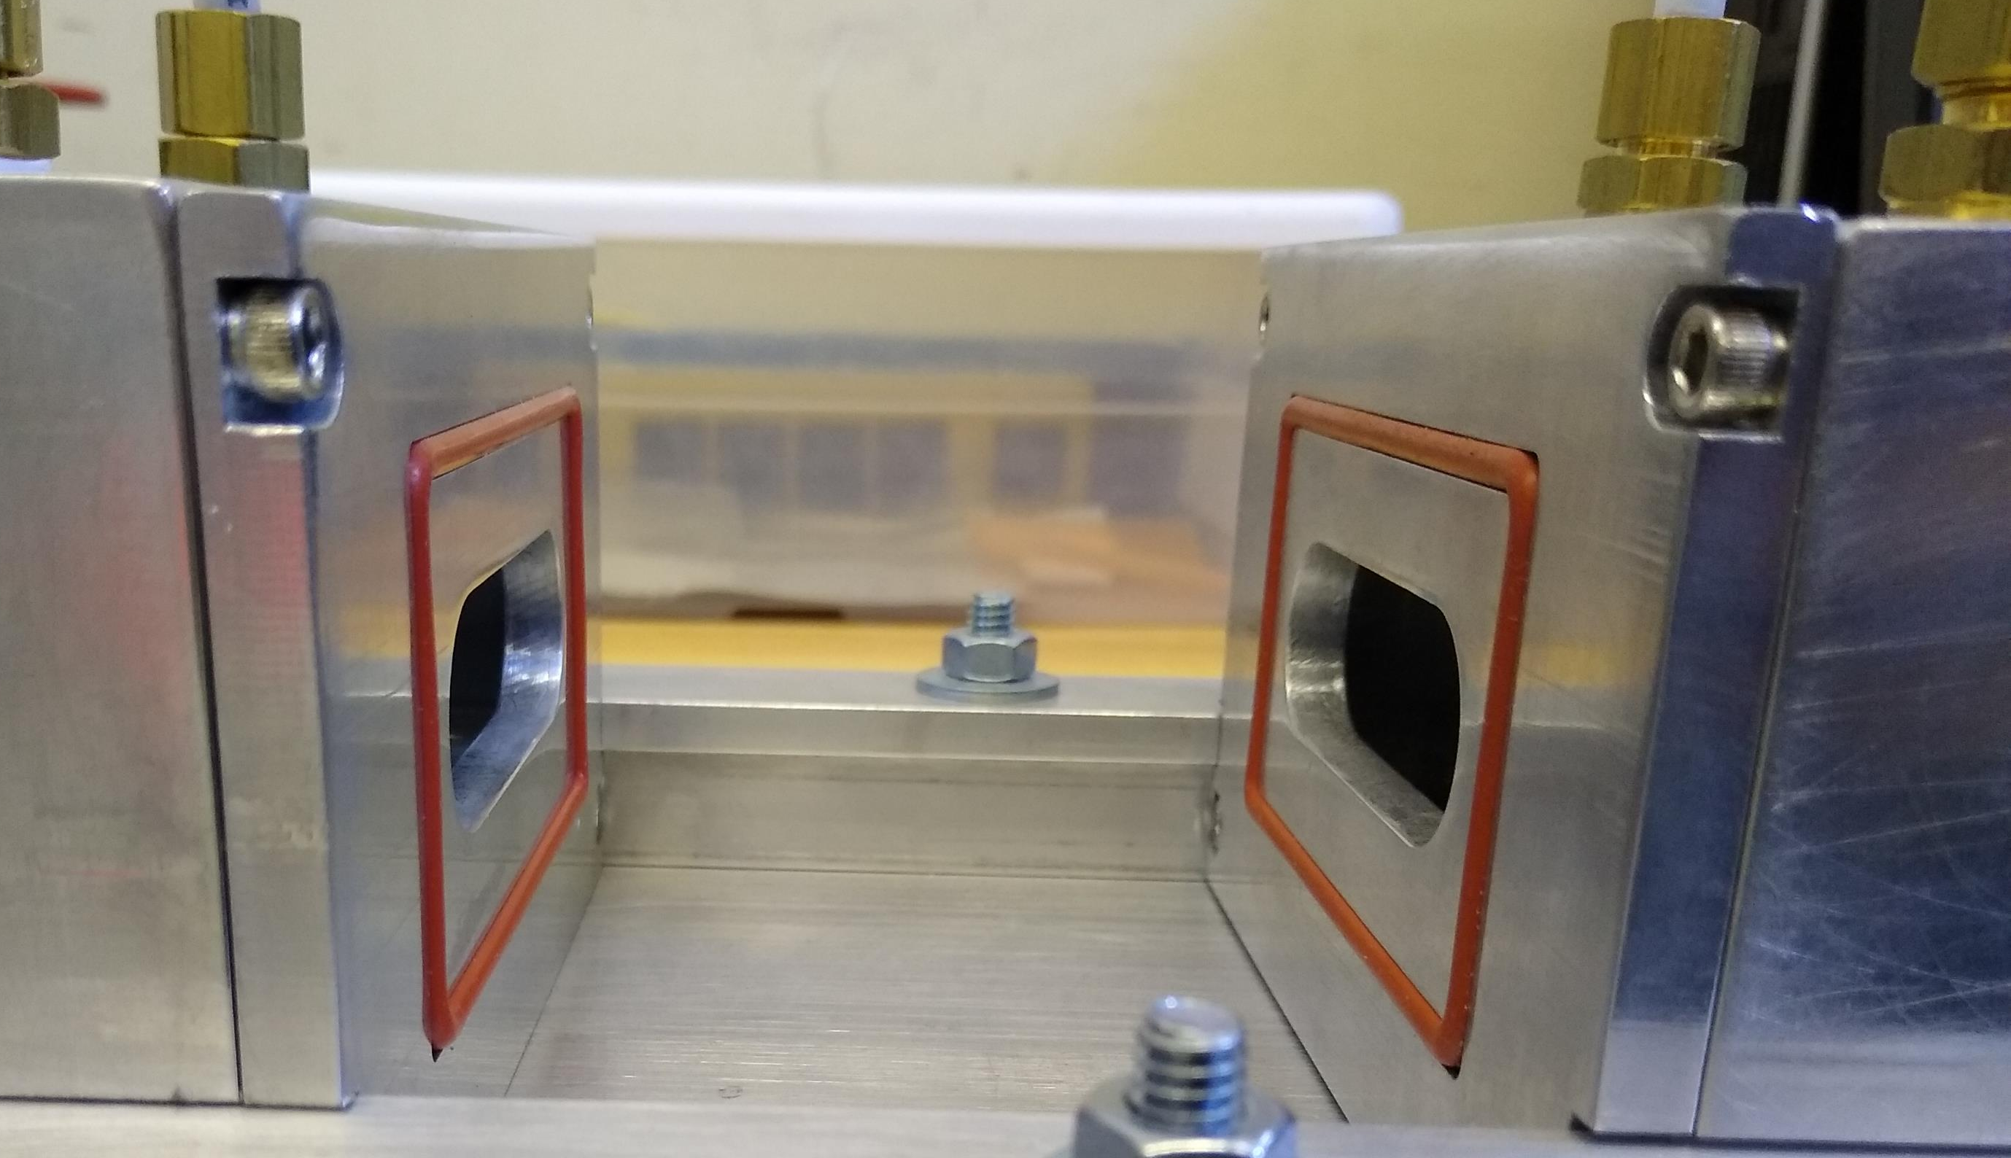
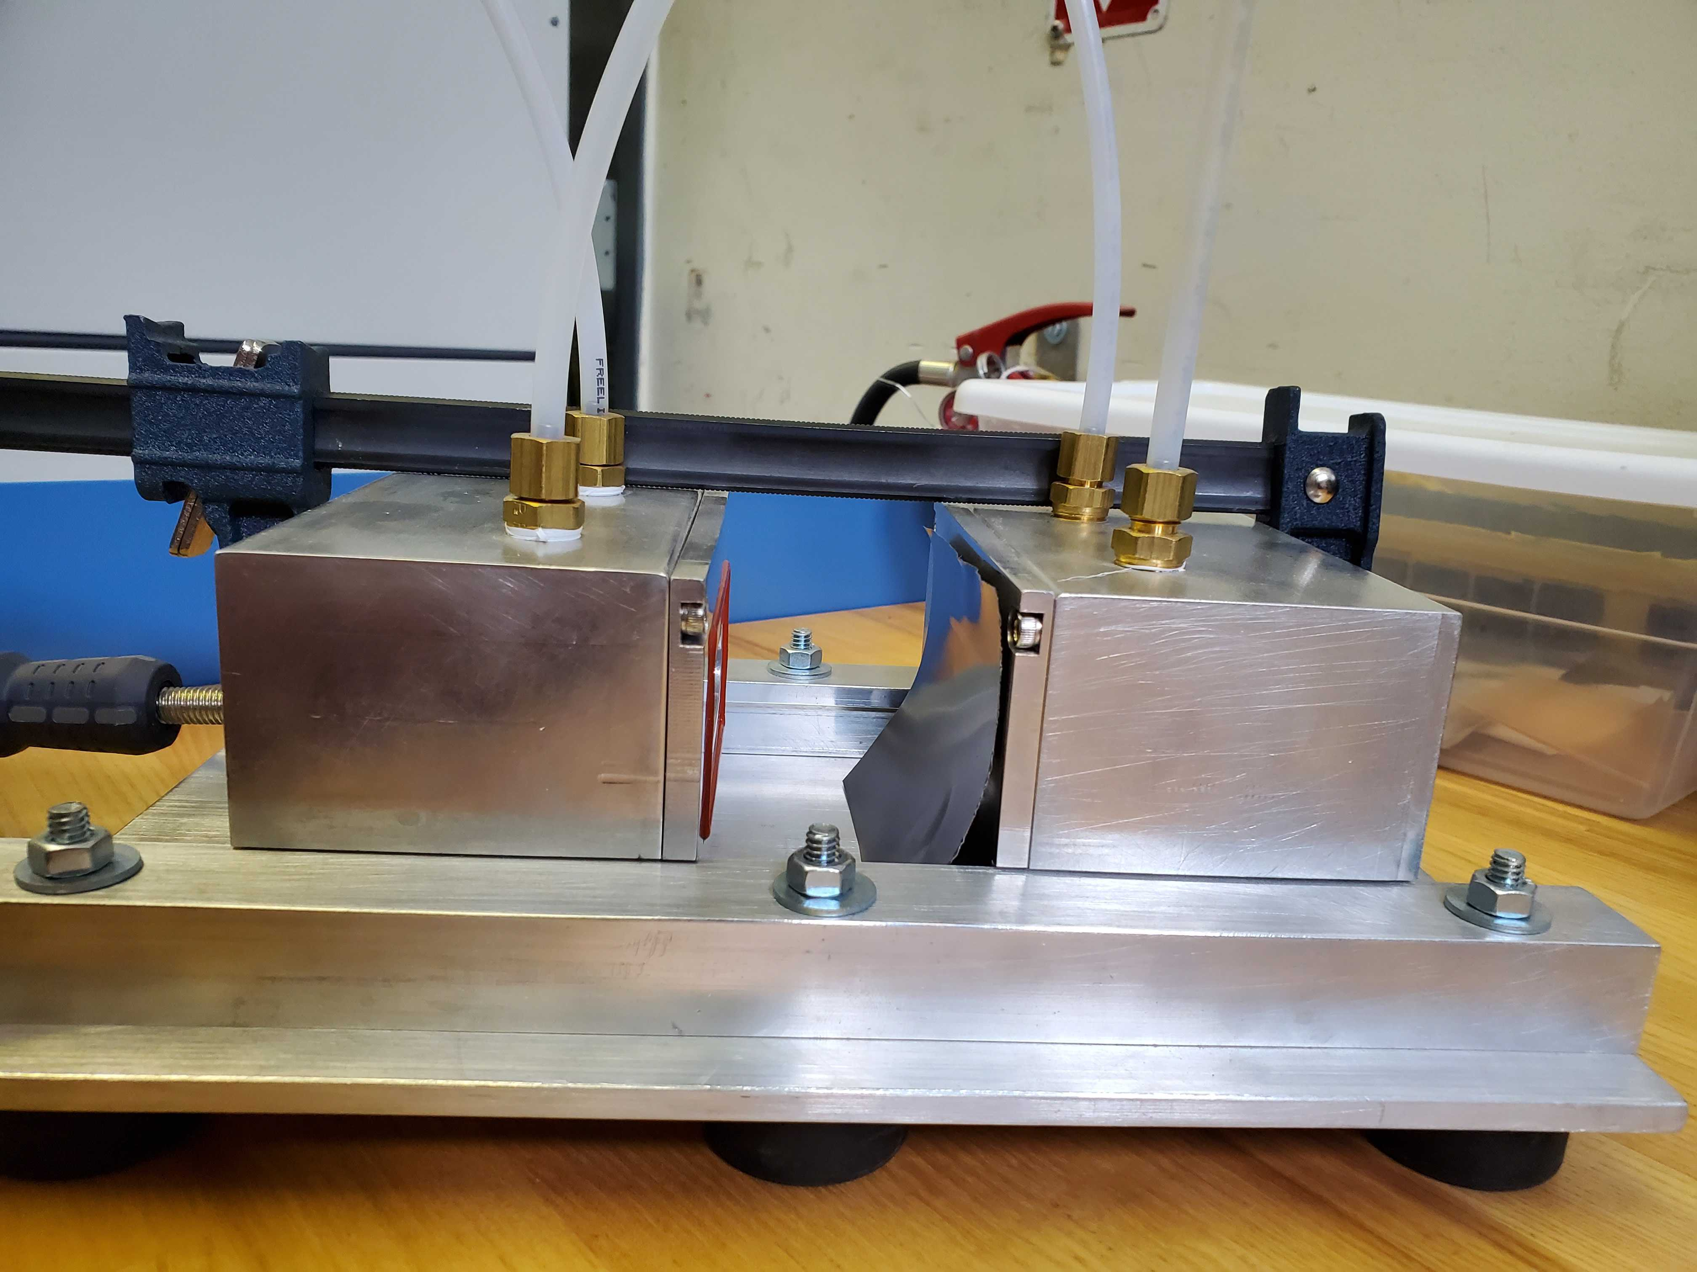
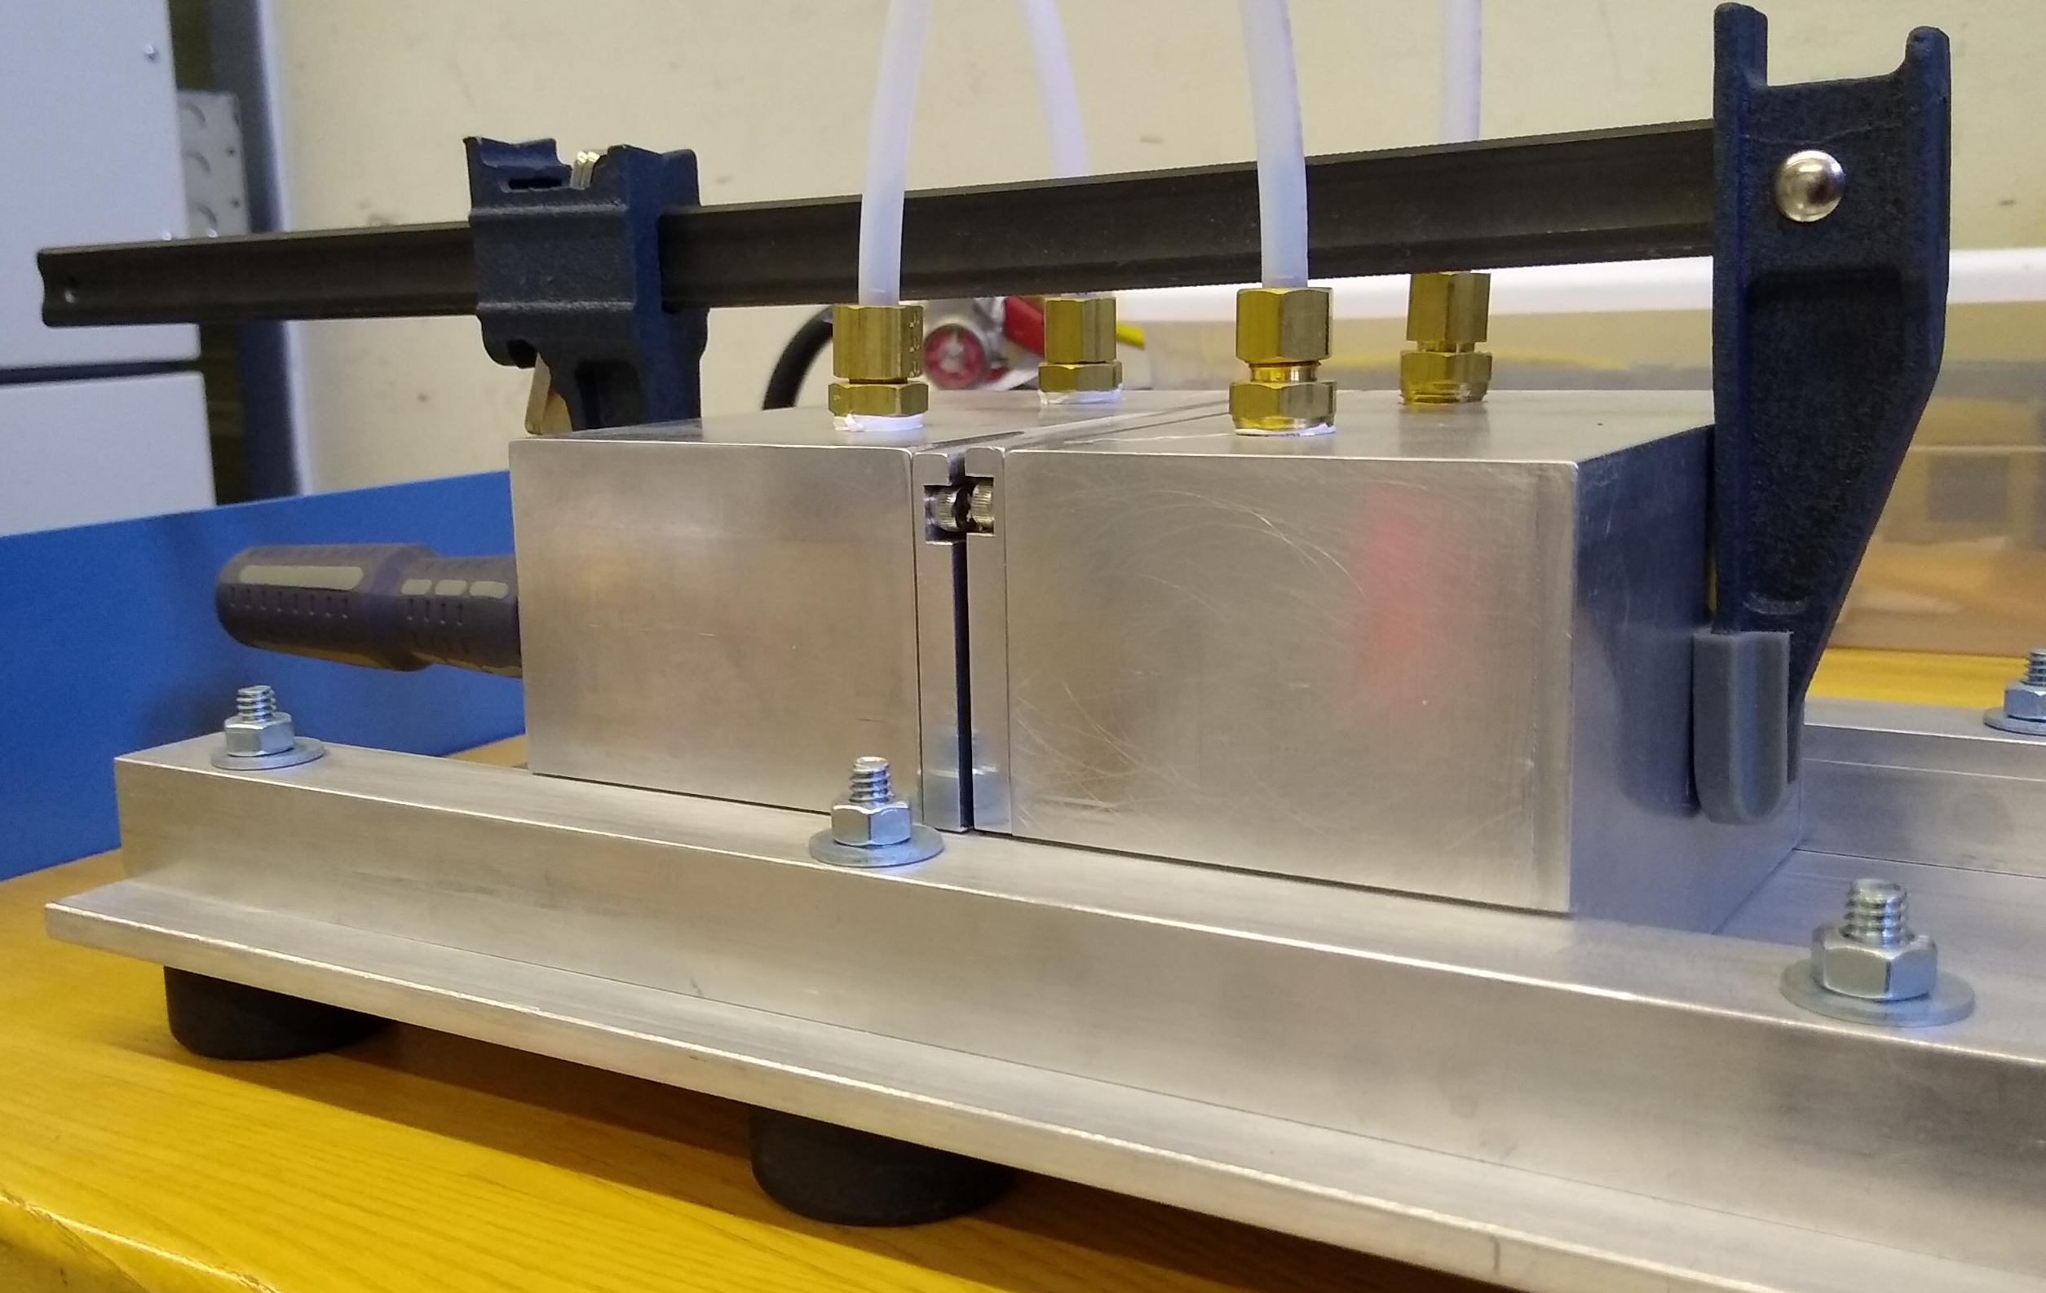
Measurement of Rn Diffusion through Titanium
Was not aware of any previous measurements for titanium
  Use similar setup to those for previous measurements.
M. Wojcik, NIM B61, 8–11(1991).
M. Wojcik, W. Wlazo, G. Zuzel, & G. Heusser, NIM A449, 158 – 171 (2000).
M. Durcik & F. Havlik, J. Radioanal. Nucl. Chem. 209, 307–313 (1996).
M. Jiranek & M. Kotrbat, Radiat. Prot. Dosim. 148, 274 (2012).
R.W. Schnee, B. DeVries, M. Bowles, AIP Conf. Proc. 2908, 100009 (2023).
L. Wu et al. arXiv:2410.06054 (2024).
Undergraduate project.
  Home-made set-up.
  Put Rn on one side, measure diffusion to other, infer D and solubility S (= concentration in Ti / concentration in air).
RAD7 radon detector
Designed by Joseph Street
Machined by Joseph Street and Nic Chott
O-rings and opening for radon
metal gasket would be better
0.1 mm Ti membrane
Clamped leak-tight system
Notes:
(1:00} [3:00]

Slide 6
Measurement of Rn Diffusion through Titanium
Hot side
Cold side
Handpump
Step 1: Add Rn to one (“hot”) side of chamber.
  Connect Pylon radon source and hand pump to the hot-side system and mix radon throughout the hot-side volume.
Step 2: Measure Rn on hot side of chamber.
  Disconnect Rn source and pump. Connect RAD7. Measure Rn escape rate through RAD7 gasket + hot-side gasket + leaks.
Step 3: Measure Rn vs. time on “cold” side of chamber.

Slide 7
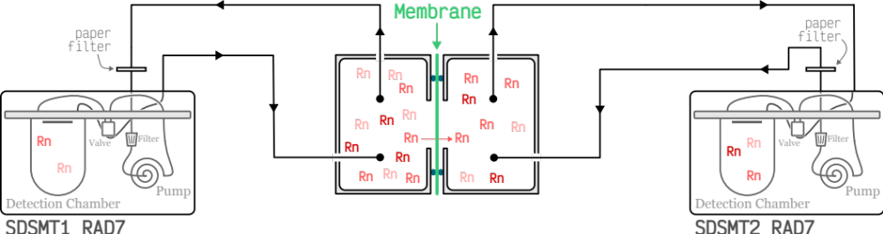
Measurement of Rn Diffusion through Titanium
Some possible leaks
Hot side
Cold side
Diffusion through RAD7 gasket
Diffusion
through gasket
Step 1: Add Rn to one (“hot”) side of chamber.
  Connect Pylon radon source and hand pump to the hot-side system and mix radon throughout the hot-side volume.
Step 2: Measure Rn on hot side of chamber.
  Disconnect Rn source and pump. Connect RAD7. Measure Rn escape rate through RAD7 gasket + hot-side gasket + leaks.
Step 3: Measure Rn vs. time on “cold” side of chamber.

Slide 8
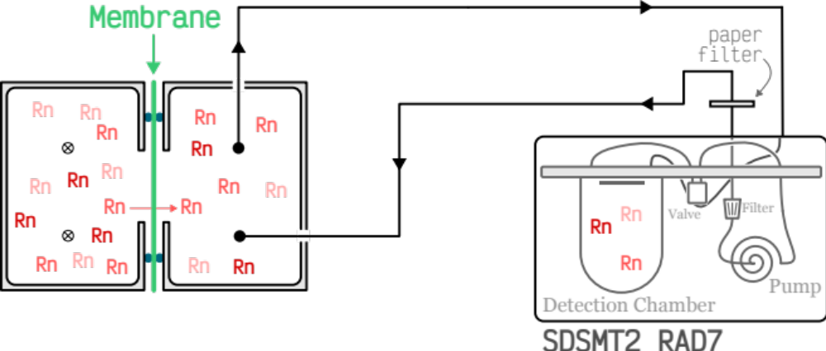
Measurement of Rn Diffusion through Titanium
Hot side
Cold side
Step 1: Add Rn to one (“hot”) side of chamber.
  Connect Pylon radon source and hand pump to the hot-side system and mix radon throughout the hot-side volume.
Step 2: Measure Rn on hot side of chamber.
  Disconnect Rn source and pump. Connect RAD7. Measure Rn escape rate through RAD7 gasket + hot-side gasket + leaks.
Step 3: Measure Rn vs. time on “cold” side of chamber.
Make additional measurements to determine rates of Rn escape.
Notes:
(1:00)[4:00]

Slide 9
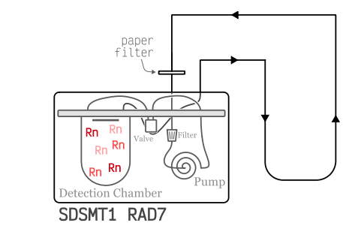
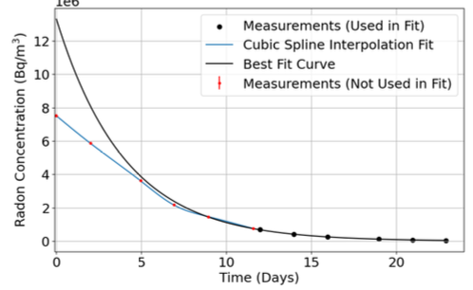
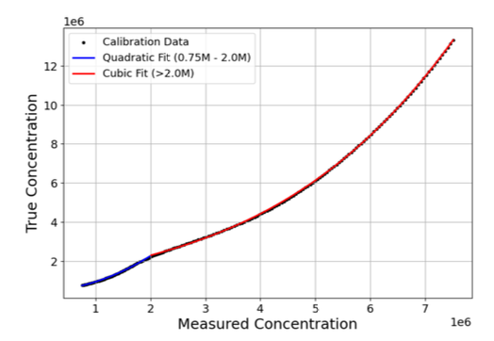
RAD7 “leaks” & Response
S.S. Poudel et al., arXiv:2606.00473 [quant-ph]
Diffusion through RAD7 gasket
Radon Concentration (MBq/m³)
Challenges:
  RAD7 response not accurate above 0.75 MBq/m³.
  RAD7 gasket allows radon diffusion from detection chamber.
N. Rodenburg
Solution:
  Measure rate of radon leaving chamber using data < 0.75 MBq/m³.
  Extrapolate true inferred concentration to earlier times.
  Map True vs. Measured concentrations.
N. Rodenburg
Notes:
If Nate does analysis for second run, add it. (1:00) [5:00]

Slide 10
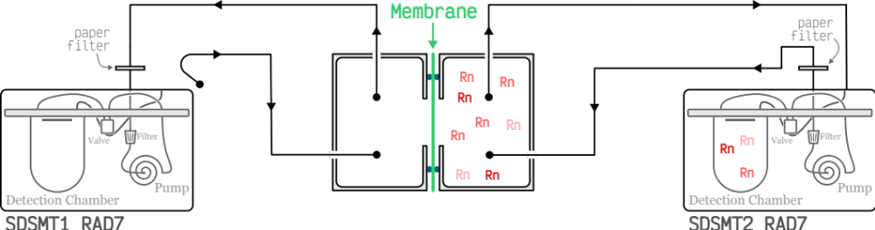
Other “Leak” Measurements and Concerns
Hot side
Cold side
Also measure escape from cold side with no Rn on hot side.
  Results consistent with escape from hot side.
Possible shortcoming is radon from hot side exiting through gasket and entering cold-side through gasket.
  Hope this is negligible, but results will provide upper limit on diffusion if such path is not negligible.
Notes:
(0:30) [5:30]

Slide 11
Other “Leak” Measurements and Concerns
Hot side
Cold side
Also measure escape from cold side with no Rn on hot side.
  Results consistent with escape from hot side.
Possible shortcoming is radon from hot side exiting through gasket and entering cold-side through gasket.
  Hope this is negligible, but results will provide upper limit on diffusion if such path is not negligible.
Notes:
(0:30) [5:30]

Slide 12
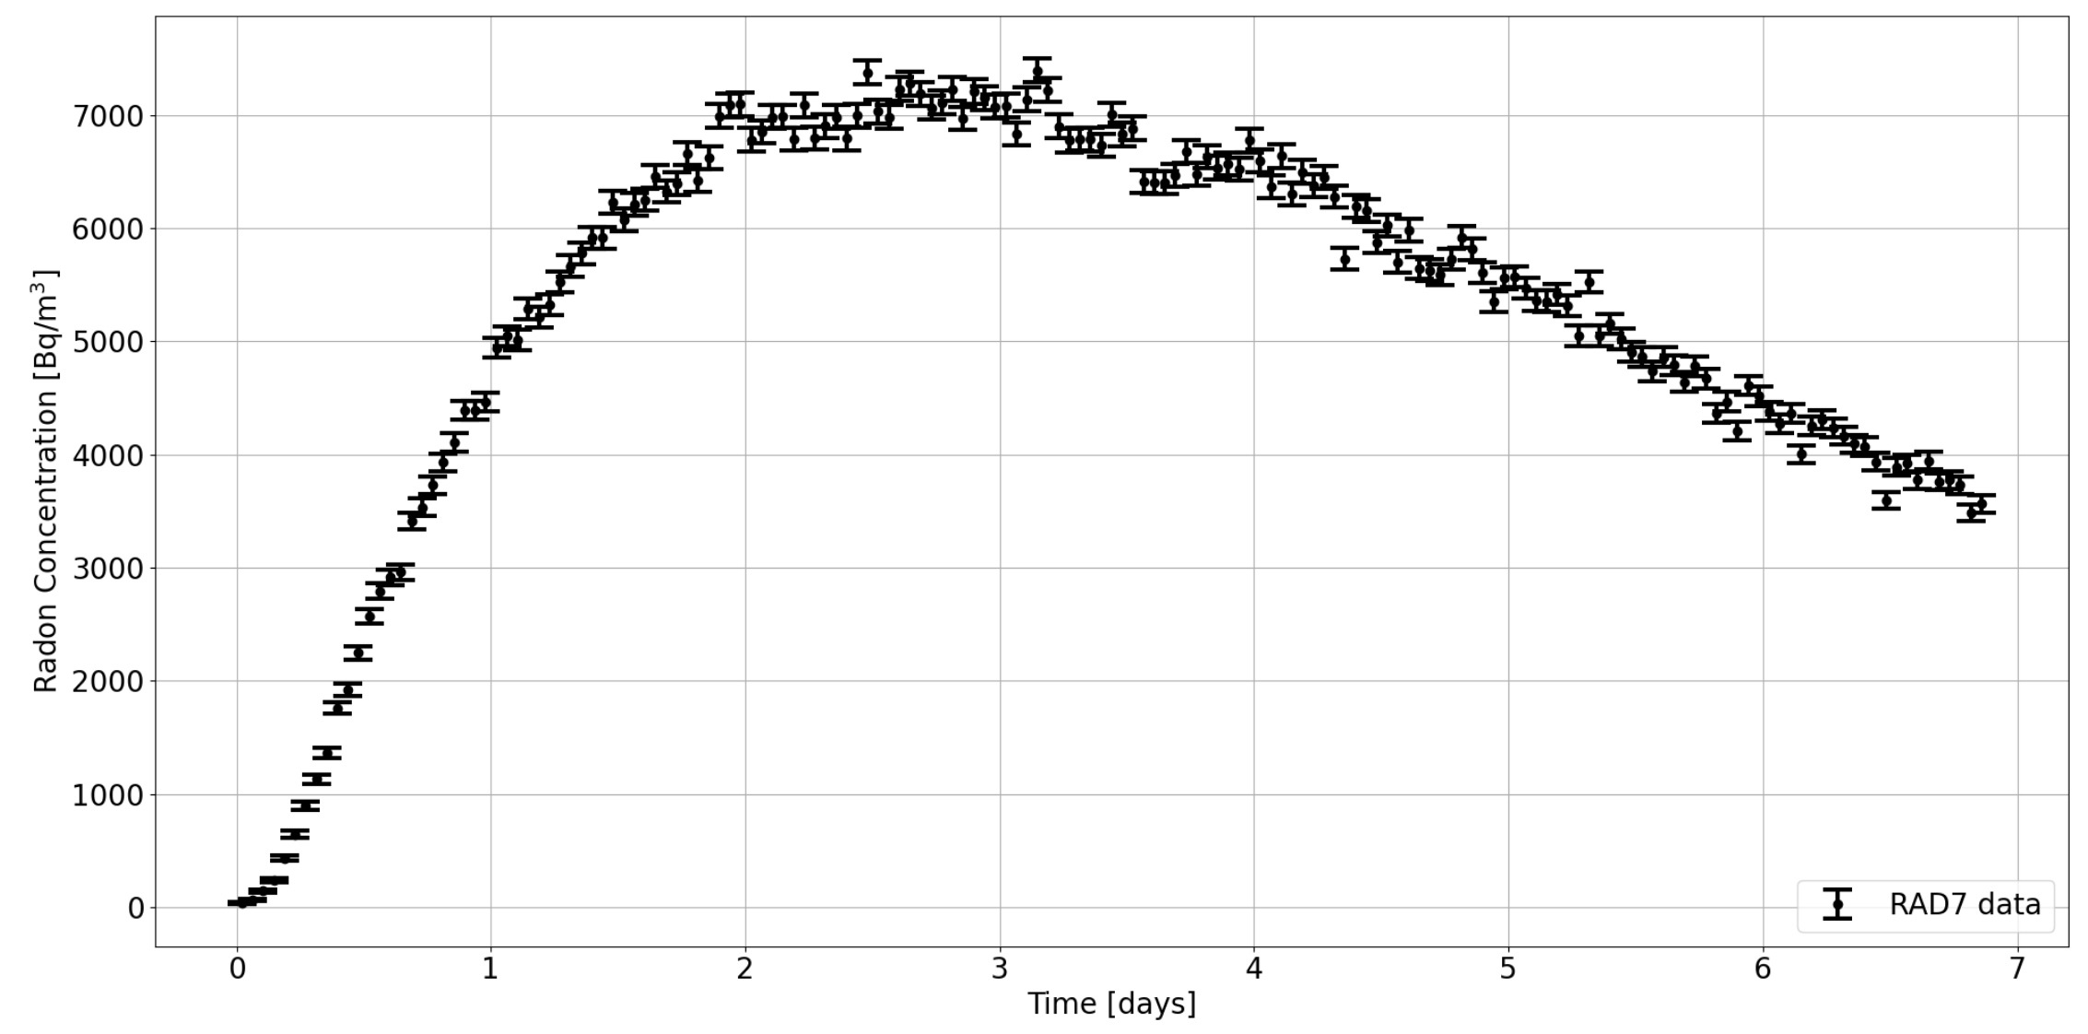
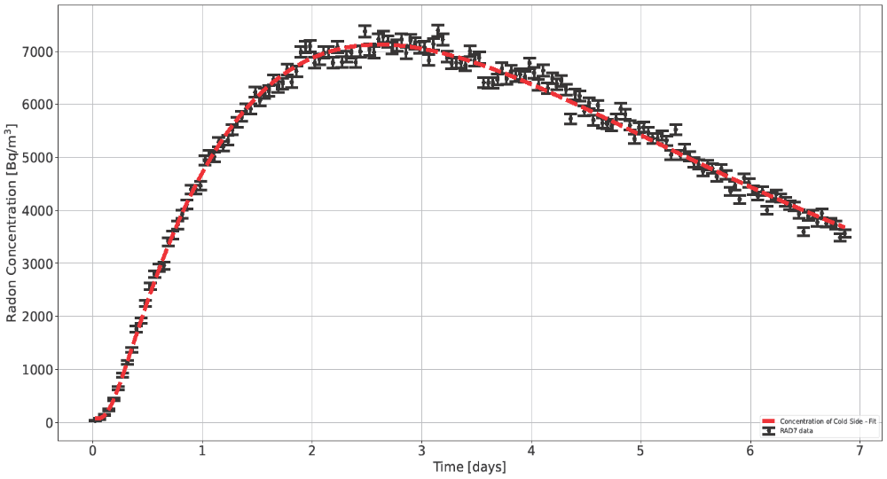
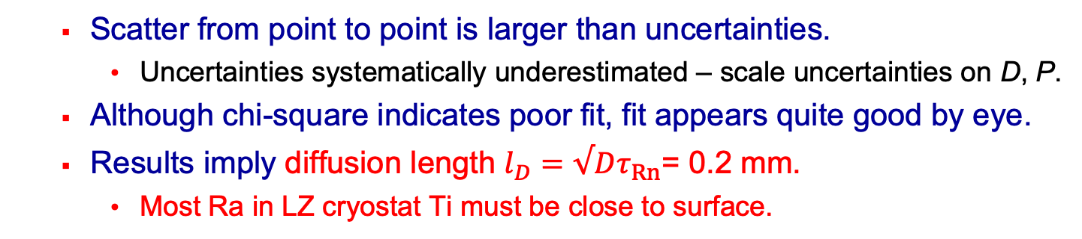
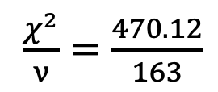
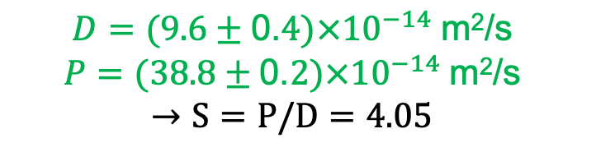
Measurement of Rn Diffusion through Titanium
Measure radon on cold side over time for 0.1 mm-thick Ti.
Find best-fit parameters to numerical solution.
  Free parameters Diffusion D and
A. Helgert
$\frac{χ^{2}}{ν}=\frac{470. 12}{163}$
7
6
5
4
3
2
1
0
Radon Concentration (kBq/m³)
$$D=(9.6±\text{0.}4)×{10}^{−14} \text{m}\text{2}\text{/s}$$
$$P=(38.8±\text{0.}2)×{10}^{−14} \text{m}\text{2}\text{/s}$$
$$→S=P/D=4.05$$
0 1 2 3 4 5 6 7
Time (days)
  Permeability P (= SD for Solubility S).
  Scatter from point to point is larger than uncertainties.
    Uncertainties systematically underestimated – scale uncertainties on D, P.
  Although chi-square indicates poor fit, fit appears quite good by eye.
  Results imply diffusion length $l_{D}=√Dτ_{Rn}$= 0.2 mm.
    Most Ra in LZ cryostat Ti must be close to surface.
For confirmation of D, measure for different thickness
(otherwise, this value of D is just an upper limit).
Notes:
maybe animate? (1:30) [7:00]

Slide 13
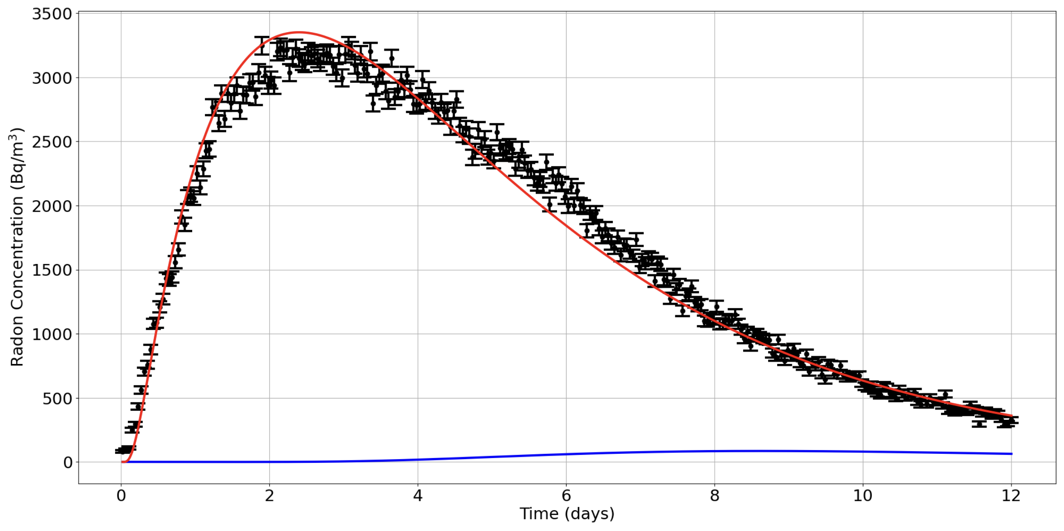
Measurement of Rn Diffusion through Titanium
Upper limit on
Performed measurement with 8x thickness (0.8 mm).
3.5
3.0
2.5
2.0
1.5
1.0
0.5
0.0
A. Helgert
Data for 0.8 mm
Radon Concentration (kBq/m³)
Prediction for D, P from 0.1-mm measurement
0 2 4 6 8. 10. 12
Time (days)
  Results not consistent with D & P from 0.1 mm.
  Must be dominated by leaks (= something other than diffusion through Ti) at 0.8 mm.
    Likely dominated by leaks at 0.1 mm.
    So previous measurement is an upper limit on diffusion of radon in Ti:
      D < 10⁻¹³ m²/s, P < 3.9 x 10⁻¹³ m²/s, Diffusion length < 0.2 mm
Consistent with but less interesting/useful than Lorenzo’s result.
Notes:
maybe animate?(1:30) [7:00]

Slide 14
Possible causes of Rn Emanation from Ti
Three possible causes:
  Ra ~ uniform in Ti, but Rn diffusion length in titanium is much larger than typical for metals (microns)?
    Need length ≳ 2 mm even when cold.
  Radium concentrated near surfaces but surface etching ~ineffective?
  Contamination added during assembly (e.g. welds)?
Impractical to rule out (3).
Will discuss (1) and (2) in detail.
XENON1T [E. Aprile et al. Eur. Phys. J. C 81, 337 (2021), arXiv:2009.13981]
measured high ratio ²²²Rn emanation to ²²⁶Ra content (60%) in Ti, but
  Electropolishing 30 μm reduced emanation by >30× to ≅ zero.
    ²²⁶Ra predominantly on the surface.
  Nitric acid (1.8% HNO₃) did nothing.
  Pickling (0.6% HF / 7.6% HN0₃) caused only 4.0±1.6 x reduction.
Was acid etching of Ti IVC surface ineffective?
Notes:
(1:30) [2:00]

Slide 15
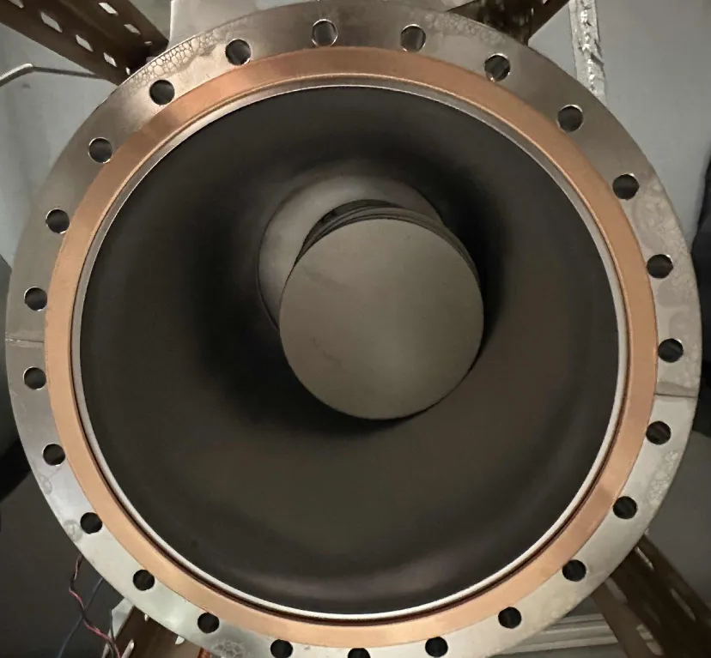
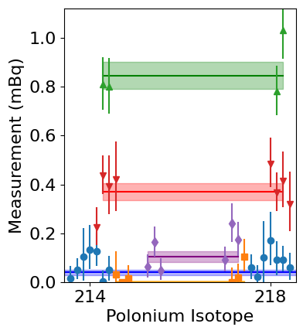
Test of AstroPak Etching of Ti
LZ ICV etching performed by AstroPak
  Avesta Red 240 Pickling Spray.
  45 minutes removed 14 μm.
Recently performed test of emanation before/after AstroPak etching of 11 Ti discs.
  3850 cm² total.
  For pre-etching measurements, performed emanations at ~100 mTorr and ~975 Torr.
  After subtraction of blank runs and nuts used as spacers between discs, obtain
    High-pressure: 0.77 ± 0.06 mBq
      Diffusion and recoils
    Low-pressure : 0.38 ± 0.06 mBq
      Diffusion ~only
    Suggests ~ half at HP due to recoils.
R. Schauer
High-pressure Ti
Low-pressure Ti
High-p blanks
High-p spacers
Low-p blanks
Notes:
(1:30) [2:30]

Slide 16
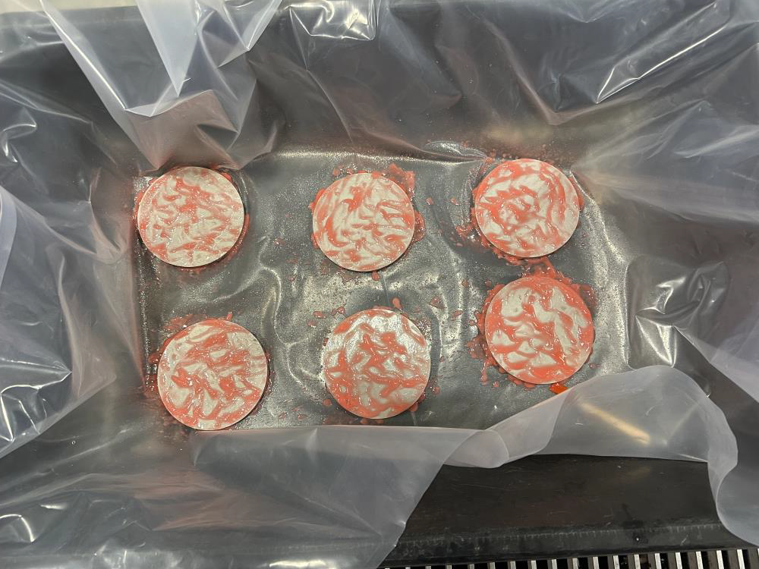
Results of (High-P) Post-etch Emanation
AstroPak applied Avesta Red 240 Pickling Spray to the 11 Ti discs.
  150 μm removed from 6.
  11 μm removed from 5.
Emanations performed at 975 Torr.
  All 11 discs emanated together.
  After subtractions of nuts and blanks, measured 0.15 ± 0.05 mBq (compared to original 0.77 ± 0.06 mBq).
    PRELIMINARY, analysis and more data runs in progress
  Implies reduction of factor 5.2 ± 1.8.
    Consistent with perfect removal at 3σ.
    Consistent with XENON1T pickling of Ti.
    If so, not as large as we would like.
Wider XLZD Ti surface R&D includes Birmingham, Boulby, and Sheffield.
Notes:
(1:30) [2:30]

Slide 17
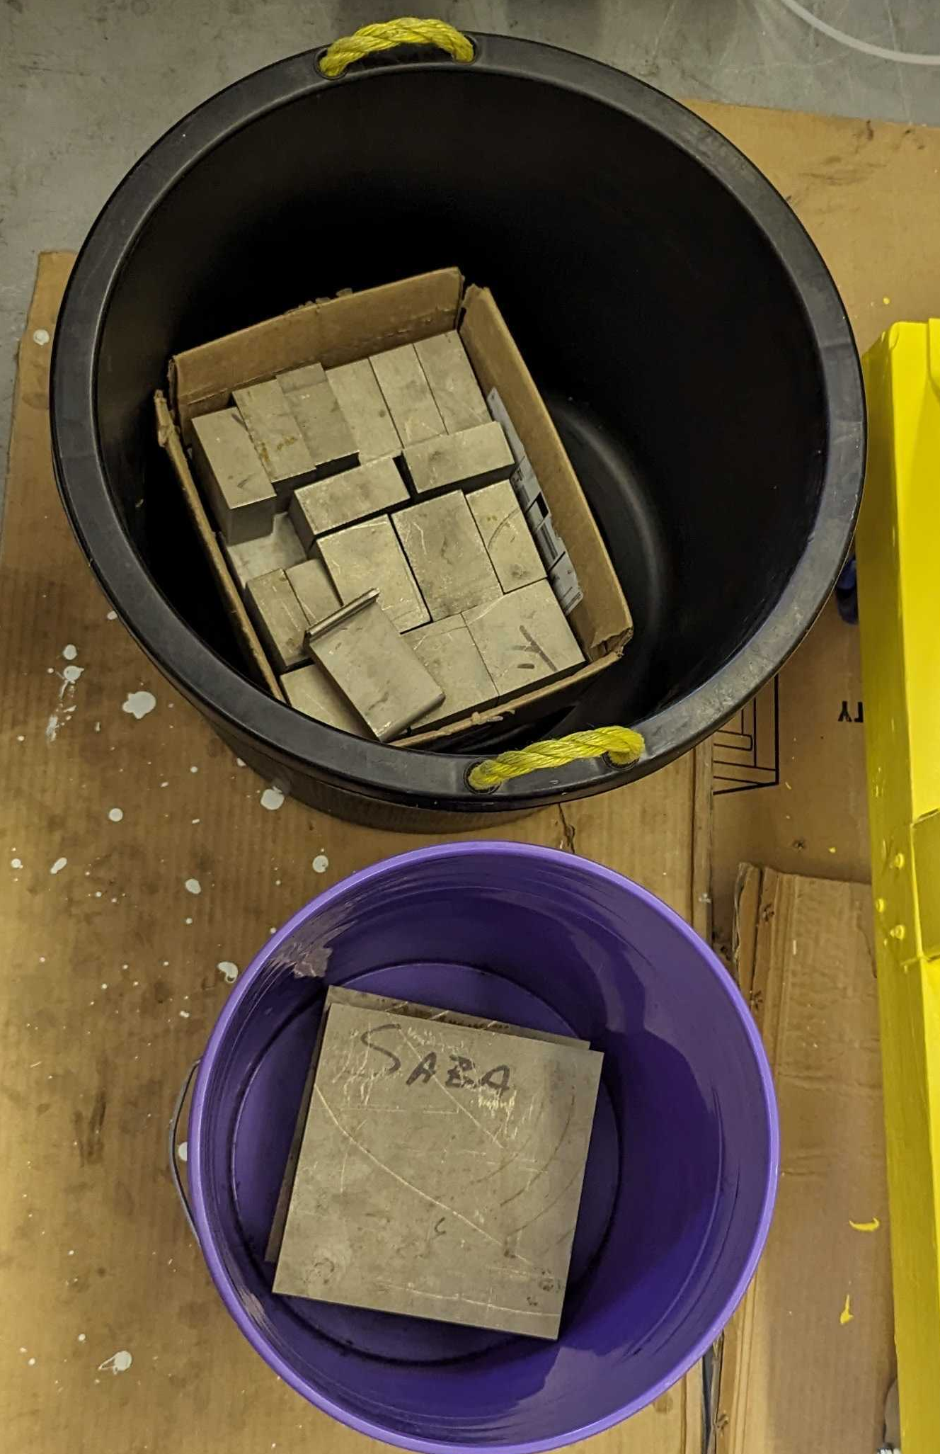
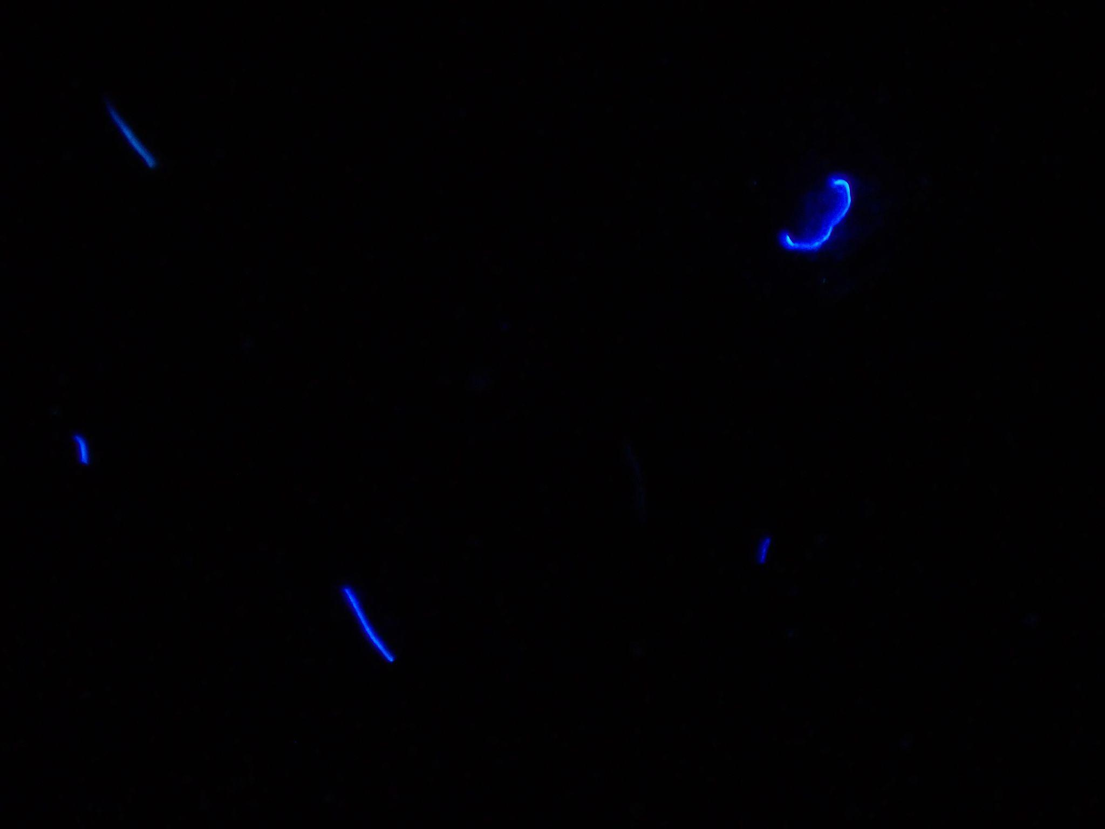

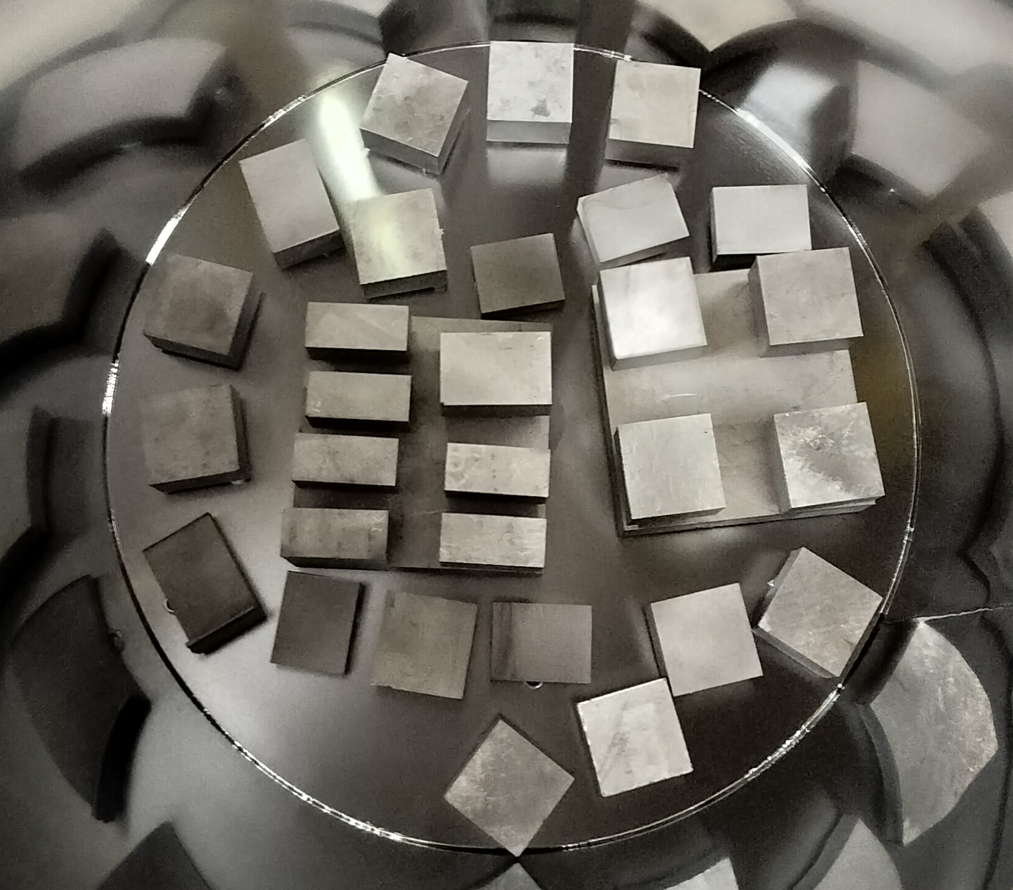
Titanium Blocks at SD Mines
Ti cutouts from LZ assayed at SD Mines.
  31 pieces totaling 0.74 m², filthy when acquired.
  Cleaned multiple ways:
    Wiping with teflon brushes, wipes.
    Ultrasonic cleaning.
    Power washing (like LZ cryostat).
  Dust assays using 44x camera under UV in dark space – enough magnification for most dust mass.
    Power washing most effective, ~10x reduction.
A. Reker
before
after
  Preliminary radon emanation results ~5 mBq.
    ~7x higher than etched LZ ICV.
      Suggests etching reduced Ra ~7x for LZ ICV.
Notes:
. (1:30) [2:30]

Slide 18
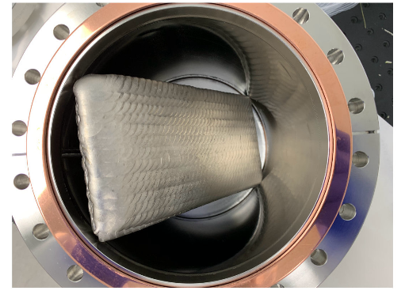
Possible causes of Rn Emanation from Ti
Three possible causes:
  Ra ~ uniform in Ti, but Rn diffusion length in titanium is much larger than typical for metals (microns)?
    Need length ≳ 2 mm even when cold.
  Radium concentrated near surfaces but surface etching not sufficiently effective?
  Contamination added during assembly (e.g. welds)?
Ti plate covered with 325 cm² TIG welds assayed at UCL.
  Used for QC via HPGe screening during assembly.
  17.2 ± 3.0 mBq/m² untreated
  11.4 ± 2.1 mBq/m² after etching
    Scales to 4.9 ±0.9 mBq in LZ, about 1/3 of the total.
U. Utku, Ph.D. thesis, University College London (2021).
Welds can be a significant problem.
Welds cannot be the main issue.
Notes:
(1:30) [2:00]

Slide 19
Conclusions & Plans for Future
Titanium is attractive for low-background cryostats.
High radon emanation from LZ Ti is becoming understood enough that future experiments should be able to avoid.
  Expect large fraction of Ra contamination to be near surface.
  May have significant contribution from welds.
  Diffusion length < 0.2 mm.
  Acid etches attempted previously not sufficient.
  (Still be careful not to add contamination during assembly!)
XLZD and others performing R&D towards better solution.
  XLZD overview in Ferdos Dastgiri’s talk (T 15:35)
  Electroplating -- see talks by Sophie Armbruster (M 13:50) and Margherita Noia (W 10:40)
  Machining off surface material
  Alternative acid etches
  (Patrick Knights’ poster)
Lorenzo: Diffusion length negligibly short.
This work supported in part by US Department of Energy (Grants No. DE-SC0014223, DE-AC02-05CH11231)

