Slide 1


Ultra-pure electroforming at Boulby deep underground laboratory
K. Johnson, P. Knights, K. Nikolopoulos, G. Rogers, P. Scovell,
E. Shoemark-Banks, D. Spathara, C. Toth, P. Walters
LRT – University of York & Boulby Underground Laboratory
24/09/2026

Slide 2
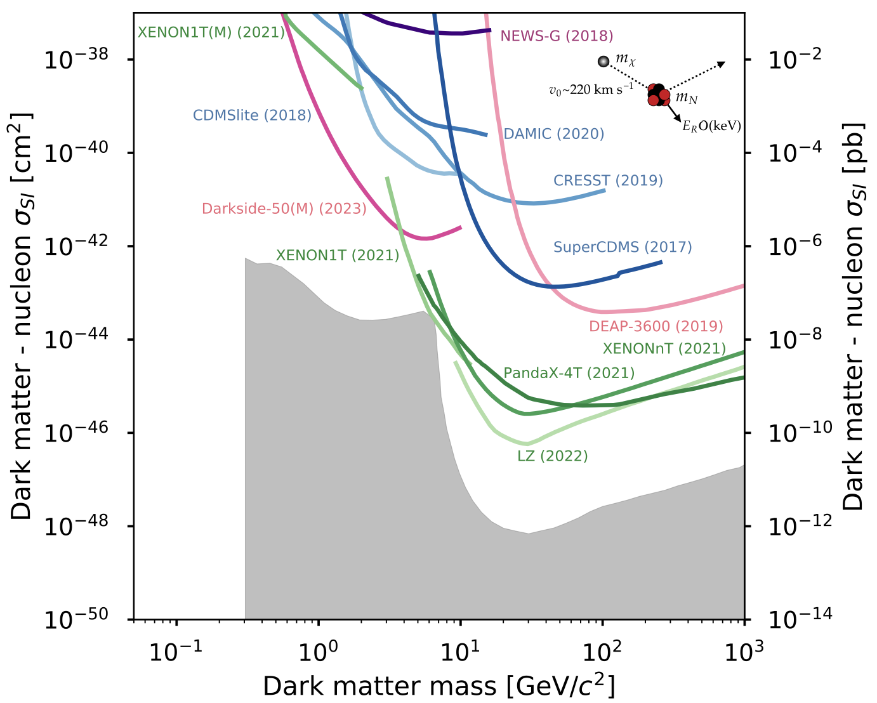
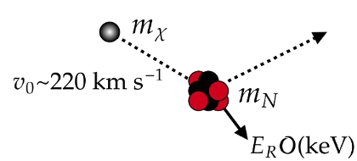
Direct dark matter detection landscape

Slide 3
Direct dark matter detection landscape
Increase exposure
Lower backgrounds

Slide 4
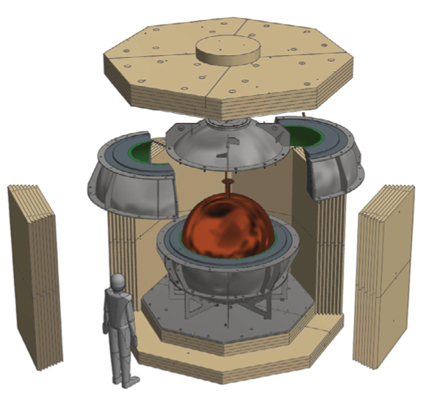
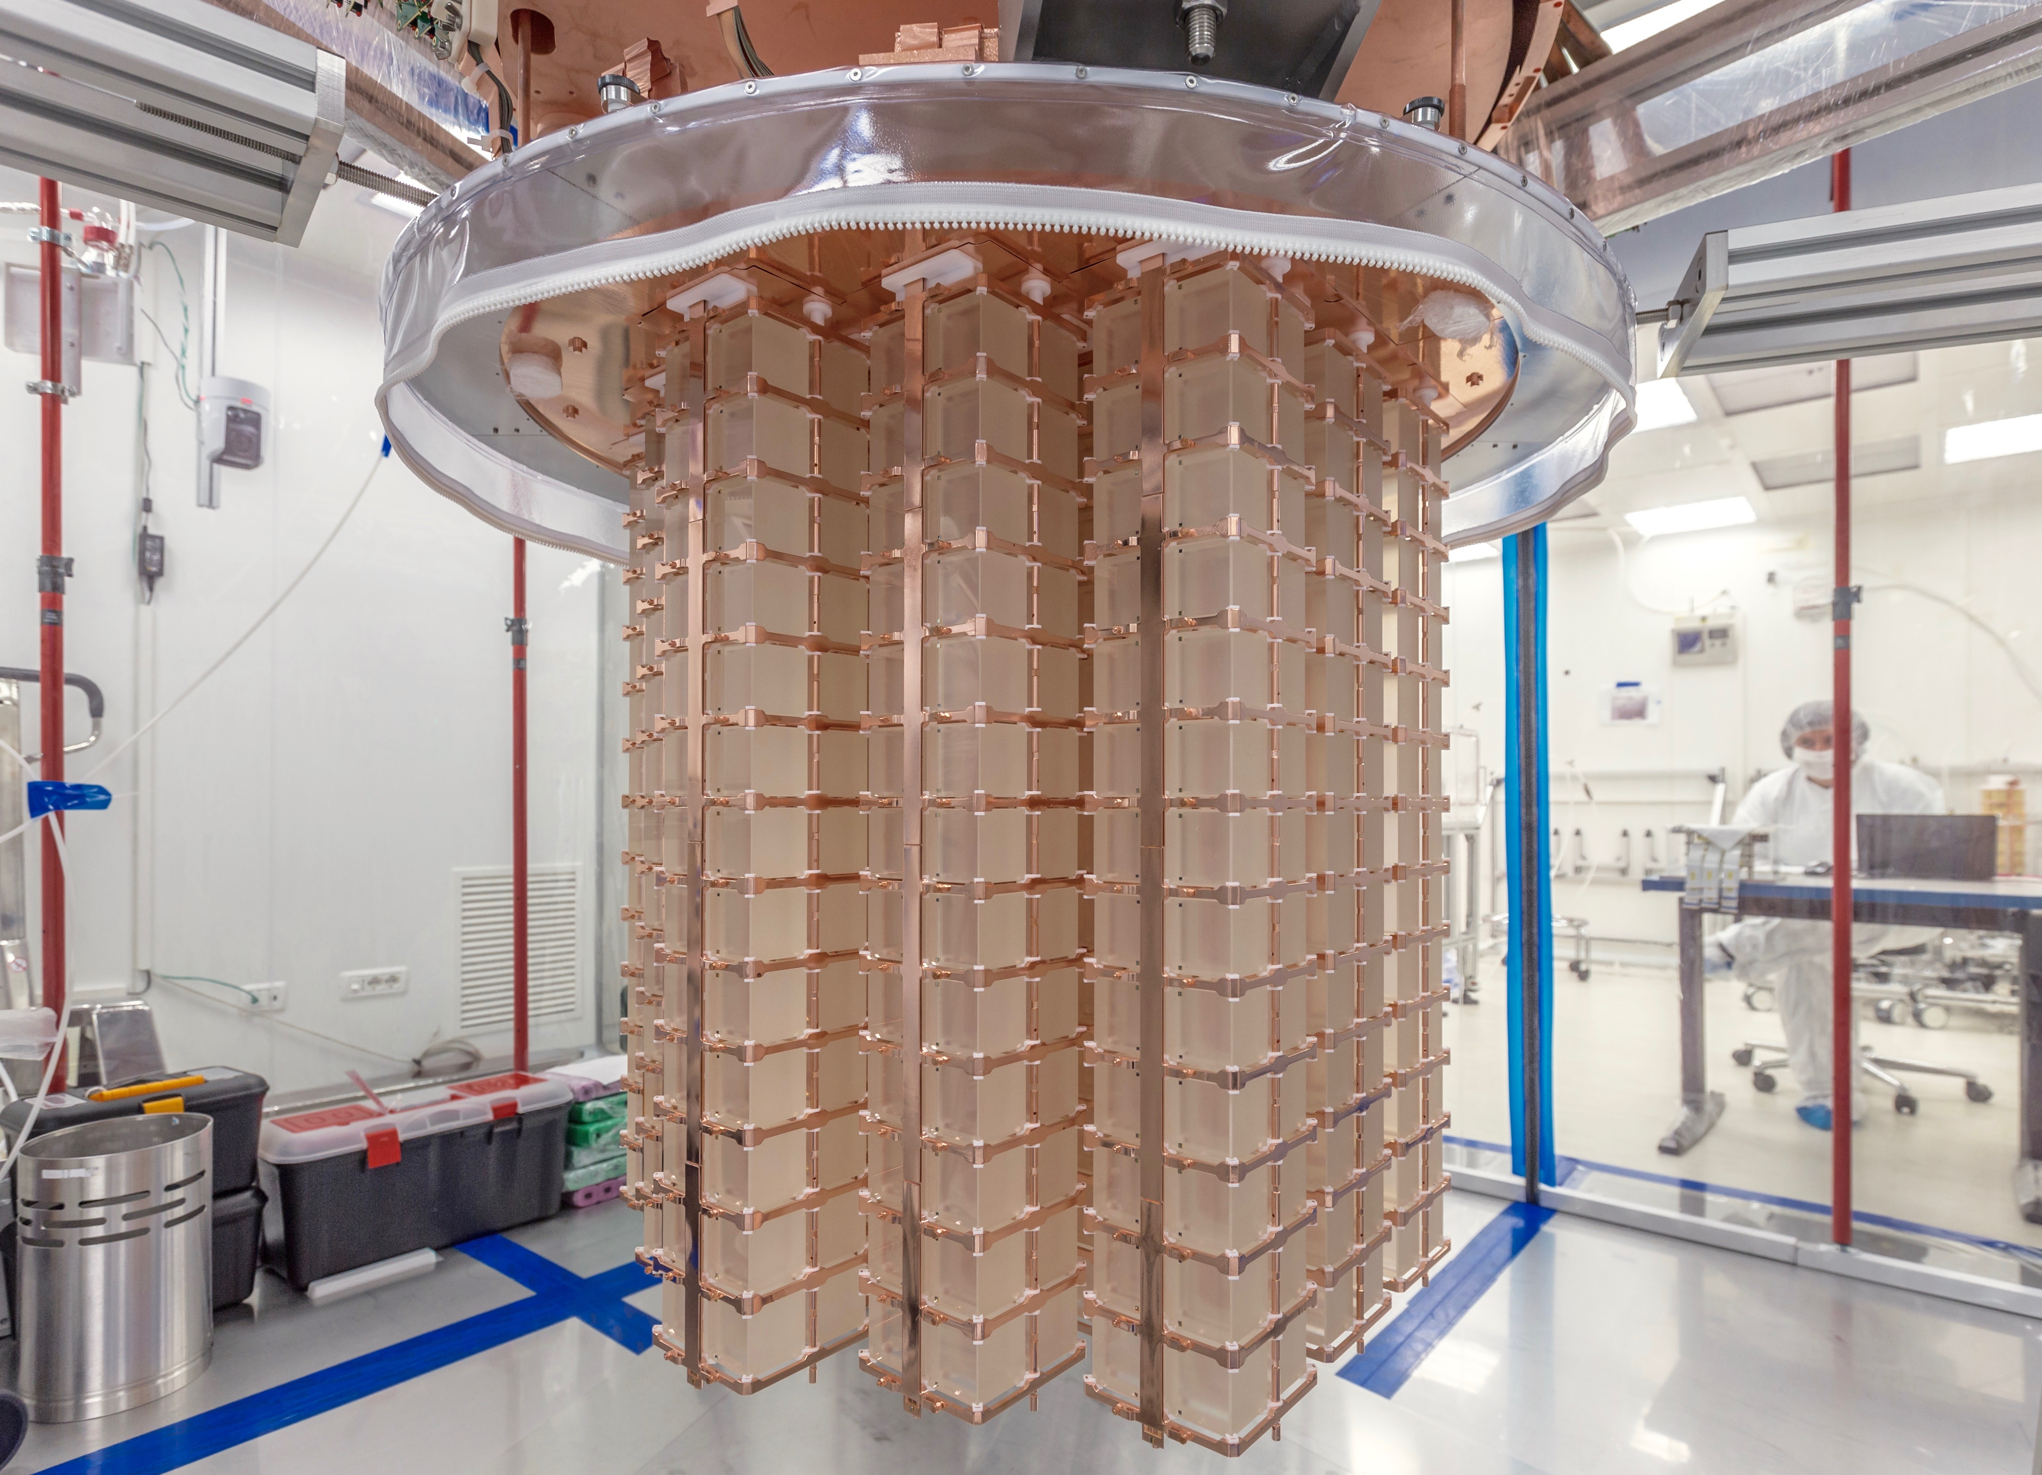

Setup
Copper as a detector material
Copper is an attractive detector material for rare event searches
  No long-lived radio-isotopes – longest ⁶⁷Cu: t_{1/2} = 62 h
  Commercially available at high-purity
  Good mechanical and electrical properties
  Favourable electrochemical properties – more on this later!
NEWS-G collaboration
https://www.snolab.ca/experiment/news-g/
CUORE collaboration
https://cuoreexperiment.org

Slide 5
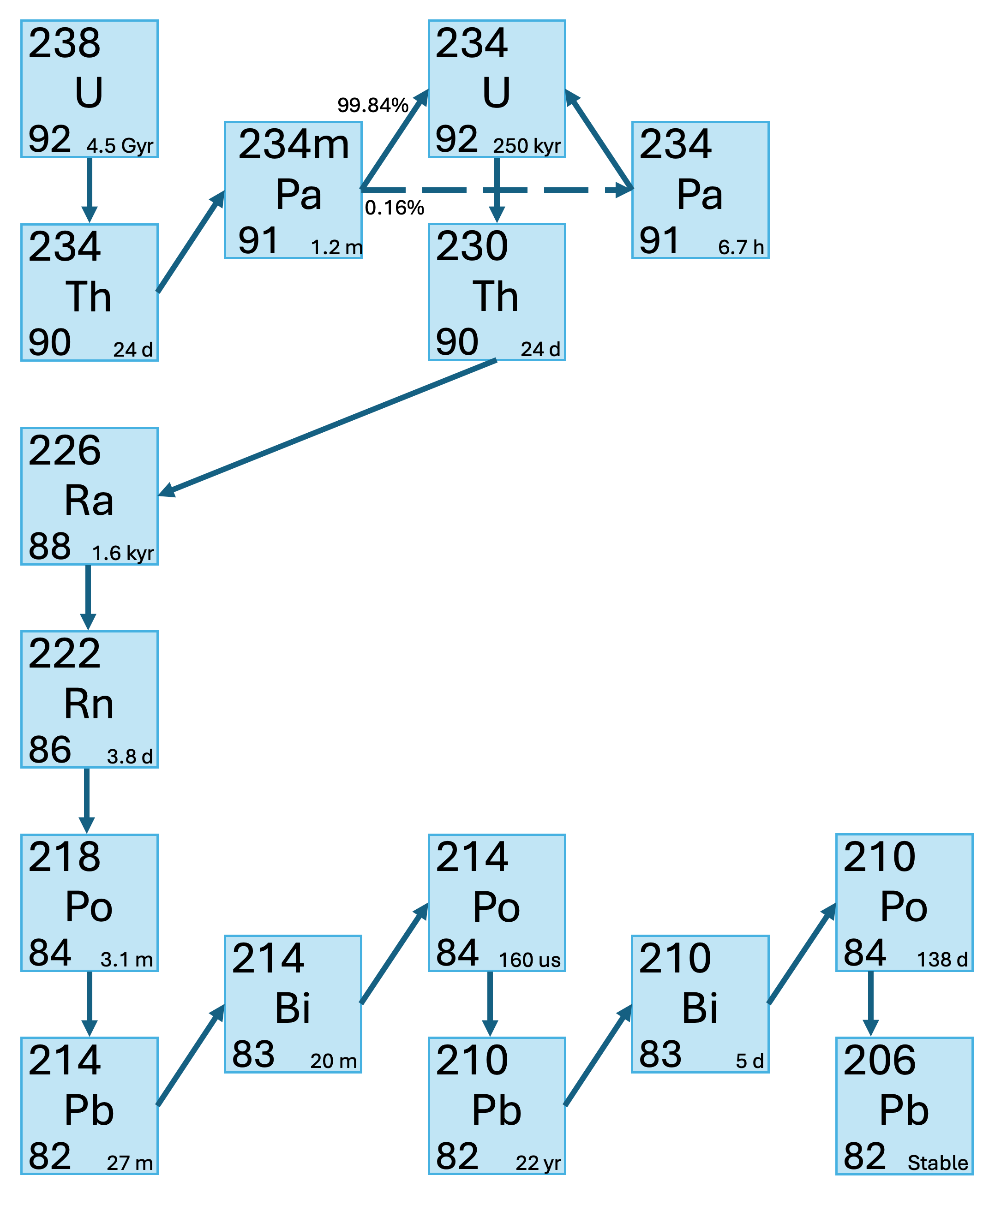
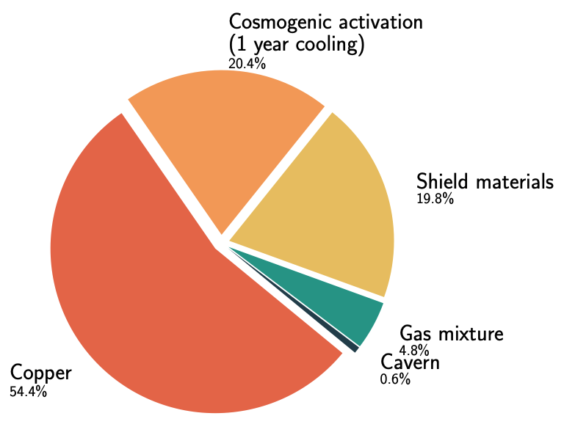
Setup
Copper background
Copper can still represent an important background
Commercial copper contaminated - ²³⁸U and ²³²Th decay chains:
  Natural ore contamination
  Implanted during manufacture and handling
  Cosmogenic activation - ⁶³Cu(n,⍺)⁶⁰Co t_{1/2} = 5.27 yr
²³⁸U decay chain
Simulated backgrounds for NEWS-G’s current detector

Slide 6
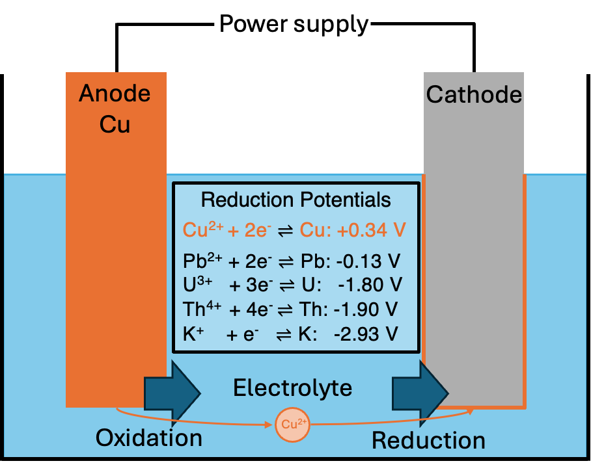
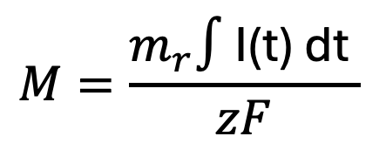
Setup
Electrodeposition
Deposit ions onto a cathode by applying a voltage
Governed by oxidation and reduction reactions
Deposited mass proportional to current
Molar mass
Current
$$M=\frac{m_{r}∫\text{I(t) dt} }{zF}$$
Faraday constant
No. e⁻
Ion

Slide 7



Copper electrodeposition
Species plating tendency governed by reduction potentials
Careful control of applied potential difference allows preferential plating of copper over contaminants
Used in industry to produce copper with excellent purity
$$E_{cell}^{0}=E_{Cathode}^{0}–E_{Anode}^{0}$$
I$f Eapplied>E_{cell}^{0} reaction procedes$
$$E_{cell}=E^{0}−\frac{RT}{nF}ln\left(\frac{{\left[C\right]}^{c}{\left[D\right]}^{d}}{{\left[A\right]}^{a}{\left[B\right]}^{b}}\right)$$

Slide 8
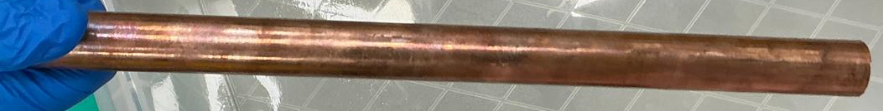
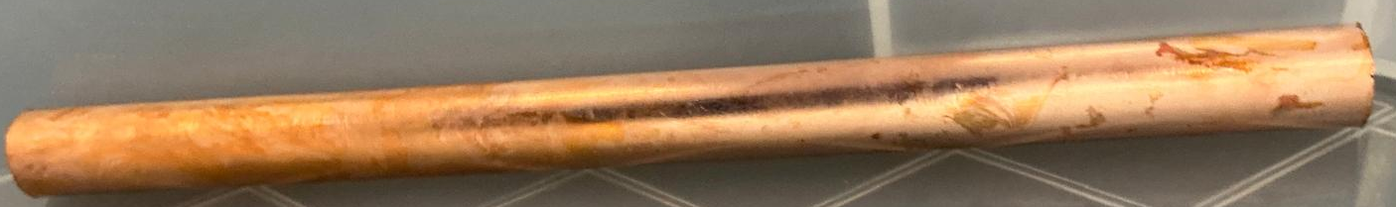
Ultra-pure copper electrodeposition
How this differs from industry – prioritise purity
Procedure principally developed by PNNL for Majorana Demonstrator
Additive free pure electrolyte
Prioritise purity over speed -> careful voltage selection
Cleanroom environment
Stringent radiopure material and reagent selection
Purity monitoring
Comprehensive cleaning procedures
Plating underground -> reduce cosmogenic activation
Cu feedstock preparation
NIMA 579 (2007) 486-489
RCTR 277 (2008) 103-110

Slide 9
Results – ICPMS
Sample of copper | ²³²Th [uBq/kg] | ²³⁸U [uBq/kg]
Commercial C10100 NIMA 828 (2016) 22-36 | 8.7 ± 1.6 | 27.9 ± 1.9
NEWS-G plated copper NIMA 988 (2021) 164844 | <0.24 | <0.11
Majorana demonstrator electroformed NIMA 828 (2016) 22-36 | <0.119 | <0.099
Orders of magnitude improvement over commercial copper
Purity results often limited by available assay techniques -> can only set limits

Slide 10
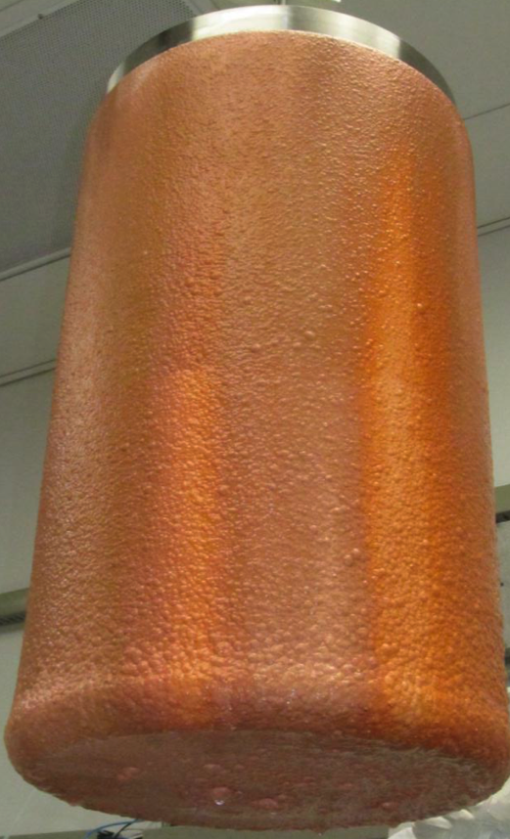
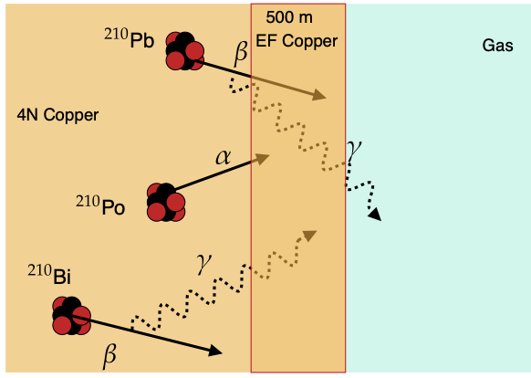
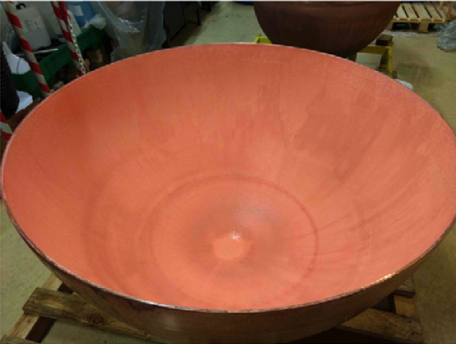
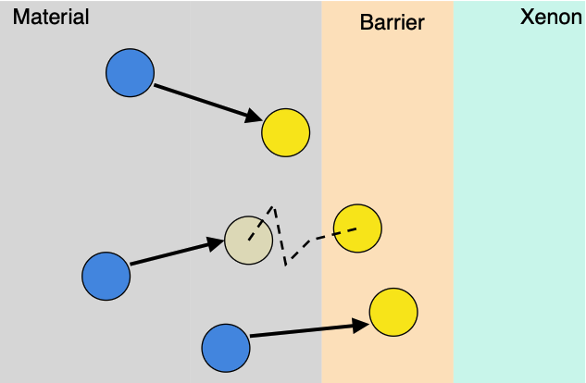
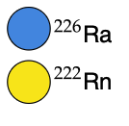

How this is/can be used for experiments
Electroplating
Electroforming
Majorana Demonstrator
Electroformed Cu
OSTI (2012) 1039850
Cu plated onto existing structure or components
Acts as an ultra-pure shield
Reduce radon emanation
Cu plated onto a mould (called mandrel)
Remove the mandrel leaving a pure copper structure
Construct large structures
NEWS-G electroplated Cu
NIMA 988 (2021) 164844
$$μ$$

Slide 11
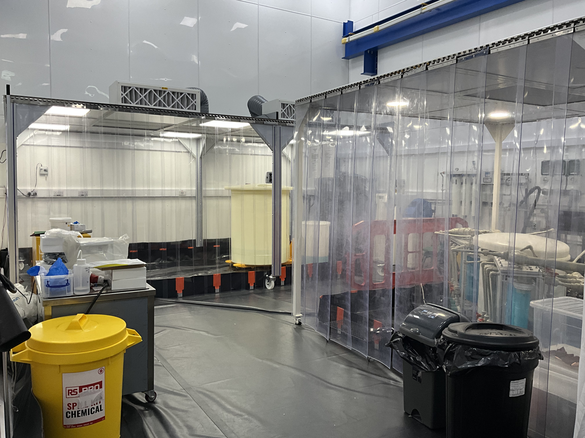
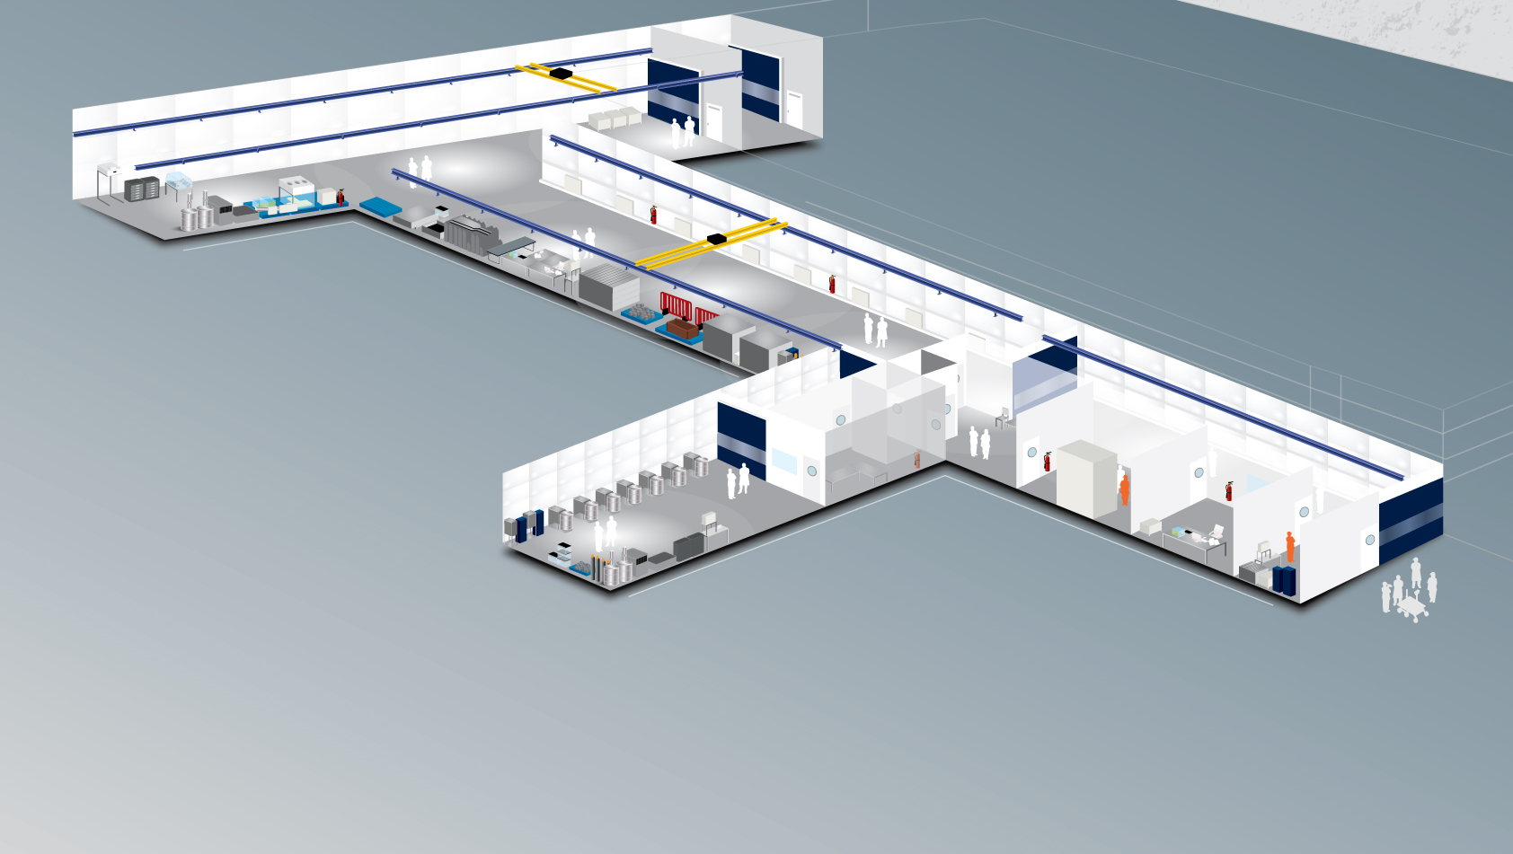
Setup
Electroforming facility at Boulby
1.1km underground at the UK’s deep underground laboratory Boulby
Dedicated ISO-6 cleanrooms within the larger Boulby cleanroom equipped with laminar flow, particle counter, type-1 water
XIA UltraLow-1800 + ICP-MS + HPGe on site at Boulby
See posters on Boulby assay:
🪧A. Hammer
🪧 B. Green
🪧 K. Johnson
Front. Phys. 2023 11:1310146
JINST 2025 20 P06010
Boulby underground lab
https://www.boulby.stfc.ac.uk/Pages/home.aspx

Slide 12
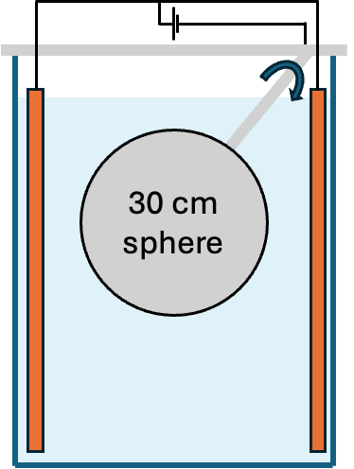
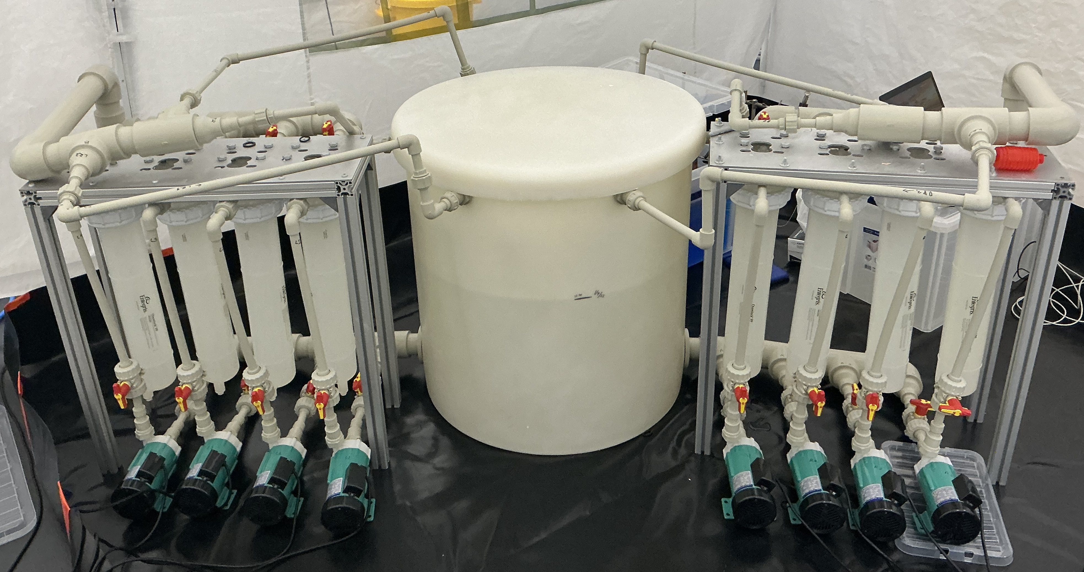
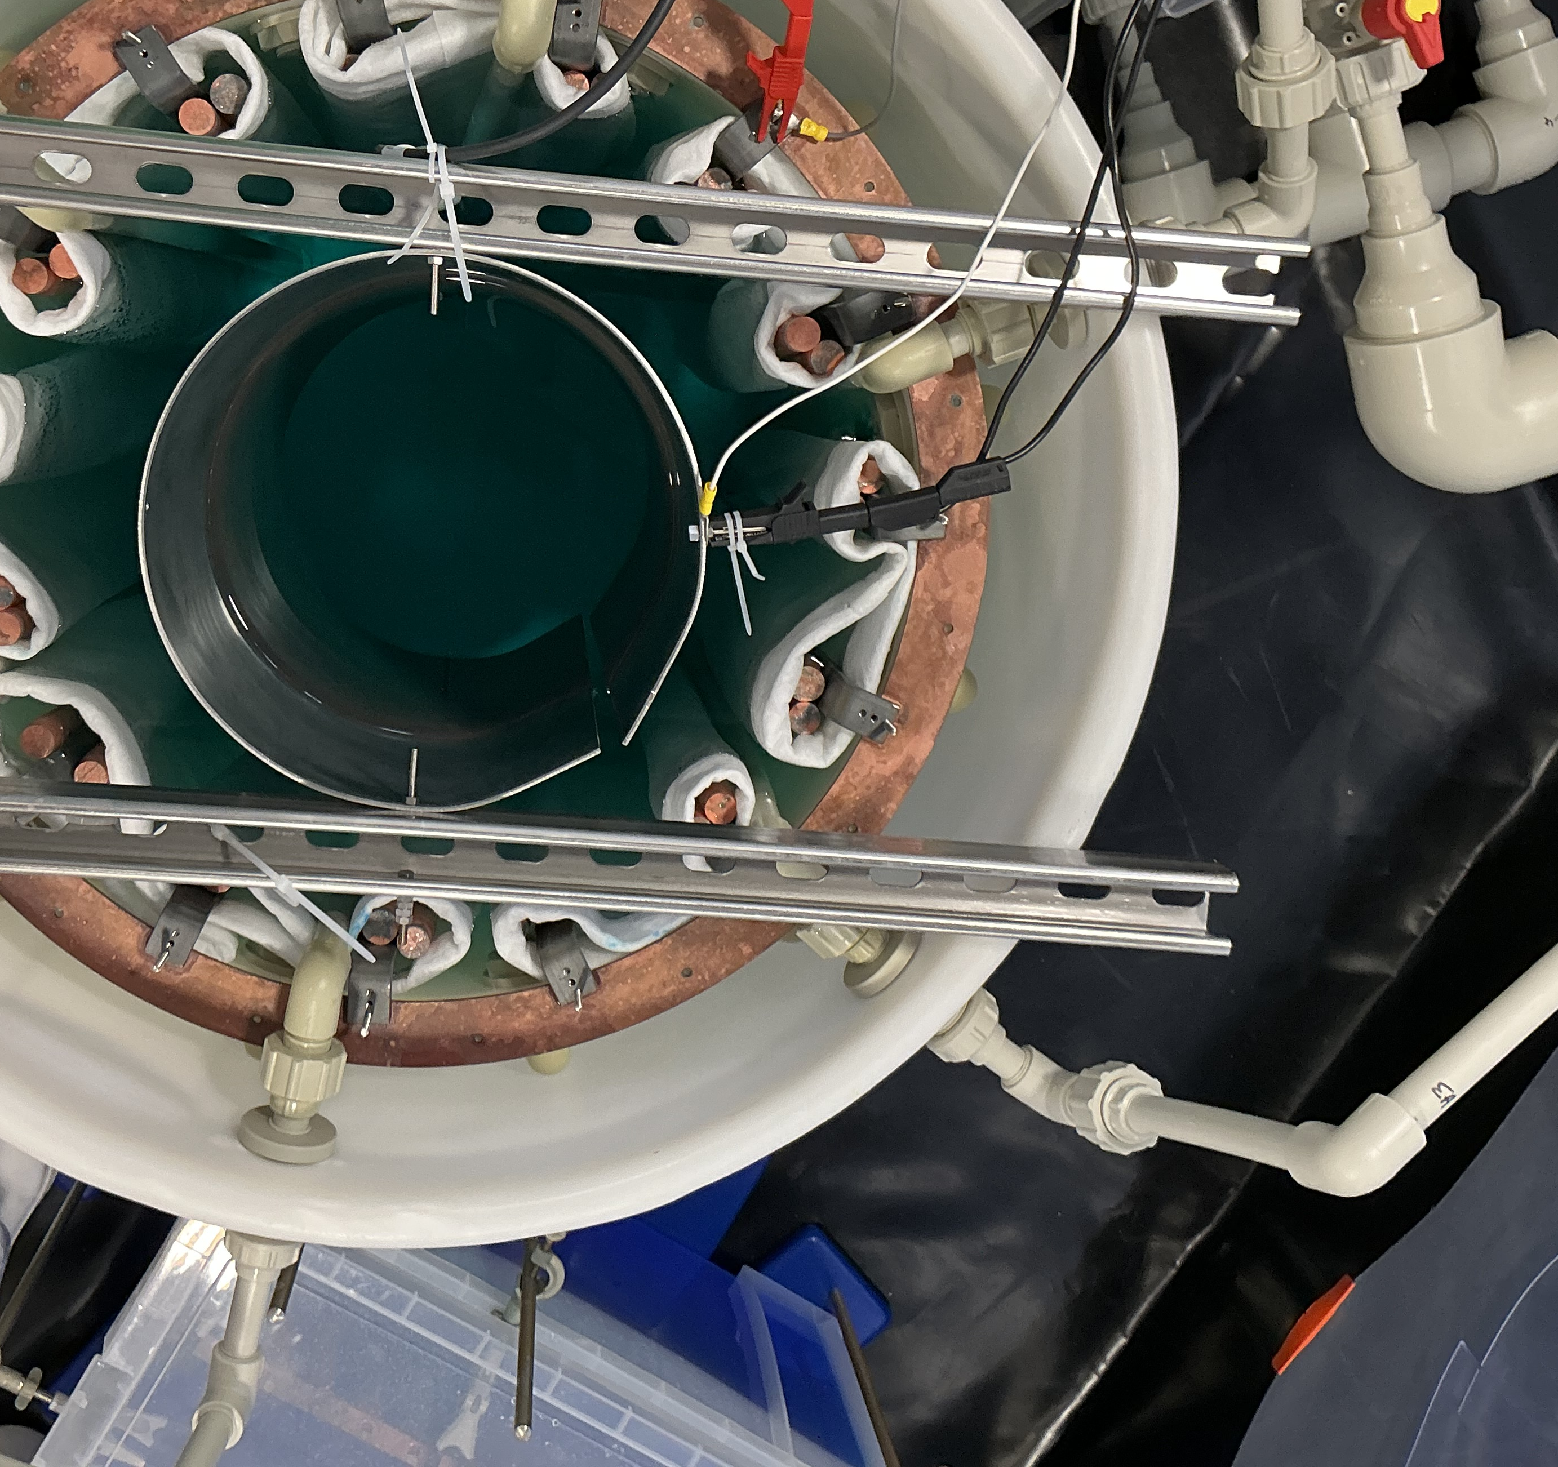
Electroforming facility at Boulby
Pure PP/PVDF pipework leached with 6M nitric acid
Electrolyte made in house from 5.5N copper feedstock etched with acidified peroxide
Multiple setups for different geometries and sizes
Larger setup’s first goal to fully electroform a 30 cm spherical proportional counter underground: DarkSPHERE-30
Near-future plans
5.5N Cu feedstock
0.2 µm recirculating filters
Inlets
CuSO₄ electrolyte
Ti anodes
Cu bus bar
Electroforming bath at Boulby
Steel cylindrical mandrel

Slide 13
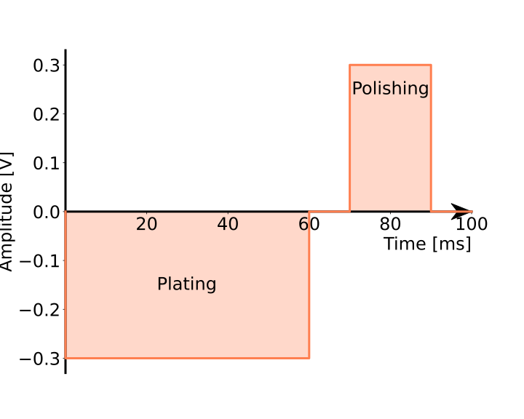
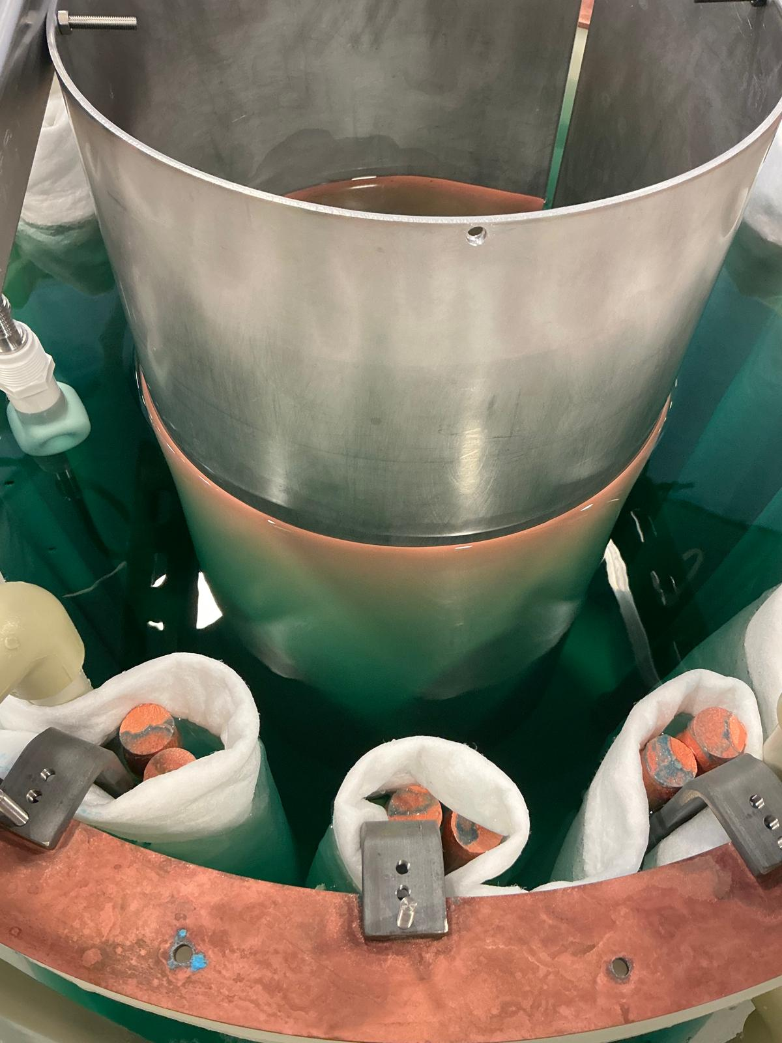
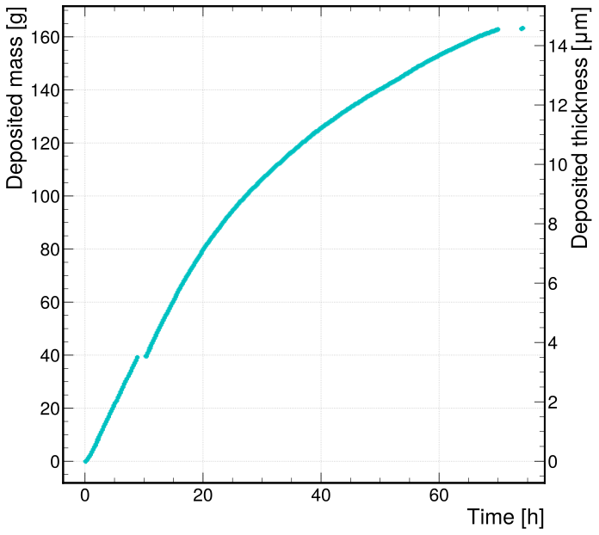
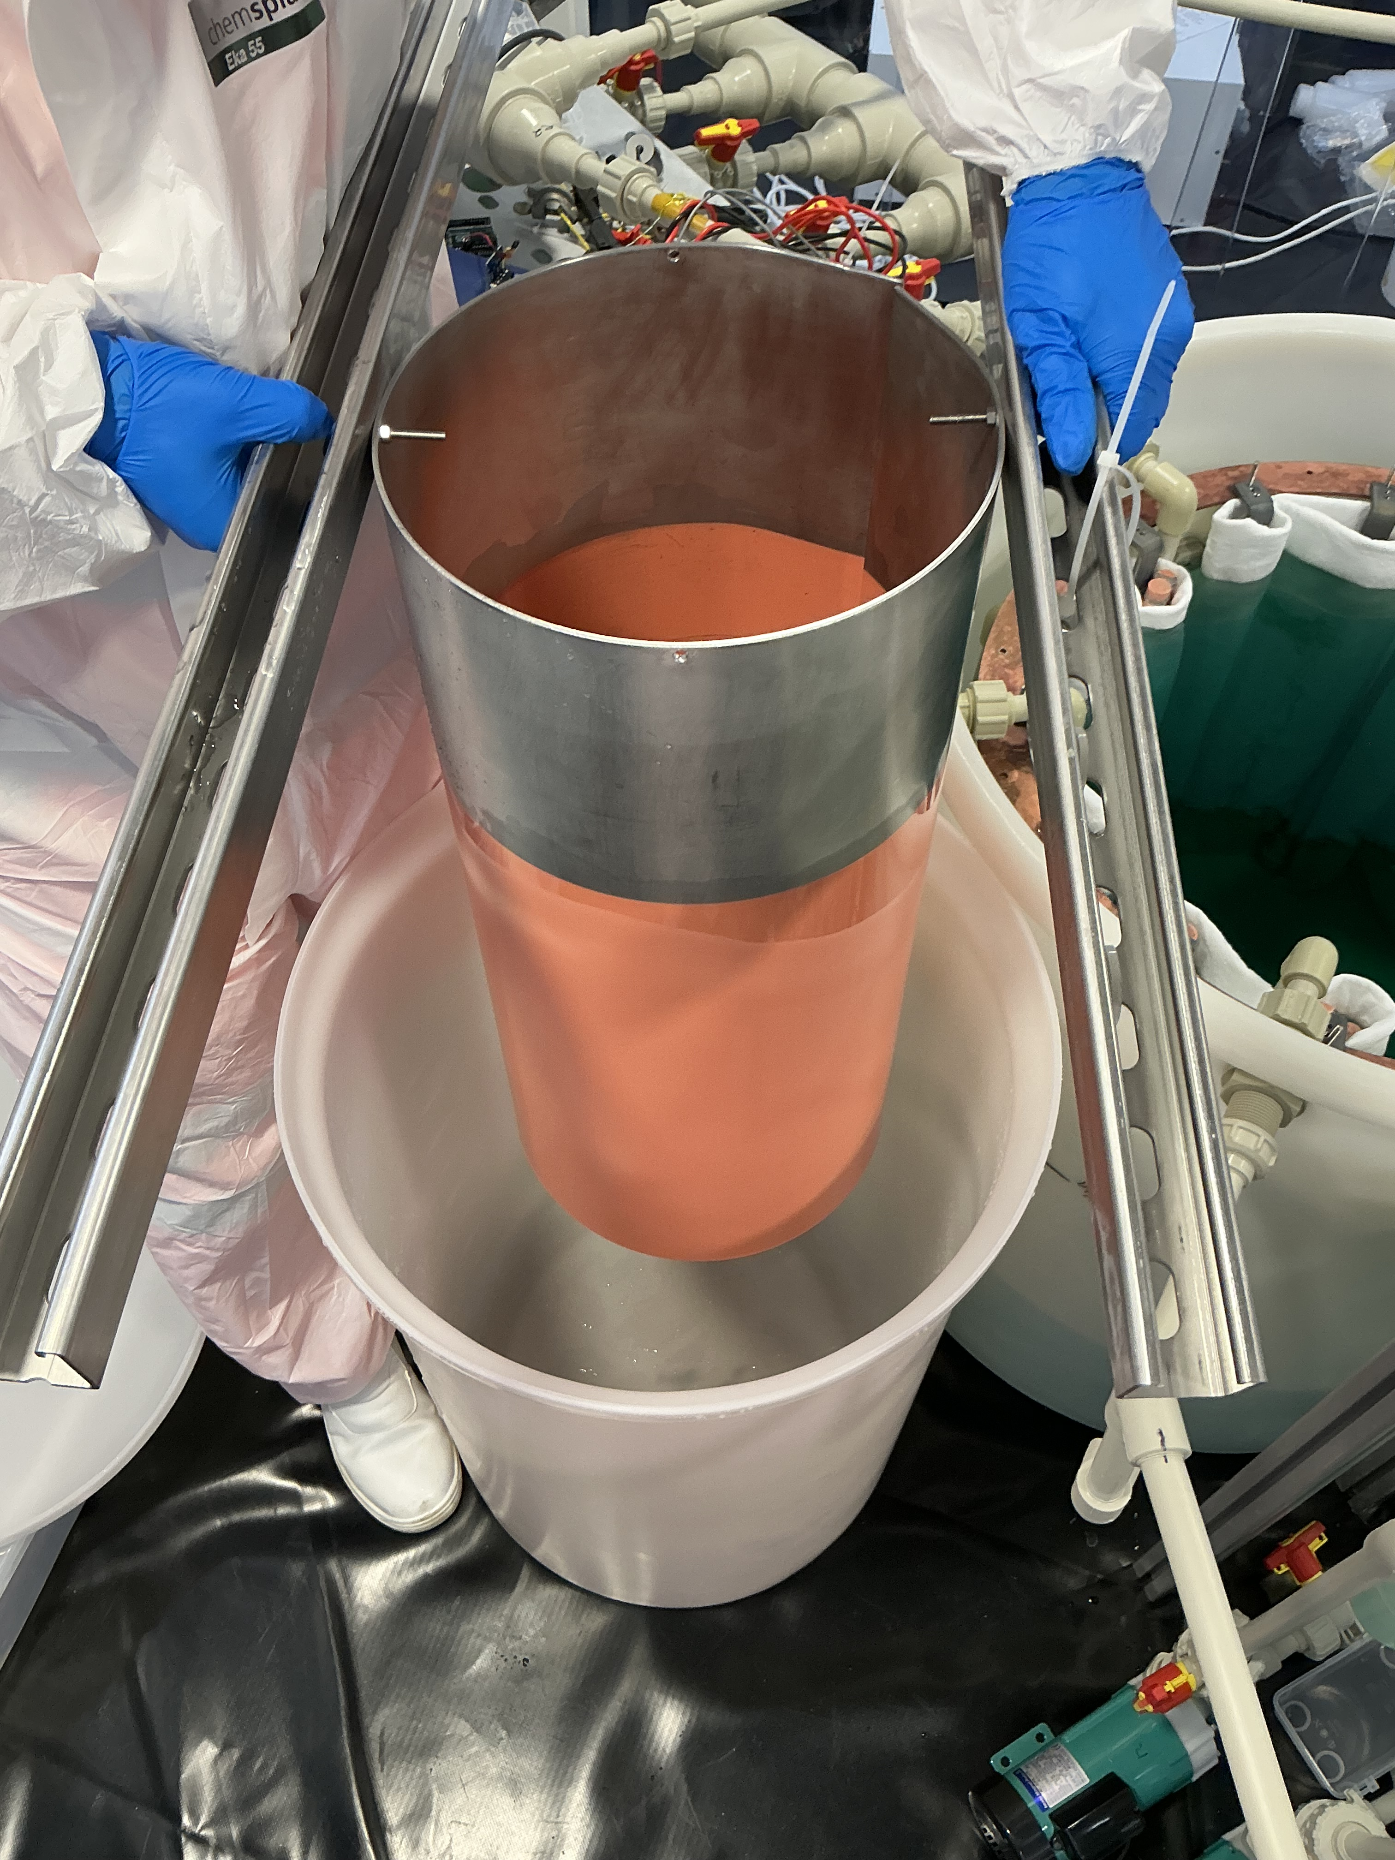
Setup
Current status
Copper pulse plated onto stainless ⌀30 cm stainless steel cylinder
Peeled copper off mandrel -> ICPMS and XIA results pending analysis
Recently transitioned to reverse pulse plating – better throwing power & purity
Exploring nitrogen cover gas and storage

Slide 14
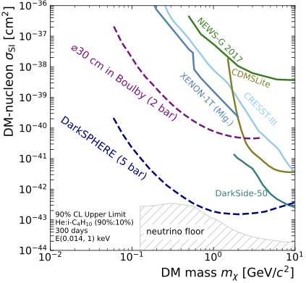
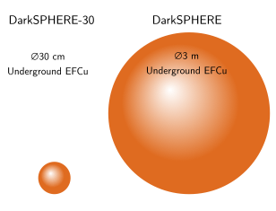
Physics Potential
Fully electroformed spherical proportional counters will have world leading sensitivity to low-mass dark matter
DarkSPHERE-30 to begin construction
Alloys being explored to improve the properties of electroformed copper – PureAlloys and PureCuAlloys projects
  NIMA 1082 (2026) 170970
  Communications Physics (2025) 8 464
  arXiv:2059.07406
  arXiv:2606.24524
See talk on Cu alloys:
👩‍🏫 D. Spathara
O(
)
Phys. Rev. D 108, 112006

Slide 15
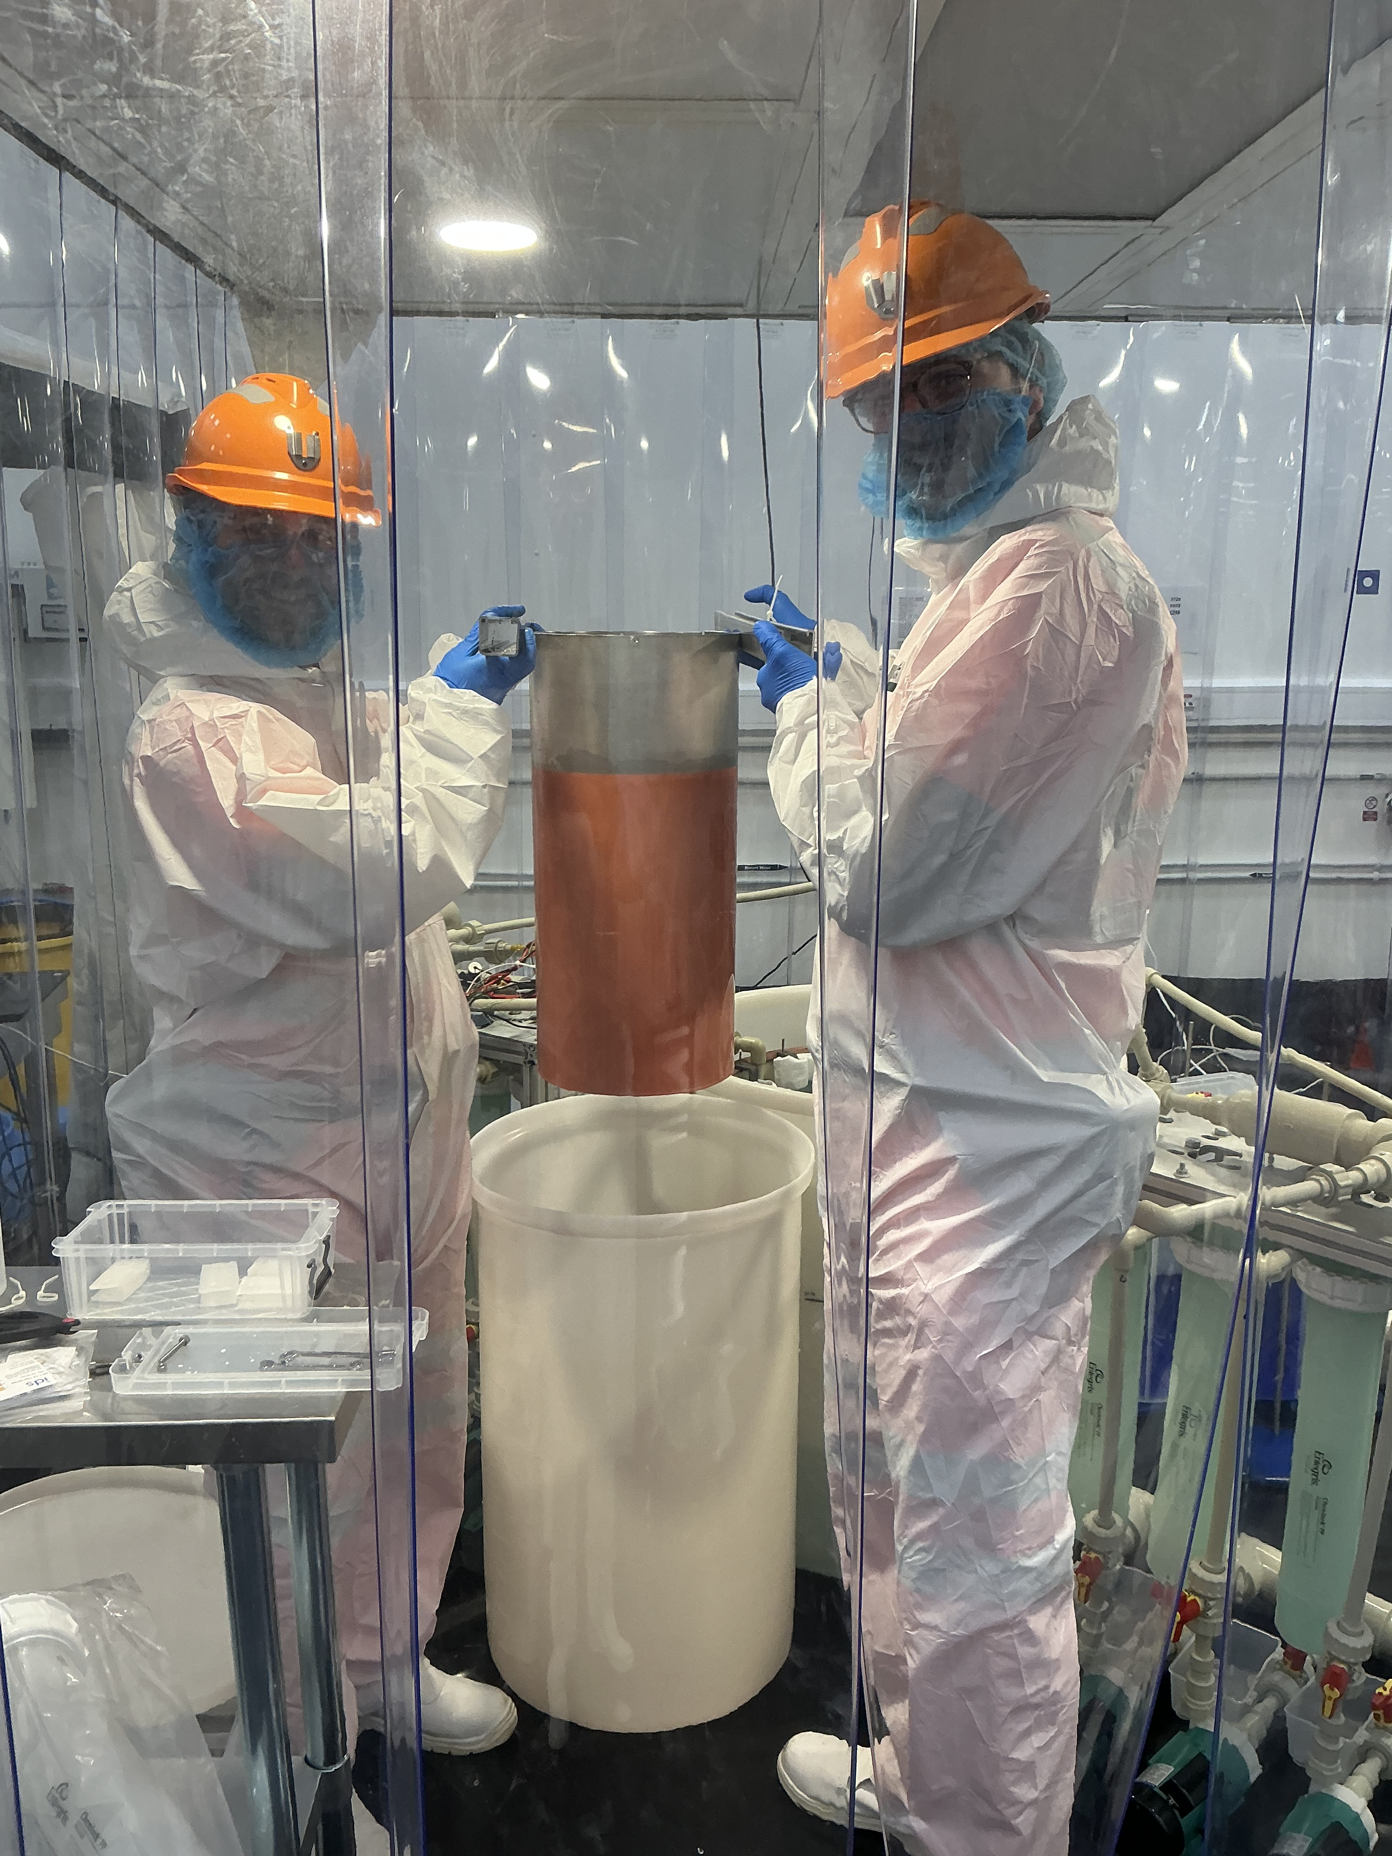
Summary
Copper electroforming for radio-pure detectors
Orders of magnitude improvement in radiopurity over commercial Cu
Electroforming facility constructed at Boulby
First copper produced
Work ongoing to electroform a ⌀30 cm SPC
Many experiments exploring the use of electroformed and plated Cu

