Slide 1
Electroformed Cu-Cr Alloys
Matthew Newton
Matthew Comins, Katarzyna Grubel, Steven Livers, Kimbrelle Thommasson, and Laura di Vacri

Slide 2
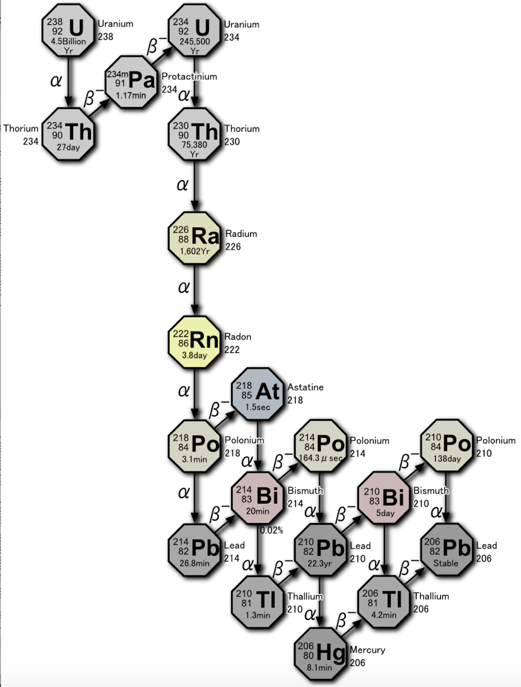
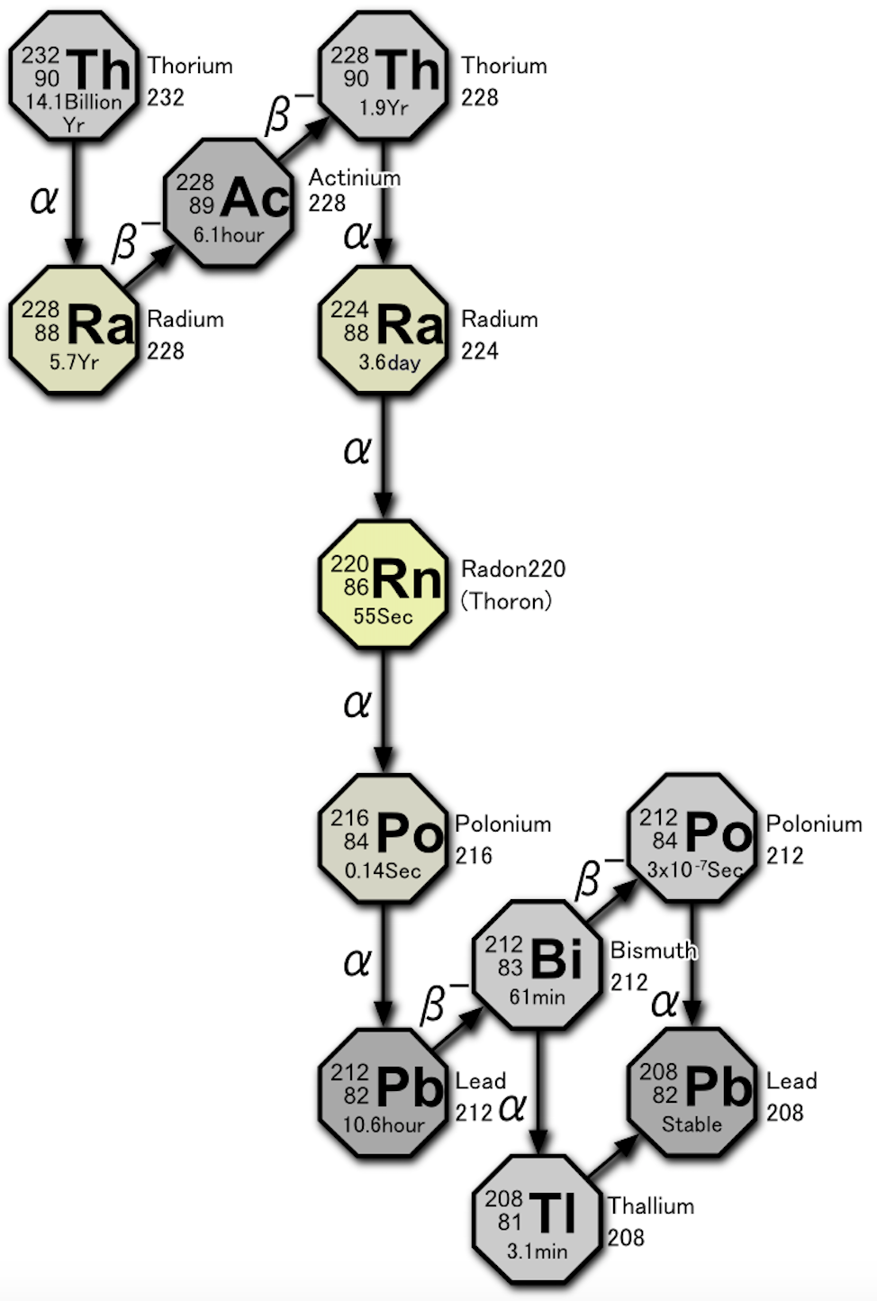
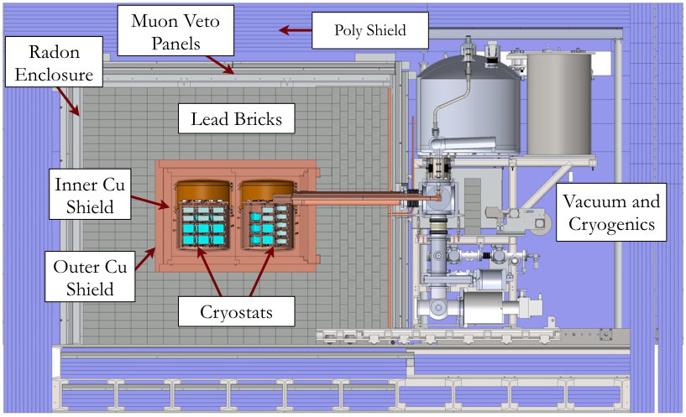
BACKGROUNDS · why radio-pure materials
Background mitigation in ultrasensitive detector: a crucial aspect
Detector materials with extremely low levels of radioactive backgrounds
Underground facilities and detector shielding
Uranium-238
Thorium-232
Majorana Demonstrator
Images from By Tosaka - Own work, CC BY 3.0, https://commons.wikimedia.org/w/index.php?curid=5531106

Slide 3
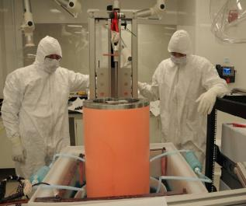
BACKGROUNDS · Choosing radio-pure materials
Detector materials must be radiopure AND mechanically capable
Copper is the field's workhorse — but it is soft, and thick, self-supporting structures push the limits
Material | Best purity (²³²Th/²³⁸U) | Yield strength [MPa] | Density [g/cm³] | Notes
Cu (EF) | <0.1 μBq/Kg | ≈90 | 8.96 | Ultrapure but soft and slow
Cu (OFHC) | 1-10 μBq/Kg | ≈70 | 8.96 | Less pure, needs treatment
Pb (ancient) | ~4x10³ μBq/Kg (²¹⁰Pb) | ≈10 | 11.3 | Great shield; structurally weak
W | ~10³ μBq/Kg | ≈750 | 19.3 | Strong and dense; hard to assay
Ti | 10³ - 10⁴ μBq/Kg | ≈ 240 | 4.5 | Under consideration at PNNL
Key material for the Majorana Demonstrator
(10.1103/PhysRevLett.130.062501)
Why copper still wins for detector components
• PNNL has developed ultra-radiopure electroformed Cu
• Low cosmogenic activation, machinable, well-characterized, benign chemistry
• But: yield strength is only ~90 MPa → thicker, heavier parts are needed for structural safety
And other past/future experiments.
NEWS-G
(10.1016/j.nima.2020.164844)
DAMIC-M
(10.1016/j.nima.2019.162933)
LEGEND
(arXiv:2107.11462)

Slide 4
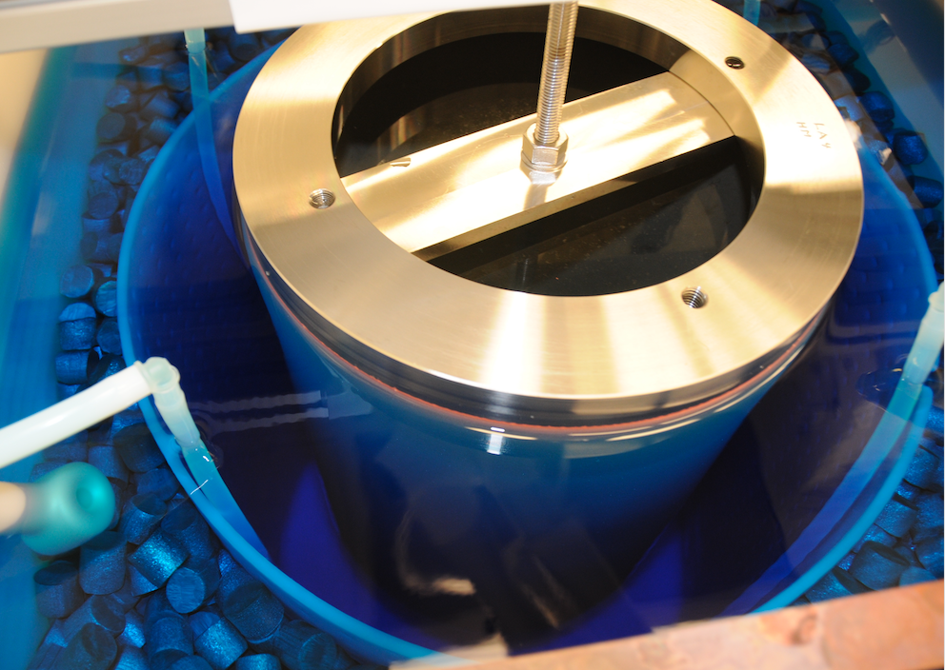
EF-Cu · Primary issues with what is currently produced
Electroformed copper is pure but weak and slow
~1 mm/mo
GROWTH RATE
Slow electrodeposition needed to keep purity — production is time-limited.
15–18 mo
TYPICAL BUILD TIME
Months of continuous plating for a single detector-scale part.
~90 MPa
PNNL EF-Cu production bath (Shallow Underground Laboratory).
The problem
YIELD STRENGTH
• Cu sacrifices radiopurity; annealing/cold-work don't help enough.
• Thicker walls = more mass = more background — a losing trade.
About 1/10 of common structural alloys — limits load-bearing use.
Refs: Hoppe et al., NIM A 764 (2014); Abgrall et al., NIM A 828 (2016); PNNL SUL production data.

Slide 5
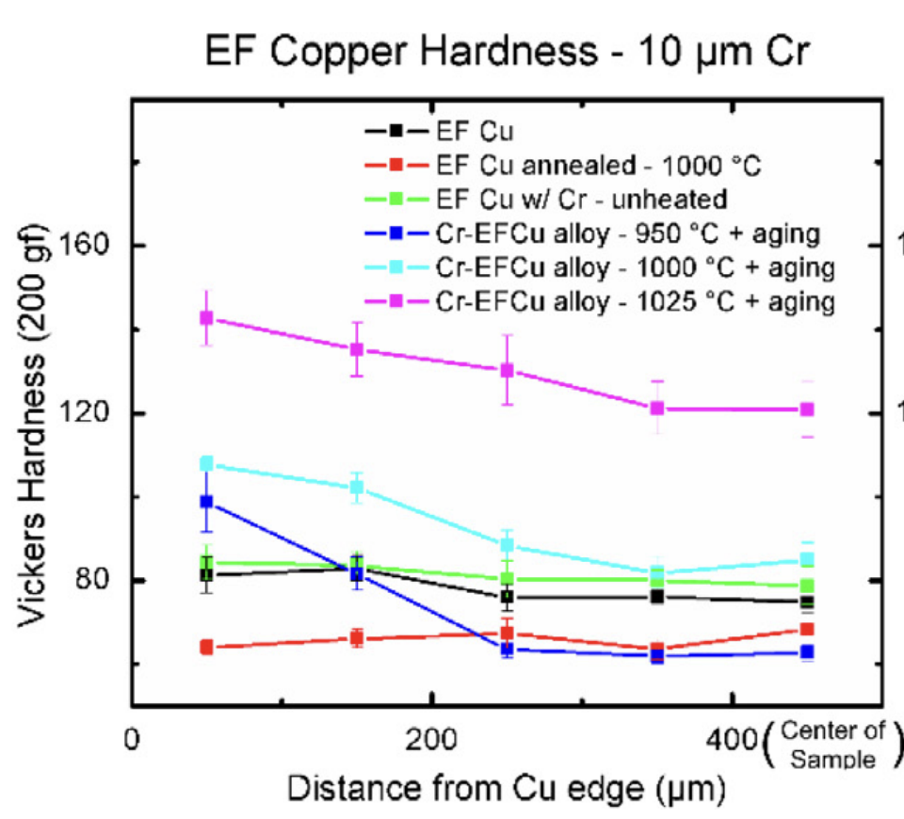
THE ANSWER · Copper–chromium alloys
Cu–Cr alloys are stronger — and can (potentially) stay radiopure
Cu–Cr precipitation-hardened alloys
Chromium in theory can be made radio-pure
The more than 1 V gap in reduction potentials between Cr and U/Th should allow for separation factors of several orders of magnitude.
Age-hardened Cu–Cr reaches 4–5× the yield of EF-Cu
Precipitation-hardened Cu–Cr exceeds 300 MPa.
Compatible with electrochemical deposition
Keeps the underground, contamination-controlled workflow.
Vickers hardness of EF-Cu vs Cu–Cr alloy under different heat treatments.
Refs: Vitale et al (2021),A preliminary investigaition into the electrodeposition and synthesis of radiopure copper-chromium alloys for rare event physics detector systems

Slide 6
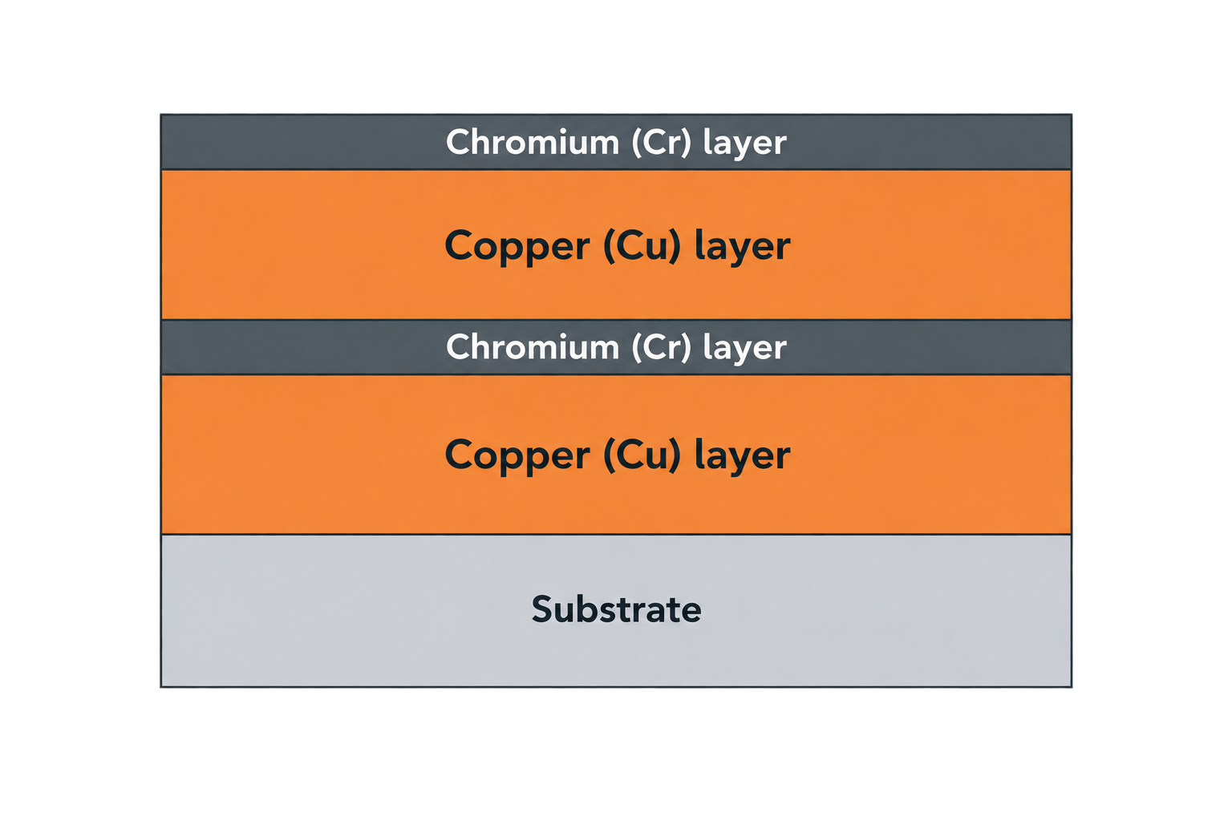
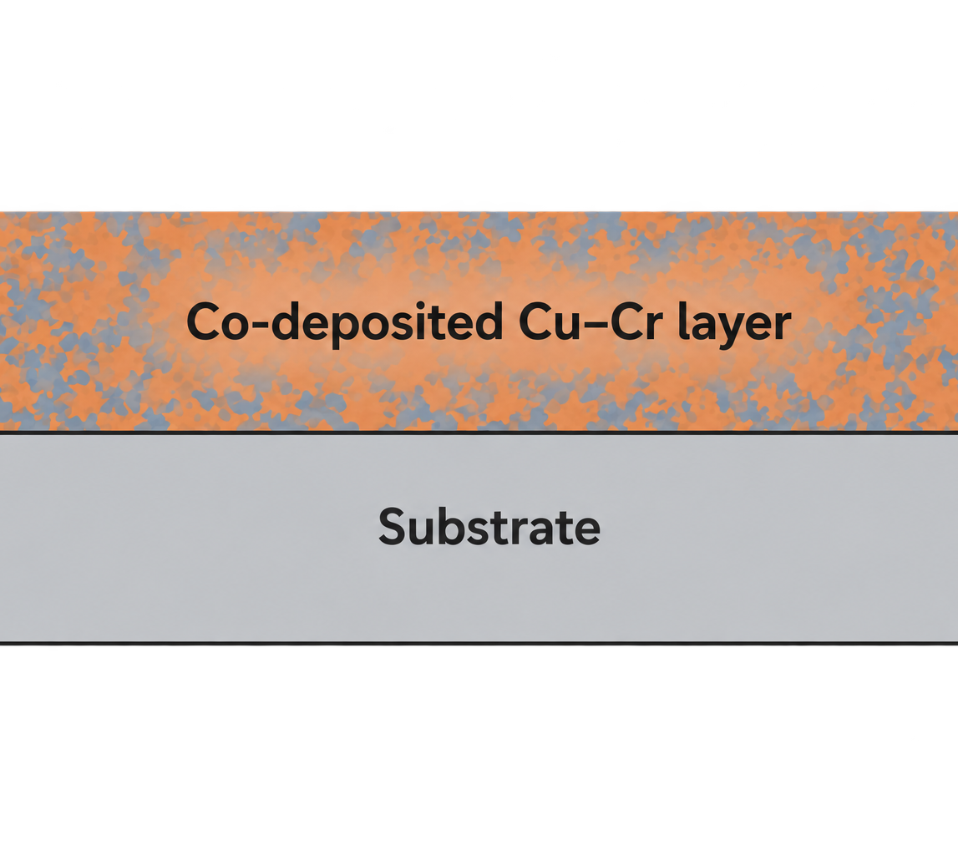
Layered plating vs. co-deposition
The approach · Deposition technique
For a bulk alloy at cm-scale thickness, we need Cr distributed throughout — not just as a coat
Layered plating: Cu + Cr + Cu
Co-deposition: Cu and Cr from a single bath
Approach
Alternate thin Cu and Cr layers, then inter-diffuse via annealing.
Approach
One electrolyte containing both Cu²⁺ and Cr(III); the alloy grows directly.
Our path: co-deposit Cu and Cr in a chemistry compatible with ultra-low-background material production.
Notes:
Pros
• Each bath separately optimized
• Uses well-known Cr(III) plating chemistry
Cons at radiopure, cm-scale thickness
• Regular transfers between baths → contamination risk
• Long annealing schedule for a uniform alloy
• Residual layered microstructure hard to eliminate
• Difficult to scale to full-detector geometries
Why we chose it
• Fewer process steps → fewer contamination pathways
• Intrinsic mixing at the atomic scale during growth
• Compatible with our existing EF-Cu infrastructure
• Directly scalable to detector-relevant geometries
Challenges we must confront
• Very different Cu²⁺ vs. Cr³⁺ reduction potentials
• Hydrogen evolution reaction (HER) at Cr³⁺ potentials
• Traditional Cr baths use organic additives → potentially not radiopure

Slide 7
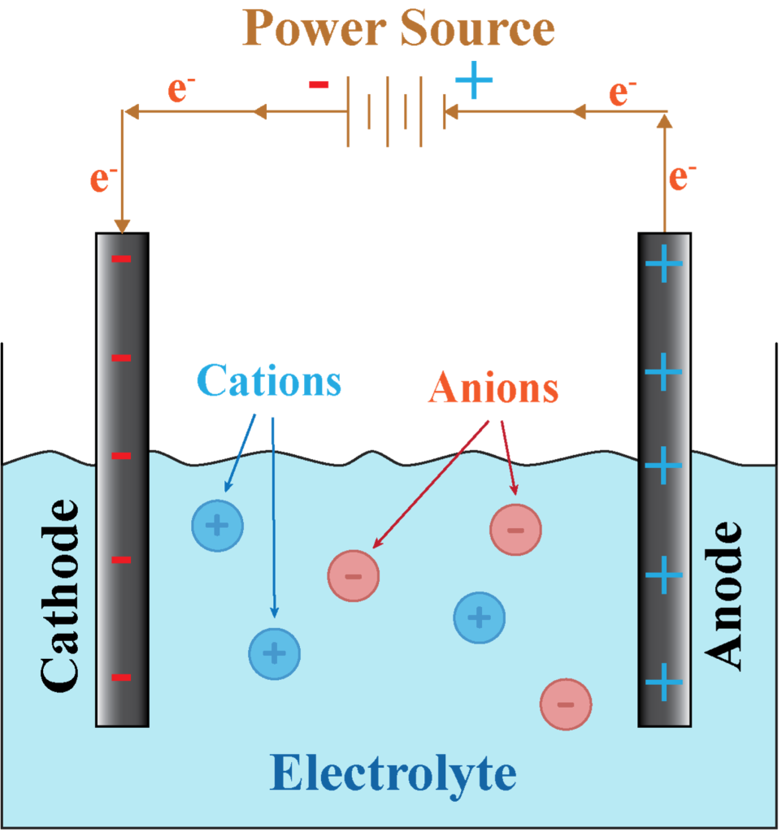
Aqueous Cr(III) electrodeposition: a two-step reduction dominated by hydrogen evolution
The approach · Aqueous deposition
Cu²⁺ is easy to reduce; Cr³⁺ is not — and everything below it competes with water
Two-step reduction of Cr(III)
Cr³⁺ + e⁻ → Cr²⁺ (slow, kinetically hindered)
Cr²⁺ + 2e⁻ → Cr⁰ (adsorbed intermediate)
Aqueous Cr(III) exists as strongly-bound aqua/complex ions:
[Cr(H₂O)₆]³⁺ [Cr(H₂O)₆₋ₓ Lₓ]⁽³⁻ˣ⁾⁺ (L = organic ligand)
Thick, stable Cr layers usually require organic additives (complexing agents, buffers, wetting agents…)
→ direct conflict with high-purity requirements
Standard reduction potentials
Species | E° [V]
Cu²⁺ | +0.34
Cr³⁺ | –0.74
Ti⁴⁺ | –1.63
UO₂²⁺ | –1.44
Th⁴⁺ | –1.90
H⁺ / H₂ (competing) | 0.00

Slide 8
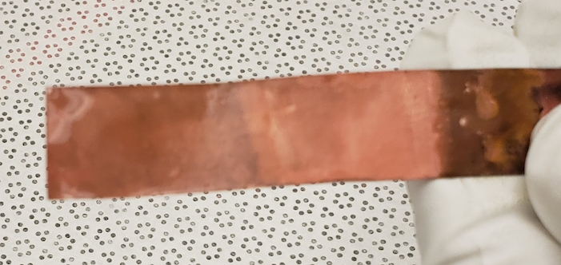
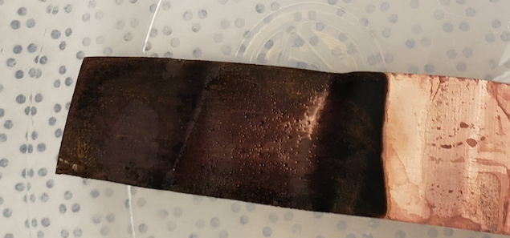
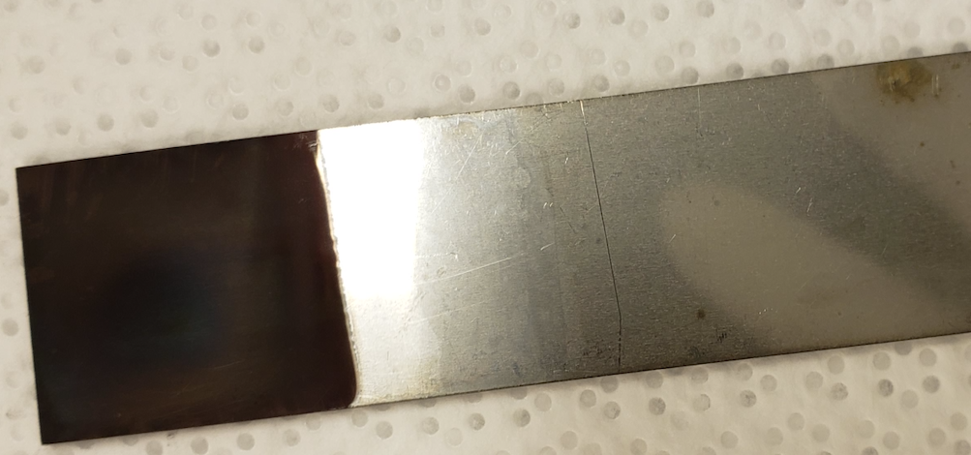
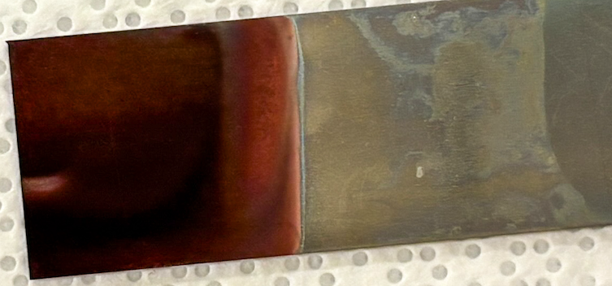
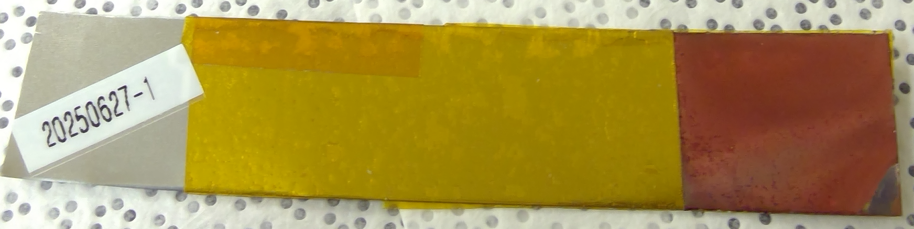
Initial Aqueous Cu-Cr depositions
Aqueous Tests
“Black” Metal is the First Step
First test depositions resulted in black metal on both Cu and SS substrates.
Subsequent tests show dark, coppery-red deposits
Cu-Cr on Cu from sulfate bath – no additives – Cu anode
Cu-Cr on Cu from sulfate bath – with additives – Cu anode
Cu-Cr on SS from sulfate bath – no additives – Cu anode
Cu-Cr on SS from sulfate bath – no additives – Cu anode
Cu-Cr on SS from sulfate bath – pH adjusted – Cu anode

Slide 9
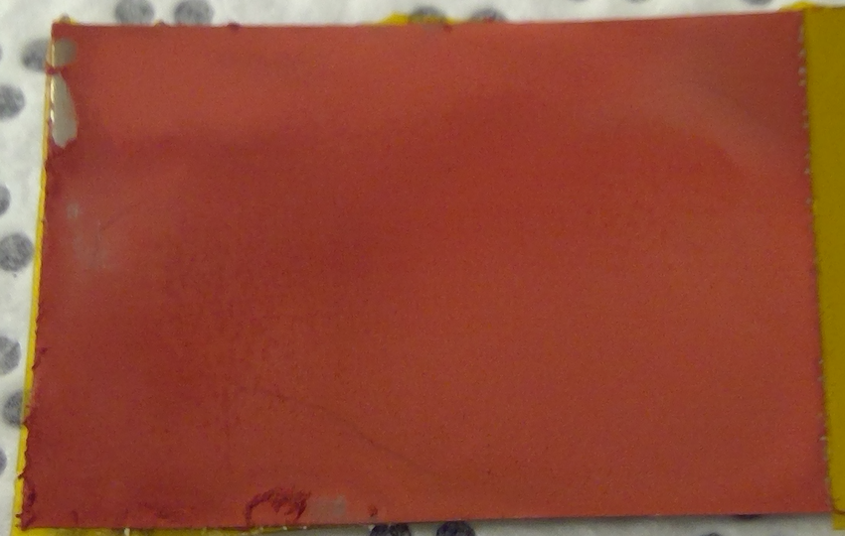
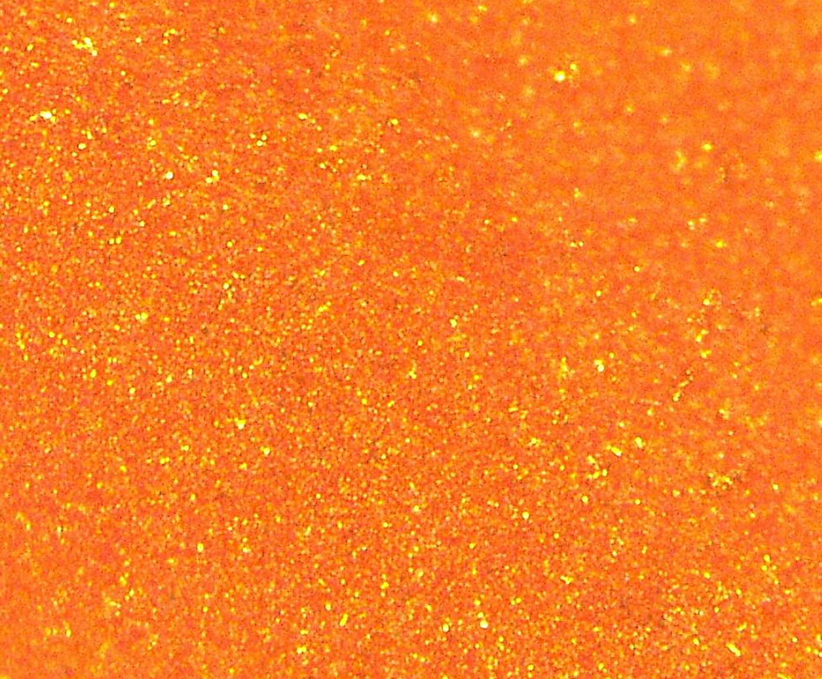
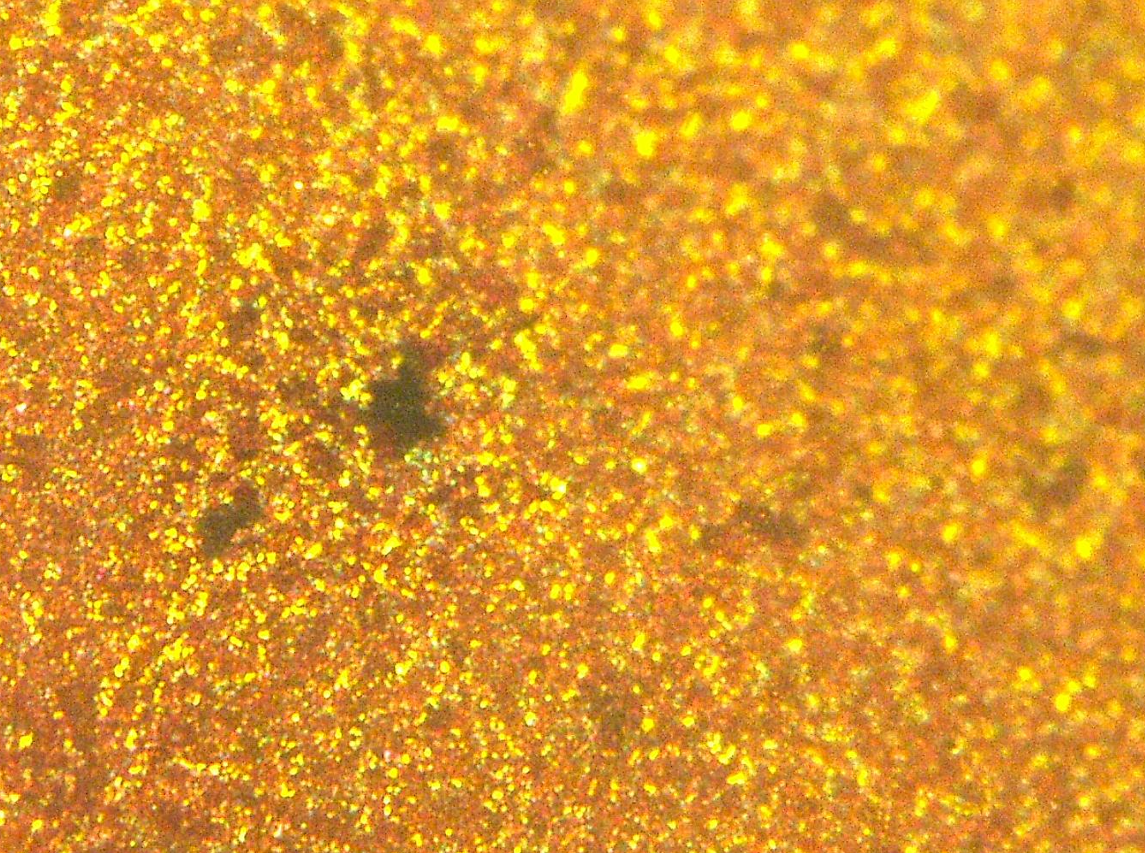
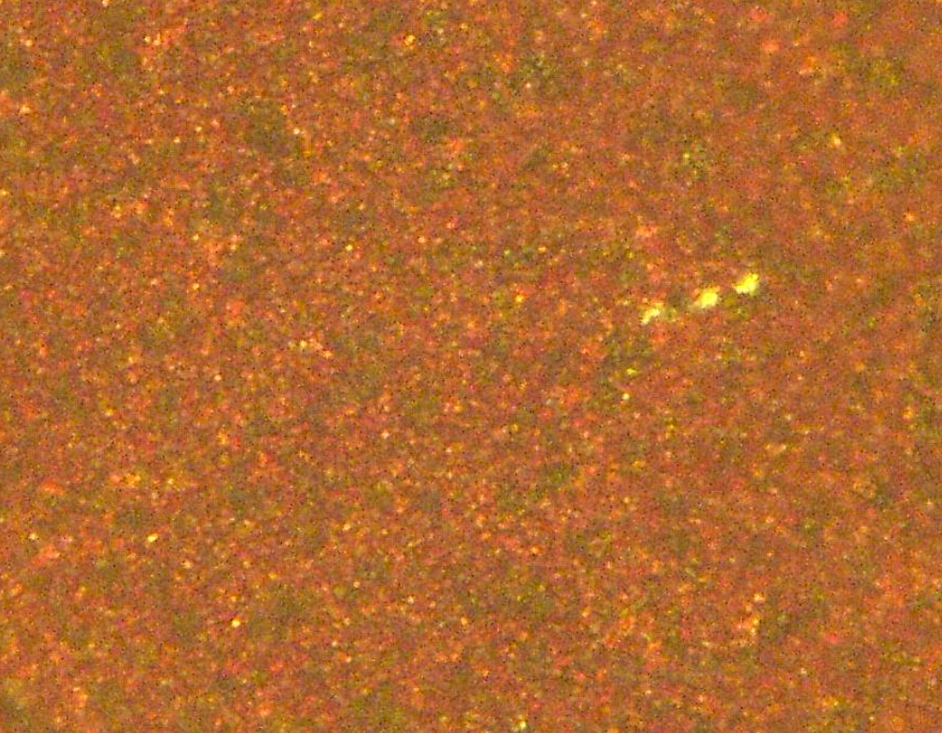
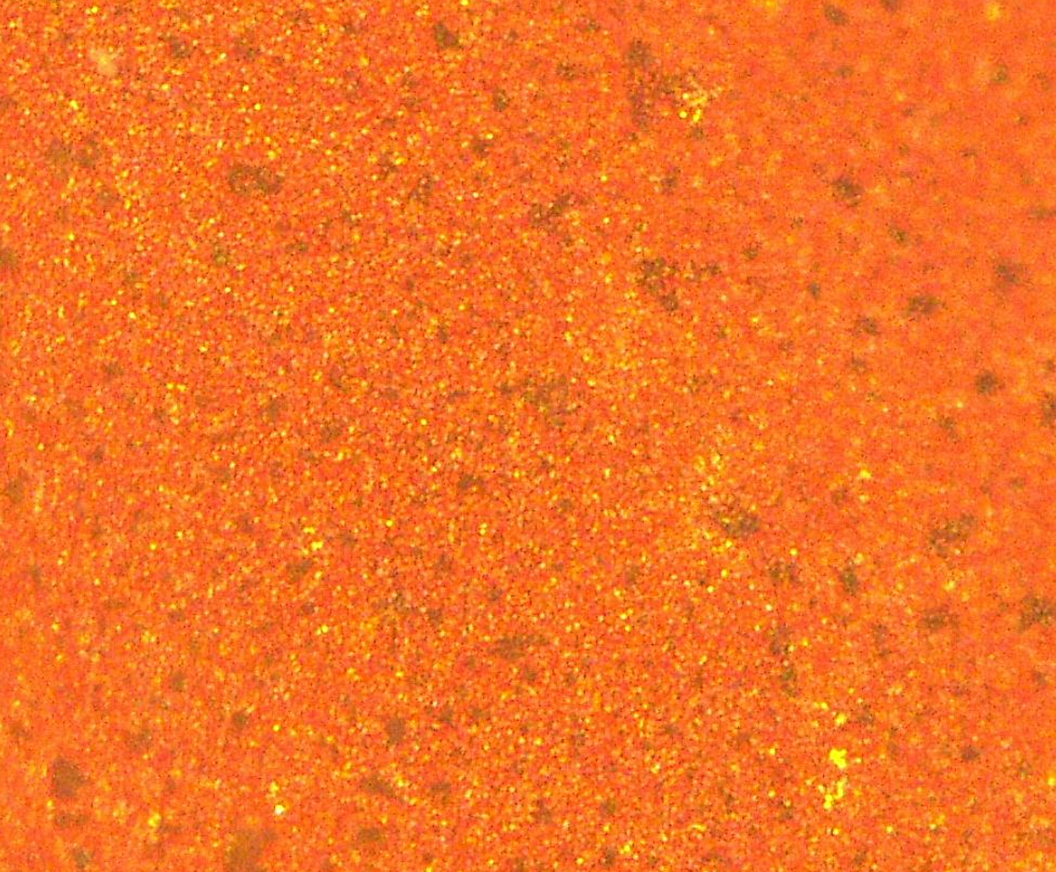
Aqueous Tests
Darker Cr rich regions are visible throughout Cu deposition
500x
500x
500x
500x

Slide 10
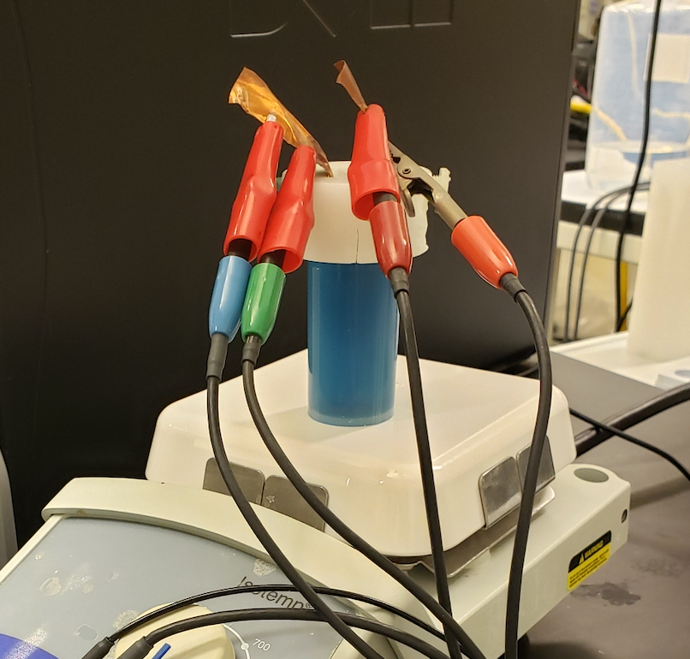
Early Tests Demonstrate Cu-Cr Co-Deposition
Aqueous Tests: Shift to chloride bath
Aqueous Cr(III) reduction in CrCl3 bath
Early testing with CrCl3 appeared to be more promising than the more common sulfate bath.
Additives included the following:
sodium formate
Boric Acid
lithium chloride
Polyethylene glycol
sodium dodecyl sulfate
Oxalic acid
Tri-sodium citrate
Several CrCl3 baths demonstrate promising Cr deposition alongside Cu.
→ Hydrogen evolution reactions hinder the deposition of high-quality Cu-Cr deposits
XRF of Aqueous Cu-Cr Deposition
Test ID | Cr wt%
10v2 | 2.37%
r1s10 | 5.57%
r5s6 | 0.53%
r6s3 | 0.31%
r7s2 | 0.66%
r8s12 | 1.71%
r11 | 2.36%
r12 | 50.40%

Slide 11
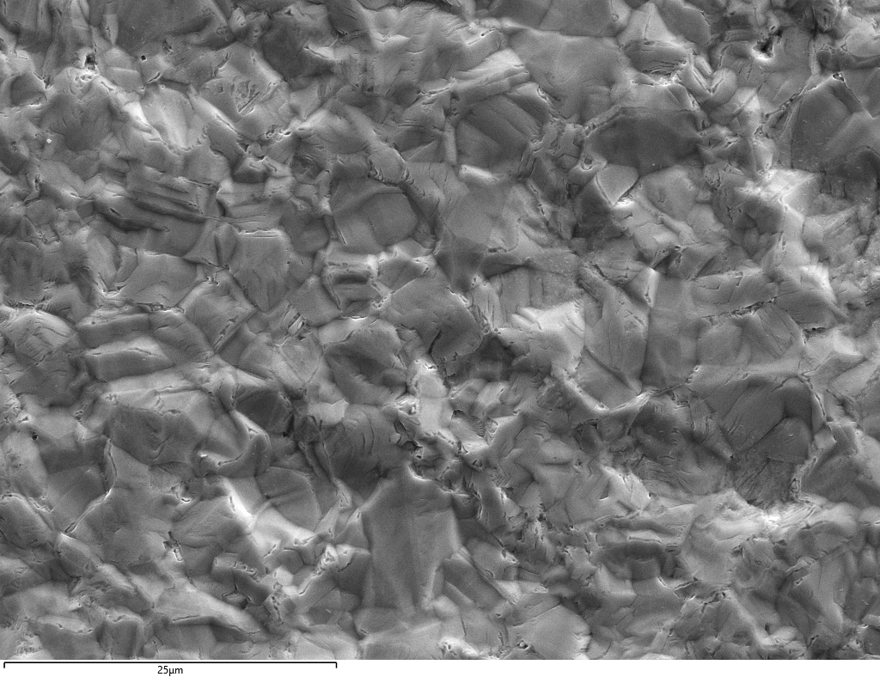
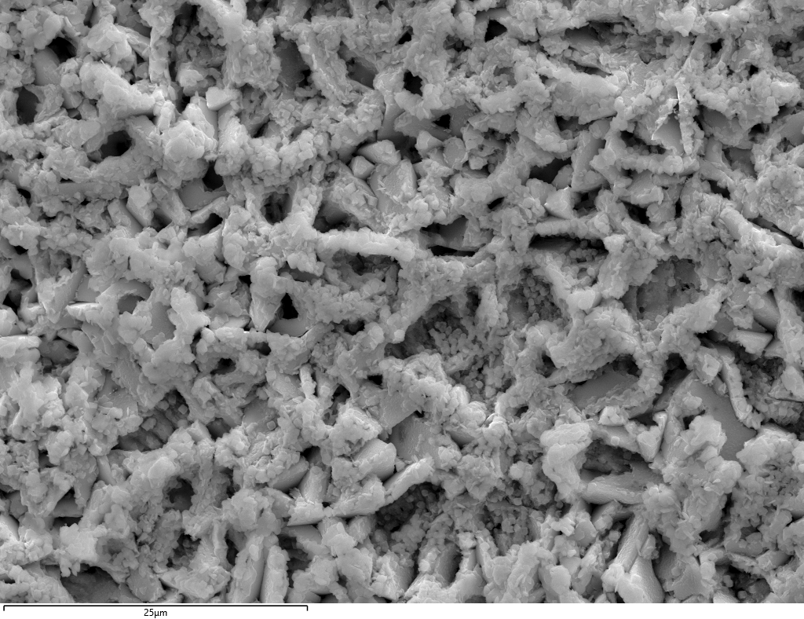
High overpotential causes porous, low-quality Cu deposits
Aqueous Tests – SEM analysis
“Clean” Surface
“Reacted” Surface

Slide 12
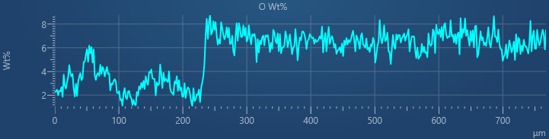
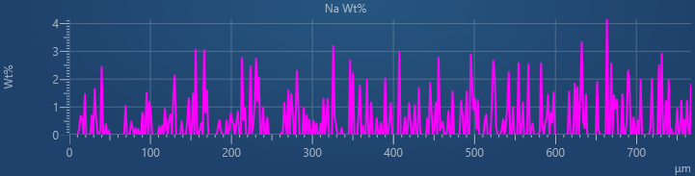
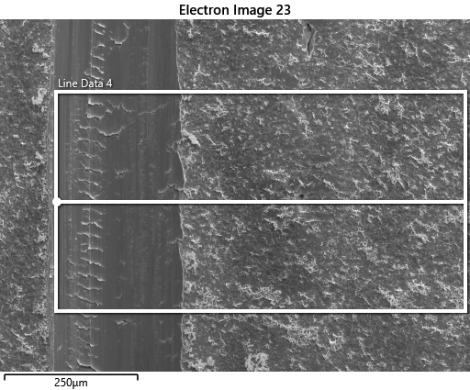
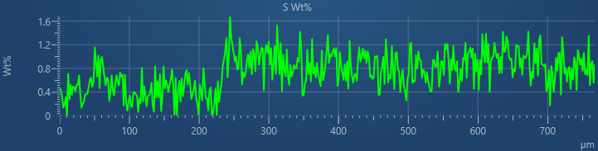
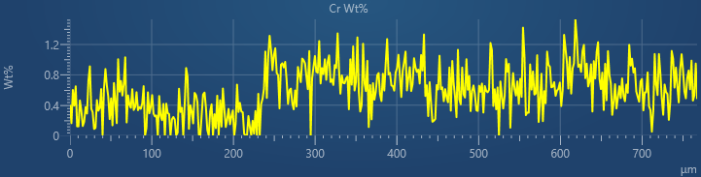
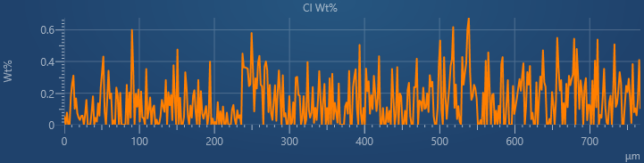
20kV EDS Linescan: HER causes Cr oxides/hydroxides
Aqueous Tests – EDS analysis
20250710-1

Slide 13
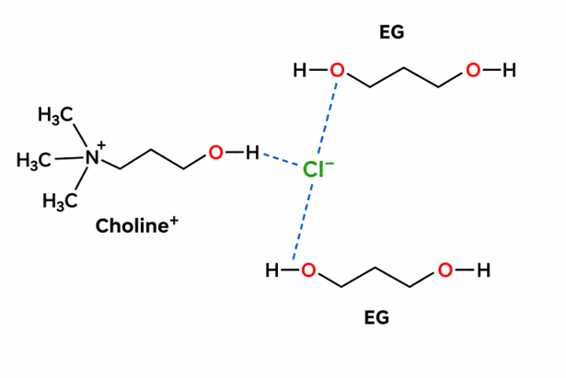
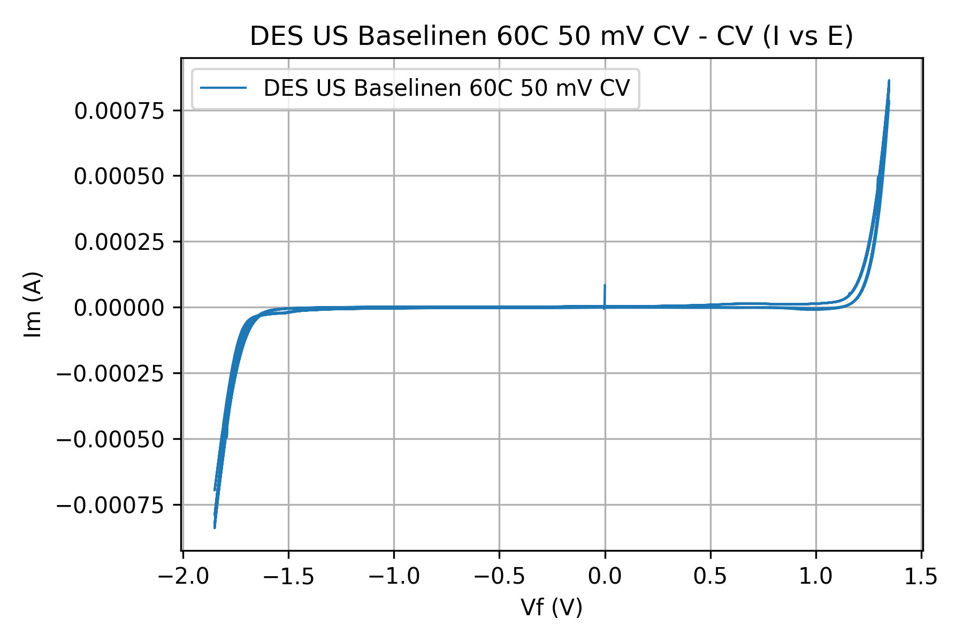
THE SHIFT · Deep eutectic solvents
Remove the water, remove the hydrogen problem
Aqueous Window
ChCl:EG 1:2 — Cl⁻ hydrogen-bonded to choline and two ethylene glycols
Cr Deposition
Cu Deposition
Aqueous Cr(III): H₂ evolves first → low efficiency, Cr(OH)₃, pitting
No free water → no HER at the working potential
Low viscosity, high conductivity DES: ~36 cP, ~7.6 mS/cm
Dissolves CrCl₃ and CuCl₂ directly; crack-free Cr (Abbott 2004)
Baseline Ethaline CV, 60 °C, sonicated, 50 mV/s. Stable window ≈ 3 V (−1.7 to +1.3 V) vs ≈ 1.2 V for water. Shown vs Ag/AgCl Reference
Cr and Cu reduction potentials both fall inside the window — no competing H₂ evolution.
DES is a fluid made of a hydrogen bond donor and a hydrogen bond acceptor
Refs: Smith, Abbott & Ryder, Chem. Rev. 114, 11060 (2014); Abbott et al., Chem. Eur. J. 10, 3769 (2004); J. Electrochem. Sci. Technol. (2020) doi:10.33961/jecst.2020.01522.

Slide 14
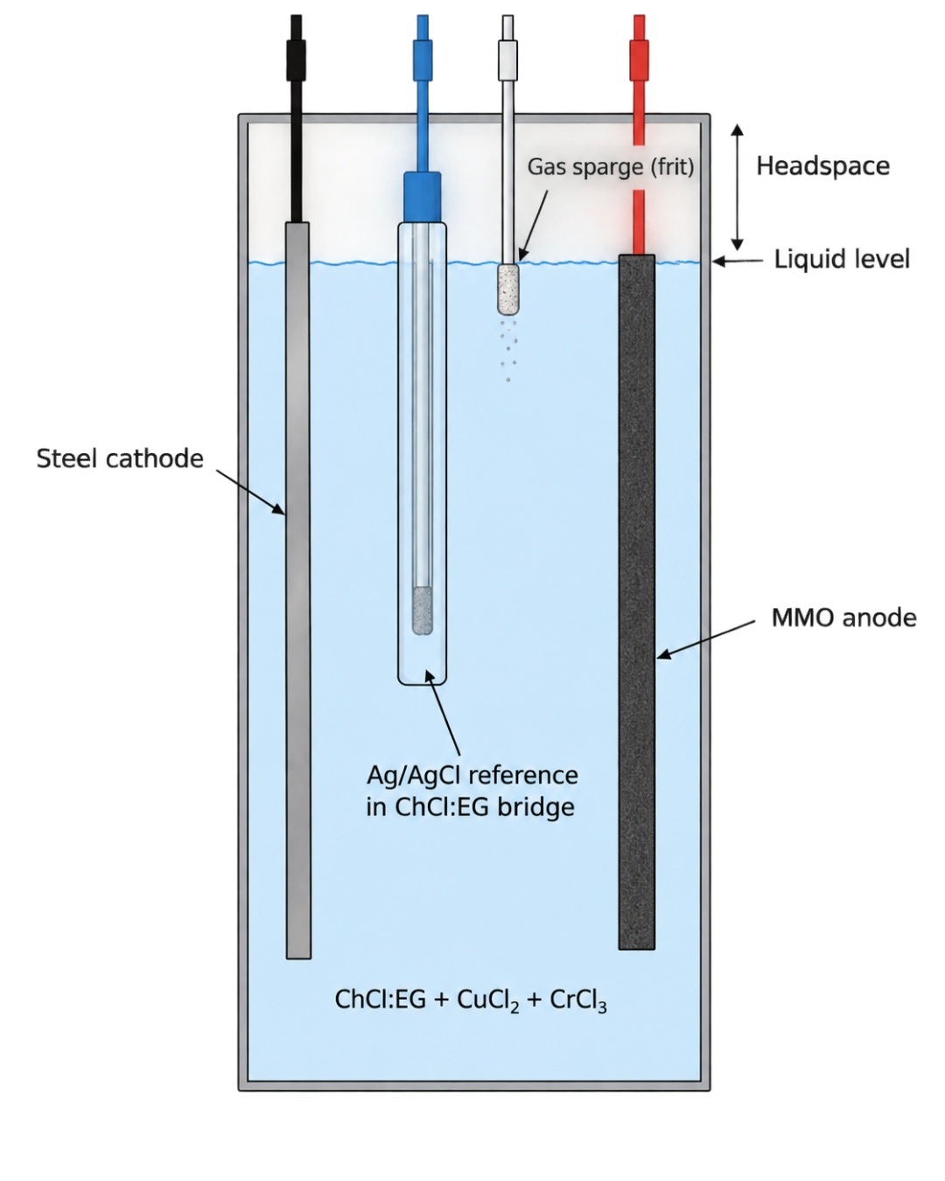
EXPERIMENTAL SETUP · Co-deposition of Cu-Cr from ChCl:EG
Sonicated three-electrode cell at 60 °C
Electrolyte
Electrodes
ChCl:EG 1:2 (Ethaline) + CuCl₂ + CrCl₃
Water-free bath → HER suppressed
Headspace sparged/blanketed
WE: steel cathode
CE: mixed-metal-oxide (MMO) anode
RE: Ag/AgCl in ChCl:EG salt bridge
Thermal & agitation
Electrochemistry
Ultrasonic bath holds cell at 60 °C
Lowers DES viscosity → better conductivity
Sonication drives mass transport; cleans surface, disrupts H₂/bubble
Gamry Interface 5000 potentiostat
Potentiostatic: −0.9 to −1.2 V vs Ag/AgCl
Held constant for each run
Run matrix
Why sonication?
Durations: 30 min → 5 h
Potential × time → thickness & Cr content
Deposits characterized post-run (SEM/EDS, LIBS, LA-ICP-MS, XRF)
DES is 40× more viscous than water
Ultrasound thins diffusion layer, refines grain size & strips bubbles
Stable T + agitation → repeatable Cu:Cr ratio
One bath: constant potential in sonicated Ethaline at 60 °C — thickness/Cr fraction tuned by potential, time & composition.

Slide 15
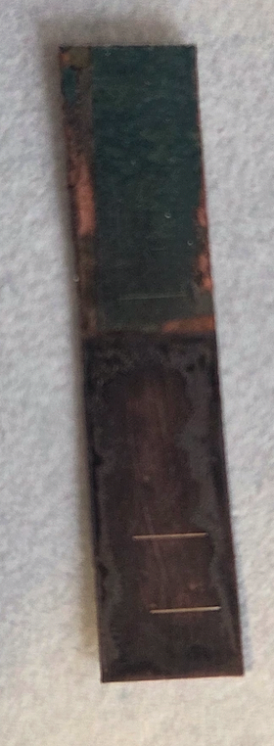
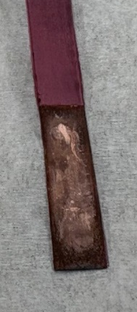
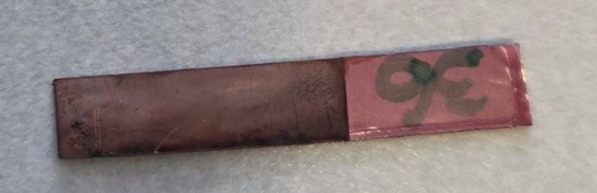
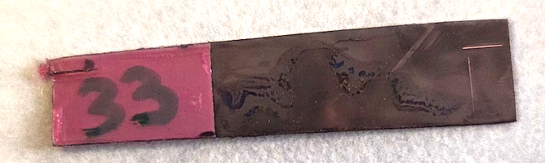
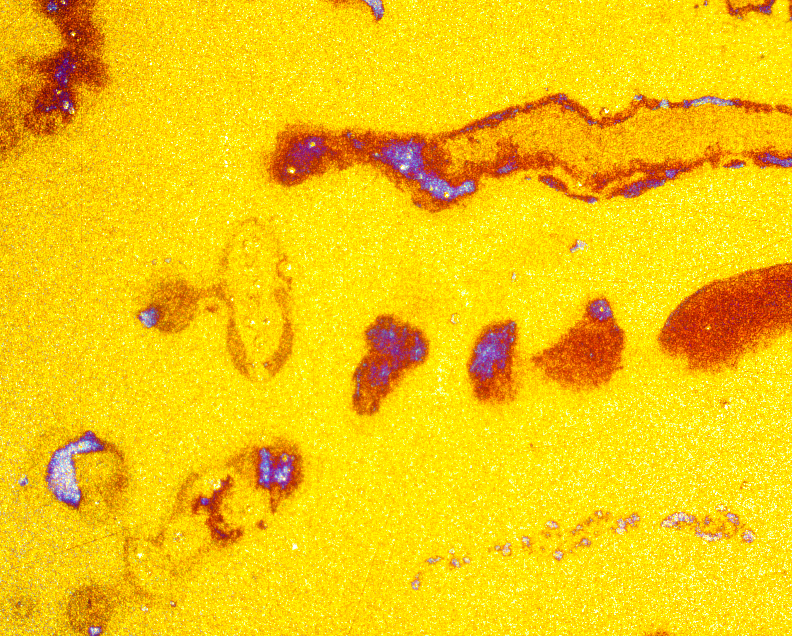
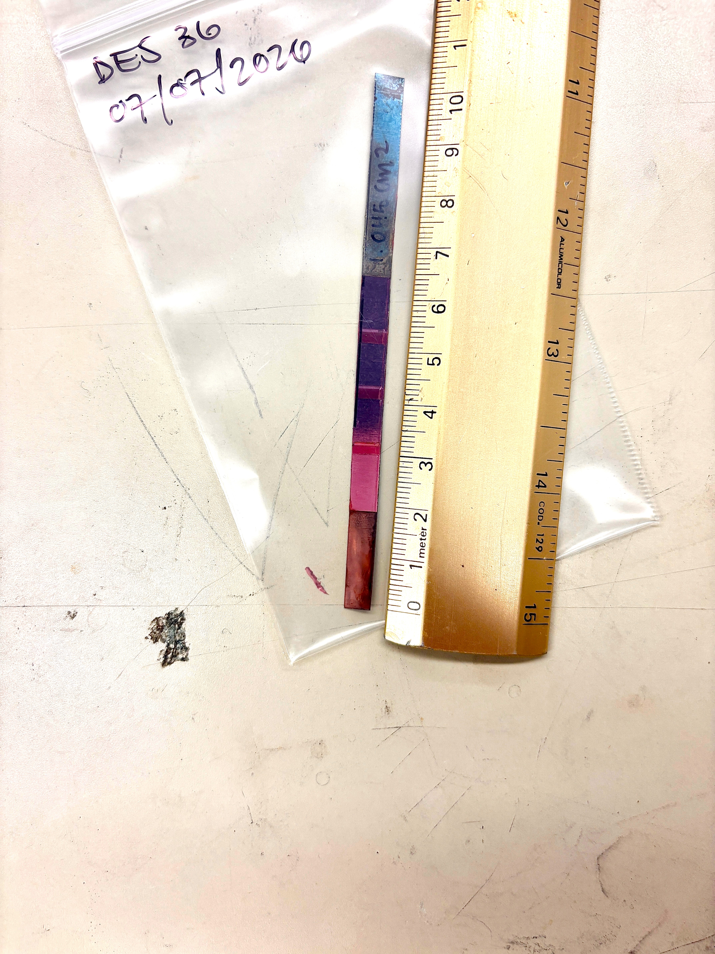
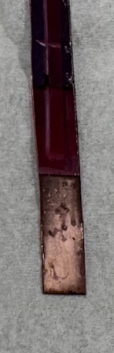
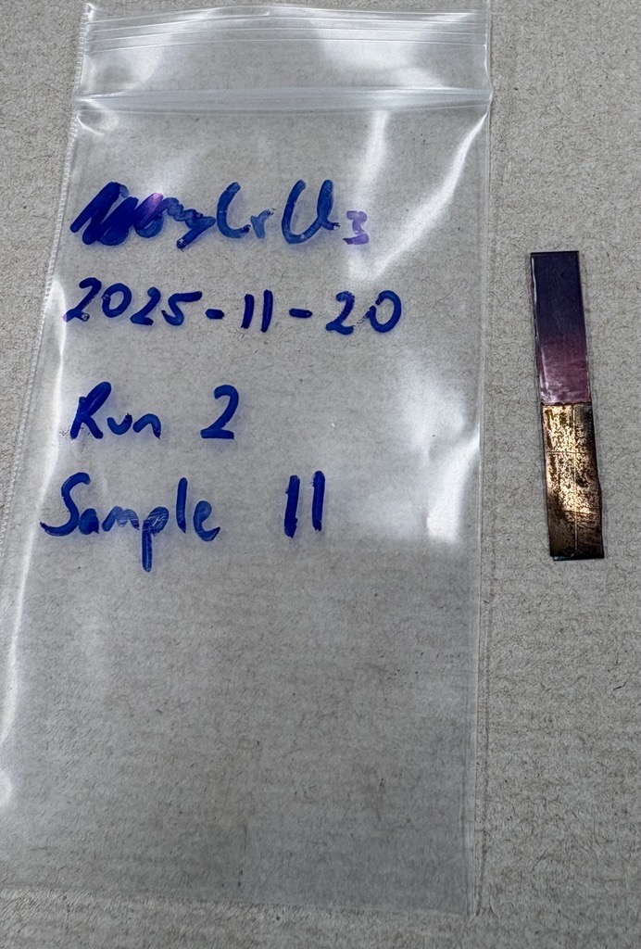
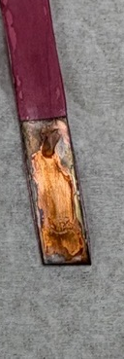
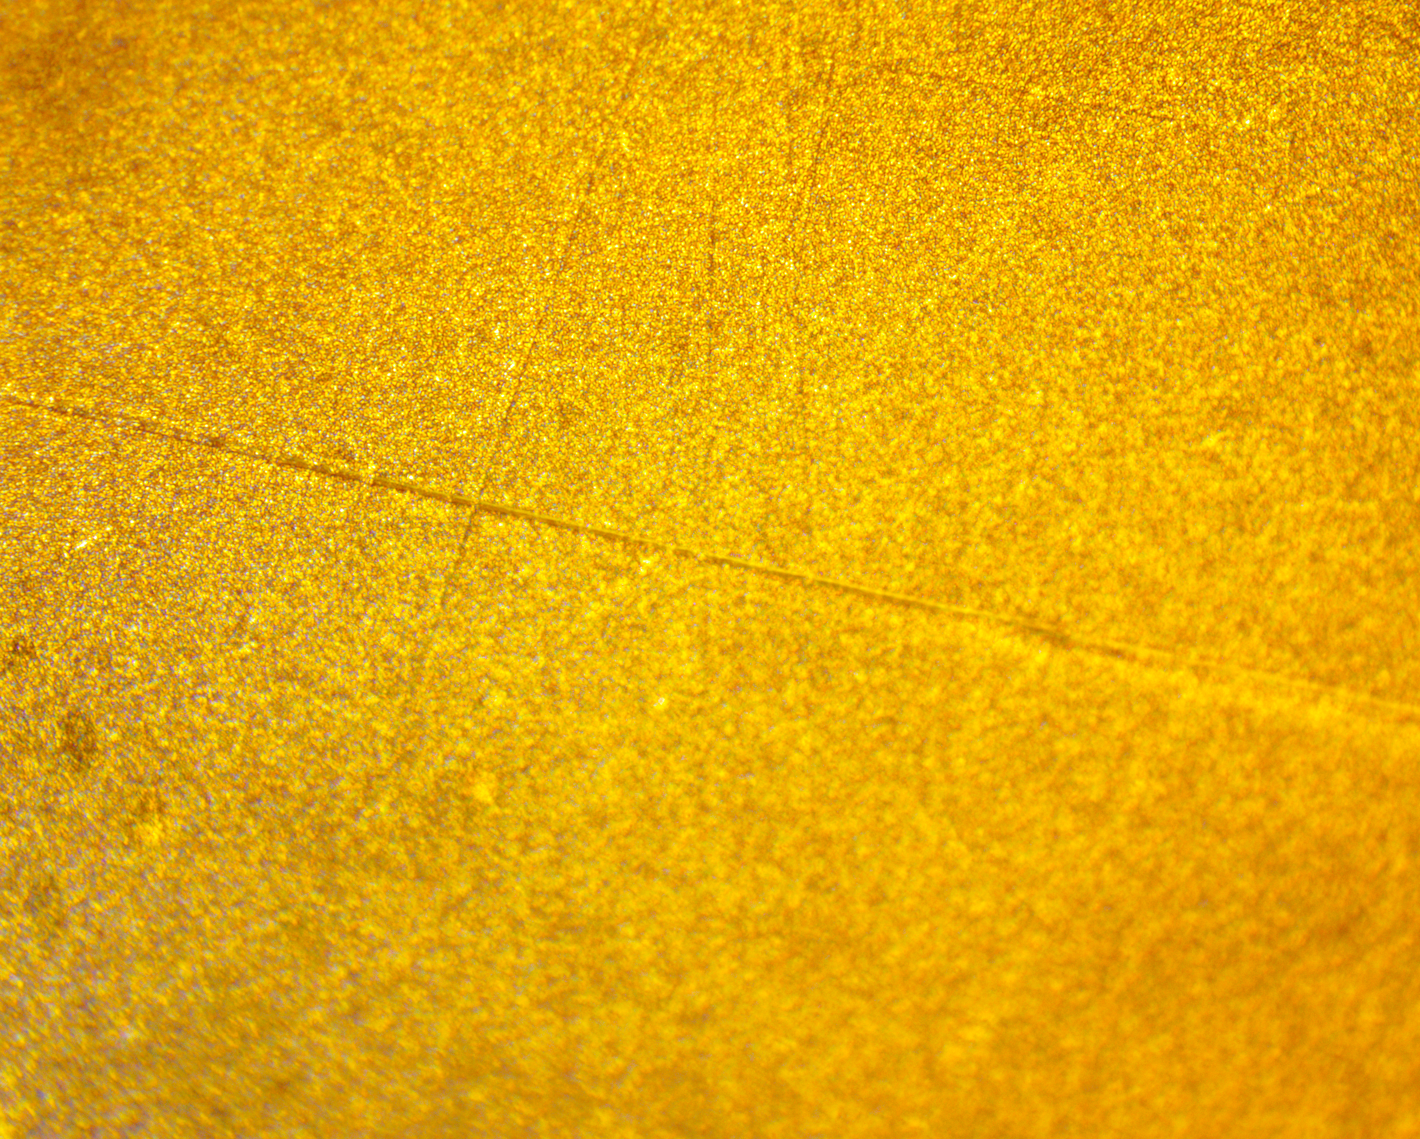
Initial DES Tests
Results – DES analysis
Cr Concentrations in DES co-deposition tests meet and in some cases exceed our target zone using XRF and LA-ICP-MS.
Most tests are co-plating around 0.4% Cr.
About 25% of tests fall within the target range of 0.4 – 1.2 wt% Cr.

Slide 16
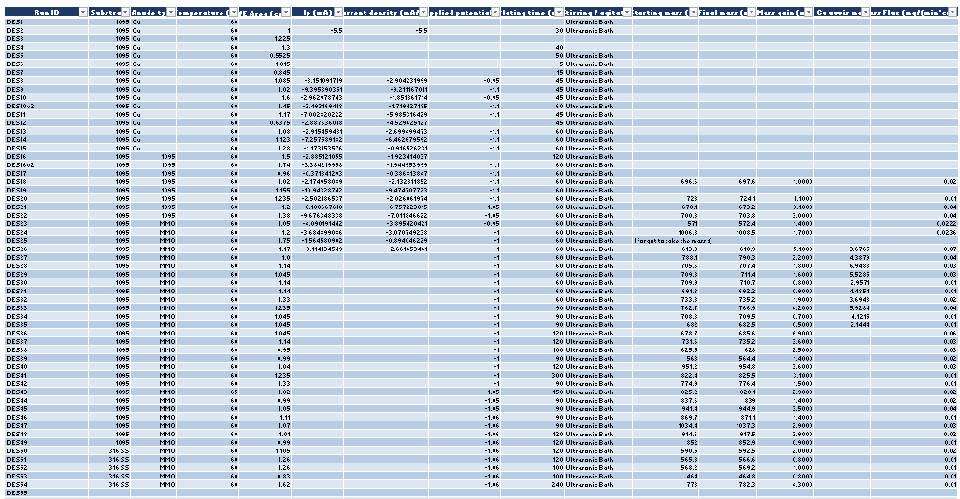
DES system has a large number of variables
Optimizing the DES system

Slide 17
Conclusions
High-purity electroformed copper is a key material to low-background detectors but shows suboptimal mechanical properties
  A stronger radio-pure material is needed
Previous work demonstrated that alloying copper with Cr can significantly increase strength without significantly affecting purity
  Individual plating, followed by annealing and precipitation hardening
This work is exploring co-electrodeposition of copper and chromium
Demonstrated that both an aqueous chloride bath and a DES bath appear to be co-depositing Cu-Cr
  Aqueous baths: higher Cr concentrations, but hydrogen evolution causes low-quality deposits.
  DES bath can achieve the target range of Cr and provide higher quality deposits, but mass transport limitations add to run times

Slide 18
Next Steps
Optimize co-plating in DES baths
  Bath composition and geometry, temperature, plating program and duration, chromium content, and thickness
Investigate alloy formation through heat treatment and precipitation hardening
Test hardness and other mechanical properties.
Transition to ultra-radiopure setup.

Slide 20
Back up slides

Slide 21
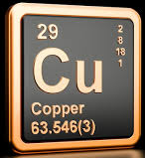
BACKGROUNDS · Choosing radio-pure materials
Copper: a key material
 | Best available purity [μBq/kg] | Yield Strength [MPa] | Density [g/cm³]
Cu | 1-10 (OFHC); <0.1 (EF*) | 70-90 | 8.96
Thermal and electrical conductivity
No major long-lived radionuclide
Low cosmogenic activation
Commercially available at relatively high purity levels
High density (for shielding)
²³²Th < 3.6 fg/g (< 0.015 μBq/kg)
²³⁸U < 9.4 fg/g (< 0.12 μBq/kg)
(10.1016/j.nima.2020.163761)
Can be produced extremely radiopure through electroforming
Key material for the Majorana Demonstrator
(10.1103/PhysRevLett.130.062501)
Element | Ionic species | Reduction potential [V]
Cu | Cu²⁺ | +0.34
Th | Th⁴⁺ | -1.90
U | UO₂²⁺ | -1.44
And other past and future low-background experiments. A few examples are:
NEWS-G
(10.1016/j.nima.2020.164844)
DAMIC-M
(10.1016/j.nima.2019.162933)
LEGEND
(arXiv:2107.11462)
PNNL electroforming facility

Slide 22
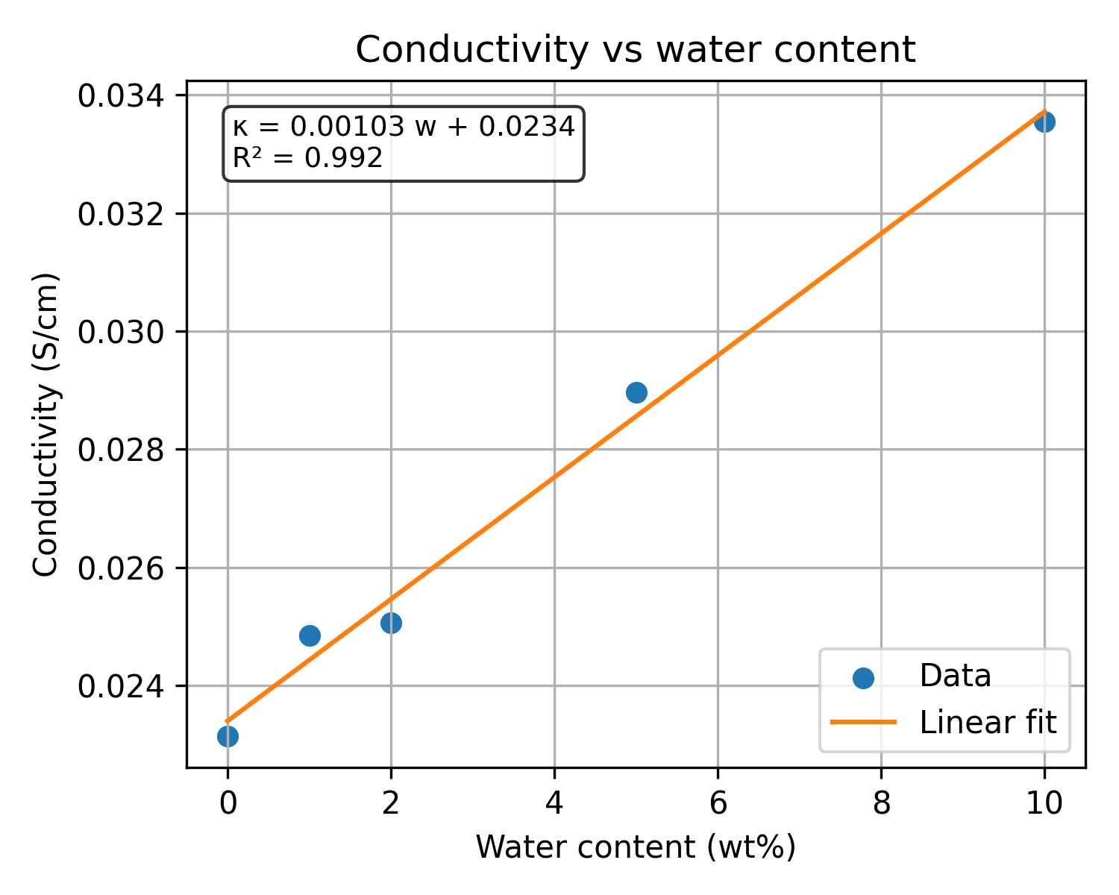
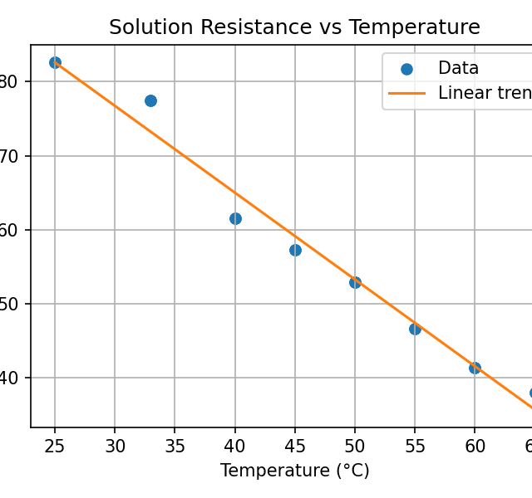
Extra Info for DES
What is the ultimate message of this slide?

Slide 23
