Slide 1
Development of an Ultrasensitive ICP-MS Assay Method for the Determination of U, Th, and K in Gadolinium Used in Scintillator Materials
Isaac J. Arnquist, Kenny Horkley,
Tyler Schlieder, Maria Laura di Vacri
Pacific Northwest National Laboratory
Scott Haselschwardt
University of Michigan
PNNL-SA-216883

Slide 2
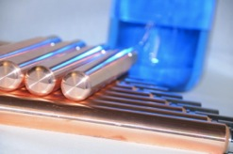
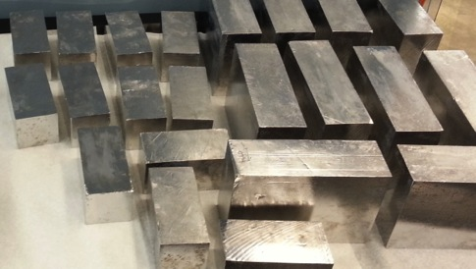
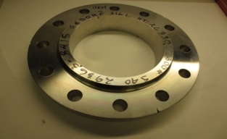
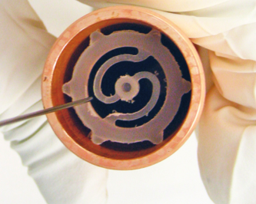
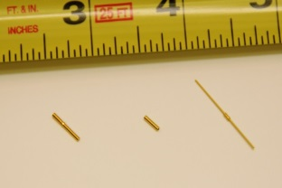
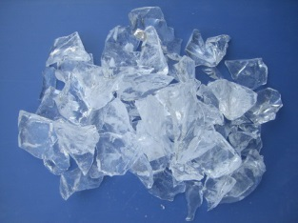
PNNL ICP-MS Toolkit
Material | Th/U Detection Limits
 | μBq/kg | ppt
Copper | <0.1 | <0.01
Titanium, Stainless Steel, Brass, Bronze, Tungsten, Lead, Nickel | <1 | <0.1
Polymers (HDPE, PTFE, PVDF, “Acrylic”, Kapton®, etc.) | <1 | <0.1
Nonpolar liquids (scintillators), Refrigerants | <0.1 | <0.01
Silicon, Quartz, Fused Silica | <0.1 | <0.01
Electronic Components (ASICs, SiPMs, resistors, capacitors, etc.) | <0.1 pg/piece <1 nanoBq/piece
Solutions | <0.01 | <0.001
For Reference
1 ppt Th = 4.1 μBq ²³²Th/kg
1 ppt U = 12.4 μBq ²³⁸U/kg

Slide 3
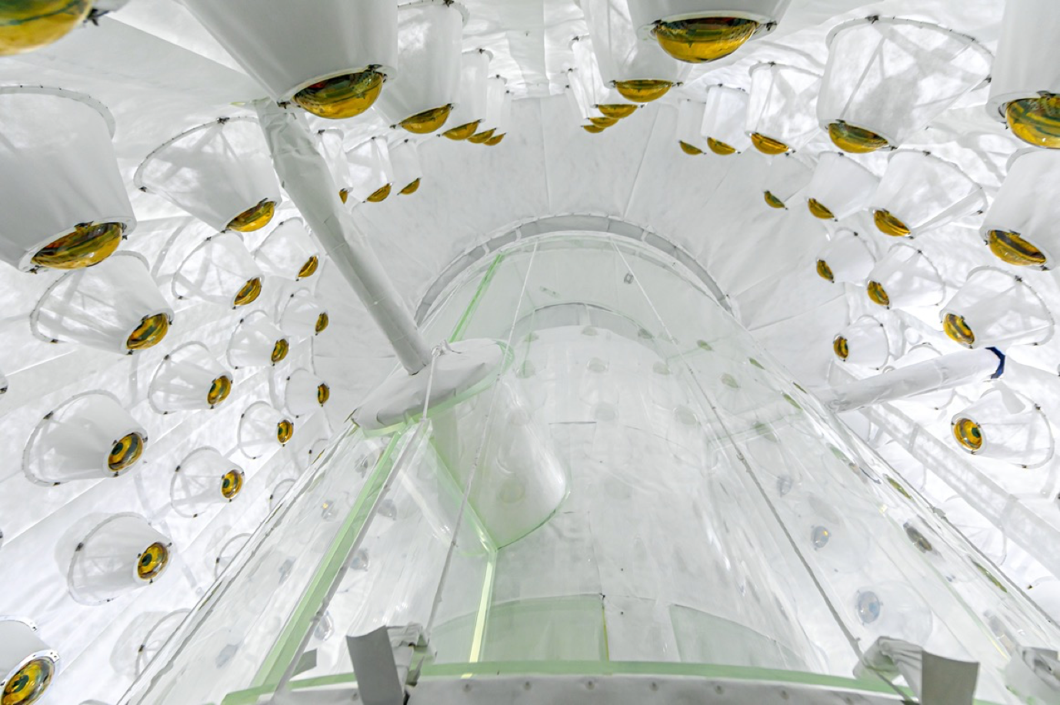
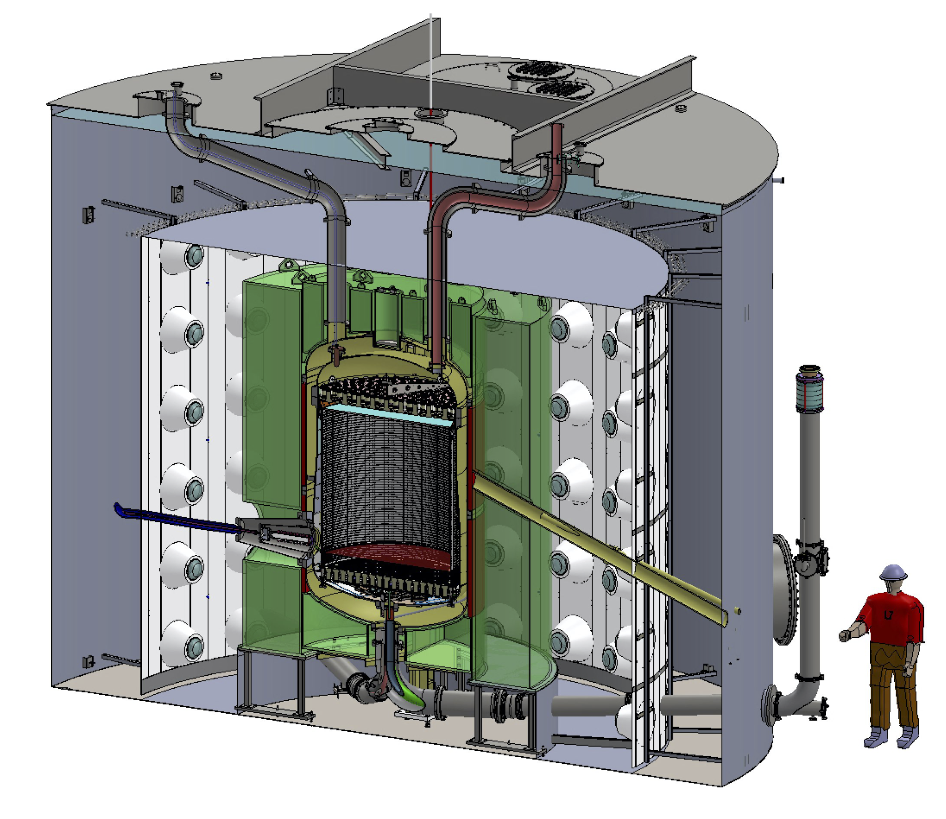
Background on Gd and connection to ULB Physics
Gd-doped liquid scintillator (GdLS) enables excellent neutron detection capability
  very high (>10⁴ barn) n-capture cross section of ^{155,157}Gd
GdLS successfully used in reactor neutrino experiments
  Daya Bay, Double-Chooz, RENO
For LZ → need much higher radiopurity by comparison:
  Minimize accidental coincidences → increase dark matter search livetime
  Target ~200 keV veto threshold for maximal efficiency
LZ

Slide 4
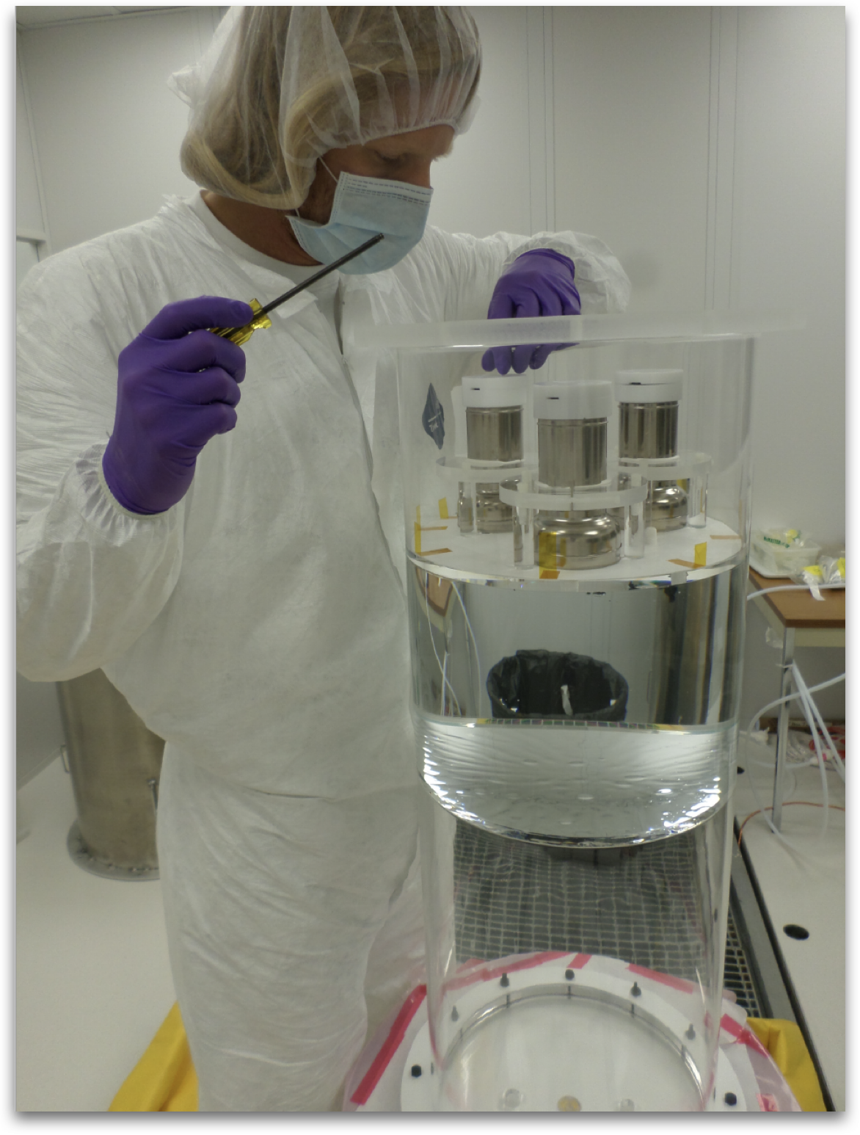
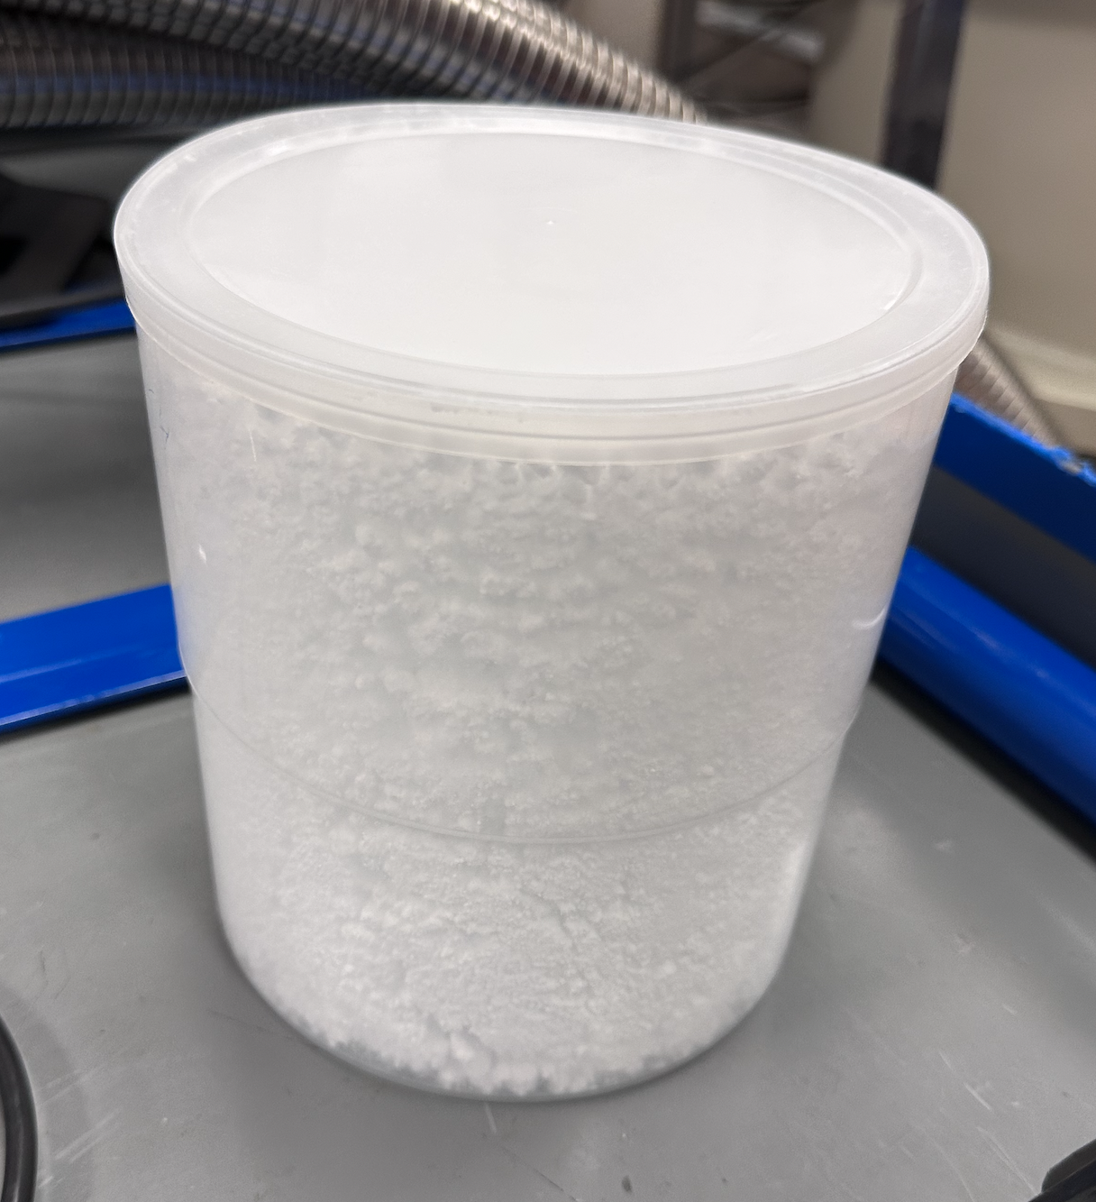
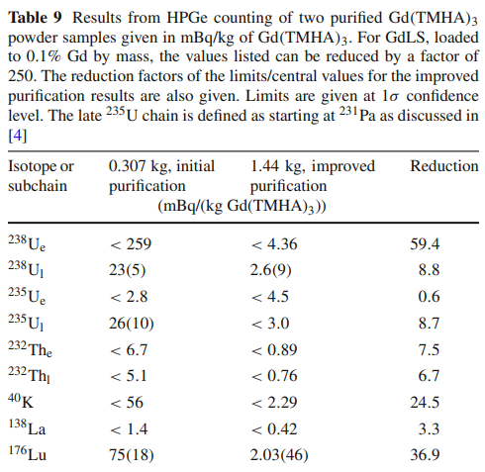
Purifying LZ GdLS
S.J. Haselschwardt et al, NIM A 937, 148–163 (2019)
GdLS Screener run → More aggressive chemical purification needed → developed at Brookhaven NL
HPGe of Gd(TMHA)₃ confirmed new procedure would meet requirements for LZ
Purified Gd(TMHA)₃ produced at BNL and screened w/HPGe
Eur. Phys. J. C (2021) 80 :1044
Notes:
From LZ Cleanliness Paper: “Achieving a low level of radioimpurities in the 17.3 t of GdLS used in the LZ OD is crucial for its performance as both an effective monitor of the experiment’s backgrounds and as an efficient veto for coincident events in the TPC. The admissible radioactive impurity levels in the GdLS are derived from the LZ requirement for a false veto rate of < 5% assuming an energy threshold of 200 keV and a maximum coincidence window of 500 µs between an interaction in the TPC and the OD. This restricts the event rate in the full 17.3 t of GdLS to be < 100 Hz. Approximately 39 Hz is expected from a combination of radioactivity in LZ construction materials and the flux of gamma-rays in the experimental hall which penetrate the water shield to reach the OD [43]. This allows for at most 61 Hz of rate to arise from impurities dissolved in the GdLS”

Slide 5
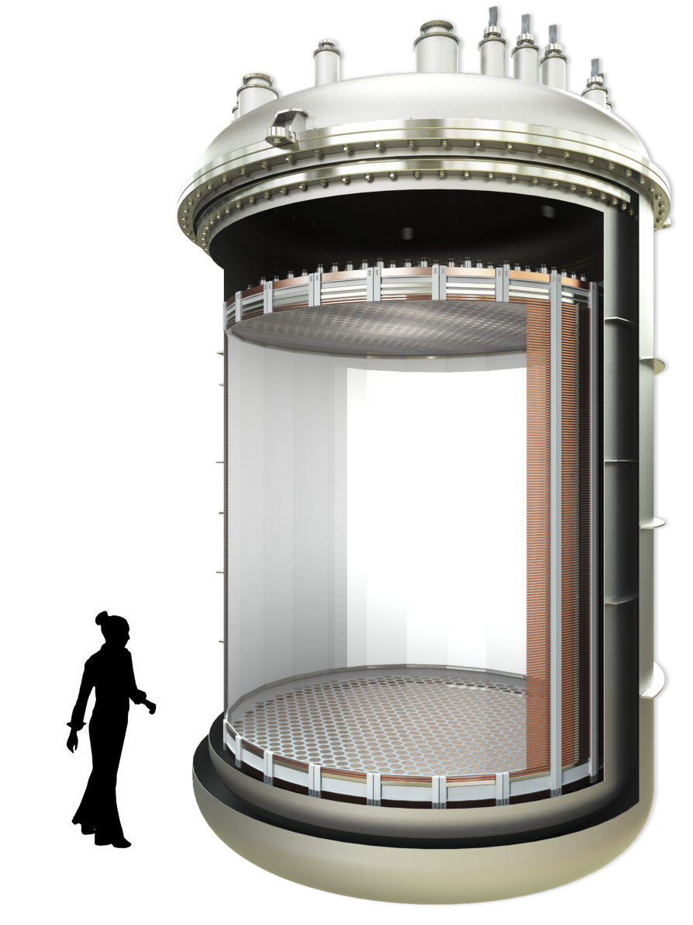
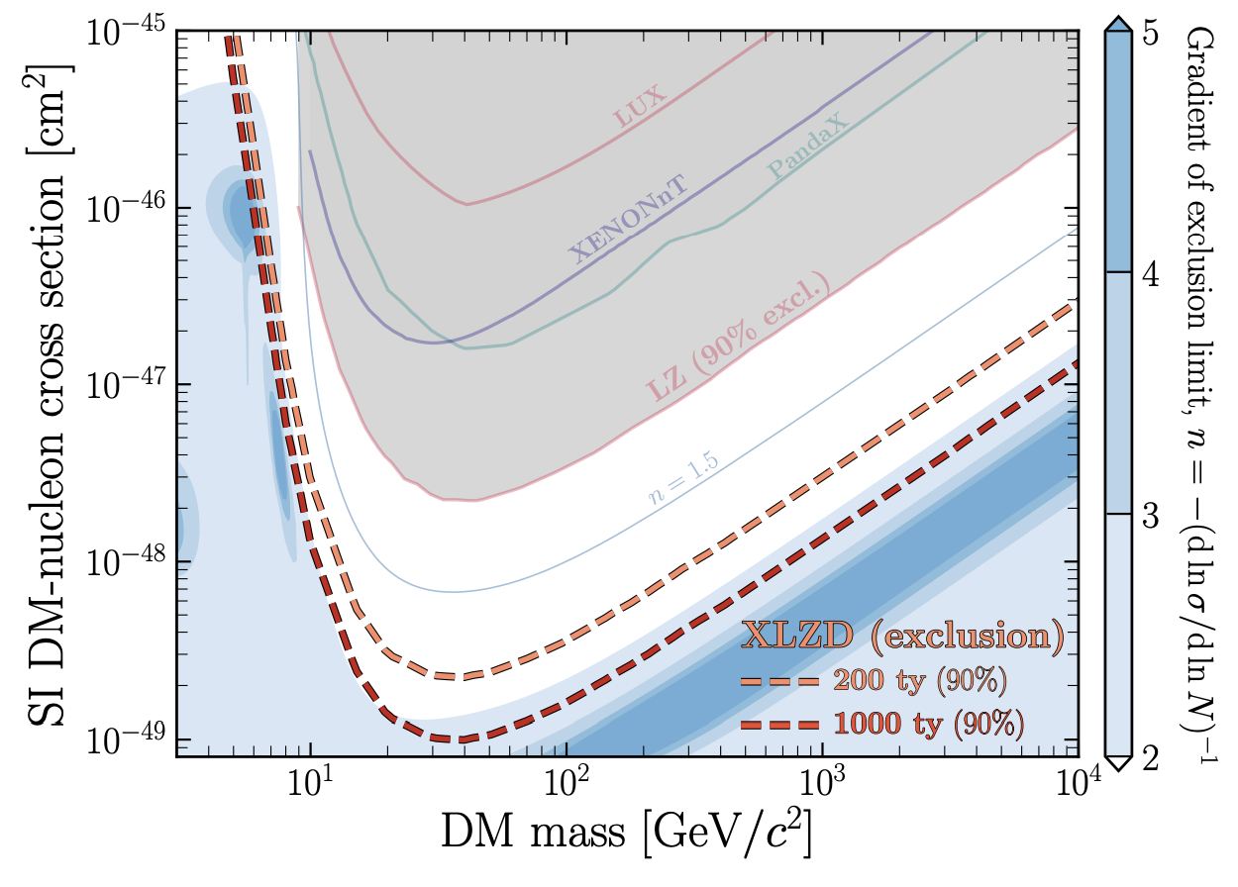
Future: GdLS Veto for XLZD DM Search
XLZD: 70-tonne liquid xenon TPC for DM search down to ‘neutrino fog’
Veto essential for control and validation of neutron backgrounds
Requires even purer GdLS
~70 t LXe

Slide 6
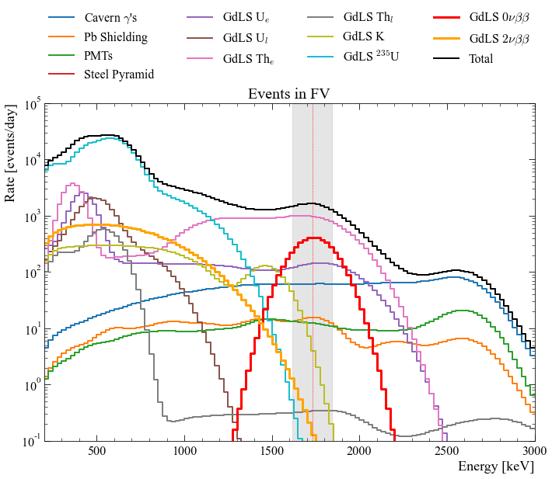
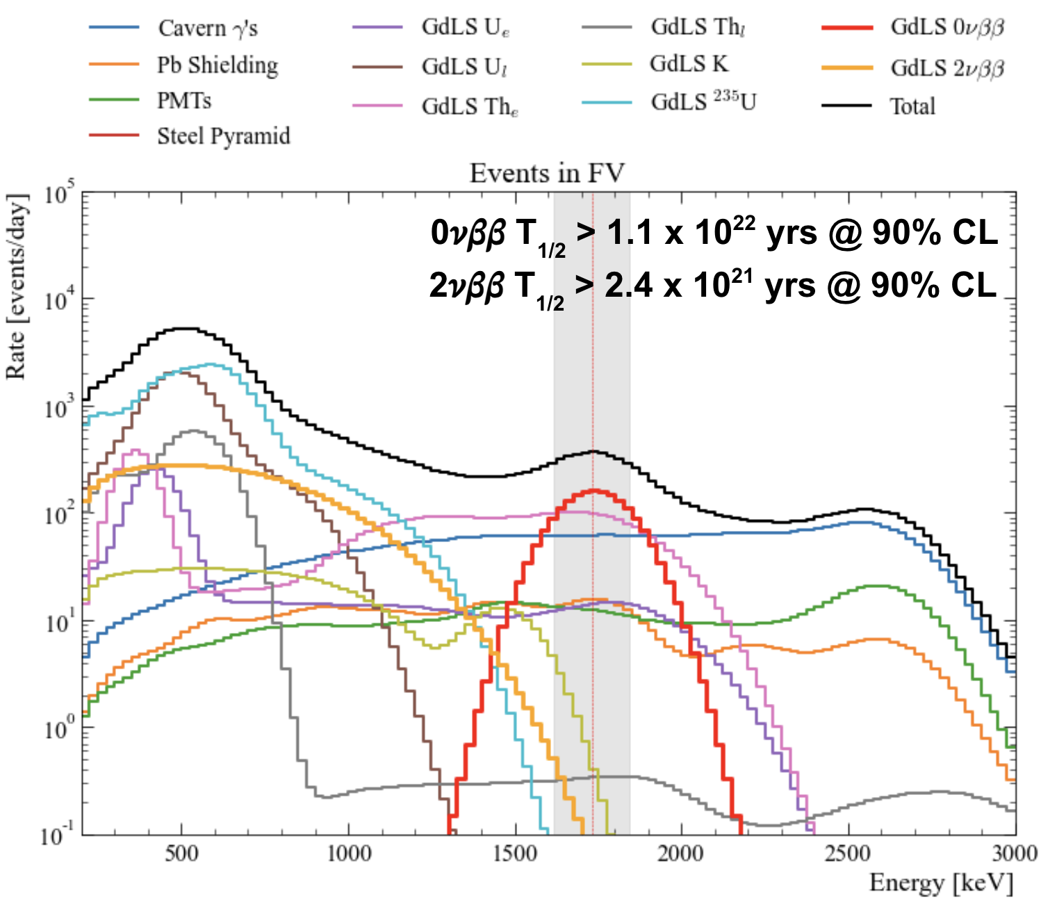
Other Science with Gd→ 0νββ of ¹⁶⁰Gd
22% of ^{nat}Gd is ¹⁶⁰Gd, a candidate 𝛽𝛽 isotope (2𝜈 not observed), Q_{𝛽𝛽}= 1.73 MeV
  ¹⁶⁰Gd interesting: few previous investigations -- high degree of deformation tests NME calcs
  3.7 kg of isotope in LZ; expect about 10x in XLZD, more if Gd % increased
  Cavern 𝛾’s limiting in LZ OD… expect lower background in XLZD
  Optimization of signal, bkg rate, light yield (energy resolution) – (U. Mich) planning a sensitivity study
²³⁴Pa (²³⁸U_{early}) & ²²⁸Ac (²³²Th_{early}): >2 MeV 𝛽’s which intersect ROI - main background
Potential collaboration between Michigan, BNL, PNNL will help assess potential sensitivity
Geant MC of a concept experiment (not XLZD) showing primary backgrounds for DBD search
Notes:
this was first glance at backgrounds for a dedicated experiment which would be a cylinder of acrylic with GdLS viewed by the LZ OD PMTs, in the LZ water tank. Key thing is to point out that the purple and pink lines that intersect the grey 0vbb region of interest are the early-chain alphas from the bullet on the slide. In an experiment which is otherwise shielded from external gammas, these are the limiting background.
the red, that is drawn normalized to a 0vbb half life of 5x10^21 yrs. The 2vbb orange curve has half life 10^19 yrs (approaching theory predicted value, which has two-orders of magnitude uncertainty)

Slide 7
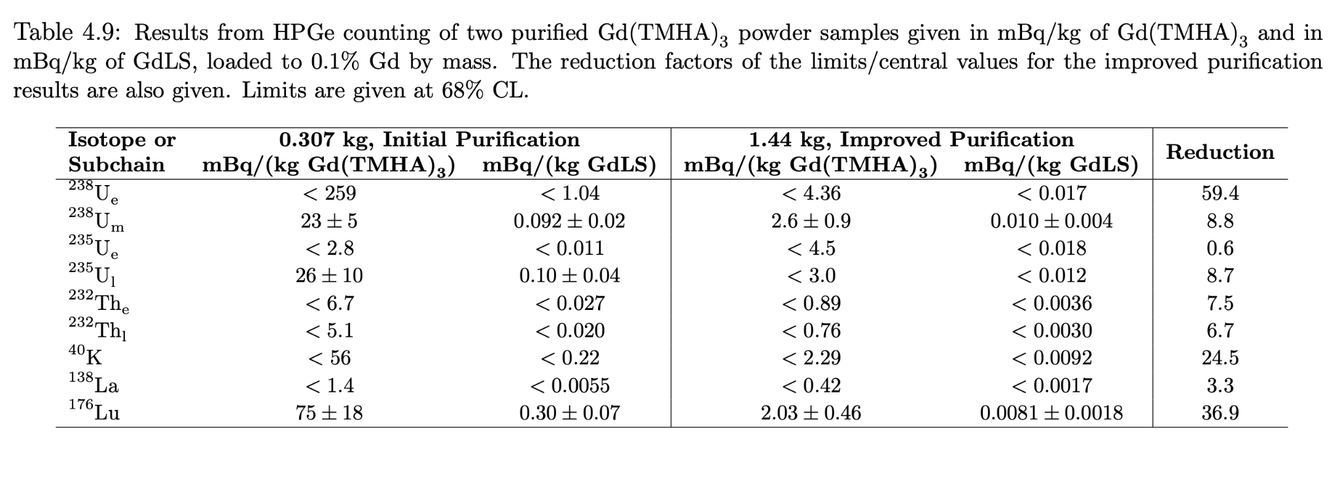
Goals
Develop more sensitive method to further evaluate radiopurity of Gd(TMHA)₃
  Most radiopurity values were upper limits
Provide more precise/constrained understanding of backgrounds for improved science reach in current (LZ) and future (XLZD, 0vbb) searches

Slide 8
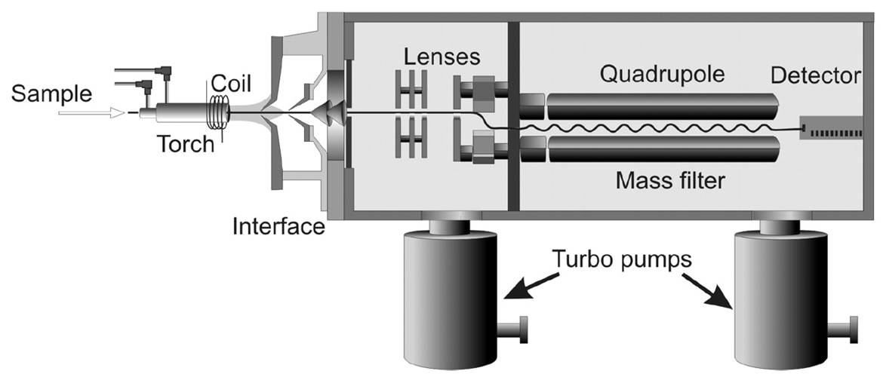
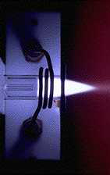
The Tool for the Job
Ultrasensitive
w/ small mass (mg-grams)
Fast Analysis (~minutes)
Plasma
Inductively
Coupled
Plasma
Mass
Spectrometry
Requires ultraclean sample processing (hours/days)
Destructive Technique, Small Samples…
Detect atoms, not radioactive decays
Notes:
Focus on: briefly describing ICP-MS history, how sample works
Involves measurement of atoms, not decays!
Typically involves sample preparations

Slide 9
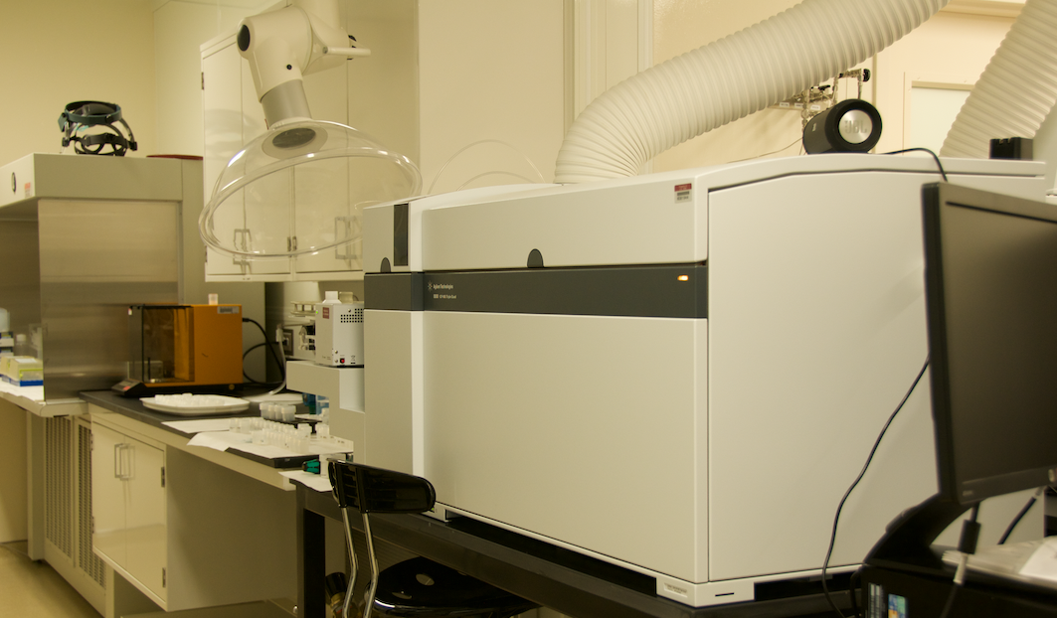
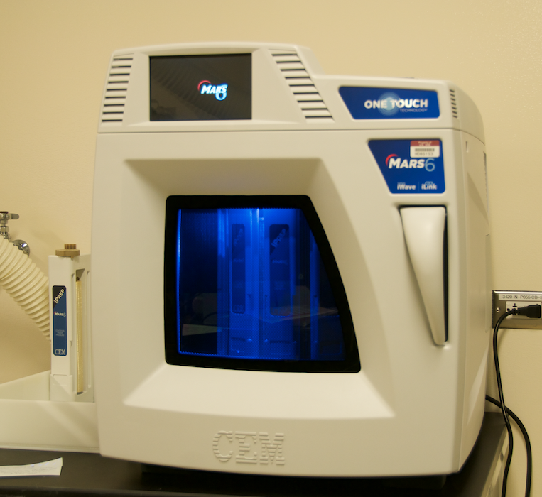
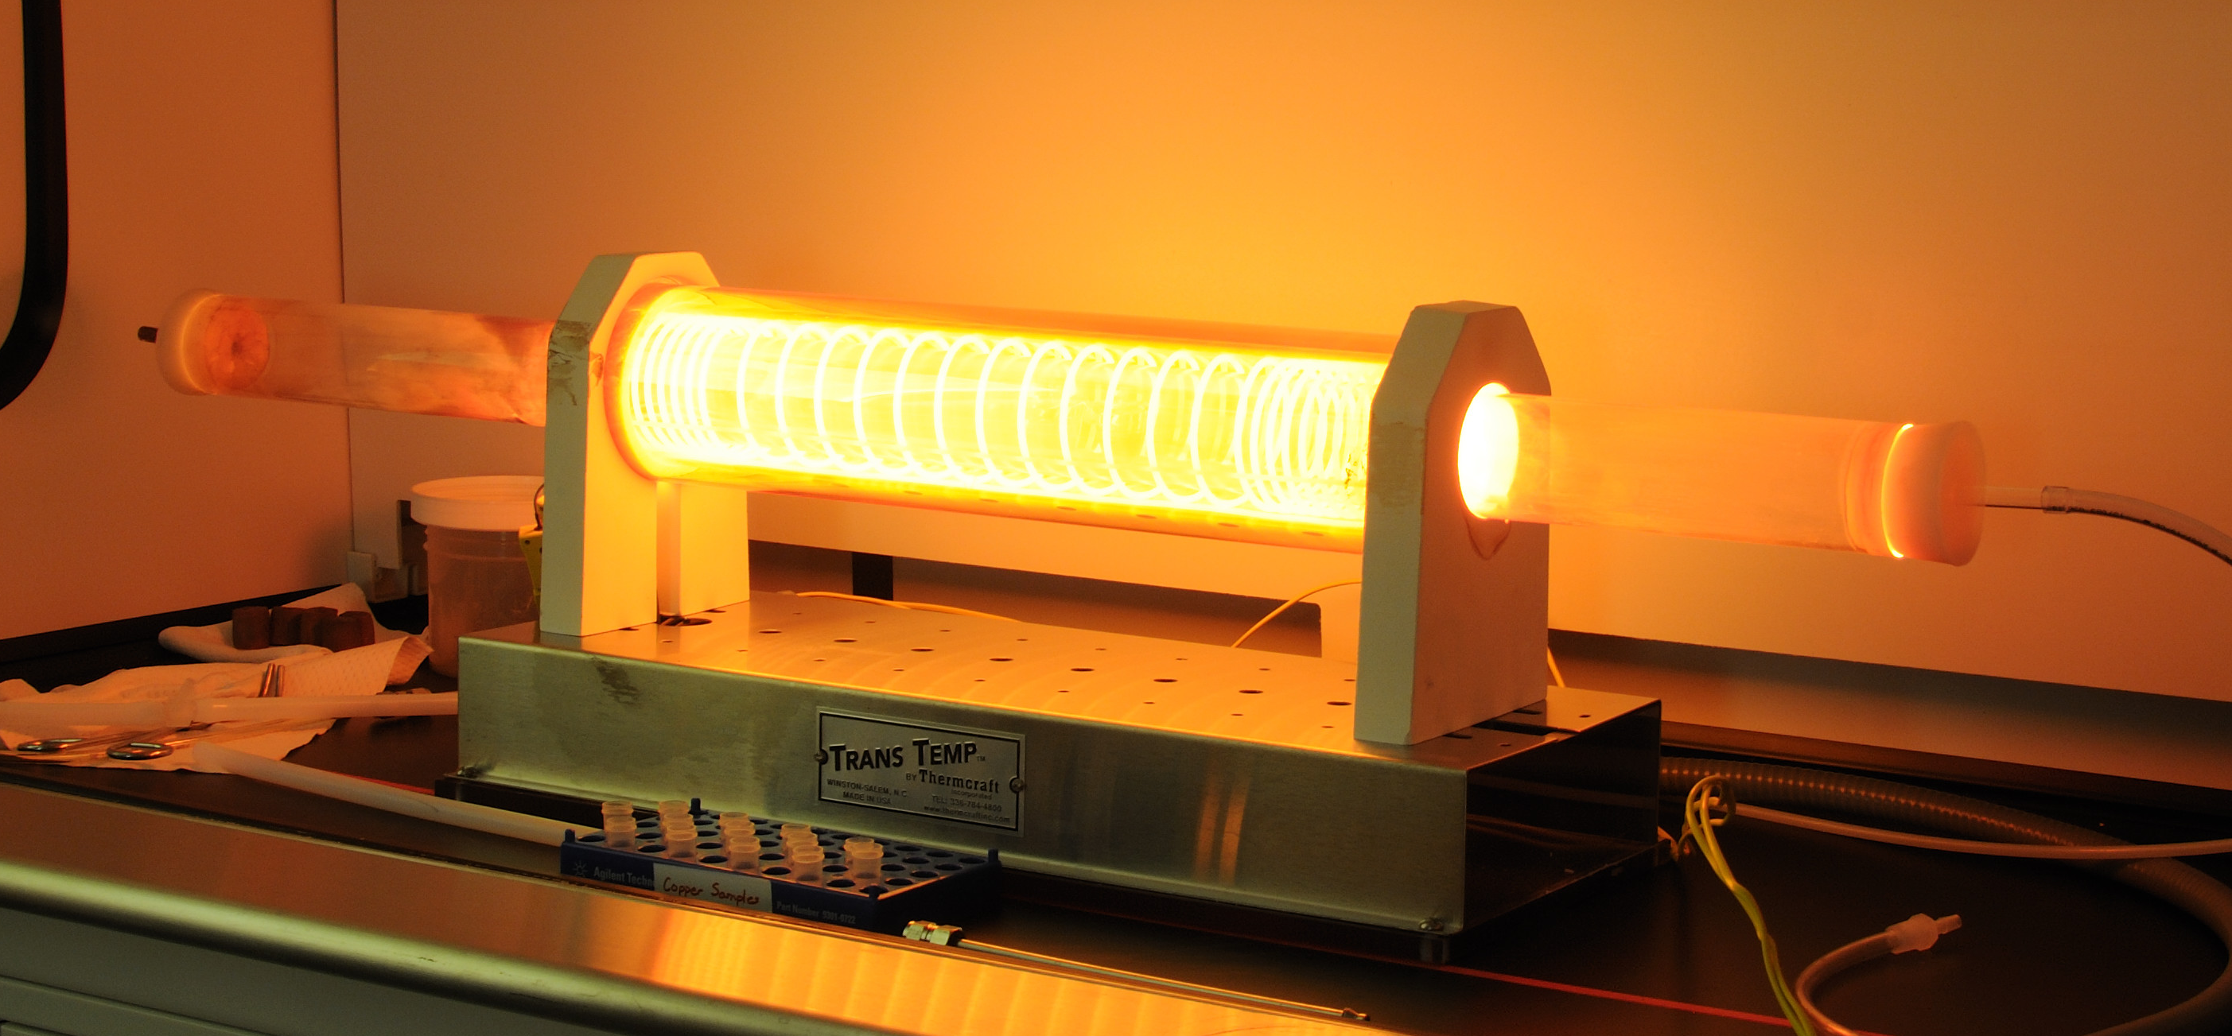
How do we process samples for ICP-MS:
PNNL’s Ultralow Background Assay Facility
Class 10000 cleanroom and Class 10 laminar flow hoods
Two dedicated ICP-MS instruments
MilliQ water purification system
Optima grade reagents
Isotope dilution methods for ²³²Th & ^{238/235}U quantitation using non-natural tracers ²²⁹Th & ²³³U
All labware is validated
  Touch the sample? → Cleaned/verified
Process Blanks
Process Blanks.
Process Blanks!

Slide 10
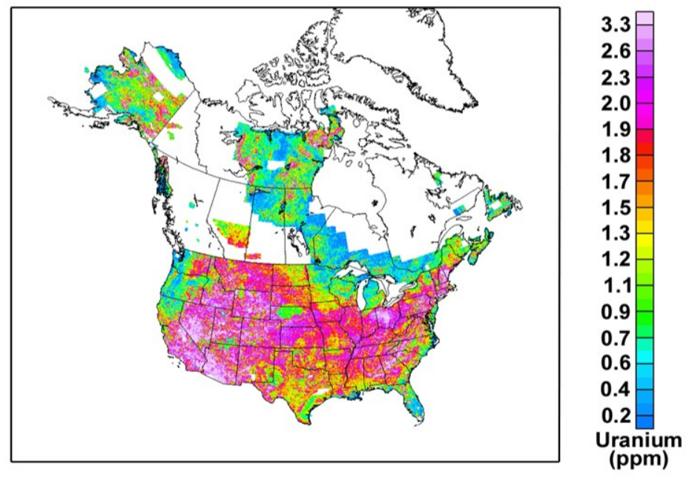
Processing Low Background Materials in a High Background World…
The world is dirty…
ULB Materials ~ 10⁶-10⁹ cleaner than Earth!
Background contribution from sample processing is vitally important to understand and minimize!
Much like the ULB Physics..
It’s a signal-to-background problem!
K is much worse! 6th most common element in Earth’s crust!
41
2.5
Bq ²³⁸U/kg
Source: http://pubs.usgs.gov/of/2005/1413/maps.htm
Th is similar to U…
Notes:
Focus:
Unfortunately for us, we do not live in a low background world
Potential backgrounds can come from anything that touches the sample
e.g., reagents, handling, dust, containers

Slide 11
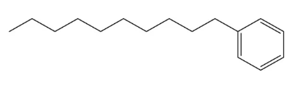
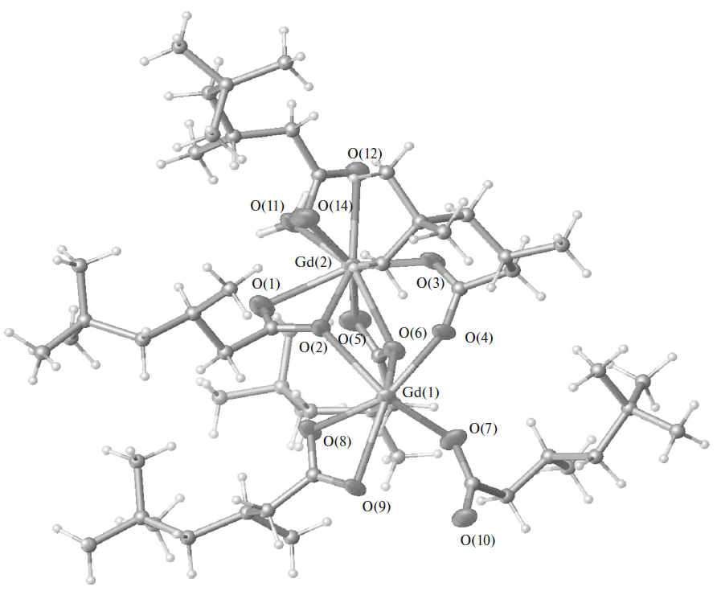
How to get Gd(TMHA)₃ into solution…
Fairly insoluble, nonpolar molecular
  why it is great for dissolving Gd ions into Linear Alkyl Benzene (LAB)
Our approach → Ultra clean dry ashing!
Gadolinium trimethylhexanoate complex
DOI: 10.1134/S0036023616020157

Slide 12
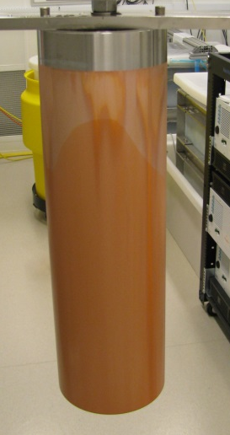
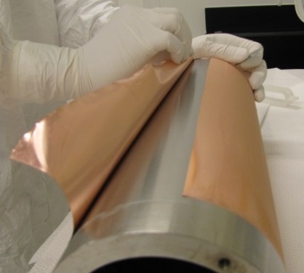
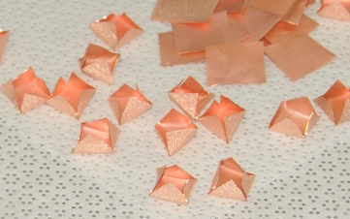
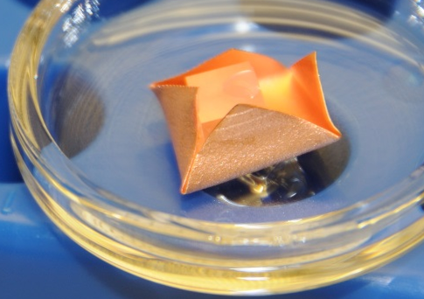
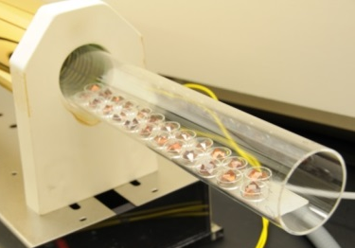
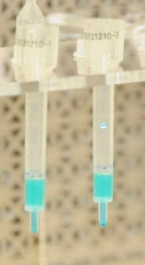
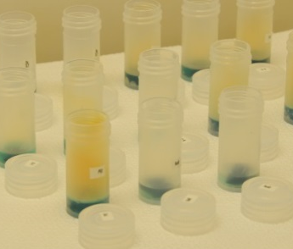
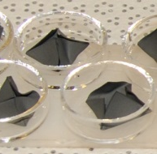

* Arnquist et al (2017)

Slide 13
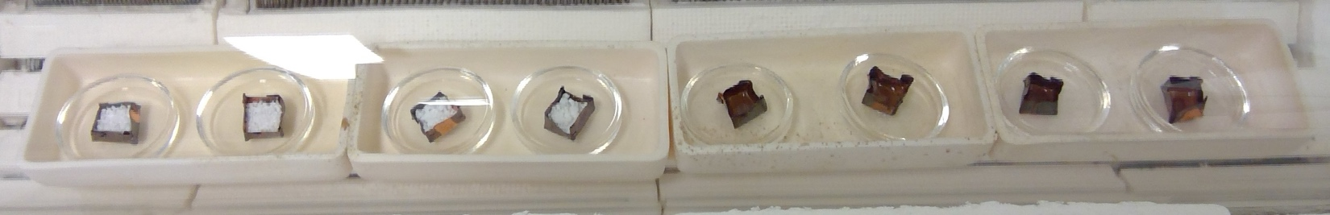
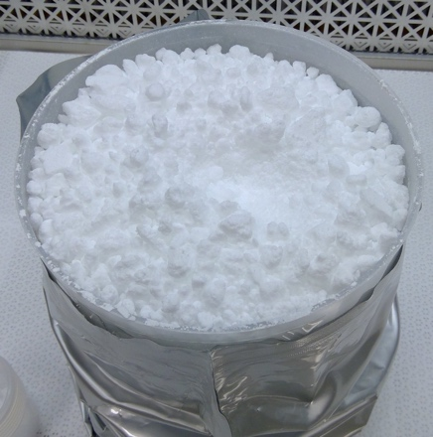
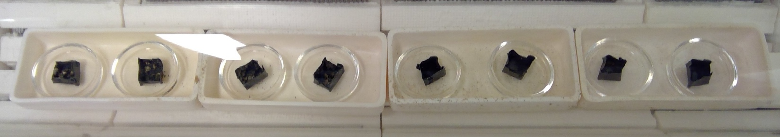
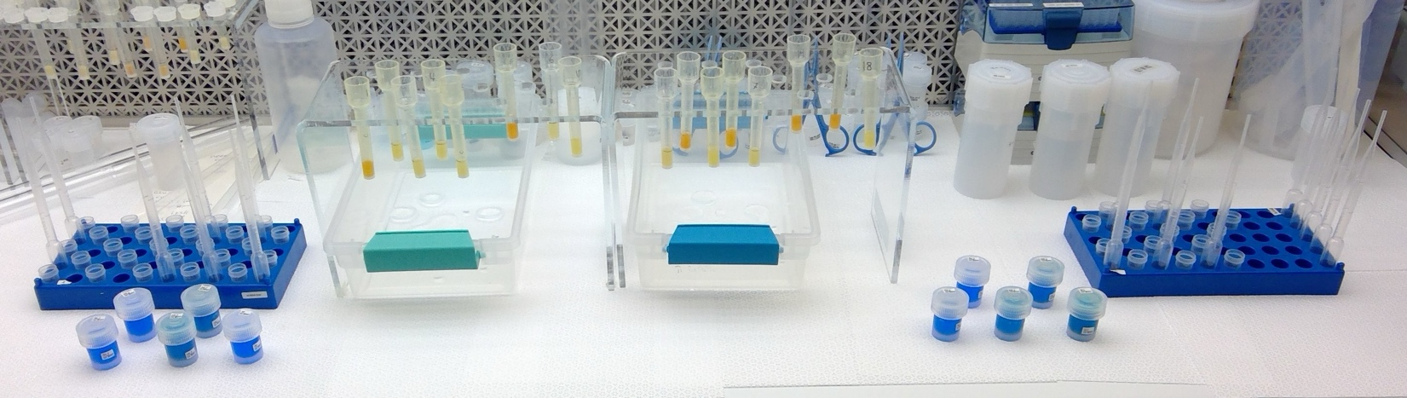
Method Adapts Well to Gd(TMHA)₃

Slide 14
Assay Results
Sample | Rep | Sample Mass [g] | ²³²Th |  | ²³⁵U |  | ²³⁸U |  |  | ⁴⁰K
 |  |  | mBq/kg | ± | mBq/kg | ± | mBq/kg | ± | ± | mBq/kg | ±
Gd(TMHA)3 | 1 | 0.3197 | 0.010 | 0.001 | 0.025 | 0.004 | 0.410 | 0.030 | 0.030 | 2.16 | 0.12
 | 2 | 0.2889 | 0.008 | 0.001 | 0.027 | 0.003 | 0.460 | 0.010 | 0.010 | 2.26 | 0.09
 | 3 | 0.2841 | 0.012 | 0.001 | 0.024 | 0.002 | 0.450 | 0.020 | 0.020 | 2.34 | 0.06
 | 4 | 0.2709 | 0.010 | 0.001 | 0.026 | 0.003 | 0.460 | 0.020 | 0.020 | 2.27 | 0.09
γ Counting Results (Imp. Purification Sample) |  | 1440 | <0.89 |  | <4.5 |  | <4.36 |  |  | <2.29
This Method LODs |  |  | 0.002 |  | 0.0003 |  | 0.010 |  |  | 0.155
Improvement: 80× 180× 100× .
New assay method allows for more sensitive investigation of material
Material is very clean (kudos to Minfang Yeh!) → meets XLZD radiopurity specs
And we can measure even lower….a new “goalpost” for Gd(TMHA)₃ production

Slide 15
Summary and Next Steps
Gd is a very useful neutron veto when utilized in LS, but must be very clean for ULB experiments
A novel assay method was developed for more sensitive investigations
  Allows for better characterization of GdLS used in LZ
  Method can measure to single digit µBq/kg levels for ²³²Th, ²³⁵U, and ²³⁸U
  Meets radiopurity specs of LZ GdLS to ~100 tonne-scale for XLZD
Future:
Wrap up ¹⁷⁶Lu and ¹³⁸La
Focus on further characterizing large batch productions through process-informed statistical sampling
  Investigate production pathway in collaboration with BNL, allowing for fine-tuning production methods
Investigate fractionation of lower decay chain isotopes by measuring stable surrogates through production pathway

Slide 16
Acknowledgements:
DOE-SC HEP KA-25
Minfang Yeh (BNL). LZ Collaboration

