Slide 1
European Physical Society Accelerator Group Board Meeting
P. McIntosh, R. Tomas
Monday 24th Nov 2025

Slide 2
Agenda for Today
Monday 24th November 2025
# | Time (CET) | Item | Who
1 | 10:00 | Welcome, Introduction, Review Agenda and Previous Actions | P McIntosh (STFC)
2 | 10:10 | EPS Update – Divisions and Group Integration | A Fantoni (INFN)
3 | 10:30 | Proposed EPS-AG Constitution changes and Process | P McIntosh (STFC)
4 | 11:00 | Jacow Update | A Rossi (CERN)
5 | 11:20 | Finances Update | N Delerue (CEA)
6 | 11:40 | Website Taskforce Update | P McIntosh (STFC)
7 | 12:00 | Summary Actions/Decisions/Meeting close
Indico page: https://indico.stfc.ac.uk/event/1719/

Slide 3
EPS Update – Divisions and Group Integration (10:10 – 20mins)
Allesandra Fantoni (INFN)

Slide 4
Actions from Previous Meetings
# | Action | Who | Status
Nov23-5 | An action document provided by EPS is needed to ensure their agreed commitments are maintained, such as the 1-wk response time. No document response received despite several requests. | PAM | Close
Jul24-3 | Identify how to formally document and capture this JUAS student grant decision, having issued acknowledgement to JUAS Director. Solution to be identified. | ND | Ongoing
Jul24-4 | To clarify that IPAC papers do not block journal publications in PRAB, JINST, NIM etc to reduce number of withdrawn papers. Further evaluation needed. | ND/RT/PAM | Ongoing
May25-1 | To distribute list of European Physics Societies who have Accelerator Groups specifically included. | ND | New
May25-2 | 2024/25 financial accounts not closed with EPS, whilst also verifying expected student grant support income. | ND | New

Slide 5
EPS-AG IPAC Organised Meetings
Since May 25 board meeting:
IPAC26 SPC2-1/2 during IPAC25 and remote (May/Jun25)
IPAC25 OC2 during IPAC25 in Taipei (Jun25).
IPAC27 OC1/SPC1 in Detroit and remote (Nov25)
Still to conduct (out to IPAC26):
IPAC26 SPC3 in Liverpool (Jan26)
IPAC26 OC2 during IPAC26 in Deauville (May26)
IPAC27 SPC2 during IPAC26 in Deauville (May26)

Slide 6
EPS-AG Constitution Changes During 2026
EPS-AG board membership mandate:
6-year duration, corresponding to 2 European IPAC conferences.
With a 50% turnover of the 16-members every 3-years.
Requiring 8 members to relinquish their role in 2026 (at time of IPAC26).
Those ending their mandate are:
Nuria Catalan Lasheras (CERN) – replaced Ezio Todesco (CERN) in 2024 – Switzerland
Nicolas Delerue (CEA) – France
Mamad Eshraqi (ESS) – Sweden
Alessandro Fabris (Elettra) – Italy
Victor Malka (Weismann U) – Isreal
Marie-Helene Moscatello (GANIL) – France
Adrian Rossi (CERN) – Switzerland
Rogelio Tomas (CERN) – Switzerland – becoming Ex-officio member
This nominally then releases:
3xCH, 2xF, 1xSE, 1xI and 1xIL representatives
5xM and 3xF representatives

Slide 7
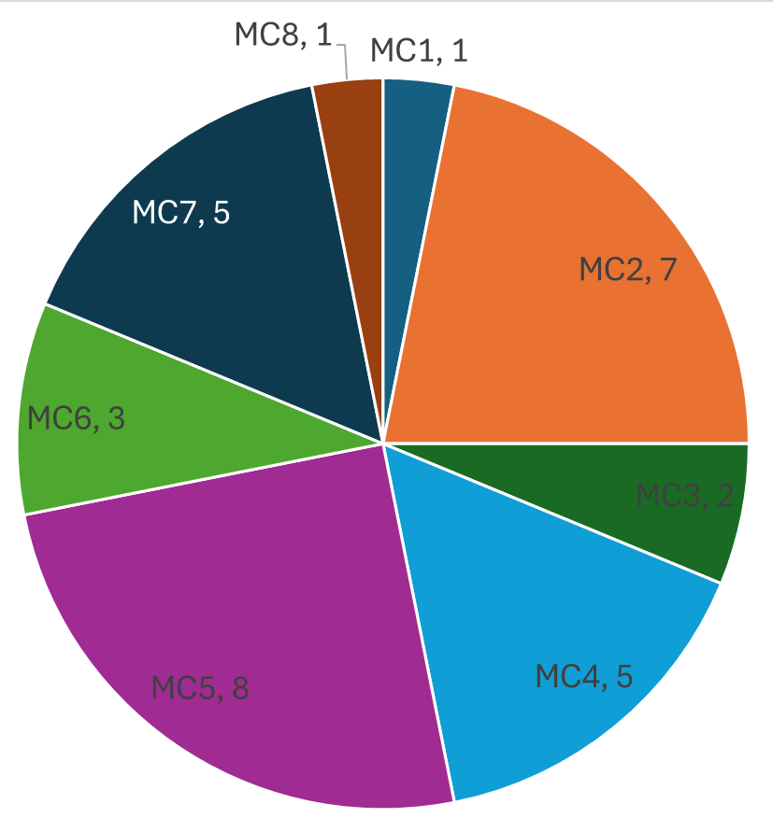
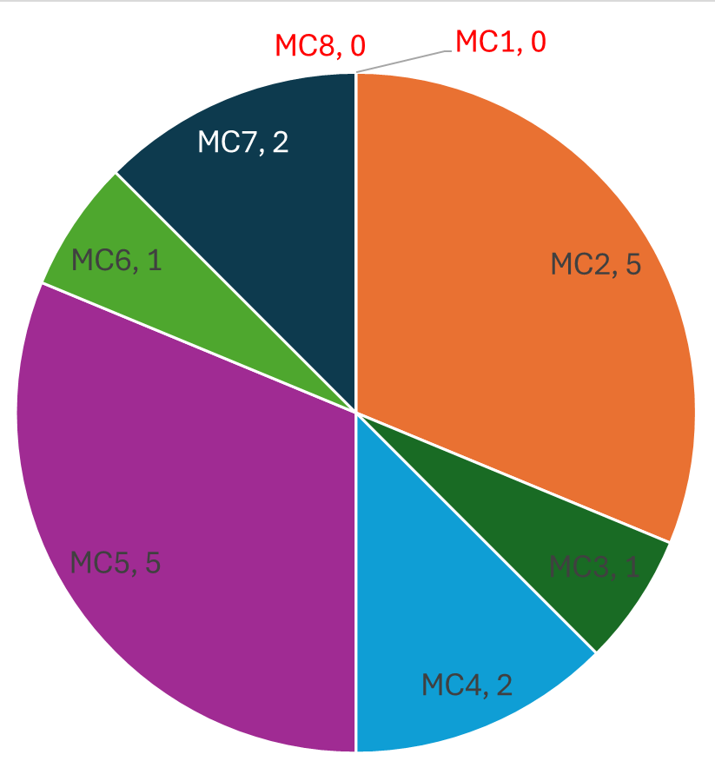
Ongoing Constitution Membership to 2029
Surname | Forename | Org | MC | M/F | Country
Chiadroni | Enrica | INFN | 3,5 | F | Italy
Gebel | Ralf | FZ-Juelich | 4,7 | M | Germany
Geloni | Gianluca | Eu-XFEL | 2,5 | M | Germany
Marcos | Jordi | CELLS | 2,5 | M | Spain
Meseck | Atoosa | HZB | 5,2 | F | Germany
Prat | Eduard | PSI | 6,2 | M | Switzerland
Thomason | John | STFC | 4,7 | M | UK
Wawrzyniak | Adriana | SOLARIS | 2,5 | F | Poland
FULL
50%
Replacements should reinforce:
MC1: Colliders and Related Accelerators
MC3: Advanced Acceleration Techniques and Novel Particle Sources
MC4: Hadron Accelerators
MC6: Beam Instrumentation, Operation Control, Feedback and Operational Aspects
MC7: Accelerator Technology and Sustainability
MC8: Applications of Accelerators, Engagement with Industry, Technology Transfer and Outreach

Slide 8
Constitution Update Process and Timescales
Encourage EPS-AG board members to send us your proposals (mid Jan26). Aiming at a balanced distribution of countries/expertise/gender. EPS-AG board will then shortlist the best 8 candidates, whom we can approach for their agreement to serve.
We will distribute the full list of proposals (end Jan26).
Aim to have shortlist conducted for 8 best candidates, with proposers and supporters (mid Feb26).
We will then contact the candidates to ask for their agreement, to organise nominations (proposers), and send the nominations to EPS (mid Mar26).
Newly voted EPS-AG members will be formally appointed during the EPS-AG General Assembly meeting at IPAC26 in Deauville (Note: all EPS-AG members need to participate in person).
Noting that the EPS formally launch the re-appointment process to vote on new members, only EPS members can vote (please check/renew your membership!).
We will shortly issue a notification to all EPS-AG members, detailing the process, nomination form and timescales.

Slide 9
Jacow Update (11:00 – 20mins)
Adriana Rossi (CERN)

Slide 10
Finances Update (11:20 – 20mins)
Nicolas Delerue (CEA)

Slide 11
Website Taskforce Update (11:40 – 20mins)
Peter McIntosh (STFC)

Slide 12
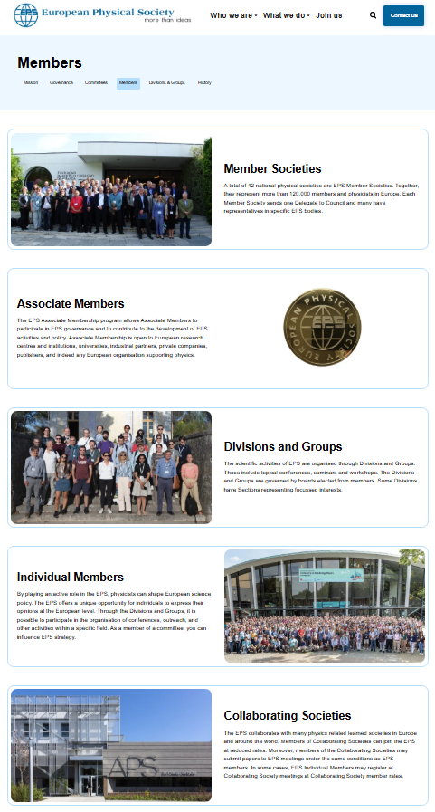
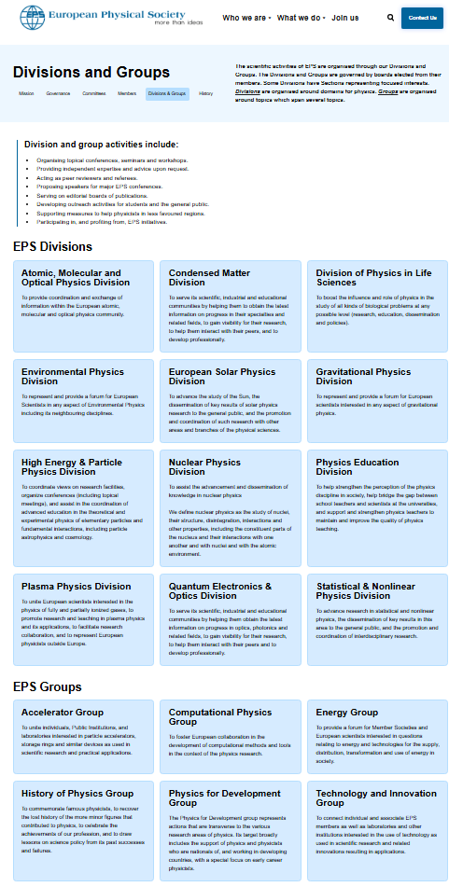
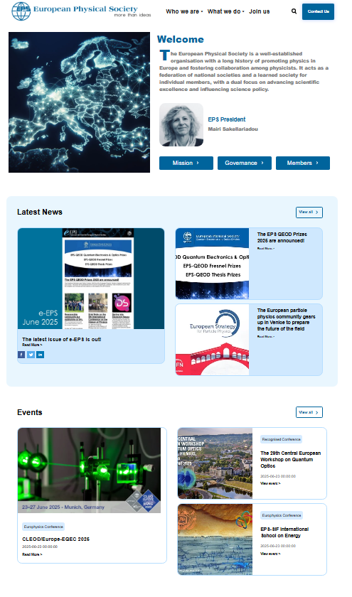
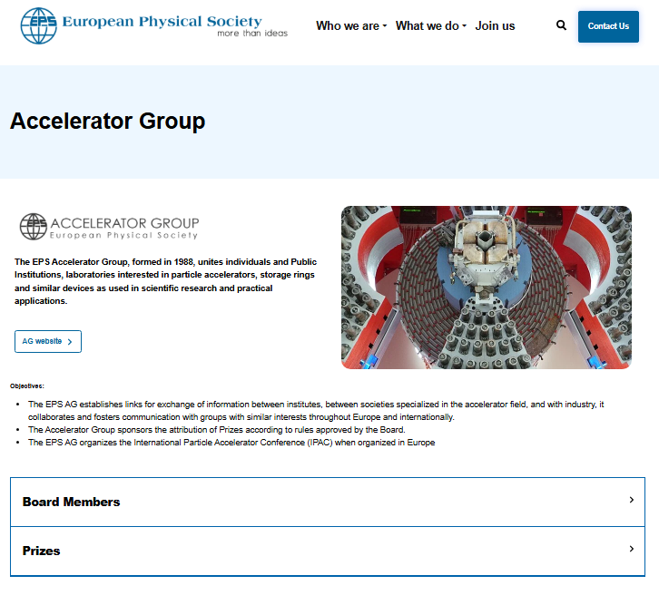
New EPS Website (1st Mtg in Jun25)
https://eps.org/who-we-are/members/divisions-and-groups/accelerator-group/
www.eps.org

Slide 13
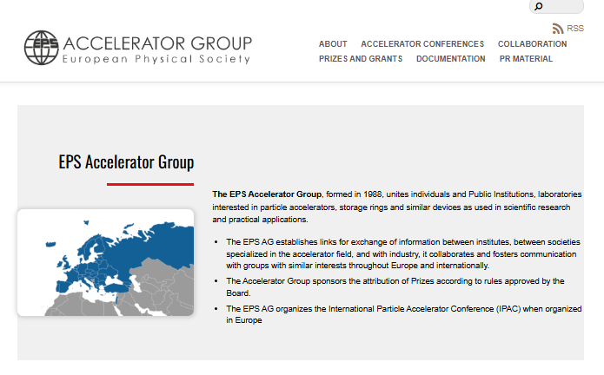
EPS-AG Webpage https://eps.org/who-we-are/members/divisions-and-groups/accelerator-group/
Contents:
Remit and Objectives.
Board Members:
Rogelio only one with external weblink!
Error also with E Todesco and no Nuria!
Prizes:
Directs to centralised EPS prize list, which describes the prize, not who has been awarded.
Don’t expect to change anything for this centralised website.
Nothing else included on the main EPS info page, except:
Redirect to another EPS-AG info page:
This is not constrained to the EPS format and each division/group presents their own specific topics, so each look very different.
https://www.eps-ag.org/
Our AG site looks very poor:
Replicates board member info, presents historic information, but not all included and some incorrect.
Needs drastic update!

Slide 14
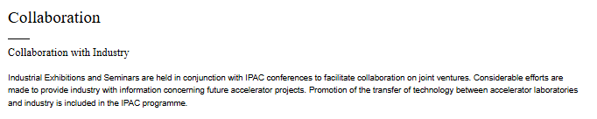
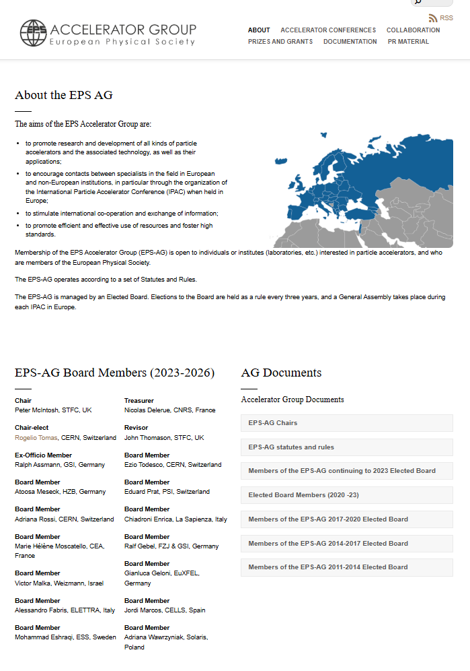
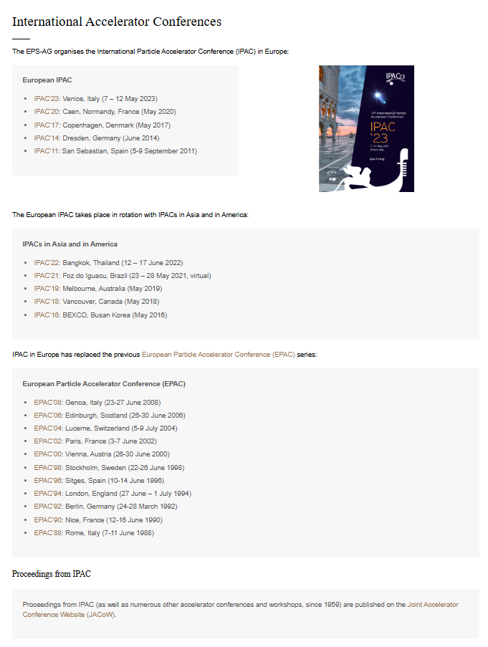
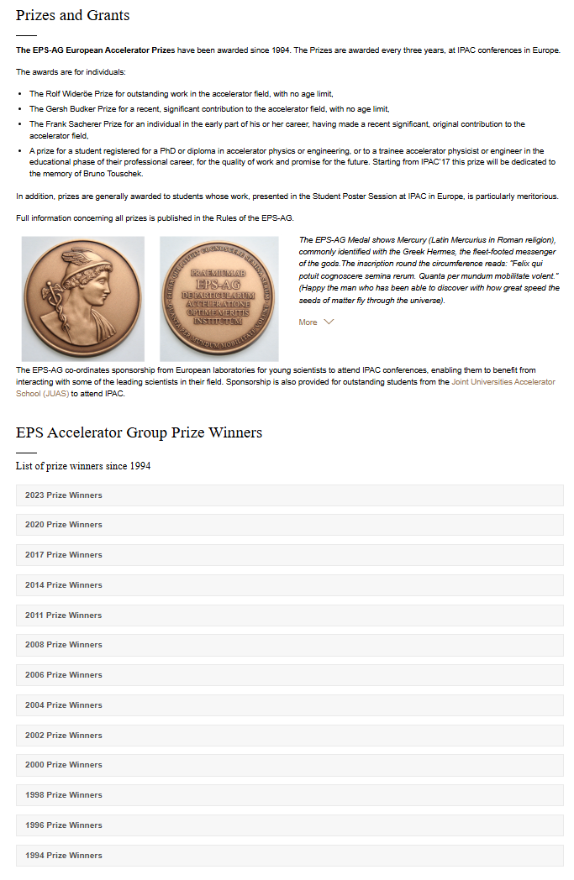
AG Page Information
Why?
Incomplete
Incomplete
Incomplete

Slide 15
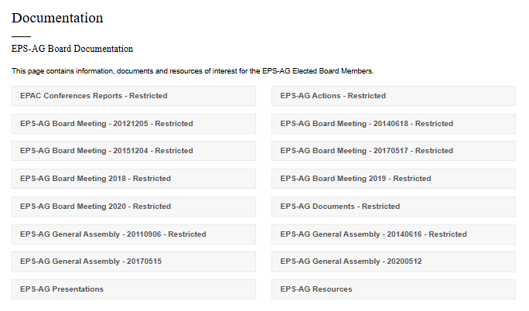

AG Page Information
What should we try and focus on for these areas?
Inaccessible,
even when
signed in!
Nothing posted here, so meaningless!

Slide 16
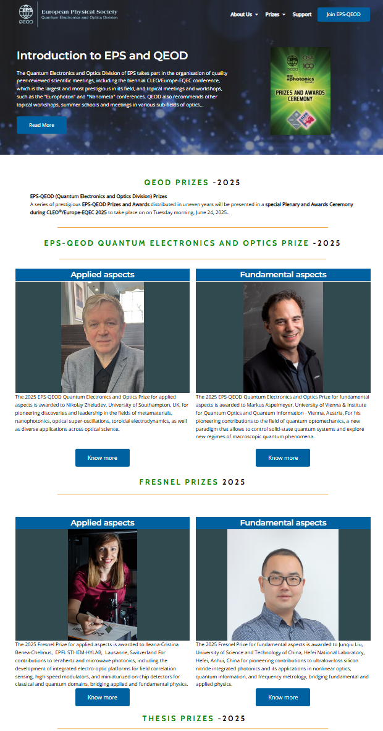
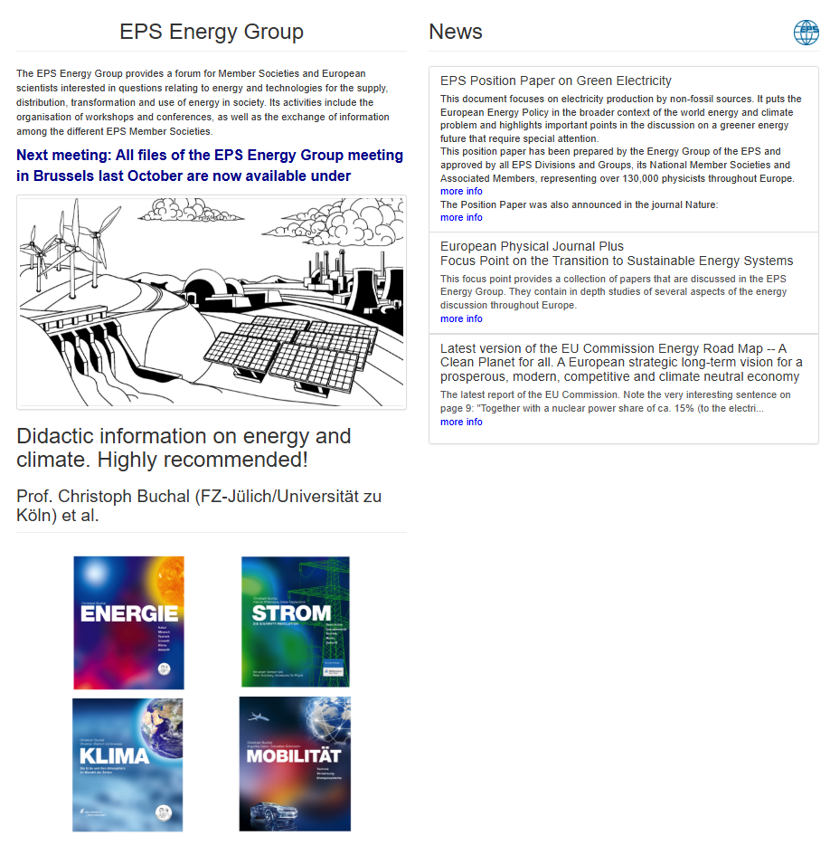
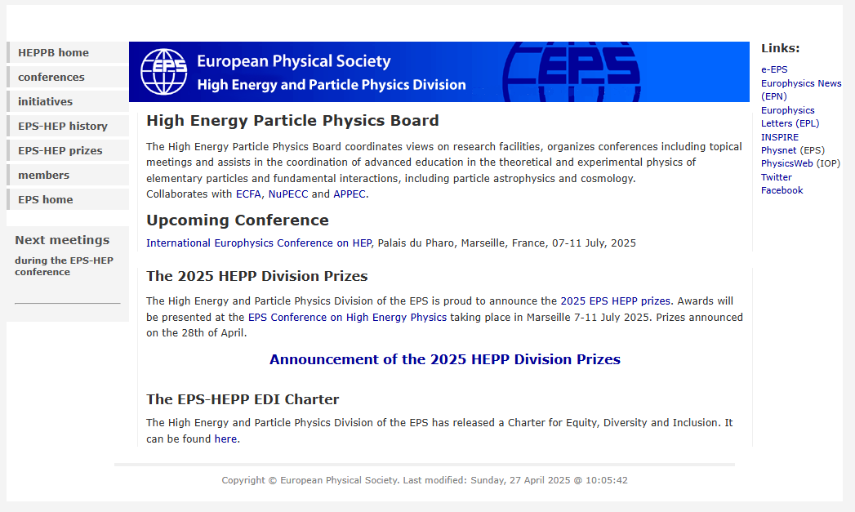
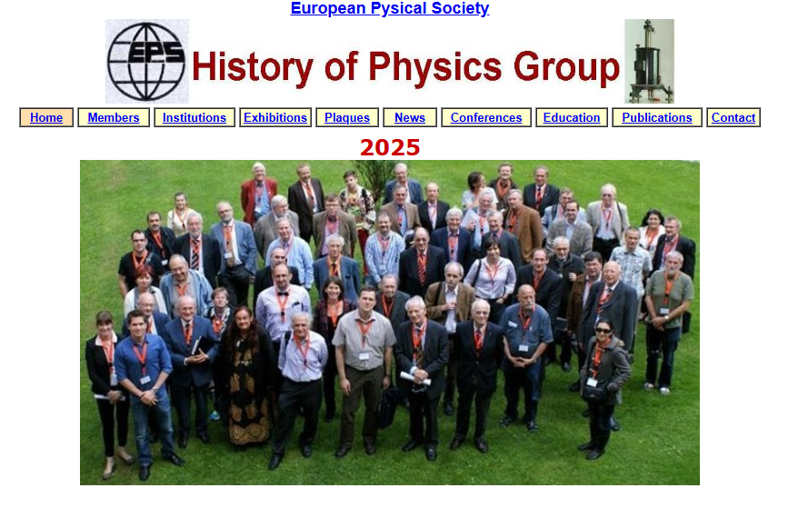
AG Website Update

Slide 17
Topics to include
EPS-AG Statutes
Previous EPAC/IPAC Conferences
Prizes
Previous board membership?
Don’t replicate board membership!
Dynamic/New ?:
Future IPAC conferences
Accelerator events
Training opportunities
Jobs
News bulletins
Query posting
Connections to other societies and EPS groups/divisions.
What else?
All historical!

Slide 18
How organise updates
We have editing rights to amend the AG pages:
WorldPress access provision in place.
Taskforce members have principal editing permissions.
EPS-AG board to approve process and provide updates.
How frequently to update – Quarterly?
Action plan to develop:
Objectives
Timescales
Responsibilities
Next meeting, when, topics to include.

Slide 19
Proposed New EPS-AG Website Structure
EPS-AG
www.eps-ag.org
Accelerator Conferences
Prizes
Grants & Sponsorship
Documents
Accelerator Group Connections
Status/Rules
Chairs
EPS-AG Membership (3-year cycle)
IPAC Past/Future
EPAC
Jacow Proceedings
Winners
Outreach
Annual Report
Jobs?
Student Grants
Event Sponsorship
Links to engagement portals
Links to jobs portals
Board Membership (replicated)
Board Minutes
Collaboration
✗
Existing
✗
New
✗
✗
Remove
Or Restart?

Slide 20
Summary/Actions/Decisions (12:00 – End)
Peter McIntosh (STFC)

Slide 21

MANY THANKS

