Slide 1

10 Years and 100PB of Ceph
Rob Appleyard
UK Academic Ceph Workshop
Manchester University, 3rd December 2025

Slide 2

History of Ceph at RAL
Early 2010s:
We have CASTOR! CASTOR everywhere!
Needed to migrate away
2015-6: Let’s replace it with Ceph
…which produced Echo
Then, what else can we use Ceph for?
Various services for local facilities
Now:
Mature Ceph services running at scale
Experienced team
Image © STFC John Dawson

Slide 3
Experimental Use cases
User-facing experimental facilities at RAL – ISIS, Diamond, CLF
Users turn up for a tightly-constrained period of experimental time and wish to guide their work with live data analysis.
Analysis tasks are user-defined
Users who want to make large datasets securely available to external institutes.
Organisational private cloud hosts a large, diverse collection of VMs
Needs high-performance data storage for VM images and working data.
WLCG Tier 1 requires very high capacity, high-throughput and low cost data access to local batch, large amounts of inter-site I/O, and an interface to the tape system.
Notes:
Tape system is CERN’s CTA system – we are talking to the EOS buffer layer

Slide 4

Echo for the WLCG
First production Ceph cluster at RAL
100PiB usable (137PiB raw), 320 hosts, 8050 active OSDs, 8+3EC.
Low-level (RADOS object store) access provided by an XrootD Ceph plugin developed in-house
All files are stored as 64MB stripes
Dedicated cluster of external XrootD gateway hosts, plus an XrootD gateway process on every worker node.
CERN/Other sites
Gateway
XRootD memory cache
XRootD server
XrdCeph
Newest storage node spec (last year):
24*18TiB HDD
2*16C/32T Xeon Silver 4514Y@2.0-3.4GHz
256GB RAM
25Gb Networking
Typical gateway host spec:
2*16C/32T Xeon Silver 4214R@3.5GHz
192GiB RAM
25Gb Networking
x400
libradosstriper
Worker Node
x31
Job container
Job container
User job
User job
Ceph Cluster
XRootD client
XRootD client
Job container
XRootD disk cache
Experiment data pool
User job
Experiment data pool
XRootD server
XRootD client
XrdCeph
GW container
libradosstriper
An architecture diagram of how Echo is accessed, from Tom Byrne’s presentation at Cephalocon 2023
Notes:
We’ve engineered for bulk throughput rather than responsiveness. Don’t care if there’s a bit of latency in there.
This year we expect to be buying 22TB HDDs

Slide 5
Non-WLCG Services
Sirius
“Our private cloud needs block device storage”
All flash, 3*replication
Deneb
“Local users want a large shared filesystem”
8-12TB HDDs, 8+3 EC
Arided
“People want to self-provision shares on a high-performance filesystem”
All flash, 3*replication

Slide 6
Early Problems: the 2015 disk generation
Early Echo hardware generation had a really bad batch of HDDs
Constant bad sectors, crashes, etc.
Major time sink
Implemented “recyclotron”
Dedicated SN which repeatedly overwrote disks until they either failed or remapped all sectors
Give the disk firmware chance to fix itself
Or fail cleanly, in which case get a warranty return
Vendor agreed that warranty replacement disks would be from a different supplier

Slide 7

Early Problems: Sirius storage media
2016: Sirius was the original underpinning storage for our private cloud
RBD Ceph cluster providing block storage for the system volumes
We bought HDD storage nodes.
Not nearly enough IOPS
☹
Whole new procurement needed for NVMe storage
Re-used SNs for the first iteration of Deneb
By NASA, ESA, H. Bond (STScI), and M. Barstow (University of Leicester) - http://www.spacetelescope.org/images/heic0516a/, Public Domain, https://commons.wikimedia.org/w/index.php?curid=477445

Slide 8
Early Mishaps: Echo EC Backfill
2017, Echo (Ceph Luminous)
In some cases, when a disk failed Ceph would identify the wrong disk.
Admins saw crashing disks, removed crashing disks
Removed 5 disks before realising error
8+3 EC means we can tolerate only 3 losses…
23k ATLAS files lost
☹

Slide 9
Xrootd Vector Read Overload (I)
Local batch has an XrootD gateway on every worker node
Massive parallel throughput available with no reference to MD server
Parallel ongoing story – quest to optimise data transfers from storage to worker.
Immutable files
Trade-off between throughput intensive read patterns (copy-to-scratch) and IOPS intensive read patterns (‘vector read’)

Slide 10

Xrootd Vector Read Overload (II)
We discovered the limit of the IOPS-for-throughput trade in May 2023
Change to batch farm deployed Friday morning
Cluster up-and-down for a whole overweekend
Monday – reverted XrootD change, reimplemented with some changes
Image by https://www.vectorportal.com, licensed under CC BY 4.0

Slide 11
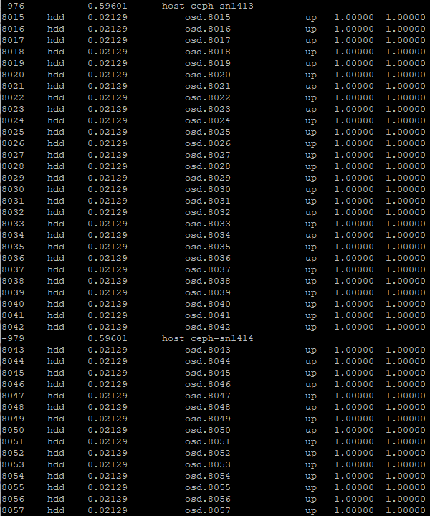
Echo Overflowed Ceph (I)
Did you know – if you have a Ceph cluster over 72PB and don’t change the defaults, it will refuse to let you add any more storage?
CRUSH weights have a hardcoded limit of 65535
Hit this in June ‘23
The fix: The Great Rescaling
Echo now thinks in petabytes
Modify the CRUSH map offline, inject the new one… magic!

Slide 12

Echo Overflowed Ceph (II)
Did you know – if you try to add a storage node that’s 1000 times the size of all the others, your cluster will get very sad?
We re-scaled Echo, but not the documentation for hardware addition
Innocent new admin followed docs and added a ‘300PB’ SN
☹
Result – very sad cluster
Externally inaccessible
Very slow admin commands
Constant mon crashes
Slow OSD operations
Fixed when we removed the problem host
Image from BBC

Slide 13

Inappropriate Deneb Use Cases
2024 – new user came along – “I want to host RAL’s CVMFS Stratum-1 on Deneb’s CephFS”
CVMFS assumes that it is talking to a fast local filesystem
Deneb’s HDD CephFS is not a fast local filesystem
☹
Result:
OSDs couldn’t keep up, constant MDS crashes, large scale breakage for everyone
Exiling problem user fixed problem
By Pablo Carlos Budassi, CC BY-SA 4.0 https://creativecommons.org/licenses/by-sa/4.0, via Wikimedia Commons

Slide 14
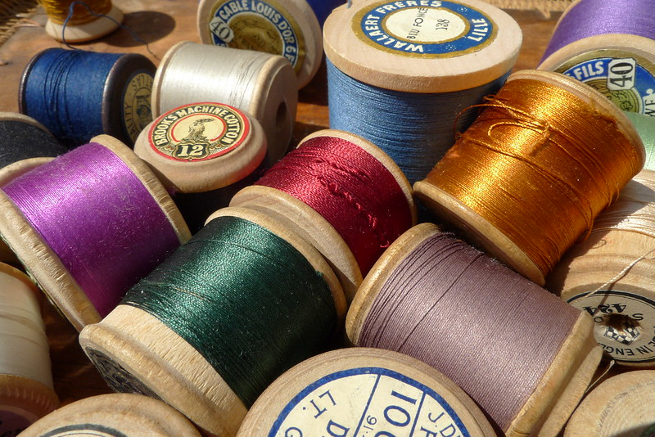
Common Threads
Echo is a very, very large Ceph cluster
Environment/budget force aggressive development practices
WLCG risk tolerance
Shared infrastructure means uncivilised users can have outsize impact
Admin inexperience led to poor choices of hardware/incident response
“sewing thread” by In Memoriam: Christopher Bulle, CC BY 2.0

Slide 15
Mitigating Risks
Many risk factors are hard to mitigate
Money
Distinctive user requirements
But many can be
Building institutional experience of the software
Greater automation
CephADM
Compartmentalisation

Slide 16

The Future
Near term goals (Q4 2025/Q1 2026)
EL9
Ceph Squid
Decommission Sirius
Medium term
Failure domains for Echo
Yes I know…
Broader deployment of CephADM
S3 Separation
Image used under CC BY-SA 4.0
Title: Moby Dick by Palmovish
Originator: Artist Palmovish
Source

Slide 17
Thank you
Facebook: Science and Technology Facilities Council
Twitter:@STFC_matters
YouTube: Science and Technology Facilities Council

