Slide 1
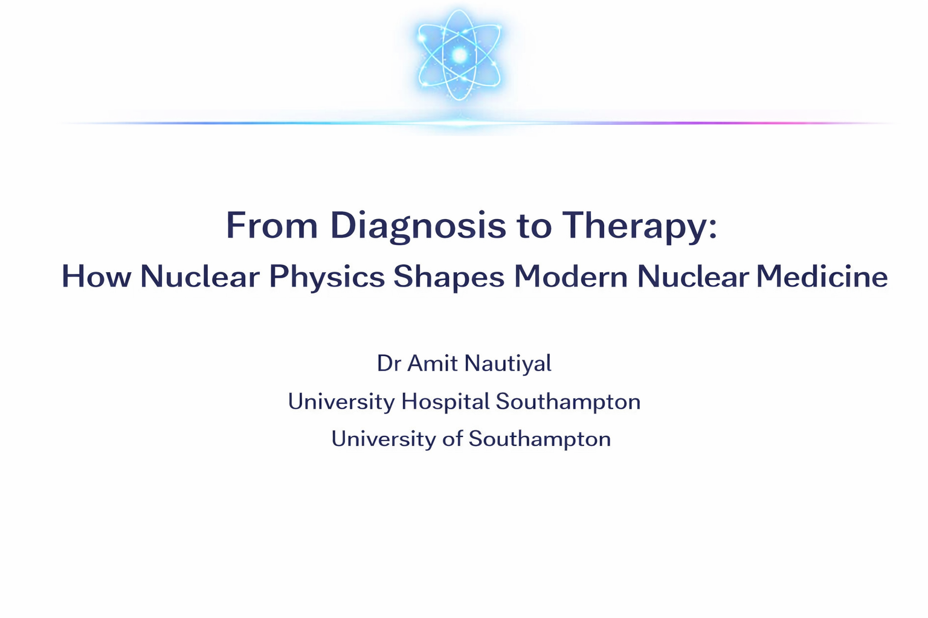

Slide 2
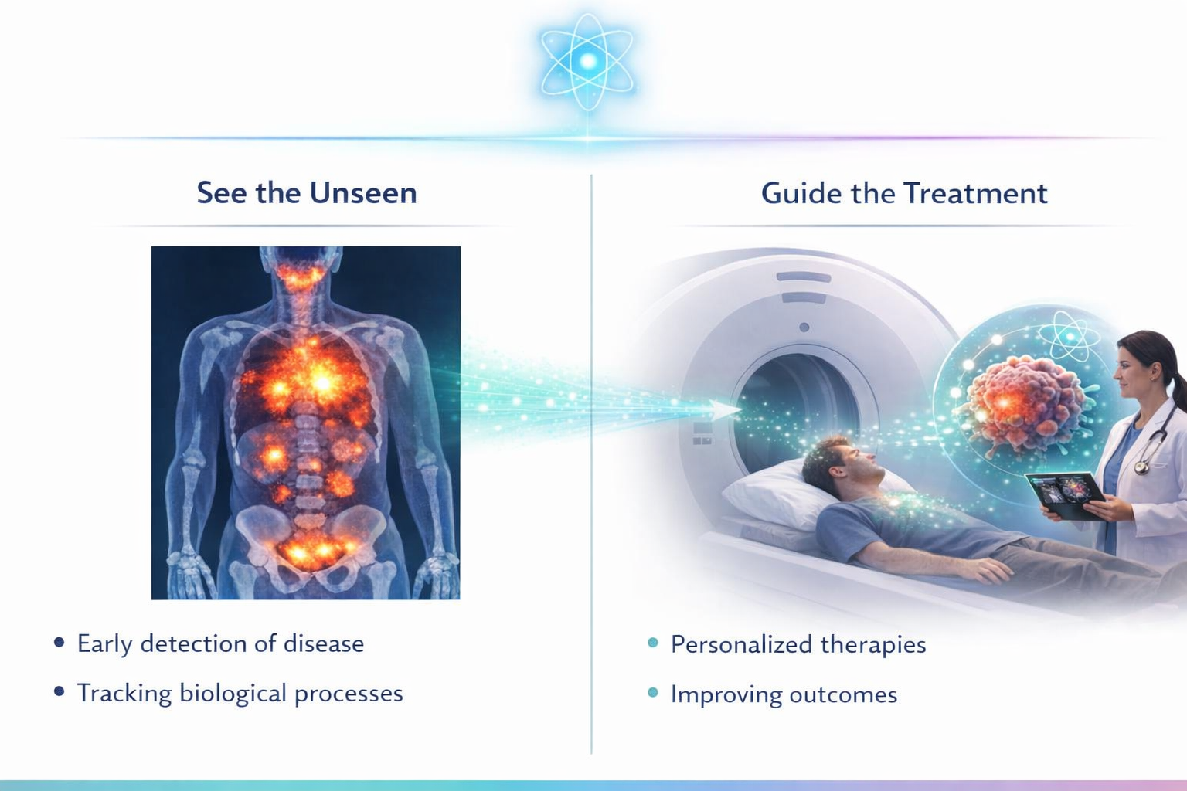

Slide 3
What is Nuclear Medicine
Small amounts of radioactive tracers
Track physiology, not just anatomy
Enables both diagnosis and therapy

Slide 4
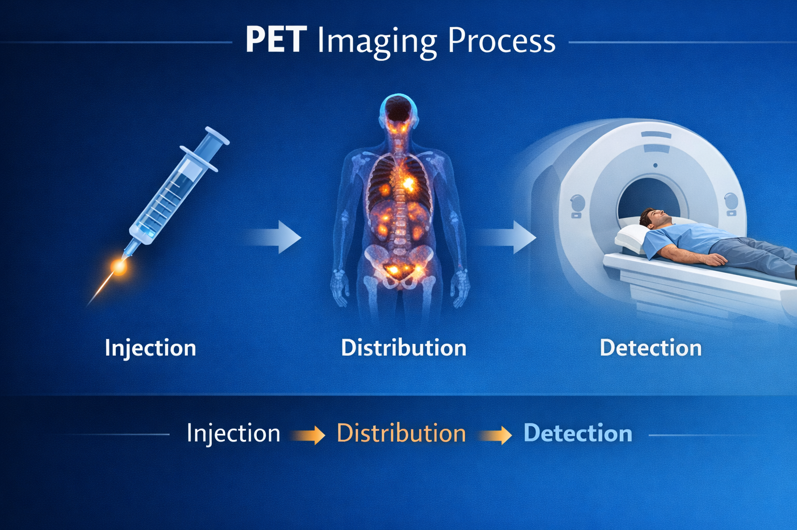

Slide 5
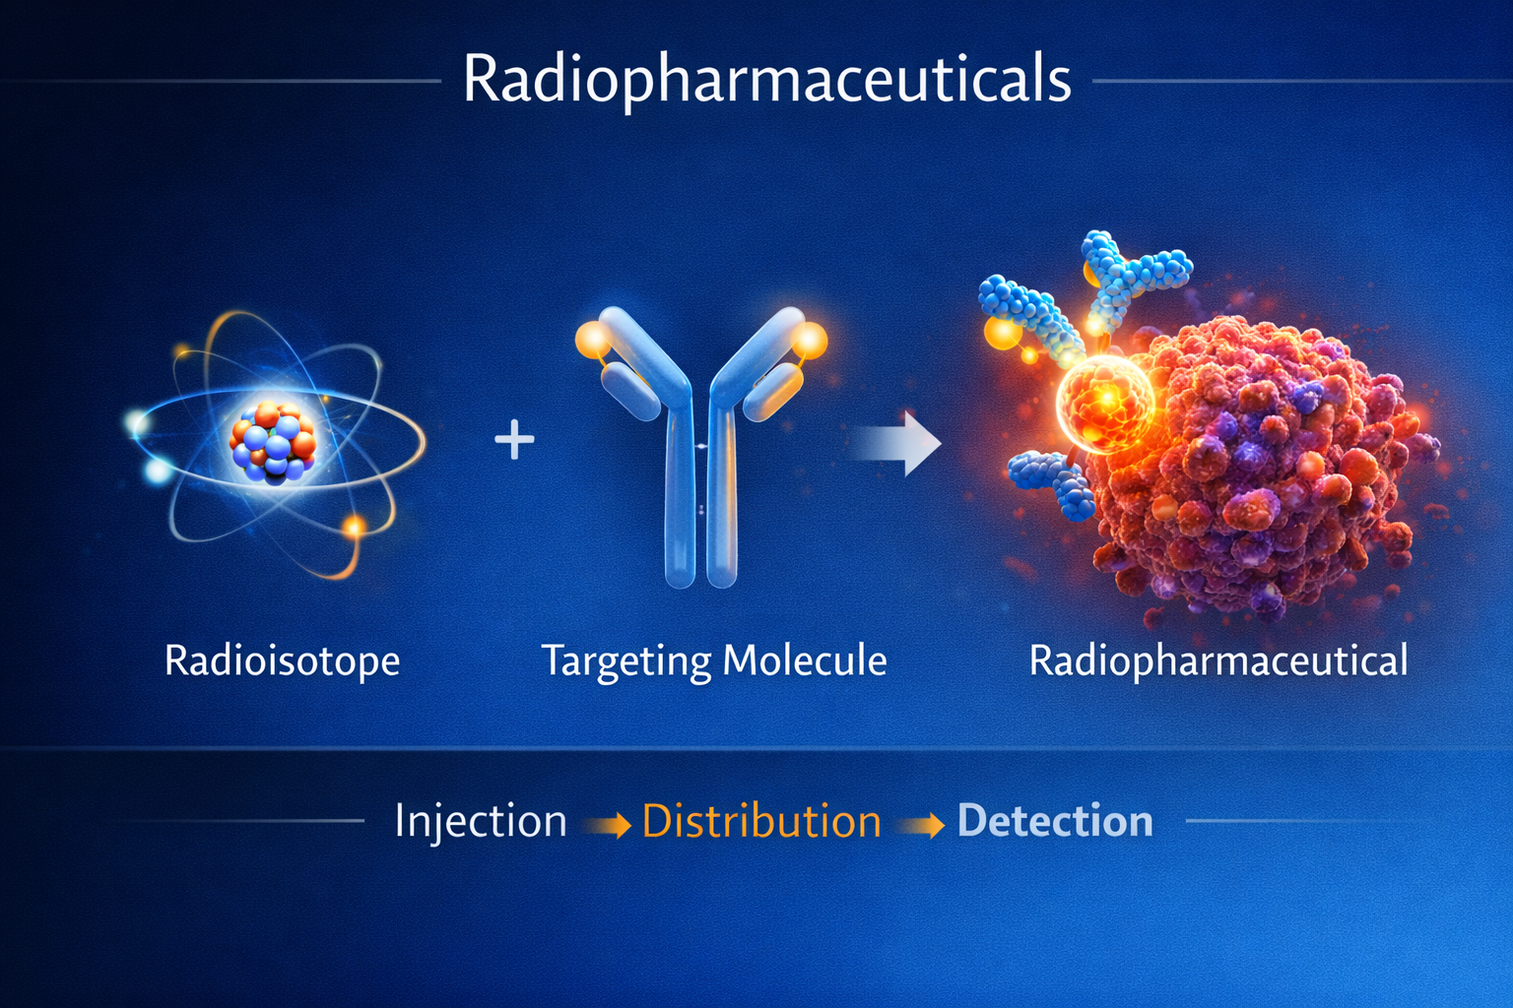
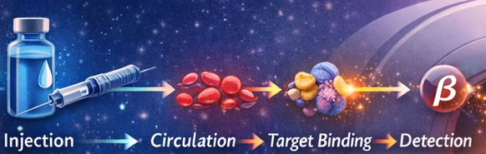
Radiopharmaceuticals: A Product of Nuclear Physics
Definition:
Radioactive isotope + biological targeting molecule
3 key physics-driven elements:
Isotope production (reactors / cyclotrons / RN Generators)
Decay properties (half-life, radiation type)
Chemical targeting (organ / tumour specific)

Slide 6
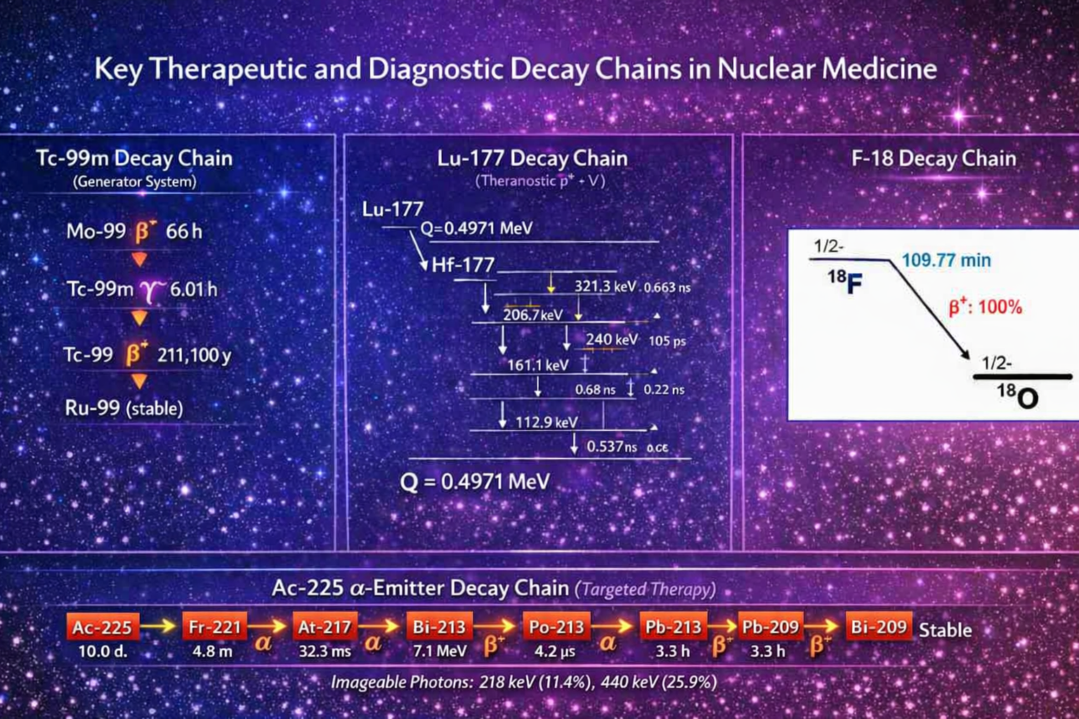

Slide 7
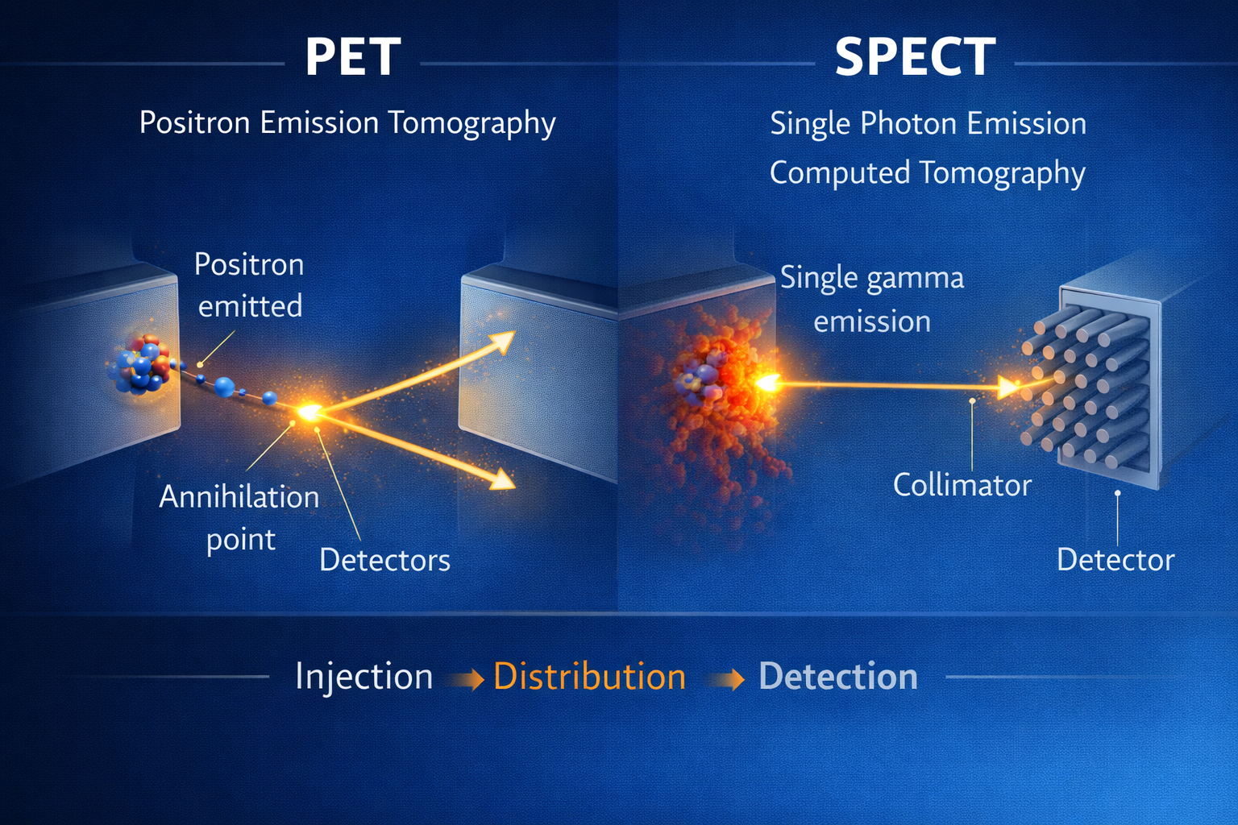
Physics Behind Imaging
PET
Positron emission → annihilation → 2 photons (180°)
SPECT
Gamma emission → detected directly
Image = reconstructed distribution of tracer

Slide 8
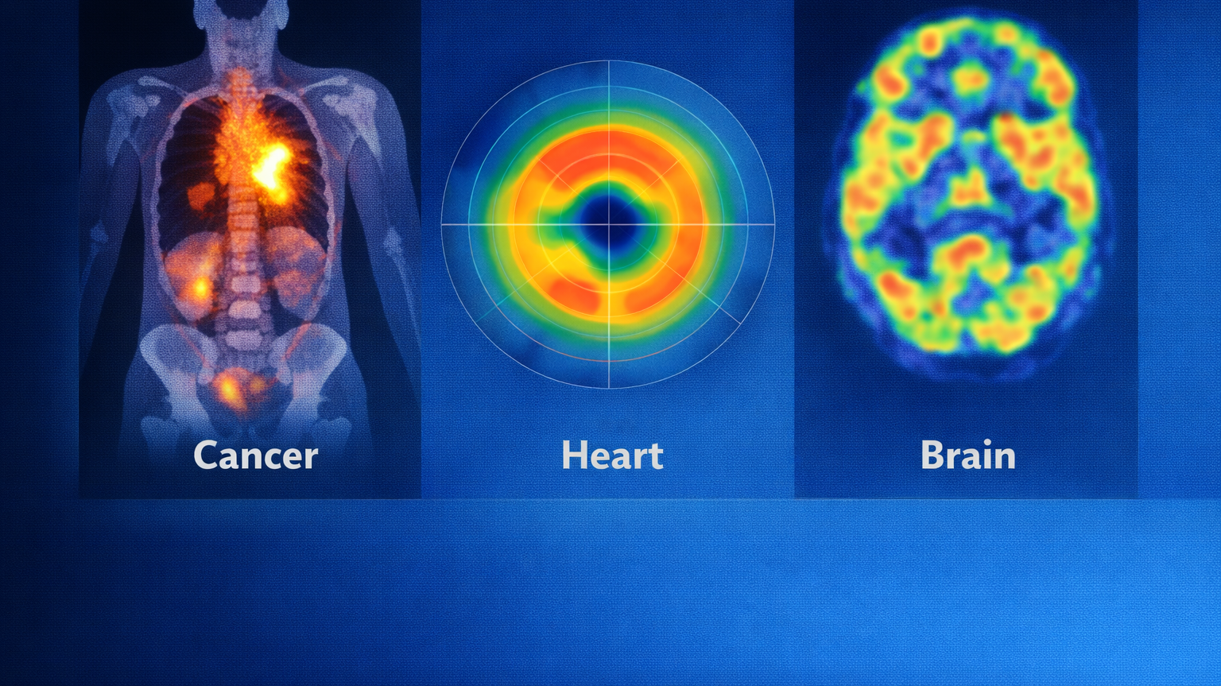
Diagnostic Imaging in Action
Oncology: tumour detection, staging and follow-up
Cardiology: perfusion & viability
Neurology: brain function
Nephrology: renal function

Slide 9
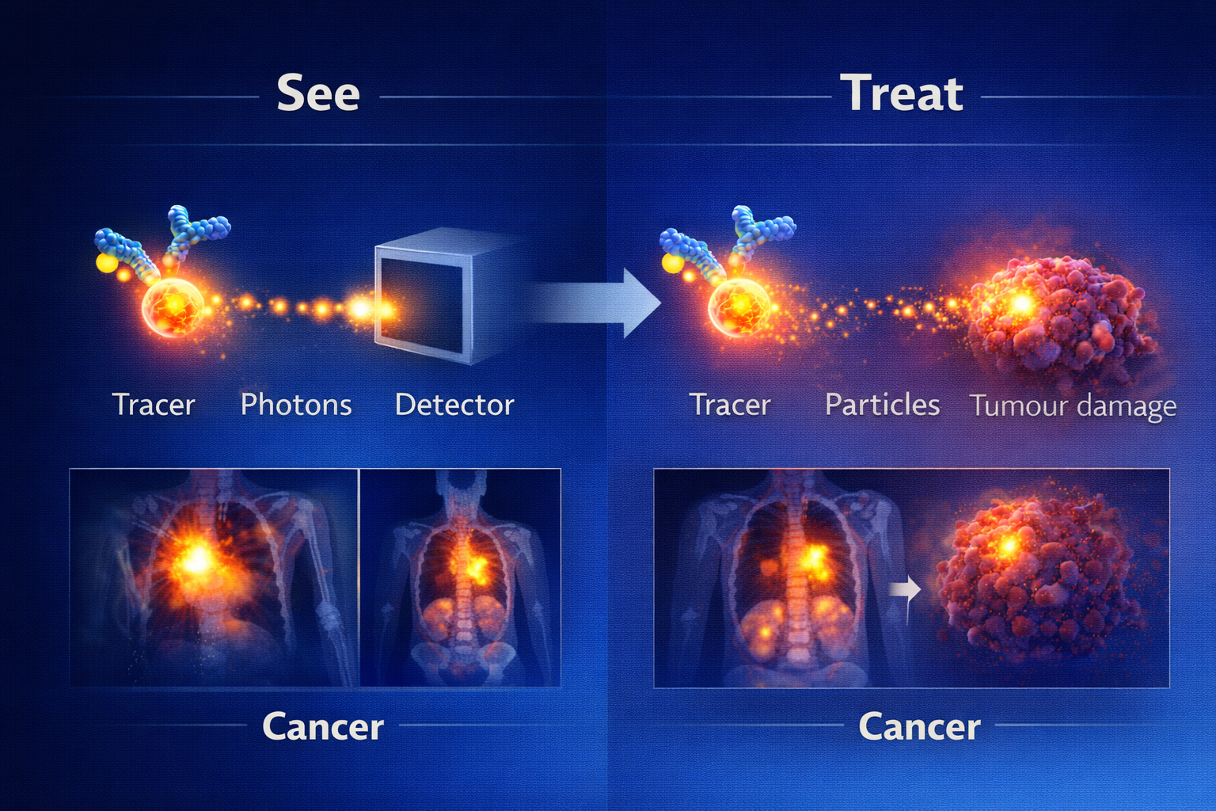
From Diagnosis to Therapy
Same targeting → Different radiation → Different purpose
Imaging | Therapy
Gamma / positron emitters | Beta / alpha emitters
Short half-life | Long half-life
Detect signal | Deliver dose
Low radiation | Therapeutic radiation

Slide 10
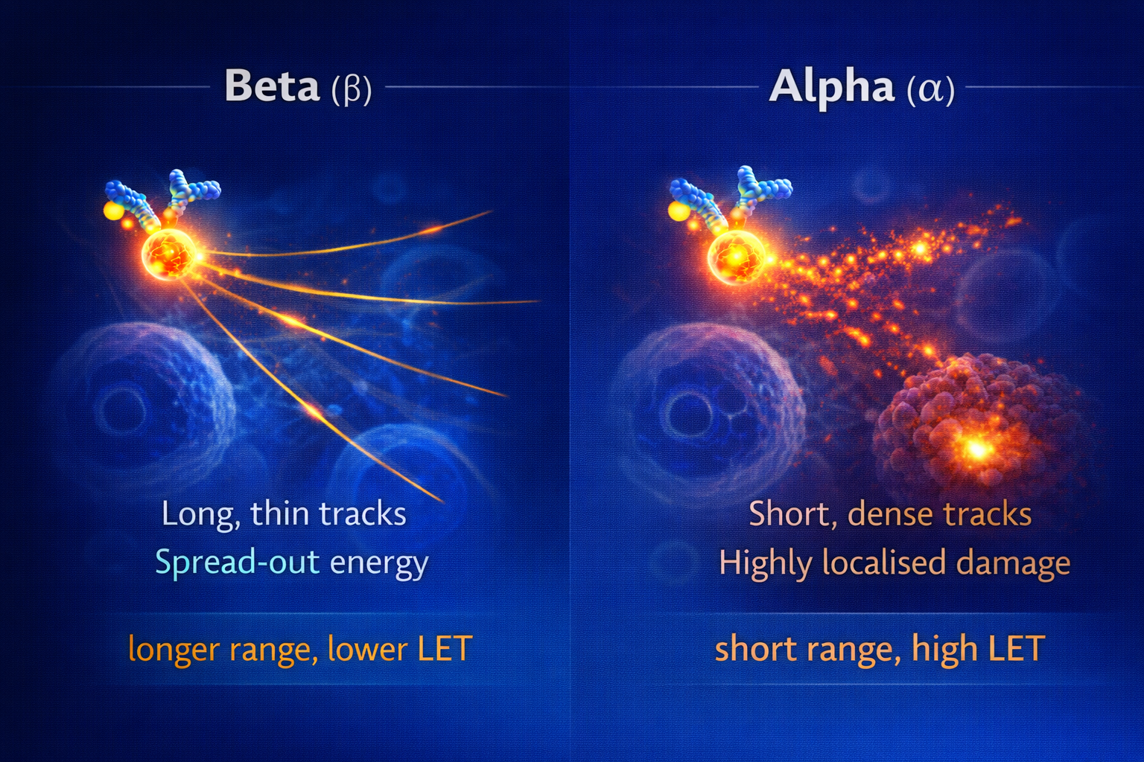
Physics in Therapy

Slide 11
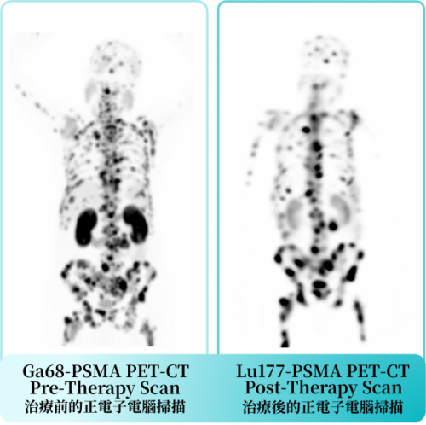
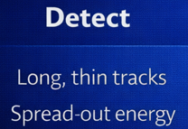

Case Study: Lu-177 PSMA Therapy
Prostate cancer → PSMA targeting
Target identification (PSMA expression)
Imaging (Ga-68 PSMA PET)
Therapy (Lu-177 PSMA)

Slide 12
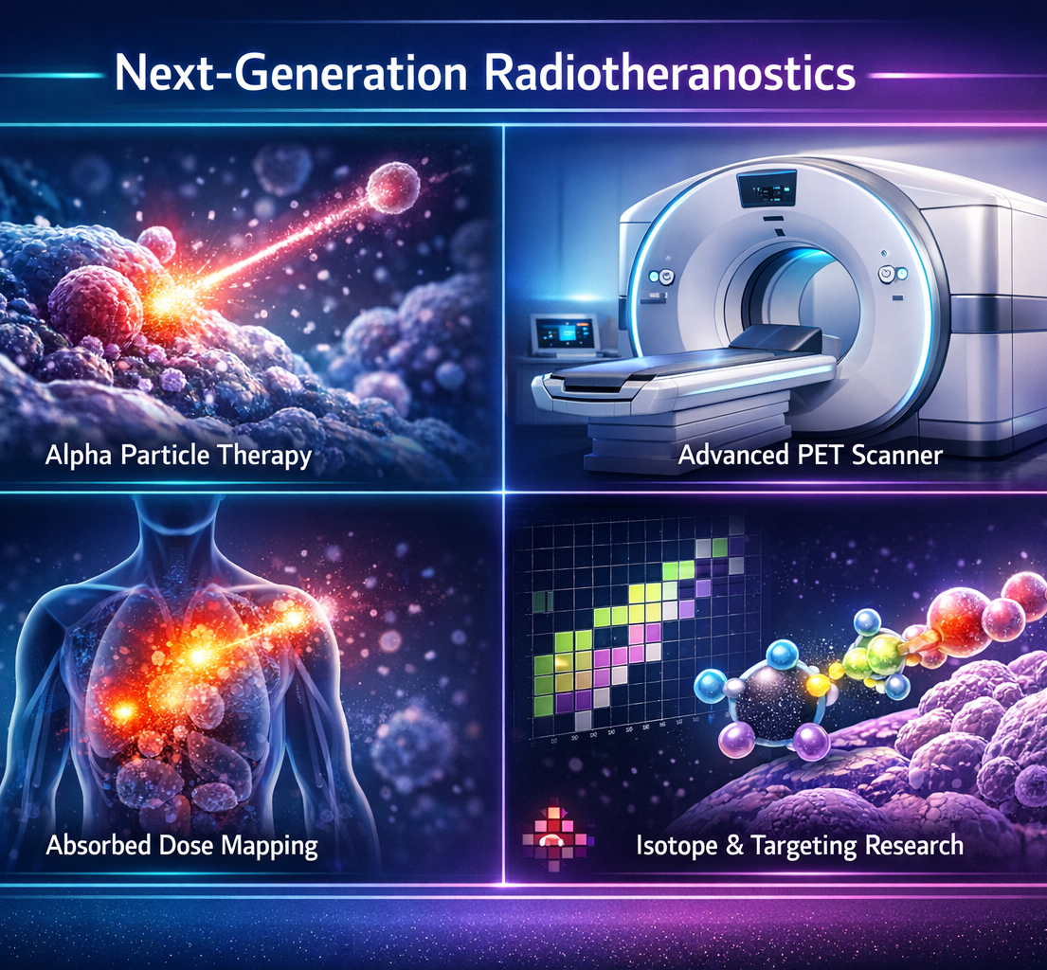
Innovations & Cutting-Edge Physics
Alpha therapy (high-LET precision)
Advanced imaging systems (CZT SPECT, digital PET, total-body PET)
Personalised dosimetry
New radionuclides & targets

Slide 13
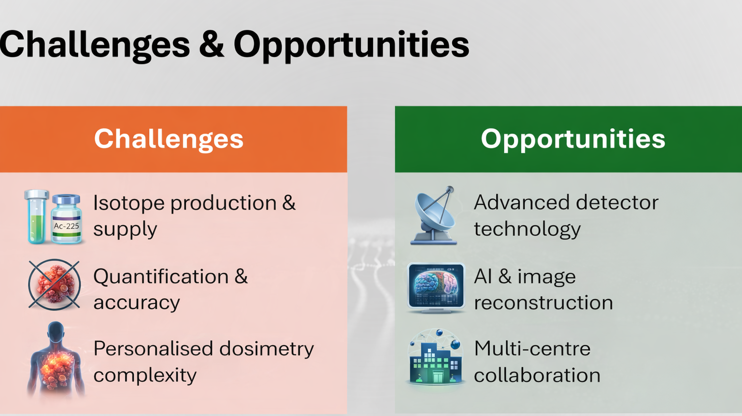

Slide 14
Key Takeaways
Nuclear physics enables functional imaging
Radiopharmaceuticals link physics with biology
Same principles drive diagnosis → therapy (theranostics)
Future lies in precision & personalised treatment
Notes:
Nuclear physics is central to modern nuclear medicine from understanding disease to treating it. To summarise, Nuclear physics allows us to move beyond structure and understand function in the body.
Radiopharmaceuticals bring together physics and biology to both image and treat disease.
And increasingly, we are combining diagnosis and therapy in a single, targeted approach—theranostics.
Looking ahead, the field is moving towards more precise, personalised treatments where physics plays a central role

Slide 15
